Slide 1
The 12th Workshop on Hadron Physics and Opportunities Worldwide
Lattice QCD for low-Q physics
Xu Feng
2024.08.08 @ Dalian, China

Slide 2
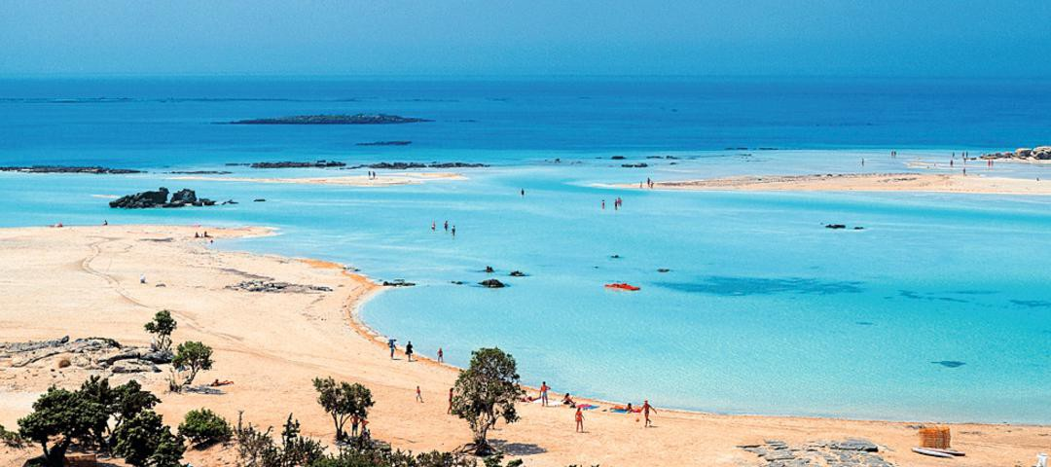
Interesting physics region
Low Q
Hadron structure at long distances
2

Slide 3
Selected topics
Two-photon exchange contribution to muonic hydrogen Lamb shift
Proton charge radius
See Wei-Zhi Xiong’s talk
Compton scattering and nucleon electromagnetic polarizabilities
Polarizabilities
See Nikos Sparveris’ talk
γZ box contribution to parity violating e-p scattering
Weak charge
Qweak collabration, Nature 557 (2018) 207
3

Slide 4
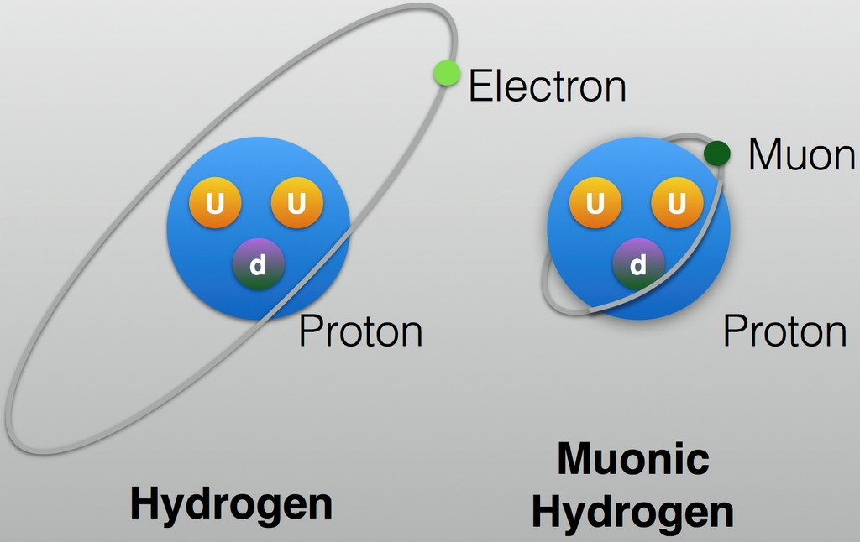
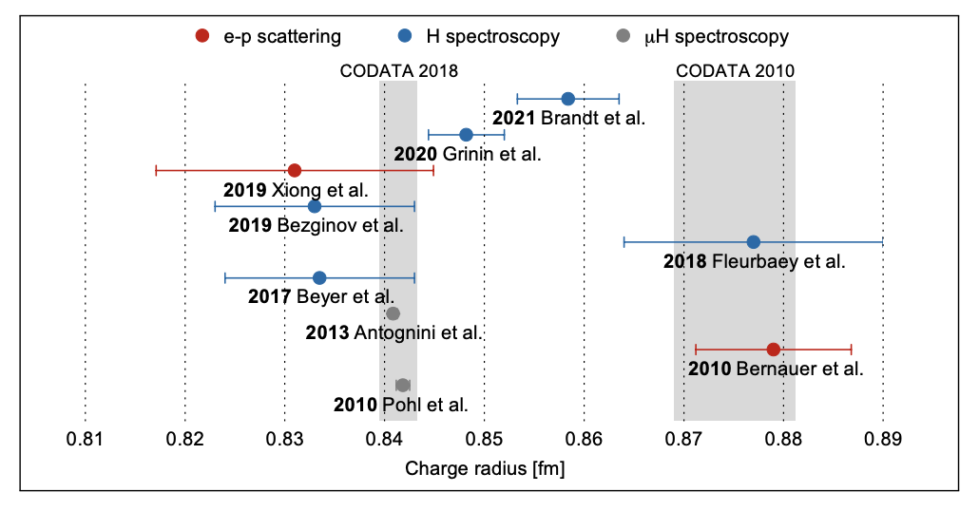
Muonic hydrogen
2010, proton charge radius from μH
【Nature 466 (2010) 213】
Precision 10 times better than before
4% smaller radius
5σ deviation → Proton size puzzle
Muon mass is about 200 times of electron
Bohr radius for μH is 200 times smaller than H
New experimental progress
Still some discrepancies
Puzzle possibly originates from experiments
However, as a fundamental quantity, the size of proton charge radius plays an important role in the theoretical prediction in atomic spectroscopy

Slide 5
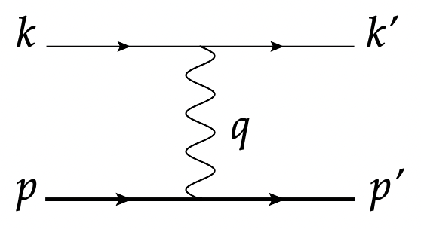
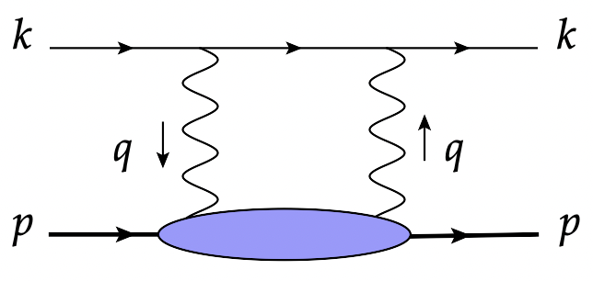
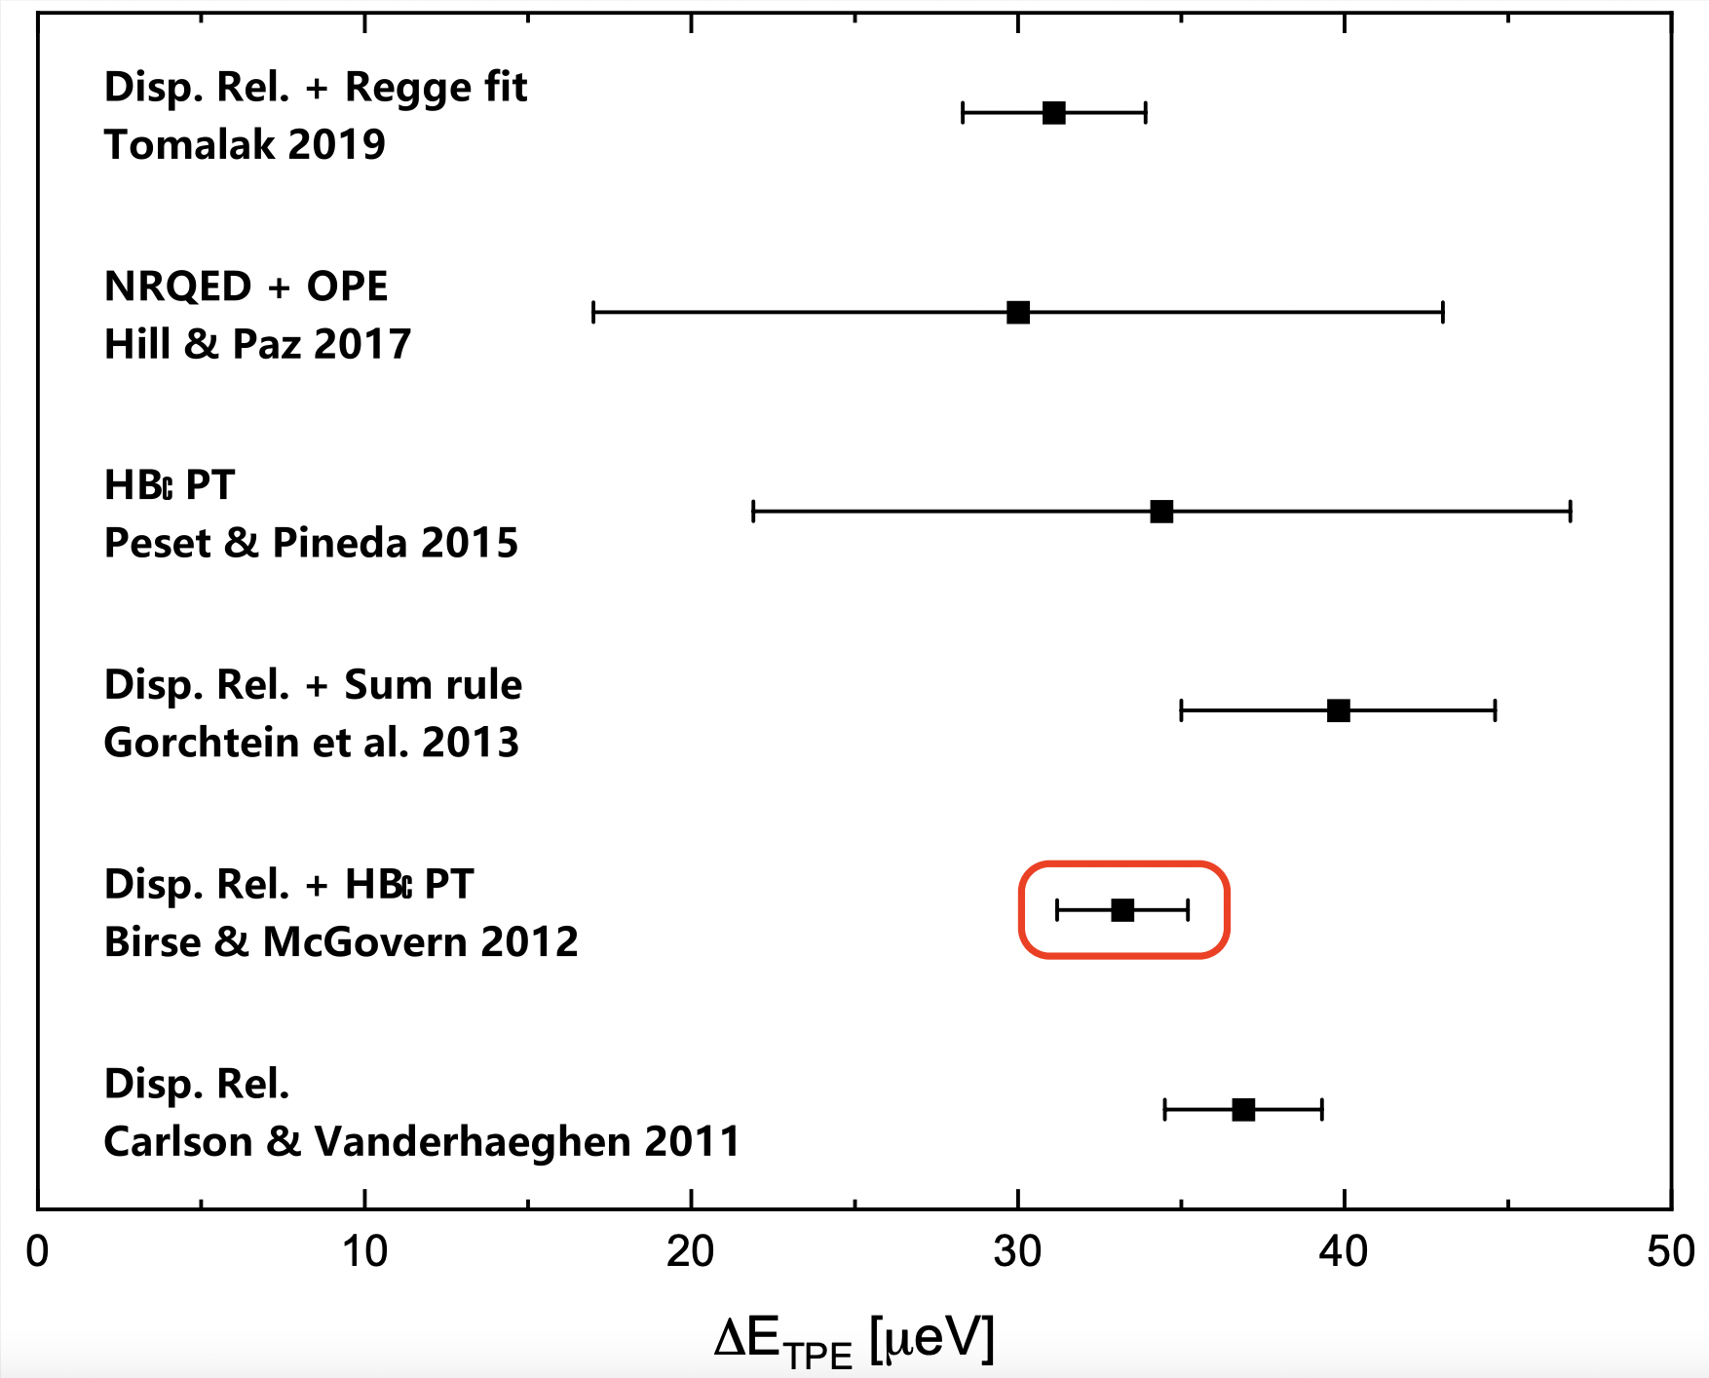
Various contributions to μH Lamb shift
Experiment
Theory
【Science 339 (2013) 417】
Exp. vs Theory
Proton size puzzle
Largest theoretical uncertainty from two-photon exchange (TPE)
Uncertainty for structure independent contribution is further reduced
【Ann.Rev.Nucl.Part.Sci.72 (2022) 389】
Upgrade of CREMA@PSI can reduce Exp. error by a factor of 5
Leaving TPE the most important source for uncertainty!
Theoretical prediction for TPE relies on data + models and ranges from 20 to 50 μeV
Our target: obtain TPE from first principles
Lattice QCD

Slide 6
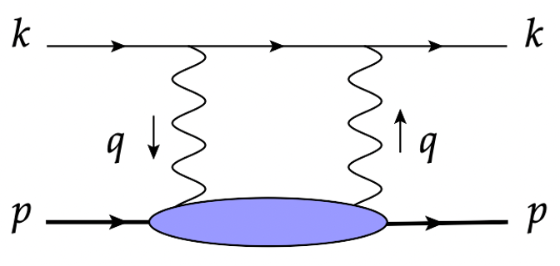
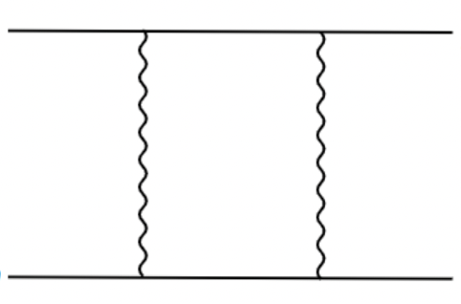
Challenges from TPE (1): IR divergence
Binding energy of μH serves as a natural IR cutoff
QCD+QED: complete information of proton structure
Bound-state QED
Loop integral sensitive to hadronic scale → highly NP
Proton treated as point-like particle + charge radius correction
Bound lepton → free lepton → IR divergence
No divergence, but rich structure information lost
Solution: subtract the divergence
-
-
Point-like particle
Charge radius

Slide 7
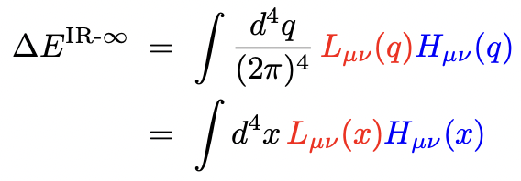
Challenges from TPE (1): IR divergence
Loop integral
Leptonic part:
→ Analytically known
Hadronic part:
→ Provided by LQCD
(statistical errors)
IR subtraction
-
-
divergence
-
divergence
-
divergence
=
finite
Key technical problem
Three diagrams contain diff. stat. errors
How to maintain the error cancellation?
If signal cancels and error does not, then signal is completely hidden by error

Slide 8
Challenges from TPE (1): IR divergence
To solve IR divergence: infinite-volume reconstruction method
【X. Feng, L. Jin, PRD 100 (2019) 094509】
Basic idea: low-energy structure information is contained in the long-distance part of hadronic function
Use
to reconstruct the quantities such as charge radius
at large
Find the appropriate weight functions
and
for the subtraction terms, yielding
=
=
Cancellation of IR divergence is rigorously fulfilled via the subtraction of weight functions
-
-
Error decreases coherently as signal. IR divergence is solved cleanly!

Slide 9
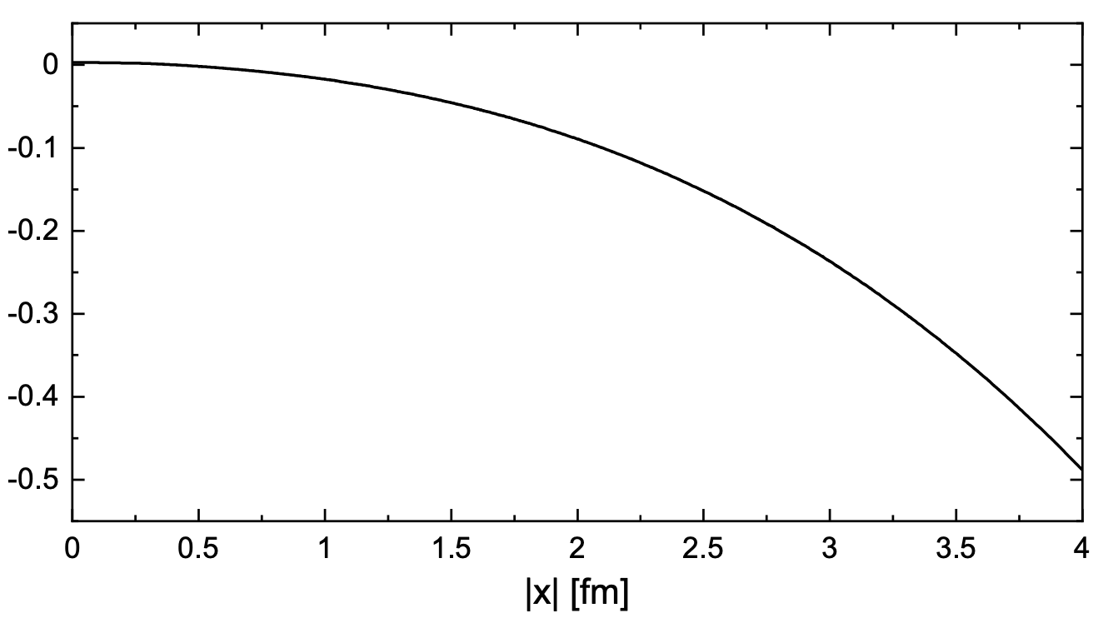
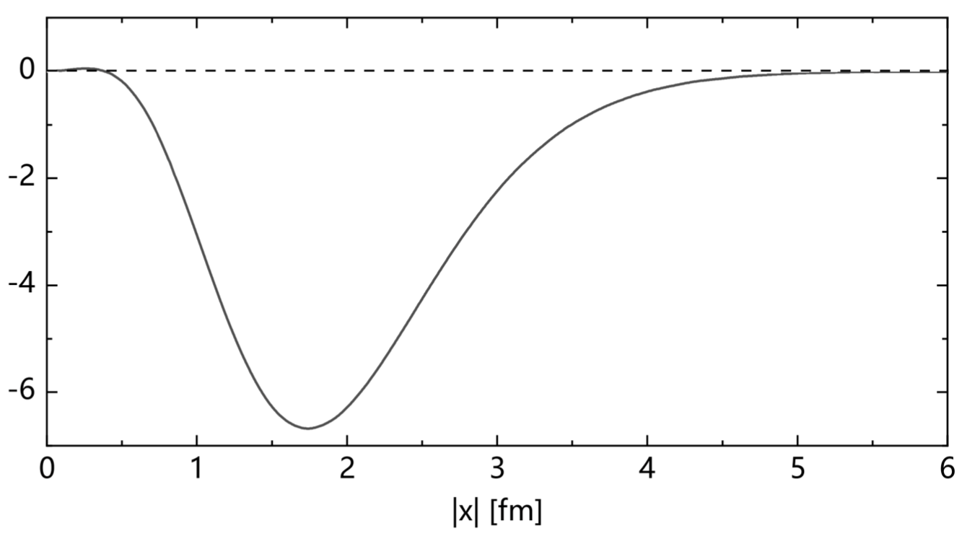
Challenges from TPE (2): Signal-to-noise problem
Property of lattice data:
As
increases, proton matrix element
decreases as
However, error decreases as
Weight function
increases fast, as
increases
Model estimate: Combine leptonic and hadronic part
Conclusion: take
as large as 5 fm
Require a 10 fm lattice for simulation
to guarantee no information lost
Decrease of S/N ratio seems an inevitable problem

Slide 10
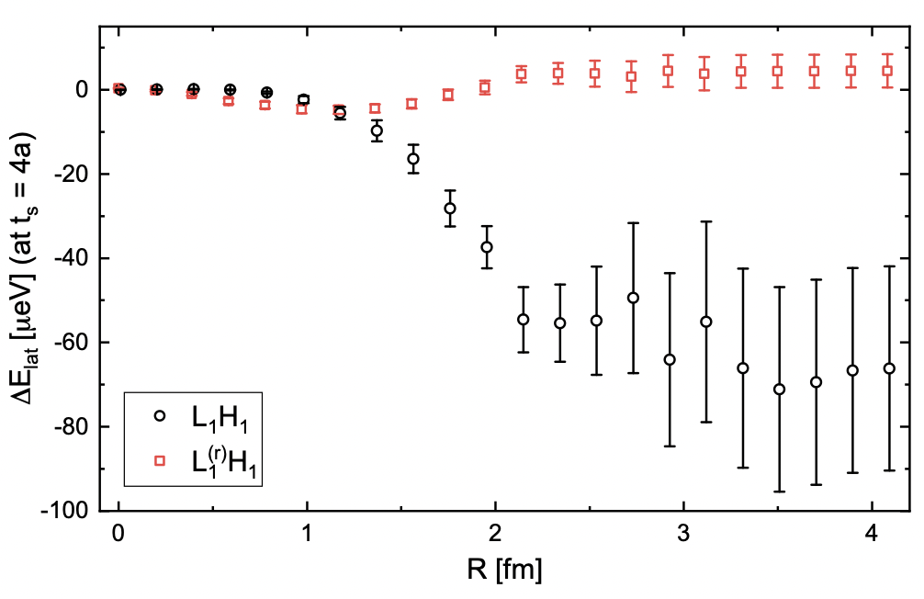
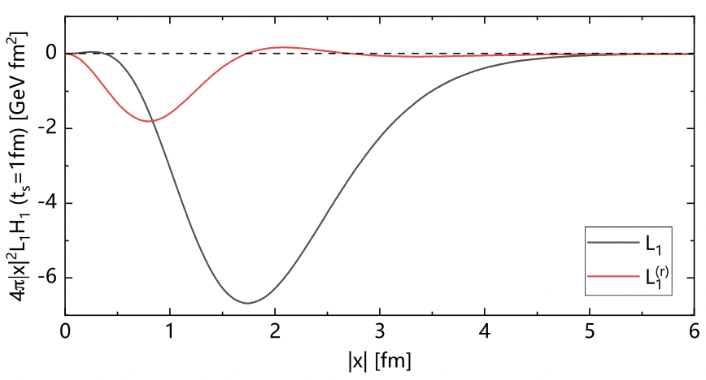
Challenges from TPE (2): Signal-to-noise problem
To solve S/N problem: optimized subtraction scheme
Trick: A = (A – B) + B
Use optimized subtraction scheme in realistic calculation
Define the reduced weight function
Choose
to minimize
in the region of 1-3 fm
Using
, (A-B) part is illustrated by the red curve
Integral within the range R:
using
, error reduced by a factor of 6!
Total contribution is
S/N problem is solved

Slide 11
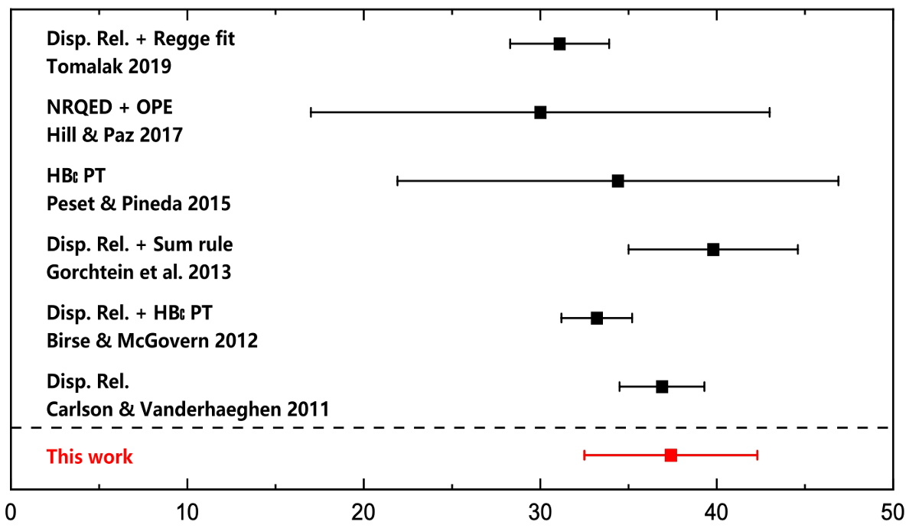
Lattice results
First lattice result @ m_{π}=142 MeV
Need to increase statistics and control systematic effects
TPE contribution [μeV]
Y. Fu, XF, L. Jin, C. Lu, PRL 128 (2022) 17, 172002

Slide 12
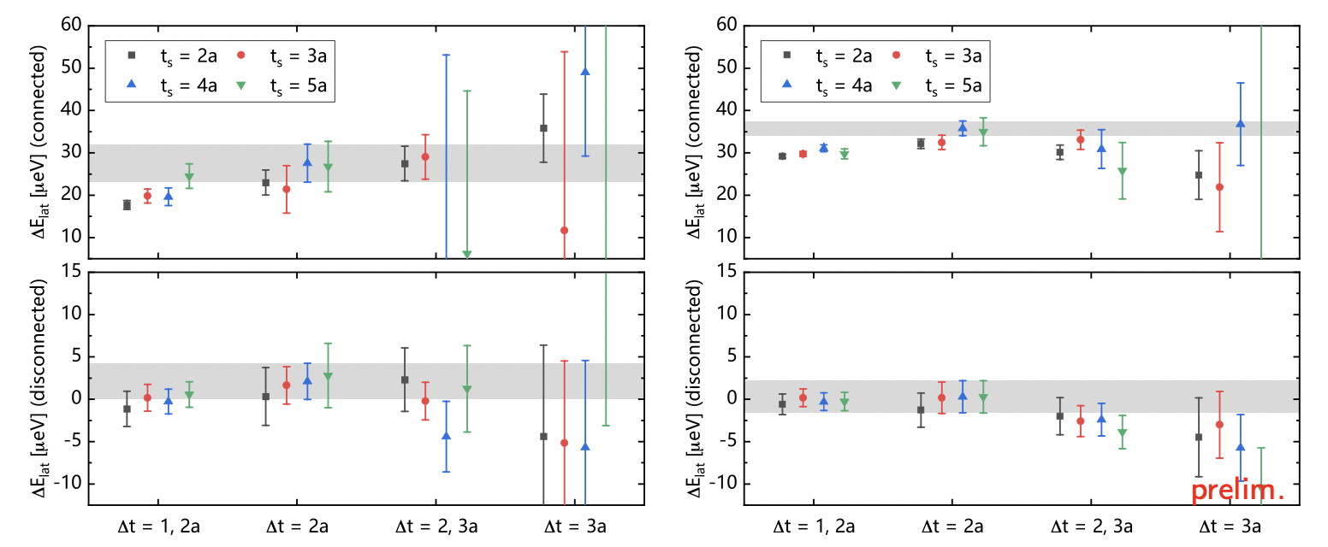
Some updates
Point-source props (n_{conf}=131) → Smeared-source props (n_{conf}=207)
Double the statistics
Using smeared props, more systematic and statistical errors are reduced
12

Slide 13
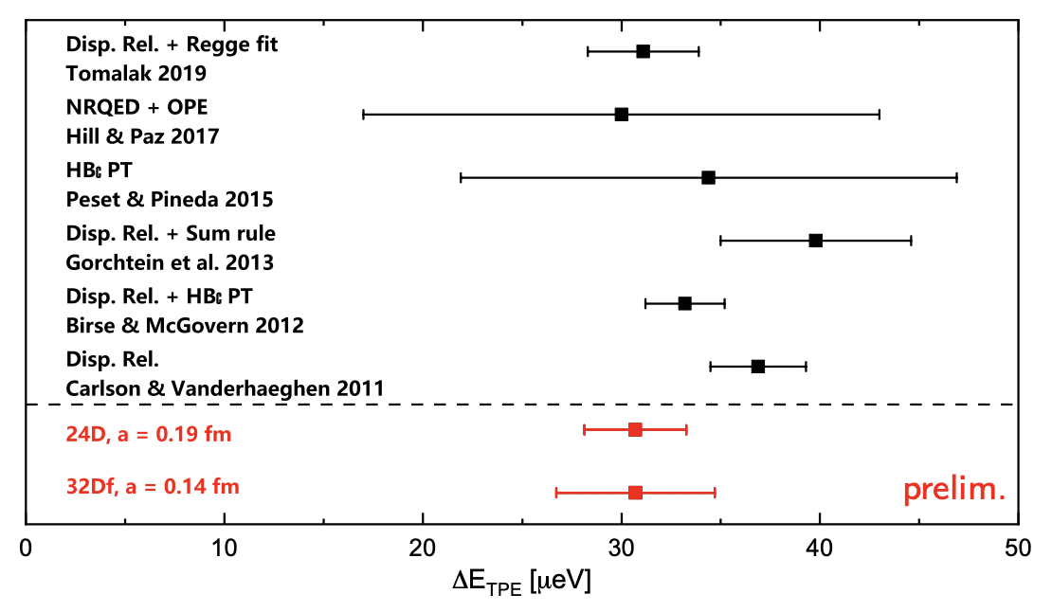
Some updates
Second ensemble: finer lattice spacing, same pion mass and volume
13

Slide 14
Selected topics
Two-photon exchange contribution to muonic hydrogen Lamb shift
Proton charge radius
See Wei-Zhi Xiong’s talk
Compton scattering and nucleon electromagnetic polarizabilities
Polarizabilities
See Nikos Sparveris’ talk
γZ box contribution to parity violating e-p scattering
Weak charge
Qweak collabration, Nature 557, 207–211 (2018)
14

Slide 15
Nucleon polarizability and Compton scattering
Nucleon E&M polarizability are most central quantities relevant for Compton scattering
$$q$$
$$μ$$
$$ν$$
$$P$$
$$T^{μν}$$
Unpolarized doubly virtual Compton scattering
$$K_{1}^{μν}=q^{μ}q^{ν}−g^{μν}q^{2}$$
$$T^{μν}\left(P,q\right)=T_{Born}^{μν}+\frac{8πM}{e^{2}}\left[−(β_{M}+O(q))K_{1}^{μν}+\left(α_{E}+β_{M}+O(q)\right)K_{2}^{μν}\right]$$
$$K_{2}^{μν}=\frac{1}{M^{2}}[\left(P^{μ}q^{ν}+P^{ν}q^{μ})P⋅q−g^{μν}{\left(P⋅q\right)}^{2}−P^{μ}P^{ν}q^{2}\right]$$
Born term
Polarizabilities
+
+……
Intermeidate states: $N$
Intermeidate states: $Nπ,N^{∗},Δ, ⋯$
15

Slide 16
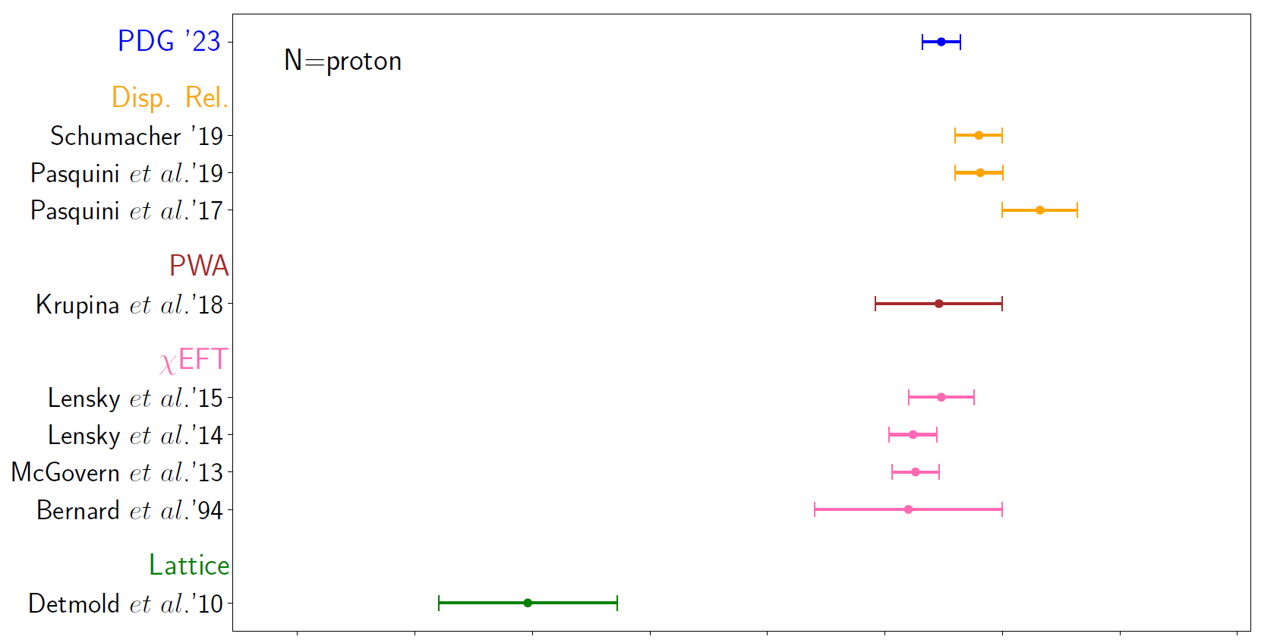
Determination of electric polarizabilities
For proton
Experiments
$$χ_{EFT}$$
Lattice ($m_{π}=390MeV$)
16

Slide 17
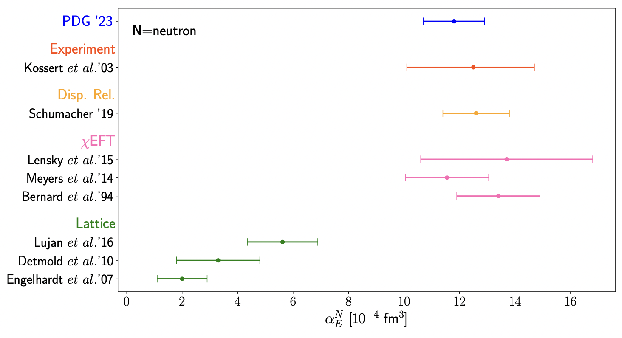
Determination of electric polarizabilities
For neutron
Experiments
$$χ_{EFT}$$
Lattice
17

Slide 18
Determination of electric polarizabilities
What is the primary source of discrepancy between lattice QCD and other studies?
Lattice calculations are performed at unphysical pion masses, ranging from 227 - 759 MeV
Unphysical quark mass effects
Background field technique is used, which converts 4pt function to 2pt function using Feynman-Hellman theorem
Hard to explore intermediate-state contributions and control systematics
Perform calculation at physical pion mass, using 4pt function
18

Slide 19
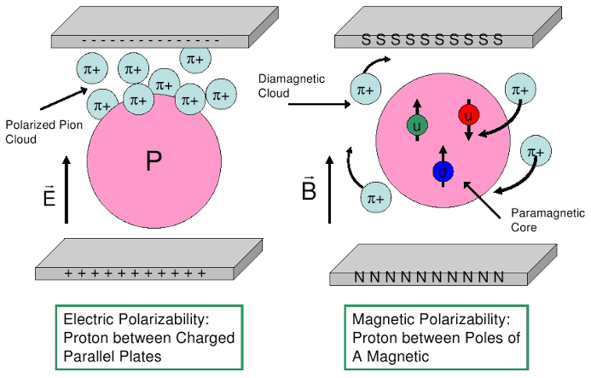
Why physical pion mass is important
Pion cloud in nucleon polarizabilities
LO in $χ_{PT}$:
$$α_{E}=\frac{5}{96}{\left(\frac{g_{A}}{f_{π}}\right)}^{2}\frac{α_{em}}{m_{π}}$$
V. Bernard et al., Phys. Rev. Lett. 67 (1991) 1515
$α_{E}$ is inversely proportional to pion mass
Use two DWF ensembles @ physical π mass
Ensembles | $m_{π}$[MeV] | L/a | T/a | a[fm] | $$N_{conf}$$
24D | 142.6(3) | 24 | 64 | 0.1929 | 207
32Dfine | 143.6(9) | 32 | 64 | 0.1432 | 82
19

Slide 20
Electric polarizability from 4-pt function
$$q$$
$$μ$$
$$ν$$
Lattice QCD input $H^{μν}\left(x\right)$
Compton tensor
$$T^{μν}=\int{d^{4}x}e^{iqx}\left\langle N\left|J^{μ}\left(x,t\right)J^{ν}\left(0\right)\right|N\right\rangle =T_{Born}^{μν}+\frac{8πM}{e^{2}}\left[−{(β}_{M}+O(q))K_{1}^{μν}+\left(α_{E}+β_{M}+O(q)\right)K_{2}^{μν}\right]$$
$$P$$
$$T^{μν}$$
Derive 3 formula to calculate $α_{E}$
$P=\left(M,0\right), q=\left(0, \vec{ξ}\right): α_{E}=−\frac{α_{em}}{12M}\int{d^{4}x {\vec{x}}^{2}\left(H^{00}\left(x\right)−H_{GS}^{00}\left(x\right)\right)}+α_{E}^{r}$
$P=\left(M,0\right), q=\left(ξ,0,0,ξ\right): { α}_{E}=\frac{α_{em}}{4M}\int{d^{4}x{ \left(t+x_{i}\right)}^{2}\left(H^{0i}\left(x\right)−H_{GS}^{0i}\left(x\right)\right)}+α_{E}^{r}$
${P=\left(M,0\right), q=\left(ξ,0\right): α}_{E}=−\frac{α_{em}}{12M}\int{d^{4}x{ t}^{2}H^{ii}\left(x\right)}+α_{E}^{r}$
Our choice
Residual term $α_{E}^{r}$ is analytically known
$$H^{ii}\left(x,t\right)=⟨N|J^{i}\left(x\right)J^{i}\left(0\right)|N⟩$$
$α_{E}^{r}=\frac{α_{em}}{M}\left(\frac{G_{E}^{2}\left(0\right)+κ^{2}}{4M^{2}}+\frac{G_{E}\left(0\right)⟨r_{E}^{2}⟩}{3}\right)$,
anomalous magnetic moment & charge radius
$G_{E}\left(0\right)=1$/0, for proton/neutron
20

Slide 21
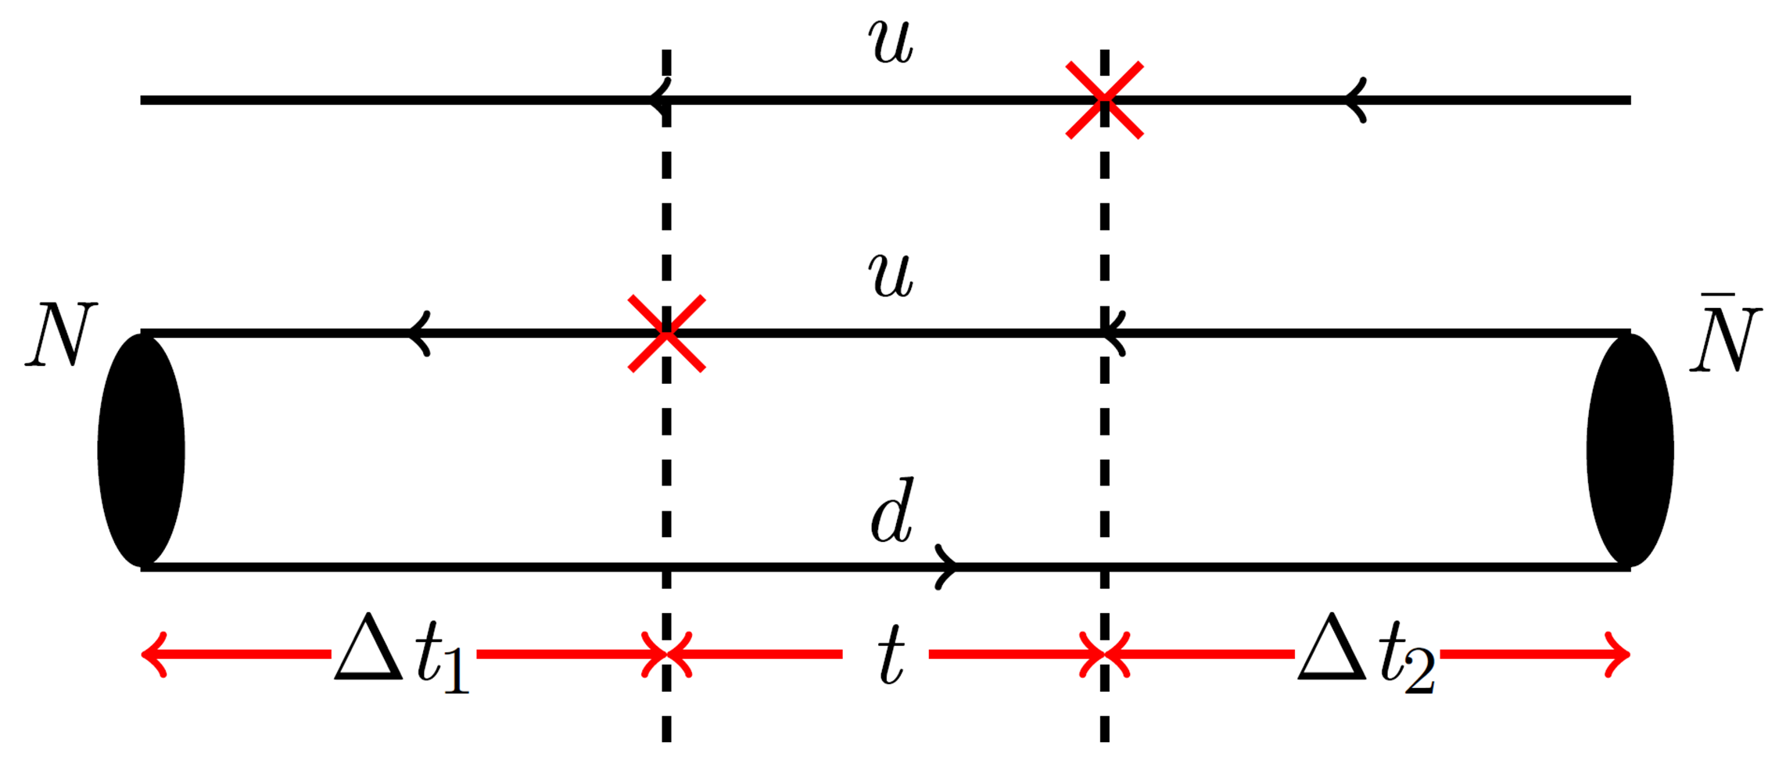
Signal of hadronic function
$$\sum_{\vec{x}}{H^{ii}(t,\vec{x})}=\sum_{k}{\left\langle p\left|J_{i}\left(0\right)\right|k\right\rangle e^{−\left(E_{k}−M\right)t}\left\langle k\left|J_{i}\left(0\right)\right|p\right\rangle }$$
signal region
Truncation
Truncation
$Δt=Δt_{1}+Δt_{2}=\left\{\begin{aligned}0.96 fm (24D) \\ 0.86 fm (32Dfine)\end{aligned}\right.$, truncation at $t_{0}=\left\{\begin{aligned}0.77 fm (24D) \\ 0.72 fm (32Dfine)\end{aligned}\right.$
In total, $Δt_{1}+Δt_{2}+t_{0}\sim$1.6-1.8 fm
21

Slide 22
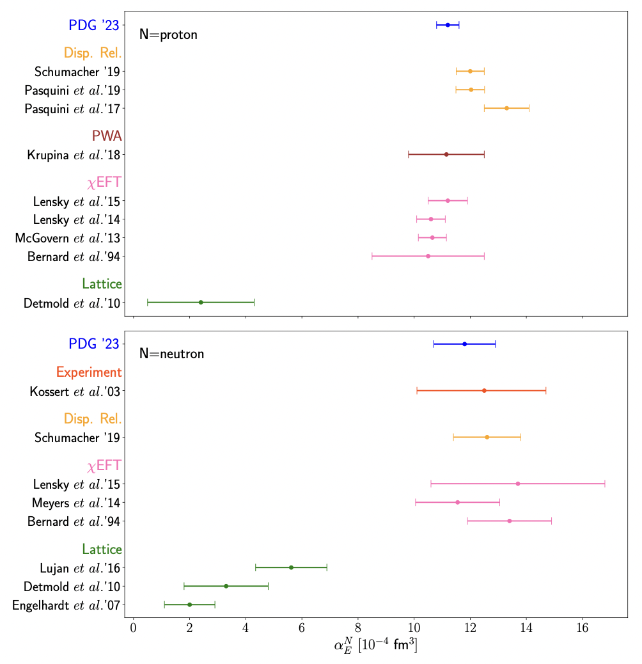
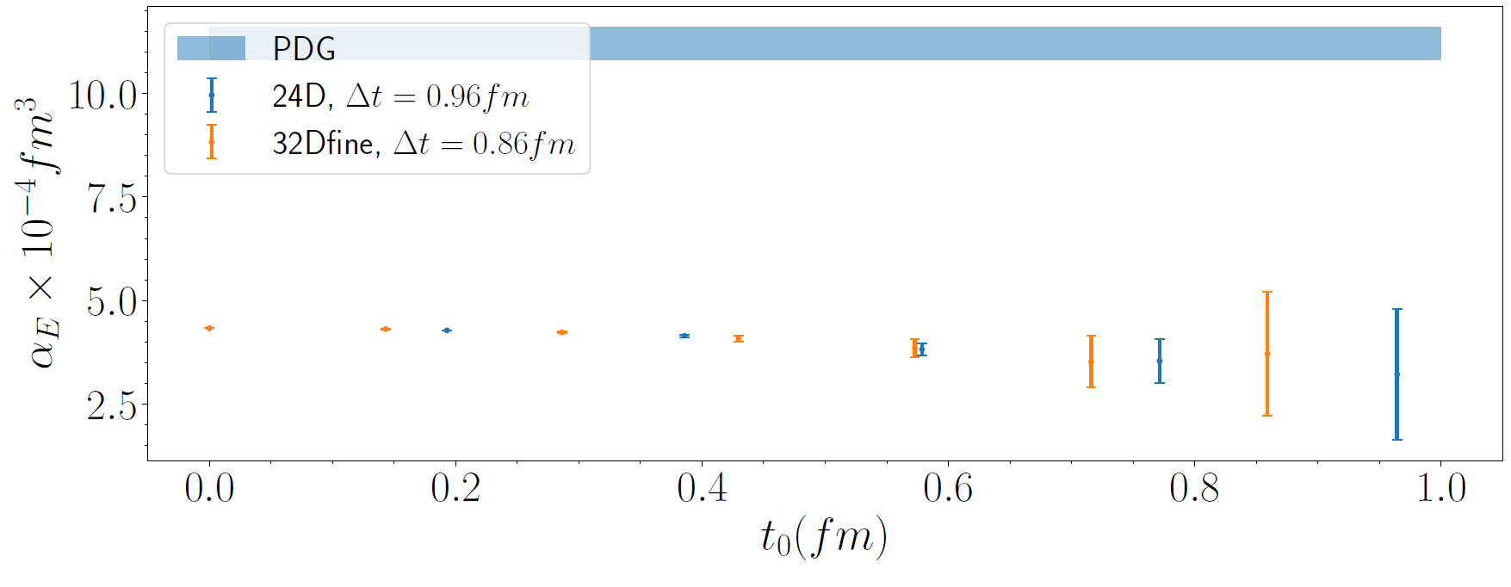
Polarizability $α_{E}$ from $H_{ii}(x)$
$$α_{E}=−\frac{α_{em}}{12M}\int{d^{4}xt^{2}H^{ii}\left(x\right)}+α_{E}^{r}$$
Polarizability extraction
PDG
Our truncation at $t_{0}$
However, lattice results are significantly below the PDG value.
22

Slide 23
Polarizability $α_{E}$ from $H_{ii}(x)$
$$α_{E}=−\frac{α_{em}}{12M}\int{d^{4}xt^{2}H^{ii}\left(x\right)}+α_{E}^{r}$$
Polarizability extraction
PDG
Our truncation at $t_{0}$
However, lattice results are significantly below the PDG value.
Need new insight to turn the decent to the magic!
23

Slide 24
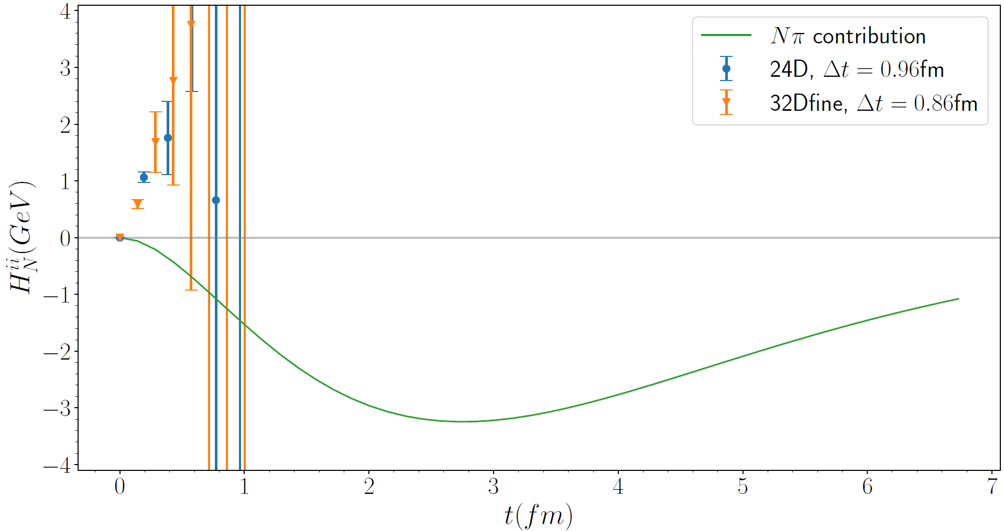
Nucleon polarizabilities and 𝑁𝜋 scattering
$$\int{d^{4}x t^{2}H_{ii}\left(x,t\right)=\int{dt t^{2}\sum_{k}{\left\langle p\left|J_{i}\left(0\right)\right|k\right\rangle e^{−\left(E_{k}−M\right)t}\left\langle k\left|J_{i}\left(0\right)\right|p\right\rangle }}}$$
$$=4\sum_{k}{\frac{\left\langle p\left|J_{i}\left(0\right)\right|k\right\rangle \left\langle k\left|J_{i}\left(0\right)\right|p\right\rangle }{{\left(E_{k}−M\right)}^{3}}}$$
Structure of hadronic function
The dominant contribution is given by $\left|k\right\rangle =|Nπ⟩$ states
$$t^{2}$$
Weight function
$$|Nπ⟩$$
$$|Nπ⟩$$
$|Nπ⟩$
$|Nπ⟩$ states contribution exhibits a peak at $t=2.8 fm$, far exceeding our truncation at $t_{0}≈0.75 fm$
Must calculate $Nπ$ contribution directly!
24

Slide 25
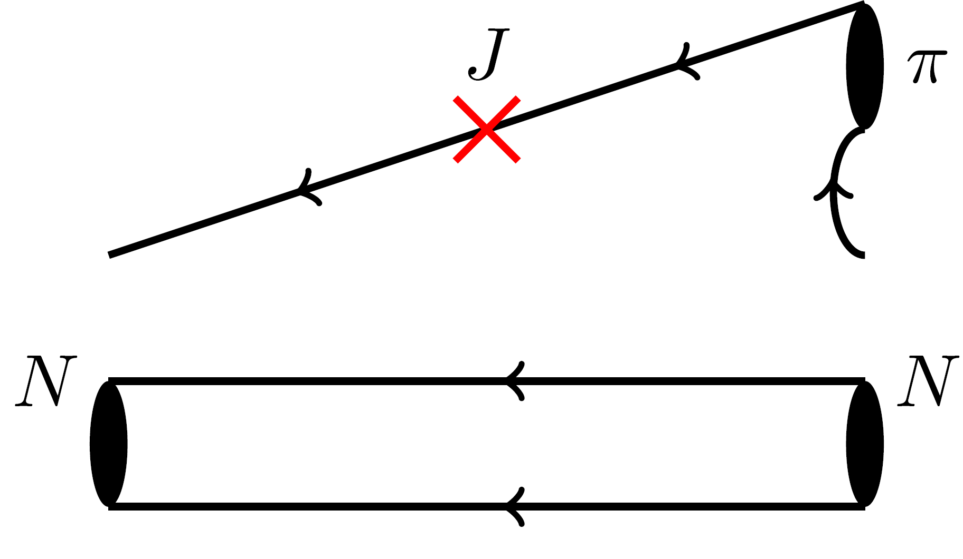
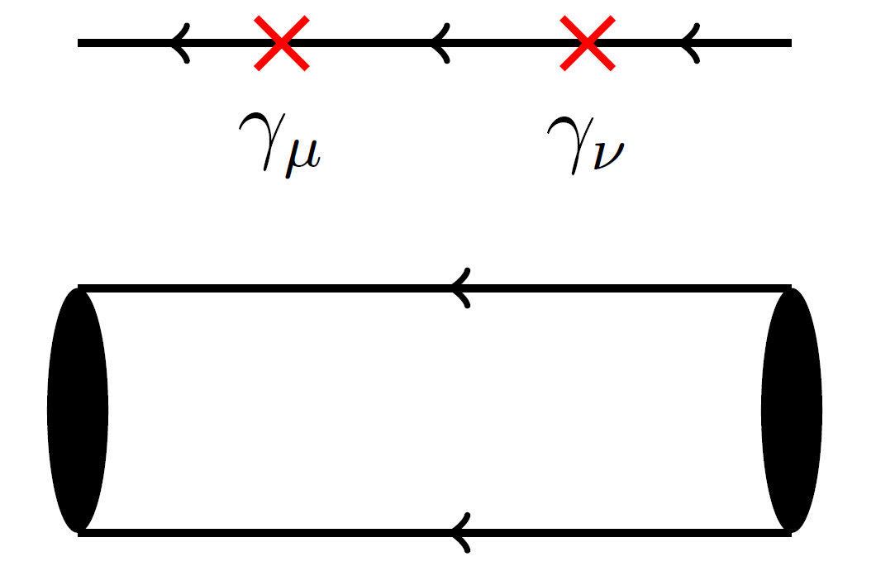
Wick contraction of $Nπ$ rescattering
$$N$$
$$N$$
$$I=1/2: O_{Nπ}^{I_{3}=+\frac{1}{2}}=O_{p}O_{π^{0}}−\sqrt{2}O_{n}O_{π^{+}},O_{Nπ}^{I_{3}=−\frac{1}{2}}=\sqrt{2}O_{n}O_{π^{0}}−O_{p}O_{π^{−}} \\ I=3/2: O_{Nπ}^{I_{3}=+\frac{1}{2}}=\sqrt{2}O_{p}O_{π^{0}}+O_{n}O_{π^{+}},O_{Nπ}^{I_{3}=−\frac{1}{2}}=O_{n}O_{π^{0}}+\sqrt{2}O_{p}O_{π^{−}}$$
}
Operators
25

Slide 26
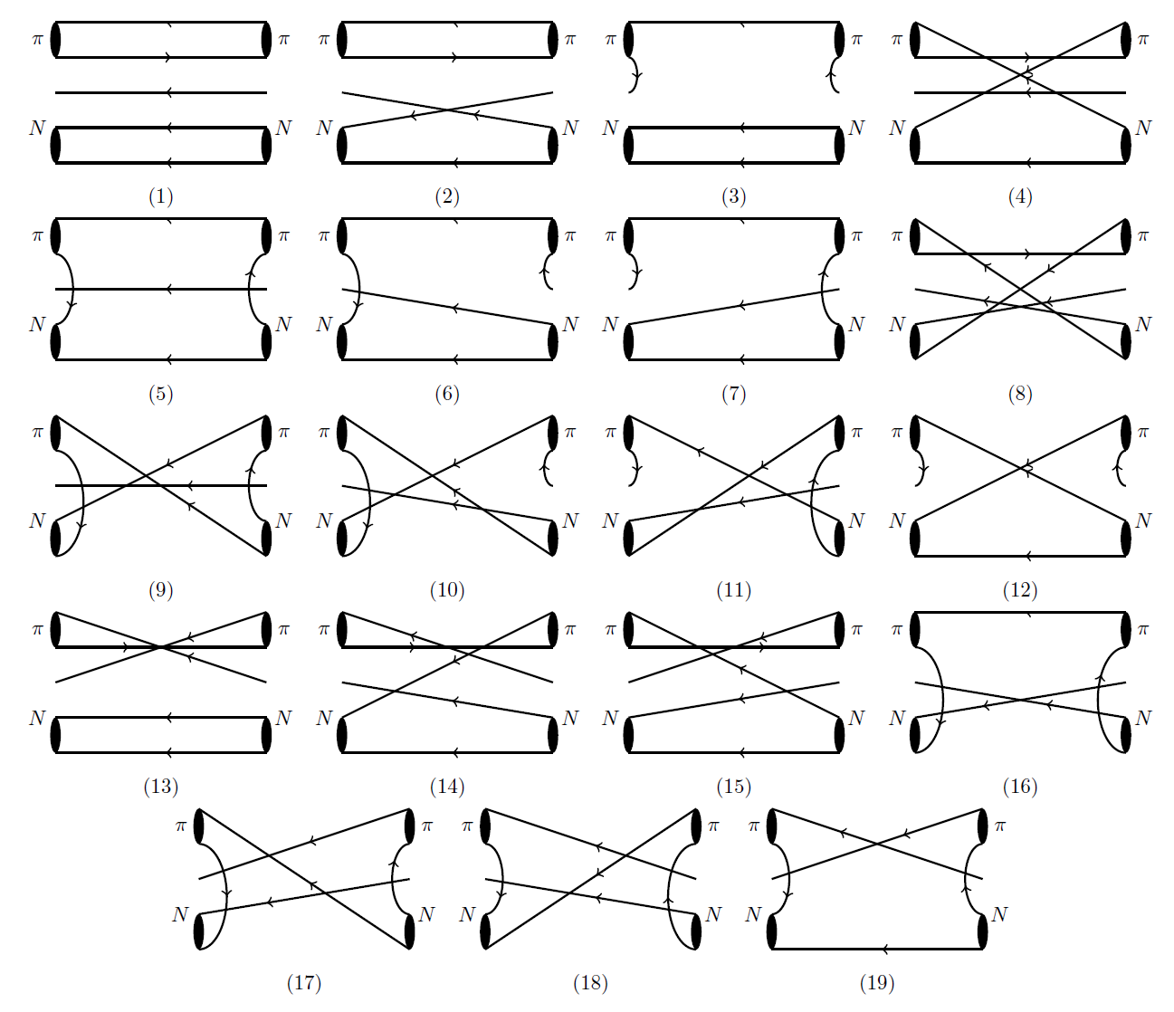
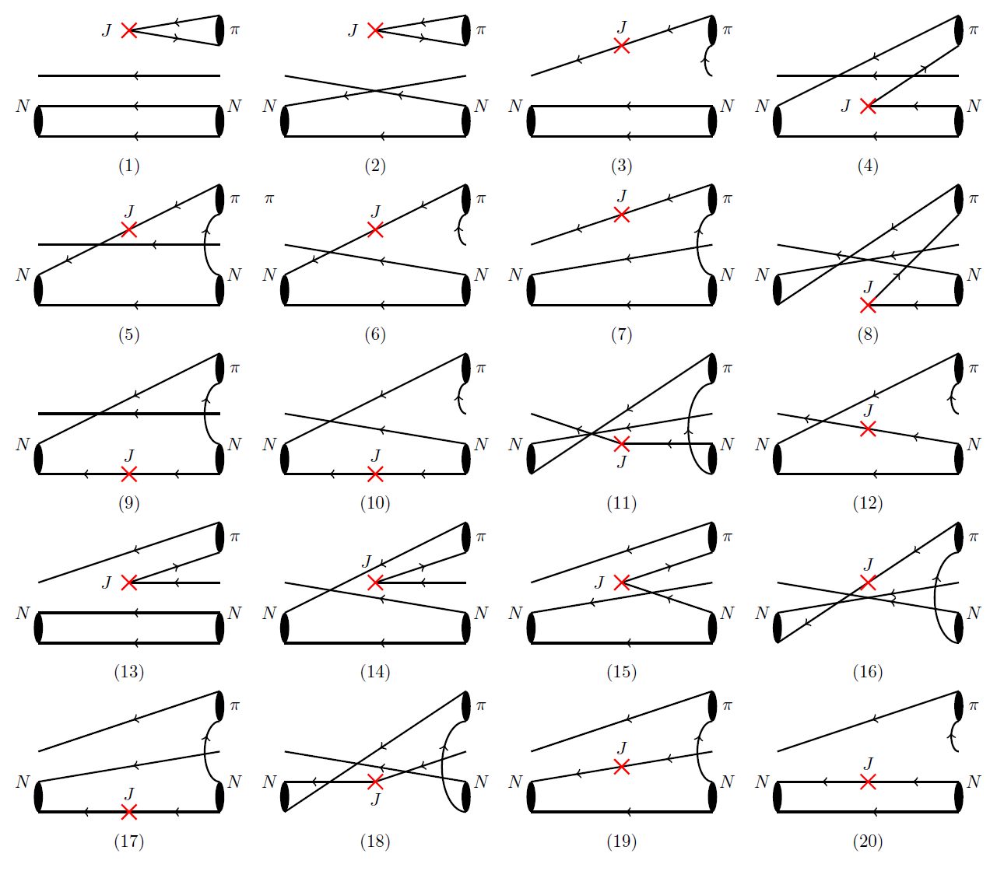
Wick contraction of $Nπ$ Rescattering
19 diagrams for $Nπ$ rescattering
20 diagrams for $N+γ→Nπ$
26

Slide 27
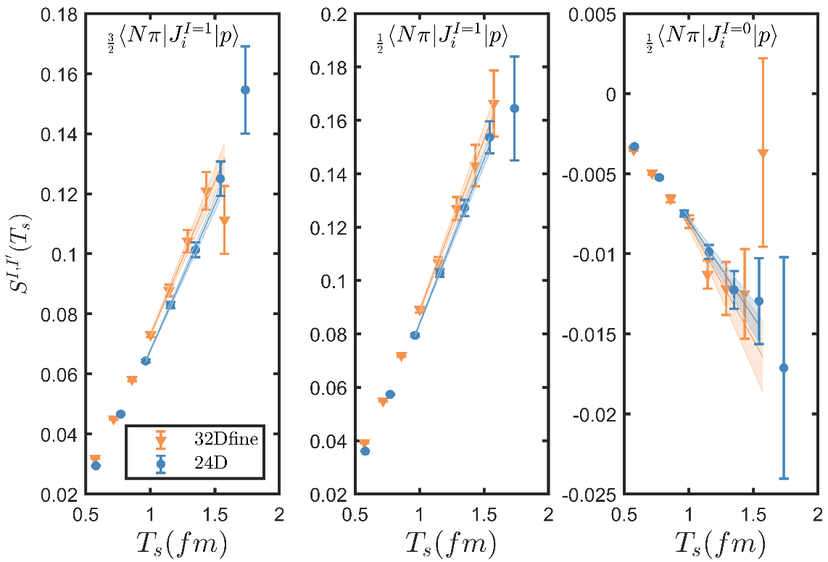
Matrix elements of 𝑁𝛾→𝑁𝜋
Nπ at the threshold
Normalization for $_{I}⟨Nπ|J_{i}^{I^{′}}|N⟩$
$$R=\frac{C_{NJNπ}\left(t_{1},t_{2}\right)}{C_{Nπ}\left(t_{1}+t_{2}\right)} \\ ×\sqrt{\frac{C_{N}\left(t_{1}\right)C_{Nπ}\left(t_{2}\right)C_{Nπ}(t_{1}+t_{2})}{C_{Nπ}\left(t_{1}\right)C_{N}\left(t_{2}\right)C_{N}(t_{1}+t_{2})}}$$
Maiani L. NPB, 293, 420(1987)
Summed insertion
$$S\left(T_{s}\right)=\sum_{t_{1}+t_{2}=T_{s}}{R(t_{1},t_{2})} \\ \underset{→}{T_{s}→∞}c_{0}+\frac{1}{\sqrt{2M}} _{I}⟨Nπ|J_{i}^{I^{′}}|N⟩⋅T_{s}$$
Linear fit $S\left(T_{s}\right)$ with $T_{s}$ to extract
27

Slide 28
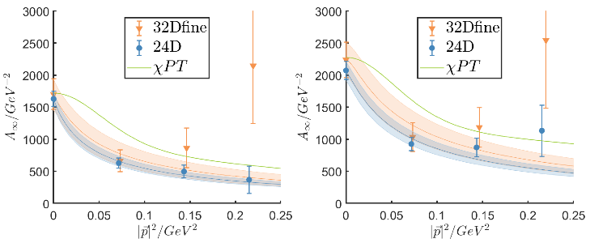
Matrix elements of 𝑁𝛾→𝑁(p)𝜋(-p) with 4 lowest mom modes
Proton
Neutron
(000)
(001)
(011)
(111)
28

Slide 29
Numerical results
Our results of $α_{E}$, in units of ${10}^{−4}fm^{3}$
X. Wang, Z. Zhang, et. al., arXiv:2310.01168
 |  | 24D | 32Dfine | PDG
Proton | $$α_{E}^{Nπ}$$ | 5.65(53) | 6.5(1.2)
 | $$α_{E}$$ | 10.0(1.3) | 9.3(2.2) | 11.2(4)
Neutron | $$α_{E}^{Nπ}$$ | 8.33(75) | 9.8(1.5)
 | $$α_{E}$$ | 9.7(1.4) | 10.1(2.4) | 11.8(1.1)
Confirm large contributions of $Nπ$ states → pion cloud picture
See Zhan-Wei Liu’s talk
Develop the methodology for lattice QCD computation of polarizabilities
More sophisticated study to control systematic effects
29

Slide 30
Selected topics
Two-photon exchange contribution to muonic hydrogen Lamb shift
Proton charge radius
See Wei-Zhi Xiong’s talk
Compton scattering and nucleon electromagnetic polarizabilities
Polarizabilities
See Nikos Sparveris’ talk
γZ box contribution to parity violating e-p scattering
Weak charge
Qweak collabration, Nature 557, 207–211 (2018)
30

Slide 31
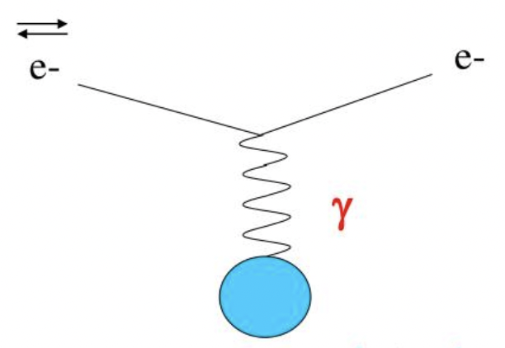
Parity-violating e-p scattering – determination of θ_{W}
Q_{weak}@JLab, P2@MESA: polarized electron and unpolarized proton
Parity conserving
Parity violating
Left-right hand asymmetry in cross section
Extract proton weak charge
31

Slide 32
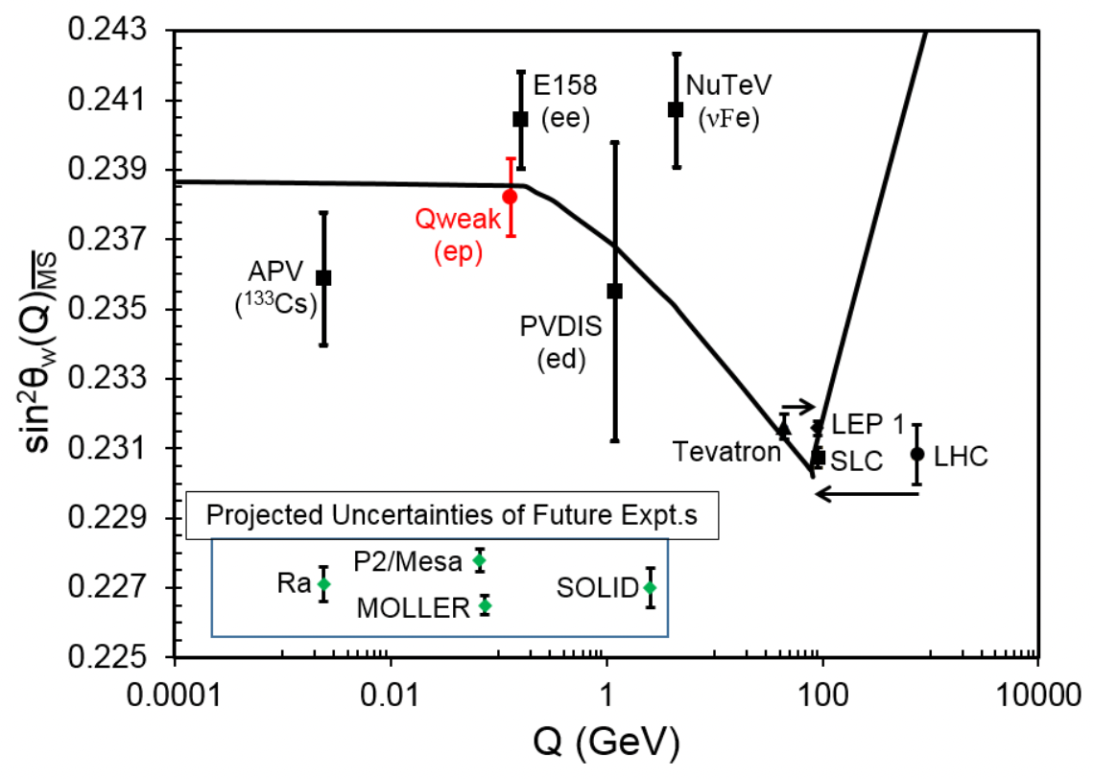
Parity-violating e-p scattering – determination of θ_{W}
Most precise measurement below Z pole
Future exp. P2@Mesa with electron energy E<155 MeV
Nearly forward scattering!
32

Slide 33
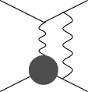
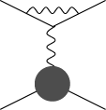
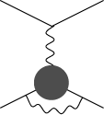
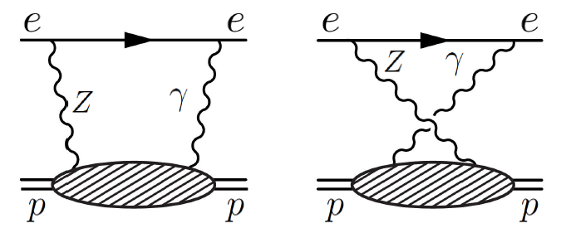
γZ box contribution
To compare the theory with experiment, one has to include electroweak corrections
J. Erler, A. Kurylov, M. Ramsey-Musolf, PRD68 (2003) 016006
At one-loop level, electroweak corrections are
WW box, γZ box, ZZ box
leptonic vertex correction
hadronic vertex correction
Nonperturbative nature
Dominate hadronic uncertainty
33

Slide 34
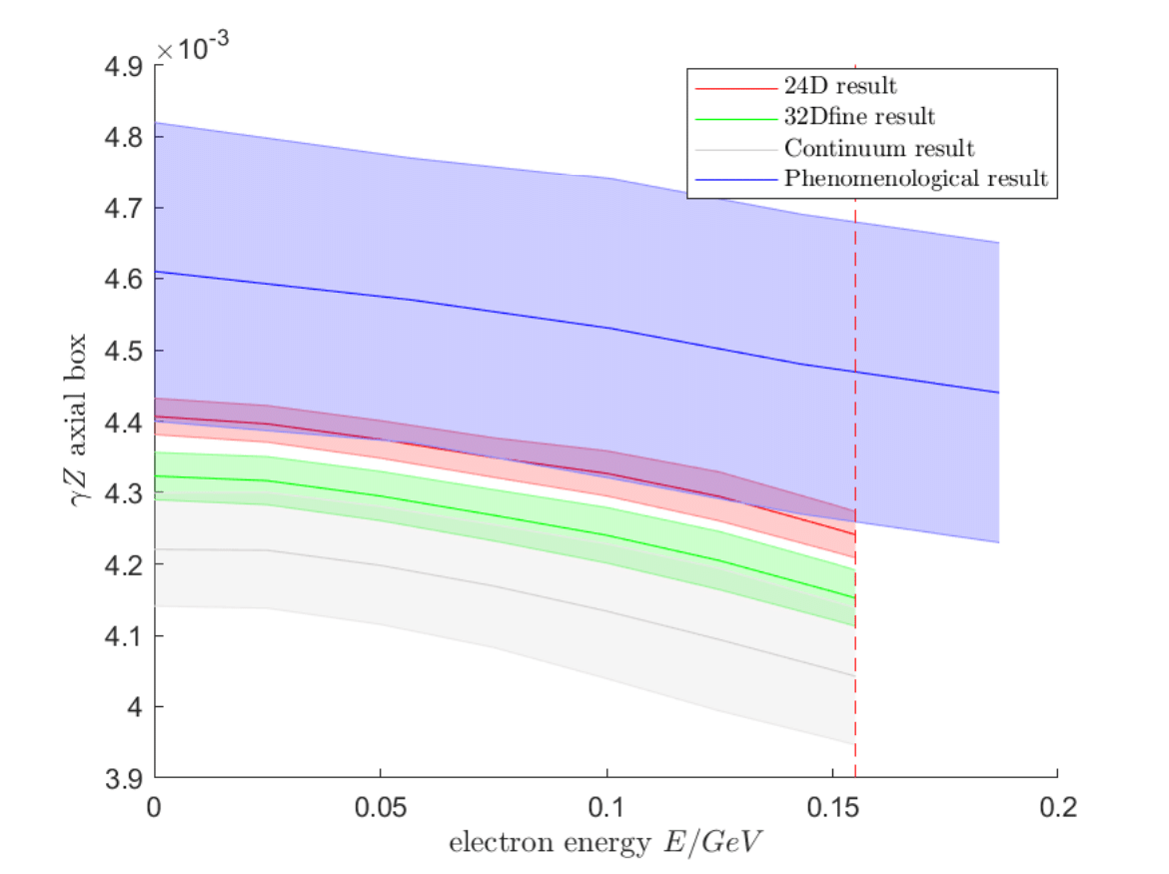
Lattice results
Results of with , compared. with phenomenological result
J. Erler, M. Gorchtein, O. Koshchii, et.al. PRD100 () 053007
Lattice results after continuum extrapolation
Preliminary
34

Slide 35
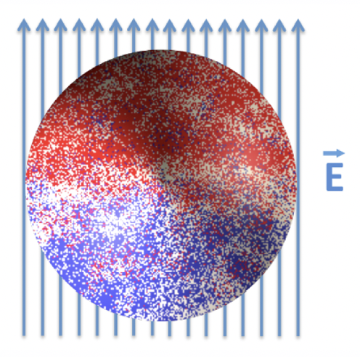
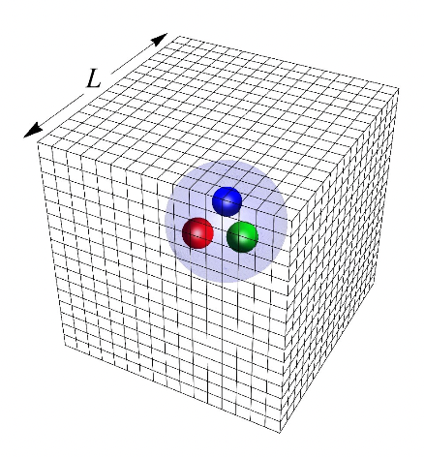
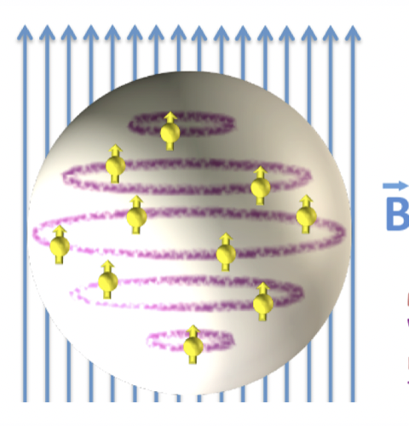
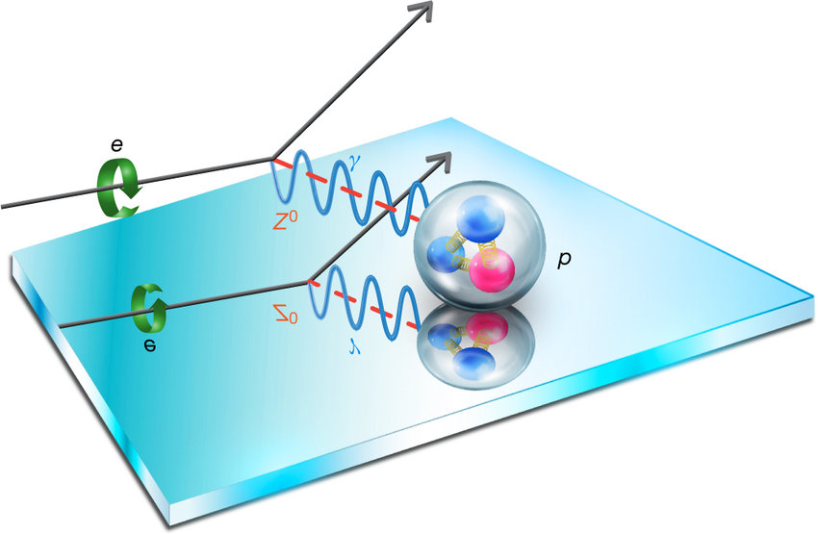
Conclusion
Nucleon structure at low Q is an exciting field for lattice QCD to explore!
Lamb shift
E&M polarizability
Parity violating e-p scattering

