Slide 1
A Study with High Precision on the Electro-production of Λ-hypernuclei in Wide Mass Range
Liguang Tang, Hampton University/JLab
On behalf of the unified JLab hypernuclear physics collaboration
A new experimental program in Hall C, created on the foundation of achievements from the 6 GeV programs separately carried out in Hall A and Hall C
Hadron-China 2024 Workshop, Dalian, China, August 4-9, 2024
1

Slide 2
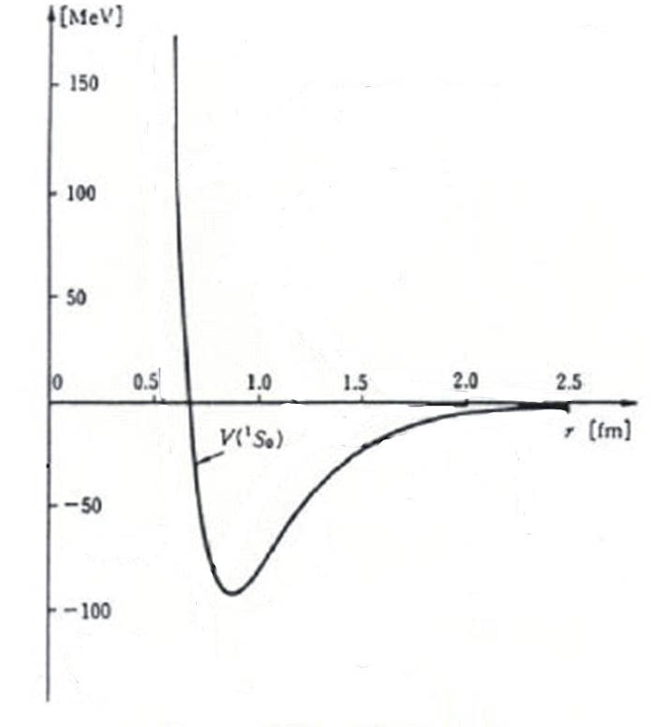
Introduction
Strong Interaction – Nuclear Physics
Short Range
Long Range
QCD
NN Interaction Model
Asymptotic Freedom
Lots of NN scat. data
Quark Degree of Freedom
Various Data of Nuclei
Recent development of LQCD has been successful on the non-strangeness sector
YN and YY are the missing parts to fully understand the flavor SU(3) breaking
ΛN
Hypernuclear physics is a unique tool and a gateway to other flavors
Λ-hypernuclei are unique to study the short range B-B interactions, since one-pion-exchange (OPE) is forbidden due to isospin conservation.
OPE
2

Slide 3
Introduction – cont.
A novel feature of Λ-hypernuclei
Short range interactions
ΛΣ coupling, ΛNN 3-B forces
Origin of Charge-symmetry-breaking (CSB)
Change of core structures
Drip line limit
No Pauli blocking to Λ
Probe the nuclear interior
Baryonic property change or single
particle nature of Λ in heavy baryonic
system
ΛN
OPE
3

Slide 4
Hypernuclear Experiments at JLab Using CW Electron Beam
The (e, e’K⁺) Reaction
e
e’
γ
K⁺
p
Λ
^{Z}A
^{Z-1}_{Λ}A
Large momentum transfer (~300-400 MeV/c)
Deeply bound, highest possible spin, both unnatural and natural parity states
Small production cross section but compensated by high beam intensity
Neutron rich hypernuclei and high iso-spin states (important to study Λ-Σ coupling)
Capable of high precision which is important for hypernuclear spectroscopy
Complimentary to spectroscopy produced by other mechanisms
4

Slide 5
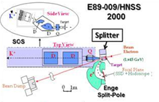
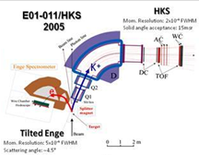
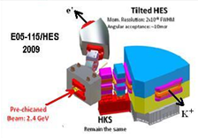
Hall C Program During CEBAF 6GeV Period
PHASE I :
(¹²_{Λ}B)
Proved feasibility with 0.8 MeV resolution
PHASE III
(⁷_{Λ}He*, ¹⁰_{Λ}Be, ¹²_{Λ}B, ⁵²_{Λ}V)
Extend further in medium heavy mass region
(~0.6 MeV FWHM)
PHASE II:
(⁷_{Λ}He, ¹²_{Λ}B, ²⁸_{Λ}Al)
High yield and better resolution (~0.6 MeV FWHM)
γ
Lifetime of Heavy Hypernuclei
5

Slide 6
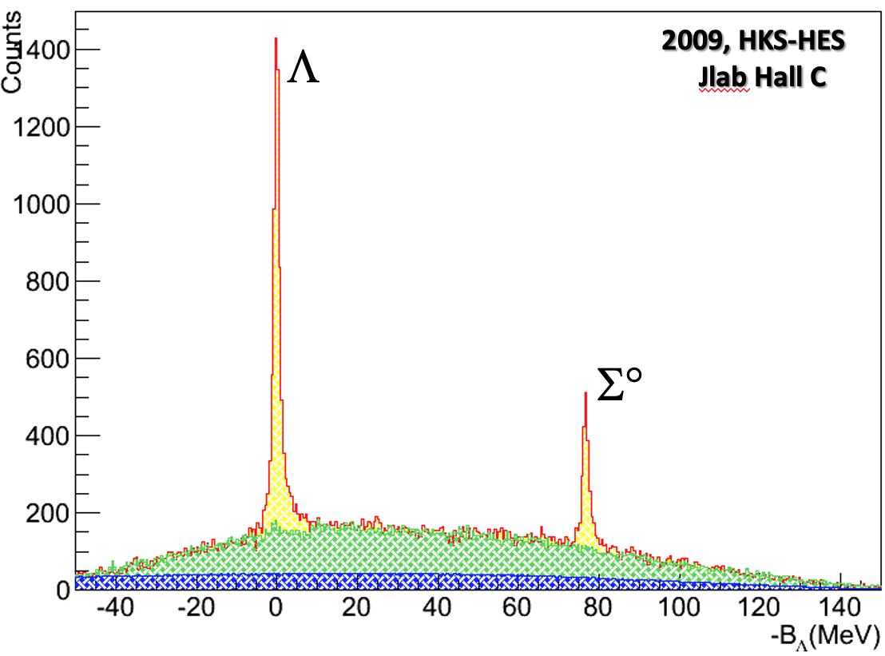
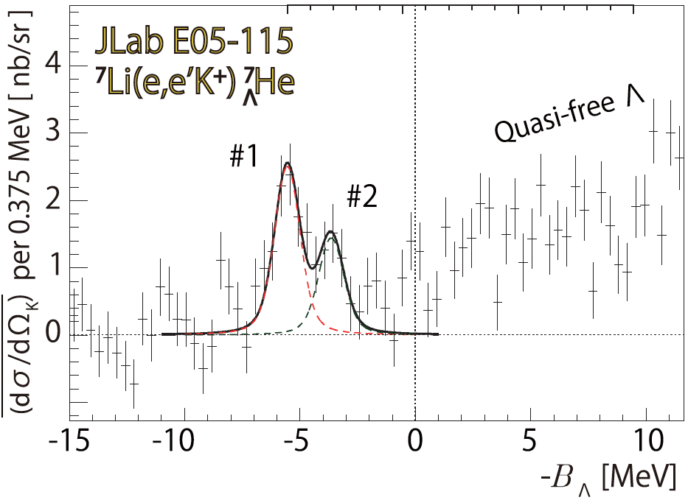
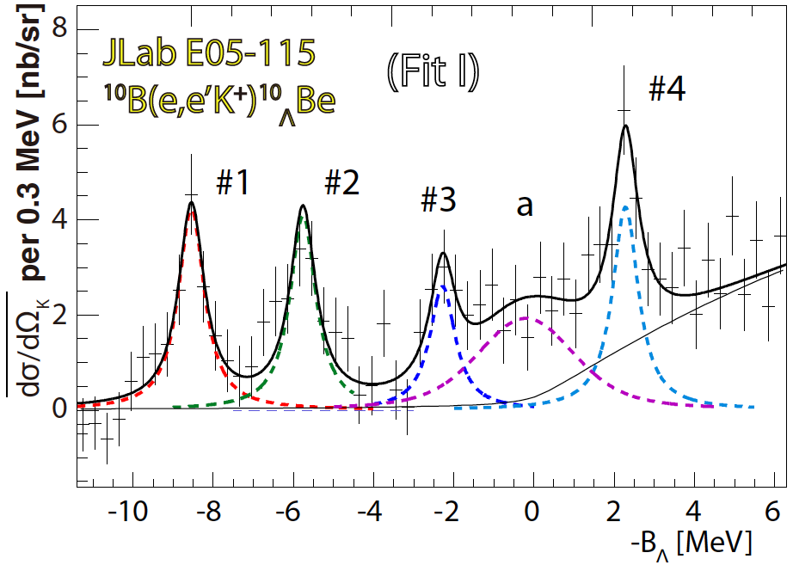
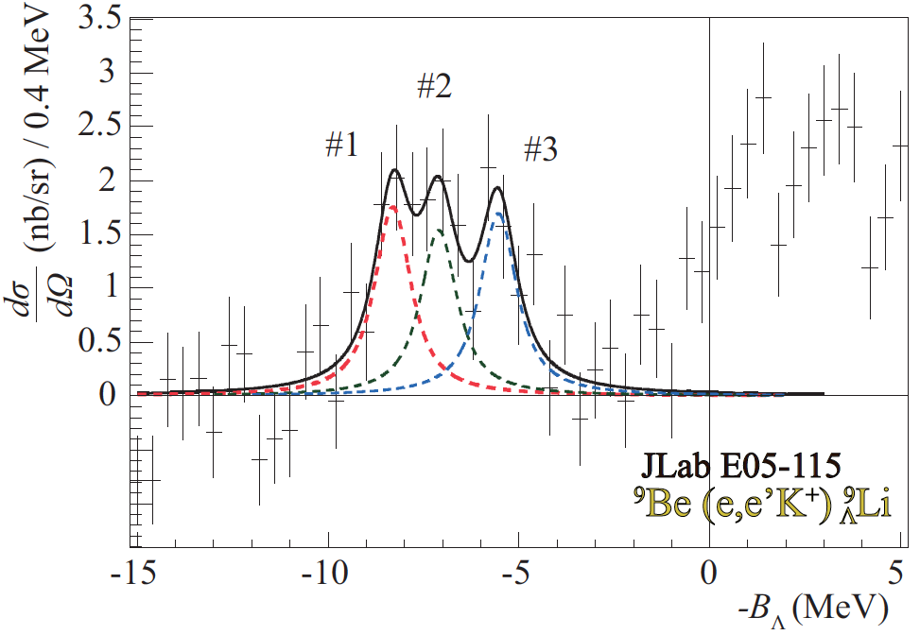
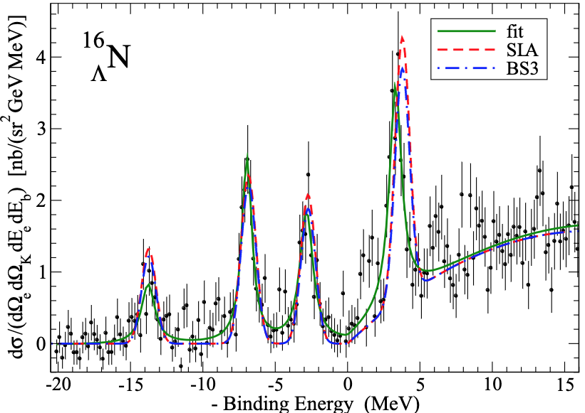
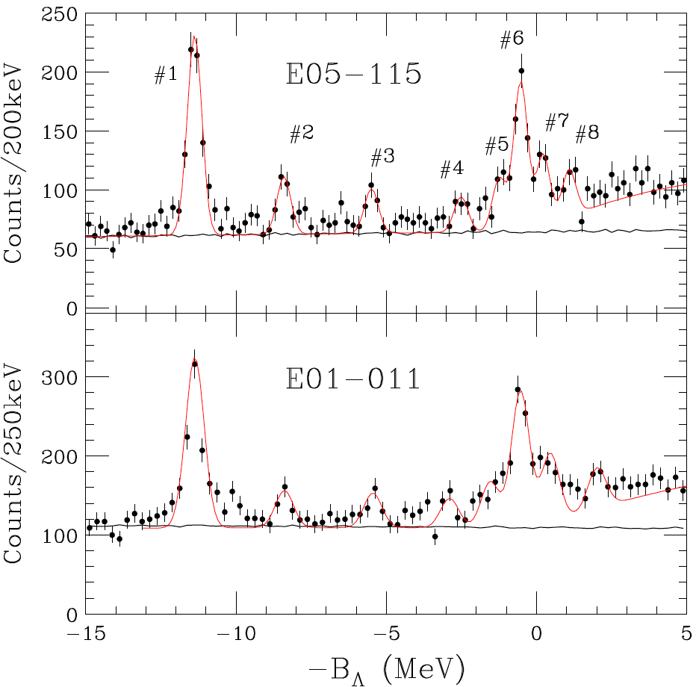
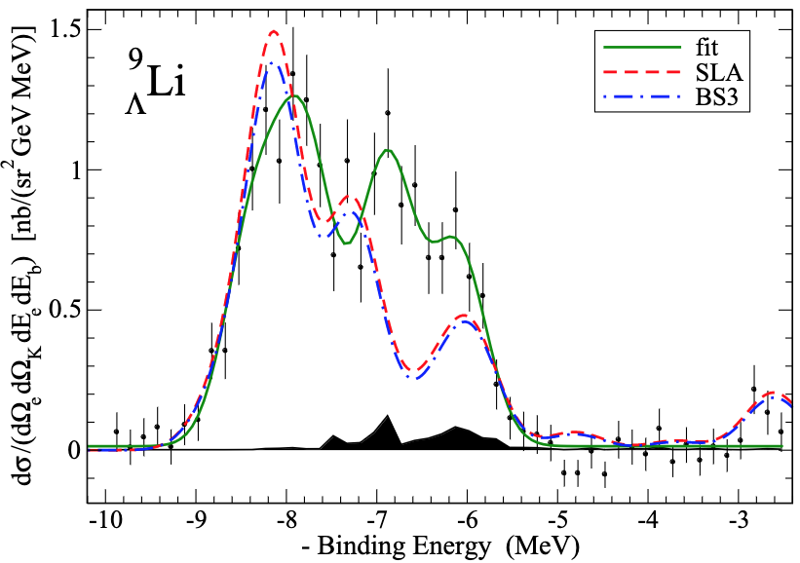
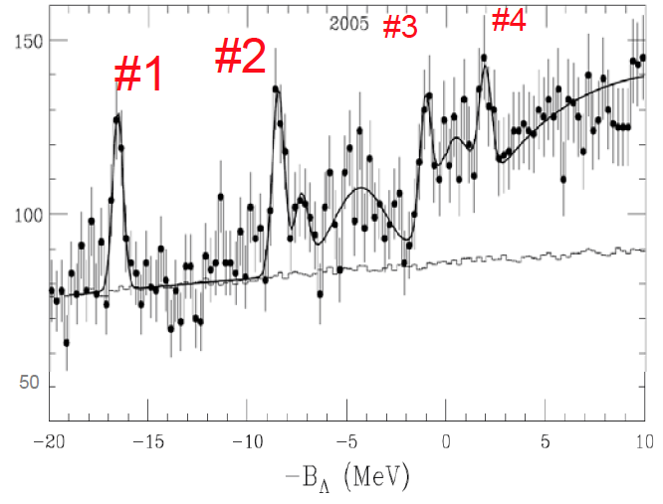
Hypernuclear Program Highlights from 6 GeV Era
⁷_{Λ}He
¹⁰_{Λ}Be
E05-115
Hall C
Hall A
⁹_{Λ}Li
¹²_{Λ}B
¹²_{Λ}B
Hall A
Energy resolution: ~700 keV FWHM
ΔB ≤ ±60 to 200 keV
depending on statistics
²⁸_{Λ}Al
²⁸S_{i}(e, e’K⁺)²⁸_{Λ}Al
E01-011
6

Slide 7
JLab Hypernuclear Program To Date
Hypernucleus | What we learned Publications Experimental Hall
H(e, e’K⁺)Λ | Cross section at forward angle New paper just accepted by PRC for publication (Hall A) and small Q² Phys. Rev. C 81 052210(R) (2010) (Hall A)
³H(e, e’K⁺)Λnn | Possible Λnn resonance Phys. Rev. C 105, L051001 (2022) (Hall A) Prog. Theor. Exp. Phys. 2022 013D01 (Hall A)
⁷Li(e, e’K⁺) ⁷_{Λ}He | CSB for iso-triplet hypernuclei Phys. Rev. C 94, 021302 (R) (2016) (Hall C) Phys. Rev. Lett. 110 012502 (2013) (Hall C)
⁹Be(e, e’K⁺) ⁹_{Λ}Li | 1st spectroscopy of ⁹_{Λ}Li Phys. Rev. C 103, L041301 (2021) (Hall C) Phys. Rev. C 99, 054309 (2019) (Hall A) Phys. Rev. C 91, 034308 (2015) (Hall A)
¹⁰B(e, e’K⁺) ¹⁰_{Λ}Be | 1st spectroscopy of ¹⁰_{Λ}Be Phys. Rev. C 93, 034314 (2016) (Hall C) Iso-spin doublet with ¹⁰_{Λ}B
¹²C(e, e’K⁺) ¹²_{Λ}B | 1st spectroscopy of ¹²_{Λ}B, pair to ¹²_{Λ}C Phys. Rev. C 99, 054309 (2019) (Hall A) A reference hypernucleus Phys. Rev. C 90, 034320 (2014) (Hall C) Demonstrated high resolution Phys. Rev. Lett. 99, 052501 (2007) (Hall A) (~750 keV FWHM) and high precision Phys. Rev. C 73, 044607 (2006) (Hall C) (ΔΒ < $±$ 50 keV) are achievable Phys. Rev. Lett. 90, 232502 (2003) (Hall C)
¹⁶O(e, e’K⁺) ¹⁶_{Λ}N | 1st spectroscopy of ¹⁶_{Λ}N Phys. Rev. C 99, 054309 (2019) (Hall A) Iso-spin doublet with ¹⁶_{Λ}O Phys. Rev. Lett. 103, 202501 (2009) (Hall A)
²⁸Si(e, e’K⁺) ²⁸_{Λ}Al | 1st spectroscopy on S-D shell nucleus Nucl. Phys. A 804 (2008) 125. (Hall C) Not finalized for publication due to high background and S/B ratio.
⁵²SCr(e, e’K⁺) ⁵²_{Λ}V | 1st spectroscopy on medium heavy Not published (Hall C) Hypernucleus. Not finalized for publication due to high background and low statistics.
8

Slide 8
Hypernuclei in wide mass range
Hypernuclear Spectroscopy Prospectives at JLab
E89-009, E01-011, E05-115(Hall C)
E94-107(Hall A)
1
20
50
200
10⁵⁷
A
H, ⁷Li, ⁹Be, ¹⁰B, ¹²C, ¹⁶O, ²⁸Si, ⁵²Cr
Future mass spectroscopy (new experiments)
Elementary Process
Strangeness electro-production
Neutron/Hyperon star,
Strangeness matter
Hyperonization →
Softening of EOS ?
Light Hypernuclei (s,p shell)
Fine structure
Baryon-baryon interaction in SU(3)
ΛΣ coupling in large isospin hypernuclei
Cluster structure/shell models
Medium/heavy Hypernuclei
Single particle potential
Distinguish ability of a Λ hyperon
U_{o}(r), m_{Λ}*(r), V_{ΛNN}, …
Precision (≤ 60 keV)
Minimized background
Characteristics

Slide 9
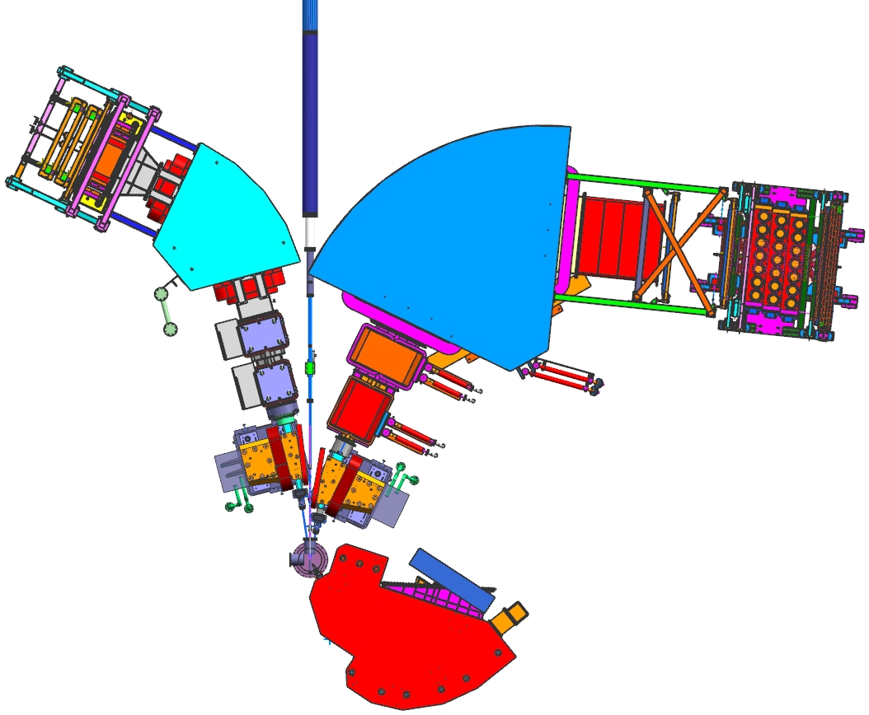
Schematic Layout For The Next Group of Experiments
5 Phase I Experiments – Hall C
Combine the features of previous Hall A and C experiments, create an optimized future program w/ the CEBAF CW beam
HES (e’)
HKS (K⁺)
HES & HKS (e, e’K⁺): Mass spectroscopy
E12-24-004, E12-24-011, E12-24-013,
E12-24-003
PCS Magnet
PCS Magnet
Target Chamber
⁶Li, ⁹Be, ¹¹B, ¹²C, ²⁷Al,
⁴⁰Ca, ⁴⁸Ca,
²⁰⁸Pb
HKS & Enge (K⁺ π⁻): Decay π⁻ spectroscopy
E12-15-008A/E12-20-013A
Enge (π⁻)
9

Slide 10
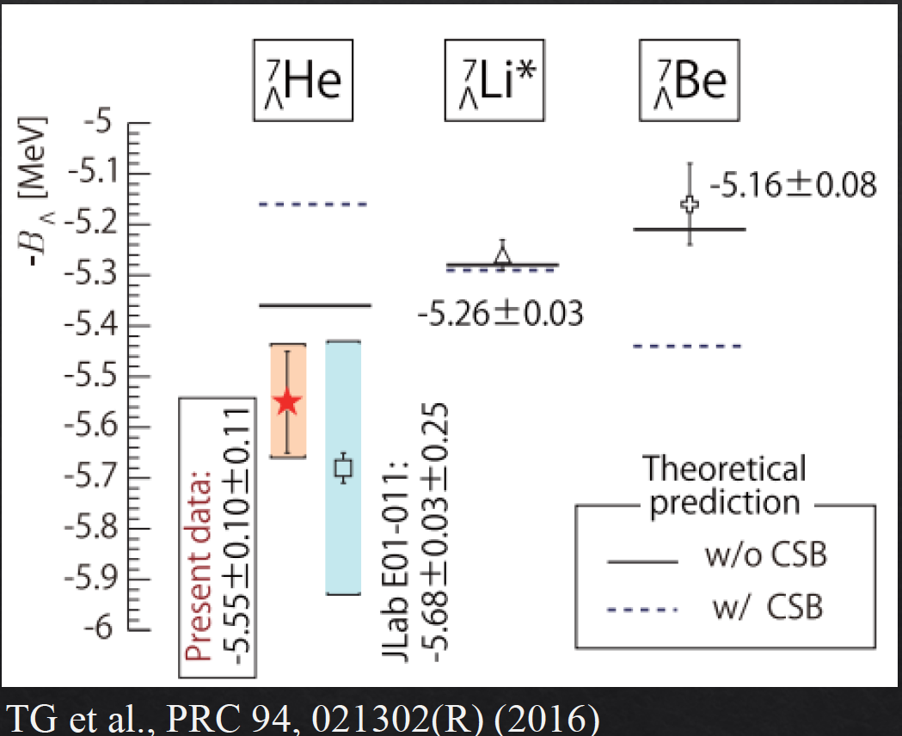
E12-24-004: Study CSB in P-shell Hypernuclei
Charge-Symmetry-Breaking in ΛN
interaction remains mystery, need precise data from more isomultiplets
NN
ΛN
10

Slide 11
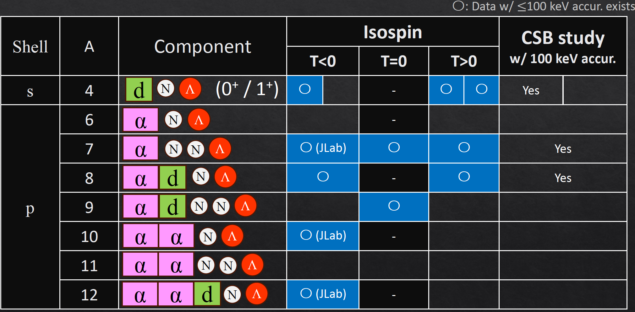
The Goal of E12-24-004 Experiment
Existing data are Limited and lacking precision
Need a precision ≤ 100 keV to pin down the origin of CSB
JLab
II
Yes
This Exp.
J-PARC
Yes
This Exp.
Yes
J-PARC E94
Yes
This Exp.
J-PARC
Yes
J-PARC E94
Yes
Targeted precision for all JLab Experiments: ΔB ≲ 60 keV
11

Slide 12
E12-24-013: Isospin Dependence in ΛNN Interaction (⁴⁰Ca and ⁴⁸Ca to ⁴⁰_{Λ}K and ⁴⁸_{Λ}K with large isospin difference)
E12-24-003: A Dependence in ΛNN Interaction ²⁰⁸Pb to ²⁰⁸_{Λ}Τl
-- Neutron stars and Hyperon Puzzle --
12

Slide 13
E12-24-013: Isospin Dependence in ΛNN Interaction (⁴⁰Ca and ⁴⁸Ca to ⁴⁰_{Λ}K and ⁴⁸_{Λ}K with large isospin difference)
E12-24-003: A Dependence in ΛNN Interaction ²⁰⁸Pb to ²⁰⁸_{Λ}Τl
-- Neutron stars and Hyperon Puzzle --
13

Slide 14
E12-24-013: Isospin Dependence in ΛNN Interaction (⁴⁰Ca and ⁴⁸Ca to ⁴⁰_{Λ}K and ⁴⁸_{Λ}K with large isospin difference)
E12-24-003: A Dependence in ΛNN Interaction ²⁰⁸Pb to ²⁰⁸_{Λ}Τl
ΛNN force becomes significant from medium-heavy hypernuclei
14

Slide 15
E12-24-013: Isospin Dependence in ΛNN Interaction (⁴⁰Ca and ⁴⁸Ca to ⁴⁰_{Λ}K and ⁴⁸_{Λ}K with large isospin difference)
¹²_{Λ}B
⁴⁰_{Λ}Κ
⁴⁰_{Λ}Κ to ⁴⁸_{Λ}Κ
Large isospin difference
Well known spectroscopy
⁴⁸_{Λ}Κ
15

Slide 16
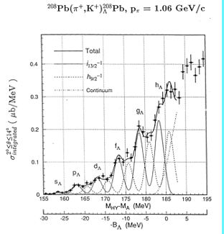
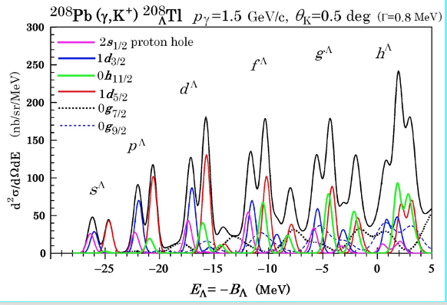
E12-24-003: A Dependence in ΛNN Interaction ²⁰⁸Pb to ²⁰⁸_{Λ}Τl
Resolution: ~2.0 MeV FWHM
Published KEK experiments
Expected Resolution: ~0.6 MeV FWHM
The next JLab experiments
Study A dependence together with the data from ⁴⁰_{Λ}K and ⁴⁸_{Λ}K
16

Slide 17
E12-24-011: Study Triaxially Deformed Nucleus -- Probing The Interior Of A Nucleus by Λ Particle --
17

Slide 18
E12-24-011: Study Triaxially Deformed Nucleus -- Probing The Interior Of A Nucleus by Λ Particle --

Slide 19
E12-24-011: Study Triaxially Deformed Nucleus -- Probing The Interior Of A Nucleus by Λ Particle --
19

Slide 20
E12-24-011: Study Triaxially Deformed Nucleus -- Probing The Interior Of A Nucleus by Λ Particle --
Study the triaxial deformation for the first time
20

Slide 21
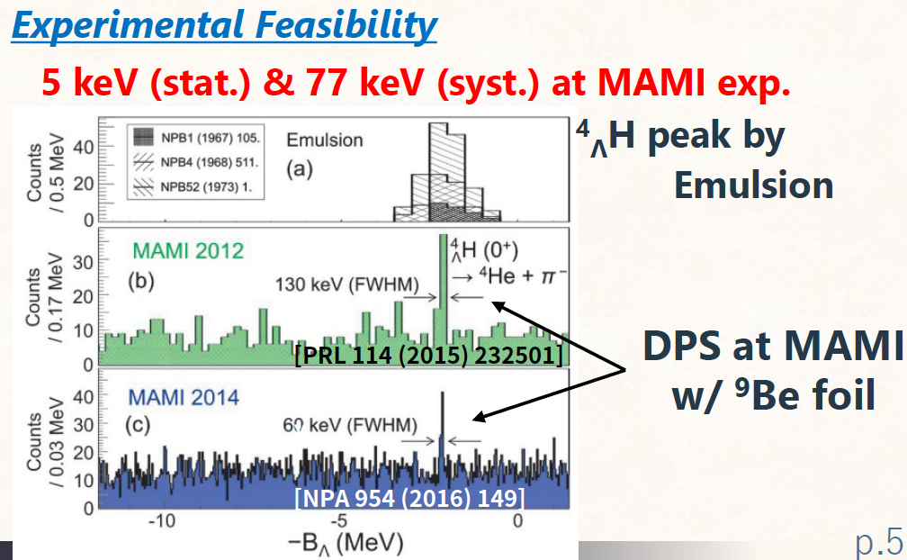
E12-15-008A/E12-20-013A: Decay Pion Spectroscopy -- Ground State of Light Hypernuclei via Hyperfragments --
Provide a set of data with high precision for modeling the ΛN interaction
21

Slide 22
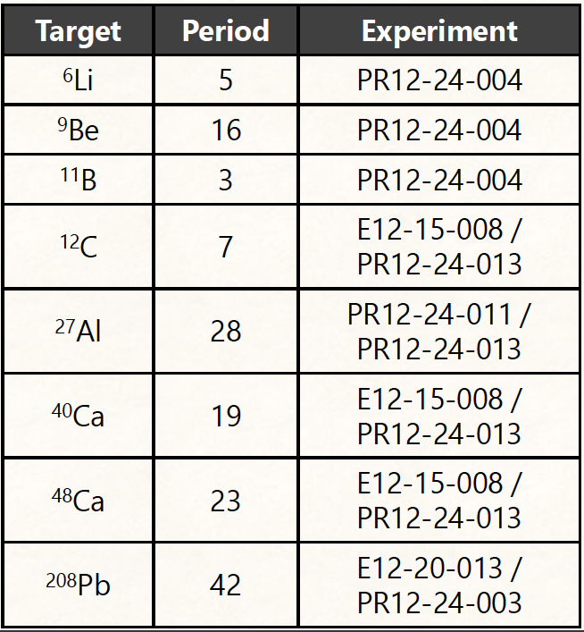
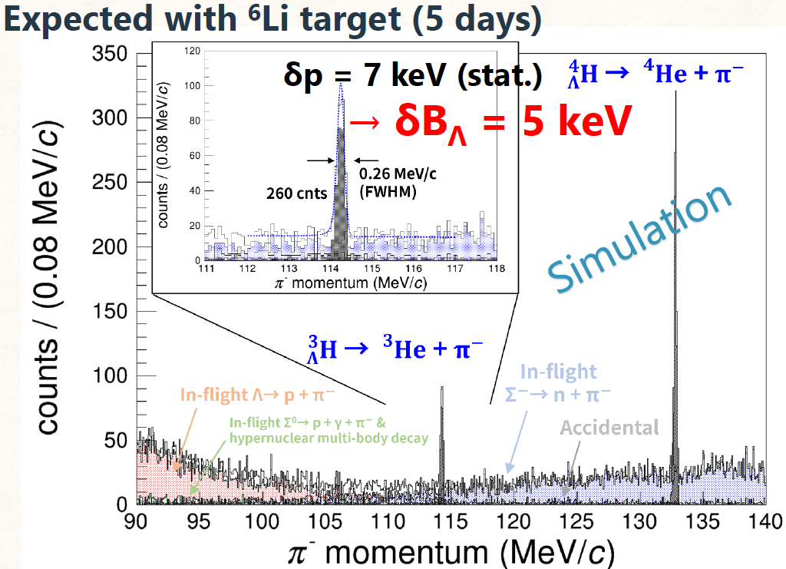
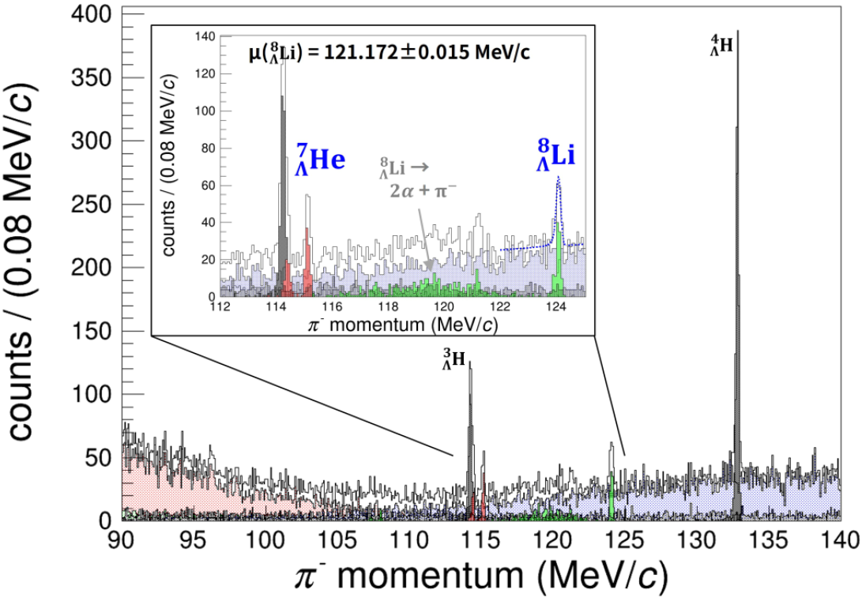
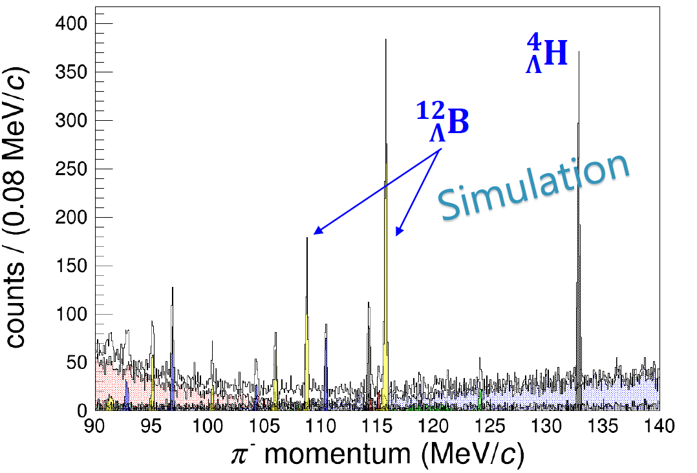
E12-15-008A/E12-20-013A: Decay Pion Spectroscopy -- Ground State of Light Hypernuclei via Hyperfragments --
Expected with ⁹Be target (simulation)
Expected with ¹²C target
22

Slide 23
Summary
High intensity CW beam at JLAB and the characteristics of electro-production make possible for high precision hypernuclear programs. The experiments in the 6 GeV era were proven successful.
There are five newly approved hypernuclear experiments which will be carried out in Hall C, starting in 2027.
Their physics ranges from CSB, ΛNN interactions, nuclear deformation probed by a Λ particle, and precise ground state mass of light hypernuclei studied by the spectroscopy of two-body decay pions.
23

