Slide 1
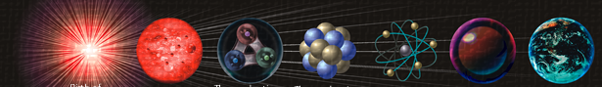
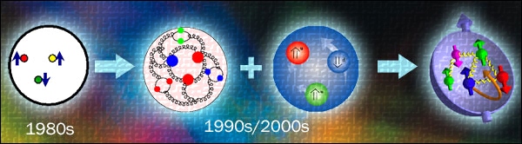


Multi-charm hadrons at LHCb
张艳席
24/Apr/2023
华中师范大学

Slide 2
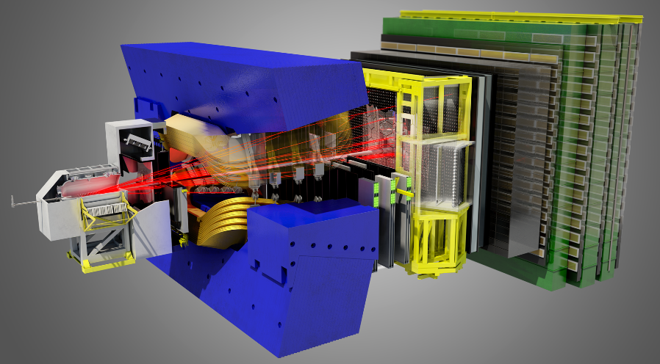
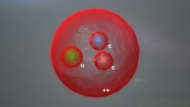
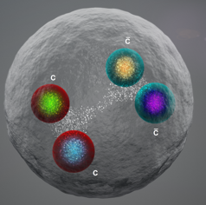
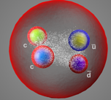



Contents
Introduction
LHCb
Doubly charmed baryon
Fully charmed tetraquark
Doubly charmed tetraquark
Summary and prospects
$$Ξ_{cc}^{++}$$
$$T_{cccc}$$
$$T_{cc}$$

Slide 3
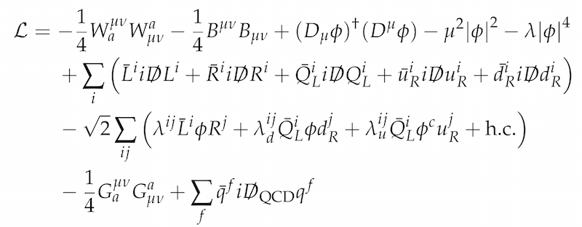
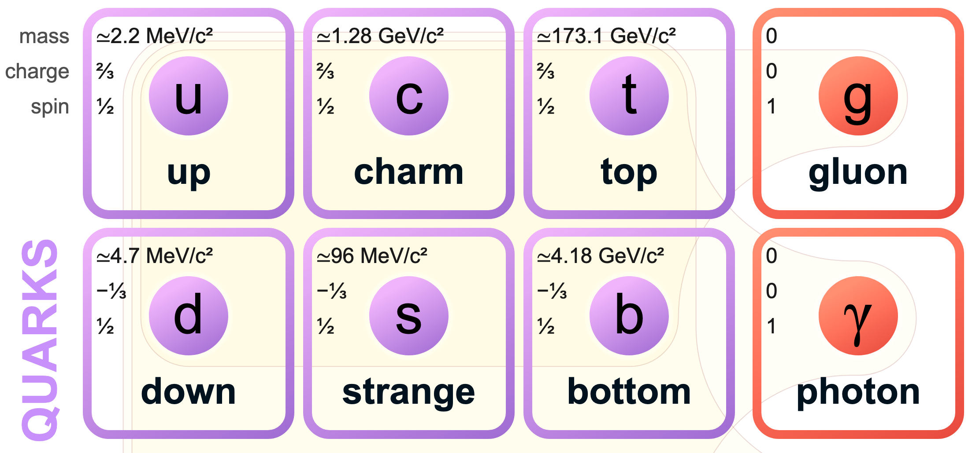
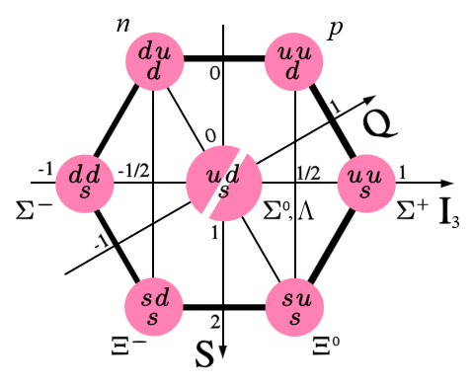

The Standard Model
${=ℒ}_{QCD}$ for the strong interaction
Gluons
Quarks
No free quarks/gluons but hadrons
Matter in Universe
Baryon octet
Notes:
只存在强子，比如质子和重子主导了自然界物质成分

Slide 4
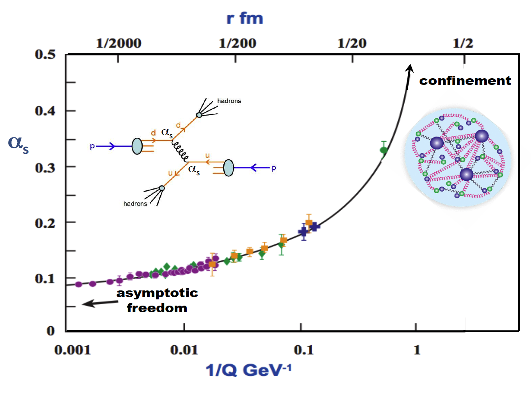
Two ends of QCD
Quark/gluon at high energy v.s. hadrons at low energy
Perturbative
Nonperturbative in QCD
hardon
dynamics
Hadron wave functions needed to calculate production, decay ...
Notes:
At high energy, processes can be calculated directly using QCD and quarks/gloun interactions
But at low energy, one can’t ignore hadron effect.

Slide 5
Two ends of QCD
Quark/gluon at high energy v.s. hadrons at low energy
Perturbative
Nonperturbative in QCD
Hadronization
Structure
hardon
dynamics
Hadron wave functions needed to calculate production, decay ...
Notes:
At high energy, processes can be calculated directly using QCD and quarks/gloun interactions
But at low energy, one can’t ignore hadron effect.

Slide 6
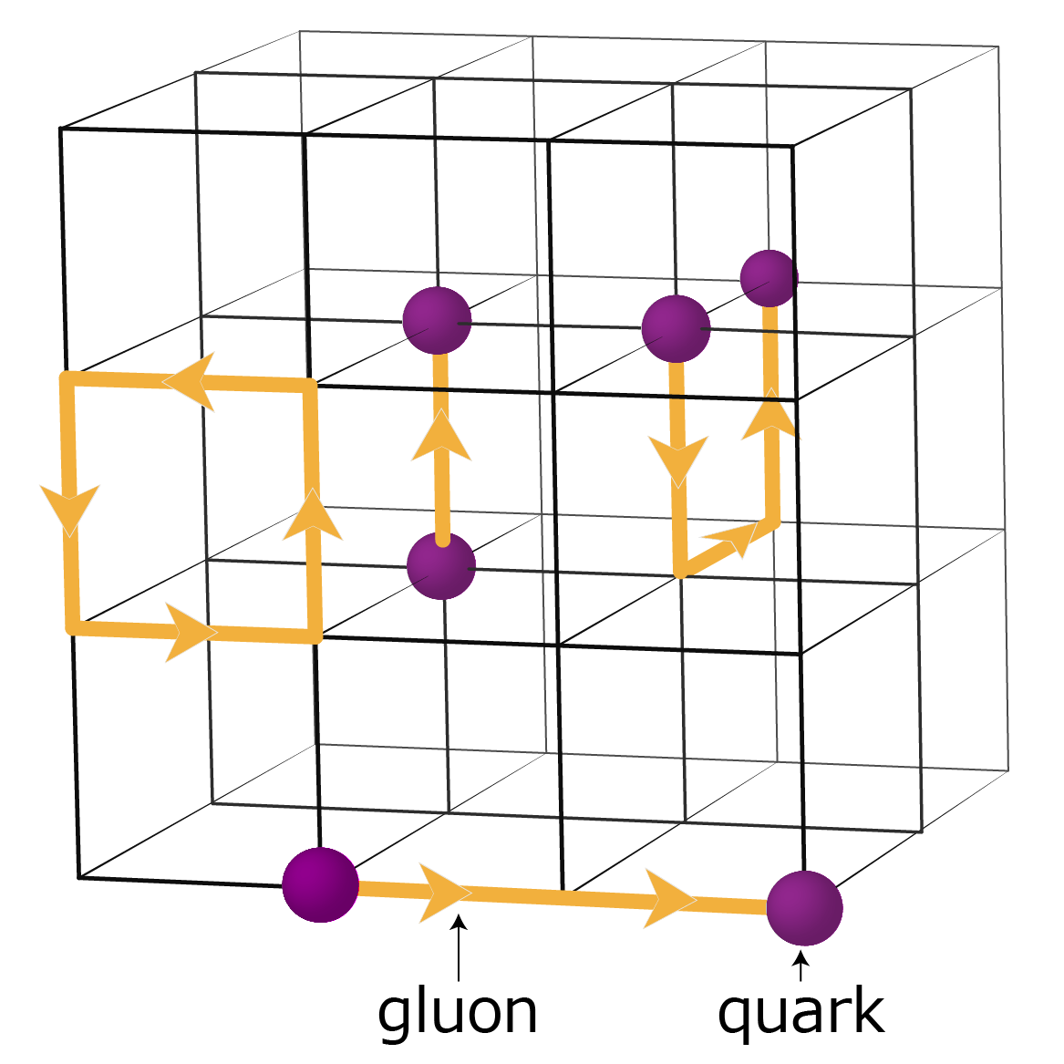
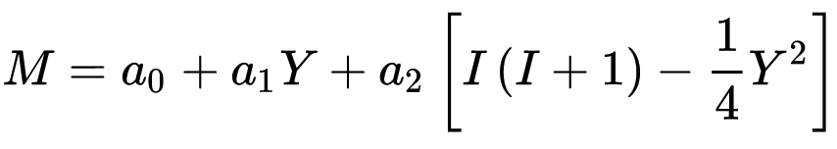
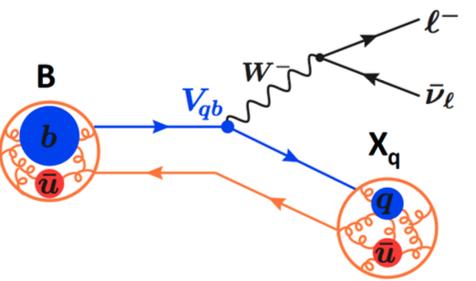
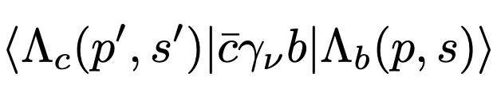
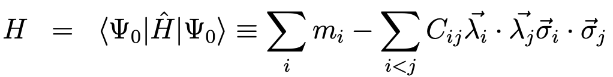


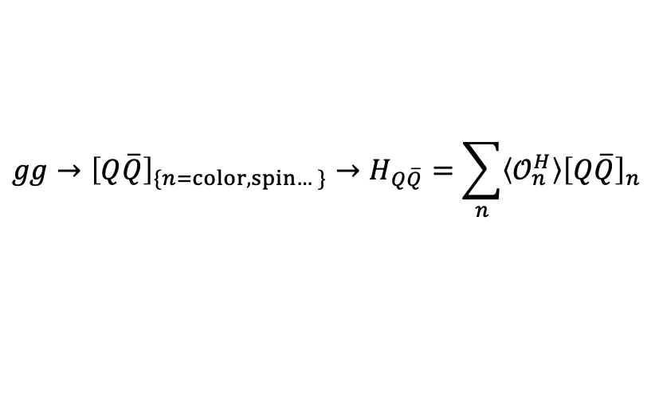


Solutions to nonperturbative QCD
Lattice QCD: limited use cases till now
$$ℒ_{QCD}$$
Models (examples)
Gell-Mann-Okubo formula for masses
Nonrelativistic QCD for heavy quarkonium production
$$gg→{\left[Q\overline{Q}\right]}_{\{n=color, spin…\}}→H_{Q\overline{Q}}=\sum_{n}{\left\langle 𝒪_{n}^{H}\right\rangle {\left[Q\overline{Q}\right]}_{n}}$$
PRL 108 (2012) 242004
Heavy quark effective theory for decay form factors
D
B
Phys.Rev.Lett. 121 (2018) 202001
Interaction inside hadrons and hadron structure
Prog.Part.Nucl.Phys. 107 (2019) 237
$$+⋯$$
Rev.Mod.Phys. 90 (2018) 015004
Model assumptions and parameters
Experimental inputs to test and develope!
Notes:
Lattice QCD

Slide 7
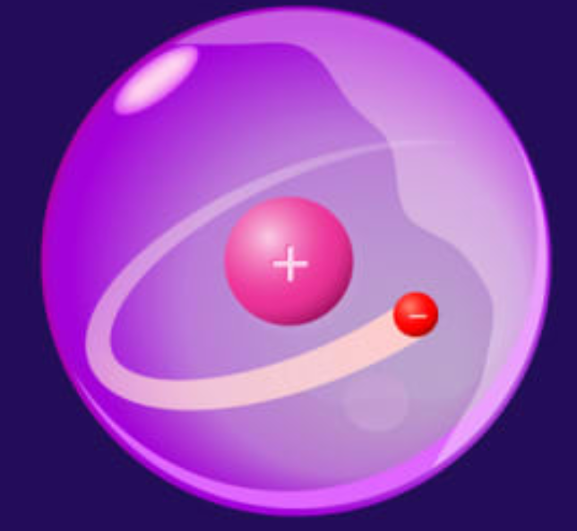
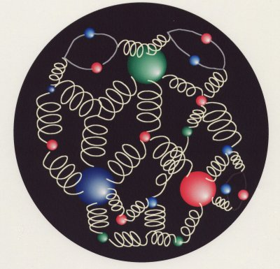
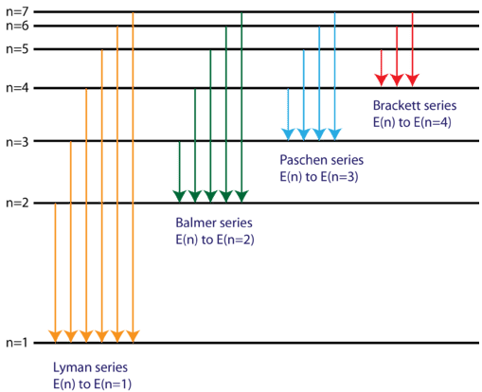
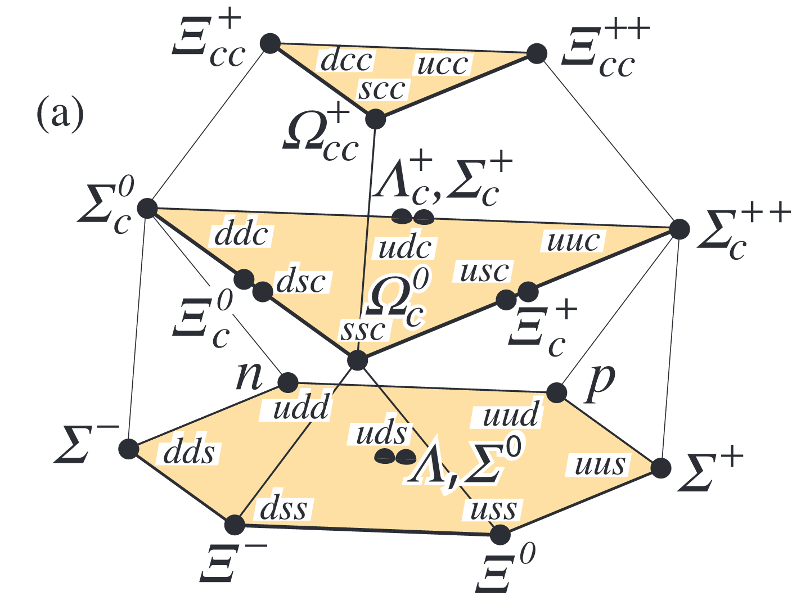
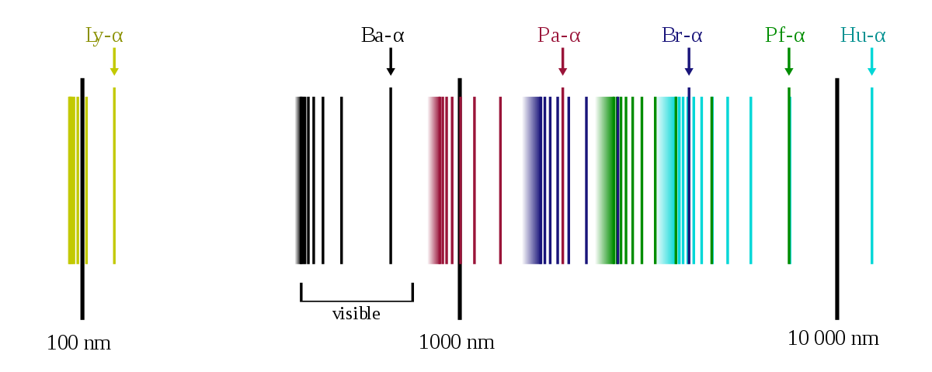
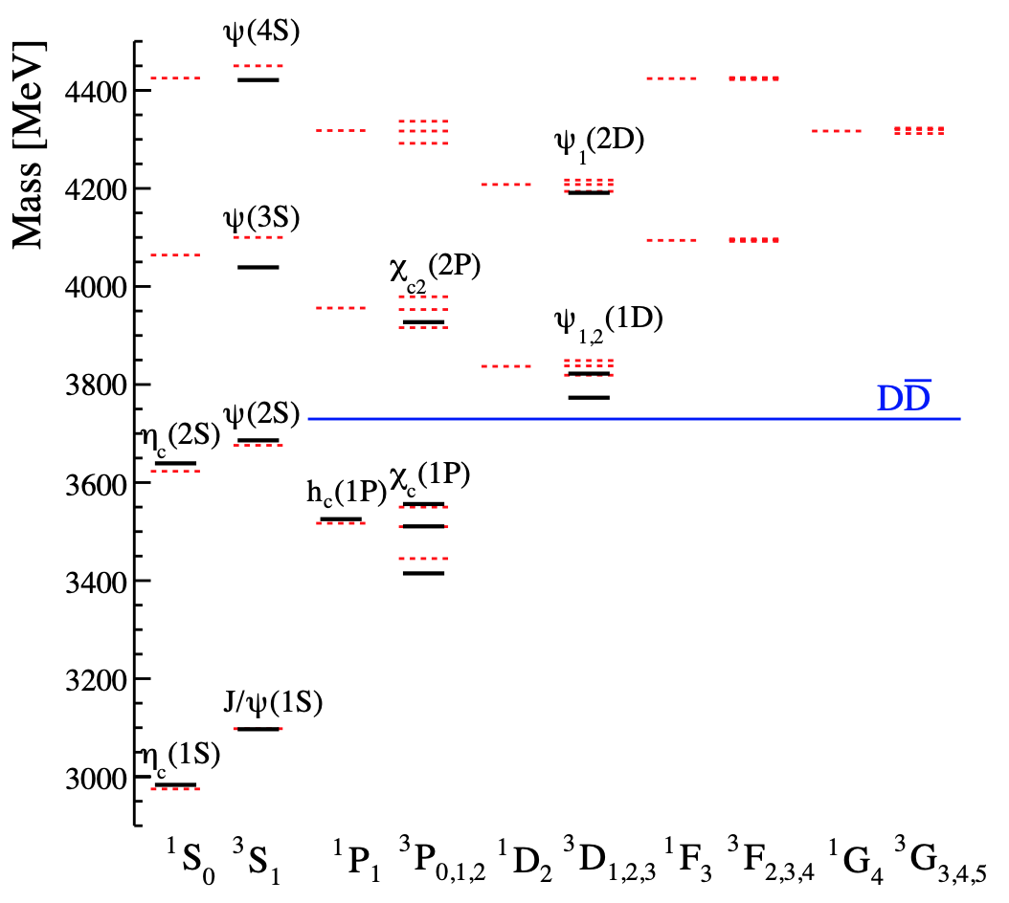
Hadron spectroscopy
Probe nonperturbative interaction and structure inside hadrons
光谱
强子谱
Measurements: existence, line-shape (mass, width), decay, excitation, multiplets… of hadrons
  → Guide to build/tune models

Slide 8
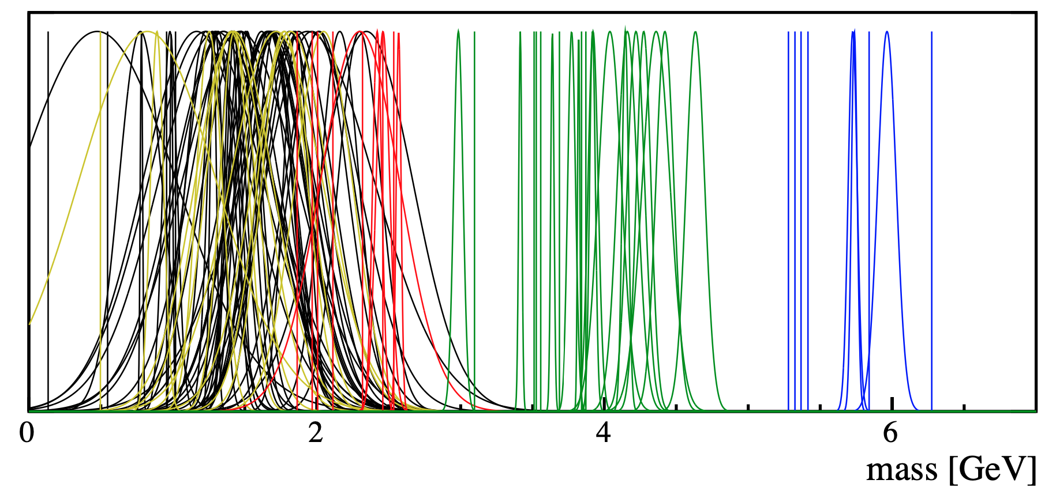


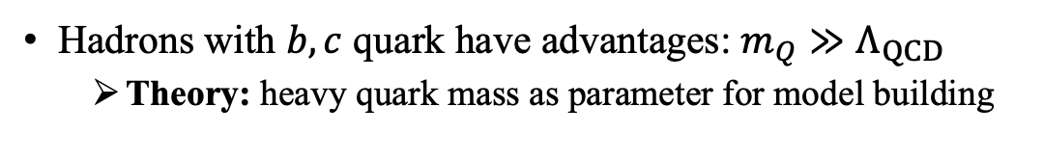



Heavy flavor hadrons
Hadrons with $b, c$ quark have advantages: $m_{Q}≫Λ_{QCD}$
  Theory: heavy quark mass as parameter for model building
→ HQEF, HQS, NRQCD…, heavy and light factorized
  → Calculations more reliable
  Experiment: Heavy states narrow, larger gap → easy to identify
Light unflavored
$D$ states
$c\overline{c}$ states
$B$ states
$$⋯$$
$K$ states
Mass and width of known mesons

Slide 9



Charmonium
Predictions with Godfrey-Isgur potential model versus observed states
Reasonably good agreement
$$\overline{c}$$
$$c$$
i
Prediction
Data
Phys.Rev.D 32 (1985) 189

Slide 10
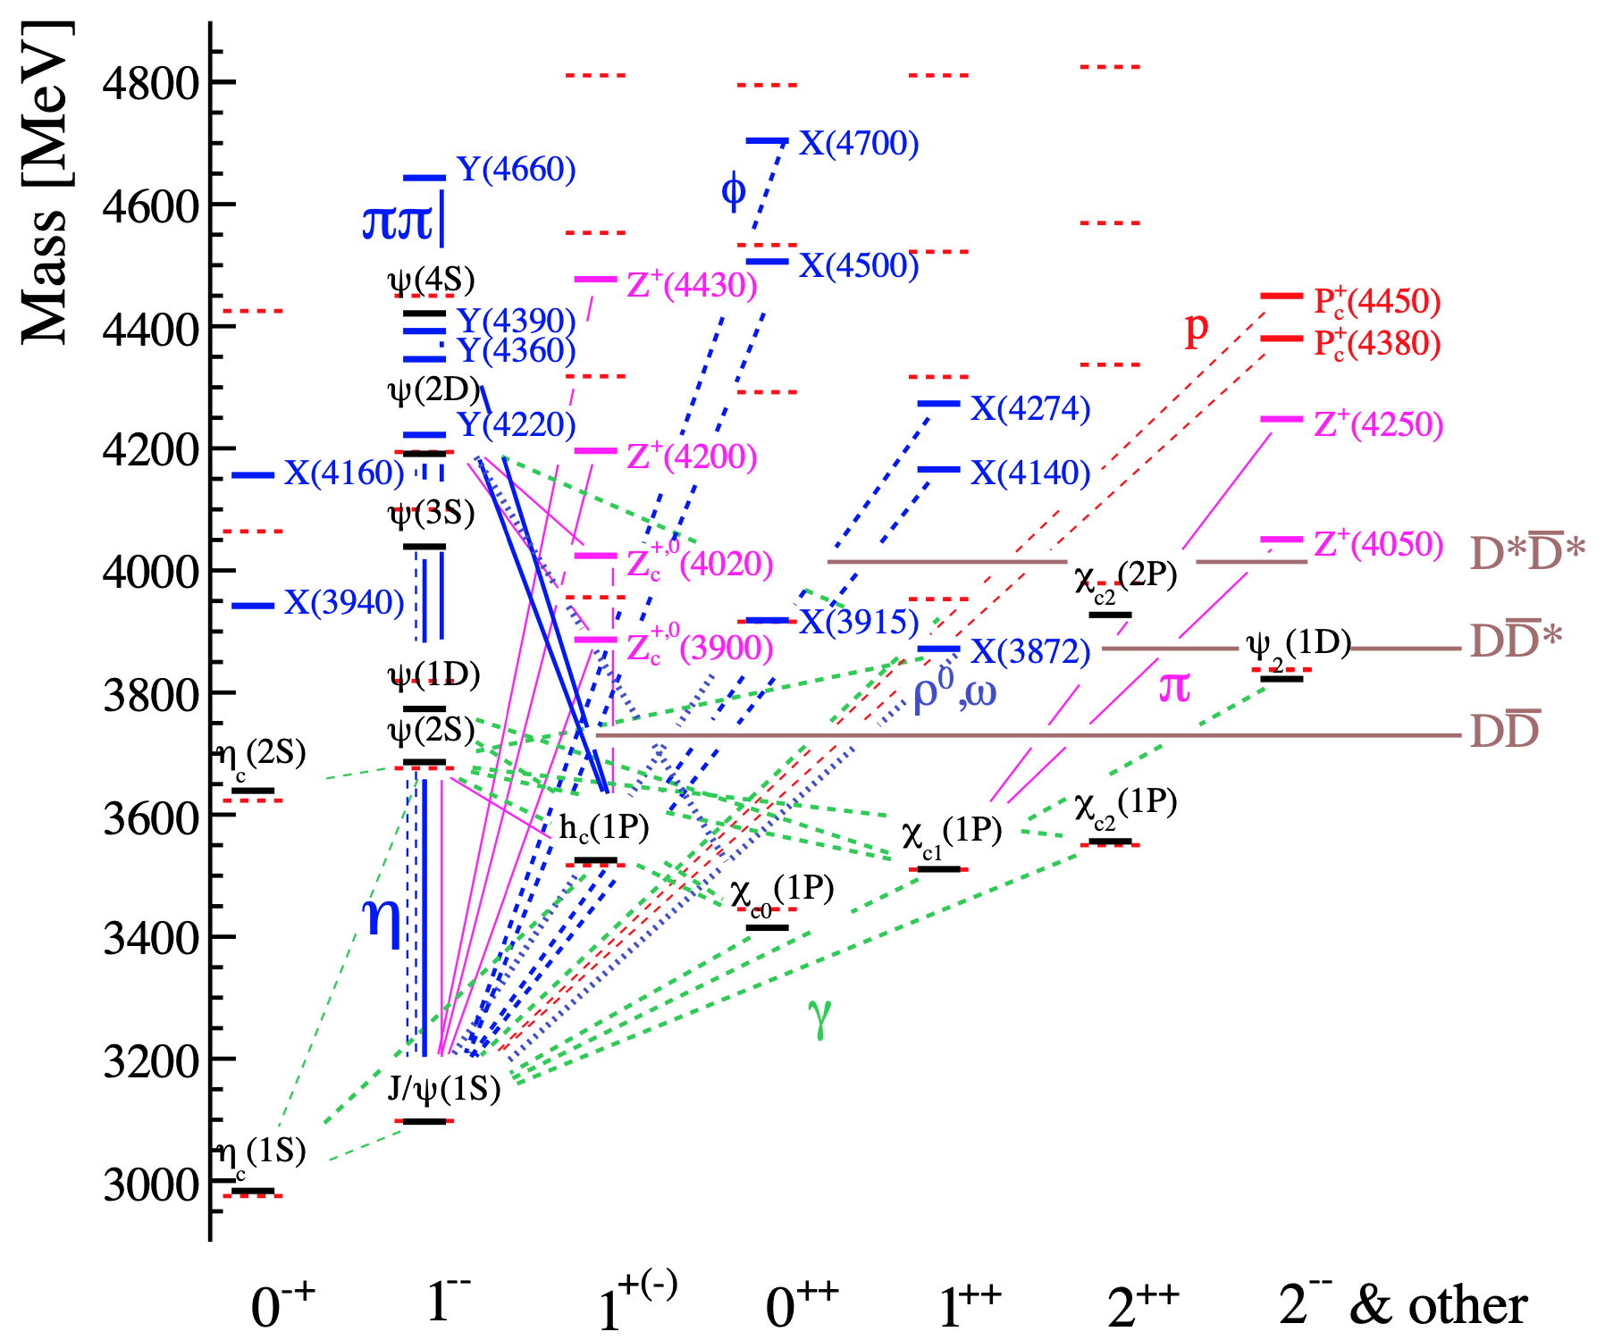





Charmonium
But many more states observed : $X, Y, Z^{+/0}, P_{c}^{+}$, beyond $c\overline{c}$ constituents
$$Z_{c}{\left(4430\right)}^{+}\left[c\overline{c}u\overline{d}\right]→ψ\left(2S\right)\left[c\overline{c}\right]π^{+}\left[u\overline{d}\right]$$
$$q$$
$$\overline{q}$$
$$c$$
$$\overline{c}$$
$c\overline{c}$ states
Rev.Mod.Phys. 90 (2018) 015003

Slide 11
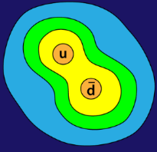


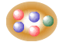


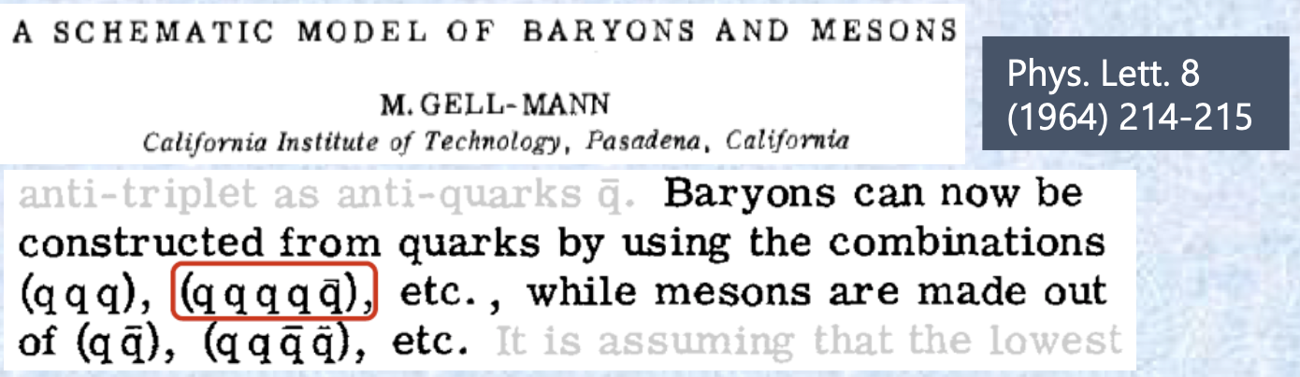
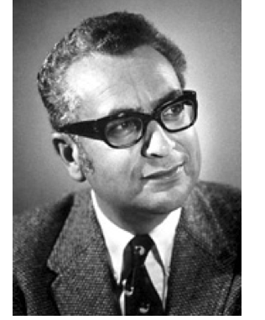
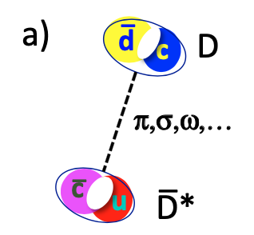
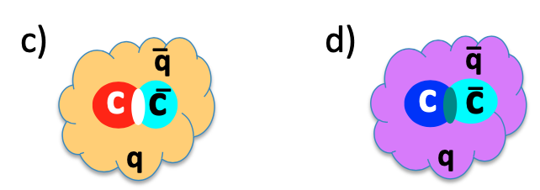




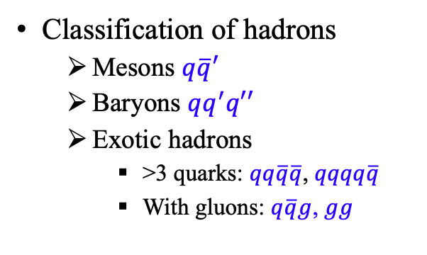


Exotic hadrons
Classification of hadrons
  Mesons $q\overline{q}′$
  Baryons $qq^{′}q′′$
  Exotic hadrons
    >3 quarks: $qq\overline{q}\overline{q}$, $qqqq\overline{q}$
    With gluons: $q\overline{q}g$, $gg$
$$q\overline{q}$$
$$qqq$$
$$qq\overline{q}\overline{q}$$
g
g
g
$$qqqq\overline{q}$$
Exotic hadrons: substructure, addition to traditional hadrons
Example: $c\overline{c}q\overline{q}$，confinement
Rev.Mod.Phys. 90 (2018) 015003
Meson-meson molecule
Hadron-charmonium
Adjoint-charmonium
Diquark
Compact
Hybrid

Slide 12
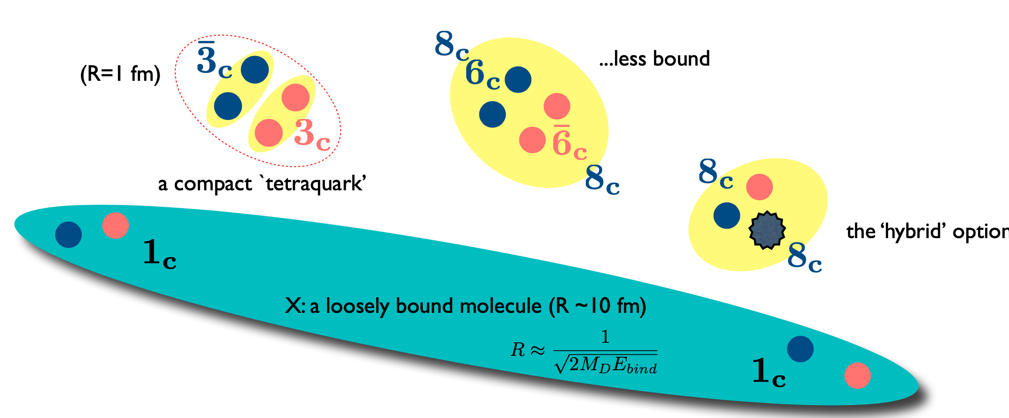
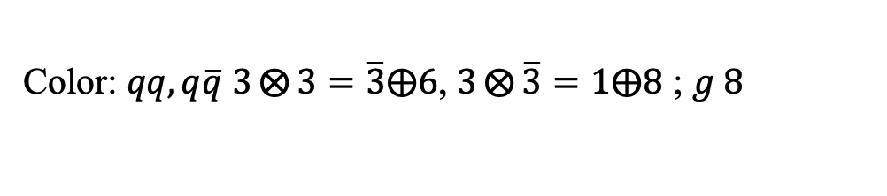
New structure in exotic states (Tetraquark)
Color: $qq,q\overline{q}$ $3⨂{3}=\overline{3}⨁6$, $3⨂{\overline{3}}=1⨁8$ ; $g 8$
争论 → 学派
QCD forces
the ‘hybrid’ option
Nuclear forces, close to Di-hadron threshold
Notes:
介绍了理论上如何探讨这些强子态，实验上如何探测呢

Slide 13
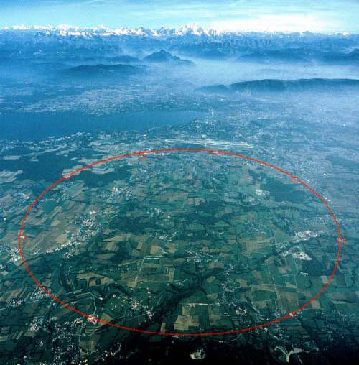
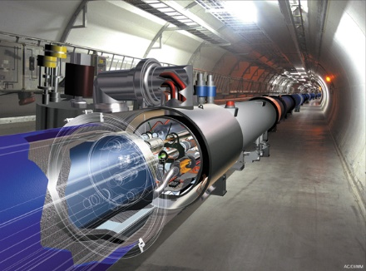


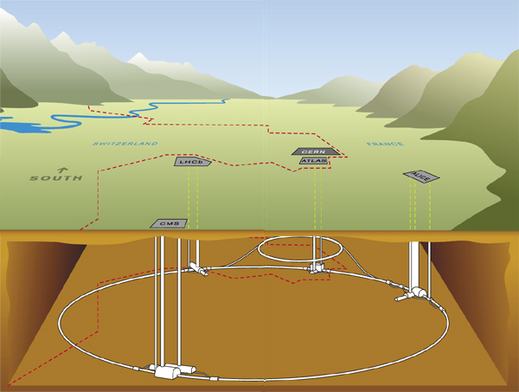



Large hadron collider (LHC)
目前全球能量最高的对撞机
束流能量: $6.5 TeV$
对撞频率: $40 MHz$
瞬时亮度: ${10}^{34} {cm}^{−2}s^{−1}$
LHC beauty experiment
大型强子对撞机“最靓”实验
日内瓦机场
欧洲核子
研究中心
超低温
超导加速器
几十至一百米
LHC 隧道

Slide 14
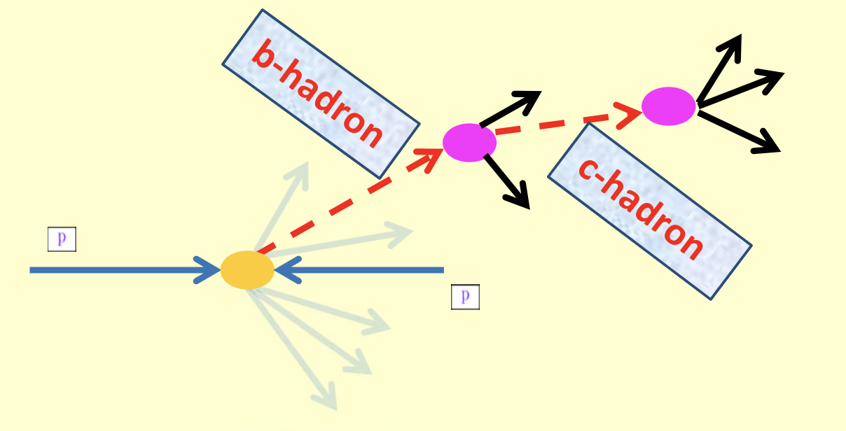
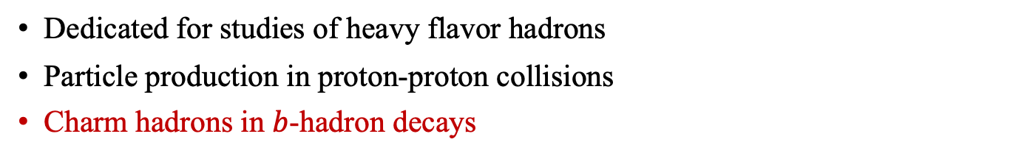

The LHCb experiment
Dedicated for studies of heavy flavor hadrons
Particle production in proton-proton collisions
Charm hadrons in $b$-hadron decays
A typical beauty hadron decay at LHCb
Stable particles
Stable particles
Beam
Beam
Background particles ($\sim 100$)

Slide 15
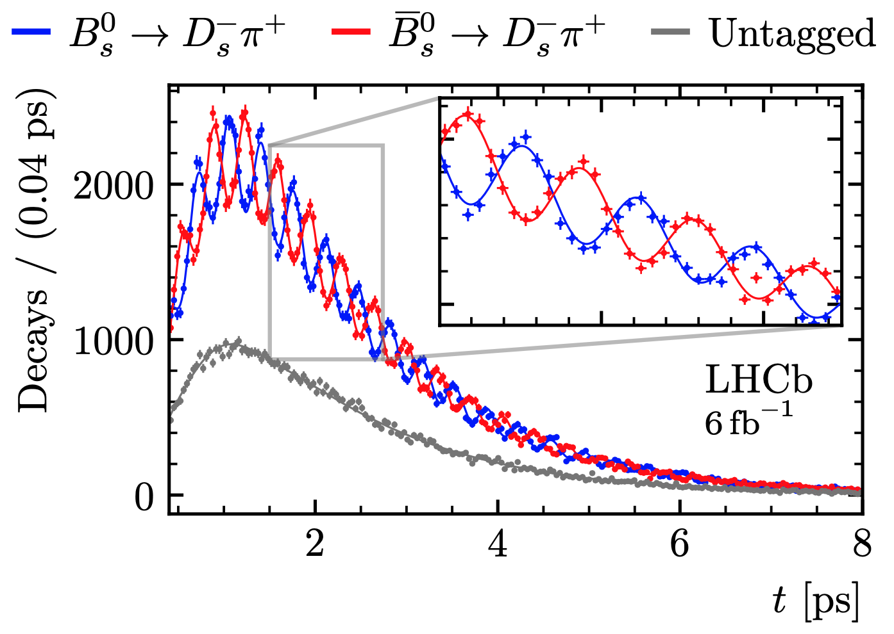
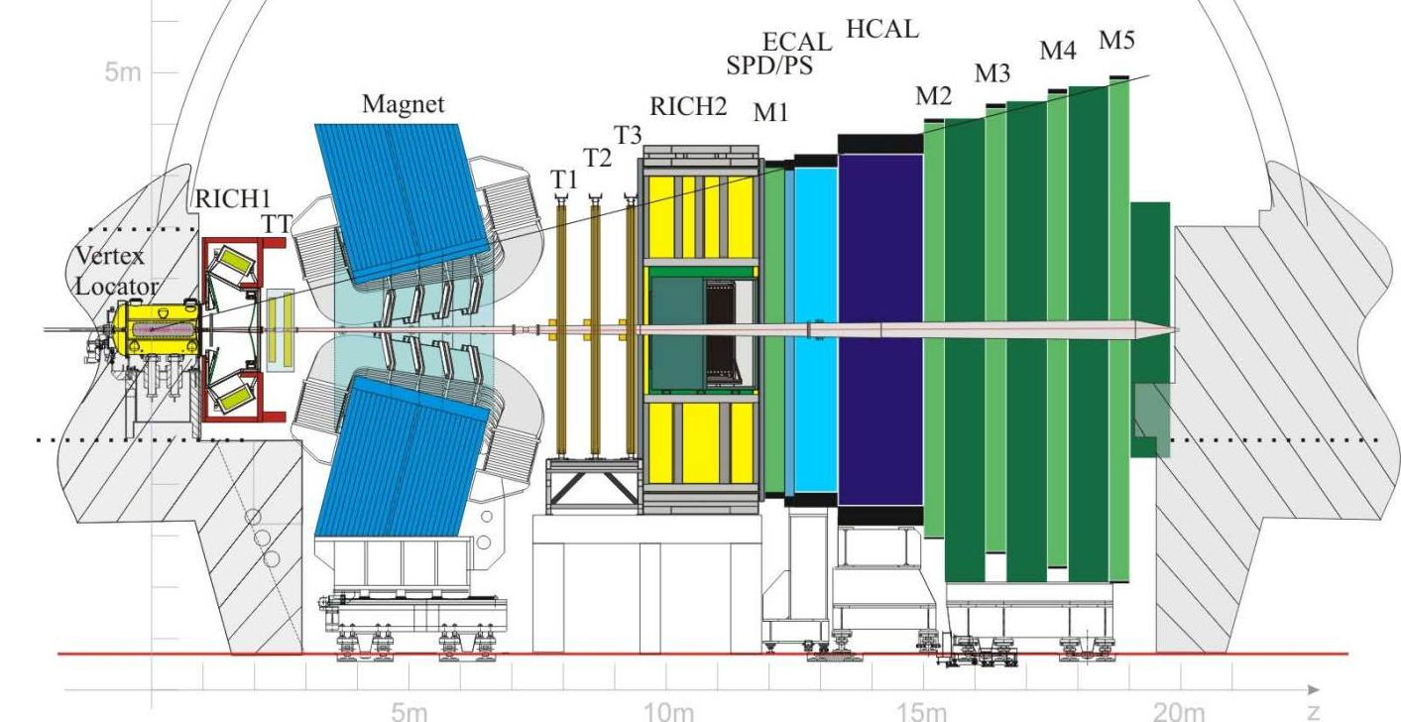
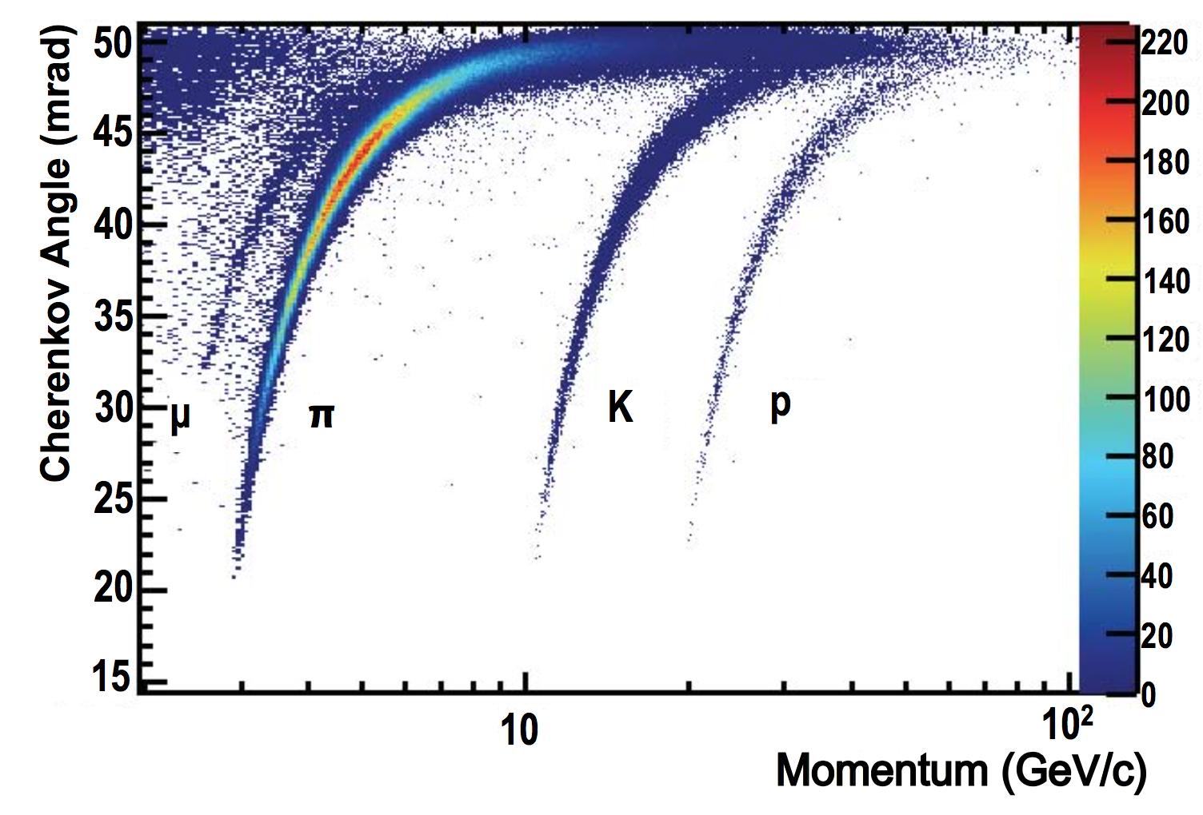
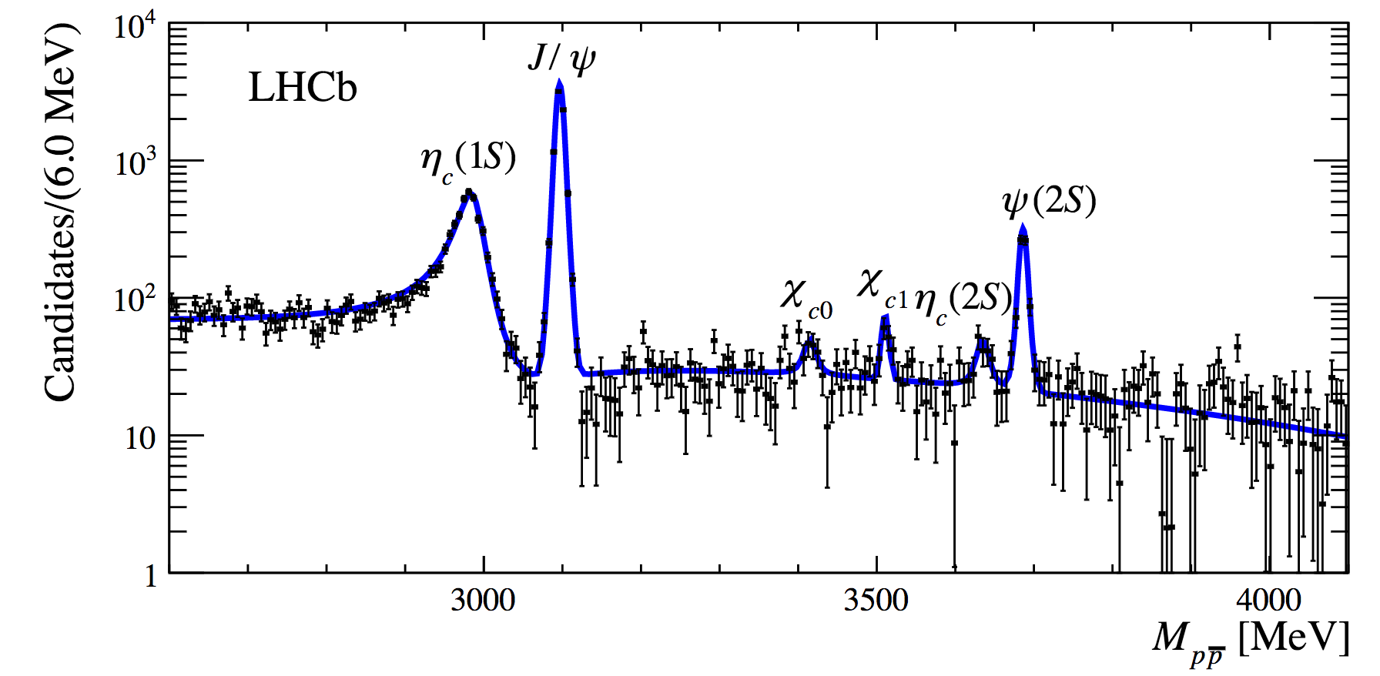
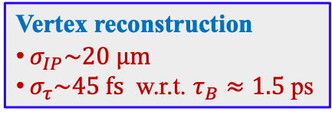
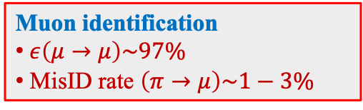


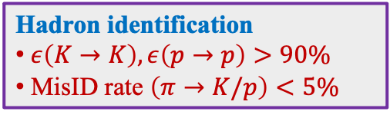
The LHCb detector
Background and resolution
JINST 3 (2008) S08005
IJMPA 30 (2015) 1530022
Vertex reconstruction
$σ_{IP}\sim 20 μm$
$σ_{τ}\sim 45 fs$ w.r.t. $τ_{B}≈1.5$ps
Muon identification
$ε\left(μ→μ\right)\sim 97\%$
MisID rate $\left(π→μ\right)\sim 1−3\%$
$pp$ collision
Track reconstruction
$ε\left(Tracking\right)\sim 96\%$
${δp}/p\sim$0.5%-1% (5-200 GeV)
$ε\left(m_{J/ψ}\right)≈15$ MeV
High mass resolution
Hadron identification
$ε\left(K→K\right),ε\left(p→p\right)>90\%$
MisID rate $\left(π→K/p\right)<5\%$

Slide 16
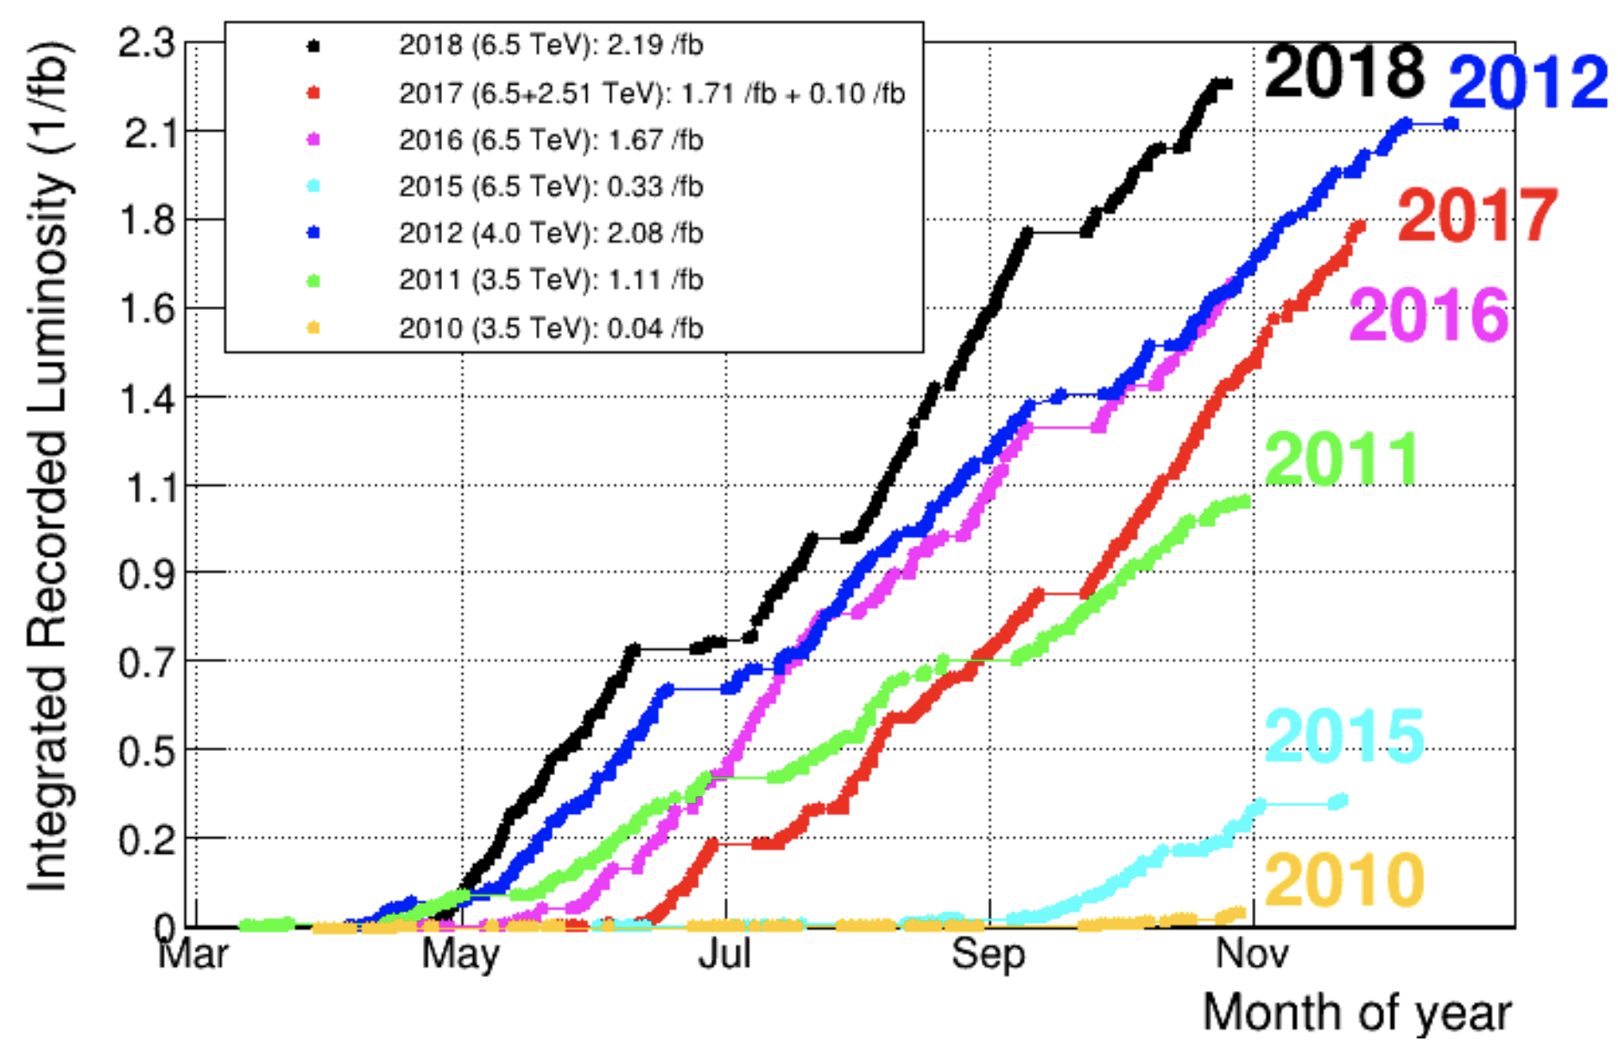

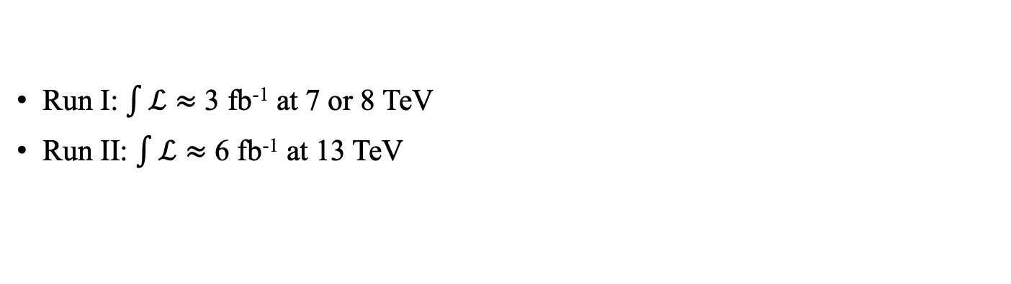




LHCb data
Run I: $\int{ℒ}≈$ 3 fb⁻¹ at 7 or 8 TeV
Run II: $\int{ℒ}≈$ 6 fb⁻¹ at 13 TeV
High production/collection rate
All possible states are produced
$pp$ collisions
$σ\left(pp→c\overline{c}X, LHCb, 13 TeV\right)≈2.3$ mb
$D^{0} : D^{+} :D_{s}^{+} : Λ_{c}^{+} : Ξ_{cc}$ …
$σ\left(pp→b\overline{b}X, LHCb, 13 TeV\right)≈0.14$ mb
$B^{+} : B^{0} : B_{s}^{0} : Λ_{b}^{0}$ …
JHEP 05 (2017) 074
PRL 118 (2017) 052002

Slide 17
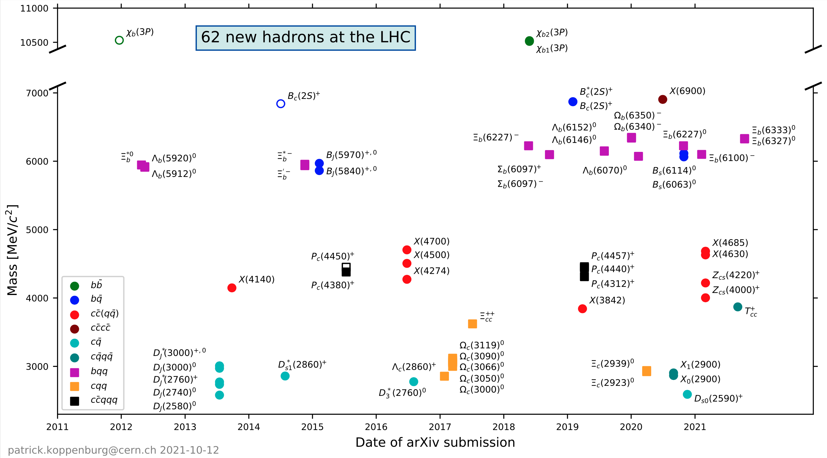


New hadron states by LHC(b)
Exotic states with $c\overline{c}$ or single $c$
Hadrons with $cc$
Focus today
https://www.nikhef.nl/~pkoppenb/particles.html

Slide 18



Observation of the doubly charmed baryon $Ξ_{cc}^{++}(ccu)$
华中师范大学
突出贡献
$$Ξ_{cc}^{++}:ccu$$

Slide 19





The doubly charmed baryon
Two SU(4) baryon 20-plets with $J^{P}=1/2^{+}$ or $J^{P}=$ ${3/2}^{+}$, each contains a SU(3) triplet with two charm quarks: $Ξ_{cc}^{+}\left(ccd\right), Ξ_{cc}^{++}\left(ccu\right), Ω_{cc}^{+}(ccs)$
${3/2}^{+}→{1/2}^{+}$ via electromagnetic interaction
${1/2}^{+}$ states decay weakly with a $c$ quark transformed to lighter quarks
$$J^{P}={\frac{1}{2}}^{+}$$
$$γ$$
$$J^{P}={\frac{3}{2}}^{+}$$

Slide 20













Experimental studies
$Ξ_{cc}^{+}(ccd)$ reported by SELEX $Ξ_{cc}^{+}→Λ_{c}^{+}K^{−}π^{+}$ and $Ξ_{cc}^{+}→pD^{+}K^{−}$ decays
Not seen by others with larger $Λ_{c}^{+}$ samples
Signal yields: $15.9 (Λ_{c}^{+}K^{−}π^{+})$ and $5.62 (pD^{+}K^{−})$
Short lifetime: $τ\left(Ξ_{cc}^{+}\right)<33$ fs @90% CL, but not zero
Large production: $R=\frac{σ\left(Ξ_{cc}^{+}\right)×BF(Ξ_{cc}^{+}→Λ_{c}^{+}X)}{σ(Λ_{c}^{+})}∼20\%$
Mass (combined): $3518.7±1.7$ MeV
$$Ξ_{cc}^{+}→Λ_{c}^{+}K^{−}π^{+}$$
SELEX: PRL 89 (2002) 112001
Nucl. Phys. Proc. Suppl. 115 (2003) 33
LHCb: JHEP 12 (2013) 090
SELEX $Ξ_{cc}^{+}$
SELEX $Ξ_{cc}^{+}$
$$Ξ_{cc}^{+}→pD^{+}K^{−}$$
SELEX
PLB 628 (2005) 18
BaBar: PRD 74 (2006) 011103
Belle: PRL 97 (2006) 162001
SELEX $Ξ_{cc}^{+}$
SELEX $Ξ_{cc}^{+}$

Slide 21














$Ξ_{cc}^{++}(ccu)$ observation by LHCb
${Ξ_{cc}^{++}→K^{−}π^{+}π^{+}Λ}_{c}^{+}$, with $Λ_{c}^{+}→pK^{−}π^{+}$
Selection requires a displaced $Ξ_{cc}^{++}$ vertex, machine learning
$${Ξ_{cc}^{++}→K^{−}π^{+}π^{+}Λ}_{c}^{+}\left(→pK^{−}π^{+}\right)$$
$$Ξ_{cc}^{++}$$
$$Λ_{c}^{+}$$
PV
PRL 119 (2017) 112001
$$S>12σ$$
$10\%$ data
for plot
Right sign
Wrong sign
$Λ_{c}^{+}$ sideband
  $≈60$ M $Λ_{c}^{+}$
  signal decays
$$Λ_{c}^{+}$$
$$+K^{−}{2π}^{+}$$
$$Ξ_{cc}^{++}$$
1.7 fb⁻¹

Slide 22





$Ξ_{cc}$ mass predictions vs data
Many model calculations available (before discovery): (non-) relativistic QCD potential models, triple harmonic-oscillator potential model, QCD sum rules, bag model or quark model …
  Predicted $Ξ_{cc}^{+,++}$ masses in range $3.5−3.7$ GeV, $M\left(Ω_{cc}^{+}\right)≈M\left(Ξ_{cc}\right)+0.1$ GeV
Lattice QCD computations:
$M\left(Ξ_{cc}\right)≈3.6$ GeV, $M\left(Ω_{cc}^{+}\right)≈3.7$ GeV, $σ∼10$ MeV
$m_{Ξ_{cc}^{++}}=3621.55±0.23±0.30 MeV/c^{2}$
LHCb:
JHEP 02 (2020) 049
Attractive binding between two $c$ quarks
From models
M. Padmanath (LHCb implication 2017)
LQCD
LHCb measurement
* No uncertainties included in figure

Slide 23




























$Ξ_{cc}$ lifetime
Lifetime of heavy flavor hadron naive assumption: dominated by the heavy quark decay
  Valid for bottom hadrons: $1.5 ps ±10\%$
$τ\left(D^{+}\right)=1040$ fs
$$D^{0}$$
$$D_{s}^{+}$$
But charm hadron lifetimes vary a lot
  Interference and non-spectator decays
$$csu$$
$$cud$$
$$c$$
$$s$$
$$c$$
$$s$$
$$w^{∗}(u\overline{d})$$
$$csd$$
$$css$$
$$d$$
$$d$$
$$d$$
$$w^{∗}$$
$$u$$
$$u$$
$$u$$
$$u$$
$$u$$
(reduce rate)
(increase rate)
$W$-exchange
Magnitude $∝f\left(1/m_{Q}\right)$
Spectator interference
$Ξ_{cc}$ lifetimes: $∼τ_{c}/2$+interference+non-spectator effects
Difficult to predict, sensitive to model parameters
$τ\left(Ξ_{cc}^{++}\right)∈[ 200−700]$ fs
$τ\left(Ξ_{cc}^{+}\right)<τ\left(Ω_{cc}^{−}\right)<τ(Ξ_{cc}^{++})$
$τ\left(Ξ_{cc}^{+}\right)∼1/3τ(Ξ_{cc}^{++})$
$$\left(ccu\right)$$
One example:
$$\left(ccd\right)$$
$$\left(ccs\right)$$
Phys. Usp. 45 (2002) 455

Slide 24



$Ξ_{cc}^{++}$ lifetime by LHCb
$τ={0.256}_{−0.022}^{+0.024}±0.014$ ps
Phys. Rev. Lett. 121 (2018) 052002
$$τ_{Ξ_{c}^{+}}> τ_{Ω_{c}^{0}}≳τ_{Ξ_{cc}^{++}}≳τ_{Λ_{c}^{+}}>τ_{Ξ_{c}^{0}}$$

Slide 25




Understanding the mass
From models
M. Padmanath (LHCb implication 2017)
LQCD
LHCb measurement
Confirm a deep binding between $cc$ → the diquark model
  $V_{cc}≈\frac{1}{2}V_{c\overline{c}}≈−130$ MeV, increases with quark mass
  $cc$ core: compact serving as color source, color $\overline{3}$
  $cc$ behaves like a heavy $\overline{Q}$ with $m_{\overline{Q}}≈3200$ MeV
  Excitation between $cc$ and $q$ calculated using $\overline{Q}q$ structure
  Excitation inside $cc$ calculated using potential model in analogy to quarkonia
$$q$$
diquark
$$c$$
$$c$$
Pro.Theor.Phys. 82 (1989) 760
PRD 66 (2002) 014008
PRD 90 (2014) 094007
…
A new system to test/tune models

Slide 26


Observation of fully charmed tetraquark $T_{4c}$
$$T_{4c}:cc\overline{c}\overline{c}$$

Slide 27







Fully heavy $QQ\overline{Q}\overline{Q}$ states
$QQ\overline{Q}\overline{Q}$ states exist using a qualitative argument from $QQ$ diquark
SU(3) color: $QQ$ $3⨂{3}=\overline{3}⨁6$, $\overline{3}$deep bound
then $QQ\overline{Q}\overline{Q}$ $\overline{3}⨂{3}$ could form color singlet “bound” state
$\overline{6}⨂6$ bound?
Blow 2 $Ξ_{cc}$ threshold
Studies back to 1970s, focusing on low-lying state
PRL 36 (1976) 1266, Z.Phys.C7 (1981) 317, PRD 25 (1982) 2370
Many advanced calculations, mostly use $QQ$ diquark. Don’t agree on:
  Are they bound?
  How many states?
  What are their masses
  Multiple quark interaction
PRL 36 (1976) 1266, Z.Phys.C7 (1981) 317
PRD86 (2012) 034004, PRD97 (2017) 094015
PRD95 (2015) 034001, PRD95 (2017) 054019
PLB773 (2017) 01647, …

Slide 28






Di-$J/ψ$ invariant mass at LHCb
Science Bulletin 65 (2020) 1983
About 34K di-$J/ψ$ signals
Efficiency vs di-$J/ψ$ mass
6200
Broad structure at $6.2−6.8$ GeV close to di-$J/ψ$ mass threshold
Narrow peak at 6.9 GeV
Hint of another structure at 7.2 GeV
Structure not present in $J/ψ$ background sample
Not caused by detection effect: only marginal variation of efficiency

Slide 29






Di-$J/ψ$ production
Two components: SPS and DPS
PLB751 (2015)479
PRD94 (2016) 05407
Double Parton Scattering (DPS)
Single Parton Scattering (SPS)
Both smooth continuum and resonant $cc\overline{c}\overline{c}$ structures.
Averagely larger di-$J/ψ$ $p_{T}$ than in DPS
Smooth di-$J/ψ$ continuum
Di-$J/ψ$ mass spectrum for continuum:
DPS: constructed from single $J/ψ$ kinematics
SPS: empirical function $Φ_{2}\left(m\right)×e^{c∙m}$
Notes:
To understand the properties of these structure, we perform fits to the mass spectrum by including components to describe these structures in addition to non resonant sps+dps contributions.

Slide 30





Di-$J/ψ$ mass modeling (I)
SPS and DPS continua
Breit-Wigner (BW) functions for peaking structures
  Threshold structure ($6.2−6.8$ GeV): two BWs, significance > $6 σ$
  Structure at 6.9 GeV: single BW, significance > $5 σ$
  Hint at 7.2 GeV: significance < $1 σ$
Science Bulletin 65 (2020) 1983
Difficult to model the dip at 6.8 GeV !
Notes:
To understand the properties of these structure, we perform fits to the mass spectrum by including components to describe these structures in addition to non resonant sps+dps contributions.

Slide 31






Di-$J/ψ$ mass modeling (II)
A wide BW interfering with SPS, a second BW for 6.9 GeV peak
  Fit quality improve from $P\left(χ^{2}\right)=4.6\%$ to $15.5\%$
  Caveat: too simple, SPS assumed to have $J^{P}$ of the wide BW
Science Bulletin 65 (2020) 1983
Wide BW
$m=6741 MeV/c^{2}$
$Γ=288 MeV/c^{2}$
Notes:
This motivates to study the second model, introducing possible interference between different components

Slide 32





Other models
One BW for threshold structure + X(6900), w/o interference, $P\left(χ^{2}\right)=1.2\%$
Only one BW, interfering with SPS, $P\left(χ^{2}\right)=2.8\%$
Threshold structure due to feed-down decays of excited charmonia (e.g. $χ_{c}J/ψ$)
Including a component for 7.2 GeV peak
Science Bulletin 65 (2020) 1983
I
II
IV
III
Notes:
Fits are als

Slide 33











Fits summary and structure
Structure at threshold: one BW, two BWs or feed-down from excited states
  Interference between a BW and SPS preferred
Structure at 6.9 GeV: consistent with a BW
Little doubt as a compact multi-quark state (instead of a hadron molecule)
Interpretation of states
  $X(6900)$ may be P- or 2S-wave state
  Broad structure at threshold in region of low lying states ($0^{++}, 1^{+−}…$)
  Coupled channel rescattering?
$η_{c}−η_{c}(2S)$
$$χ_{c0}−χ_{c0}$$
$$χ_{c1}−χ_{c1}$$
$$Ξ_{cc}−Ξ_{cc}$$
$$χ_{c0}−χ_{c0}$$
  [PRL102 (2009) 114039, PRD102 (2020) 114030, PRD102 (2020) 074003, EPJC80 (2020) 871, PRD102 (2020) 114039, arXiv2006.13756, 2009.08376, PRL 126 (2021) 132001, PRD 103 (2021) 014001, PRD 104 (2021) 014018, PRD 103 (2021) 05163…]
$$J/ψ−J/ψ$$
$$J/ψ−ψ(2S)$$
$$J/ψ−ψ(2S)$$
Many thresholds

Slide 34


ATLAS and CMS reproduction
CMS-PAS-BPH-21-003
ATLAS-CONF-2022- 040

Slide 35


Observation of doubly charmed tetraquark $T_{cc}$
$$T_{cc}:cc\overline{u}\overline{d}$$

Slide 36






Doubly charmed tetraquark
In heavy quark limit $m_{Q}→∞$, $QQ\overline{q}{\overline{q}}^{′}$ states tightly bound and stable against strong decays
True for $bb\overline{q}\overline{q}′$ according to models and lattice QCD, but not conclusive for $cc\overline{q}\overline{q}′$, $bc\overline{q}\overline{q}$
Studies boosted by discovery of $Ξ_{cc}^{++}$
Models for $δm≡m_{T_{cc}^{+}}−\left(m_{D^{∗}}+m_{D}\right)$
LatticeQCD
$Ξ_{cc}^{++}$ discovered
PRD 99 (2019) 034507

Slide 37




Observation of $T_{cc}^{+}$ at LHCb
Narrow structure observed in $D^{0}D^{0}π^{+}$ mass spectrum
  Minimal quark contents $cc\overline{u}\overline{d}$
  Close to $D^{∗+}D^{0}$ threshold
  Structure not present in ${\overline{D}}^{0}D^{0}π^{+}$ final state
Quark contents: $cc\overline{u}\overline{d}$
Prompt production
arXiv:2019.01038
arXiv:2019.01056

Slide 38




Fit with Breit-Wigner function
Lowest $cc\overline{u}\overline{d}$ state has $s_{cc}=1, s_{\overline{u}\overline{d}}=0,l=0$, so $J^{P}=1^{+}$
Data modelled with sum of a P-wave relativistic BW plus 2-body phase space
Prog.Part.Nucl.Phys.107 (2019) 237
$δm_{BW}=−273±61±5_{−14}^{+11}$ keV, negative by $4.3σ$
$Γ_{BW}=410±165±{43}_{−38}^{+18 }$keV, not a weak decay due to width
Below threshold
$m_{BW}=3874.83±0.09$ MeV
First observation after predictions 40 years ago
PRD25 (1982) 2370
PLB123 (1983) 449
Z.Phys.C30 (1986) 457
...
Nature Commun. 13 (2022) 3351
Nature Phys. 18 (2022) 751

Slide 39









Advance modeling of signal line shape
arXiv:2019.01038
arXiv:2019.01056
Unitarized 3-body Breit-Wigner for $T_{cc}^{+}$
Considering coupling to amplitdues of decays:
$$D^{0}D^{0}π^{+}$$
Detection mode
$$D^{∗+}D^{0}$$
$$T_{cc}^{+}$$
$$D^{0}D^{+}π^{0}$$
$$D^{+}D^{∗0}$$
Below threshold
$$D^{0}D^{+}γ$$
$δm_{U}=−361±{40}_{−8}^{+9}$ keV, negative by $9σ$
$Γ_{U}\left(FWHM\right)=47.8±1.9$keV
Fit quality slightly better than BW

Slide 40











Intermediate offshell $D^{∗+ }$
$m_{D^{0}π^{+}}$ distribution: data and unitarized model agree with each other, suggesting true $D^{∗+}$ contribution
$$T_{cc}^{+}$$
$$D^{∗+}D^{0}$$
$$D^{0}D^{0}π^{+}$$
$m_{D^{0}D^{0,+}}$ in $D^{0}D^{0,+}$ samples: receive contribution from partially reconstructed $T_{cc}^{+}→D^{∗+}D^{0}$ decays, yields and shapes in unitarized model agree with data
$$T_{cc}^{+}$$
$$D^{∗+}D^{0}$$
$$D^{0}D^{0}π^{+}$$
$$T_{cc}^{+}$$
$$D^{∗}D$$
$$D^{0}D^{+}π/γ$$

Slide 41


The isospin partner?
$T_{cc}^{+}$ may be an isoscalar or zero-component of isotriplet: ${\hat{T}}_{cc}^{++}(cc\overline{d}\overline{d}),{\hat{T}}_{cc}^{+}\left(cc\overline{u}\overline{d}\right),{\hat{T}}_{cc}^{0}\left(cc\overline{u}\overline{u}\right)$
$T_{cc}^{+}$ consistent with the isoscalar state
  Constentency between $T_{cc}^{+}$ and $D^{0}D^{0}, D^{0}D^{+}$ mass spectrum
  No hint of ${\hat{T}}_{cc}^{++}$ in $D^{+}D^{+}$ or $D^{+}D^{0}π^{+}$ spectrum
$$T_{cc}^{+}$$
$$D^{∗+}D^{0}$$

Slide 42







The $T_{cc}^{+}$ structure
Compact tetraquark $cc\overline{u}\overline{d}$: long anticipated, mass and $J^{P}$ consistent
But also consistent with loosely bound $D^{∗+}D^{0}$ molecule: $D^{∗+}D^{0}$ S-wave, mass close to threshold, dynamics, fewer state…
  Predicted a shallow $D^{∗}D$, $I(J^{P})={0(1}^{+})$, state within molecule model, other $I(J^{P})$ not possible
  A second state of $D^{∗0}D^{+}$?
Compact
Molecule
Phys.Rev.D 88 (2013) 114008…
PLB 822 (2021) 136693, arXiv:2110.02944, CPL 38(2021) 092001, arXiv:2110.15270, arXiv:2111.01081, arXiv:2110.07484, arXiv:2110.13765, arXiv:2109.02531, arXiv:2109.02828
Similarity between $T_{cc}^{+}$ and $χ_{c1}(3872)$
$m\left(χ_{c1}(3872)\right)−m\left(D^{∗0}\right)−m\left(D^{0}\right)=0.07±0.13$ MeV
$m\left(T_{cc}^{+}\right) −m\left(D^{∗+}\right)−m\left(D^{0}\right)=0.27±0.06$ MeV
Phys.Rev.D 104 (2021)114042
$Γ(X\left(3872\right))=0.96±0.28$ MeV
$Γ\left(T_{cc}^{+}\right) =0.41±0.18$ MeV
JHEP 08 (2020) 123 for $χ_{c1}(3872)$
The same underlying dynamics?

Slide 43








Molecule or compact tetraquark
Hadron molecule: shallow binding in $s$-wave so $m, J^{P}, I$ determined
Compact: more viable configurations, more states
Other exotic states hinting at molecules: pentaquarks $P_{c}^{+}(c\overline{c}uud)$ and $P_{cs}^{0}(c\overline{c}uds)$…
$P_{c}^{+}(c\overline{c}uud)$
$P_{cs}^{0}(c\overline{c}uds)$
$Ξ_{c}{\overline{D}}^{∗}$
PRL122 (2019) 222001
Science Bulletin 66 (2021) 1278
Measurement of $J^{P}$ to confirm

Slide 44



















Molecule or compact tetraquark
Other exotic states difficult to fit molecules
Discovery of $X(c\overline{c}s\overline{s})$ and $Z_{cs}^{+}(c\overline{c}u\overline{s})$ in $B^{+}→J/ψφK^{+}$ by LHCb
$X(c\overline{c}s\overline{s})$
$Z_{cs}^{+}(c\overline{c}u\overline{s})$
PRL 127 (2021) 082001
15$σ$
18$σ$
20$σ$
17$σ$
15$σ$
4.8$σ$
5.5$σ$
S-wave
States | $J^{PC}$ | Mass/MeV | Width/MeV | Nearest thresholds/MeV
$$X(4140)$$ | $$1^{++}$$ | $4118$(33) | 162(53) | $D_{s}^{+}D_{s}^{∗}− :$ 4080
$$X(4150)$$ | $$2^{−+}$$ | $4146$(38) | 135(65) | $D_{s}^{+}D_{s}^{∗}− :$ 4080
$$X(4274)$$ | $$1^{++}$$ | $4294$(7) | 53(7) | $D_{s}^{+}D_{s0}^{∗}{\left(2317\right)}^{−}$: 4286
$$X(4500)$$ | $$0^{++}$$ | $4474$(4) | 77(12) | $D_{s}^{+}D_{s1}^{∗}{\left(2536\right)}^{−}$: 4503
$$X(4630)$$ | $$1^{−+}$$ | $4626$(110) | 174(137) | ${D_{s0}^{∗}(2317)}^{±}$ : 4636
 |  |  |  | ${D_{s}^{∗}}^{−}D_{s1}^{∗}{\left(2536\right)}^{−}$: 4647
$$X(4685)$$ | $$1^{++}$$ | $4684$(17) | 126(42) | $D_{s}^{∗+}D_{s2}^{∗}{\left(2573\right)}^{−}$: 4681
$$X(4700)$$ | $$0^{++}$$ | $4694$(16) | 87(18) | $D_{s}^{∗+}{\overline{D}}_{s2}^{∗}{\left(2573\right)}^{−}$: 4681
$J^{P}=1^{+}$
$J^{P}=1^{+}$
$J^{P}=0^{−}$
$J^{P}=1^{−}$
$J^{P}=0^{+}$
$J^{P}=J^{−}$
$J^{P}=J^{−}$
$J^{P}=J^{−}$
Two $X$ states $J^{P}$ consistent with $D_{s}^{(∗)}{{\overline{D}}^{(∗)}}_{s}$ molecule states ?
Exotic quantum number

Slide 45





Summary and prospects
Hadron spectroscopy: useful and fun
LHCb: a discovery machine for new hadrons
Observations of: $ccq$ → $cc\overline{c}\overline{c}$ → $cc\overline{q}\overline{q}$
Do we understand more about $cc$ binding? Yes in some models
Tetraquarks or molecules? Preferences show up
Prospects
Prog.Part.Nucl.Phys. 107 (2019) 237
Resolve problems and search exotics in all forms
  Fully heavy: $J/ψ+Q\overline{Q}$ ; Doubly charmed tetraquark: $Σ_{c}^{(∗)}D^{(∗)}$…; Triple charm: $J/ψD$; Hidden charm tetraquark: $Σ_{c}^{(∗)}{\overline{D}}^{(∗)}$…
Upgrade are important
$7×$ data by 2030, $14×$ for hadronic
Sensitivity for $Ξ_{bc}$ and $T_{bc}$ states

Slide 46








LHCb “experiment”

Slide 47
Backup slides

Slide 48








How to detect them
Particles living long enough to be detected directly: $p^{±}, π^{±},K^{±},μ^{±},γ,e^{±},n$
Use them to construct unstable particles
$$A → F_{1}+F_{2}$$
mother
daughters
Invariant mass:
$M_{A}^{2}=E^{2}−{\vec{p}}^{2}={\left(E_{1}+E_{2}\right)}^{2}−{\left({\vec{p}}_{1}+{\vec{p}}_{2}\right)}^{2}$
Phys.Lett.B 716 (2012) 1, Phys.Lett.B 716 (2012) 30
Ideal experiment
With resolution
With background
Production rate, efficiency
A good experiment: resolution , production , efficiency , background

Slide 49



The LHCb experiment at CERN
日内瓦机场
CERN

Slide 50









$Ξ_{cc}^{+}(ccd)$?
LHCb inconsistent with SELEX
$∆Ξ_{cc}=m(Ξ_{cc}^{++})$_{LHCb}$−$ $m(Ξ_{cc}^{+})$_{SELEX} $=103±2$ MeV
Inconsistent with being isospin partners !
Lattice QCD
$0<∆Ξ_{cc}≲2$ MeV by models and LQCD
Science 347 (2015) 1452
$Ξ_{cc}^{+}$direct search with full LHCb data
Local significance of 3.1$σ$ at 3620 MeV/c²
No signal at mass of SELEX
Sci. China-Phys. Mech. Astron. 63, 221062 (2020)
$$\frac{σ\left(Ξ_{cc}^{+}→Λ_{c}^{+}K^{−}π^{+}\right)}{σ\left(Ξ_{cc}^{++}→Λ_{c}^{+}K^{−}π^{+}π^{+}\right)}<0.6 (95\%)$$
for $m=$3620 MeV/c² and $τ=80$ fs
SELEX $Ξ_{cc}^{+}$
LHCb $Ξ_{cc}^{++}$
Production of $Ξ_{cc}^{++}$ and $Ξ_{cc}^{+}$ should be similar
Very small$τ$ or Br($Ξ_{cc}^{+}→Λ_{c}^{+}K^{−}π^{+}$)

Slide 51









Other studies of $Ξ_{cc}^{++}$
Production ( pp at $\sqrt{s}=13$TeV)
Chin. Phys. C44 (2020) 022001
$$\frac{σ(Ξ_{cc}^{++}→Λ_{c}^{+}K^{−}π^{+}π^{+})}{σ(Λ_{c}^{+})}=\left(2.22±0.27±0.29\right)×{10}^{−4}$$
$p_{T}$>4 GeV
$σ\left(Ξ_{cc}^{++}\right) \sim 100×\frac{10\%}{Br\left(Ξ_{cc}^{++}→Λ_{c}^{+}K^{−}π^{+}π^{+}\right)}$nb
[J.-W. Zhang, et al.,
Phys.Rev.D 83 (2011) 034026]
→
$\sim 1$0 nb⁻¹ in pQCD
${Ξ_{cc}^{++}→π^{+}Ξ}_{c}^{+}$ observed
Phys. Rev. Lett. 121 (162002) 2018
$\frac{B\left(Ξ_{cc}^{++}→Ξ_{c}^{+}π^{+}\right) }{B(Ξ_{cc}^{++}→Λ_{c}^{+}K^{−}π^{+}π^{+})}\sim 1/3$
$Ξ_{cc}^{++}→D^{+}pK^{−}π^{+}$ not observed
JHEP 10 (2019)124
$\frac{B\left(Ξ_{cc}^{++}→D^{+}pK^{−}π^{+}\right) }{B(Ξ_{cc}^{++}→Λ_{c}^{+}K^{−}π^{+}π^{+})}<0.01$7 (90%)

Slide 52




Di-$J/ψ$ sample at LHCb
Full Run1 and Run2 data
Two production processes
Science Bulletin 65 (2020) 1983
JHEP 06 (2017) 047
Double Parton Scattering (DPS)
About 34K di-$J/ψ$ signals
Smooth di-$J/ψ$ continuum
Single Parton Scattering (SPS)
Both smooth continuum and resonant $cc\overline{c}\overline{c}$ structures.
Averagely larger $p_{T}$ than DPS

Slide 53

Exotics

Slide 54



Amplitude pole and scattering length
Unitarized model: $δm_{pole}=−360±{40}_{−0}^{+4}$ keV, $Γ_{pole}=48±2_{−14}^{+0}$ keV, close to peak mass and FWHM
Scattering length: $a=[−\left(7.16±0.51\right)+i \left(1.85±0.28\right)]$ fm, attraction force
Detailed studies in
arXiv:2110.07484
arXiv:2108.06002

Slide 55

Tetraquarks

Slide 56


$X(6900)$ signal stability

Slide 57



Di-$J/ψ$ invariant mass (II)
Science Bulletin 65 (2020) 1983
Same structures in all high di-$J/ψ$ $p_{T}$ bins, evidence increasing with $p_{T}$

Slide 58



The bottom partner
Searched for in $Υμ^{+}μ^{−}$final state by LHCb and CMS
LHCb: 6.3 fb⁻¹
CMS: 35.9 fb⁻¹
PLB 808 (2020) 135578
JHEP 10 (2018) 086
No obvious signals. Eager to see full data analysis at CMS/ATLAS

Slide 59





$Ξ_{cc}^{+}$?
LHCb inconsistent with SELEX
$∆Ξ_{cc}=m(Ξ_{cc}^{++})$_{LHCb}$−$ $m(Ξ_{cc}^{+})$_{SELEX} $=103±2$ MeV
Inconsistent with being isospin partners !
$0<∆Ξ_{cc}≲2$ MeV by models and LQCD
Lattice QCD
$Ξ_{cc}^{+}$direct search with full LHCb data
Science 347 (2015) 1452
Sci. China-Phys. Mech. Astron. 63, 221062 (2020)
Local signif. of 3.1$σ$ at 3620 MeV/c²
$$\frac{σ\left(Ξ_{cc}^{+}→Λ_{c}^{+}K^{−}π^{+}\right)}{σ\left(Ξ_{cc}^{++}→Λ_{c}^{+}K^{−}π^{+}π^{+}\right)}<0.6 (95\%)$$
for $m=$3620 MeV/c² and $τ=80$ fs
SELEX $Ξ_{cc}^{+}$
LHCb $Ξ_{cc}^{++}$
Very small$τ$ or Br($Ξ_{cc}^{+}→Λ_{c}^{+}K^{−}π^{+}$)

Slide 60













Conventional charmonia $c\overline{c}→J/ψφ$
$$X(4700)$$
$$X(4685)$$
$$X\left(4630\right):1^{−+}$$
$$X(4500)$$
$$X(4274)$$
$$X(4140)$$
$$X(4150)$$
i
Prediction
Data
Phys.Rev.D 32 (1985) 189
$$0^{−+}$$
$$1^{−−}$$
$$1^{+−}$$
$$J^{++}$$
$$2^{−+}$$
$$J^{−−}$$

