Slide 1
Studies on Higgs Boson Yukawa Couplings and Self-coupling at ATLAS Experiment
刘彦麟
山东大学
2023.04.24

Slide 2
What’s the Fundamental Building Block of Matter? And what’s the origin of mass?

Slide 3
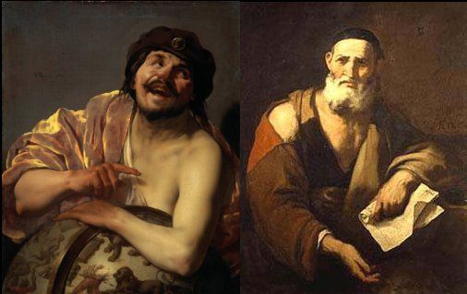
A Long Time Ago…
Our Chinese ancestors: Fire, Water, Wood, Metal and Earth are the Five Elements (referred as “Wuxing”)
Greek philosophers: everything is composed of “uncuttable” elementary particles
After going through a long Dark Ages, then followed by the Renaissance and Scientific Revolution…

Slide 4
Modern Science Came
J. Dalton proposed the atom theory in the 19th century
In 1897 J.J. Thomson discovered electron
E. Rutherford discovered the nucleus in 1911
Later Bohr model was proposed to describe the structure of atom
Proton was discovered in 1917
J. Chadwick discovered neutron in 1932
Nucleus was found to consist of protons and neutrons at the center of atom
Nobel prize in 1906
Nobel prize in 1922
Nobel prize in 1935

Slide 5
Then Particle Accelerators Came
A large variety of particles were discovered through the collisions (referred as “particle zoo”)
To classify these particles, M. Gell-Mann* and G. Zweig proposed the “quark model”
Later quantum chromodynamics (QCD) was developed to describe the strong interactions
S. Glashow, A. Salam and S. Weinberg developed the electroweak theory to unify electromagnetic and weak forces
W and Z bosons discovered in 1983
[*Nobel Prize in 1969]
[Nobel Prize in 2004]
[Nobel Prize in 1979]
[Nobel Prize in 1984]

Slide 6
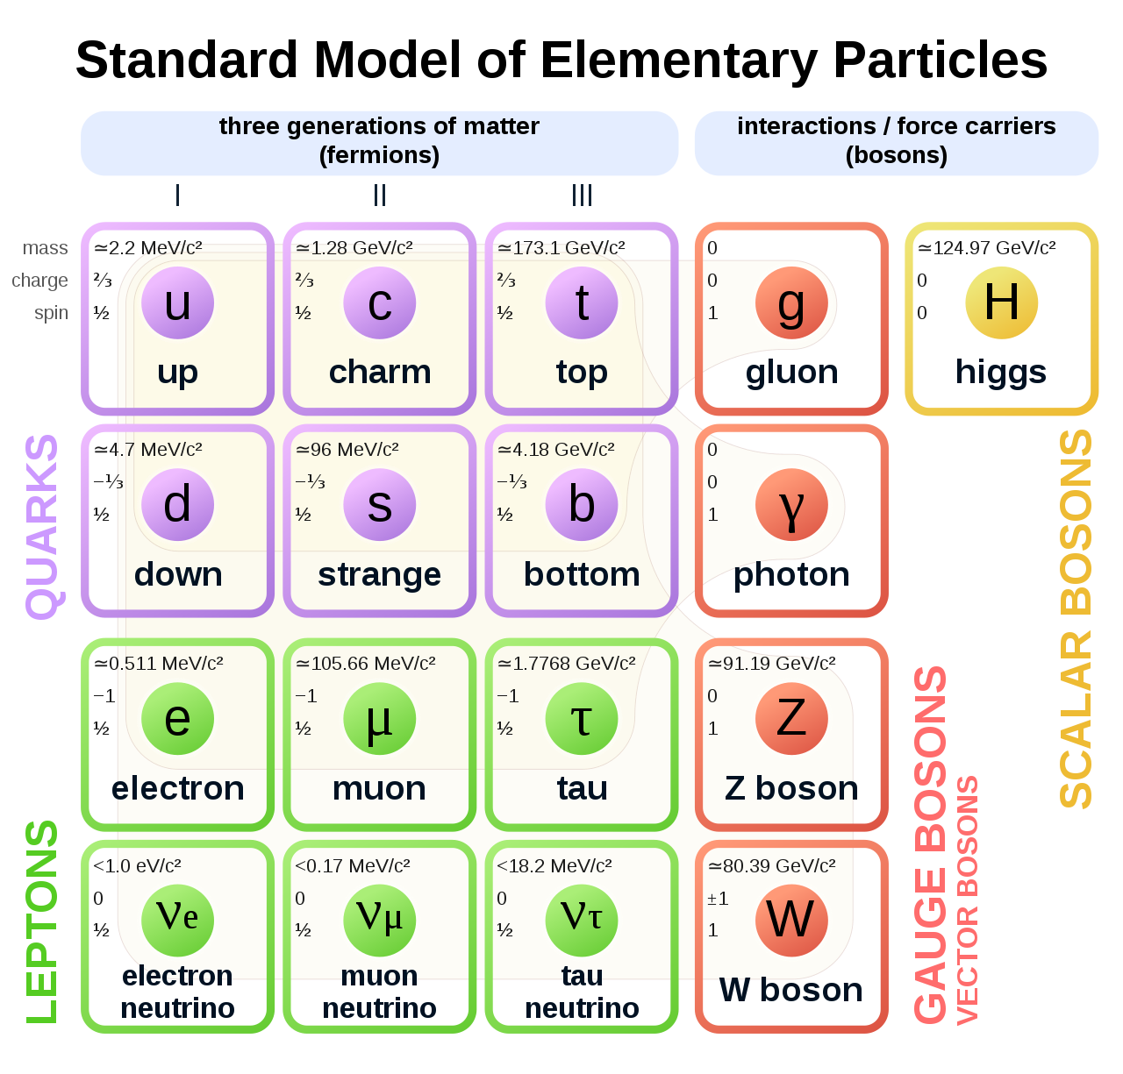
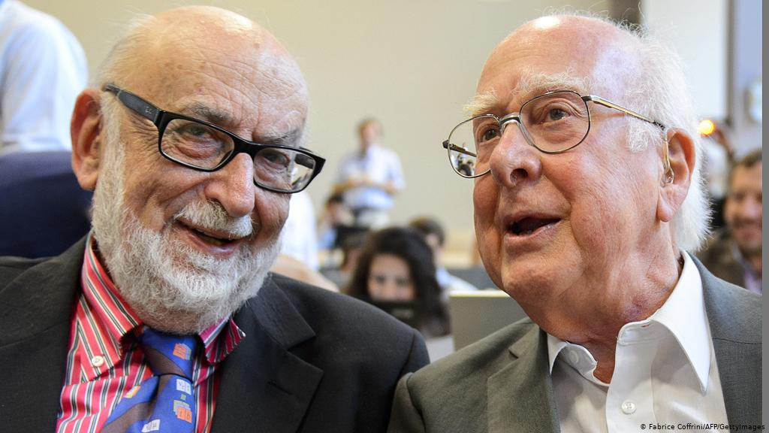
Standard Model
A theoretical framework to describe the elementary particles and their interactions
The cornerstones of the SM:
Gauge invariance (based on SU(3)⨉SU(2)⨉U(1)): depicting strong and electroweak interactions
Higgs mechanism: trigger the EWSB; W, Z bosons and fermions acquire masses through EWSB; predicts the Higgs boson
Higgs boson discovered in 2012
[Nobel Prize in 2013]

Slide 7
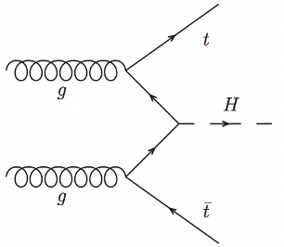
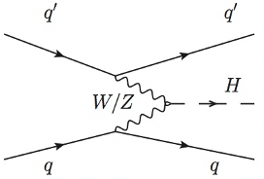
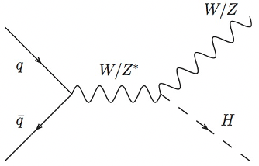
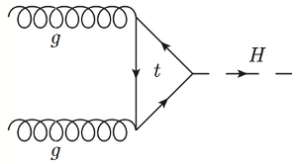
It’s Not the End…
A New Chapter: measuring Higgs boson properties including couplings is crucial for our understanding on origin of mass
Can also be used as an approach to probe new physics beyond the SM, source of matter-antimatter asymmetry, etc
Higgs boson production at the LHC
gluon-gluon Fusion (ggF): 48.5 pb
Vector Boson Fusion (VBF): 3.8 pb
Associated production with vector boson (VH): 2.3 pb
Associated production with top quark pair (ttH): 0.5 pb

Slide 8
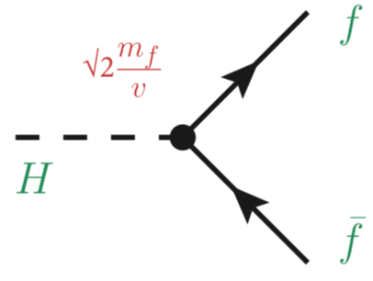
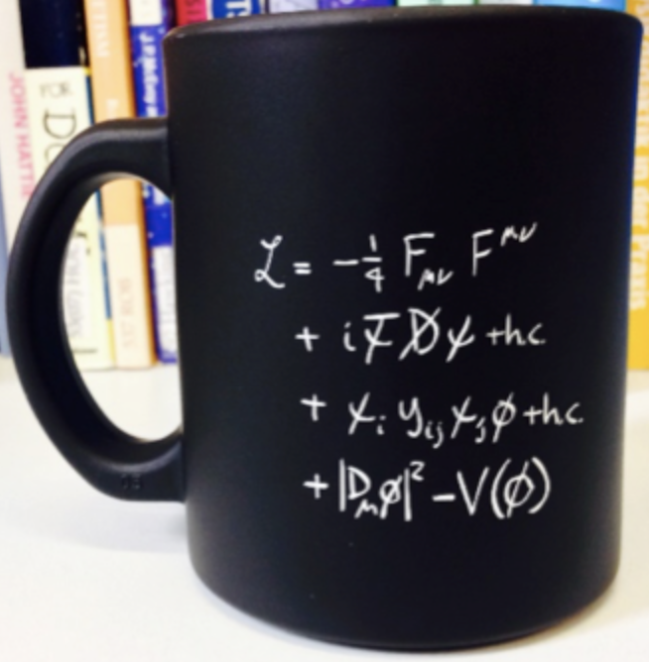
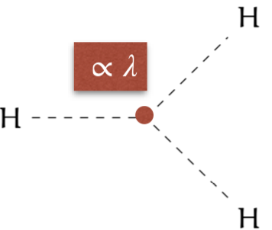
Yukawa Couplings and Self-coupling
Higgs boson couples to fermions through Yukawa interactions
Giving masses to quarks and leptons
Coupling strength is proportional to fermion’s mass
Higgs potential:
In SM, λ ≈ 0.13 give m_{H} ≈ 125 GeV
HH productions provide directly access to Higgs self-coupling κ_{λ} (λ_{HHH}/λ_{SM})

Slide 9
Topics to be Covered Today
CP Property of the Top-quark Yukawa Coupling via ttH/tH (H→𝛾𝛾): Yukawa coupling to 3rd generation fermion
Search for SM H→μμ: Yukawa coupling to 2nd generation fermion
HH→bb𝜏𝜏 and HH(+H) combination: Higgs boson trilinear self coupling

Slide 10
Our Facility: ATLAS Detector

Slide 11
Particle Identifications at ATLAS
The main final-state particles used for the physics analysis: electron, muon, tau, jet, b-jet, and missing transverse energy $E_{T}^{miss}$
Different types of particles interact with certain sensitive sub-detectors and give different responses in the experiments

Slide 12
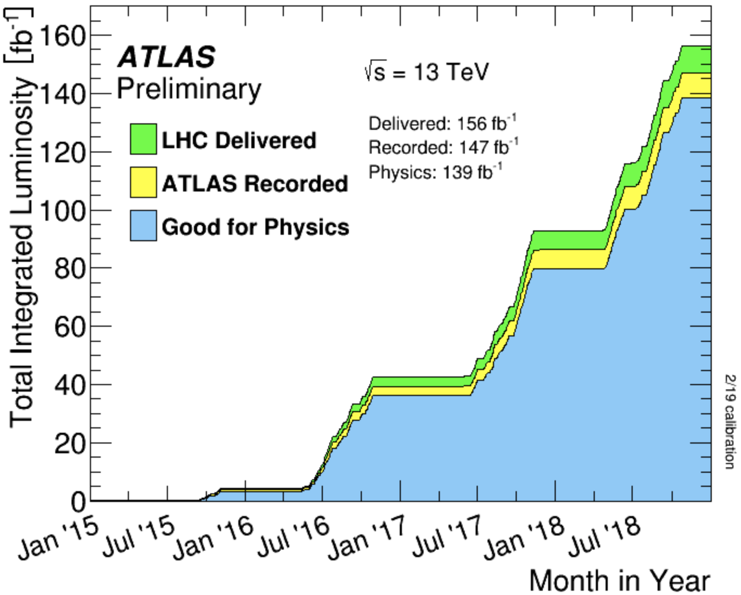
Run 2 Dataset
139 fb⁻¹ of 13 TeV pp collision data collected for physics by the ATLAS detector during the LHC Run 2
Great performance of ATLAS detector and operation of the LHC
Where we are now

Slide 13
CP Property of the Top-quark Yukawa Coupling via ttH/tH (H→𝛾𝛾)

Slide 14
Why Doing This?
Large matter-antimatter asymmetry in universe: crucial to look for additional CP violation sources
First direct probe to the CP property of the top-Higgs Yukawa coupling (strongest one) using ttH/tH at tree level
Lagrangian written as:
κ_{t} (>0): coupling strength; α: CP-mixing angle
In SM, κ_{t} = 1, α = 0
Any deviation from SM observed can be a sign of new physics and account for the explanation of the observed matter-antimatter asymmetry
J. Ellis et al.

Slide 15
How to Probe this?
The presence of a CP-odd component in the t-H coupling will have impact on
rate and kinematics of ggF process
rate of H→𝛾𝛾 decay
rate and kinematics of ttH and tH processes
Measure the rate of ttH/tH processes and shapes of observables sensitive to the CP nature of the t-H coupling
Contributions from ggF and H→𝛾𝛾 constrained by the Higgs combination results
ggF
H→𝛾𝛾
ttH
tH

Slide 16
Why in H→𝛾𝛾 Channel?
𝛾𝛾 channel: small rate, but clean signature and good resolution; solid bkg. estimation from data sideband → most sensitive channel to study ttH process
𝛾𝛾 selection: two isolated photons with p_{T} > 35/25 GeV; 105 GeV < m_{𝛾𝛾} < 160 GeV (fitting discriminant)
ttH/tH selection: ≥1 b-tagged jet (77% eff.)
“Lep” region (≥1 top decay leptonically): ≥ 1 isolated electron or muon with p_{T} > 15 GeV
“Had” region (both tops decay hadronically): 0 selected lepton, ≥ 3 jets

Slide 17
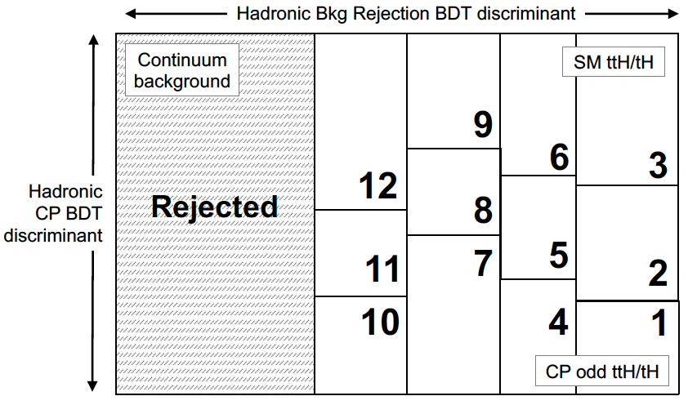
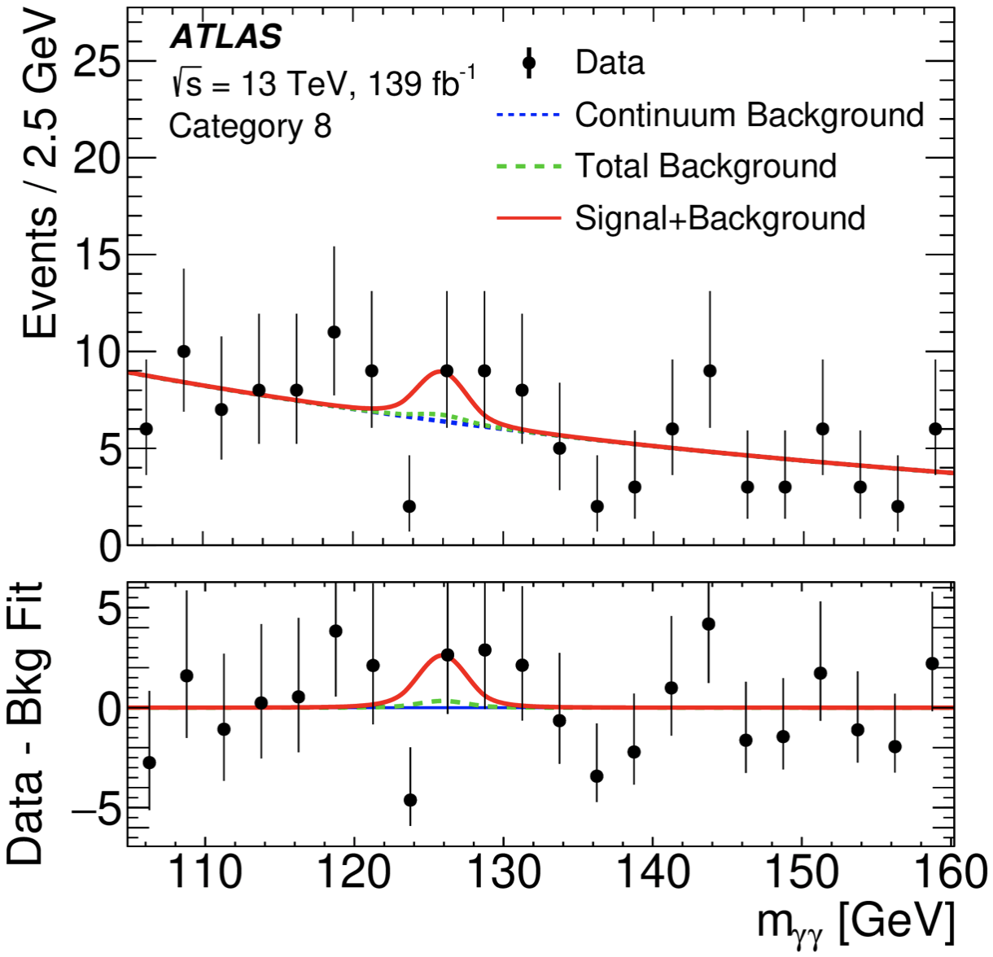
Analysis Methodology
In each region, trained two BDTs:
Bkg. rejection BDT: separate ttH-like events from 𝛾𝛾+jets and tt𝛾𝛾 background
CP BDT: separate CP-even and CP-odd couplings using ttH/tH processes
Categorize events based on 2D BDTs: 12 categories in Had and 8 categories in Lep
Signal extraction: simultaneous fit to m_{𝛾𝛾} spectra in all 20 categories

Slide 18
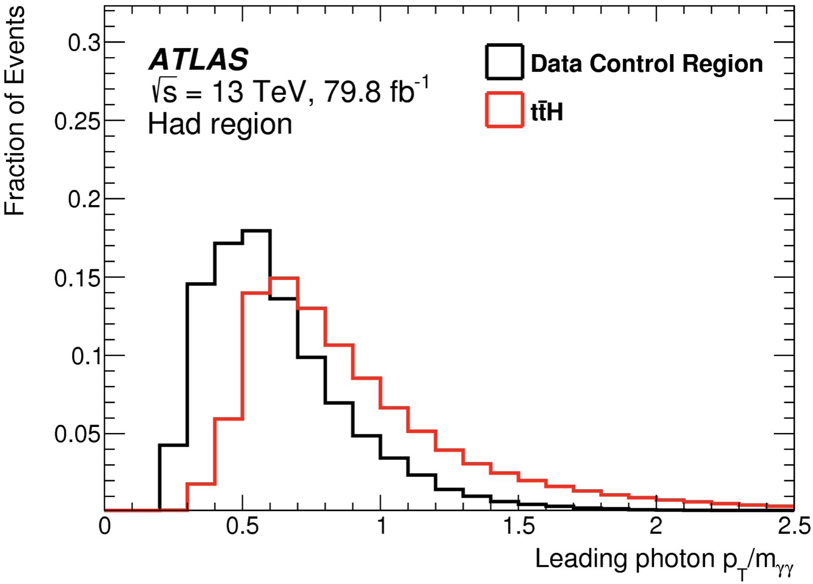
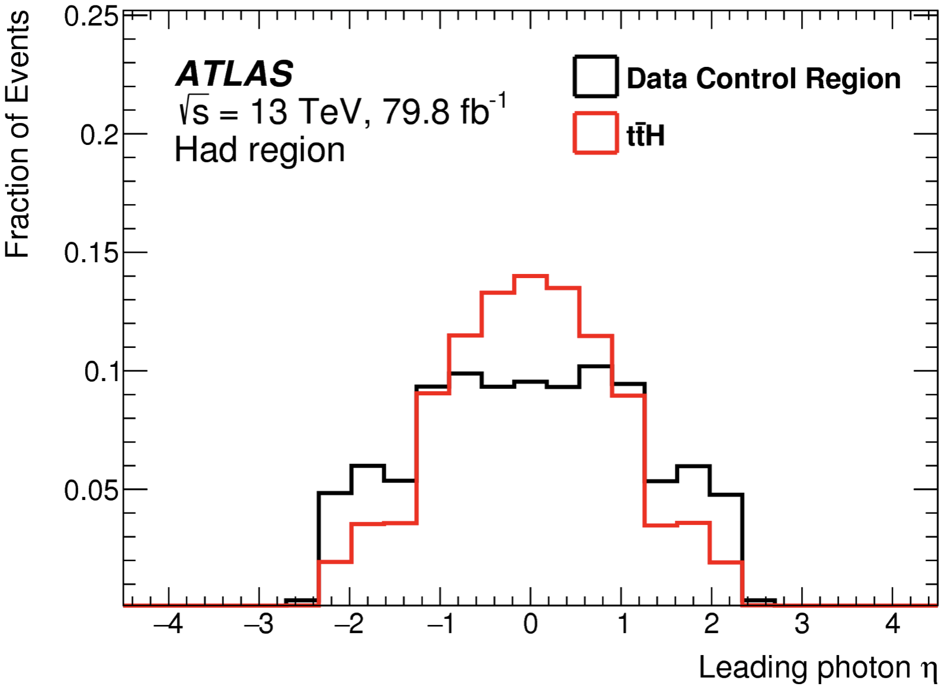
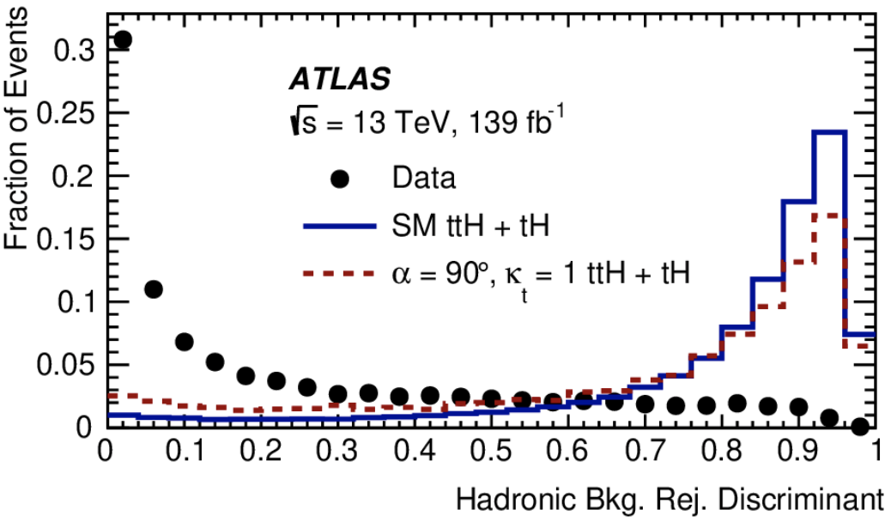
Background Rejection BDT
Trained with low-level input variable like 4 vector info of γ, j, l, and MET
Good separation power between ttH/tH and background, no strong dependence on CP mixing angle
p_{T,𝛾1}/m_{𝛾𝛾}
η_{𝛾1}
Bkg. rej. BDT

Slide 19
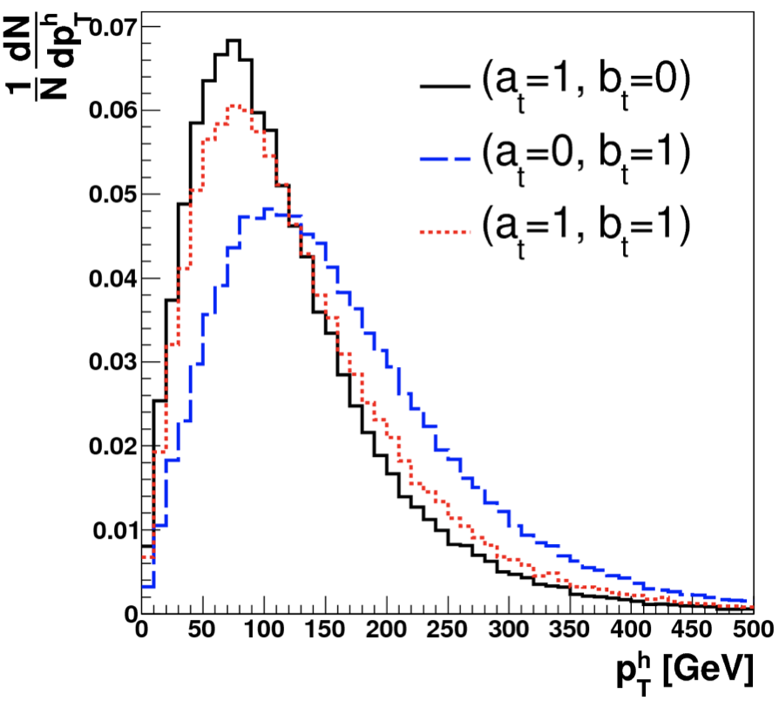
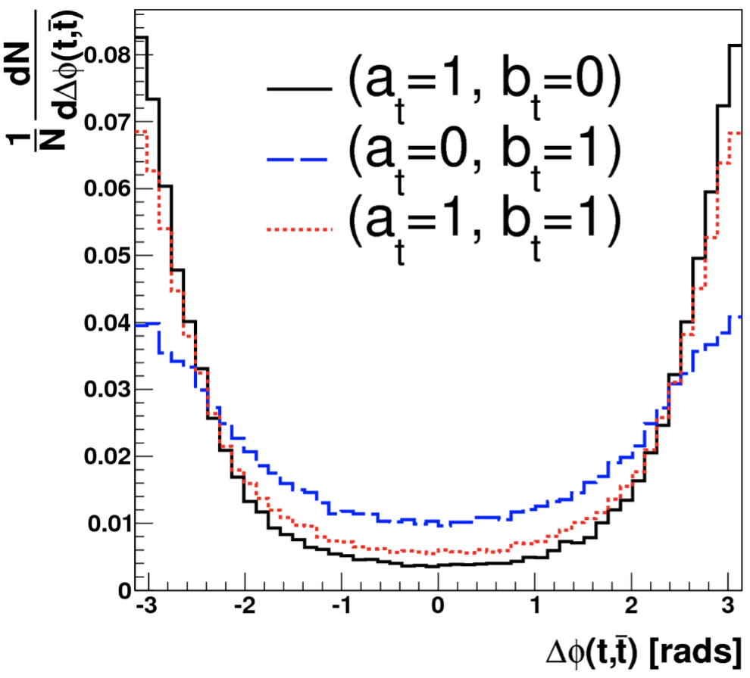
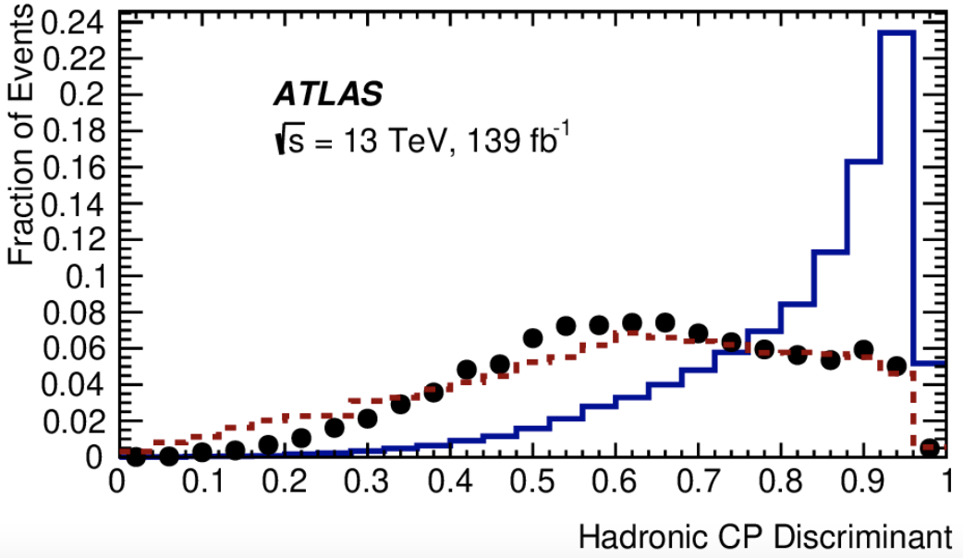
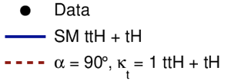
CP BDT
Training variables: p_{T}/η of 𝛾𝛾 system and two top candidates (t1, t2); ϕ_{𝛾𝛾,t1} and ϕ_{𝛾𝛾,t2}; Δη_{t1t2} and Δϕ_{t1t2}; m_{𝛾𝛾, t1}, m_{t1t2}, etc
p_{T,H}
Δϕ_{t1t2}
CP BDT
PRD 92, 015019 (2015)

Slide 20
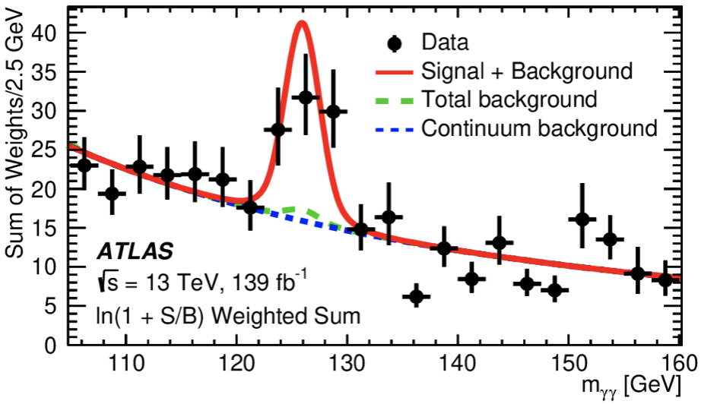
Significance for ttH(→𝛾𝛾)
Assuming CP-even coupling, the measured signal strength (μ=σ_{obs}/σ_{SM}) for ttH via H→𝛾𝛾 is:
The background-only hypothesis is rejected with an observed (expected) significance of 5.2σ (4.4σ) → ttH observation in single Higgs decay channel
μ = 1.43
$$\begin{matrix}+0.33 \\ −0.31\end{matrix}(stat.)$$
$$\begin{matrix}+0.21 \\ −0.15\end{matrix}(sys.)$$

Slide 21
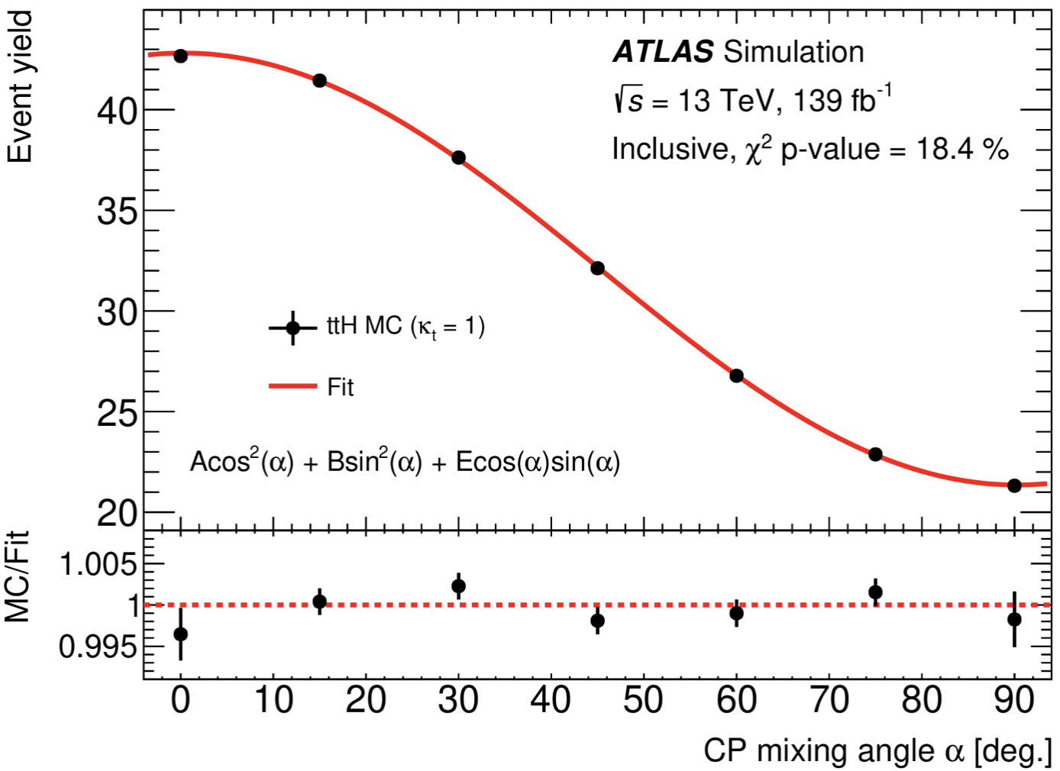
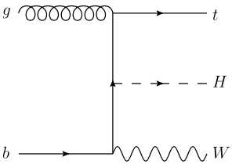
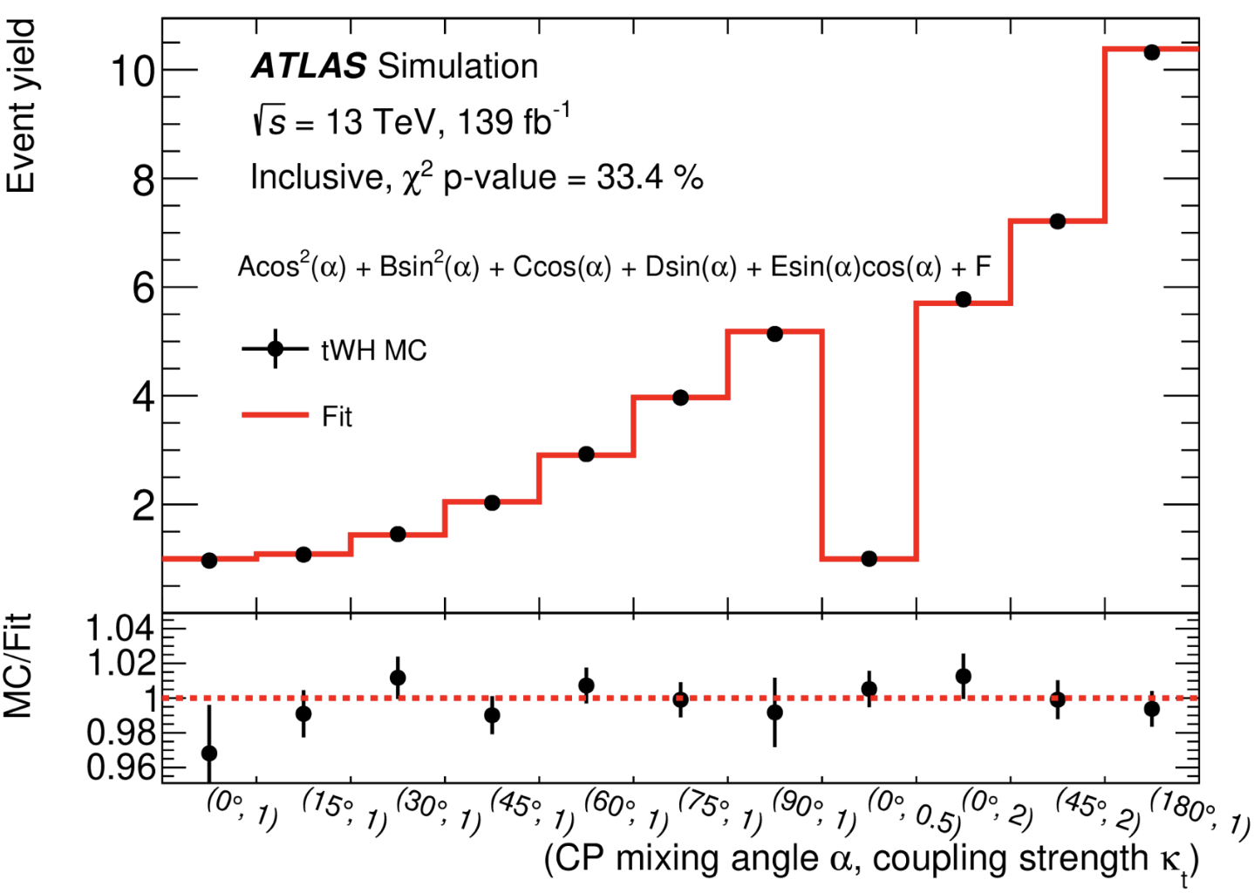
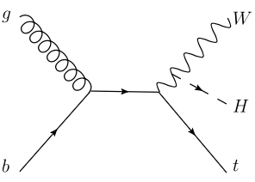
ttH/tH Signal Yield Parametrization
ttH and tH signal yields parametrized into κ_{t} and α in each category
ttH following the form:
tH:
Need to consider the interference between t-H and W-H couplings
t-H
ttH
W-H
tH

Slide 22
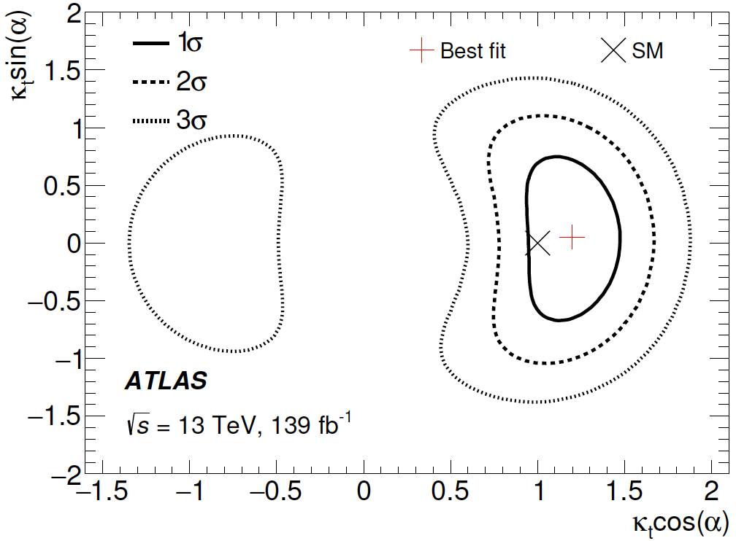
Results on CP Constraint
H→𝛾𝛾/ggF loops constrained by the Higgs combination result (link)
The measurements consistent with the SM prediction, and no sign of CP violation in the top-Yukawa interaction observed

Slide 23
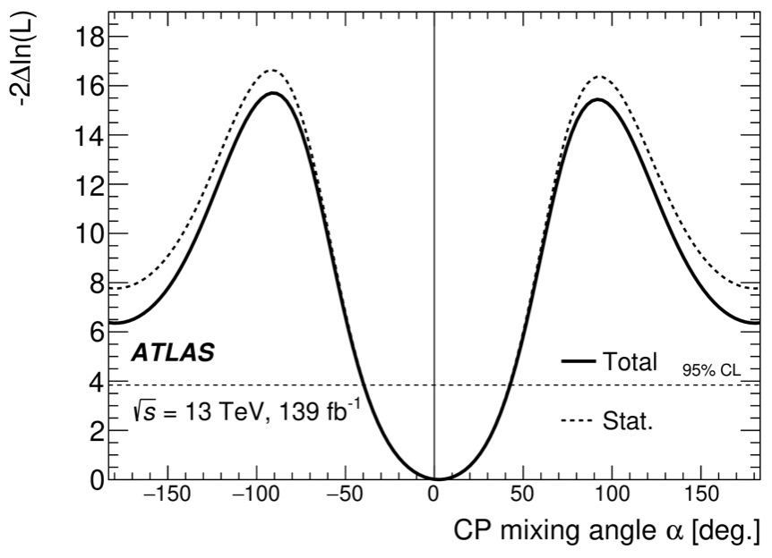
Exclusions for CP-odd Component
Likelihood scan of α with κ_{t} floating in the fit
|α|>43° is excluded at 95% C.L.
Pure CP-odd hypothesis is excluded at 3.9σ → stringent exclusion result for CP-odd component in the top-Yukawa interaction to date
Phys. Rev. Lett. 125 (2020) 061802

Slide 24
Search for SM H→μμ

Slide 25
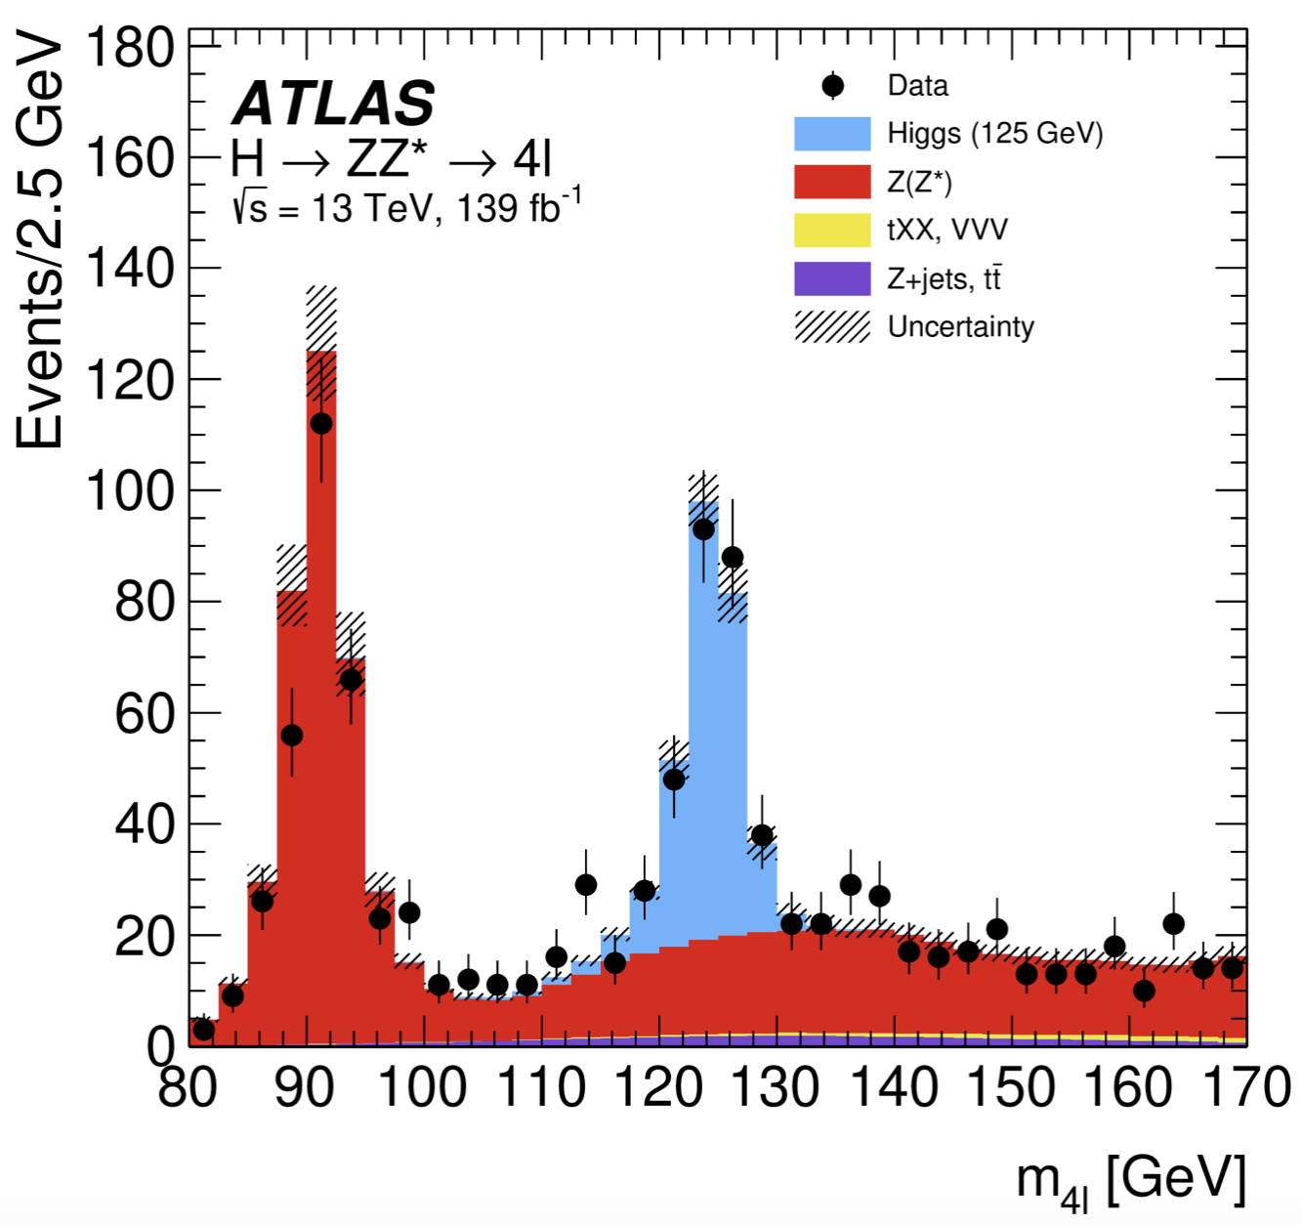
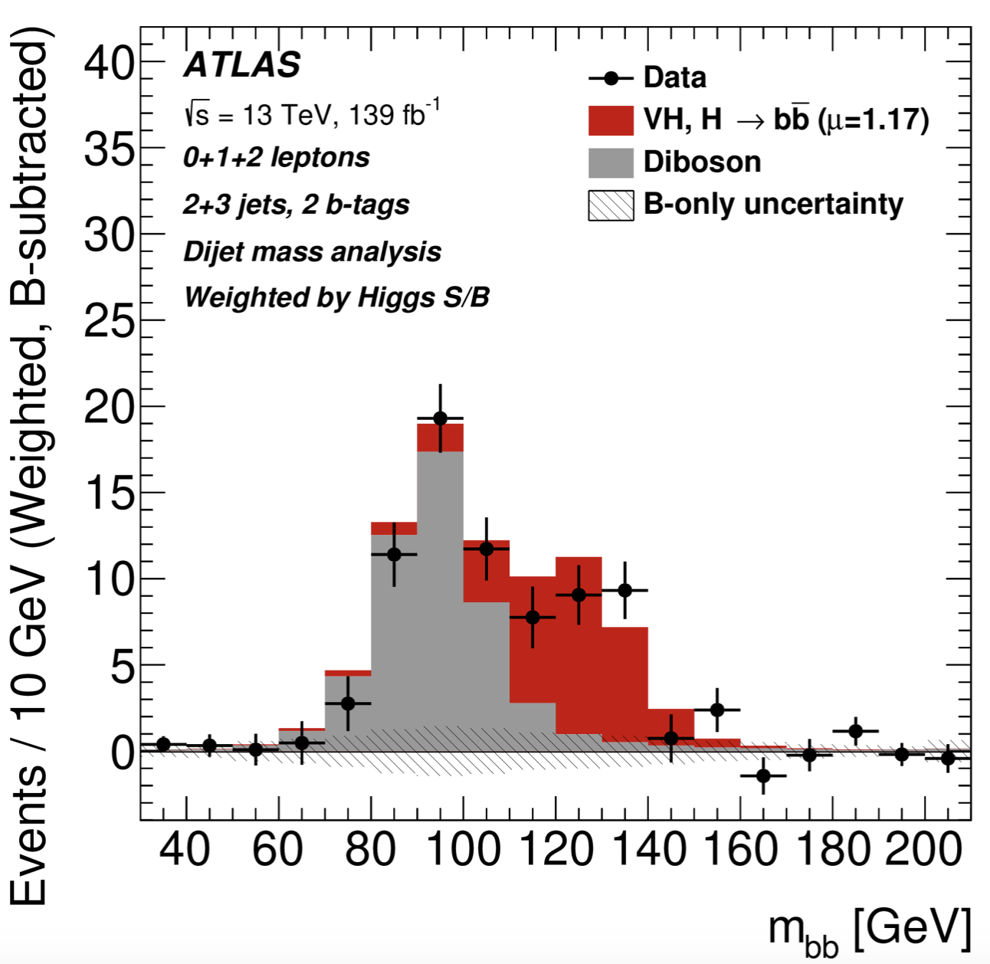
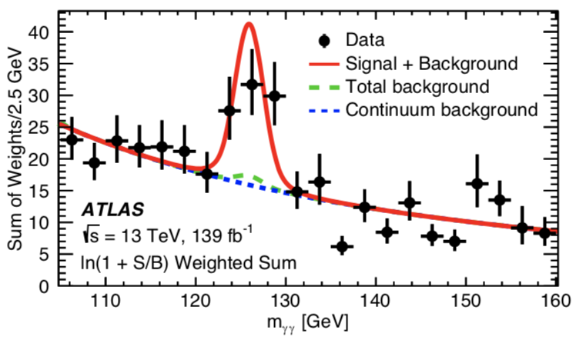
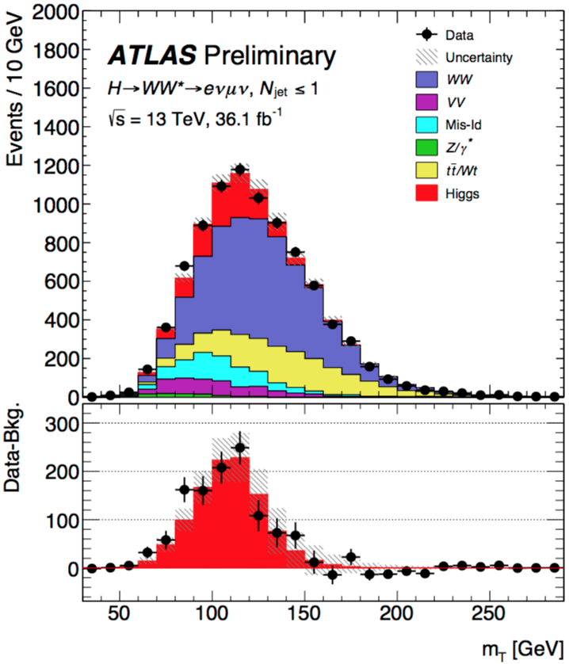
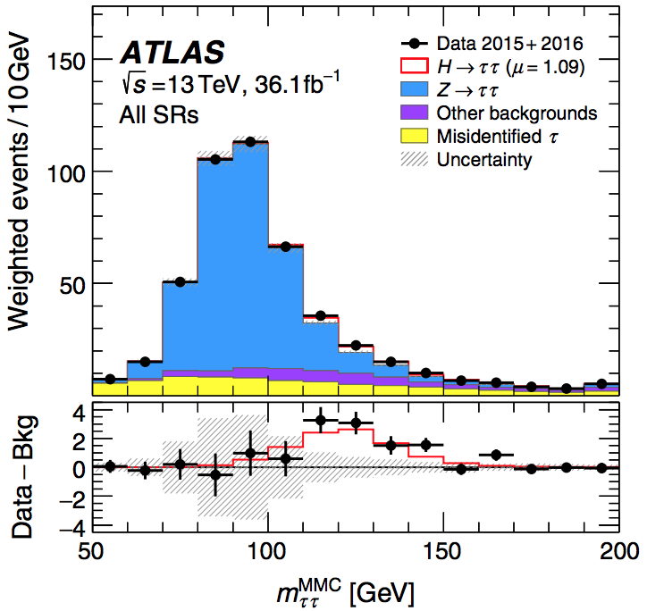
What We’ve Learned about the Higgs
H→ZZ→4l
H→bb
ttH (H→γγ)
Higgs coupling to gauge bosons
Higgs couplings to the third generation of fermions
H→WW
One of the next big milestones:
Higgs couplings to the second generation of fermions
H→𝜏𝜏

Slide 26
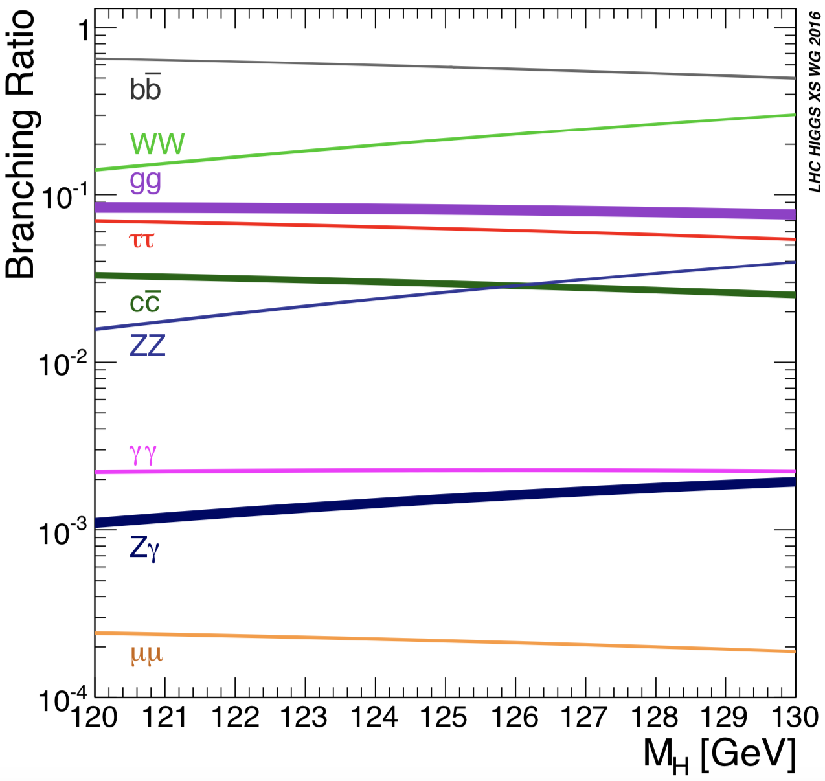
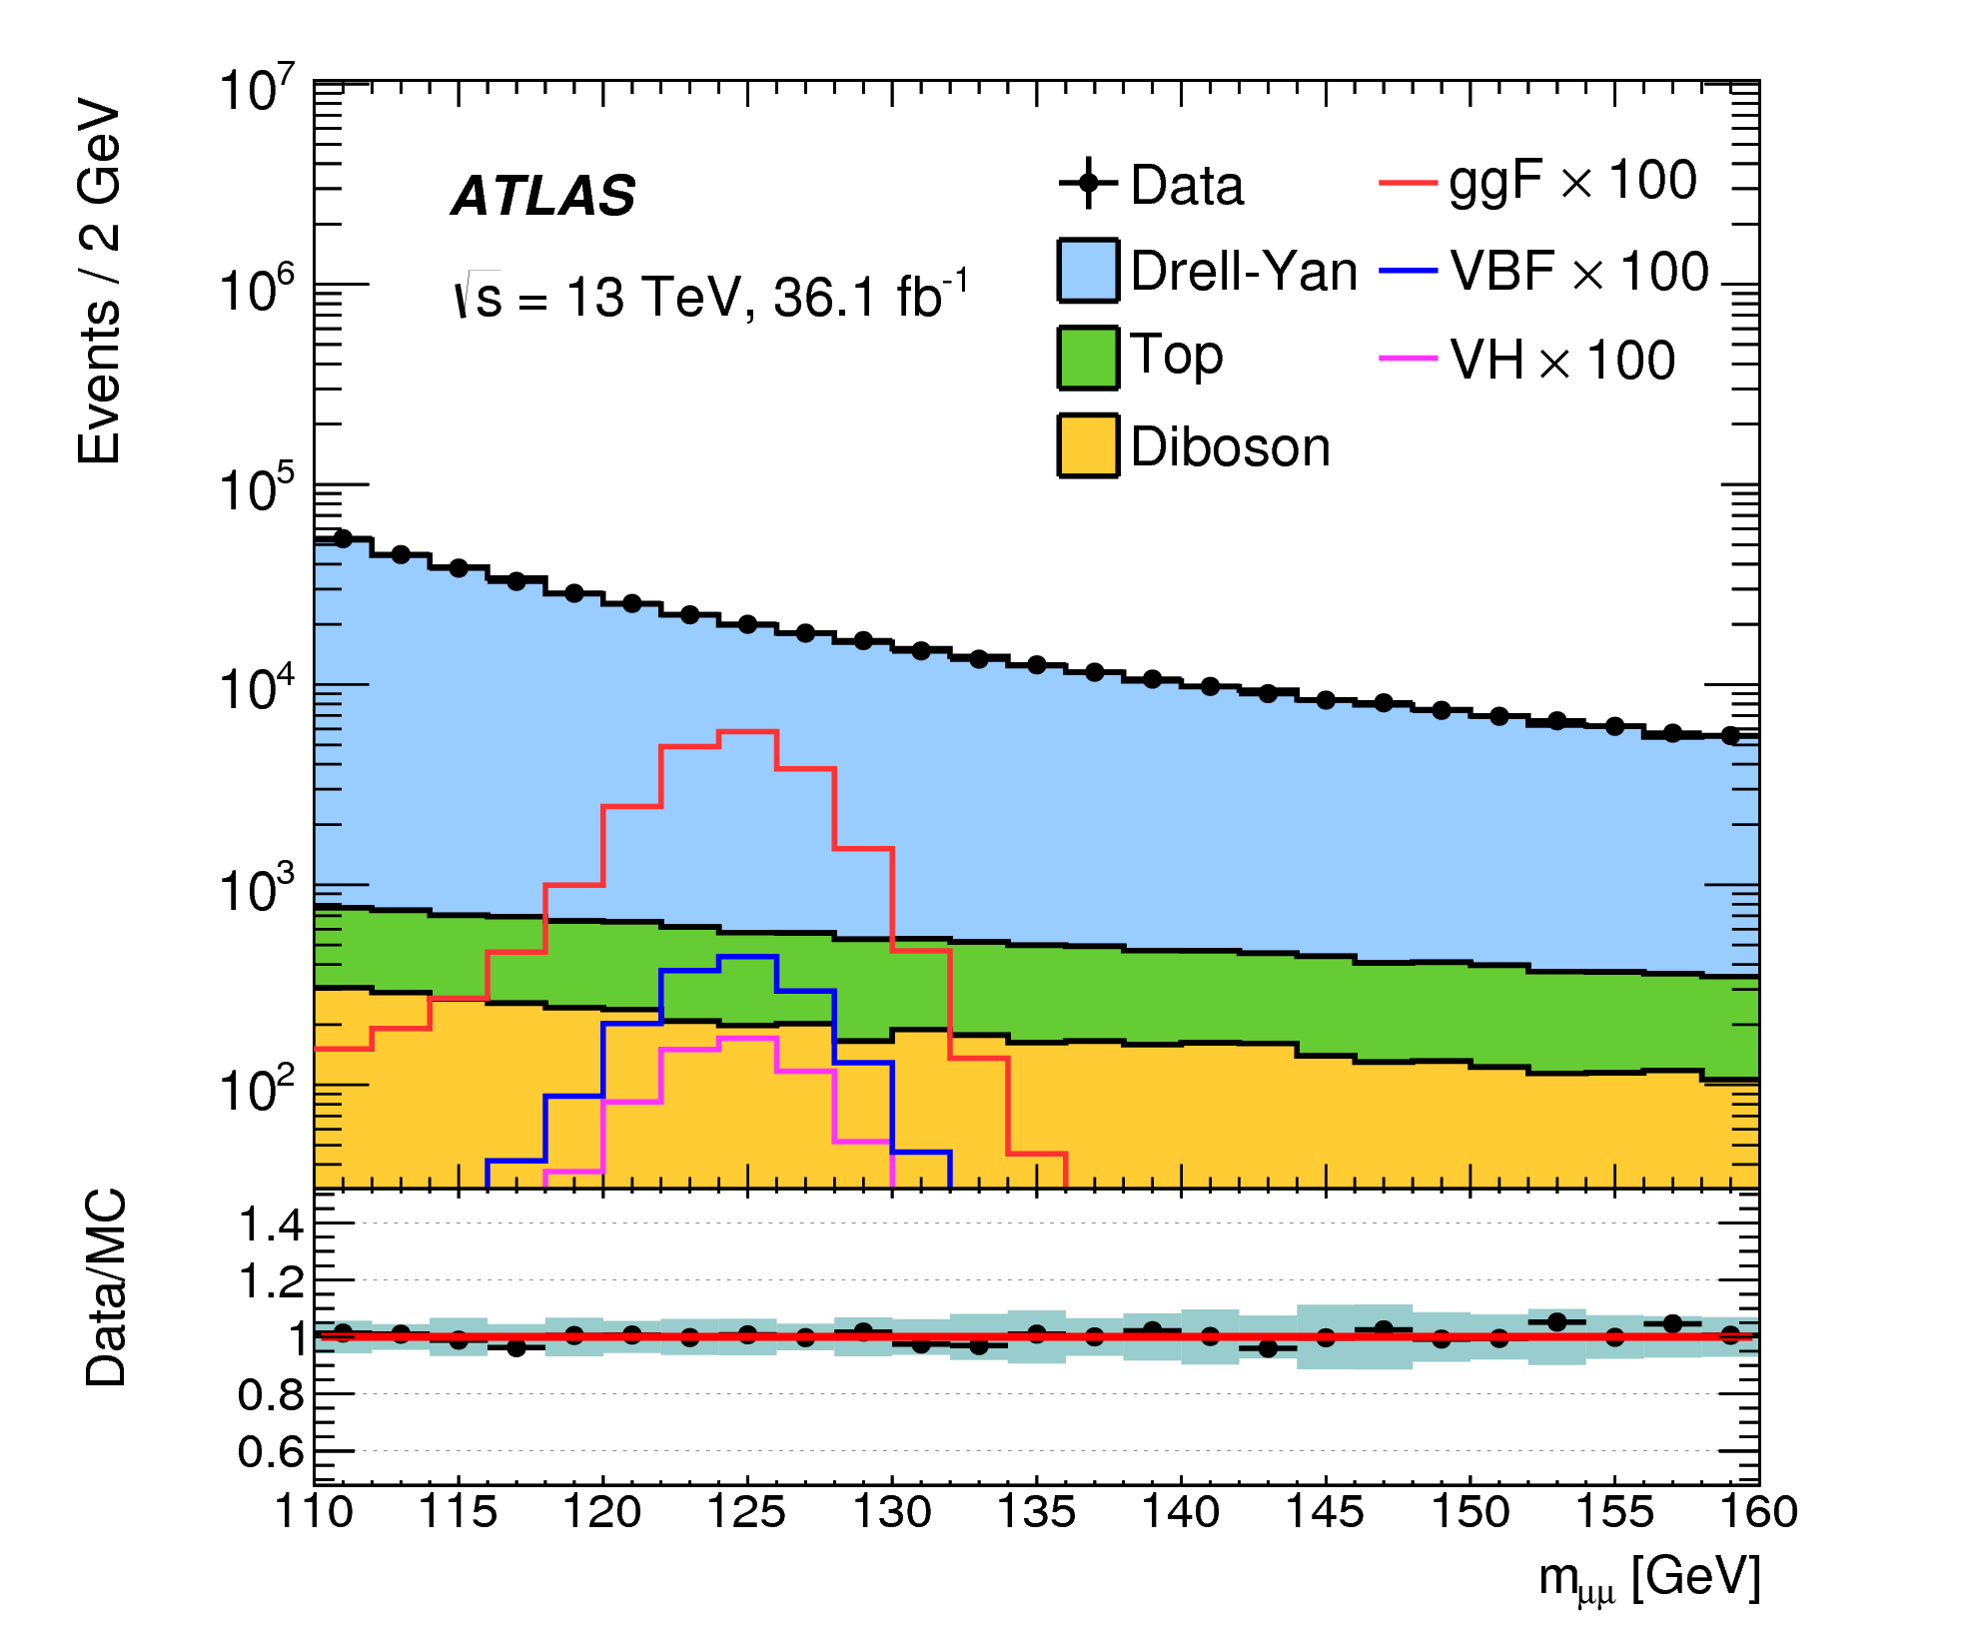
Physics Motivation
H→μμ: most promising channel to explore Yukawa coupling to the 2nd generation fermions
H→cc not very sensible under the current luminosity
Major challenge for H→μμ: low branching ratio and large irreducible background from Drell-Yan
S/B: ~0.1%
2.17×10⁻⁴

Slide 27
Overview of Analysis Strategy
Sig. signatures: two isolated muons with opposite charge
BDT-based categorization to enhance signal sensitivity
Driven by the different Higgs boson production modes
Data driven approach used for bkg. estimation
S+B PDF used to fit the observed m_{μμ} spectra simultaneously in all the categories to derive the final signal strength μ
Sig. and bkg. modeled by analytic functions

Slide 28
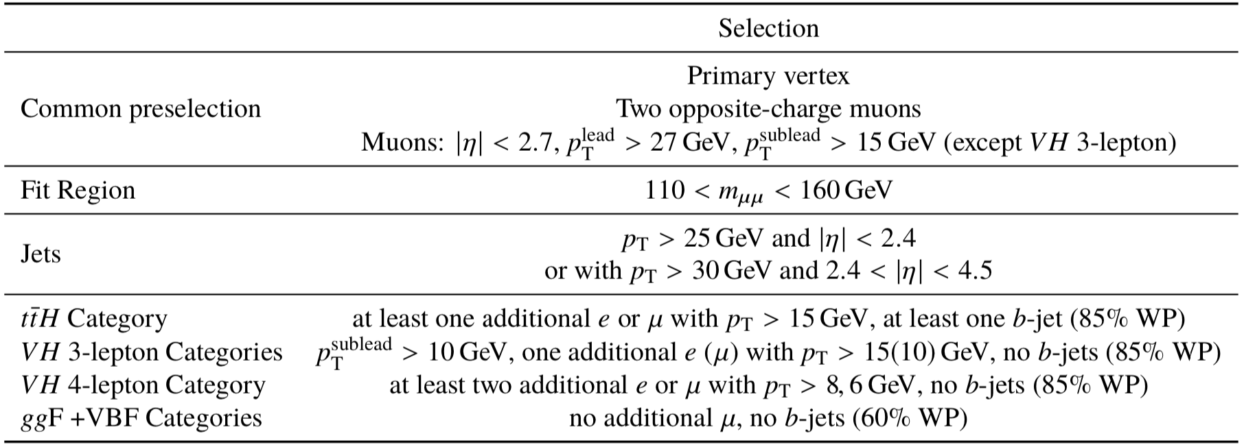
Event Selection for H→μμ
Single muon trigger with p_{T} threshold of 26 or 50 GeV
Selected events sorted into 20 categories in total, which are mutually exclusive and in the order of ttH(1) →VH(3)→VBF(4)→ggF(12)

Slide 29
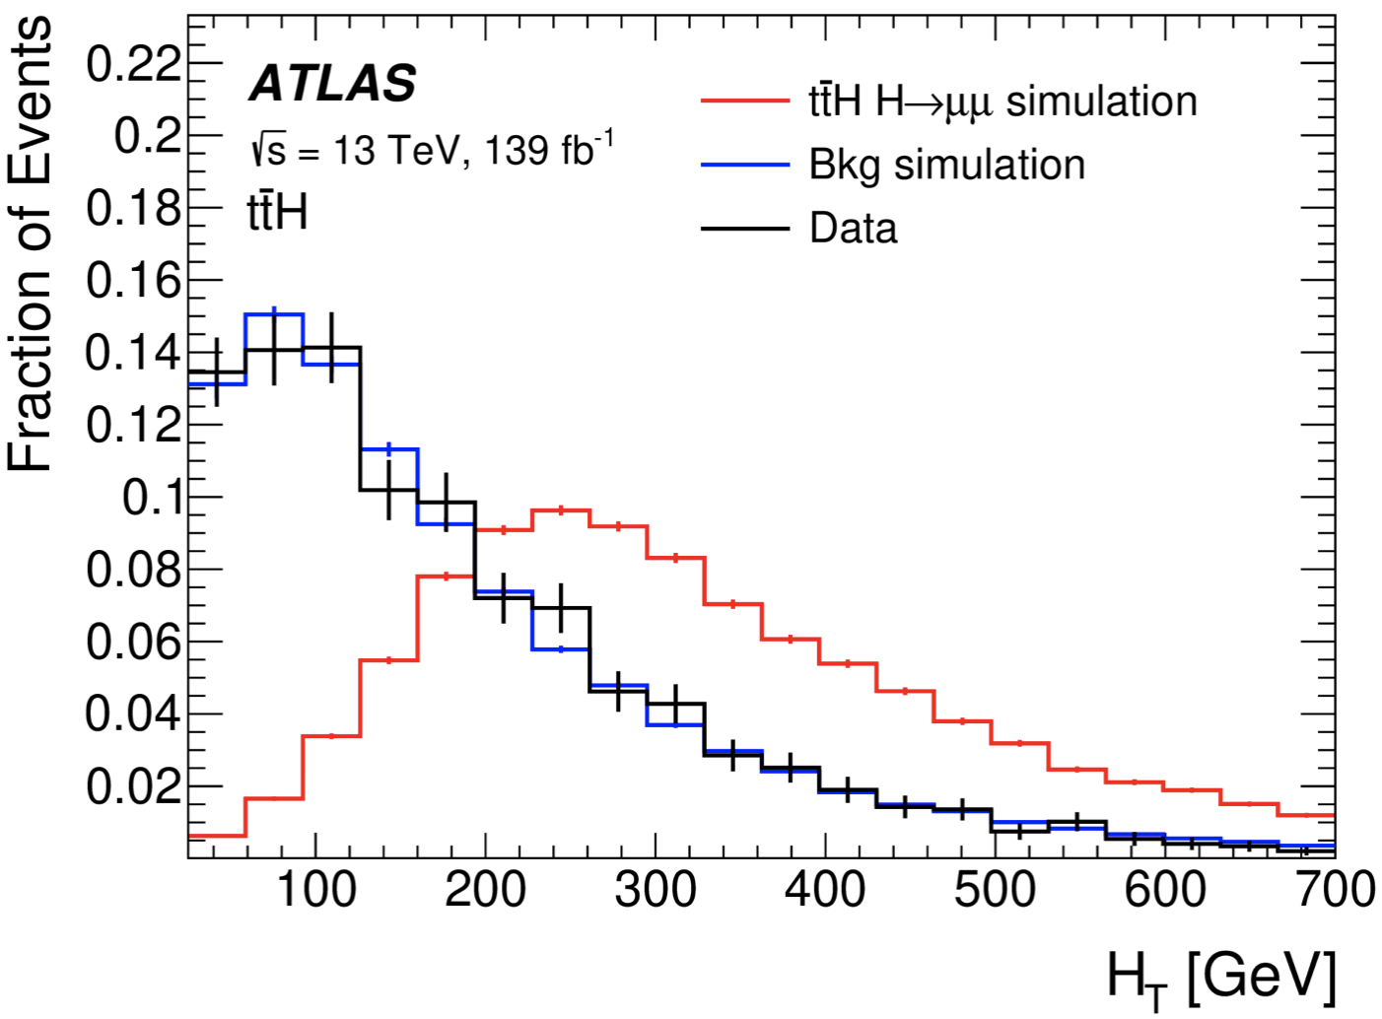
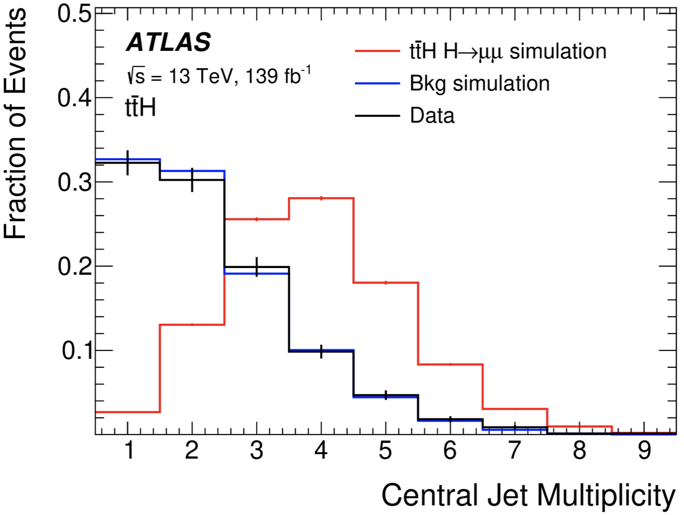
ttH Categorization
Target semi/dileptonic decays of the top pair
Requiring ≥1 extra e/μ and ≥1 b-tagged jet
Two highest-p_{T} muons with opposite charge as the Higgs candidate
BDT trained to distinguish ttH signal from all bkgs (ttbar, ttZ, diboson, etc)
Training variables: p_{T} of e/μ, invariant masses of leptons/tops, as well as N_{jet} and N_{b-jet}, and H_{T}
H_{T}
N_{jet}

Slide 30
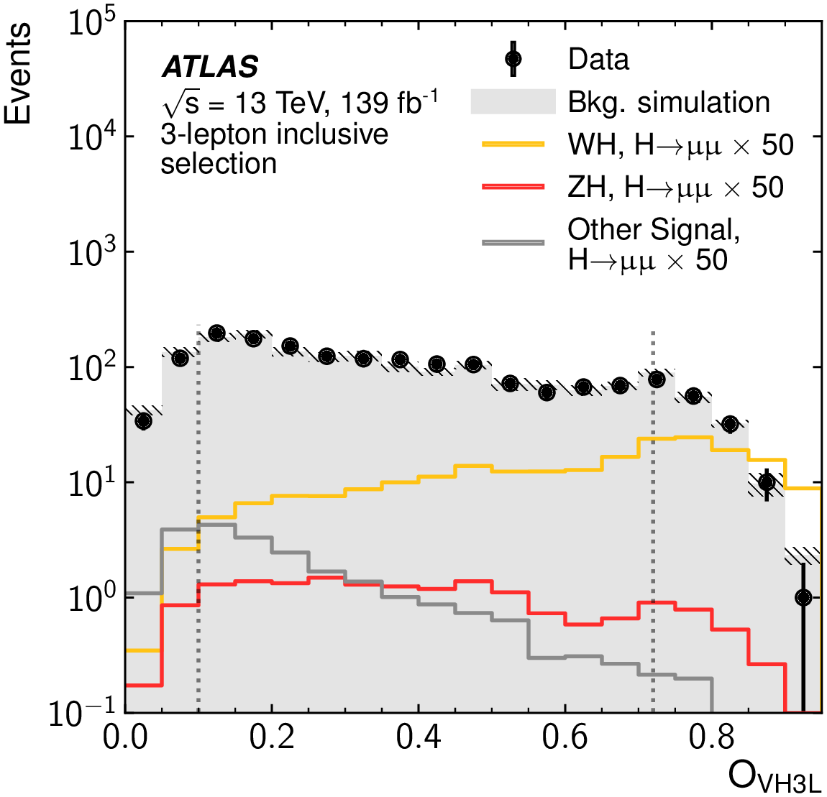
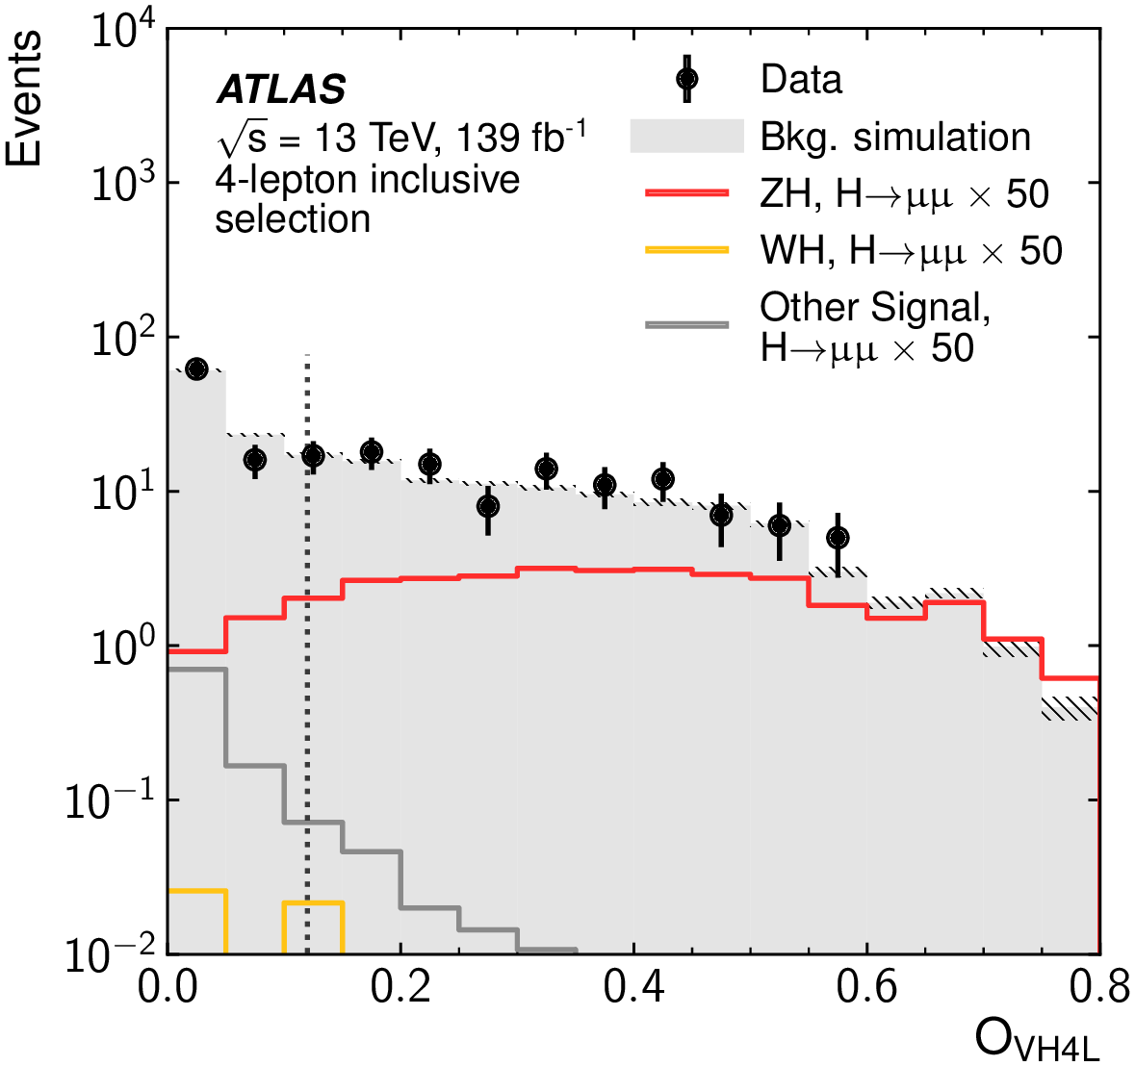
VH Categorization
Target WH/ZH in leptonic decays: requiring 1/2 additional leptons apart from the dimuon pair
Two BDTs trained for 3-lep and 4-lep cases using invariant mass and angular variables of lepton systems as well as $E_{T}^{miss}$and N_{jet}
2 Cate. for 3-Lep
1 Cate. for 4-Lep

Slide 31
VBF/ggF Categorization (1)
Events not selected into ttH or VH are classified into 0-, 1- and ≥2-jet regions
Veto events with any b-jet or extra muon
In the 2-jet region, first a BDT trained to disentangle VBF sig. and bkg.: 4 VBF categories defined
3 BDTs (ggF&VBF sigs vs bkg.) trained in each N_{jet} region to categorize the remaining events: 4 ggF categories defined based on each BDT
Training variables: $p_{T}^{μμ}$, y_{μμ}, cosθ*, p_{T} and η of jets, $p_{T}^{jj}$, y_{jj}, Δɸ_{jj,μμ}, m_{jj}, $N_{track}^{j}$, etc

Slide 32
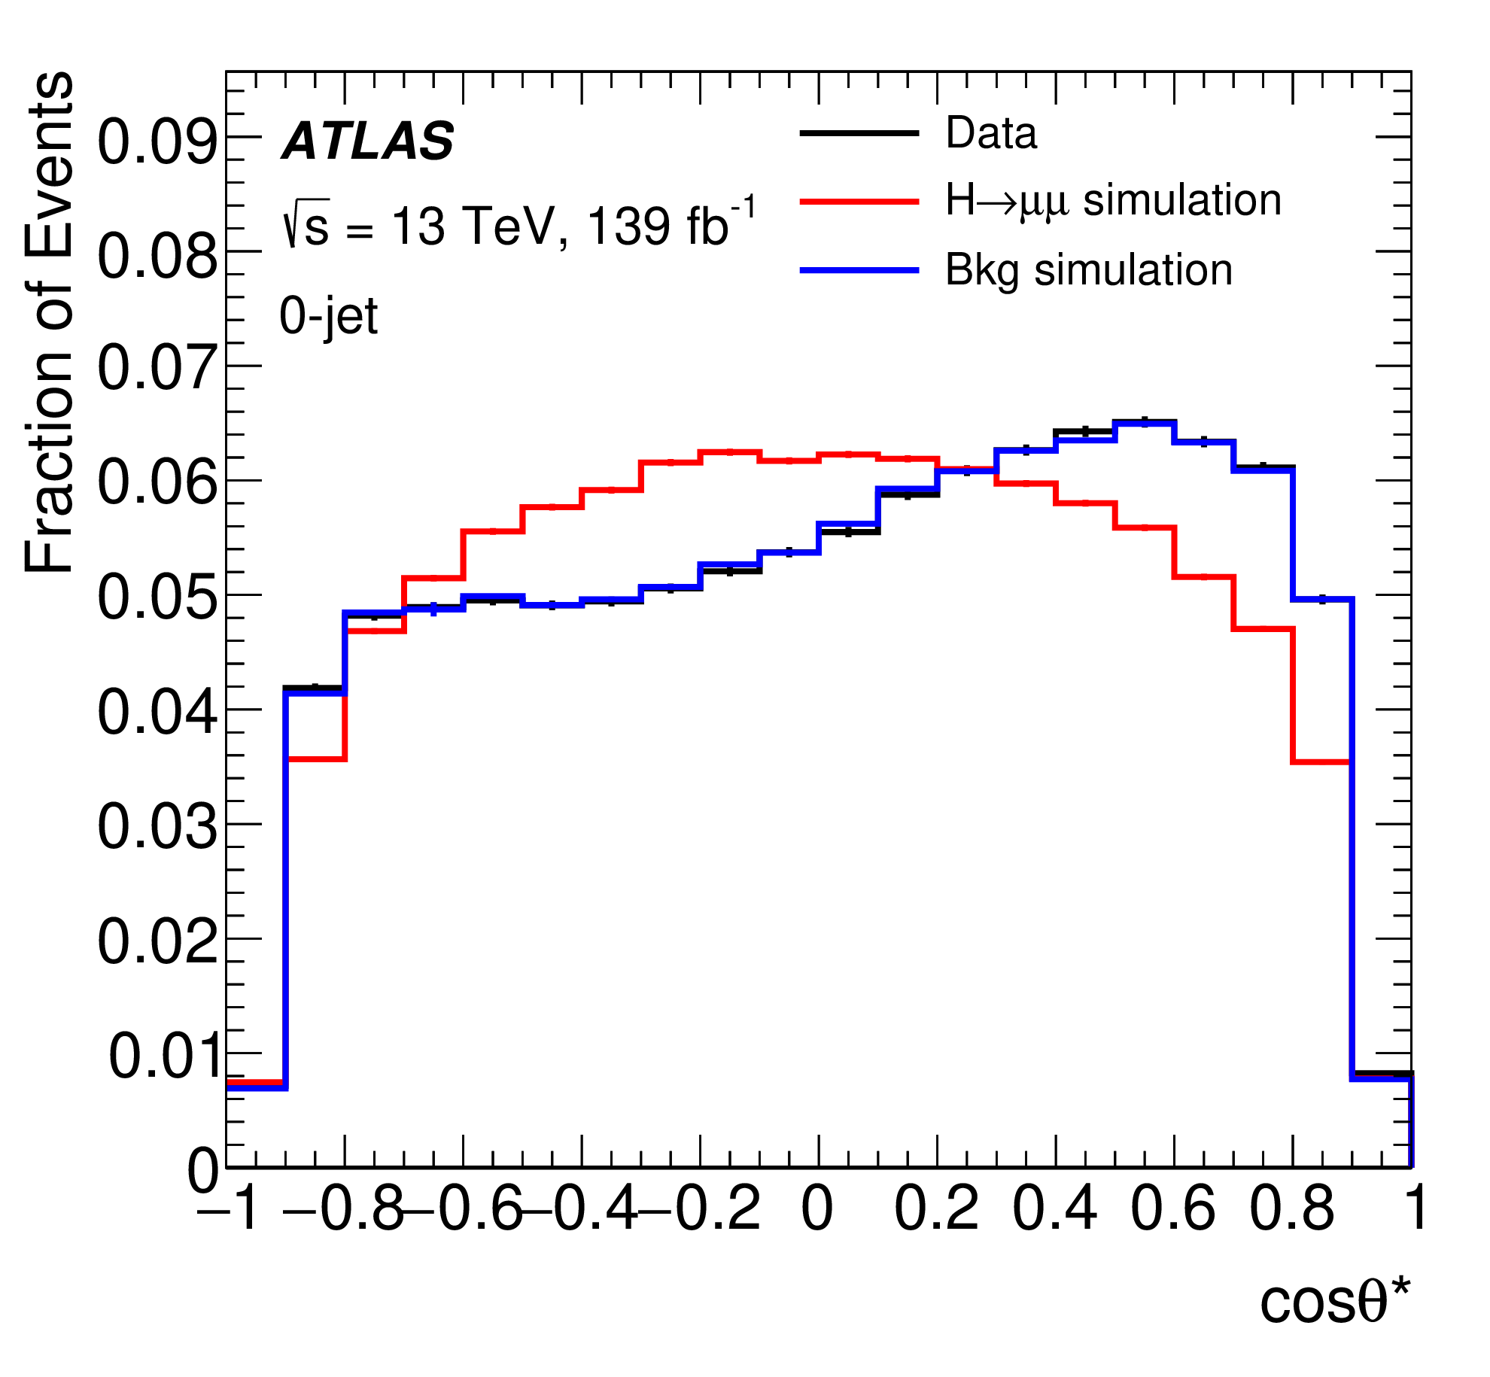
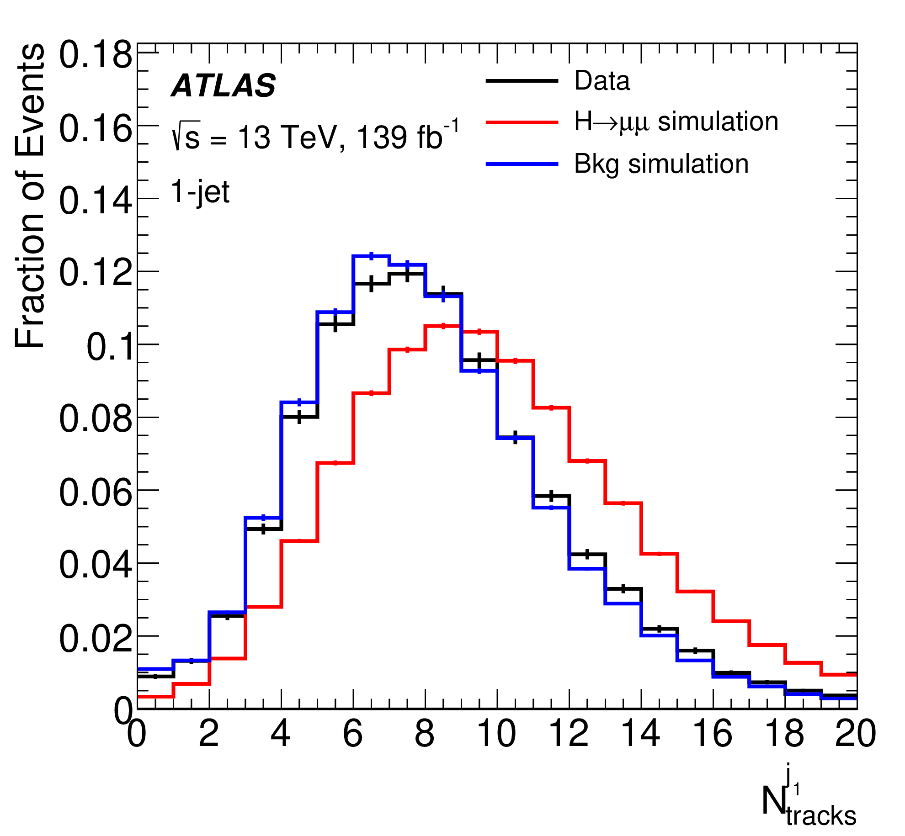
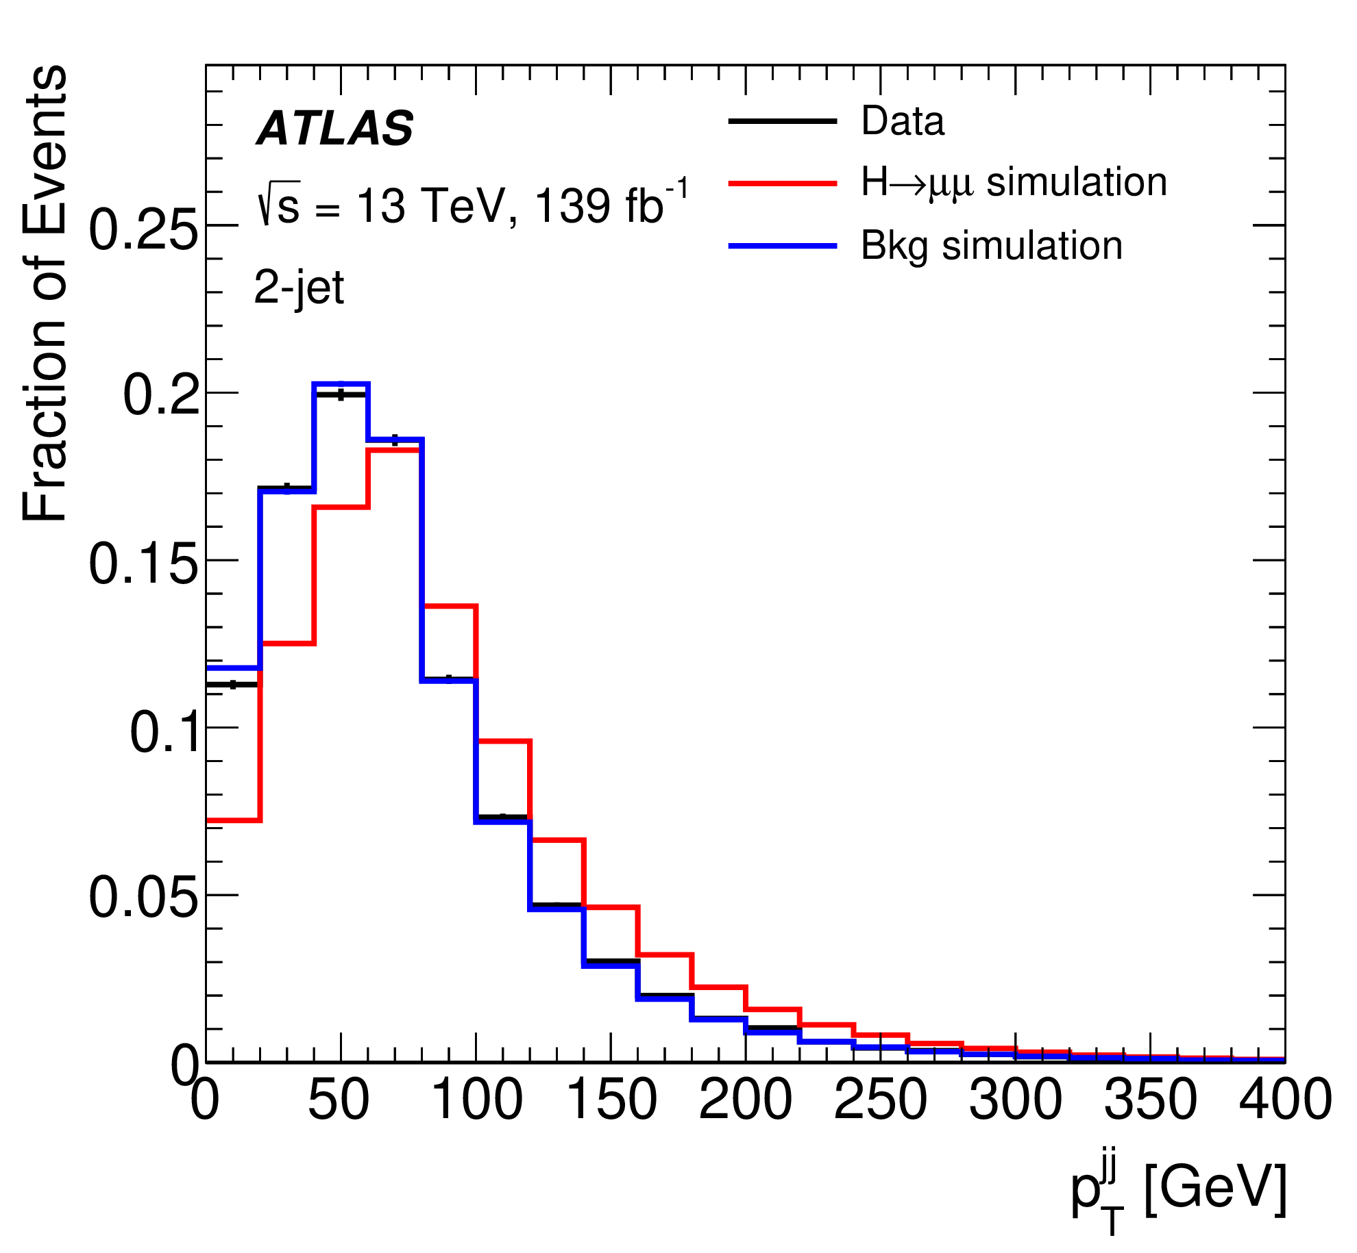
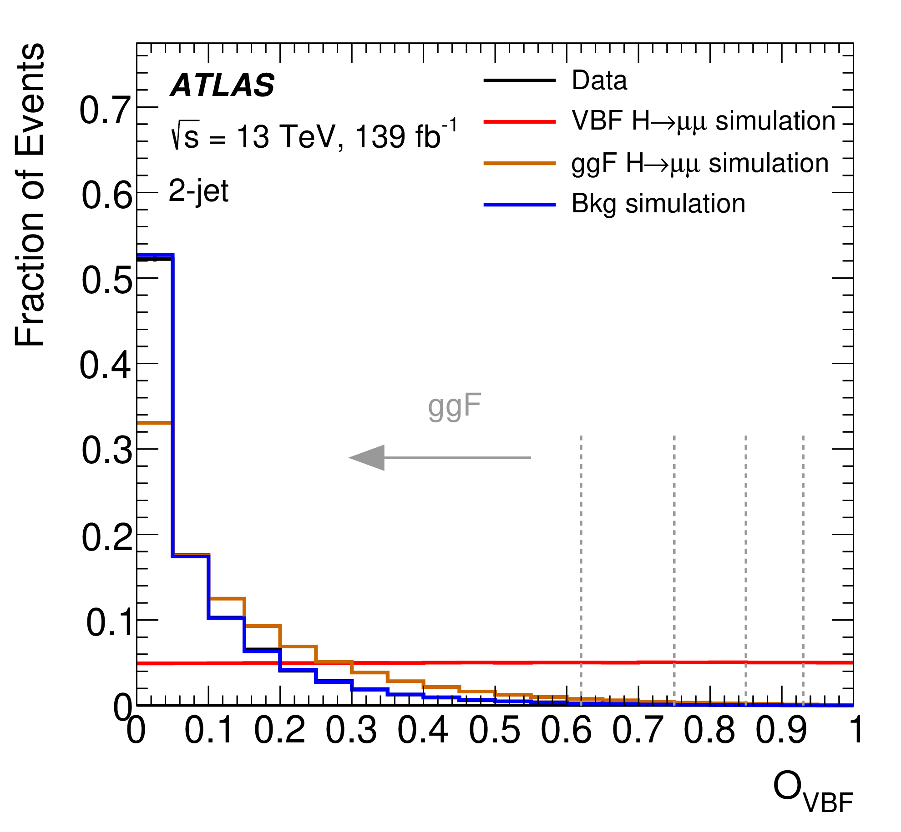
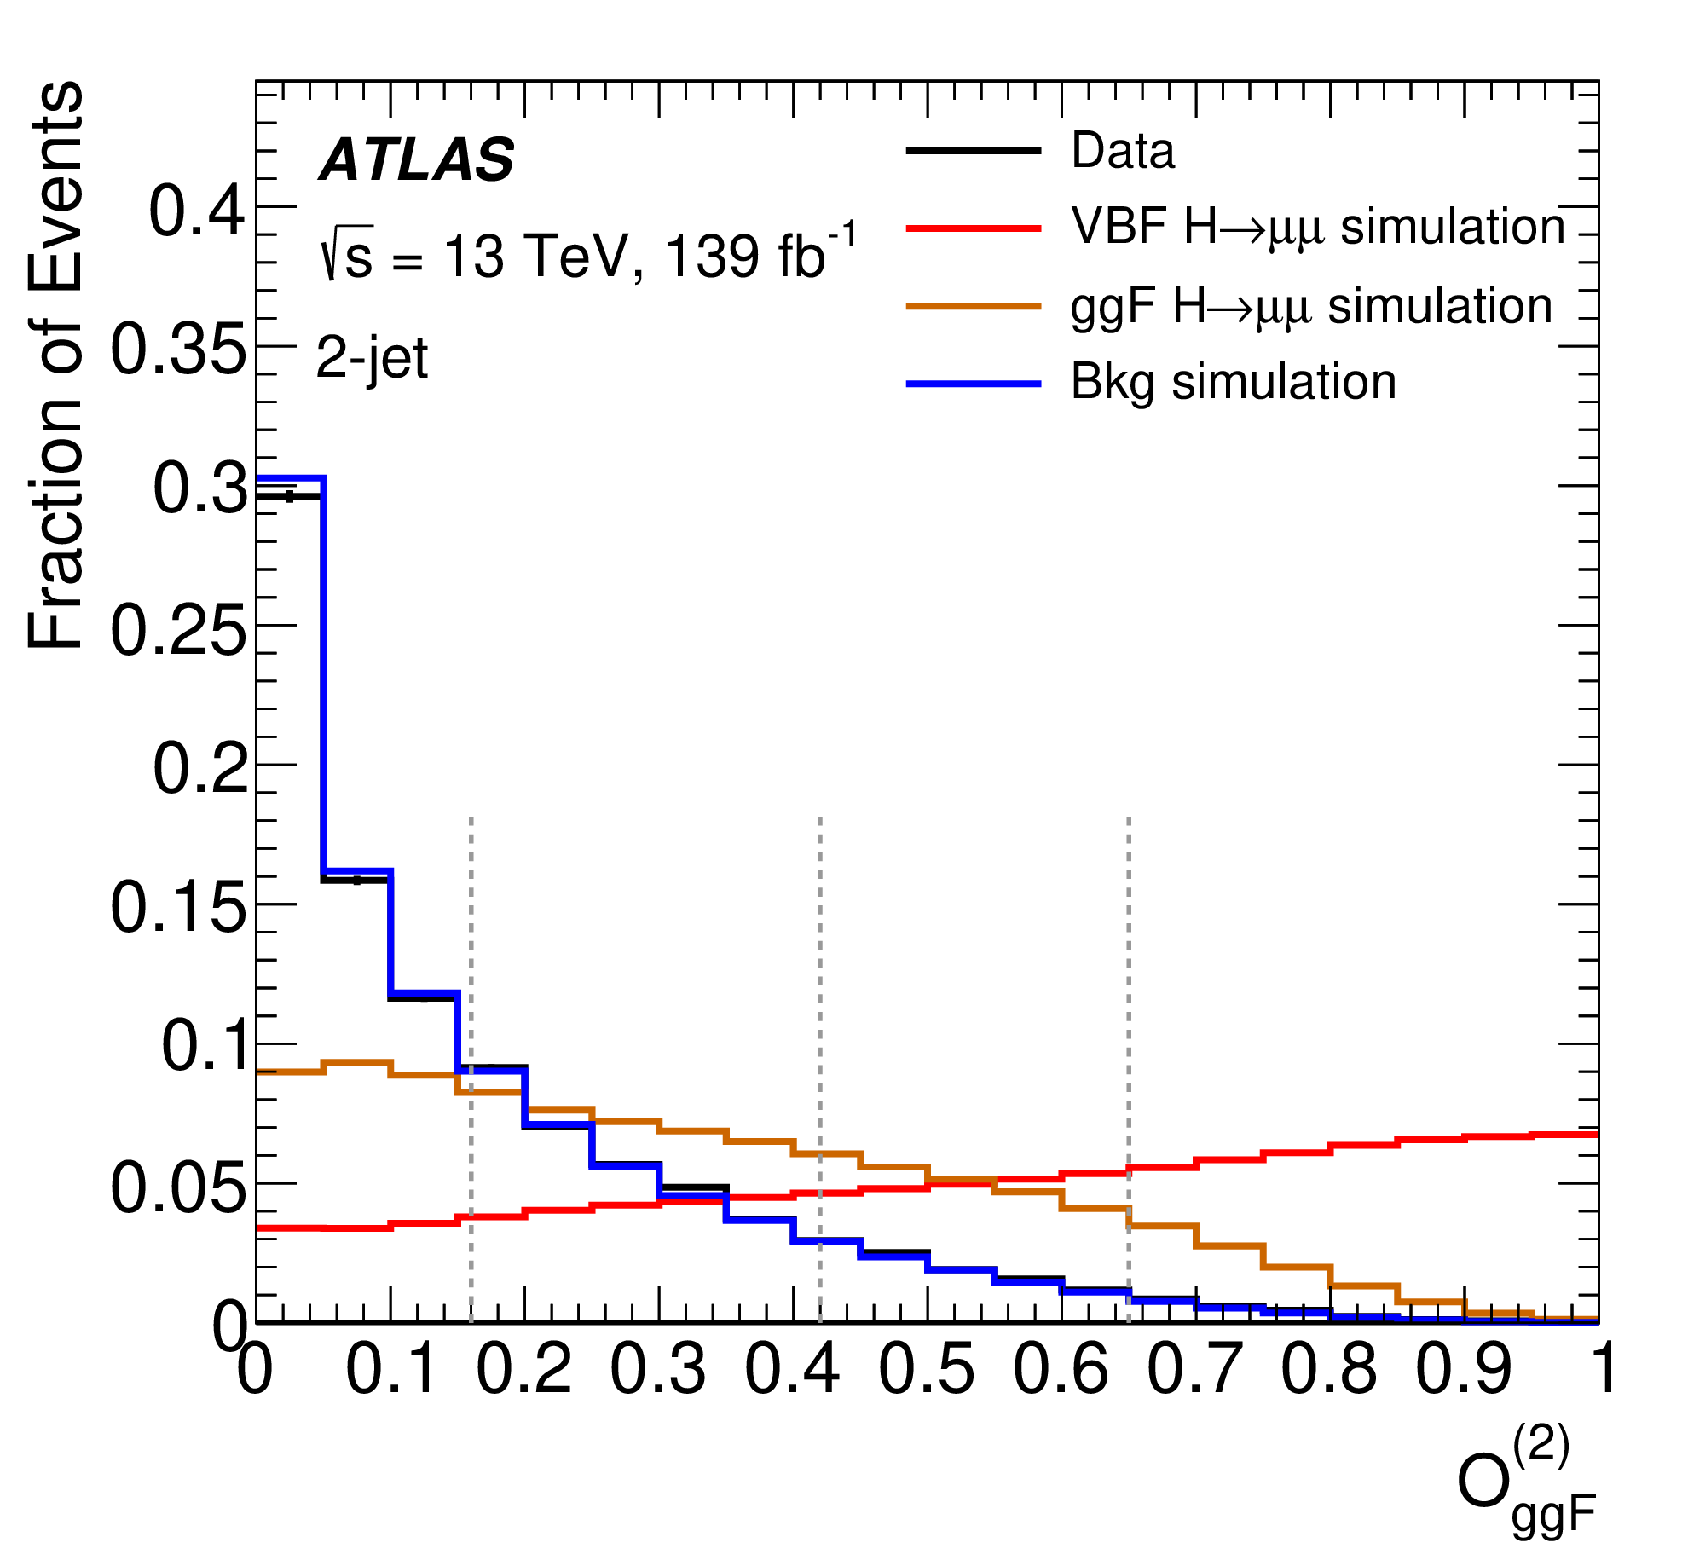
VBF/ggF Categorization (2)
$$p_{T}^{jj}$$
cosθ*
$$N_{track}^{j}$$
Four groups of categories: VBF, ggF-2jet, ggF-1jet and ggF-0jet
In each group, four categories defined based on the signal purity
VBF BDT
ggF 2-jet

Slide 33
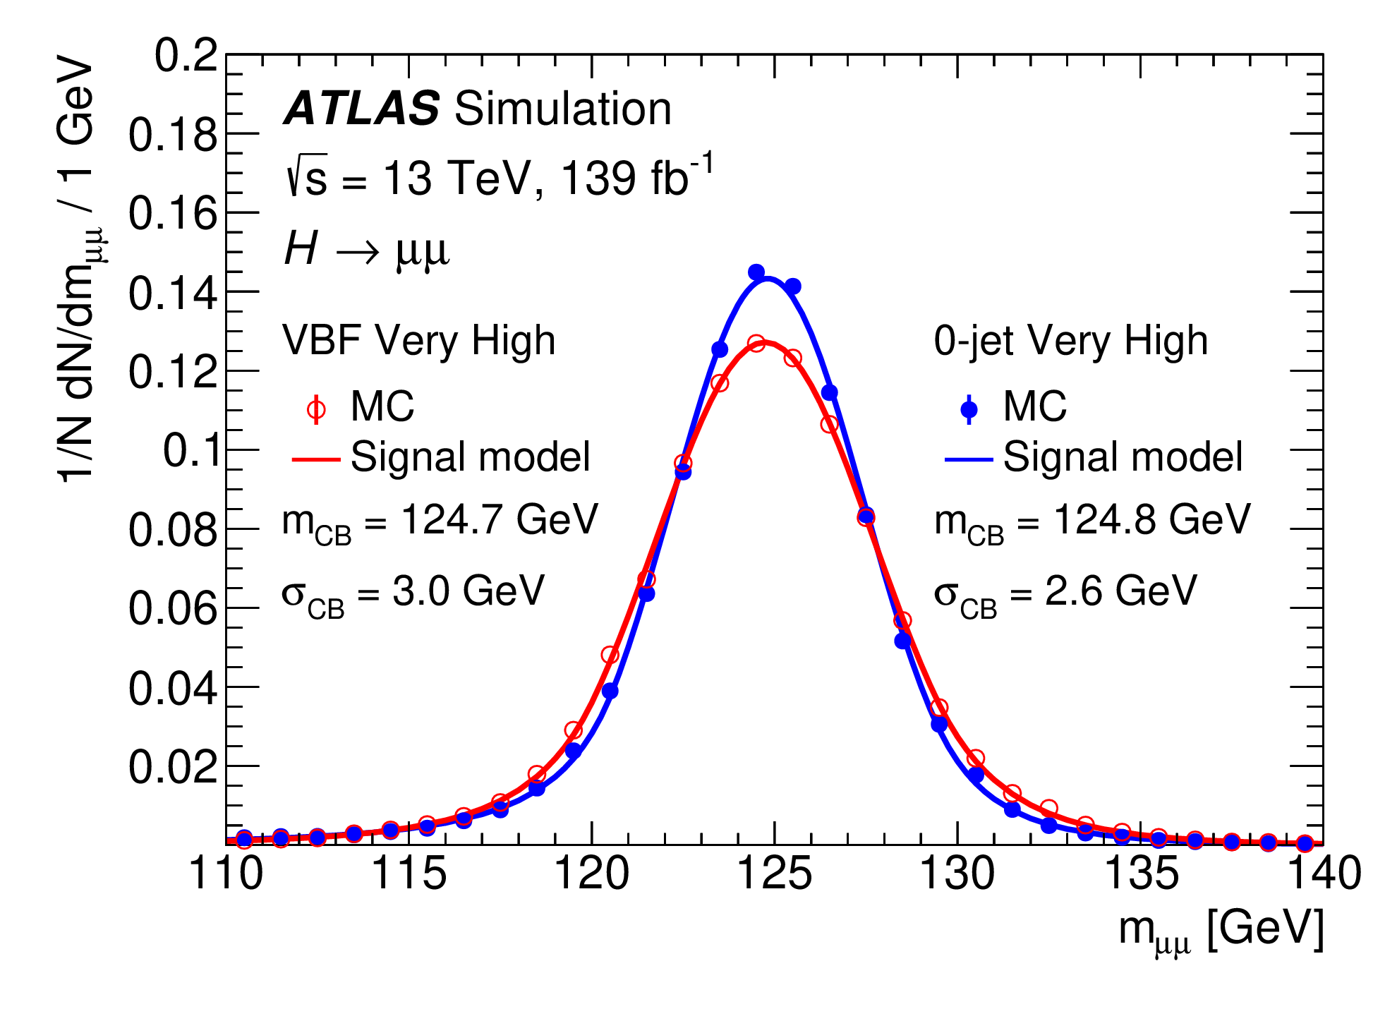
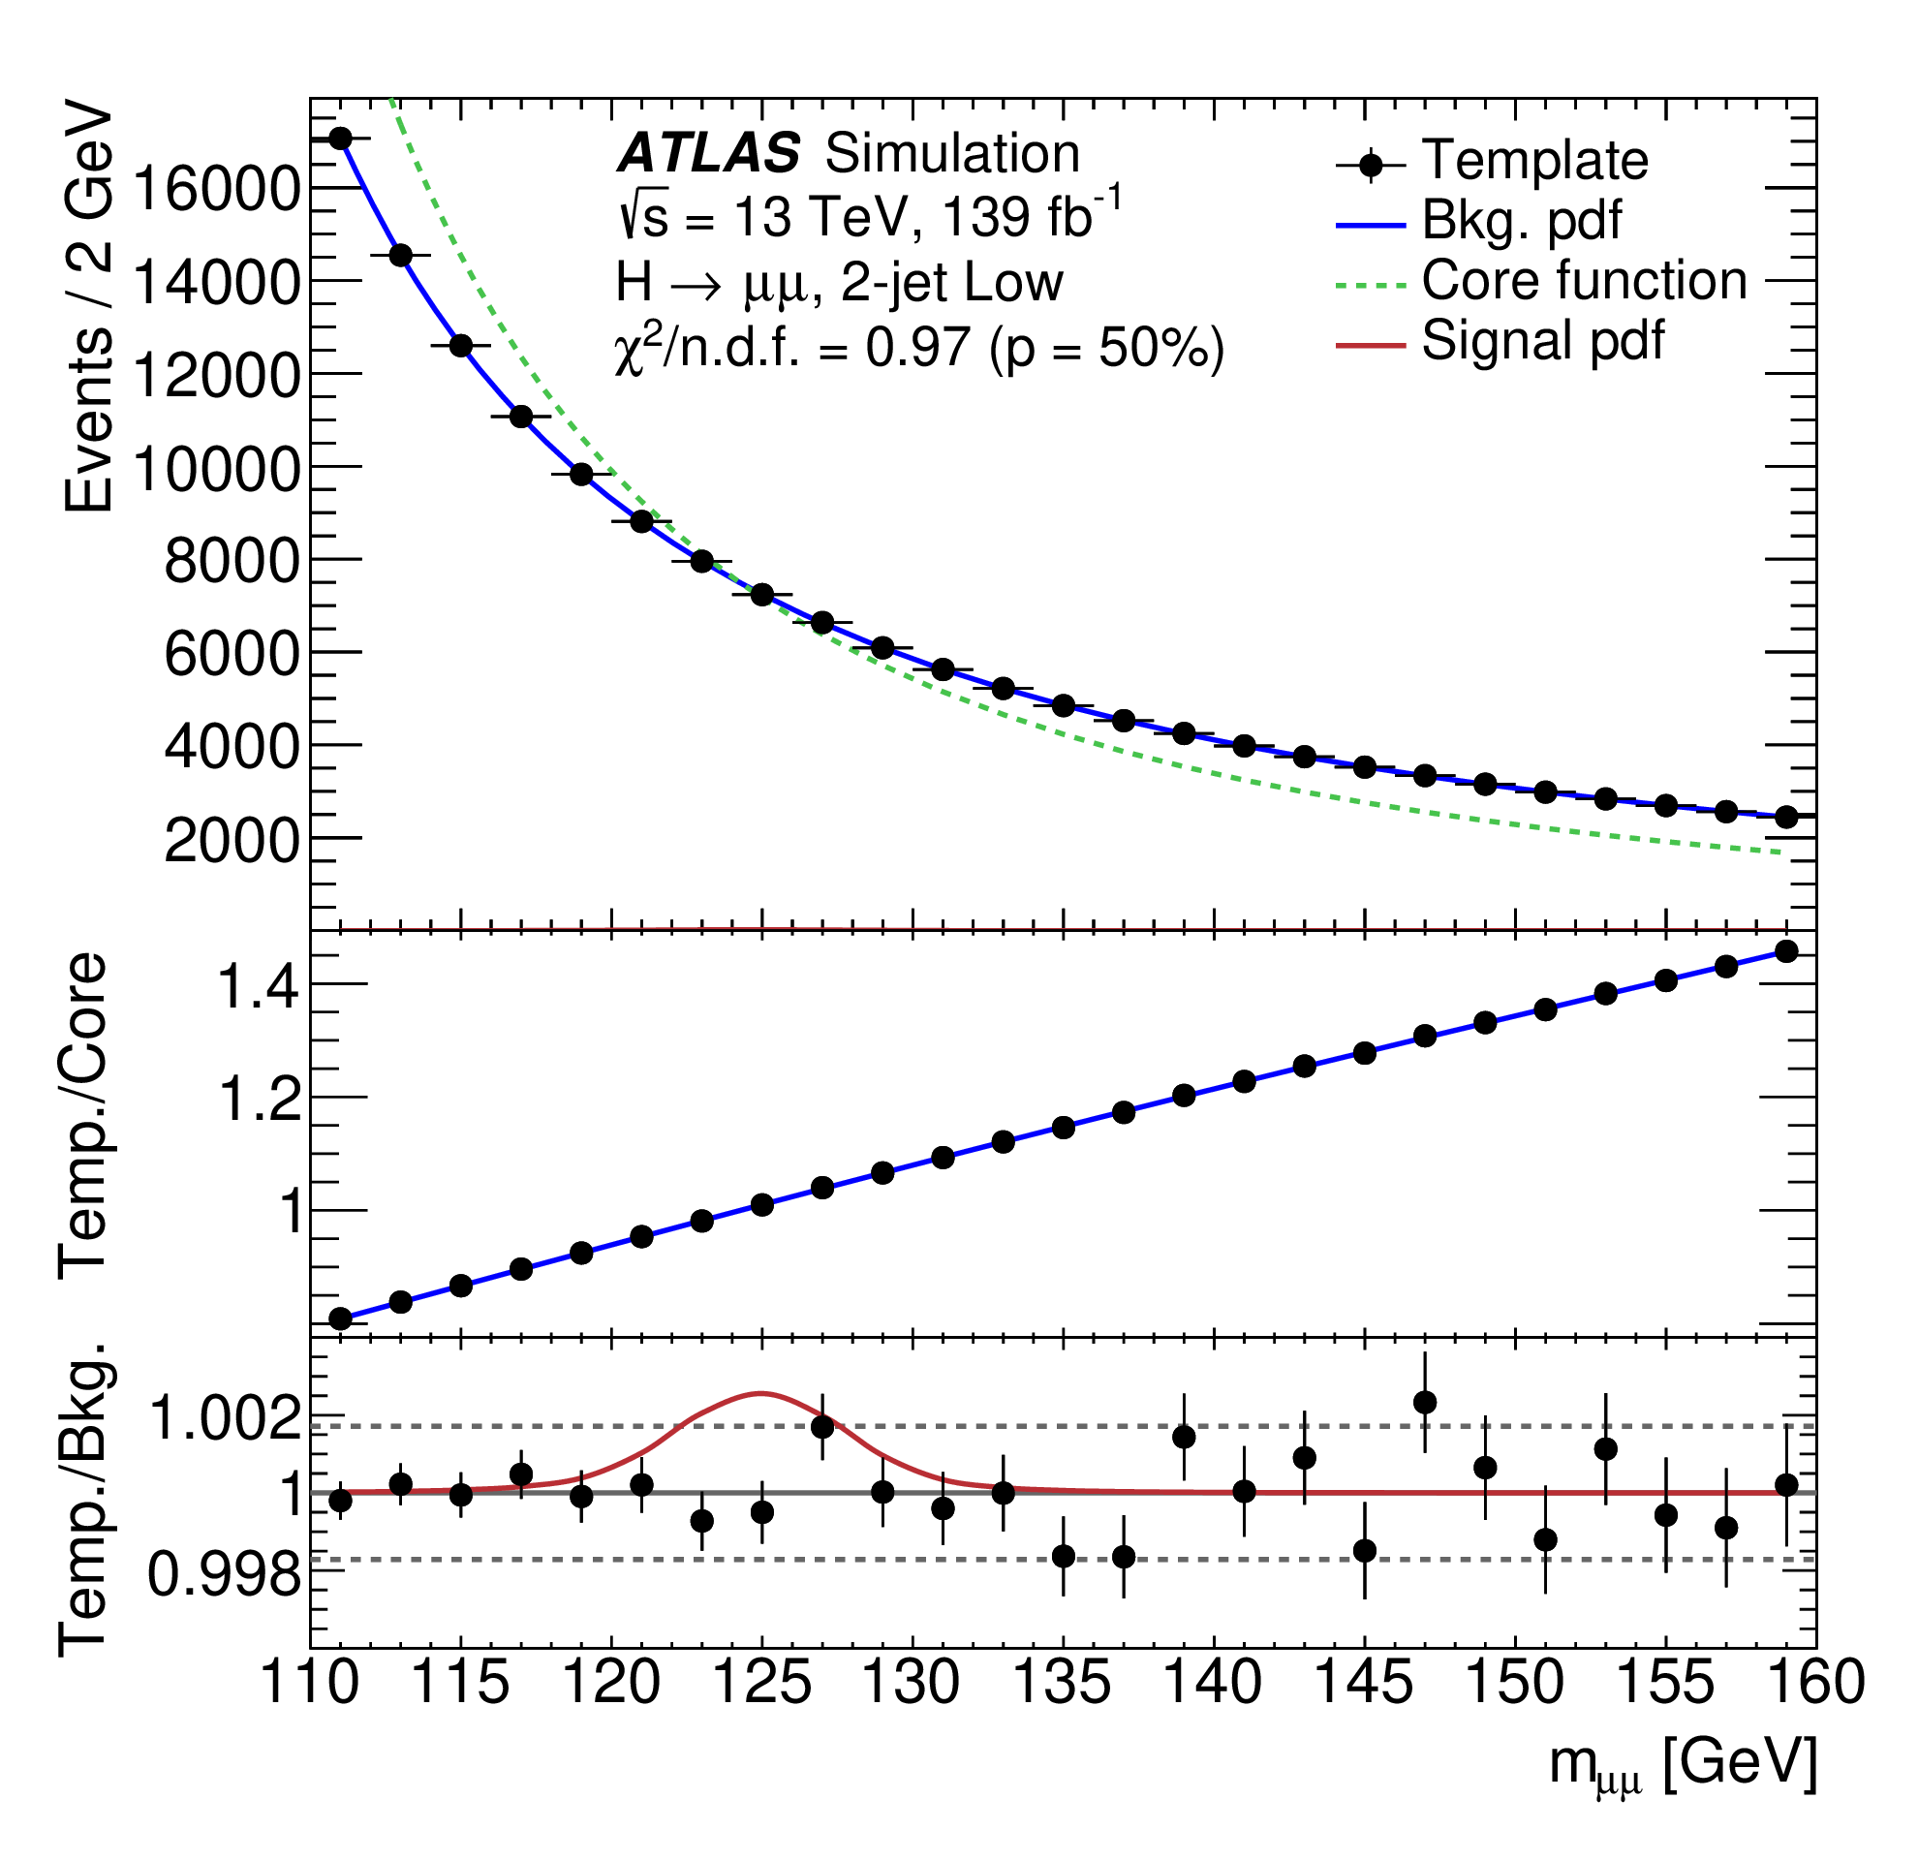
Signal and Background Modeling
Signal: double-sided Crystal Ball containing a Gaussian core and power-law tails (CB width ranging from 2.6-3.2 GeV)
Background: a “core function” multiplied by an “empirical function”
Core function: a LO DY line-shape convoluted with a Gaus. function
Empirical function: used to correct for distortions of the mass shape and smaller bkg.
Potential bkg. mis-modeling considered as sys. unc. (“spurious signal”)

Slide 34
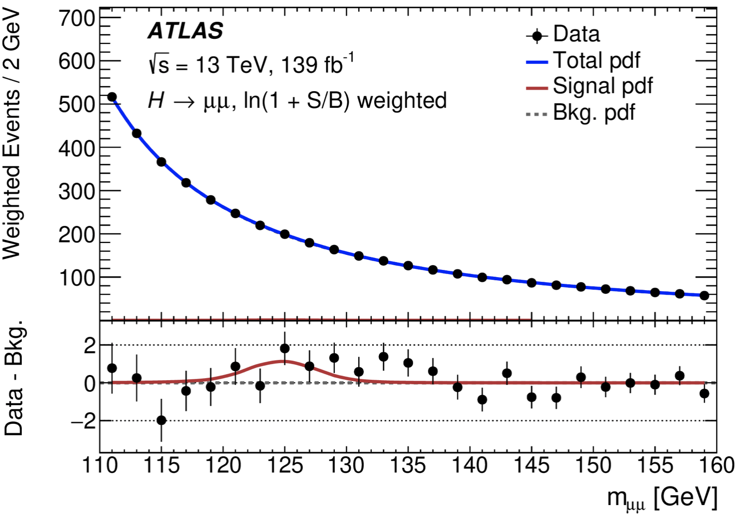
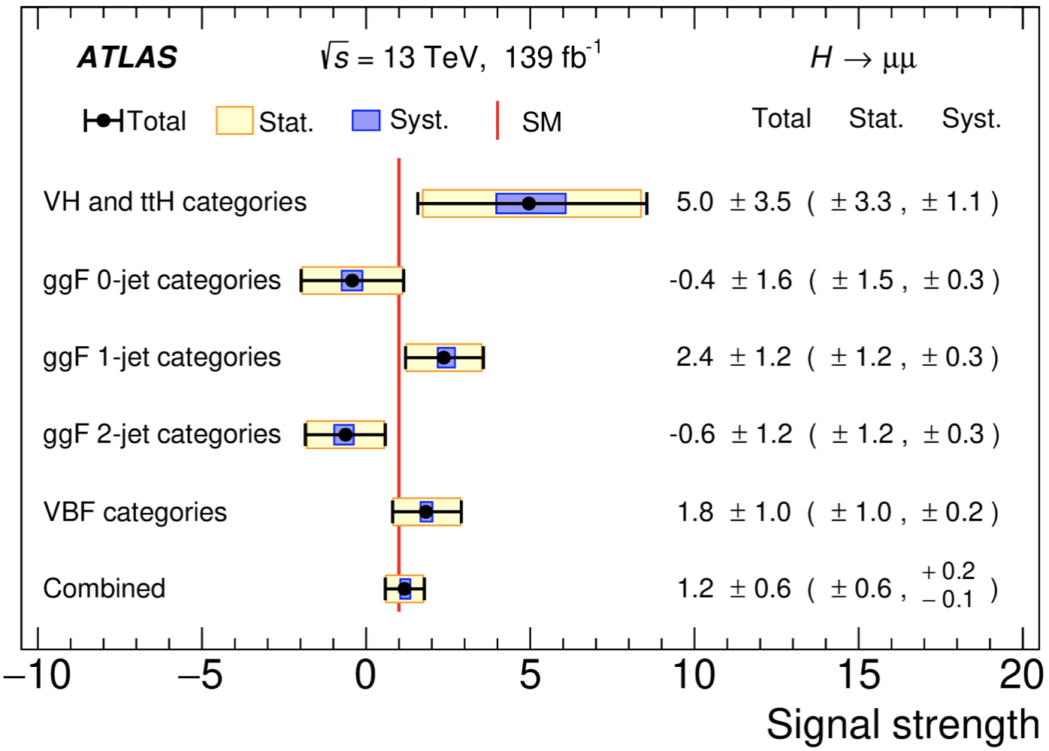
H→μμ Results
A simultaneous maximum-likelihood fit performed to the observed m_{μμ} spectra of in 20 categories
The measured signal strength is:
Results are statistical uncertainty dominated
The observed (expected) significance is 2.0 (1.7) σ
Combined μ = 1.17
$$±0.58(Stat.)$$
$$\begin{matrix}+0.18 \\ −0.13\end{matrix}(sys.)$$
Phys. Lett. B 812 (2021) 135980
Phys. Rev. Lett. 119 (2017) 051802

Slide 35
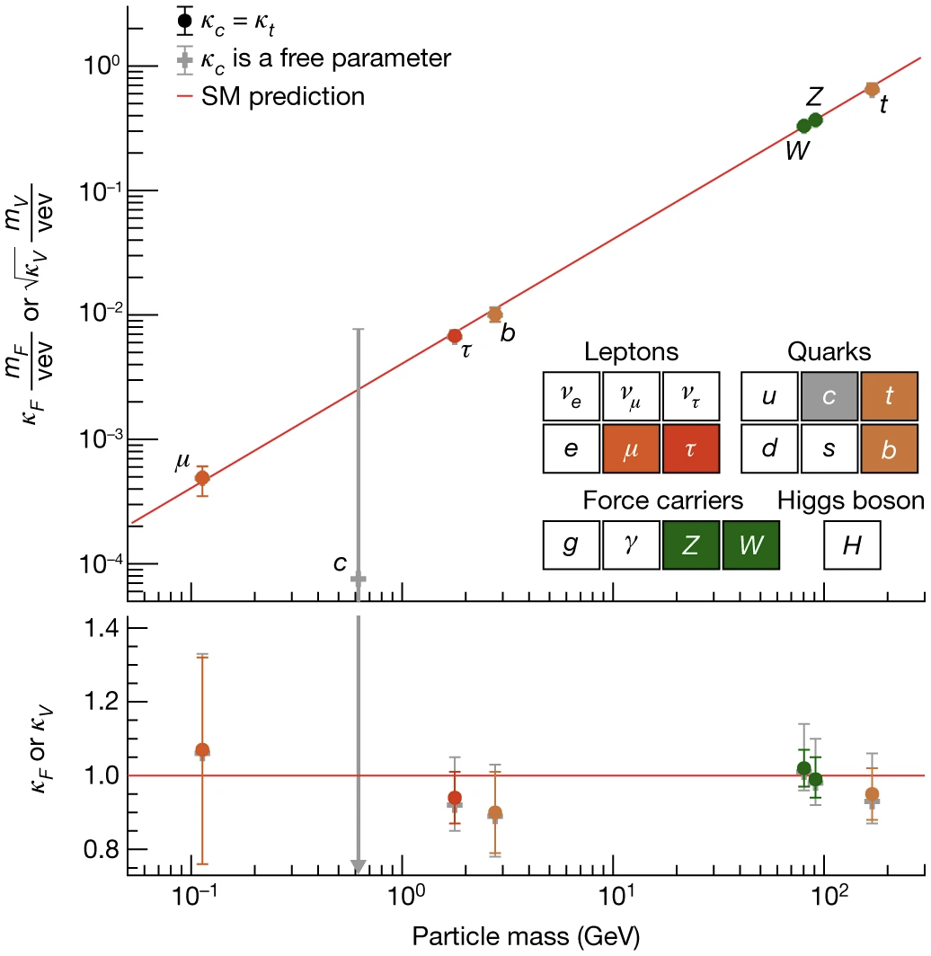
Bonus
In the Higgs combination results, H→𝛾𝛾 and H→μμ provide sensitive constraint on t-H and μ-H couplings.
Nature 607, 52–59 (2022)

Slide 36
Search for HH→bb𝜏𝜏

Slide 37
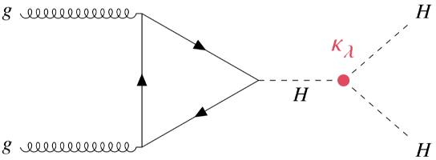
HH Production
SM non-resonant HH: $σ_{HH}^{ggF}$= 31.05 fb, $σ_{HH}^{VBF}$= 1.72 fb
Direct access to Higgs self-coupling (κ_{λ}) and potential
Various BSM theories predict heavy resonances decaying into HH
Narrow width approximation
2HDM as benchmark model

Slide 38
bb𝜏𝜏 Final State
HH Branching Ratios
Di-𝜏 Branching Ratios
bb𝜏𝜏: 7.4%, 3rd largest BR, relatively clean signature compared to other channels with higher BR
Performed in two channels depending on 𝜏 decay: 𝜏_{had}𝜏_{had} (42%) and 𝜏_{lep}𝜏_{had} (45.6%)

Slide 39
Event Selection
Signal signature: two b-jets (DNN-based tagger, 77%) and 𝜏_{had}𝜏_{had}/𝜏_{lep}𝜏_{had} with opposite charge
Trigger-dependent thresholds on e/μ/τ_{had} and jets
e/μ veto for 𝜏_{had}𝜏_{had}; exactly 1 e/μ for 𝜏_{lep}𝜏_{had}
$m_{ττ}^{MMC}$ > 60 GeV for all channels; m_{bb} < 150 GeV for 𝜏_{lep}𝜏_{had}
Signal region | Tau/Lepton | Trigger
𝜏_{had}𝜏_{had} | 2 hadronic 𝜏 | Single or Di-tau Trigger (STT/DTT)
𝜏_{lep}𝜏_{had} SLT | 1 hadronic 𝜏 + 1 e/μ | Single lepton trigger (SLT)
𝜏_{lep}𝜏_{had} LTT | 1 hadronic 𝜏 + 1 e/μ | Lepton+tau trigger (LTT)

Slide 40
Background Estimation
ttbar with true 𝜏_{had}: shape from simulation, normalization determined in the fit
Z + heavy-flavor: shape from simulation, normalization from a dedicated Z(→ll)+heavy-flavor control region in the fit
Single Higgs and other processes: estimated from simulation
Jets → fake 𝜏_{had} background: estimated with data-driven approach (shown in next two slides)

Slide 41
Fake Factor Method
Combined FFs derived for ttbar and multi-jet in 𝜏_{lep}𝜏_{had}
ID: pass loose tau ID
Anti-ID: fail loose but with RNN > 0.01
FF method used for multi-jet in 𝜏_{had}𝜏_{had}

Slide 42
Scale Factor Method in 𝜏_{had}𝜏_{had}
Fake 𝜏_{had} from ttbar in 𝜏_{had}𝜏_{had} channel estimated using simulation
SFs used to correct 𝜏_{had} misidentification eff.: determined by fitting $m_{T}^{W}$ distribution of MC to data in ttbar CR of 𝜏_{lep}𝜏_{had} SLT category
1 prong: close to 1 below 40 GeV, ~0.6 above 70 GeV
3 prong: ~20% larger than the 1 prong SFs

Slide 43
Uncertainties
Breakdown of the relative contributions to the unc. in the extracted signal XS
Data statistic unc. dominated for now
Leading sys. sources:
MC statistical unc.
Theory unc. on top and single Higgs processes

Slide 44
Resonant Signal Extraction
Eur. Phys. J. C (2016) 76:235
500 GeV PNN
Parametrized neural networks (PNN) used as discriminant
Parametrized in mass of scalar (θ = m_{X})
Training variables same as non-resonant case
It provides near-optimal sensitivity and continuity over the entire range
1 TeV PNN

Slide 45
Resonant HH→bb𝜏𝜏 Results
arXiv:2209.10910
Observed (expected) upper limits: 920-23 fb (840-12 fb) depending on the mass region
Local (global) significance for 1 TeV is 3.0σ (2.0σ)

Slide 46
Non-resonant Signal Extraction
MVA trained to separate SM signal and total background
𝜏_{had}𝜏_{had}: BDT; 𝜏_{lep}𝜏_{had}: neural network
Input variables: m_{HH}, m_{bb}, $m_{ττ}^{MMC}$, ΔR(b,b), ΔR(𝜏,𝜏), $E_{T}^{miss}$, Δϕ(l𝜏,bb), etc
Output scores used as final discriminant
𝜏_{had}𝜏_{had}
𝜏_{lep}𝜏_{had} SLT
𝜏_{lep}𝜏_{had} LTT

Slide 47
Non-resonant HH→bb𝜏𝜏 Results
arXiv:2209.10910
ATLAS-CONF-2021-052
Observed (expected) limit at 95% CL: 4.7 (3.9) × σ_{SM}
4x improvement over 36.1 fb⁻¹ result (12.7 × σ_{SM})
Observed (expected) constraint on κ_{λ}: -2.4 ≤ κ_{λ} ≤ 9.2 (-2.0 ≤ κ_{λ} ≤ 9.0)

Slide 48
HH(+H) Combination

Slide 49
HH Combination
Performed statistical combination for different HH analyses to maximize sensitivity to HH production
Including three major channels: bb𝜏𝜏, bb𝛾𝛾 and bbbb
Systematics correlated where appropriate (like luminosity, flavor tagging, signal theory uncertainties, etc)

Slide 50
Resonant HH Combination Result
bb𝛾𝛾 dominates
ATLAS-CONF-2021-052
bb𝜏𝜏 dominates
bbbb dominates
No statistically significant excess found, largest excess at 1.1 TeV: local (global) significance is 3.2σ (2.1σ)

Slide 51
κ_{λ} Constraint from Single Higgs
κ_{λ} also can be probed through NLO EW correction of single Higgs processes (e.g. in the production, decay, Higgs self-energy)
Combination of HH and single Higgs is expected to provide the most sensitive results of κ_{λ}

Slide 52
Results from HH+H Combination
Obs. (exp.) limits: 2.4 (2.9) × σ_{SM}
Obs. (exp.) κ_{λ} constraint: -0.4 ≤ κ_{λ} ≤ 6.3 (-1.9 ≤ κ_{λ} ≤ 7.6)
The best constraints on HH signal strength and κ_{λ} to date
arXiv:2211.01216

Slide 53
Summary
Presented the Yukawa couplings and self-coupling studies based on the Run 2 dataset
The measurements are in line with the SM prediction, and the most stringent results achieved at ATLAS
The LHC Run 3 is expected provide more room for exploring the Yukawa couplings and Higgs self-coupling
Possible evidence for H→μμ at ATLAS, observation combining ATLAS and CMS analyses

Slide 54
Backup

Slide 56
Signal and Background Modeling
Total background includes resonant background (non-ttH Higgs) and continuum processes
Signal and resonant background modeled by the double-sided crystal ball functions
Continuum background modeled by one-parameter functions
Exponential function:
Power Law function:
Choice based on tt𝛾𝛾 sample by applying stringent criteria on potential biases in the extracted signal yields

Slide 57
Event Categorization
Categorization is done in Had and Lep regions separately
The boundaries are chosen to achieve a strong separation between CP-even and CP-odd signals, as well as a good sensitivity to ttH process

Slide 58
CP even
CP odd

Slide 60
JHEP 04 (2014) 004

Slide 61
H→μμ: FSR Recovery

Slide 62
ttH Categorization
Target semi/dileptonic decays of the top pair
Requiring ≥1 extra e/μ and ≥1 b-tagged jet
Two highest-p_{T} muons with opposite charge as the Higgs candidate
BDT trained to distinguish ttH signal from all backgrounds (ttbar, ttZ, diboson, etc)
Training variables: p_{T} of e/μ, invariant masses of leptons/tops, as well as jet and b-jet multiplicities, and H_{T}
1 ttH Cate.
After cut

Slide 63
Categorization Performance (1)
Calculated in the 120-130GeV region
Major sensitive ones are VBF, ggF 2-jet and 1-jet categories

Slide 64
Categorization Performance (2)
Signal decomposition by production mode in each category
The categories show high purity in their targeted production modes

Slide 65
H→μμ: Background Model
A “core function” multiplied by an “empirical function” is used to model the background shape
Core function is a LO DY line-shape convoluted with a Gaussian function mimicking detector mass resolution effects
Empirical function is used to correct for distortions of the mass shape and smaller background
Power law function:
Epoly function:
Spurious signal (SS) uncertainty: derived by using S+B PDF to fit the pure background templates
Fast-simulation DY used for ggF/VBF categories, while full-sim non-DY bkg. samples used for VH/ttH categories

Slide 66
Background Model Selection Criteria
P(𝝌2) > 1% for background only fits with
Data sideband
Full simulation
Fast simulation (before and after
reweighing to the data sidebands)
SS within 20% of the signal statistical unc. normalized to data statistics
Smallest degree of freedom
Smallest SS value
In the order of priority decreasing

Slide 67
Background Function in Each Category
All functions pass the pre-defined selection criteria with SS values under control
Chosen functions are typically with less degree of freedom comparing with EPS due to improved procedure

Slide 69
Selection Criteria

Slide 70
Signal Acceptance × Efficiency
The acceptance times efficiency for the non-resonant ggF+VBF evaluated w.r.t. targeted 𝜏 decay modes
𝜏_{had}𝜏_{had}: 4.0%, 𝜏_{lep}𝜏_{had} SLT: 4.0%, 𝜏_{lep}𝜏_{had} LTT: 1.0%
Around factor 2 improvement on signal acceptance compared with previous publication*
Driven by improved reconstruction and identification of 𝜏_{had} and b-jets**
*Phys. Rev. Lett. 121, 191801
**ATL-PHYS-PUB-2017-003, ATL-PHYS-PUB-2017-013, ATL-PHYS-PUB-2019-033

Slide 71
HL-LHC Projection
ATL-PHYS-PUB-2022-005

Slide 72
κ_{λ}-dependence of XS and BR
Cross section
Decay BR

Slide 73
ggF HH cross section depends on κ_{λ} and κ_{t}
Any (κ_{λ} , κ_{t}) can be obtained via a linear combination of three basis samples at different κ_{λ} values with κ_{t} = 1

Slide 74
VBF HH XS depends on κ_{2V}, κ_{λ} and κ_{V}
A linear combination of 6 samples with different (κ_{2V}, κ_{λ}, κ_{V}) values
Rank 1 basis used

Slide 75
Flavor Tagging Improvement
Likelihood-based calibration
provides >2x reduction in uncertainties
Move to a higher b-tagging efficiency WP (70% → 77%)

Slide 76
𝜏 Identification Improvement
RNN ID shows 2x improvement compared with BDT
Moved from “medium” to “loose” WP
Per-tau efficiency:
1-prong: 75% → 85%
3-prong: 60% → 75%

Slide 78
Nima Arkani-Hamed’s talk

