Slide 1
Bin Yan
Institute of High Energy Physics
华中师范大学
April 24, 2023
Application of the jet charge in electroweak and Higgs physics
In cooperation with Hai Tao Li, Xiaorui Wong and C.-P. Yuan, PLB833(2022)137300, 2301.07914, 2302.02084
Notes:
1

Slide 2
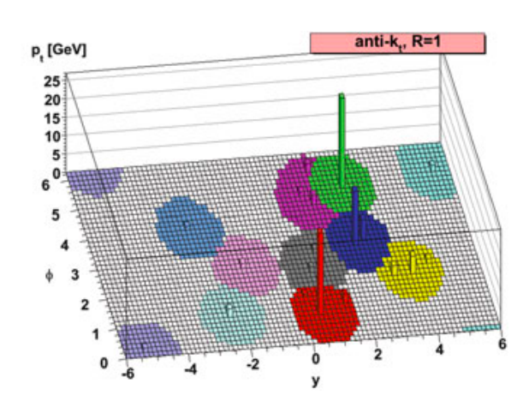
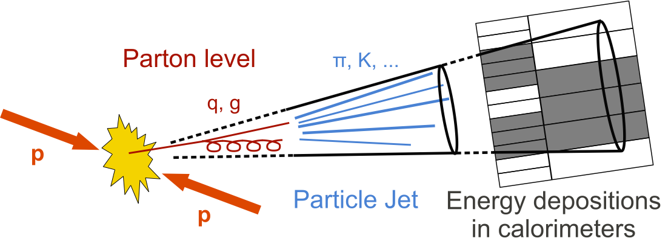
Jet charge definition
Transverse-momentum-weighting scheme:
K: To regulate the sensitivity of the soft gluon radiation
R.D. Field and R.P. Feynman, NPB136,1(1978)

Slide 3
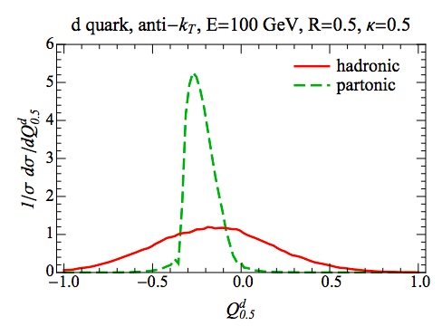
Jet charge definition
Jet charge is not an Infrared-safe quantity
The collinear radiation
W.J.Waalewijn, PRD86(2012)094030
The jet charge can be defined only at the hadron level
It depends on the knowledge of the Fragmentation functions

Slide 4
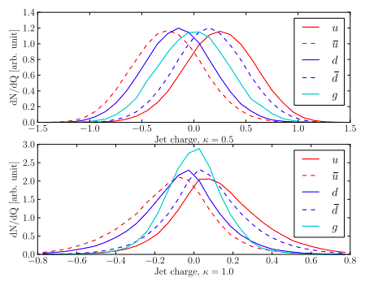
Jet charge definition
D. Krohn, M. D. Schwartz, T. Lin, W.J. Waalewijn, PRL 110(2013)21,212001
Parton shower and hadronization can not wash out the primordial quark charge information

Slide 5
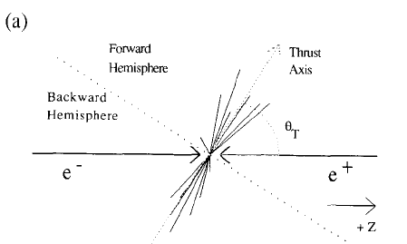
jet charge @ LEP
ALEPH Collaboration, PLB 259,377 (1991)
Jet charge asymmetry & forward-backward asymmetry
Average charges
The electroweak properties of the Z boson

Slide 6
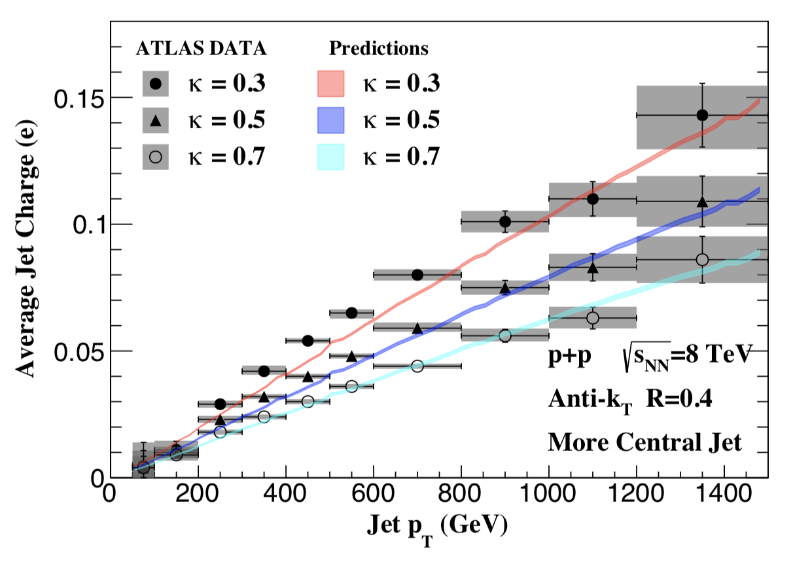
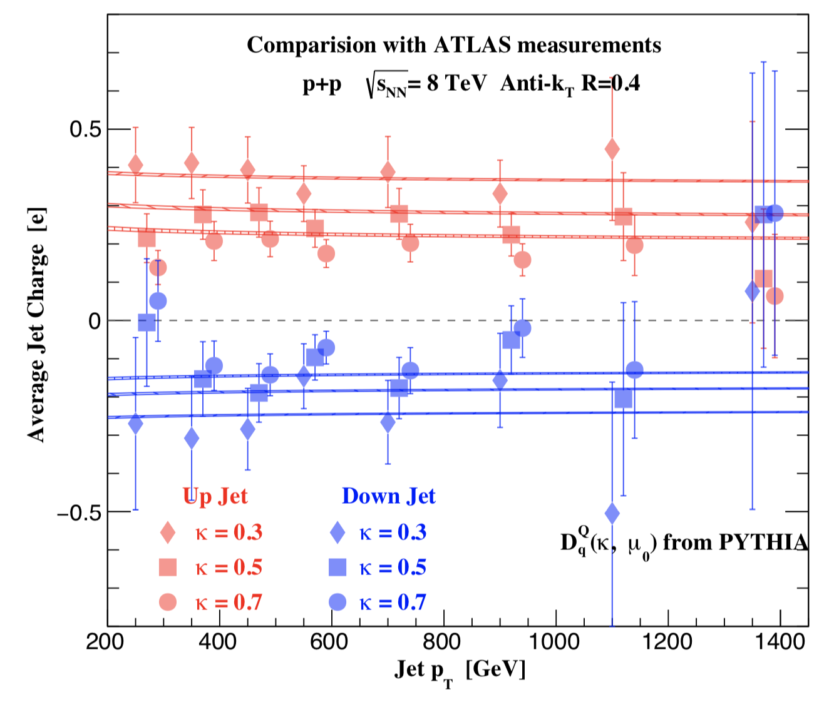
Jet charge @ LHC
D. Krohn, M. D. Schwartz, T. Lin, W.J. Waalewijn, PRL 110(2013)21,212001
W.J.Waalewijn, PRD86(2012)094030
H. T. Li and I. Vitev, PRD 101(2020)076020
Perfect agreement between theory and data

Slide 7
Probing the Zbb coupling with jet charge

Slide 8
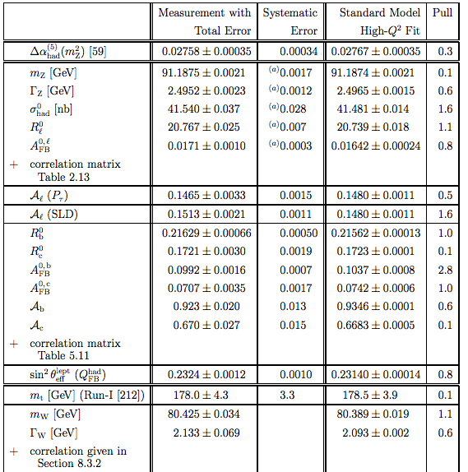
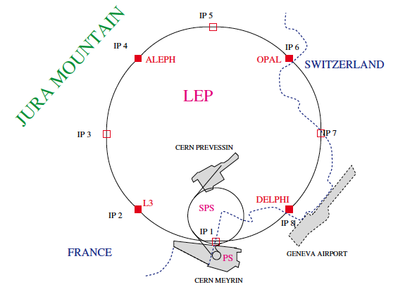
Electroweak Precision measurement
Phys.Rept. 427 (2006) 257-454
LEP：1989-2000

Slide 9
Status of Zbb couplings
PDG 2021
Excluded by off-Z pole data
Large deviation of the Zbb coupling
The degeneracy of the Zbb coupling

Slide 10
Zbb couplings@ colliders
A. Lepton colliders:
S. Gori, Jiayin Gu, Lian-Tao Wang, JHEP 04(2016) 062
Bin Yan and Shu-Run Yuan, work in progress
B. LHC Zh production and Z boson rare decay:
Bin Yan, C.-P. Yuan, PRL127(2021)5,051801
Hongxin Dong, Peng Sun, Bin Yan and C.-P. Yuan, PLB829(2022)137076
C. HERA and EIC with polarized lepton beam:
Bin Yan, Zhite Yu and C.-P. Yuan, PLB822(2021)136697
Hai Tao Li, Bin Yan and C.-P. Yuan, PLB833(2022)137300
Zhuoni Qian and Bin Yan, work in progress

Slide 11

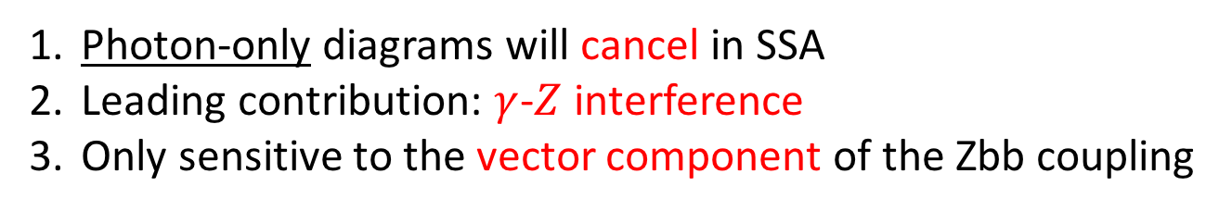
Zbb couplings@EIC
Bin Yan, Zhite Yu and C.-P. Yuan, PLB822(2021)136697
Polarized lepton beam
Single-Spin Asymmetry (SSA):
$+/−$: right/left-handed lepton
Photon-only diagrams will cancel in SSA
Leading contribution: $γ$-$Z$ interference
Only sensitive to the vector component of the Zbb coupling

Slide 12


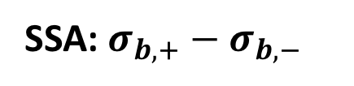

DIS cross section
Polarized cross section
$λ_{e}=±1$: lepton helicity
SSA: $σ_{b,+}−σ_{b,−}$
Two possible combination:
$$F_{1,L}=C_{q}⊗(q+\overline{q})$$
$$F_{3}=C_{q}⊗(q−\overline{q})$$

Slide 13
Zbb couplings @EIC
Polarized lepton beam
Single-Spin Asymmetry:
vector component of the Zbb coupling
Is it possible to probe the axial-vector component at the EIC?
Average jet charge weighted Single-Spin Asymmetry (WSSA):

Slide 14


Jet Charge Weighted SSA
SSA: $σ_{b,+}−σ_{b,−}$
$$F_{1,L}=C_{q}⊗(q+\overline{q})$$
$$F_{3}=C_{q}⊗(q−\overline{q})$$
Key point:
WSSA:

Slide 15



Zbb couplings @EIC
WSSA
SSA

Slide 16
Probing the Higgs properties with jet charge

Slide 17
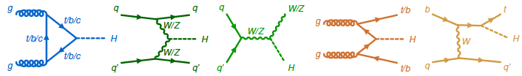

Higgs production and decay @LHC

Slide 18
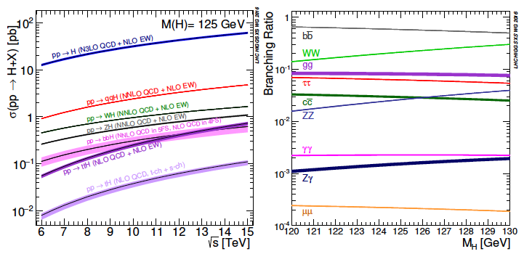
Higgs production and decay @LHC

Slide 19
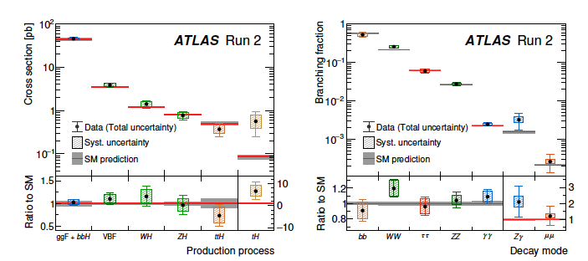
Higgs production and decay @LHC
The data agrees with the SM prediction very well

Slide 20
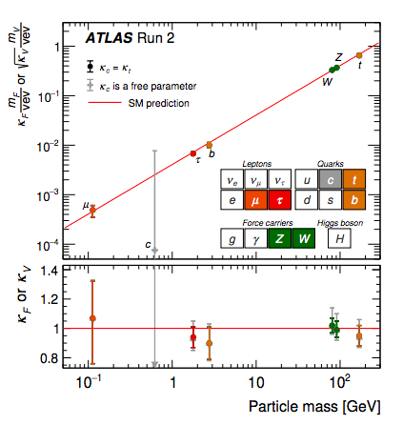
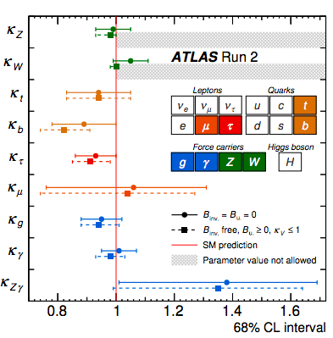
Higgs couplings @LHC
Nature 607 (2022)7917,52-59
The data agrees with the SM prediction very well

Slide 21
GF and VBF Higgs production
Larger Cross section
Higgs couplings at the loop level
Smaller Cross section
Higgs couplings at the tree level
Electroweak symmetry breaking mechanism
VBF Higgs production plays an important role in Higgs physics

Slide 22
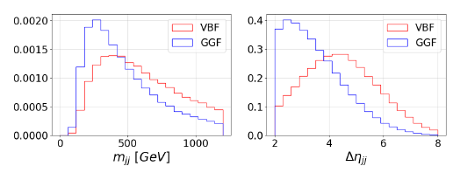
Higgs production mechanisms
Discriminating VBF and gluon fusion Higgs production
The rapidity gap and the invariant mass of the two jets
V.D. Bargeer, K.m.Cheung. T. Han, J. Ohnemus and D. Zeppenfeld, 1991
N. Kauer, T. Plehn, D. L. Rainwater and D. Zeppenfeld, 2001
……

Slide 23
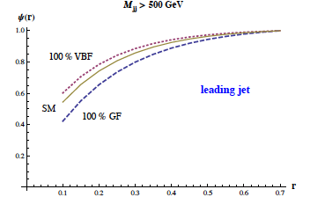
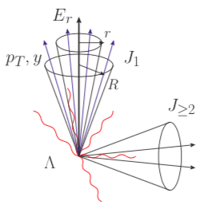
Higgs production mechanisms
Discriminating VBF and gluon fusion Higgs production
Soft gluon radiation effects: Jet energy profile
V. Rentala, N. Vignaroli, H.N. Li, Zhao LI and C.-P. Yuan, 2013

Slide 24
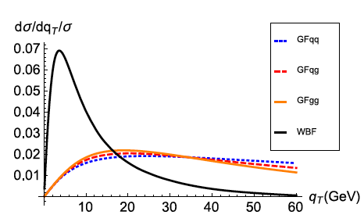
Higgs production mechanisms
Discriminating VBF and gluon fusion Higgs production
Soft gluon radiation effects: TMD effects
P. Sun, C.-P. Yuan and F. Yuan, 2016, 2018

Slide 25
Higgs production mechanisms
Discriminating W-boson fusion, Z-boson fusion and gluon fusion Higgs production
Separating the W boson’s contribution from the VBF Higgs production is an important task for determining the Higgs gauge coupling
The key observable: Jet Charge
W: opposite sign for the two jet charges
Z: same or opposite sign for the two jet charges
G: the sign of the jet charge is arbitrary

Slide 26
Higgs production mechanisms

Slide 27
Jet charge asymmetry
<Q> means the Average value

Slide 28
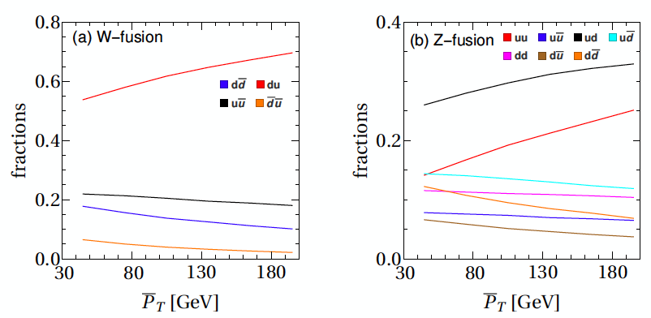
Jet charge asymmetry

Slide 29
Higgs production mechanisms
HL-LHC
The limits from Rh and jet charge asymmetry are not depending on the assumption of the Higgs width

Slide 30
Higgs gluon effective couplings@ CEPC
The jet charges are uncorrelated for the signal, while it exhibits a strong correlation for the backgrounds

Slide 31
Higgs gluon effective couplings @CEPC
The jet charge information should be considered for the BDT or Machine Learning analysis

Slide 32
Summary
A. The jet charge is a useful observable for both the QCD and new
physics searches;
B. We proposed to use jet charge weighted single-spin asymmetry to probe the Zbb anomalous couplings;
C. We demonstrated that the jet charge can be used to discriminate Higgs production mechanisms and probe the Higgs gluon effective couplings.
Thank you!

