Slide 1
Studies on Higgs Boson Yukawa Couplings and Self-coupling at ATLAS Experiment
刘彦麟
山东大学
北京大学核物理前沿与交叉专题，2023.12.11

Slide 2
What’s the fundamental building block of matter? And what’s the origin of mass?

Slide 3
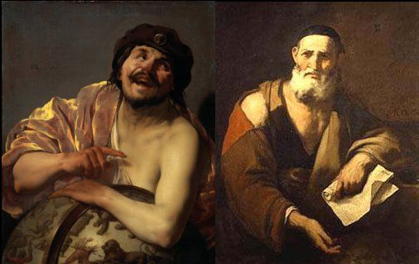
A Long Time Ago…
Our Chinese ancestors: Fire, Water, Wood, Metal and Earth are the Five Elements (referred as “Wuxing”)
Greek philosophers: everything is composed of “uncuttable” elementary particles
After going through a long Dark Ages, then followed by the Renaissance and Scientific Revolution…

Slide 4
Modern Science Came
J. Dalton proposed the atom theory in the 19th century
In 1897 J.J. Thomson discovered electron
E. Rutherford discovered the nucleus in 1911
Later Bohr model was proposed to describe the structure of atom
Proton was discovered in 1917
J. Chadwick discovered neutron in 1932
Nucleus was found to consist of protons and neutrons at the center of atom
Nobel prize in 1906
Nobel prize in 1922
Nobel prize in 1935

Slide 5
Then Particle Accelerators Came
A large variety of particles were discovered through the collisions (referred as “particle zoo”)
To classify these particles, M. Gell-Mann* and G. Zweig proposed the “quark model”
Later quantum chromodynamics (QCD) was developed to describe the strong interactions
S. Glashow, A. Salam and S. Weinberg developed the electroweak theory to unify electromagnetic and weak forces
W and Z bosons discovered in 1983
[*Nobel Prize in 1969]
[Nobel Prize in 2004]
[Nobel Prize in 1979]
[Nobel Prize in 1984]

Slide 6
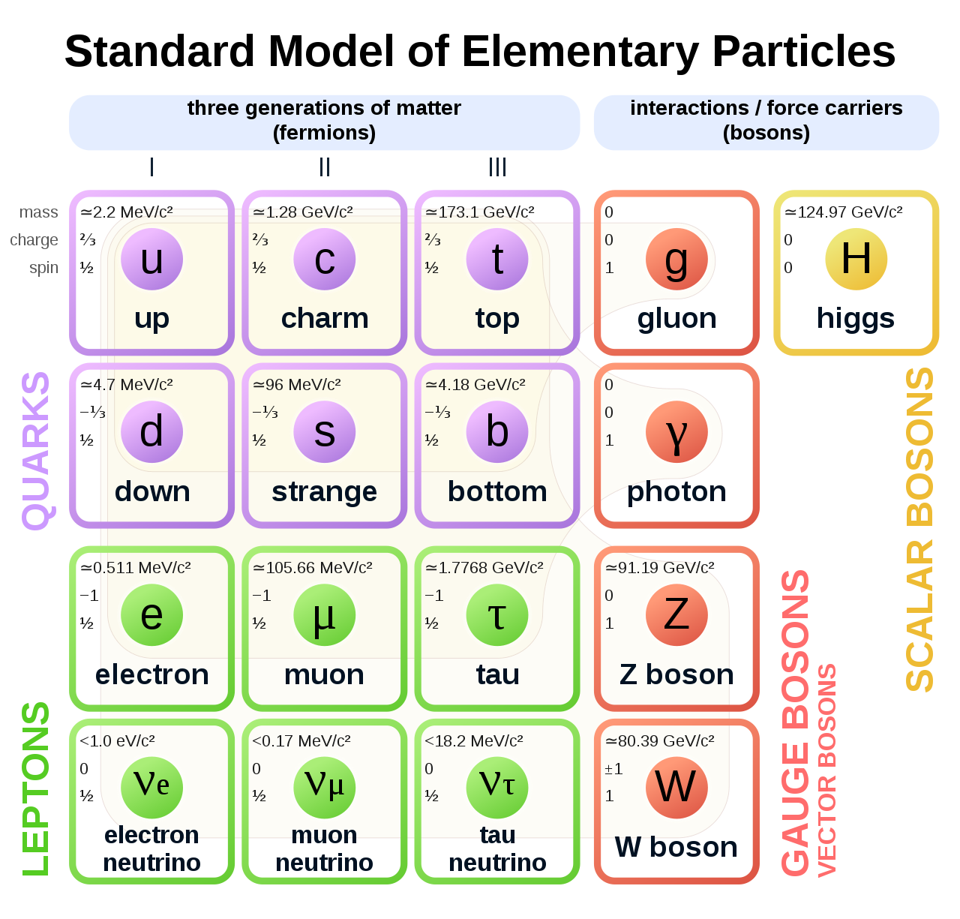
Standard Model
Describe the elementary particles and their interactions
The cornerstones of the SM:
Gauge invariance (based on SU(3)⨉SU(2)⨉U(1)): depicting strong and electroweak interactions
Higgs mechanism: trigger the EWSB; W, Z bosons and fermions acquire masses through EWSB; predicts the Higgs boson
The “God Particle” Higgs boson discovered at the LHC in 2012!

Slide 7
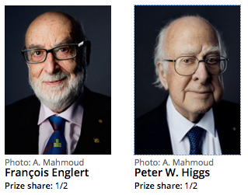
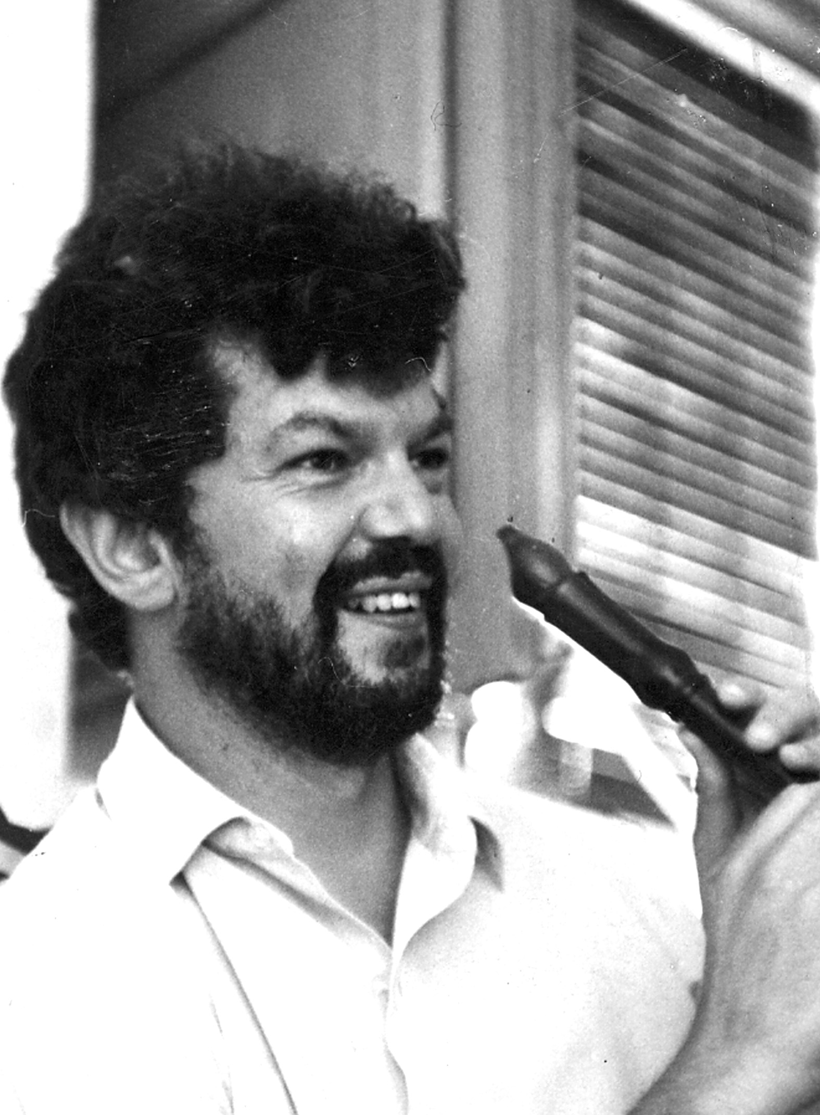
Nobel Prize in Physics in 2013
Brout passed away in 2011

Slide 8
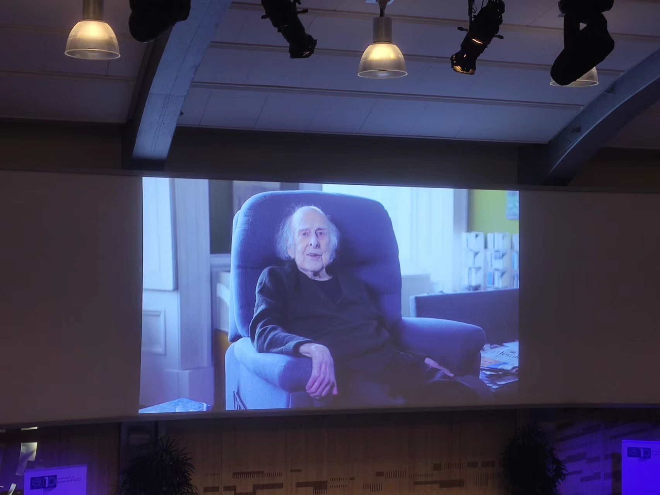
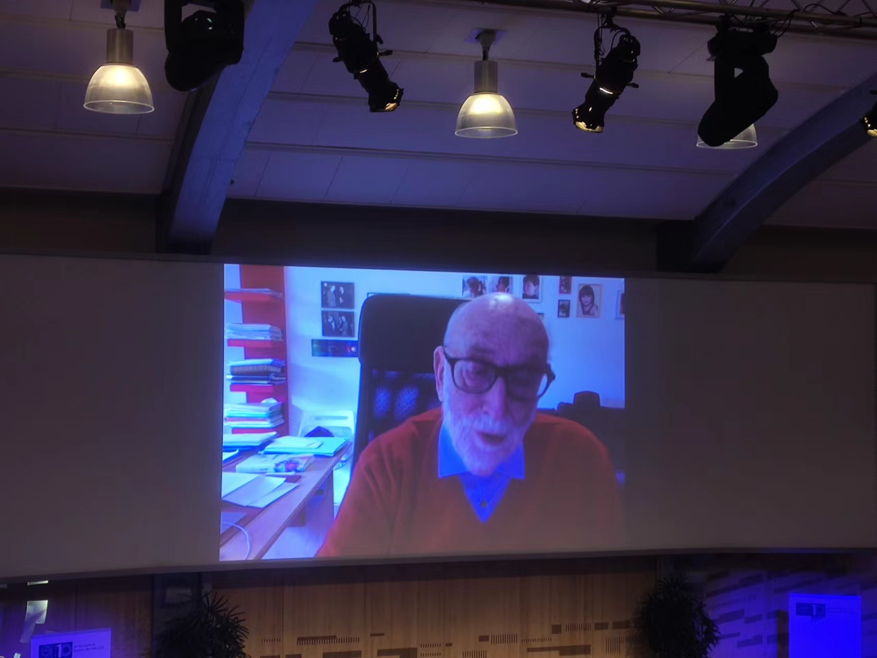
July 4th, 2022: 10th Anniversary of Higgs Discovery

Slide 9
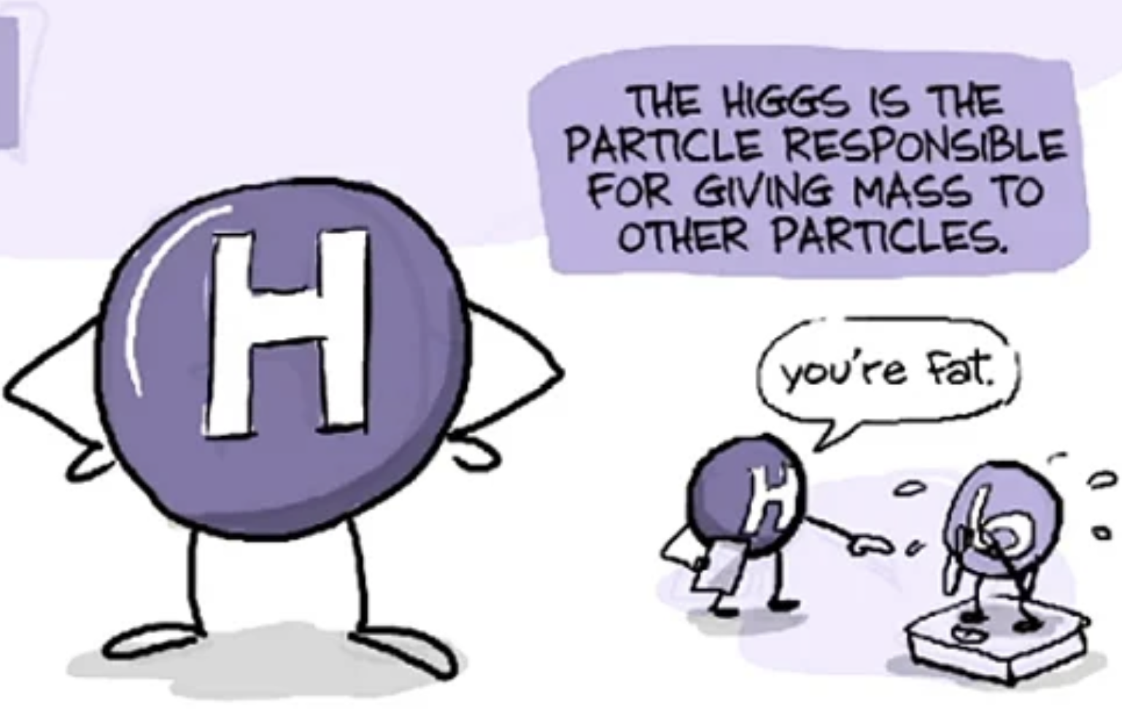
A Big Discovery in Particle Physics
Not just a discovery of another particle
The Higgs discovery to particle physics is like the DNA discovery to biology

Slide 10
It’s Not the End…
A New Chapter: measuring Higgs boson properties including couplings is crucial for our understanding on origin of mass and new physics probe
Does it also couple to all the massive particles (including fermions) as predicted by the SM ?
What are its mass, width, rate, and other quantum numbers (spin and parity) ?
Is it an elementary or composite particle ?
Will it decay to other final states not predicted by the SM ?
How to access the structure of the Higgs potential?
…

Slide 11
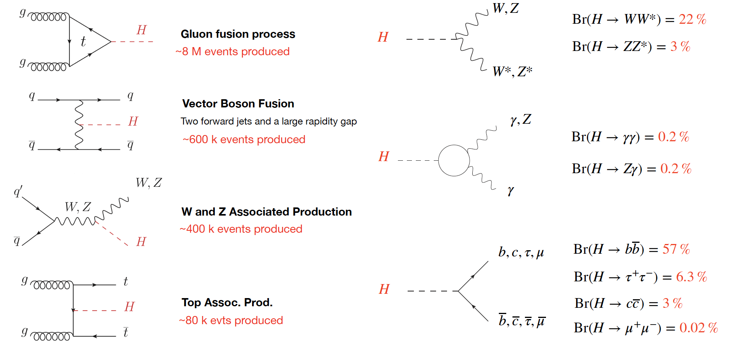
Higgs Production and Decay at LHC
ggF
VBF
VH
ttH

Slide 12
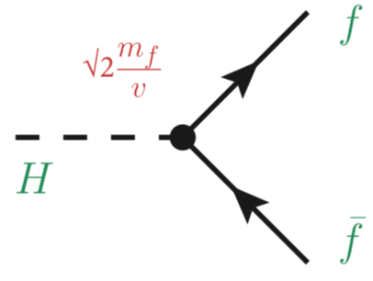
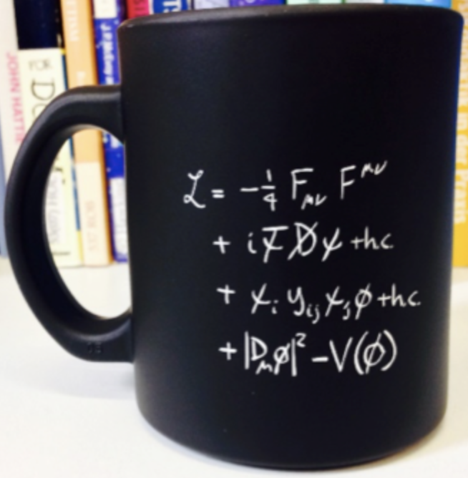
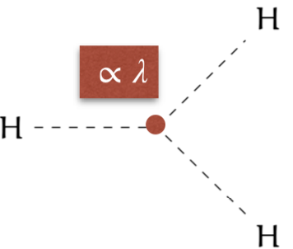
Higgs Yukawa Couplings and Self-coupling
Higgs boson couples to fermions through Yukawa interactions
Giving masses to quarks and leptons
Coupling strength is proportional to fermion’s mass
Higgs potential:
In SM, λ ≈ 0.13 give m_{H} ≈ 125 GeV
HH productions provide directly access to Higgs self-coupling κ_{λ} (λ_{HHH}/λ_{SM})

Slide 13
Topics to be Covered Today
CP Property of the Top-quark Yukawa Coupling via ttH/tH (H→𝛾𝛾): Yukawa coupling to 3rd generation fermion
Search for SM H→μμ: Yukawa coupling to 2nd generation fermion
HH→bb𝜏𝜏 and HH(+H) combination: Higgs boson trilinear self coupling

Slide 14
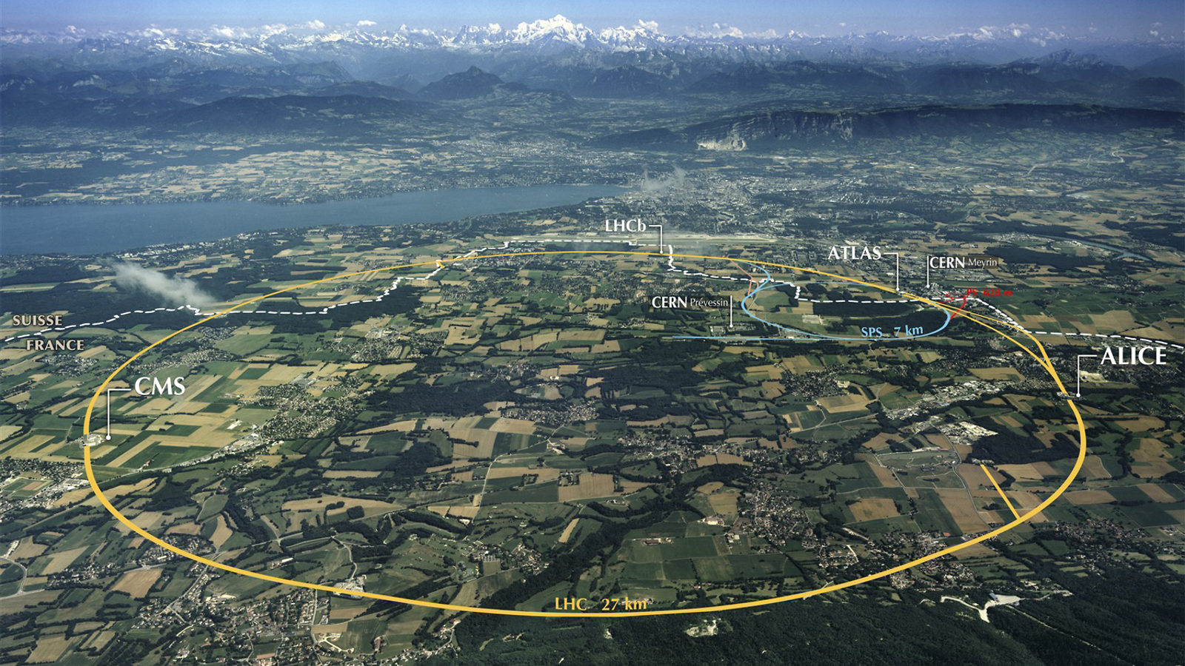
ATLAS
LHC

Slide 15
Our “Camara”: ATLAS Detector

Slide 16
Particle Identifications at ATLAS
The main final-state particles used for the physics analysis: electron, muon, tau, jet, b-jet, and missing transverse energy $E_{T}^{miss}$
Different types of particles interact with certain sensitive sub-detectors and give different responses in the experiments

Slide 17
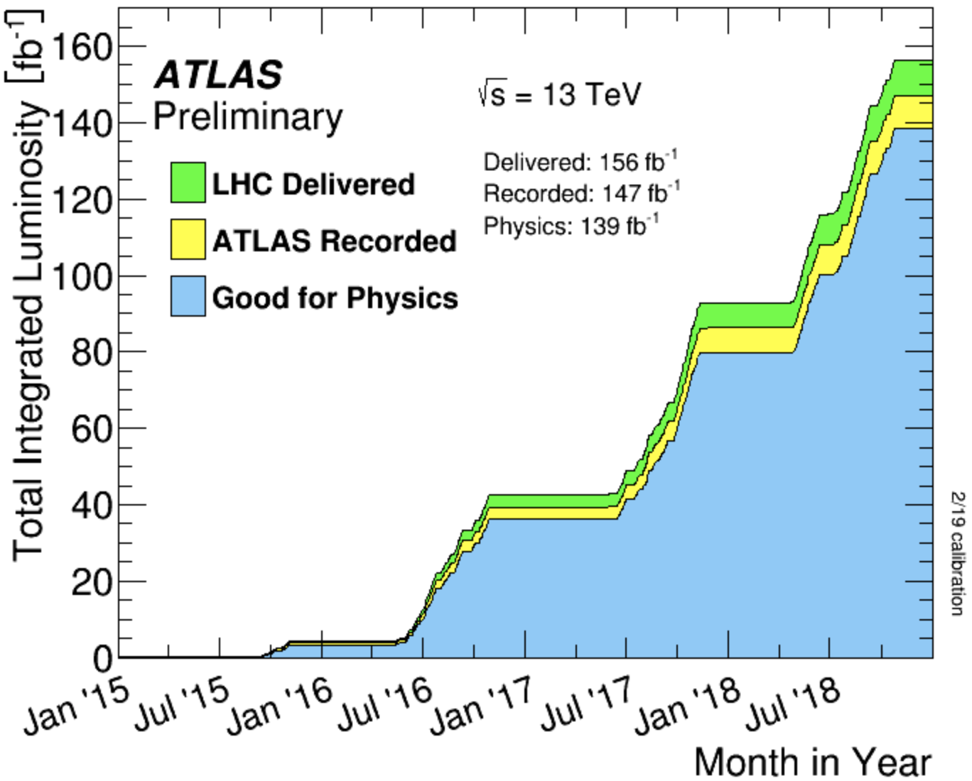
Run 2 Dataset
Great performance of ATLAS detector and operation of the LHC
139 fb⁻¹ of 13 TeV pp collision data collected for physics by the ATLAS detector during the LHC Run 2
Where we are now

Slide 18
CP Property of the Top-quark Yukawa Coupling via ttH/tH (H→𝛾𝛾)

Slide 19
Why Doing This?
Large matter-antimatter asymmetry in universe: crucial to look for additional CP violation sources
Yukawa couplings provide an unambiguous and more sensitive probe of a CP-mixed state compared to Higgs-gauge-boson couplings
First direct probe to the CP property of the top-Higgs Yukawa coupling (strongest one) using ttH/tH at tree level
Lagrangian written as:
κ_{t} (>0): Yukawa coupling strength; α: CP-mixing angle
In SM, κ_{t} = 1, α = 0 (CP is purely even)
J. Ellis et al.

Slide 20
How to Probe this?
The presence of a CP-odd component in the t-H coupling have impact on:
rate and kinematics of ggF process
rate of H→𝛾𝛾 decay
rate and kinematics of ttH and tH processes
Measure the rate of ttH/tH processes and shapes of observables sensitive to the CP nature of the t-H coupling
ggF
tH
ttH
H→𝛾𝛾

Slide 21
Why in H→𝛾𝛾 Channel?
𝛾𝛾 channel: small rate, but clean signature and good resolution; solid bkg. estimation from data sideband → most sensitive channel to study ttH process
𝛾𝛾 selection: two isolated photons with p_{T} > 35/25 GeV; 105 GeV < m_{𝛾𝛾} < 160 GeV
ttH/tH selection: ≥1 b-tagged jet
“Lep” region (≥1 top decay leptonically): ≥ 1 isolated electron or muon with p_{T} > 15 GeV
“Had” region (both tops decay hadronically): 0 selected lepton, ≥ 3 jets

Slide 22
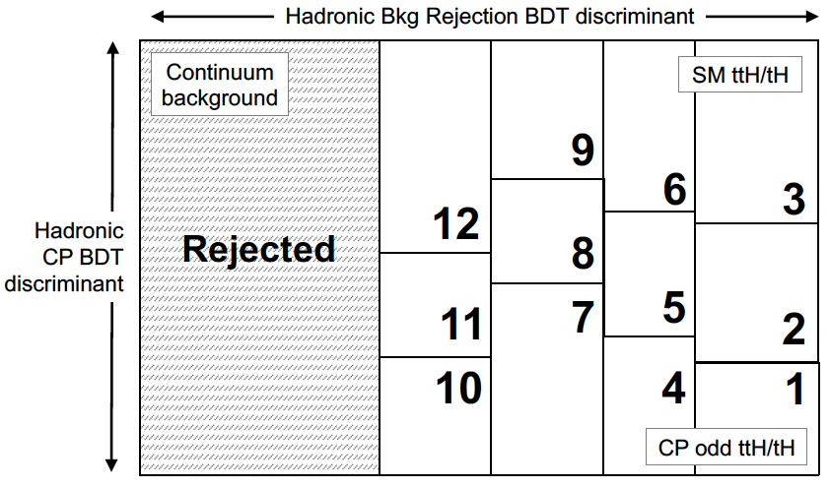
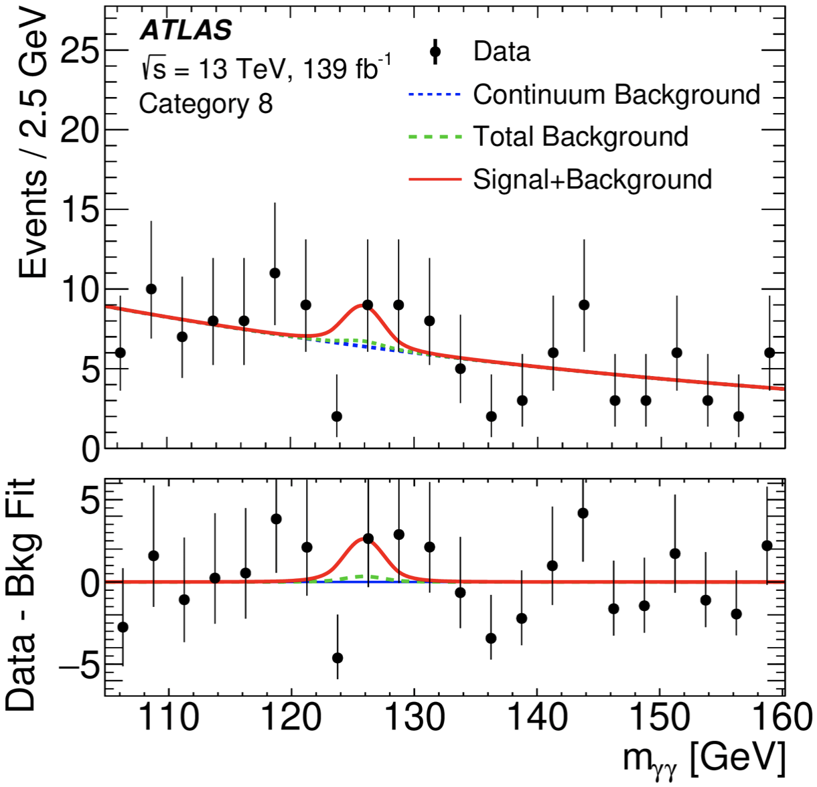
Analysis Methodology
In each region, trained two BDTs:
Bkg. rejection BDT: separate ttH-like events from 𝛾𝛾+jets/tt𝛾𝛾 bkg.
CP BDT: separate CP-even and CP-odd couplings using ttH/tH
Categorize events based on 2D BDTs: 12 categories in Had and 8 in Lep
Signal extraction: simultaneous fit to m_{𝛾𝛾} spectra in all 20 categories

Slide 23
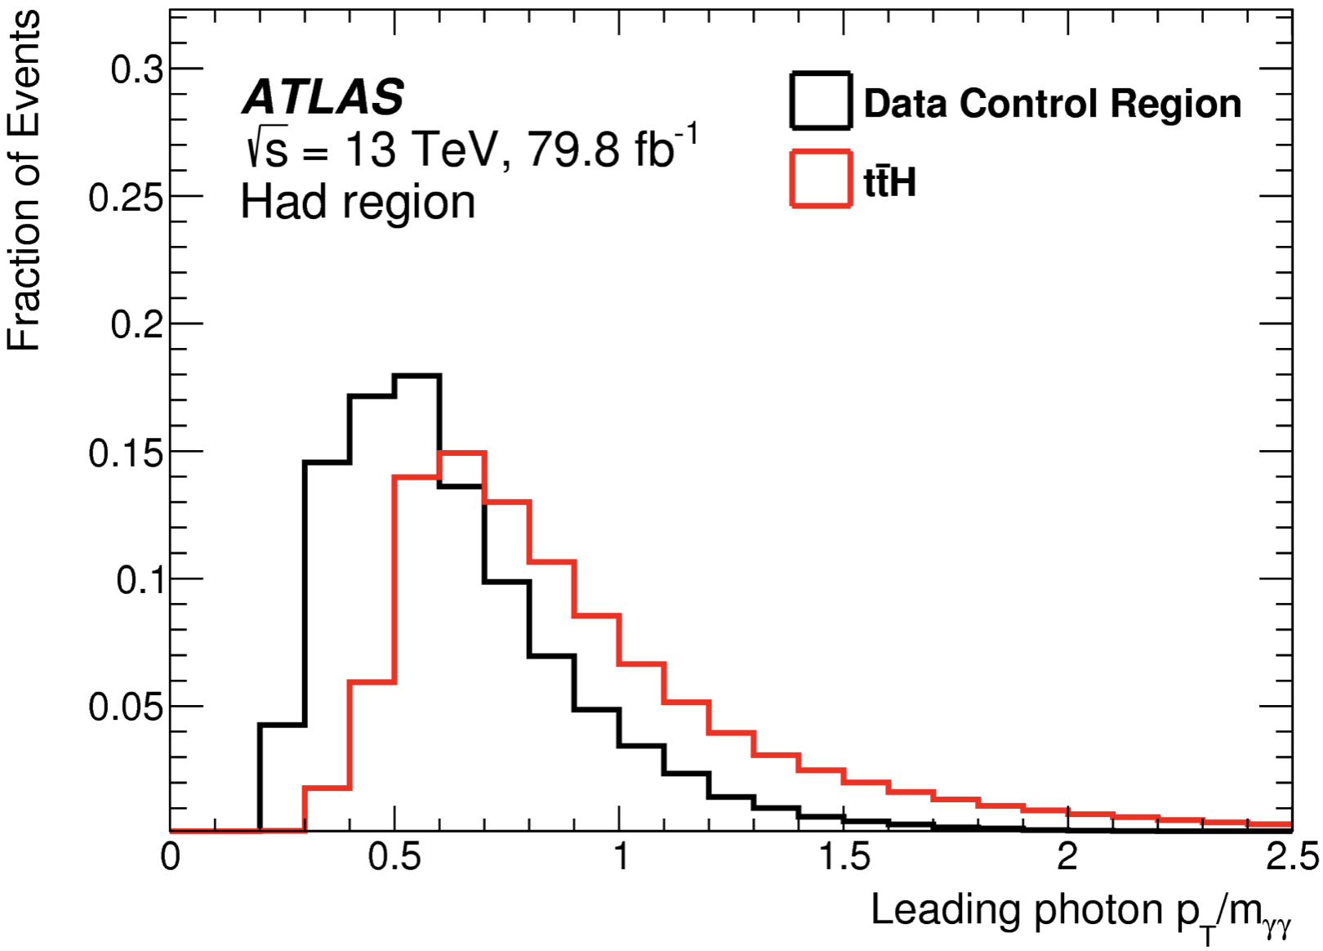
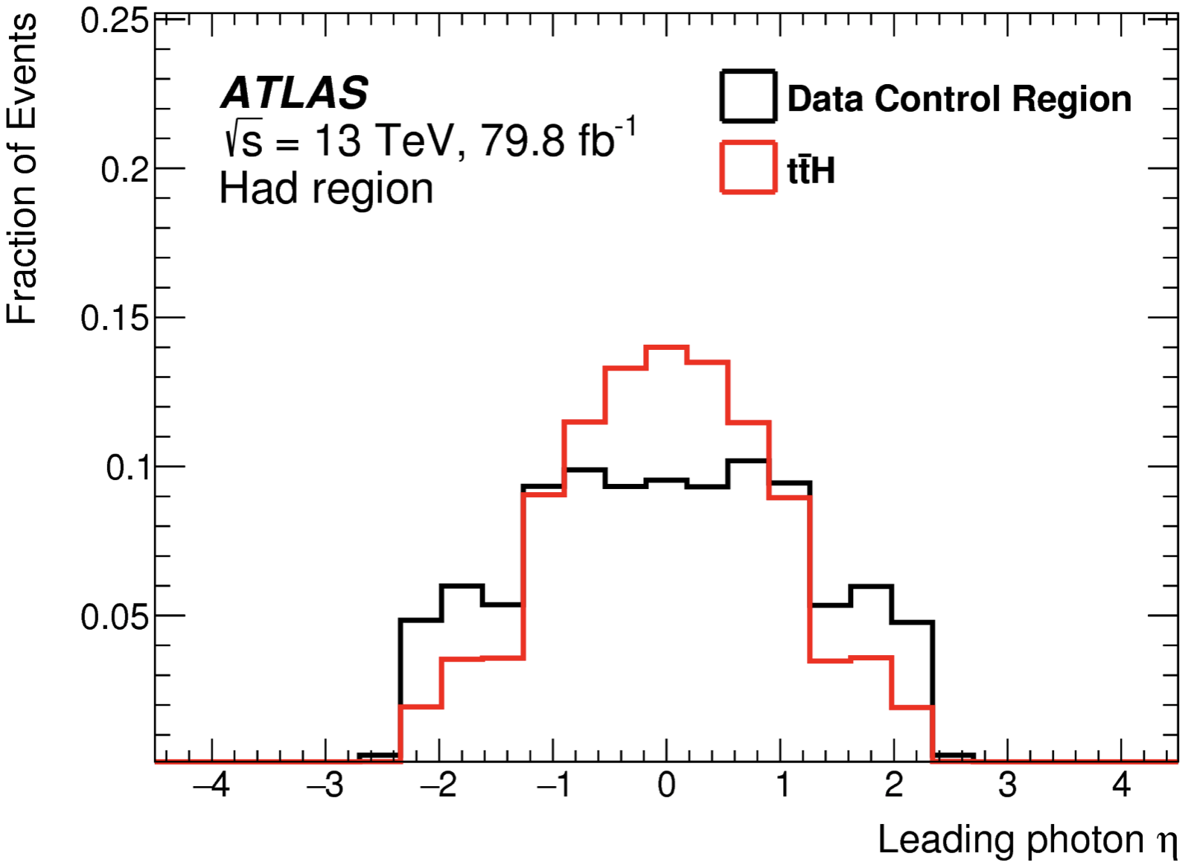
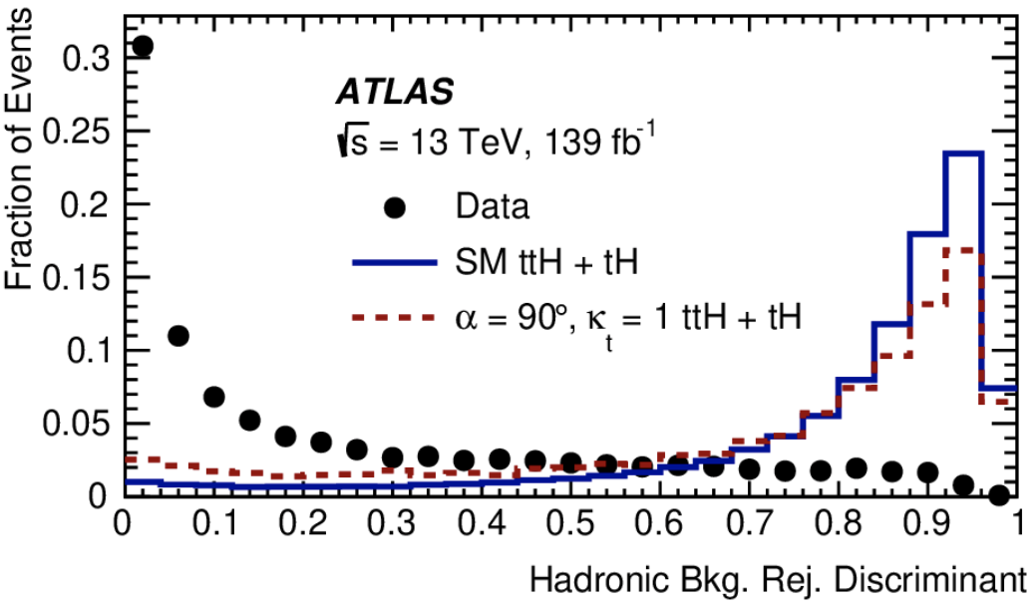
Background Rejection BDT
Trained with low-level input variable like 4 vector info of γ, j, l, and MET
Good separation power between ttH/tH and background, no strong dependence on CP mixing angle
p_{T,𝛾1}/m_{𝛾𝛾}
η_{𝛾1}
Bkg. rej. BDT

Slide 24
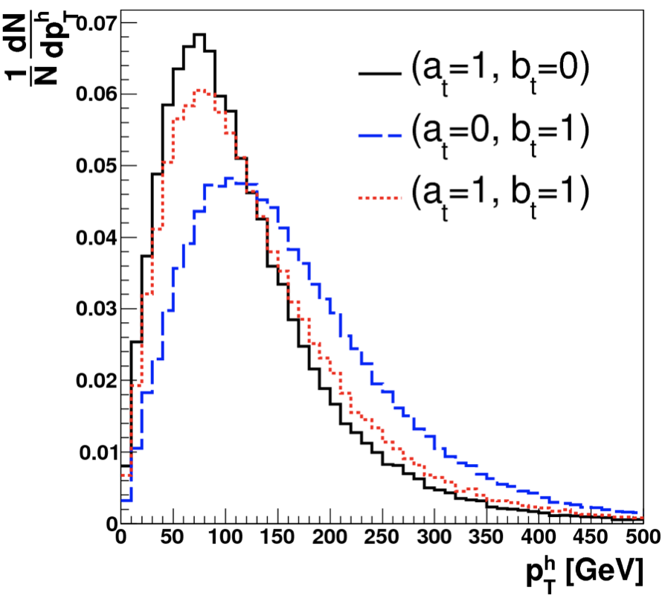
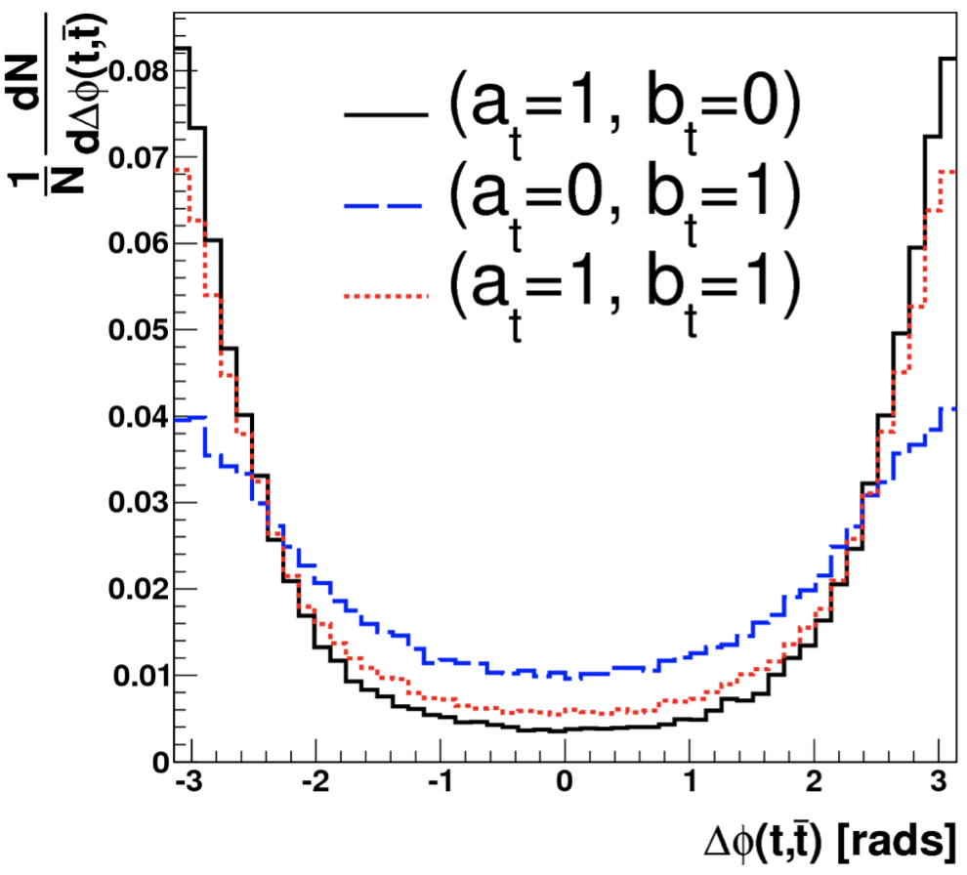
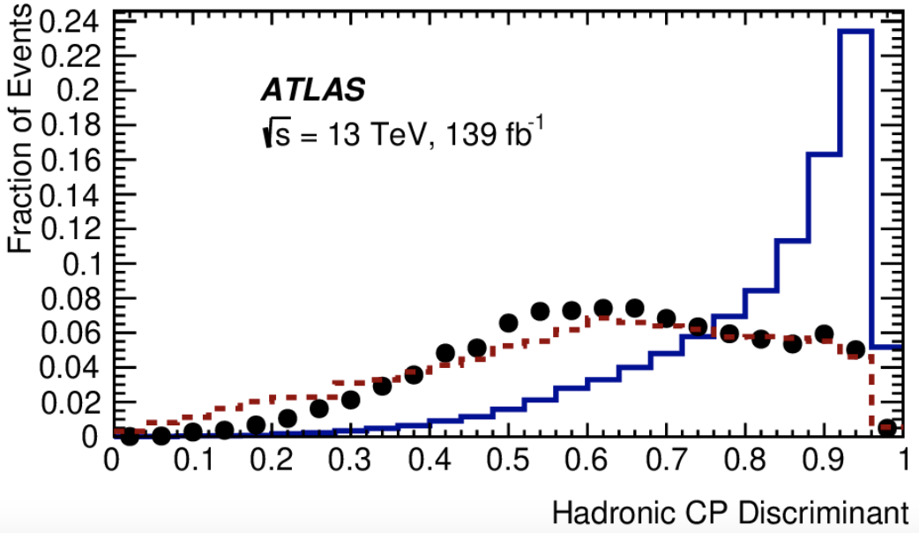
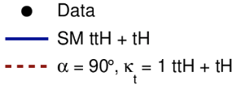
CP BDT
Training variables: p_{T}/η of 𝛾𝛾 system and two top candidates (t1, t2); ϕ_{𝛾𝛾,t1} and ϕ_{𝛾𝛾,t2}; Δη_{t1t2} and Δϕ_{t1t2}; m_{𝛾𝛾, t1}, m_{t1t2}, etc
CP BDT
p_{T,H}
Δϕ_{t1t2}
Ref: PRD 92, 015019 (2015)

Slide 25
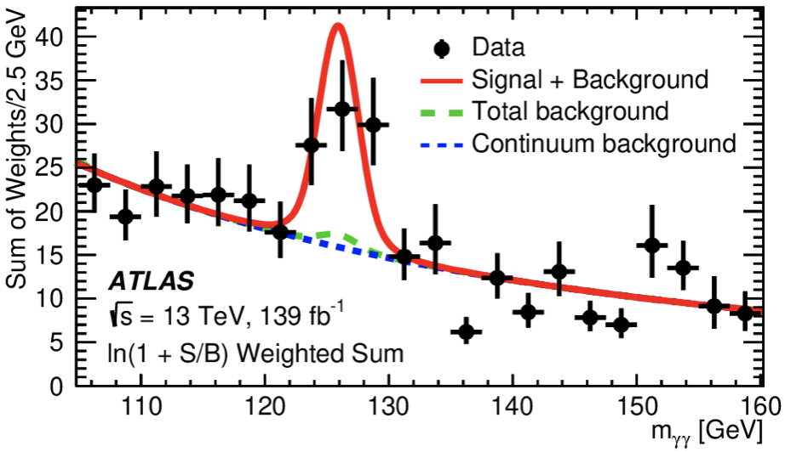
Signal Significance for ttH(→𝛾𝛾)
Assuming CP-even coupling, the measured signal strength (μ=σ_{obs}/σ_{SM}) for ttH via H→𝛾𝛾 is:
The background-only hypothesis is rejected with an observed (expected) significance of 5.2σ (4.4σ) → ttH observation in single Higgs decay channel
μ = 1.43
$$\begin{matrix}+0.33 \\ −0.31\end{matrix}(stat.)$$
$$\begin{matrix}+0.21 \\ −0.15\end{matrix}(sys.)$$

Slide 26
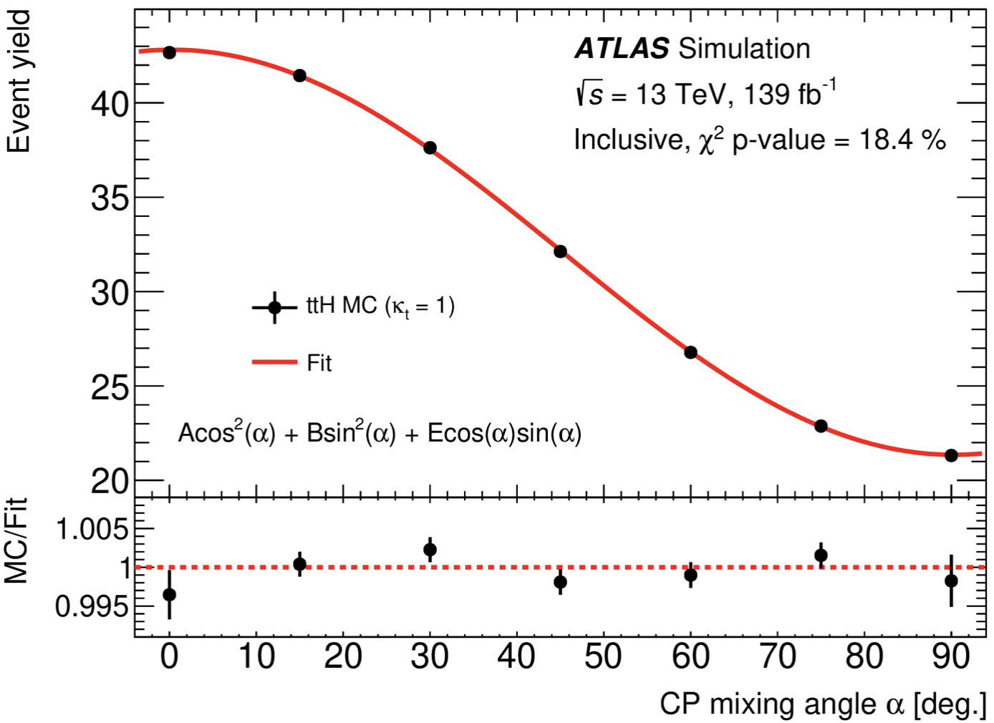
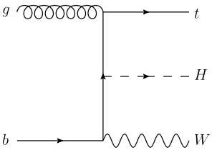
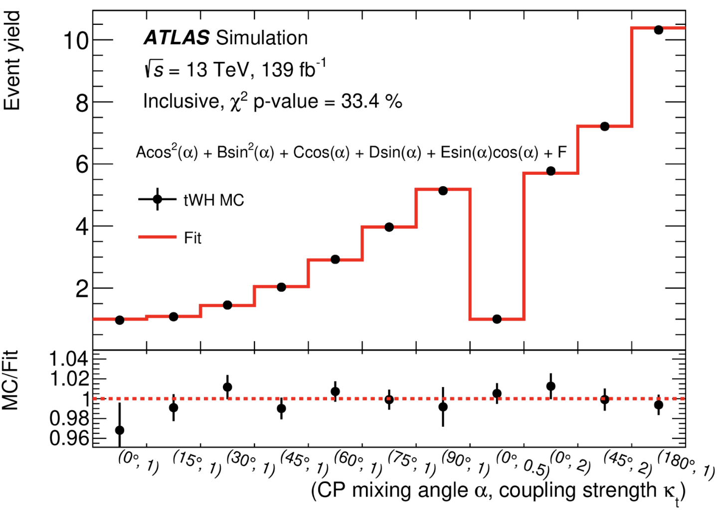
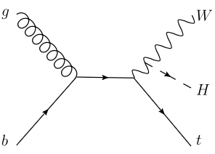
ttH/tH Signal Yield Parametrization
ttH/tH yields parametrized into κ_{t} and α in each category
ttH following the form:
tH:
Need to consider the interference between t-H and W-H couplings
t-H
ttH
W-H
tH

Slide 27
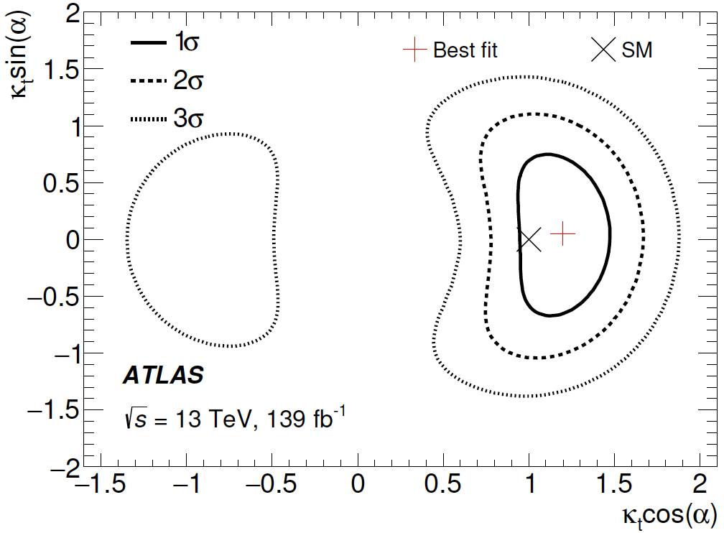
Results on CP Constraint
H→𝛾𝛾/ggF loops constrained by the Higgs combination result (link)
The measurements consistent with the SM prediction, and no sign of CP violation in the top-Yukawa interaction observed

Slide 28
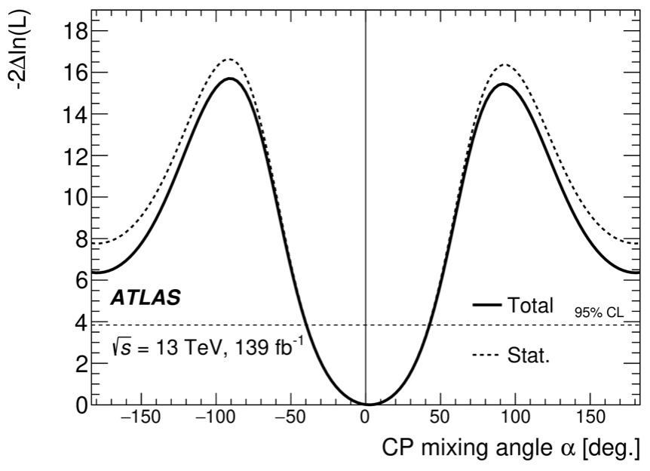
Exclusions for CP-odd Component
Likelihood scan of α with κ_{t} floating in the fit
|α|>43° is excluded at 95% C.L.
Pure CP-odd hypothesis is excluded at 3.9σ → stringent exclusion result for CP-odd component in the top-Yukawa interaction to date
Phys. Rev. Lett. 125 (2020) 061802

Slide 29
Search for SM H→μμ

Slide 30
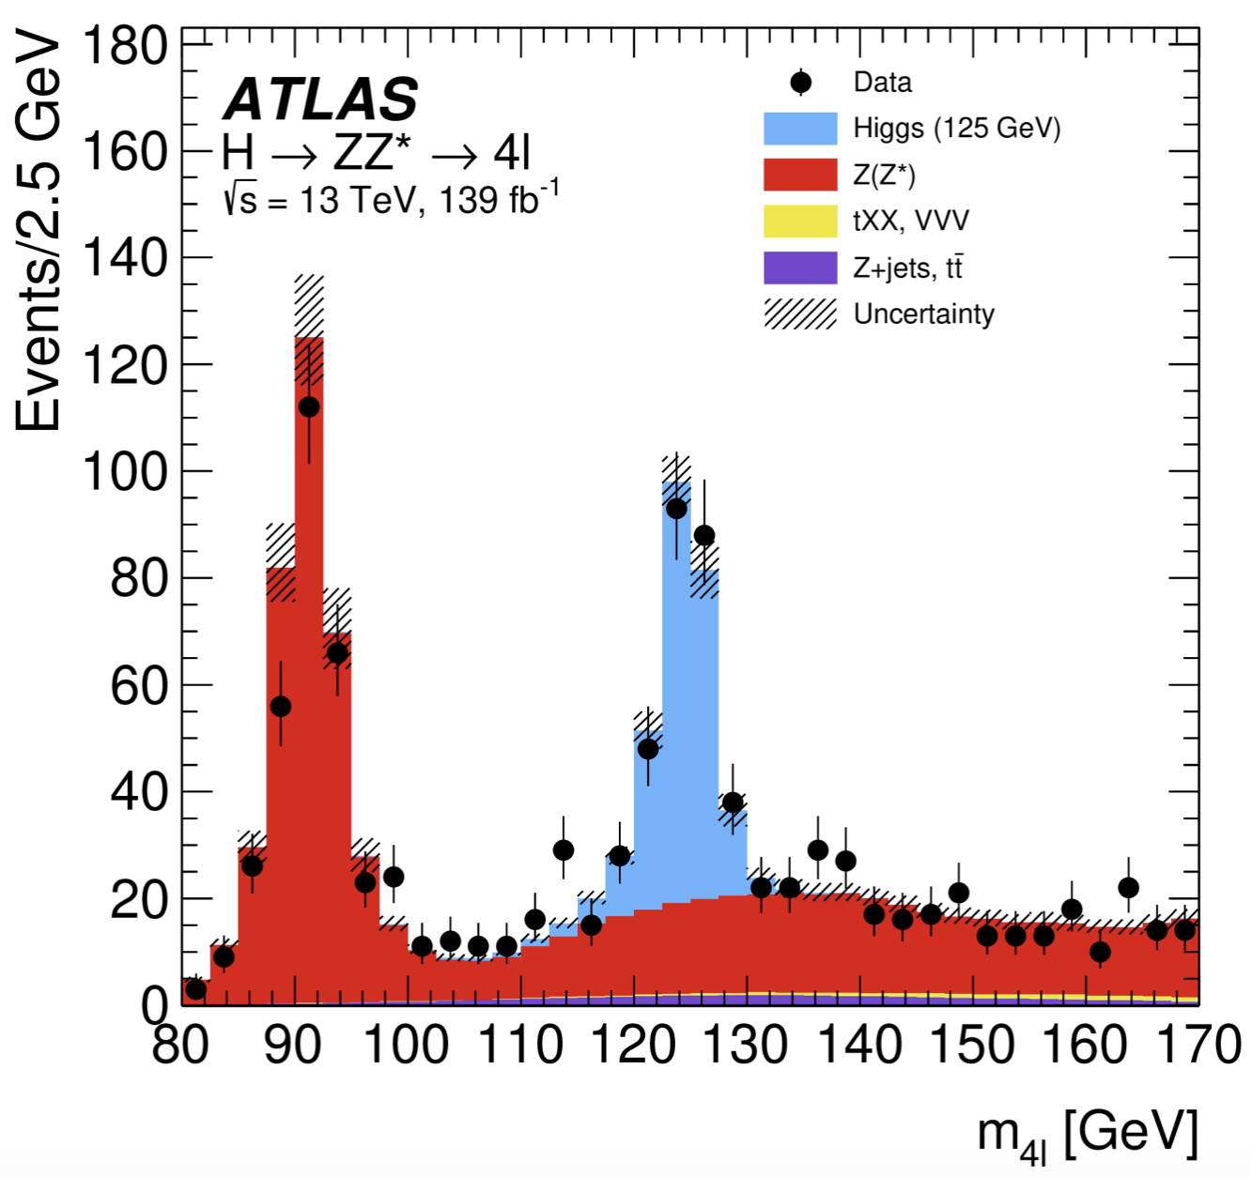
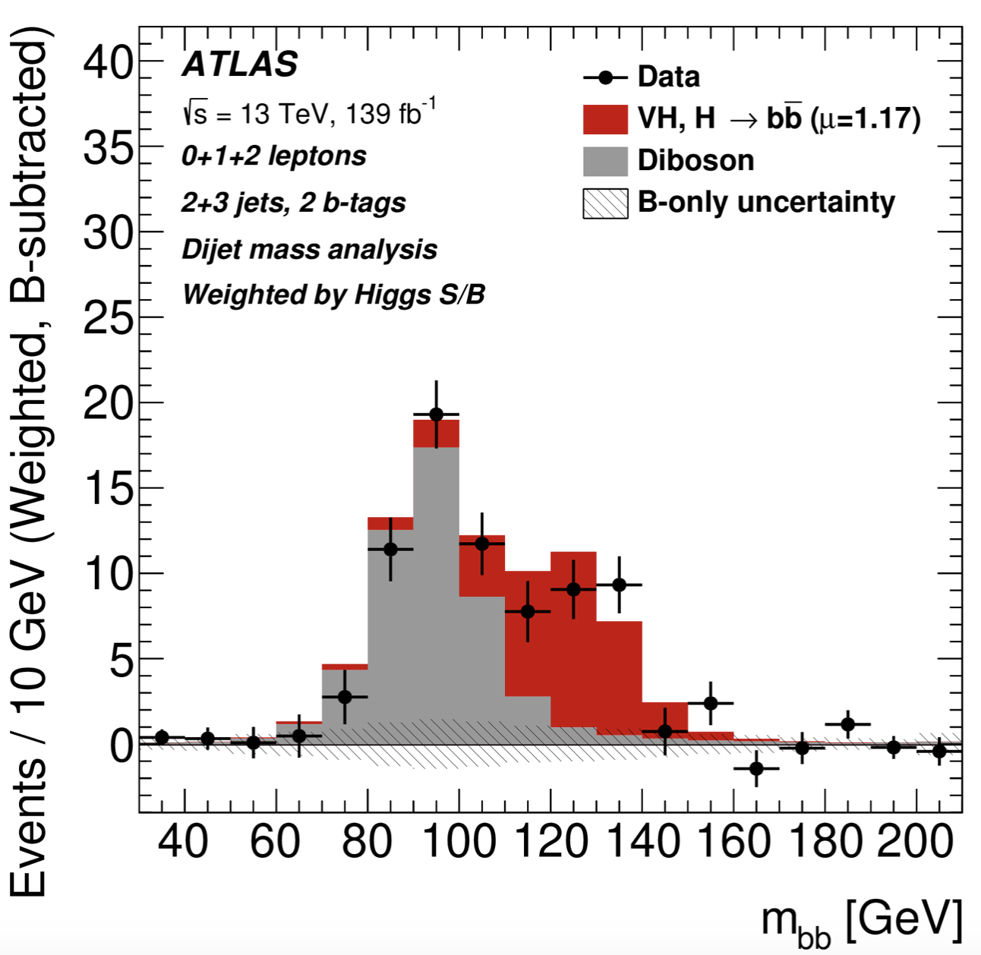
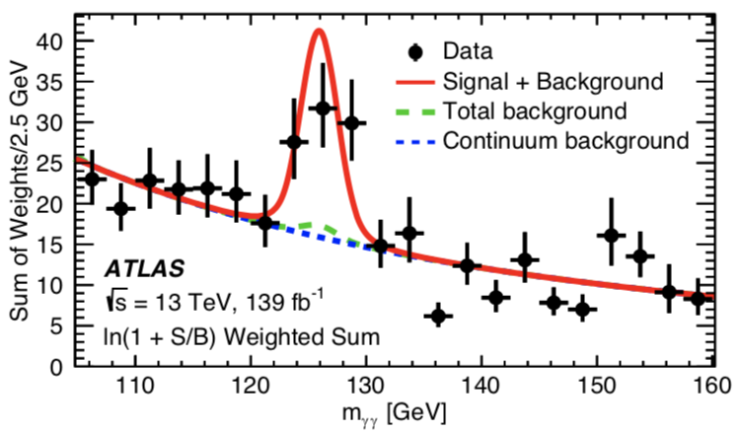
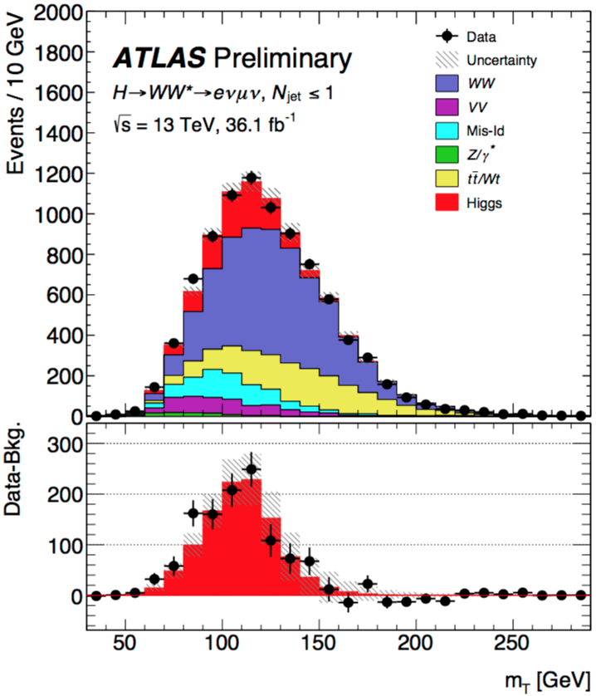
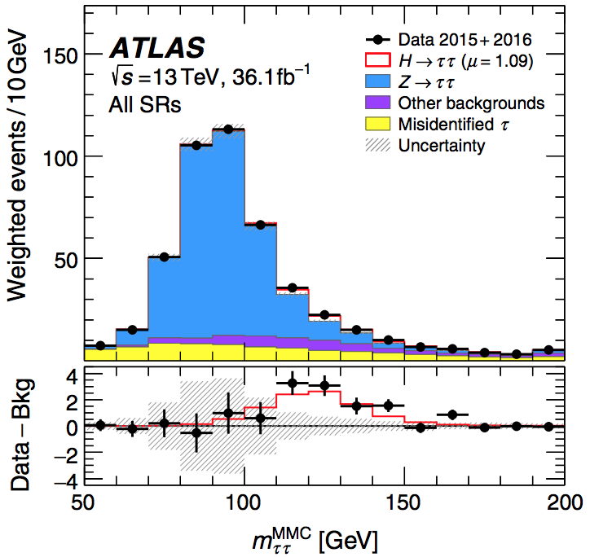
What We’ve Learned about the Higgs
H→ZZ→4l
H→bb
ttH (H→γγ)
Higgs coupling to gauge bosons
Higgs couplings to the 3rd generation fermions
H→WW
One of the next big milestones:
Higgs couplings to the 2nd generation fermions
H→𝜏𝜏

Slide 31
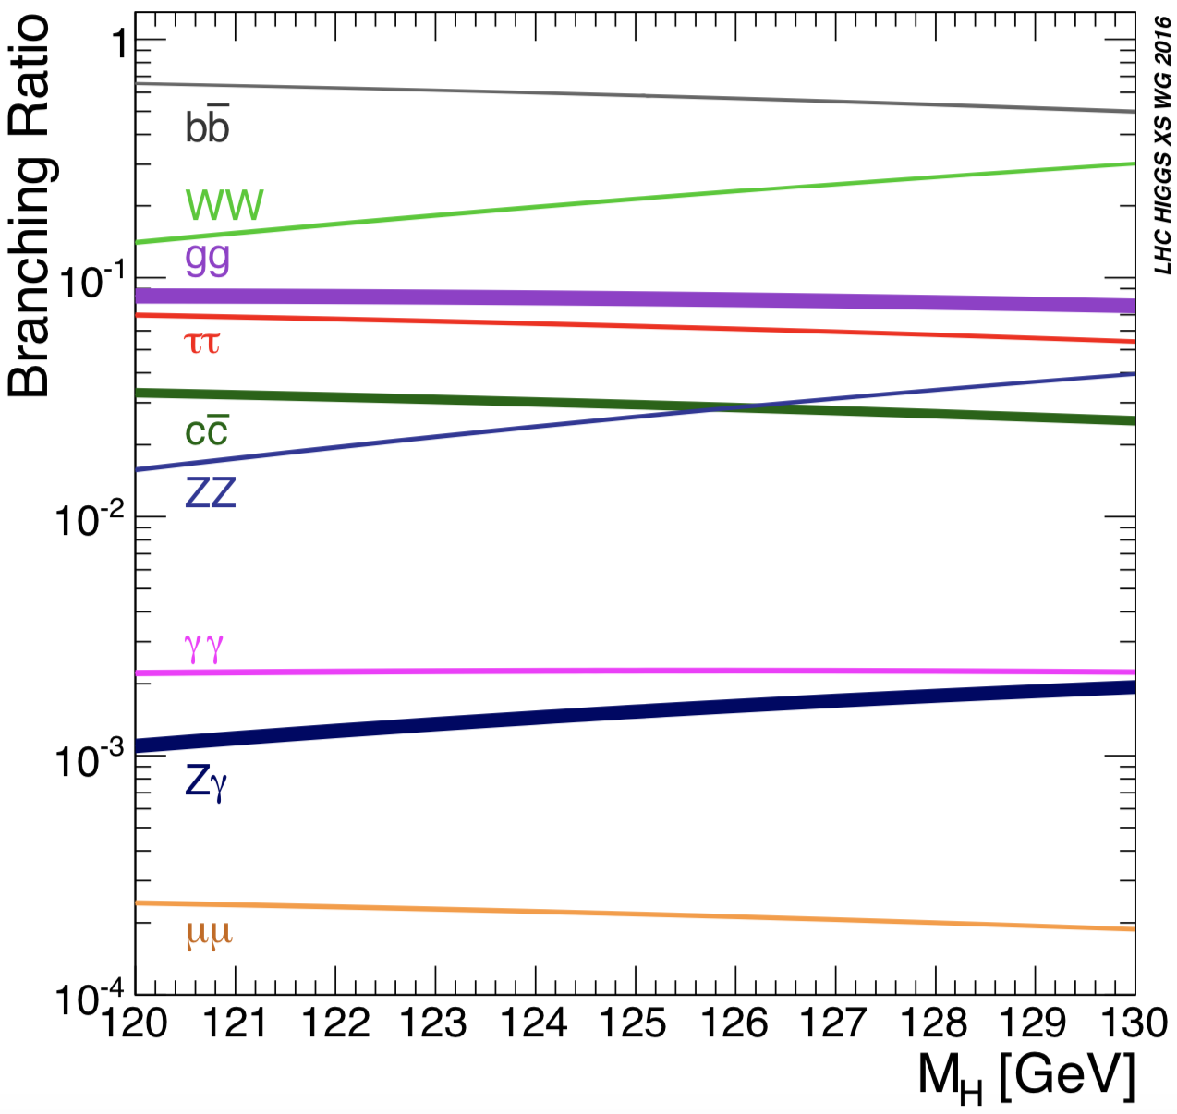
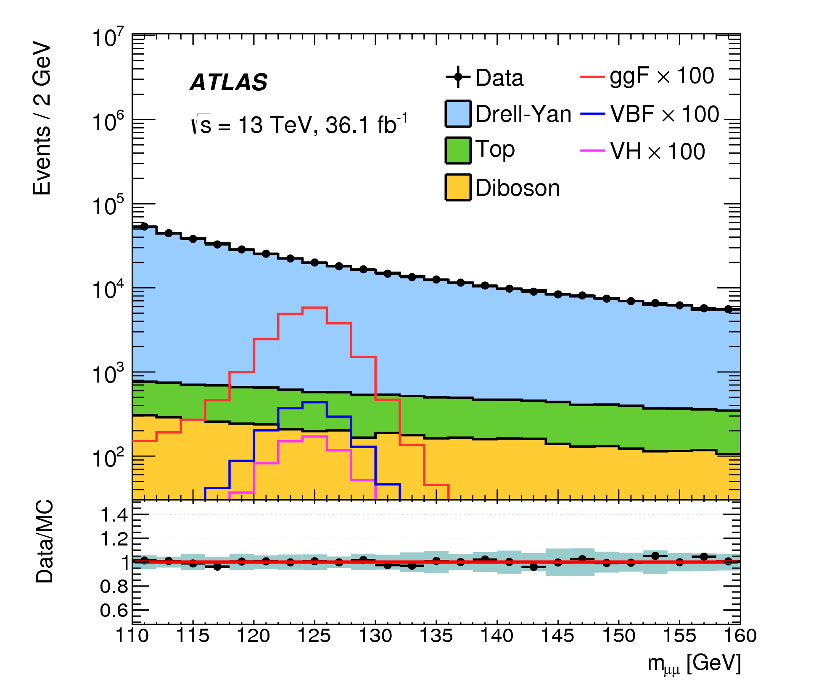
Physics Motivation
H→μμ: most promising channel to explore Yukawa coupling to the 2nd generation fermions
H→cc not very sensible under the current luminosity
Major challenge for H→μμ: low branching ratio and large irreducible background from Drell-Yan
S/B: ~0.1%
2.17×10⁻⁴

Slide 32
Overview of Analysis Strategy
Sig. signatures: two isolated muons with opposite charge
BDT-based categorization to enhance signal sensitivity
Driven by the different Higgs boson production modes
Data driven approach used for bkg. estimation
Sig.+Bkg. PDF used to fit the observed m_{μμ} spectra simultaneously in all the categories to extract the signal
Sig. and bkg. modeled by analytic functions

Slide 33
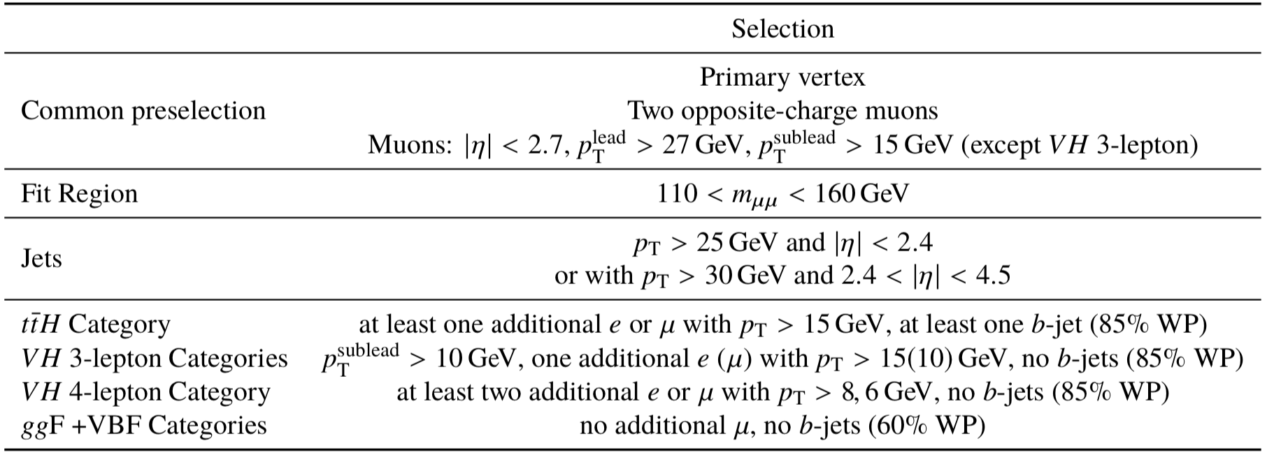
Event Selection for H→μμ
Single muon trigger with p_{T} threshold of 26 or 50 GeV
Selected events sorted into 20 categories in total, which are mutually exclusive and in the order of ttH(1) →VH(3)→VBF(4)→ggF(12)

Slide 34
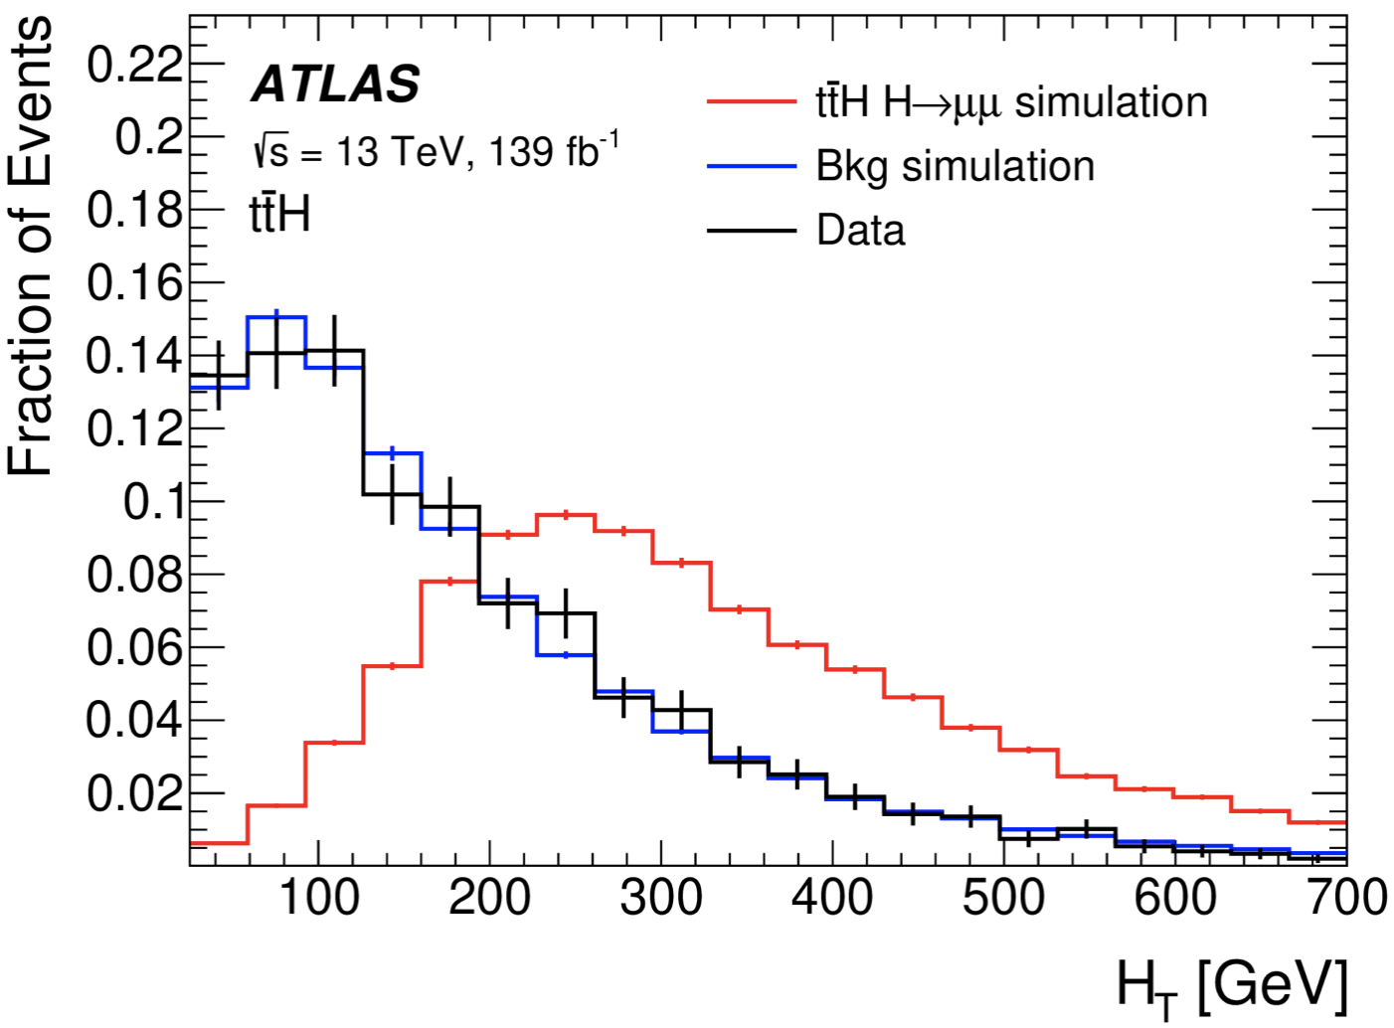
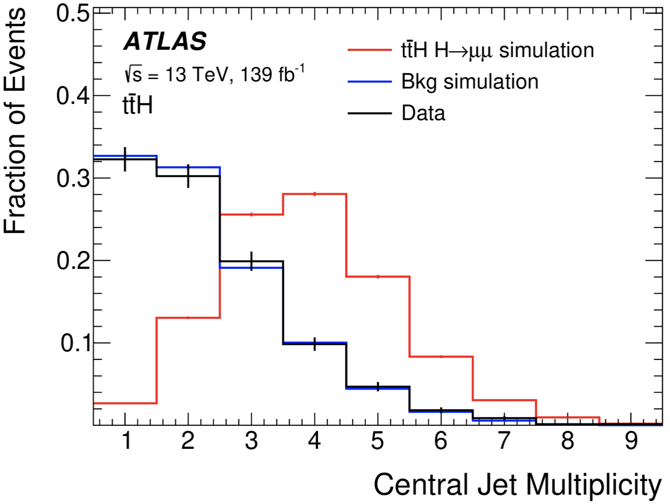
ttH Categorization
Target semi/dileptonic decays of top pair
≥1 extra e/μ and ≥1 b-tagged jet
Two highest-p_{T} muons with opposite charge as the Higgs candidate
BDT trained to distinguish ttH sig. from all bkgs. (ttbar, ttZ, diboson, etc)
Training variables: p_{T} of e/μ, invariant masses of leptons/tops, as well as N_{jet} and N_{b-jet}, and H_{T}
H_{T}
N_{jet}

Slide 35
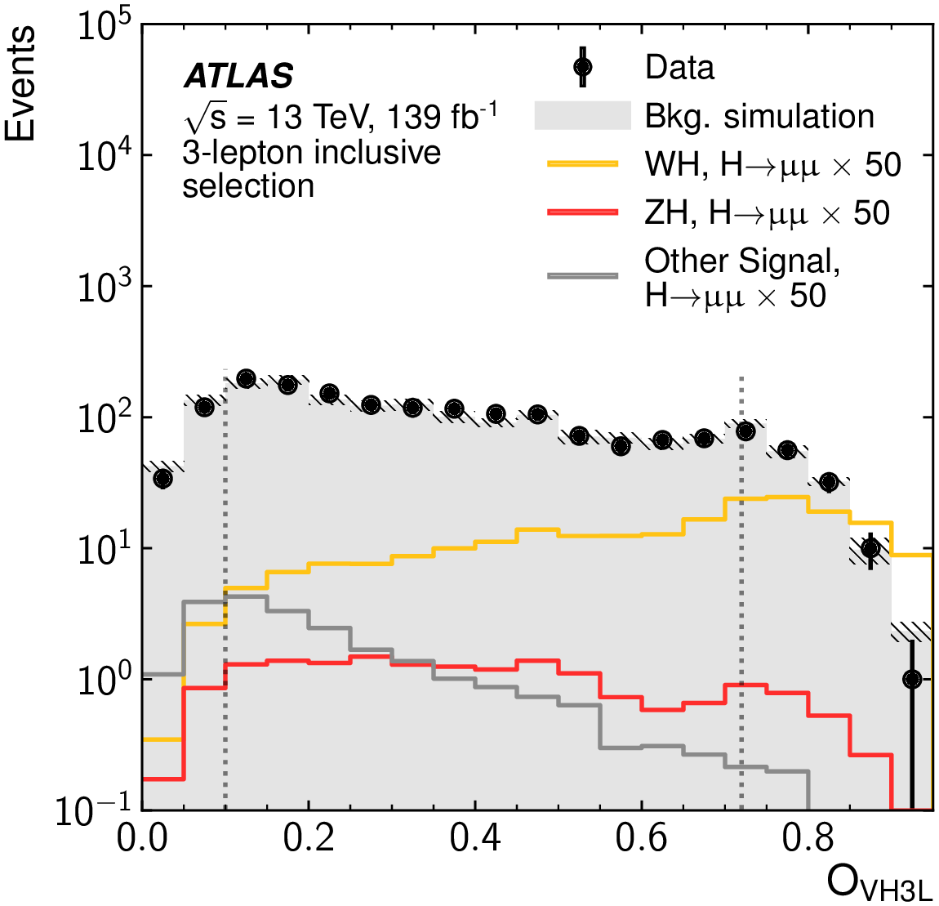
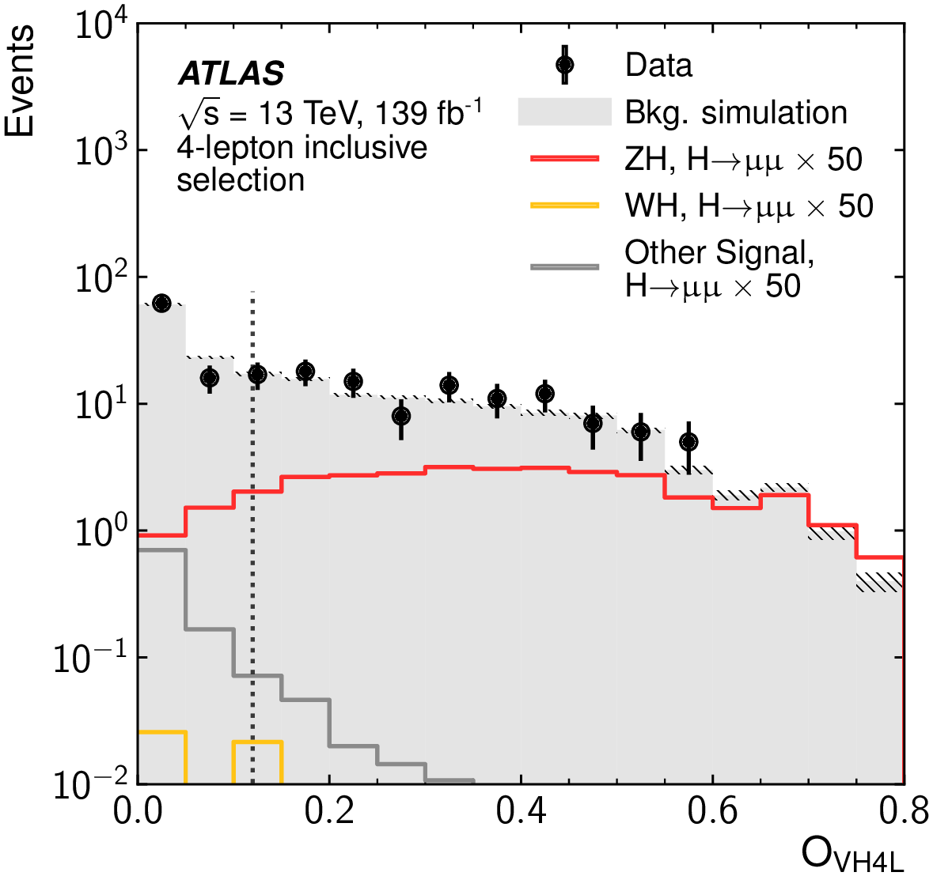
VH Categorization
Target WH/ZH in leptonic decays: 1/2 additional leptons except muon pair
Two BDTs trained for WH and ZH using invariant mass and angular variables of lepton systems as well as $E_{T}^{miss}$and N_{jet}
2 Cate. for WH
1 Cate. for ZH

Slide 36
VBF/ggF Categorization (1)
Event failing ttH/VH selection
≥2-jet
1-jet
0-jet
Train a VBF BDT (VBF sig. vs bkg.)
Train a ggF 2-jet BDT (ggF+VBF sig. vs bkg.)
Train a ggF 1-jet BDT (ggF+VBF sig. vs bkg.)
Train a ggF 0-jet BDT (ggF+VBF sig. vs bkg.)
4 VBF categories
4 ggF 2-jet categories
4 ggF 1-jet categories
4 ggF 0-jet categories
Training variables: $p_{T}^{μμ}$, y_{μμ}, cosθ*, p_{T} and η of jets, $p_{T}^{jj}$, y_{jj}, Δɸ_{jj,μμ}, m_{jj}, $N_{track}^{j}$, etc

Slide 37
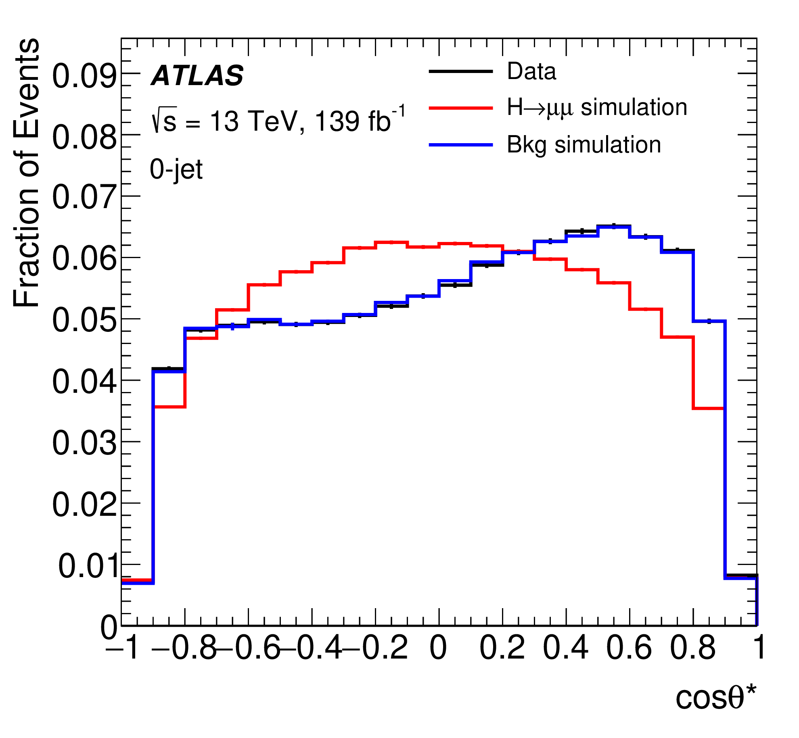
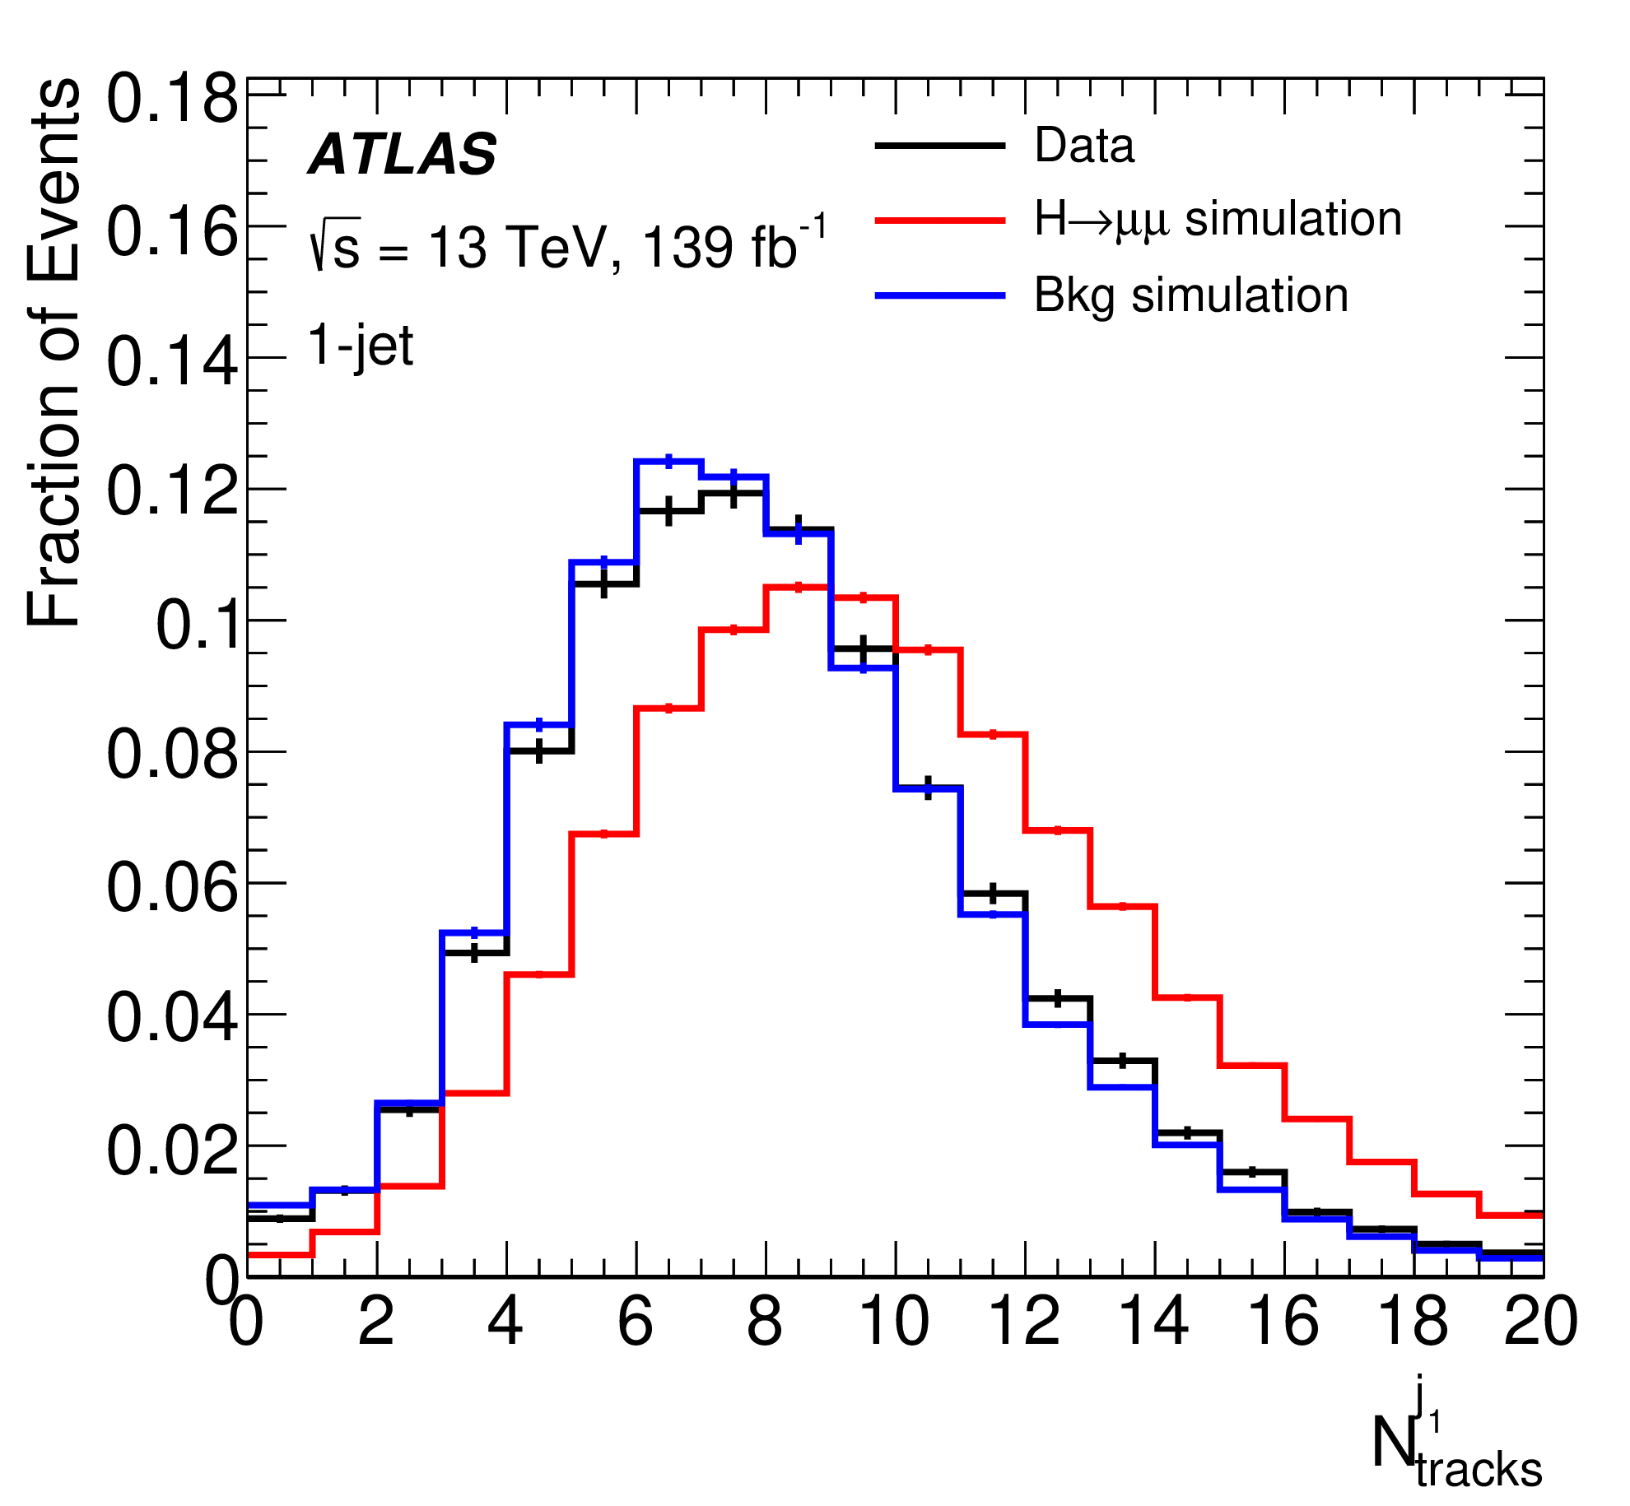
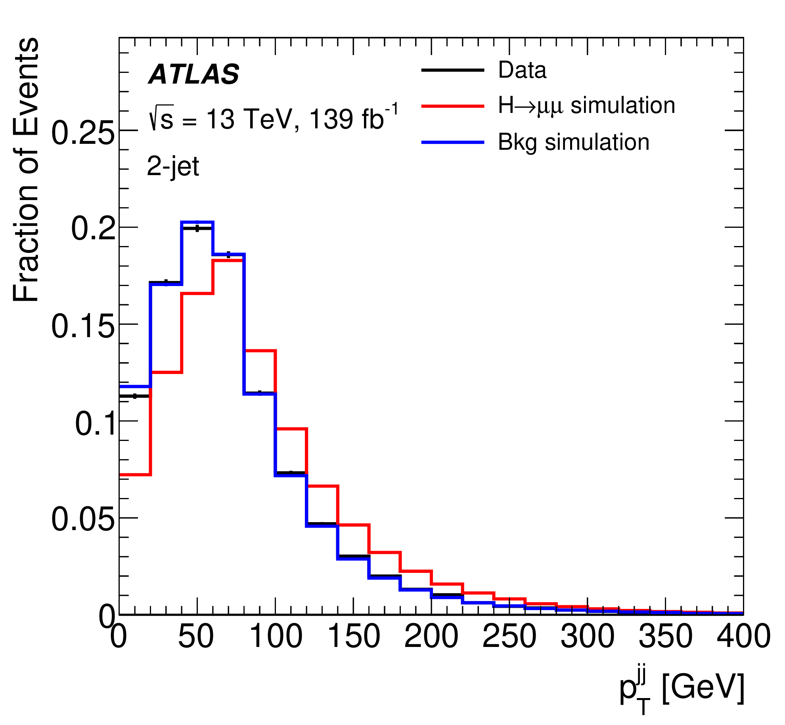
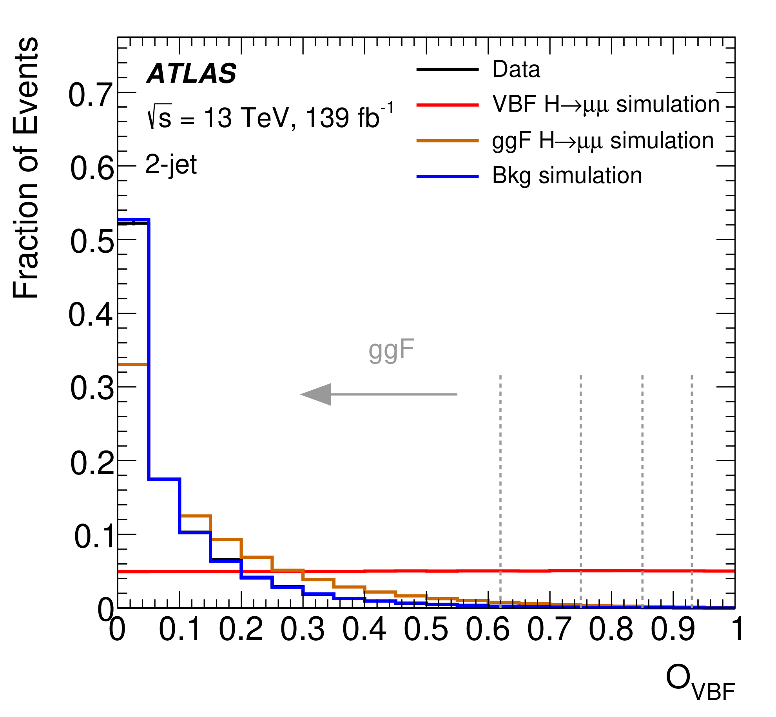
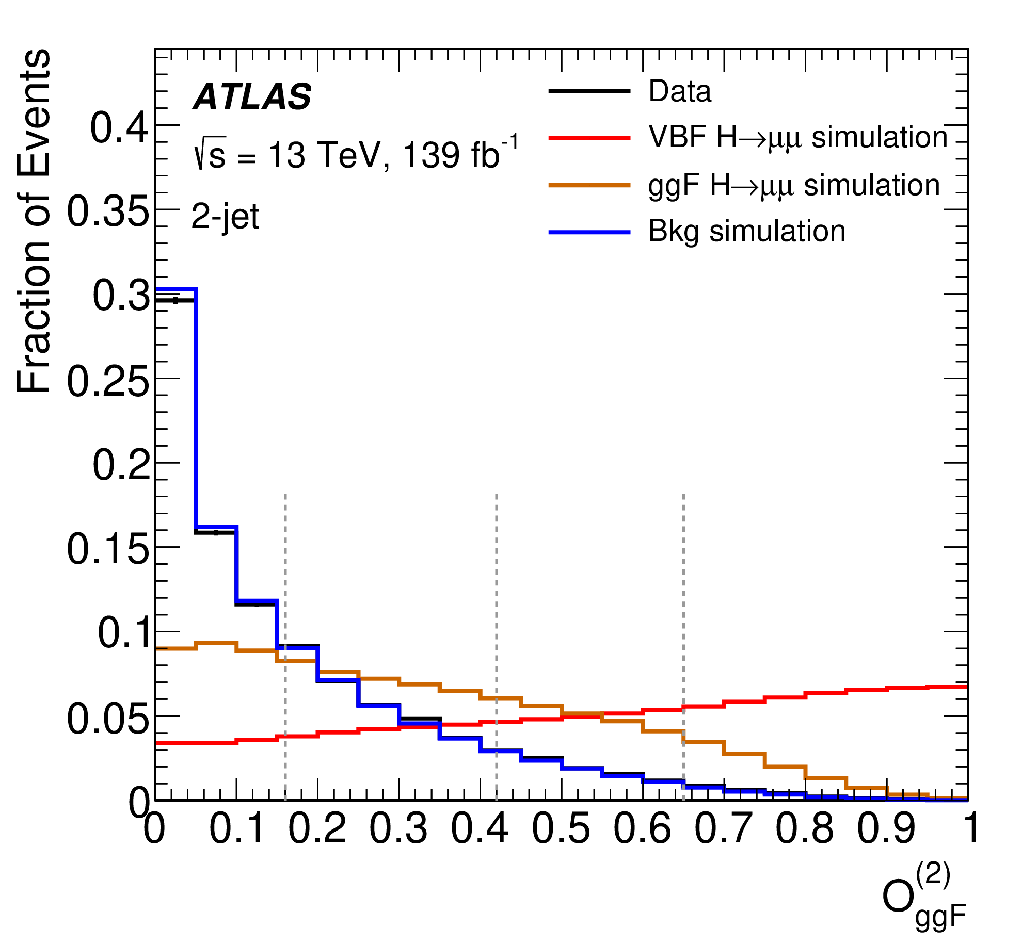
VBF/ggF Categorization (2)
$$p_{T}^{jj}$$
cosθ*
$$N_{track}^{j}$$
Four groups of categories: VBF, ggF 2-jet, ggF 1-jet and ggF 0-jet
In each group, four categories defined based on the signal purity
VBF BDT
ggF 2-jet

Slide 38
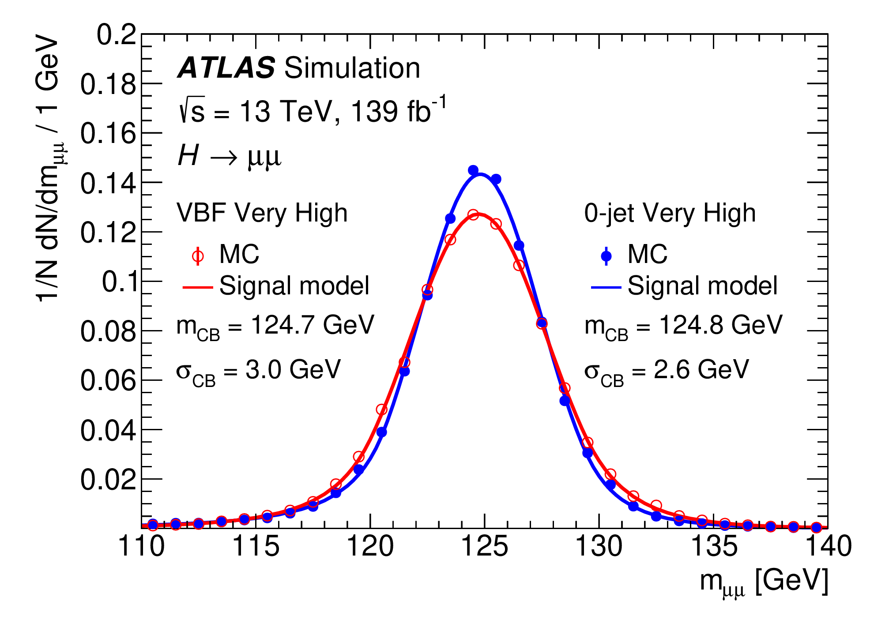
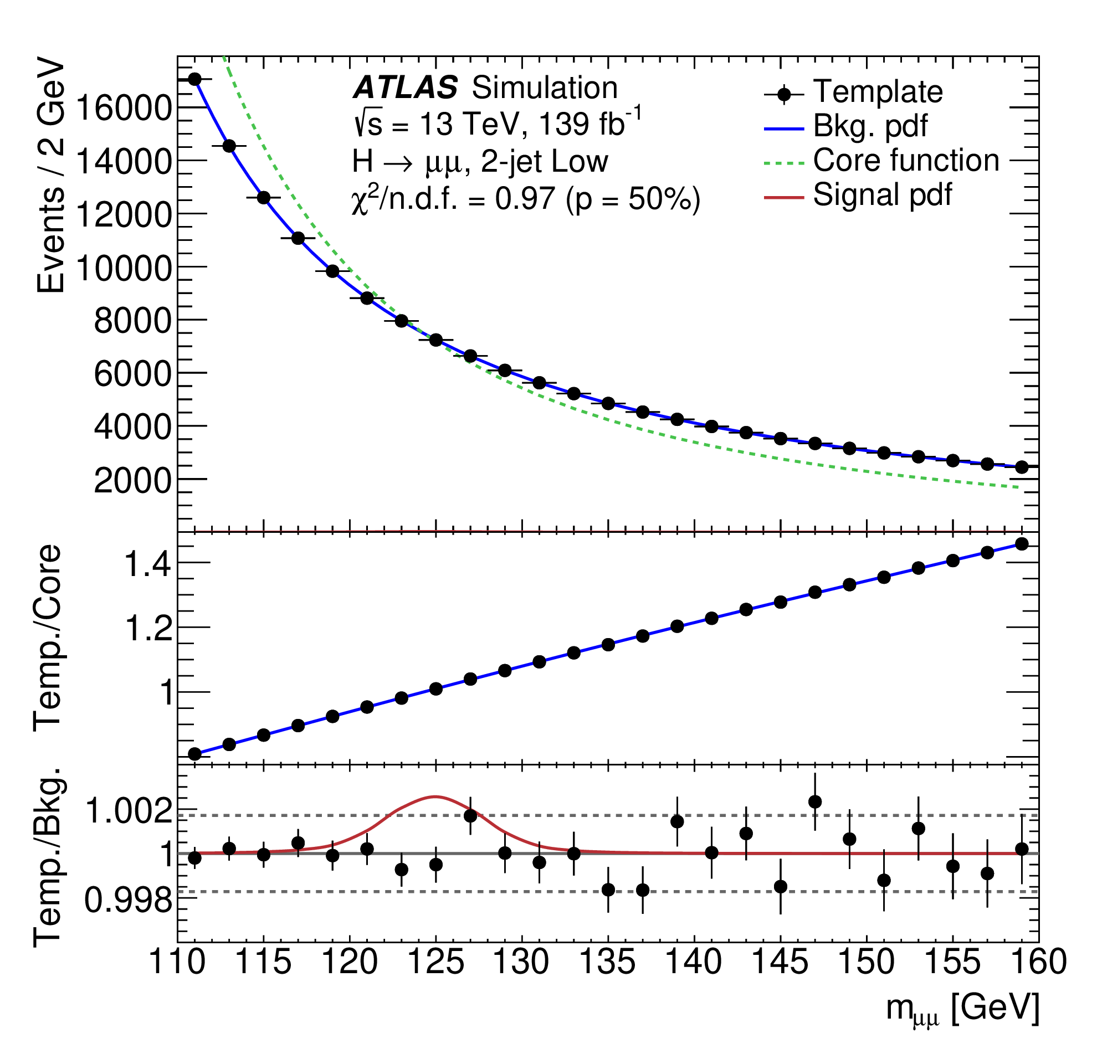
Signal and Background Modeling
Signal: double-sided Crystal Ball containing a Gaussian core and power-law tails (σ_{CB} ranging from 2.6-3.2 GeV)
Background: a “core function” multiplied by an “empirical function”
Core function: Drell-Yan mass shape convoluted with Gaus. function
Empirical function: correct for distortions of the mass shape and smaller bkg.
Potential bkg. mis-modeling treated as sys. unc. (“spurious signal”)

Slide 39
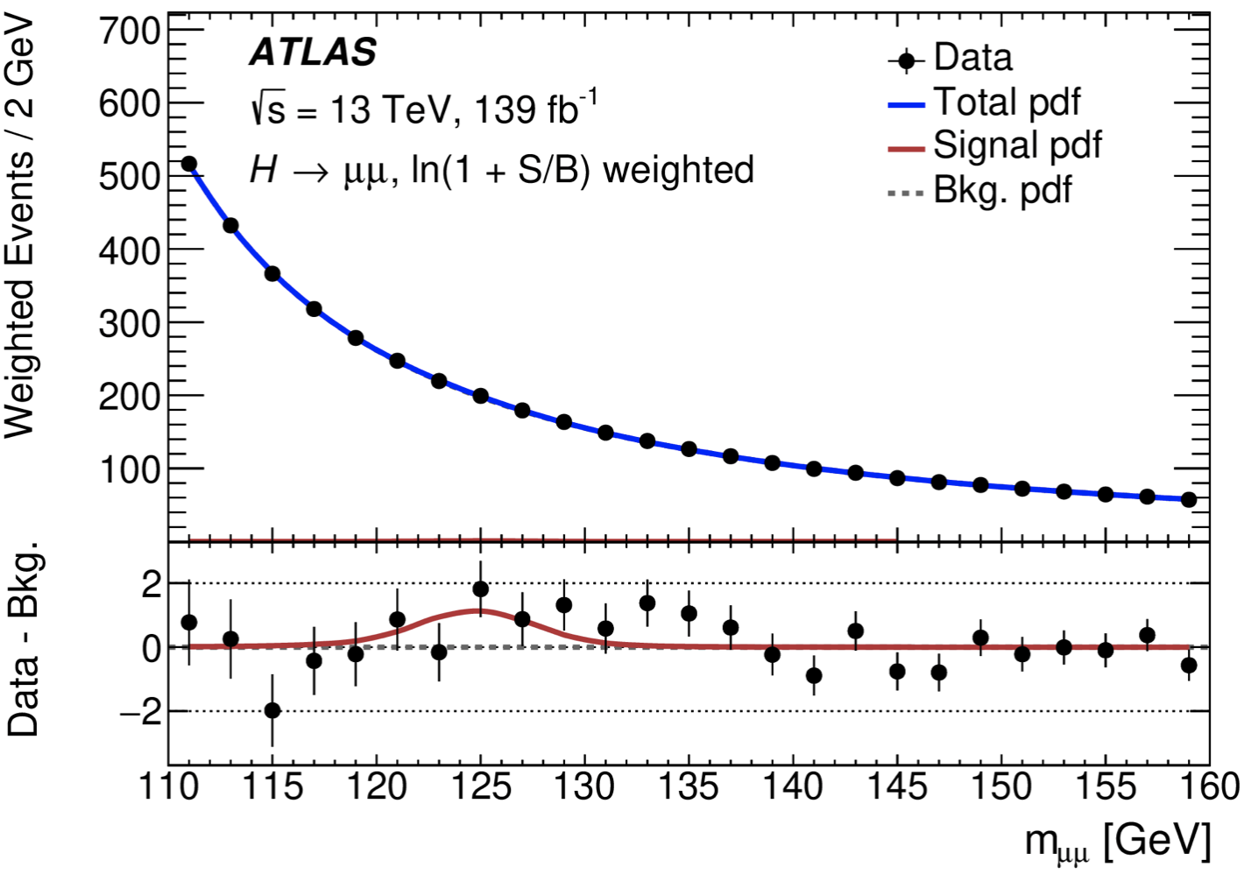
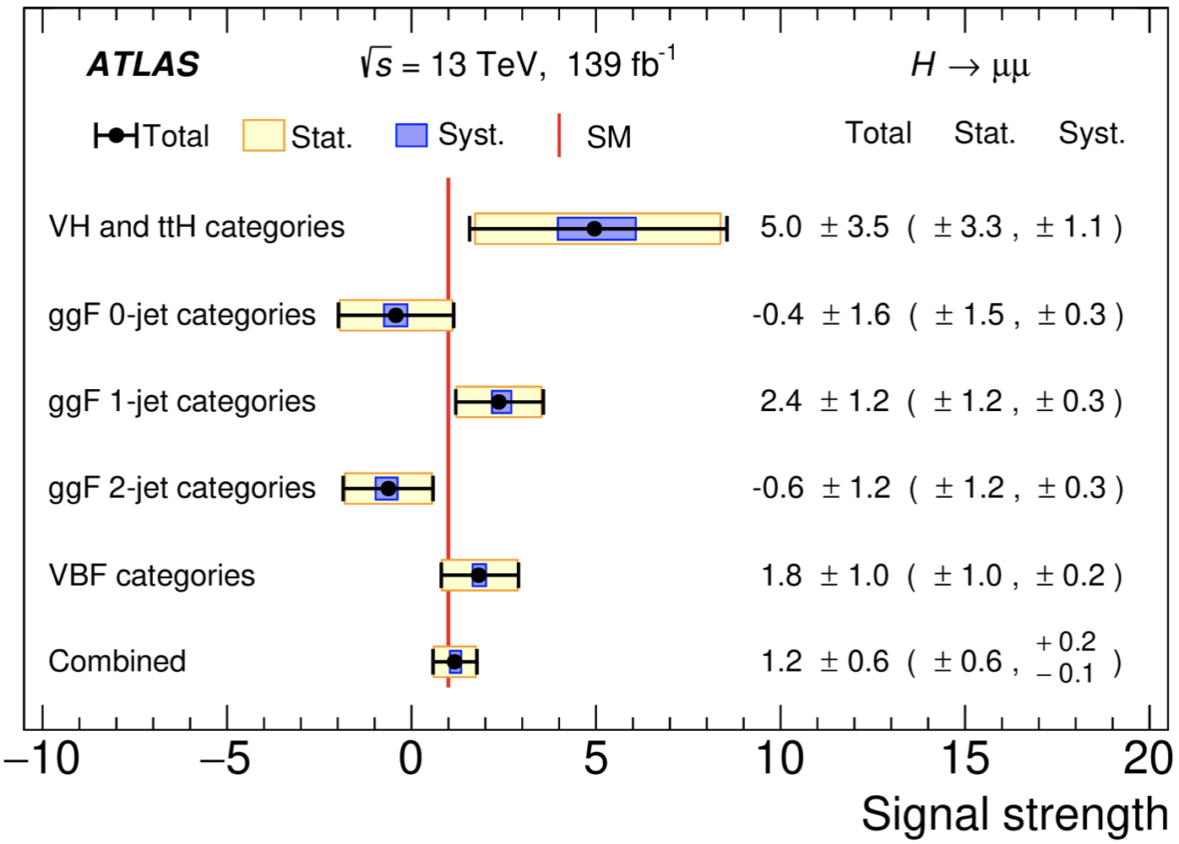
H→μμ Results
A simultaneous maximum-likelihood fit performed to the observed m_{μμ} spectra in 20 categories
The measured signal strength is:
Results are statistical uncertainty dominated
The obs. (exp.) significance is 2.0 (1.7) σ
Combined μ = 1.17
$$±0.58(Stat.)$$
$$\begin{matrix}+0.18 \\ −0.13\end{matrix}(sys.)$$
Phys. Lett. B 812 (2021) 135980
Phys. Rev. Lett. 119 (2017) 051802

Slide 40
Higgs Couplings
Up to now, five main production channels and five main decay channels observed and being used for measurements
Global signal strength: 1.05±0.06
Nature 607, 52–59 (2022)

Slide 41
Search for HH→bb𝜏𝜏

Slide 42
Higgs Potential Not Determined Yet
New physics (e.g. first order electroweak phase transition) can cause a significant deviation away from SM predicted Higgs potential
Measurements of Higgs self-coupling can provide discrimination between different scenarios/models
Ref: Phys. Rev. D 101, 075023 (2020)

Slide 43
HH Production
SM non-resonant HH: $σ_{HH}^{ggF}$= 31.05 fb, $σ_{HH}^{VBF}$= 1.72 fb
Direct access to Higgs self-coupling (κ_{λ}) and potential
VBF: unique process to probe HHVV coupling (κ_{2V})
Various BSM theories predict heavy resonances decaying into HH
Narrow width approximation
2HDM as benchmark model

Slide 44
bb𝜏𝜏 Final State
HH Branching Ratios
Di-𝜏 Branching Ratios
bb𝜏𝜏: moderate BR, relatively clean signature
Split into two channels depending on 𝜏 decay: 𝜏_{had}𝜏_{had} and 𝜏_{lep}𝜏_{had}

Slide 45
Event Selection
Signal signature: two b-jets (DNN-based tagger, 77%) and 𝜏_{had}𝜏_{had}/𝜏_{lep}𝜏_{had} with opposite charge
Trigger-dependent thresholds on e/μ/τ_{had} and jets
e/μ veto for 𝜏_{had}𝜏_{had}; exactly 1 e/μ for 𝜏_{lep}𝜏_{had}
$m_{ττ}^{MMC}$ > 60 GeV for all channels; m_{bb} < 150 GeV for 𝜏_{lep}𝜏_{had}
Signal region | Tau/Lepton | Trigger
𝜏_{had}𝜏_{had} | 2 hadronic 𝜏 | Single or Di-tau Trigger (STT/DTT)
𝜏_{lep}𝜏_{had} SLT | 1 hadronic 𝜏 + 1 e/μ | Single lepton trigger (SLT)
𝜏_{lep}𝜏_{had} LTT | 1 hadronic 𝜏 + 1 e/μ | Lepton+tau trigger (LTT)

Slide 46
Categorization Strategy
Rev. Phys. 5 (2020) 100045
Phys. Lett. B 800 (2020) 135103
BDT trained on κ_{λ}=10 ggF signal vs bkg.
BDT trained on SM ggF signal vs bkg.
BDT trained on SM VBF signal vs bkg.

Slide 47
ggF vs VBF Categorization BDT
BDT trained to separate ggF HH from VBF HH on events with 4 jets (two VBF-jet candidates + two H→bb)
Input variables: $m_{jj}^{VBF}$, Δ$R_{jj}^{VBF}$, η_{j1}×η_{j2}, etc
BDT cuts optimized in each SR to achieve the best limit on HH as well as constraint for κ_{λ} and κ_{2V}
VBF
ggF

Slide 48
Discriminant BDTs
In each SR, BDTs trained in low m_{HH}, high m_{HH} and VBF categories respectively and used as final discriminants
Input variables: m_{HH}, m_{bb}, $m_{ττ}^{MMC}$, ΔR(b,b), ΔR(𝜏,𝜏), $E_{T}^{miss}$, etc
Low m_{HH}
High m_{HH}
VBF

Slide 49
Discriminant BDTs in 𝜏_{lep}𝜏_{had}
SLT
LTT

Slide 50
Background Estimation
ttbar and Z+heavy-flavor processes: shape from simulation, normalizations determined from the control region
Single Higgs and other processes: estimated from simulation
Jets → fake 𝜏_{had} background: estimated with data-driven approach (including fake factor a.k.a. ABCD method and scale factor method)

Slide 51
Upper Limit on Non-resonant HH XS
No significant excess seen above the SM prediction (μ=1)
Obs. (exp.) limit on HH XS is 5.9 (3.1) × σ_{SM}
The exp. limit represents the best constraint on HH XS in single channel
Obs. limit higher than exp. due to a statistical fluctuation in the 𝜏_{lep}𝜏_{had} SLT high m_{HH} region
ATLAS-CONF-2023-071
Major uncertainties coming from data/MC statistics as well as theory unc. on top and single Higgs processes

Slide 52
Constraints for κ_{λ} and κ_{2V}
ATLAS-CONF-2023-071
Obs. (exp.) constraint on κ_{λ}: -3.2 ≤ κ_{λ} ≤ 9.1 (-2.5 ≤ κ_{λ} ≤ 9.2)
Obs. (exp.) constraint on κ_{2V}: -0.4 ≤ κ_{λ} ≤ 2.6 (-0.2 ≤ κ_{λ} ≤ 2.4)

Slide 53
Resonant Signal Extraction
Ref: Eur. Phys. J. C (2016) 76:235
500 GeV PNN
Parametrized neural networks (PNN) used as discriminant
Parametrized in mass of scalar (θ = m_{X})
Training variables same as non-resonant
It provides near-optimal sensitivity and continuity over the entire range
1 TeV PNN

Slide 54
Resonant HH→bb𝜏𝜏 Results
JHEP 07 (2023) 040
Obs. (exp.) upper limits: 920-23 fb (840-12 fb) depending on the mass region
Local (global) significance for 1 TeV is 3.0σ (2.0σ)

Slide 55
HH(+H) Combination

Slide 56
HH Combination
Performed statistical combination for different HH decay channels to maximize sensitivity to HH production
Considered three major channels: HH→bb𝜏𝜏, HH→bb𝛾𝛾 and HH→bbbb
Systematics correlated where appropriate (like luminosity, flavor tagging, signal theory uncertainties, etc)

Slide 57
κ_{λ} Constraint from Single Higgs
κ_{λ} also can be probed through NLO EW correction of single Higgs processes (e.g. in the production, decay, Higgs self-energy)
Combination of HH and single Higgs is expected to provide the most sensitive results of κ_{λ}

Slide 58
Results from HH+H Combination
Obs. (exp.) limits: 2.4 (2.9) × σ_{SM}
Obs. (exp.) κ_{λ} constraint: -0.4 ≤ κ_{λ} ≤ 6.3 (-1.9 ≤ κ_{λ} ≤ 7.6)
The best constraints on HH signal strength and κ_{λ} to date
Phys. Lett. B 843 (2023) 137745

Slide 59
Resonant HH Combination Result
No statistically significant excess found, largest excess at 1.1 TeV: local (global) significance is 3.2σ (2.1σ)
bb𝛾𝛾 dominates
bb𝜏𝜏 dominates
bbbb dominates
arXiv:2311.15956 (submitted to PRL)

Slide 60
Summary
Presented the Yukawa couplings and self-coupling studies based on the Run 2 dataset
The measurements are in line with the SM prediction, and the most stringent results obtained at ATLAS
The LHC Run 3 is expected to provide more room for exploring the Yukawa couplings and Higgs self-coupling
Possible evidence for H→μμ at ATLAS, observation combining ATLAS and CMS analyses

Slide 61
To Be Continued…
From Nima Arkani-Hamed

Slide 62
HL-LHC Projection
ATL-PHYS-PUB-2022-053

Slide 63
We Were Doing Better than Projection
ATL-PHYS-PUB-2015-046

Slide 64
We Were Doing Better than Projection
ATL-PHYS-PUB-2015-046
Obs. (exp.) limit on HH: 4.7 (3.9) × σ_{SM}
Obs. (exp.) κ_{λ} constraint: -2.4 ≤ κ_{λ} ≤ 9.2 (-2.0 ≤ κ_{λ} ≤ 9.0)
The HL-LHC projection (3 ab⁻¹) in 2015 was surpassed with just 139 fb⁻¹ data

Slide 65
Backup

Slide 67
Event Categorization
Categorization is done in Had and Lep regions separately
The boundaries are chosen to achieve a strong separation between CP-even and CP-odd signals, as well as a good sensitivity to ttH process

Slide 68
CP even
CP odd

Slide 70
JHEP 04 (2014) 004

Slide 71
H→μμ: FSR Recovery

Slide 72
Categorization Performance (1)
Calculated in the 120-130GeV region
Major sensitive ones are VBF, ggF 2-jet and 1-jet categories

Slide 73
Background Model Selection Criteria
P(𝝌2) > 1% for background only fits with
Data sideband
Full simulation
Fast simulation (before and after
reweighing to the data sidebands)
SS within 20% of the signal statistical unc. normalized to data statistics
Smallest degree of freedom
Smallest SS value
In the order of priority decreasing

Slide 74
Fake Factor Method
Combined FFs derived for ttbar and multi-jet in 𝜏_{lep}𝜏_{had}
ID: pass loose tau ID
Anti-ID: fail loose but with RNN > 0.01
FF method used for multi-jet in 𝜏_{had}𝜏_{had}

Slide 75
Scale Factor Method in 𝜏_{had}𝜏_{had}
Fake 𝜏_{had} from ttbar in 𝜏_{had}𝜏_{had} channel estimated using simulation
SFs used to correct 𝜏_{had} misidentification eff.: determined by fitting $m_{T}^{W}$ distribution of MC to data in ttbar CR of 𝜏_{lep}𝜏_{had} SLT category
1 prong: close to 1 below 40 GeV, ~0.6 above 70 GeV
3 prong: ~20% larger than the 1 prong SFs

Slide 76
Signal Acceptance × Efficiency
The acceptance times efficiency for the non-resonant ggF+VBF evaluated w.r.t. targeted 𝜏 decay modes
𝜏_{had}𝜏_{had}: 4.0%, 𝜏_{lep}𝜏_{had} SLT: 4.0%, 𝜏_{lep}𝜏_{had} LTT: 1.0%
Around factor 2 improvement on signal acceptance compared with previous publication*
Driven by improved reconstruction and identification of 𝜏_{had} and b-jets**
*Phys. Rev. Lett. 121, 191801
**ATL-PHYS-PUB-2017-003, ATL-PHYS-PUB-2017-013, ATL-PHYS-PUB-2019-033

Slide 77
κ_{λ}-dependence of XS and BR
Cross section
Decay BR

Slide 78
BSM Physics in HH Processes
Anomalous κ_{λ} would result in enhanced HH XS and modified kinematics of the process due to different contributions and interference of diagrams
JHEP04 (2013) 151
Rev. Phys. 5 (2020) 100045
Phys. Lett. B 800 (2020) 135103

Slide 79
ggF HH cross section depends on κ_{λ} and κ_{t}
Any (κ_{λ} , κ_{t}) can be obtained via a linear combination of three basis samples at different κ_{λ} values with κ_{t} = 1

Slide 80
VBF HH XS depends on κ_{2V}, κ_{λ} and κ_{V}
A linear combination of 6 samples with different (κ_{2V}, κ_{λ}, κ_{V}) values
Rank 1 basis used

Slide 81
Flavor Tagging Improvement
Likelihood-based calibration
provides >2x reduction in uncertainties
Move to a higher b-tagging efficiency WP (70% → 77%)

Slide 82
𝜏 Identification Improvement
RNN ID shows 2x improvement compared with BDT
Moved from “medium” to “loose” WP
Per-tau efficiency:
1-prong: 75% → 85%
3-prong: 60% → 75%

