Slide 1
Evidence of the baryonic decay $D_{s}^{∗+}→p\overline{n}$
Reporter : Ruoyun Ma
Nov. 19, 2023
2202183057@stu.htu.edu.cn

Slide 2
Outline
Motivation
Data sample
Analysis method
Single tag selection and yield
Double tag selection
Background analysis
Summary and Next to do

Slide 3
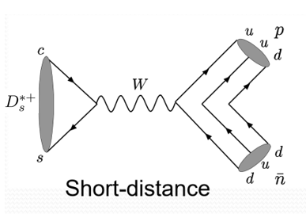
Motivation
$D_{s}^{∗+}→p\overline{n}$ provide a probe to study of weak annihilation decays of charmed mesons
$ℬ(D_{s}^{∗+}→p\overline{n}$) $∼$None [PDG, PTEP 2022 (2022) 083C01]
First measurement of the baryonic decay $D_{s}^{∗+}→p\overline{n}$

Slide 4
Data Sample
BOSS Version: 7.0.3 $\sqrt{s}=4.178 GeV$
Data Sample
2016: 3.19${fb}^{−1}$
Signal MC (Double tag efficiencies & Signal shape)
$D_{s}^{−}$ decays generically(tag models)
Signal model $D_{s}^{∗+}→p\overline{n}$ (PHSP)
Inclusive MC(Tag efficiencies & Background check & IO check)
$10×$ the data set

Slide 5
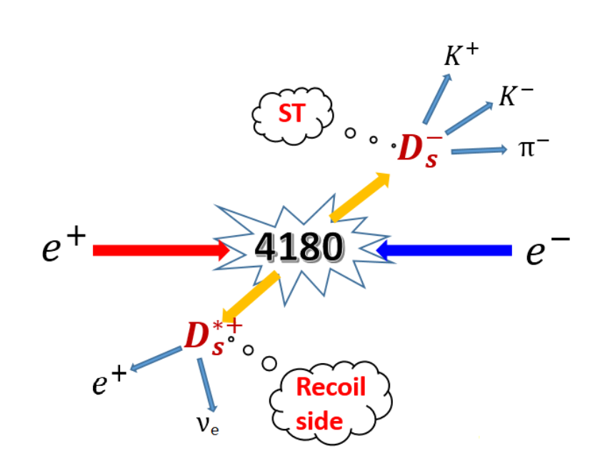
Analysis Method
The branching fraction of $D_{s}^{∗+}→p\overline{n}$ is determined by
$Br\left(D_{s}^{∗+}→p\overline{n}\right)=\frac{N_{DT}^{tot}}{\sum_{i}{N_{ST}^{i}}∙ε_{DT}^{i}/ε_{ST}^{i}}$ ($i=$specific tag mode)

Slide 6
Analysis Method
Single tag modes

Slide 7
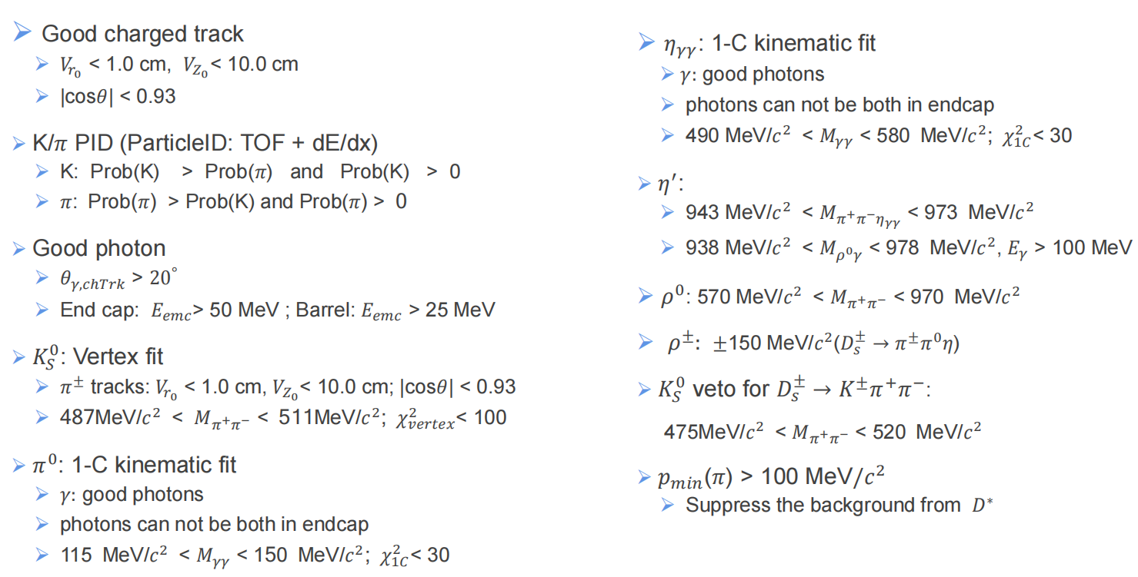
Single Tag Selection
$$D_{s}^{−}$$

Slide 8
Single Tag Selection
One single tag candidate per charge per mode per event
For multiple candidates, choose minimum| $M_{D_{s}^{−}} −m_{D_{s}^{−}}$|
ST mode ranges are about $3σ$ region of $M_{D_{s}^{−}}$
Tag mode | Mass Region(GeV/ ) | Tag mode | Mass Region(GeV/ )
 | (1.950 , 1.986) |  | (1.947 , 1.990)
 | (1.948 , 1.991) |  | (1.920 , 2.000)
 | (1.930 , 2.000) |  | (1.935 , 1.990)
 | (1.938 , 1.997) |  | (1.953 , 1.983)
 | (1.940 , 1.987) |  | (1.935 , 1.990)
 | (1.950 , 1.987) |  | (1.995 , 1.982)

Slide 9
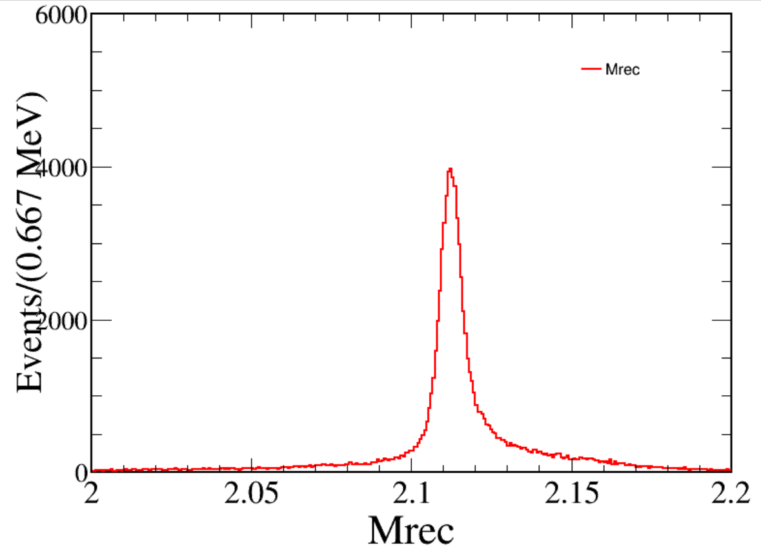
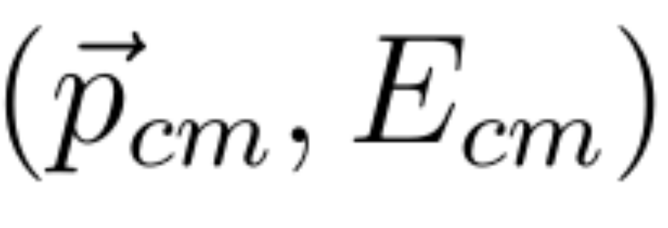
Single Tag Yields
ST yields are determined by fitting the $M_{rec}$ distributions of each ST mode
The recoil mass of ST $D_{s}^{−}$ mesons
is the four momentum of the systrm;
is the measured momentum of the ST candidate.

Slide 10
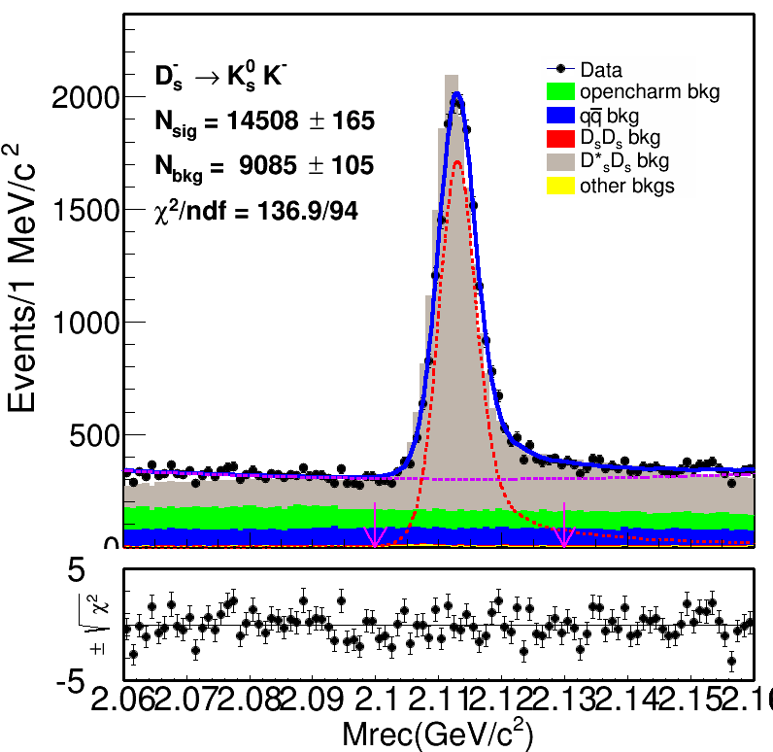
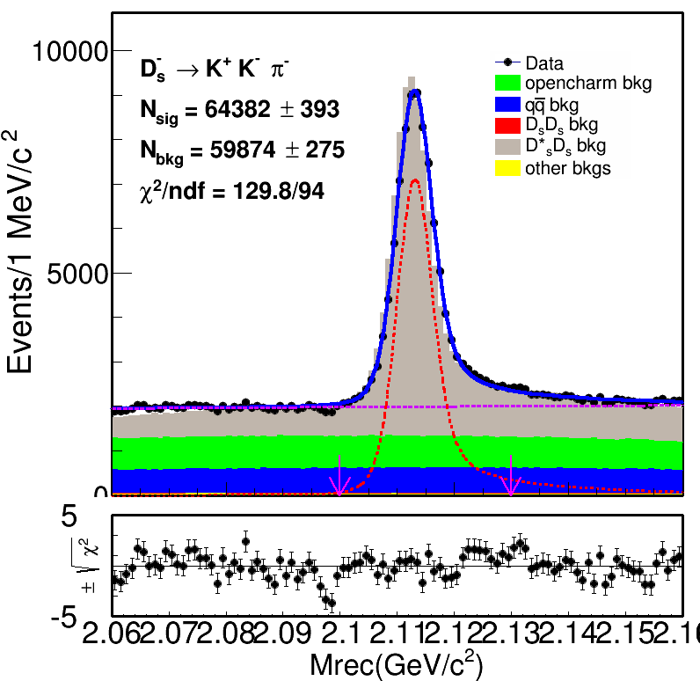
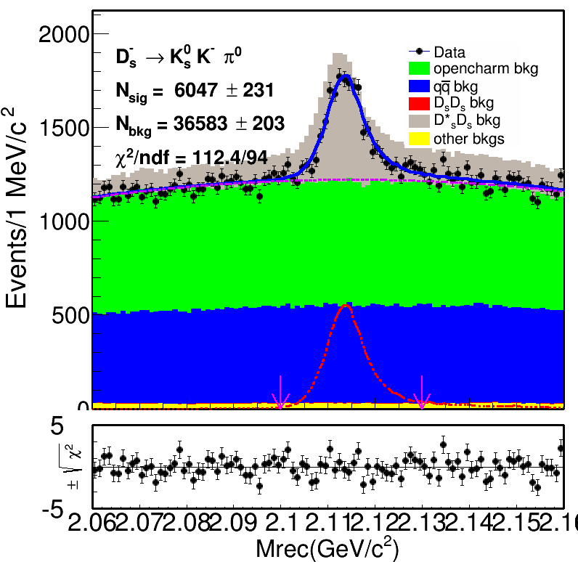
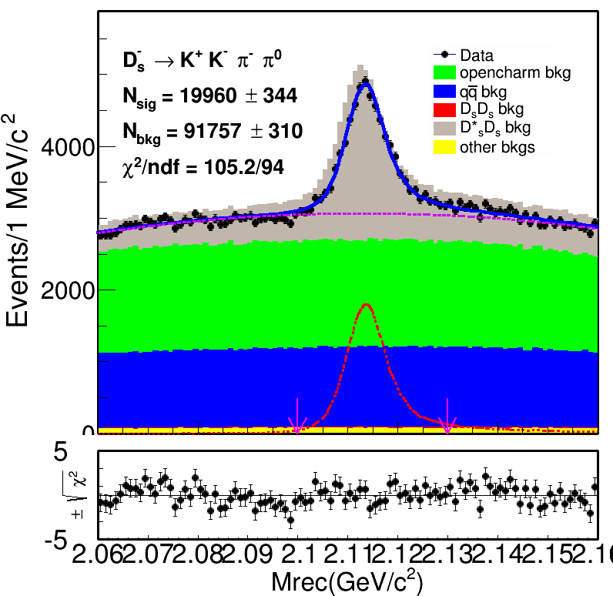
Single Tag Yields 4.178 GeV
Fit the $M_{rec}$ distributions in data
Truth matched signal shape gauss + 2nd Chebychev Polynomial

Slide 11
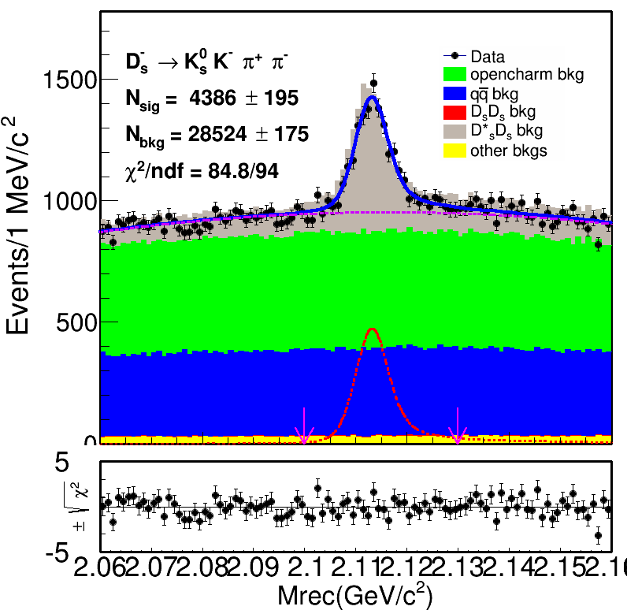
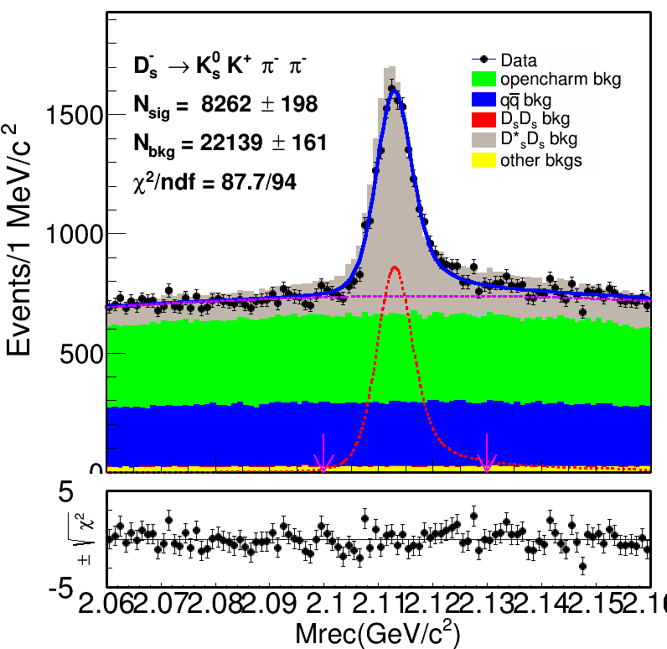
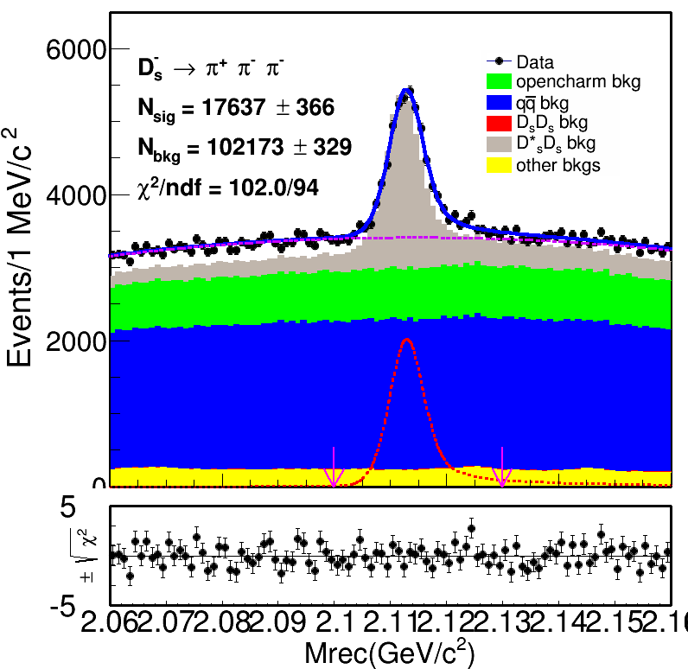
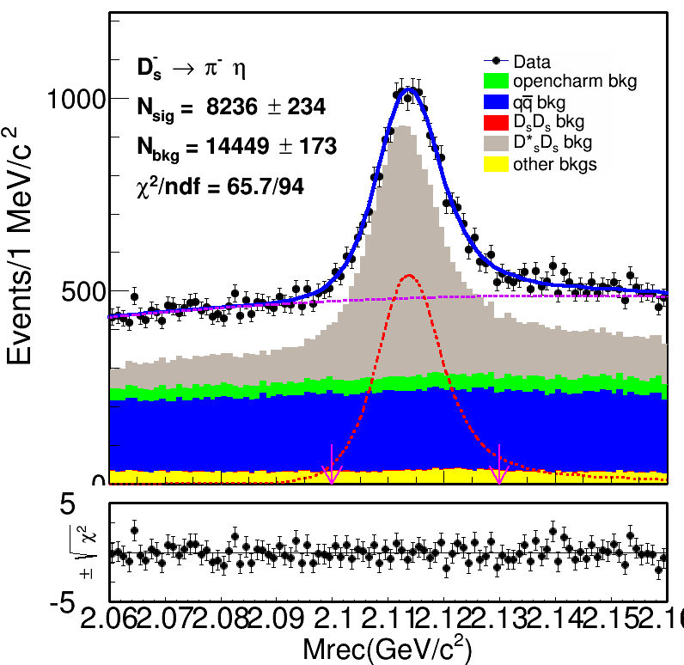
Single Tag Yields 4.178 GeV
Fit the $M_{rec}$ distributions in data
Truth matched signal shape gauss + 2nd Chebychev Polynomial

Slide 12
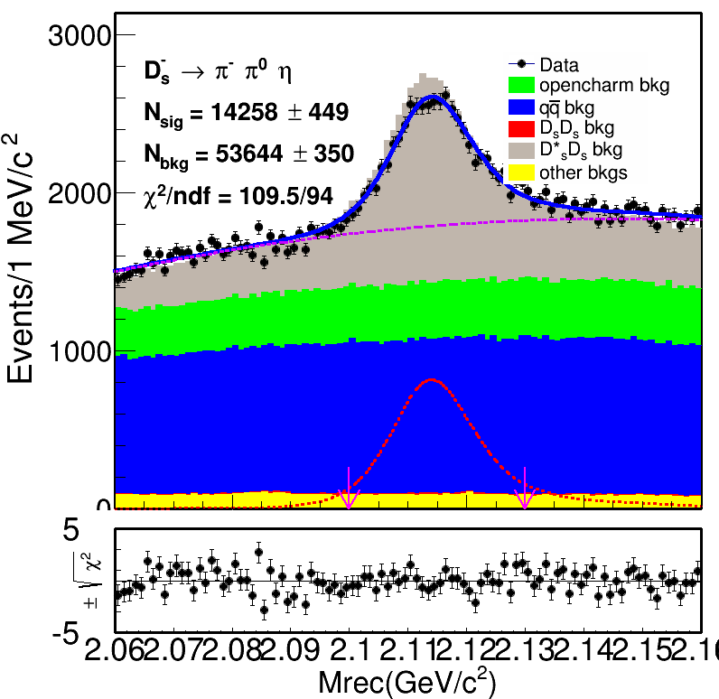
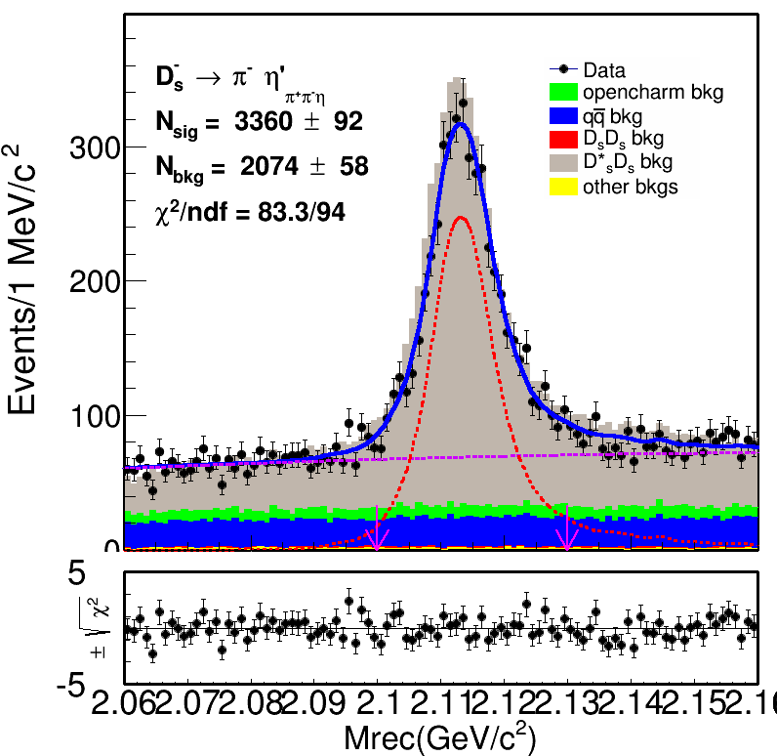
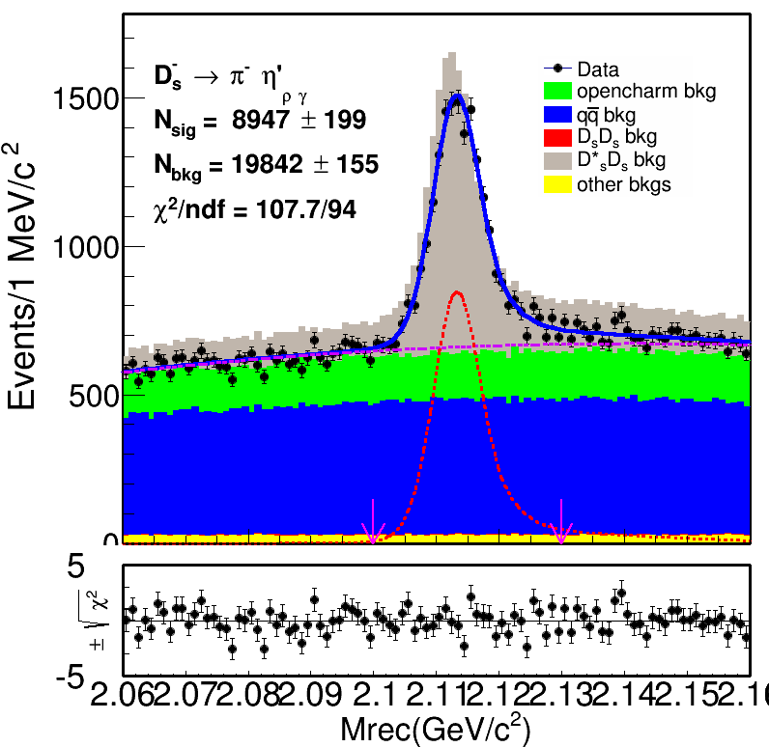
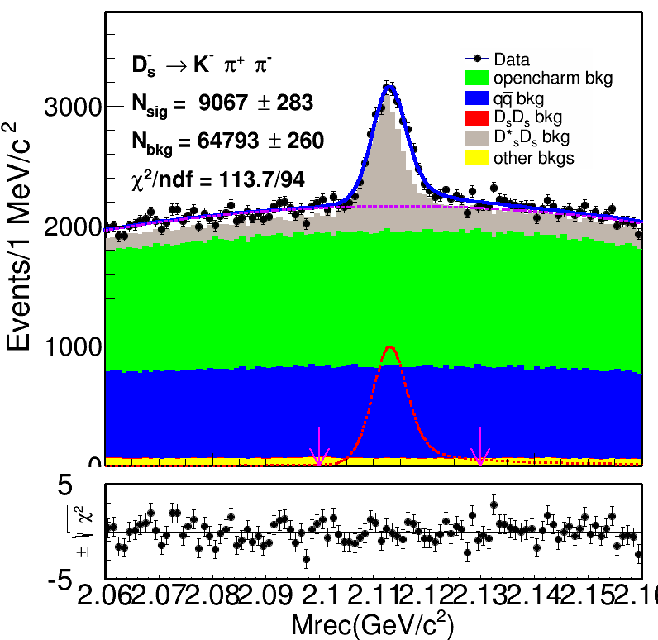
Single Tag Yields 4.178 GeV
Fit the $M_{rec}$ distributions in data
Truth matched signal shape gauss + 2nd Chebychev Polynomial

Slide 13
Single Tag Yields 4.178 GeV
ST yields of data
Tag mode

Slide 14
Single Tag Efficiency
ST efficiencies $ε_{ST}=N_{fit}/N_{gen}$
$N_{fit}$ is determined by fitting $M_{rec}$ distributions in inclusive MC (01 ~ 10 round)
$N_{gen}$ is determined by counting according to the truth information
Tag mode

Slide 15
Double Tag Selection
For the double tag, we require that there is only one track at the signal side to be identified as a proton
Good charged track
cm; cm;
Proton/anti-proton selection
Prob(p) >Prob(K)&Prob(p)>Prob( )&Prob(p)>0.001

Slide 16
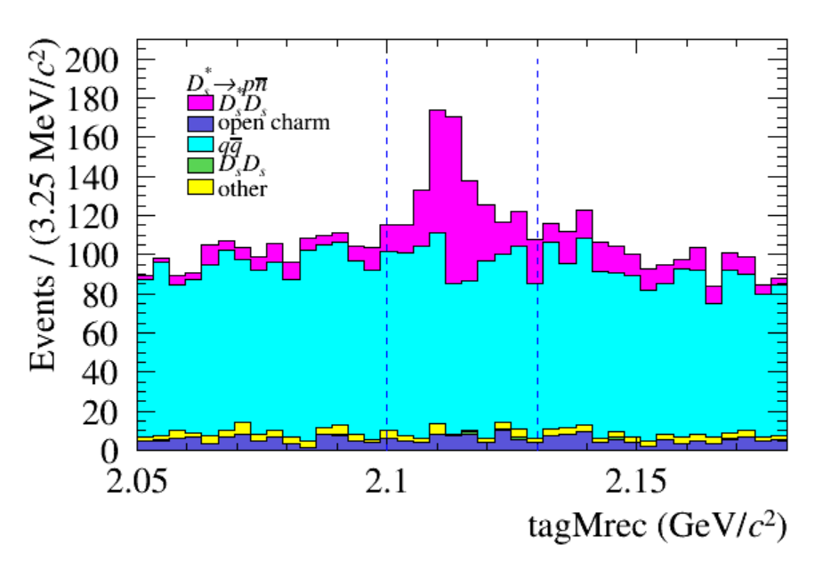
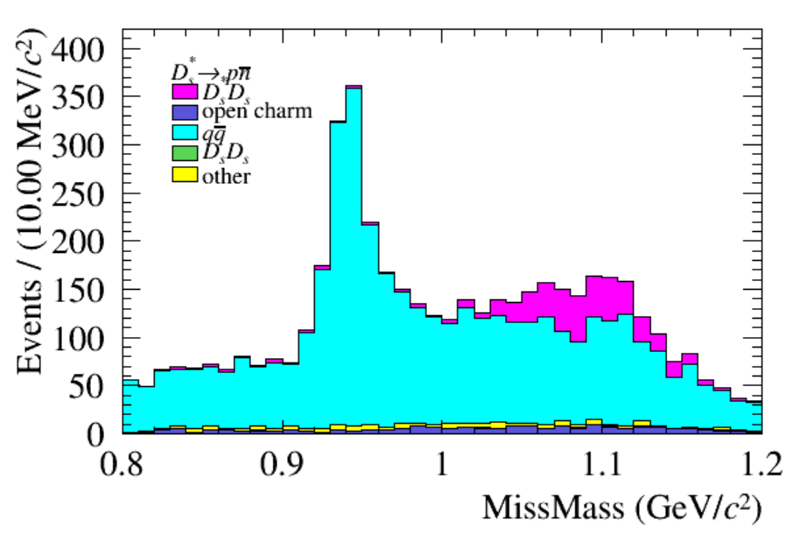
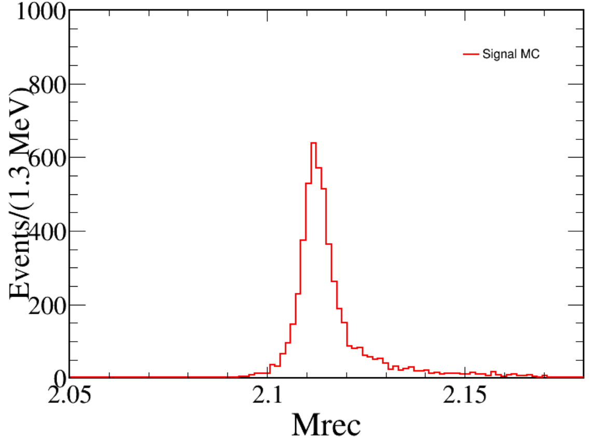
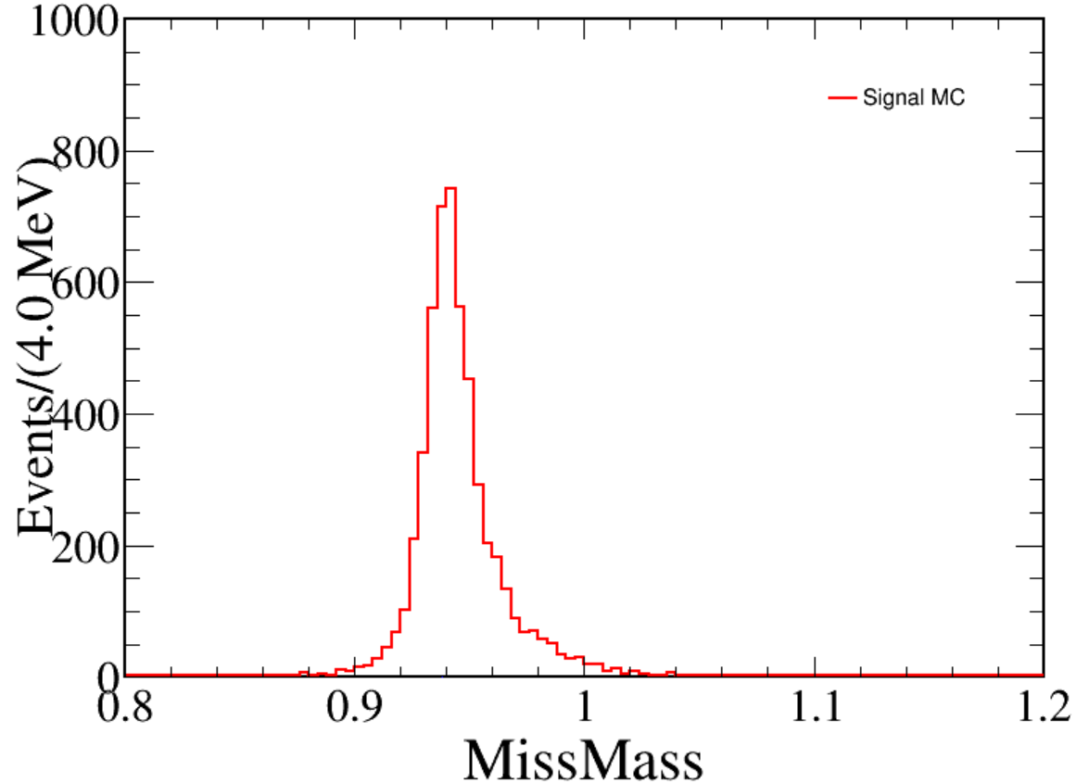
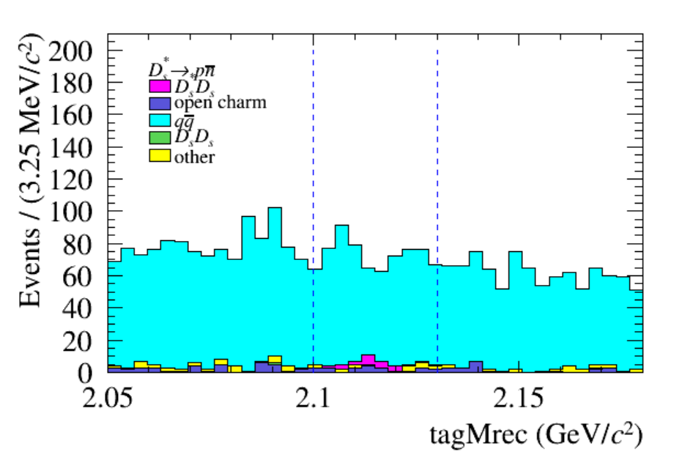
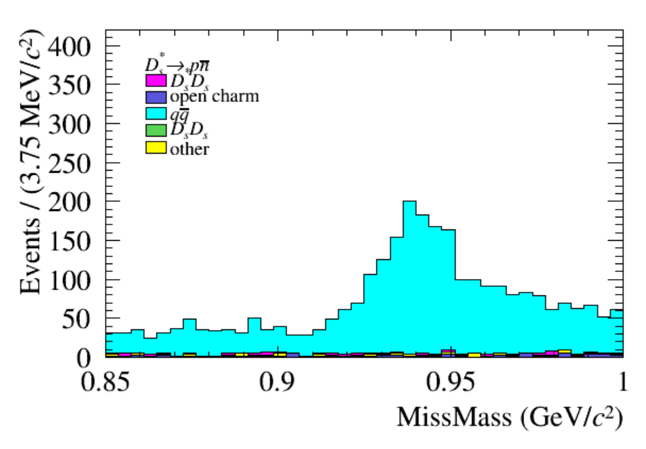
Background Analysis
Two main backgrounds
true proton/anti-proton from qqbar
DT yields are determined by fitting the single tag $M_{rec}$ and $M_{miss}$
Background shape
Signal MC shape ：
MIssMass (0.85 ,1.00)
tagMrec (2.05 ,2.18)

Slide 17
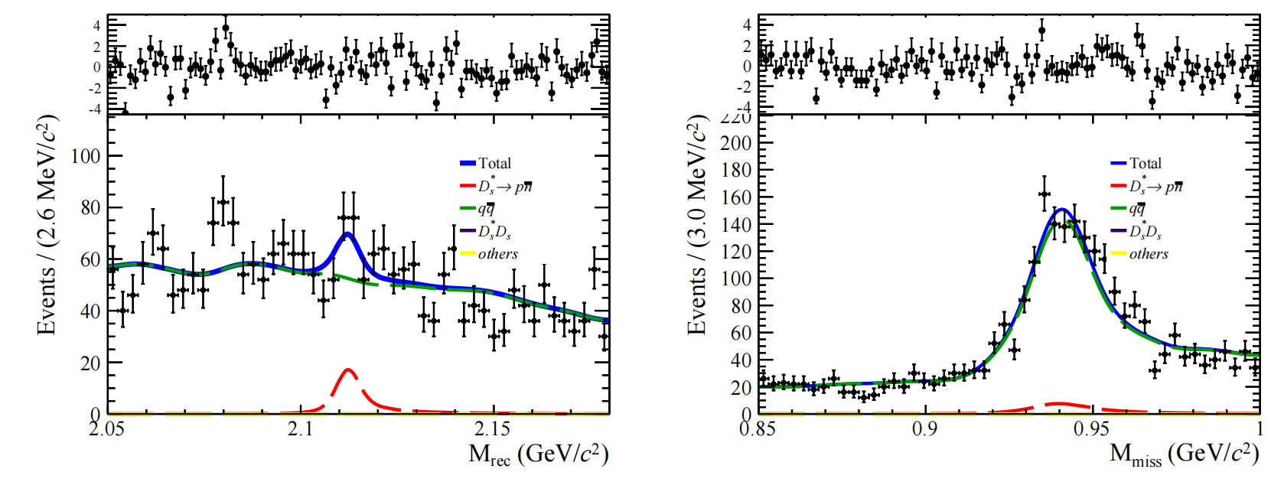
Result
Two - dimensional fitting $M_{rec}$ and $M_{miss}$ distributions
Signal significance :3.8

Slide 18
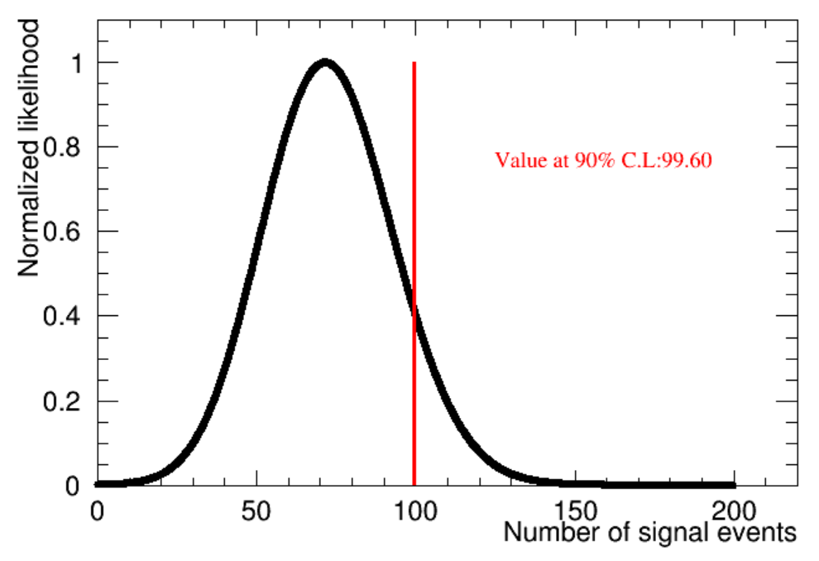
Result
Upper limit
Profile likelihood scan on signal yields without systematic uncertainties
Estimate upper limit at 90% C.L.
The upper limit on the number of signal events is 99.6

Slide 19
Summary and Next to do
The expected upper limit on the number of signal events is estimated to be $99.6@$ 90% CL
In the current analysis, we used inclusive Monte Carlo simulation at 10 times the energy of 4.178 GeV
We will analyze the inclusive Monte Carlo simulation at 40 times in future
4.178 GeV → 4.13GeV; 4.16GeV; 4.19GeV; 4.20GeV; 4.21GeV; 4.22GeV; 4.23GeV

