Slide 1
HCAL clustering algorithm based on cellular automaton
Weizheng Song
23.12.6

Slide 2
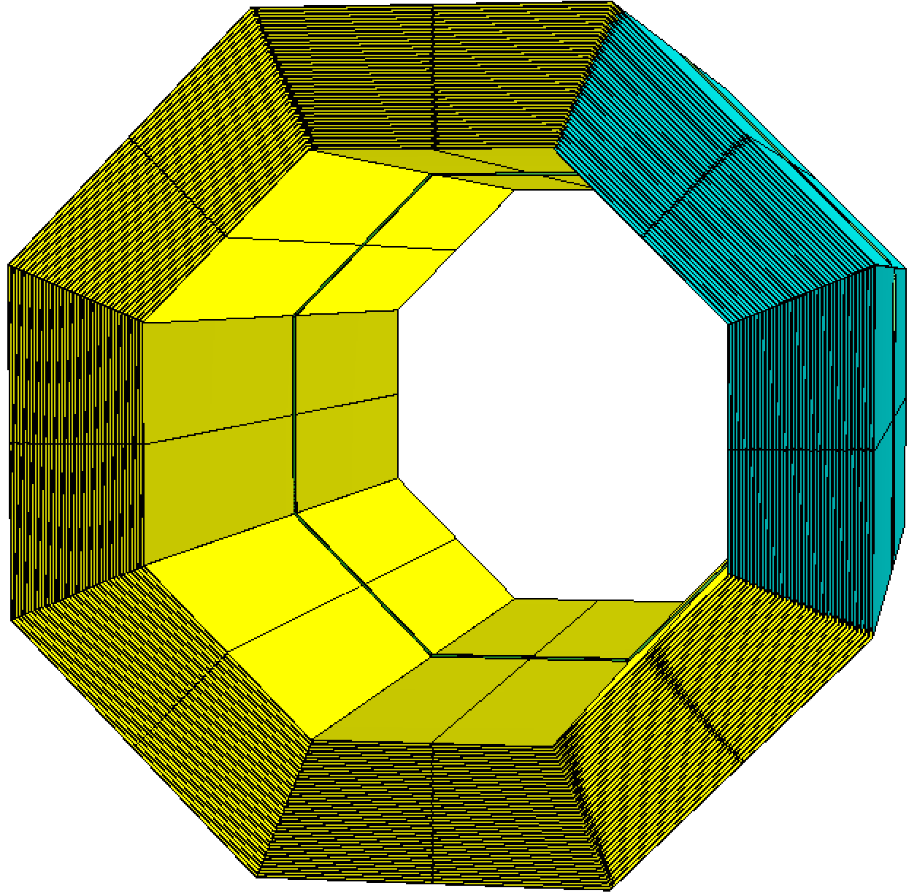
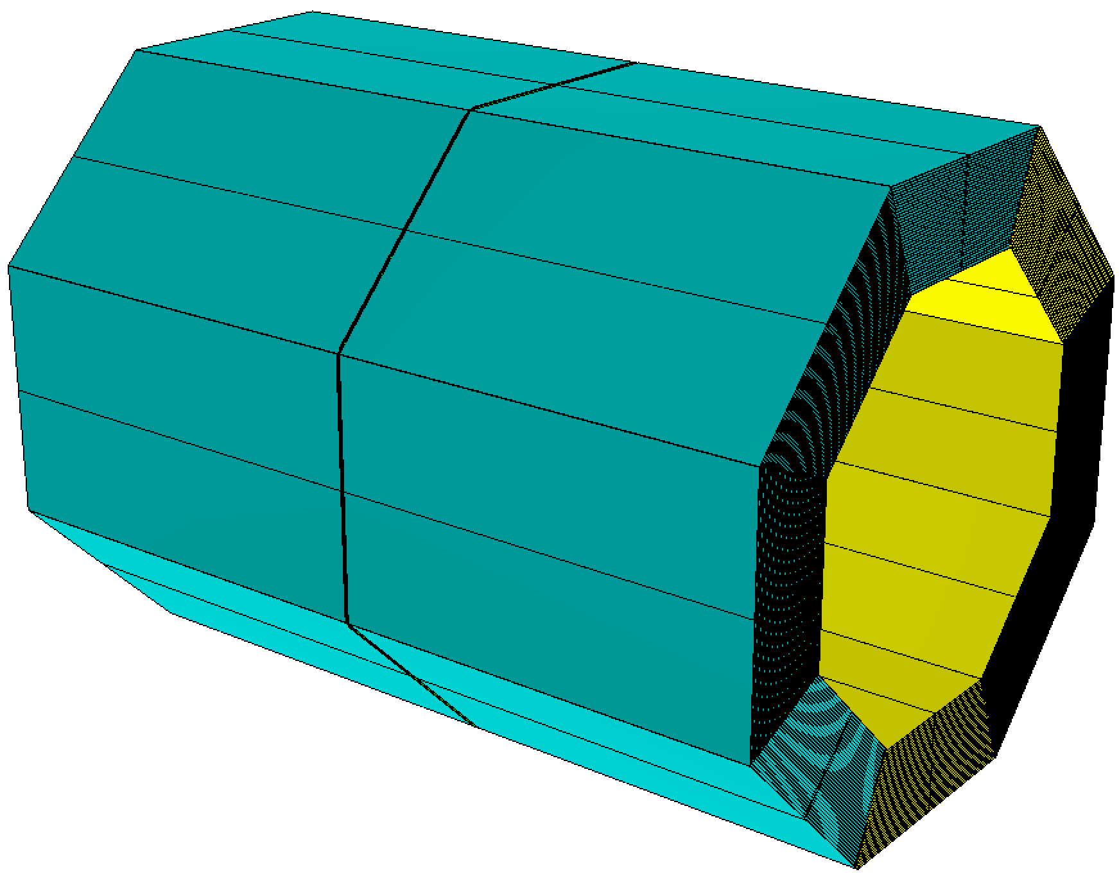
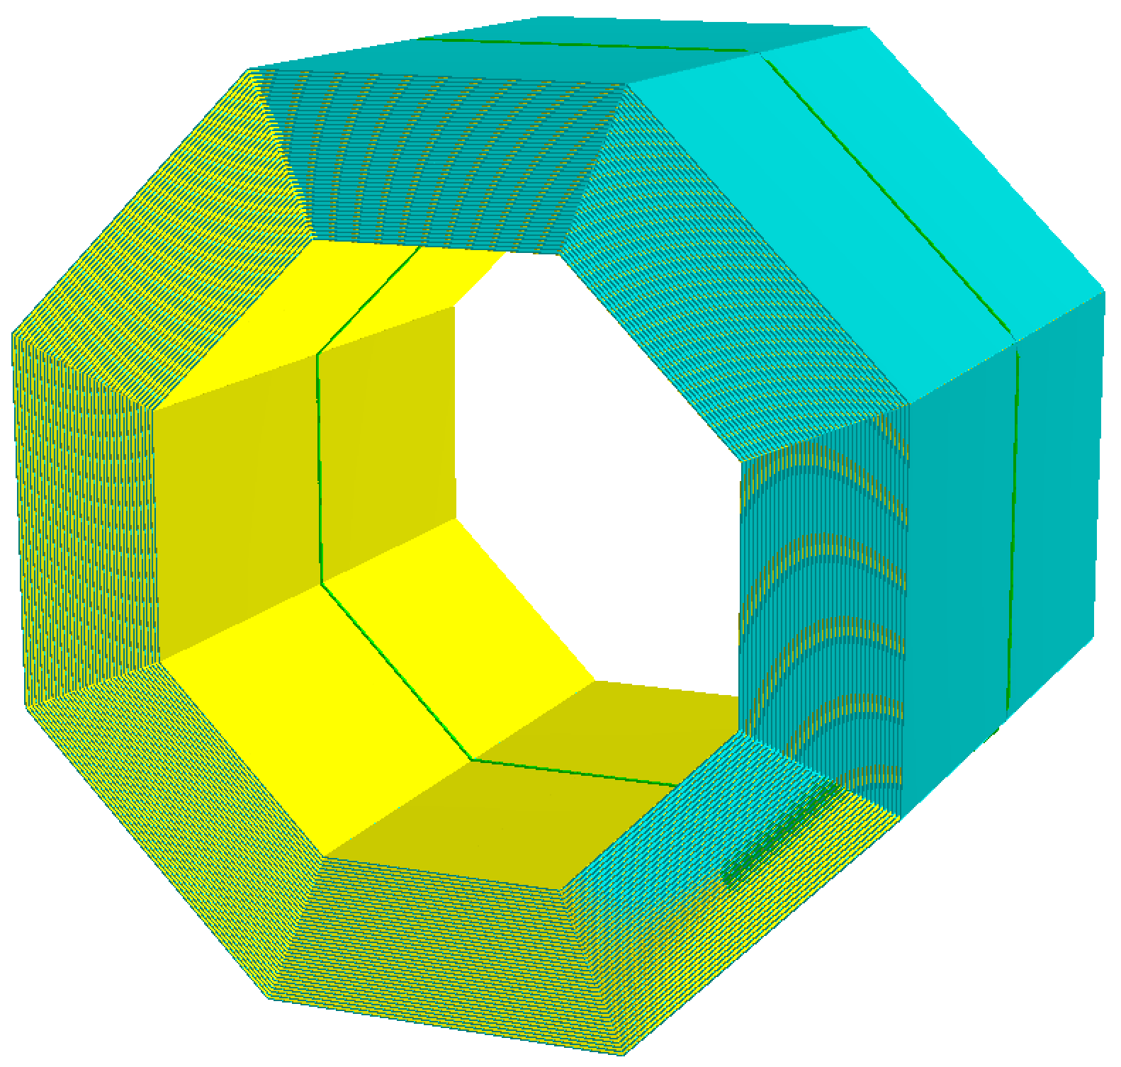
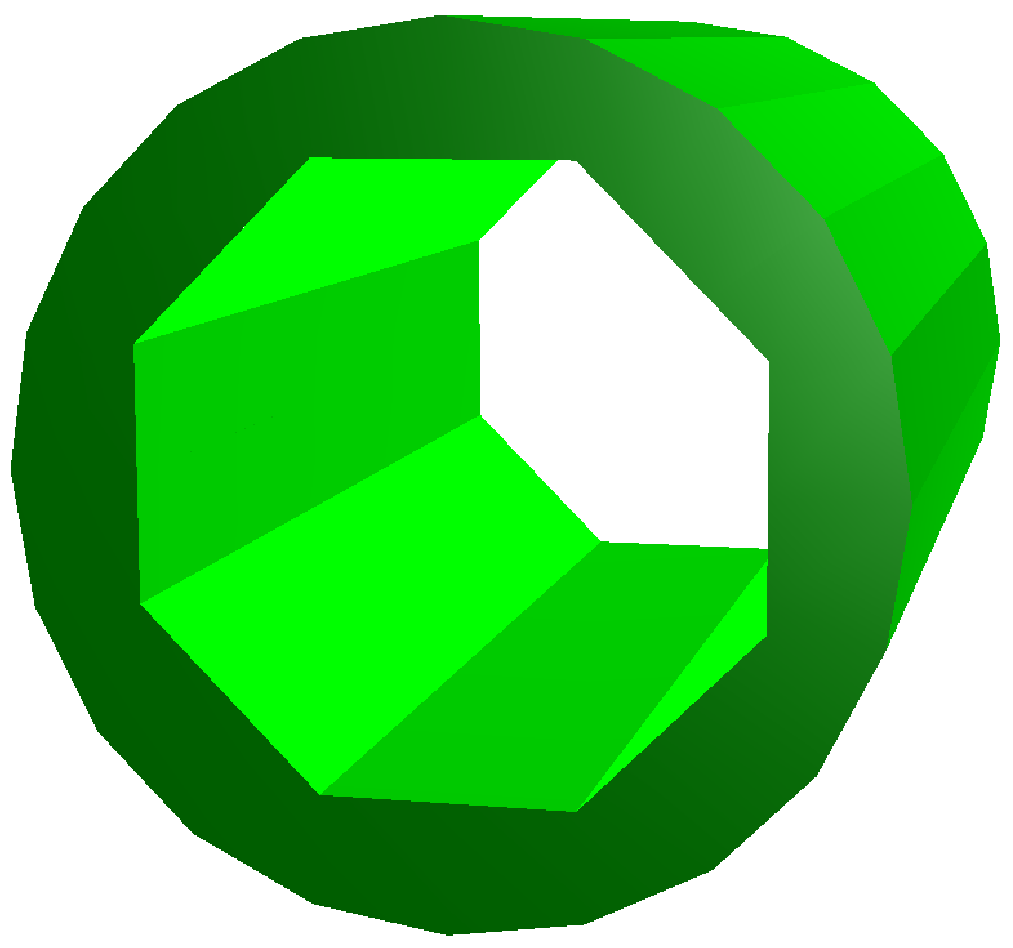
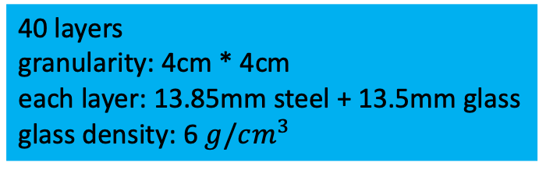
HCAL geometry
CEPCSW & DD4HEP
AHCAL
GSHCAL
8960mm
3491mm
&
2150mm
need more validation
40 layers
granularity: 4cm * 4cm
each layer: 26.5mm: 20mm steel + 3mm scintillant
40 layers
granularity: 4cm * 4cm
each layer: 13.85mm steel + 13.5mm glass
glass density: 6 $g/cm^{3}$

Slide 3
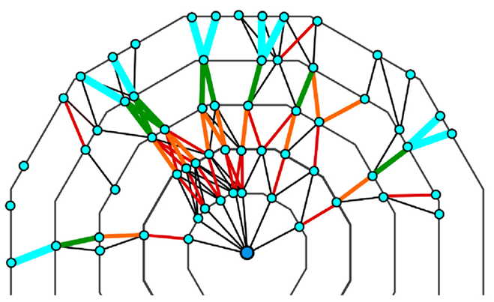
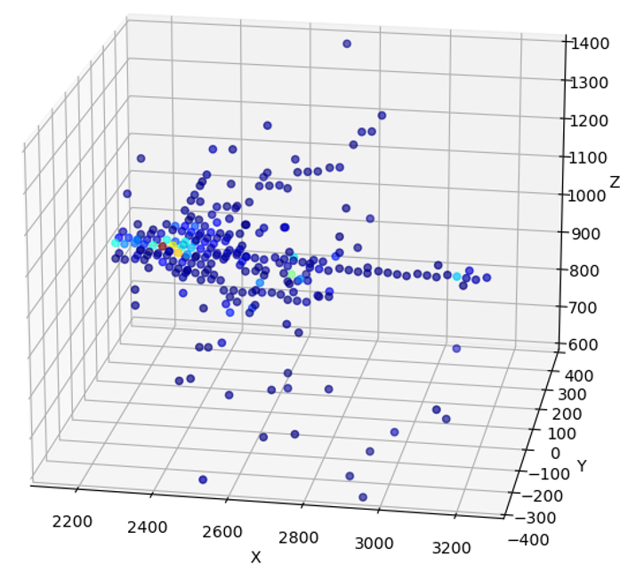
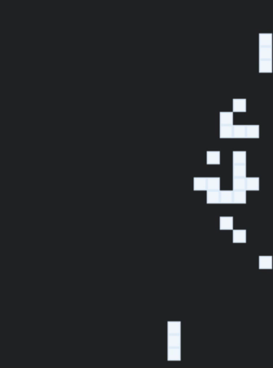
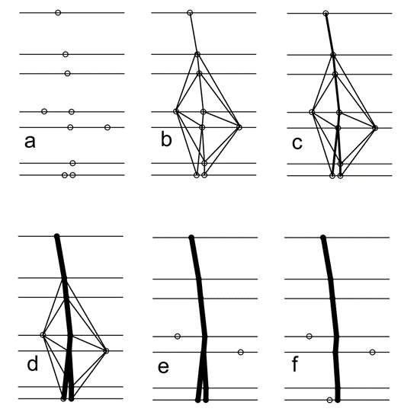
Cellular automaton & HCAL clustering
Cellular automaton is a discrete dynamic system whose behavior is completely determined by local mutual relations of states of these systems
cell has two state (on or off)
each cell updates its status in response to what happens to its neighboring cells
track like
Cellular
automaton
Track
Finding
HCAL
Clustering
reconstructing hadronic showers
identifying individual particles

Slide 4
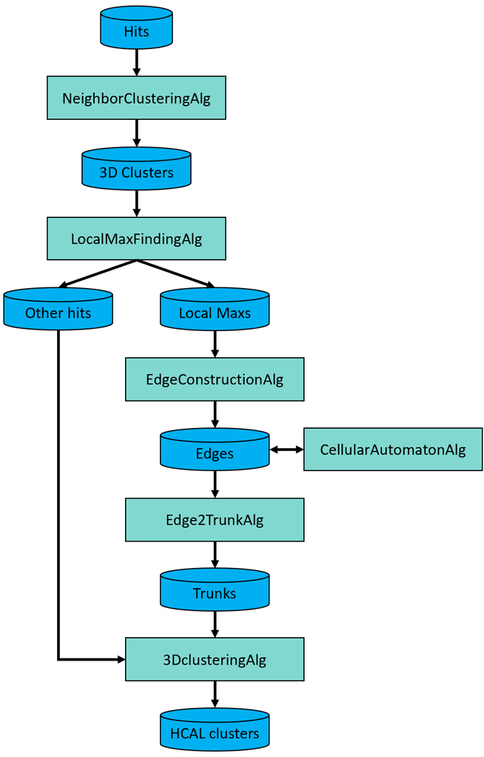
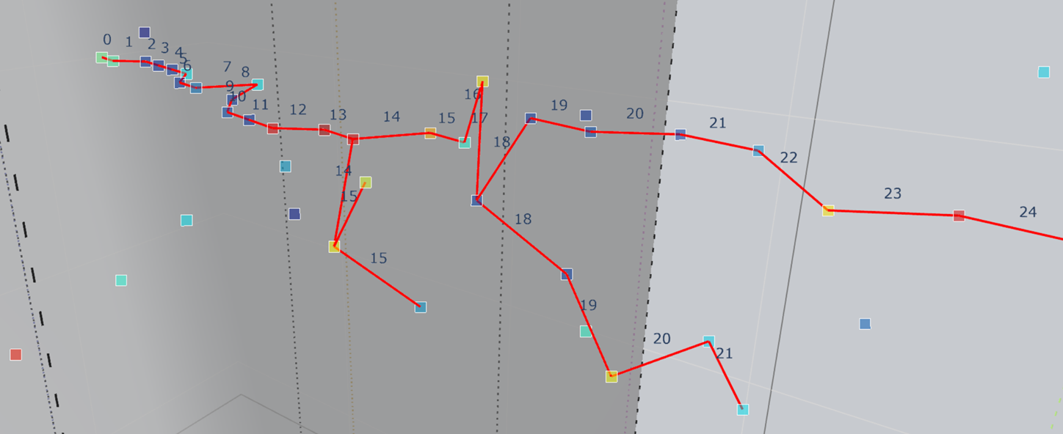
Preliminary results of cellular automaton
local maximum
edge
particle candidate

Slide 5
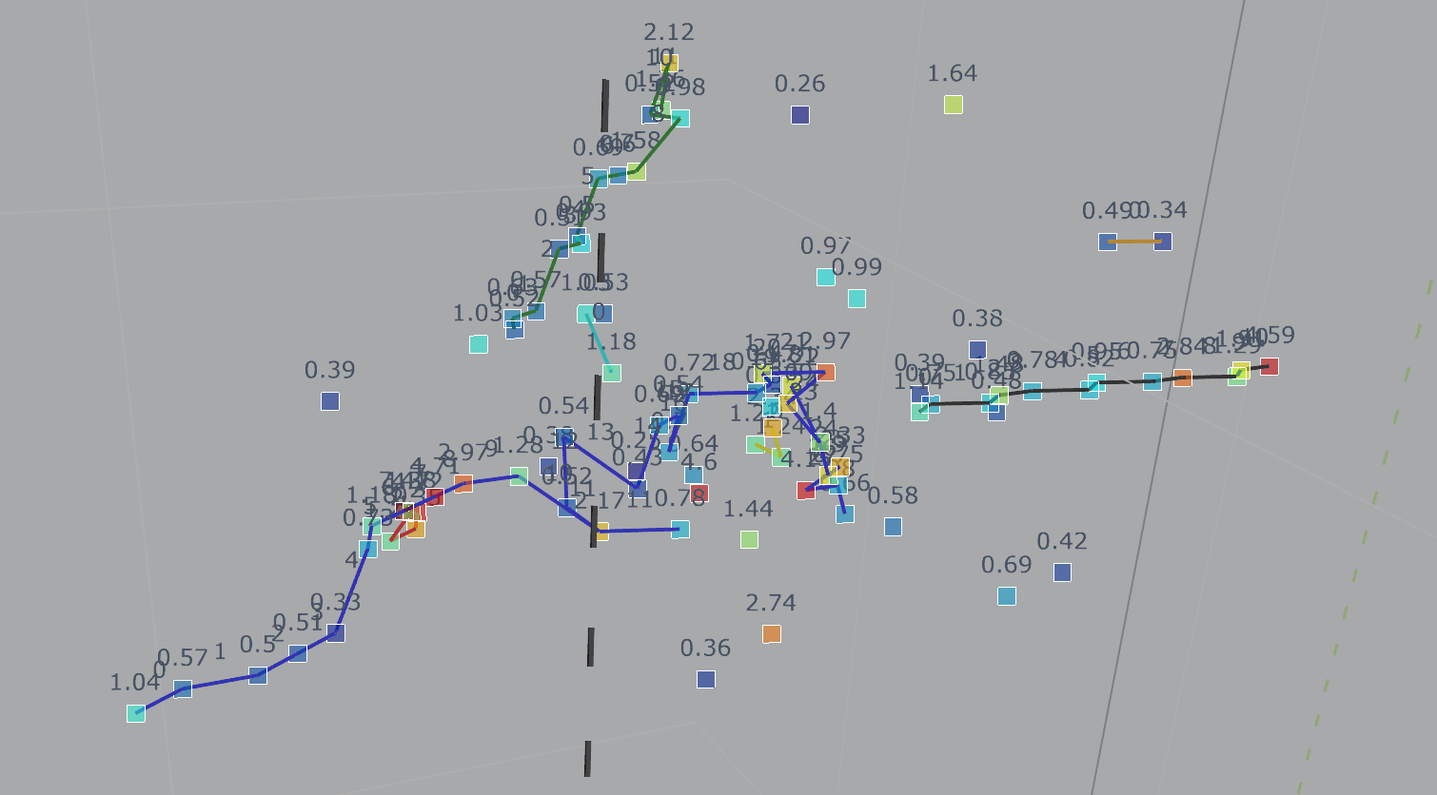
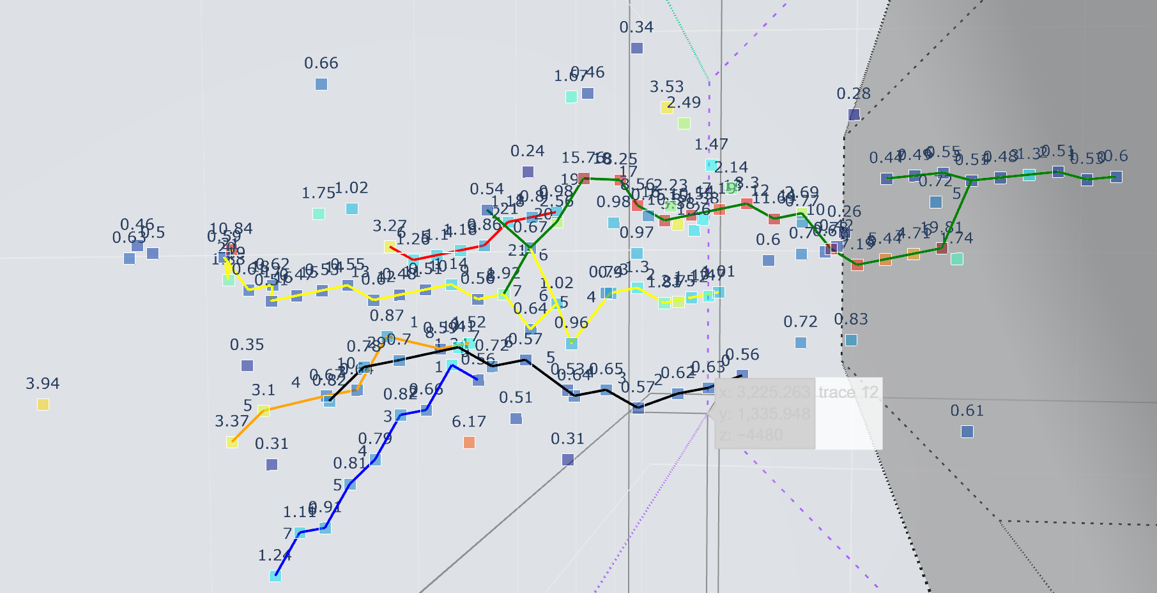
The road ahead
single
hadron
overlapping
particles
need more performance check and optimization

