Slide 1
Status of Stereo Crystal ECal
Huaqiao Zhang, Xiao Zhao(IHEP, Beijing)
Chengdong Fu, Fangyi Guo (CEPC software)
Yong Liu, Gang Li, Qian Liu, Manqi, Shengsun, Jianbei, Jianchun,Joao et. al…

Slide 2
Outline
The design of SCEcal
The simulation of SCEcal
Energy and 3D position resolution
γ/γ and γ/π separation
Higgs → γγ mass resolution
PFA H→di-jet mass resolution (developing)
Summary

Slide 3
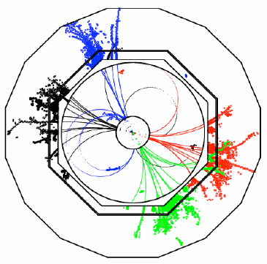
Requirement of a CEPC PFA calorimeter
CEPC Physics requirements
Precision measurements with Higgs and Z/W
Jet energy resolution (dEjet/Ejet- 3~4%)
Charged particles : 65% (tracker)
Photons: 25% (ECAL)
Neutral Hadrons: 10% (HCAL + ECAL)
PFA based Calorimeter (CEPC)
Good Shower separation
Small Moliere radius (Dense detector)
High lateral granularity (~Moliere radius)
Good Energy resolution
Critical in some special process
Sophisticate algorithm
Multi-million channels(energy and timing)
Multi-Dimensional information
Overlap removal

Slide 4
Stereo Crystal Electromagnetic Calorimeter: Basic idea
Crystal module
Crystal not pointing back to IP(Z axis)
Angle with inner det. radius is 𝛼
𝛼 = 0; point to IP(Z axis)
𝛼 <= 90 degrees
Segmentation along R
Ex: N_l = 10 layers
Uniform along Z
Ex: 1 cm each seg.
Total crystal volumme
pi*(r2^2-r1^2) * Z
Use BGO as baseline
~20.5 radiation length
Readout and mounting at R2 surface
𝛼
D
readout
r2
phi
r1
CEPC: Z = 6.7 m
r1 = 1.9 m, r2 = 2.2 m
Total volume: 26 m³
𝛼=0
Cylindrical coordinate system
（Z, R, phi）

Slide 5
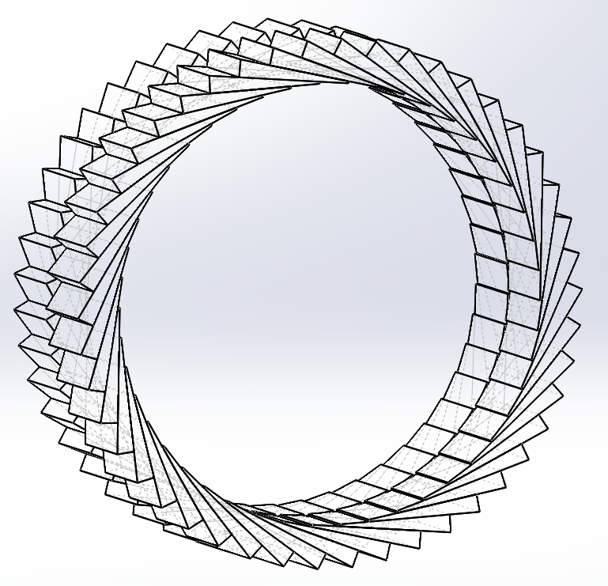
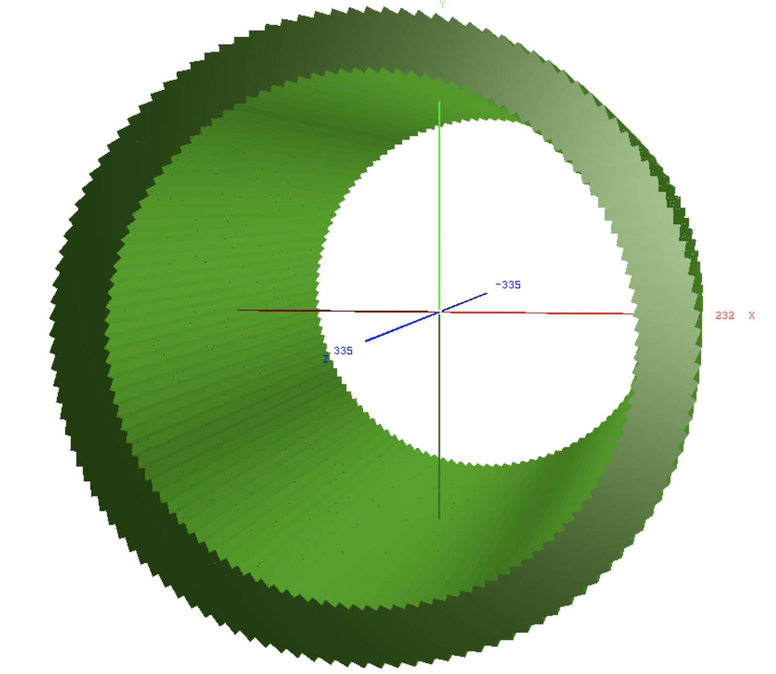
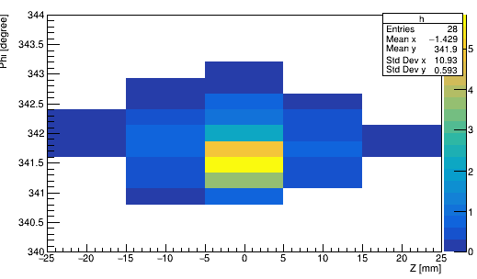
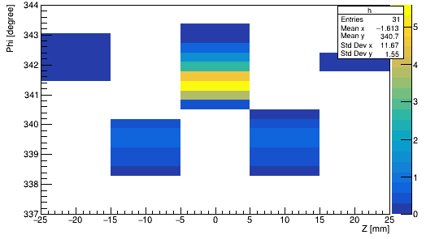
Stereo Crystal Electromagnetic Calorimeter: Design
To improve the 3D position resolution
Pointing angle of even layers alone Z: 𝛼
Pointing angle of odd layers alone Z： 𝛼’= -𝛼
Not proportional to real angle/size
Traditional Crystal Ecal
SCEcal
Left eye
Right eye

Slide 6
Analytical optimization of SCECal geometry
3 DoF. determined the full barrel design (For a given R1, R2)
𝛼: [0,90] : pointing angle
N_l:[1,2,3….]: samplings along R
correlate with the crystal size along phi and 𝛼; Typically ~1 cm
Z: for the moment choose 1 cm segmentation, uniformly
Crystal length D = sqrt(r2^2 – r1^2*sin(𝛼)^2) – r1*cos𝛼
Crystal bar open phi angle phi=acos(r2^2 + r1^2 -D^2)/(2*r1*r2)
Phi segmentation = phi/N_l
Total number of crystal bars per Z segmentation: 2*pi*N_l/phi
Shower depth along r S_{n} at n^{th} layer:
S_{n} = F_{n+1} – F_{n}
F_{n}= r1* ( sin𝛼 /sin(𝛼 –n*phi/N_l) – 1 )
Crystal thickness x_{n}:
x_{n}=S_{n}*sin(𝛼 –n*phi/N_l)

Slide 7
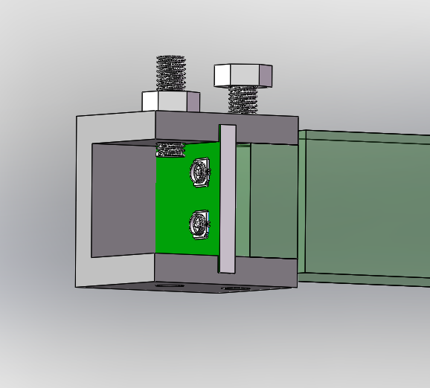
Design of Endcap SCECal
New
Total shape looks like bottle stopper
Option 1:
Similar idea of pointing angle definition along phi for each layer with same polar angle.
Adjacent layers(same polar angle) with reversed pointing angle
Option 2:
The pointing angle defined as angle between beam direction in (ex. Horizontal plane) for crystals in the same horizontal plate
Adjacent layers(same horizontal plane) with reversed pointing angle
SiPM Readout and mounting at outside plane(same as Barrel)
not in Simulation yet
BGO+SiPM

Slide 8
Introduction of SCECal simulation
Simulation and reconstruction done using CEPCSW
Geometry implemented by Chengdong FU
Crystals without wrapper/gap etc. (not reality)
Simulation readout using carloStep info (no digitization)
Reconstruction code initially provided by Fangyi Guo
Development and reconfiguration by Huaqiao Zhang and X. Zhao
Performance of Energy, position resolution of photon:
Different R segmentations tested: 5/10/14 layers
10 layers turn out to be the best
Different recontruction method:
Under developing
The following study based on 10 layers segmentation on R

Slide 9
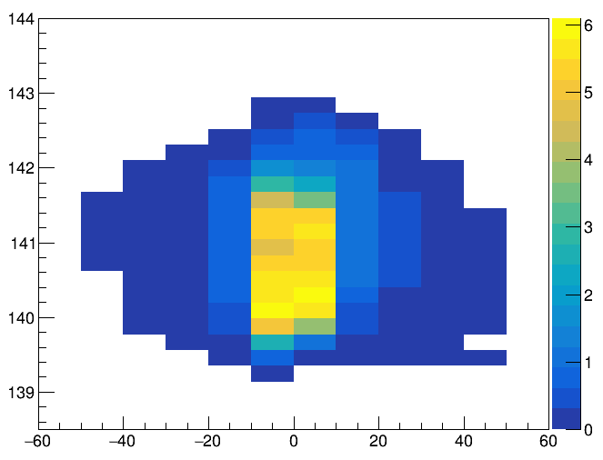
Simplified Reco method for isolated particle
Find a Cluster, energy is the sum of crystals about 30 MeV
Hit (red points): The cross point of two nearby cluster crystal
Geometric center of hit define its z, phi, R
Assign hit energy as sum of the two crossed crystals
Renormalize the total energy to the Energy of cluster
Cluster Phi/Z/R: energy weighted phi/Z/R of all hits
R [mm]

Slide 10
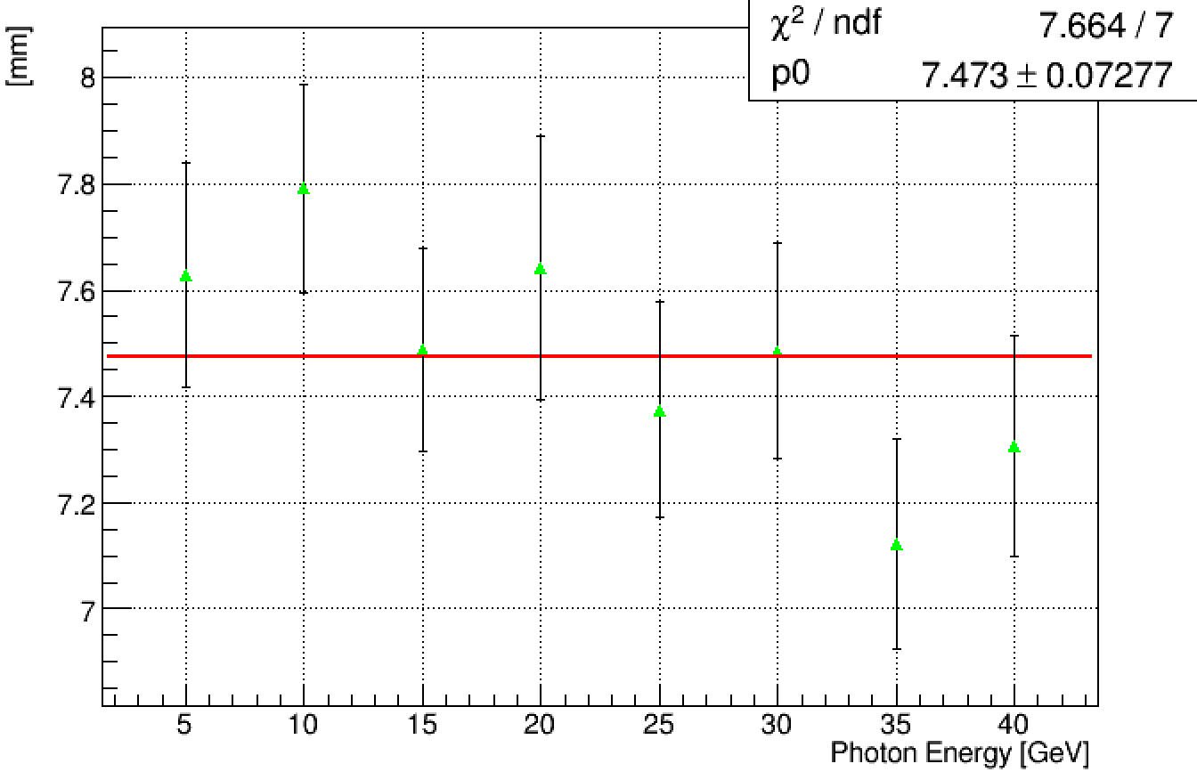
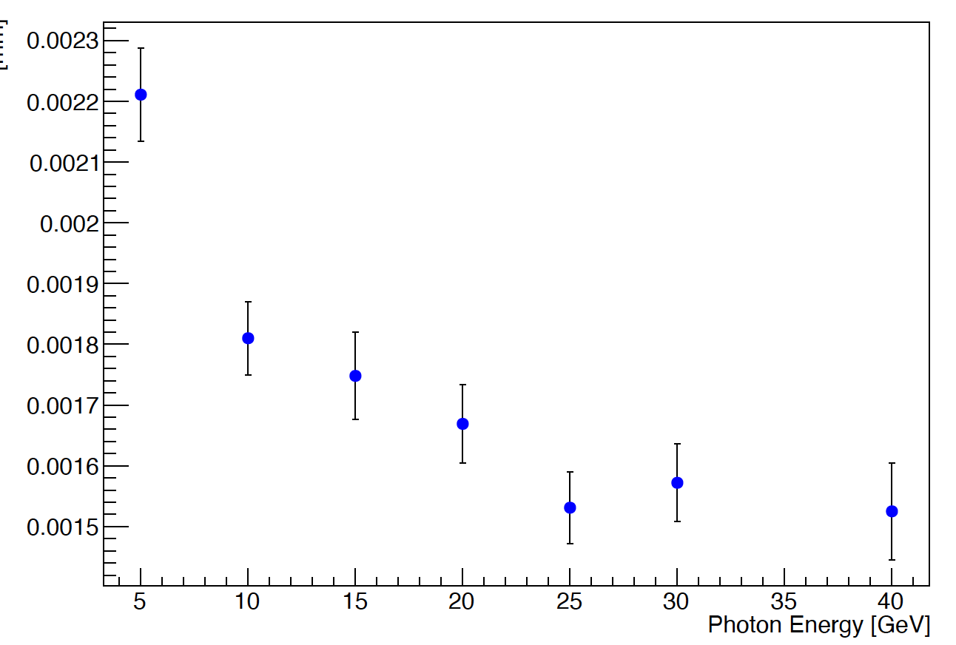
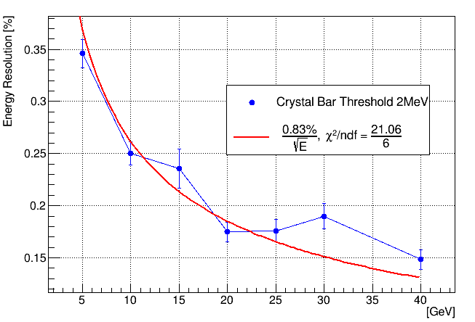
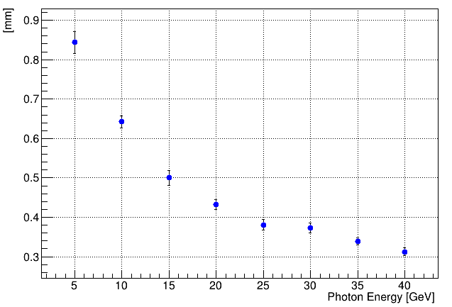
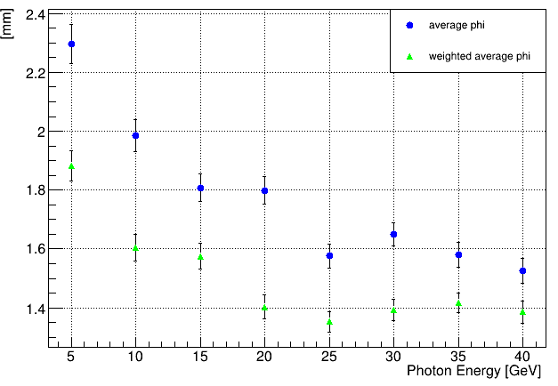
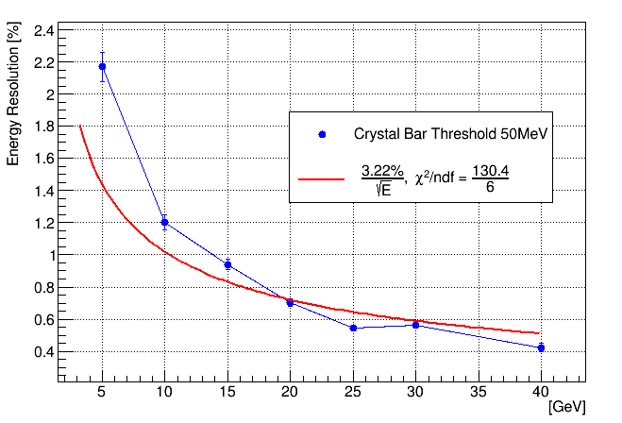
Performance of Energy and 3D positioning resolution
5GeV gamma, phi: 10~350°(bugfix needed around 0), theta: 90°
Z resolution ~ 0.84 mm; Phi resolution ~ 1.9 mm
R resolution ~ 7.6 mm; Energy resolution as function of Threshold
E resolution with gaus. fit
E resolution
R resolution
Threshold：0.1MeV
Phi resolution
E resolution
Z resolution

Slide 11
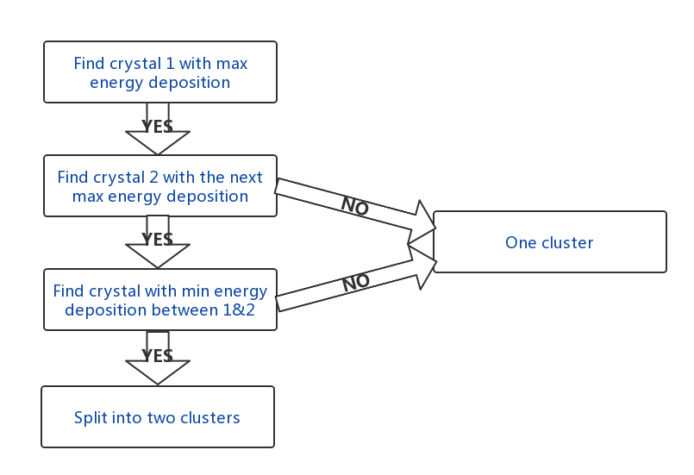
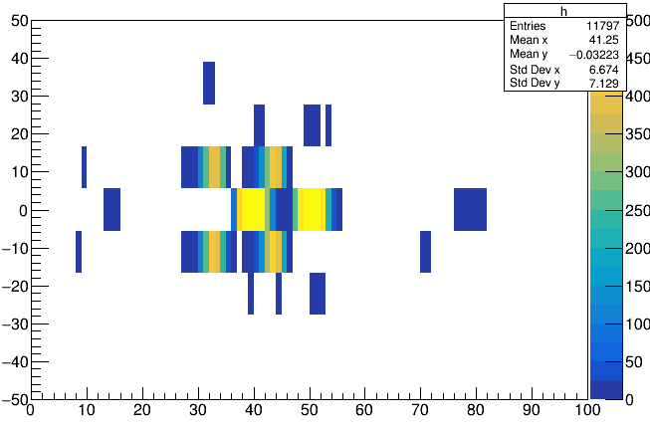
Simplified Reco method for 2 particle separation
For each layer (along Z):Find two locations with maximum energy deposition and separate them by the min. value between them
Merge clusters in individual layers use layer matching alg.
Criteria on delta phi according to its point angle direction
Z
Two 5GeV γ
Phi

Slide 12
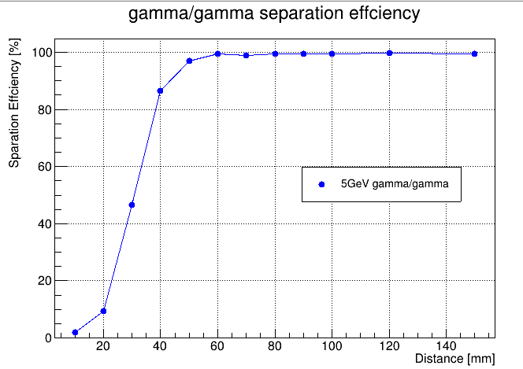
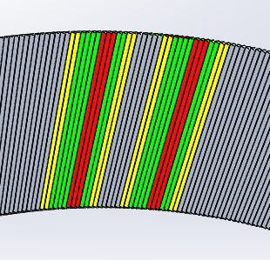
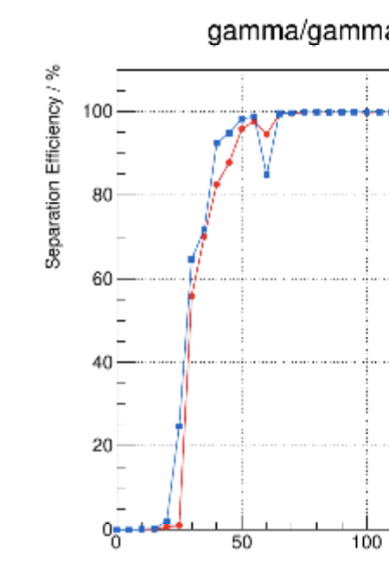
Separation between two 5 GeV photons
Two 5 GeV photons, vary distance in between them
Success reconstruction: 2 neutral particles, 3.3GeV<Eγ<6.6GeV for each photon
Threshold: 2MeV
two γ from IP
SiW/1cm^3 cubes Crys.

Slide 13
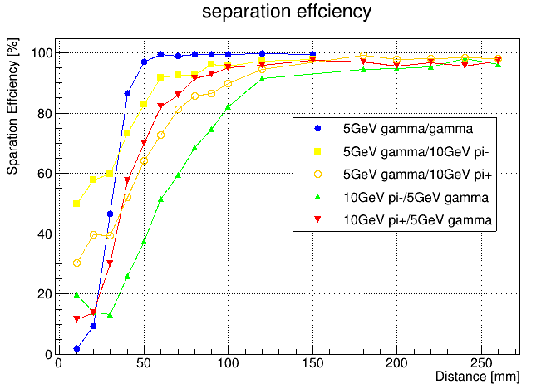
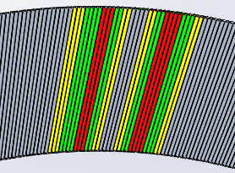
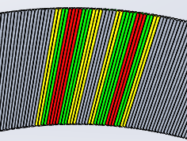
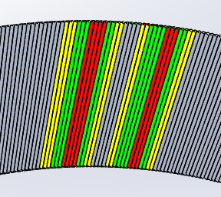
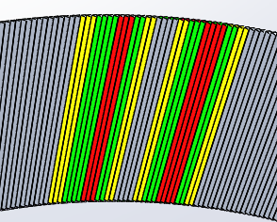
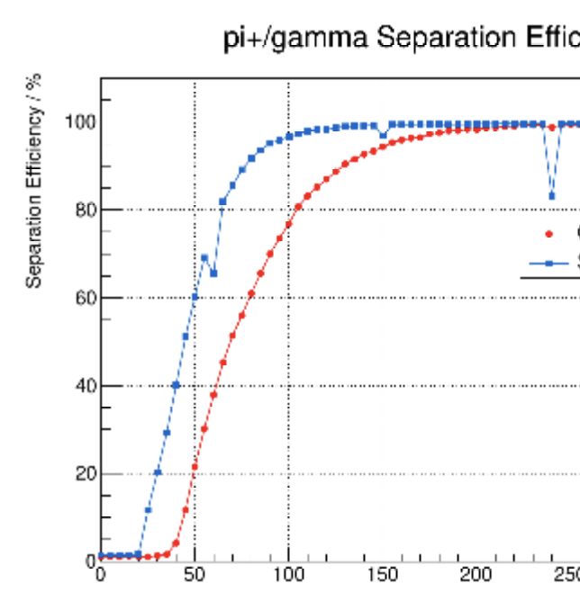
Separation between γ/π
5 GeV γ/10GeV π, vary distance in between them
Success reconstruction: 3.3GeV<E_{γ}<6.6GeV
Different π/γ separation power: pointing angle / magnetic field
γ
π+
π+
γ
Threshold: 2MeV
π-
γ
γ
π-
SiW/1cm^3 cubes Crys.

Slide 14
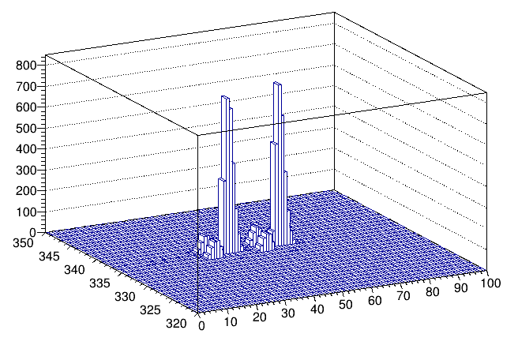
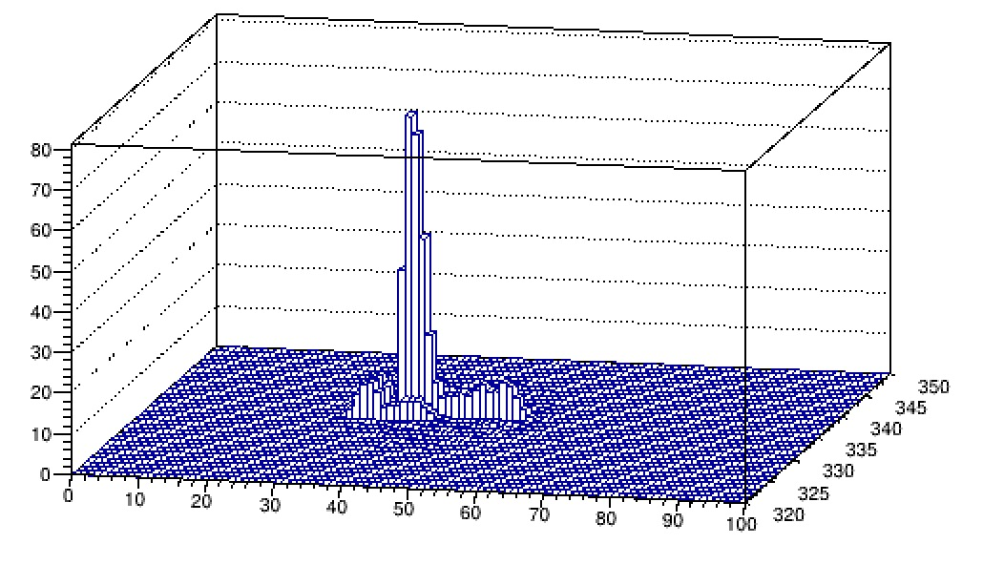
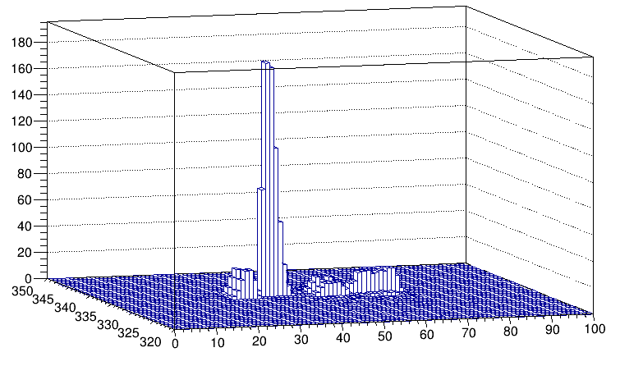
Event display of shower seperation
Two 5 GeV photon, 66 mm distance
Two 5 GeV photon, 165 mm distance
5 GeV photon and 10 GeV pi-, 66mm
5 GeV photon and 10 GeV pi-, 195mm

Slide 15
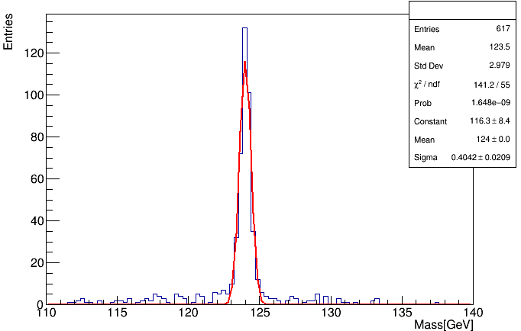
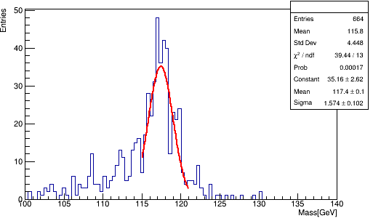
Boson mass resolution in H→ γγ
Sample: ZH->2neutrinos + γγ at 240 GeV
Energy, position reconstruction and separation using simplified reconstruction method described above
Crystal energy threshold: 2 MeV/50MeV
BMR = 0.33%
BMR = 1.3%
Threshold: 2MeV
Threshold: 50MeV

Slide 16
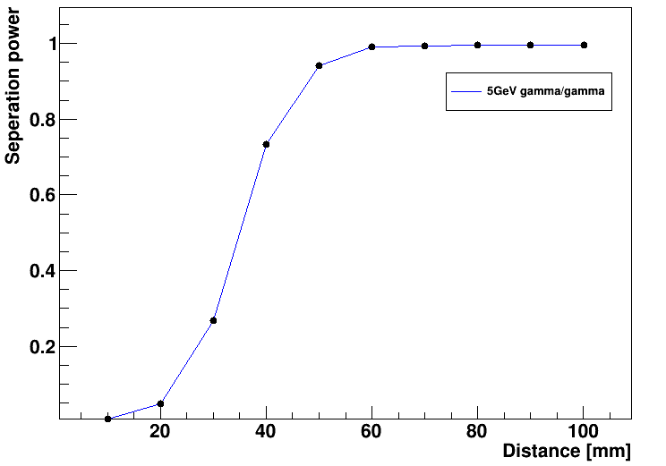
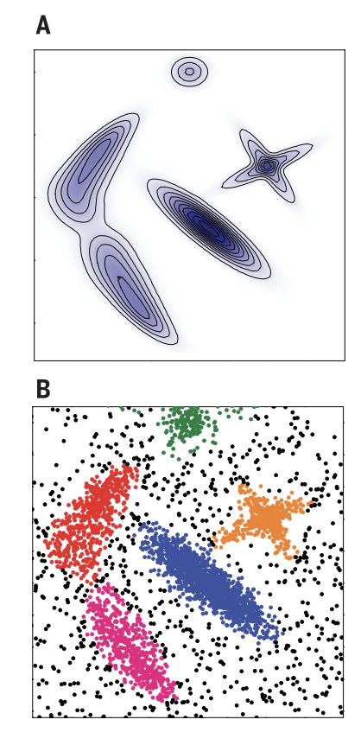
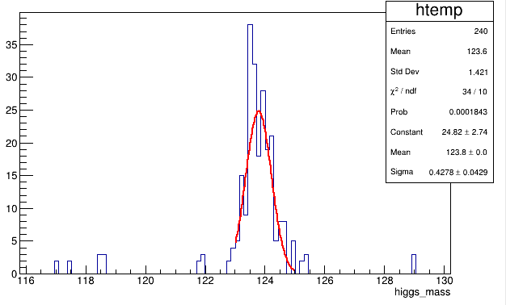
γ/γ performance using CLUE algorithm
New
CLUE (CLUstering of Energy):
Input parameters to determine cluster seeds, outliers and follower hits
the cut-off distance in the calculation of local energy density (dc);
the minimum density to promote a hit as a seed or the maximum density to demote a hit as an outlier (ρc);
the maximum distance for a hit to be linked to a nearest higher point (δo);
the minimum distance for a local high density hit to be promoted as a seed (δc).
Current CMS HGCal reco. alg.
γ/γ separation
even dc :1 rho: 2 delta_c: 2 delta_o:3
odd dc :1 rho: 0.2 delta_c: 2 delta_o: 2
Separate the raw data into odd and even modules
higgs->$γγ$
CLUE clustering algorithm
science.1242072
BMR: 0.35%
Merge odd/even sub-Clusters
[1] https://cds.cern.ch/record/2802590/files/CR2022_027.pdf
Consistent with simplified method, further tunning possible

Slide 17
Multiple particle separation (PFA)
Separation of multiple particle within jet is crucial for PFA
Suffering from
Ghost hits （multiple hit solution)
Multiple particle shower deposit energy in the same crystal
Fine tuning of hit definition
Add timing? Add readout in front of crystal(double-side readout)?
Still (long) way to be mature for PFA
Checked clustering algorithm: calo only
Which tracker? Which HCal?
Which PFA?
Detail tuning of algorithm

Slide 18
Thoughts about Ghost hits
Confusion of red hit with yellow ones
Happens only in small phi/R range
R-range: 0-30CM
Phi-range: -4.5 cm - +4.5 cm (10 layer)
Large probability have hits in middle shower depth, small chance to have hits in small or large shower depth
Big energy deposited in middle shower depth hit, small in inner/outer depth
If ghost hits happens
largest change of phi: ~4.5 cm,
Largest change of R: ~15cm
R
Phi
Phi range
Ghost hit in Z*phi plane: 1cm * 9cm
Ghost hit in R*phi plane: 30cm * 9cm
Not yet estimated, but should be very small chance to have ghost hit have big impact

Slide 19
Summary
Stereo Crystal Ecal
2D readout, 3D position reconstruction of particle shower
Mounting and readout behind Ecal
Radiation shielding, minimize material budget
Uniform along Z, phi, and R: no dead regions
Calorimeter only can provide:
Good energy, 3D position resolution of shower
Good di-photon, photon-pion separation
Good higgs mass resolution in di-photon
PFA Higgs--> di-jet mass resolution need further work
Key: Multi-particle shower separation
Choice of crystal, SiPM et. al can benefit from other studies
Simplified prototype: SiPM + Sci. + NIM equipment just arrived
Searching personal power to work on this

Slide 20
Backup

Slide 21
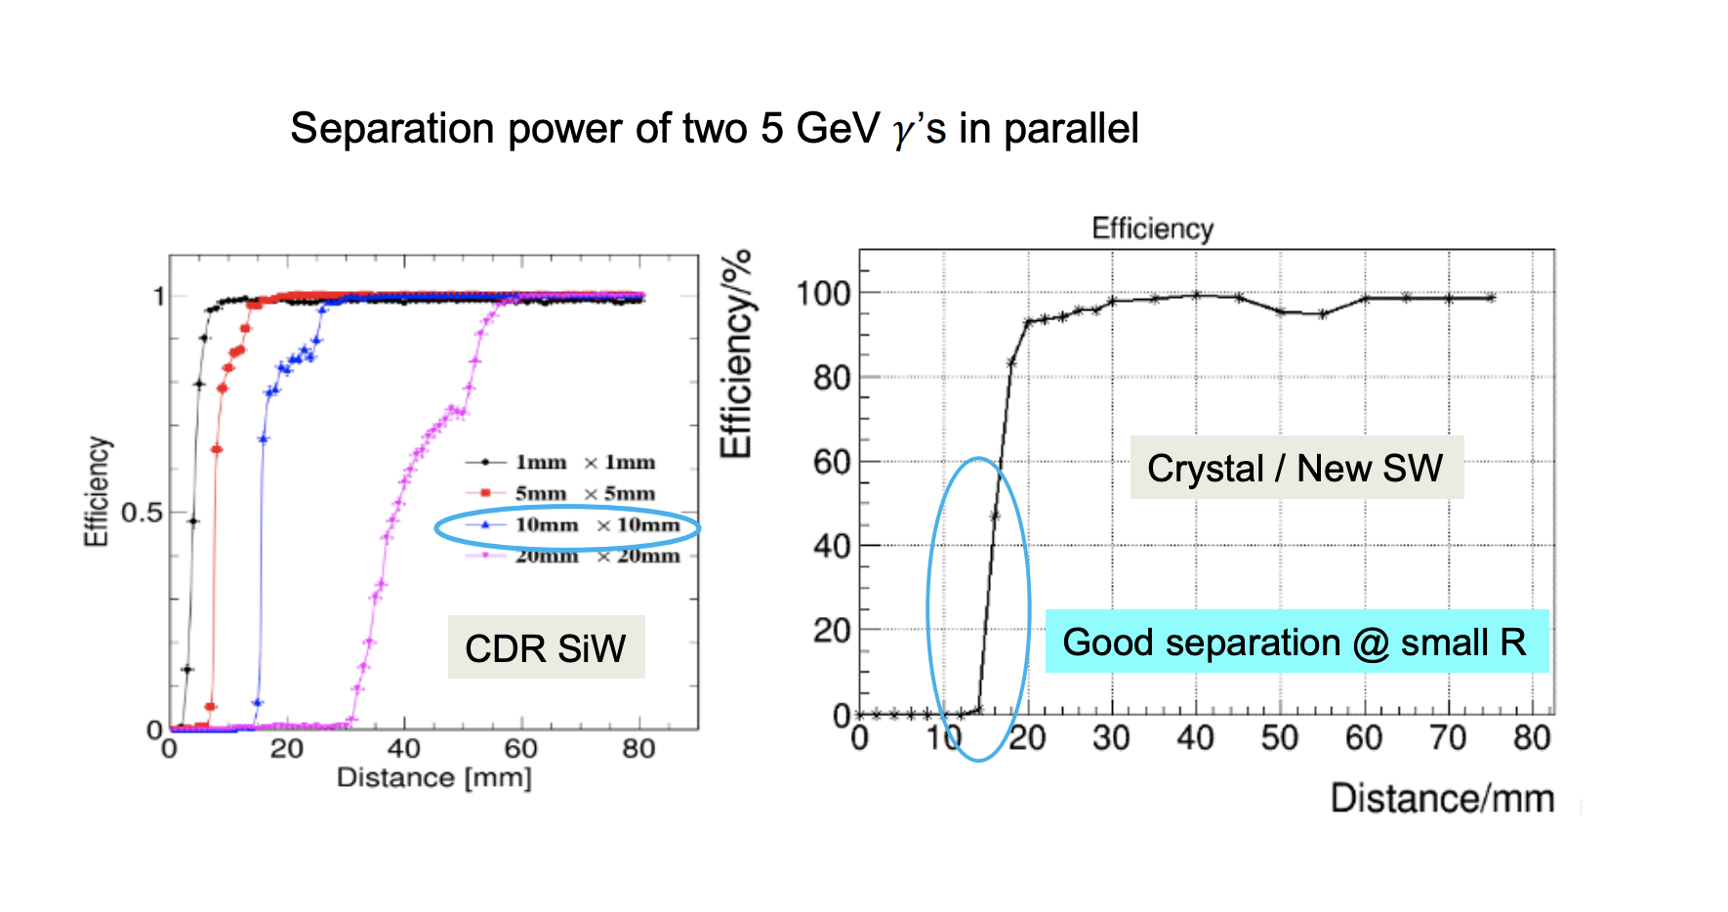
Existing crystal ecal performance
https://indico.ihep.ac.cn/event/15229/session/15/contribution/11/material/slides/0.pdf

Slide 22
Typical crystals (From Ren-yuan Zhu’s slides)

