Slide 1
CEPC Control System Development in EDR
环形正负电子对撞机
Circular Electron Positron Collider
27 Dec., 2023
Dapeng Jin
Institute of High Energy Physics, CAS, Beijing

Slide 2
Outline
Challenges & current status
Further to do
Summary

Slide 3
Challenges & current status
Overall
Reliability & availability : radiation hardness & high temperature resistance (in tunnel, ~32 ℃) : low cost on large scale (First priority).
Maintainability : Flexibility : Scalability (Second priority).

Slide 4
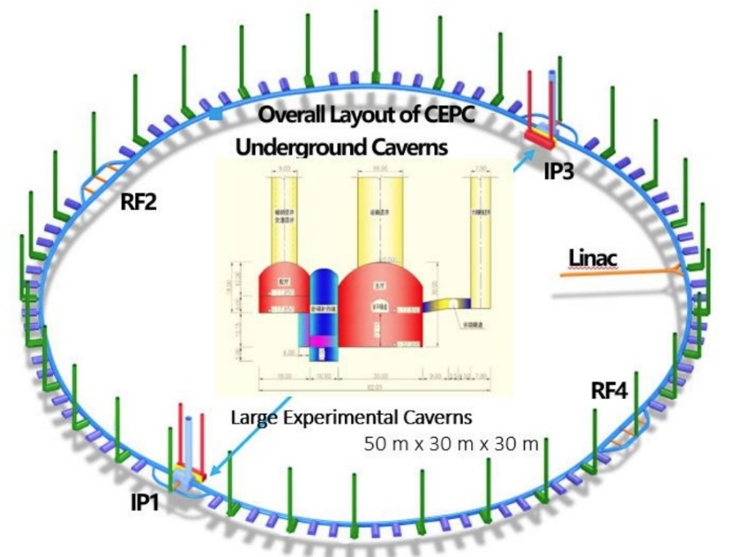
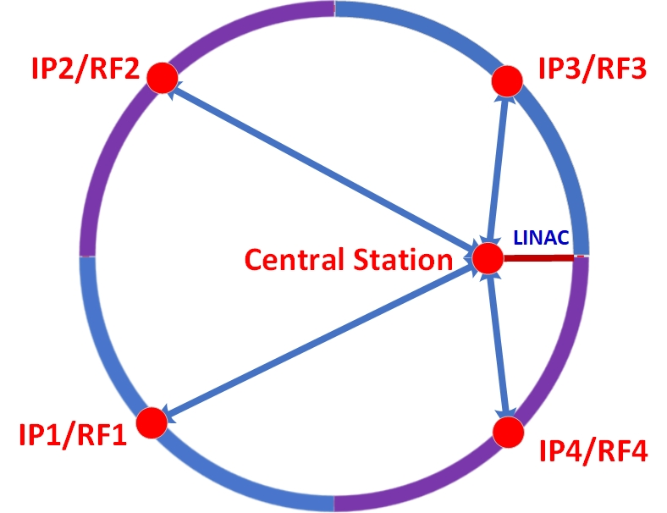
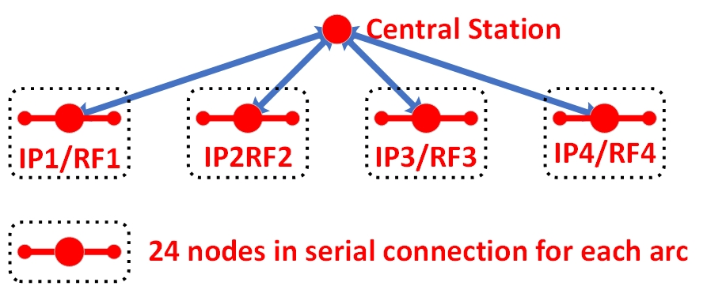
Challenges & current status
Fiber routing
Optical fibers as backbone to minimize cables || routing topology:
4-arc routing, balance between total fiber length, performance, maintainability and scalability => radiation hardness for those in tunnel.
Central station at LINAC to ease the first stage beam commissioning.

Slide 5
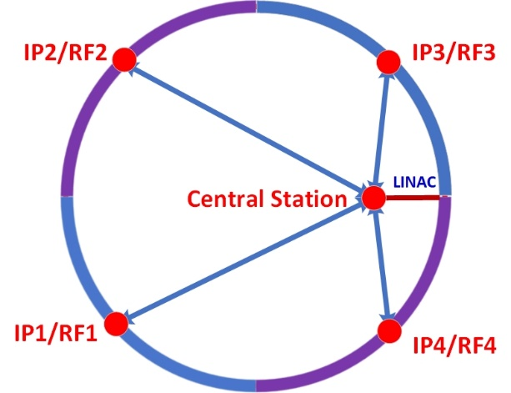
Challenges & current status
Machine protection
Response speed is the key point. Loop structure in the tunnel with redundancy for both reliability and availability.
Isolation of protection and monitoring. Few and radiation-hard chips used for protection. Connection for protection along the whole ring, those for monitoring integrated into the overall data acquisition and control.

Slide 6
Challenges & current status
Timing system & reference line
Beam instrumentation along the whole ring with high requirements => Performance, radiation-hardness & cost.
Temperature variation induced drift compensation. 0.7ns for 10km optical fiber with 1 ℃ change normally.
High-temperature(~32℃) resistance.
Good experiences of development and application in the BEPCII & HEPS.

Slide 7
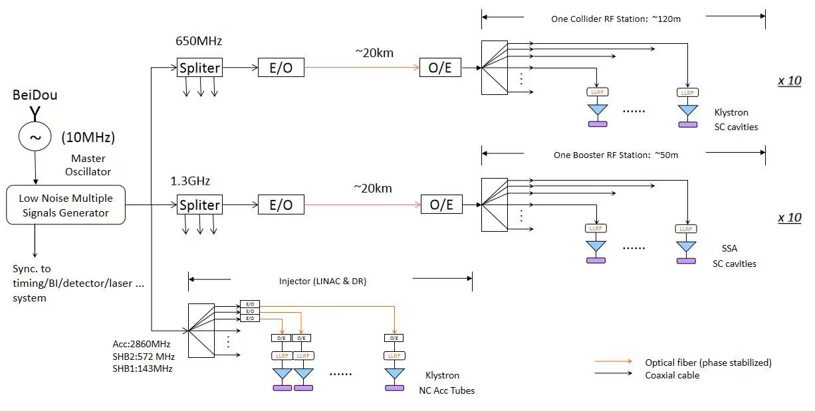
Challenges & current status
Timing system & reference line
Preliminary design of the reference line (experiences in BEPCII & HEPS)

Slide 8
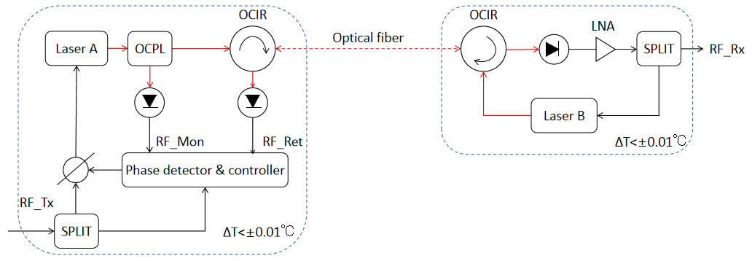
Challenges & current status
Timing system & reference line
Transmission and compensation part of the reference line in detail
(Compensation for more than 1 clock cycle needs to be tested)
Integration of timing system and reference line under consideration.

Slide 9
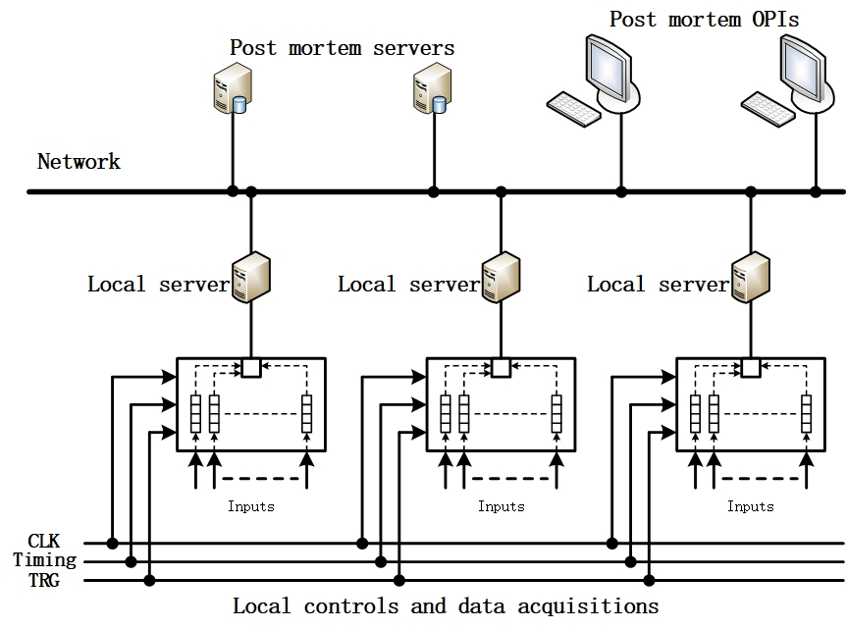
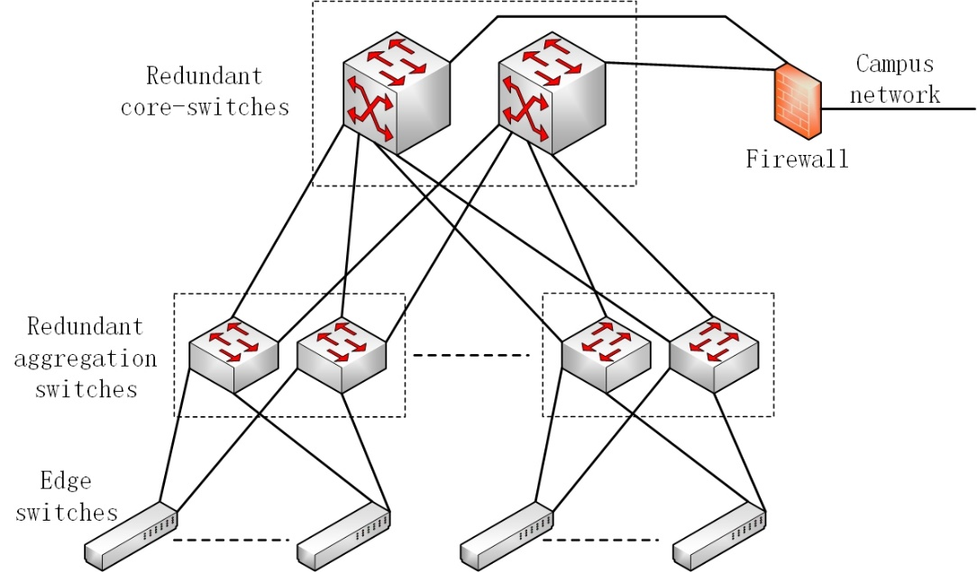
Challenges & current status
Data acquisition and analysis
Distributed data acquisition, online and offline analysis.
Post mortem and real-time health monitoring with time correlated data. Size of front end controllers’ data caches and accuracy of timestamp.
Multi-layer network : control and DAQ

Slide 10
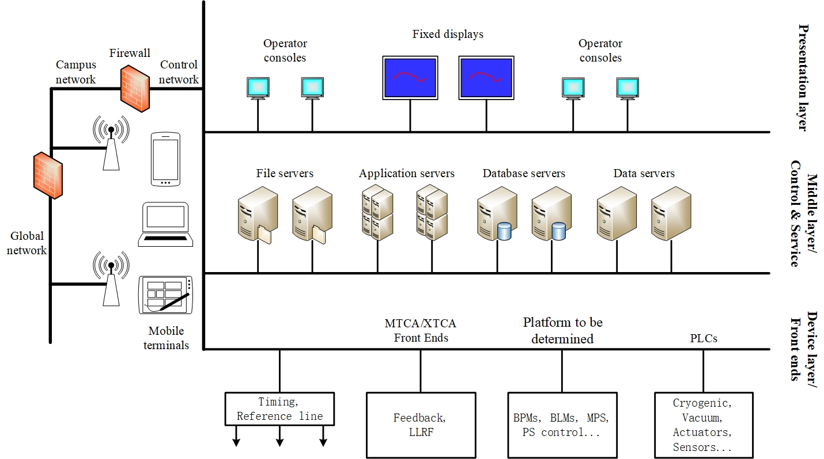
Challenges & current status
Control structure
Overall control & zone allocation.
Automation: development, installation, configuration, log, alarm, AI analysis, health report …
Joint development & management.

Slide 11
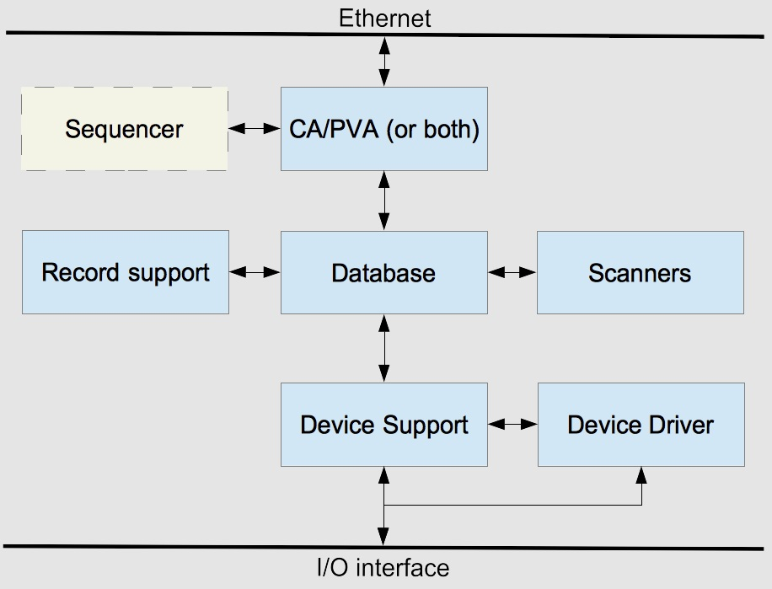
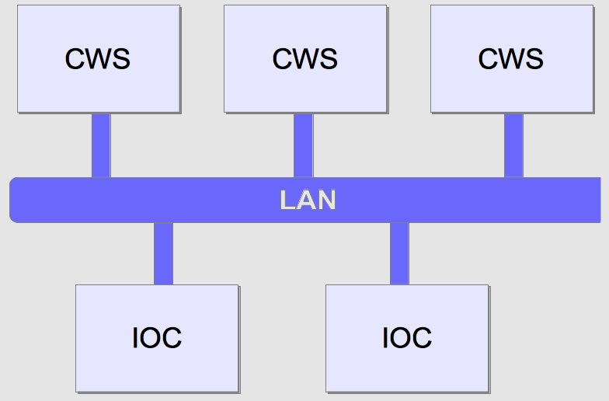
Challenges & current status
Control platform
EPICS is the current selection
Good structure and performance.
Good toolsets to use.
Widely used, also by us.
CWS : Client WorkStation
IOC : Input/Output Controller

Slide 12
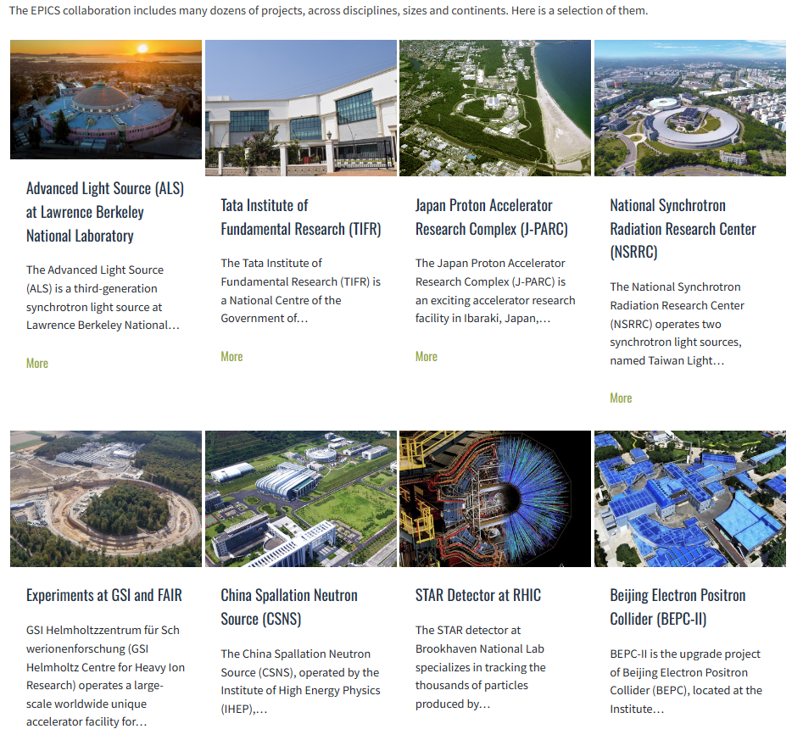
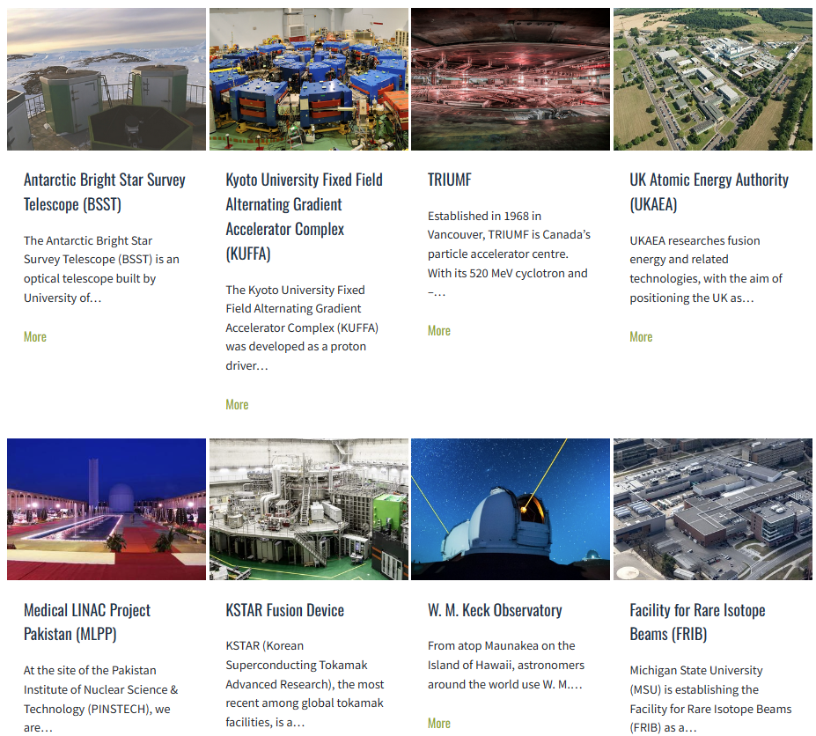
Challenges & current status
Control platform

Slide 13
Challenges & current status
Tunnel inspection
Robot considered to do the inspection
Easy to avoid strong radiation.
Easy to install more inspection equipment.
Low cost.
Ground guide method to be used.

Slide 14
Further to do
To integrate the timing system and reference line together, design and development.
For timing system and reference line, long distance, long time, large temperature variation compensation & test.
Radiation hard optical fibers and electronics test.
Design of software structure and development for data acquisition, storage, analysis and display.
Design and development of control structure and automation.

Slide 15
Summary
Key issues have been identified till now, much work need to be done together with the related systems.
Experiences from previous and current facilities help to the design and development, radiation-hardness and long distance transmission needs to be studied thoroughly.
Thanks for your attention!

