Slide 1
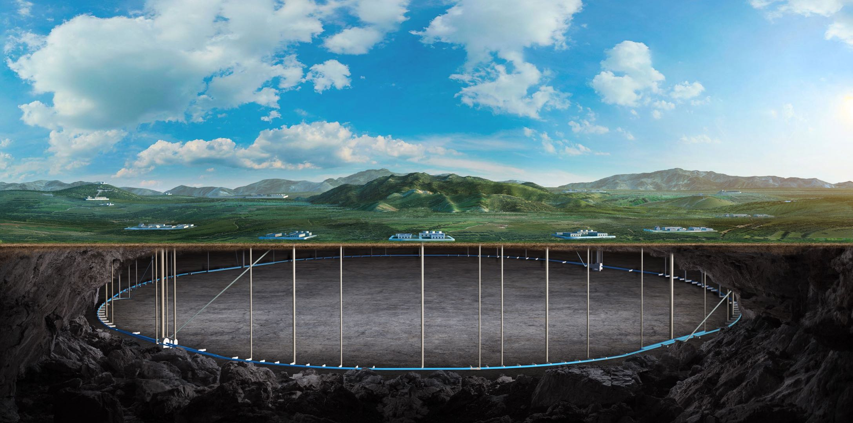
CEPC Mechanics system and mockup tunnel in EDR
Haijing Wang, Xiaolong Wang, Yongsheng Ma, Minxian Li, Lei Wu

Slide 2
Content
CEPC mechanics system plan in EDR
Magnet supports and mockup tunnel
MDI mechanics
Collimators
Mockup tunnel
Mockup structure
Things to verify
Cost estimation
Summary

Slide 3
CEPC mechanics system plan in EDR
Magnet supports and mockup tunnel
Huge number of supports. It is necessary to verify the stability and flexibility of the structure, the construction and installation method, and alignment efficiency.
Elements in Collider | Unit | Number
Dipole support | set | 13314
Quadrupole support | set | 4128
Sextupole support | set | 1128
Corrector support | set | 3544
Vacuum device support | set | 98979
Beam Instrument Support | set | 4254
RF Support | set | 100
Elements in Linac | Unit | Number
Bunching system support | set | 1
Magnet support | set | 144
EBTL support | set | 6
Accelerating structure support | set | 604
Vacuum device support | set | 5589
Beam Instrument support | set | 213
Elements in Damping Ring | Unit | Number
Magnet support | set | 184
Vacuum device support | set | 335
Beam Instrument support | set | 41
Elements in Booster | Unit | Number
Dipole support | set | 14866
Quadrupole support | set | 3458
Sextupole support | set | 100
Corrector support | set | 1200
Vacuum device support | set | 69164
Beam Instrument support | set | 2412
RF support | set | 12
Elements in Transport lines | Unit | Number
Magnet support | set | 450
Vacuum device support | set | 3732
Beam Instrument support | set | 82

Slide 4
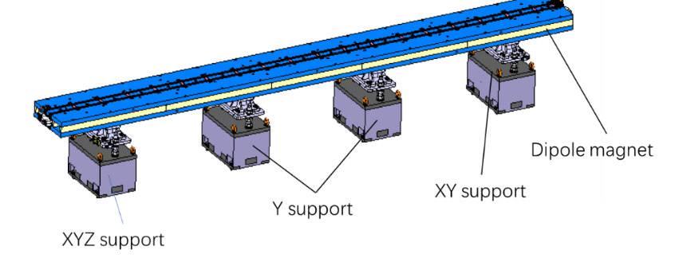
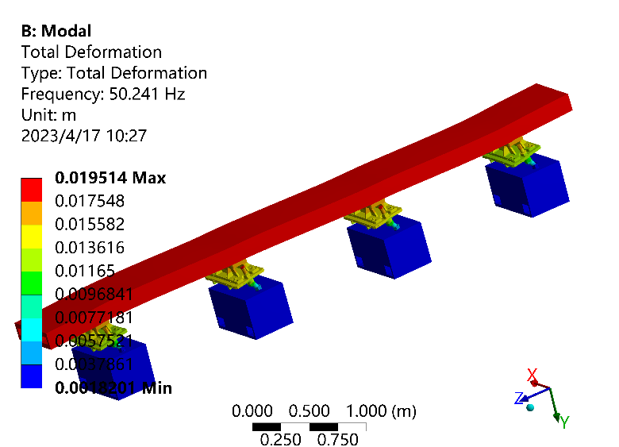
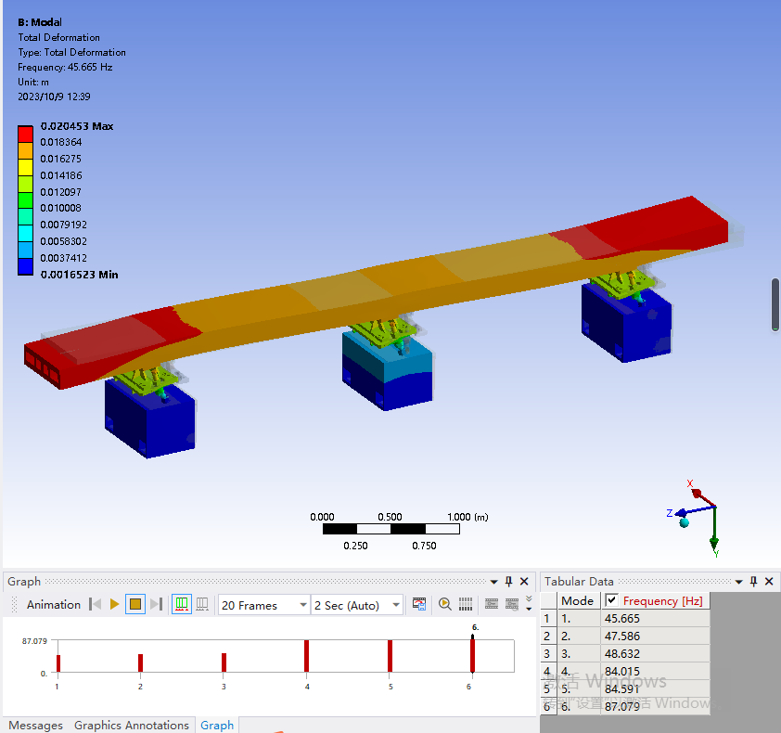
CEPC mechanics system plan in EDR
Magnet supports and mockup tunnel
For the TDR design, the natural frequency between different magnets differs much → optimize them to avoid over-design or weak stability.
Dipole support in TDR
Order of modes | Dipole & support | Quadrupole & support
1 | 50.2 | 27.3
2 | 51.3 | 31.5
3 | 59.7 | 33.2
No. of dipole supports | Maximum deformation (um) | 1st natural frequency (Hz)
2 | 50.5 | 33.2
3 | 13.0 | 45.7
4 | 6.5 | 50.2
No. of support points should be discussed with magnet and accelerator physics colleagues.

Slide 5
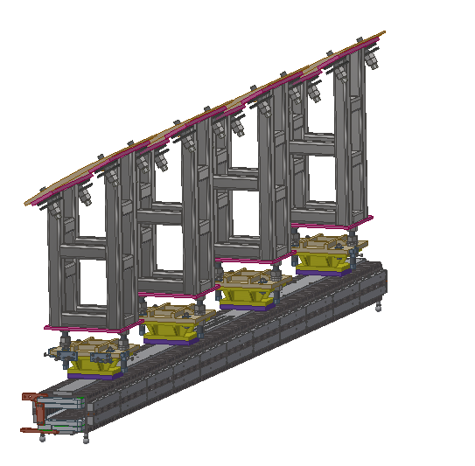
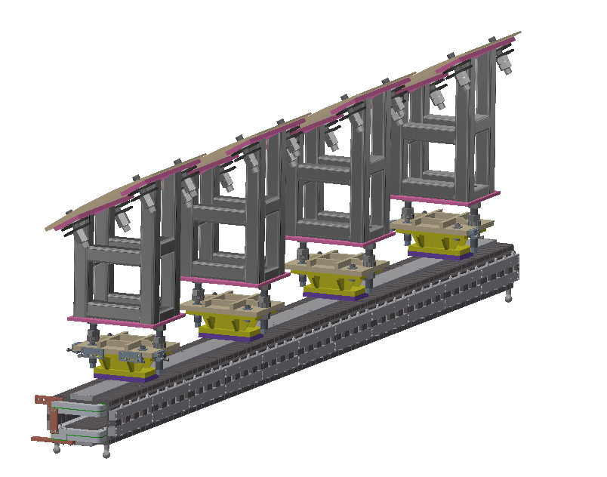
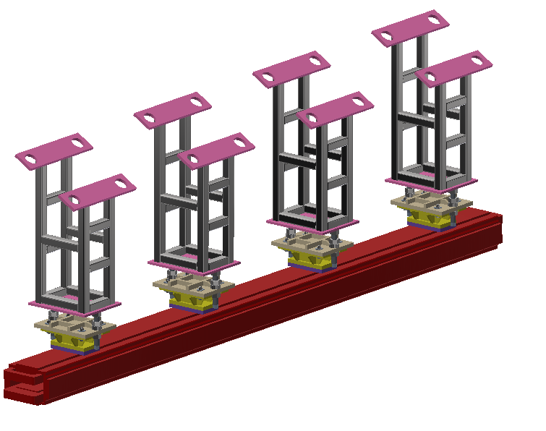
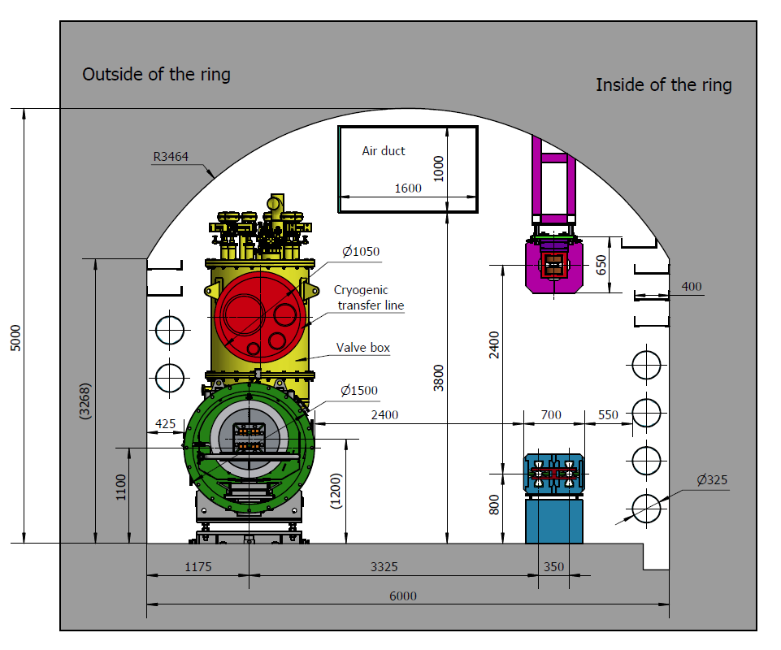
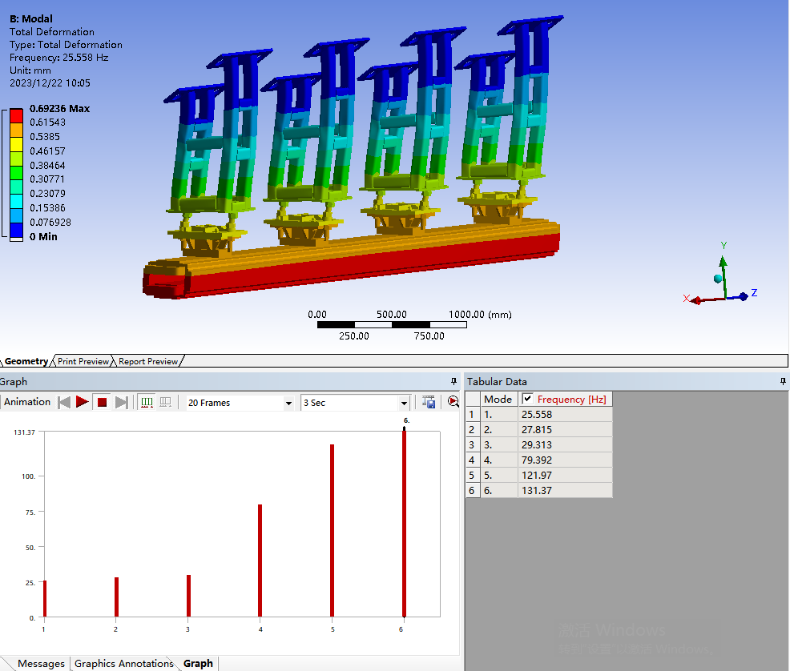
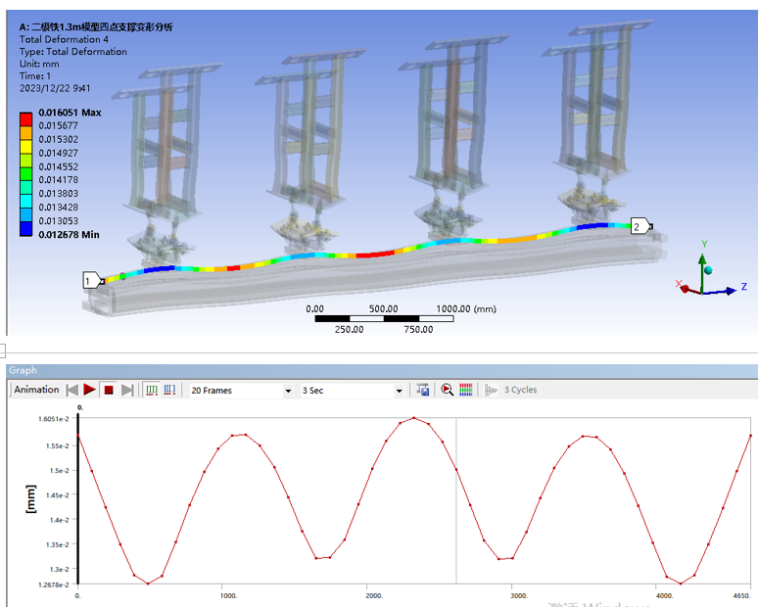
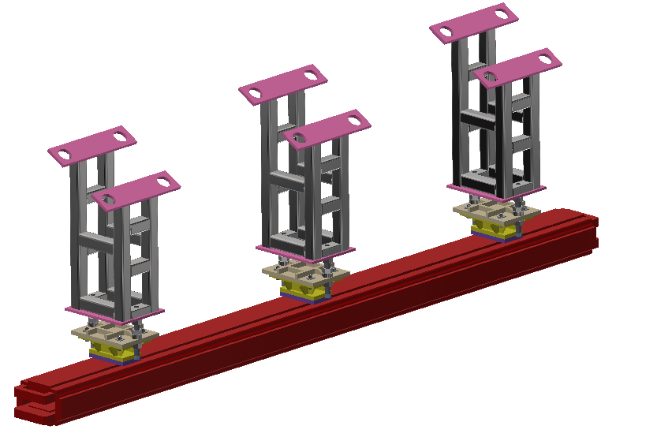
CEPC mechanics system plan in EDR
Magnet supports and mockup tunnel
For the TDR design, the Booster ring is 2.4 meters higher above Collider. → stability can be improved by shorter support.
Change support height
Change steel sections
Change support number

Slide 6
CEPC mechanics system plan in EDR
Magnet supports and mockup tunnel
For the TDR design, the Booster ring is 2.4 meters higher above Collider. → stability can be improved by shorter support.
Support height (m) | 1.3 | 1 | 0.7 | 1.3 | 1.3 | 1.3 | 1.3
Support No. | 4 |  |  | 3 | 2 | 4 | 4
Steel section (mm) | 80*80*5 |  |  |  |  | 60*60*3 | 80*80*3
Max. deformation on dipole (um) | 4 | 1 | 1 | 7.4 | 22 | 5.4 | 5.2
1st order of mode /Hz | 25.5 X | 35.9 X | 48.9 X | 22.5 X | 18.7 X | 17.7 X | 21.5 X
2nd order of mode /Hz | 27.8 yaw | 39.0 X+yaw | 56.3 yaw | 24.5 yaw | 19.5 yaw | 19.0 yaw | 23.5 yaw

Slide 7
CEPC mechanics system plan in EDR
Magnet supports and mockup tunnel plan
The final magnet support scheme (such as individual girder or common girder).
The deformation and stability simulation and optimization of typical supports.
The structure design of more magnet supports.
The mockup tunnel and the verification of support structure, stability, installation and alignment.
Aim
Be simple and fulfill the physics requirements, large adjustment ranges and high resolution.
Direction | Range of adjustment | Direction | Resolution
X | ≥±20 mm | X | ≤10μm
Y | ≥±30 mm | Y | ≤10μm
Z | ≥±20 mm | Z | ≤10μm

Slide 8
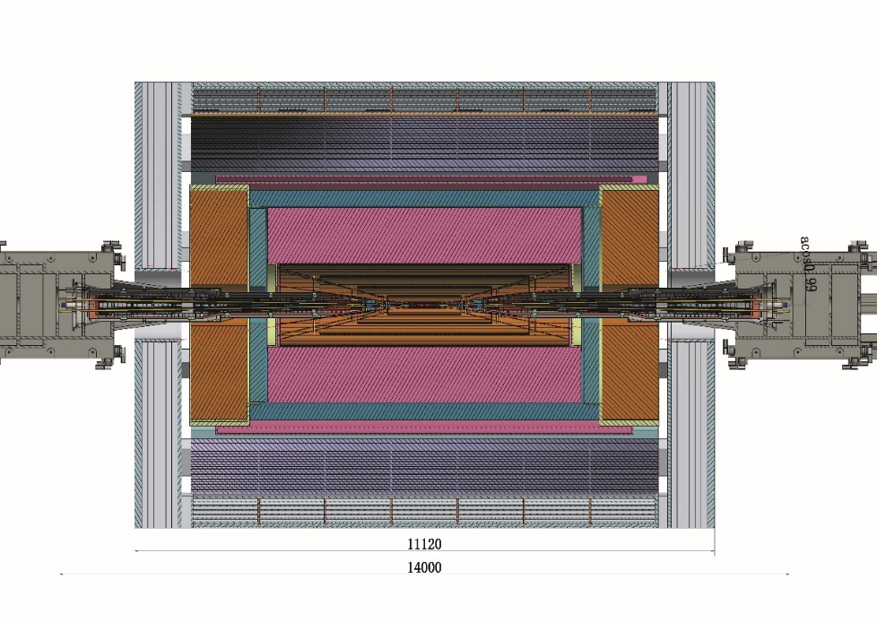
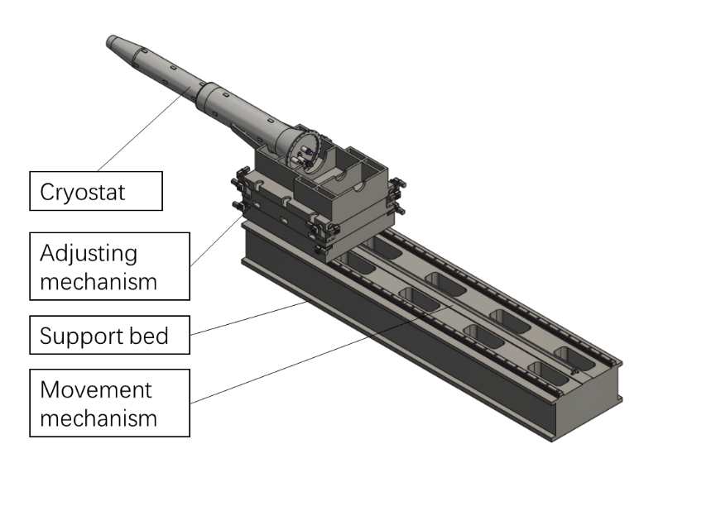
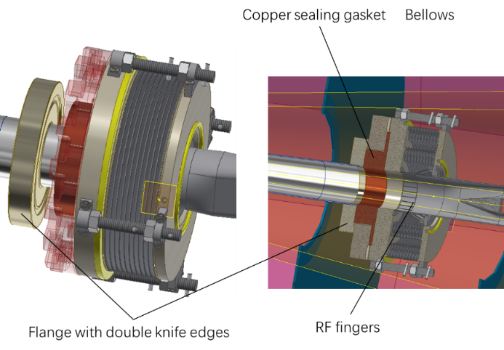
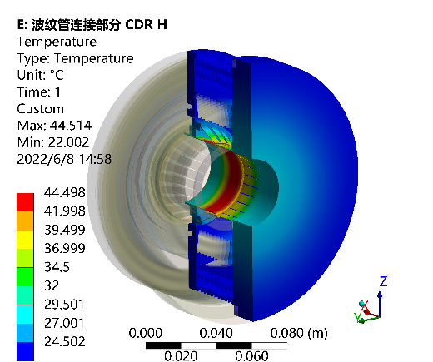
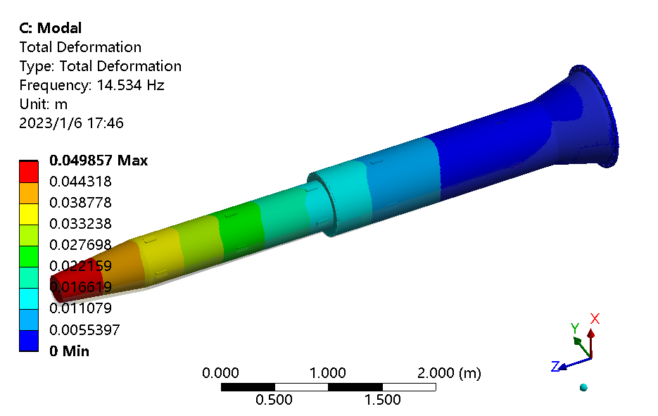
CEPC mechanics system plan in EDR
MDI mechanics
In TDR, we have optimized the MDI layout, all the accelerator devices within the detective angle acos0.99.
Preliminary design and analyses of cryostat support and RVC.

Slide 9
CEPC mechanics system plan in EDR
MDI mechanics plan
Further assessment and mechanical design of the RVC, and a prototype if possible.
The basically determined structure design of the support for cryostat at MDI, the detailed FEA of structure and stability, including the rough assessment of Lorenz force, quench cases and temperature change. Begin the necessary technique study if possible (eg. Vibration, movement and alignment related techniques).
Refine the mechanics layout of all the accelerator components on base of TDR design.
Aim:
RVC leak rate: 2.7 ×10^{–11} Pa·m³/s
Support resolution: 5 um. Support can work theoretically.

Slide 10
CEPC mechanics system plan in EDR
Collimators
In TDR, we made a preliminary design of horizontal movable collimator for background decreasing.
Jaw and vacuum vessel material: Glidcop Al-15, can endure the SR and HOM power in normal operation.

Slide 11
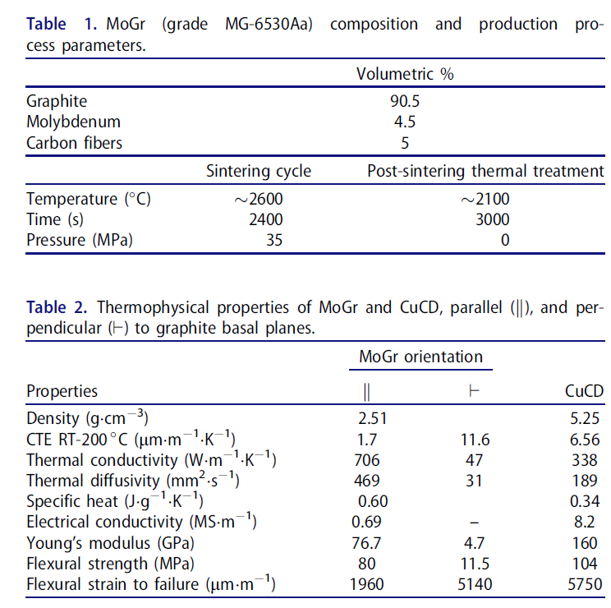
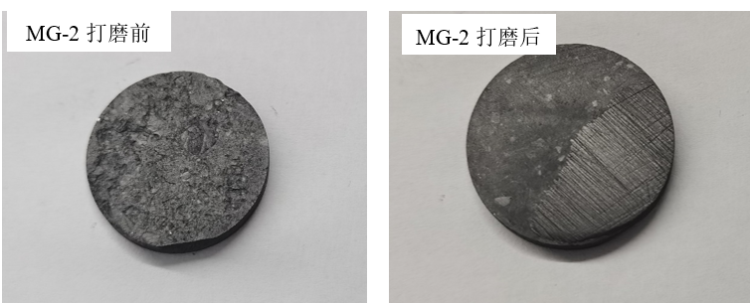
CEPC mechanics system plan in EDR
Collimators
For MPS collimators: beam incidence into the jaw, causing intense thermal shock.
We are focusing on the new material similar to MoGr developed by LHC.
Materials of jaw tips
Facilities | Material
LHC | CFC→MoGr
SKEKB | Ta→CFC→CFC+Ta
HEPS | Graphite
APSU | Al or MoGr
Fcc-ee | MoGr
Samples developed recently, Gr 50%，Mo 25%，Ti 25%.
By vacuum hot pressing sintering method. Needs to be tested.

Slide 12
CEPC mechanics system plan in EDR
Collimator plan
The structure design and detailed FEA of the collimator for background decreasing and MPS, cooperate with accelerator physics, beam-material interaction and impedance colleagues.
Begin the necessary technique study if possible (eg. Tip material and connecting technique with jaw body. )
Aim:
Collimators can work theoretically.
Thermal conductivity of new material ≥600 W/(m.K）
Connection strength higher than 90% strength of base material.

Slide 13
Mockup tunnel
CEPC is a 100 km facility with huge numbers of devices. There are many techniques and construction method to be verified in the mockup.
The support stability and flexibility.
The alignment method and alignment efficiency improvement.
The installation method and operation space verification like HEPS before tunnel installation.
The tunnel mockup is a good way for CEPC exhibition, with some typical devices like magnet and support, vacuum devices and cryomodules.

Slide 14
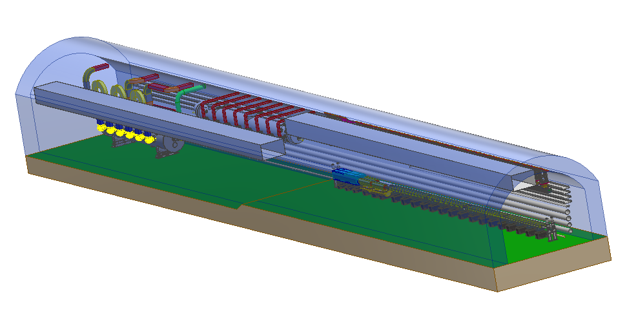
Tunnel mockup
A 60 m long tunnel mockup, including parts of arc section and part of RF section.

Slide 15
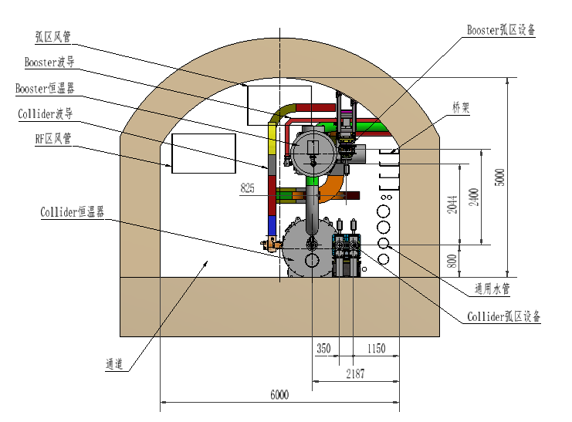
Tunnel mockup
Mockup structure

Slide 16
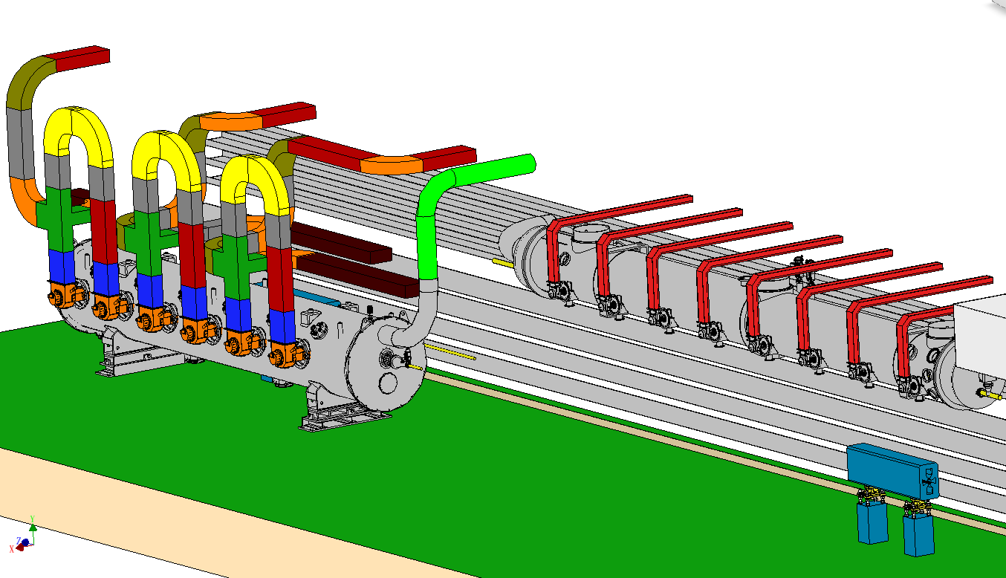
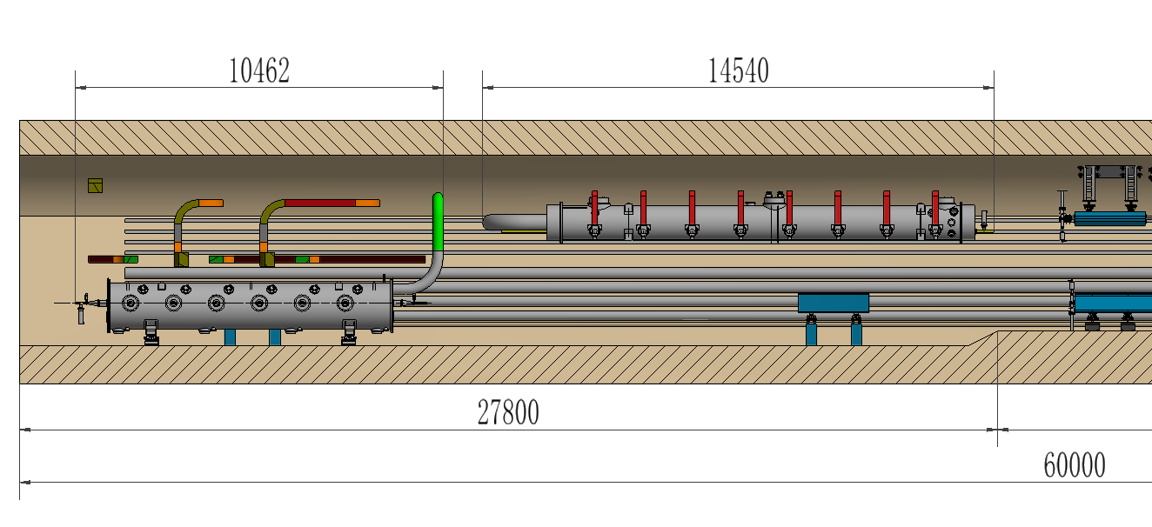
Tunnel mockup
Mockup structure
RF section: 28 m.
1 Collider cryomodule, 1 Booster cryomodule, wave guides, 2 single-aperture quadrupoles and supports.
1:1 fake models made of plastic or steel sheets.

Slide 17
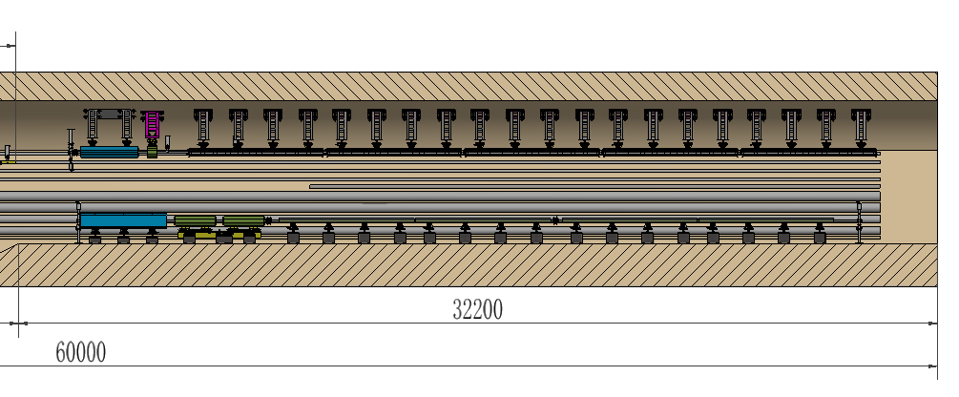
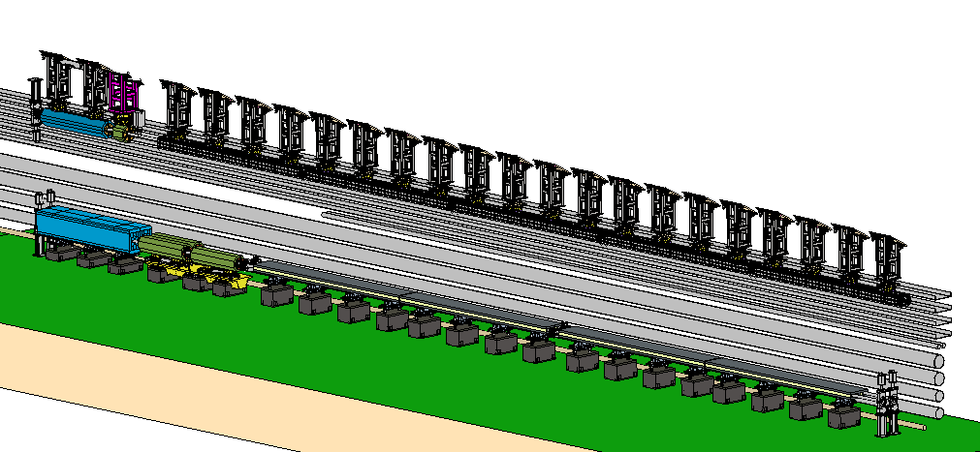
Tunnel mockup
Mockup structure
Arc section: 32 m.
Collider: 1 quadrupole, 3 sextupole, 1 dipole (4 cores), 2 correctors and 2 BPMs, supports, vacuum devices.
Booster: 1 quadrupole, 1 sextupole, 5 dipoles, supports, vacuum devices.

Slide 18
Tunnel mockup
Mockup structure
Arc section: 32 m.
Collider: 1 quadrupole, 3 sextupole, 1 dipole (4 cores), 2 correctors and 2 BPMs, supports, vacuum devices.
Booster: 1 quadrupole, 1 sextupole, 5 dipoles, supports, vacuum devices.
Collider arc section devices
Booster arc section devices

Slide 19
Tunnel mockup
Mockup structure
Arc section 32 m.
All the magnets are fake steel model with real weight, can be replaced by magnet prototype.
All the supports are prototypes, and installed as real project (eg. grouting).
The vacuum tubes and bellows are prototypes.
Valves, pumps and BPMs are fake ones.

Slide 20
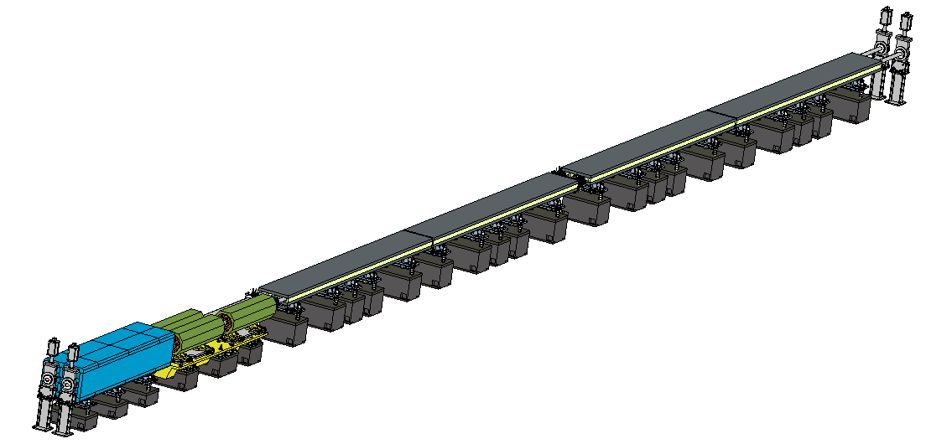
Tunnel mockup
Things to verify
Collider: Installation experiment of all devices, operating space
Coil installation and connection on site
Magnet & support stability
Valve
Vacuum tubes
Bellows
Dipole & support
Sextupole & support
Quadrupole & support
Stability for dipole will be compared with 3 or 4 supports

Slide 21
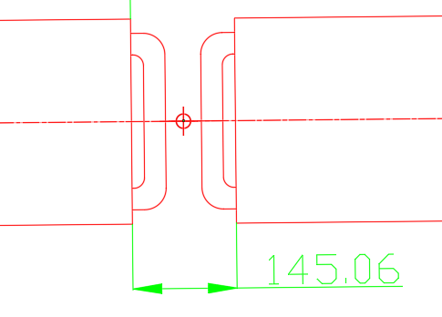
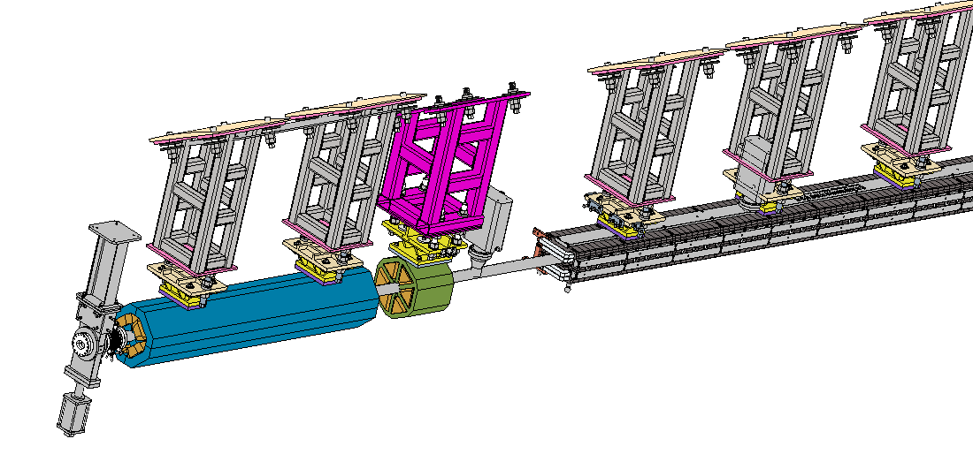
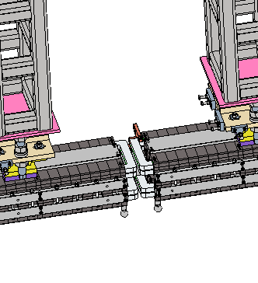
Tunnel mockup
Things to verify
Booster: Installation experiment of all devices, operating space
Difficulties: installation to the ceiling, tight space between dipoles
Magnet & support stability
Dipole & support
Sextupole & support
Vacuum devices
Quadrupole & support

Slide 22
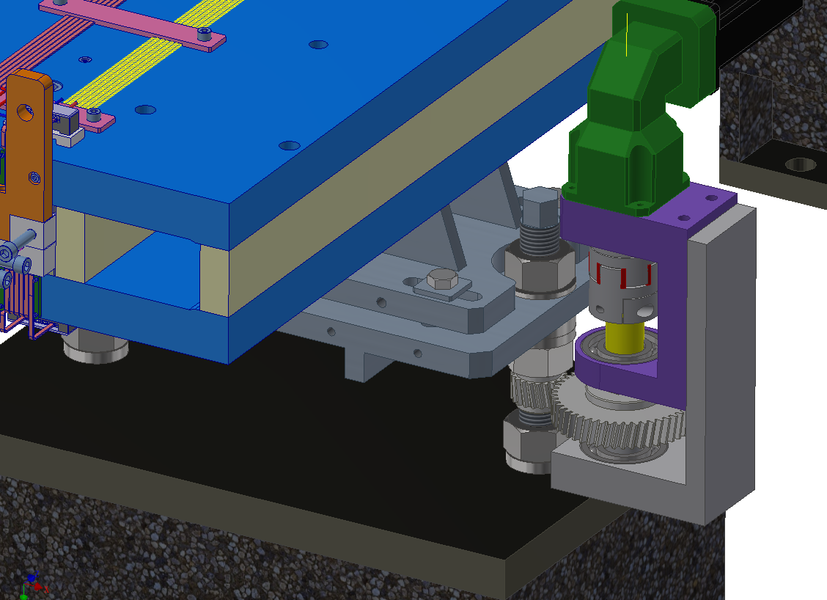
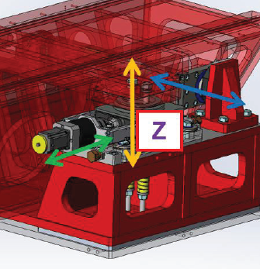
Tunnel mockup
Things to verify
Semi-automatic adjustment and high-precision alignment field
Aim: save alignment manpower and cost.
Add some movable drivers and interface on the adjusting mechanism.
Validating the technical solution in PAPS, and conducting tunnel alignment simulations in mockup.
For dipole supports
For sextupole girders, similar to girder of EBS

Slide 23
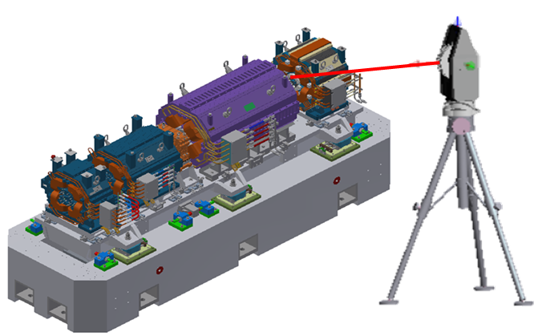
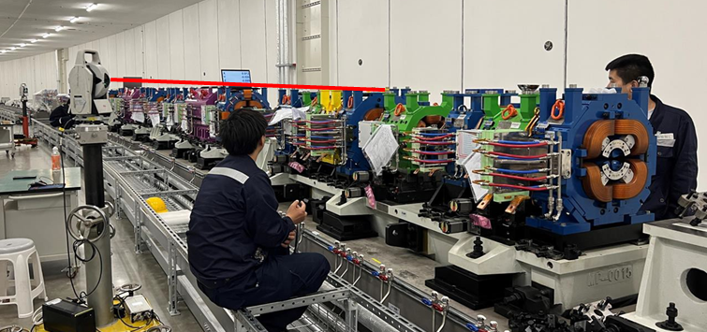
Tunnel mockup
Things to verify
Pre-alignment and tunnel alignment are the most time-consuming and labor-intensive task in the alignment process.
The alignment method right now:
Laser tracker
Single-point monitoring, single-point adjustment, manual operation, repeated iterations, inefficiency.
High-precision alignment field
Multi-camera photogrammetry system
Multi-point synchronous monitoring
50% lower cost, significantly larger number of synchronous monitoring points.

Slide 24
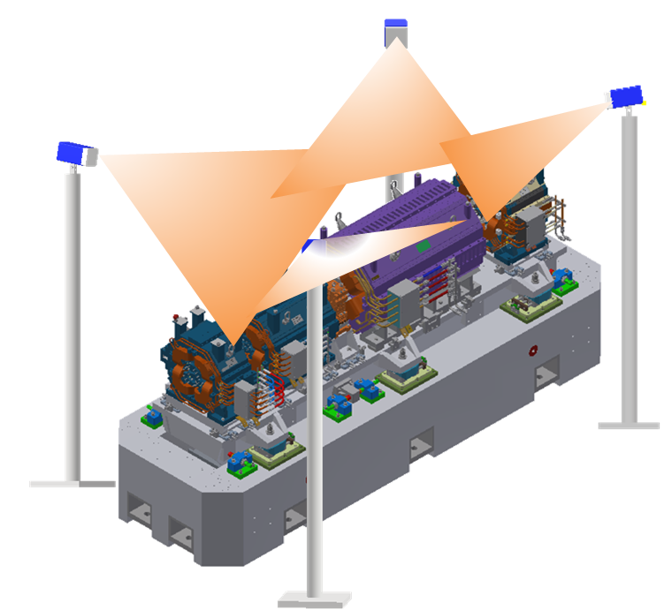
Tunnel mockup
Things to verify
功能
根据被测对象类型，自动调整测量视野；
自动标定相机内外参数和畸变系数。
通过空间坐标提取，采集标定工装图像，自动建立多目相机空间位姿数学模型；
高带宽图像传输，实时获取测量场内监测点实测坐标，显示\输出实测坐标与理论坐标的差值。
系统预期指标
标定场范围0.5m~20m
采集频率：≥15 Hz
空间单点测量误差：≤ 4μm+4μm/m

Slide 25
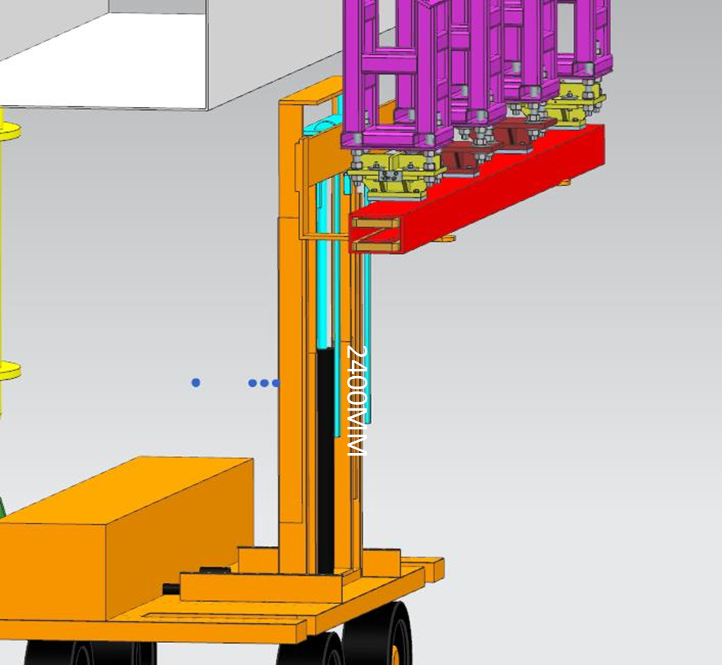
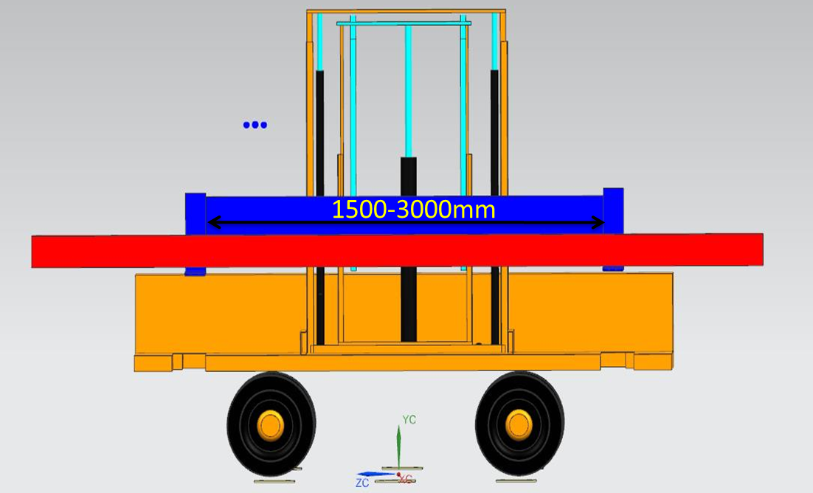
Tunnel mockup
Things to verify
Magnet transport vehicles
Aim: efficiency of the transportation and installation of the magnets.
The resolution of the lifting fork is designed as better than 0.5 mm for the coarse positioning.

Slide 26
Cost
模拟隧道
共798万
实验验证件~439万，含隧道内设备124万，三自由度安装运输车35万及准直高精度测量场280万。
子设备名称 | 单位 | 数量 | 价格 | 备注
Collider二极铁支撑 | 套 | 1 | 16
Collider四极铁支撑 | 套 | 1 | 4
Collider六极铁支撑 | 套 | 1 | 12
Collider校正铁支撑 | 套 | 1 | 2
Collider二极铁配重 | 套 | 1 | 17 | 2.7ton/每铁芯*4
Collider四极铁配重 | 套 | 1 | 10.5 | 7ton/每铁芯
Collider六极铁配重 | 套 | 1 | 4 | 0.9ton/每铁芯*3
Booster二极铁支撑 | 套 | 1 | 4
Booster四极铁支撑 | 套 | 1 | 3
Booster六极铁支撑 | 套 | 1 | 2
Booster二极铁配重 | 套 | 1 | 2 | 1.2ton/每铁芯
Booster四极铁配重 | 套 | 1 | 3 | 2ton/每铁芯
Booster六极铁配重 | 套 | 1 | 0 | 0.25ton/每铁芯
真空设备 | 套 | 1 | 41.4 | 真空盒+波纹管
真空设备支架 | 套 | 1 | 4 | 12 in Collider +3 in Booster
三自由度安装运输车 | 辆 | 1 | 35
准直高精度测量场 | 套 | 1 | 280
部件名称 | 组件名称 | 数目 | 单位
多目摄影测量系统 | 测量相机 | 4 | 套
 | 同步控制器 | 1 | 套
 | 工控机 | 1 | 台
 | 测量软件 | 1 | 套
 | 基准尺 | 1 | 套
 | 相机姿态调整机构 | 1 | 套
辅助工装 | 相机标定工装 | 1 | 套
 | 基准测量工装 | 1 | 组
*准直预算 王小龙； 真空设备预算 马永胜。

Slide 27
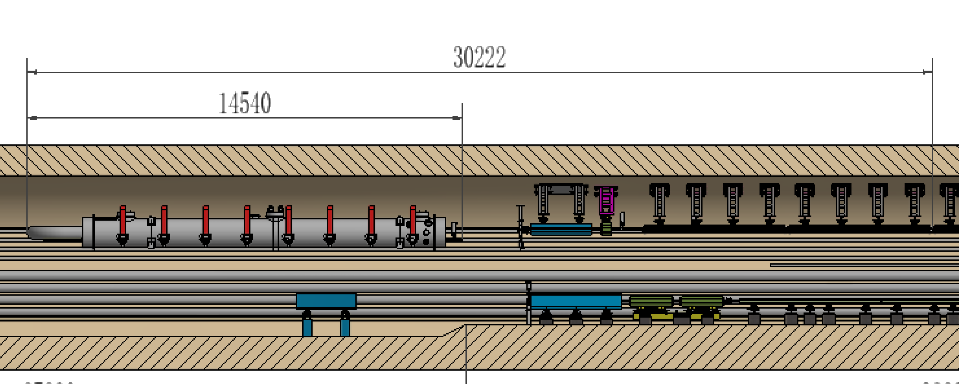
Cost
模拟隧道
共795万
隧道~332万（粗估，按1000m³及2.5%钢筋计算)。最短可30米，只含Booster RF模组及Booster 四极铁、六极铁及2块二极铁。
展示件~24w
子设备名称 | 单位 | 数量 | 价格
模拟隧道 | 米 | 60 | 332
Collider 高频腔支撑 | 套 | 1 | 1
Booster高频腔支撑 | 套 | 1 | 2
Collider 高频腔模拟件 | 套 | 1 | 8
Booster高频腔模拟件 | 套 | 1 | 8
通用管线模拟件 | 套 | 1 | 5
真空束测模拟件 | 套 | 1 | 3

Slide 28
Cost
MDI 关键工艺验证
RVC样机：27万
MDI超导铁支架调节及准直验证样机：56万
准直器关键工艺验证
耐热冲击材料试验：59万
材料连接及性能测试：30万
其他 60万
Autodesk PDMC： 20万，共4人
Ansys：10w/年，共30万
差旅费:10万
设备名称 | 子设备名称 | 单位 | 数量 | 价格
RVC样机 |  | 套 | 1 | 27
 | 充气波纹管组件 | 套 | 1 | 9
 | 管路 | 套 | 1 | 1
 | 固定法兰及真空盒 | 套 | 1 | 3
 | 两个真空腔体及支撑 | 套 | 1 | 2
 | 铜密封圈 | 件 | 10 | 3
 | 改制及测试费 | 套 | 1 | 9
MDI超导铁支架调节及准直验证样机 |  | 套 | 1 | 56
 | 上层支架 | 套 | 1 | 18
 | 支架调节机构 | 套 | 7 | 14
 | 悬臂托架 | 套 | 1 | 11
 | 辅助支撑 | 套 | 1 | 3
 | 恒温器模拟件 | 套 | 1 | 5
 | 位移传感器及限位开关 | 套 | 6 | 4
 | 控制系统 | 套 | 1 | 2

Slide 29
Summary
A tunnel mockup has been preliminary designed according to TDR design. Based on which the stability of magnet & support assembly, the high-precision alignment field, and the installation experiment can be verified.
The mechanics system also wants to make some progress on the magnet support design, the MDI mechanics and the collimators.

