Slide 1

Selected topics on $T_{c\overline{s}0}(2900)$
Dian-Yong chen
Southeast University
Zi-Li Yue, et al., PRD 107 (2023), 034018; EPJC 83 (2023), 769,
Man-Yu Duan, et al., arXiv:230509436

Slide 2
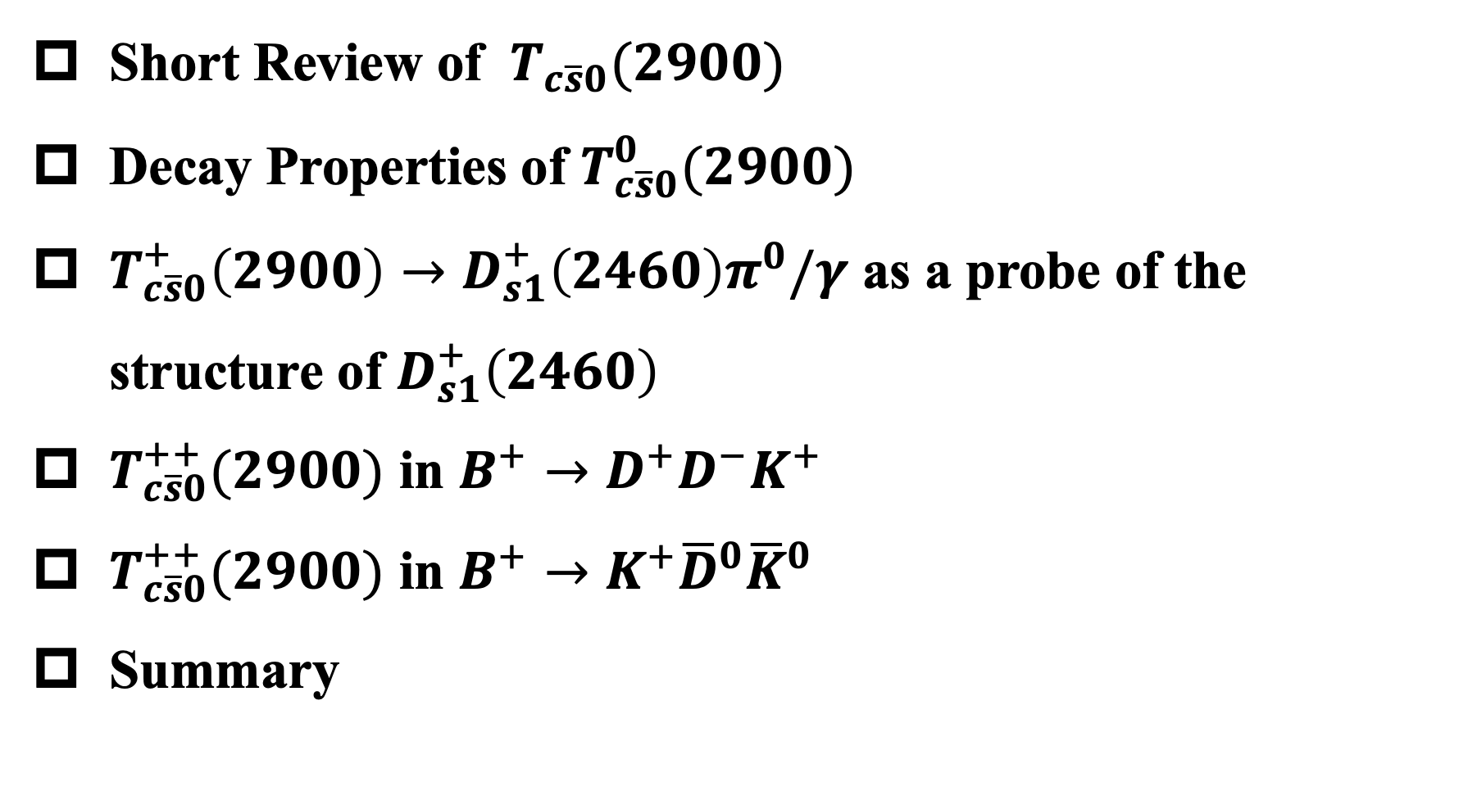
Outline
Short Review of $T_{c\overline{s}0}(2900)$
Decay Properties of $T_{c\overline{s}0}^{0}(2900)$
$T_{c\overline{s}0}^{+}\left(2900\right)→D_{s1}^{+}\left(2460\right)π^{0}/γ$ as a probe of the structure of $D_{s1}^{+}\left(2460\right)$
$T_{c\overline{s}0}^{++}(2900)$ in $B^{+}→D^{+}D^{−}K^{+}$
$T_{c\overline{s}0}^{++}(2900)$ in $B^{+}→K^{+}{\overline{D}}^{0}{\overline{K}}^{0}$
Summary

Slide 3
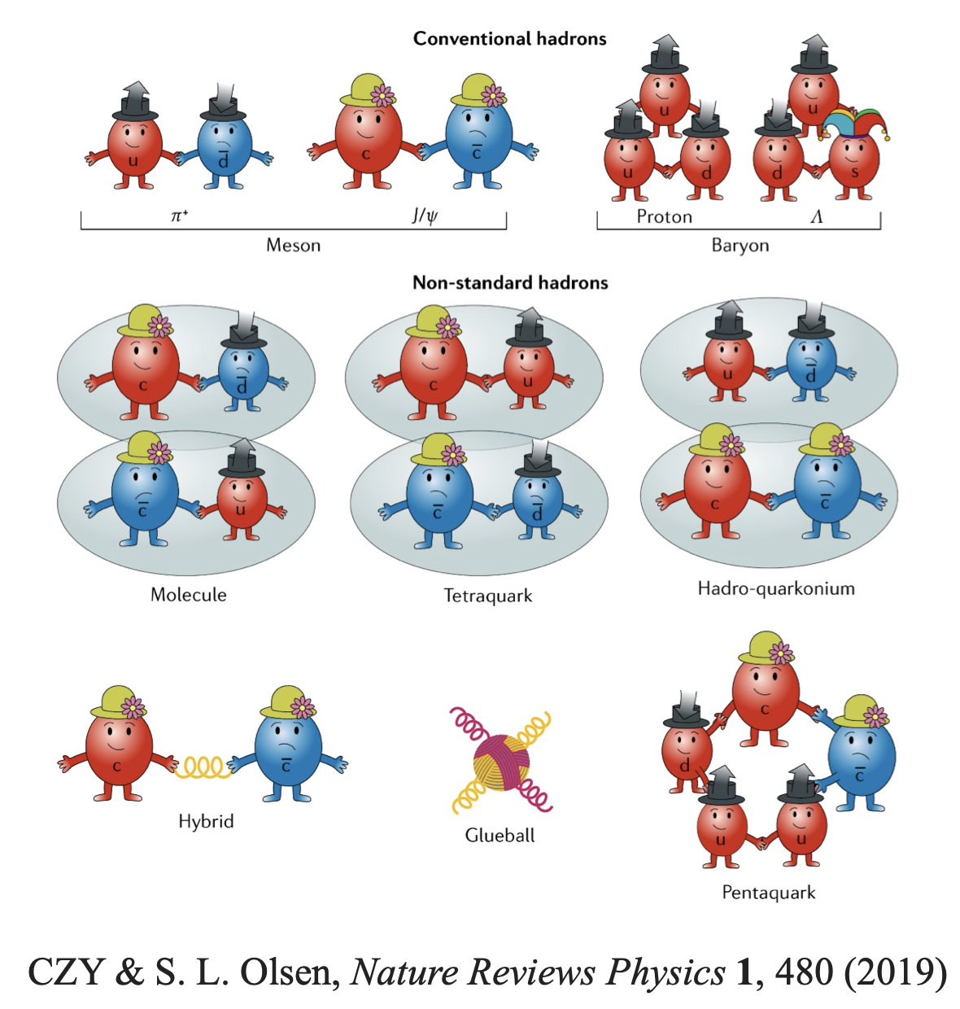
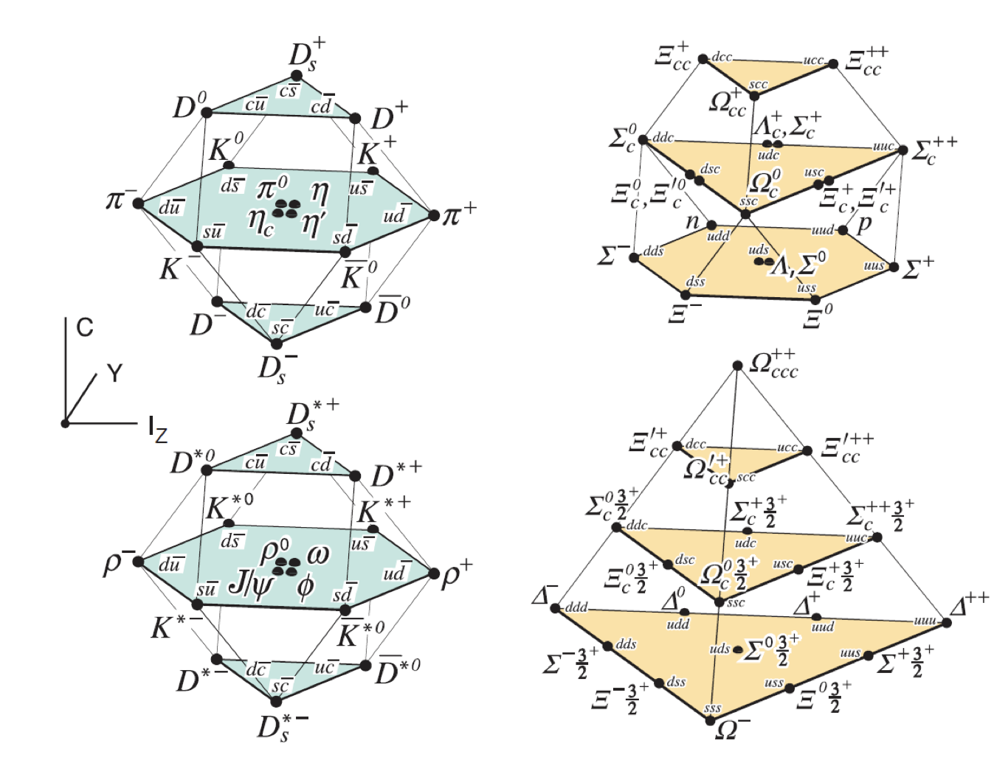
Background
Borrowed from Yuan‘s talk
Great success!!

Slide 4
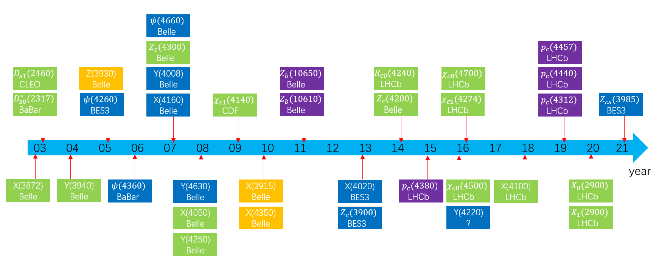
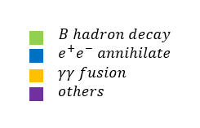
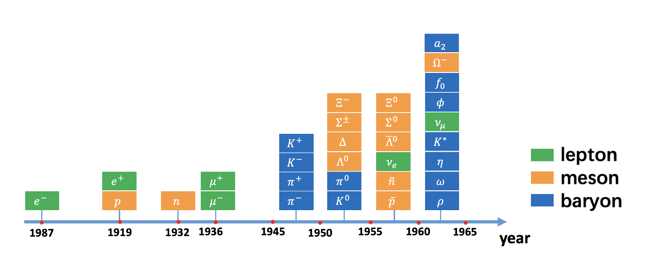
Discovery of heavy exotic states

Slide 5
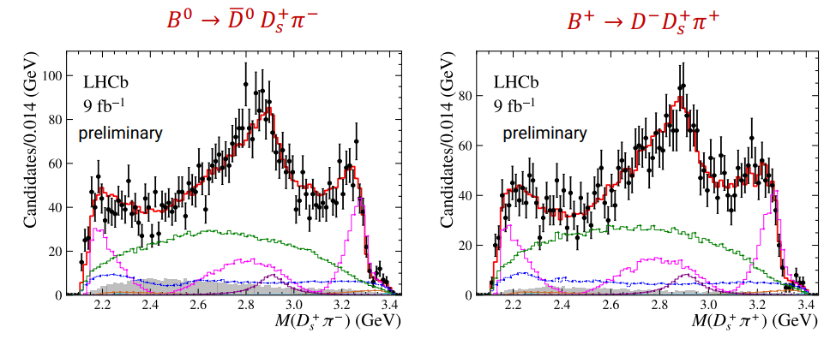




Short Review of $T_{c\overline{s}0}\left(2900\right)$: Experiment
Fully open flavor state composed of [$c\overline{s}u\overline{d}$] and [$c\overline{s}\overline{u}d$]
First observation of a doubly charged tetraquark states
$$T_{c\overline{s}0}^{0}$$
$$T_{c\overline{s}0}^{++}$$
[LHCb], Phys.Rev.Lett. 131 (2023) 4, 041902 [arXiv:2212.02716 ]

Slide 6

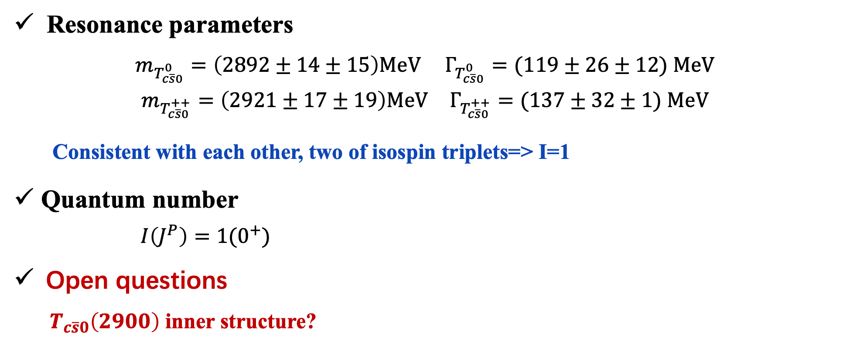
Short Review of $T_{c\overline{s}0}\left(2900\right)$: Experiment
Resonance parameters
$m_{T_{c\overline{s}0}^{0}}=\left(2892±14±15\right)MeV$ $Γ_{T_{c\overline{s}0}^{0}}=(119±26±12) MeV$
$m_{T_{c\overline{s}0}^{++}}=\left(2921±17±19\right)MeV$ $Γ_{T_{c\overline{s}0}^{++}}=(137±32±1) MeV$
Consistent with each other, two of isospin triplets=> I=1
Quantum number
$I\left(J^{P}\right)=1(0^{+})$
Open questions
$T_{c\overline{s}0}\left(2900\right)$ inner structure?

Slide 7

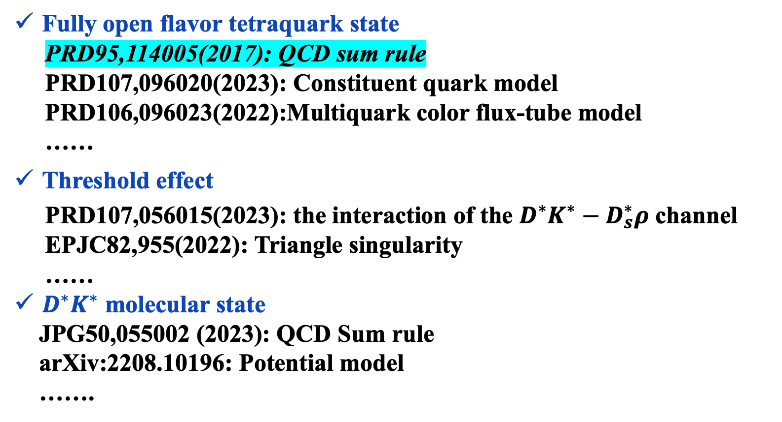
Short Review of $T_{c\overline{s}0}\left(2900\right)$: Theory
PART of theoretical explanations of the $T_{c\overline{s}0}^{0/++}$
Fully open flavor tetraquark state
PRD95,114005(2017): QCD sum rule
PRD107,096020(2023): Constituent quark model
PRD106,096023(2022):Multiquark color flux-tube model
……
Threshold effect
PRD107,056015(2023): the interaction of the $D^{∗}K^{∗}−D_{s}^{∗}ρ$ channel
EPJC82,955(2022): Triangle singularity
……
$D^{∗}K^{∗}$ molecular state
JPG50,055002 (2023): QCD Sum rule
arXiv:2208.10196: Potential model
…….

Slide 8


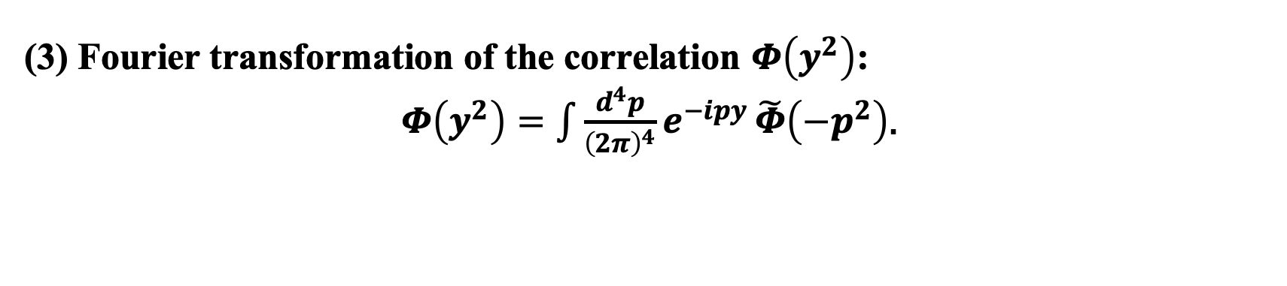
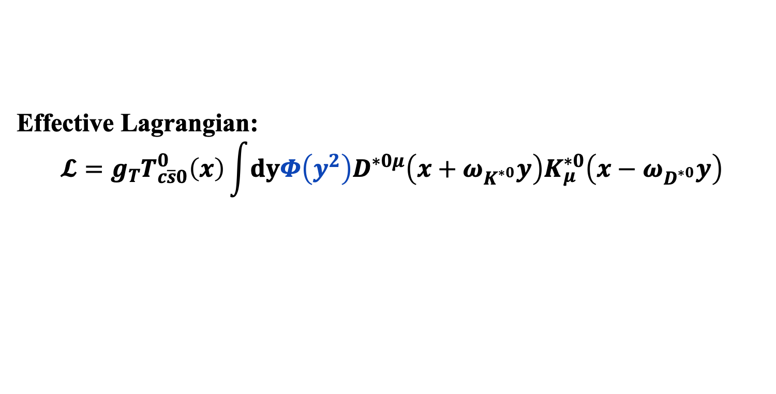

Decay properties of $T_{c\overline{s}0}^{0}\left(2900\right)$
Molecular structure of $T_{c\overline{s}0}^{0}\left(2900\right)$
$${|T}_{c\overline{s}0}^{0}\left(2900\right)⟩=|D^{∗0}K^{∗0}⟩$$
Effective Lagrangian:
$$𝓛=g_{T}T_{c\overline{s}0}^{0}\left(x\right)\int{dyΦ\left(y^{2}\right)D^{∗0μ}\left(x+ω_{K^{∗0}}y\right)K_{μ}^{∗0}\left(x−ω_{D^{∗0}}y\right)}$$
Correlation function
(1) Describe the interior structure of the molecular state
(2) Avoid divergency in the ultraviolet region.
(3) Fourier transformation of the correlation $Φ\left(y^{2}\right)$:
$Φ\left(y^{2}\right)=\int{\frac{d^{4}p}{{\left(2π\right)}^{4}}e^{−ipy}}\tilde{Φ}\left(−p^{2}\right)$.
Gaussian form: $\tilde{Φ}\left(p_{E}^{2}\right)=\text{exp}\left(−p_{E}^{2}/Λ_{T}^{2}\right)$

Slide 9
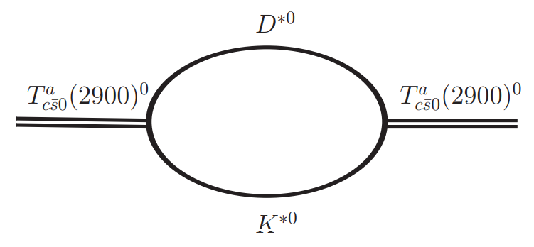

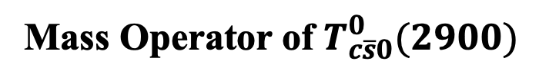
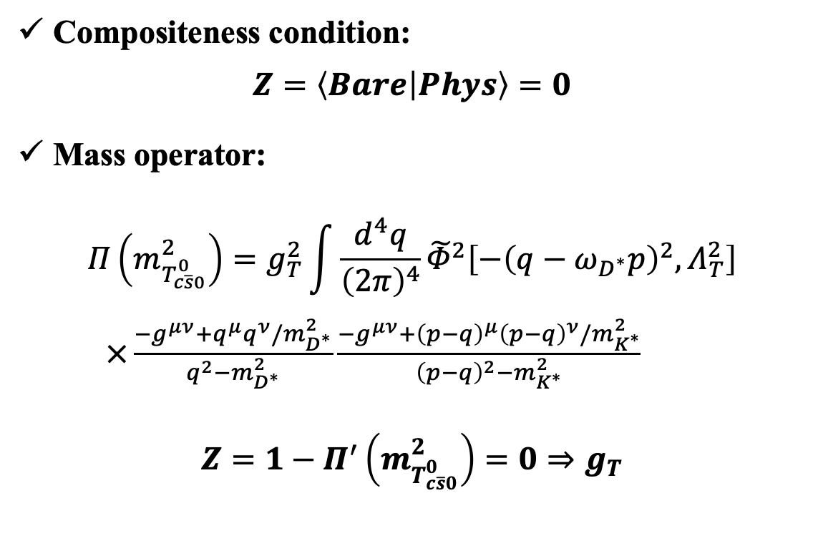
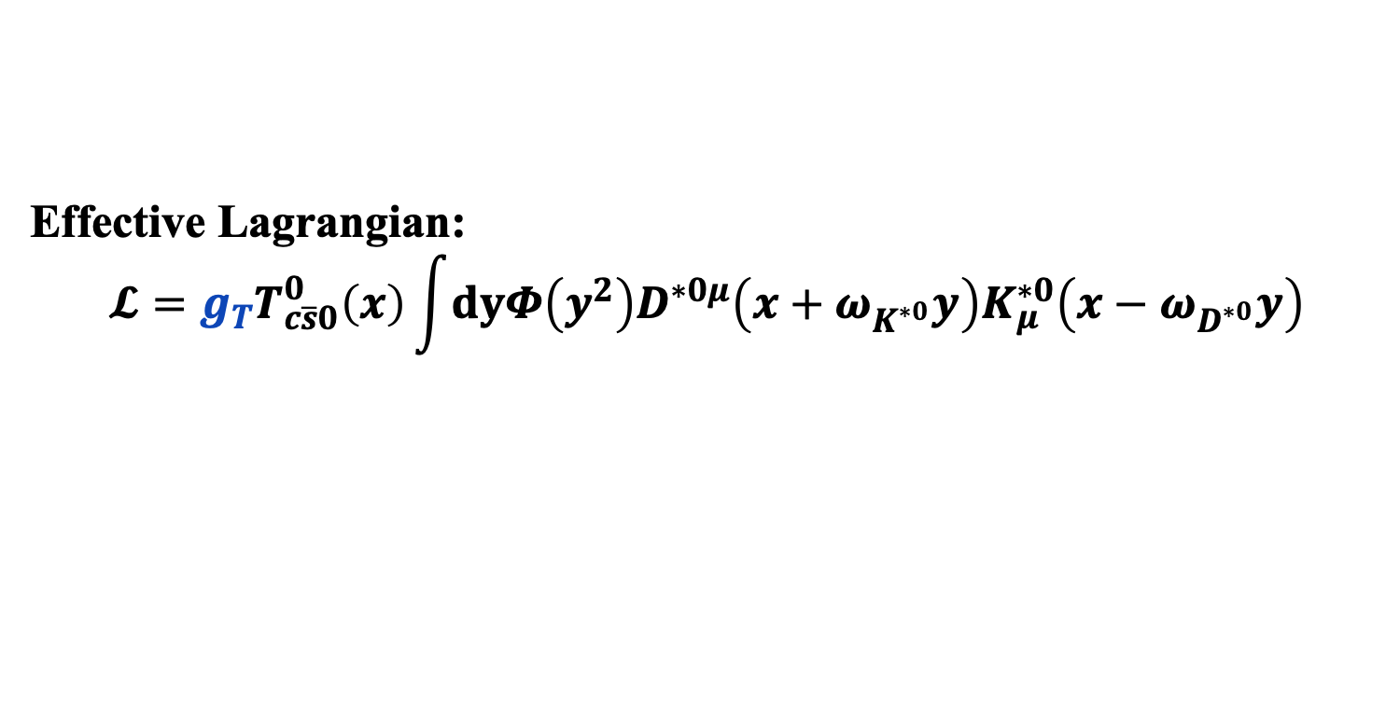
Decay properties of $T_{c\overline{s}0}^{0}\left(2900\right)$
Effective Lagrangian:
$$𝓛=g_{T}T_{c\overline{s}0}^{0}\left(x\right)\int{dyΦ\left(y^{2}\right)D^{∗0μ}\left(x+ω_{K^{∗0}}y\right)K_{μ}^{∗0}\left(x−ω_{D^{∗0}}y\right)}$$
Compositeness condition:
$$Z=\left\langle Bare | Phys\right\rangle =0$$
Mass operator:
$$Π\left(m_{T_{c\overline{s}0}^{0}}^{2}\right)=g_{T}^{2}\int{\frac{d^{4}q}{{\left(2π\right)}^{4}}{\tilde{Φ}}^{2}\left[−{\left(q−ω_{D^{∗}}p\right)}^{2},Λ_{T}^{2}\right]}$$
$×\frac{−g^{μν}+q^{μ}q^{ν}/m_{D^{∗}}^{2}}{q^{2}−m_{D^{∗}}^{2}}\frac{−g^{μν}+{\left(p−q\right)}^{μ}{\left(p−q\right)}^{ν}/m_{K^{∗}}^{2}}{{\left(p−q\right)}^{2}−m_{K^{∗}}^{2}}$
$$Z=1−Π^{′}\left(m_{T_{c\overline{s}0}^{0}}^{2}\right)=0⇒g_{T}$$
Mass Operator of $T_{c\overline{s}0}^{0}(2900)$

Slide 10
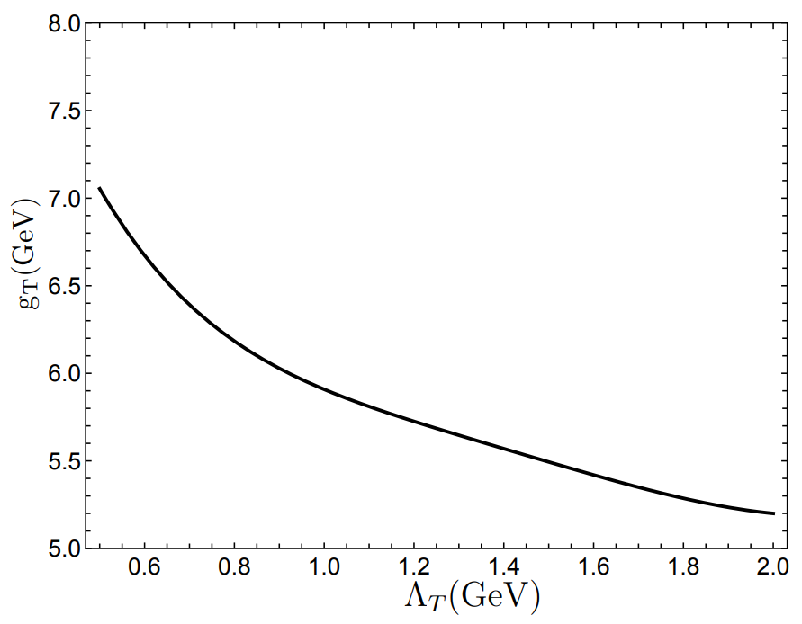
Decay properties of $T_{c\overline{s}0}^{0}\left(2900\right)$
Effective Lagrangian:
$$𝓛=g_{T}T_{c\overline{s}0}^{0}\left(x\right)\int{dyΦ\left(y^{2}\right)D^{∗0μ}\left(x+ω_{K^{∗0}}y\right)K_{μ}^{∗0}\left(x−ω_{D^{∗0}}y\right)}$$
Compositeness condition:
$$Z=\left\langle Bare | Phys\right\rangle =0$$
Mass operator:
$$Π\left(m_{T_{c\overline{s}0}^{0}}^{2}\right)=g_{T}^{2}\int{\frac{d^{4}q}{{\left(2π\right)}^{4}}{\tilde{Φ}}^{2}\left[−{\left(q−ω_{D^{∗}}p\right)}^{2},Λ_{T}^{2}\right]}$$
$×\frac{−g^{μν}+q^{μ}q^{ν}/m_{D^{∗}}^{2}}{q^{2}−m_{D^{∗}}^{2}}\frac{−g^{μν}+{\left(p−q\right)}^{μ}{\left(p−q\right)}^{ν}/m_{K^{∗}}^{2}}{{\left(p−q\right)}^{2}−m_{K^{∗}}^{2}}$
$$Z=1−Π^{′}\left(m_{T_{c\overline{s}0}^{0}}^{2}\right)=0⇒g_{T}$$

Slide 11
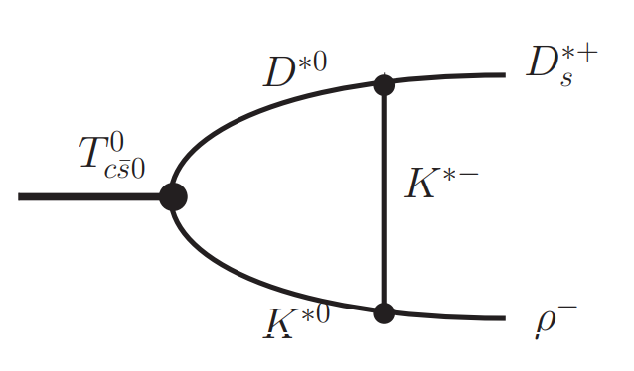
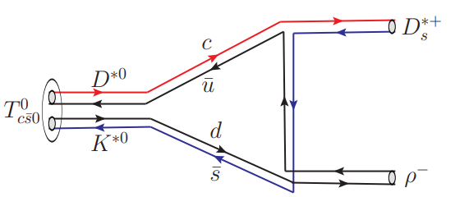
Decay properties of $T_{c\overline{s}0}^{0}\left(2900\right)$
Two body decay mechanism
quark level
hadron level

Slide 12

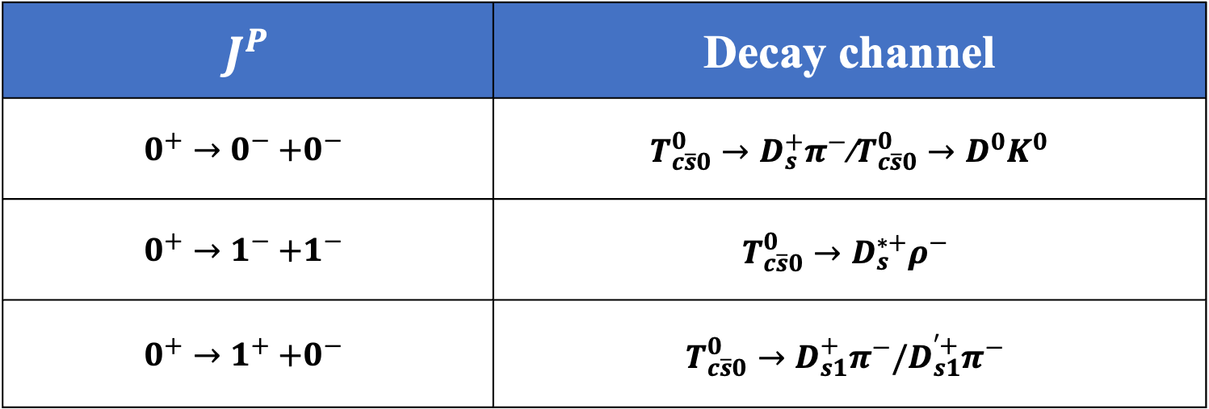
Decay properties of $T_{c\overline{s}0}^{0}\left(2900\right)$
The possible two body decay channels:
${ T}_{c\overline{s}0}^{0}→(c\overline{s})(\overline{u}d), (c\overline{u})(d\overline{s})$
$J^{P}$ | Decay channel
$$0^{+}→0^{−}{+0}^{−}$$ | $T_{c\overline{s}0}^{0}→D_{s}^{+}π^{−}$/$T_{c\overline{s}0}^{0}→D^{0}K^{0}$
$$0^{+}→1^{−}{+1}^{−}$$ | $$T_{c\overline{s}0}^{0}→D_{s}^{∗+}ρ^{−}$$
$$0^{+}→1^{+}{+0}^{−}$$ | $$T_{c\overline{s}0}^{0}→D_{s1}^{+}π^{−}/D_{s1}^{′+}π^{−}$$

Slide 13
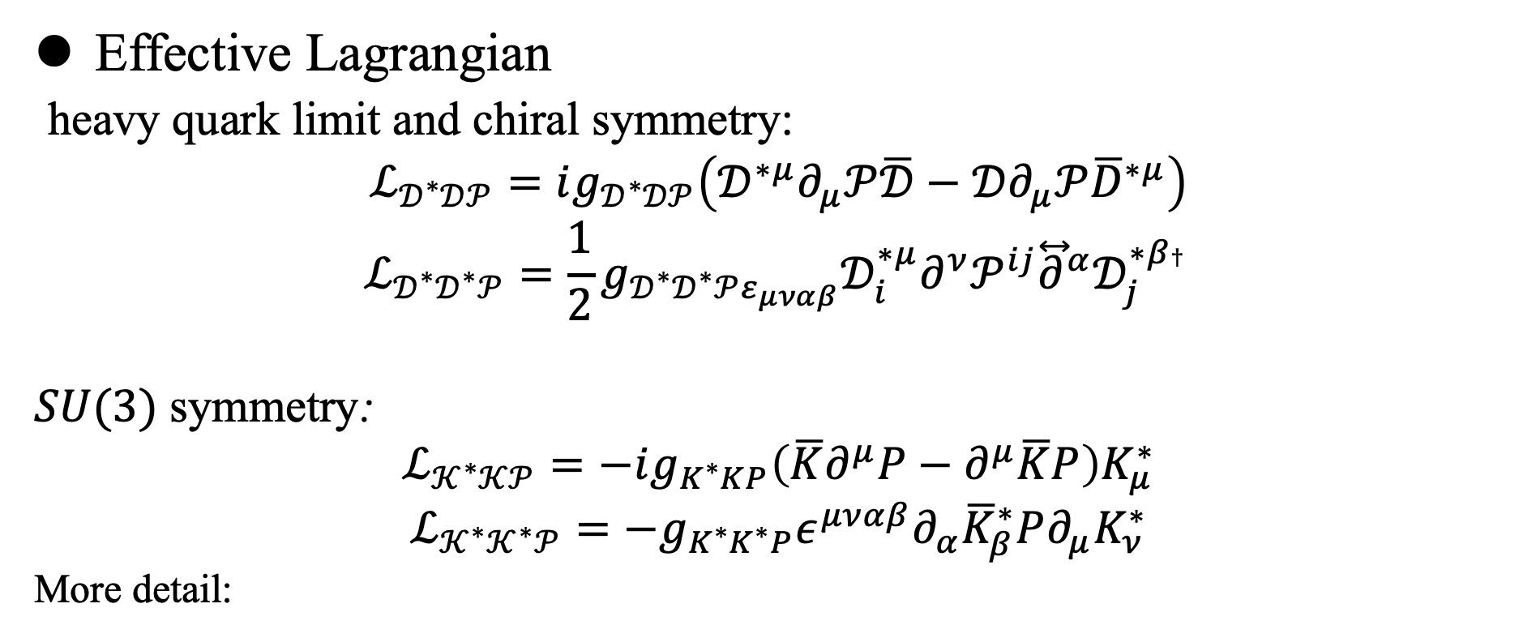
Decay properties of $T_{c\overline{s}0}^{0}\left(2900\right)$
Effective Lagrangian
heavy quark limit and chiral symmetry:
$$ℒ_{𝒟^{∗}𝒟𝒫}=ig_{𝒟^{∗}𝒟𝒫}\left(𝒟^{∗μ}∂_{μ}𝒫\overline{𝒟}−𝒟∂_{μ}𝒫{\overline{D}}^{∗μ}\right)$$
$$ℒ_{𝒟^{∗}𝒟^{∗}𝒫}=\frac{1}{2}g_{𝒟^{∗}𝒟^{∗}𝒫ε_{μναβ}}𝒟_{i}^{∗μ}∂^{ν}𝒫^{ij}{\overset{⃡}{∂}}^{α}𝒟_{j}^{∗β† }$$
$SU(3)$ symmetry:
$$ℒ_{𝒦^{∗}𝒦𝒫}=−ig_{K^{∗}KP}\left(\overline{K}∂^{μ}P−∂^{μ}\overline{K}P\right)K_{μ}^{∗}$$
$$ℒ_{𝒦^{∗}𝒦^{∗}𝒫}=−g_{K^{∗}K^{∗}P}ε^{μναβ}∂_{α}{\overline{K}}_{β}^{∗}P∂_{μ}K_{ν}^{∗}$$
More detail:
Zi-Li Yue, Cheng-Jian Xiao and Dian-Yong Chen, Phys.Rev.D 107 (2023) 3, 034018

Slide 14
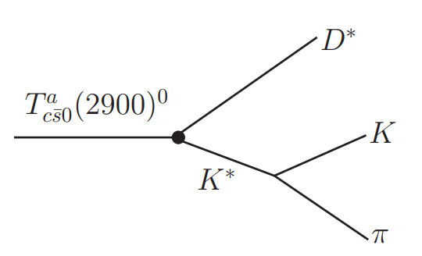

Decay properties of $T_{c\overline{s}0}^{0}\left(2900\right)$
The possible decay mode:
Three body decay: $T_{c\overline{s}0}^{0}→D^{∗0}{(Kπ)}^{0}$
$K^{∗}$ decay width:$47.3±0.5 MeV$
Decay width:
$$dΓ=\frac{1}{{\left(2π\right)}^{3}}\frac{1}{32M^{3}}\overline{{\left|ℳ\right|}^{2}}dm_{12}^{2}dm_{23}^{2}$$

Slide 15
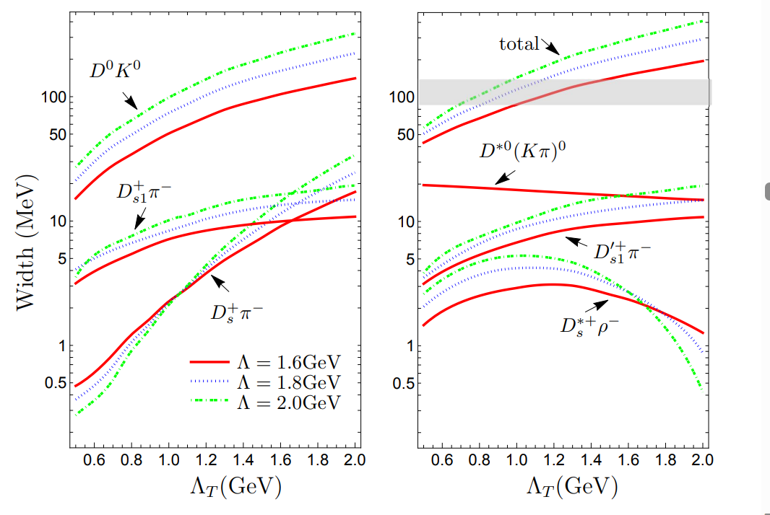
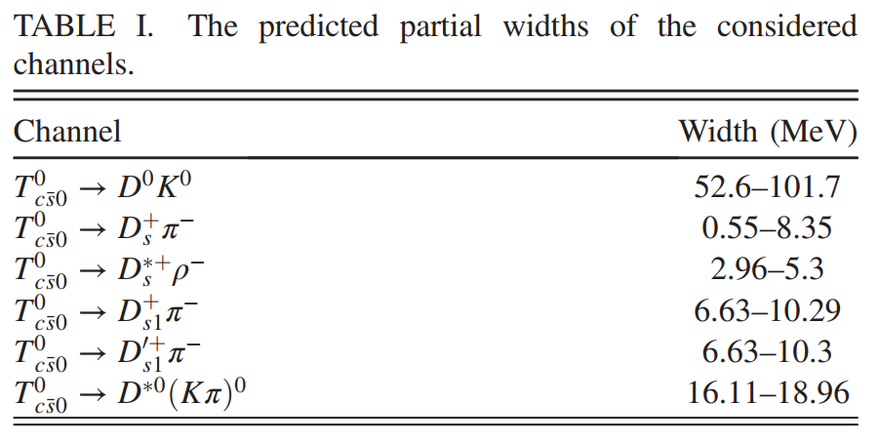
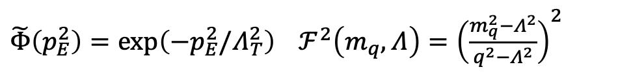
Decay properties of $T_{c\overline{s}0}^{0}\left(2900\right)$
$\tilde{Φ}\left(p_{E}^{2}\right)=\text{exp}\left(−p_{E}^{2}/Λ_{T}^{2}\right)$ $ℱ^{2}\left(m_{q},Λ\right)={\left(\frac{m_{q}^{2}−Λ^{2}}{q^{2}−Λ^{2}}\right)}^{2}$
Zi-Li Yue, Cheng-Jian Xiao and Dian-Yong Chen, Phys.Rev.D 107 (2023) 3, 034018

Slide 16
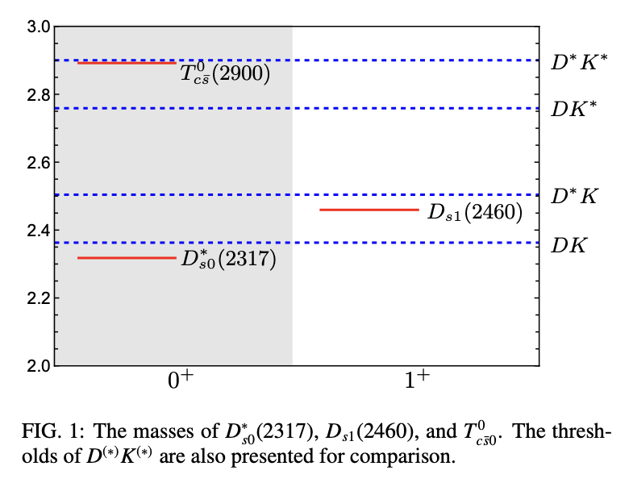
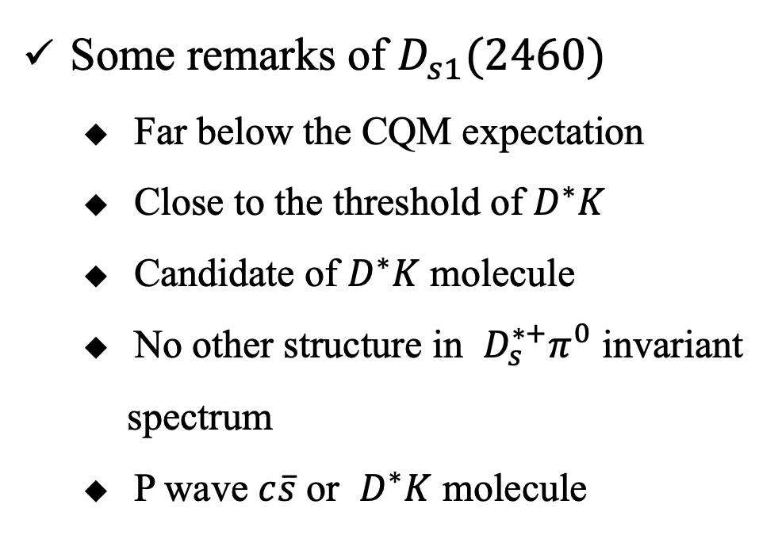
$$T_{c\overline{s}0}^{+}\left(2900\right)→D_{s1}^{+}\left(2460\right)π^{0}/γ$$
States near DK thresholds
Some remarks of $D_{s1}(2460)$
  Far below the CQM expectation
  Close to the threshold of $D^{∗}K$
  Candidate of $D^{∗}K$ molecule
  No other structure in $D_{s}^{∗+}π^{0}$ invariant spectrum
  P wave $c\overline{s}$ or $D^{∗}K$ molecule

Slide 17
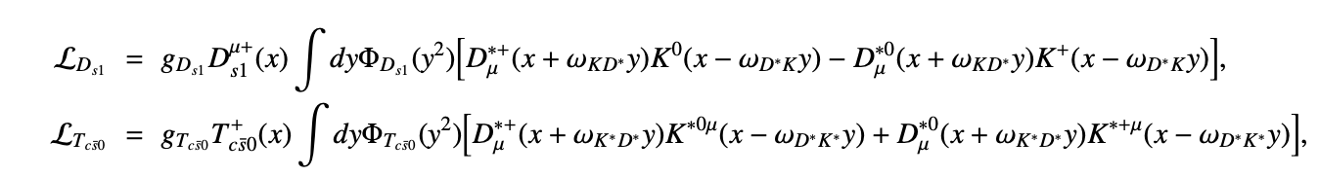
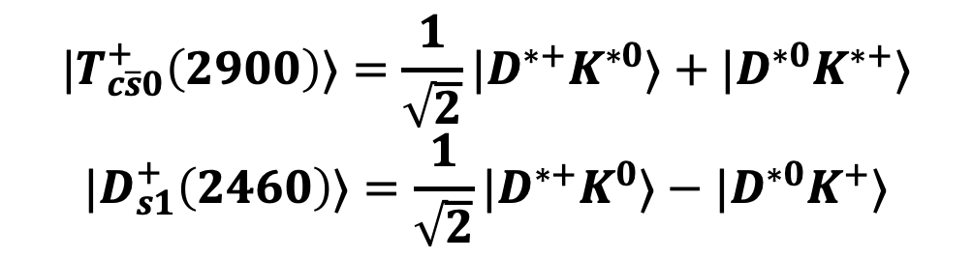
$$T_{c\overline{s}0}^{+}\left(2900\right)→D_{s1}^{+}\left(2460\right)π^{0}/γ$$
Molecular structure of $T_{c\overline{s}0}^{+}\left(2900\right)$ and $D_{s1}^{+}\left(2460\right)$
$${|T}_{c\overline{s}0}^{+}\left(2900\right)⟩=\frac{1}{\sqrt{2}}|D^{∗+}K^{∗0}⟩+|D^{∗0}K^{∗+}⟩$$
$${|D}_{s1}^{+}\left(2460\right)⟩=\frac{1}{\sqrt{2}}|D^{∗+}K^{0}⟩−{|D}^{∗0}K^{+}⟩$$
Relevant effective Lagrangians

Slide 18
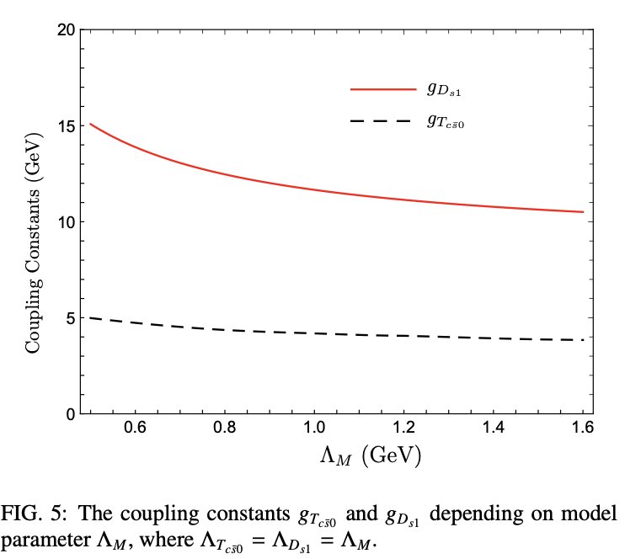
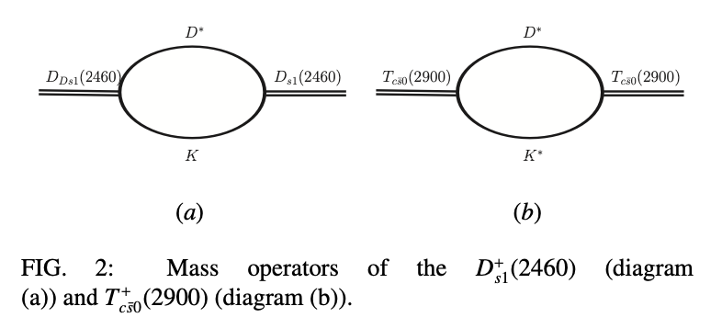


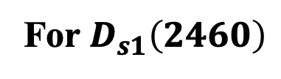
$$T_{c\overline{s}0}^{+}\left(2900\right)→D_{s1}^{+}\left(2460\right)π^{0}/γ$$
Relevant coupling constants
For $D_{s1}\left(2460\right)$

Slide 19

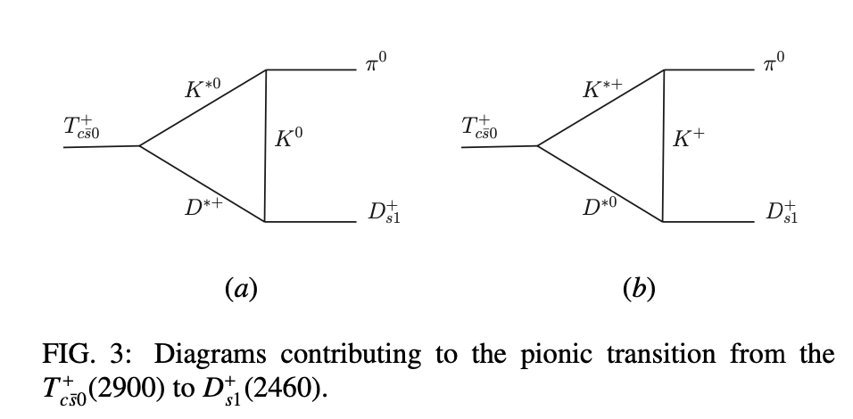
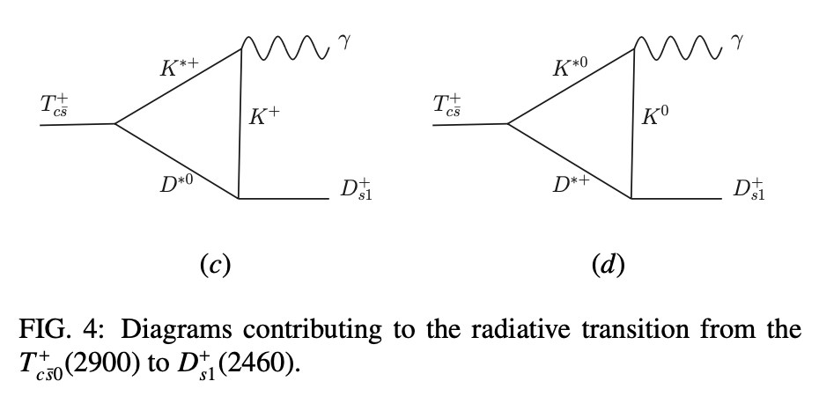

$$T_{c\overline{s}0}^{+}\left(2900\right)→D_{s1}^{+}\left(2460\right)π^{0}/γ$$
Charmed-strange meson frame
heavy quark limit and chiral symmetry
$$T_{c\overline{s}0}^{+}\left(2900\right)→D_{s1}^{+}\left(2460\right)π^{0}$$
$$T_{c\overline{s}0}^{+}\left(2900\right)→D_{s1}^{+}\left(2460\right)γ$$

Slide 20
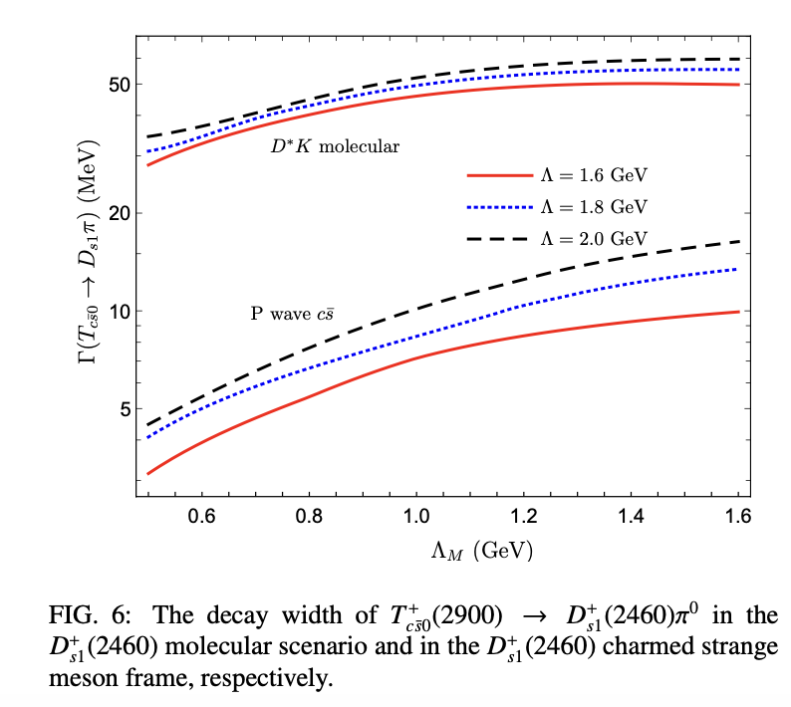
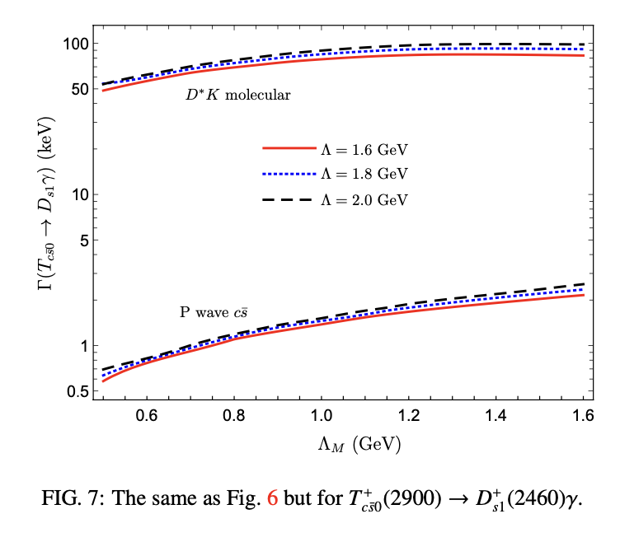
$$T_{c\overline{s}0}^{+}\left(2900\right)→D_{s1}^{+}\left(2460\right)π^{0}/γ$$
Partial Widths depending on model parameter
Zi-Li Yue, Cheng-Jian Xiao, and Dian-Yong Chen Eur.Phys.J.C 83 (2023),769

Slide 21
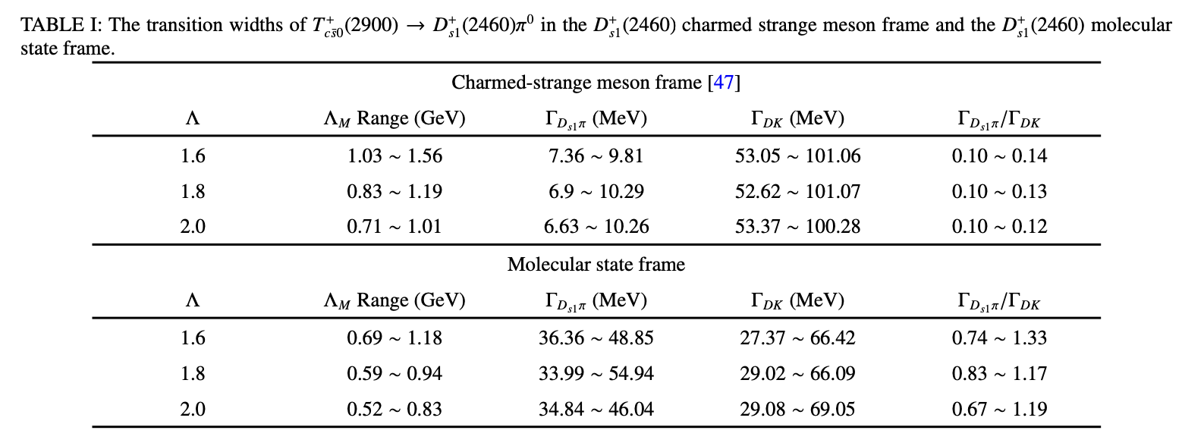



$$T_{c\overline{s}0}^{+}\left(2900\right)→D_{s1}^{+}\left(2460\right)π^{0}/γ$$
Comparison with DK mode
$D_{s1}(2460)$ as a P wave charmed strange meson
$Γ[D_{s1}π]$/$Γ\left[DK\right]∼0.1$
$D_{s1}(2460)$ as a $D^{∗}K$ molecular state
$Γ[D_{s1}π]$/$Γ\left[DK\right]∼1$
$T_{c\overline{s}0}^{+}\left(2900\right)→D_{s1}^{+}\left(2460\right)π^{0}$ could be a probe of structure of $D_{s1}^{+}\left(2460\right)$.

Slide 22
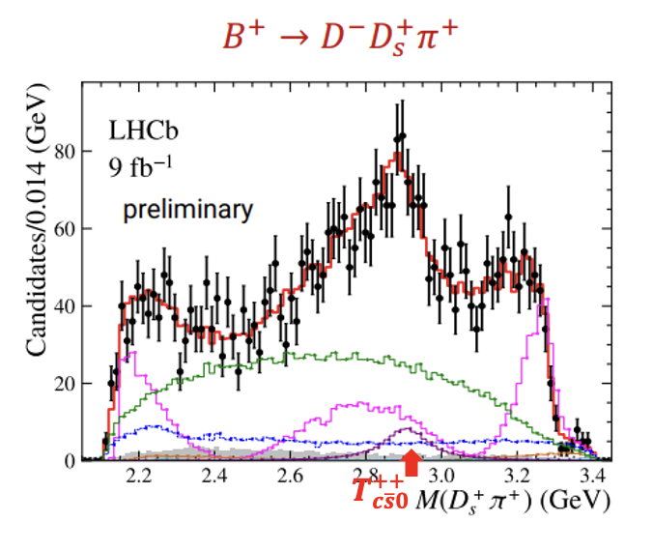
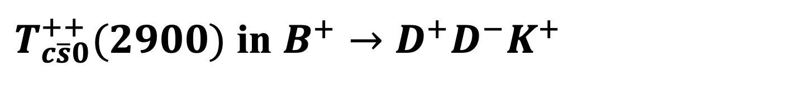
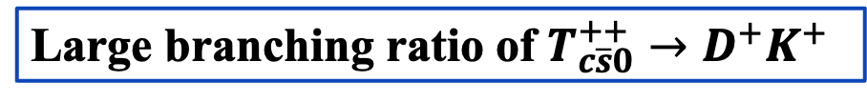

$T_{c\overline{s}0}^{++}(2900)$ in $B^{+}→D^{+}D^{−}K^{+}$
Observation of $B^{+}→D^{−}T_{c\overline{s}0}^{++}→D^{−}D_{s}^{+}π^{+}$
Large branching ratio of $T_{c\overline{s}0}^{++}→D^{+}K^{+}$
$$B^{+}→D^{−}T_{c\overline{s}0}^{++}{→D^{−}(D}^{+}K^{+})$$

Slide 23
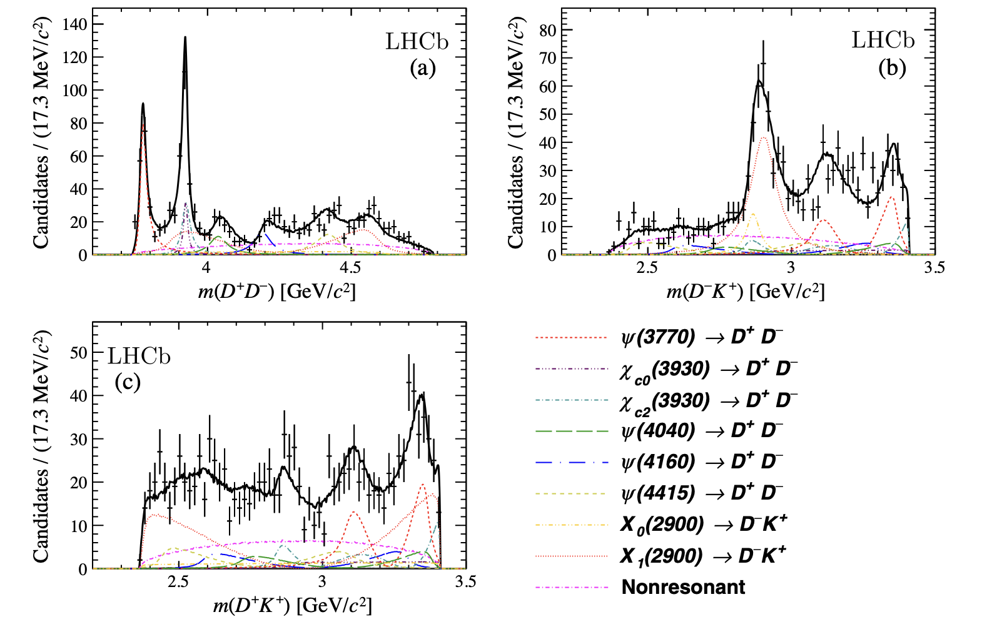
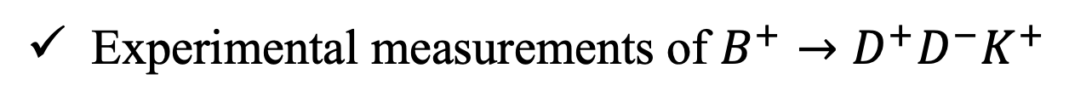
$T_{c\overline{s}0}^{++}(2900)$ in $B^{+}→D^{+}D^{−}K^{+}$
Experimental measurements of $B^{+}→D^{+}D^{−}K^{+}$
LHCb Collaboration Phys. Rev. D102, 112003 (2020)

Slide 24
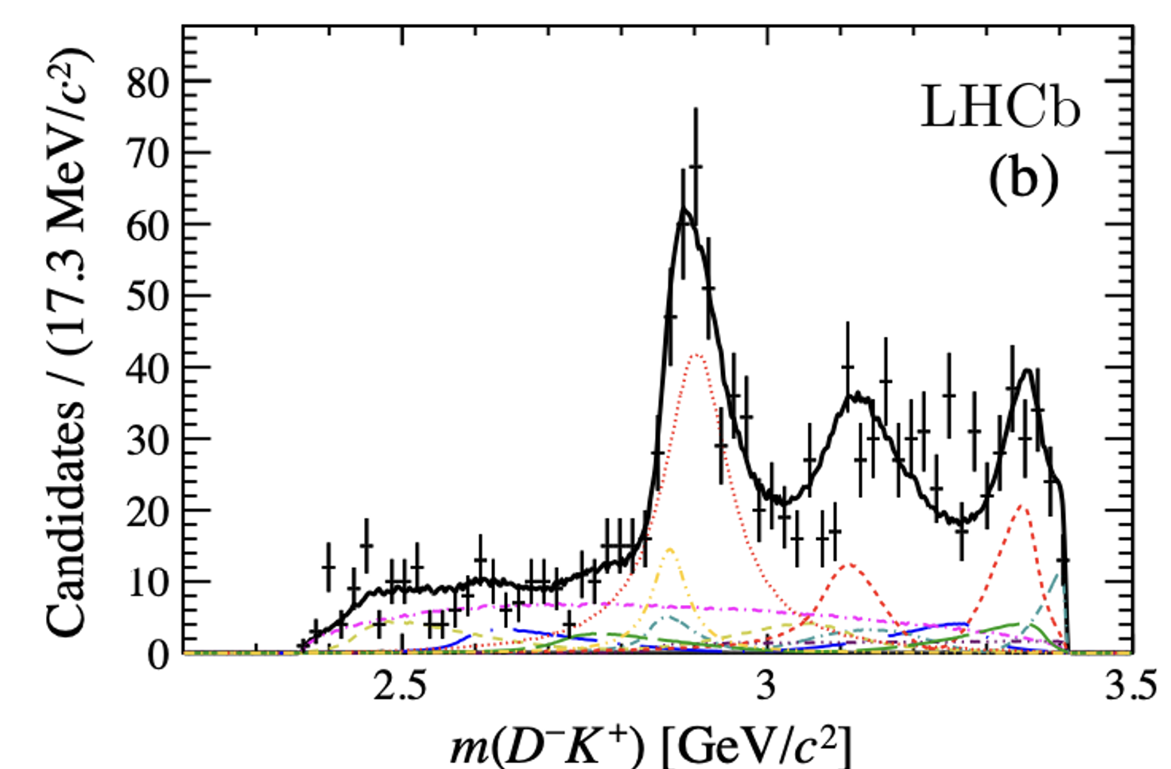


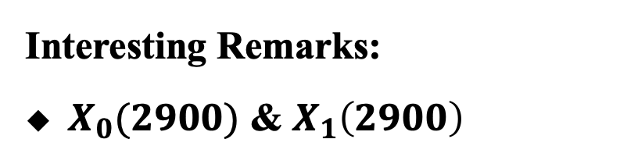
$T_{c\overline{s}0}^{++}(2900)$ in $B^{+}→D^{+}D^{−}K^{+}$
Experimental measurements of $B^{+}→D^{+}D^{−}K^{+}$
Interesting Remarks:
$X_{0}(2900)$ & $X_{1}\left(2900\right)$
$$X_{1}(2900)$$
$$X_{0}(2900)$$
LHCb Collaboration Phys. Rev. D102, 112003 (2020)

Slide 25
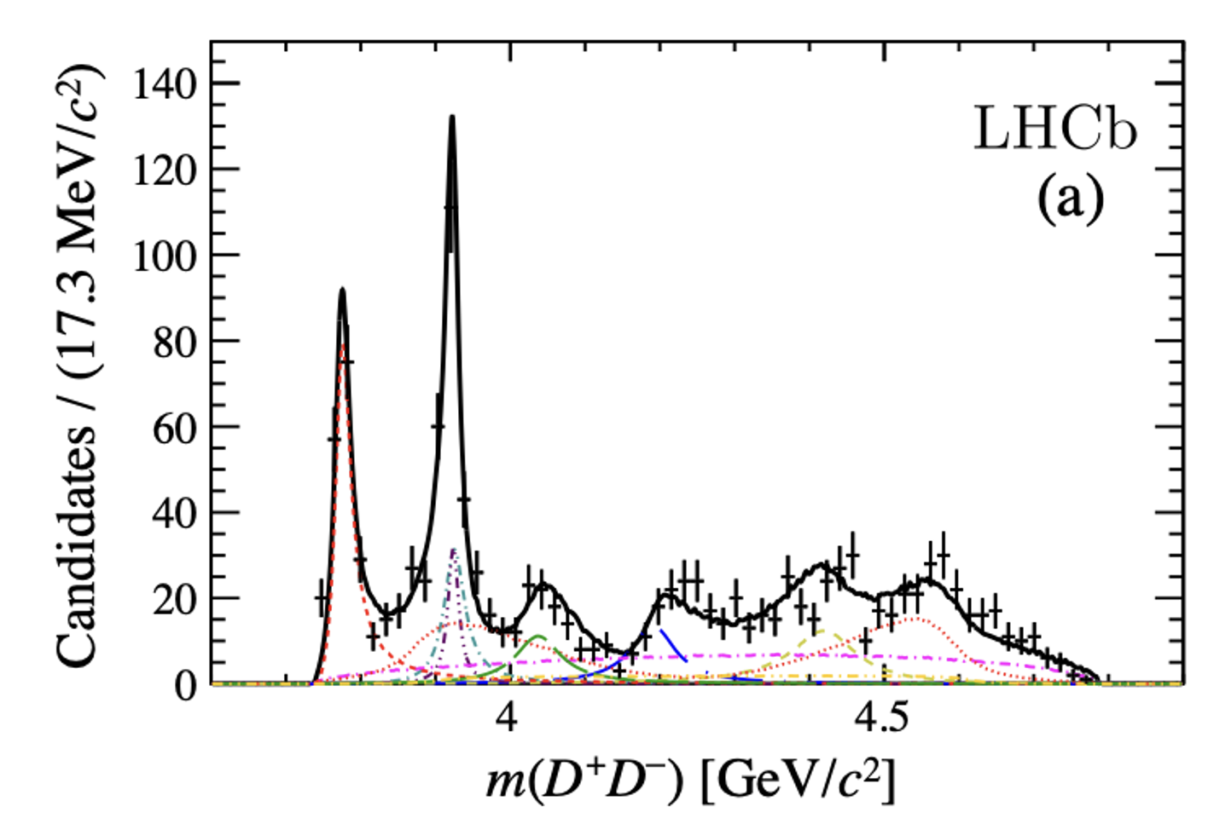


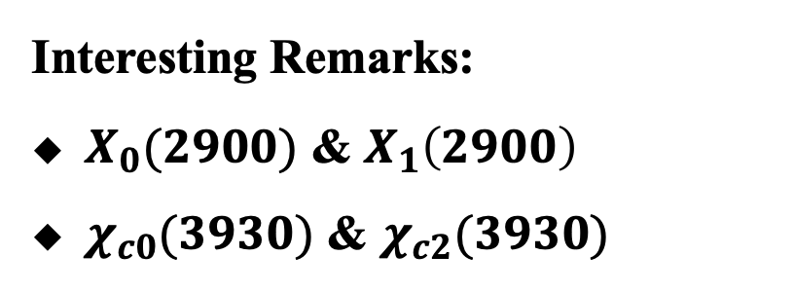
$T_{c\overline{s}0}^{++}(2900)$ in $B^{+}→D^{+}D^{−}K^{+}$
Experimental measurements of $B^{+}→D^{+}D^{−}K^{+}$
Interesting Remarks:
$X_{0}(2900)$ & $X_{1}\left(2900\right)$
$χ_{c0}(3930)$ & $χ_{c2}(3930)$
$χ_{c2}(3930)$
$χ_{c0}(3930)$
LHCb Collaboration Phys. Rev. D102, 112003 (2020)

Slide 26
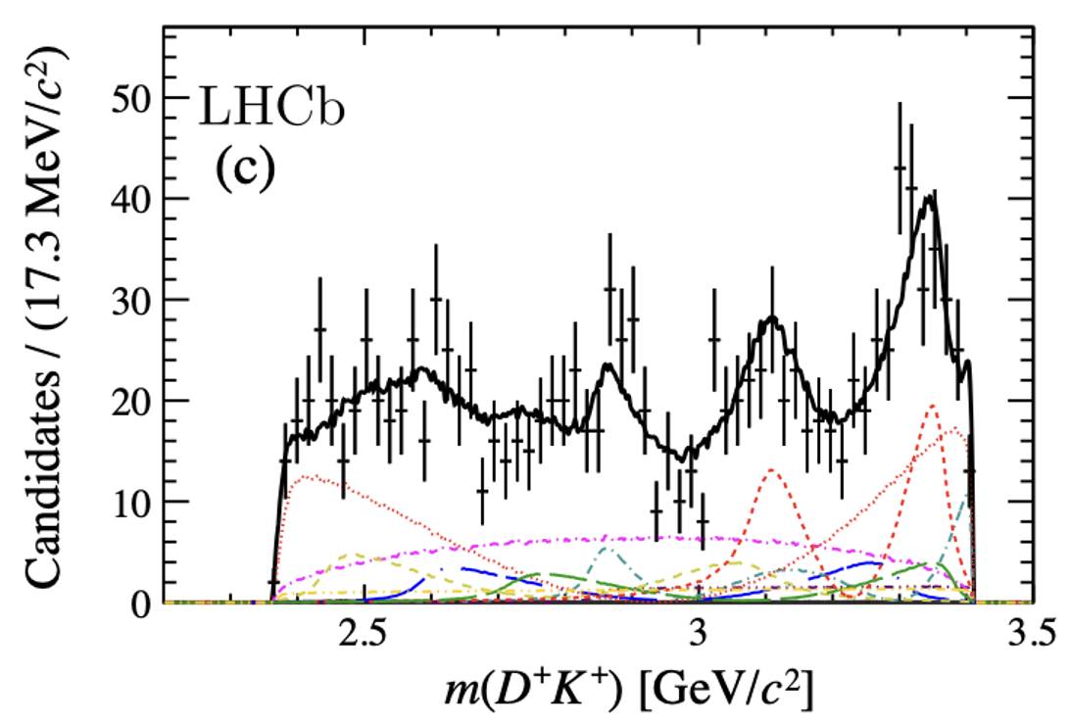
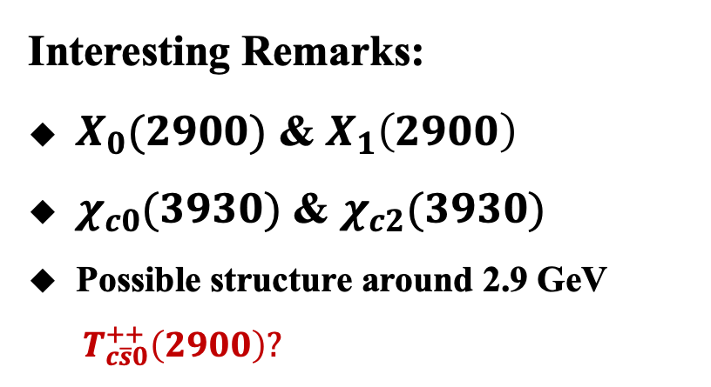
$T_{c\overline{s}0}^{++}(2900)$ in $B^{+}→D^{+}D^{−}K^{+}$
Experimental measurements of $B^{+}→D^{+}D^{−}K^{+}$
Interesting Remarks:
$X_{0}(2900)$ & $X_{1}\left(2900\right)$
$χ_{c0}(3930)$ & $χ_{c2}(3930)$
Possible structure around 2.9 GeV
$T_{c\overline{s}0}^{++}\left(2900\right)?$
Possible structure?
LHCb Collaboration Phys. Rev. D102, 112003 (2020)

Slide 27

$T_{c\overline{s}0}^{++}(2900)$ in $B^{+}→D^{+}D^{−}K^{+}$
Experimental measurements of $B^{+}→D^{+}D^{−}K^{+}$
Interesting Remarks:
$X_{0}(2900)$ & $X_{1}\left(2900\right)$
$χ_{c0}(3930)$ & $χ_{c2}(3930)$
Possible structure around 2.9 GeV
$T_{c\overline{s}0}^{++}\left(2900\right)?$
Possible structure?
$$χ_{c2}(3930)$$
LHCb Collaboration Phys. Rev. D102, 112003 (2020)

Slide 28


$T_{c\overline{s}0}^{++}(2900)$ in $B^{+}→D^{+}D^{−}K^{+}$
Experimental measurements of $B^{+}→D^{+}D^{−}K^{+}$
Interesting Remarks:
$X_{0}(2900)$ & $X_{1}\left(2900\right)$
$χ_{c0}(3930)$ & $χ_{c2}(3930)$
Possible structure around 2.9 GeV
$T_{cs0}^{++}\left(2900\right)?$
Involvement of$T_{cs0}^{++} (2900)$ would change the fit fraction of $χ_{c0}(3930)$ and $χ_{c2}(3930).$
LHCb Collaboration Phys. Rev. D102, 112003 (2020)

Slide 29








$T_{c\overline{s}0}^{++}(2900)$ in $B^{+}→D^{+}D^{−}K^{+}$
$$B^{+}→D^{−}D^{∗+}K^{∗+}$$
Production and decay mechanism
Transition amplitudes
Two Meson loop function
Unknown coupling constants: $C_{1} , g_{T_{c\overline{s}0}^{++}D^{∗}K^{∗}} ,g_{T_{c\overline{s}0}^{++}DK}$

Slide 30




$T_{c\overline{s}0}^{++}(2900)$ in $B^{+}→D^{+}D^{−}K^{+}$
Coupling constant $g_{T_{c\overline{s}0}^{++}D^{∗}K^{∗}}$
Coupling constant $g_{T_{c\overline{s}0}^{++}DK}$
Molecular estimation: $Γ_{T_{c\overline{s}0}^{++}→DK}=85 MeV$ [Phys.Rev.D 107 (2023) 3, 034018]

Slide 31





$T_{c\overline{s}0}^{++}(2900)$ in $B^{+}→D^{+}D^{−}K^{+}$
Transition amplitude of $B^{+}→{D^{−}D}^{+}K^{+}$
$$−it_{3}=−iC_{3}$$
Transition amplitude of $B^{+}→D^{−}D^{∗+} K^{∗+}$
$$−it_{1}=−iC_{1}ε\left(D^{∗}\right)⋅ε(K^{∗})$$
Similarity of $B^{+}→D^{−}D^{∗+} K^{∗+}$ and $B^{+}→{D^{−}D}^{+}K^{+}$
In $B^{+}→D^{−}D^{∗+} K^{∗+}$ process
No $ψ\left(3770\right)，X_{0,1}(2900)$
Similar nonresonant
contribution.
Determine $C_{3}$ with nonresonant contributions and assume $C_{1}=C_{3}$

Slide 32


$T_{c\overline{s}0}^{++}(2900)$ in $B^{+}→D^{+}D^{−}K^{+}$
$T_{c\overline{s}0}^{++}(2900)$ contributions in $B^{+}→D^{+}D^{−}K^{+}$
Background contributions in $B^{+}→D^{+}D^{−}K^{+}$

Slide 33



$T_{c\overline{s}0}^{++}(2900)$ in $B^{+}→D^{+}D^{−}K^{+}$
$T_{c\overline{s}0}^{++}(2900)$ Signal
With interferences
Man-Yu Duan, En Wang, Dian-Yong Chen, arXiv: 2305.09436

Slide 34



$T_{c\overline{s}0}^{0}(2900)$ in $B^{+}→K^{+}{\overline{D}}^{0}{\overline{K}}^{0}$
Resonance contributions to $B^{+}→D^{+}D^{−}K^{+}$
$D^{+}D^{−}$ resonance: ~ 45%
$D^{−}K^{+}$ resonance: ~ 35%
Possible $T_{cc}^{++}\left(2900\right)$ contribution

Slide 35




$T_{c\overline{s}0}^{0}(2900)$ in $B^{+}→K^{+}{\overline{D}}^{0}{\overline{K}}^{0}$
Construct a new process to detect $T_{c\overline{s}0}(2900)$
$$B^{+}→K^{+}{\overline{D}}^{0}{\overline{K}}^{0}$$
Belle, Phys.Lett.B 542 (2002) 171
$D\overline{D}$ resonance($c\overline{c}$):
$D^{−}K^{+}$ resonance($X_{0,1}(2900)$):
$DK$ resonance($D_{s}^{∗∗}$ ):
$T_{c\overline{s}0}^{0}\left(2900\right)$ contribution
Branching fraction: $\left(5.5±1.6\right)×10^{−4}$
$ρ^{+}−$like resonance near threshold

Slide 36








$T_{c\overline{s}0}^{0}(2900)$ in${ B}^{+}→K^{+}{\overline{D}}^{0}{\overline{K}}^{0}$
Transition amplitude of $B^{+}→K^{+}{\overline{D}}^{∗0}{\overline{K}}^{∗}$
$$Br\left[B^{+}→K^{+}{\overline{D}}^{∗}{\overline{K}}^{∗}\right]=\left(1.5±0.4\right)×10^{−3}$$
Transition amplitude of $B^{+}→K^{+}{\overline{D}}^{∗0}{\overline{K}}^{∗}→K^{+}T_{c\overline{s}0}^{0}\left(2900\right)→K^{+} {\overline{D}}^{0}{\overline{K}}^{0}$

Slide 37




$T_{c\overline{s}0}^{0}(2900)$ in${ B}^{+}→K^{+}{\overline{D}}^{0}{\overline{K}}^{0}$
Fit data with both $T_{c\overline{s}0}^{0}(2900)$, $ρ(770)$ and $ρ(1450)$
Total transition amplitude

Slide 38

Summary
In the $D^{∗}K^{∗}$ molecular frame
  dominant decay into DK，$D_{s}^{∗} π$is also sizable
  $T_{c\overline{s}0}^{+}(2900)→D_{s1}^{+}\left(2460\right)π^{0}$
    charmed strange meson: $Γ\left[D_{s1}π\right]:Γ\left[DK\right]=0.1$
    molecular state: $Γ\left[D_{s1}π\right]:Γ\left[DK\right]=1$
  $T_{c\overline{s}0}^{++}(2900)$ in $B^{+}→D^{−}D^{+}K^{+}$;
  $T_{c\overline{s}0}^{0}(2900)$ in${ B}^{+}→K^{+}{\overline{D}}^{0}{\overline{K}}^{0}$;

Slide 39


