Slide 1
Jason L Evans
Tsung-Dao Lee Institute
Proton Decay and
SU(5) Grand Unification

Slide 2



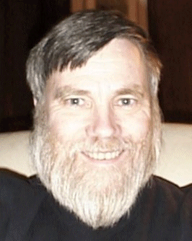
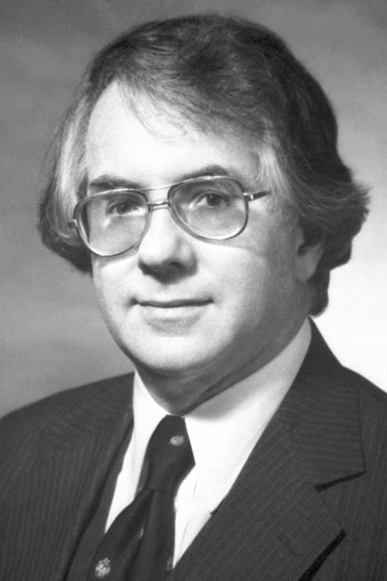


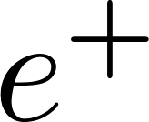






Georgi and Glashow: Grand Unification
Strong, electromagnetic, and weak forces are conjectured to arise from a single fundamental interaction based on the gauge group SU(5).
SM subgroup of SU(5)
interactions mixes quarks and leptons
  Interactions violate B,L not B-L
Notes:
CDF+D0 give 80.427 pm 0.0089, This combined with LHC Atlas and LHCb assuming systematic error or 4.7 MeV, which corresponds to CDF uncertainty from PDF and QED radiation. These wre then combined with LEP2 to give this.
Pull is a measure of Mwfit-mWpred divided by sqrt(0.0080^2+0.0056^2) this gives 6.5 sigma

Slide 3
Georgi and Glashow: Grand Unification
Strong, electromagnetic, and weak forces are conjectured to arise from a single fundamental interaction based on the gauge group SU(5).
SM subgroup of SU(5)
Embedding lead to charge quantization
interactions mixes quarks and leptons
  Interactions violate B,L not B-L
Proton Lifetime mediated by X
Notes:
CDF+D0 give 80.427 pm 0.0089, This combined with LHC Atlas and LHCb assuming systematic error or 4.7 MeV, which corresponds to CDF uncertainty from PDF and QED radiation. These wre then combined with LEP2 to give this.
Pull is a measure of Mwfit-mWpred divided by sqrt(0.0080^2+0.0056^2) this gives 6.5 sigma

Slide 4

Georgi and Glashow: Grand Unification
Strong, electromagnetic, and weak forces are conjectured to arise from a single fundamental interaction based on the gauge group SU(5).
SM subgroup of SU(5)
interactions mixes quarks and leptons
Heavy Gauge Boson leads to P decay
  Lifetime must be very long
Notes:
CDF+D0 give 80.427 pm 0.0089, This combined with LHC Atlas and LHCb assuming systematic error or 4.7 MeV, which corresponds to CDF uncertainty from PDF and QED radiation. These wre then combined with LEP2 to give this.
Pull is a measure of Mwfit-mWpred divided by sqrt(0.0080^2+0.0056^2) this gives 6.5 sigma

Slide 5

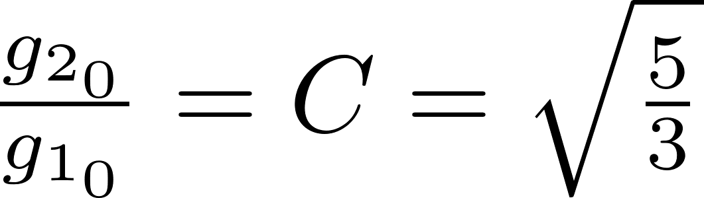
Grand Unification: Proton Decay
determined to get coupling unification (Georgi,Quinn,Weinberg)
At time strong coupling not measured
Notes:
CDF+D0 give 80.427 pm 0.0089, This combined with LHC Atlas and LHCb assuming systematic error or 4.7 MeV, which corresponds to CDF uncertainty from PDF and QED radiation. These wre then combined with LEP2 to give this.
Pull is a measure of Mwfit-mWpred divided by sqrt(0.0080^2+0.0056^2) this gives 6.5 sigma

Slide 6
Grand Unification: Proton Decay
determined to get coupling unification (Georgi,Quinn,Weinberg)
At time strong coupling not measured
Now
Notes:
CDF+D0 give 80.427 pm 0.0089, This combined with LHC Atlas and LHCb assuming systematic error or 4.7 MeV, which corresponds to CDF uncertainty from PDF and QED radiation. These wre then combined with LEP2 to give this.
Pull is a measure of Mwfit-mWpred divided by sqrt(0.0080^2+0.0056^2) this gives 6.5 sigma

Slide 7


Grand Unification: Proton Decay
determined to get coupling unification (Georgi,Quinn,Weinberg)
Eq. determine Mass of and so GUT scale
  and not consistent with today
Proton lifetime very long (But not long enough)
Notes:
CDF+D0 give 80.427 pm 0.0089, This combined with LHC Atlas and LHCb assuming systematic error or 4.7 MeV, which corresponds to CDF uncertainty from PDF and QED radiation. These wre then combined with LEP2 to give this.
Pull is a measure of Mwfit-mWpred divided by sqrt(0.0080^2+0.0056^2) this gives 6.5 sigma

Slide 8

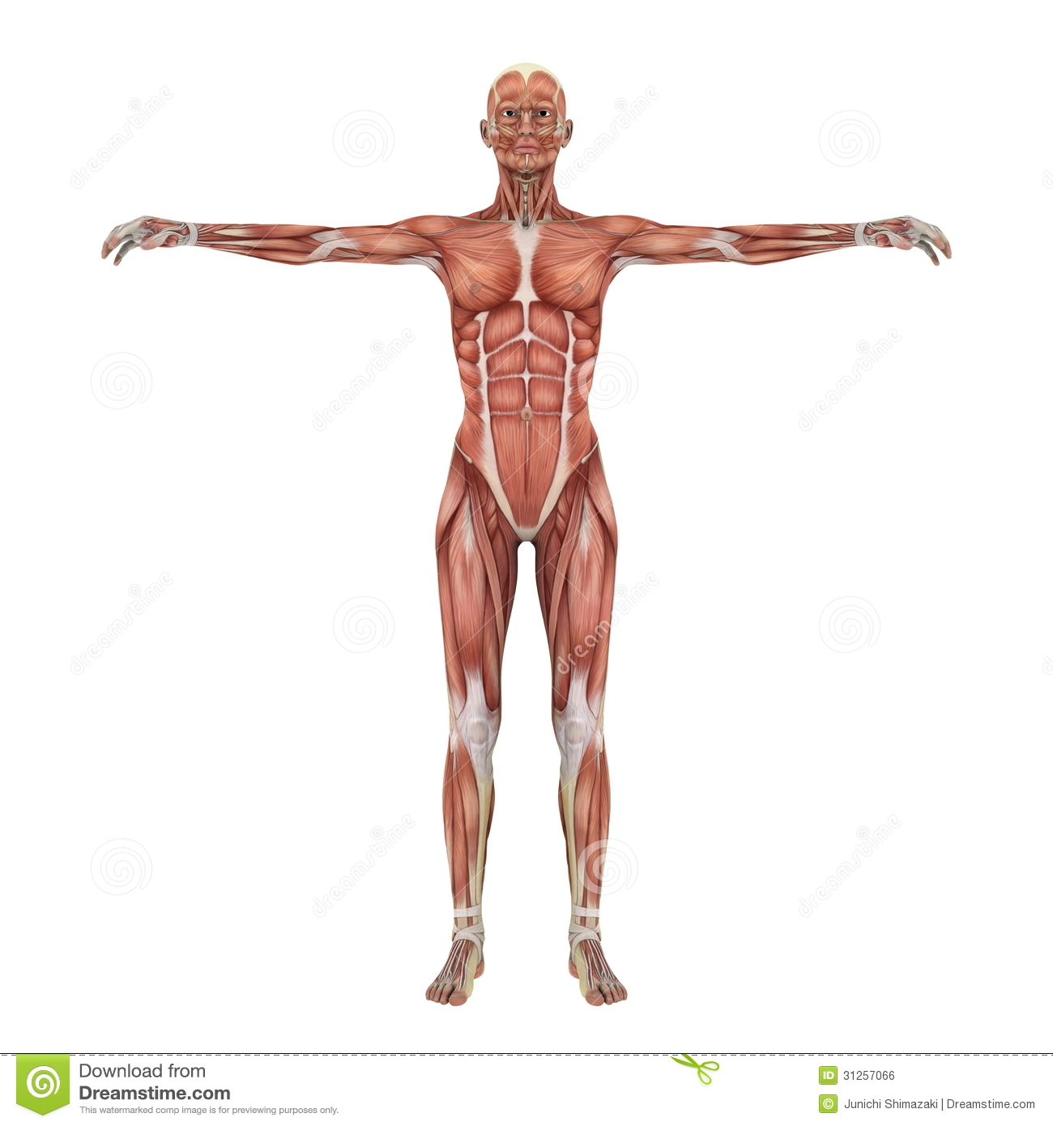
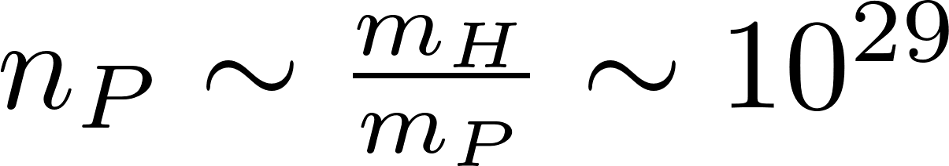
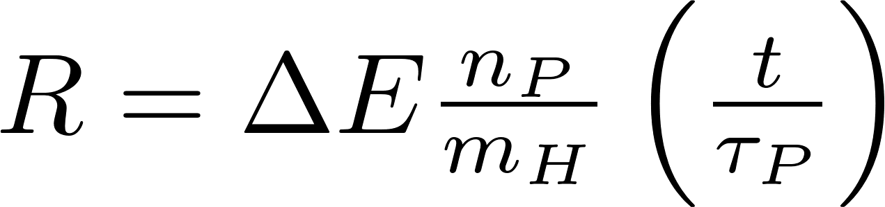
Proton Decay Constraints: LIFE
First measurement of was anthropic _{Goldhaber}
Human Body container of Protons
  Proton Decay Kills
Radiation deposited (J/kg⁻¹)
Energy deposited depends on decay
10 J/kg⁻¹ in 60 days is lethal
  Proton Lifetime constraint
Notes:
CDF+D0 give 80.427 pm 0.0089, This combined with LHC Atlas and LHCb assuming systematic error or 4.7 MeV, which corresponds to CDF uncertainty from PDF and QED radiation. These wre then combined with LEP2 to give this.
Pull is a measure of Mwfit-mWpred divided by sqrt(0.0080^2+0.0056^2) this gives 6.5 sigma

Slide 9

Proton Decay Constraints: Super-K
Super-Kamiokande sensitive to SM interacting particles
Super-Kamiokande is a water Cherenkov detector
  Particles moving faster than light produce EM rings
Look for standard model biproducts in giant water vat
Notes:
CDF+D0 give 80.427 pm 0.0089, This combined with LHC Atlas and LHCb assuming systematic error or 4.7 MeV, which corresponds to CDF uncertainty from PDF and QED radiation. These wre then combined with LEP2 to give this.
Pull is a measure of Mwfit-mWpred divided by sqrt(0.0080^2+0.0056^2) this gives 6.5 sigma

Slide 10
Proton Decay Constraints: Super-K
Super-Kamoikande sensitive to SM interacting particles
Super-Kamiokande is a water Cherenkov detector
  Particles moving faster than light produce EM rings
Cutting Edge Constraints: Super-K
Many different modes looked for
Notes:
CDF+D0 give 80.427 pm 0.0089, This combined with LHC Atlas and LHCb assuming systematic error or 4.7 MeV, which corresponds to CDF uncertainty from PDF and QED radiation. These wre then combined with LEP2 to give this.
Pull is a measure of Mwfit-mWpred divided by sqrt(0.0080^2+0.0056^2) this gives 6.5 sigma

Slide 11
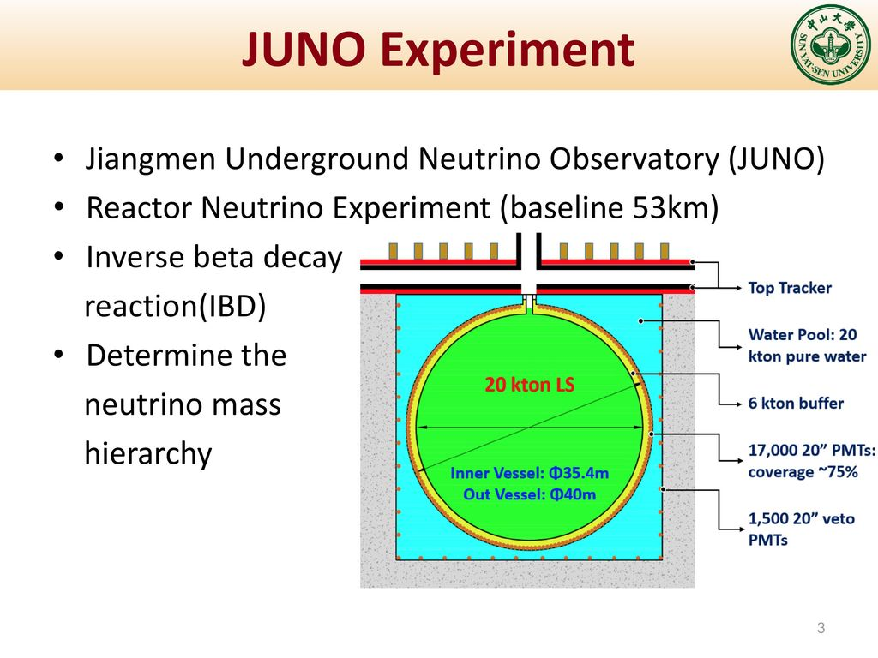
Proton Decay Constraints: Future
  JUNO Experiment a Liquid Scintillator (LS)
    Detects the time evolution of energy
    Eff: 65% Signal retained 99.995% Background Rejected
Notes:
Can only compete in with Kaon decay signal
Pull is a measure of Mwfit-mWpred divided by sqrt(0.0080^2+0.0056^2) this gives 6.5 sigma

Slide 12
Proton Decay Constraints: Future
  JUNO Experiment a Liquid Scintillator (LS)
    Detects the time evolution of energy
    Eff: 65% Signal retained 99.995% Background Rejected
JUNO Will improve by factor of 3
Current and Future proton decay prospects
Notes:
Can only compete in with Kaon decay signal
Pull is a measure of Mwfit-mWpred divided by sqrt(0.0080^2+0.0056^2) this gives 6.5 sigma

Slide 13
Proton Decay Constraints: Future
  JUNO Experiment a Liquid Scintillator (LS)
    Detects the time evolution of energy
    Eff: 65% Signal retained 99.995% Background Rejected
Current and Future proton decay prospects
Hyper-K will Improve many bounds
Notes:
Can only compete in with Kaon decay signal
Pull is a measure of Mwfit-mWpred divided by sqrt(0.0080^2+0.0056^2) this gives 6.5 sigma

Slide 14
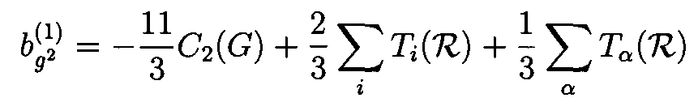
Viable SU(5) Unification: Supersymmetry
Running deflected at SUSY scale
Unification Scale pushed up
Additional light gauged states can deflect RG running
In complete rep. contribution of SUSY
Notes:
CDF+D0 give 80.427 pm 0.0089, This combined with LHC Atlas and LHCb assuming systematic error or 4.7 MeV, which corresponds to CDF uncertainty from PDF and QED radiation. These wre then combined with LEP2 to give this.
Pull is a measure of Mwfit-mWpred divided by sqrt(0.0080^2+0.0056^2) this gives 6.5 sigma

Slide 15



Supersymmetry: Dimension-5 Proton Decay
At SUSY scale four fermion interactions generated
  Evolve to hardon scale, corrections
  Amplitude size depend on SUSY masses
Colored Higgs
Amplitude scaling
Proton lifetime
Notes:
CDF+D0 give 80.427 pm 0.0089, This combined with LHC Atlas and LHCb assuming systematic error or 4.7 MeV, which corresponds to CDF uncertainty from PDF and QED radiation. These wre then combined with LEP2 to give this.
Pull is a measure of Mwfit-mWpred divided by sqrt(0.0080^2+0.0056^2) this gives 6.5 sigma

Slide 16
Supersymmetry: Dimension-5 Proton Decay
At SUSY scale four fermion interactions generated
  Evolve to hardon scale, corrections
  Amplitude size depend on SUSY masses
Colored Higgs
Amplitude scaling
SUSY Mass Dependent
Proton lifetime
Notes:
Pull is a measure of Mwfit-mWpred divided by sqrt(0.0080^2+0.0056^2) this gives 6.5 sigma

Slide 17
Supersymmetry: Minimal SU(5) and CMSSM
Dimension-5 proton decay constraint
  Important constraints on parameter space
Current Bounds
Notes:
Black 8 TeV LHC, Blue 14 TeV with 300 inverse fb and green with 3000 inverse fb. Purple is for 3000 inverse fb with 33 TeV Center of mass energy and red is 100 TeV LHC with 3000 inverse fb

Slide 18
Supersymmetry: Minimal SU(5) and CMSSM
Dimension-5 proton decay constraint
  Important constraints on parameter space
After Hyper-K
(JUNO Similar)
Notes:
This is an old Higgs mass calculator, and so masses change a lot.

Slide 19







How reliable are these constraints?
Amplitudes destructively interfere
  Error important
Matrix elements squared contributes to proton decay error doubled
Alpha strong still an important error on proton lifetime
  From gauge coupling matching conditions
  Error strongly dependent on if c is non-zero
Depend on Dimension-5 couplings
Notes:
C not equal to zero means that lambda (H Sigma Hbar) and lambda’ (Sigma^3) are free parameters. Otherwise, only one is free. Lambda’ generall quite small to get long enough proton lifetime. It increases the vev of SU(5) breaking. When

Slide 20
How reliable are these constraints?
Amplitudes destructively interfere
  Error important
Matrix elements squared contributes to proton decay error doubled
Alpha strong still an important error on proton lifetime
  From gauge coupling matching conditions
  Error strongly dependent on if c is non-zero
Depend on Dimension-5 couplings
Sensitivity due to exponential

Slide 21

Supersymmetry: Minimal SU(5) Error
Effect of Hadron Matrix elements alone
3-$σ$ bounds still relatively strong

Slide 22



Supersymmetry: Minimal SU(5) Error
Effect of Hadron Matrix elements alone
Effect of strong couplings significant
  Still give meaningful constraints
Central value
$α_{s}$ error
Constraints relatively under control
$σ_{tot}=\sqrt{σ_{had}^{2}+σ_{τ_{p}}^{2} }$
$c$ non-zero
Notes:
CDF+D0 give 80.427 pm 0.0089, This combined with LHC Atlas and LHCb assuming systematic error or 4.7 MeV, which corresponds to CDF uncertainty from PDF and QED radiation. These wre then combined with LEP2 to give this.
Pull is a measure of Mwfit-mWpred divided by sqrt(0.0080^2+0.0056^2) this gives 6.5 sigma

Slide 23
Supersymmetry: Minimal SU(5) Error
Effect of Hadron Matrix elements alone
Effect of strong couplings significant
  Still give meaningful constraints
Now Look at a few different parameter set
Similar kind of error hang over SUSY proton decay
Notes:
Green lines for c not equal to zero
Note: different Higgs calculator

Slide 24
Upper Limit of Proton Lifetime
Minimal SU(5) with CMSSM
  Random scan of point
  After Hyper-K tuned points left
Notes:
CDF+D0 give 80.427 pm 0.0089, This combined with LHC Atlas and LHCb assuming systematic error or 4.7 MeV, which corresponds to CDF uncertainty from PDF and QED radiation. These wre then combined with LEP2 to give this.
Pull is a measure of Mwfit-mWpred divided by sqrt(0.0080^2+0.0056^2) this gives 6.5 sigma

Slide 25




Supersymmetry: Minimal SU(5) in GMSB
$$tan β=5$$
How do things change with other SUSY breaking mechanism?
Messenger scale with 5 and $\overline{5}$
Sparticle masses generated effectively at one-loop
$$\left\langle Z\right\rangle =z+F_{z}θ^{2}$$
To appear: JLE, Shegekami
Notes:
IF Lambda_d constrained by Higgs mass. Can’t move it up much for give tan beta. Can increase tan beta too much because that shortens the proton lifetime.
Lamabda_d determined by Higgs mass which then determines the size of the squarks. Since the squarks are weakly dependent on Lambda_L, the w boson mass is reduced by lambda_D and so reduces the proton decay lifetime

Slide 26

Supersymmetry: Missing Partner Model
Minimal missing partner model
  Solve doublet triplet splitting (Doublet stays massless)
75 breaks SU(5)
  No doublet
  DT splitting works
Notes:
CDF+D0 give 80.427 pm 0.0089, This combined with LHC Atlas and LHCb assuming systematic error or 4.7 MeV, which corresponds to CDF uncertainty from PDF and QED radiation. These wre then combined with LEP2 to give this.
Pull is a measure of Mwfit-mWpred divided by sqrt(0.0080^2+0.0056^2) this gives 6.5 sigma

Slide 27

Supersymmetry: Missing Partner Model
Minimal missing partner model
  Solve doublet triplet splitting (Doublet stays massless)
  Colored Higgs mass from higher dimensional operator
    Tends to be suppressed
Notes:
CDF+D0 give 80.427 pm 0.0089, This combined with LHC Atlas and LHCb assuming systematic error or 4.7 MeV, which corresponds to CDF uncertainty from PDF and QED radiation. These wre then combined with LEP2 to give this.
Pull is a measure of Mwfit-mWpred divided by sqrt(0.0080^2+0.0056^2) this gives 6.5 sigma

Slide 28
Supersymmetry: Missing Partner Model
Minimal missing partner model
  Solve doublet triplet splitting (Doublet stays massless)
  Colored Higgs mass from higher dimensional operator
    Tends to be suppressed
Current constraints
Notes:
CDF+D0 give 80.427 pm 0.0089, This combined with LHC Atlas and LHCb assuming systematic error or 4.7 MeV, which corresponds to CDF uncertainty from PDF and QED radiation. These wre then combined with LEP2 to give this.
Pull is a measure of Mwfit-mWpred divided by sqrt(0.0080^2+0.0056^2) this gives 6.5 sigma

Slide 29
Supersymmetry: Missing Partner Model
Minimal missing partner model
  Solve doublet triplet splitting (Doublet stays massless)
  Colored Higgs mass from higher dimensional operator
    Tends to be suppressed
Little Beyond Future constraints
Same as dark matter extent
Notes:
CDF+D0 give 80.427 pm 0.0089, This combined with LHC Atlas and LHCb assuming systematic error or 4.7 MeV, which corresponds to CDF uncertainty from PDF and QED radiation. These wre then combined with LEP2 to give this.
Pull is a measure of Mwfit-mWpred divided by sqrt(0.0080^2+0.0056^2) this gives 6.5 sigma

Slide 30

Supersymmetry: Flipped SU(5)
Flipped SU(5) suppresses dimension 5 proton decay due to missing partner mechanism
Notes:
CDF+D0 give 80.427 pm 0.0089, This combined with LHC Atlas and LHCb assuming systematic error or 4.7 MeV, which corresponds to CDF uncertainty from PDF and QED radiation. These wre then combined with LEP2 to give this.
Pull is a measure of Mwfit-mWpred divided by sqrt(0.0080^2+0.0056^2) this gives 6.5 sigma

Slide 31
Supersymmetry: Flipped SU(5)
Flipped SU(5) suppresses dimension 5 proton decay due to missing partner mechanism
  Higgs supersymmetric mass term forbidden
  Has additional gauge freedom due to U(1), including gauginos
Proton Decay not really a problem
Notes:
CDF+D0 give 80.427 pm 0.0089, This combined with LHC Atlas and LHCb assuming systematic error or 4.7 MeV, which corresponds to CDF uncertainty from PDF and QED radiation. These wre then combined with LEP2 to give this.
Pull is a measure of Mwfit-mWpred divided by sqrt(0.0080^2+0.0056^2) this gives 6.5 sigma

Slide 32
Non-supersymmetric SU(5): Resurrection
Heavy gauge boson is too light, p-decay too quickly
Notes:
CDF+D0 give 80.427 pm 0.0089, This combined with LHC Atlas and LHCb assuming systematic error or 4.7 MeV, which corresponds to CDF uncertainty from PDF and QED radiation. These wre then combined with LEP2 to give this.
Pull is a measure of Mwfit-mWpred divided by sqrt(0.0080^2+0.0056^2) this gives 6.5 sigma

Slide 33
Non-supersymmetric SU(5): Resurrection
Heavy gauge boson is too light, p-decay too quickly
  Need light states to push up unification scale (Haba, Mimura, Yamada)
And
Notes:
CDF+D0 give 80.427 pm 0.0089, This combined with LHC Atlas and LHCb assuming systematic error or 4.7 MeV, which corresponds to CDF uncertainty from PDF and QED radiation. These wre then combined with LEP2 to give this.
Pull is a measure of Mwfit-mWpred divided by sqrt(0.0080^2+0.0056^2) this gives 6.5 sigma

Slide 34
Non-supersymmetric SU(5): Resurrection
Heavy gauge boson is too light, p-decay too quickly
  Need light states to push up unification scale (Haba, Mimura, Yamada)
Viable asymptotically free models can be found (Haba, Mimura, Yamada)
    Several possibilities(Below just a few)
    Involve large strange reps of SM gauge symmetries
HK discovery limit
SK limit
(8,3,0) Lightest state
(Haba, Mimura, Yamada)

Slide 35

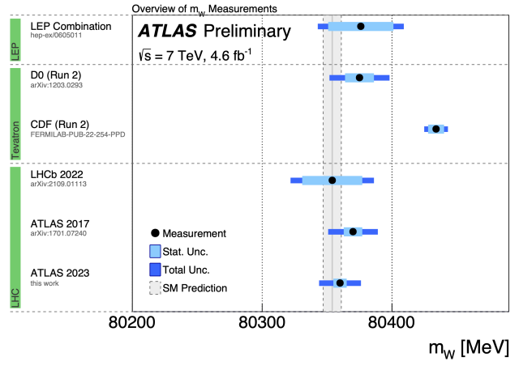

Are New Electroweak Scale States Needed?
Maybe!!
W-boson anomaly requires new electroweak interacting states
Best fit for the (LEP-2, Tevatron, LHC, LHCb data)
2204.04204
SM prediction for
(Fit all date except and predict )
(Pull 6.5 )
2204.04204
?
Even without CDF, some pull for larger
Notes:
In this paper they consider a slight different thing for the triplet but they have a dimensional parameter associated with the relevant coupling and so is effectively doing the same things.

Slide 36






Are New Electroweak Scale States Needed?
Triplet can contribute to Electroweak symmetry breaking
If , then only contributes to W mass
Only contributes to the W boson
  If we take hypercharge non-zero would also contribute to Z
Generates vev
Notes:
In this paper they consider a slight different thing for the triplet but they have a dimensional parameter associated with the relevant coupling and so is effectively doing the same things.

Slide 37




“Who Order That”(Issac Rabi)
Like the discovery of the muon, Who order a triplet?
SU(5) Grand unification?
  Gauge coupling unification
Dotted: SM
Dashed: Real triplet
Solid: Complex Triplet
Proton Decay?
Notes:
In this paper they consider a slight different thing for the triplet but they have a dimensional parameter associated with the relevant coupling and so is effectively doing the same things.

Slide 38


Proton Decay : Dimension-6
Dimension-6 proton decay
The decay proceeds via the heavy gauge boson

Slide 39
Proton Decay : Dimension-6
Dimension-6 proton decay
The decay proceeds via the heavy gauge boson
Same Vertex: Can we suppress it

Slide 40
Proton Decay : Dimension-6
Dimension-6 proton decay
The decay proceeds via the heavy gauge boson
Mixing SU(5) reps to suppress proton decay?
  Doesn’t work since total decay width unchanged

Slide 41
Proton Decay : Dimension-6
Dimension-6 proton decay
The decay proceeds via the heavy gauge boson
Mixing SU(5) reps and suppression of proton decay
  Doesn’t work since total decay width unchanged
Mixing incomplete SU(5) reps to suppress proton decay
Creates independent mass matrices for EACH SM rep

Slide 42




Proton Decay : Dimension-6
Dimension-6 proton decay
The decay proceeds via the heavy gauge boson
Mixing SU(5) reps and suppression of proton decay
Mixing incomplete SU(5) reps to suppress proton decay
  Each SM rep has a different mixing angle
+

Slide 43

Proton Decay: Dimension-6
Dimension-6 proton decay
The decay proceeds via the heavy gauge boson
Mixing SU(5) reps and suppression of proton decay
Mixing incomplete SU(5) reps to suppress proton decay
  Each SM rep has a different mixing angle
  With a proton lifetime of
  Lifetime constraints requirements

Slide 44




Proton Decay: Colored Higgs
SM Yukawa Couplings
Colored Higgs Yukawa couplings
  Proton Decay greatly enhanced since
Or

Slide 45


Proton Decay: Colored Higgs
SM Yukawa Couplings
Colored Higgs Yukawa couplings
Proton Decay greatly enhanced since

Slide 46
Conclusions
  Grand unification is one of the best motivated models on the market
    Explains charge quantization and “Explains” SM matter content
  Minimal models of SU(5) need additional light matter
  Supersymmetry is one justification for needed light matter content
    Unified theories with low-scale SUSY breaking testable at JUNO, HK
    Different models of SU(5) have different proton decay signatures
  Non-SUSY SU(5) needs additional light matter
    Light matter can be justified by W-boson anomaly
    Model has unique proton decay signature dues to mixing

Slide 47
W-Boson Anomaly
Best fit for the (LEP-2, Tevatron, LHC, LHCb data)
2204.04204
SM prediction for
(Fit all date except and predict )
(Pull 6.5 )
2204.04204
?
Even without CDF, some pull for larger
Notes:
CDF+D0 give 80.427 pm 0.0089, This combined with LHC Atlas and LHCb assuming systematic error or 4.7 MeV, which corresponds to CDF uncertainty from PDF and QED radiation. These were then combined with LEP2 to give this.
Pull is a measure of Mwfit-mWpred divided by sqrt(0.0080^2+0.0056^2) this gives 6.5 sigma

Slide 48
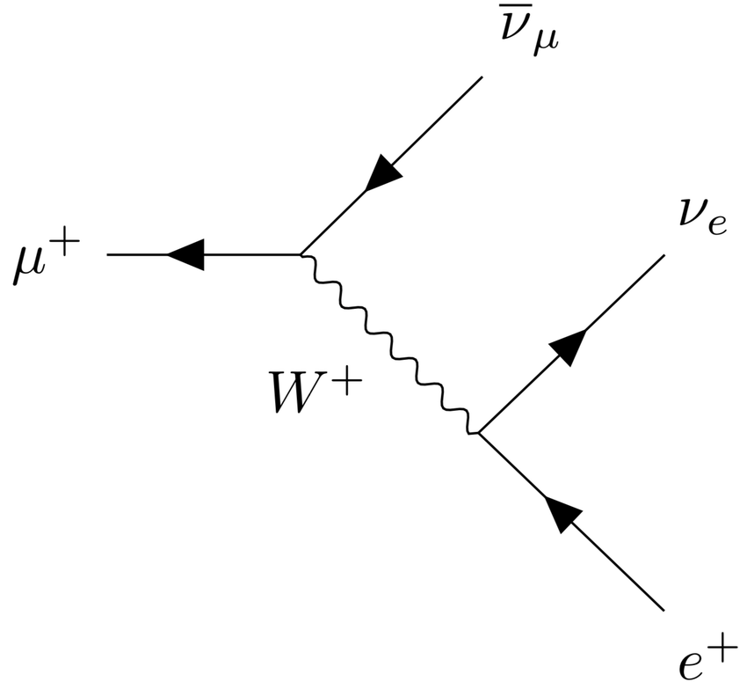

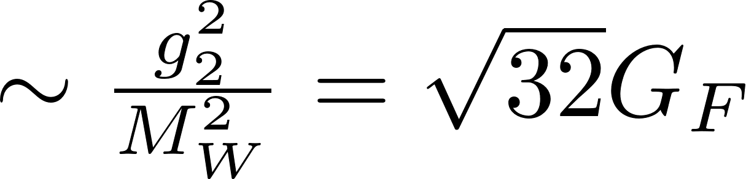
W Boson Mass Shift From New Physics
Fermi Constant determined from muon decay
  Very precisely measured
Notes:
Muon mass even more precisely measured, m_mu=105.658 3755(23) MeV/c^2
alpha is more accurate as well
GF defined in on shell scheme

Slide 49



W Boson Mass Shift From New Physics
Fermi constant determined from muon decay
Fermi constant input, predicted
  This defines way to changes prediction
  In terms of SMEFT this is
Notes:
Muon mass even more precisely measured, m_mu=105.658 3755(23) MeV/c^2
Weak mixing angle and alpha are more accurate as well
GF defined in on shell scheme

Slide 50




W Boson Mass Shift From New Physics
Fermi Constant determined from muon decay
Fermi constant input, predicted
  This defines way to changes
  In terms of SMEFT this is
Give
Give
Give
Notes:
The dependents on alpha,theta_W and GF are from the goria paper

Slide 51

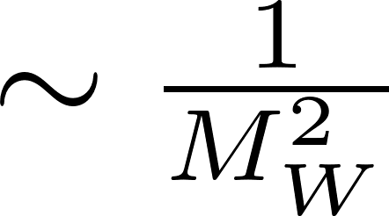



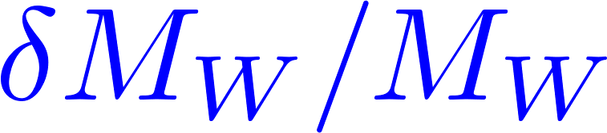
W Boson Mass Shift From New Physics
Fermi Constant determined from muon decay
Fermi constant generally taken as input
Example: Supersymmetry
  Correction now in terms of S,T
  Light charged Higgsino and Wino
0.12%
0.08%
0.04%
0%
 | 100 | 150 | 200 | 250
 | 0.09% | 0.04% | 0.02% | 0.01%
Notes:
Muon mass even more precisely measured, m_mu=105.658 3755(23) MeV/c^2
Weak mixing angle and alpha are more accurate as well
GF defined in on shell scheme
Delta r is from self energy, vertex corrections, and counter terms.

Slide 52
Possible Tree-Leve Solutions
Possible single field extensions which explain deviation
Bagnaschi, Ellis, Madigan, Mimasu, Sanz, You
Notes:
In this paper they consider a slight different thing for the triplet but they have a dimensional parameter associated with the relevant coupling and so is effectively doing the same things.

Slide 53




Triple Higgs Boson and the Fermi Constant
This mass correction alters weak mixing angle
This leads to a correction to the measured W boson mass
Is there motivation for this new field?
Diagonalizes A,Z
Notes:
In this paper they consider a slight different thing for the triplet but they have a dimensional parameter associated with the relevant coupling and so is effectively doing the same things.

Slide 54


Triple Higgs Boson Signatures
The neutral Higgs bosons small mix
Couplings to SM fermions quite suppressed
Dominant signature from decays to SM massive bosons
Couplings
so suppressed
Notes:
In this paper they consider a slight different thing for the triplet but they have a dimensional parameter associated with the relevant coupling and so is effectively doing the same things.

Slide 55

“Who Order That”(Issac Rabi)
Like the discovery of the muon, why would nature have a triplet?
  At face value it does nothing but give mass to

Slide 56
“Who Order That”(Issac Rabi)
Like the discovery of the muon, Who order a triplet?
SU(5) Grand unification?
  Gauge coupling unification
Dotted: SM
Dashed: Real triplet
Solid: Complex Triplet
Proton Decay?
Notes:
In this paper they consider a slight different thing for the triplet but they have a dimensional parameter associated with the relevant coupling and so is effectively doing the same things.

Slide 57


SU(5) Grand Unification
Matter fields embedded into larger representation
  Leads to charge quantization
  Simplest group which fits the SM, SU(5)
Q
$$\overline{D}$$
10
$$\overline{U}$$
5
$$\overline{E}$$
L
G
X
24
W
W boson here
B

Slide 58


Grand Unification
Matter fields embedded into larger representation
SU(5) Breaking with single real 24 Rep
  For a generic renormalizable interaction
  Light triplet alone from SU(5) breaking is difficult
Can we use this Y=0 Triplet?
Notes:
Non renormalizable operators may allow us to tune the triplet light, but then we would in general have a very heavy vector gauge boson like M_P. This comes from tuning the tree level against the 1/MP pieces so you get something of order (lambda-kappa V/MP) to tune. For V of order 10^14, we would get Sigma_8 of order 10^10 GeV which would wreck the coupling unification.

Slide 59


Grand Unification
Matter fields embedded into larger representation
SU(5) Breaking with single real 24 Rep
If we include an additional 24, can get a light triplet
  Lots of freedom from many couplings
  Relevant masses
Notes:
Non renormalizable operators may by allowing us to tune the triplet light, but then we would in general have are very heavy vector gauge boson like M_P. This comes from tuning the tree level against the 1/MP pieces so you get something of order (lambda-kappa V/MP) to tune. For V of order 10^14, we would get Sigma_8 of order 10^10 GeV which may wreck the coupling unification.

Slide 60


Proton Decay : Dimension-6
Dimension-6 proton decay
  Expected lifetime over 5 orders of magnitude too small
Notes:
Non renormalizable operators may by allowing us to tune the triplet light, but then we would in general have are very heavy vector gauge boson like M_P. This comes from tuning the tree level against the 1/MP pieces so you get something of order (lambda-kappa V/MP) to tune. For V of order 10^14, we would get Sigma_8 of order 10^10 GeV which would reck the coupling unification.

Slide 61
Proton Decay : Dimension-6
Dimension-6 proton decay
The decay proceeds via the heavy gauge boson

Slide 62
Proton Decay : Dimension-6
Dimension-6 proton decay
The decay proceeds via the heavy gauge boson
Same Vertex: Can we suppress it

Slide 63
Proton Decay : Dimension-6
Dimension-6 proton decay
The decay proceeds via the heavy gauge boson
Mixing and suppression of proton decay
This linear combination massless : SM field

Slide 64


Proton Decay : Dimension-6
Dimension-6 proton decay
The decay proceeds via the heavy gauge boson
Mixing SU(5) reps and suppression of proton decay
SM field interaction combination of these

Slide 65



Proton Decay : Dimension-6
Dimension-6 proton decay
The decay proceeds via the heavy gauge boson
Mixing SU(5) reps and suppression of proton decay
SM field interaction combination of these
+

Slide 66
Proton Decay : Dimension-6
Dimension-6 proton decay
The decay proceeds via the heavy gauge boson
Mixing SU(5) reps and suppression of proton decay
Mixing incomplete SU(5) reps to suppress proton decay
Creates independent mass matrices for EACH SM rep

Slide 67
Proton Decay : Dimension-6
Dimension-6 proton decay
The decay proceeds via the heavy gauge boson
Mixing SU(5) reps and suppression of proton decay
Mixing incomplete SU(5) reps to suppress proton decay
  Each SM rep has a different mixing angle
+

Slide 68
Proton Decay: Dimension-6
Dimension-6 proton decay
The decay proceeds via the heavy gauge boson
Mixing SU(5) reps and suppression of proton decay
Mixing incomplete SU(5) reps to suppress proton decay
  Each SM rep has a different mixing angle
  With a proton lifetime of
  Lifetime constraints requirements

Slide 69
Proton Decay: Colored Higgs
SM Yukawa Couplings
Colored Higgs Yukawa couplings
  Proton Decay greatly enhanced since
Or

Slide 70
Proton Decay: Colored Higgs
SM Yukawa Couplings
Colored Higgs Yukawa couplings
Proton Decay greatly enhanced since

Slide 71


Threshold Corrections: Colored Higgs Mass
The breaking of SU(5) splits some masses
These masses are constrained by gauge coupling unification
  Three question, 6 unknown leads to continuum of solutions

Slide 72
Threshold Corrections: Colored Higgs Mass
The breaking of SU(5) splits some masses
These masses are determined by gauge coupling unification
  Three question, 6 unknown leads to continuum of solutions
Equations afford a solution
Lifetime well beyond experimental limit (maybe short not an exhaustive study)

Slide 73



SM Yukawa Couplings: The Low Scale
Minimal SU(5): Yukawa couplings explained by suppressed operator
Because GUT scale suppressed contribution too small
Yukawa can be accommodated by vector
  Mixing can split the Yukawa Couplings
Theory
Experiment

Slide 74


Conclusions
W boson mass anomaly dominated by CDF measurement
  Put is present in a lesser degree in other experiments
W boson constrained by Fermi Constant
  Shifts in can lead to deviation in
Loop level explanations are tightly constrained by experiment
  Requires electroweak interacting particle
Fits to SMEFT show only a few possibilities
  Triplet Higgs being one of them
  Some others seem difficult to realize
Triplet Higgs can be motivated by Grand unification
  Unification scale suppressed
  Dimension-6 proton decay suppressed by mixing
  Colored Higgs mediated proton decay enhanced, but still ok
  Yukawa couplings also explained by mixing

Slide 75
Grand Unification: Proton Decay
determined to get coupling unification (Georgi,Quinn,Weinberg)
How do we fix this?
Eq. determine Mass of and so GUT scale
  and not consistent with today
Proton lifetime could be beyond current experimental limit
Notes:
CDF+D0 give 80.427 pm 0.0089, This combined with LHC Atlas and LHCb assuming systematic error or 4.7 MeV, which corresponds to CDF uncertainty from PDF and QED radiation. These wre then combined with LEP2 to give this.
Pull is a measure of Mwfit-mWpred divided by sqrt(0.0080^2+0.0056^2) this gives 6.5 sigma

Slide 76
Proton Decay Constraints: Super-K
Super-Kamoikande sensitive to SM interacting particles
Super-Kamiokande is a water Cherenkov detector
  Particles moving faster than light produce EM rings
Current limits from Super-Kamiokande
Notes:
CDF+D0 give 80.427 pm 0.0089, This combined with LHC Atlas and LHCb assuming systematic error or 4.7 MeV, which corresponds to CDF uncertainty from PDF and QED radiation. These wre then combined with LEP2 to give this.
Pull is a measure of Mwfit-mWpred divided by sqrt(0.0080^2+0.0056^2) this gives 6.5 sigma

Slide 77
Proton Decay Constraints: Future
  JUNO Experiment a Liquid Scintillator (LS)
    Detects the time evolution of energy
    Eff: 65% Signal retained 99.995% Background Rejected
JUNO’s capabilities versus Super-K
Other Future Experiments (Hyper-Kamiokande)
  Scaled up Super-K
Notes:
Can only compete in with Kaon decay signal
Pull is a measure of Mwfit-mWpred divided by sqrt(0.0080^2+0.0056^2) this gives 6.5 sigma

Slide 78
Proton Decay : Dimension-6
Dimension-6 proton decay
The decay proceeds via the heavy gauge boson

Slide 79
Proton Decay : Dimension-6
Dimension-6 proton decay
The decay proceeds via the heavy gauge boson
Same Vertex: Can we suppress it

Slide 80
Proton Decay : Dimension-6
Dimension-6 proton decay
The decay proceeds via the heavy gauge boson
Mixing and suppression of proton decay
This linear combination massless : SM field

Slide 81
Proton Decay : Dimension-6
Dimension-6 proton decay
The decay proceeds via the heavy gauge boson
Mixing SU(5) reps and suppression of proton decay
SM field interaction combination of these

Slide 82
Proton Decay : Dimension-6
Dimension-6 proton decay
The decay proceeds via the heavy gauge boson
Mixing SU(5) reps and suppression of proton decay
SM field interaction combination of these
+

Slide 83
Proton Decay : Dimension-6
Dimension-6 proton decay
The decay proceeds via the heavy gauge boson
Mixing SU(5) reps and suppression of proton decay
Mixing incomplete SU(5) reps to suppress proton decay
Creates independent mass matrices for EACH SM rep

Slide 84
Proton Decay : Dimension-6
Dimension-6 proton decay
The decay proceeds via the heavy gauge boson
Mixing SU(5) reps and suppression of proton decay
Mixing incomplete SU(5) reps to suppress proton decay
  Each SM rep has a different mixing angle
+

Slide 85
Proton Decay: Dimension-6
Dimension-6 proton decay
The decay proceeds via the heavy gauge boson
Mixing SU(5) reps and suppression of proton decay
Mixing incomplete SU(5) reps to suppress proton decay
  Each SM rep has a different mixing angle
  With a proton lifetime of
  Lifetime constraints requirements

Slide 86
Proton Decay: Colored Higgs
SM Yukawa Couplings
Colored Higgs Yukawa couplings
  Proton Decay greatly enhanced since
Or

Slide 87
Proton Decay: Colored Higgs
SM Yukawa Couplings
Colored Higgs Yukawa couplings
Proton Decay greatly enhanced since

