Slide 1
Weekly Report
Pan Huang
NJU
IHEP
2024.1.15

Slide 2
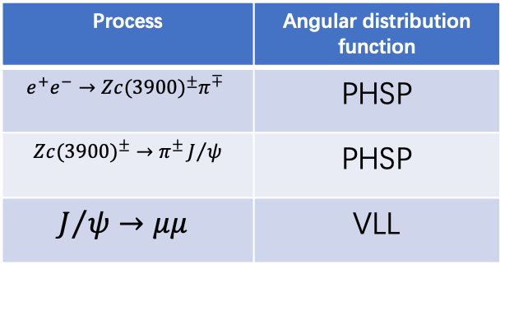
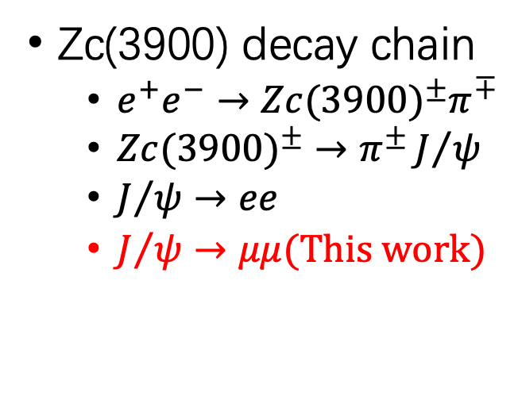
Simply repeat the observation of Zc(3900)
Signal MC sample information(plan to generate)
Zc(3900) decay chain
$e^{+}e^{−}→{Zc(3900)}^{±}π^{∓}$
${Zc(3900)}^{±}→$ $π^{±}J/ψ$
$J/ψ→ee$
$J/ψ→μμ(This work)$
Process | Angular distribution function
$$e^{+}e^{−}→{Zc(3900)}^{±}π^{∓}$$ | PHSP
${Zc(3900)}^{±}→$ $π^{±}J/ψ$ | PHSP
$$J/ψ→μμ$$ | VLL
4.26GeV Data @BESIII of 2013 (BOSS 7.0.3)
Sample | luminance | center-mass energy | Run number
4260 | 828.4±0.1±5.5 | 4257.97±0.04±0.66 | 29677-30367 31561-31981
4.26GeV Inclusive MC (BOSS 7.0.3)
Sample | luminance | center-mass energy | Run number
4260 | 825.7 | 4256.0 | 29677-30367 31561-31981

Slide 3
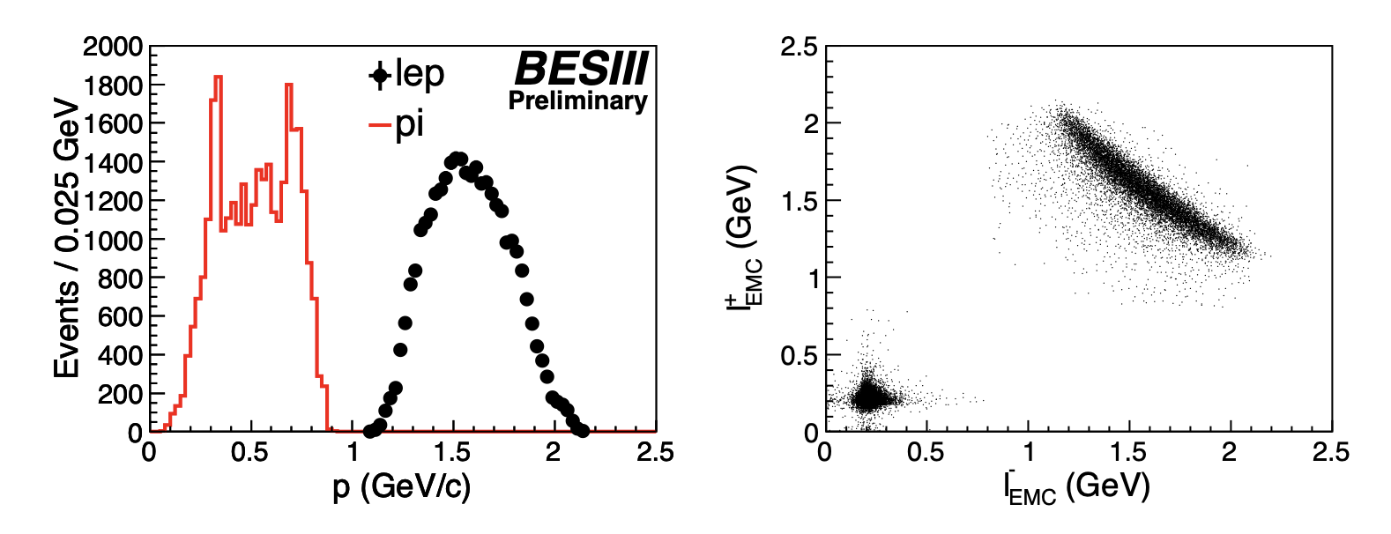
Simply repeat the observation of Zc(3900)
Traditional analysis
Good charged track selection
$\left|cosθ\right|<0.93$, $\left|\text{V}\text{z}\right|<1$0cm,$\left|\text{V}\text{r}\right|<1$cm
Four good tracks & total charge = 0
Sort by the momentum of four well charged tracks ($P_{1}>P_{2}>P_{3}>P_{4})$
For lepton: $P_{1}>1GeV$/c, $P_{2}>1GeV$/c
For pion: $P_{1}<1GeV$/c, $P_{1}<1GeV$/c
$μ : E_{EMC}<0.35GeV$
Vote $γμμ$: $cos\left(θ_{π^{+}π^{−}}\right)<0.98$
Zc(3900)@BESIII

Slide 4
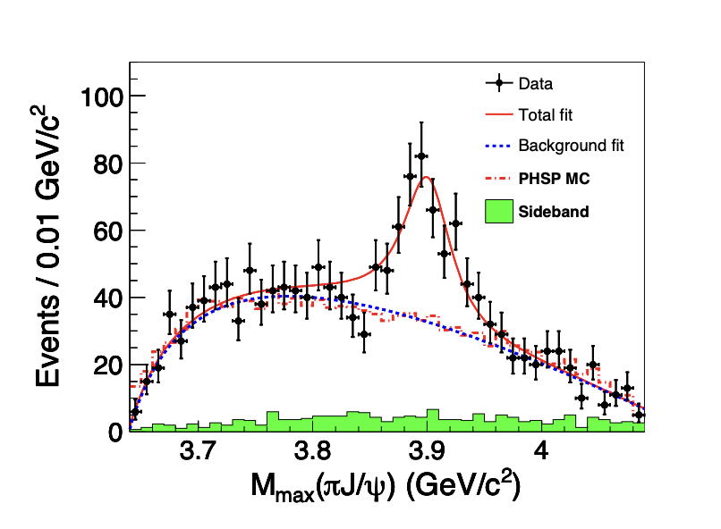
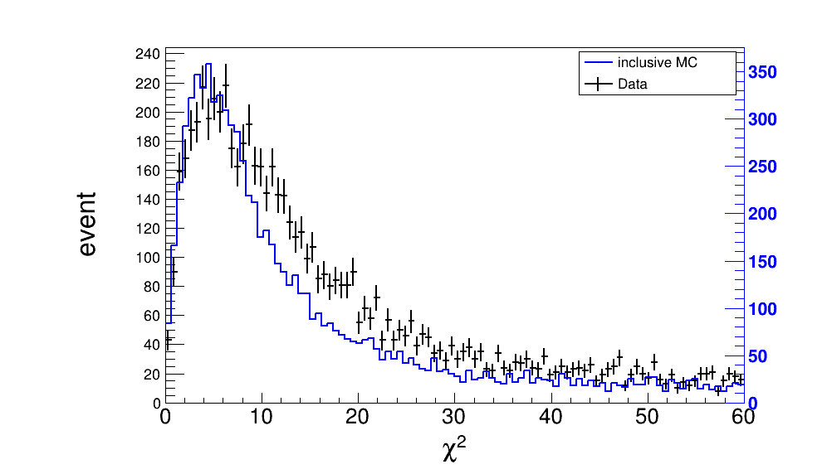
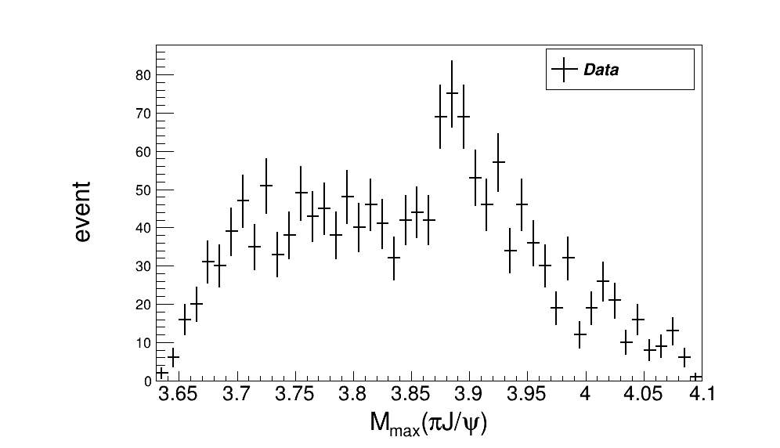
Simply repeat the observation of Zc(3900)
Traditional analysis
4C kinematic Fit:
$χ^{2}<60$
Signal Range: $\left|M_{μ^{+}μ^{−}}−M_{J/ψ}\right|<\text{0.02}\text{GeV}\text{/}c^{2}$
4C Kinematic fit $χ^{2}$distribution
$Z_{c}$(3900) Invariant mass distribution
Zc(3900)@BESIII

Slide 5
Thank you

