Slide 1
Top Quark EW Coupling Precision Measurement
Mustapha BIYABI
22 January 2024

Slide 2
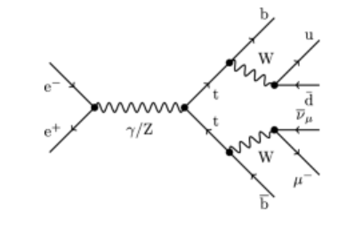
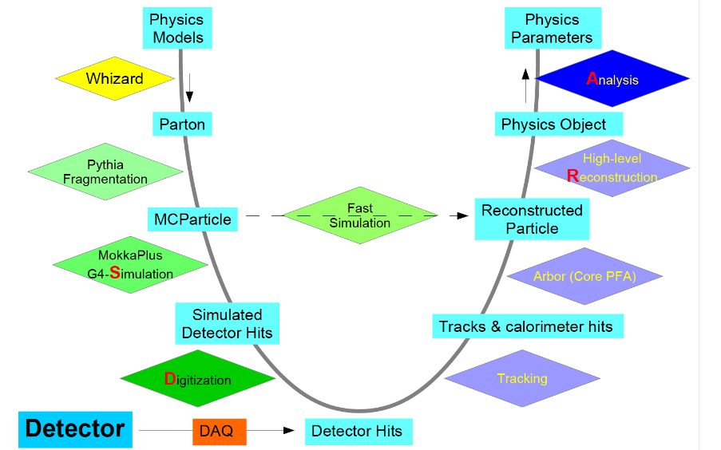
Introduction
- For the semi-leptonic channel, data samples:
There are two simulation methods for CEPC detector:
- Fast Simulation.
- Full Simulation is a method using Geant4-based tools to simulate the particle transport and the detector response and then reconstruct the responses back to original signals.

Slide 3
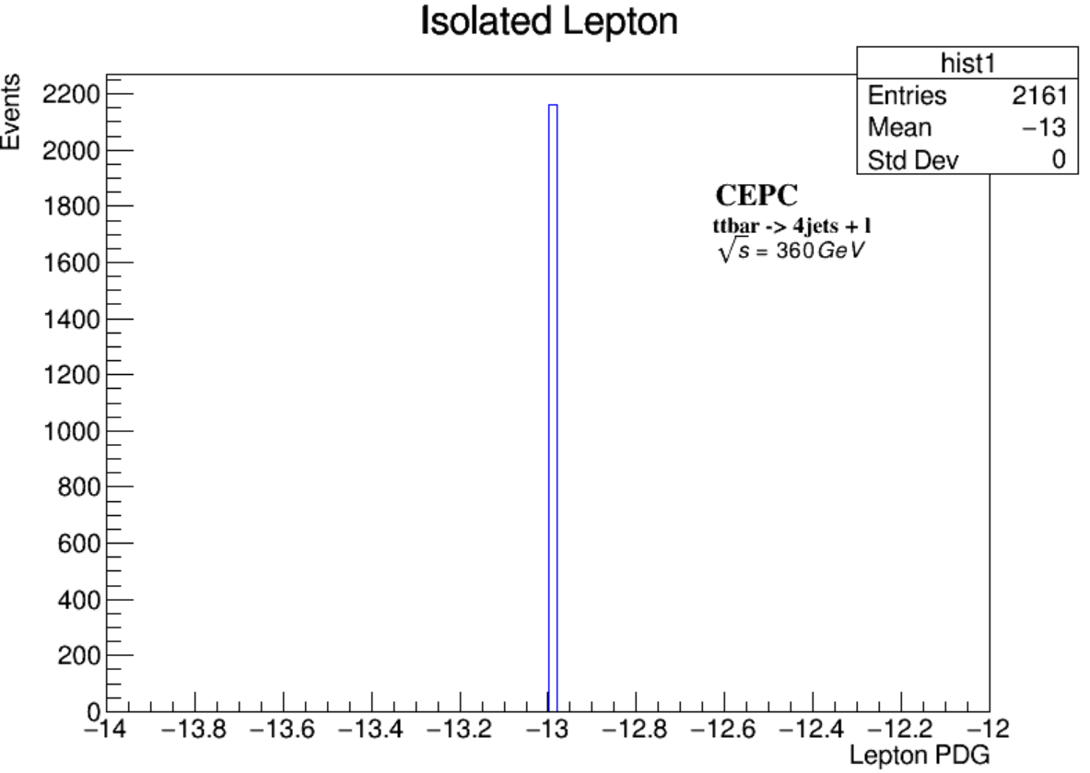
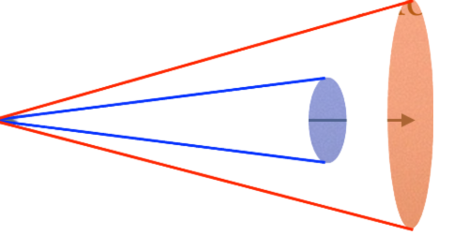
Lepton Isolation
The only lepton we have in the final state comming from the decay of W Boson:
- Check if the reconstructed particle is charged and corresponds to a lepton.
- Different parameters for particle identification (PID), specifically for identifying e and μ based on their energy deposits in various parts of a particle detector, such as:
The maximum allowed ratio of energy deposited in the Ecal to the sum of energies deposited in both the Ecal and Hcal.
- Use rectangular cuts on track and cone energy, like :
The cosine of the half-angle of the cone used in the isolation criteria.
The maximum allowed energy within the isolation cone.
The maximum allowed energy for any track within the isolation cone.

Slide 4
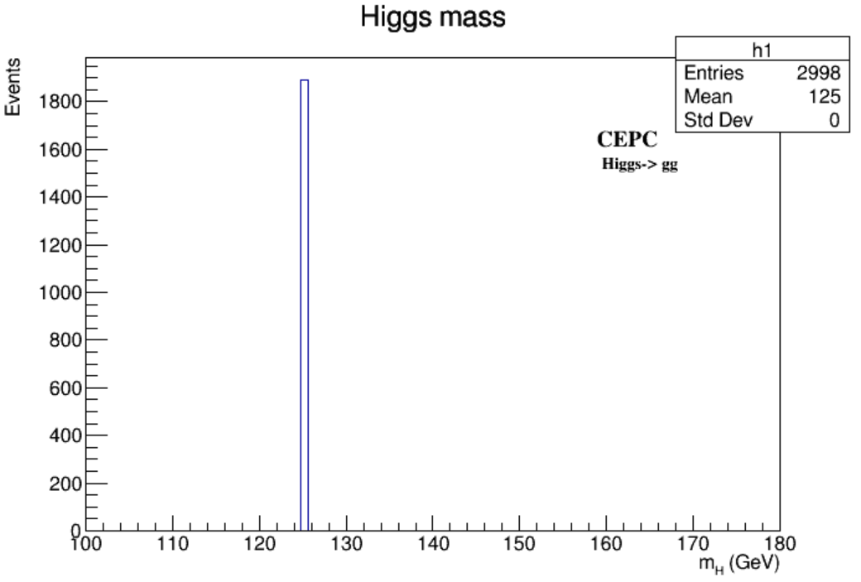
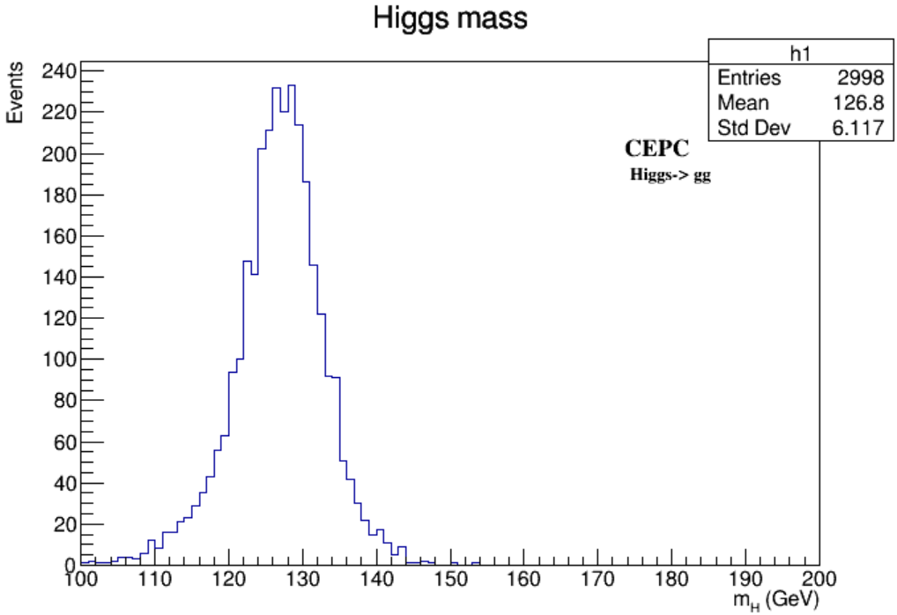
Testing Samples
To evaluate the performance of the Data Generation/FSClasser software at 360 GeV:

Slide 5
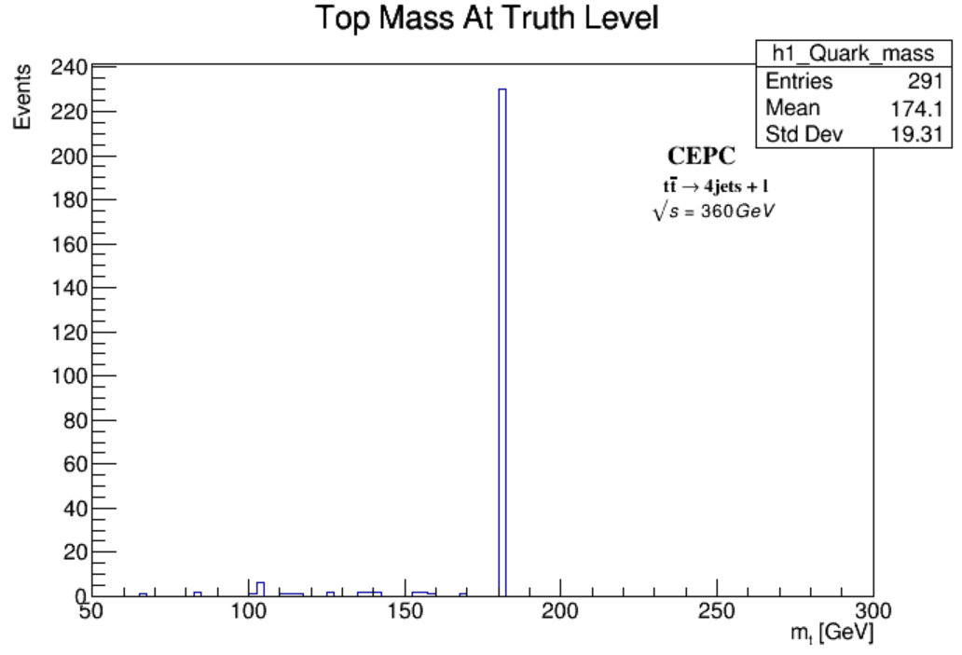
Top Mass Truth Level
The isolated lepton for this Top mass is Muon.
Set the jet energies to beam energy (180GeV).
For electron being isolated we will have more less evnts due to ISR.
The standard deviation is expected due to the imperfection of the matching.
- Low Statistics.

Slide 6
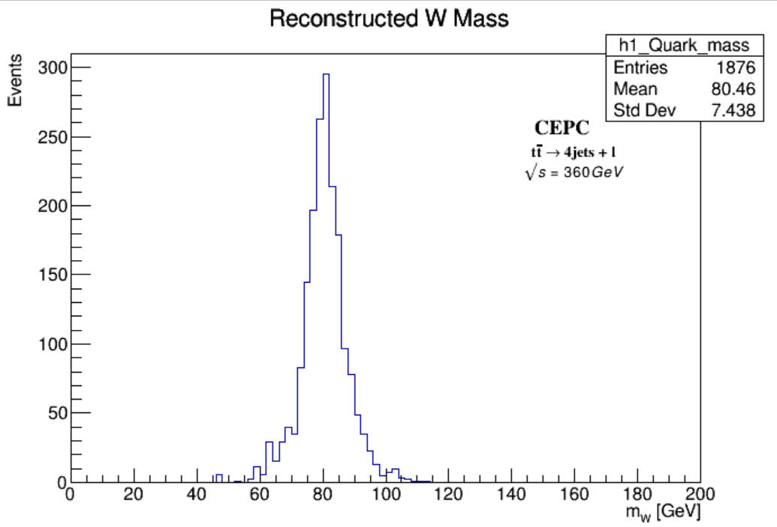
Reconstructed Top Mass
Increased #events.
Select three jets such that the deviation between the SM value and the calculated value is minimized.
Without setting the jet energies to beam energy (180GeV).

Slide 7
Thanks for Your Attention
22 January 2024

