Slide 1
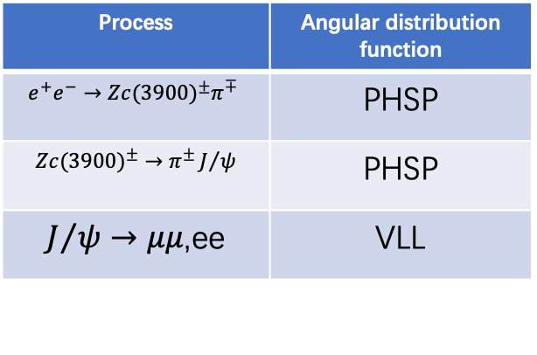
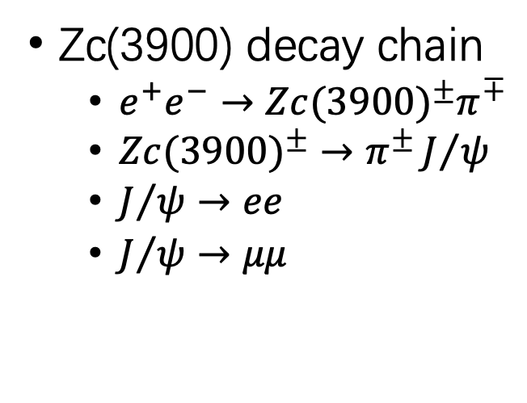
Simply repeat the observation of Zc(3900)
Signal MC sample information(plan to generate)
Zc(3900) decay chain
  $e^{+}e^{−}→{Zc(3900)}^{±}π^{∓}$
  ${Zc(3900)}^{±}→$ $π^{±}J/ψ$
  $J/ψ→ee$
  $J/ψ→μμ$
Process | Angular distribution function
$$e^{+}e^{−}→{Zc(3900)}^{±}π^{∓}$$ | PHSP
${Zc(3900)}^{±}→$ $π^{±}J/ψ$ | PHSP
$J/ψ→μμ$,ee | VLL
4.26GeV Data @BESIII of 2013 (BOSS 7.0.3)
Sample | luminance | center-mass energy | Run number
4260 | 828.4±0.1±5.5 | 4257.97±0.04±0.66 | 29677-30367 31561-31981
4.26GeV Inclusive MC (BOSS 7.0.3)
Sample | luminance | center-mass energy | Run number
4260 | 825.7 | 4256.0 | 29677-30367 31561-31981

Slide 2
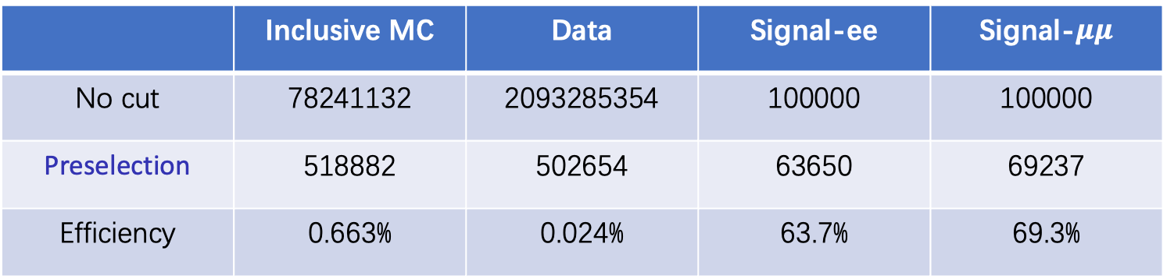
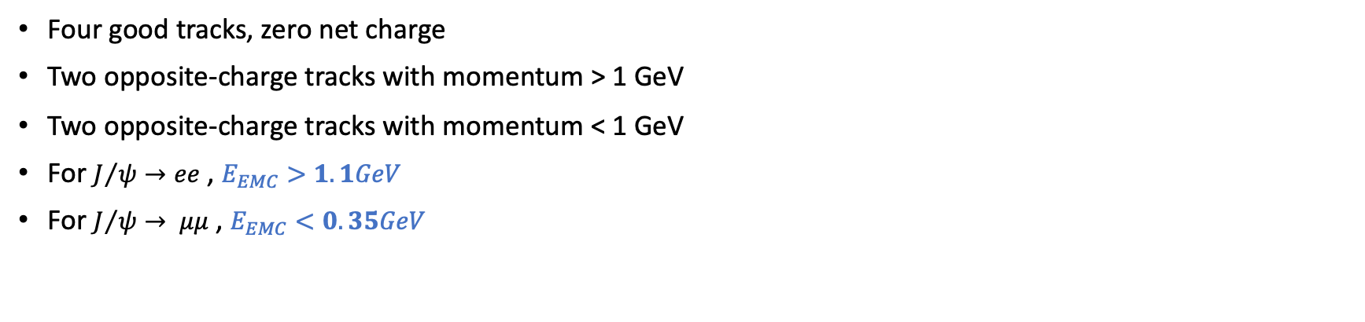
Preselection
Four good tracks, zero net charge
Two opposite-charge tracks with momentum > 1 GeV
Two opposite-charge tracks with momentum < 1 GeV
For $J/ψ→ee$ , $E_{EMC}>1.1GeV$
For $J/ψ→ μμ$ , $E_{EMC}<0.35GeV$
 | Inclusive MC | Data | Signal-ee | Signal-$μμ$
No cut | 78241132 | 2093285354 | 100000 | 100000
Preselection | 518882 | 502654 | 63650 | 69237
Efficiency | 0.663% | 0.024% | 63.7% | 69.3%

Slide 3
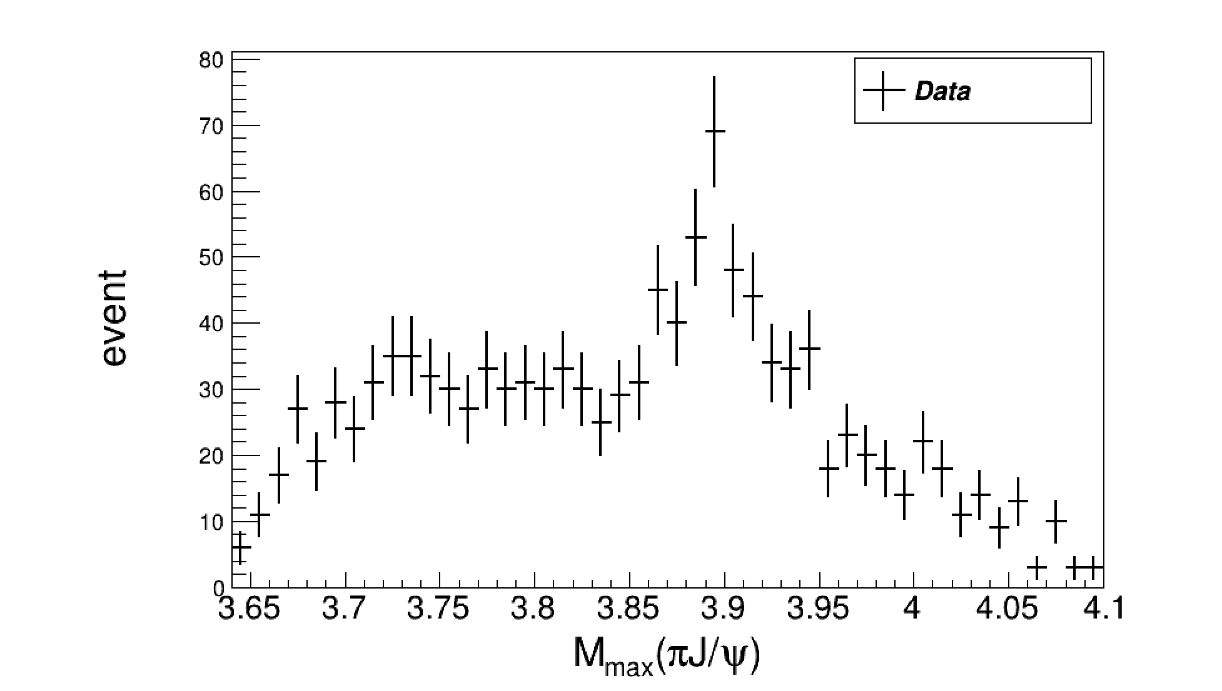
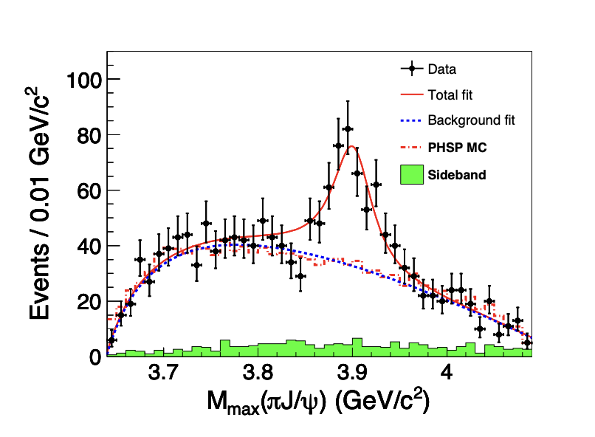
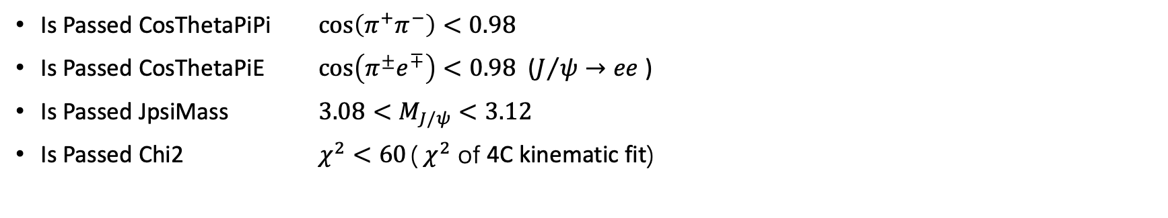
Further cut
Is Passed CosThetaPiPi $\cos\left(π^{+}π^{−}\right)<0.98$
Is Passed CosThetaPiE $\cos\left(π^{±}e^{∓}\right)<0.98$ ($J/ψ→ee$ )
Is Passed JpsiMass $3.08<M_{J/ψ}<3.12$
Is Passed Chi2 $χ^{2}<60$ ($χ^{2}$ of 4C kinematic fit)
Zc(3900)@BESIII

