Slide 1
The Design and Production of CMS-MEO GEM Front-end Electronic Board (GEB)
CMS-MEO GEM 探测器前端电子学设计与生产
  Zhihua Xue，Zhe Li，Zihan Liang，
  Ke Wang，Dayong Wang，Yong Ban
  PKU，07.13.2024

Slide 2
Outline
Outline:
Introduction of CMS ME0 GEB
CMS ME0 GEB design
ME0 GEB Test
Summary

Slide 3
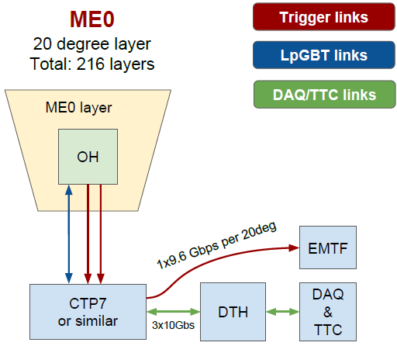
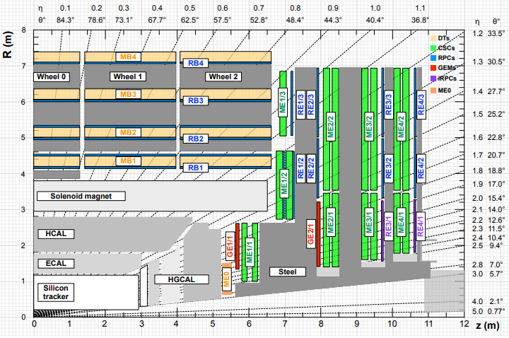
Introduction of CMS ME0 GEB
Introduction of GEB:
GEB: An important part of the readout electronics system.
Function of GEB:
  Carrier of front-end and back-end electronics system
  Front-end signal transmission carrier
  Provide direct shielding for GEM detectors
GEB
Work of Peking University HEP group:
  Design and test of ME0 GEB and GE2/1 GEB
  Design of automatic tester
DAQ system of CMS
Progress:
  The ME0 GEB prototype and pre-production have been completed
  ME0 GEB production will be done
GE2/1
ME0
CMS detector cross section

Slide 4
Introduction of CMS ME0 GEB
Requirements of ME0 GEB
  Signal transmission:
    Ensure that the characteristic impedance is 100 Ohm for differential line, and small fluctuations in characteristic impedance to reduce signal reflections
    Ensuring that time delay of the signal lines are the same to meet isochronism requirement
    Low BER (Bit Error Rate) and noise
  Power Supply:
    Meet the different power requirements of VFAT and ASIAGO boards
    Effective power distribution systems
    Power monitor, current, voltage and temperature monitor
    Prevent large voltage drop during transmission
    Validate the voltage to set value
  Mechanical performance:
    Total board thickness is less than 1.1mm, limited by installation space.
    Lower than the IPC standard curvature 0.75%.
    standoffs aligned and firmed mounted

Slide 5
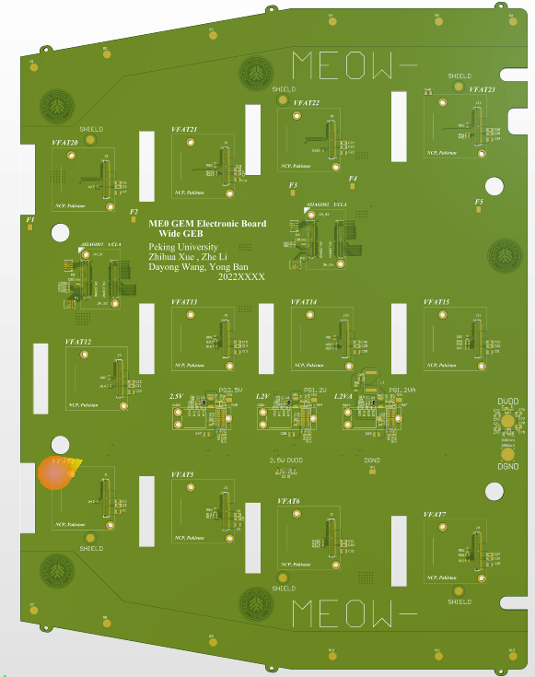
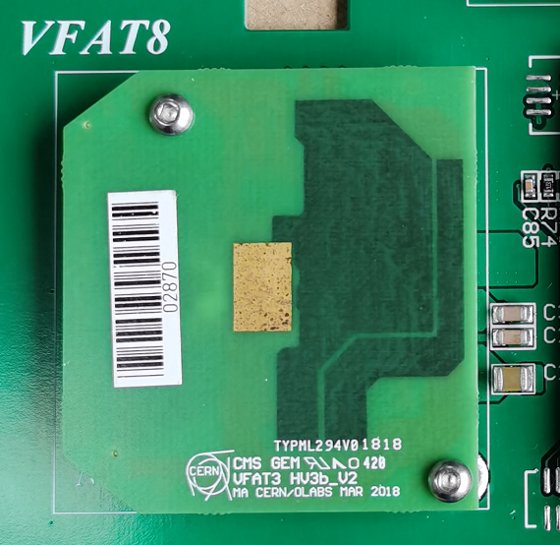
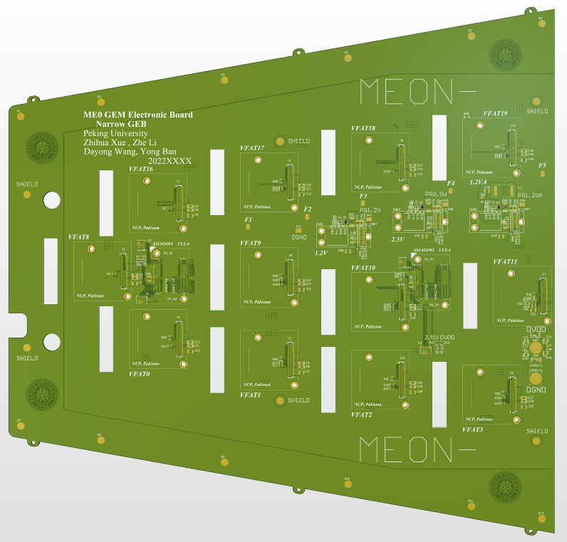
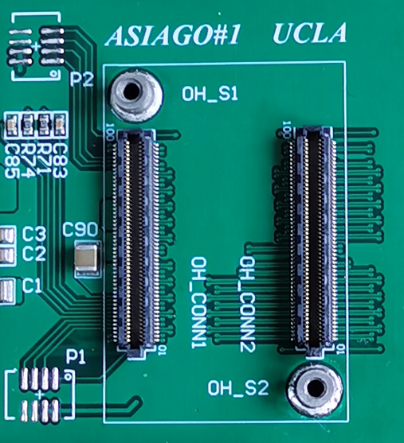
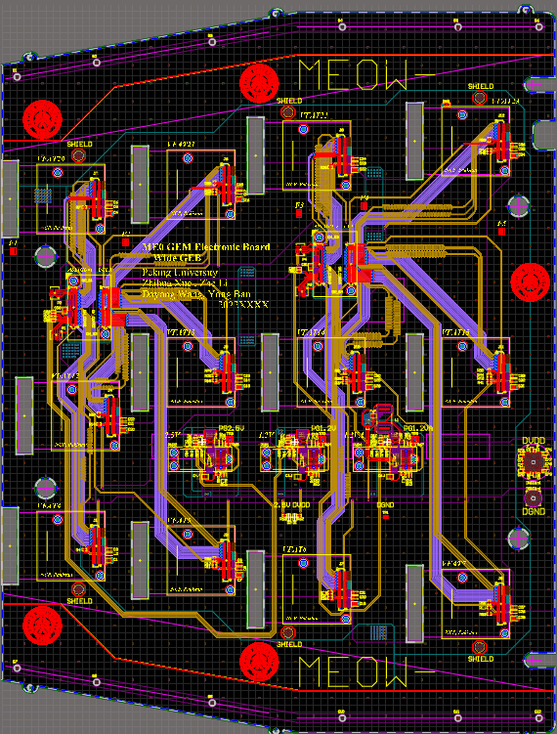
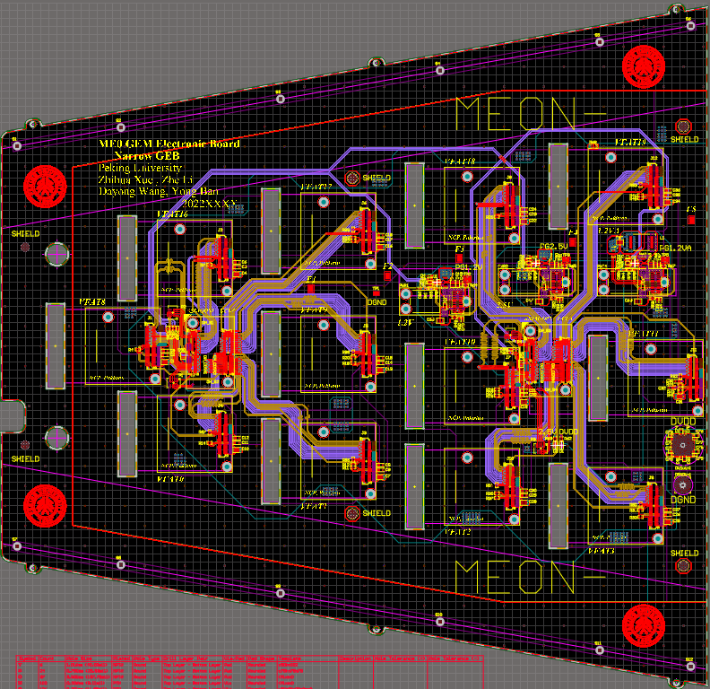
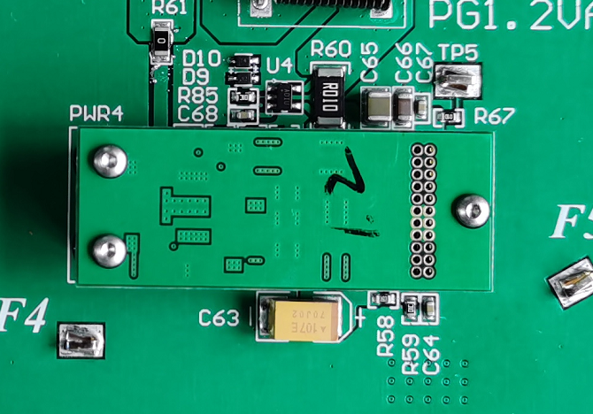
CMS ME0 GEB design
GEB with its function modules
The VFAT chip converts the signal on the readout strips into digital signal
A set of GEB connects to:
24 VFATs
4 ASIAGO boards (2 OH-CONN on each)
6 FEAST (1.2VA, 1.2VD and 2.5V)
VFAT Connector and standoff
Electrical components on ASIAGO board convert the signal from GEB into an optical signal on the optical fiber
Narrow board
Wide board
OH Connector and standoff
FEASTs provide voltage to chips on VFAT and OH board
FEAST Connector and standoff

Slide 6
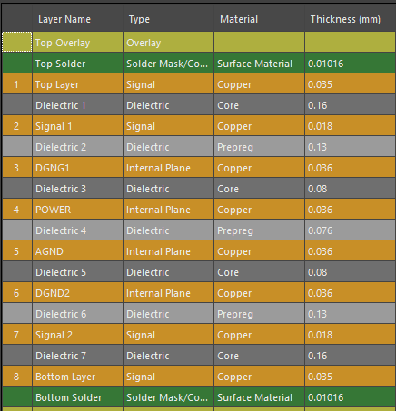
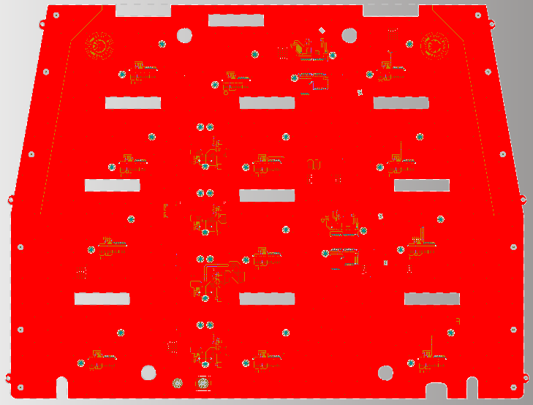
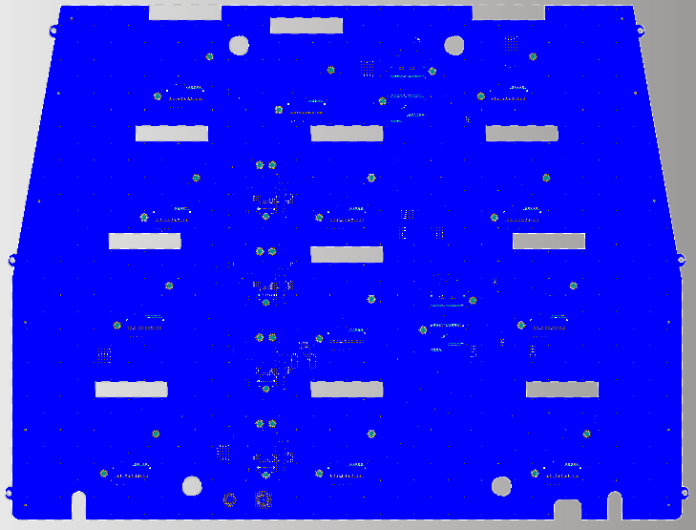
Stacks
To meet characteristic impedance requirement:
  Choose proper dielectric constant: surface solder 3.5 medium 4.2
  Copper thickness for signal layer: 0.5 Oz
  Top, Bottom and Power layer: 1 Oz
  Mini number of vias for each differential pair: 2 vias (Reduce the fluctuation of characteristic impedance)
To meet mechanical performance requirement:
  Board thickness: 1.05mm (within the requirement 1.1mm)
  Symmetrical arrangement and the same copper laying method (Reduce the curvature)
Stacks structure
For example, top layer and bottom layer are laid with the same copper arrangement, in order to reduce the board curvature
Top layer
Bottom layer

Slide 7
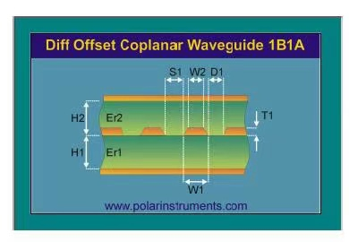
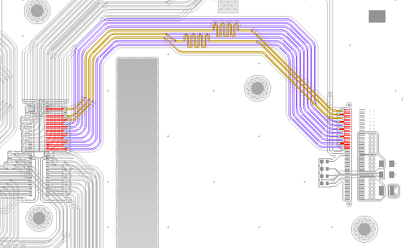
Characteristic impedance and routing
Characteristic Impedance
Set to 100Ohm for differential pair:
Factors that affects characteristic impedance:
W1,W2:Line width
S1:Differential line separation
D1:Ground strip separation
H1,H2:Stack thickness
Er1, Er2: Dielectric constant of the medium
Characteristic Impedance fluctuation: <10%
Characteristic impedance design software: Polar Si9000
Routing:
(1) Differential signal lines: linewidth / gap / linewidth: 0.1/0.25/0.1 mm (Considering coupling effect)
(2) Other parameters: Minimum distance to another pairs / DGND: 0.55mm / 0.6mm.
(3) Simpler routing design: Reduce routing corner

Slide 8
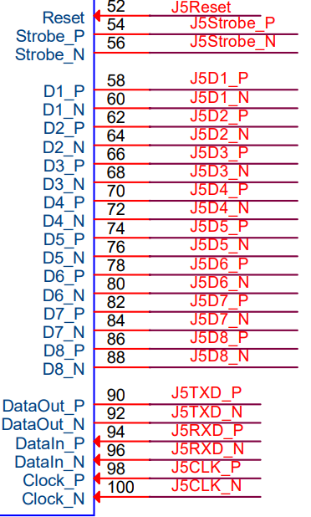
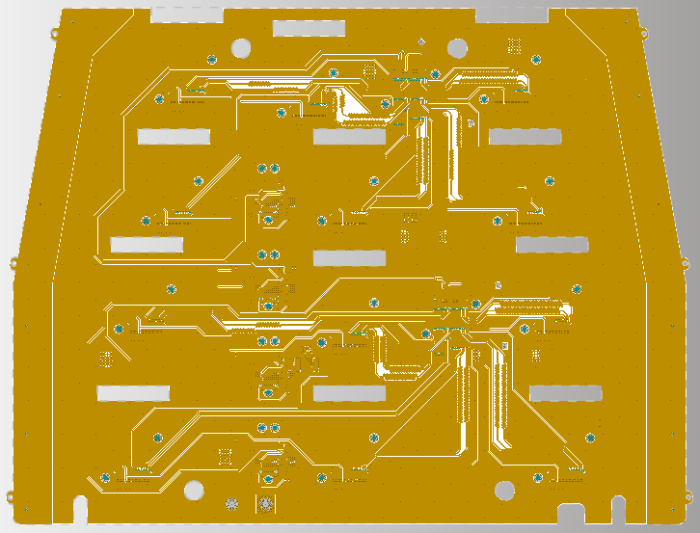
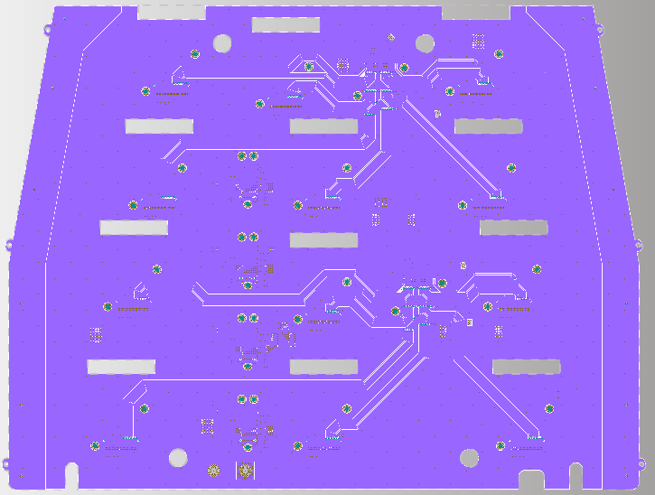
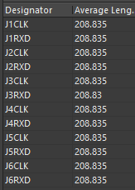
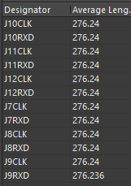
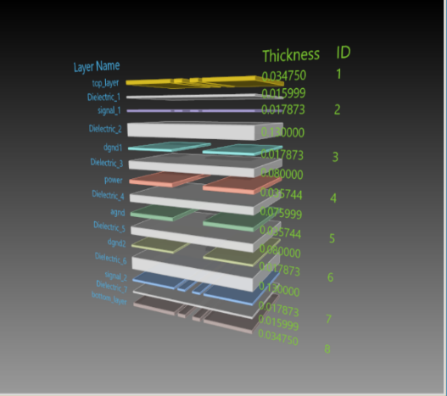
Signal
Signals introduction:
VFAT trigger unit outputs 9 differential signals:
VFAT communication E-port has 3 pairs of differential signals
VFAT reset signal
LVCMOS level signal: RESET
Signals are arranged on two layers:
Signal1 and signal2
Prevent crossover of signal lines as in GE1/1 case
To meet time resolution requirement of signals:
Equal length(CLK and RXD):
J1-J6,J7-J12 To ensure signal isochronism
Signal1 Layer
Signal2 Layer
Both signal layers have upper (Top layer or bottom layer) and lower shielding layers (DGND1 and DGND2) to reduce signal interference

Slide 9
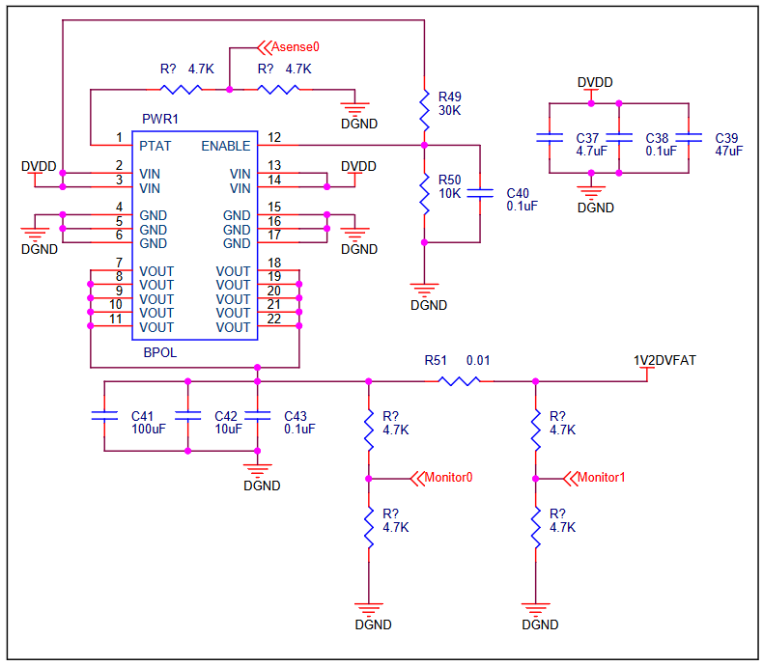
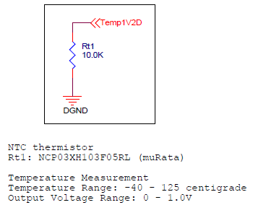
Power monitor and temperature measurement
Power monitor:
introduced to ensure that the voltage value of the supply is normal
OH power supply；
  PWR1: 1V2DVFAT ---1.3A for one ASIAGO, total is 2.6A.
  PWR2: PWR2V5 --- 0.2A for one ASIAGO, total is 0.4A.
VFAT power supply:
  PWR1: 1V2DVFAT ---70mA for one ASIAGO, total is 840mA.
  PWR2: PWR2V5 --- <1mA for every VFAT
  PWR3: 1V2AVFAT ---140mA for one VFAT, total is 1.68A
The output monitoring voltage show whether the FEAST is working properly.
To monitor the current output of each power supply, we use Monitor to detect the voltage drop through the current sensing resistor with a resistance of 0.01 Ohm.
Temperature measurement:
introduced to ensure that the power modules is working properly
Voltage measurement：
  Monitor1 and Monitor0 are 0.6V (1.2V × 0.5)
Current measurement:
  If Ir51 = 3.44A, voltage of Monitor0 –Monitor1 = 17.2mV
  (3.44A × 0.01Ω × 0.5)
Power monitor
Temperature measurement
Calibration of current source using precision resistors on the ASIAGO - more accurate measurement
Properly use a current source to keep the ADC input voltage between 0-1V

Slide 10

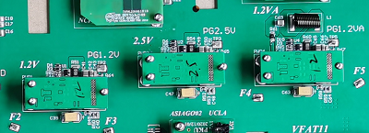
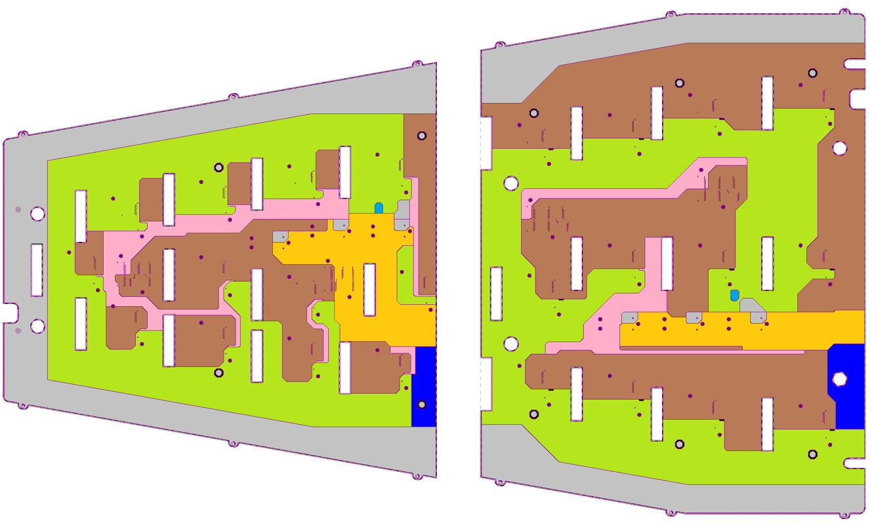
Power distribution system
The VFAT and ASIAGO requires a different FEAST power supply
3 FEASTs provides 3 voltages to the corresponding modules of VFAT and ASIAGO modules
FEAST
GEB distribute the voltage from FEAST to VFAT and ASIAGO modules through vias and power plane.
In addition, grounding operation is achieved through the DGND and AGND planes.
Prevent voltage loss:
(1) The thickness of the power supply layer is 1oz
(2) For high current power supply, we provide large area power plane
Different colors show different power supply areas and link to different FEAST

Slide 11
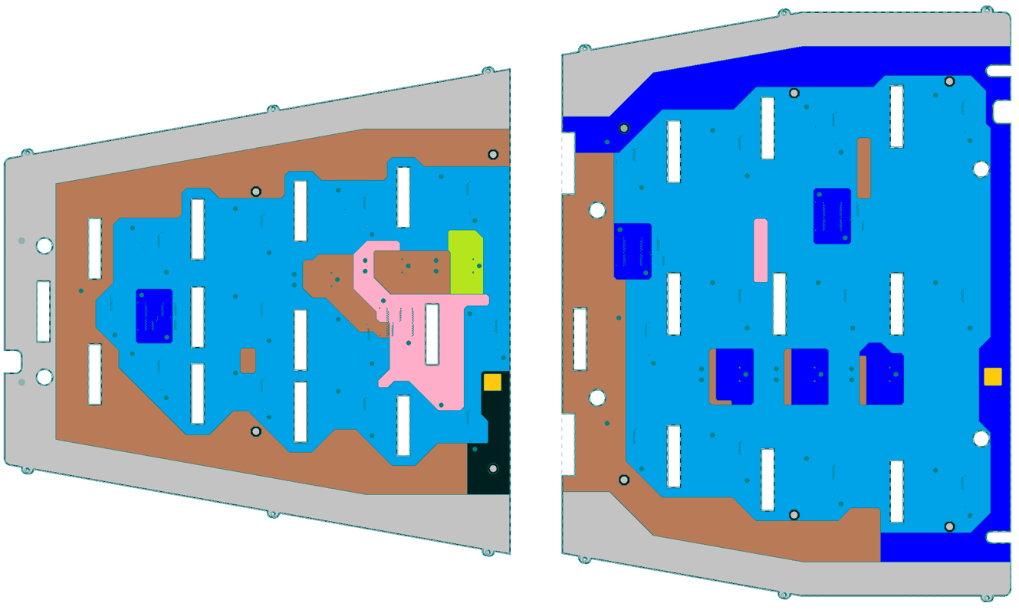
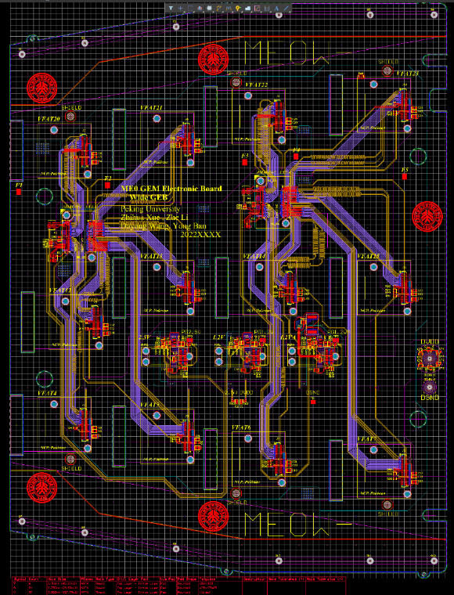
Grounding system and shielding system
Grounding system:
2 DGND layer(digital ground) and 1 AGND(analog ground) layer.
Shielding system:
The signal layer is between top/bottom layer and grounding layers to avoid electromagnetic interference.
Shielding pads are added to reduce noise.
chimney
Shielding Pads
chimney
Split plane of AGND layer

Slide 12
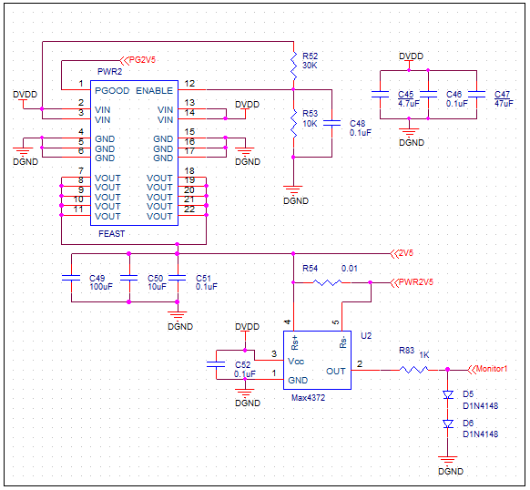
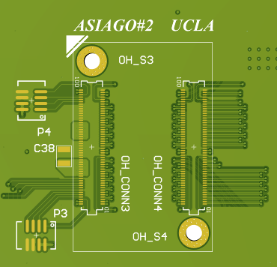
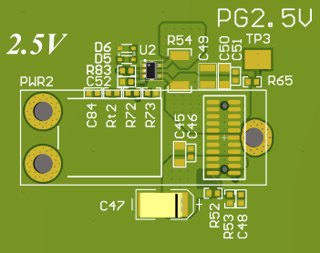
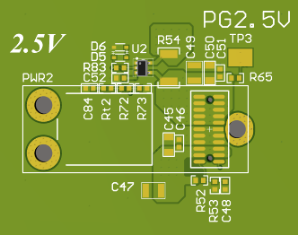
Main updates
Switch to halogen-free material
Change from 4 to 3 DC-DC converters
  Remove one 1.2V FEAST, using 3 DC-DC converters
Remove Max4372 (Considering the radiation tolerance)
  Measure the current by resistors directly
Change polarized capacitors to non-polarized ones
  Prevent possible damage from power supply
Silkscreen updates and add posts for OH orientation
OH orientation
Capacitance value: 0.1u, 10u, 100u
Capacitance value: 0.1u, 4.7u, 47u
Non-polarized capacitors
C39,C47,C63
Remove Max4372

Slide 13
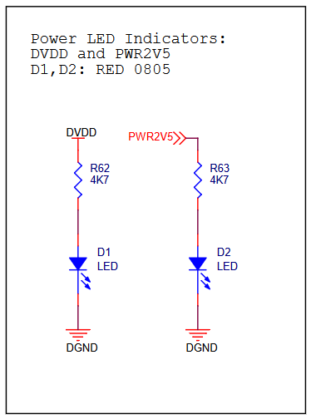
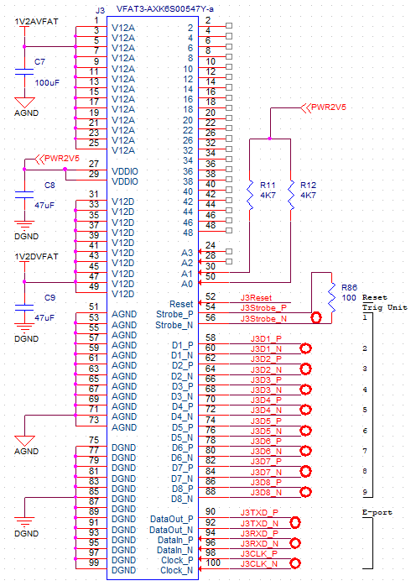
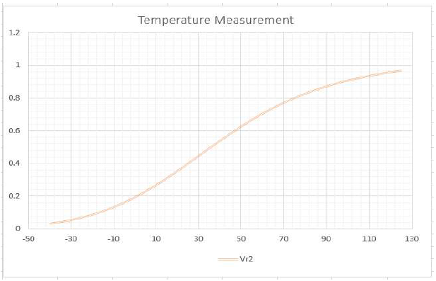
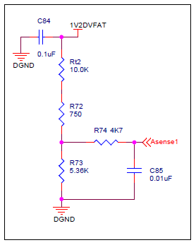
Main updates
Remove the power LED indicator from the GEB board
  DVDD and PWR2V5
Modify temperature measurement circuit
Termination resistors
  100Ohm for impedance matching
Make VFAT HDLC addresses final
  Remove extraneous resistors
Fiber routing update
  Adjust the fiber to avoid interference
Additional soldering pads for shielding layer
Power monitor of 1V2DVFAT
HDLC Address
LED
Termination Resistor
Temperature measurement

Slide 14
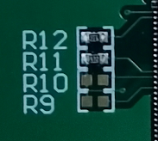

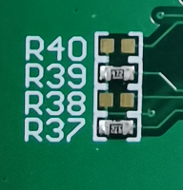
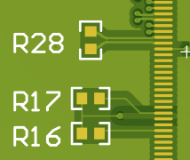
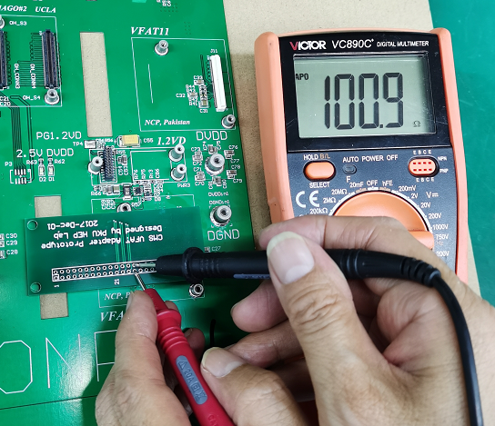
HDLC Address
VFAT Connector | HDLC_Address | Soldering resistors
 | A[3:0]
J1 | 0001 | R1
J2 | 0010 | R2
J3 | 0011 | R3,R4
J4 | 0100 | R5
J5 | 0101 | R6,R7
J6 | 0110 | R8,R9
J7 | 0111 | R10,R11,R12
J8 | 1000 | R13
J9 | 1001 | R14,R15
J10 | 1010 | R16,R17
J11 | 1011 | R18,R19,R20
J12 | 1100 | R21,R22
HDLC Address Resistors
Termination Resistor
100 ohm Termination
resistor measure:
R23-R30
HDLC Address
Make VFAT HDLC addresses final (remove extraneous resistors) R9,R10….R38,R40 should be removed.

Slide 15
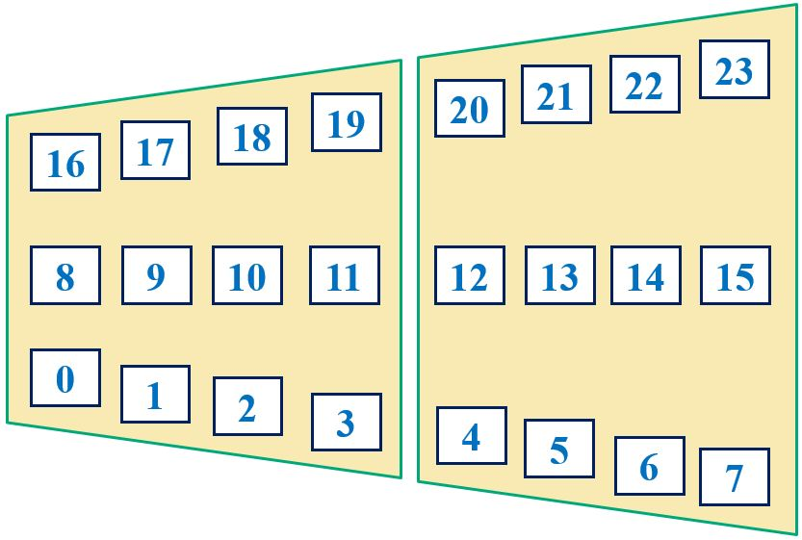
VFAT label
  VFAT0→VFAT23
Narrow GEB
VFAT label | VFAT Connector
VFAT0 | J4
VFAT1 | J3
VFAT2 | J10
VFAT3 | J9
VFAT8 | J1
VFAT9 | J5
VFAT10 | J7
VFAT11 | J11
VFAT16 | J2
VFAT17 | J6
VFAT18 | J8
VFAT19 | J12
Wide GEB
VFAT label | VFAT Connector
VFAT4 | J1
VFAT5 | J3
VFAT6 | J7
VFAT7 | J9
VFAT12 | J4
VFAT13 | J5
VFAT14 | J10
VFAT15 | J11
VFAT20 | J2
VFAT21 | J6
VFAT22 | J8
VFAT23 | J12

Slide 16
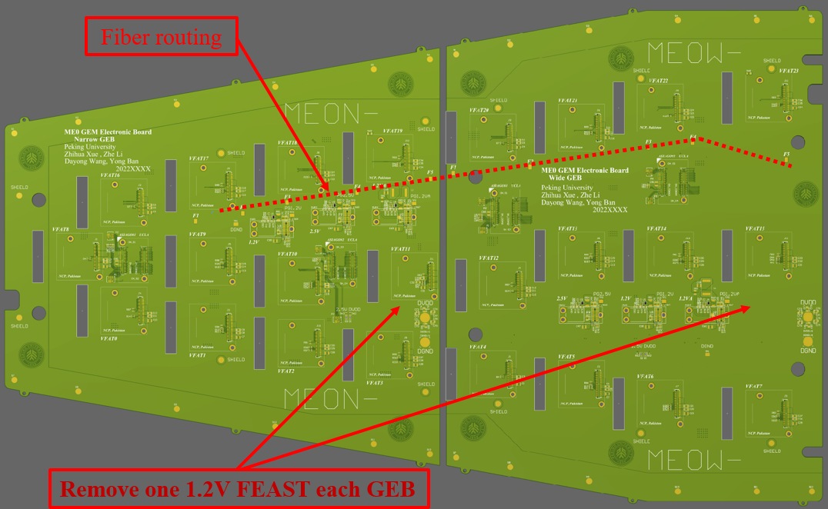
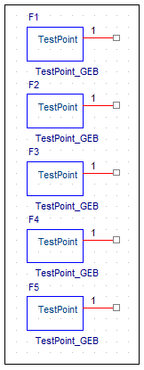
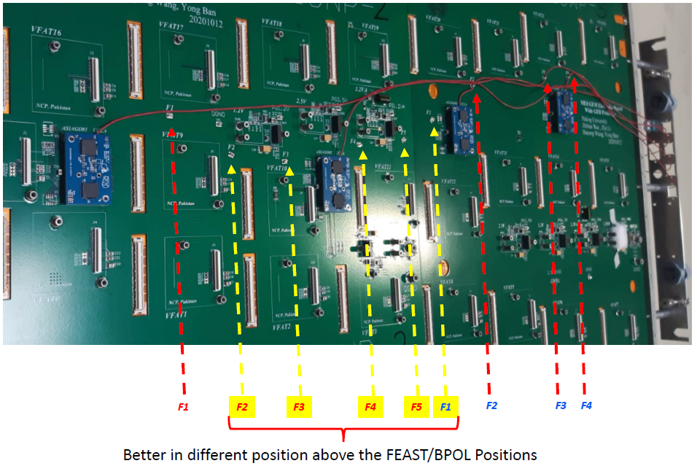
Fiber routing
• Fiber fixing
5 KEYSTONE 5016 for narrow GEB
5 KEYSTONE 5016 for wide GEB
attach optical fiber to zipline
• In order to ensure it is firm, many through holes are placed on the keystone.
• In order to avoid signal interference ,
- 1. The keystone is not grounded
- 2. No signal routes through the occupied position

Slide 17
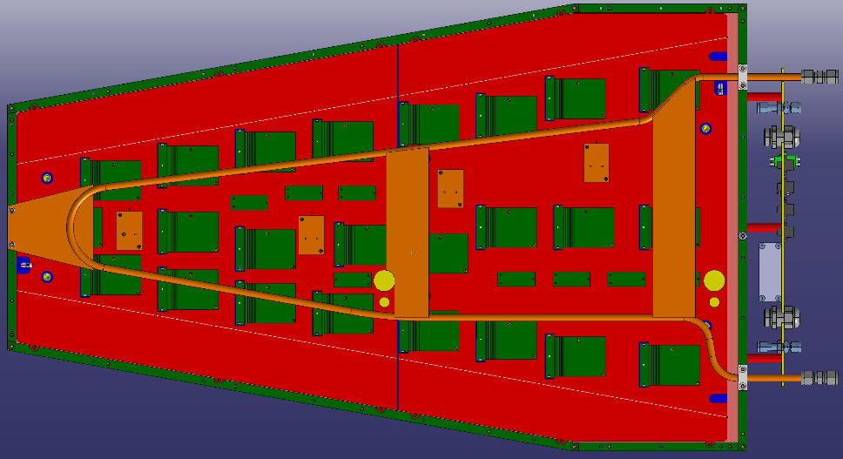
Cooling system
Cooling system:
The cooling system is modified as the number of FEAST is from 4 to 3.
Cooling system
• Remove the 1.2VD FEAST which is located in the positions marked by the purple X
Prototype ME0 GEB

Slide 18
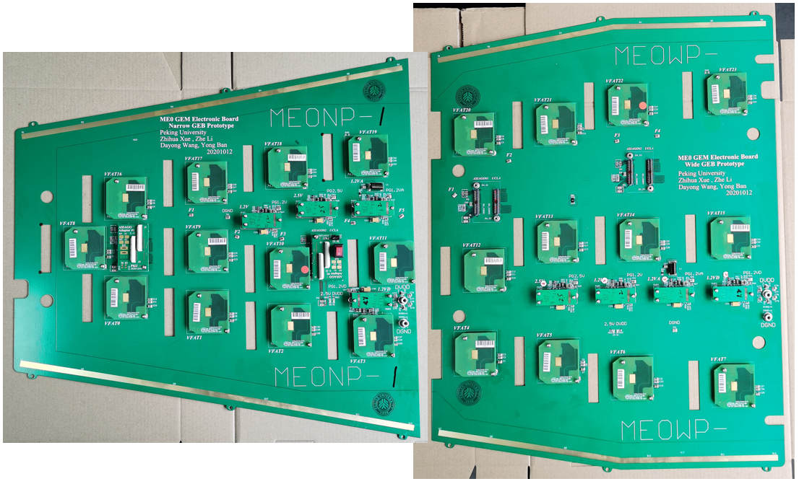
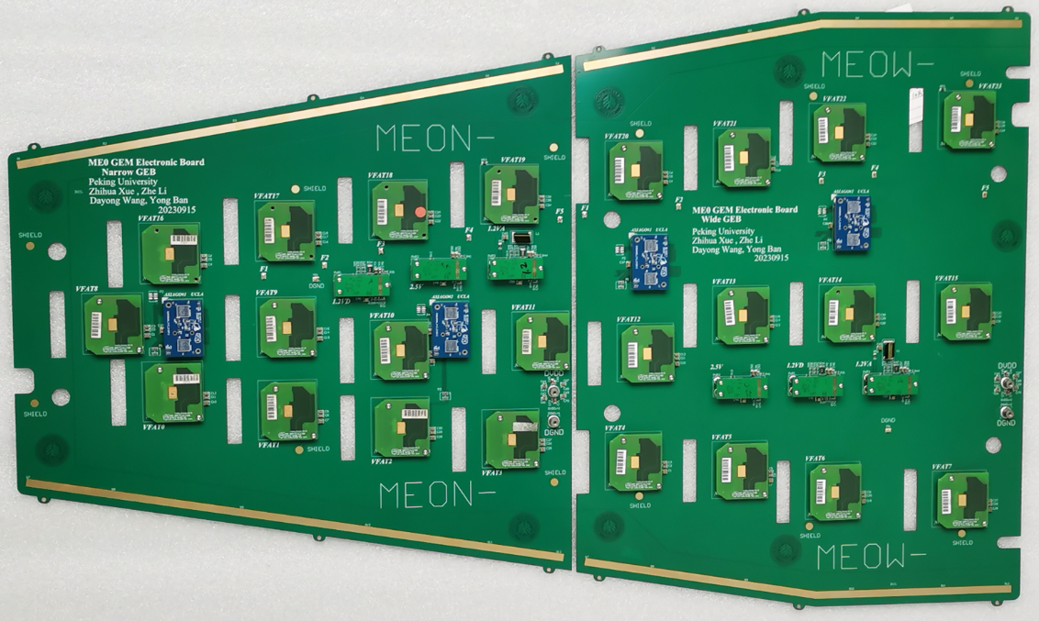
ME0 GEB ProtoType: April 2021
  ME0_narrow_V30, 2 pieces, Joseph Carlson, UCLA
  ME0_wide_V30, 4 pieces, Joseph Carlson, UCLA
  ME0_narrow_V30, 3 pieces, Michele Bianco, CERN
  ME0_wide_V30, 2 pieces, Michele Bianco, CERN
  1+1 PKU
ME0 GEB Pro-Production: November 2023 ( after EDR/ESR)
  ME0_GEB_V52_Wide, 4 pieces, Jeremie A Merlin, CERN
  ME0_GEB_V52_Narrow, 4 pieces, Jeremie A Merlin, CERN
ME0 GEB Production:
  April 2024
  255+255 pieces bare PCB boards ( after MRR, GEM ME0 GEB Manufacturing Readiness Review) completed
  ME0_GEB_V52_Wide, 14 pieces, Jeremie A Merlin, CERN
  ME0_GEB_V52_Narrow, 14 pieces, Jeremie A Merlin, CERN
  next month
  75+75 pieces， will be done

Slide 19
GEB Test
Test at GEB production site in China:
  Power module test
  Signal connectivity test (A new tool)
  Characteristic impedance test
  Bending degree test
  Mechanical compatibility test
  BER test (A new tool)
  Flying Probe test
Acceptance test at CERN:
  Similar as GE2/1 acceptance test at CERN, to make sure no damage caused by shipping.

Slide 20
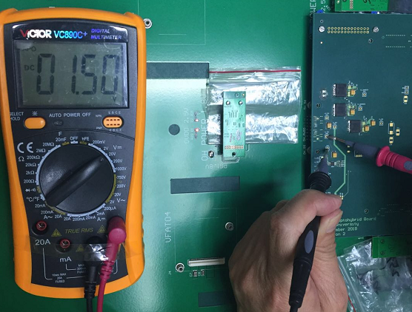
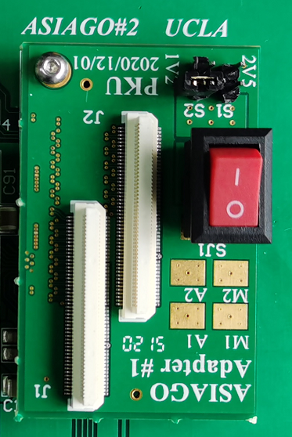
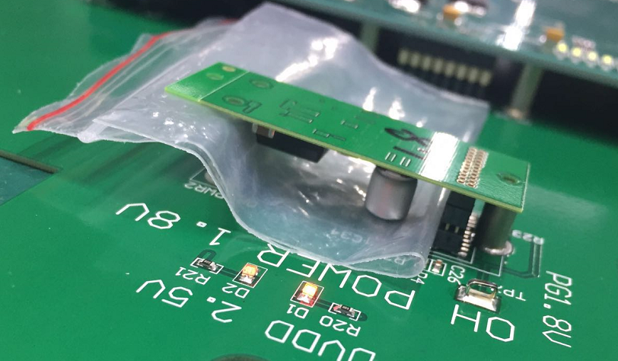
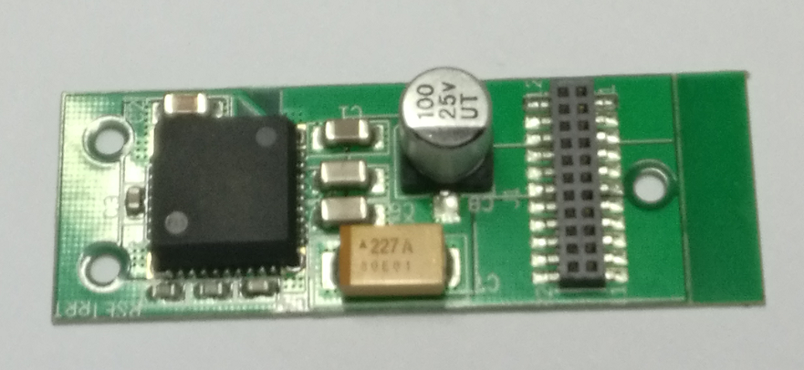
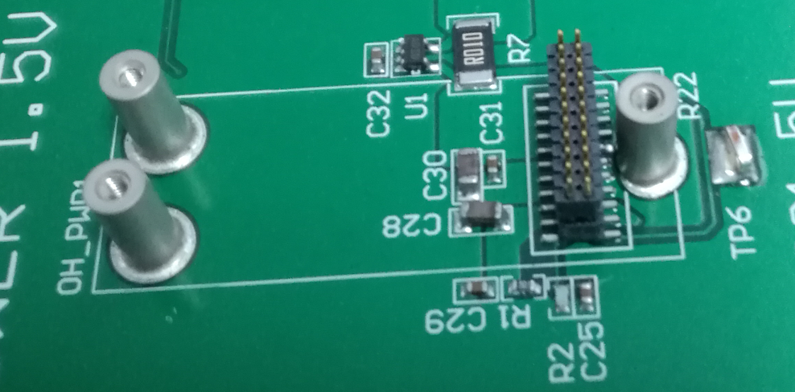

Power module test
Load board
Voltage and current test of 3 power modules:
  2.5V on OH board
  1.2V digital power、1.2V analog power supply on VFAT
→ The power test has been done with the ME0 GEB(wide & narrow) prototypes, the results meet the GEB design requirements, and the fluctuations are within a reasonable range

Slide 21



Signal Connectivity Test: FPGA-computer based device
  Device:
  using Xilinx Spartan-6 FPGA and LabVIEW
  Used in acceptance test of GE2/1 GEB
  The device was verified and successfully used in GE2/1 mass production
  Flow chart of the test device
Connectivity test:
  all VFAT signal channels and power supply pins
BER test:
schematic diagram
Test Criteria:
No short and open circuit (connectivity)
No error occurs in one minute (BER)

Slide 22




Test board and adaptors
VFAT Adaptor
ASIAGO Adaptor
Test Board of PKU

Slide 23


Characteristic Impedance test
Characteristic Impedance test results
(provided by Sinofast company)
Characteristic Impedance fluctuation Simulation results (Using Ansys SIwave)
Plane | Signal_1/Signal_2
Differential Wire | 98.9679Ohm
Characteristic impedance fluctuation of most differential line is within 10%

Slide 24



Mechanical Compatibility & Flying Probe Test
Mechanical compatibility test
Mount VFAT (Plugin Card), ASIAGO modules, and FEAST to check the collimation of Standoff.
Test criteria: VFAT, ASIAGO and FEAST in line with the standoffs
Test results of ME0 GEB: Standoff has good collimation
For the standoffs, we stay with the current 5 mm standoffs, but you should have a strict tolerance during QC to make sure the total height after soldering is <= 5.15 mm
Measure Results：around 5.05mm. Some of them are 5.00mm.
Flying probe test:
The factory performs automated flying probe test during GEB production.
Automated flying probe test machine

Slide 25



Test At UCLA and FIT
Integration test with OH and VFATs
The goal:
6 ME0 GEBs (2N + 4W) arrived and underwent testing at UCLA
• Testing process:
• Check voltages with only FEASTs loaded onto GEB
• Load one ASIAGO (ME0 Optohybrid) and one VFAT and
• Check ASIAGO is ready and can communicate with VFAT
• Fully load GEB and check communication with all VFATs (tests full communication chain and DAQ elinks)
• Take current measurements using current sensing chips + thermistors on ME0 GEB and reading out through ADC of ASIAGO
• Check uplink and downlink error rates and eye diagrams
eye diagram
Noise test

Slide 26



Manpower & facilities
  Sinofast in Shenzhen, China has long term collaboration with CMS-GEM team, has produced all GE1/1 & GE2/1 GEBs and ME0 GEB prototypes.
  200 workers with a variety of PCB production equipment and assembly equipment.
  4-5 weeks of the production of GEB PCB + 1 week of assembly for a batch of production
  Etching Machine CNC drilling machine
  Laminating Machine

Slide 27


Shipment and timeline
Distance and time:
  Shipment time is ~ 7-14 days from China to CERN (via air-flight)
Packing:
  Each GEB wrapped up in individual packages with foam to absorb shock for shipping.
  2 GEBs will be packed in one carton box.
  The carton boxes will be put into wooden boxes in transportation
Timeline:
  Start of design -> the first version -> UCLA and CERN -> ESR -> Pro-Production
  4/2020 -> 4/2021 -> 6/2021 -> 6/2023 -> 9/2023
  Final Production:
  4/2024 (28 pieces: 14 narrow and 14 wide)
  Next month ( 75 + 75 pieces)
  Later (166 + 166 pieces)

Slide 28
Summary
The design of production version of ME0 GEB (wide and narrow) is completed. Many improvements and updates are made in mechanical properties, power distribution and signal transmission.
Quality Control standards and procedures are established with prototypes, both at production site and after arrivals at CERN
  Flying probe test, characteristic impedance measurement, visual check
  Bending degree test, mechanical compatibility test etc.
  Power module test
  Signal connectivity test, bit error test, eye diagrams
ME0 GEB production (510 pieces, 255 narrow + 255 wide GEB boards)
  The final production version GEB (bare PCB) has already been completed
  In April, the assembled GEB have been shipped to CERN (14+14 pieces)
  Now, 75+75 pieces GEB boards have been assembled in Shenzhen. Once the test is complete, it will be shipped to CERN
  The 166+166 pieces GEB boards has not been assembled.

