Slide 1
arxiv number: 2312.08652

Slide 2
- Propagator and Polarization Function -
Lagrangian of SU(2) NJL model at finite $μ_{5}$ and chemical potential $μ$
The quark mass
The quark propagator satisfies
After Fourior transformation

Slide 3
- Propagator and Polarization Function -
Write the propagator in Real-Time formalism (RTF)
Only knowledge of 11-component is sufficient for later calculation.
The polarization function
The spectral function

Slide 4
- Propagator and Polarization Function -
Sixteen delta function, $\left(r,s\right)=±$

Slide 5
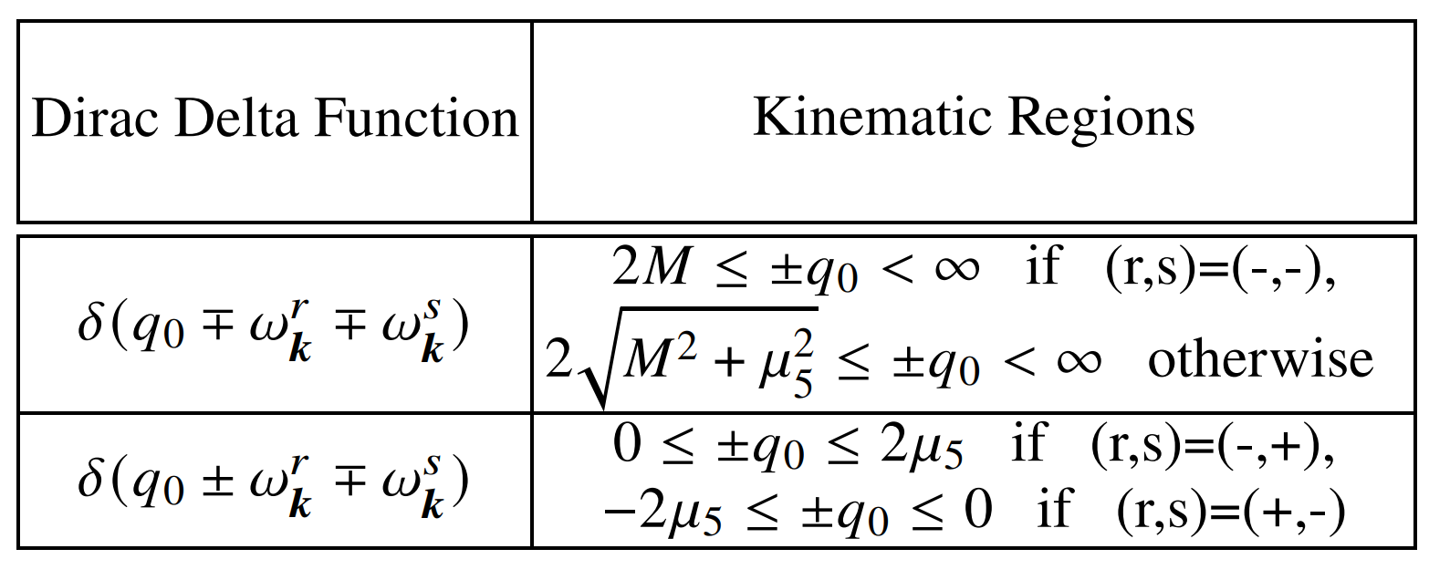
- Propagator and Polarization Function -
Mott transition

Slide 6
- Numerical Results -
Low temperature: Chiral catalysis (CC)
High temperature: Inverse chiral catalysis (ICC)

Slide 7
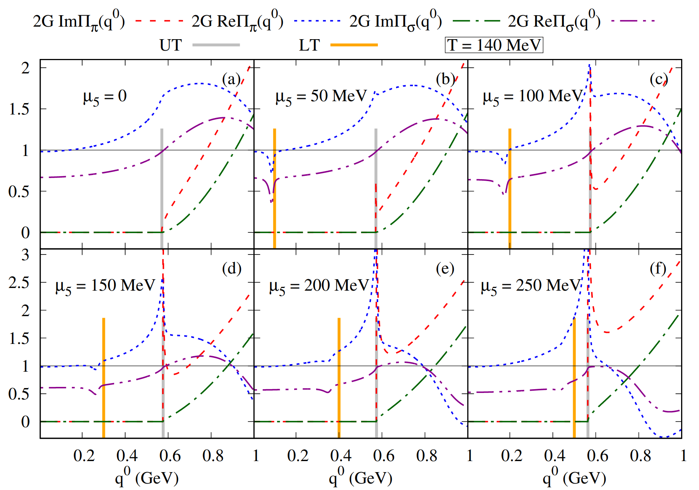
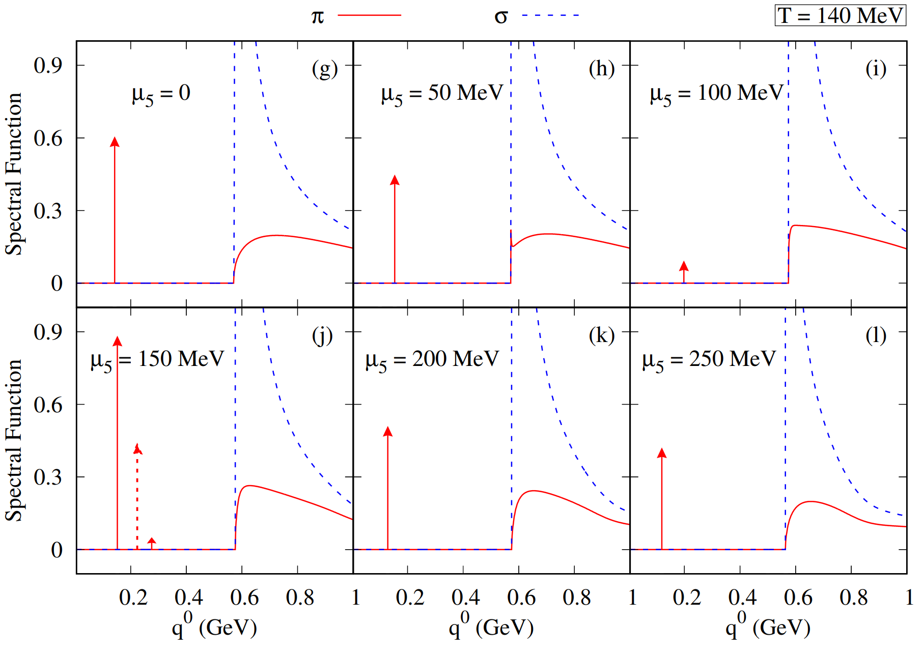
- Spectral Function -
Three solutions in pole equation
Negative slope $→$ imaginary coupling $→$ unphysical modes

Slide 8
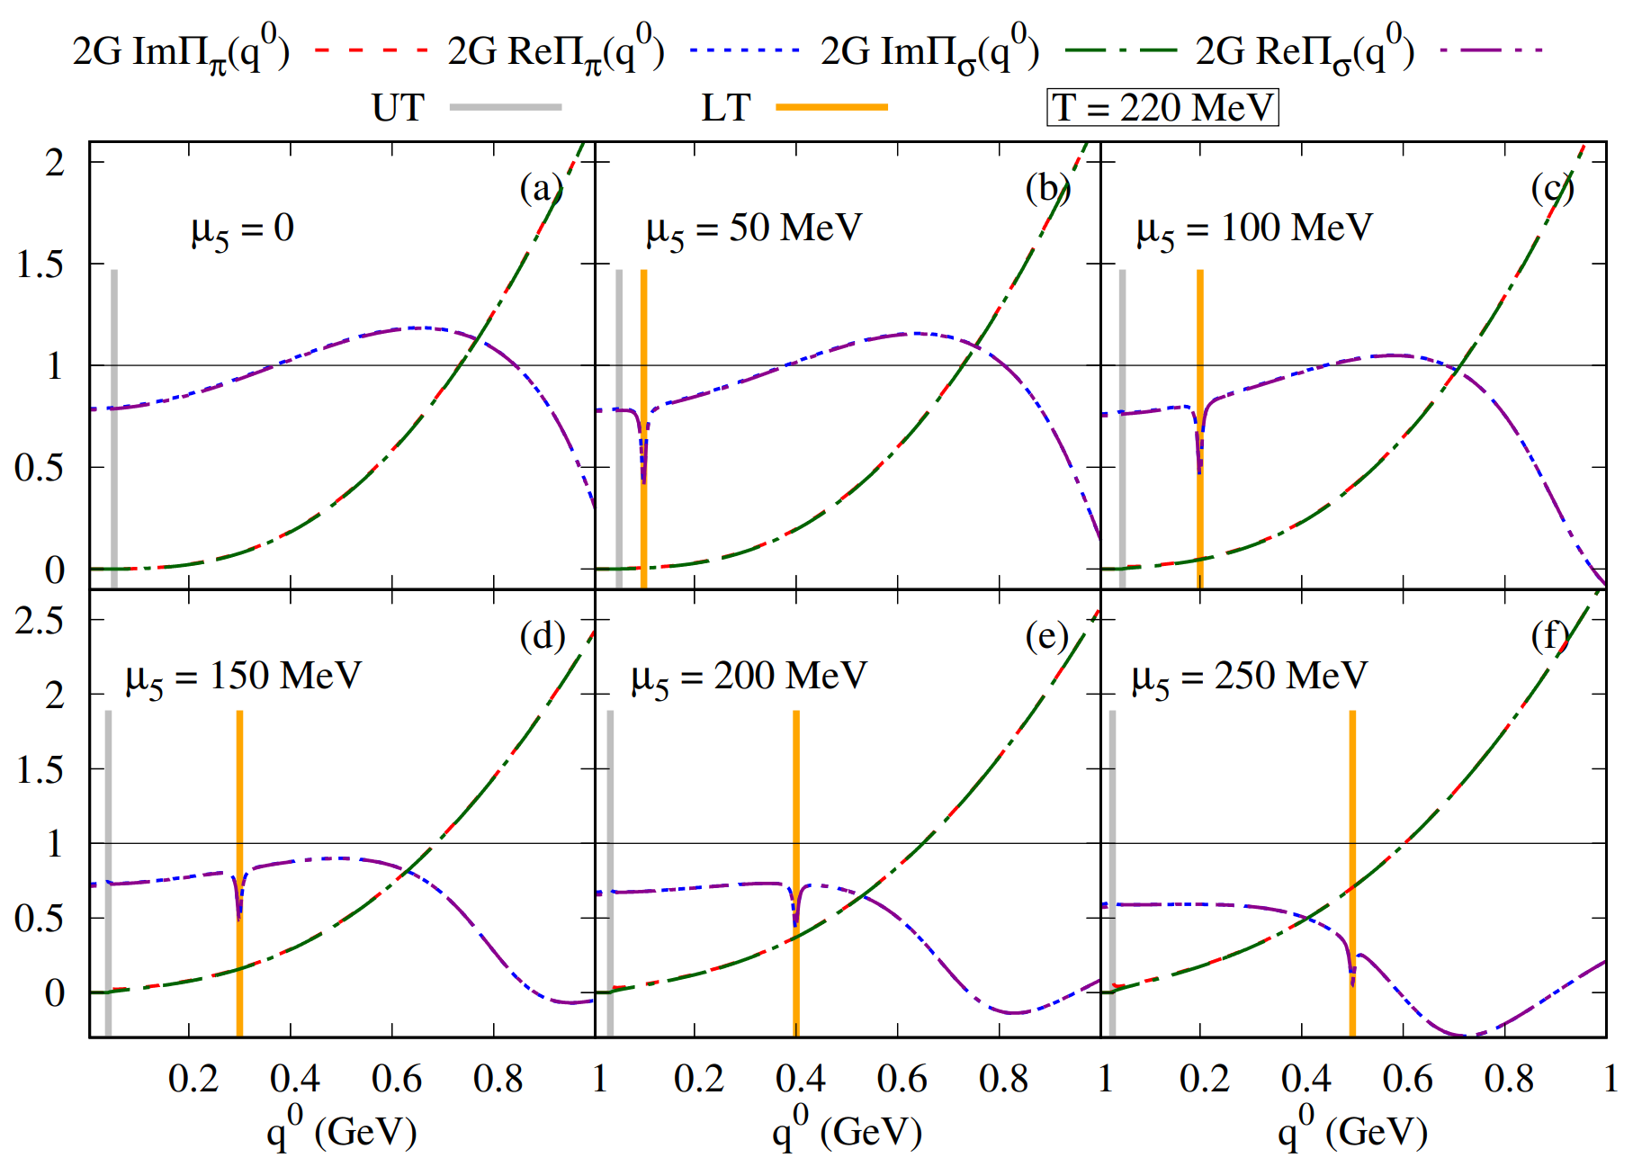
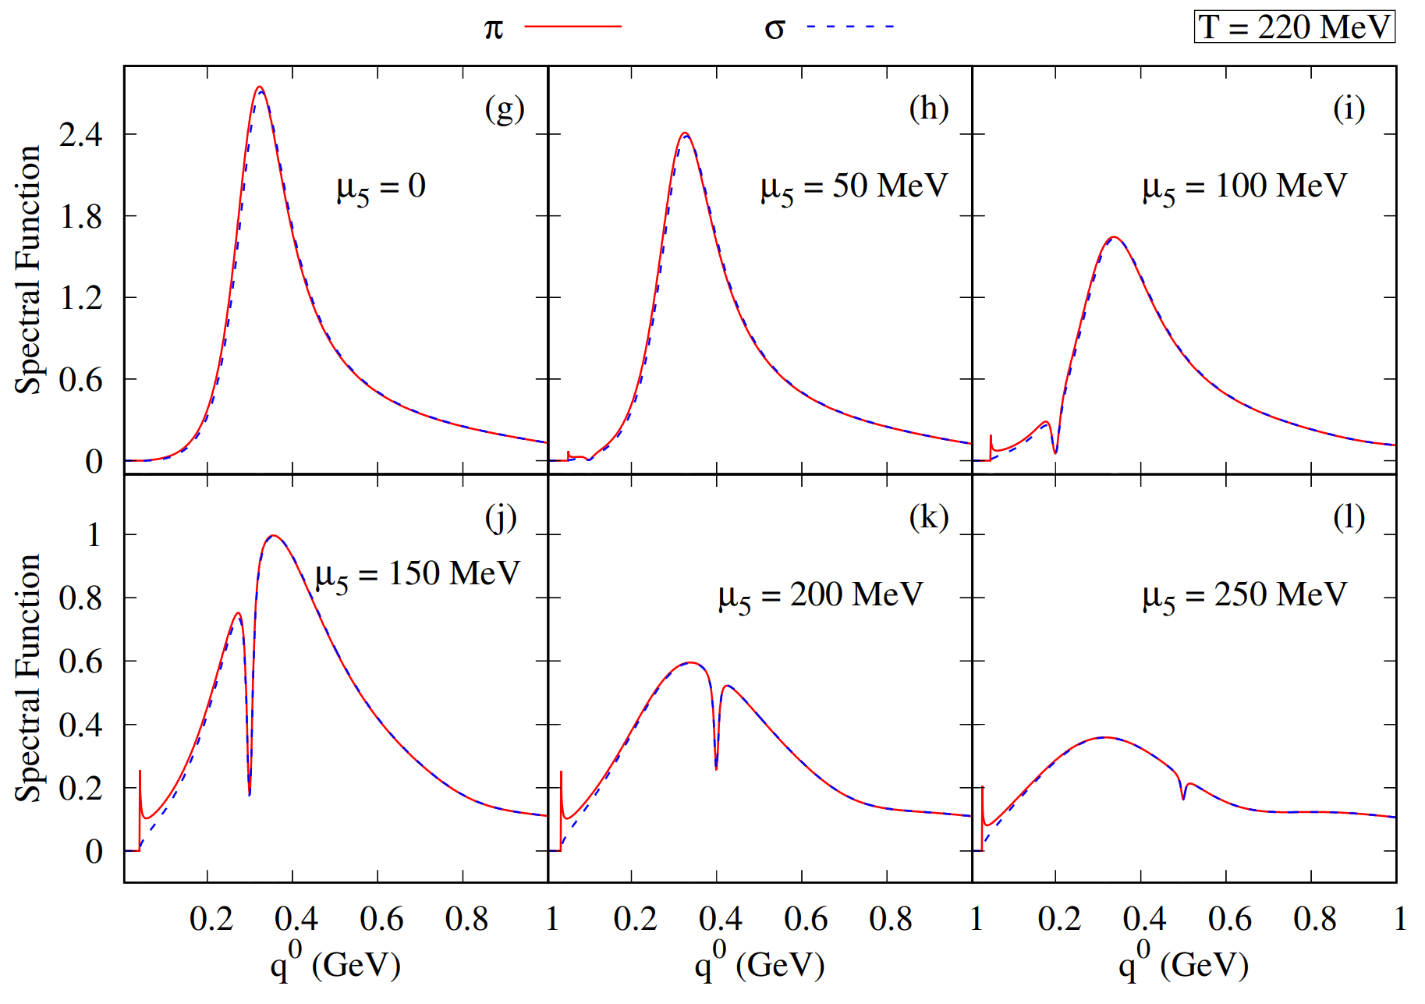
- Spectral Function -
Contribution of Landau cut
Dirac structure $→$ Wigner-Breit structure
Multiple solutions of pole equation is induced by CCP
Use the derivative of $ReΠ_{M}\left(q^{0}\right)$ to locate the physical solution
Resonances become less stable as $μ_{5}$ increases

Slide 9
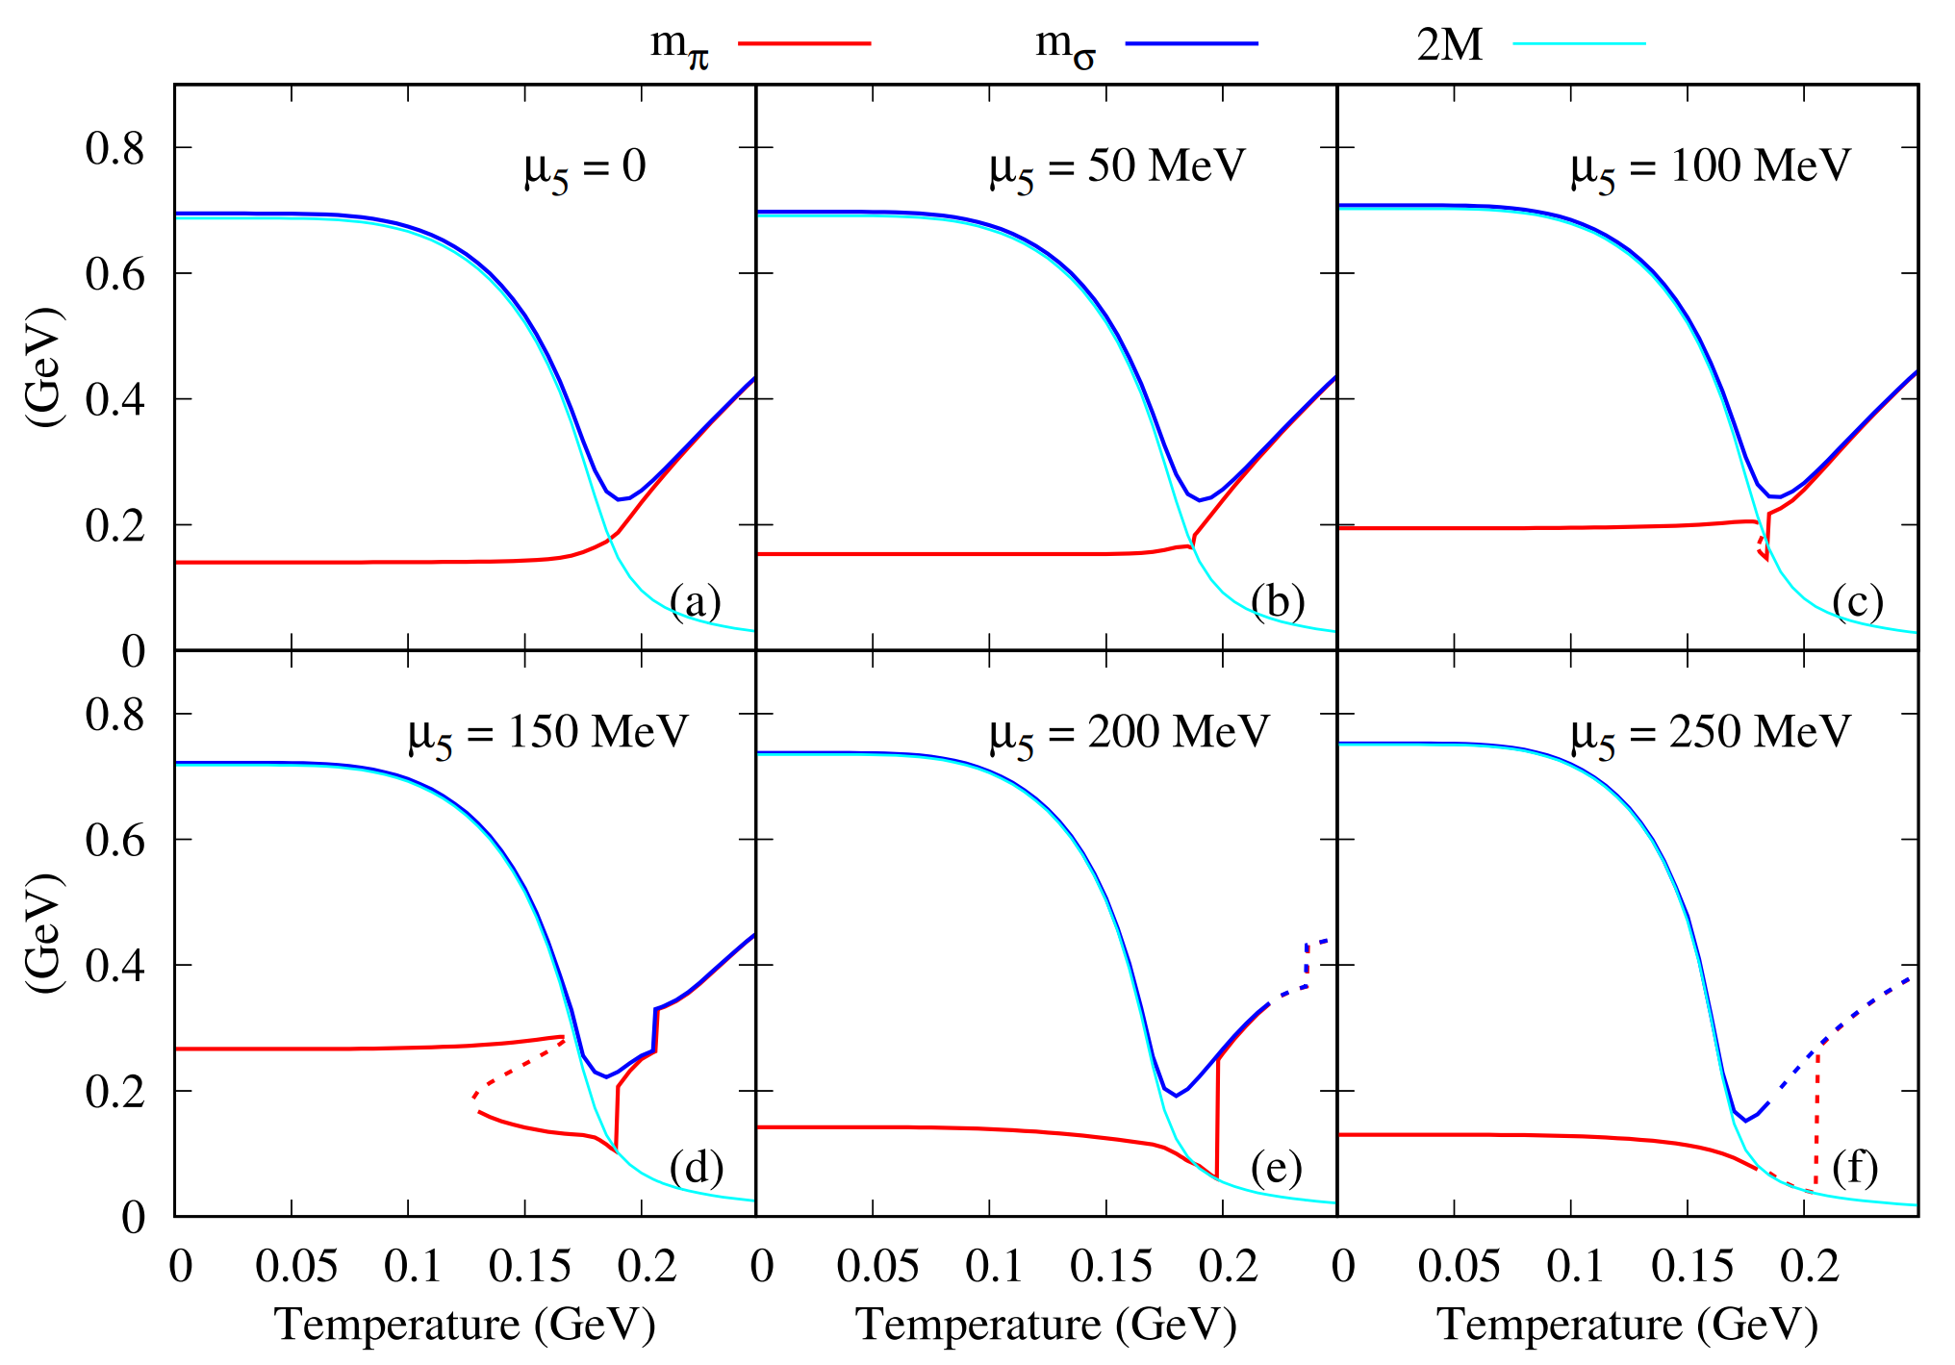
- Spectral Function -

Slide 10
- Spectral Function -
Mass jump structure induced by CCP

Slide 11
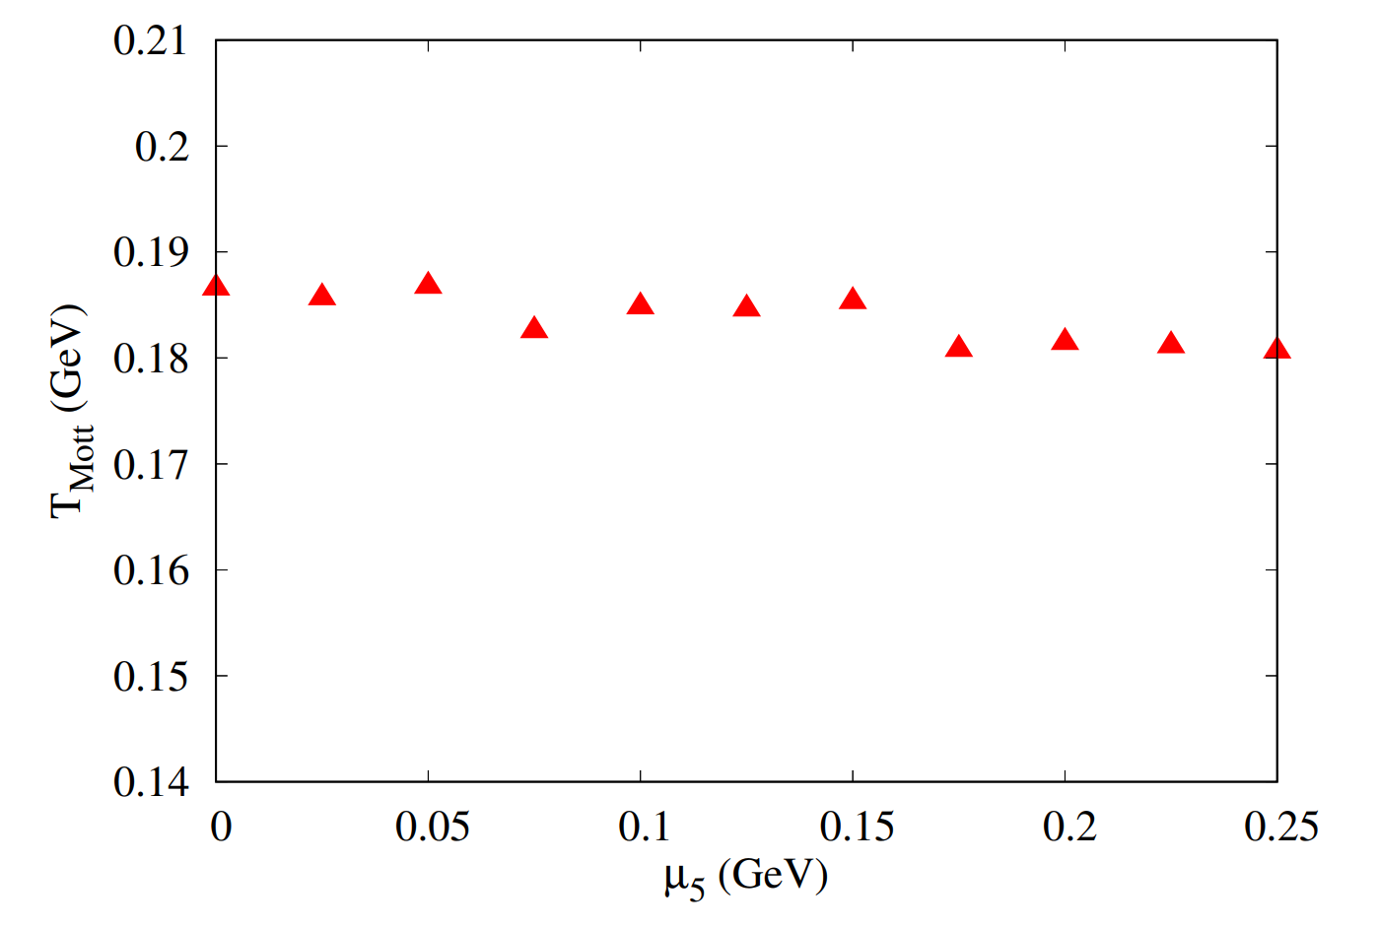
- Spectral Function -

Slide 12
- Summary -
CC in low temperature, and ICC in high temperature;
Chiral chemical potential (CCP) provides a new cut in polarization function, which leads to multiple solutions of pole equation and mass jump at certain $μ_{5}$.
Use the derivative of $ReΠ_{M}\left(q^{0}\right)$ to locate the physical solution.

Slide 13
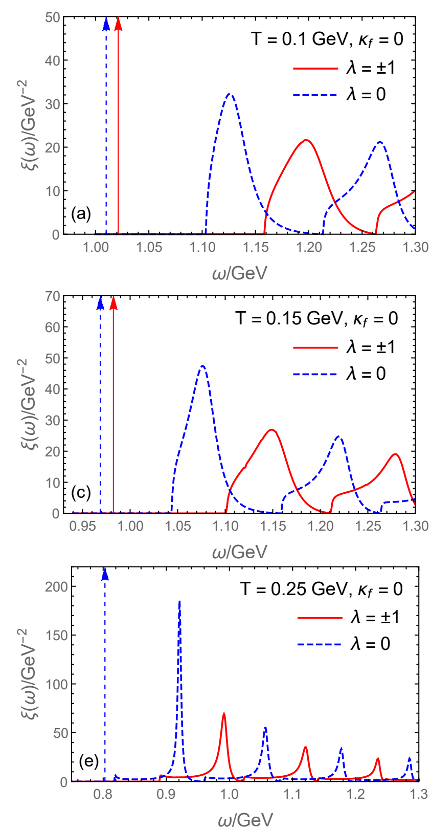
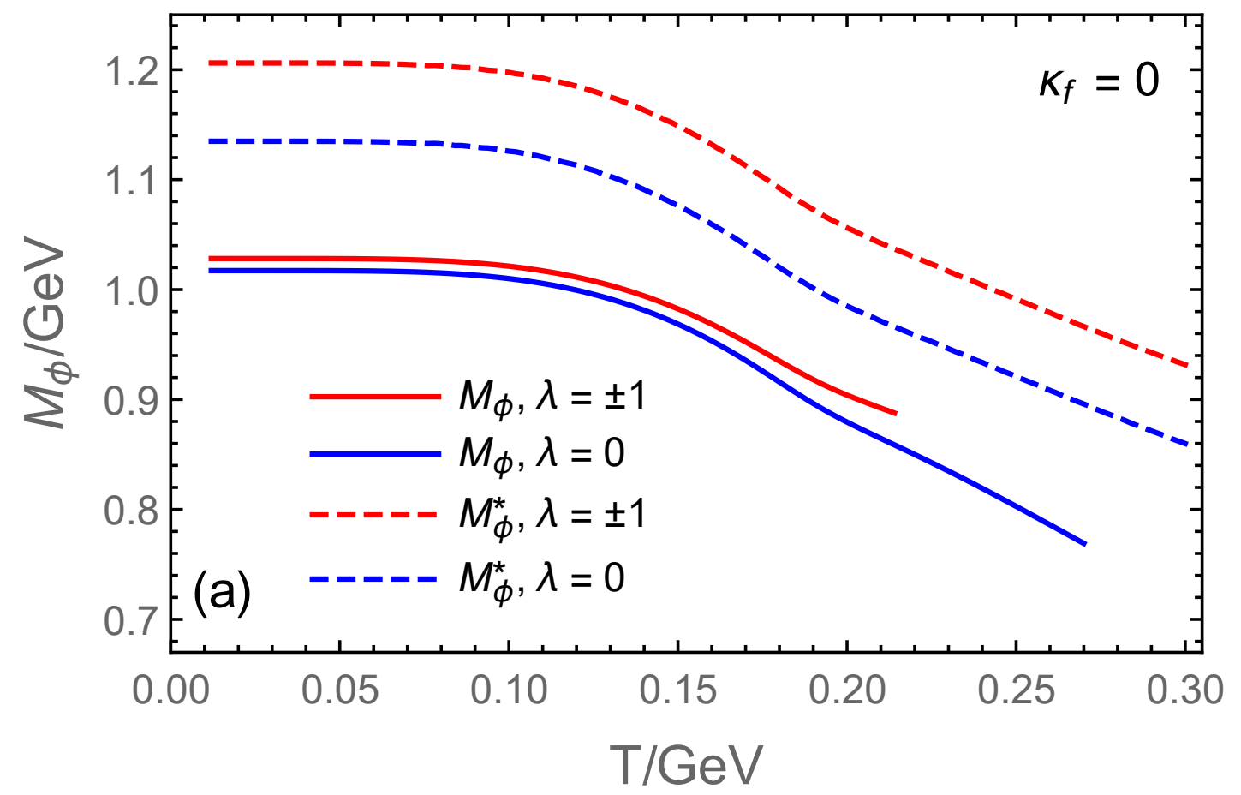
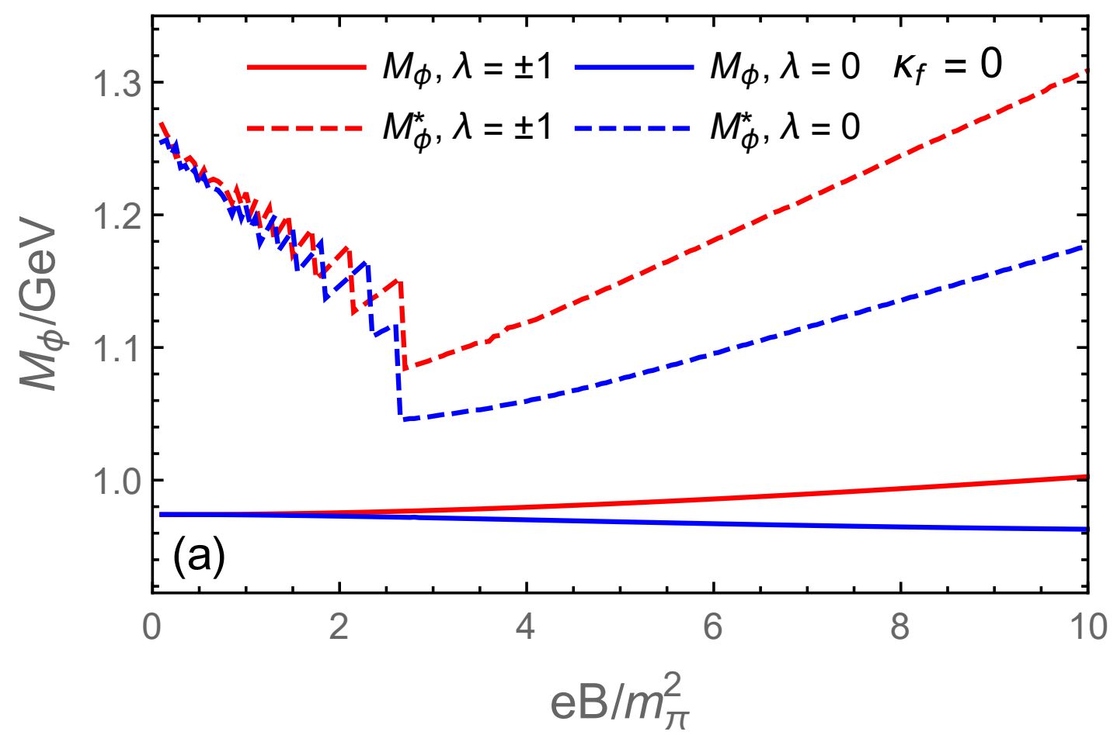
- Spectral Function in MF -
Mass jump structure induced by MF
(Xin-li Sheng, 2209.01872)

Slide 14
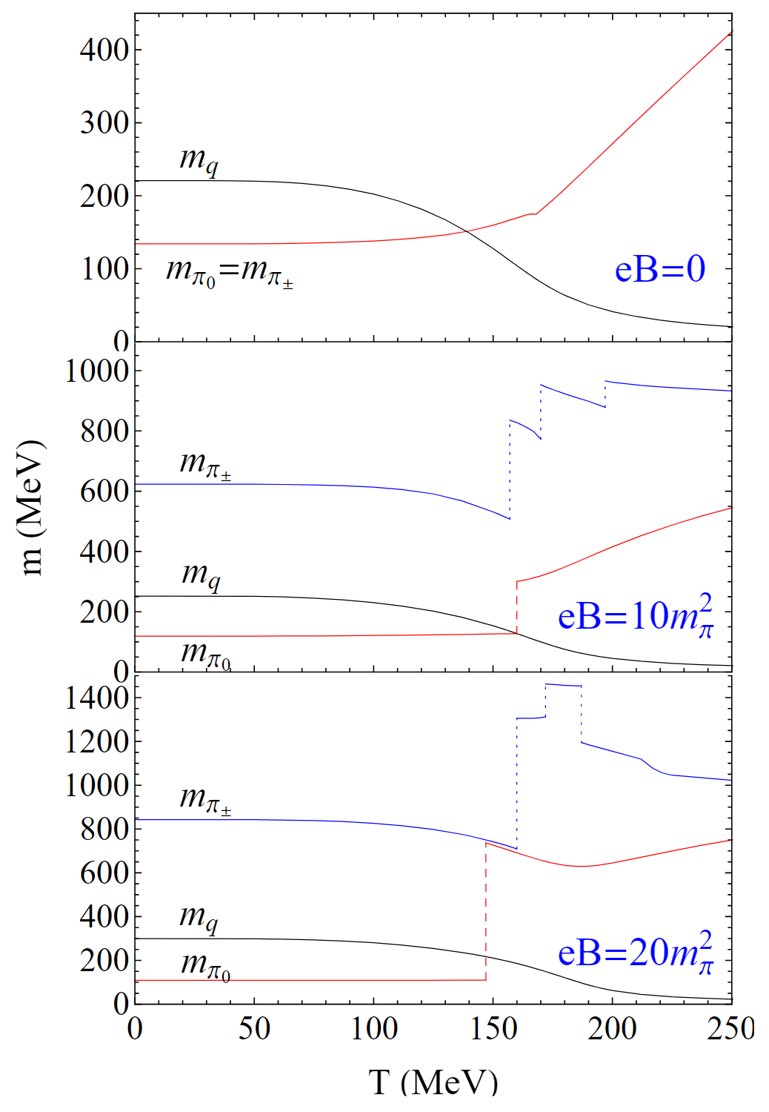
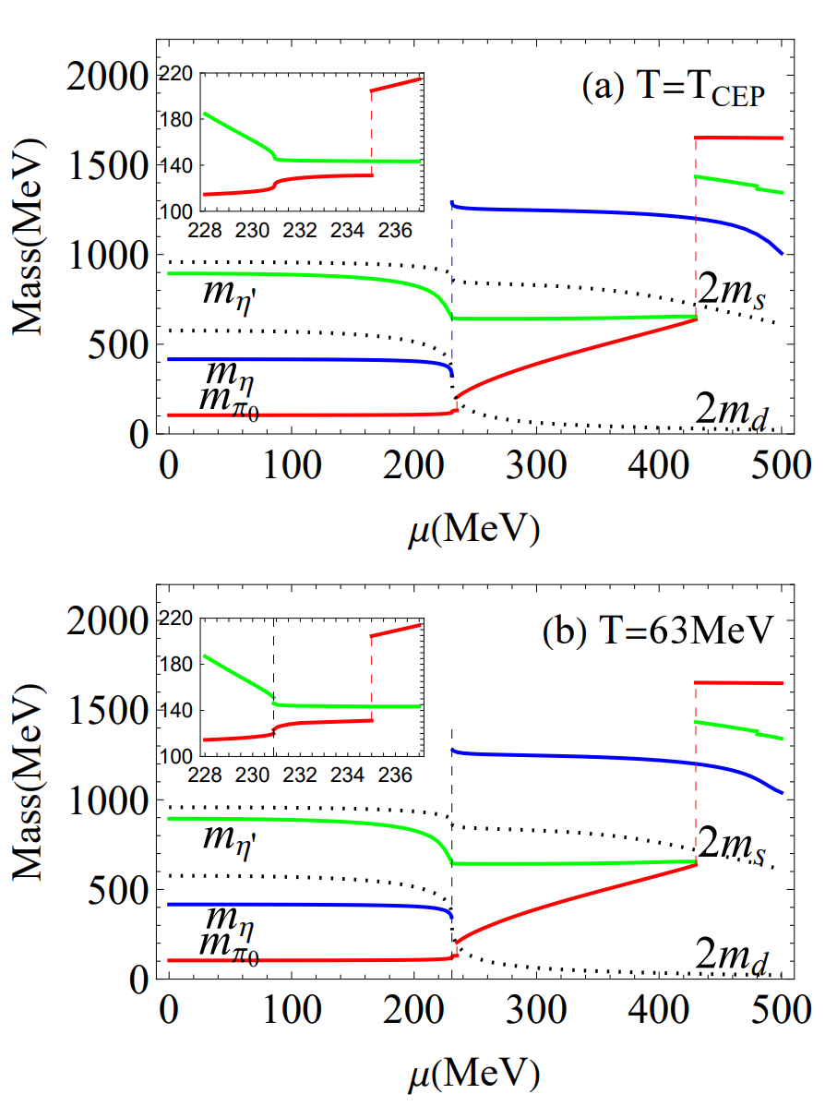
- Mesonic Mass Jumps in MF -

