Slide 1
TRACCC在CEPC顶点探测器中的应用
YiZhou Zhang, Xiaocong Ai, Tao Lin, WeiDong Li
zhangyz@ihep.ac.cn
15th Aug 2024

Slide 2
2
1
Introduction
2
CEPC Geometry in ACTS
Outline
3
Seeding algorithm for CEPC
4
Integration of TRACCC with CEPCSW

Slide 3
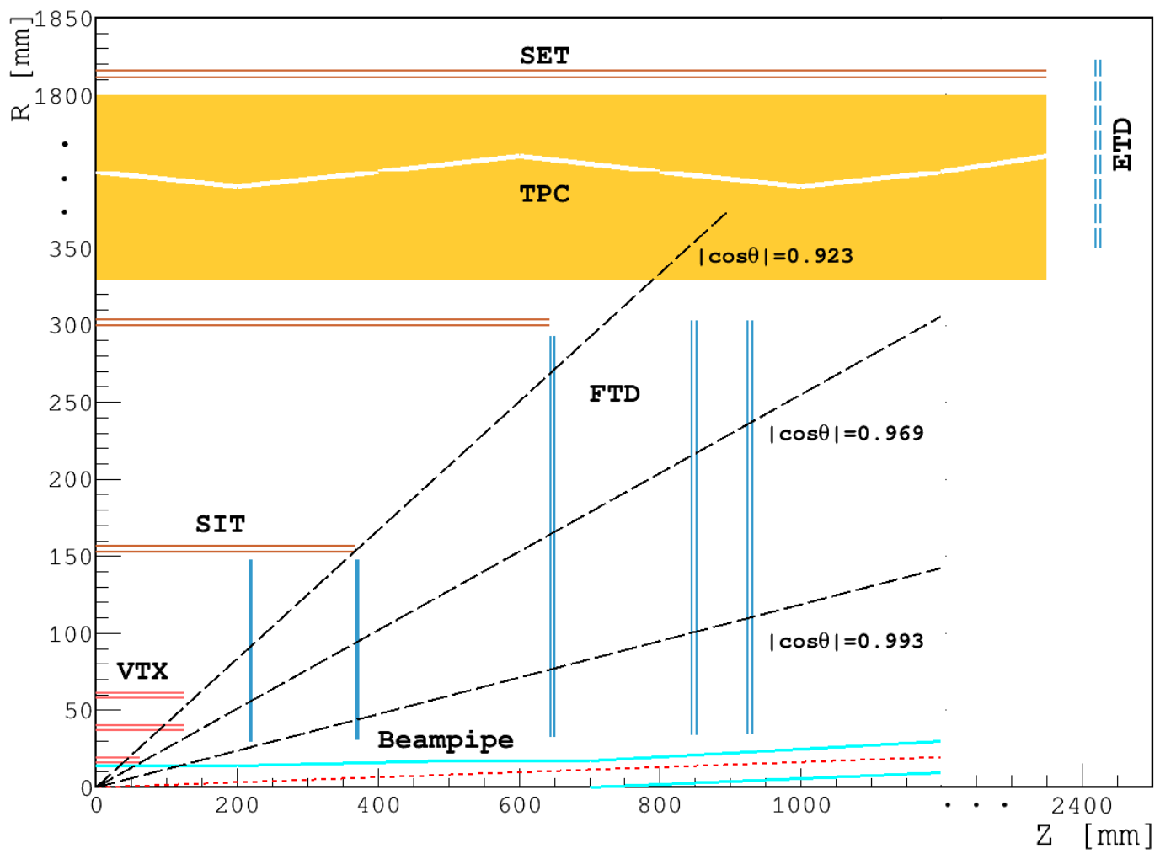
1
3
Introduction
Circular Electron Positron Collider (CEPC)
The CEPC is a future experiment mainly designed to precisely measure the Higgs boson’s properties and search for new physics beyond the Standard Model.
At 250 GeV: Higgs bosons are produced ($4×{10}^{6}$)
At 160 GeV: W bosons are produced ($>{10}^{8}$)
At 90 GeV: Z bosons are produced ($>4×{10}^{12}$)
*The Conceptual Design Report (CDR) has been completed in Oct. 2018. And the Technical Design Report (TDR) is now being written.
ACTS Common Tracking Software
ACTS是一个用于高能物理和核物理实验带电粒子径迹重建，不依赖于特定的实验装置的软件包。
ACTS documents: https://acts.readthedocs.io/
TRACCC is one of ACTS R&D projects, providing full chain demonstrator for track reconstruction on accelerators.
This Contribution
We plan to apply ACTS’ reconstruction tool in the reference detector of TDR, and to compare its performance with our origin reconstruction algorithm.
This Contribution will introduce the integration of ACTS & TRACCC with CEPC software (CEPCSW) environment.
Code working in progress:
https://code.ihep.ac.cn/zhangyz/cepcsw-acts/-/tree/master/Reconstruction/InDetActsTracking
CEPC探测器重建面临的挑战:
多事例堆积
高束流本底（Z能区）
高数据采集率
Layout of the CEPC baseline tracker (CDR)

Slide 4
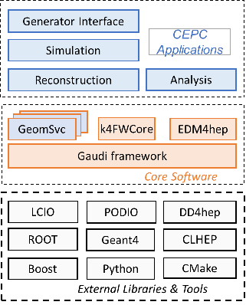
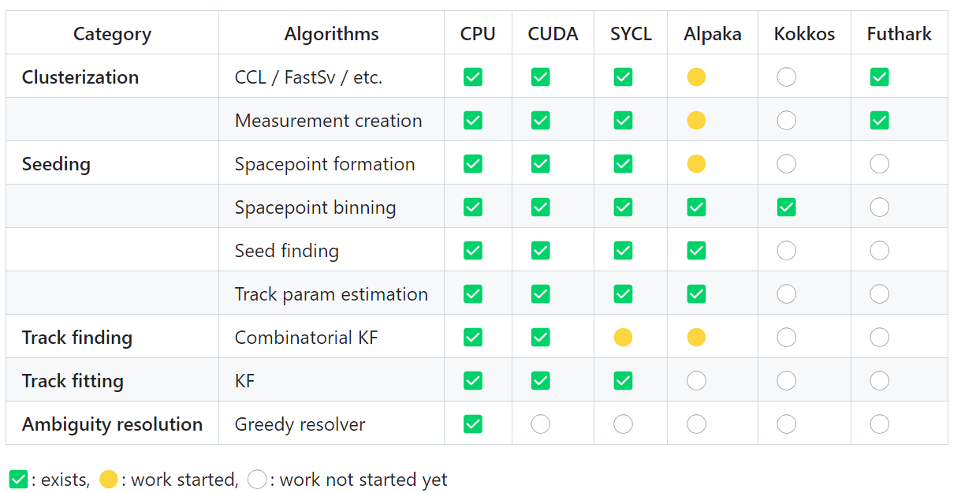
1
4
Introduction
TRACCC & SYCL
使用SYCL编写的径迹重建算法，是TRACCC的主要开发方向之一。
SYCL is a high-level C++ programming model. An uniformed written code can run on a variety of platforms.
* High Portability and Programming Efficiency 👆
TRACCC is developing track reconstruction algorithm using SYCL. Its track finding algorithm is not finished yet.
CEPC software (CEPCSW) environment
Applications: simulation, reconstruction and analysis
Core software:
framework: Gaudi
detector description tool: DD4hep
event data model: EDM4hep
event data manager: k4FWCore
Other CEPC-specific components
Integration of TRACCC
Imply the seeding algorithm for the VTX detector based on TRACCC in the CEPCSW environment.
Status of TRACCC
CEPCSW structure

Slide 5
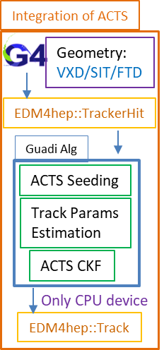
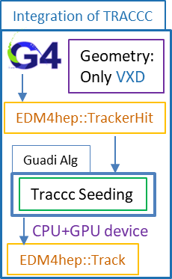
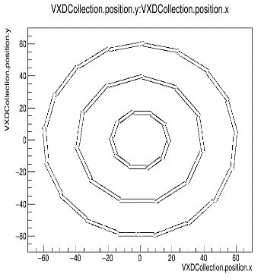
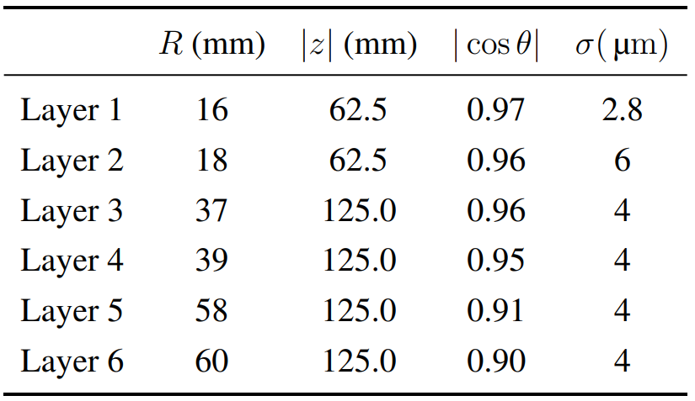
1
5
Introduction
Overview of This Contribution
Integration of ACTS’ full silicon track reconstruction algorithm & TRACCC’s seeding algorithm on VTX detector with CEPCSW
Steps:
Convert the CEPC geometry to ACTS format
Extend the seeding algorithm for CEPC VTX detector structure
Integration of ACTS & TRACCC with CEPCSW
CEPC VTX: three layers, both sides of which are mounted with silicon pixel sensors
ACTS & TRACCC: three layers with single-sided silicon pixel sensors
Integration of ACTS & TRACCC
Layout of CEPC VTX detector
The X–Y projection of the VTX

Slide 6
6
1
Introduction
2
CEPC Geometry in ACTS
Outline
3
Seeding algorithm for CEPC
4
Integration of TRACCC with CEPCSW

Slide 7
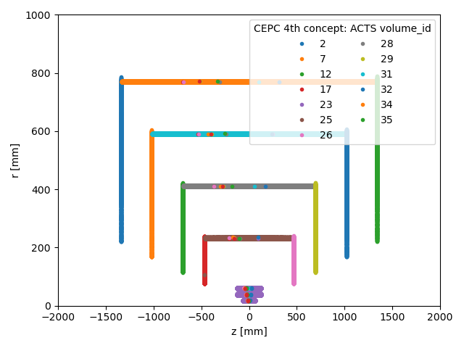
2
7
CEPC Geometry in ACTS
Geometry Conversion
Convert the CEPC geometry file (in DD4hep format) to tgeo format.
Write the config file to specify the volumes (VXD, SIT, and FTD) that needs to be generated.
Use ACTS’ tgeo reader to generate csv files.
Write the digitization config file to provide the segmentation information of each surface.
*Verification: Use Fast ATLAS Track Simulation (FATRAS) & ACTS’ digitization tool to produce full simulation information and generate cells.
The correctness of the geometric transformation is verified.
FATRAS generates hits in z-r plane
VXD + SIT + FTD (layer 0-3)
⑤
①
③
④
②

Slide 8
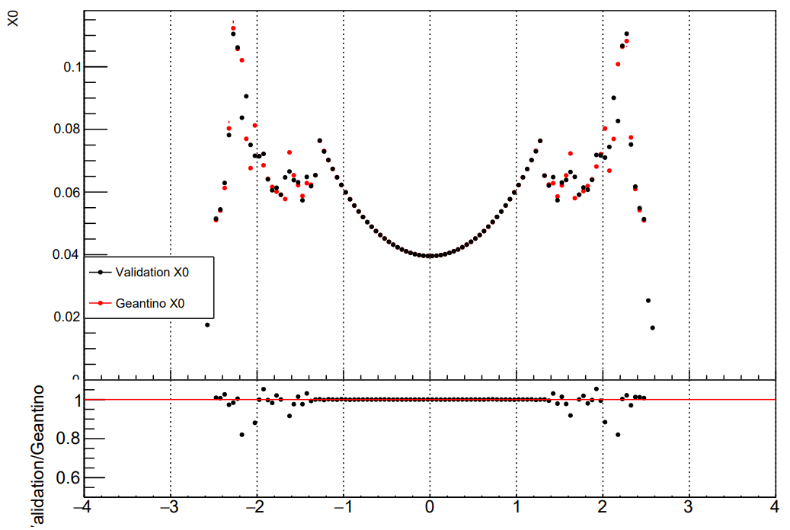
2
8
CEPC Geometry in ACTS
Material mapping
为了提高重建效率，ACTS在重建时使用简化的material。
将原本复杂的material被映射到tracking geometry的不同表面上。
ACTS’ material mapping includes 3 steps：
① Create a JSON file:
configure which surface the material is mapped onto and with which binning.
② Geant4 simulation:
collect the material inside the detector from the detailed geometry.
③ Mapping:
all the steps are projected onto the closest surfaces (or volume) and averaged out over many events to create a map.
η
Validation of Material Mapping
VXD + SIT + FTD (layer 0-3)
DD4hep
root
②
Geant4 simulation
CRD_o1_v01.xml
geant4_material_tracks.root
json
tgeo
Mapping
Validation
material.json
CRD_o1_v01.tgeo.root
json
③
Acts geometry
geometry-map.json
json
CRD_o1_v01_config.json
①

Slide 9
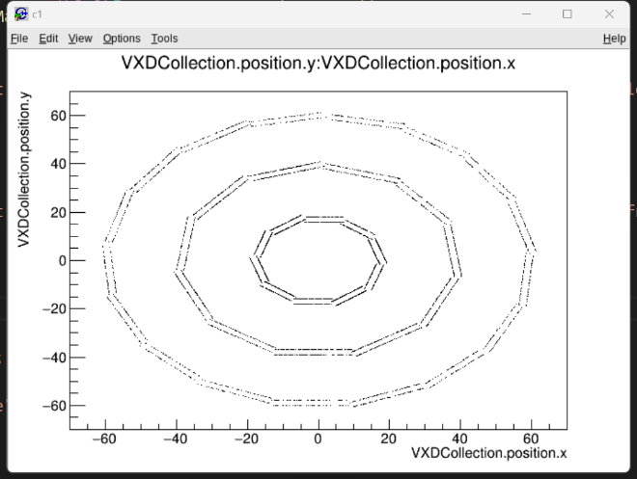
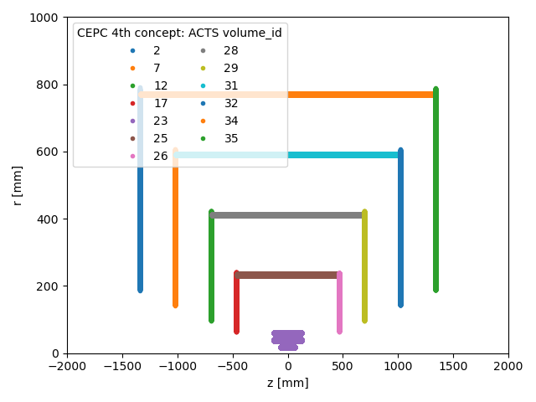
2
9
CEPC Geometry in ACTS
Gid Conversion
CEPCSW & ACTS 使用不同的geometry id。因此，为了在重建时获取正确的module信息，需要把CEPCSW的cellid转化为acts的gid.
VXD CEPCSW cellid:
Layer: {0,1,2,3,4,5} # Indicate 6 layers from inside to outside
Module: { L0: 0-9, L1: 0-9,
L2: 0-10, L3: 0-10,
L4: 0-16, L5: 0-16} # Indicate ladders in the φ direction
Sensor: 0
Barrelside: 1 for z > 0 else -1 # one ladders has 2 sensors separated by z
Generated hits of CEPC VXD by Geant4
VXD ACTS gid:
Volume: {23}
Boundary: 0
Layer: {2, 4, 6} # adjacent layers are too close, so being treated as the same layers
Approach: 0
Sensitive: {L2: 1-40, L4: 1-44, L6:1-68}
The sensitive counts from z>0 to z<0, then counts in φ direction (the order is same to CEPC), and then counts from inner to outer layers.
ACTS volume ids of VXD + SIT + FTD

Slide 10
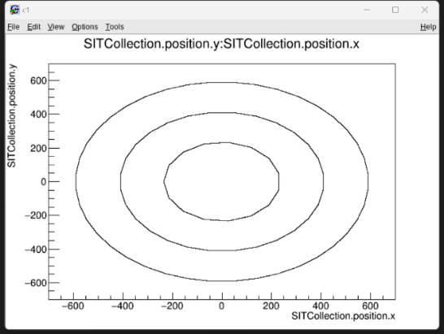
2
10
CEPC Geometry in ACTS
Gid Conversion
In CEPCSW, the outermost layer of SIT is considered in drift chamber.
We now only consider the inner 3 layers.
SIT CEPCSW cellid:
Layer: {0,1,2} # Indicate 3 layers from inside to outside
Module: {L0: 0-14, L1: 0-27, L2: 0-39} # Indicate ladders in the φ direction
Sensor: {L0: 0-9, L1: 0-14, L2:0-21} } # Indicate sensors in the z direction
Barrelside: 0
Generated hits of CEPC SIT by Geant4
SIT ACTS gid:
volume: {25, 28, 31} # Indicate 3 layers from inside to outside
Boundary: 0
Layer: 2
Approach: 0
Sensitive: {vol25: 1-150, vol28: 1-420, vol31:1-880}
The sensitive counts in z direction (range z from large to small), then counts in φ direction (the order is same to CEPC), and then counts from inner to outer layers.
ACTS volume ids of VXD + SIT + FTD

Slide 11
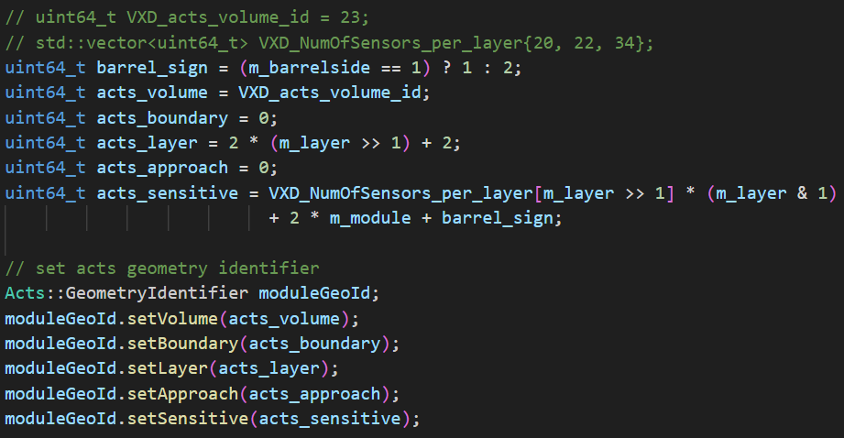
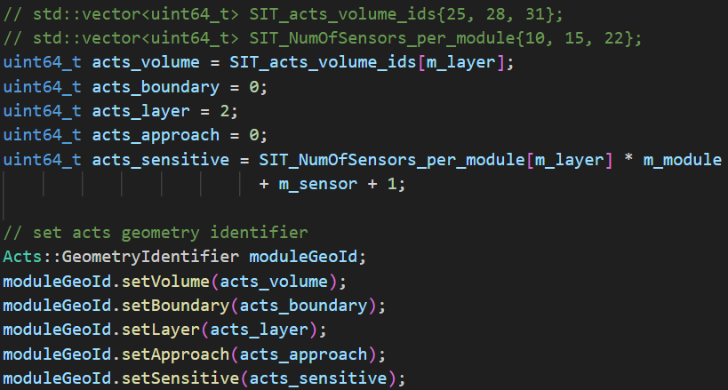
2
11
CEPC Geometry in ACTS
Converter for VXD gid
Converter for SIT gid
Validation of Gid Conversion
We get the global & local position of EDM4hep::TrackerHit.
Give the local position & converted Gid to Acts::Surface, if the gid conversion is correct, Acts::Surface can get the correct global position.
The conversion has been validated.
Code to check Gid Conversion

Slide 12
12
1
Introduction
2
CEPC Geometry in ACTS
Outline
3
Seeding algorithm for CEPC
4
Integration of TRACCC with CEPCSW

Slide 13
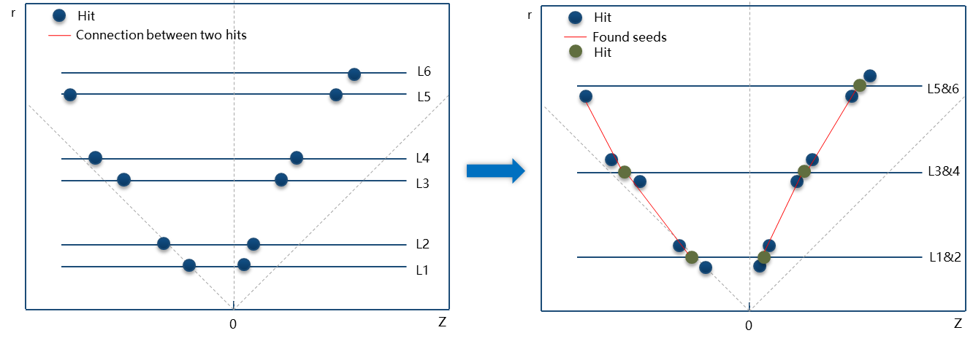
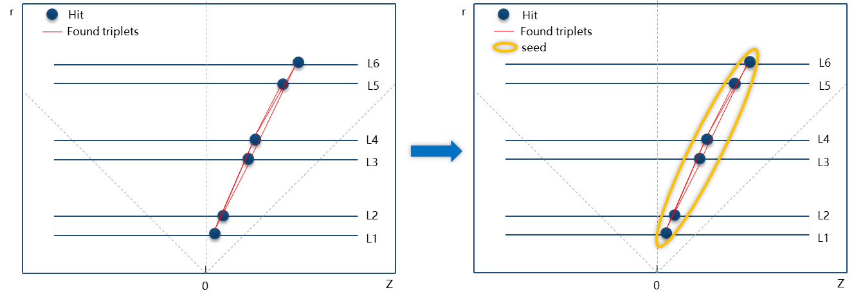
3
Triplets Finding
13
Seeding algorithm for CEPC
6-layers seeds finding
2 methods of modify the TRACCC algorithm to be suitable for 6-layers CEPC geometry.
1. Triplets Finding:
Before seeding, treating adjacent layers as one layer, and considering nearby space-points in two layers as one-space point.
2. Seed Formation:
After seeding, combine the found triplets that sharing the same space-points into a “big” seed.
We have implied Seed Formation in TRACCC.
Seed Formation

Slide 14
3
 | bottom | middle | top
 | 1 | 3 | 5
lowest $d_{0}$ | 1 | 3 | 6
 | 1 | 3 | 7
 | 2 | 3 | 5
 | 2 | 3 | 6
 | 2 | 3 | 7
14
Seeding algorithm for CEPC
r
In GPU
Example:
Paralleling for hit 3 👉
Hit
Found triplets
Paralleling middle sp
7
6
L6
5
L5
4
L4
3
L3
Bot_inner | Bot_outer | Mid_inner | Mid_outer | Top_inner | Top_outer
1 | 2 | 3 | 3 | 5 | 6
2
L2
1
L1
{1，2}
1.radius() < 2.radius()
{5，6} | {7, 6}
5.radius() < 6.radius()
0
Z
6-layers seeds finding: Seed Formation steps in GPU
For each middle space point in parallel:
pick the triplet with the lowest impact params ($d_{0}$) among all the triplets where the middle sp is located
find the bottom sp & top sp that are closest to the bottom sp & top sp of the current triplet
form a new seed of 5 points and sort them according to their radius (distance to the origin of coordinates)

Slide 15
3
15
Seeding algorithm for CEPC
In CPU
r
For hit 3 👇
Hit
Found triplets
Bot_inner | Bot_outer | Mid_inner | Mid_outer | Top_inner | Top_outer
1 | 2 | 3 | 3 | 5 | 6
middle sp
7
6
L6
5
L5
For hit 4 👇
＋
4
L4
Bot_inner | Bot_outer | Mid_inner | Mid_outer | Top_inner | Top_outer
1 | 2 | 4 | 4 | 5 | 6
3
L3
2
L2
1
L1
Bot_inner | Bot_outer | Mid_inner | Mid_outer | Top_inner | Top_outer
1 | 2 | 3 | 4 | 5 | 6
0
Z
{3，4}
3.radius() < 4.radius()
6-layers seeds finding: Seed Formation step in CPU
Iterate through all new 5-points seeds:
if two seeds have the same bottom sp & top sp, merge both into hexaplets (6-layers seeds)

Slide 16
16
1
Introduction
2
CEPC Geometry in ACTS
Outline
3
Seeding algorithm for CEPC
4
Integration of TRACCC with CEPCSW

Slide 17
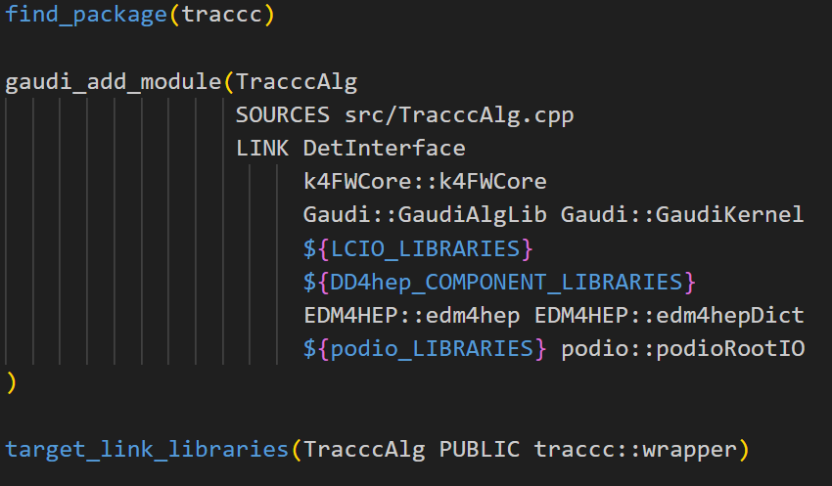
4
17
Integration of TRACCC with CEPCSW
Copy?
CEPCSW
Alg
EDM4hep::
SimTrackerHit
EDM4hep::
Track
traccc::wrapper
TRACCC
package
Package the seeding algorithm
Write a wrapper to wrap the seeding functions that CEPCSW needed.
Calling the TRACCC package in CEPCSW alg.
Pull request: https://github.com/cepc/CEPCSW/pull/270
Avoid the overhead from data copy
We want TRACCC be able to use the hits data simulated by G4 directly !!
EDM4hep and *VecMem may use the same memory.
* TRACCC uses VecMem as the vectorised data model across multiple device types.

Slide 18
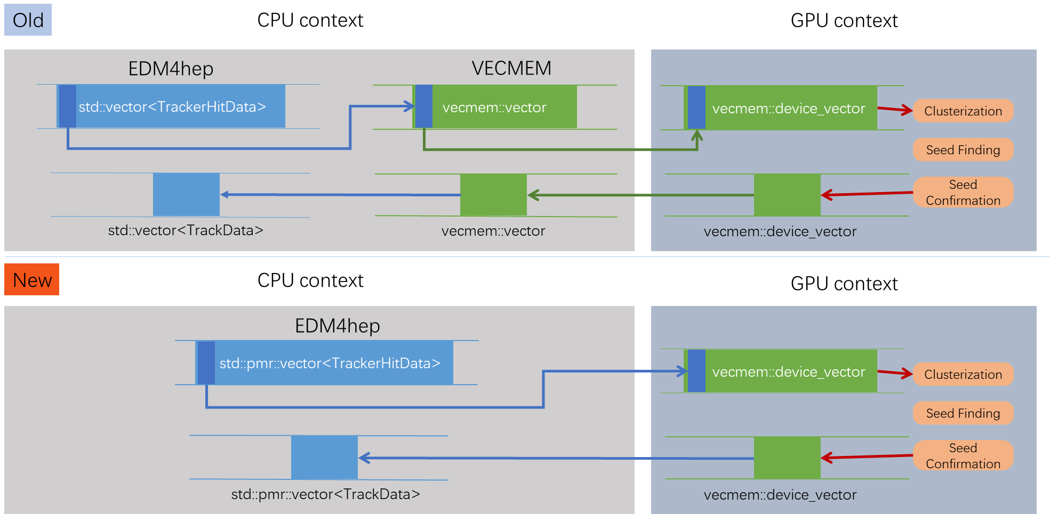
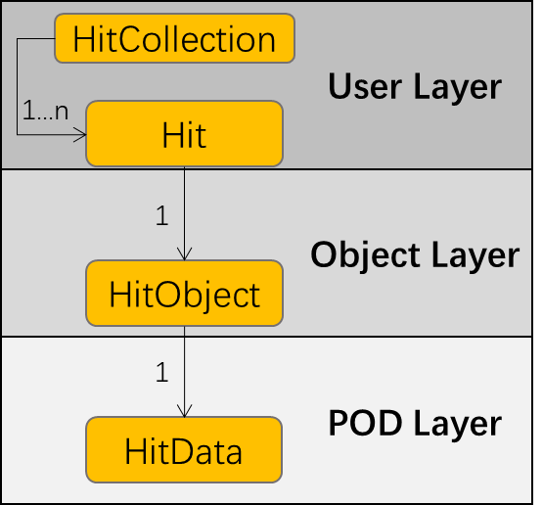
4
18
Integration of TRACCC with CEPCSW
Modify the EDM4hep
We want EDM4hep & VecMem use the same storage format (std::pmr::vector),
So TRACCC can directly use the hit data with no data-copy.
Modify the data storage format of PODIO
EDM4hep is generated by PODIO,
so we modify the DataContainer of PODIO:
Add Collection layer interfaces:
Add CollectionData layer interfaces:
Modify the DataContainer storage format (vector → pmr::vector)
Layout of the PODIO storage format
We add interfaces to get pmr::vector directly.

Slide 19
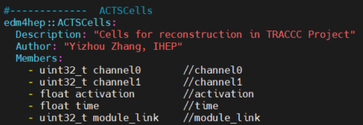
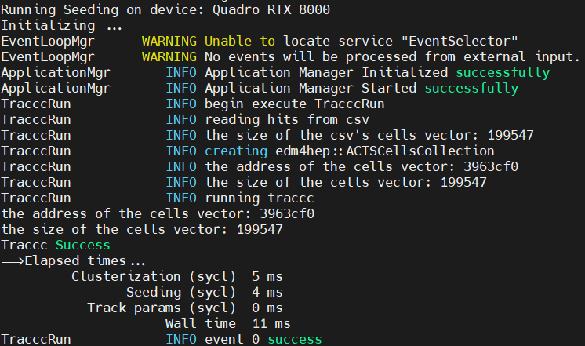
4
19
Integration of TRACCC with CEPCSW
Customized EDM4hep data collection
Define a data collection whose member is totally the same with the EDM of TRACCC
So we can directly use edm4hep::ACTSCells as the input of TRACCC.
edm4hep.yaml
Verification
Now TRACCC can directly read the simulated hits from Geant4 which is stored in EDM4hep format.
No non-essential data-copy occurs.
In CEPCSW alg
The address of pmr::vector does not changed.
No data copy occurs.
In TRACCC alg
Running in CEPCSW

Slide 20
4
20
Integration of TRACCC with CEPCSW
Geant4 simulation (1 event, 50 tracks)
TRACCC reconstruction
Verification of the seeding algorithm
Simulated mu- of 100 Gev in Geant4, and reconstructed in TRACCC
*The yellow and red parts of the simulation do not have hits in the outermost layers (layer 4/5)
*The blue part G4 produced secondary particles (e-).
tracks are found correctly!

Slide 21
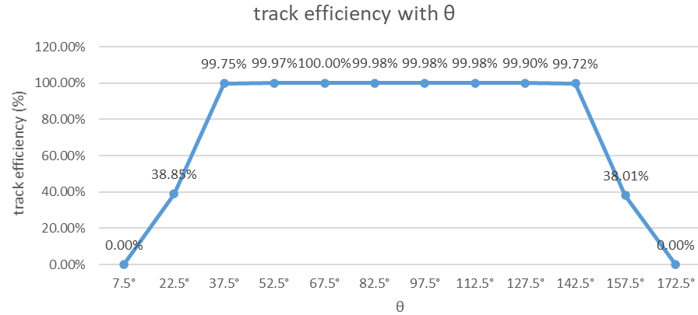
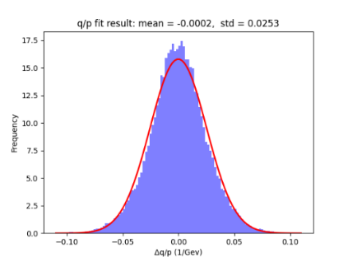
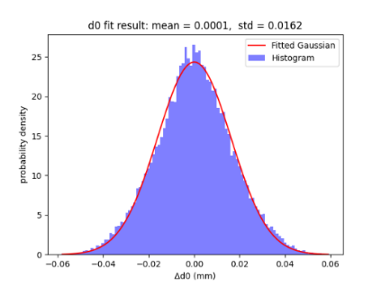
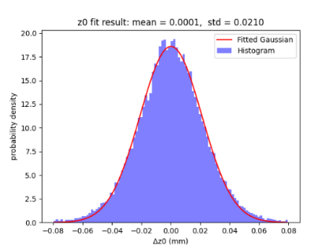
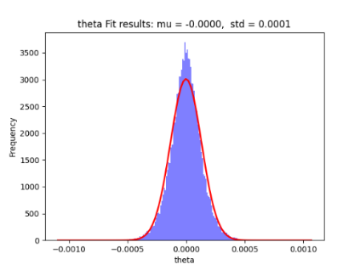
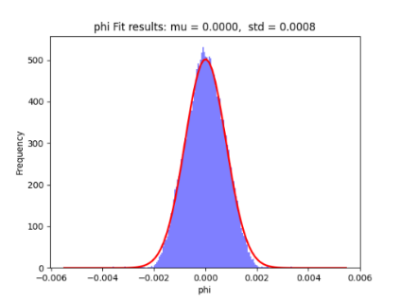
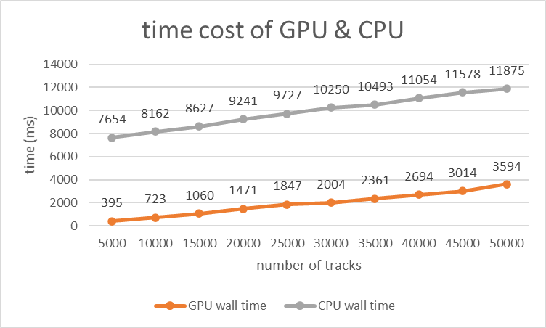
4
21
Integration of TRACCC with CEPCSW
Seeding efficiency evaluation
Particle: mu- Energy: 5 Gev
Track efficiency with θ
$$track eff=\frac{N_{rec tracks}}{N_{total tracks}}$$
Material effects track efficiency at low θ angle.
Difference between rec and sim track param
Track parameters include qoverp, d0, z0, theta, phi
Computing evaluation of TRACCC seeding
Run TRACCC in heterogeneous device:
CPU: Intel(R) Xeon(R) Silver 4214 CPU @ 2.20GHz
GPU: NVIDIA Corporation TU102GL [Quadro RTX 8000]

Slide 22
4
22
Integration of ACTS with CEPCSW
TGeo root file
Gaudi Algorithm View
Initialize: read the CEPC geometry, get the Acts::TrackingGeometry.
Execute: read the EDM4hep::
TrackerHit of current event, generate SpacePoints & measurements, and store the connection between ModuleGid & meas idx into SourceLinks.
Follow the Acts::Example, we write the Seeding Alg & Track Params Estimation & CKF using Acts tools.
And finally get the track & track state stored in Acts::TrackContainer.
GaudiAlgorithm::initialize()
Get Acts::TrackingGeometry
TGeo config file
GaudiAlgorithm::execute()
material map file
Event Loop
Seeding Alg
SpacePoints
Global 3D position
& Variance in Rho & Z
Seeds
Track Params Estimation
EDM4hep::
TrackerHit
Gid
conversion
InitialTrackParameters
SourceLinks
CKF
Local 2D position
& Variance in loc0 & loc1
Track & Track State
Measurements
SpacePoints follows ActsExamples::SimSpacePoint
SourceLinks follows ActsExamples::IndexSourceLink
Measurements directly use Acts::BoundVariantMeasurement
GaudiAlgorithm::finalize()

Slide 23
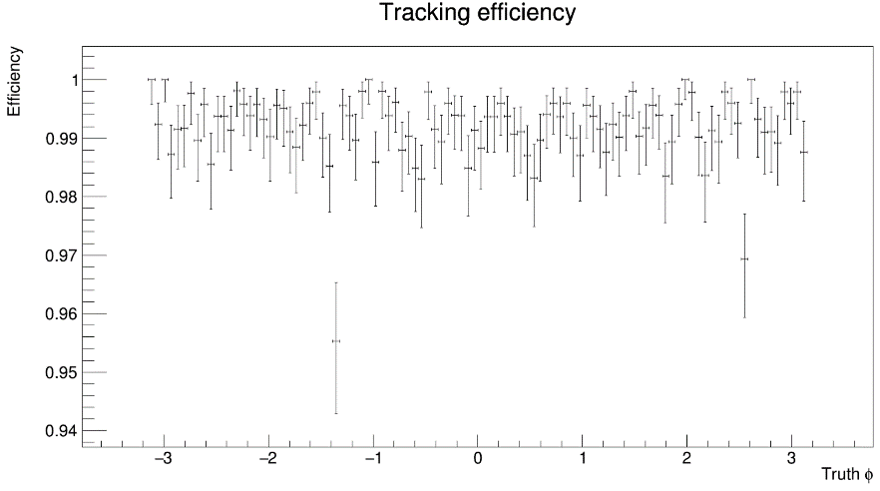
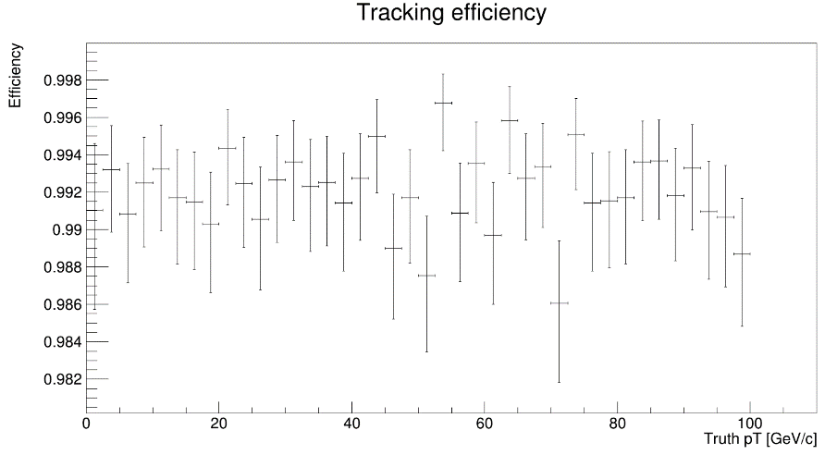
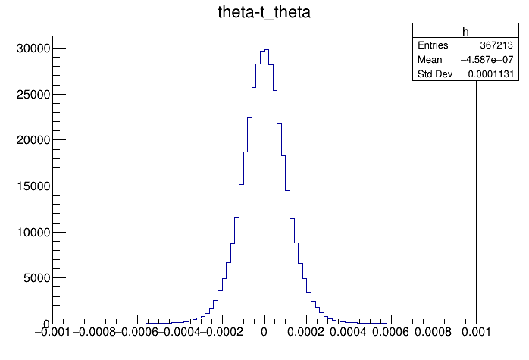
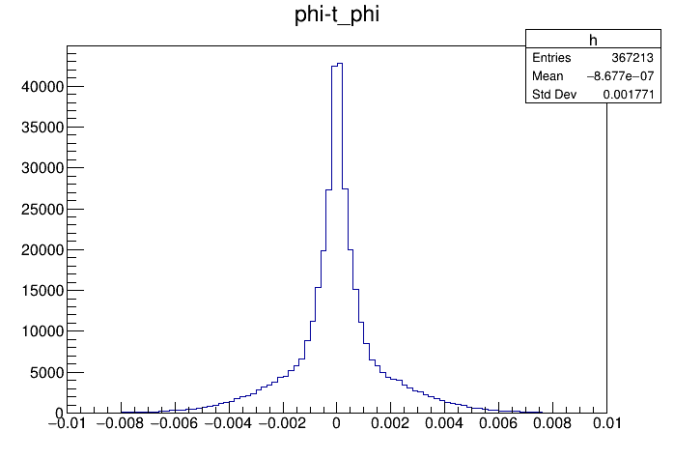
4
23
Integration of ACTS with CEPCSW
ACTS tracking efficiency evaluation
Particle: mu- Energy: 1:100Gev
Distribution of Δφ & Δθ
Tracking efficiency with Φ & pT

Slide 24
Summary & future work
24
Application of TRACCC seeding to the CEPC vertex detector
Summary
Implement the CEPC detector geometry in ACTS format
The TRACCC has been successfully applied for GPU-based seeding for CEPC vertex detector
Update the TRACCC algorithm to be suitable for 6-layers CEPC geometry
Use one common memory for both EDM4hep and VecMem to avoid the overhead from data copy
Integrate the ACTS & TRACCC in CEPCSW
Future work
Further analysis of seeding efficiency & computing performance
Comparison between ACTS reconstruction & origin reconstruction algorithm.

Slide 25
Thank you
YiZhou Zhang, Xiaocong Ai, Tao Lin, WeiDong Li
zhangyz@ihep.ac.cn
15th Aug 2024

Slide 26
Backup

Slide 27
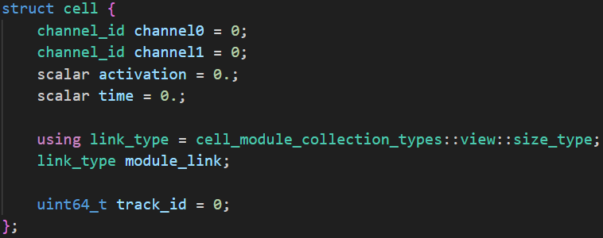
2
27
CEPC Geometry in ACTS
Adapt cuts of the parameters
TRACCC use some parameters to determine whether the space points can form a triplet. The cuts for some of the parameters are adapted to CEPC pixel geometry.
modified
triplet_finding_helper::isCompatible
Modify the EDM
Add “track id” to the EDM of cells, so we can trace back from the found seeds to origin tracks:
Seed → space point → cluster → cell
*for the evaluation of track efficiency.
Add track id to EDM of TRACCC

Slide 28
3
28
Integration of ACTS with CEPCSW
Get local position from EDM4hep
EDM4hep::TrackerHit do not directly provide the local position.
We set the segmentations in the cellid to get the local position.
The grid size of both VTX & SIT is set to 25um.
Get and store the local position in measurement
VXD
Module size (x-y × z direction)
Layer 0, 1:
11mm*62.5mm
880 * 5000 (25um/bin)
Layer 2, 3, 4, 5:
22mm*125mm
880 * 5000 (25um/bin)
SIT
Module size (x-y × z direction)
Layer 0, 1, 2:
97.55mm*91.85mm
3902 * 3674 (25um/bin)

