Slide 1
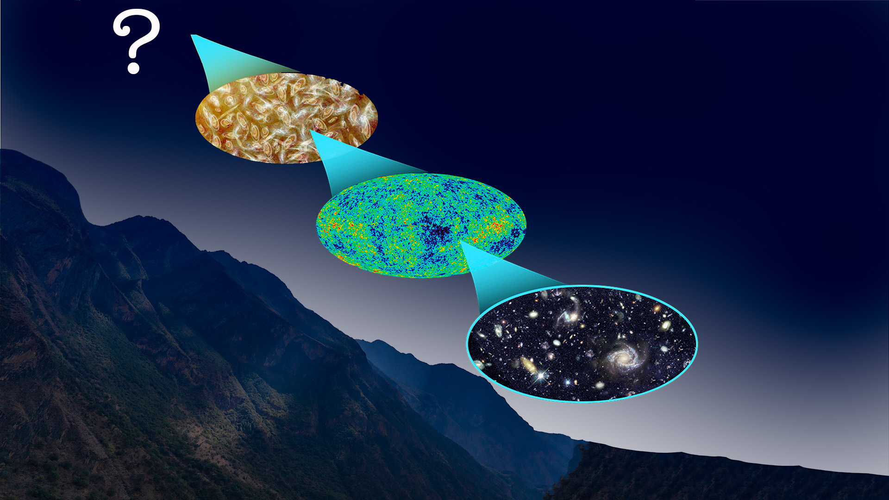
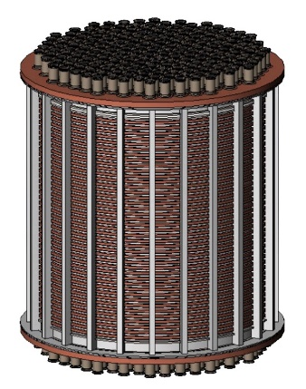
¹³⁴Xe 2𝜈𝛽𝛽/0𝜈𝛽𝛽 Search in PandaX-4T Experiment
Xiyu Yan (颜玺雨)
2024-08-16
Sun Yat-sen University, China
On behalf of PandaX collaboration

Slide 2
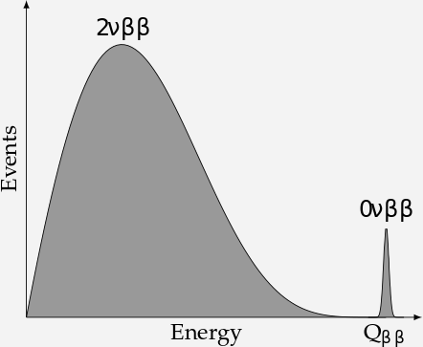
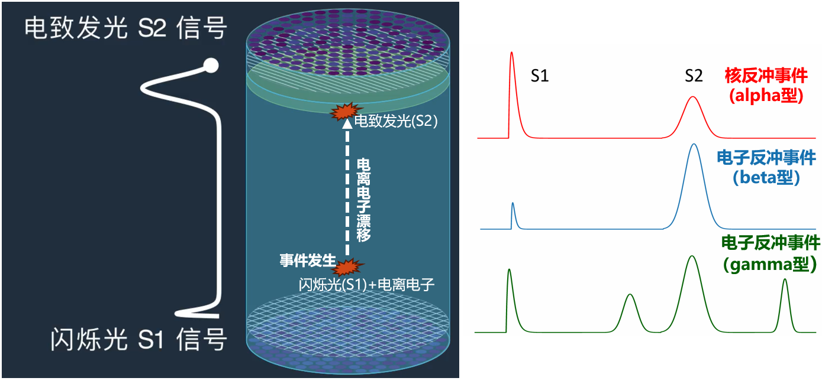
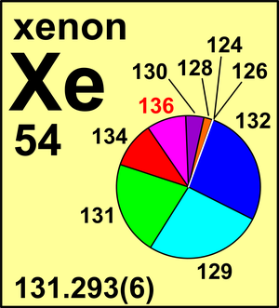
Neutrinos are Dirac or Majorana?
Double Beta Decay (2𝜈𝛽𝛽 )
Neutrinoless Double Beta Decay (0𝜈𝛽𝛽 )
0𝜈𝛽𝛽 probes: Majorana or Dirac; Lepton number violation; Measures effective Majorana mass.
PandaX-4T: more ¹³⁴Xe; much less ¹³⁶Xe; wider energy range; self shielding effect; discovery possible

Slide 3
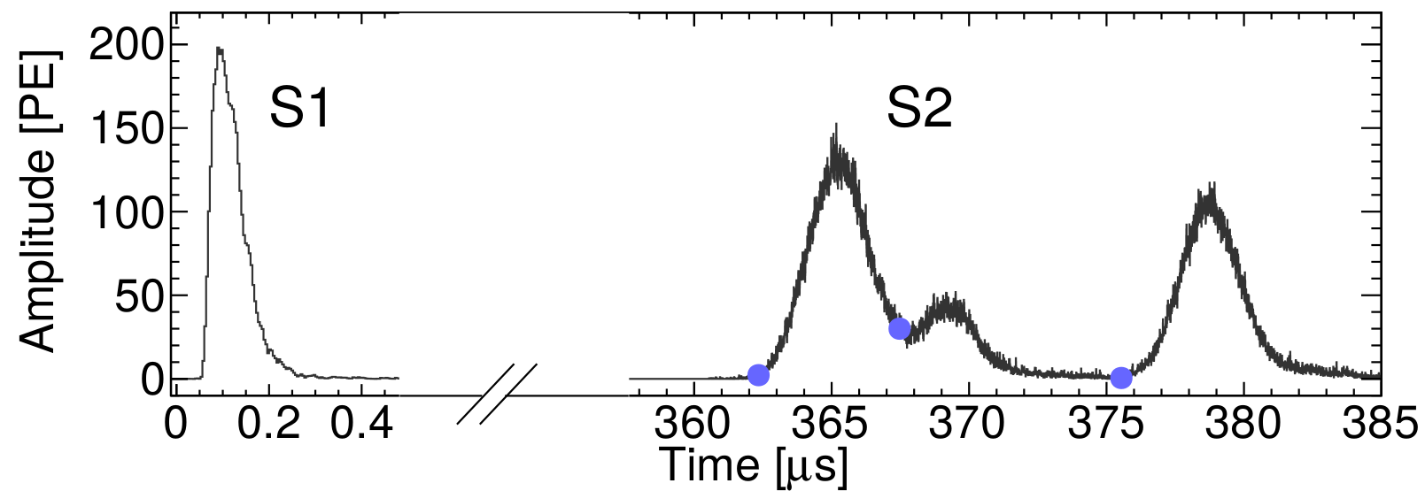
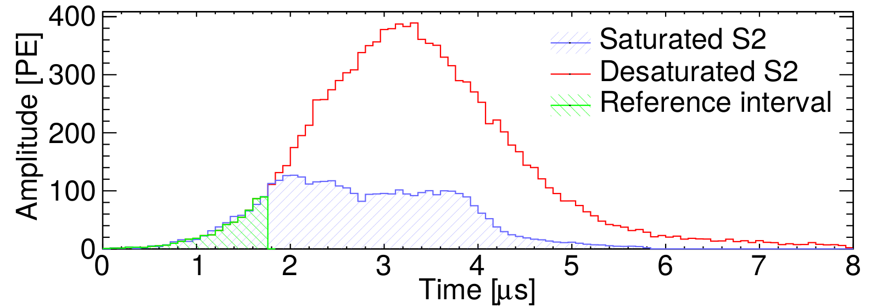
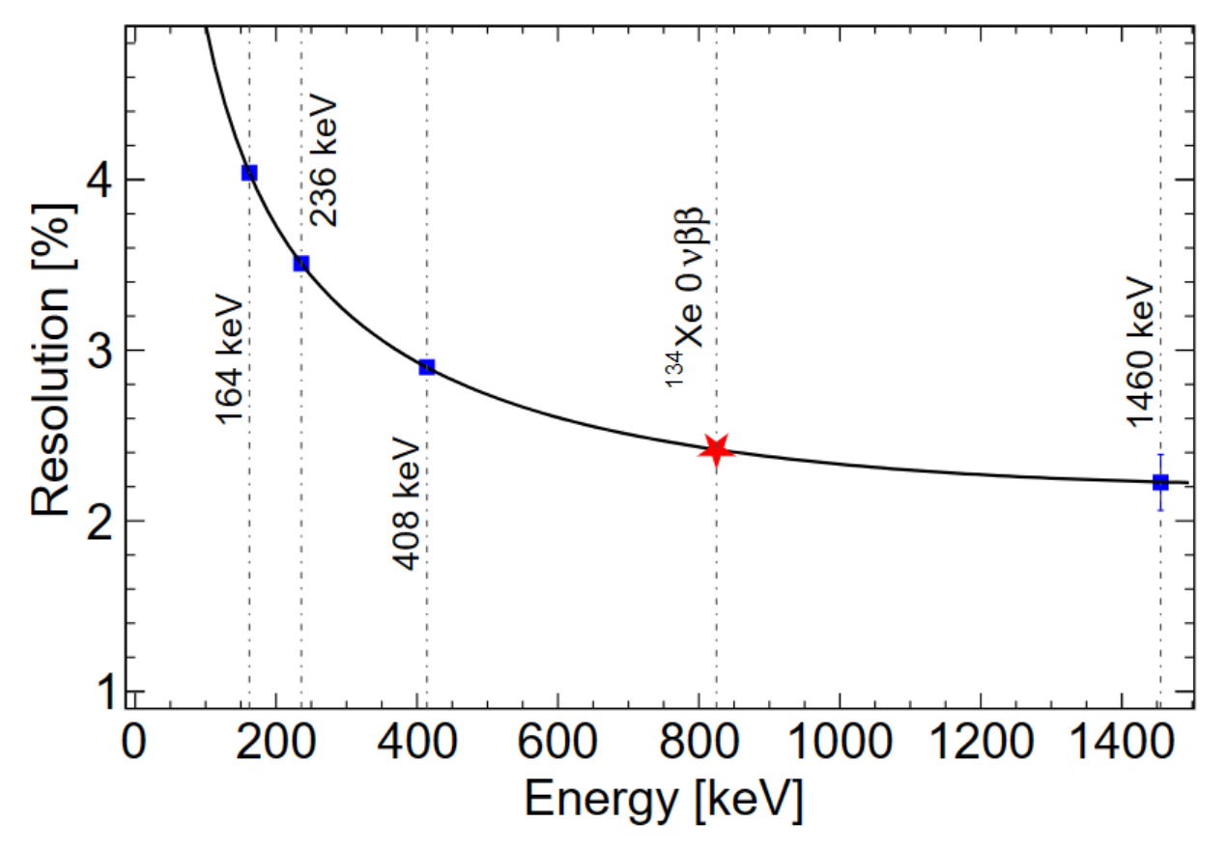
Extending detector response in [200, 1000] keV
MeV gammas events are mostly MS events, while signals are mostly SS events.
PMT bases suffer saturation from 164 keV to MeV.
Energy resolution @ Q-value : σ/E=2.4% (3.56% in EXO-200 )

Slide 4
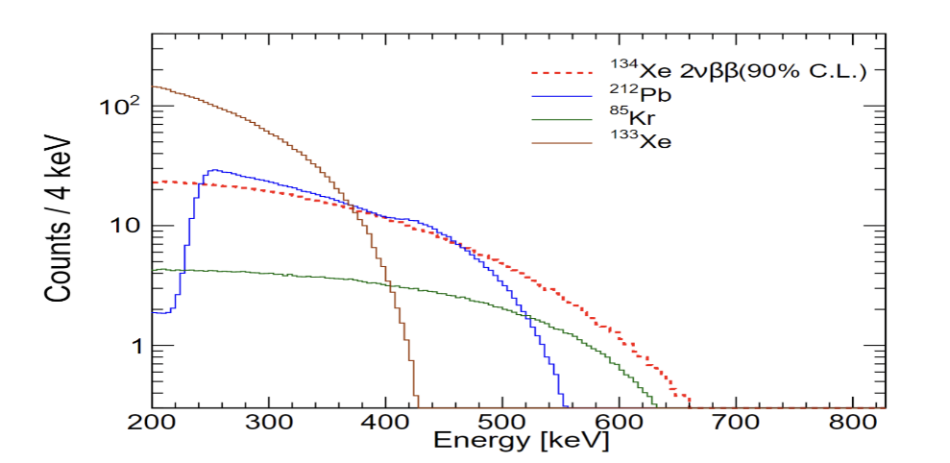
Background model and systematic uncertainties
  Included in the likelihood function: target mass and overall efficiency
  Independently : bin size and energy scale
 | Component | Input Counts | Constraint
 | ⁶⁰Co | 130 | 13%
Materials | ⁴⁰K | 133 | 8%
 | ²³²Th | 950 | 5%
 | ²³⁸U | 274 | 8%
 | ¹³⁶Xe | 12372 | 5%
 | ²¹²Pb | 1012 | 29%
 | ⁸⁵Kr | 296 | 52%
LXe | ¹³³Xe | 3423 | 10%
 | ²¹⁴Pb | 19429 | Free
 | ¹²⁵Xe | - | Free
 | Other Xe | - | Free
Systematic uncertainties |  | Values
Target Mass | ¹³⁴Xe abundance | 0.29%
 | Density of LXe | 0.13%
 | FV uniformity | 1.6%
Overall Efficiency | Quality cuts | 0.03%
 | SS fraction | 6.4%
Bin size |  | -
Energy Scale |  | -

Slide 5
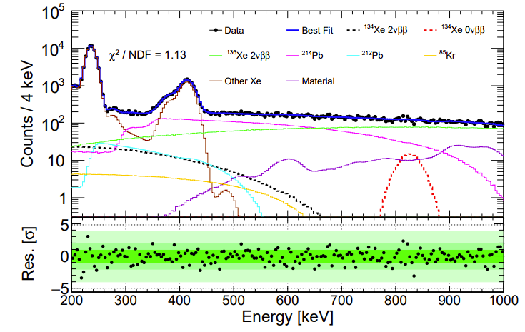
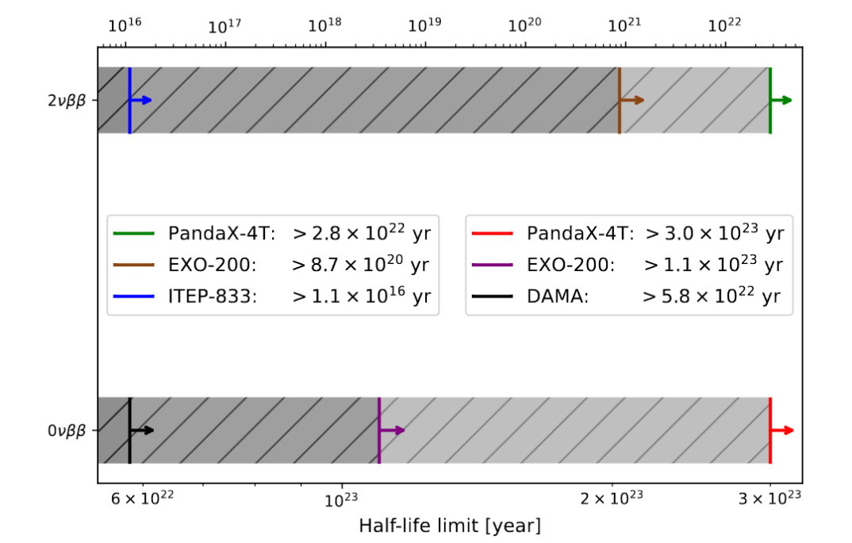
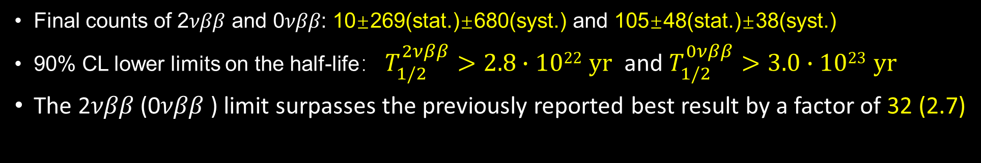
¹³⁴Xe half-life limits @ PandaX-4T
Final counts of 2𝜈𝛽𝛽 and 0𝜈𝛽𝛽: 10±269(stat.)±680(syst.) and 105±48(stat.)±38(syst.)
90% CL lower limits on the half-life： $T_{1/2}^{2νββ}>2.8∙1022 yr$ and $T_{1/2}^{0νββ}>3.0∙1023 yr$
The 2𝜈𝛽𝛽 (0𝜈𝛽𝛽 ) limit surpasses the previously reported best result by a factor of 32 (2.7)
PandaX, Phys.Rev.Lett. 132 (2024) 15, 152502

