Slide 1
Locating a Super PeVatron at Cygnus Region
Cong Li
On behalf of LHAASO Collaboration
2024.8.14
Institute of High Energy Physics(IHEP),CAS

Slide 2
Outline
Origin of cosmic rays
LHAASO detector
Results from Cygnus region
Prospects

Slide 3
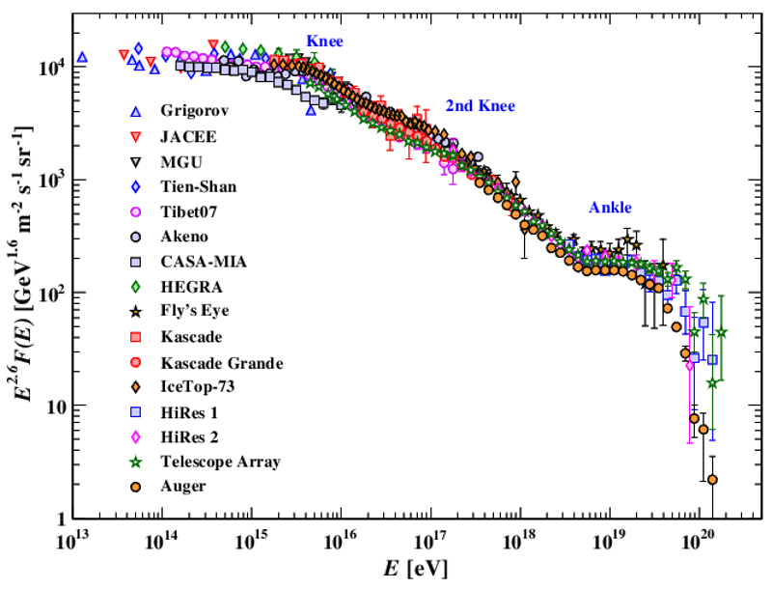
Where dose the highest energy particles come from ?
PeVatron
EeVatron
Galactic sources
???
Extragalactic sources
Physics Procedia 61 ( 2015) 425-434.arXiv:1910.03721v1

Slide 4
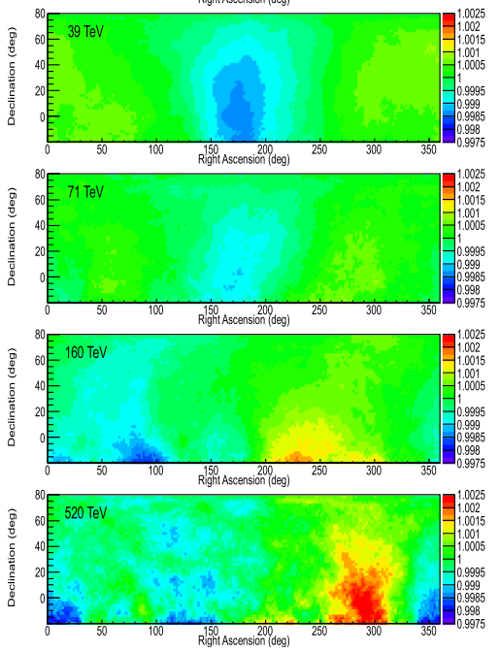
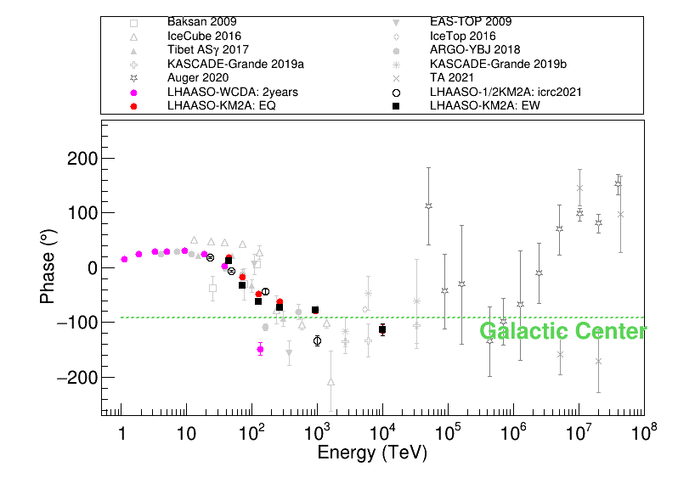
Where dose the highest energy particles come from ?
Where is the upper limit for galactic accelerator ?
ICRC2023 WeiGao
https://iopscience.iop.org/article/10.3847/1538-4357/aac6cc

Slide 5
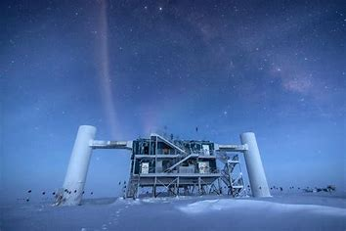
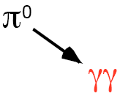
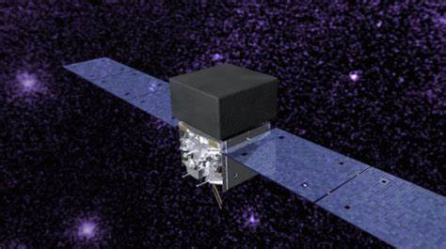
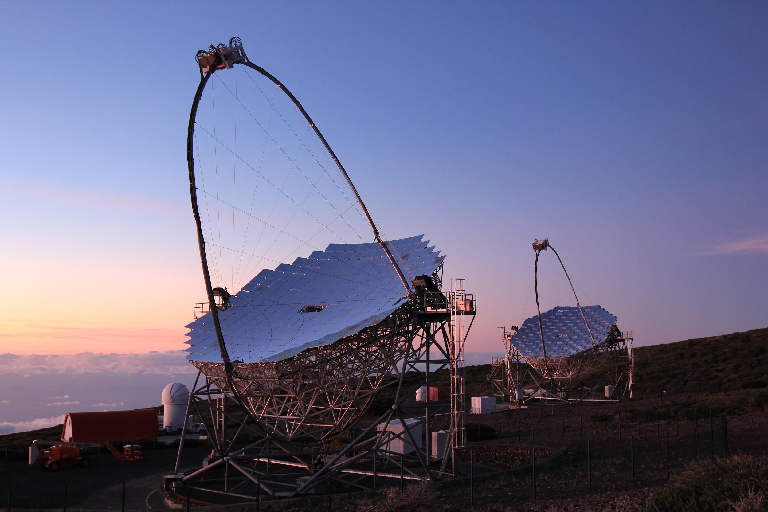
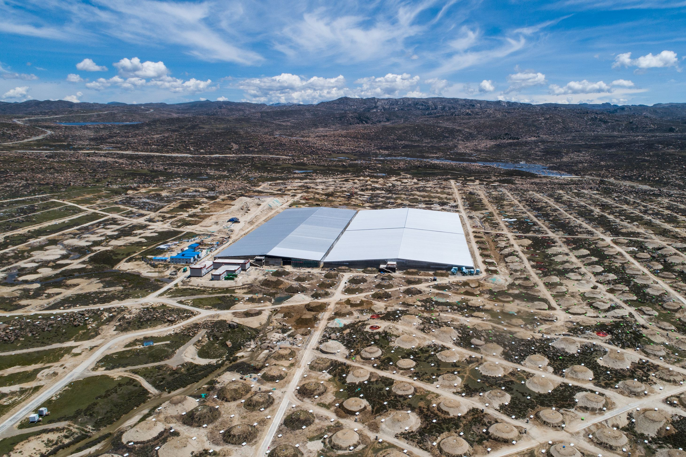
How to trace the cosmic ray accelerator？

Slide 6
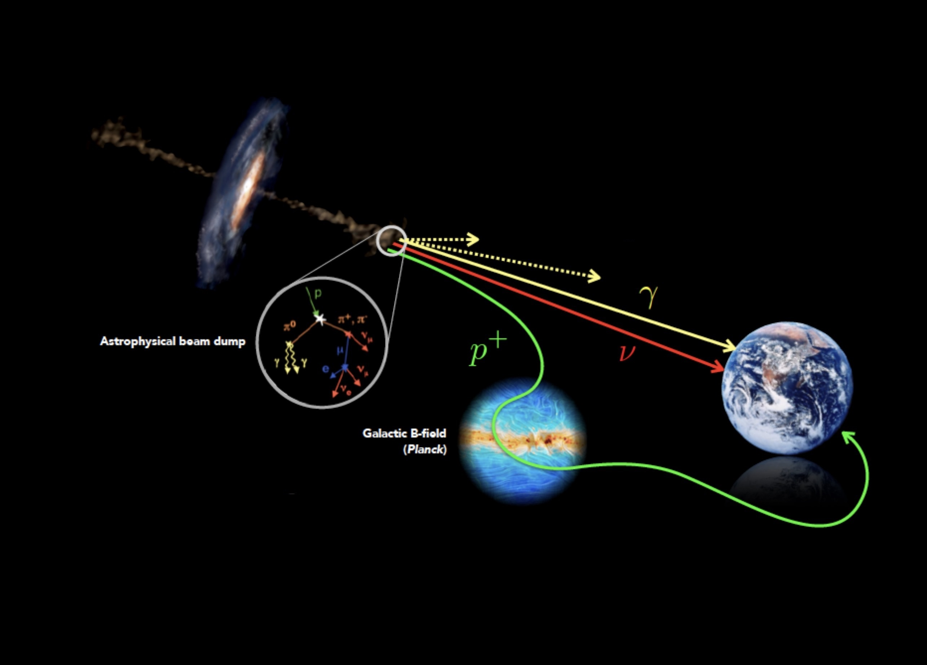
Gamma-rays Probe Cosmic Rays
Gamma-rays point approximately to the position of accelerators.
Cosmic rays directions are randomized by Magnetic Fields in the Universe.

Slide 7
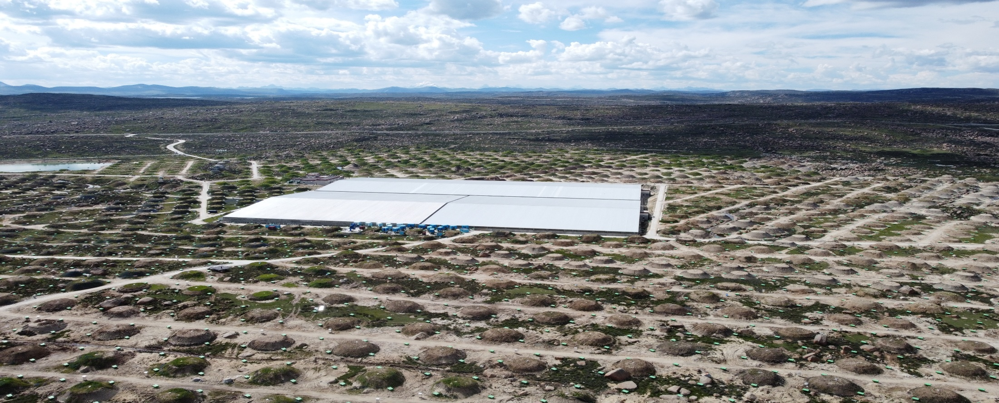
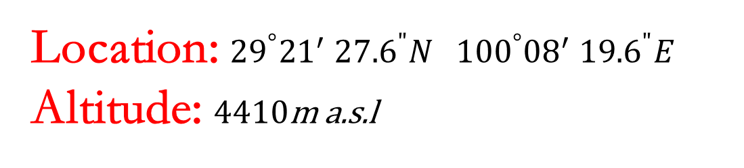
Location: ${29}^{°}{21}^{′}$ ${27.6}^{"}N{ 100}^{°}{08}^{′} {19.6}^{"}E$
Altitude: 4410m a.s.l

Slide 8
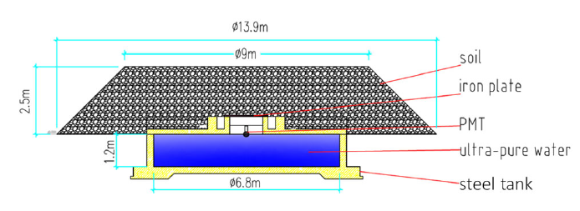
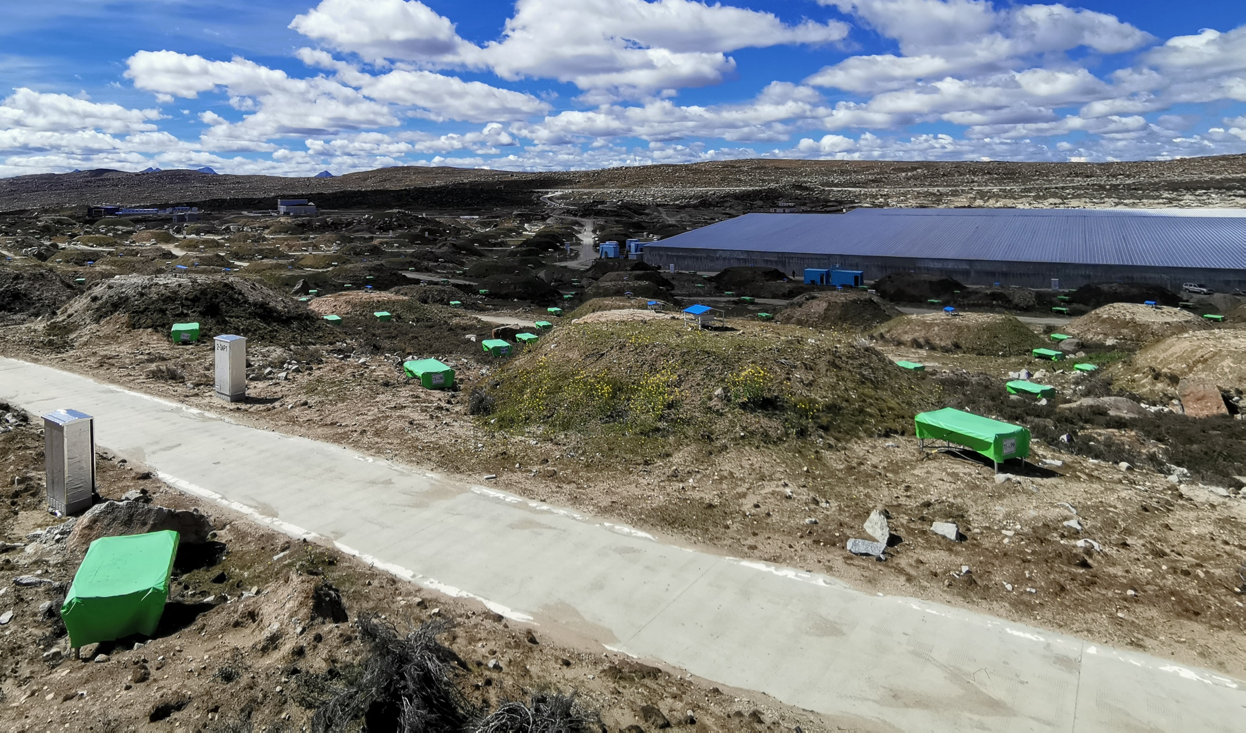
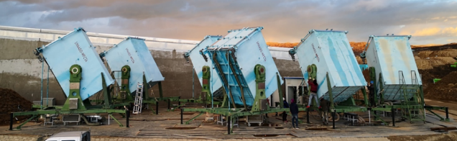
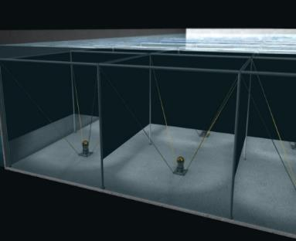
MD
1188x36m²
WFCTA
ED
5216x1m²
WCDA
3120x25m²

Slide 9
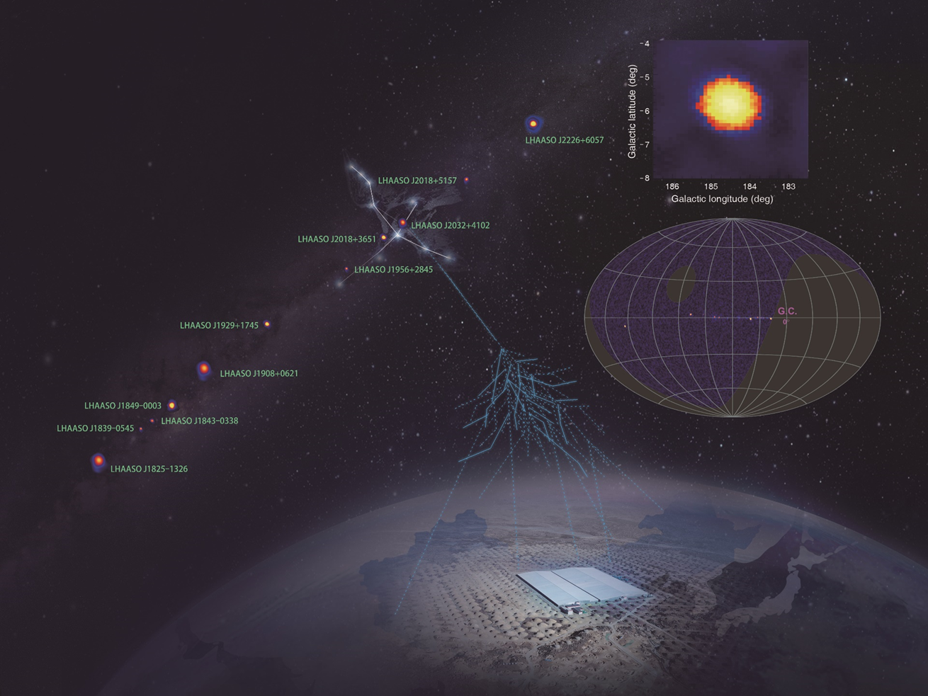
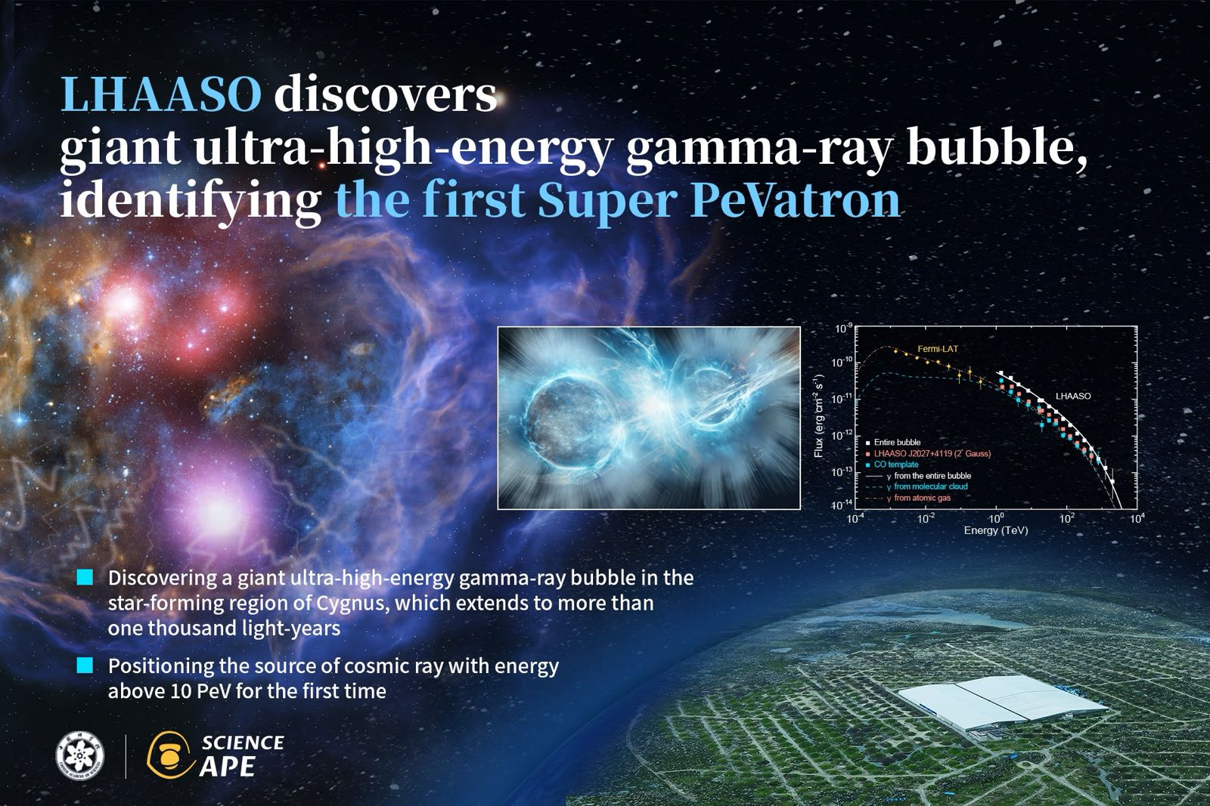
The 1st CR-Source Candidate by LHAASO
Cygnus Bubble, Science Bulletin,
arXiv:2310.10100
LHAASO J0534+2202
PeVatrons, Nature 594:33-36 (2021)
2.5 PeV

Slide 10
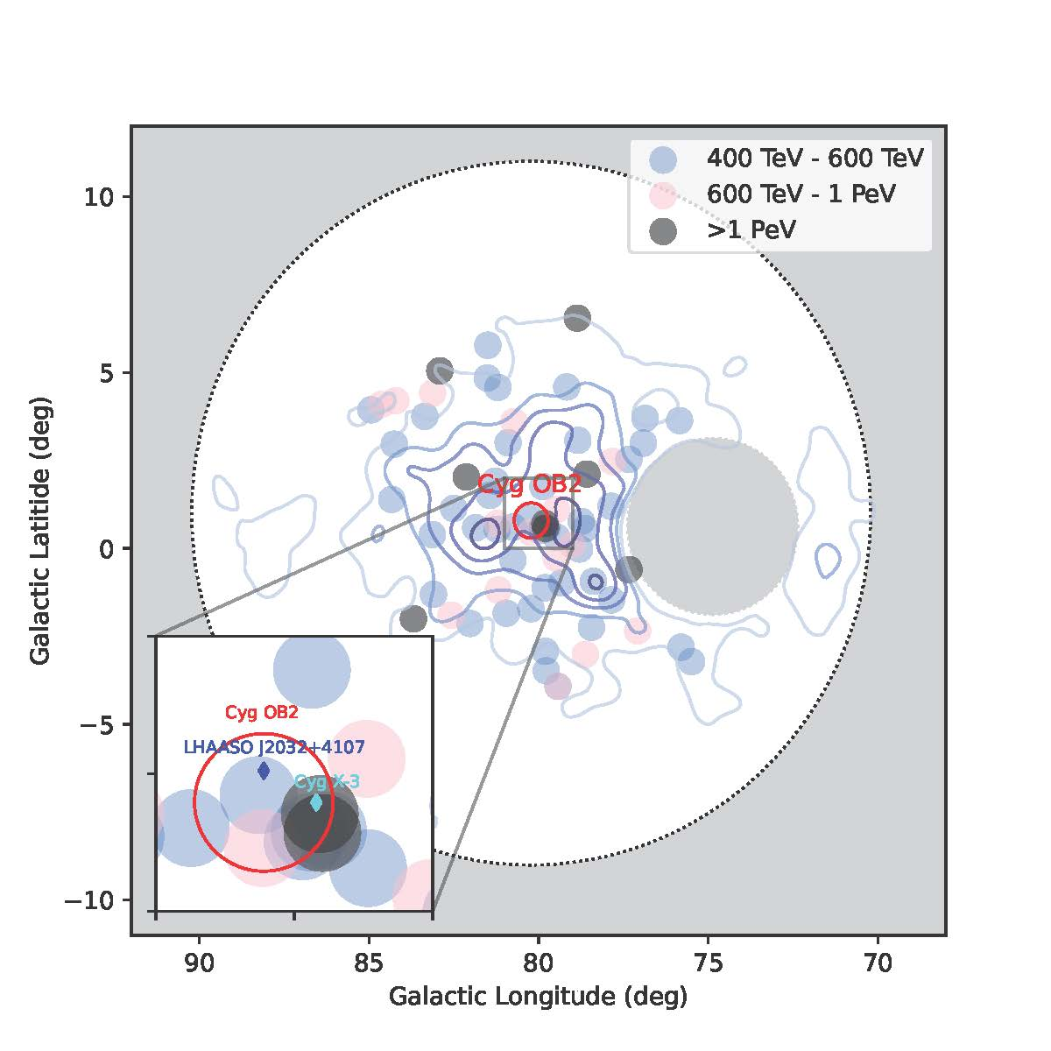
A Bubble of UHE γ’s centered at a complex core
Energy (TeV) | Ne | Nu | Theta (deg) | Dr (m)
1087 | 5904 | 13 | 19.4 | 143
1188 | 5480 | 14 | 34.4 | 73
1208 | 6939 | 13 | 14.2 | 131
1350 | 6938 | 8 | 27.1 | 43
1379 | 6469 | 9 | 17.4 | 52
1421 | 6258 | 7 | 12.7 | 57
1784 | 6665 | 13 | 18.0 | 41
2481 | 13815 | 29 | 33.0 | 99
The UHE photos are dispersed distributed, and are not correlated with any small scale sources.

Slide 11
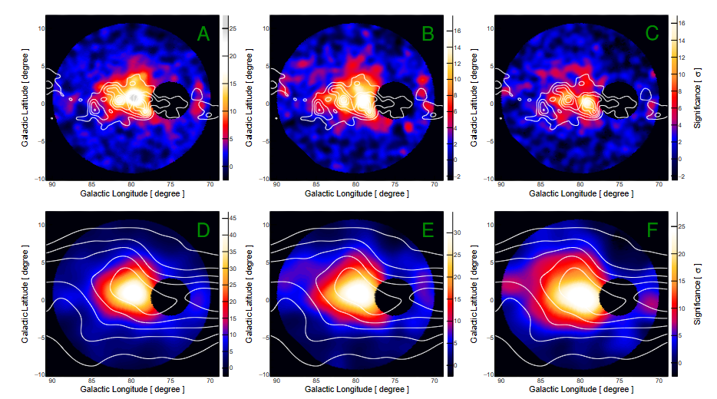
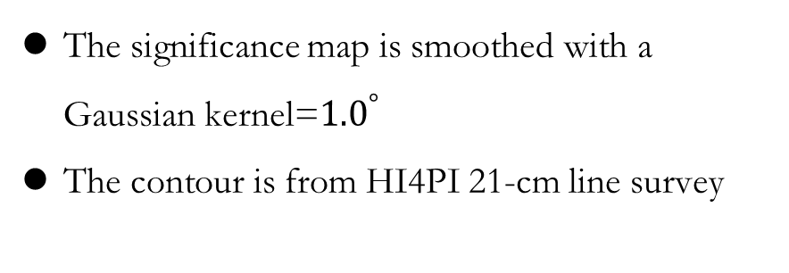
Association with HI gas distribution over ~200 pc
The significance map is smoothed with a Gaussian kernel=${1.0}^{°}$
The contour is from HI4PI 21-cm line survey
Clear correlation with gas distribution indicating a hadronic origin of photons in the Bubble
The signal is elongated along the disk and extends to 10°
>100 TeV
1-20TeV
25-100TeV

Slide 12
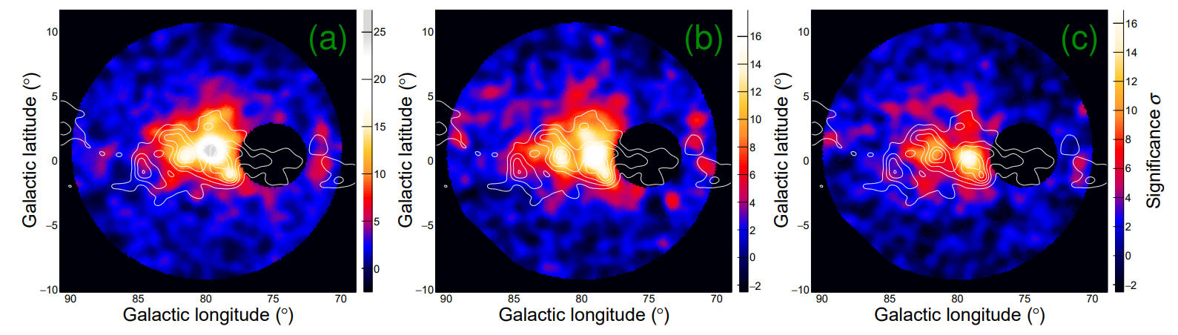
Association with molecular cloud
The contour is from CfA galactic CO survey
The significance map is smoothed with a Gaussian kernel of σ=0.3°
High significance at UHE range
>100 TeV

Slide 13
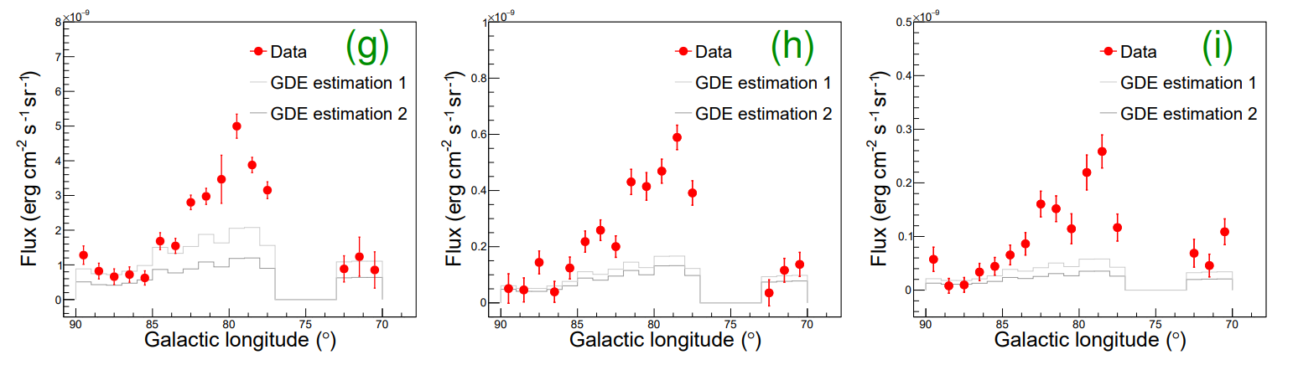

Radial profile of the extended emission
$$F_{γ}=w_{CR}×N_{HI+H2}$$
A very sharp distribution of gamma ray emission towards the center agree with CR propagation scenario and rule out a significant contribution from GDE.

Slide 14
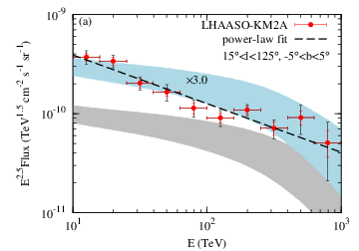
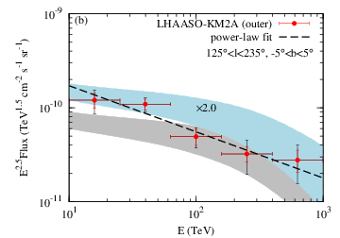
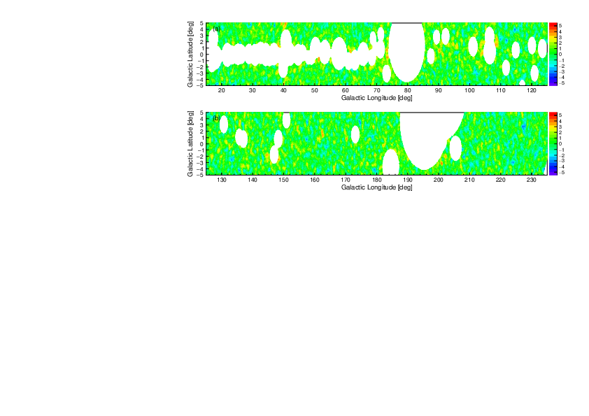
Galactic Diffuse Emission
Inner Galactic Region Outer Galactic Region
PhysRevLett.131.151001

Slide 15
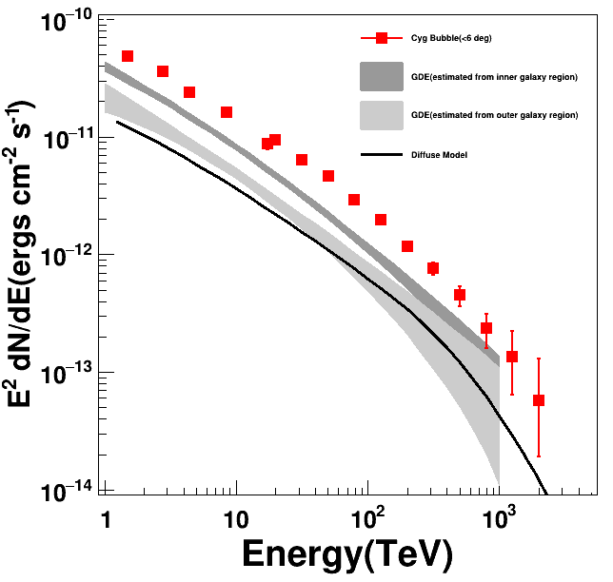
Energy spectrum
Energy Bin | Non | Nb
400TeV-630TeV | 42 | 6.8
630TeV-1PeV | 14 | 1.9
1PeV-1.6PeV | 6 | 0.6
1.6PeV-2.5PeV | 2 | 0.2
Almost background free
The spectrum can extend beyond PeV without sharp cut-off , which shows a slightly softening feature.
It is definitely a PeVatron, or even a Super-PeVatron

Slide 16
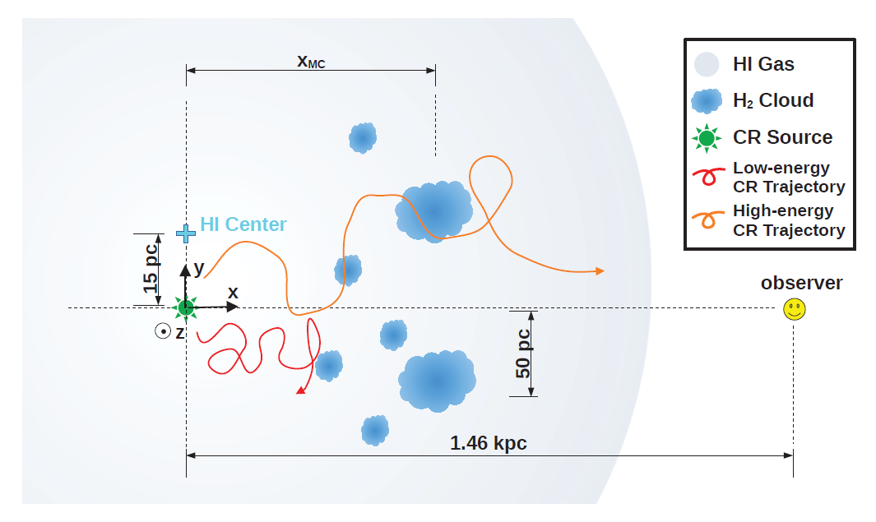
Interpretation
Have the highest energy cosmic rays have escaped from the accelerator?
What we observed is the projection of gamma rays produced is a 3D space.

Slide 17
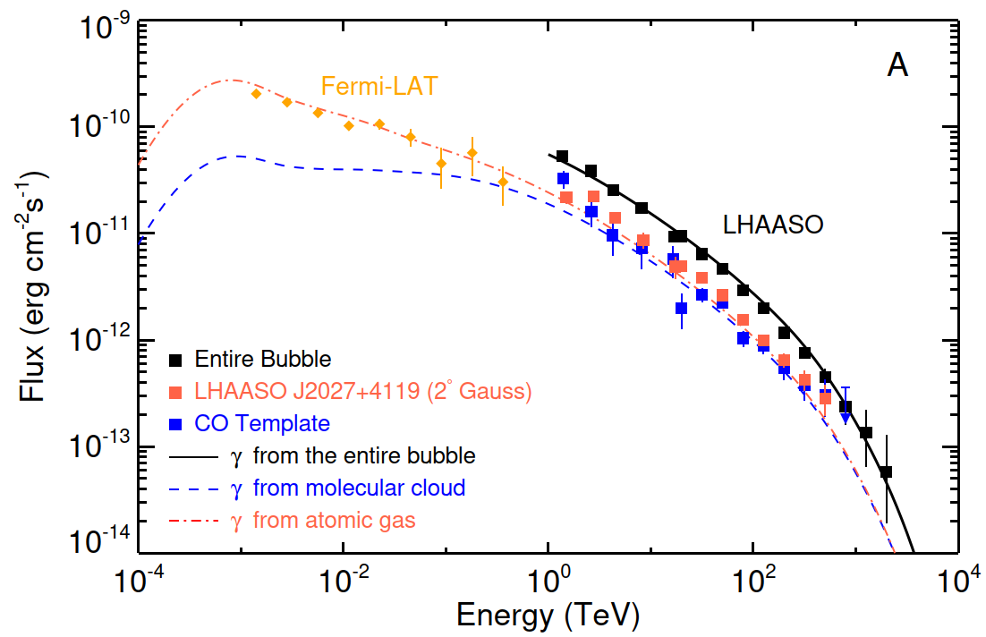
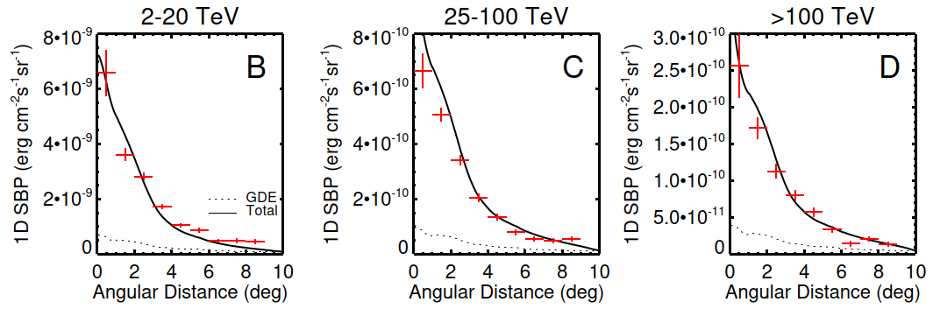
Fitting results
The energy spectrum and morphology can be fitted well if we assume a PeV cosmic ray accelerator at the center of Cygnus region.

Slide 18
Conclusion
A giant ultra-high energy gamma-ray bubble is discovered at Cygnus Region.
The morphology and spectrum indicates a cosmic ray accelerator located at the center accelerating cosmic rays at least to 10 PeV.
This is the first time locating a Super PeVatron in galaxy.

Slide 19
Thanks very much !
Any question?
licong@ihep.ac.cn

