Slide 1
More bosons are different - ATLAS results as example
Yusheng Wu (吴雨生)
University of Science and Technology of China
第十四届全国粒子物理学术会议 2024.8
山东大学 青岛

Slide 2
Physics richness
Demanding requirements
All under control
New precision measurements
Fruitful achievements
A place to look for surprise
More Boson Physics
Disclaimer:
Meant to give audience a taste of facts about MBP, not meant for a full review

Slide 3
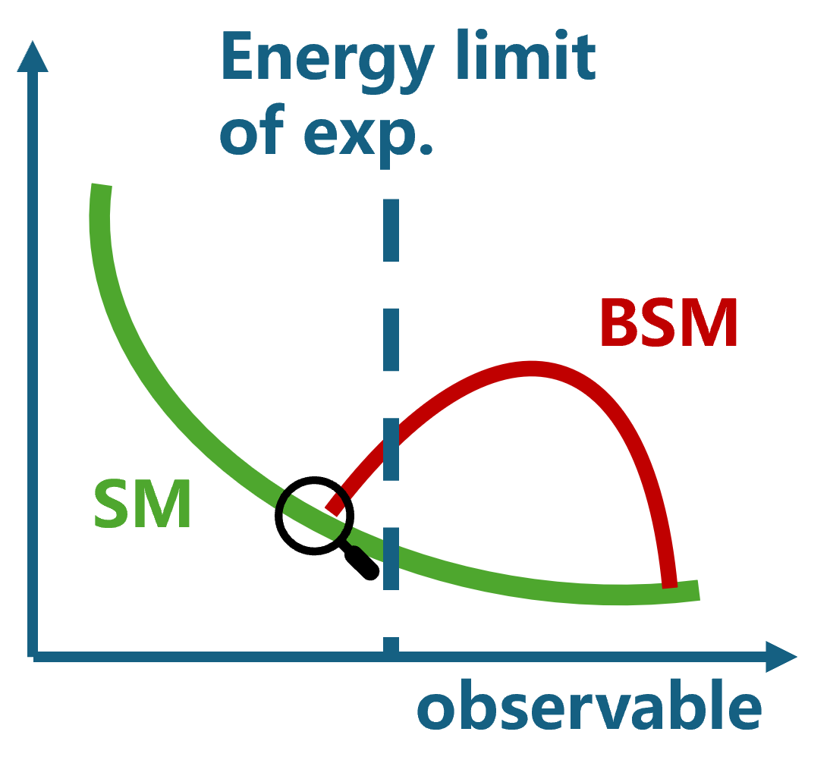
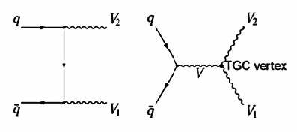
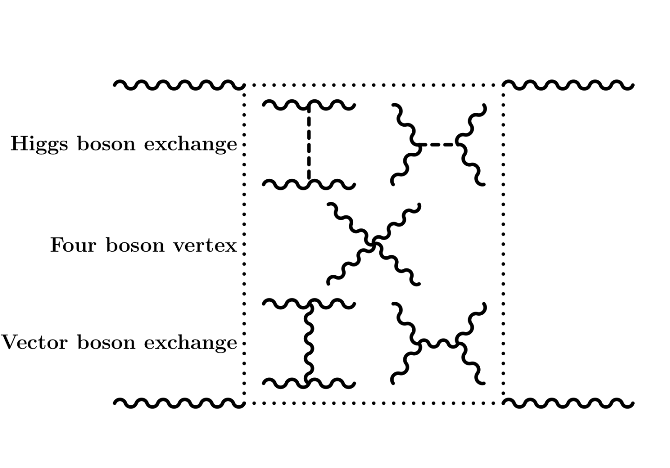
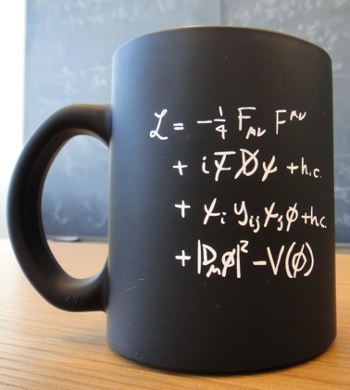
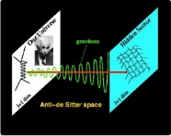
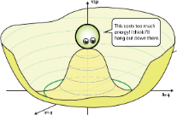
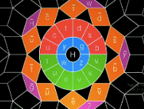
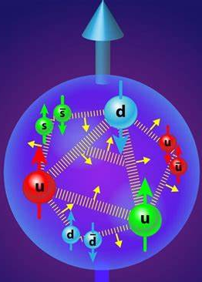
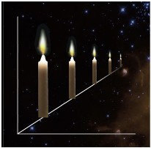
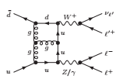
Physics with More (Multiple) Bosons at the LHC
Multiboson production
EWSB, Goldstone
Effective Field Approaches
New Physics
Boson scattering
Non-Abelian Structure
Proton structure and PDF
New Standard Candle
Frontier of precision test

Slide 4
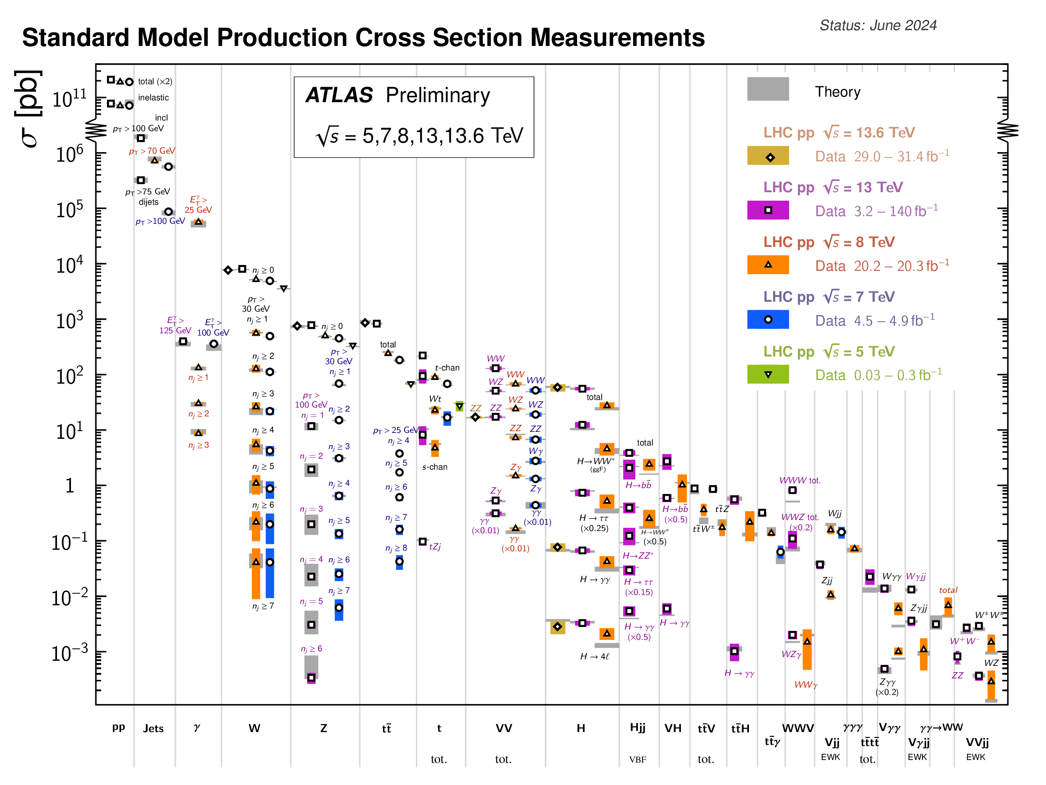
MBP: W$±$, Z, H, γ
MBP key to
multiple fundamental science questions
ZZ
Golden channel for Higgs physics; offshell Higgs → Higgs width; Higgs invisible decay
Searches for Graviton, Heavy resonances …
Searches for Dark matter mono-Z,
dark photon
Precision test, probe of neutral TGC; ZZ scattering → EWSB
Example
Substantial part of LHC physics program
Rare production from O(10) pb to < fb

Slide 5
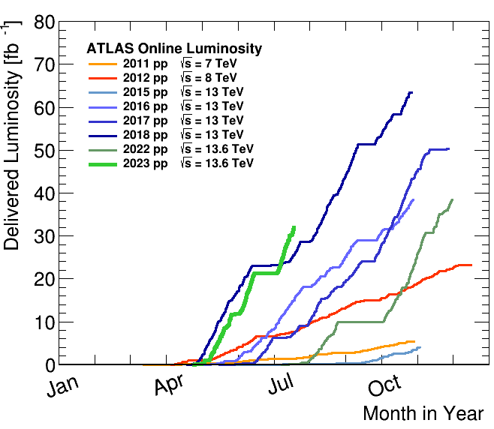
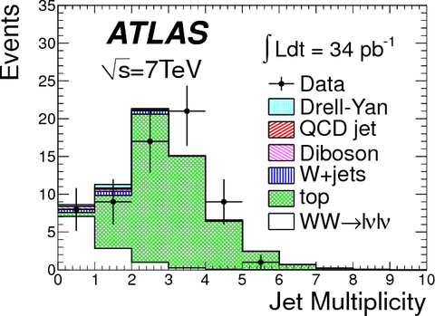
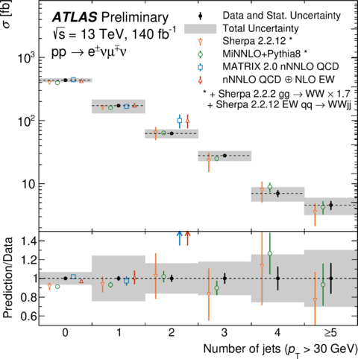
Demanding Statistics
PRL 107 (2011) 041802
ATLAS-CONF-2023-012
From handful of signal events to precision measurement era:
Owing to successful, stable operation of LHC and detector
Crucial for experimental teams to deliver leading contributions in detector upgrade, operation, and calibration, …

Slide 6
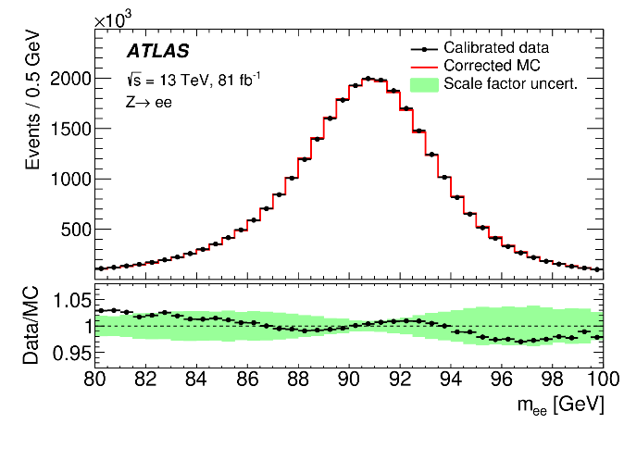
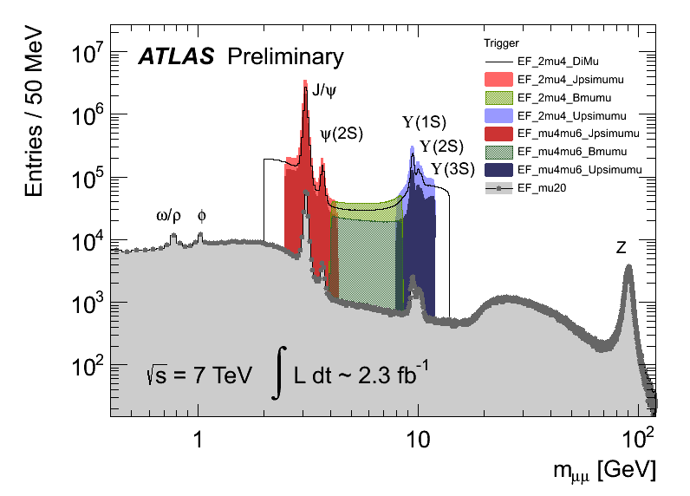
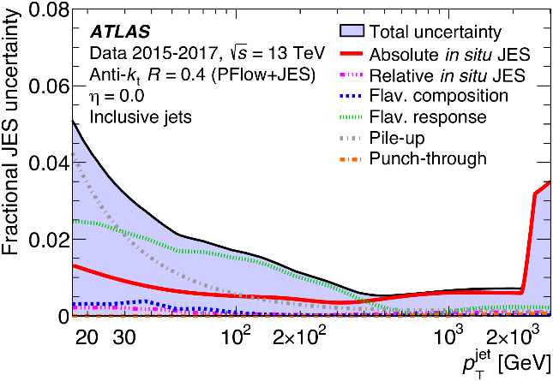
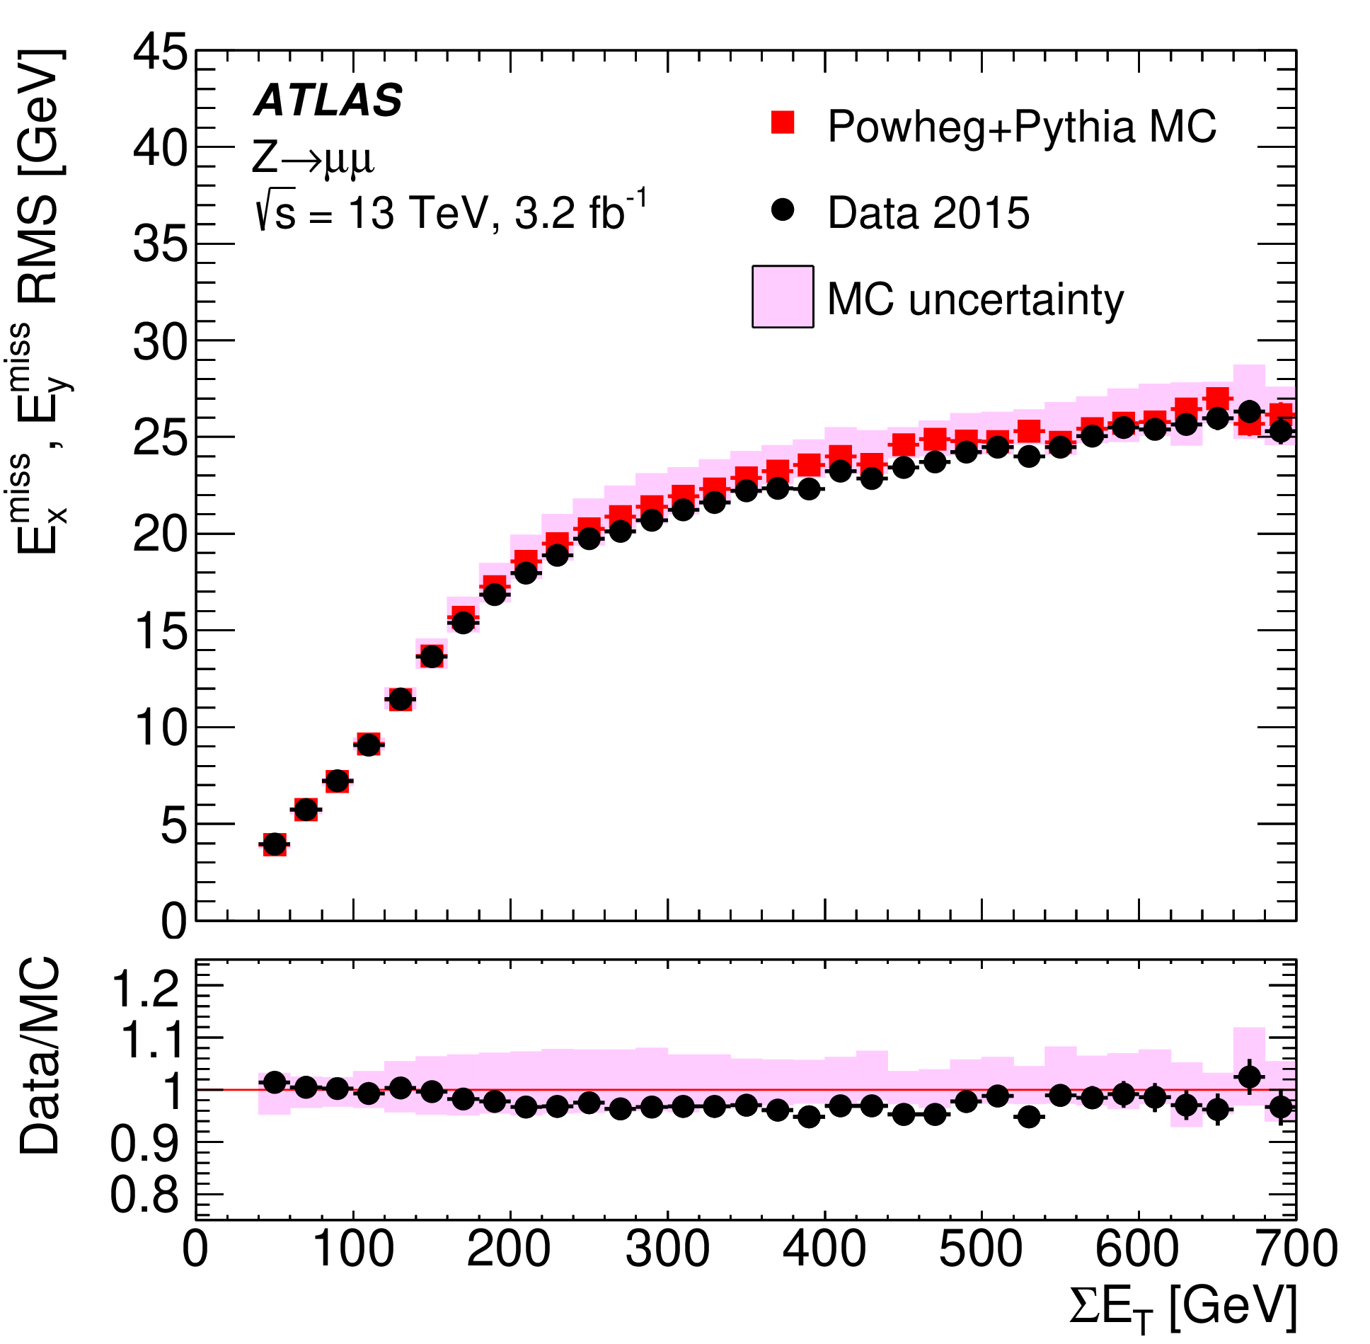
Demanding Precision
MB goes to complex final states: crucial to precisely measure e, μ, jets, E_{T}^{miss}, jets, …
Per-mil to percentage precision achieved in many!
Need all-around knowledge
Continuous innovation
demanded
Z(ee)
scale
dimuon mass
JINST 14 (2019) P12006
Jet energy scale
Missing E_{T} resolution
EPJC 78 (2018) 903
EPJC 81 (2021) 689

Slide 7
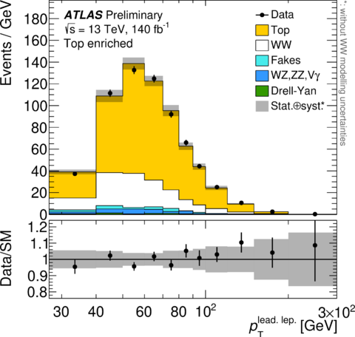
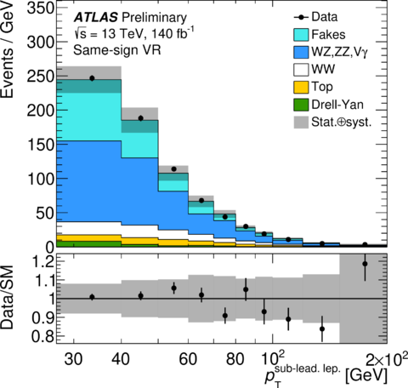
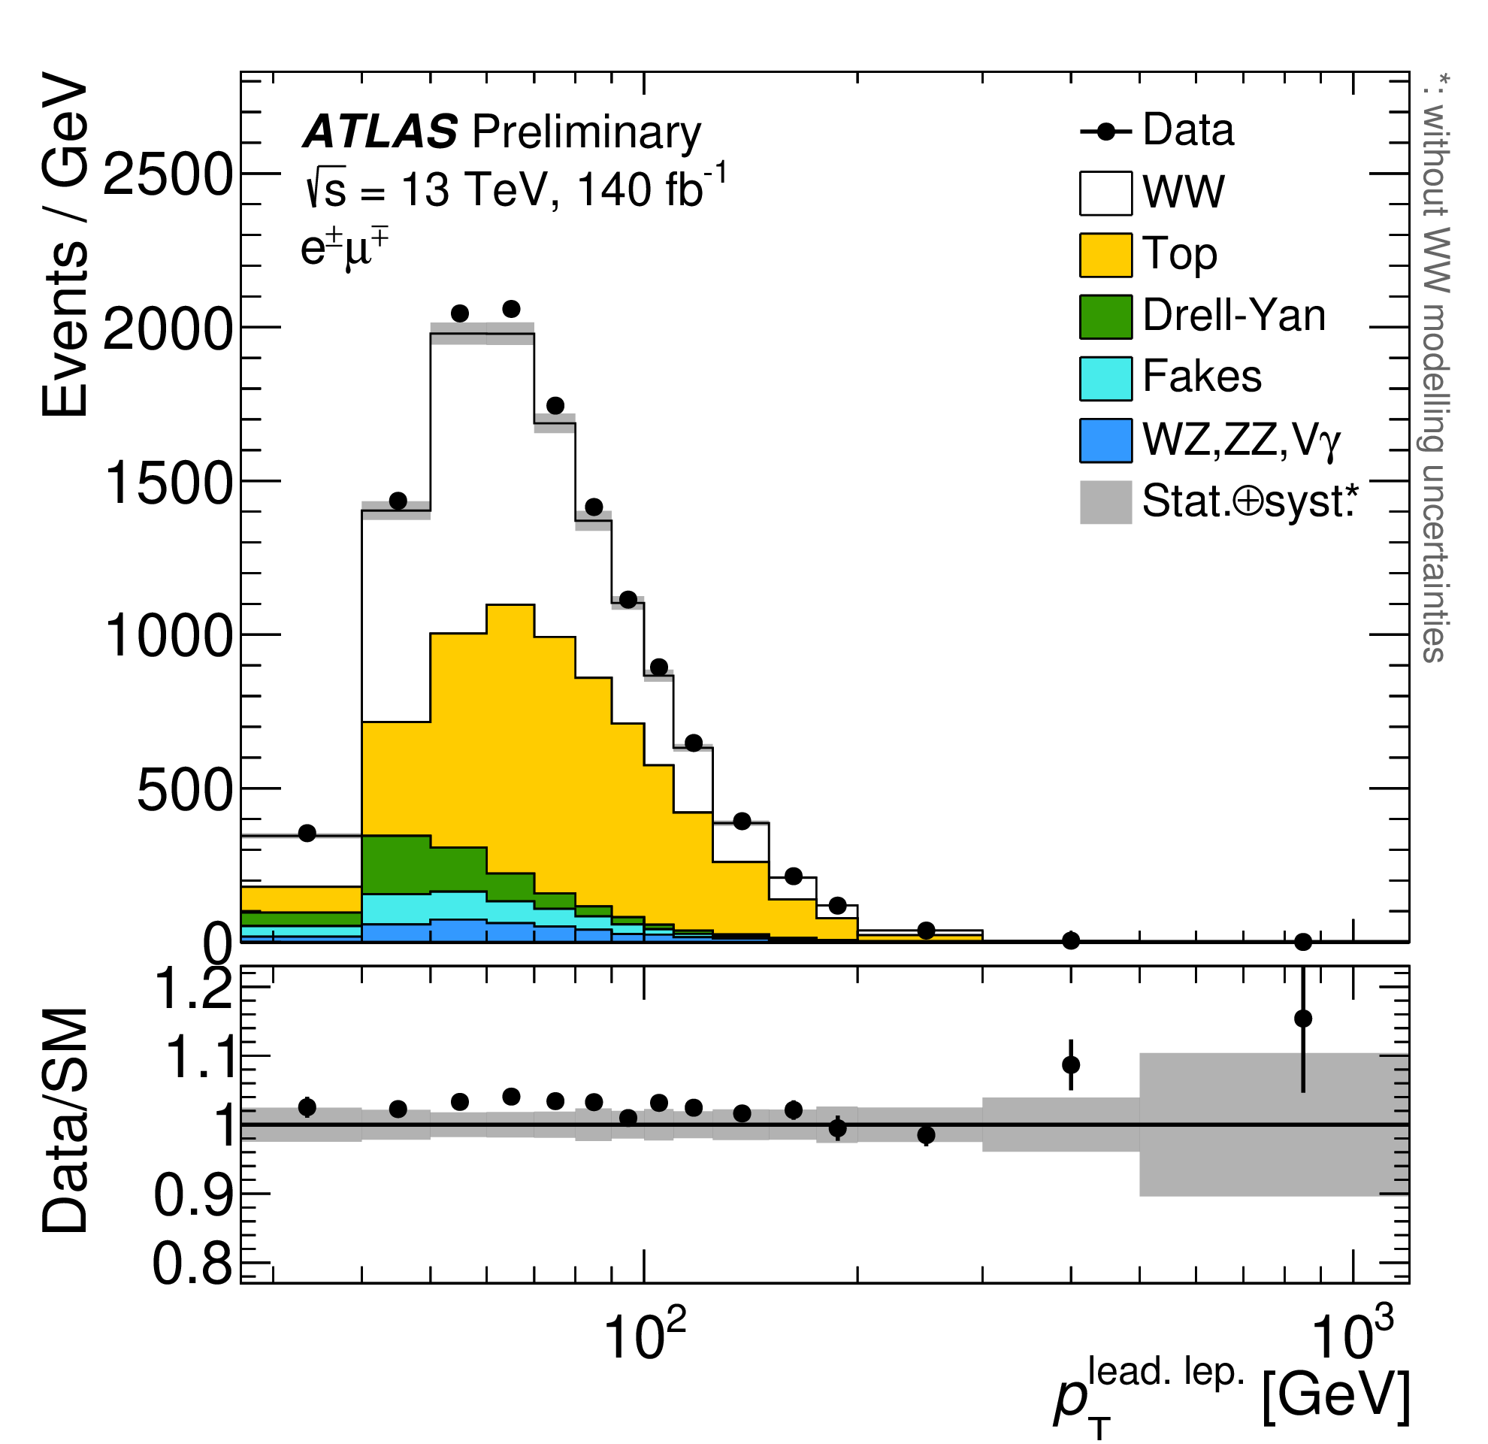
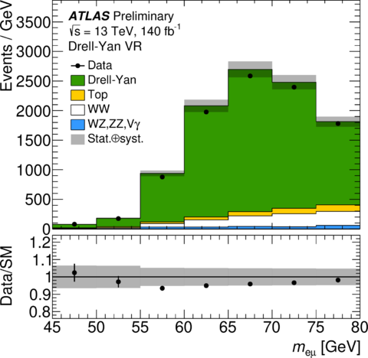
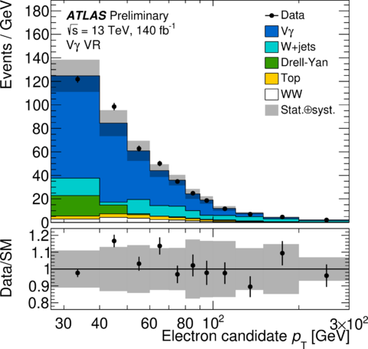
All (backgrounds) under Control
ATLAS-CONF-2023-012
Top
V+jets
WZ, ZZ
Delicate analysis optimization
Precise background estimation often
with data regions
DY
WW as example:
fight against large
backgrounds
V+γ
A precise estimation of backgrounds with confidence is a key to precision
e.g., a few % precision in WW asks for ~1% precision in Top
➔ State of Art for background control!

Slide 8
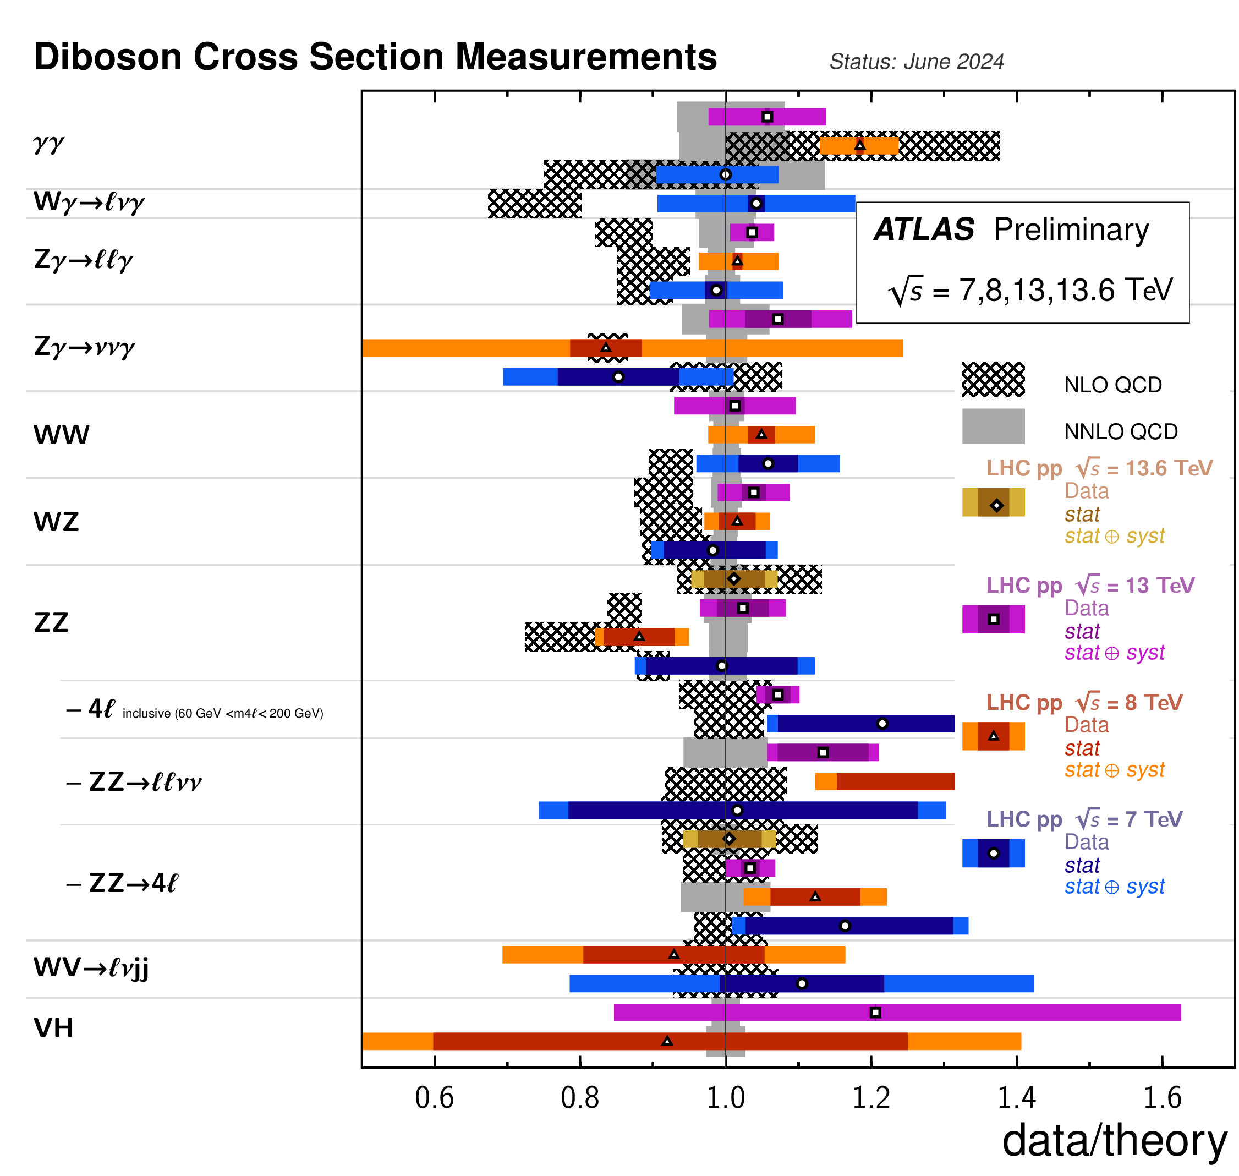
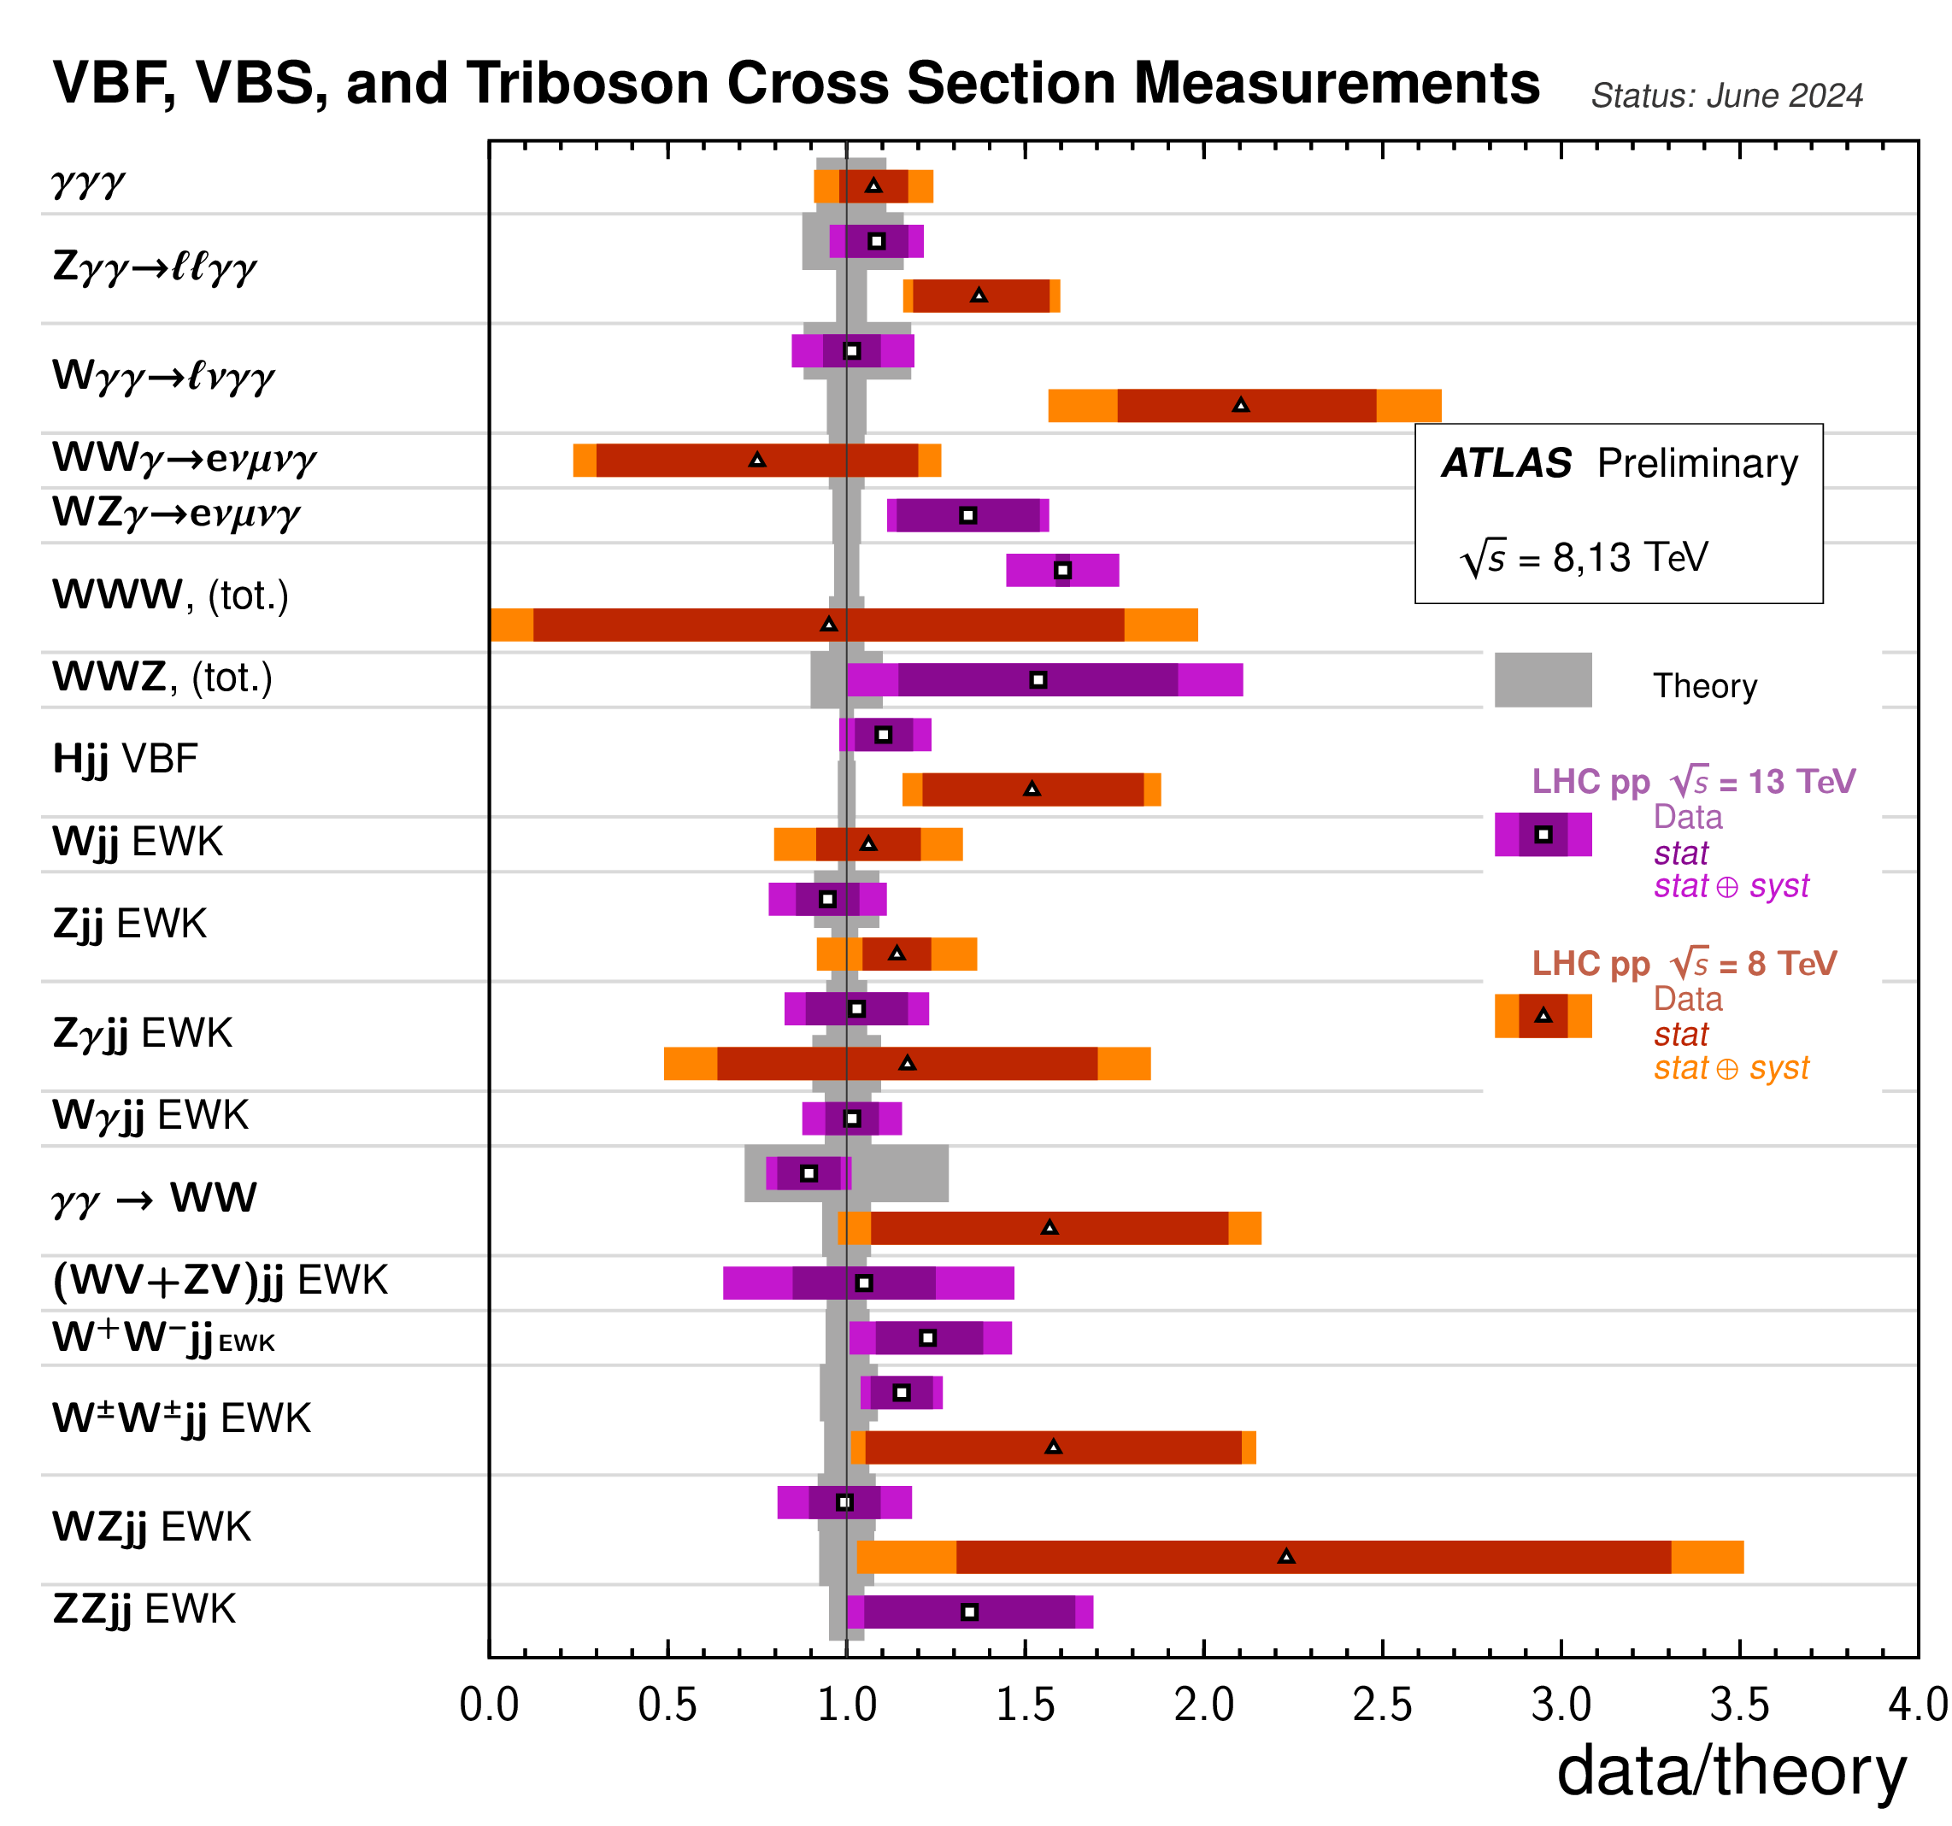
(NEW) Precision Measurements
ATL-PHYS-PUB-2024-011
A 15-year endeavor: from discovery mode → precision mode

Slide 9
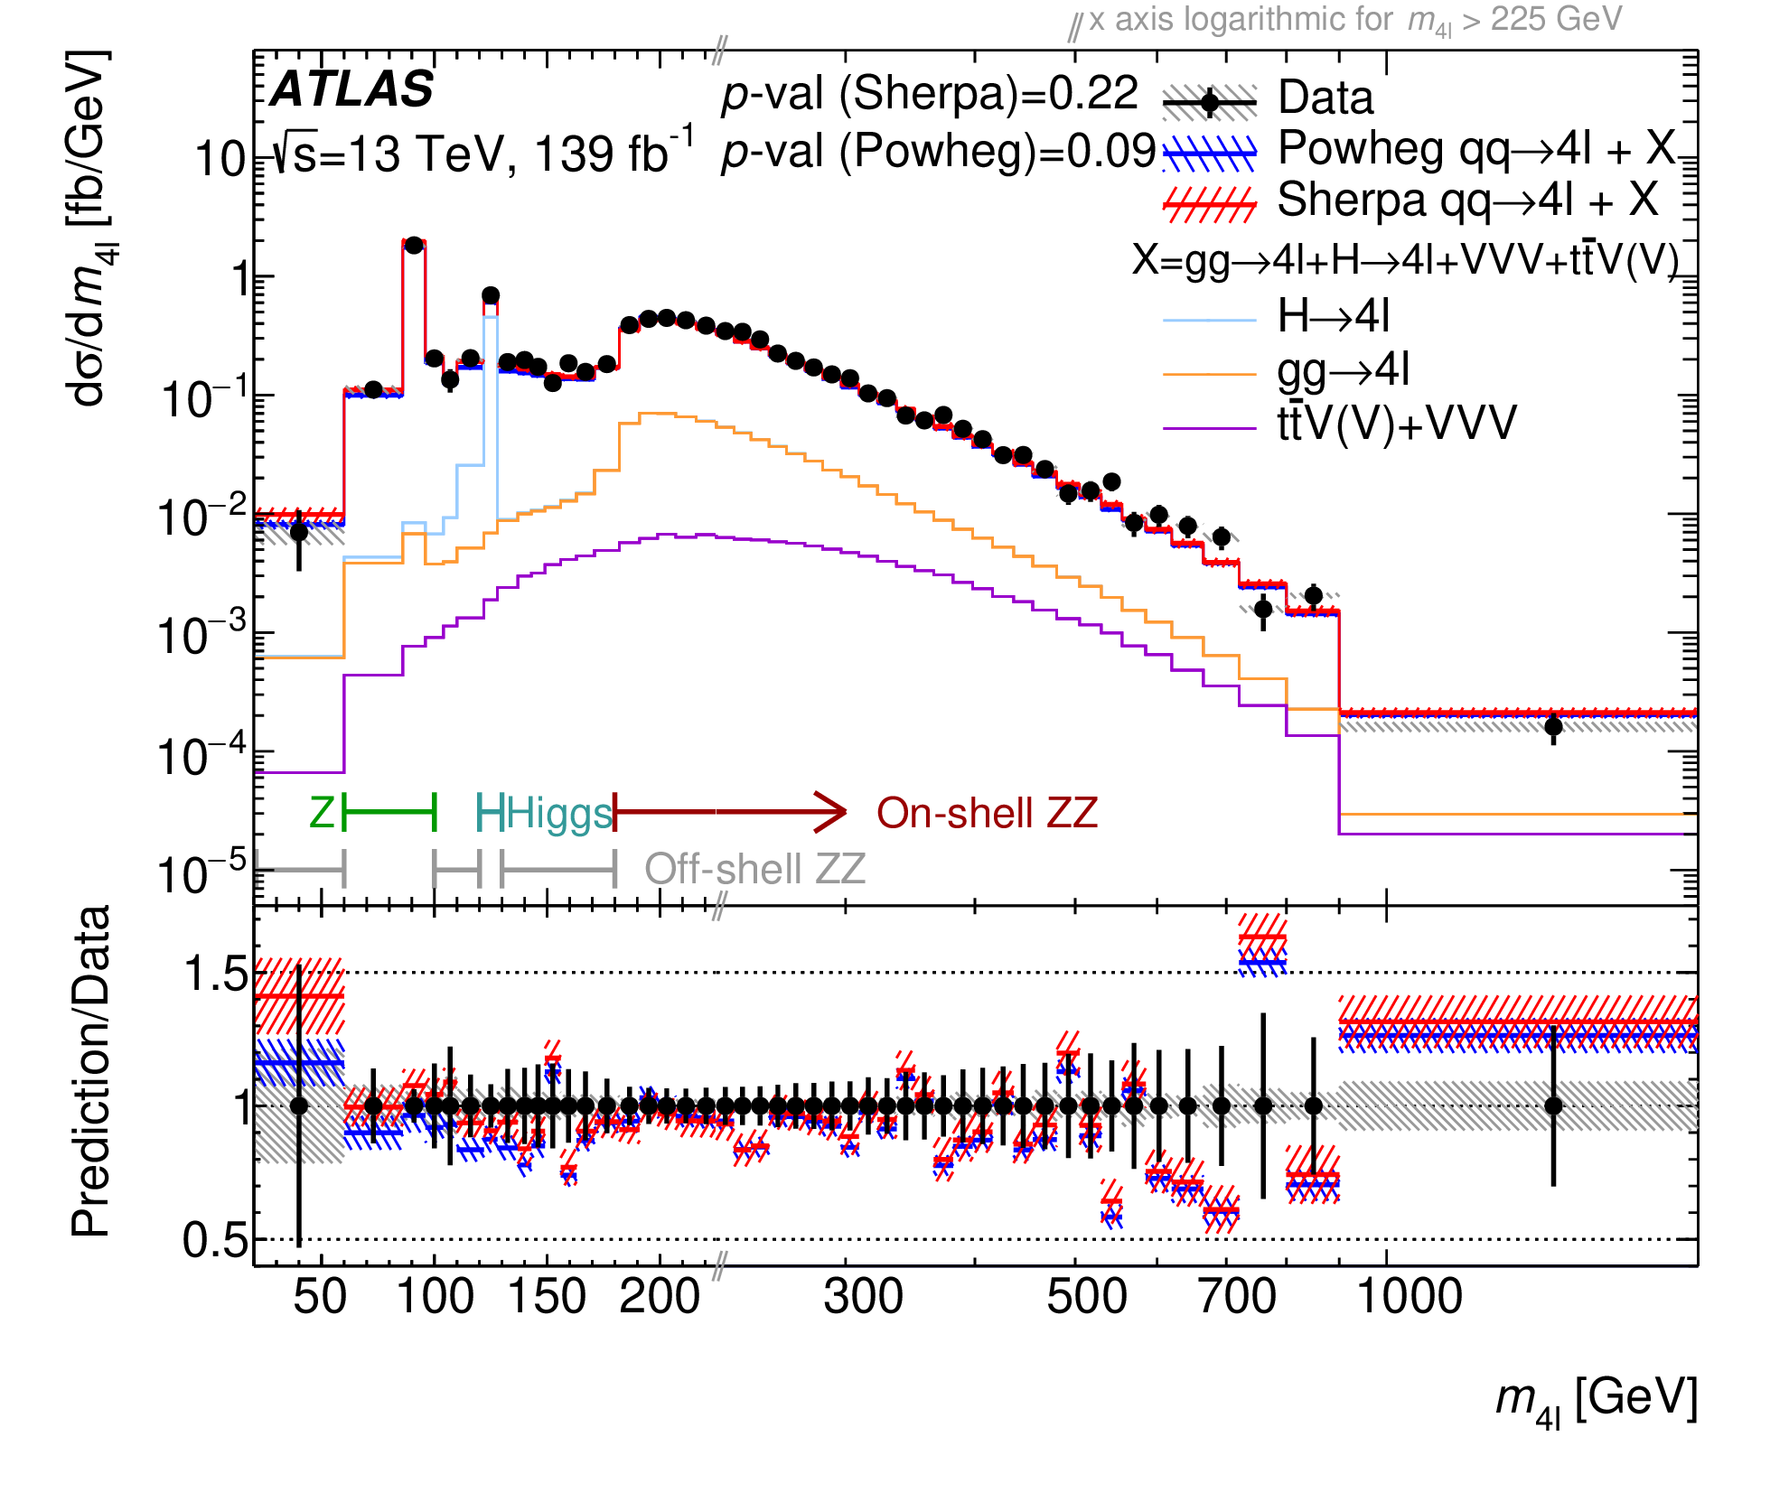
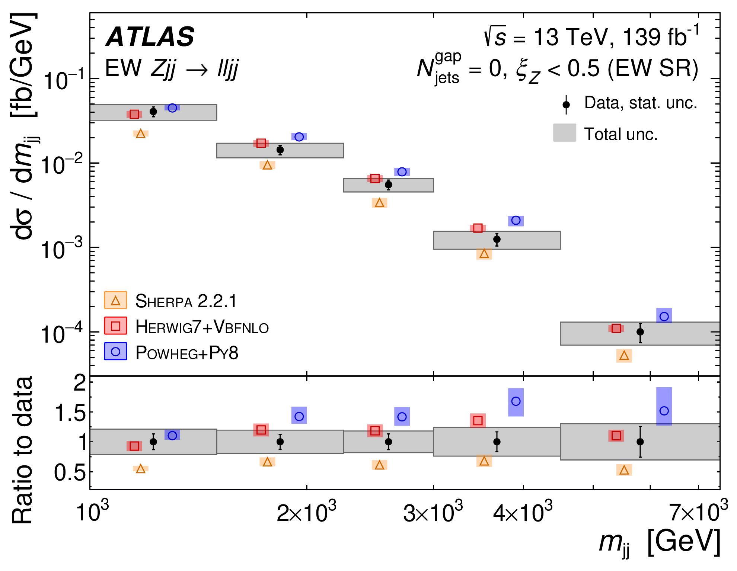
Precision Differential Measurements
JHEP 07 (2021) 005
EPJC 81 (2021) 163
Beautiful 4-lepton lineshape measurements:
covers a broad spectrum of EW physics
VBF Zjj gives precise m(jj) measurement:
probes energetic VBF topology

Slide 10
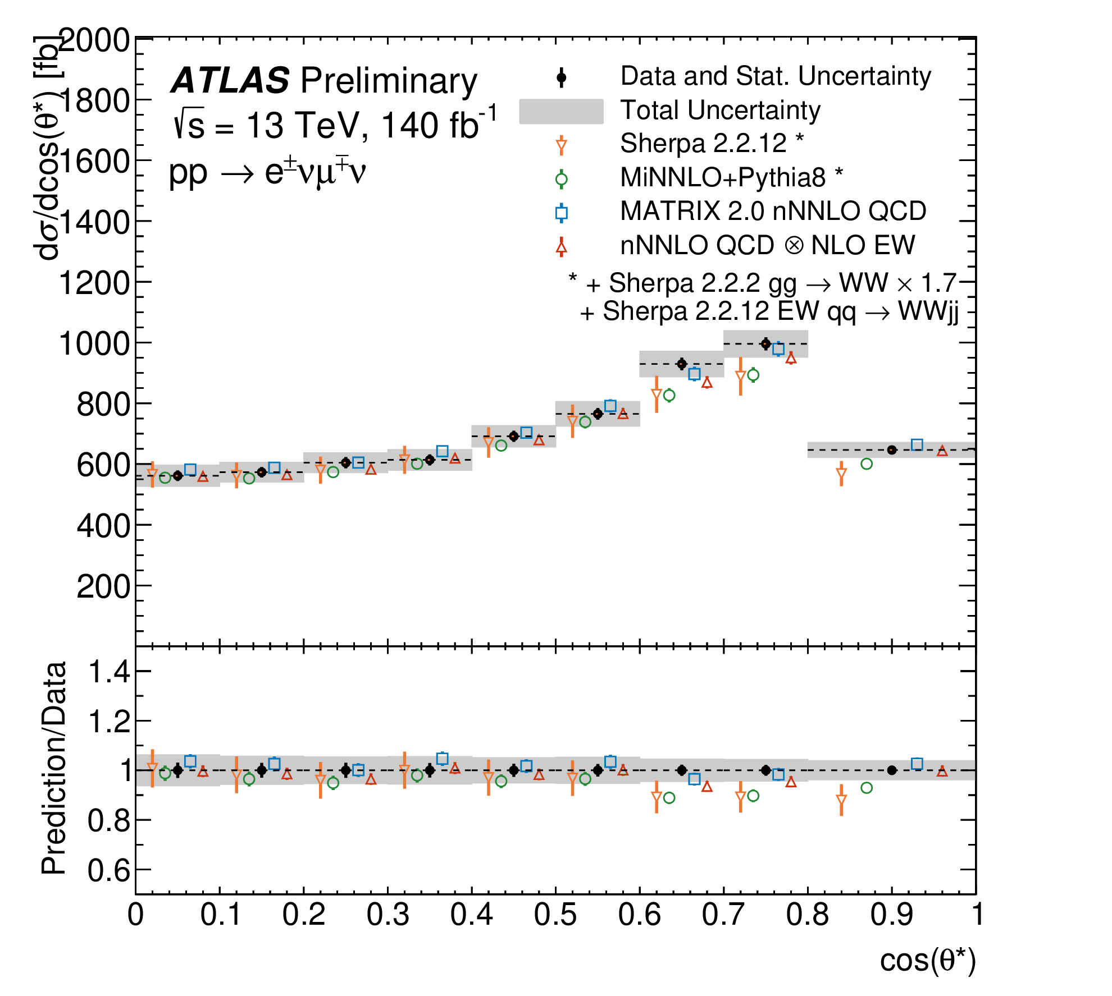
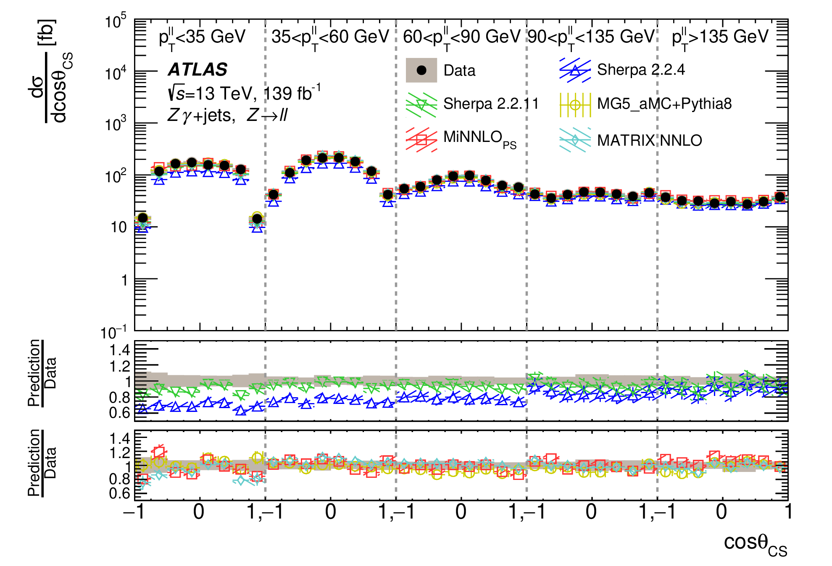
Precision Differential Measurements
ATLAS-CONF-2023-012
JHEP 07 (2023) 72
WW angular measurements
Zγ+jets angular measurements
Open room for future spin-structure measurements

Slide 11
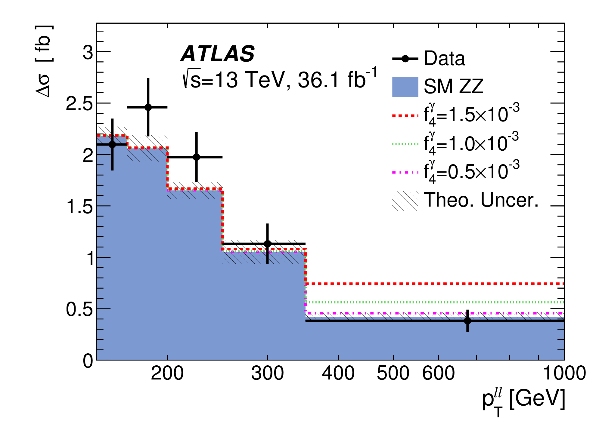
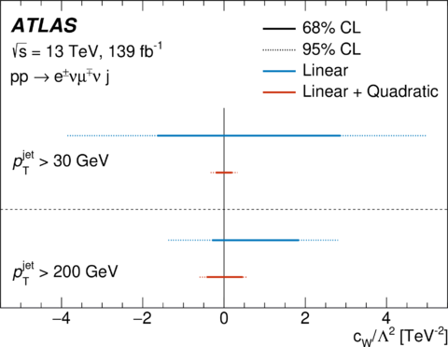
Precision Differential Measurements
JHEP 10 (2019) 127
JHEP 06 (2021) 003
ZZ → ll+MET offers sensitive constraint nTGCs
(initiated the work with unfolded spectrum)
WW+1 jet process offers precision
to study phase space dependence of EFT-SM interference

Slide 12
Achievement in a Nutshell
Rediscovered all diboson process
MBP enters precision era
Lots of inputs to HEPDATA for long investigation
EFT Studies being pursued
Discovered all VBF/VBS process
MBP succeeds rare exploration
First sign of SM EWSB nature
Room to pursue deep structure
Discovered triboson, γγ scatter process
MBP expands new territories
EFT sensitivity
Physics diversity offered
March into physics depth
MBP goes to boson properties: polarization, spin-structure, quantum
Physics beyond boundaries Measurement+

Slide 13
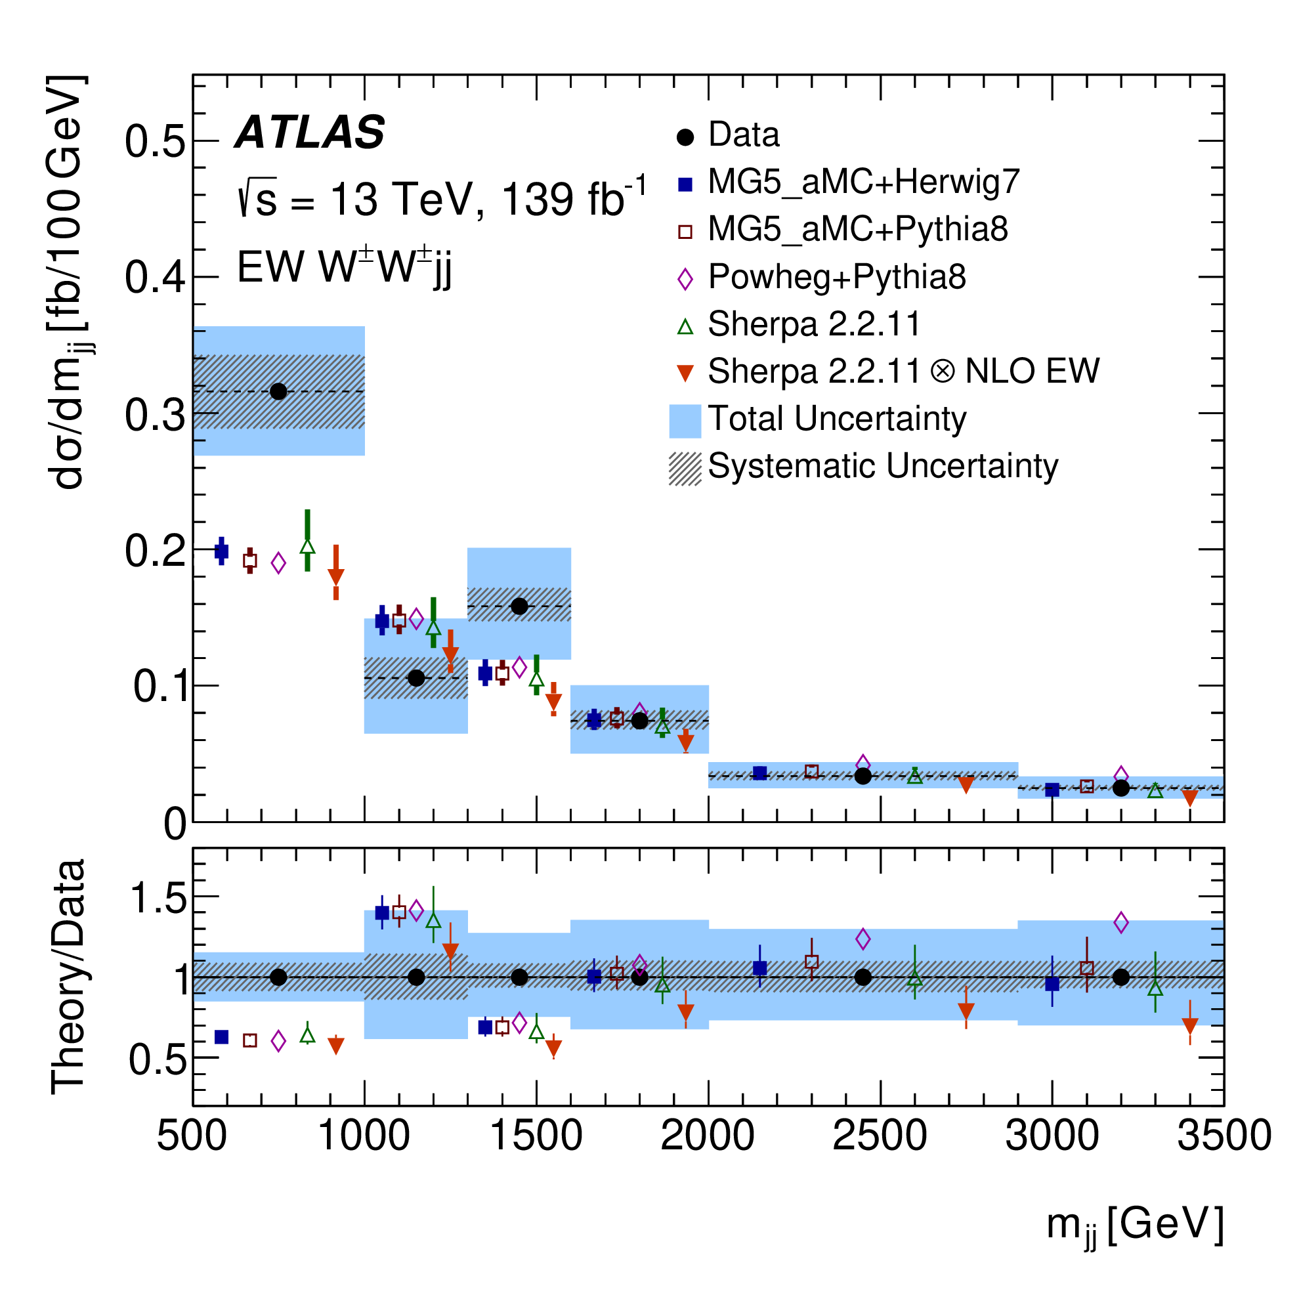
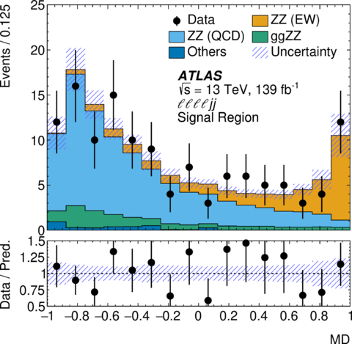
Vector Boson Scattering
JHEP 04 (2024) 026
Nature Physics 19 (2023) 237–253
Measurement of VBS W$±$W$±$ – The Cleanest
Observation of VBS ZZ – The Rarest
First sight of SM consistency + Modelling scrutinized in new territory

Slide 14
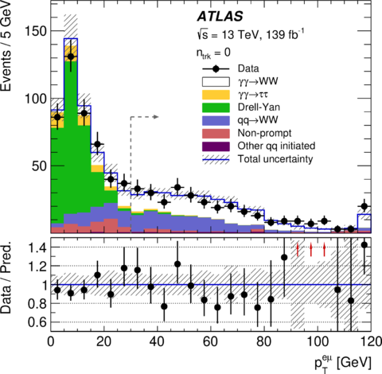
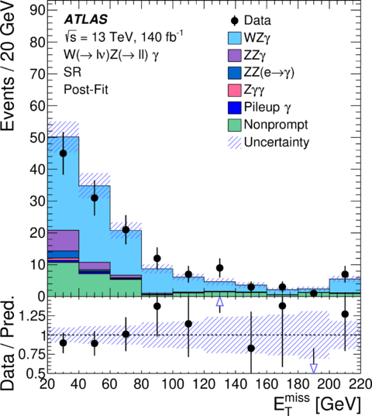
γγ Scattering and Triboson
PLB 816 (2021) 136190
PRL132 (2024) 021802
Observation of exclusive γγ→WW
Observation of WZγ
New unique initial states, boson numbers + 1

Slide 15
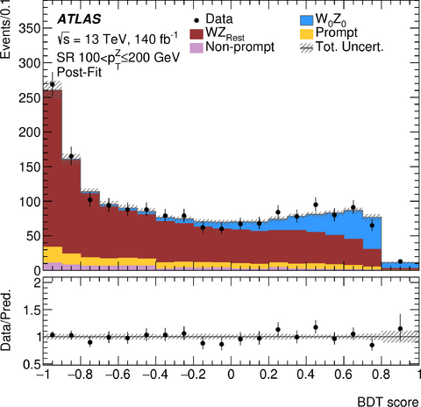
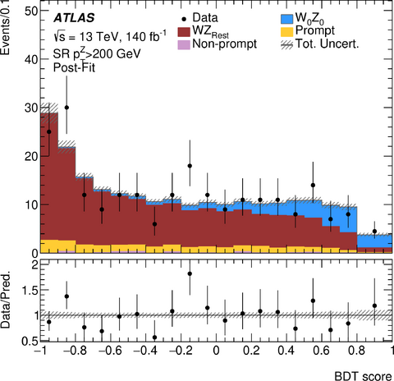
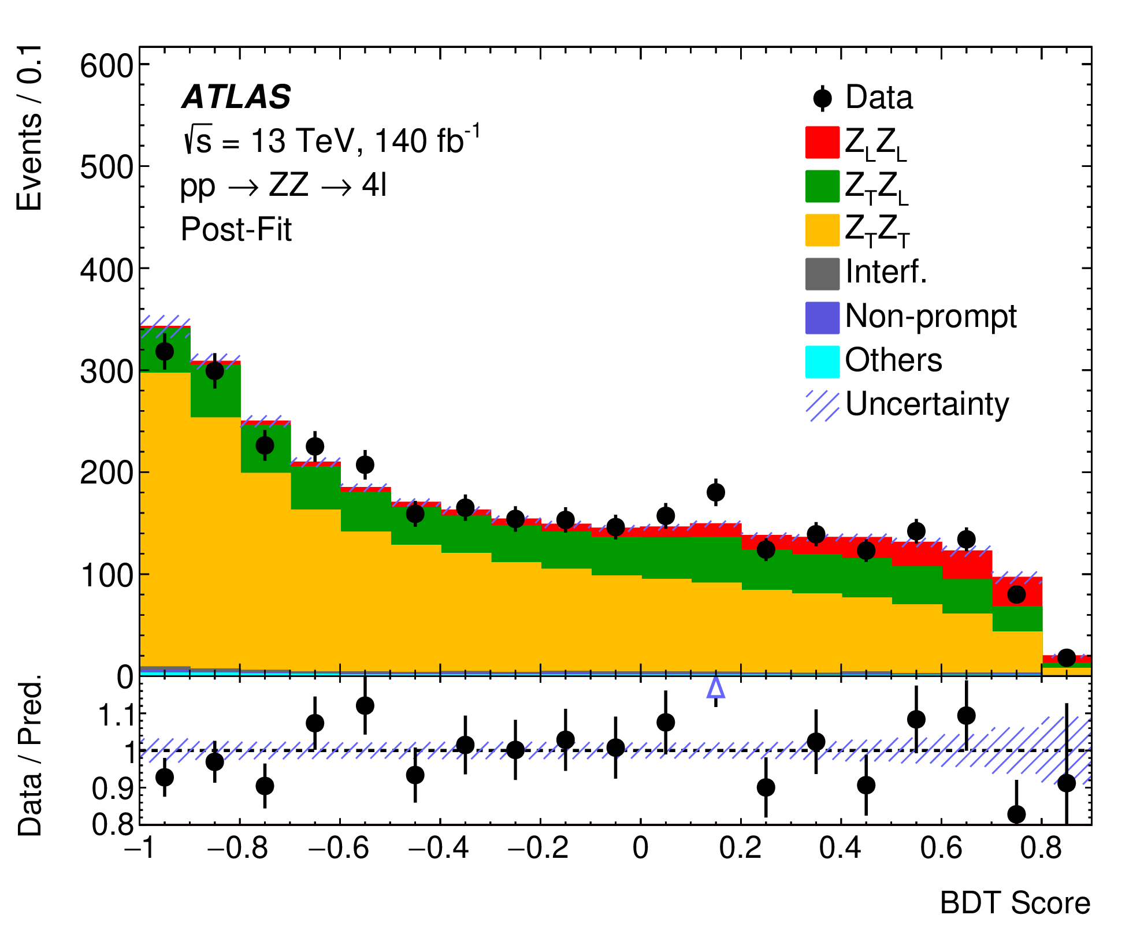
Diboson Polarization
arXiv:2402.16365 (accepted by PRL)
JHEP 12 (2023) 107
100<pT(Z)<200 GeV
pT(Z)>200 GeV
A first attempt to study
energy dependence on W_{L}Z_{L} production
(Goldstone Boson Equivalence Theorem)
+ observation of RAZ effects
A comprehensive study + ML
→ first evidence on Z_{L}Z_{L} production

Slide 16
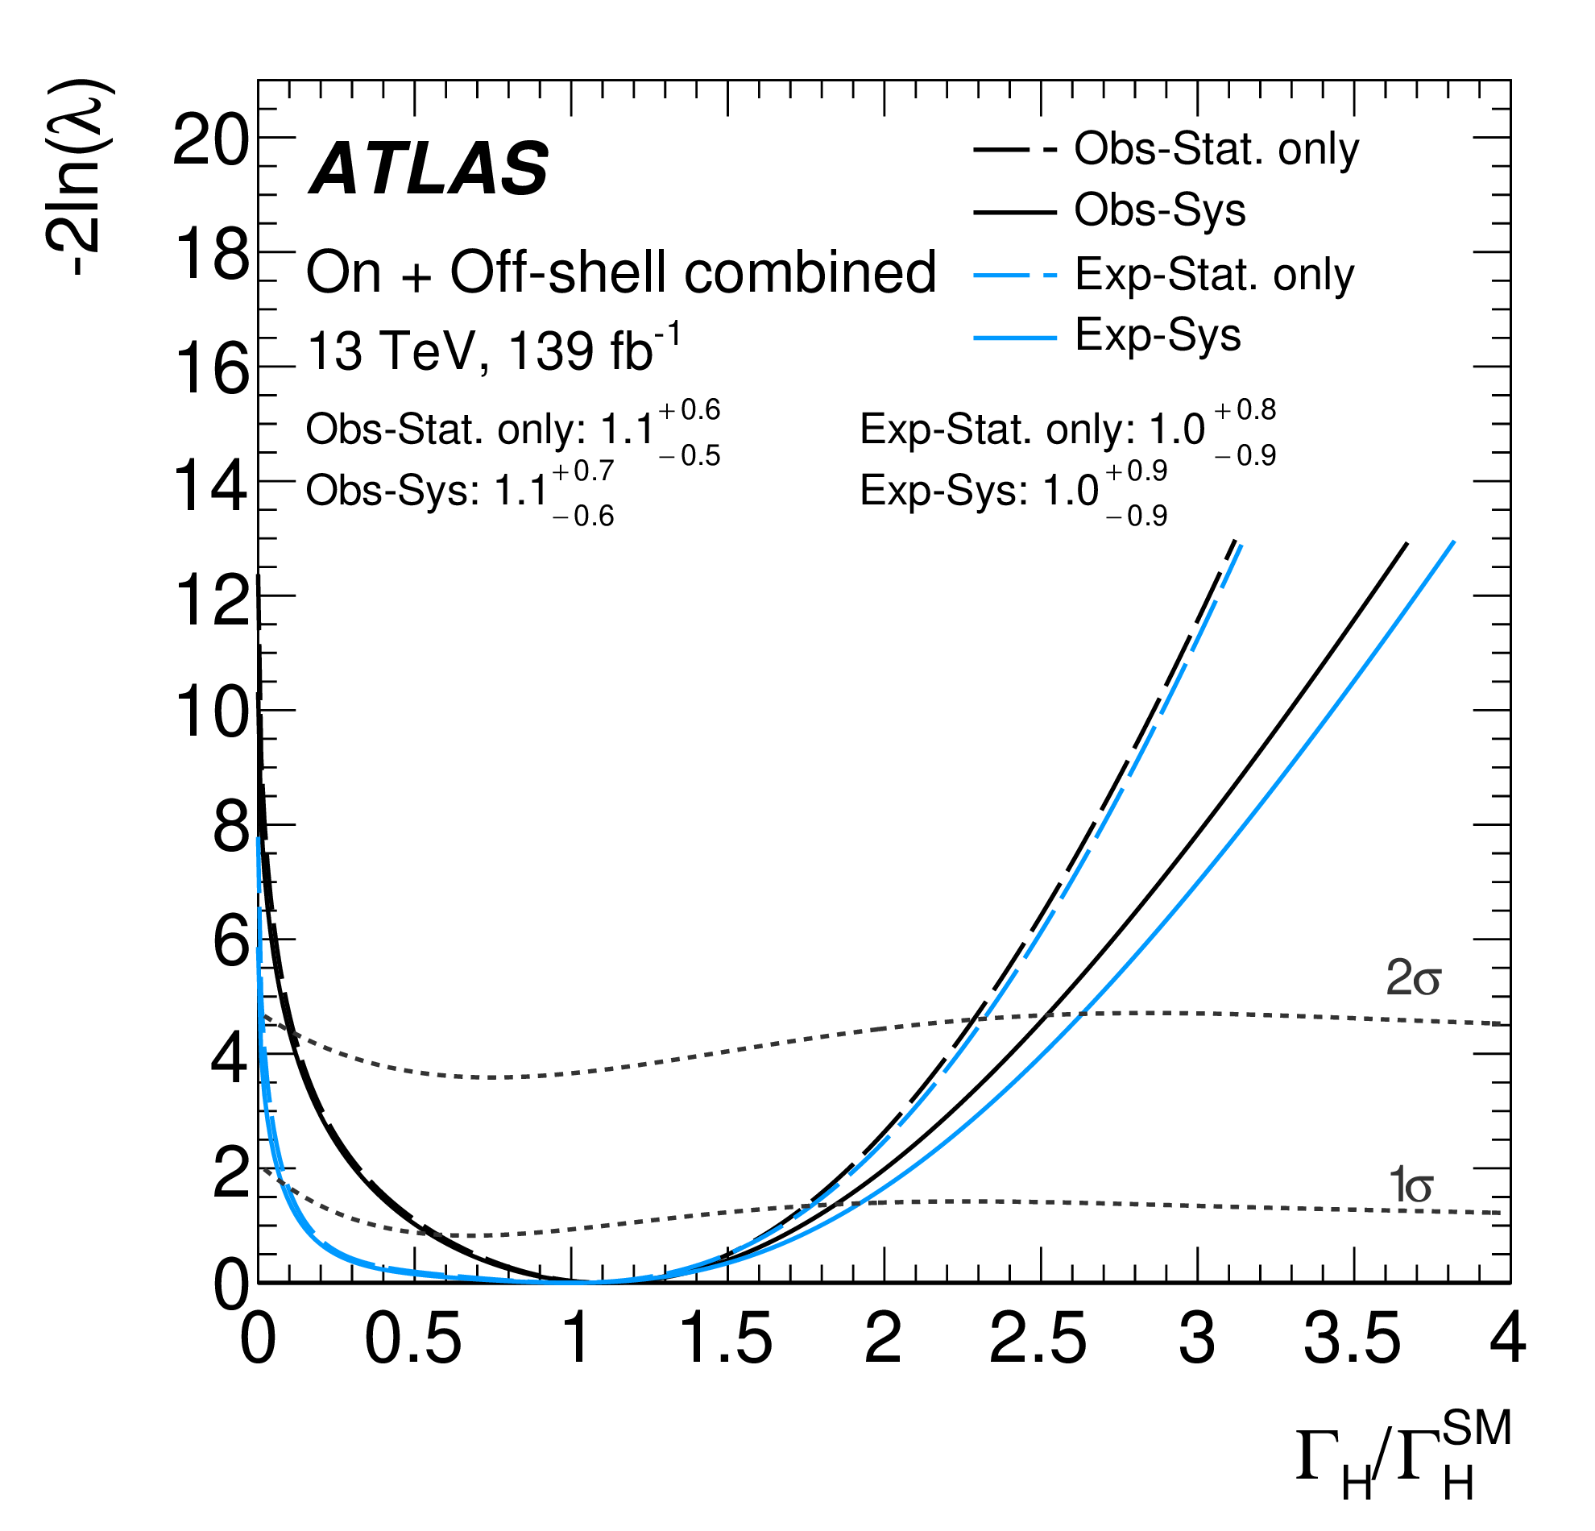
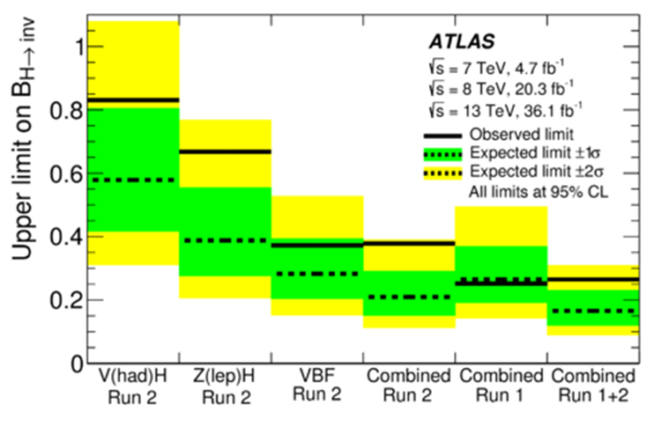
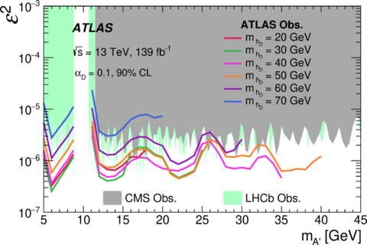
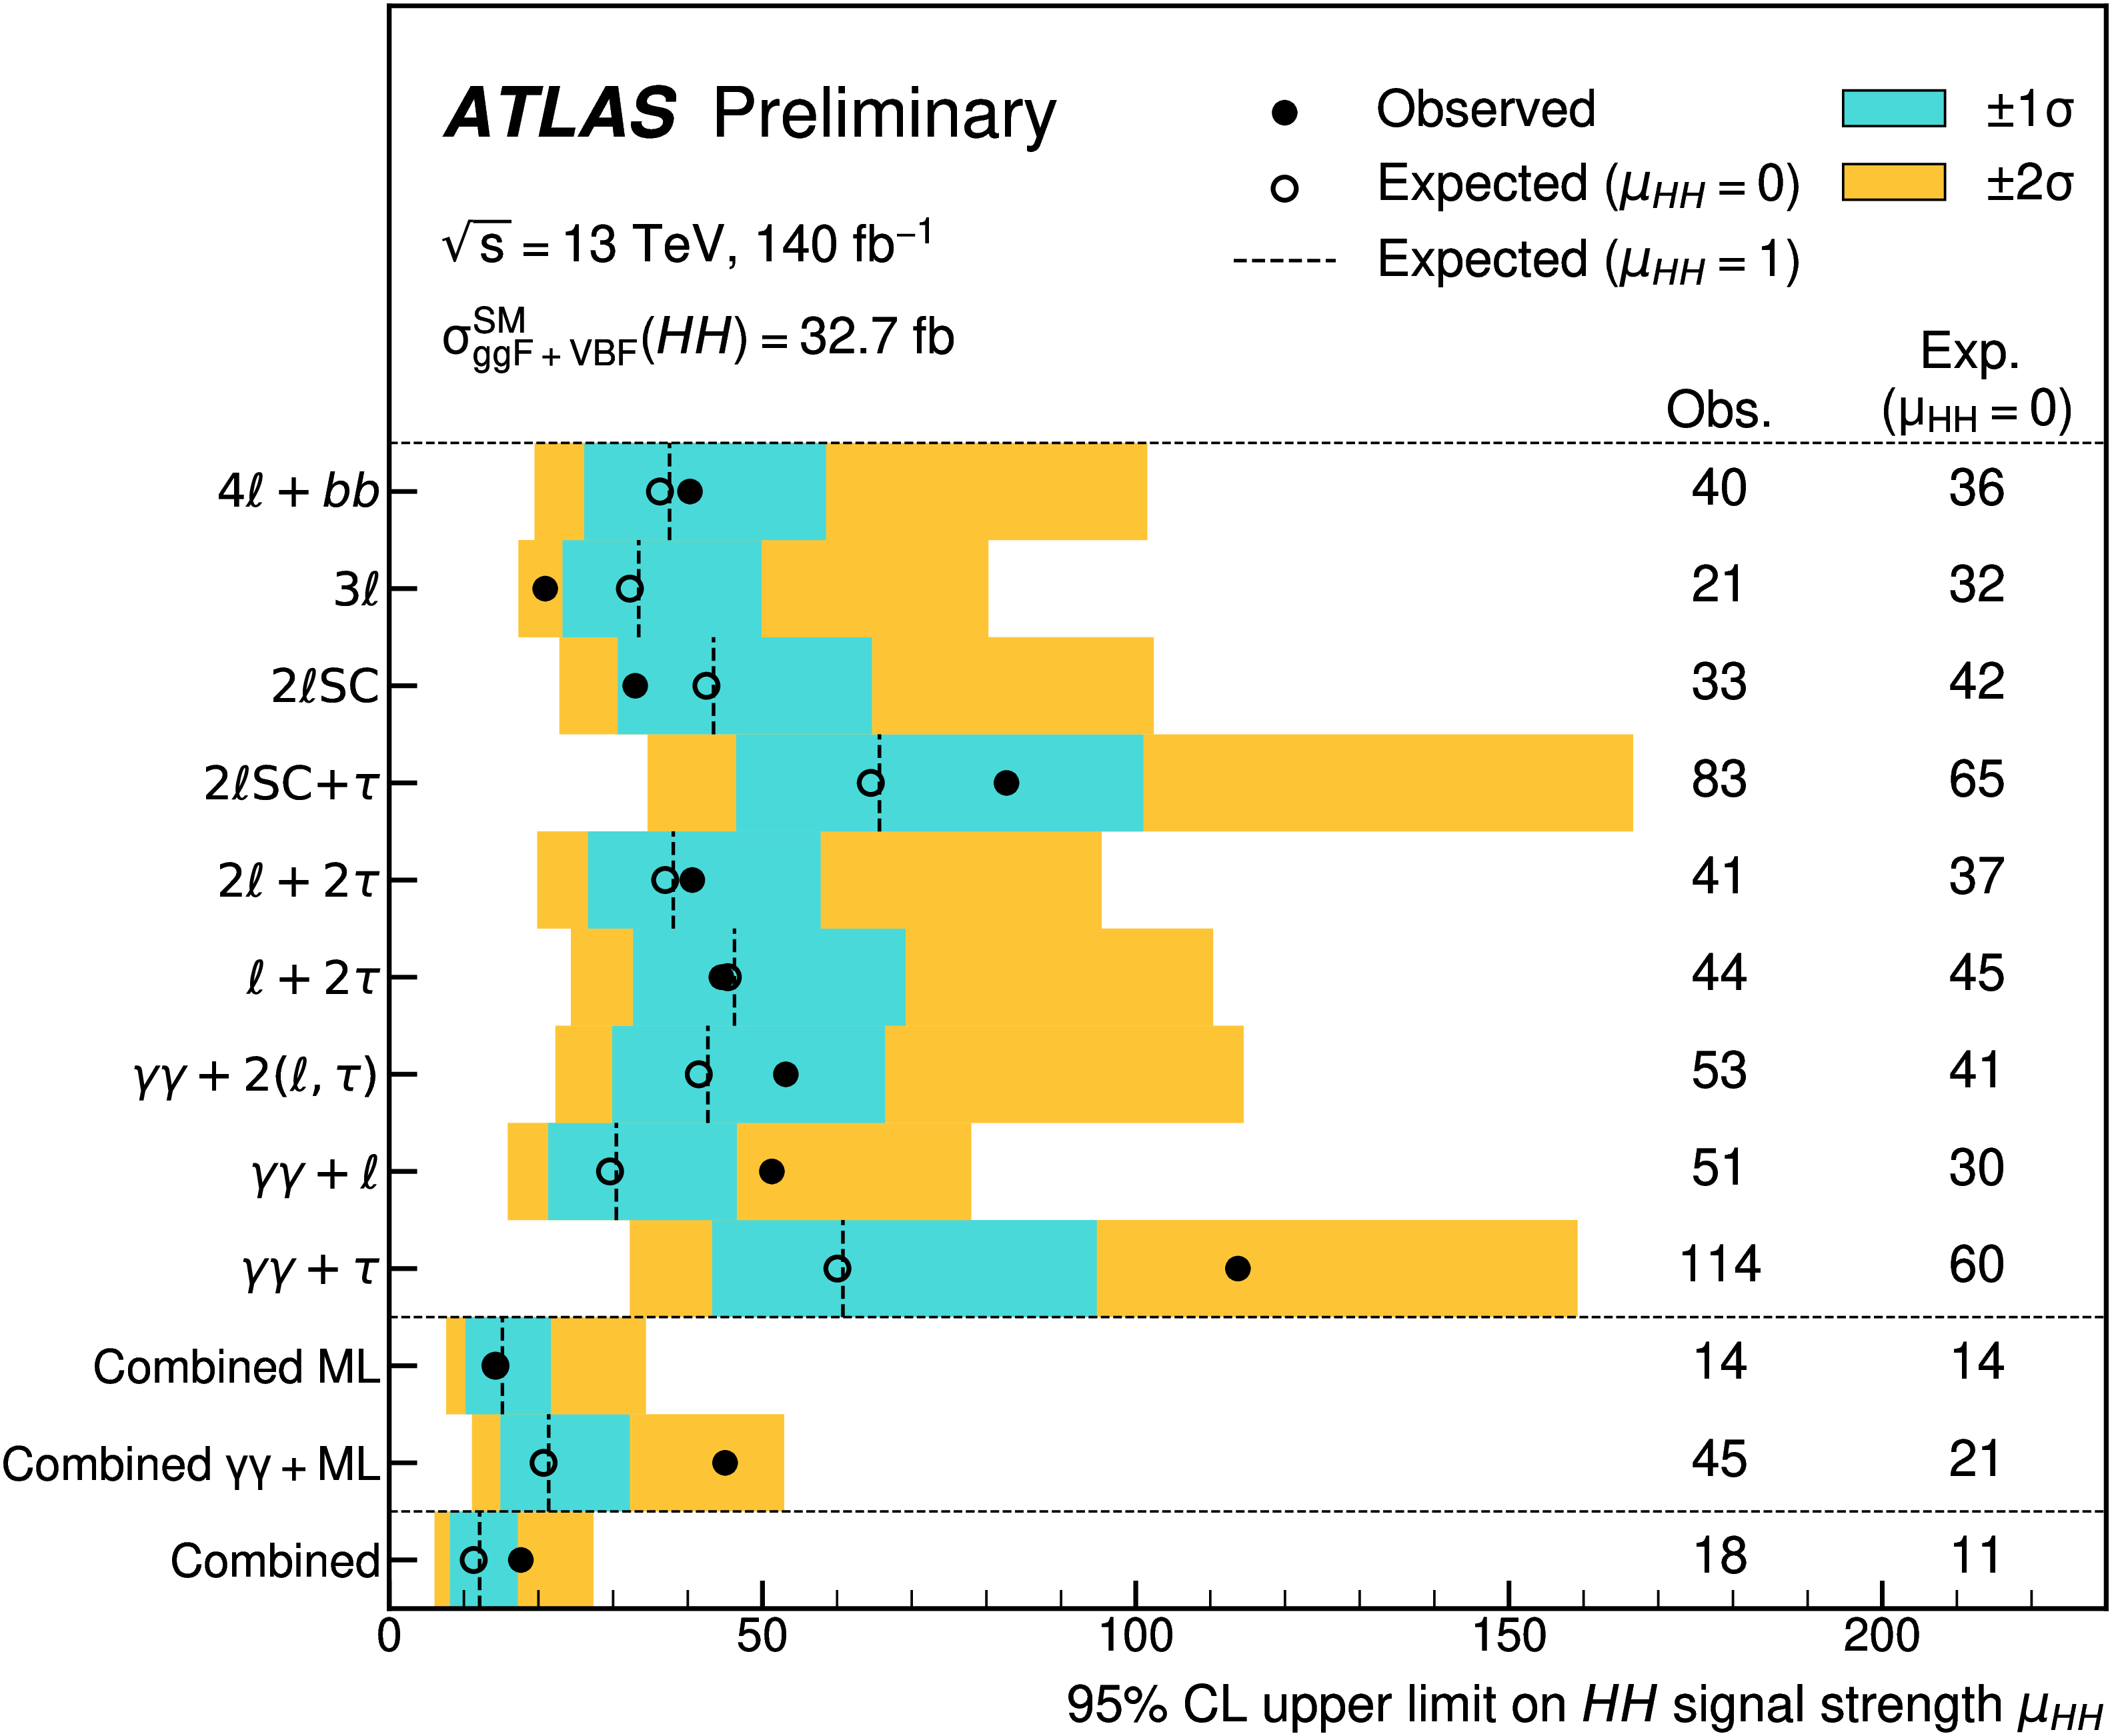
PRL 122 (2019) 231801
PLB 846 (2023) 138223
ZZ bkg. to leading dark matter search
Offshell H→ZZ ➔
$Γ$_{H} < 10.5 MeV
Best sensitivity
Measurement+
ZZ
PRL 131 (2023) 251801
ATLAS-CONF-2024-005
Example of a systematic approach with ZZ
HH → ZZbb
Complementary sensitivity
Sensitive Search for dark photon via Z→4l+X

Slide 17
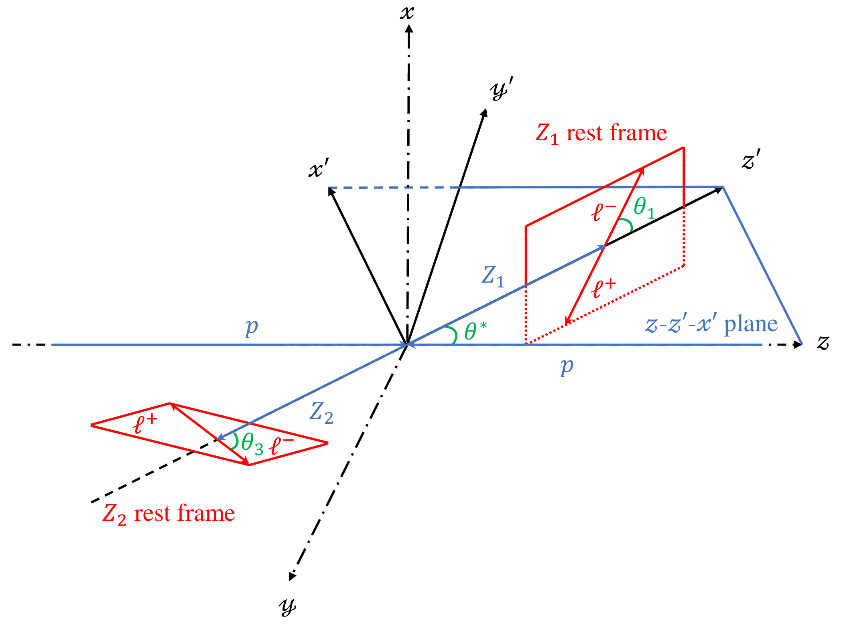
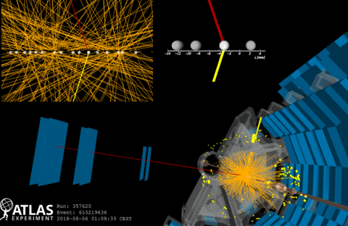
Summary/Outlook
Effective Field Approaches
MBP had a comprehensive development since start of LHC
To significantly improve on measurement precision
Property/Mechanism Exploration
Rich in physics and unique place to look for next surprises!
To pursue the benefit of adding intrinsic dimension / scrutiny
Adventure into New Territory
Very active field,
Please pay attention to other topics in this session!
To systematically plan ahead

Slide 18
THANKS

