Slide 1
What I talk about
When I talk about
Nuclear shape
M. Kimura (RIKEN)
Shape of ¹²C
Shape of ²⁰Ne

Slide 2
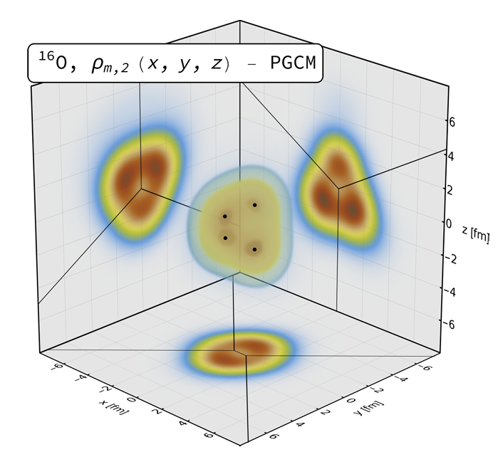
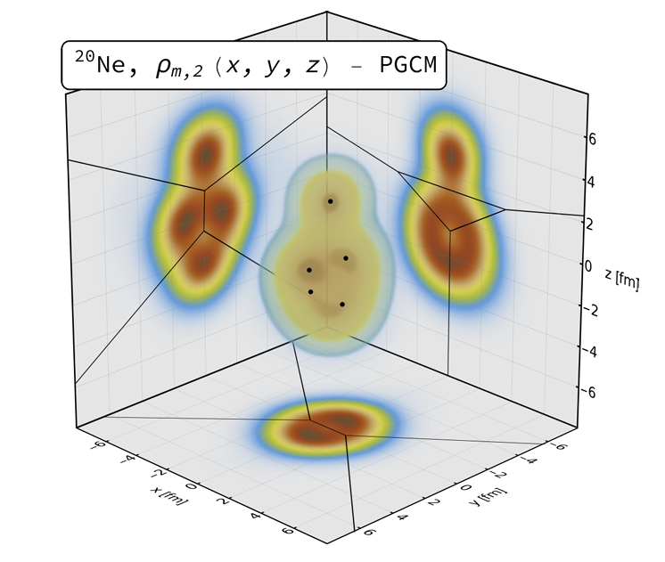
Shape of nuclei from high energy collisions
I’m really excited to learn that high energy nuclear collisions provide us
great opportunities to probe nuclear shape !
A bowling pin
in femto-scale
G. Giacalone, et al., arXiv.240295995
Today, let me tell you what I talk about shape of ¹²C and ²⁰Ne

Slide 3
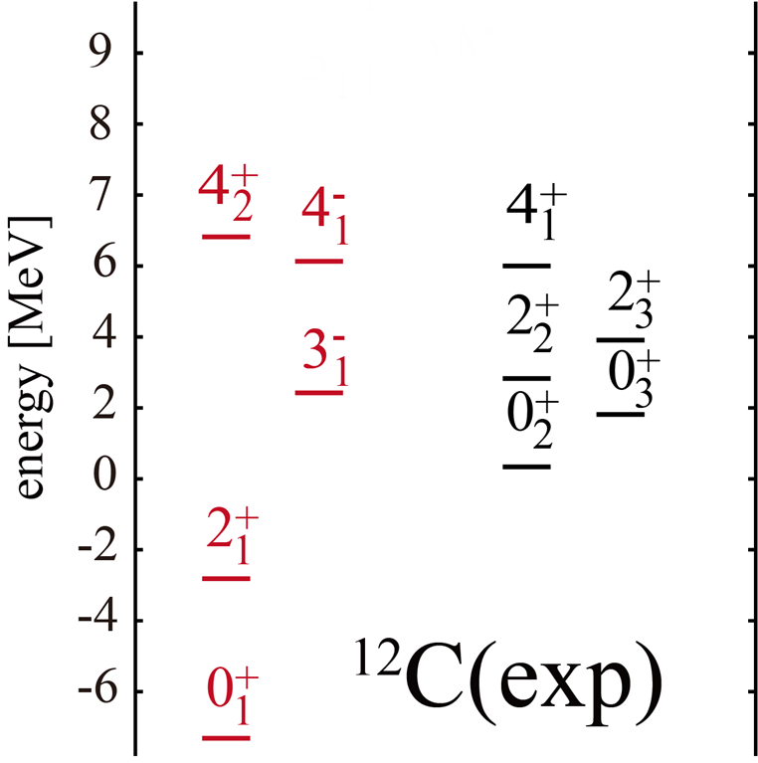
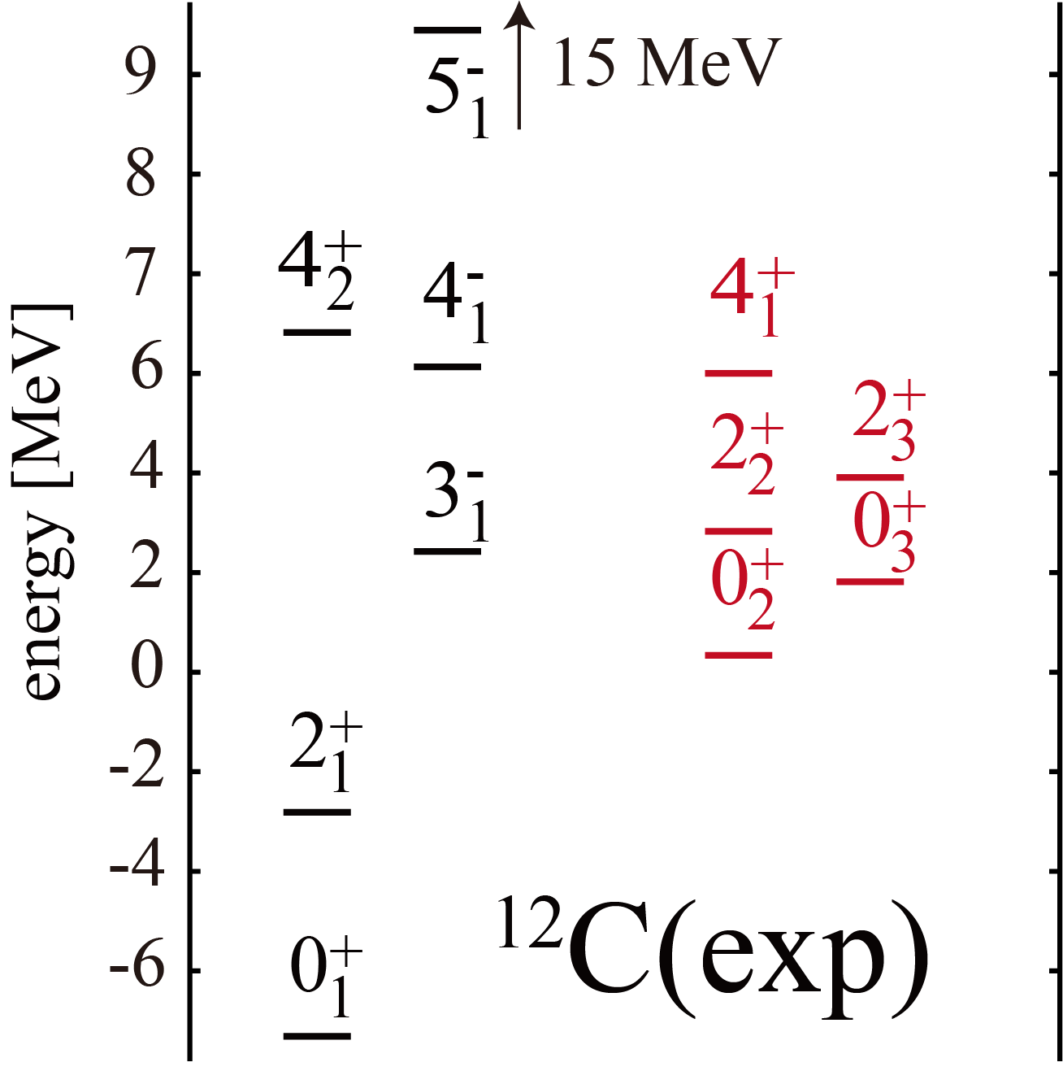
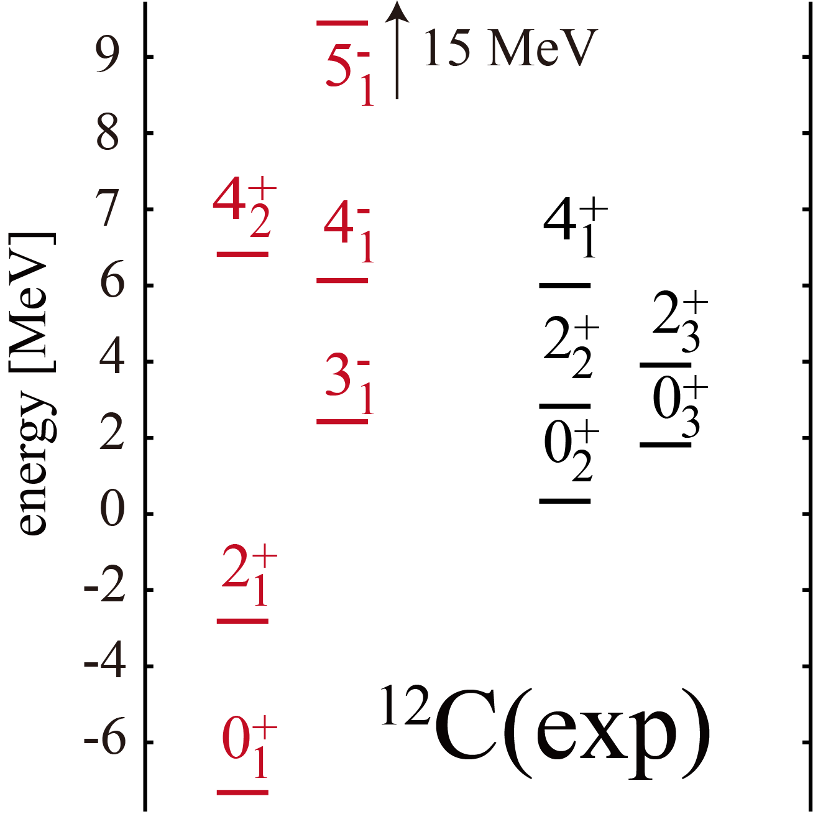
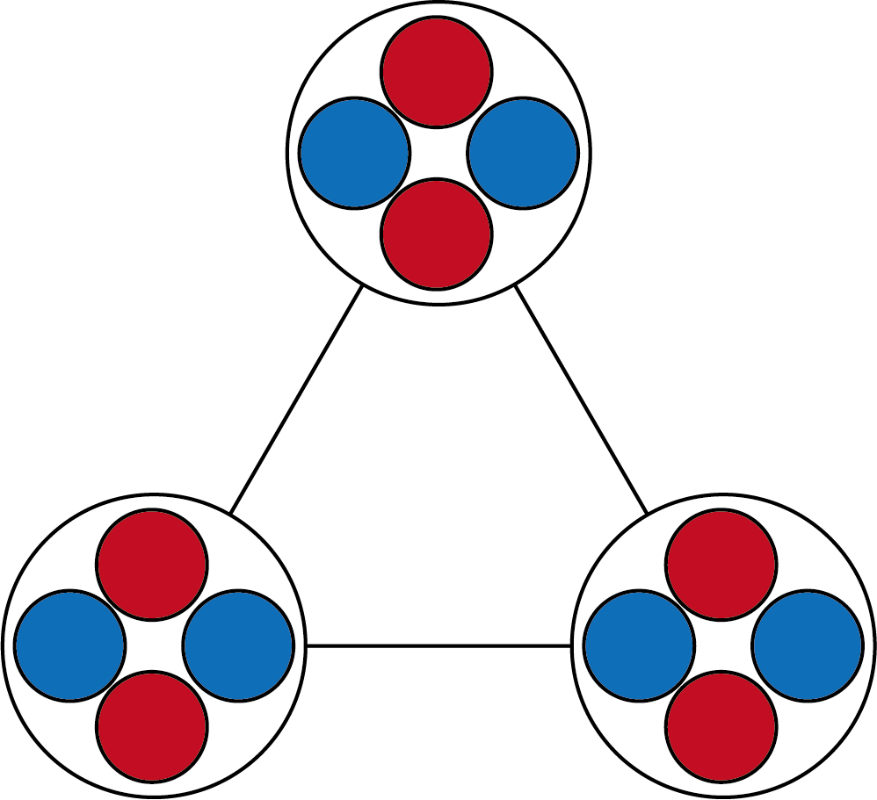
Two different aspects of ¹²C
Spinning triangle of Alphas
Alpha particle BEC
Three alpha particles locate
in a triangle configuration (D_{3h} symmetry)
The Hoyle state and neighboring states are Bose-Einstein condensate of α particles.
R. Bijker and F. Iachello, PRC61, 067305 (2000).
A. Tohsaki, H. Horiuchi, P. Schuck, G. Röpke,
PRL87, 192591 (2001).
◎ Due to the symmetry, 0⁺, 2⁺, 3⁻, 4±, 5⁻
states constitute “ground band”
B. Zhou et al., Nature Comm. 14, 8206 (2023).
◎ 4⁺ and 4⁻ states should degenerate
◎ 5⁻ state should exist

Slide 4
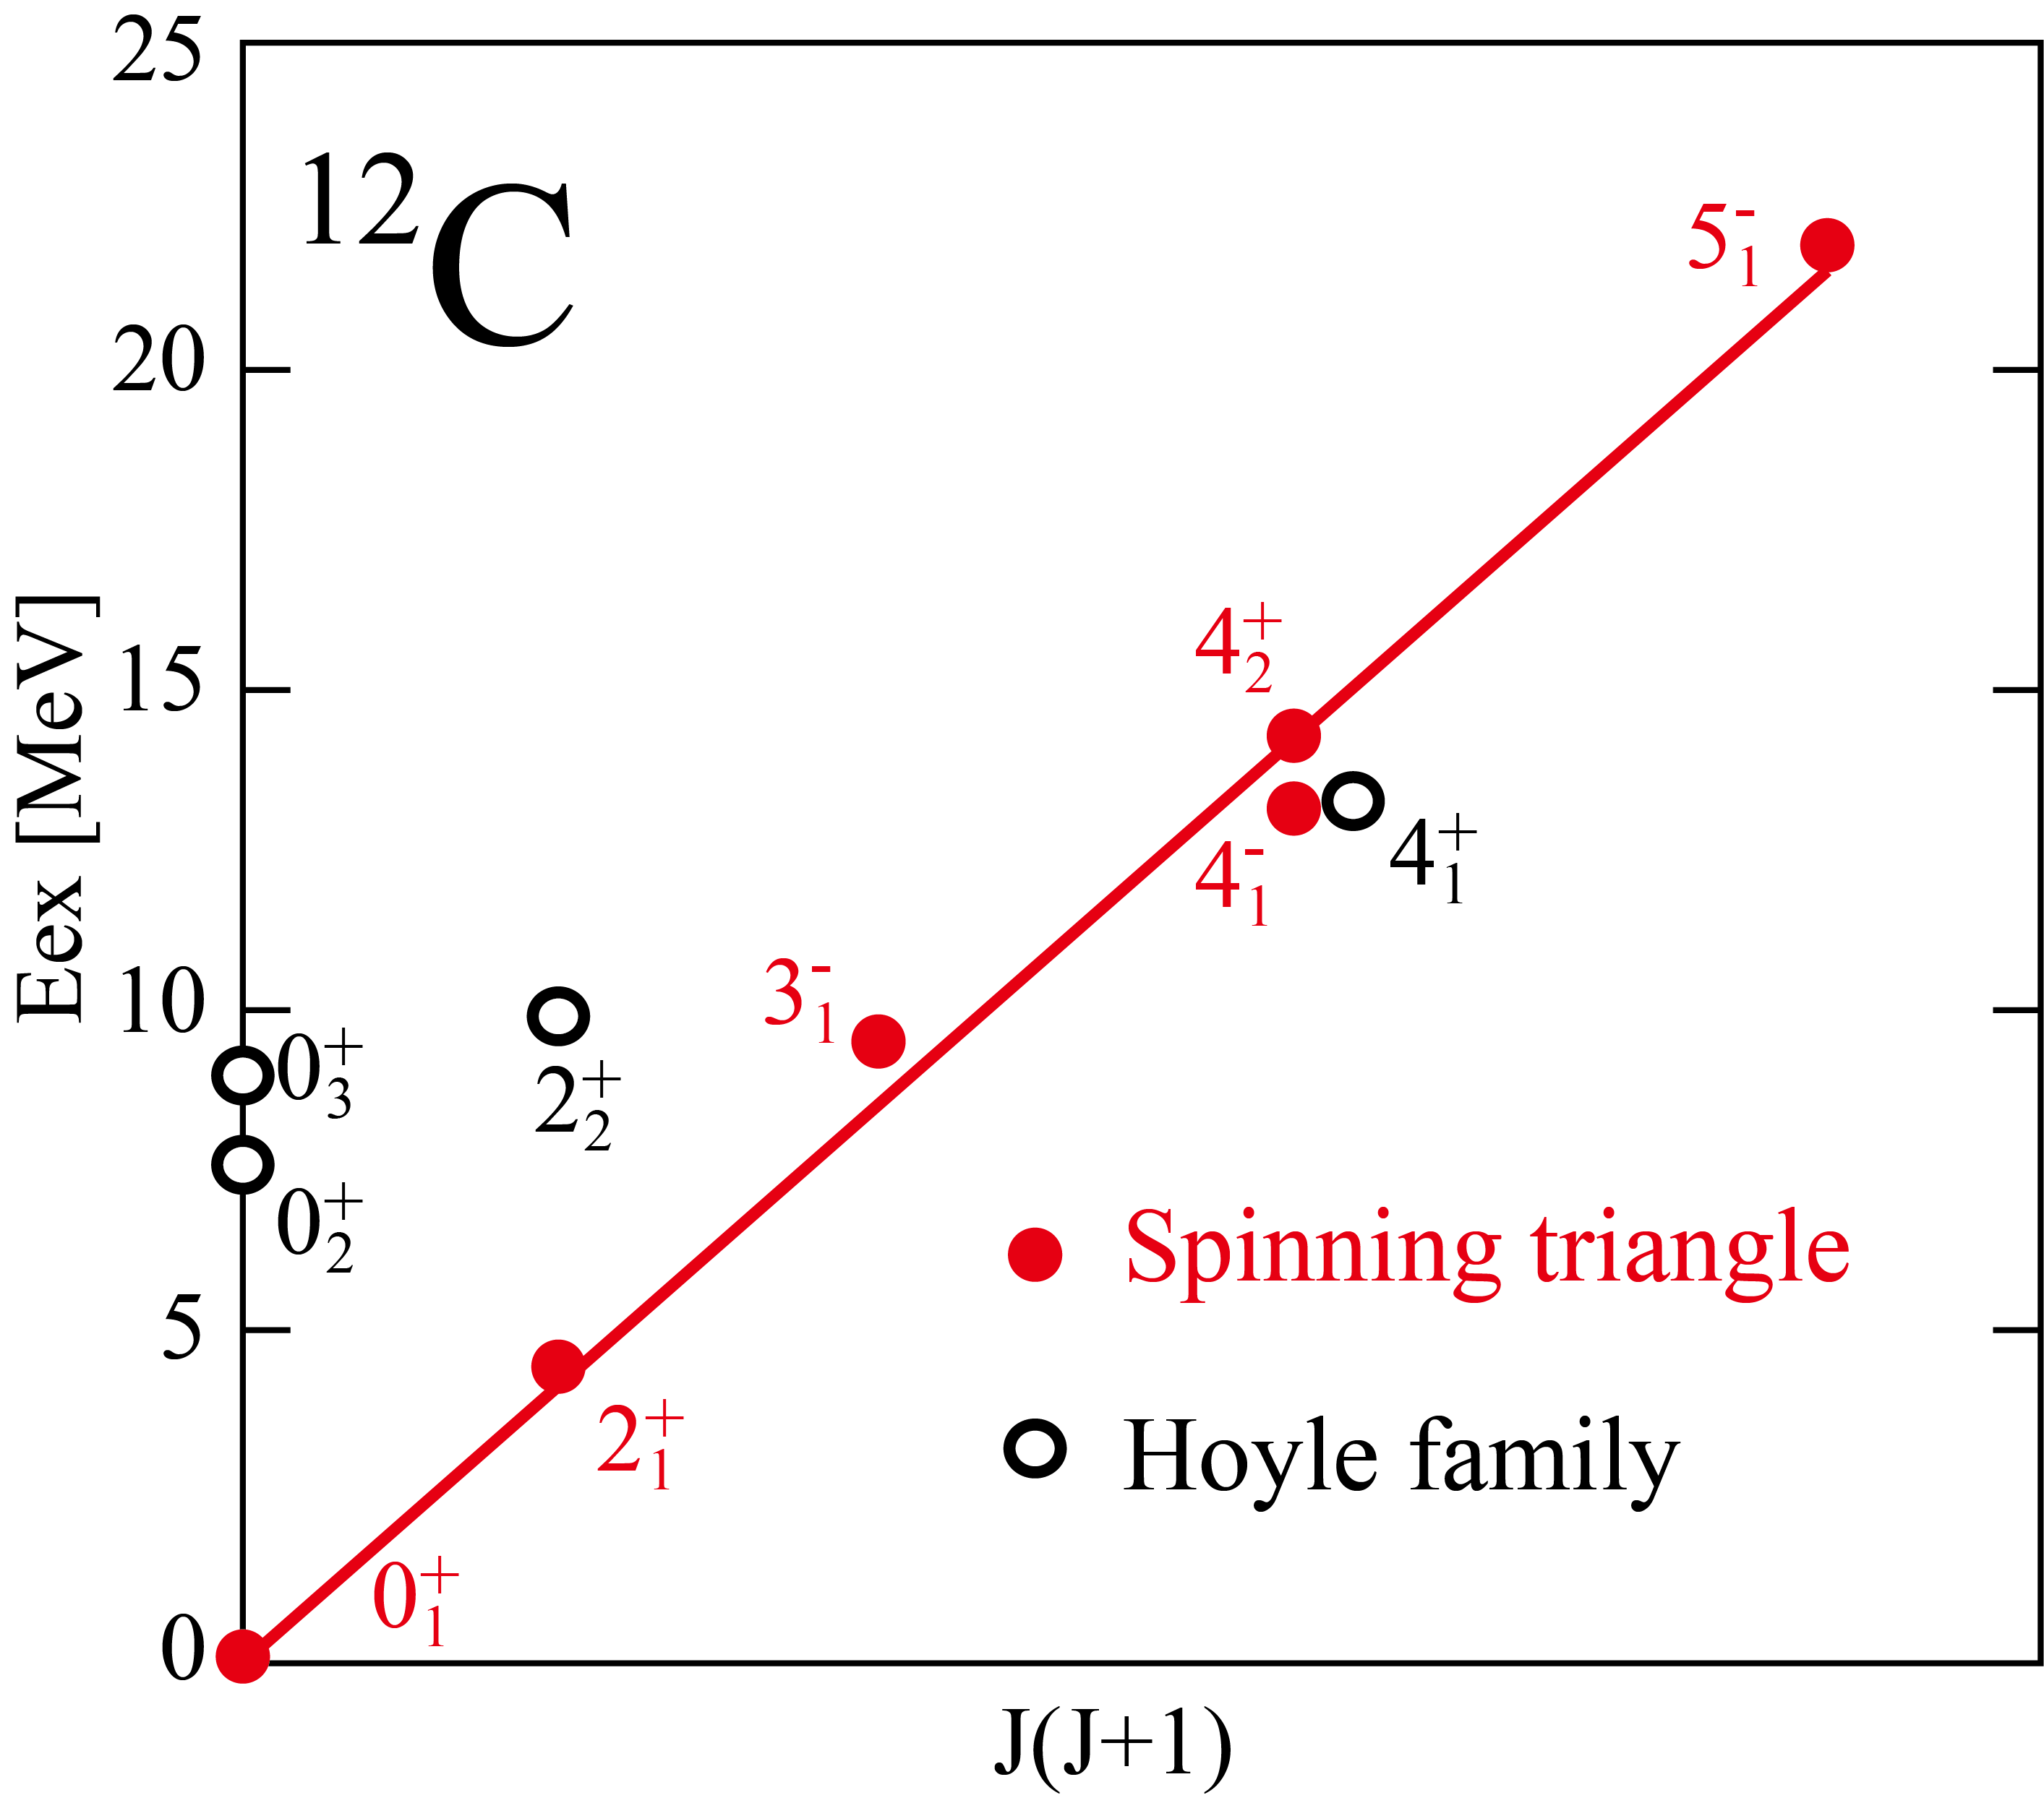
Two different aspects of ¹²C
Spinning triangle of Alphas
D.J. Marín-Lámbarri, et al. PRL113, 012502(2014)
Three alpha particles locate
in a triangle configuration (D_{3h} symmetry)
R. Bijker and F. Iachello, PRC61, 067305 (2000).
◎ Due to the symmetry, 0⁺, 2⁺, 3⁻, 4±, 5⁻
states constitute “ground band”
◎ 4⁺ and 4⁻ states should degenerate
◎ 5⁻ state should exist

Slide 5
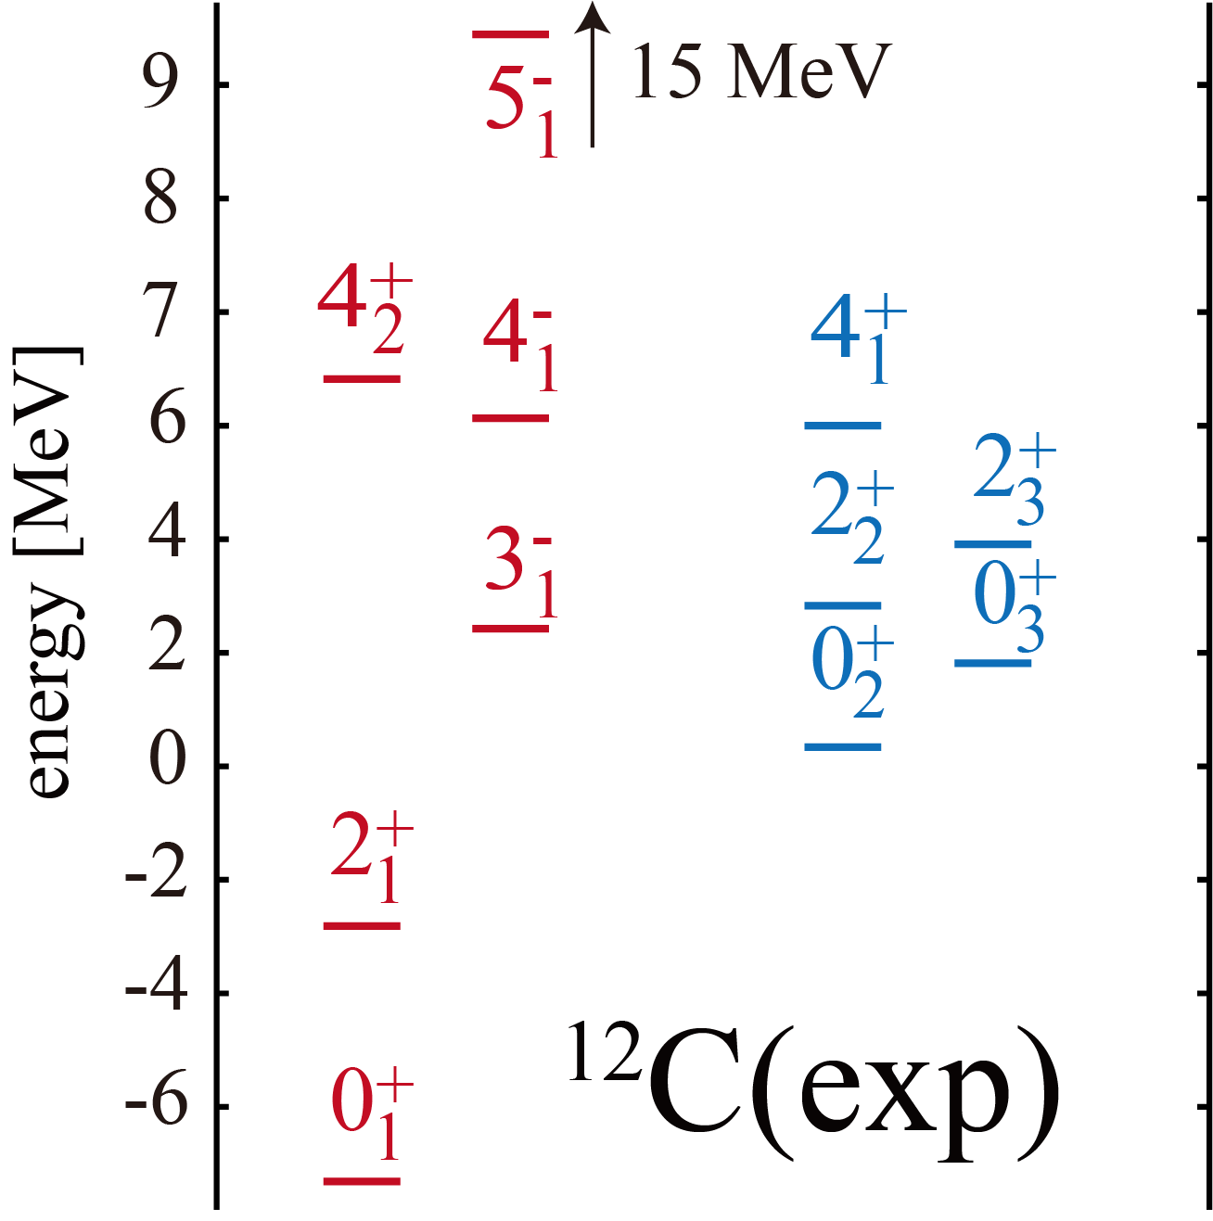
Two different aspects of ¹²C
Two different phases coexist in a single nucleus
Triangle
of alphas
Bosonic
gas of
alphas

Slide 6
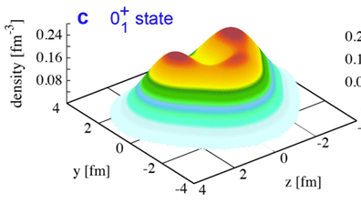
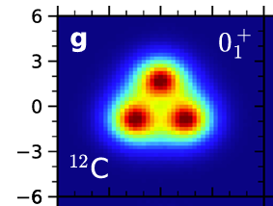
Two different aspects of ¹²C
Let me discuss shape of the ground band
only from exp. data with minimal assumption
Triangle
of alphas
LSSM
Bosonic
gas of
alphas
Shape of ¹²C from theories
Lattice EFT

Slide 7

Rebuilding nuclear shape form observables
M.K. and Y. Taniguchi, EPJA 60, (2024)

Slide 8
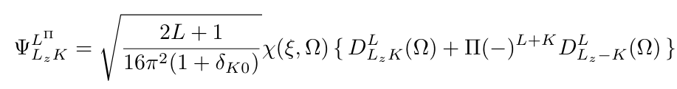
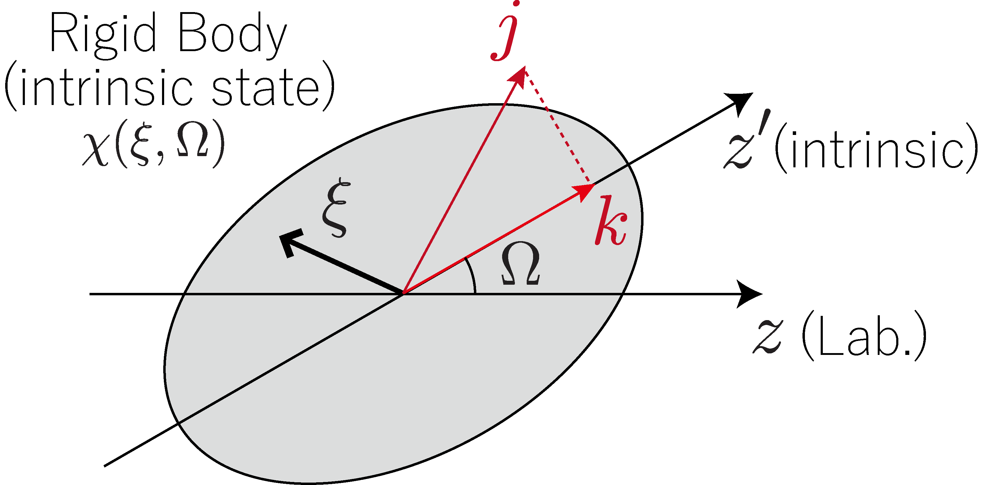
Rebuilding nuclear shape from observables
I only assume that the 0⁺, 2⁺, 3⁻ and 4⁺ states constitute
“the ground band” sharing the same intrinsic state
(This is the only assumption I made)
Non-axial and parity-asymmetric rigid rotor (a textbook matter)
laboratory
(observable)
intrinsic
(unobservable)

Slide 9
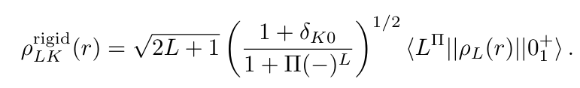
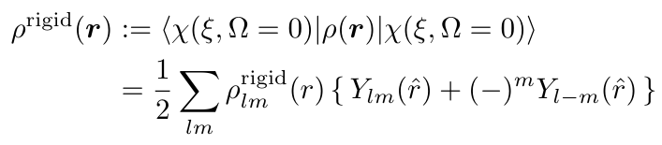
Rebuilding nuclear shape from observables
Let us consider the diagonal/transition densities (observed by electron scatt.)
Using the rigid-rotor wave function, the diagonal/transition densities can be related to the density of the rigid body (See EPJA 60, (2024) for derivation)
multipole decomp.
rigid-body density
(unobservable)
transition density
(observable)
rigid-body density
(unobservable)
multipole decomp.
rigid-body density
(unobservable)

Slide 10
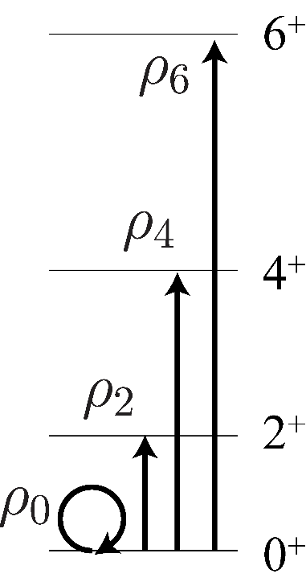
Rebuilding nuclear shape from observables
Actually, this is not a new idea.
In 1970’s, it has been already applied to axial and parity-symmetric rotor case.
¹⁵²Sm; intrinsic density
L.S. Carcman et al., PRC78, 1388 (1978).
Here, we have extended this to the Non-axial and parity-asymmetric cases

Slide 11
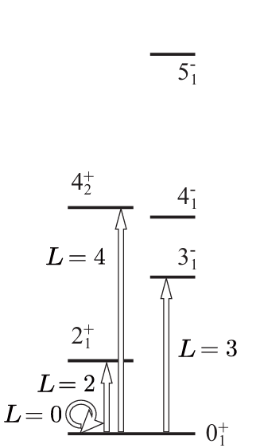
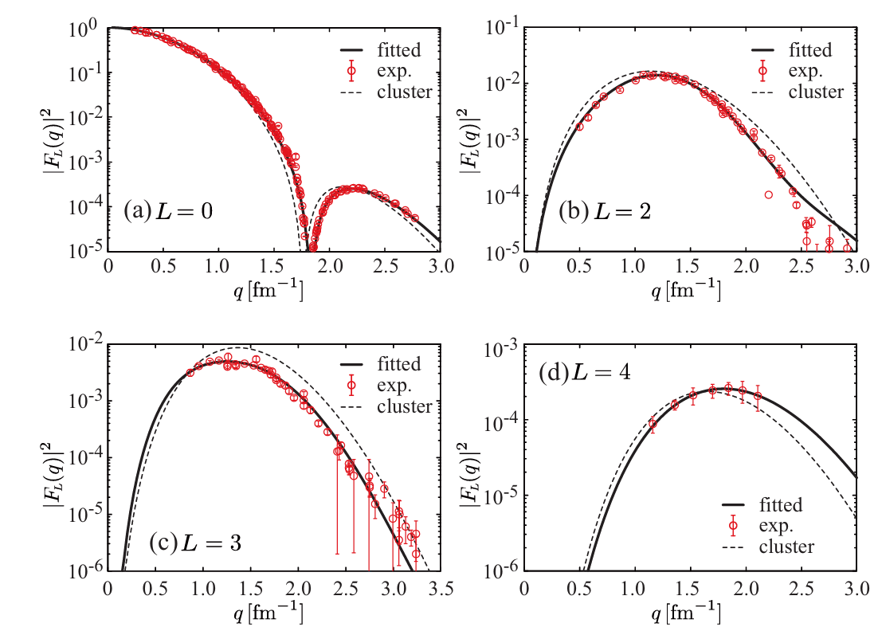
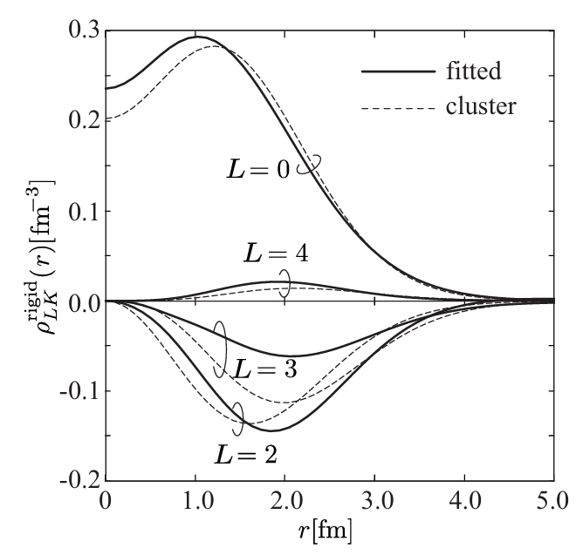
Rebuilding shape of ¹²C
And inverse Fourier transform to the densities.
Diagonal/Transition formfactors (Fourier transform of densities) were measured.
We just fit it (no trick, no theory).

Slide 12
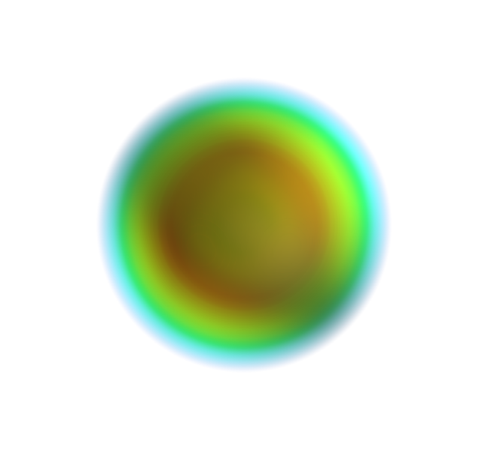
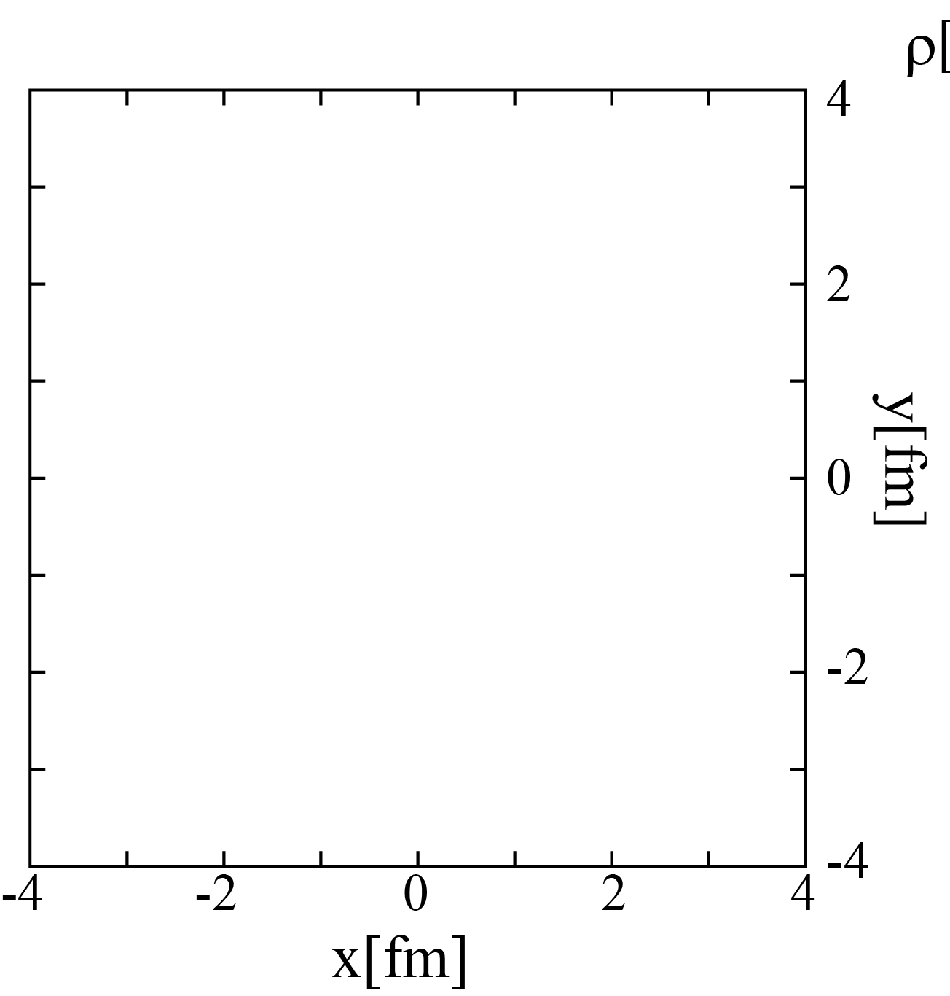
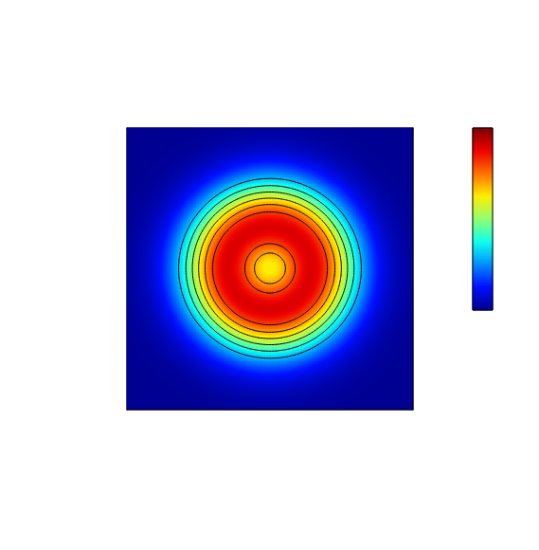
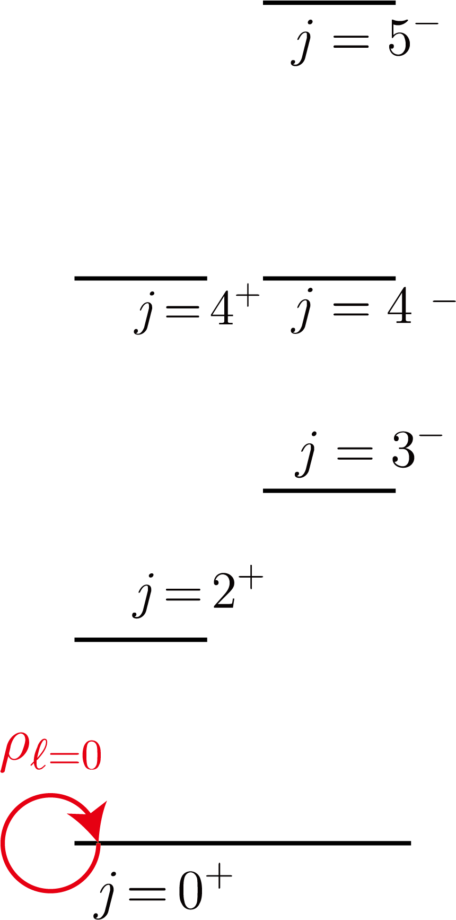
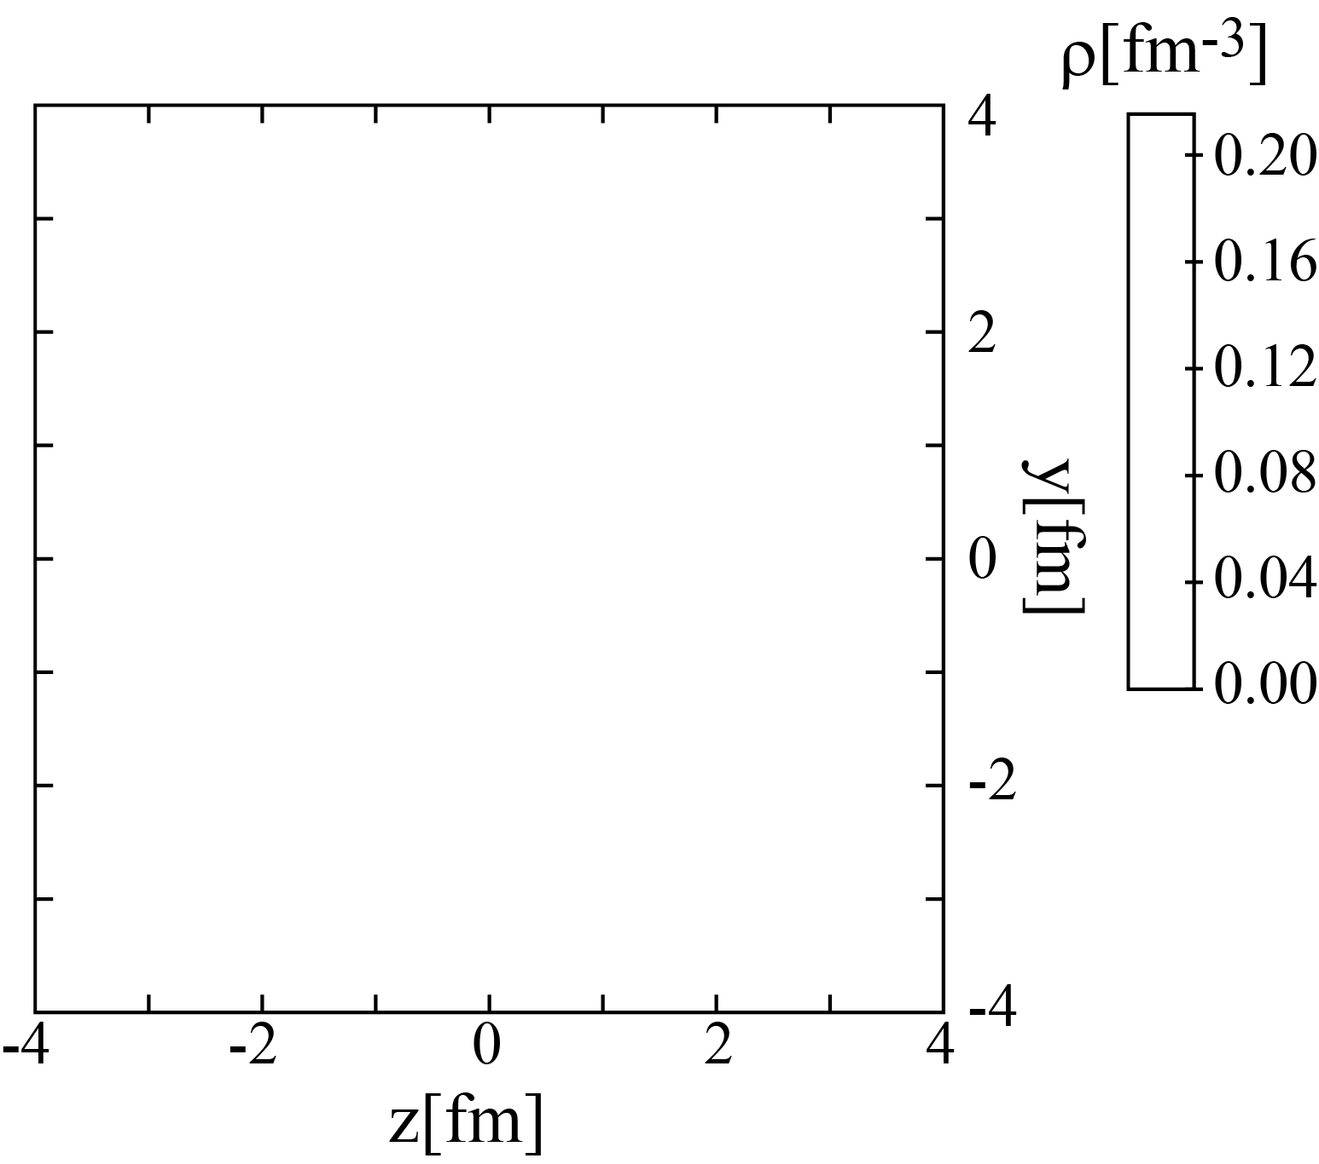

Rebuilding shape of ¹²C
We rebuild the rigid density of ¹²C by superposing the “observed” transition densities
$$ℓ=0$$
rigid-body density
(unobservable)
multipole decomp.
rigid-body density
(unobservable)
With only the $ℓ=0$ density, it is spherical
0.10
0.08
0.06
0.04
0.02
0.00

Slide 13
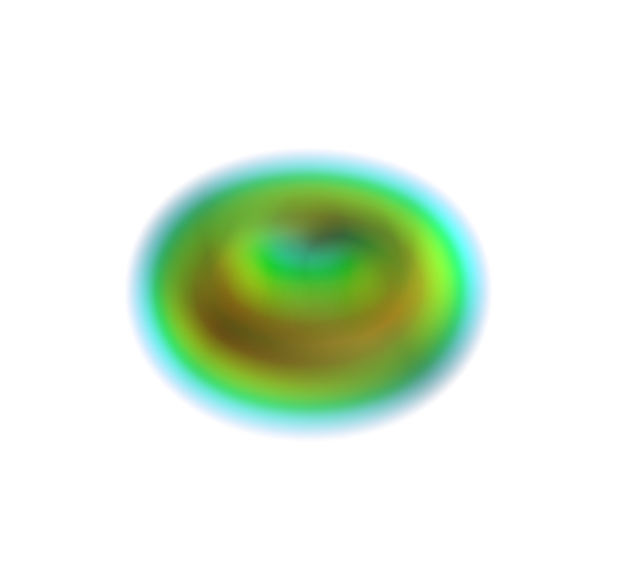
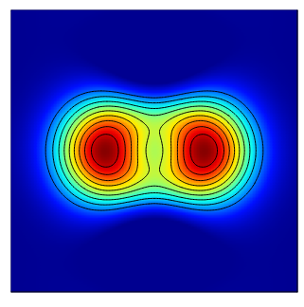
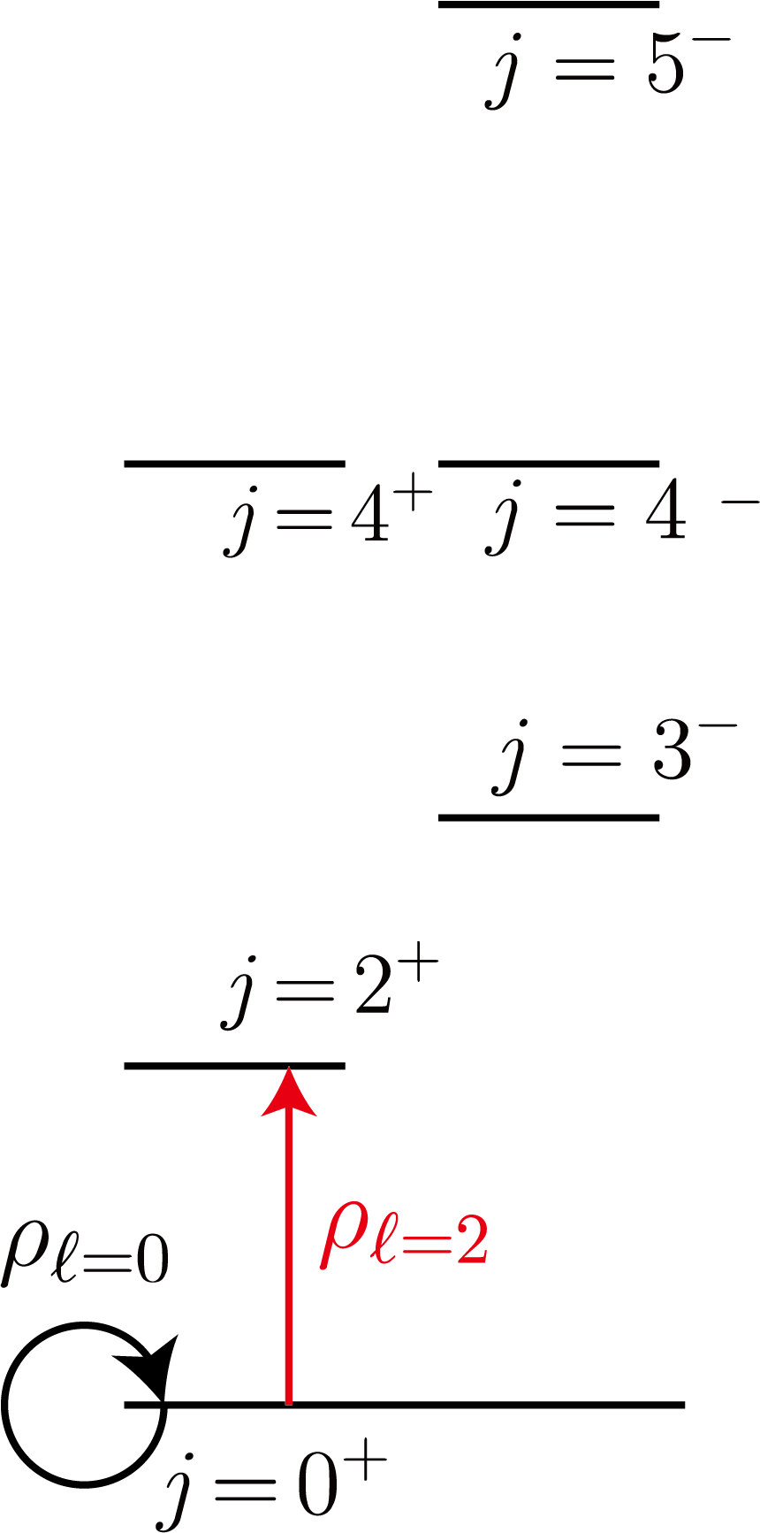
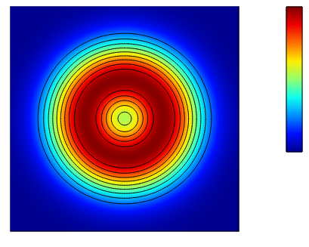

Rebuilding shape of ¹²C
We rebuild the rigid density of ¹²C by superposing the “observed” transition densities
$$ℓ=0+2$$
rigid-body density
(unobservable)
multipole decomp.
rigid-body density
(unobservable)
With only the $ℓ=0$ density, it is spherical
The addition of $ℓ=2$ density makes it toroidal shape
0.10
0.08
0.06
0.04
0.02
0.00

Slide 14


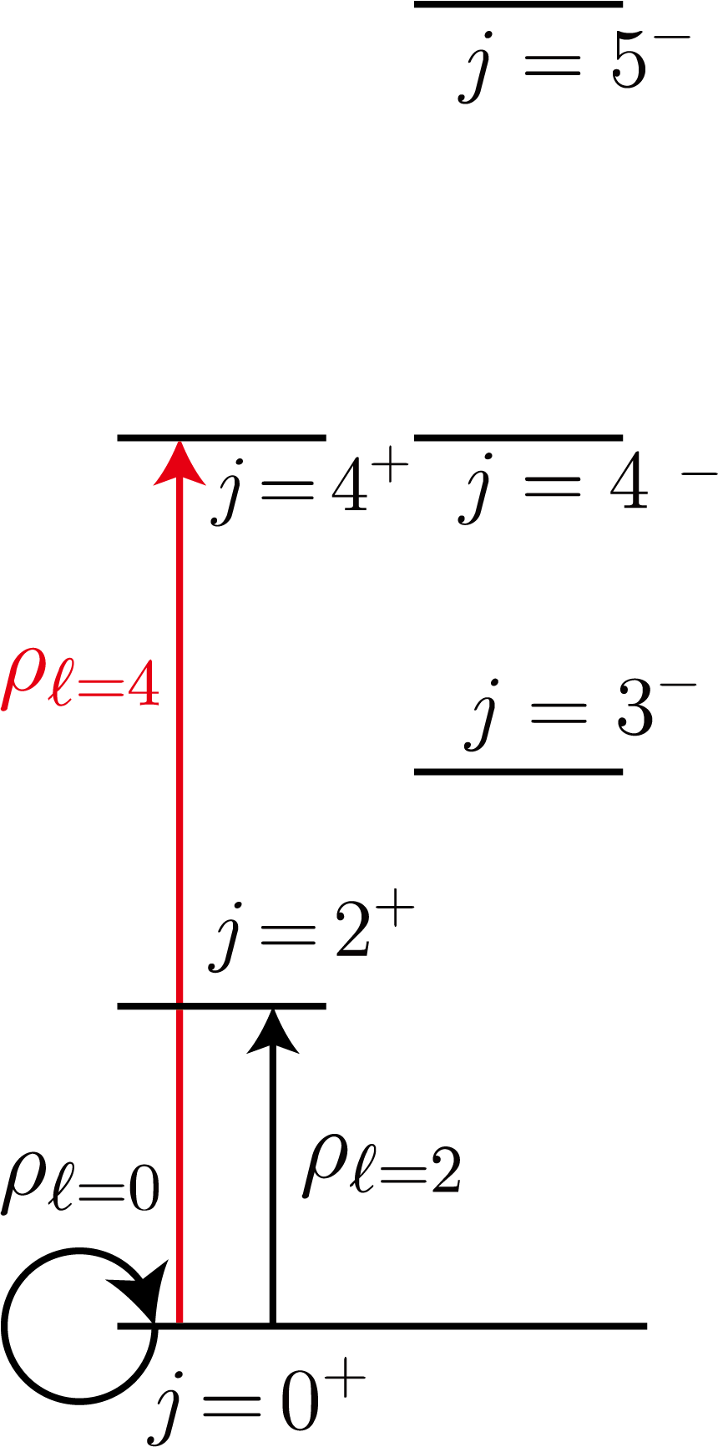
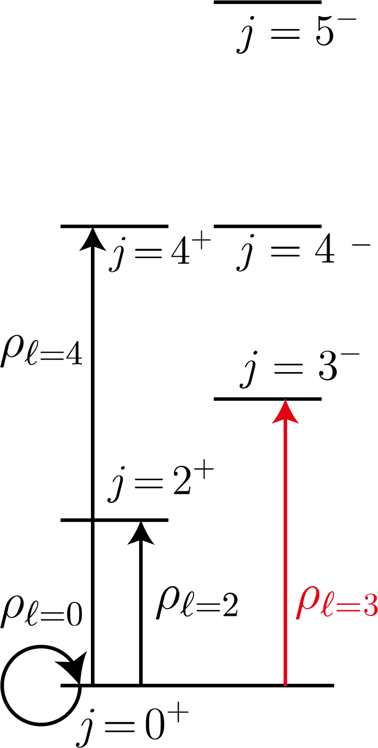
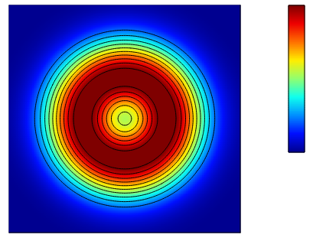

Rebuilding shape of ¹²C
We rebuild the rigid density of ¹²C by superposing the “observed” transition densities
$$ℓ=0^{+}+2^{+}+4^{+}$$
rigid-body density
(unobservable)
multipole decomp.
rigid-body density
(unobservable)
With only the $ℓ=0$ density, it is spherical
The $ℓ=2$ density makes it toroidal shape
0.10
0.08
The $ℓ=4$ density emphasizes toroidal shape
0.06
0.04
0.02
0.00

Slide 15
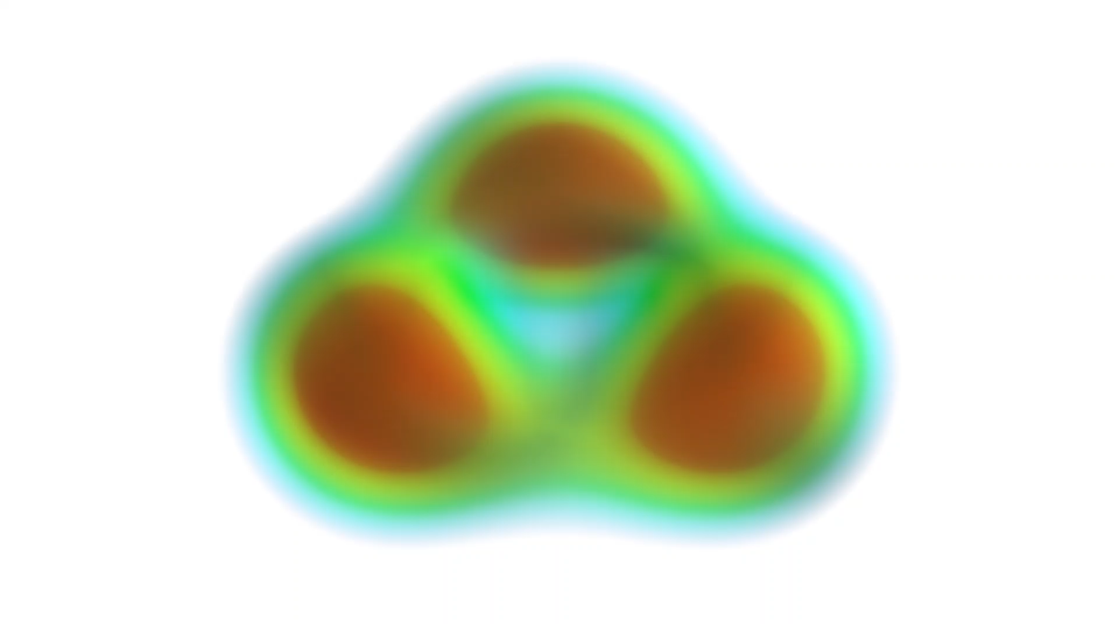
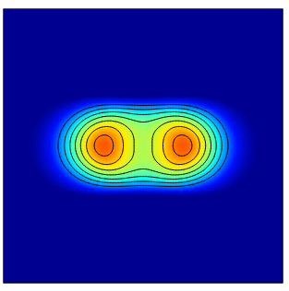
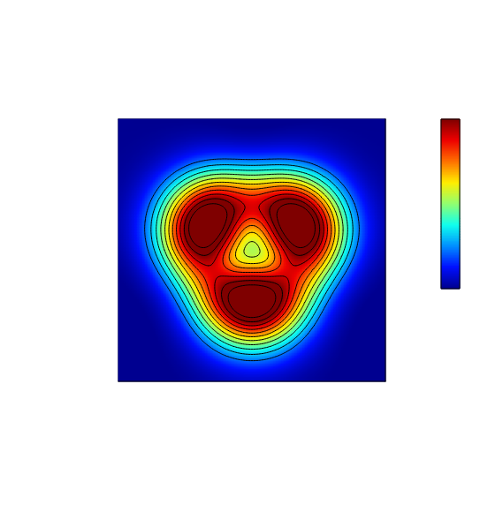

Rebuilding shape of ¹²C
We rebuild the rigid density of ¹²C by superposing the “observed” transition densities
$$ℓ=0^{+}+2^{+}+4^{+}+3^{−}$$
rigid-body density
(unobservable)
multipole decomp.
rigid-body density
(unobservable)
With only the $ℓ=0$ density, it is spherical
The $ℓ=2$ density makes it toroidal shape
0.10
0.08
The $ℓ=4$ density emphasizes toroidal shape
0.06
0.04
0.02
0.00
! ! !

Slide 16
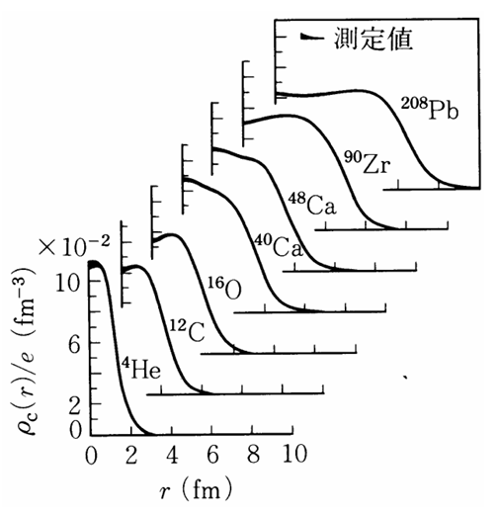
Summary for the shape of ¹²C
I only assumed that the 0⁺, 2⁺, 3⁻ and 4⁺ states constitute
“the ground band” sharing the same intrinsic state
(This is the only assumption I made)
A beautiful triangular shape of ¹²C showed up!
(3 alphas?)
0.10
0.08
0.06
Density at the vertex is as high as 0.11 fm⁻³ which is much larger than typical density (～ 0.08 fm⁻³).
Do you think this is unrealistic (no saturation)?
0.04
0.02
0.00
Among all nuclei, there is only one nucleus
which has such high central density.
That’s alpha particle (0.11 fm⁻³).
Do you think that this is an accidental coincidence?
M.K. and Y. Taniguchi, EPJA 60, (2024)

Slide 17
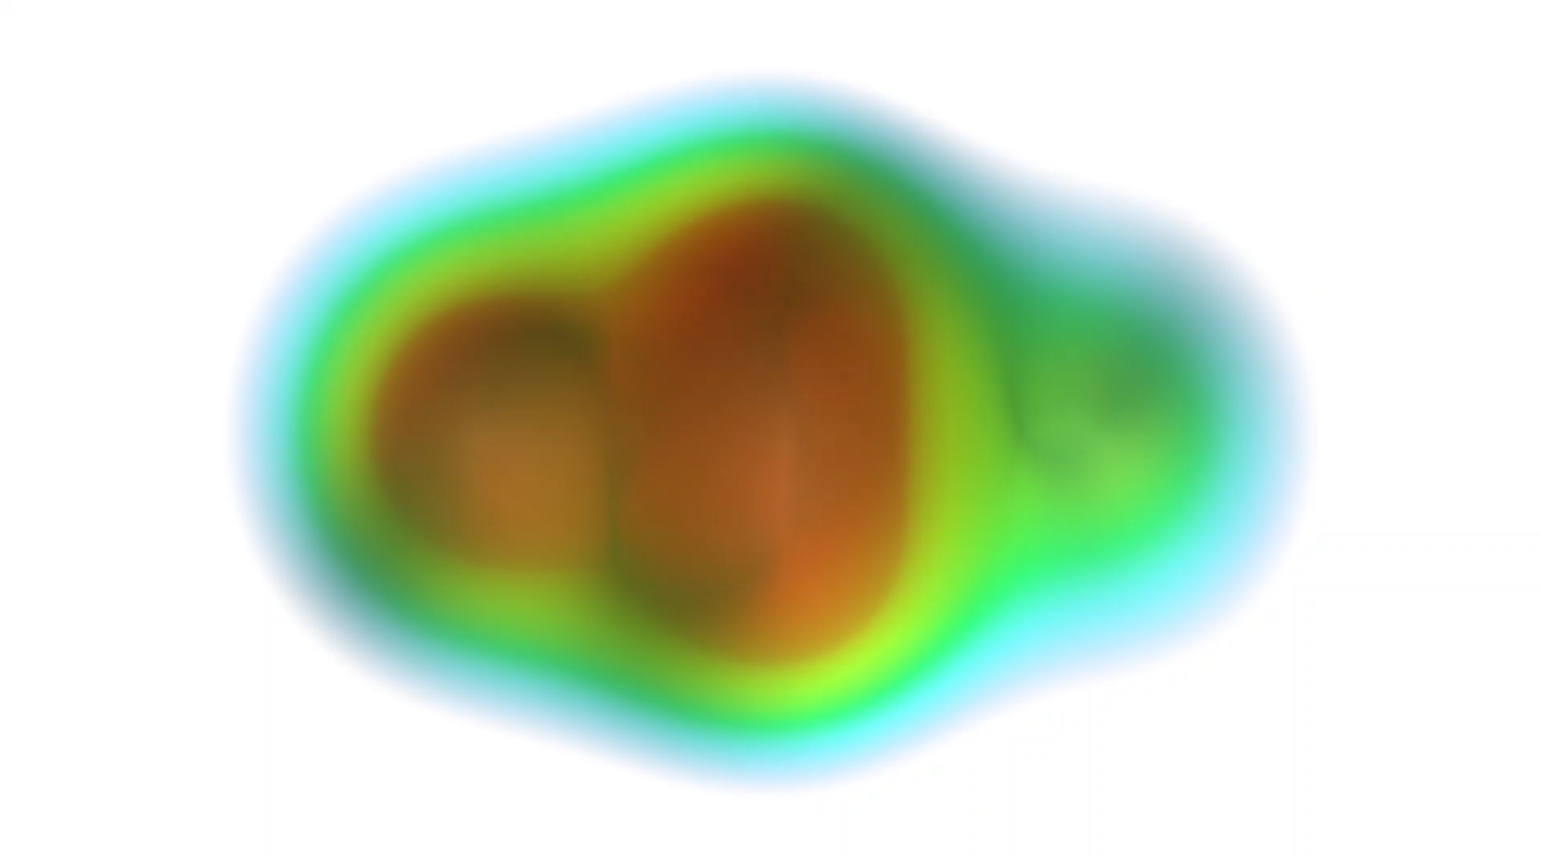
Shape of ²⁰Ne
a bowling pin
in femto-scale

Slide 18

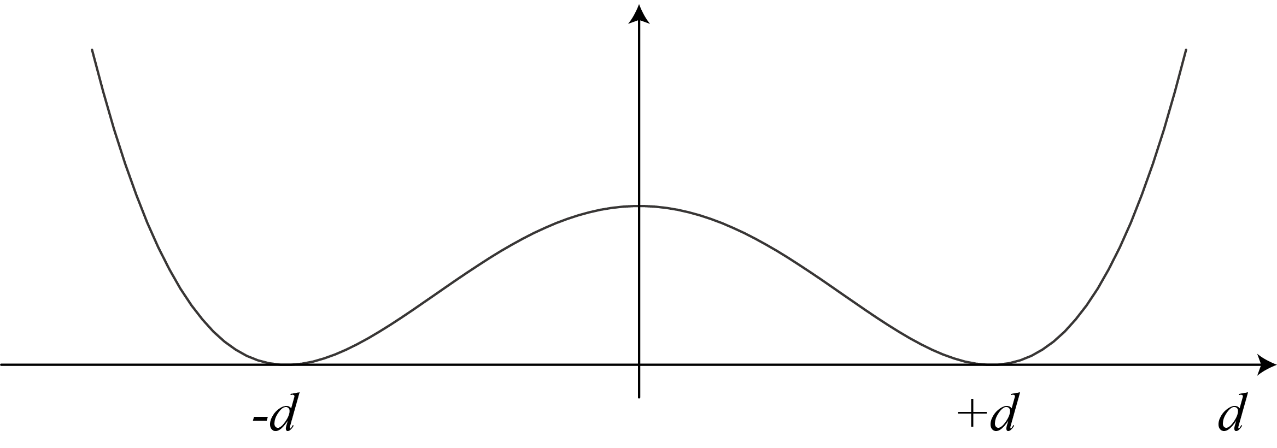
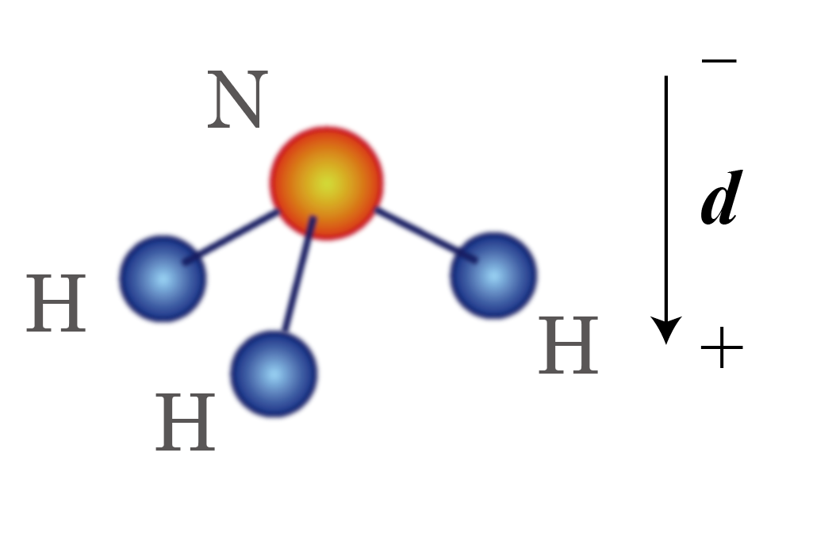

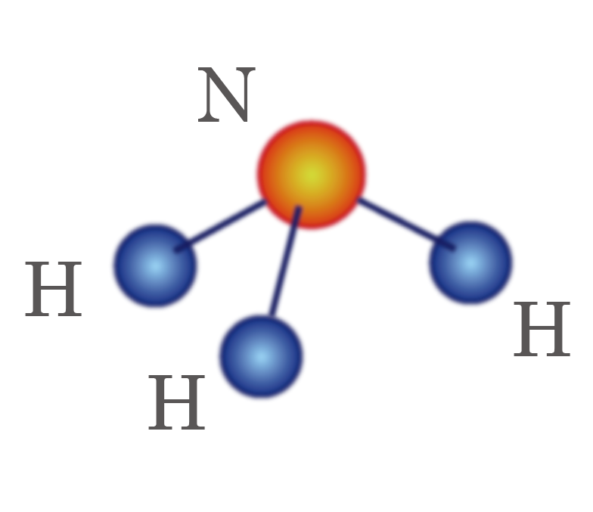
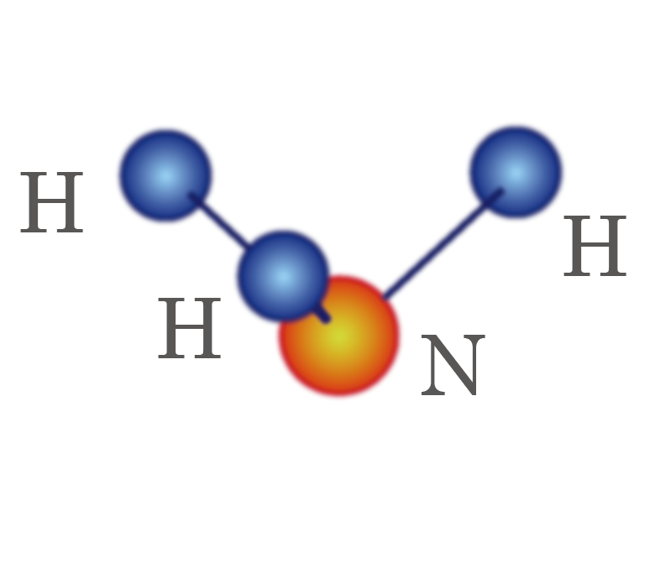
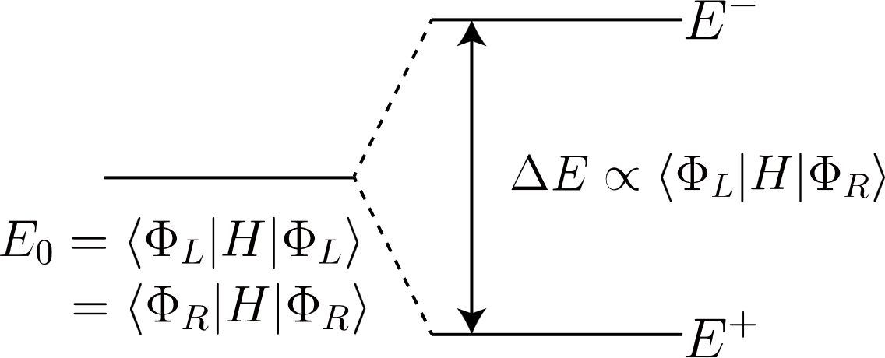
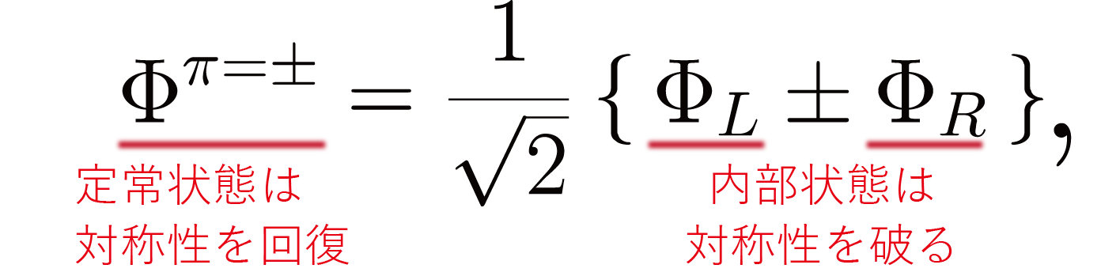

Why ²⁰Ne is a bawling pin?
It’s well known as the parity symmetry breaking of the intrinsic state
A most famous example: inversion doublet of NH₃ molecule
NH₃ molecule breaks parity symmetry. Potential energy surface with two minima
Broken symmetry is restored in the Laboratory frame.
restored sym.
broken sym.
The symmetry restoration splits positive- and negative-parity states
The splitting is proportional to the transition matrix

Slide 19

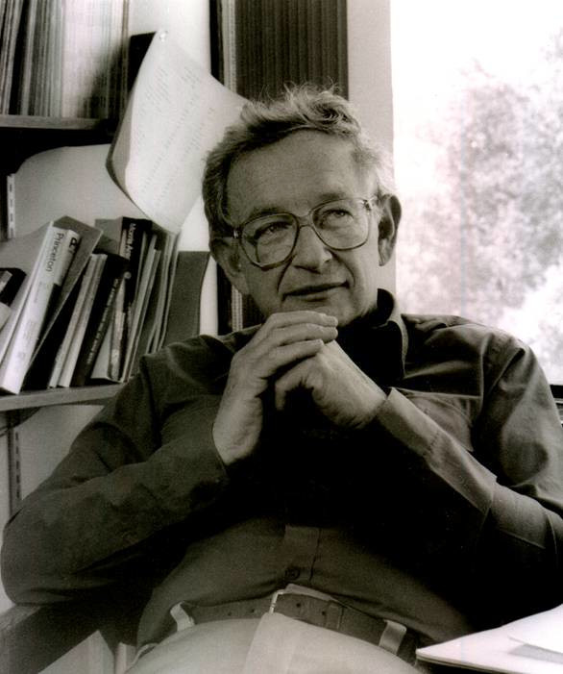
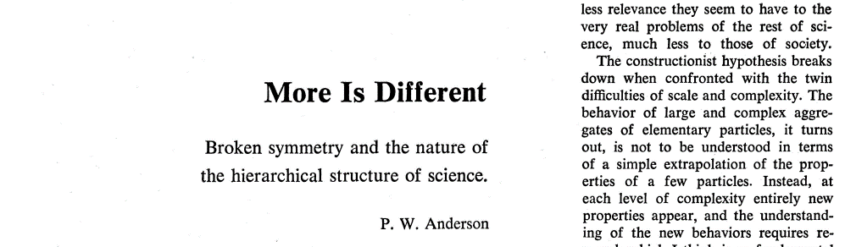
Inversion doublet of NH₃
Let us look at this tunnelling in another way
Consider the time-evolution of a symmetry broken state
E
The system oscillates between through the tunneling
Its frequency (3×10¹⁰Hz) is proportional to the energy splitting and the tunneling probability
See also
P.W. Anderson

Slide 20
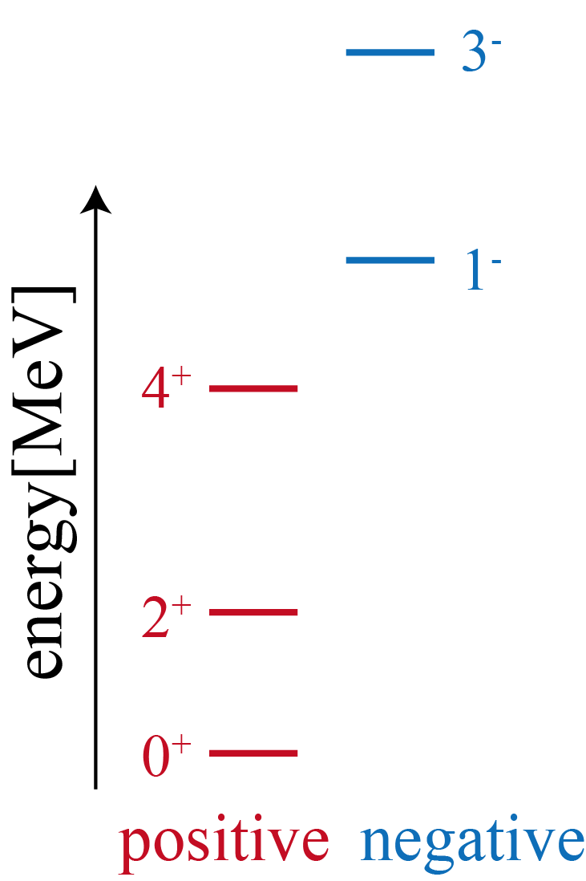
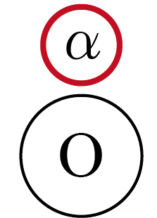
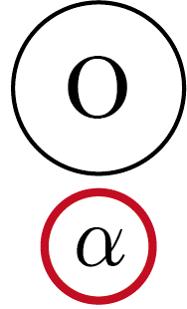
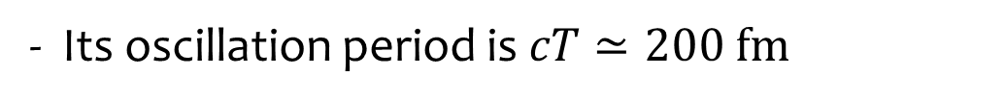
Inversion doublet of ²⁰Ne
It is well known that nuclei have similar inversion doublets
²⁰Ne is the best example.
H. Horiuchi and K. Ikeda, PTP40, 277 (1968).
- ²⁰Ne is composed of ¹⁶O and α clusters
- α cluster tunnels through ¹⁶O
²⁰Ne
5.8 MeV
- Its oscillation period is $cT≃200 fm$
Too fast to be observed in low-energy nuclear physics
but much shorter than the time-scale of high energy nuclear collisions

Slide 21
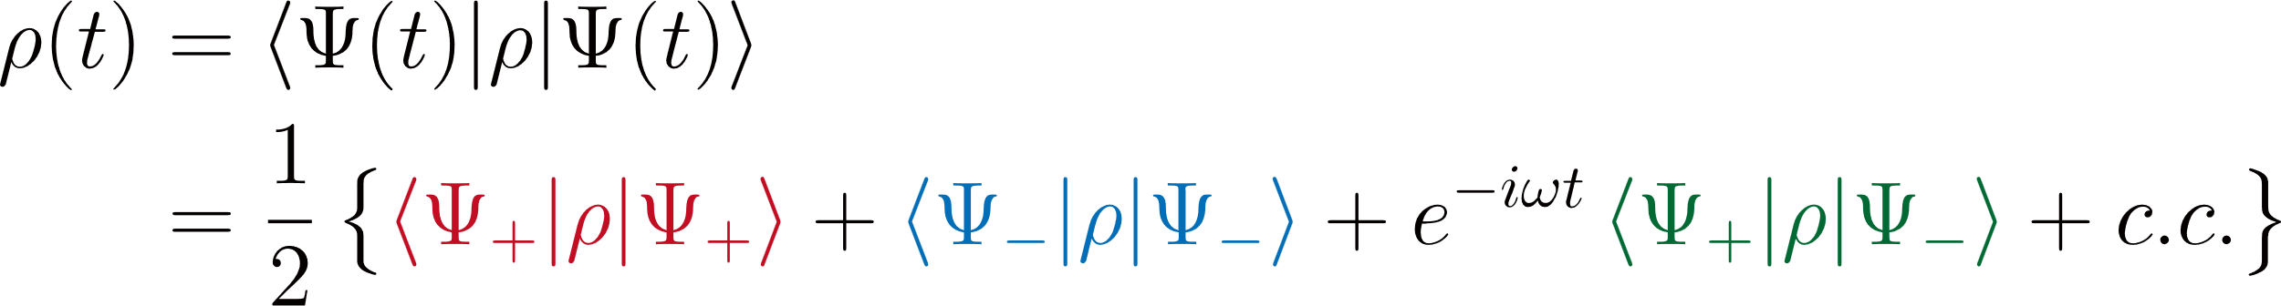
Rebuilding inversion doublet of ²⁰Ne
Let us rebuild the inversion doublet of ²⁰Ne
Time-evolution of a symmetry broken state
and its density distribution (time-dependent)
intrinsic density of
positive-parity band
intrinsic density of
negative-parity band
transition density between
positive and negative bands
Unfortunately, there is not enough electron scattering data
⇨ It’s a pity that we have to rely on the theories…

Slide 22
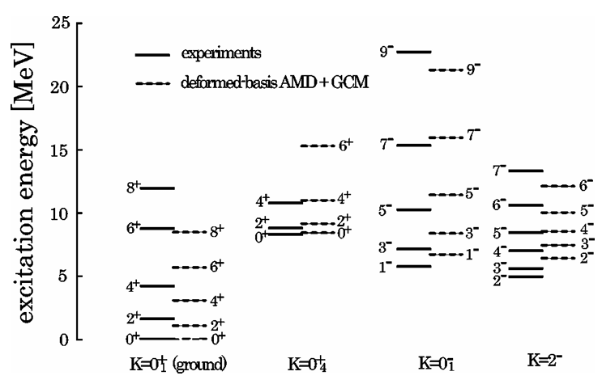
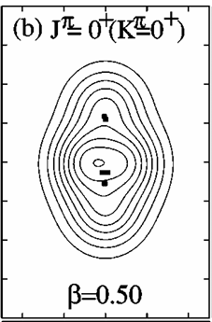


Rebuilding inversion doublet of ²⁰Ne
My old calculation for ²⁰Ne
M. Kimura, PRC69, 0443119 (2004)
- A beyond mean-field calculation by AMD
(AMP+GCM) with Gogny D1S
- It explained most of the observed states
below 15 MeV, and EM transitions
- It yielded symmetry broken intrinsic state
positive
negative

Slide 23





Rebuilding inversion doublet of ²⁰Ne
Time-evolution of a symmetry broken state
and its density distribution (time-dependent)
intrinsic density of
positive-parity band
intrinsic density of
negative-parity band
transition density between
positive and negative bands
$$cT≃200 fm$$
Too fast for low-energy physics but much shorter than the high energy nuclear collisions

Slide 24


Summary: What we talk about When we talk about Nuclear shape
Shape of ¹²C
Minimum assumption: The 0⁺, 2⁺, 3⁻ and 4⁺ states have the same intrinsic state
The electron scattering data reveal a beautiful triangle shape of ¹²C
Shape of ²⁰Ne
We know the inversion motion of ²⁰Ne, but never watched it.
High-energy nuclear collisions might be its first witnesses.
Future
This is just the tip of the iceberg
$$cT≃200 fm$$
⁹Be, ¹⁶O, , … etc.

