Slide 1


Hydrodynamic modeling of high-energy nuclear collisions
SOPHIA
HADRON
PHYSICS
GROUP
Exploring nuclear physics
across energy scales
Beijing, China
Apr.20-23, 2024
Tetsufumi Hirano (Sophia Univ.)

Slide 2
Plan of this talk
Introduction
Constraints on initial conditions from causality
Non-equilibrium components in very low p_{T} region
Summary

Slide 3
1. Introduction

Slide 4
Strategy of QGP study
First Principle
Effective Model
Top-down approach
QGP
Bottom-up approach
Phenomenology
Phenomenological analysis of data by using
“Dynamical Modeling”
Experiment

Slide 5
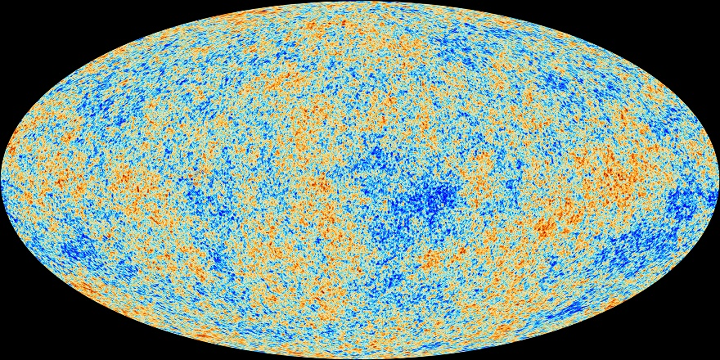
Analysis tool in observational cosmology
Cosmological parameters
Energy budget
Hubble constant (lifetime)
Curvature (flatness)
Information about inflation
…
CAMB, CMBFAST,
CosmoMC,…
Cosmic Microwave Background
Fluctuations of temperature (Planck)
http://www.esa.int/spaceinimages/Images
/2013/04/Planck_CMB_black_background

Slide 6
Analysis tool in high-energy nuclear collisions
Bottom-up approach in high-energy nuclear collisions
Physics properties of the QGP
Equation of state
Shear viscosity
Bulk viscosity
Stopping power
…
?
Y.Zhou, talk at QM2018
Need Standard model/Analysis tool/Event generator
for high-energy nuclear collisions

Slide 7
Dynamical modeling of high-energy nuclear collisions
Final Observables
time
jet
jet
hadron gas
Dynamical Modeling
QGP fluid
Glasma
collision axis
0
Initial Colliding Nuclei
Gluon
saturation

Slide 8
Dynamical modeling of high-energy nuclear collisions
hadronic
observables
Hadronic transport
time
jet
jet
hadron gas
string
fragmentation
Recombination
model
QGP fluid
Hydro-
dynamics
Modification of
jet structure
hydro+jet
approach
Glasma
collision axis
Classical Yang-Mills
0
Gluon
saturation
CGC theory
pQCD
Soft sector
Hard sector

Slide 9
2. Constraints on initial conditions from causality

Slide 10
Issue 1:
Violation of causality in hydro simulations
Criteria from non-linear causality
Red: Acausal
Purple: Intermediate
Blue: Causal
R. Krupczak et al. (The ExTrEMe Collaboration), arXiv: 2311.02210 [nucl-th]
F.S. Bemfica et al., Phys. Rev. Lett. 126, 222301 (2021).
Tendency for violation of causality near the edge regions
→ Importance of non-equilibrium physics?
Transverse profile in Pb+Pb collisions at 5.02 TeV by using T_{R}ENTo + Free-streaming + MUSIC

Slide 11

Hydrodynamic attractor
Hydrodynamic attractor
Fluid dynamics far from equilibrium is justified(?)
Almost any initial conditions are acceptable (?)
Relaxation “time”
$$w_{π}\sim 0.2$$
“equilibrium measure”
Local equilibrium
Courtesy of T.Hoshino
Scrutinize from non-linear causality
“time”~(tau)^{2/3}
M.P. Heller and M. Spaliński, Phys. Rev. Lett. 115, 072501 (2015).

Slide 12










Relation between causality and Reynolds number
$$Re_{π}^{−1}=±8\left(f−1\right)$$
Courtesy of T. Hoshino
$$f>1.12$$
Acausal from necessary conditions
Acausal
$$Re_{π}^{−1}>0.96$$
Causal
$$\left(φ>0\right)$$
$$0.96<f<1.03$$
Causal from sufficient conditions
Acausal
$$f<0.76$$
$$Re_{π}^{−1}<0.24$$
$$\left(φ>0\right)$$
Constraint inverse Reynolds number from causality

Slide 13
Short summary 1
Constraint of the inverse Reynolds number from non-linear causality
Importance of non-equilibrium description prior to hydrodynamic evolution
Effects of non-linear causality on Bayesian analysis*
*R. Krupczak et al. (The ExTrEMe Collaboration), arXiv: 2311.02210 [nucl-th]

Slide 14
3. Non-equilibrium components at very low p_{T}

Slide 15

Issue 2:
Lack of thermal yields at very low p_{T}
Common understanding in low p_{T} region → Boosted thermal dist.
Failure to reproduce very low p_{T} data $(p_{T}<0.5 GeV)$ even by using a state-of-the-art hydro model
➔ Long-standing issue of missing low p_{T} components(!?)
Talks by G. Nijs (Apr. 19), W. van der Schee (Apr. 21)
Example from TRAJECTUM
G. Nijs et al., Phys. Rev. C 103, 054909 (2021).
Zimanyi et al. (1979), Kataja-Ruuskanen (1990), Gavin-Ruuskanen (1991), Sollfrank et al. (1991), Begun et al. (2014, 2015), Huovinen et al. (2017), Guillen-Ollitrault (2021), Grossi et al. (2021).

Slide 16
Core-corona picture
Bozek (2005, 2009), Aichelin, Werner (2009), Becattini, Manninen (2009),
Pierog et al. (2015), Akamatsu et al. (2018), Kanakubo et al. (2018, 2020, 2022a, 2022b)
Core:
Equilibrated matter~
QGP fluids
Figures: Courtesy of Y.Kanakubo
Corona:
Non-equilibrium partons
Multiplicity
(The number of particles)
Low
High

Slide 17
Dynamical core-corona initialization
DCCI
Dense/soft
Core:
Equilibrated matter
~ QGP fluids
Initial distribution
in phase space:
Partons or fields
Corona:
Non-eq. matter
~ Partons
Dilute/hard
Separation of initial distribution just after collisions dynamically
Y. Kanakubo et al., Phys. Rev. C 101, 024912 (2020); Phys. Rev. C 105, 024905 (2022); Phys. Rev. C 106, 054908 (2022).

Slide 18
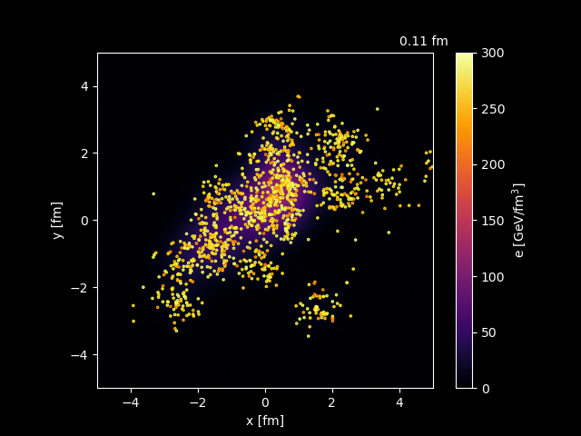
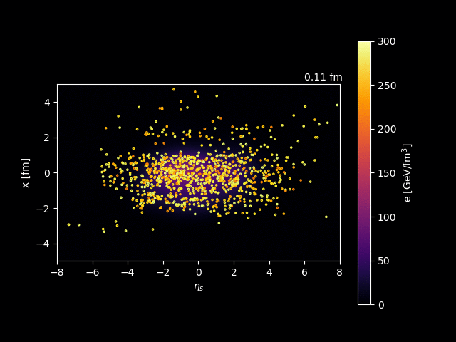


How DCCI works in AA
Pb+Pb 2.76 TeV
Transverse plane ($\left|η_{s}\right|<0.5$)
$x−η_{s}$ plane ($\left|y\right|<0.5$)
Movies: Courtesy of Y. Kanakubo

Slide 19
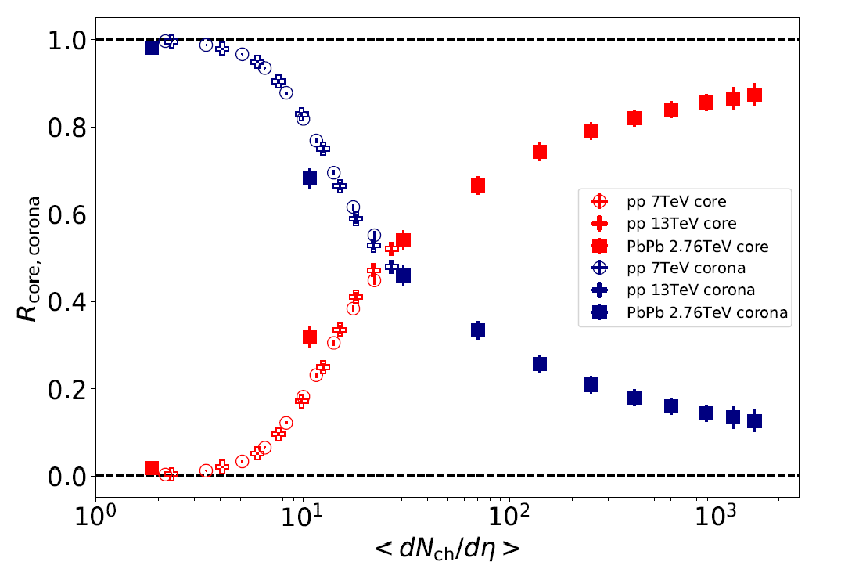

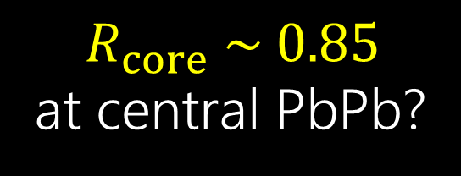
Clear scaling with multiplicity
O+O
Core
Onset of
core dominance at $\left\langle dN_{ch}/dη\right\rangle ∼20$
Y. Kanakubo et al., Phys. Rev. C 105, 024905 (2022).
$$R_{core} \sim 0.85$$
at central PbPb?
Corona
*O+O at sqrt_snn = 7 TeV from PYTHIA Angantyr

Slide 20
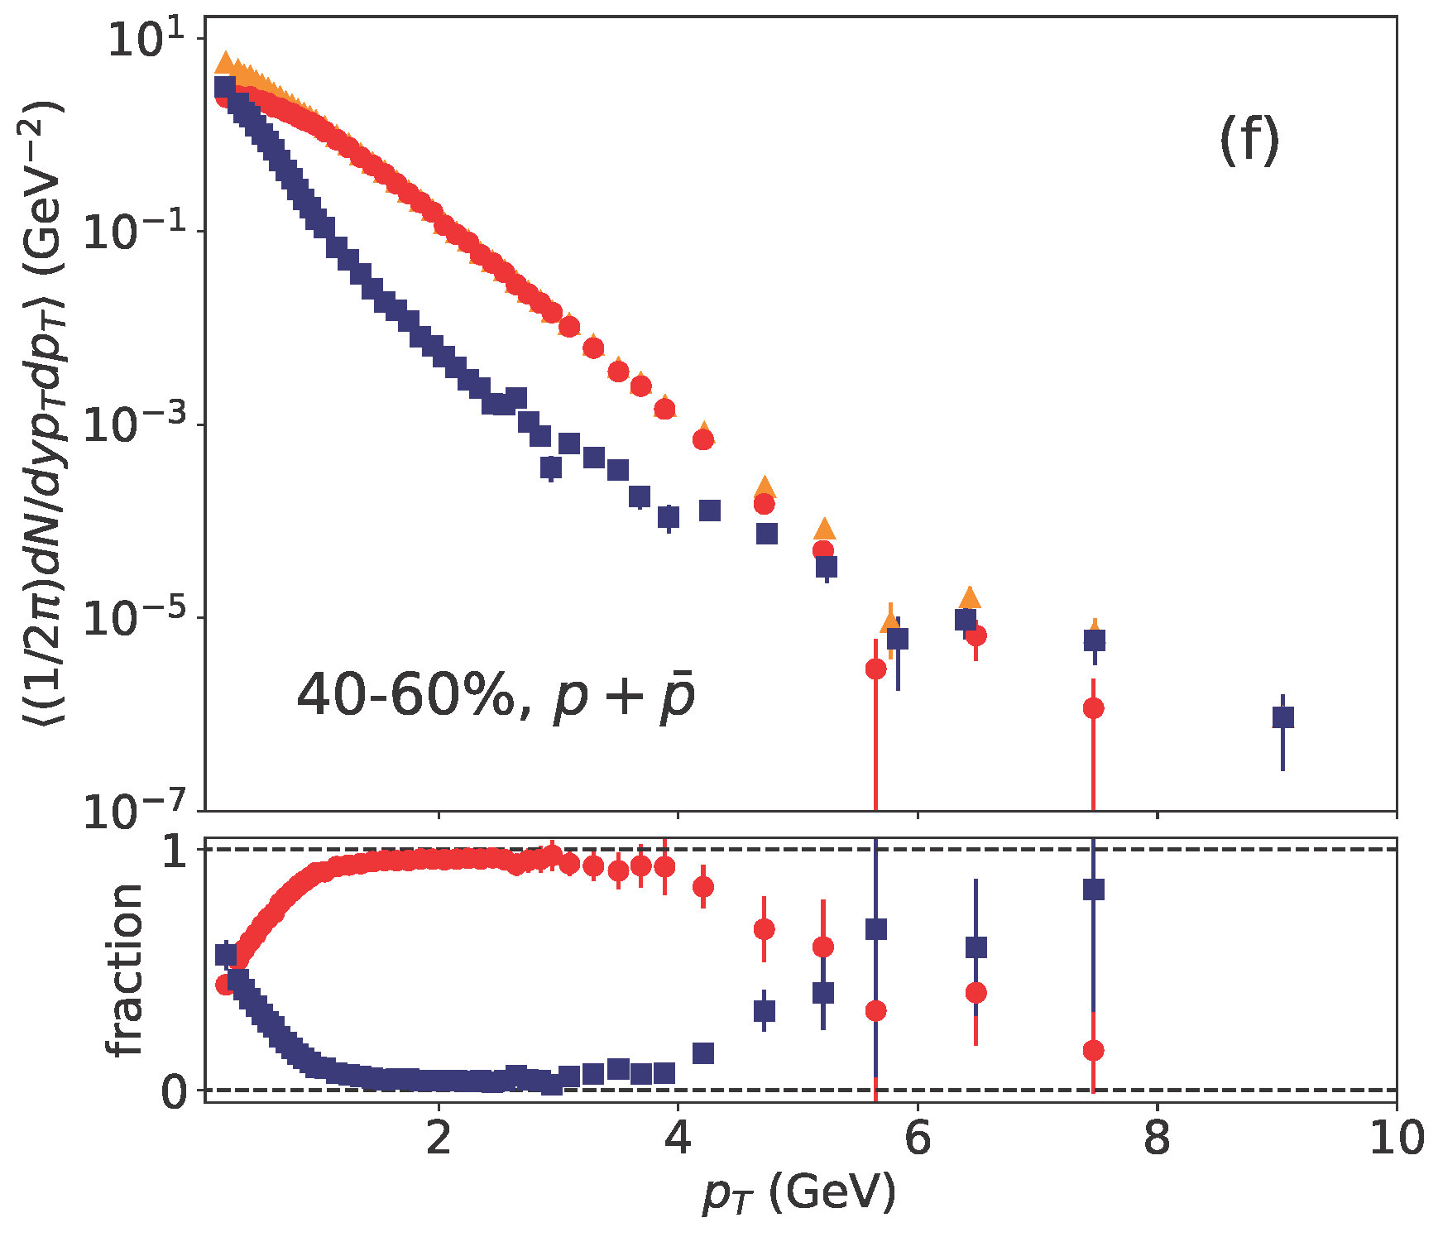
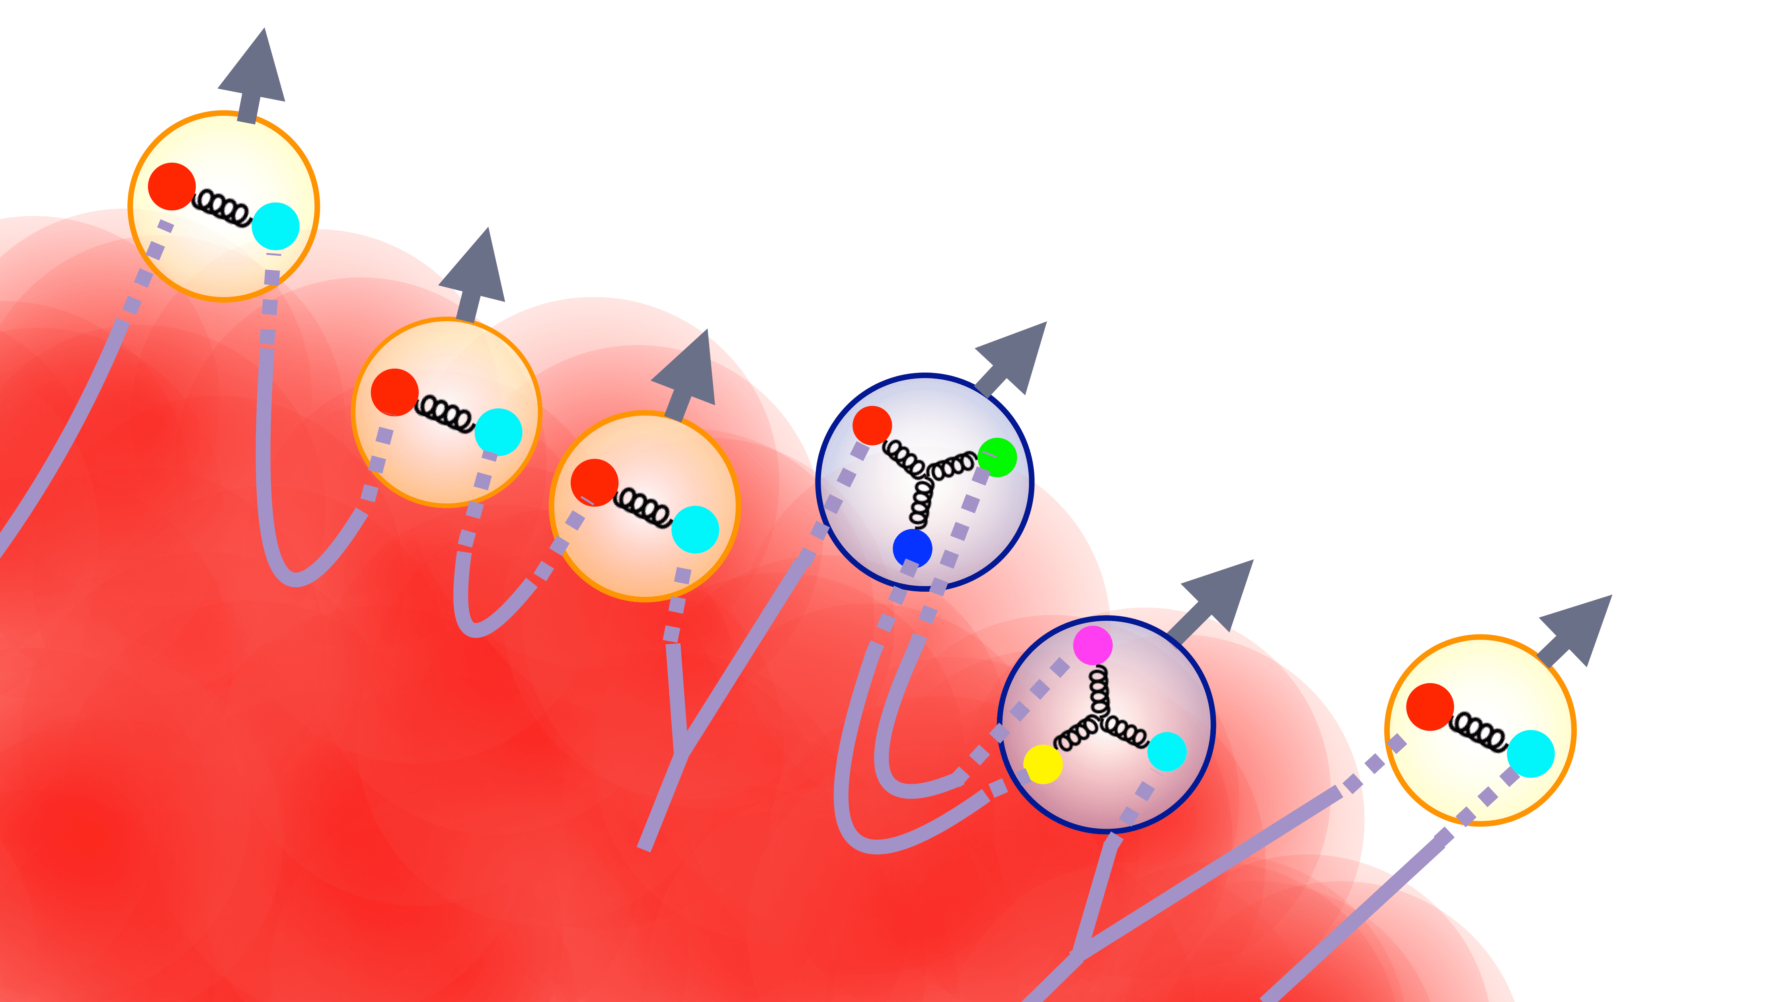
“Soft-from-corona” components
“hard strings” in DCCI2
Total
PbPb 2.76 TeV
Courtesy of Y. Tachibana
Core
https://www.sophia.ac.jp/eng/article/news/release/press20230213/
Corona
Y. Kanakubo et al., Phys. Rev. C 106, 054908 (2022).
Traversing hard partons
String formation
R_{corona} ~ 50%
Fragment into soft hadrons
← Power-law shape

Slide 21
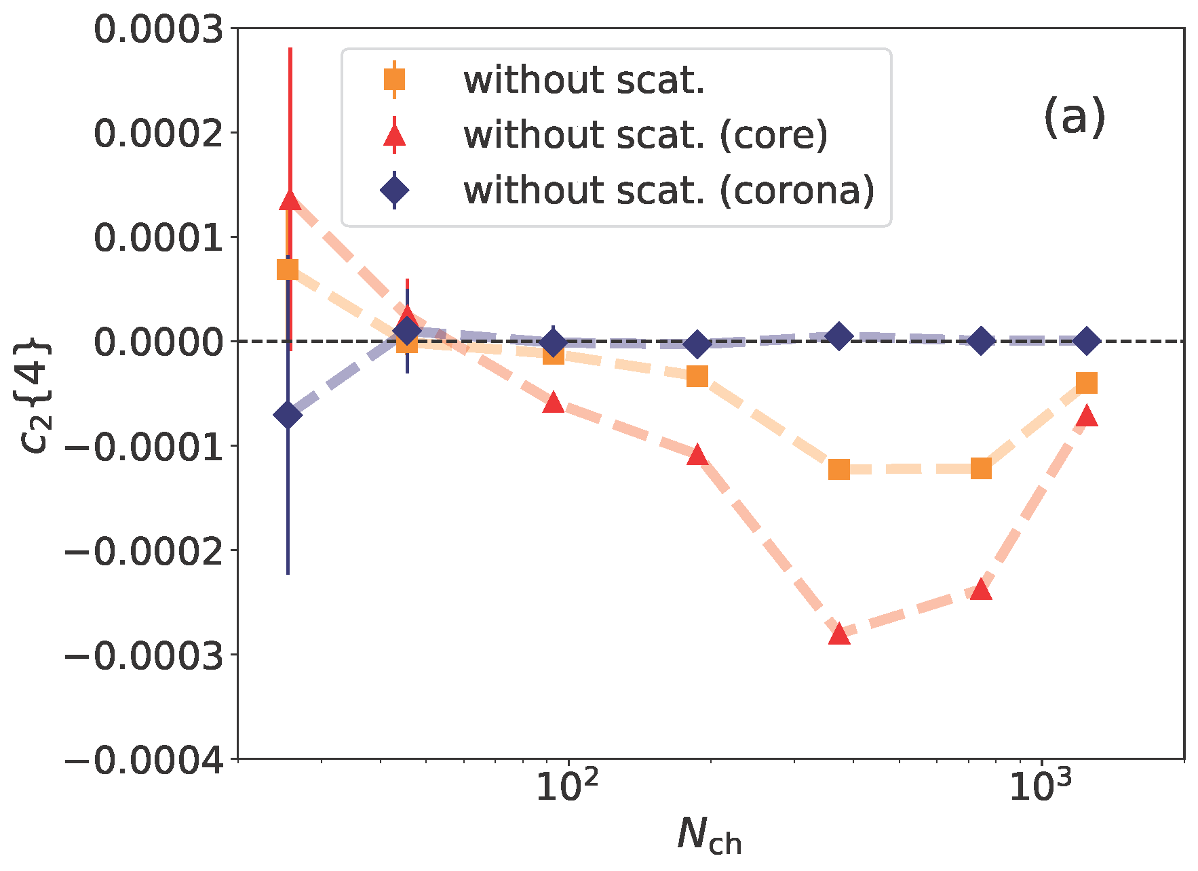
Corona dilutes c₂{4}
Dilution effect even after non-flow subtraction
PbPb
2.76 TeV
Importance in mean p_{T}, v_{n}, dN/deta, etc.
Y. Kanakubo et al., Phys. Rev. C 106, 054908 (2022).
Lesson for experimental people
→ Avoid very low p_{T}
0.2<p_{T}<3.0 GeV, |η|<0.8 (ALICE)
Lesson for theory people
→ Do not ignore corona

Slide 22
Short summary 2
“Mind the gap”
Soft-from-corona components can fill the gap
Use p_{T} *differential* data in Bayesian analysis, otherwise, develop a “full event generator”
Importance of non-equilibrium process in understanding QGP properties

Slide 23
Summary
Success of dynamical modeling
Discovery of QGP fluidity
Bayesian analysis provides properties of QGP
Dawn of precision era in the physics of high-energy nuclear collisions
Issues of current dynamical modeling
Acausal initial conditions
Lack of very low p_{T} components
Importance of description
in the non-equilibrium stage
to understand
equilibrated matter
and initial conditions

Slide 24
3. Short comments toward precision study

Slide 25



Response to shape of thermalized matter
Flow generated by anisotropic pressure gradient
…
$n=2$ (quadrupole)
Elliptic flow
$n=3$ (hexapole)
Triangular flow
$n=4$ (octapole)
Quadrangular flow
Ollitrault (1992)
Alver, Roland (2010)
Kolb (2003)
Fourier decomposition of azimuthal distribution
→ Rich information about properties of system
Talks by Jia, Giacalone, van der Schee, Zhou, Song, Ma, Luzum, Nonaka, Ke, Pang, …

Slide 26



Toward precision study of nuclear shape
$$v_{n}≈κ_{n}ε_{n}$$
$v_{n}$: The $n$th anisotropic flow
$ε_{n}$: The $n$th deformation parameter
Conventional studies
Initial deformation → Hydrodynamic (or transport model) responses to extract bulk and transport properties
TH et al. (2013)
Toward precision study
Anisotropic flow → Initial deformation → Nuclear structure? (Supplement to nuclear structure study???)
Typical size of bumpiness on an event-by-even basis?
Corona (non-equilibrated) region “deforms” the shape of initial profiles of created matter, in particular, in small colliding system
How much is the system equilibrated after all?
Entropy density
Distribution
From MC-Glauber

Slide 27
Extra slides

Slide 28
Outlook
hadronic
observables
Did we understand dynamics after all?
Hadronic transport
How much energy deposited?
How much initial nuclei lose their energy?
Recombination
model
string
fragmentation
Hydro-
dynamics
Modification of
jet structure
hydro+jet
approach
How much deposited energy thermalized?
Classical Yang-Mills
EIC and LHC forward
(and Forward Physics Facility?)
CGC theory
pQCD
Soft sector
Hard sector

Slide 29
Standard picture of heavy ion reactions
Observation
Radiation
Leptons, Photons
Hadrons
Leptons, Photons,
Probe
time
Hadron gases
Recombination
Fragmentation
Bulk
QGP
fluids
Jets
Heavy quarks
Interaction
collision axis
0
Glasma
Nuclei
Gluon saturation
Dilute parton “gases”

Slide 30
2. Current understanding of transport properties

Slide 31
TRAJECTUM* as an example
*The old Roman name for the city of Utrecht
time
Hadronic transport
(SMASH)
hadron gas
Relativistic hydrodynamics
(Viscous fluids)
QGP fluid
collision axis
Free streaming
0
T_{R}ENTo:
CGC⇔Glauber
Colliding nuclei
G. Nijs et al., Phys. Rev. Lett. 126, 202301 (2021); Phys. Rev. C 103, 054909 (2021).

Slide 32
Results from TRAJECTUM
Bayesian analysis → Posterior distribution of parameters
Dynamical modeling works well!
G. Nijs et al., Phys. Rev. Lett. 126, 202301 (2021).

Slide 33
Current understanding of transport coefficients
Well constrained by a large volume of data set
Dawn of new precision era
“Condensed matter physics” of the QGP
G. Nijs et al., Phys. Rev. Lett. 126, 202301 (2021).
*See also some updates: G. Nijs and W. van der Schee, Phys. Rev. C 106, 044903 (2022).

Slide 34
No need to improve dynamical models?

Slide 35
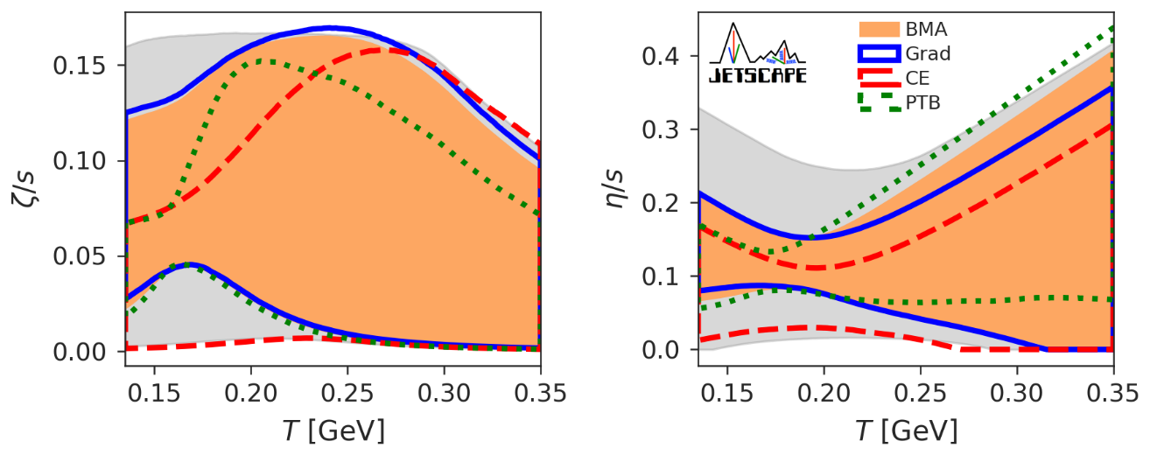
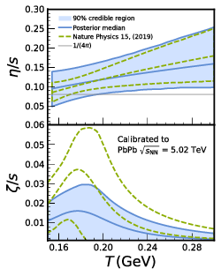
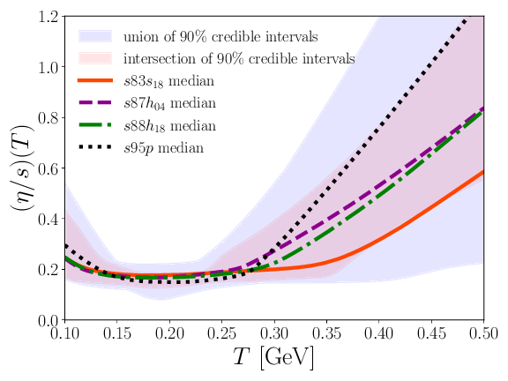

Results from other groups
G. Nijs et al.,
Phys. Rev. Lett. 126, 202301 (2021).
D. Everett et al. (JETSCAPE Collaboration),
Phys. Rev. Lett. 126, 242301 (2021).
$𝒪(10)$ difference in $ζ/s$
Hint for missing piece(s)?
J. Auvinen et al.,
Phys. Rev. C 102, 044911 (2020).
J.E. Parkkila et al.,
Phys. Rev. C 104, 054904 (2021).

Slide 36


Constraint on initial conditions from non-linear causality
Green: Never intrudes acausal region
Blue: Guaranteed to be causal
Courtesy of T. Hoshino
Acausal
No way to start from a state away from local equilibrium despite of hydrodynamization
equilibrium measure
$$(1.10, 0.96)$$
$$(0.11, 0.76)$$
Acausal
Demand for alternative approach based on non-equilibrium physics
“time”
T. Hoshino and TH, in preparation

Slide 37







Equilibrium measure and inverse Reynolds number
Equilibrium measure
$$f=\frac{3}{2}τ\frac{1}{w}\frac{dw}{dτ}=1+\frac{3φ}{8e}=1±\frac{1}{8}{Re}_{π}^{−1}$$
Local equilibrium
Out-of-equilibrium
$$w=τT,$$
$e$: Energy density,
$$φ=π^{00}−π^{33}$$
$$Re_{π}^{−1}=±8\left(f−1\right)$$
$$−:φ<0$$
$$+:φ>0,$$
Note: Various definition of the inverse Reynolds number can be found in the literature.

Slide 38
Go “Forward”
Toward understanding
dynamics as a whole

Slide 39

Energy distribution
Energy deposited at $−1<η<1$
0.2-0.3% of total energy
(minimum bias case)
Small change in forward
→ Large change in central
Importance of modeling
at primary collisions
ex.) Highly depends on MPI
parameters in PYTHIA
PYTHIA Angantyr Pb+Pb 2.76 TeV
Minimum bias, parton level
Courtesy of Y.Kanakubo

Slide 40
Understanding central region from forward baryon production
Change of net baryon distribution due to MPI parameters
PYTHIA Angantyr
Pb+Pb 2.76 TeV
Minimum bias
parton level
Initial energy deposited in the central region is highly correlated with baryon stopping
The more minijet are produced,
the more baryons stop
Courtesy of Y.Kanakubo

Slide 41
Fraction of core and corona components
DCCI2 p+p 7 TeV
DCCI2 Pb+Pb 2.76 TeV
Important in quantifying how much matter thermalized in forward
Courtesy of Y. Kanakubo

Slide 42


Correlation between central and forward
Central
More mini-jet production
Forward
More baryon
stopping
Importance of particle identification at forward
$$\frac{dN_{p−\overline{p}}}{dy}$$
$$R_{Y/π}(y)$$

Slide 43
Did we understand basic dynamics after all?
time
Evolution of thermalized energy?
Baryon transport, pressure gradient or diffusion?
hadron gas
How much deposited energy thermalized?
QGP fluid
collision axis
How much energy deposited?
←→ How much initial nuclei lose their energy?
0
Gluon
saturation
These basic questions must be also important
in EIC and LHC forward region.

Slide 44
Backup slides

Slide 45
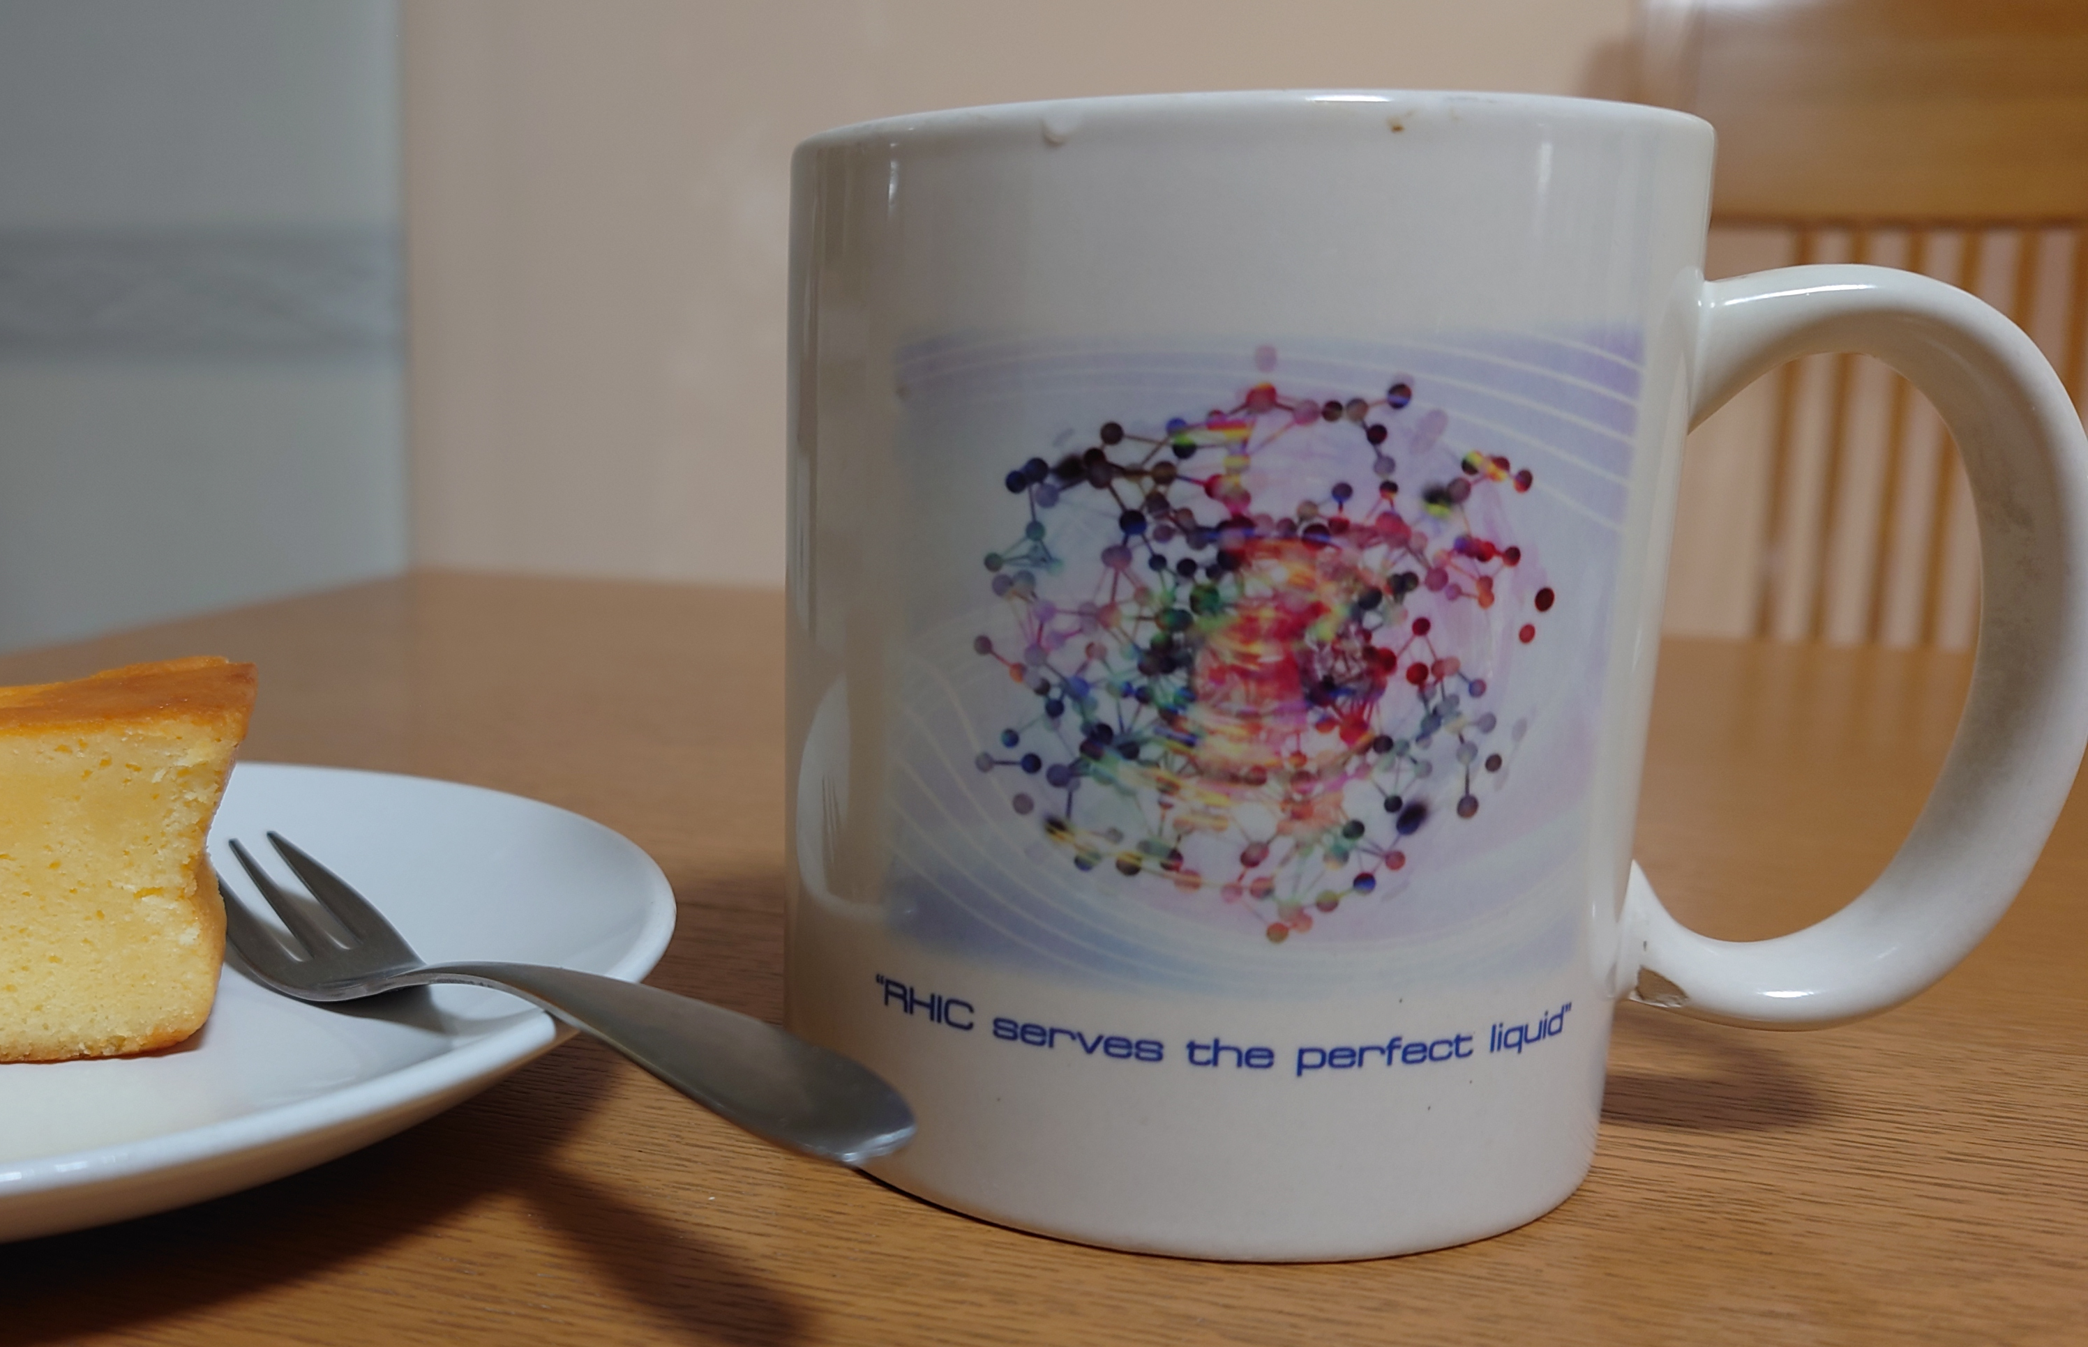
Introduction
Discovery of perfect fluidity announced in 2005*
←Essential role played by “Dynamical Modeling”
…
Precision QGP physics
QGP fluids as thermal media
Validation of QGP fluidity
*https://www.bnl.gov/newsroom/news.php?a=110303

Slide 46
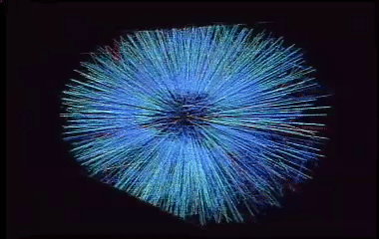
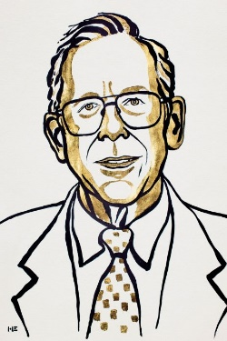
Bottom-up approach
Observational cosmology
High-energy nuclear collisions
https://www.nobelprize.org/prizes/physics/2019/peebles/facts/
http://www.esa.int/spaceinimages/Images
/2013/04/Planck_CMB_black_background
Cosmic Microwave Background
Fluctuations of temperature (Planck)
3-D event display (STAR)
Y.Zhou, talk at QM2018
Cosmological parameters
Energy budget
Hubble constant
Lifetime of Universe
…
Properties of the QGP
Equation of state
Transport coefficients
Stopping power
…

Slide 47




Bayesian parameter estimation
Prior distribution $P\left(X\right)$: Flat distribution in parameter space
21 model parameters including initial conditions and transport coefficients
Set of data $Y$
System: PbPb 2.76 TeV, 5.02 TeV
Observables: multiplicity, transverse energy, PID yields, transverse momentum spectra, mean p_{T}, v_{n},
Bayes’ theorem
Likelihood $P(Y|X)$
$$P\left(X | Y\right)=\frac{P\left(Y | X\right)P(X)}{P(Y)}$$
Posterior $P(X|Y)$: Probability distribution with 90% confident region of model parameter
J.E. Bernhard, Ph.D thesis, Duke Univ. (2018); arXiv:1804.06469.
G. Nijs et al., arXiv:2010.15130.

Slide 48
Posterior distributions
Solid: Pb+Pb, p+Pb
Dashed: Pb+Pb only
G. Nijs et al., Phys. Rev. Lett. 126, 202301 (2021).

Slide 49



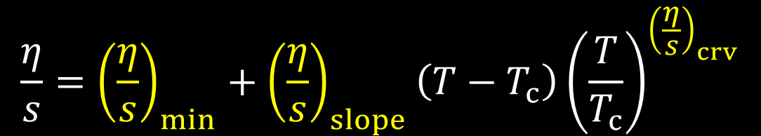
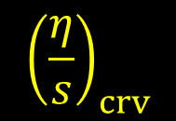

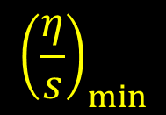
Parametrization of shear viscosity
$$\frac{η}{s}$$
$$\frac{η}{s}={\left(\frac{η}{s}\right)}_{min}+{\left(\frac{η}{s}\right)}_{slope}\left(T−T_{c}\right){\left(\frac{T}{T_{c}}\right)}^{{\left(\frac{η}{s}\right)}_{crv}}$$
$${\left(\frac{η}{s}\right)}_{crv}$$
$${\left(\frac{η}{s}\right)}_{slope}$$
$${\left(\frac{η}{s}\right)}_{min}$$
G. Nijs et al., Phys. Rev. Lett. 126, 202301 (2021).
$$T_{c}=154 MeV$$
$$T$$

Slide 50

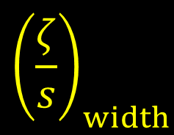
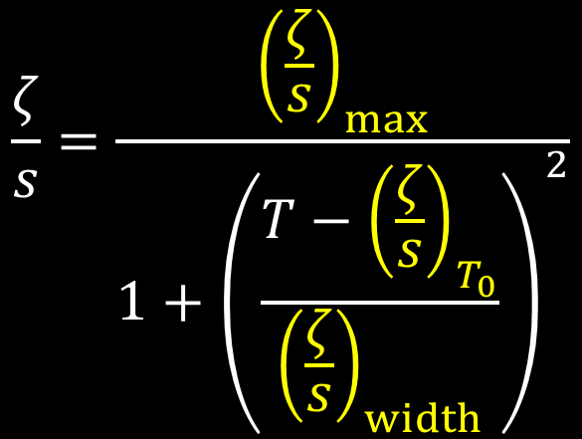
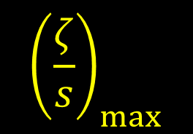
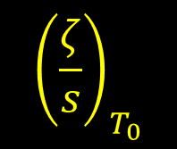

Parametrization of bulk viscosity
$$\frac{ζ}{s}=\frac{{\left(\frac{ζ}{s}\right)}_{max}}{1+{\left(\frac{T−{\left(\frac{ζ}{s}\right)}_{T_{0}}}{{\left(\frac{ζ}{s}\right)}_{width}}\right)}^{2}}$$
$$\frac{ζ}{s}$$
$${\left(\frac{ζ}{s}\right)}_{max}$$
$${\left(\frac{ζ}{s}\right)}_{width}$$
$${\left(\frac{ζ}{s}\right)}_{T_{0}}$$
$$T$$
G. Nijs et al., Phys. Rev. Lett. 126, 202301 (2021).

Slide 51





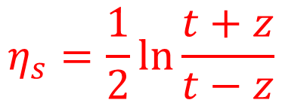


Boost invariance
Boost invariance along $z$ axis
→ No $η_{s}$ dependence of thermodynamic variables
$$η_{s}=\frac{1}{2}\ln{\frac{t+z}{t−z}}$$
$$t$$
$$τ=\sqrt{t^{2}−z^{2}}$$
Bjorken flow (1D Hubble flow)
$$u^{μ}=\frac{1}{τ}\left(t,0, 0, z\right)$$
$$e\left(x\right)→e\left(τ\right),$$
$$P\left(x\right)→P\left(τ\right),etc.$$
$$z$$
→ (0+1)-dimensional problem
J.D. Bjorken, Phys. Rev. D 27, 140 (1983).

Slide 52

Resolution 1: Constraint on equilibrium measure from non-linear causality
Hydrodynamic attractor solution
Is fluid dynamics far from equilibrium justified?
Are (almost) any initial conditions acceptable?
Relaxation time
$$w_{π}\sim 0.2$$
Local equilibrium
M.P. Heller and M. Spaliński, Phys. Rev. Lett. 115, 072501 (2015).

Slide 53
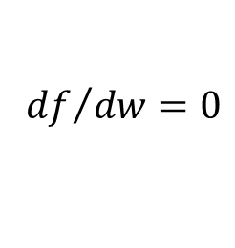



“Time” evolution of equilibrium measure
Relaxation “time”
Conformal fluid
$$w_{π}=τ_{π}T=C_{τπ}=\frac{2−\ln{2}}{2π}$$
$$\sim 0.208$$
→ Solutions relax to a single curve with relaxation time $w_{π}$
1st (gradient exp.)
2nd (gradient exp.)
$${df}/{dw}=0$$
“Hydrodynamic attractor”

Slide 54
Causality violation in transverse plane
time
Red: Acausal
Purple: Intermediate (not determined)
Blue: Causal
Violations predominate in the early stage and/or the edge region.
To demonstrate this in a much simpler system, e.g., boost-invariant system
C. Plumberg et al., Phys. Rev. C 105, L061901 (2022).

Slide 55
Causality in non-linear regime?
Causality of second order hydrodynamics under
static equilibrium background in linear perturbation
$$Π=0, π^{μν}=0, u^{μ}=0$$
bulk pressure
shear stress
four velocity
See, e.g., W.A. Hiscock, L. Lindblom, Annals of Physics 151, 466 (1983).
→ Need to go beyond linear regime to capture full non-linearity of relativistic dissipative hydrodynamic equations
F.S. Bemfica et al., Phys. Rev. Lett. 126, 222301 (2021).

Slide 56












Characteristic velocity
Quasi-linear PDE
Characteristic eqs.
$$A^{α }(Ψ)∇_{α}Ψ=F$$
$$\det\left(A^{α}ξ_{α }\right)=0,$$
$$ξ^{α}=∇^{α}Φ(x)$$
$$Ψ=\left(e, u^{μ},Π,π^{0μ},π^{1μ},π^{2μ},π^{3μ}\right)$$
$$Φ\left(x\right)=0$$
Normal vector of characteristic surface
→ Space-like vector
$$t$$
$$ξ^{α}$$
$$ξ^{α}=bu^{α}+v^{α},$$
$$ξ⋅ξ=b^{2}+v⋅v≤0$$
$$0$$
$$x$$
Characteristic velocity
$$0≤k\left(={{−b}^{2}}/{v⋅v}\right)≤1,$$
$$0≤k=v_{c}^{2}≤1$$
W.A. Hiscock and T.S. Olson, Phys. Lett. A 141, 125 (1989); F.S. Bemfica et al., Phys. Rev. Lett. 126, 222301 (2021).

Slide 57

Condition from non-linear causality
$$F_{i}\left(e,P,Π,π^{μν},η,ζ,⋯\right)≥0$$
Necessary and sufficient conditions
in Israel-Stewart type model (DNMR eqs.) from characteristic velocity
← Inequality among thermodynamic variables, dissipative currents and transport coefficients.
Constraint initial conditions from non-linear causality?
F.S. Bemfica et al., Phys. Rev. Lett. 126, 222301 (2021).

Slide 58



Conformal fluids in Bjorken expansion
Balance eq. (Landau frame) and EoS
$$∂_{μ}T^{μν}=0,$$
$$T^{μν}=eu^{μ}u^{ν}−PΔ^{μν}+π^{μν},$$
$$P=e/3$$
Constitutive eq. (BRSSS eq.)
*Gradient expansion up to 2nd order and “resumed”
**Keep relevant terms in Bjorken expansion and neglect non-linear term
R. Baier et al., JHEP 0804, 100 (2008).
$$τ_{π}Δ_{ αβ}^{μν}Dπ^{αβ}+π^{μν}=2η∇^{μ}u^{ν}−\frac{4}{3}τ_{π}π^{μν}θ$$

Slide 59






Note on derivation of “resumed” BRSSS
R. Baier et al., JHEP 0804, 100 (2008).
Original BRSSS eq. from gradient expansion up to 2nd order
*Keep relevant terms in Bjorken expansion and neglect non-linear term
$$π^{μν}=2η∇^{⟨μ}u^{ν⟩}−2ητ_{π}\left(Δ_{ αβ}^{μν}D∇^{⟨α}u^{β⟩}+\frac{θ}{3}∇^{⟨μ}u^{ν⟩}\right)$$
$$≈\frac{π^{μν}}{2η}$$
$$Dη≈−ηθ$$
(From $η/s$ =const.)
$$τ_{π}Dπ^{\left\langle μν\right\rangle }+π^{μν}=2η∇^{⟨μ}u^{ν⟩}−\frac{4}{3}τ_{π}θπ^{μν}$$
$π^{μν}$ is promoted to a dynamical variable

Slide 60








Hydrodynamic equations under Bjorken expansion
Boost invariant flow $u^{μ}=\frac{1}{τ}\left(t,0, 0, z\right)$
$$τ=\sqrt{t^{2}−z^{2}}$$
$$η_{s}=\frac{1}{2}\ln{\frac{t+z}{t−z}}$$
$$\frac{d}{dτ}e(τ)=−\frac{4}{3τ}e(τ)+\frac{1}{τ}φ(τ)$$
J.D. Bjorken, Phys. Rev. D 27, 140 (1983).
$$\left(1+τ_{π}\frac{d}{dτ}\right)φ(τ)=−\frac{4τ_{π}}{3τ}φ(τ)+\frac{4η}{3τ}$$
$$φ=π^{00}−π^{33}$$
Note:
Transverse pressure
Longitudinal pressure
$$P_{T}=\frac{e}{3}+\frac{φ}{2}$$
$$P_{L}=\frac{e}{3}−φ$$

Slide 61





Variable transformation
“Conformal time”:
$$w=τT$$
$$f=\frac{3}{2}τ\frac{1}{w}\frac{dw}{dτ}$$
“Equilibrium measure”:
$$C_{τπ}wf\frac{df}{dw}+4C_{τπ}f^{2}+\left(\frac{3}{2}w−8C_{τπ}\right)f−C_{η}+4C_{τπ}−\frac{3}{2}w=0$$
$$τ_{π}=\frac{C_{τπ}}{T}$$
Transport coefficients:
$$η=C_{η}s,$$
M.P. Heller and M. Spaliński, Phys. Rev. Lett. 115, 072501 (2015).
Note 1: In ideal hydrodynamics, $w∝τ^{2/3}$ from $T∝τ^{−1/3}$
Note 2: Different normalization employed for $f$

Slide 62






Behavior of solutions
$$Δf=\left(−4\frac{f}{w}−\frac{3}{2C_{τπ}}+\frac{8}{w}+\frac{C_{η}}{C_{τπ}wf}−\frac{4}{fw}+\frac{3}{2C_{τπ}f}\right)Δw$$
$$\frac{df}{dw}<0$$
Transport coefficients from AdS/CFT
$$C_{η}=\frac{1}{4π}$$
P.Kovtun et al., Phys. Rev. Lett. 94, 111601 (2005).
$$\frac{df}{dw}>0$$
$$C_{τπ}=\frac{2−\ln{2}}{2π}$$
R. Baier et al., JHEP 0804, 100 (2008).
“Flow vector” $\left(Δw, Δf\right)$

Slide 63


Solutions from gradient expansion
Constitutive eq. (BRSSS eq. with relevant terms in Bjorken expansion)
$$π^{μν}=2η∇^{⟨μ}u^{ν⟩}−2ητ_{π}Δ_{ αβ}^{μν}D∇^{⟨α}u^{β⟩}−\frac{2}{3}ητ_{π}θ∇^{⟨μ}u^{ν⟩}$$
$$f\left(w\right)=1+\frac{2}{3}C_{η}w^{−1}+\frac{4}{9}C_{τπ}C_{η}w^{−2}+𝒪(w^{−3})$$
1st order in gradient
2nd order in gradient

Slide 64



Solution directly from EoM
$$C_{τπ}wf\frac{df}{dw}+4C_{τπ}f^{2}+\left(\frac{3}{2}w−8C_{τπ}\right)f−C_{η}+4C_{τπ}−\frac{3}{2}w=0$$
$$f\left(w\right)=\sum_{n}{r_{n}w^{−n}}$$
$$f\left(w\right)=1+\frac{2}{3}C_{η}w^{−1}+\frac{4}{9}C_{τπ}C_{η}w^{−2}+𝒪(w^{−3})$$

Slide 65








Equilibrium measure and inverse Reynolds number
$$Re_{π}^{−1}=\sqrt{\frac{6\left|π_{μν}π^{μν}\right|}{e^{2}}}$$
$$Re_{π}^{−1}=\frac{3\left|φ\right|}{e},$$
$$φ=π^{00}−π^{33}$$
*Normalized such that $Re_{π}^{−1}=1$ at $P_{L}=0$
E.g.) V.E. Ambrus et al., Phys. Rev. Lett. 130, 152301 (2023).
Equilibrium measure
$$f=\frac{3}{2}τ\frac{1}{w}\frac{dw}{dτ}=1+\frac{3φ}{8e}=1±\frac{1}{8}{Re}_{π}^{−1}$$
Local equilibrium
Out-of-equilibrium
$$Re_{π}^{−1}=±8\left(f−1\right)$$
$$−:φ<0$$
$$+:φ>0,$$
Note: Various definition of the inverse Reynolds number can be found in the literature.

Slide 66




Constraint on initial conditions from non-linear causality
Boundary (for necessary conditions):
A solution goes across ${df}/{dw}=0$ at $(w,f)=(0.38, 1.12)$.
Boundary (for sufficient conditions):
A solution goes across ${df}/{dw}=0$ at $(w,f)=(1.54, 1.03).$
$$(1.10, 0.96)$$
$$(0.11, 0.76)$$
Initial conditions in Bjorken expansion are
highly constrained by non-linear causality.

Slide 67




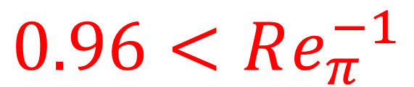

Discussion
$$Re_{π}^{−1}=\sqrt{\frac{6π_{μν}π^{μν}}{e^{2}}}$$
$$0$$
$$1$$
Causal
Acausal
$$Re_{π}^{−1}<0.24$$
$$0.96<Re_{π}^{−1}$$
Conformal kinetic theory with RTA
$$Re_{π}^{−1}<0.75$$
V.E. Ambrus et al., Phys. Rev. Lett. 130, 152301 (2023).
Talk by Werthmann

Slide 68









Dynamical Core Corona Initialization (DCCI2) model
$$t$$
Hadronic afterburner
JAM
Y. Nara et al.,Phys. Rev. C61, 024901 (2000)
Hadronization
PYTHIA8 (string fragmentation)
iS3D (thermal hadron sampling)
M. McNelis et al., Comput. Phys.Commun. 258, 107604 (2021).
DCCI + QGP dynamics
(3+1)-D hydro with source terms
$$z$$
Y. Tachibana and TH, Phys. Rev. C 90, 021902 (2014).
Initial parton production
PYTHIA8/PYTHIA8 Angantyr
T. Sjöstrand et al., Comput. Phys. Commun. 191, 159 (2015);
C. Bierlich et al., JHEP 1610 139 (2016)
Figures: Courtesy of Y.Kanakubo

Slide 69

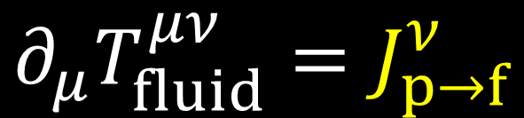





Dynamical initialization
M.Okai et al. (2018)
Conservation of the whole system
$$∂_{μ}T_{fluid}^{μν}=J_{p→f}^{ν}$$
$$∂_{μ}\left(T_{fluid}^{μν}+T_{parton}^{μν}\right)=0$$
$$∂_{μ}T_{parton}^{μν}=−J_{p→f}^{ν}$$
Hydrodynamic equations with source terms
Step 1 Generate
initial partons
Step 2
Model source term
Step 3
Solve hydro eqs. with vacuum initial condition
$$T_{parton}^{μν}\left(0^{+}\right)$$
$J_{p→f}^{ν}=−∂_{μ}T_{parton}^{μν}(t)$
$$∂_{μ}T_{fluid}^{μν}=J_{p→f}^{ν}$$
with
$$T_{fluid}^{μν}\left(t_{0}\right)=0$$

Slide 70
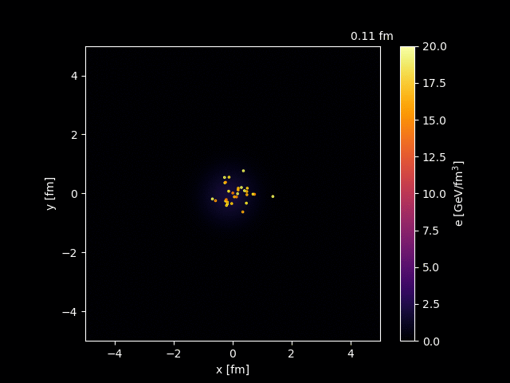
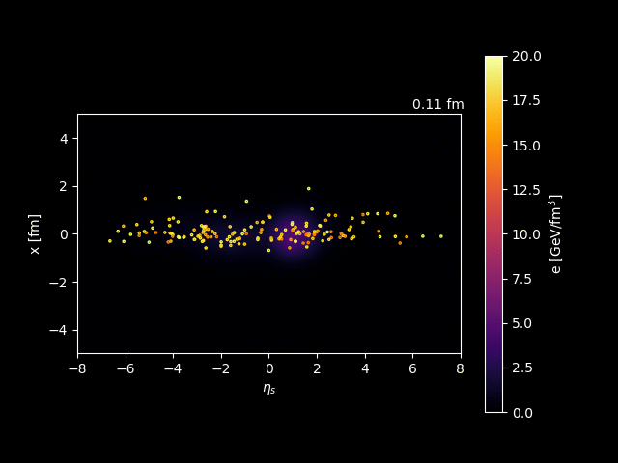
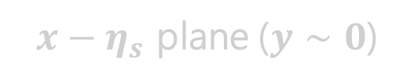
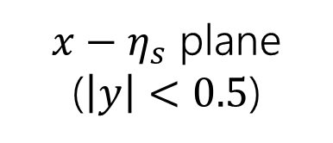
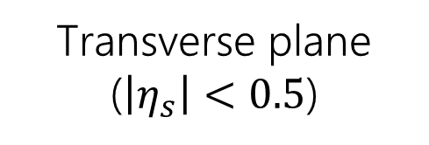
How DCCI works in pp
p+p 7 TeV
Transverse plane ($\left|η_{s}\right|<0.5$)
$x−η_{s}$ plane ($\left|y\right|<0.5$)
$x−η_{s}$ plane ($y∼0$)
Movies: Courtesy of Y.Kanakubo

Slide 71
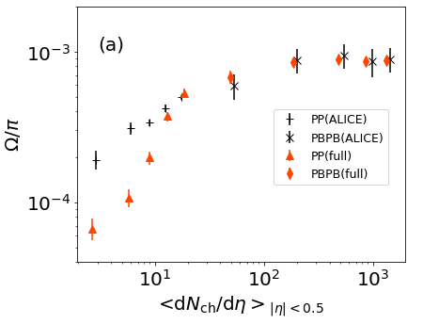


$Ω/π$ ratio from p+p to Pb+Pb
Fixing parameters to control fraction of core/corona
(Backup slides for details)
B. Abelev et al. (ALICE Collaboration), Phys. Lett. B 728, 216-227 (2014); erratum 734, 409-410 (2014)
J. Adam et al., (ALICE Collaboration), Nature Phys. 13 535-539 (2017)
Smooth increase of core contribution
→ Smooth enhancement of $Ω/π$
*Deviation from data at low multiplicity can be attributed to PYTHIA default tuning

Slide 72
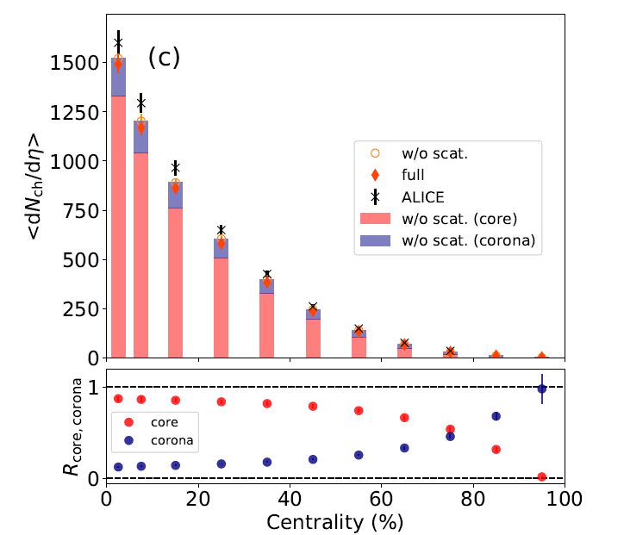
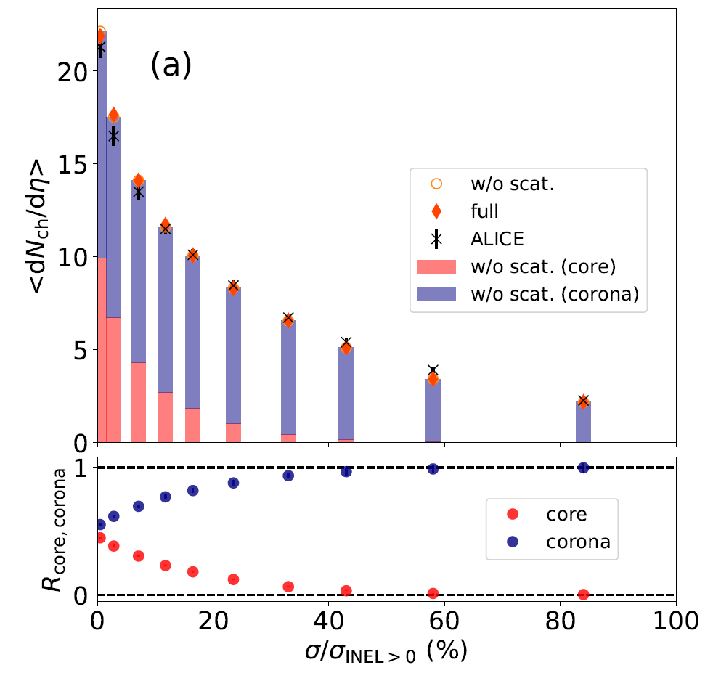

Fraction of core and corona components
Pb+Pb 2.76 TeV
p+p 7 TeV
Corona
K. Aamodt et al., (ALICE Collaboration), Phys. Rev. Lett. 106, 032301 (2011)
Core
J. Adam et al., (ALICE Collaboration), Nature Phys. 13, 535-539 (2017)
PbPb: corona $∼20\%$ at 40-60% centrality
pp: core/corona $∼50\%$ at σ/σ_{INEL} = 0-0.95%

Slide 73
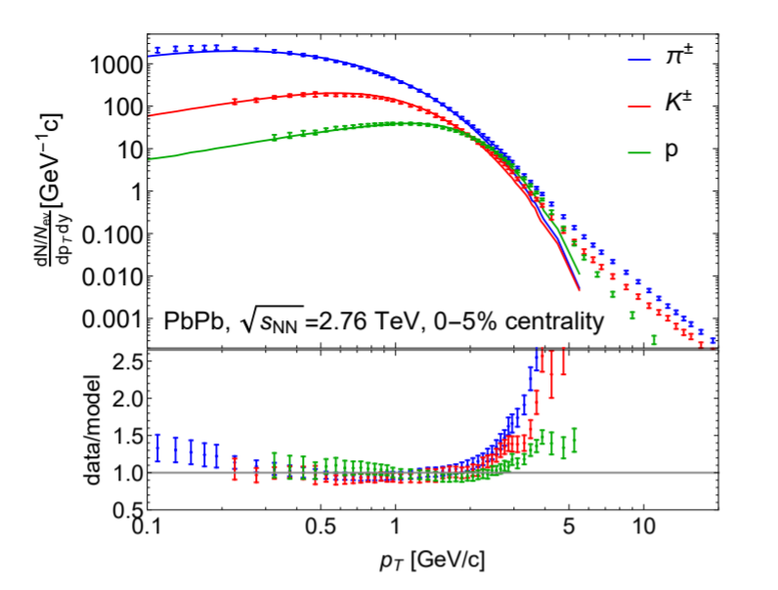
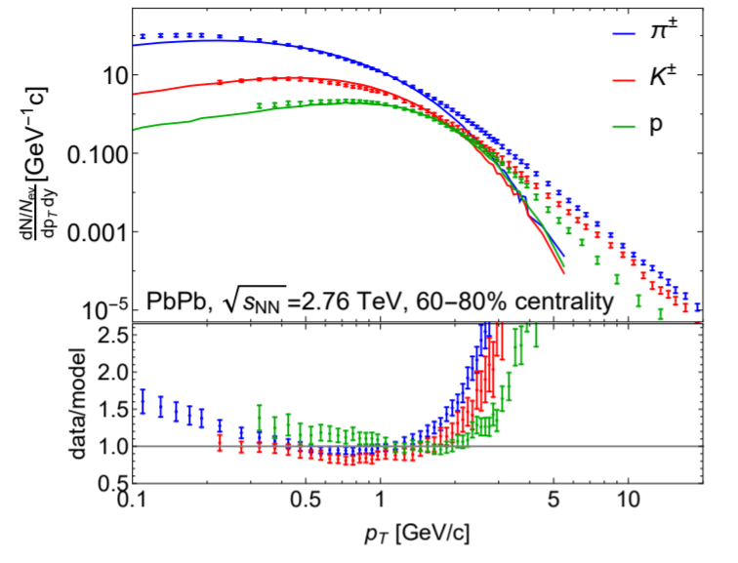
Lessons from a cutting edge model: TRAJECTUM
G. Nijs et al., Phys. Rev. C 103, 054909 (2021).
Prevailing paradigm: 99% soft (~core) components
Current understanding: Lack of core at very low p_{T} (≲0.5 GeV)
Question: Soft components always from core?

Slide 74
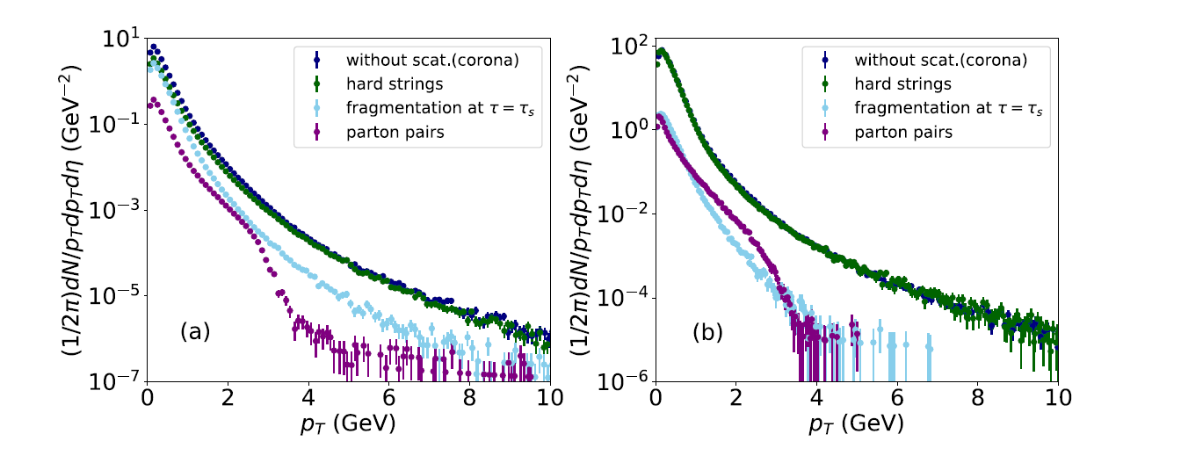
“Soft-from-corona” components
“hard strings” in DCCI2
Courtesy of Y. Tachibana
Parton level
Traversing hard partons (p_{T} ≳ 3 GeV)
String formation
Hadron level
See, for example,
“New model of Quark-Gluon Plasma solves a long-standing discrepancy between theory and data”
https://www.sophia.ac.jp/eng/article/news/release/press20230213/
Fragment into soft hadrons
← Power-law shape

Slide 75
Low p_{T} enhancement from corona
Total
(core+corona)
w/scat
PbPb 2.76 TeV
core
w/ scat
Core
Corona
R_{corona} ~ 50%
Note: Not so better agreement in pion/kaon cases
← Partly due to lack of hard parton in PYTHIA Angantyr

Slide 76
Transverse energy evolution
Thermalization
DCCI2
pdV work
Transverse energy
Free streaming
Exp
data
Free streaming
hadronization
PYTHIA/Angantyr
Parton production
Y. Kanakubo et al., Phys. Rev. C 105, 024905 (2022).
Time
How much matter thermalized is highly correlated
with initial production under constraint from exp data.

