Slide 1





Hydrodynamics & Bayesian Analysis
Department of physics, Hiroshima University
International Institute for Sustainability with Knotted Chiral Meta Matter／SKCM².
Hiroshima University
Kobayashi Maskawa Institute, Nagoya University
Department of Physics, Nagoya University
Chiho NONAKA
April 23, 2024@Exploring nuclear physics across energy scales 2024, Beijing

Slide 2
Contents
Introduction
Hydrodynamics in Heavy Ion Collisions
  Framework
  Model Parameters
Bayesian Analysis
  Simple application: Blast wave model
  Transport Coefficients
Model development
  Relativistic resistive hydrodynamic model
  Charge dependent flow
Summary

Slide 3
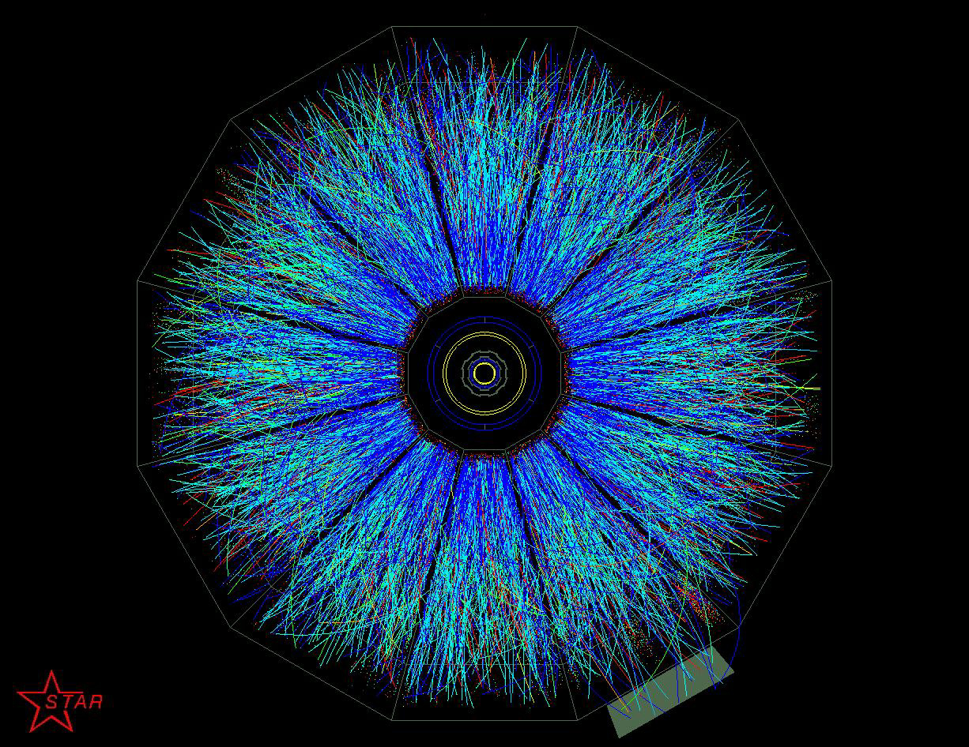
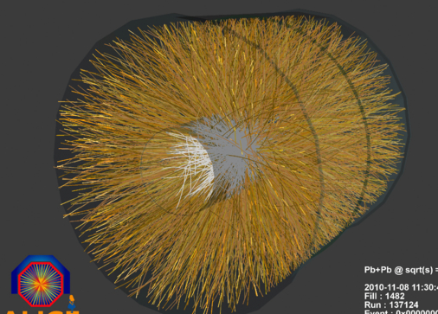
Success of Relativistic Hydrodynamic Model
Dynamical model for description of relativistic heavy ion collisions
高
2000: Relativistic Heavy Ion Collider
T
Success of relativistic hydrodynamic model
Strongly Interacting
Quark-Gluon Plasma
QCD Critical Point
LHC:2010
Heavy Ion collisions start!
陽子、中間子など
?
Hadron Phase
Color Super Conductor
Neutron star
μ_{B}

Slide 4
Hydrodynamic Model
Experimental data
collisions
Hadrons
Leptons
Photons

Slide 5
Hydrodynamic Model
Experimental data
collisions
Model
QGP Production?
Hadrons
Leptons
Photons
Multiple particle production
Hydrodynamic picture
Landau
Bjorken
Success of hydrodynamic model at RHIC
Relativistic viscous hydrodynamic model
One of important phenomenological models

Slide 6
Hydrodynamic Model
Experimental data
collisions
Model
Hydrodynamics
Hadrons
Leptons
Photons
Equation of State

Slide 7
Equation of State
Equation of State
  Lattice QCD
HotQCD,PRD90,094503(2014)
T
Quark-Gluon Plasma
QCD Critical Point
陽子、中間子など
?
Hadron Phase
μ_{B}
Color Super Conductor
(2+1) flavor, Highly improved staggered quark action
Nt=6,8,10,12,Ns=4Nt → continuum limit
Parametrization of EoS
Neutron star
MeV
finite μ: sign problem

Slide 8
Equation of State
Experimental data
collisions
hydrodynamics
Hydrodynamics
Hadrons
Leptons
Photons
QCD phase diagram
EoS: lattice QCD
Transport coefficients ?

Slide 9
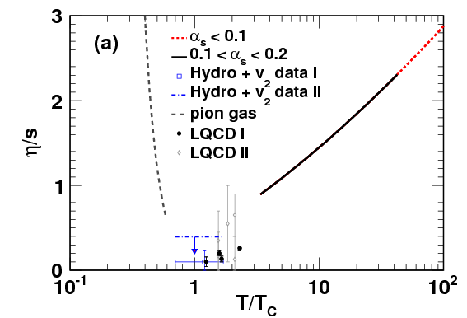
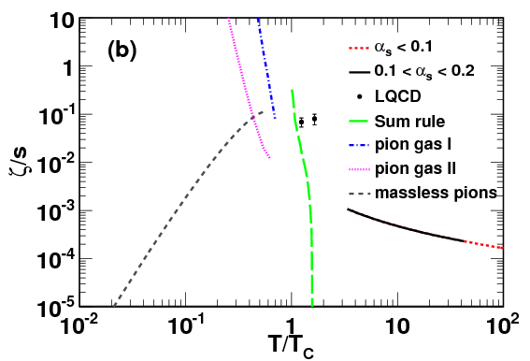
Property of QGP
Status for transport coefficients from theories
shear viscosity
bulk viscosity
Hydro
Chen,Deng,Dong,Wang,PRC87,024910(2013)
Shear viscosity takes the minimum around T_{c}.
Cf. η/s=1/4π AdS/CFT
Bulk viscosity
Temperature dependence is unclear.

Slide 10

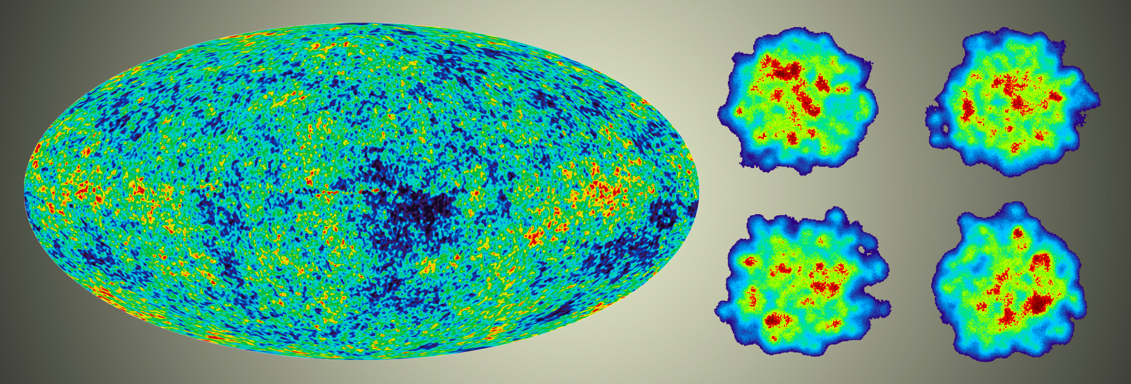
Initial Condition
Experimental data
collisions
hydrodynamics
Initial conditions
Hydrodynamics
Hadrons
Leptons
Photons
QCD phase diagram
EoS: lattice QCD
Transport coefficients: parameters
Energy (entropy) density distributions
parameters

Slide 11
From Fluid to Particles
Experimental data
collisions
hydrodynamics
hadronization
freezeout
Hydrodynamics
Hadrons
Leptons
Photons
Initial conditions
Final state interactions
QCD phase diagram
EoS: lattice QCD
Hadron based event
generator
Transport coefficients: parameters
Energy (entropy) density distributions
Hadronization
parameters: freezeout
temperatures
parameters
Cooper Frye formula
Coalescence model

Slide 12
Parameters in Hydrodynamic Model
Powerful and Successful Model
but…
O(10) parameters
  Initial conditions
  Freezeout process: hydrodynamics particles
  QGP property
    Transport coefficients
Experimental Data
  P_{T} spectra
  Rapidity distributions
  Collective flow
Ex.
Freezeout temperature
Radial flow
P_{T} spectra
strong correlation
P_{T}

Slide 13
Parameters in Hydrodynamic Model
Powerful and Successful Model
but…
O(10) parameters
  Initial conditions
  Freezeout process: hydrodynamics particles
  QGP property
    Transport coefficients
Experimental Data
  P_{T} spectra
  Rapidity distributions
  Collective flow
All parameters are related with observables.
Bayesian analysis

Slide 14
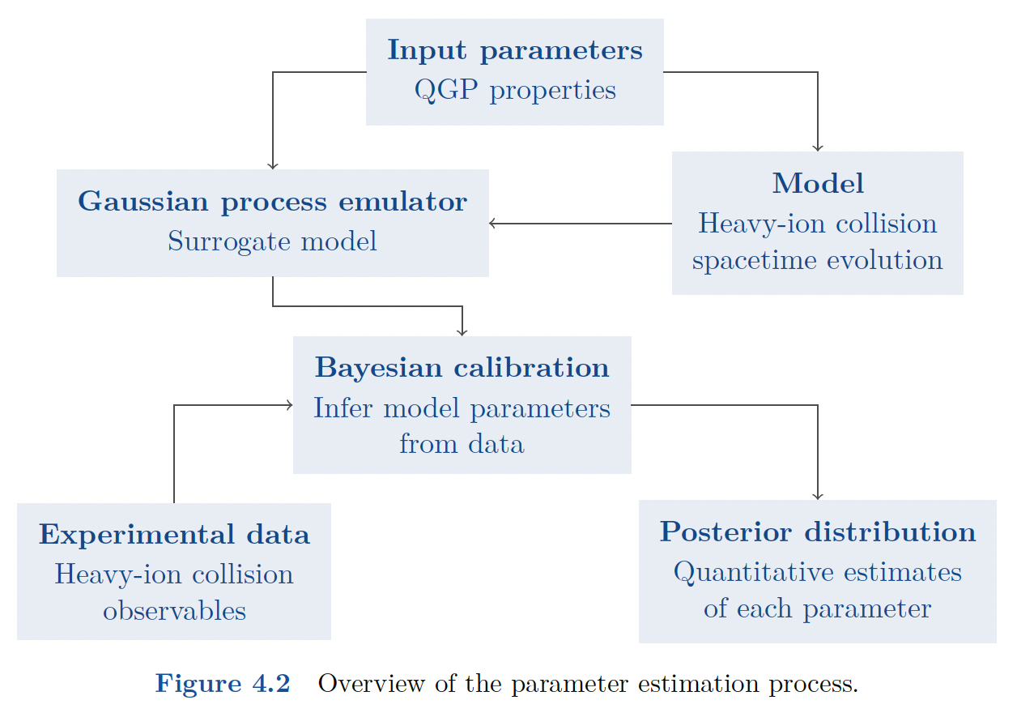
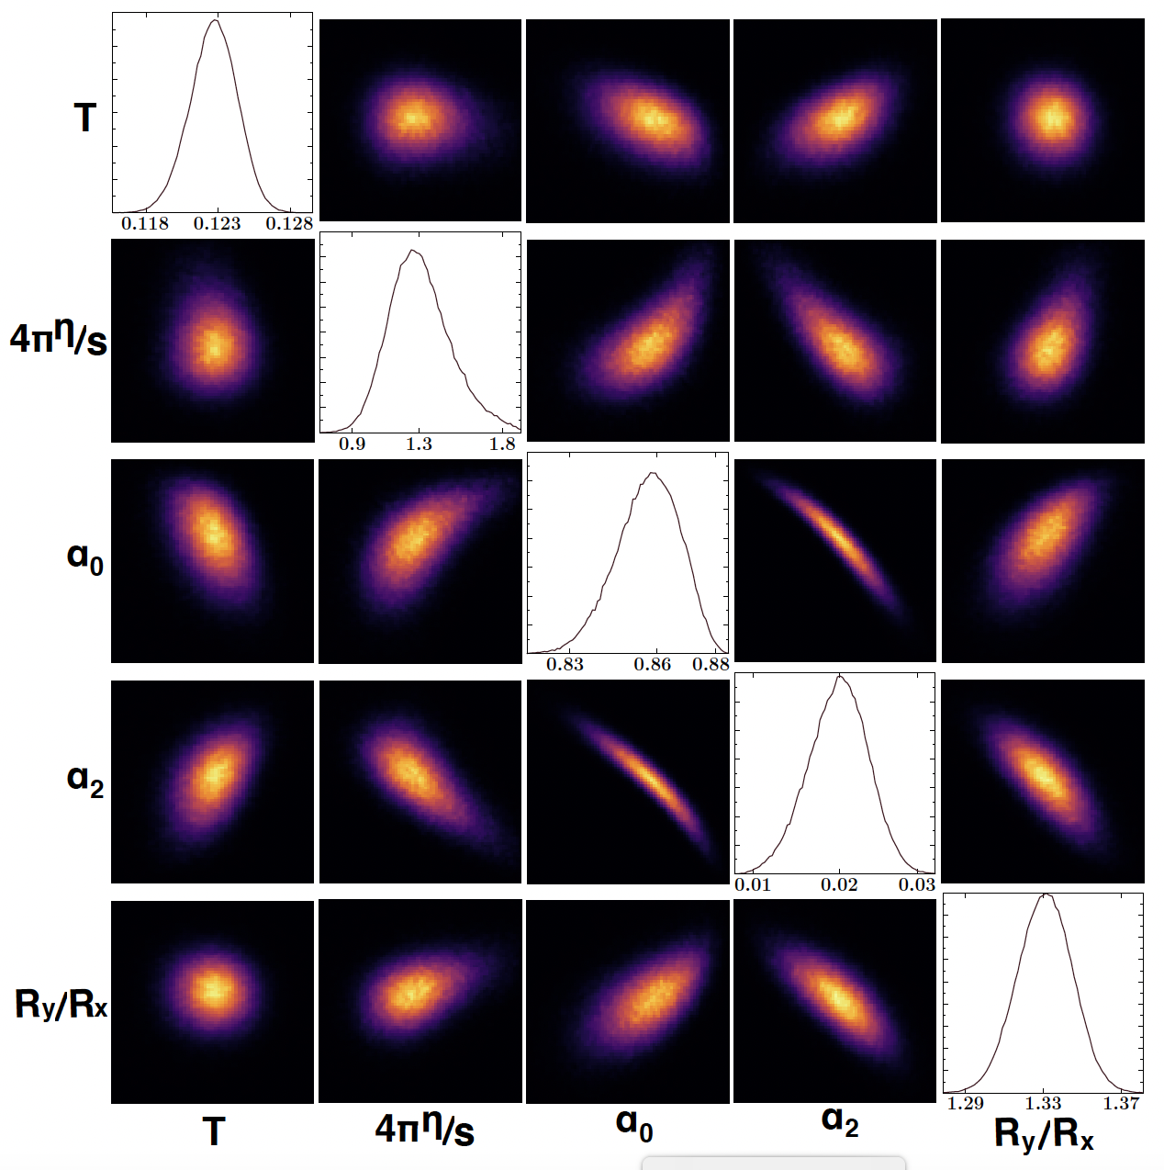
Bayesian Analysis
Jonah E. Bernhard,arXiv:1804.06469
Initial condition, viscosity, freezeout temperature..
Hydrodynamic model
P_{T} spectra
Collective flow
…

Slide 15
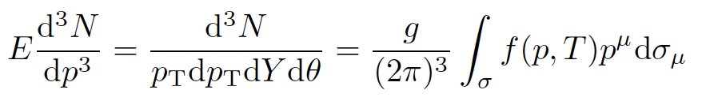
Blast Wave Model
Retiere, Lisa, PRC70,044907(2004)
Yang, Fries, J. Phys.: Conf. Ser. 832 012056
Parameters
Shear viscosity: η/s
Freezeout temperature: T
flow: α₀, α₂, n
Ellipticity for reaction region: R_{y}/R_{x}

Slide 16
Blast Wave Model
Retiere, Lisa, PRC70,044907(2004)
Yang, Fries, J. Phys.: Conf. Ser. 832 012056
Parameters
Shear viscosity: η/s
Freezeout temperature: T
flow: α₀, α₂, n
Ellipticity for reaction region: R_{y}/R_{x}
Experimental data
ALICE Pb+Pb TeV
30-40%, 40-50%
π, K, p
P_{T} distribution, v2(P_{T})

Slide 17
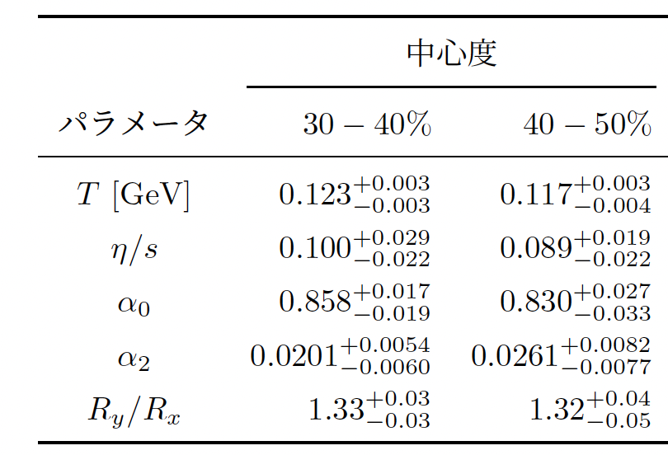
Results
30-40 %
Diagonal elements: probability
centrality
parameters
Off diagonal elements: correlation
  T vs α₀, α₂

Slide 18
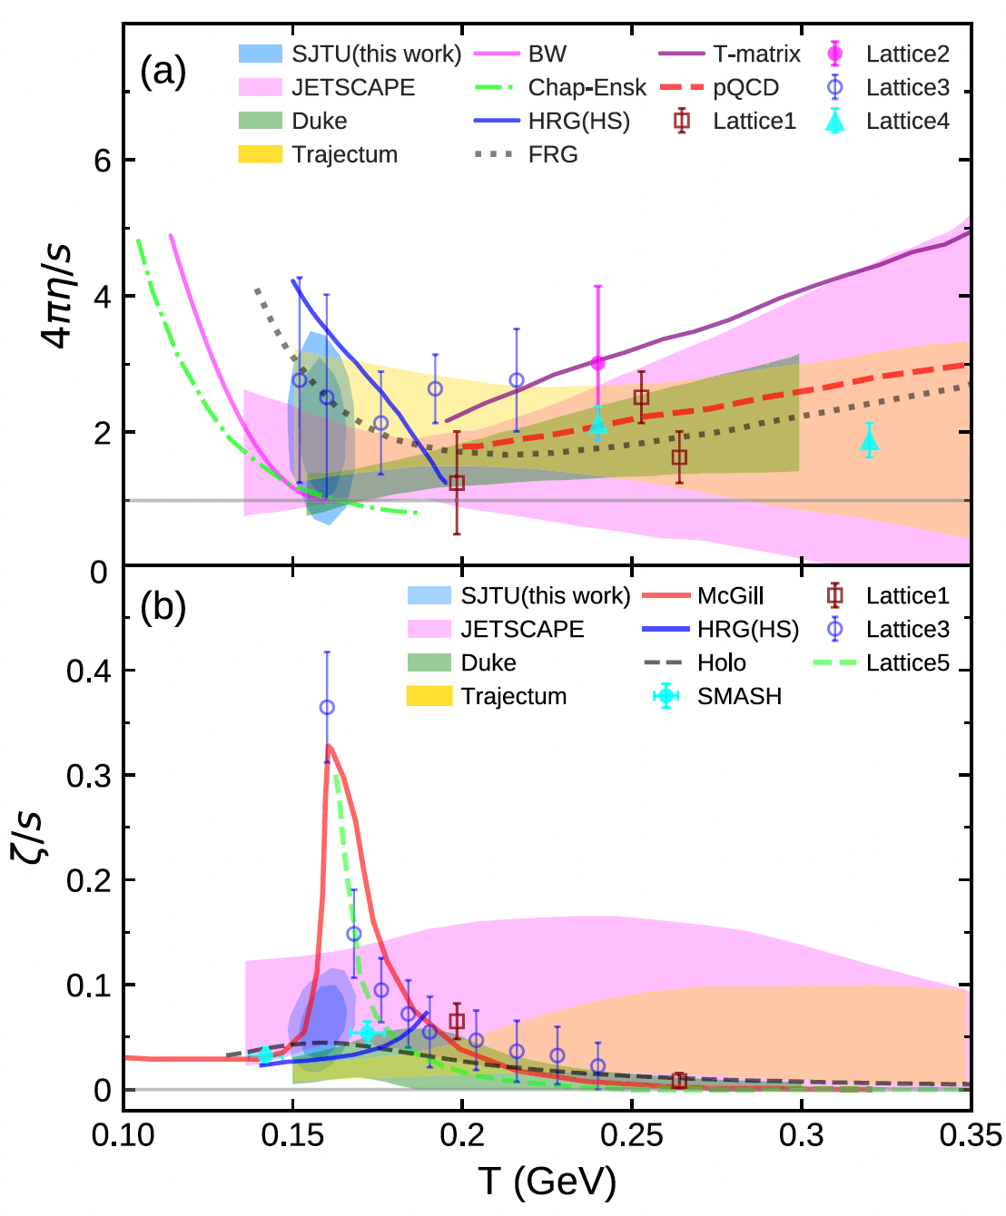
Applications
Transport coefficients
Jet energy loss
Heavy Flavor …
Duke: Bernhard, Moreland, Bass, Nat. Phys. 15,1113 (2019).
JETSCAPE: D. Everett et al. PRL126, 242301 (2021).
Trajectum: Nijs, W. van der Schee, PRL.129, 232301
(2022).
BW:Yang and Fries, PRC 105, 014910 (2022).
Ex. Yang and Chen, PRC107, 064910(2023)

Slide 19
Parameters in Hydrodynamic Model
Powerful and Successful Model
but…
O(10) parameters
  Initial conditions
  Freezeout process: hydrodynamics particles
  QGP property
    Transport coefficients
Experimental Data
  P_{T} spectra
  Rapidity distributions
  Collective flow
All parameters are related with observables.
Bayesian analysis
Model, Observables
Model development, Observables

Slide 20
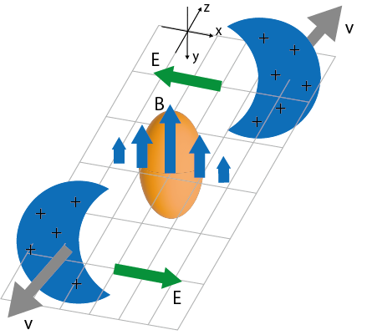
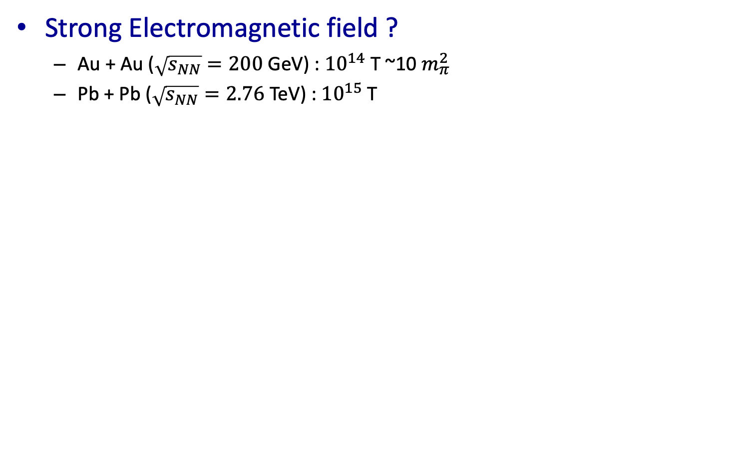
Electromagnetic Field in Heavy Ion Collisions
Strong Electromagnetic field ?
  Au + Au ($\sqrt{s_{NN}}=200$ GeV) : ${10}^{14}$ T ~10 $m_{π}^{2}$
  Pb + Pb ($\sqrt{s_{NN}}=2.76$ TeV) : ${10}^{15}$ T
Nakamura, Miyoshi, C. N. and Takahashi, Phys. Rev. C 107, (2023) 014901
Nakamura, Miyoshi, C. N. and Takahashi, Eur.Phys.J.C 83 (2023) 3, 229.
Nakamura, Miyoshi, C. N. and Takahashi, Phys. Rev. C 107 (2023) 3, 034912

Slide 21
Relativistic Resistive
Magneto-Hydrodynamics (RRMHD)
Nakamura, Miyoshi, C. N. and Takahashi, PRC107, no.1, 014901 (2023)
Experimental data
collisions
thermalization
hydro
hadronization
freezeout
Initial conditions
Hydrodynamics
Glauber model
+approximate solutions of Maxwell eq.
Hydrodynamic eq. + Maxwell eq. + Ohm’s law

Slide 22





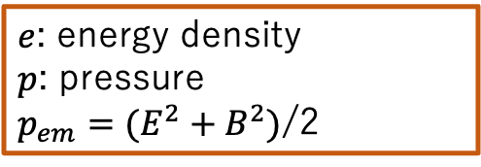

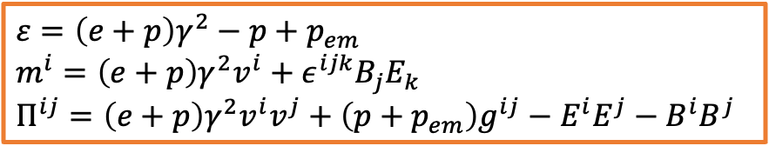


Relativistic Resistive
Magneto-Hydrodynamics (RRMHD)
Nakamura, Miyoshi, C. N. and Takahashi, PRC107, no.1, 014901 (2023)
RRMHD equation
  Conservation law＋Maxwell eq. ＋Ohm’s law
  $$∂_{μ}T^{μν}=F^{νλ}J_{λ}$$
  $$J^{μ}=J_{c}^{μ}+qu^{μ}$$
$e$: energy density
$p$: pressure
$p_{em}=(E^{2}+B^{2})$/2
$$ε=\left(e+p\right)γ^{2}−p+p_{em}$$
$$m^{i}=\left(e+p\right)γ^{2}v^{i}+ε^{ijk}B_{j}E_{k}$$
$$Π^{ij}=\left(e+p\right)γ^{2}v^{i}v^{j}+\left(p+p_{em}\right)g^{ij}−E^{i}E^{j}−B^{i}B^{j}$$
Energy Conservation
$$∂_{t}ε+∇⋅m=0$$
Momentum conservation
$$∂_{t}m^{i}+∇⋅Π^{i}=0$$
Faraday’s law
$$∂_{t}\vec{B}+∇×\vec{E}=0$$
Ohm’s law
$$\vec{J}=q\vec{v}+σγ[\vec{E}+\vec{v}×\vec{B}−\left(\vec{v}⋅\vec{E}\right)\vec{v}]$$
Ampere’s law
$∂_{t}\vec{E}−∇×\vec{B}=−\vec{j}$
  Integration with quasi-analytic solutions
$$=:{\vec{J}}_{c}$$
$$∂_{t}\vec{E}−∇×\vec{B}=q\vec{v}$$
$$∂_{t}\vec{E}={\vec{J}}_{c}$$
operator
splitting
    $${\vec{E}}_{⊥}=−\vec{v}×\vec{B}+\left(E_{⊥}^{0}+\vec{v}×\vec{B}\right)\exp\left(−σγt\right)$$
$${\vec{E}}_{∥}=E_{∥}^{0}exp⁡(−σt/γ)$$
Komissarov, Mon. Not. R. Astron. Soc. 382, 995-1004 (2007)

Slide 23
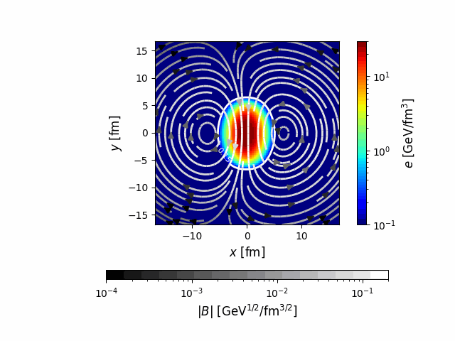
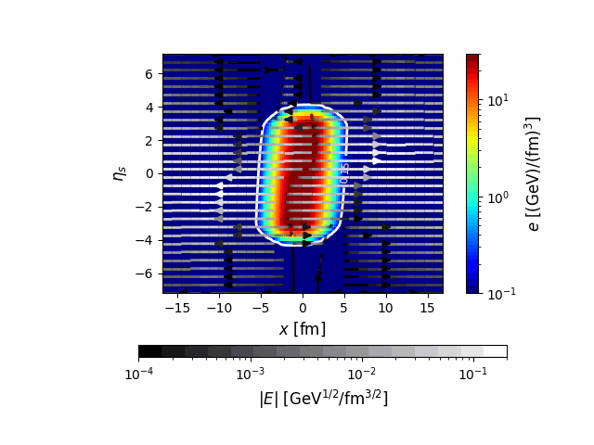

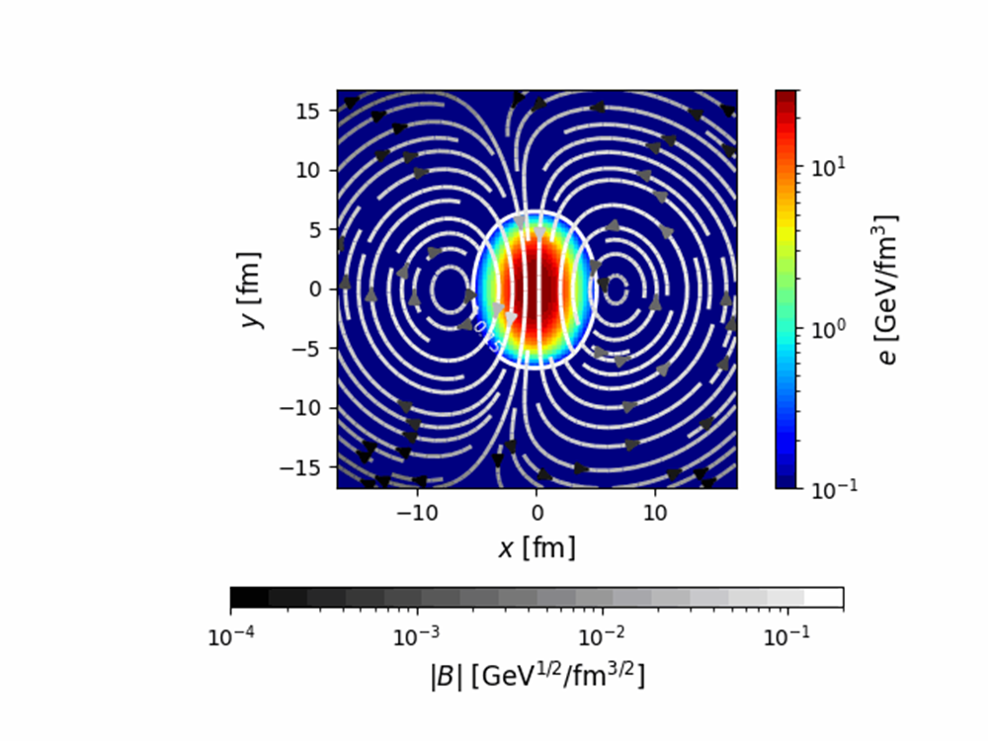






Space-time Evolution
Nakamura, Miyoshi, C. N. and Takahashi, PRC 107, no.1, 014901 (2023)
Au+Au collision system
First calculation in HIC with RRMHD code
$$x−η_{s} plane$$
$x−y$平面
Collision axis
$$η_{s}$$
Energy density
$y$ [fm]
Energy density
initial
Initial
$x$ [fm]
$x$ [fm]
Magnetic field strength
Electric field strength
Analysis of Heavy Ion Collisions

Slide 24
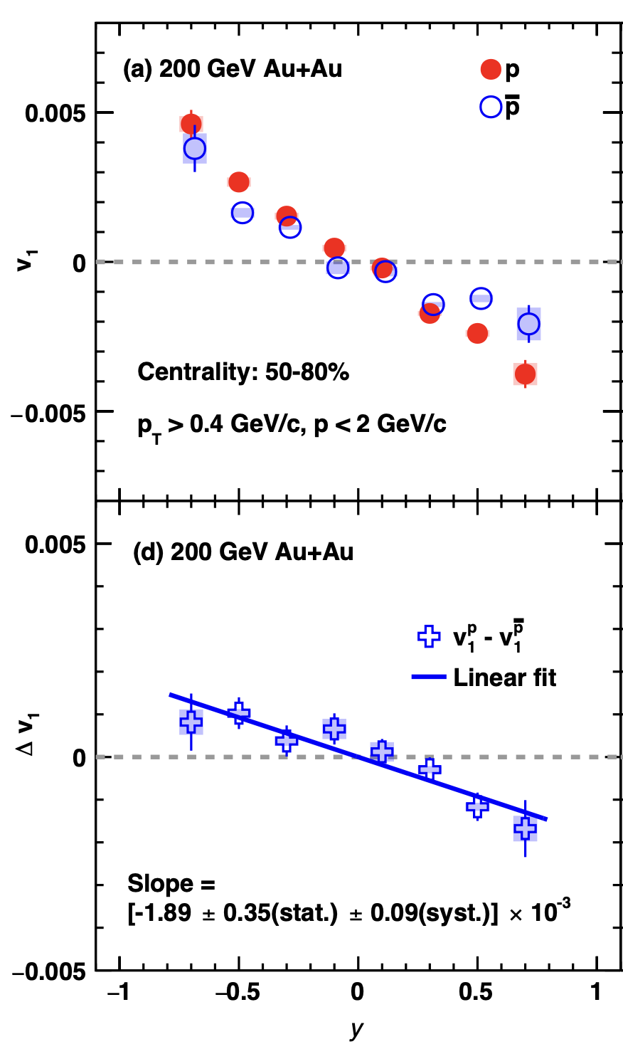
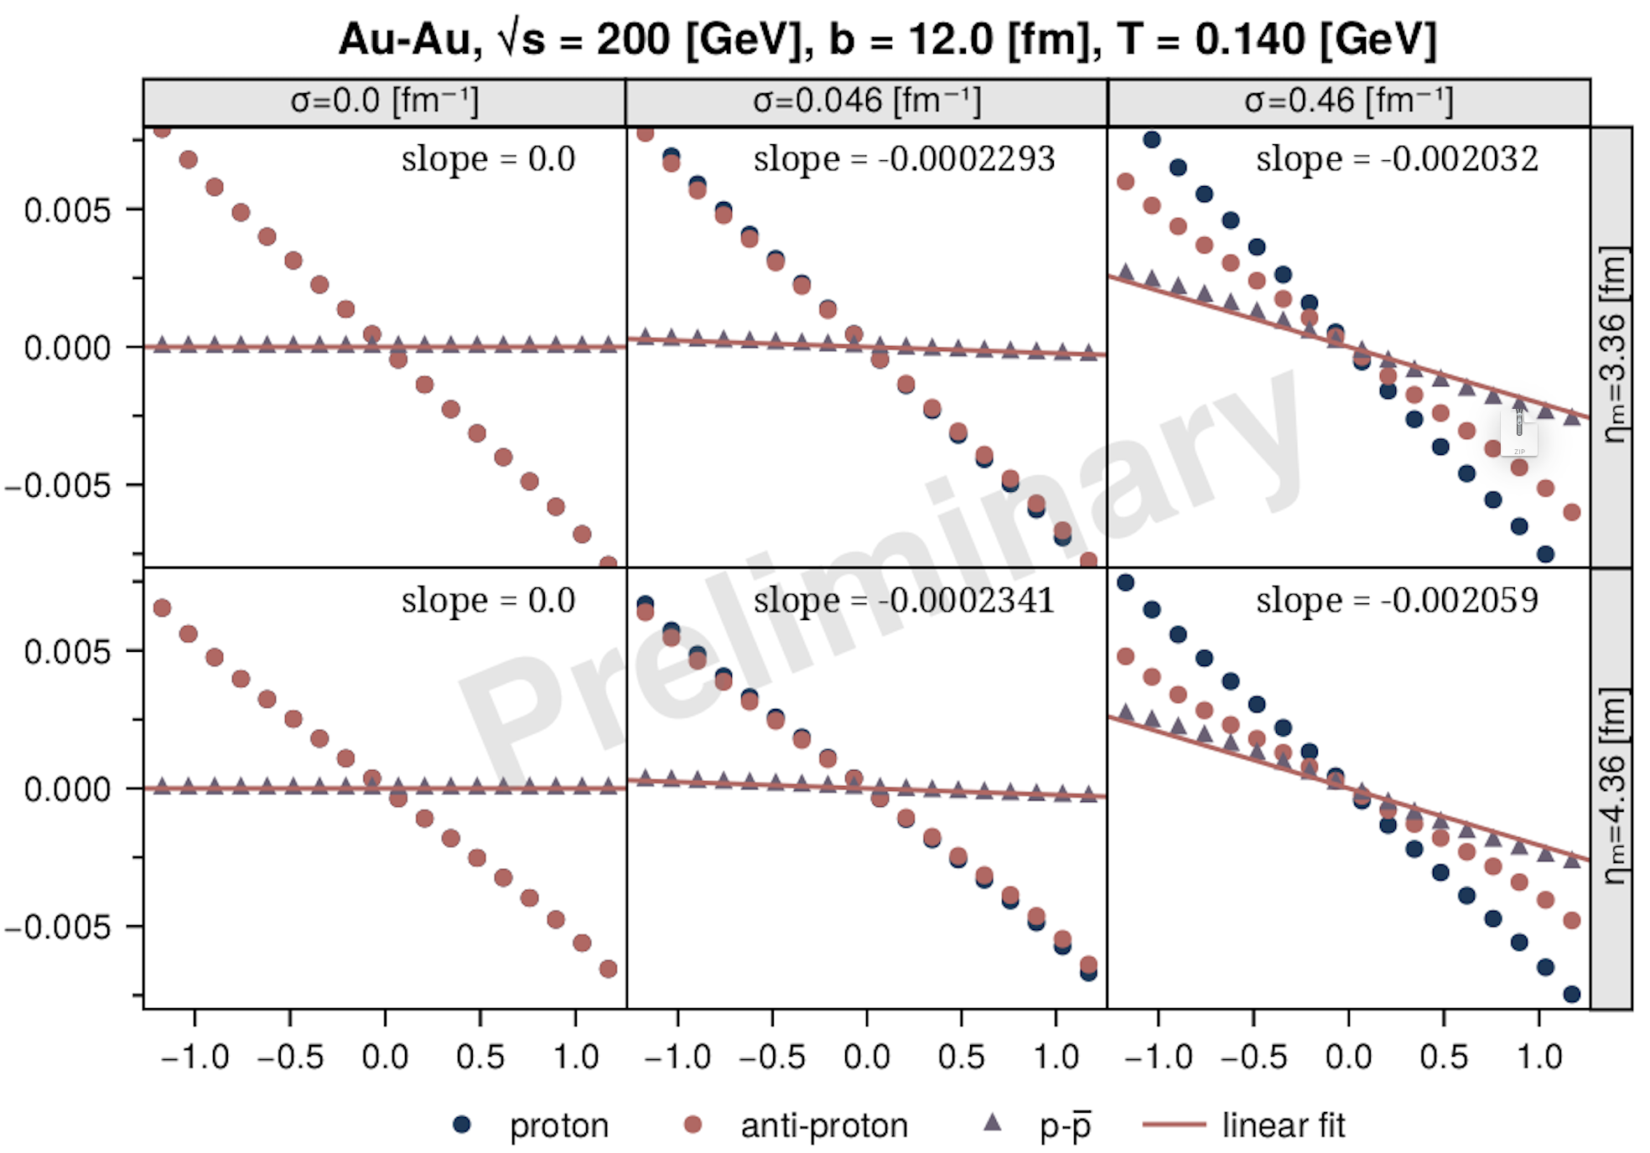
Electromagnetic Field Effect
Benoit
STAR arXiv:2304.03430
v₁: initial condition
Δv₁: charge conductivity
Bayesian analysis

Slide 25
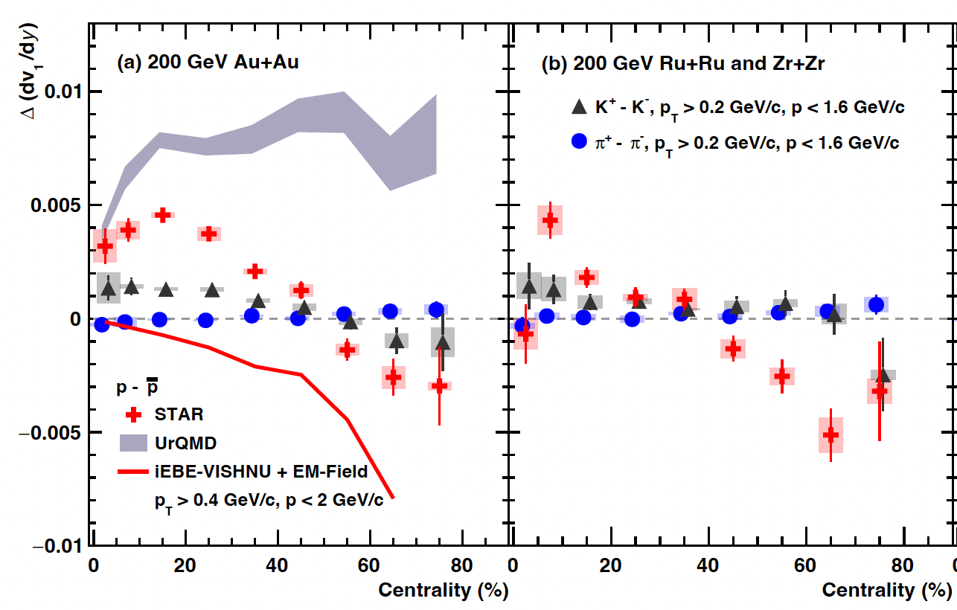
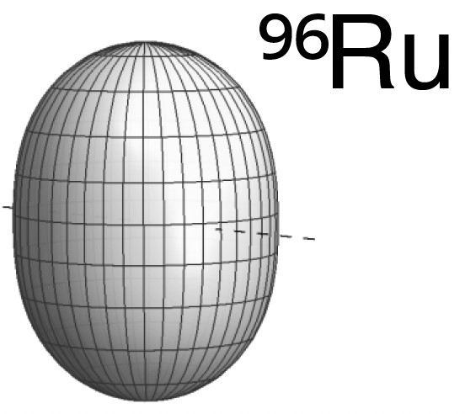
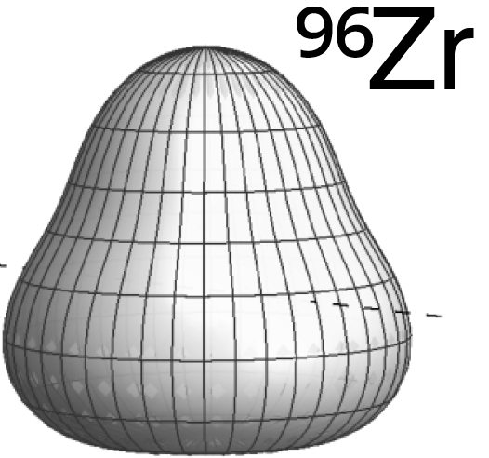
Nuclear Structure
Au+Au collisions
Ru+Ru, Zr+Zr collisions

Slide 26
Summary
Hydrodynamic Model
  Description of dynamics of relativistic Heavy Ion Collisions
  O(10) Parameters
Improvement of Model
Physical observables
Interpretation of results
Bayesian Analysis
  Strong tool for determination of parameters in models
  Wide application
  Standard tool

Slide 28
Symmetric and Asymmetric Systems
RHIC
Au-Au collisions
  Symmetric pressure gradient
  Almond-shaped medium
Cu-Au collisions
  Asymmetric pressure gradient
  Distorted Almond-shaped medium
Au
Au
Au
Cu
Hirono, Hongo, Hirano

Slide 29
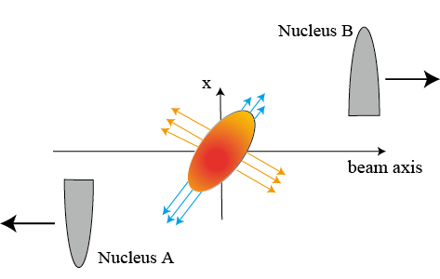
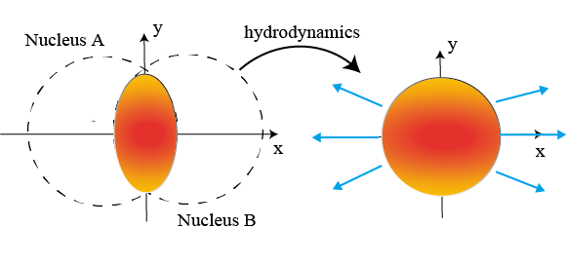
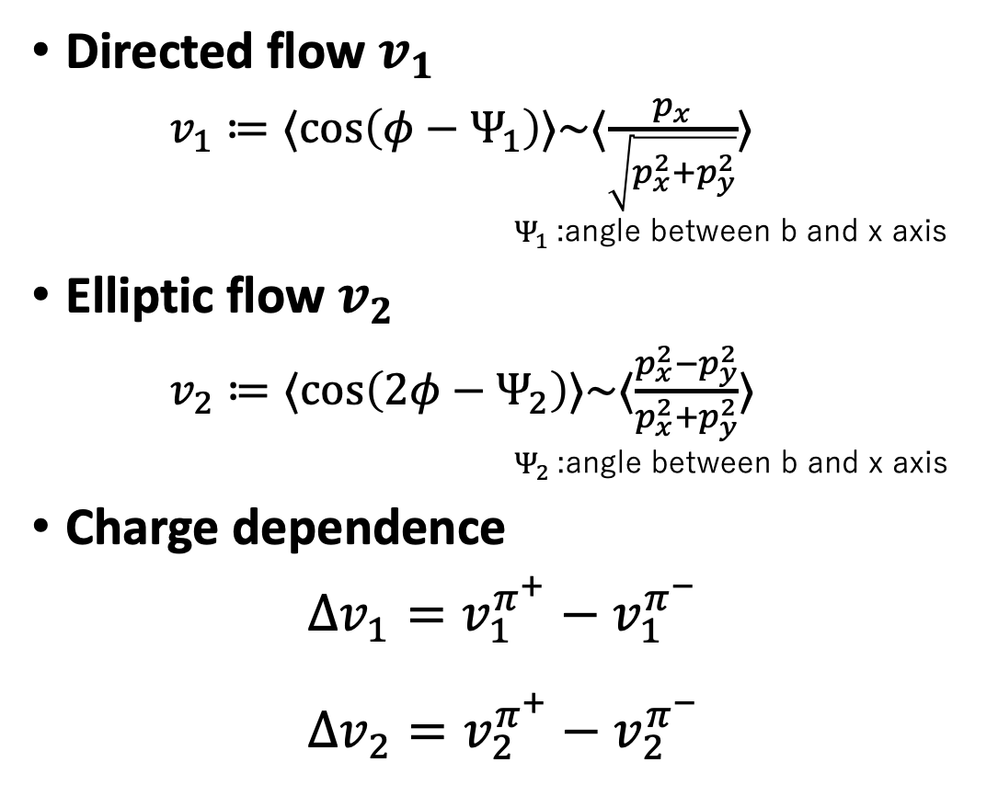


Analysis on High-Energy Heavy-Ion Collisions
$⟨ ⋅ ⟩$ : average over yield
Directed flow $v_{1}$
$v_{1}≔⟨\cos\left(φ−Ψ_{1}\right)⟩\sim ⟨\frac{p_{x}}{\sqrt{p_{x}^{2}+p_{y}^{2}}}⟩$
              $Ψ_{1}$:angle between b and x axis
Elliptic flow $v_{2}$
$v_{2}≔⟨\cos\left(2φ−Ψ_{2}\right)⟩\sim ⟨\frac{p_{x}^{2}−p_{y}^{2}}{p_{x}^{2}+p_{y}^{2}}⟩$
              $Ψ_{2}$:angle between b and x axis
Charge dependence
$Δv_{1}=v_{1}^{π^{+}}−v_{1}^{π^{−}}$
$Δv_{2}=v_{2}^{π^{+}}−v_{2}^{π^{−}}$
tilted pressure gradient
asymmetric shape
hydrodynamic expansion
$$\vec{b}$$

Slide 30

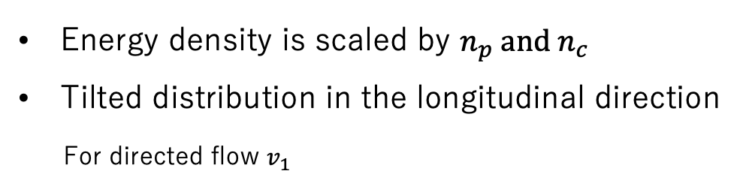
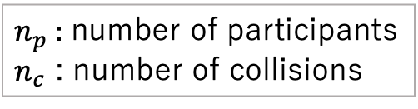

Initial Condition：QGP Medium
Bozek, et al, Phys. Rev. C 81, 054902(2010)
$n_{p}$: number of participants
$n_{c}$ : number of collisions
Tilted Glauber model
Freezeout hypersurface
Energy density
Energy density is scaled by $n_{p} and n_{c}$
Tilted distribution in the longitudinal direction
For directed flow $v_{1}$
$$x−y plane$$
$$x−η_{s}plane$$
Au+Au
Au
Au
Au
Au
Tilted pressure gradient
Au
Cu
Cu
Cu+Au
Au
asymmetric shape
distorted

Slide 31
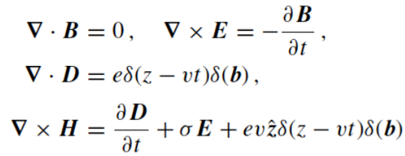
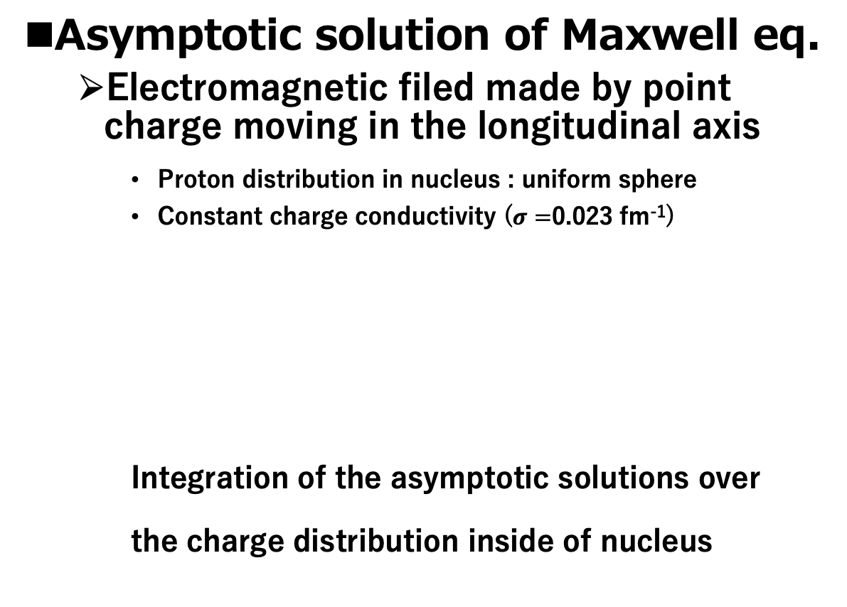
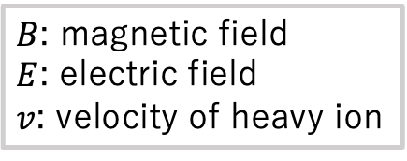
Initial Condition：Electromagnetic Fields
Tuchin, Phys.Rev.C88,024911(2013)
Asymptotic solution of Maxwell eq.
  Electromagnetic filed made by point charge moving in the longitudinal axis
    Proton distribution in nucleus : uniform sphere
    Constant charge conductivity ($σ=$0.023 fm⁻¹)
    Integration of the asymptotic solutions over
    the charge distribution inside of nucleus
$B$: magnetic field
$E$: electric field
$v$: velocity of heavy ion

Slide 32
Electromagnetic Field in Symmetric and Asymmetric Systems
Au-Au collisions
  Magnetic field
    Strong magnetic field
  Electric field
    No electric field
Cu-Au collisions
  Magnetic field
    Strong magnetic field
  Electric field
    due to the asymmetry
    of the charge distribution
Au
Au
Cu
Magnetic field
Au
Magnetic field
Electric field
E=0
Hirono, Hongo, Hirano

Slide 33






Initial Condition：Electromagnetic Fields ($η_{s}=0)$
Tuchin, Phys.Rev.C88,024911(2013)
Au＋Au（$b=10$ fm）
Cu＋Au（$b=10$ fm）
Au+Au
  Strong magnetic fields in QGP
  Electric field ～０ in QGP
Cu+Au
  Strong magnetic field in QGP
  Finite electric field in QGP
$$B_{y}$$
$$B_{y}$$
Au
Au
Au
Cu
$$E_{x}$$
$$E_{x}$$
Au
Au
Au
Cu
Freezeout hypersurface

Slide 34
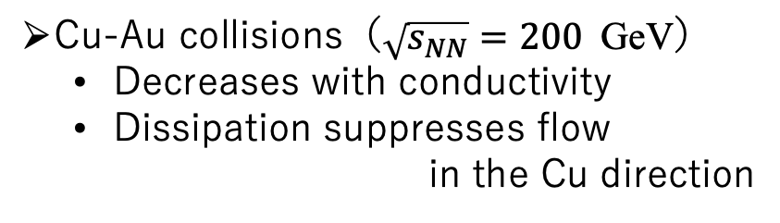



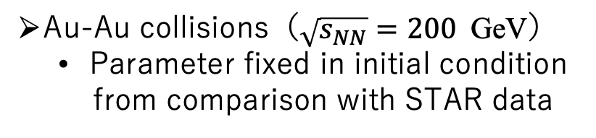


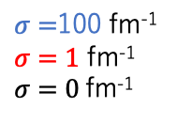
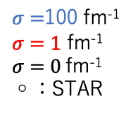

Directed Flow
$v_{1}≔⟨\cos\left(φ−Ψ_{1}\right)⟩\sim ⟨\frac{p_{x}}{p_{T}}⟩$
Nakamura, Miyoshi, C. N. and Takahashi, PRC 107, no.1, 014901 (2023)
$$η=\frac{1}{2}\ln{\frac{|p|+p_{z}}{|p|−p_{z}}}$$
Au-Au collisions（$\sqrt{s_{NN}}=200$GeV）
  Parameter fixed in initial condition
  from comparison with STAR data
Cu-Au collisions（$\sqrt{s_{NN}}=200$GeV）
  Decreases with conductivity
  Dissipation suppresses flow
  in the Cu direction
STAR Collaboration, Phys. Rev. Lett. 101 (2008), 252301
$σ=$100 fm⁻¹
$σ=1$ fm⁻¹
$σ=0$fm⁻¹
◦：STAR
$σ=$100 fm⁻¹
$σ=1$ fm⁻¹
$σ=0$fm⁻¹
$$v_{1}$$
$$v_{1}$$
Consistent with STAR data
Dissipation suppresses flow
$$η$$
$$η$$

Slide 35








Energy Transfer by Ohm Dissipation
Nakamura, Miyoshi, C. N. and Takahashi, PRC 107, no.1, 014901 (2023)
Energy Transfer
$$D\left(u\right)≔j^{μ}e_{μ}=γ[j⋅\left(E+v×B\right)−q\left(v⋅E\right)]$$
Au + Au ($η_{s}=0$)
Cu + Au ($η_{s}=0$)
Ex
Ex
Au
Au
Au
Cu
energy of
the electromagnetic field
Thermal energy
Kinetic energy
Au+Au collisions
Cu+Au collisions
$σ=100$ fm⁻¹
$σ=100$ fm⁻¹
Asymmetric dissipation
-> reduces pressures gradient
Symmetric dissipation
$x$ [fm]
$x$ [fm]
$${\text{no} \text{contribution} \text{to} v}_{1}$$
$$\text{contribution} \text{to} v_{1}$$

Slide 36
Directed Flow
$v_{1}≔⟨\cos\left(φ−Ψ_{1}\right)⟩\sim ⟨\frac{p_{x}}{p_{T}}⟩$
Nakamura, Miyoshi, C. N. and Takahashi, PRC 107, no.1, 014901 (2023)
$$η=\frac{1}{2}\ln{\frac{|p|+p_{z}}{|p|−p_{z}}}$$
Au-Au collisions（$\sqrt{s_{NN}}=200$GeV）
  Parameter fixed in initial condition
  from comparison with STAR data
Cu-Au collisions（$\sqrt{s_{NN}}=200$GeV）
  Decreases with conductivity
  Dissipation suppresses flow
  in the Cu direction
STAR Collaboration, Phys. Rev. Lett. 101 (2008), 252301
$σ=$100 fm⁻¹
$σ=1$ fm⁻¹
$σ=0$fm⁻¹
◦：STAR
$σ=$100 fm⁻¹
$σ=1$ fm⁻¹
$σ=0$fm⁻¹
$$v_{1}$$
$$v_{1}$$
Consistent with STAR data
Dissipation suppresses flow
$$η$$
$$η$$

Slide 37

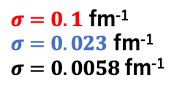
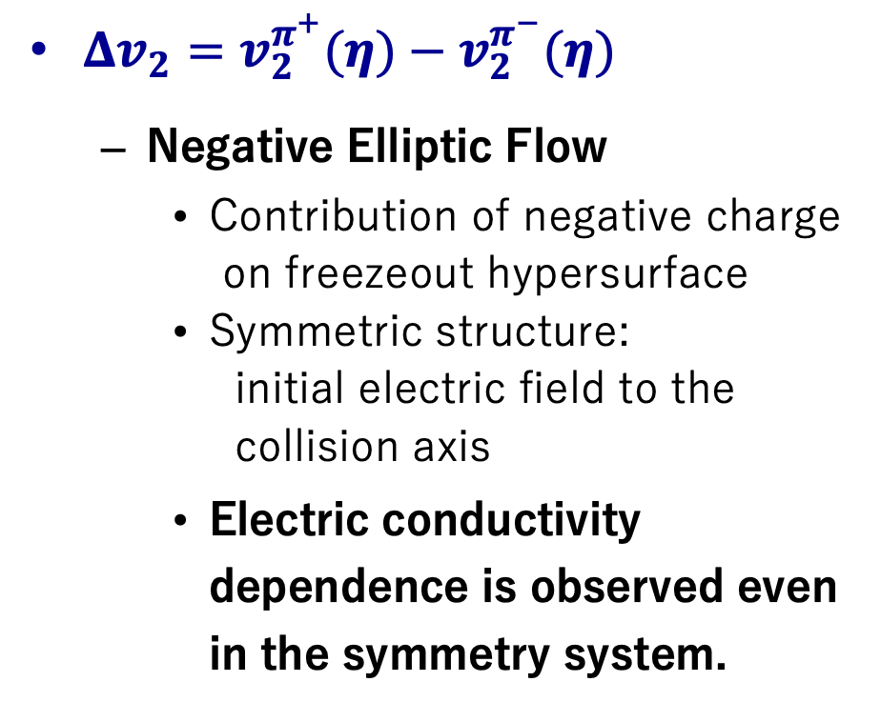





Charge Dependence of Δv₂：Au＋Au
Nakamura, Miyoshi, C. N. and Takahashi, PRC 107, no.1, 014901 (2023)
$Δv_{2}=v_{2}^{π^{+}}(η)−v_{2}^{π^{−}}(η)$
  Negative Elliptic Flow
    Contribution of negative charge
    on freezeout hypersurface
    Symmetric structure:
    initial electric field to the
    collision axis
    Electric conductivity dependence is observed even in the symmetry system.
Charge distribution
on freezeout hypersurface
Ex
Au
Au
$y$ [fm]
$x$ [fm]
$x$ [fm]
$σ=0.1$ fm⁻¹
$σ=0.023$ fm⁻¹
$σ=0.0058$fm⁻¹
$$Δv_{2}$$
$$η=\frac{1}{2}\ln{\frac{|p|+p_{z}}{|p|−p_{z}}}$$
$$η$$

Slide 38
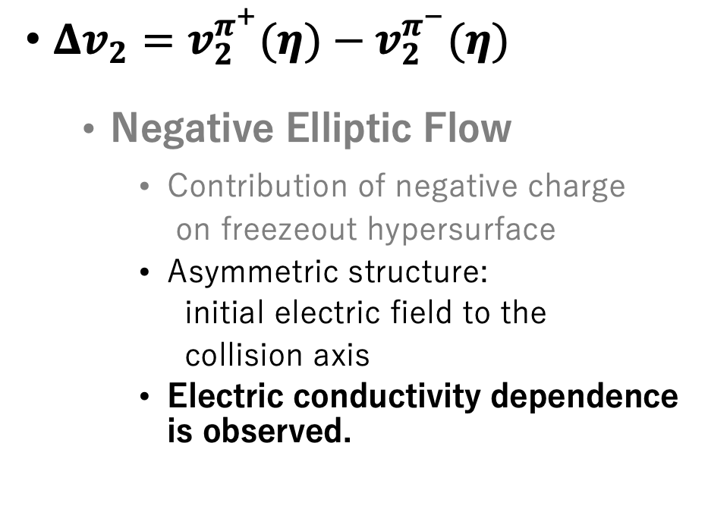


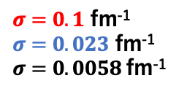




Charge Dependence of Δv₂：Cu＋Au
Nakamura, Miyoshi, C. N. and Takahashi, PRC 107, no.1, 014901 (2023)
$Δv_{2}=v_{2}^{π^{+}}(η)−v_{2}^{π^{−}}(η)$
  Negative Elliptic Flow
    Contribution of negative charge
    on freezeout hypersurface
    Asymmetric structure:
    initial electric field to the
    collision axis
    Electric conductivity dependence is observed.
Charge distribution
on freezeout hypersurface
【副論文3】 K. N., T. Miyoshi, C. Nonaka and H. R. Takahashi, arXiv:2212.02124 [nucl-th]
$$E_{x}$$
Au
Cu
$y$ [fm]
$x$ [fm]
$σ=0.1$ fm⁻¹
$σ=0.023$ fm⁻¹
$σ=0.0058$fm⁻¹
$$Δv_{2}$$
Δv₂:
initial electromagnetic field distribution
electrical conductivity
$$η=\frac{1}{2}\ln{\frac{|p|+p_{z}}{|p|−p_{z}}}$$
$$η$$

Slide 39



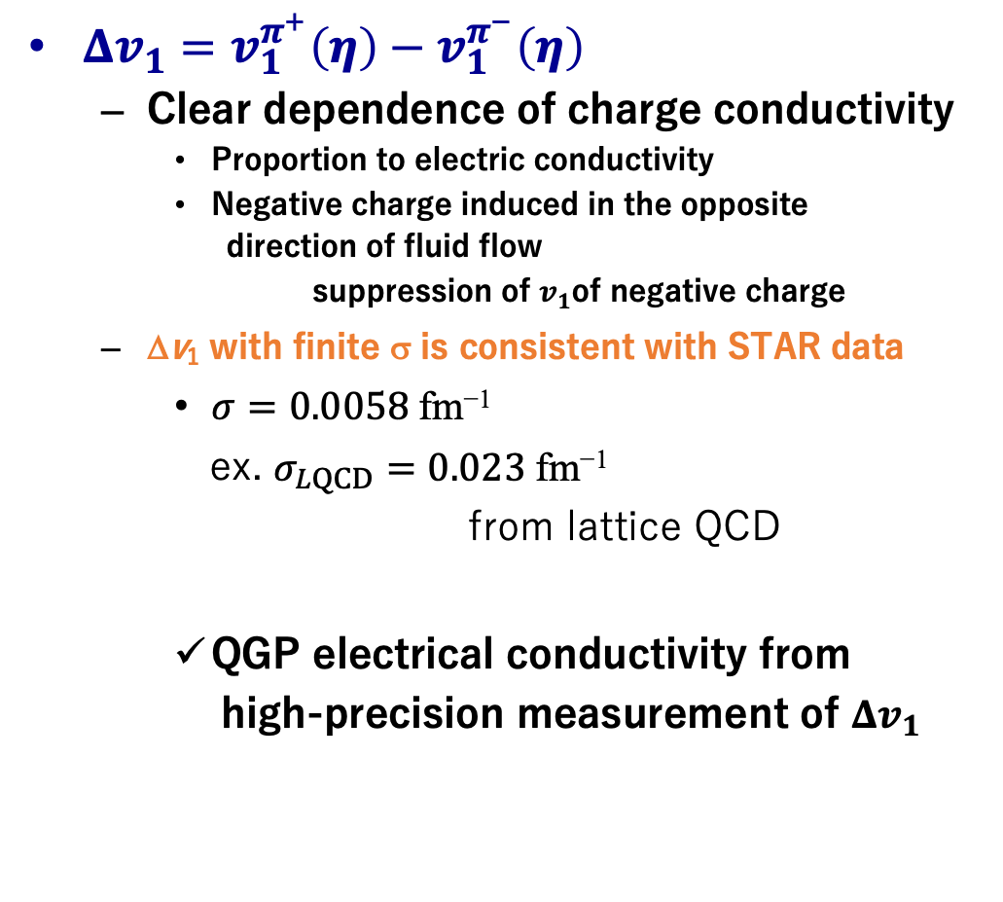

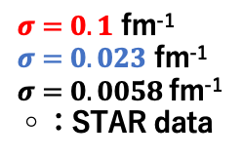

Charge Dependence of Δv₁：Au＋Au
$Δv_{1}=v_{1}^{π^{+}}\left(η\right)−v_{1}^{π^{−}}\left(η\right)$
  Clear dependence of charge conductivity
    Proportion to electric conductivity
    Negative charge induced in the opposite
    direction of fluid flow
    suppression of $v_{1}$of negative charge
  Δv₁ with finite σ is consistent with STAR data
    $σ=0.0058$ $\text{fm}\text{−1}$
    ex. $σ_{LQCD}=0.02\text{3 }\text{fm}\text{−1}$
    from lattice QCD
    QGP electrical conductivity from
    high-precision measurement of $Δv_{1}$
Charge distribution on freezeout hypersurface
$x$ [fm]
$x$ [fm]
$σ=0.1$ fm⁻¹
$σ=0.023$ fm⁻¹
$σ=0.0058$fm⁻¹
◦：STAR data
STAR collaboration,
Phys. Rev. Lett. 112 (2014) no.16,
162301
Gert Aarts, et al.
Phys. Rev. Lett., 99:022002, 2007.
$$Δv_{1}$$
$$η$$
$$η=\frac{1}{2}\ln{\frac{|p|+p_{z}}{|p|−p_{z}}}$$

Slide 40

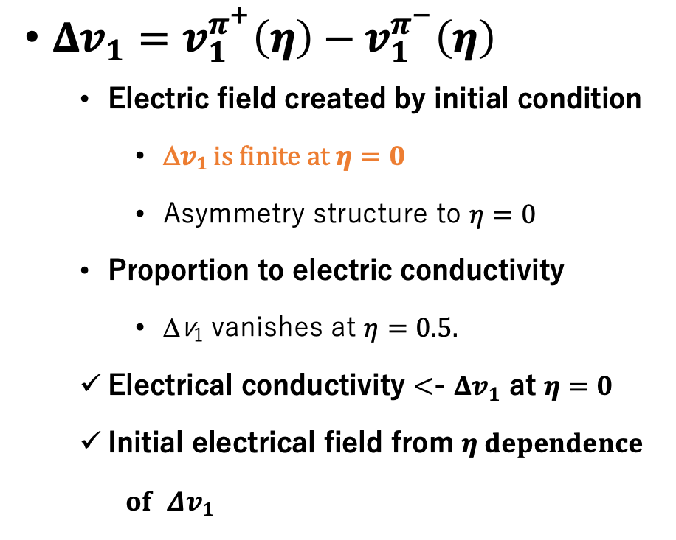




Charge Dependence of Δv₁：Cu＋Au
Nakamura, Miyoshi, C. N. and Takahashi, Phys. Rev. C 107 (2023) 3, 034912
$Δv_{1}=v_{1}^{π^{+}}\left(η\right)−v_{1}^{π^{−}}\left(η\right)$
  Electric field created by initial condition
    Δ$v1 is finite at η=0$
    Asymmetry structure to $η=0$
  Proportion to electric conductivity
    Δv₁ vanishes at $η=0.5.$
  Electrical conductivity <- $Δv_{1}$ at $η=0$
  Initial electrical field from $η dependence$
  $of$ $Δv_{1}$
Charge distribution on freezeout hypersurface
$x$ [fm]
$x$ [fm]
$σ=0.1$ fm⁻¹
$σ=0.023$ fm⁻¹
$σ=0.0058$fm⁻¹
$$Δv_{1}$$
Asymmetric system has advantage in explore of
QGP electrical conductivity.
$$η$$

Slide 41


RRMHD Equation in Milne Coordinates
New
$$τ=\sqrt{t^{2}−z^{2}}$$
$$η_{s}=\frac{1}{2}\ln{\frac{t+z}{t−z}}$$
Milne coordinates
  Expanding systems in the longitudinal direction $(τ,x,y,η_{s})$
    Strong expansion in the longitudinal direction is effectively included.
    Number of grid of fluid is saved.
  RRMHD Equation
    $$∂_{τ}\left(τU\right)+∂_{i}\left(τF^{i}\right)=τS$$
    $U= \left({D \atop \begin{aligned}m_{j} \\ ε \\ B^{j} \\ E^{j} \\ q\end{aligned}}\right), F^{i}=\left({Dv^{i} \atop \begin{aligned}Π^{ji} \\ m^{i} \\ ε^{jik}E_{k} \\ ε^{jik}B_{k} \\ J^{i}\end{aligned}}\right), S=\left({0 \atop \begin{aligned}\frac{1}{2}T^{ik}∂_{j}g_{ik} \\ −\frac{1}{2}T^{ik}∂_{0}g_{ik} \\ 0 \\ J_{c}^{i} \\ 0\end{aligned}}\right)$
The first RRMHD code in Milne coordinates

