Slide 1
High Voltage CMOS Pixel Detector
Hui Zhang

Slide 2
Contents
CMOS Development Flow
  Design Environment
  Design
  Production
  Package
  Measurements
High Voltage CMOS Pixel Detector
  What is HVCMOS
  Application
  Variants of HVCMOS
  Components of Pixel Detector
  Some Examples of Measurement Results

Slide 3


CMOS Development Flow

Slide 4
CMOS Development Flow
Foundry
EDA
Design
Production
Package
Test

Slide 5
Design Environment
Foundries and PDKs (Package Design Kit)
  Foundry: TSMC, UMC, TSI, Lfoundry, SMIC…
  CMOS, HVCMOS, BiCMOS, FinFET …
  350nm, 180nm, 65nm, 55nm, ….
EDA Tools
  Cadence Virtuoso, Cadence Assure
  License costs for industrial use > 100k€/project

Slide 6
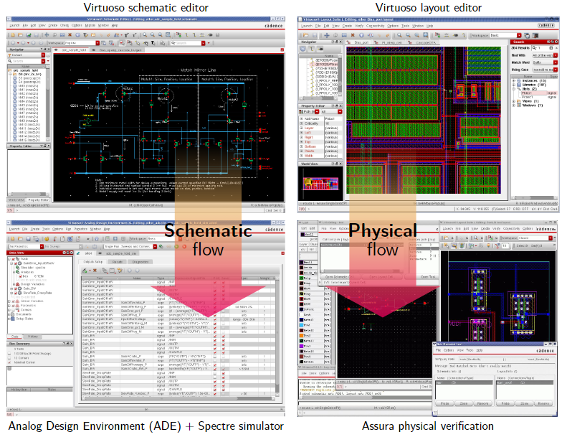
Design
Notes:
在DRC和LVS满足之后，还需要考虑到几个问题，如
看各层金属的覆盖面积是否符合要求，通常要大于30%
看各层金属的面积分布是否均匀。
如果导线过长，需要在n井中加入p+ attene diode. 天线二极管，。。。

Slide 7
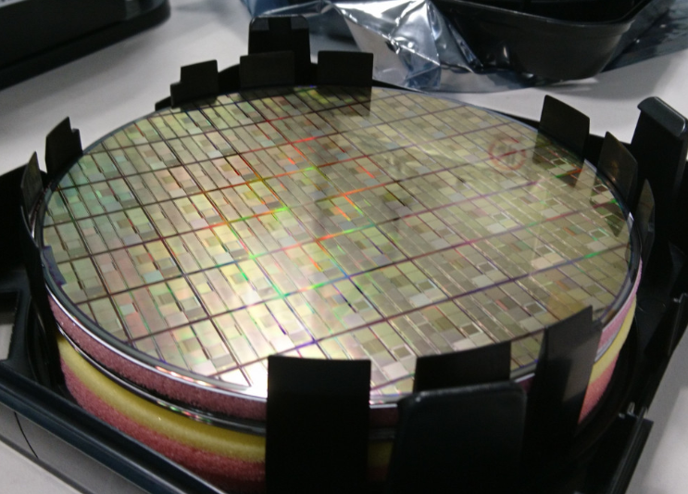
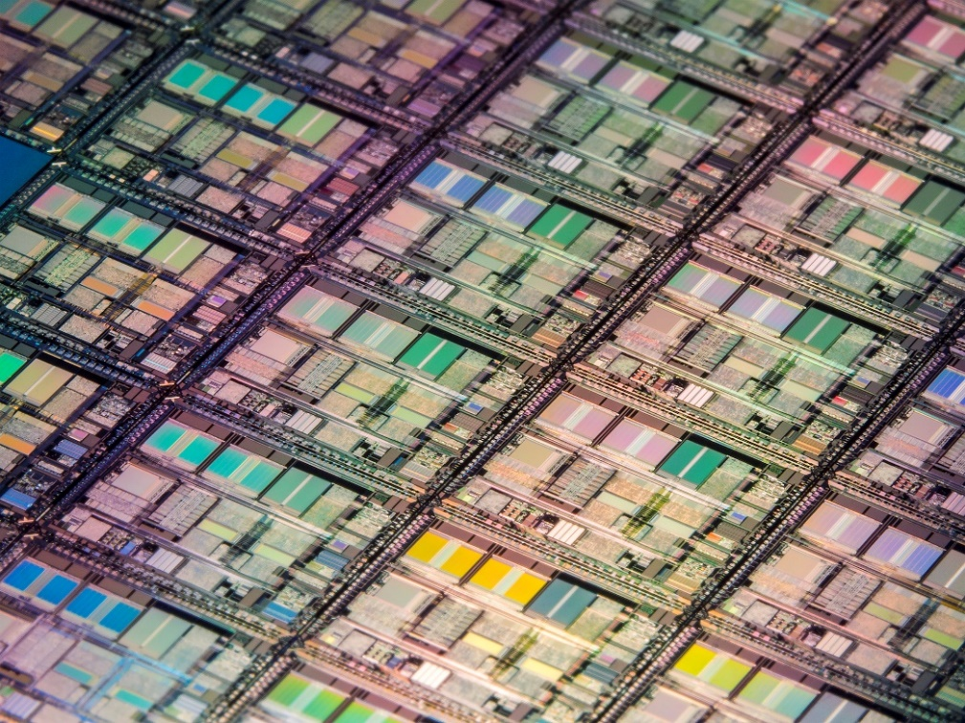
Production
Engineering Run
MPW (Multi-Project Wafer)

Slide 8
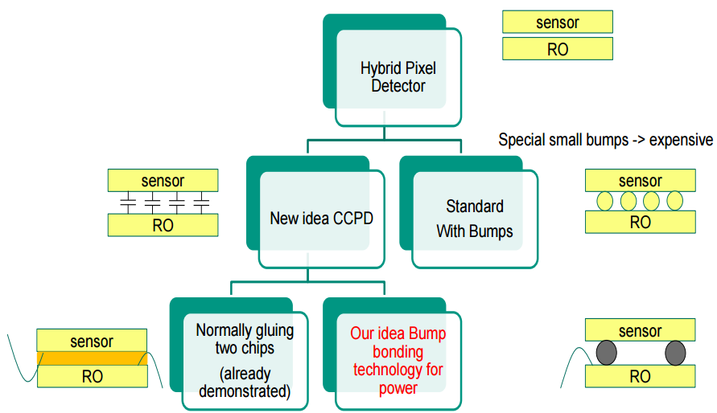
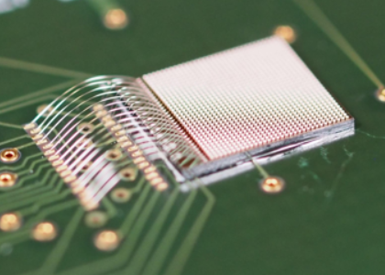
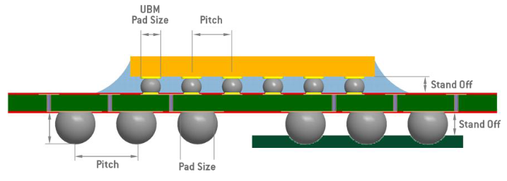
Package
Wire Bonding
Flip Chips
Notes:
为了提高空间分辨率，像素阵列规模不断扩大而像素尺寸及其间距不断减小。由于倒装焊对芯片的共面性要求极为苛刻，焊球开路、短路、填充料塌陷空洞等故障率呈指数型增长。极大地降低了探测器的可靠性，也增加了芯片互连的难度和成本。

Slide 9
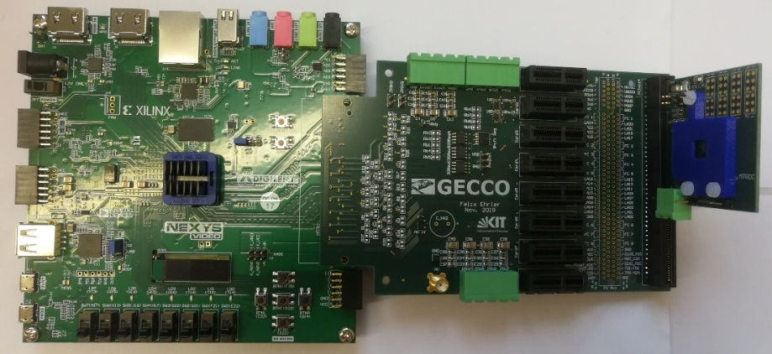
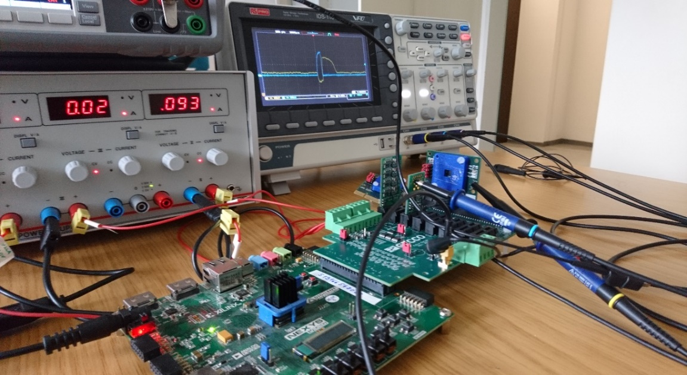
Measurements
PCB design
Firmware Development
Software Development
Build up Measuring System

Slide 10
HVCMOS Technology

Slide 11
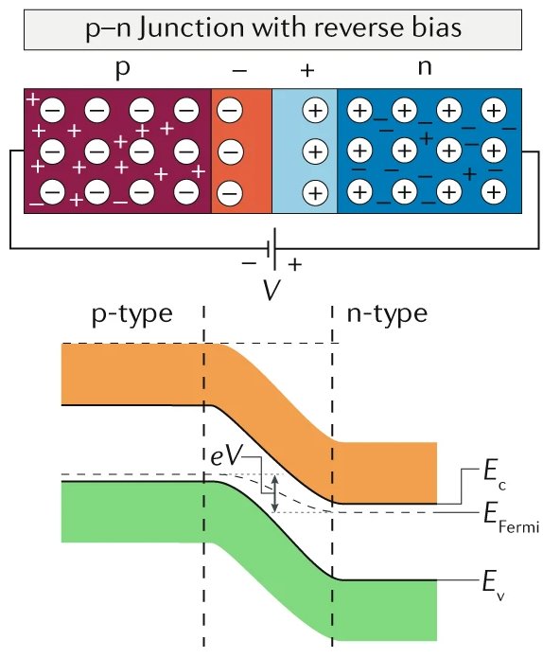
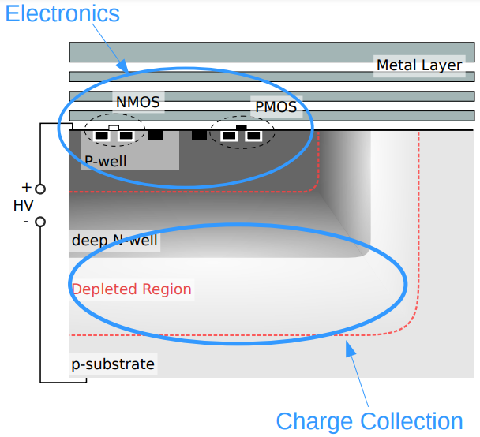
What is HVCMOS
It is essentially a standard n-in-p sensor fabricated by a CMOS foundry
High resistivity substrate (up to 1kOhmcm or more)
Electronics placed inside the pixels
Notes:
它本质上是由 CMOS 代工厂制造的标准 n-in-p 传感器
他有高的阻抗衬底（可达1kOhmcm以上）
Electronics 放置在像素内

Slide 12
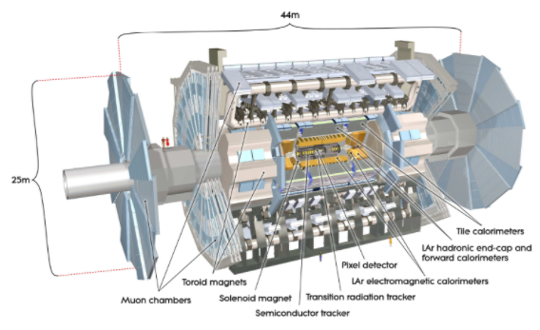
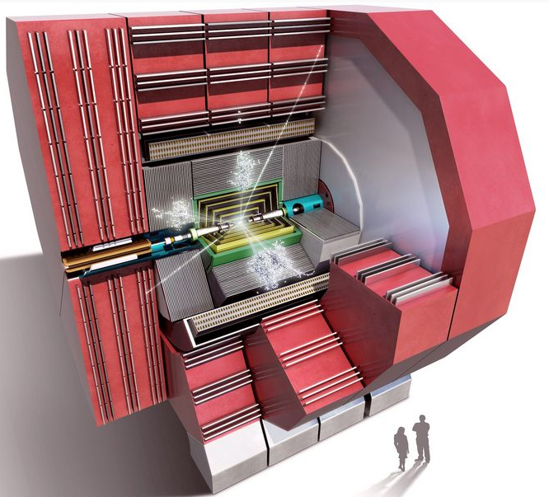
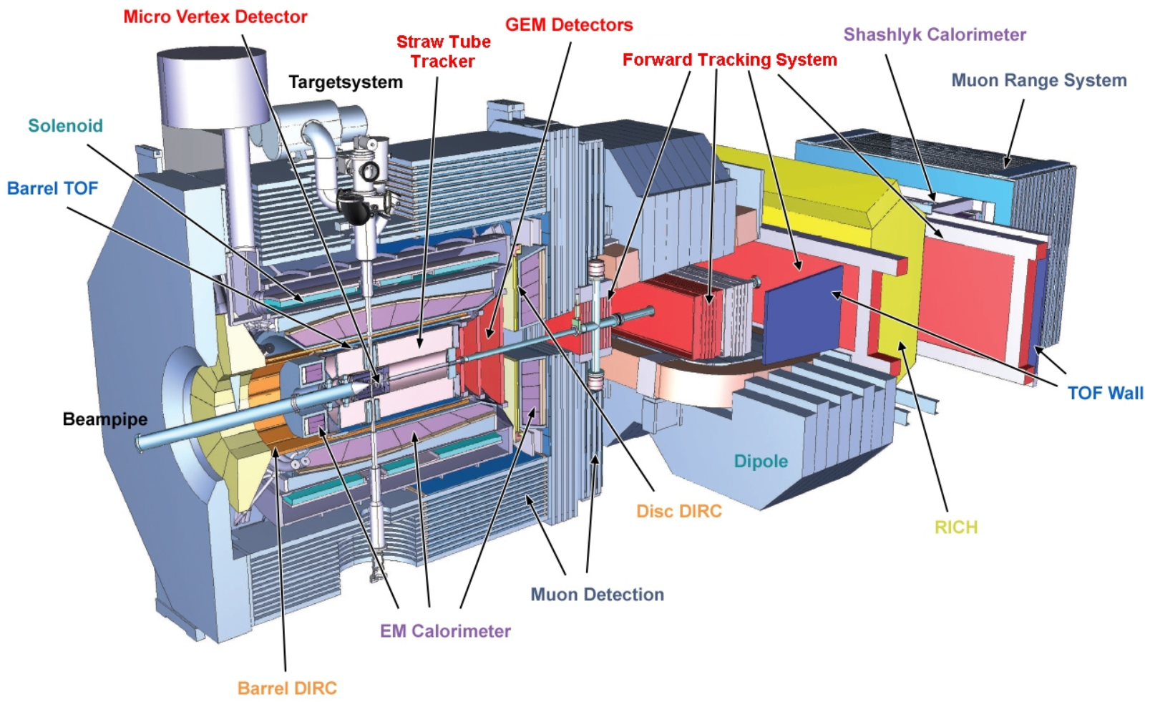
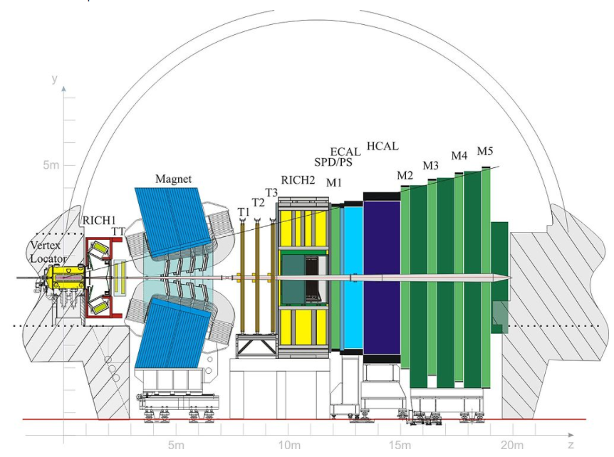
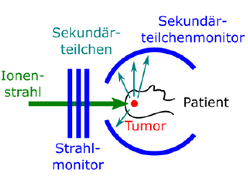
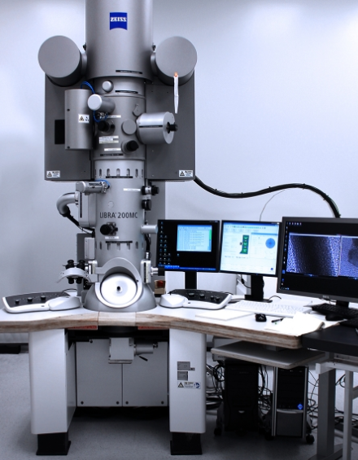
Applications
Particle physics experiments
  LHC: ATLAS, LHCb, CMS, LHCb
  CLIC
  CEPC
  Mu3e
  KATRIN
  PANDA
Medicine
Electron microscope
ATLAS
CLIC
PANDA
LHCb
Pictures of the respective collaborations

Slide 13
Applications
High Voltage CMOS Technology for Particle Physics Experiments
High Voltage CMOS Technology for beam monitor with counting electronics for Heidelberg Ion Beam Therapy Centre
High Voltage CMOS Technology for Scanning Transmission Electron Microscopy

Slide 14
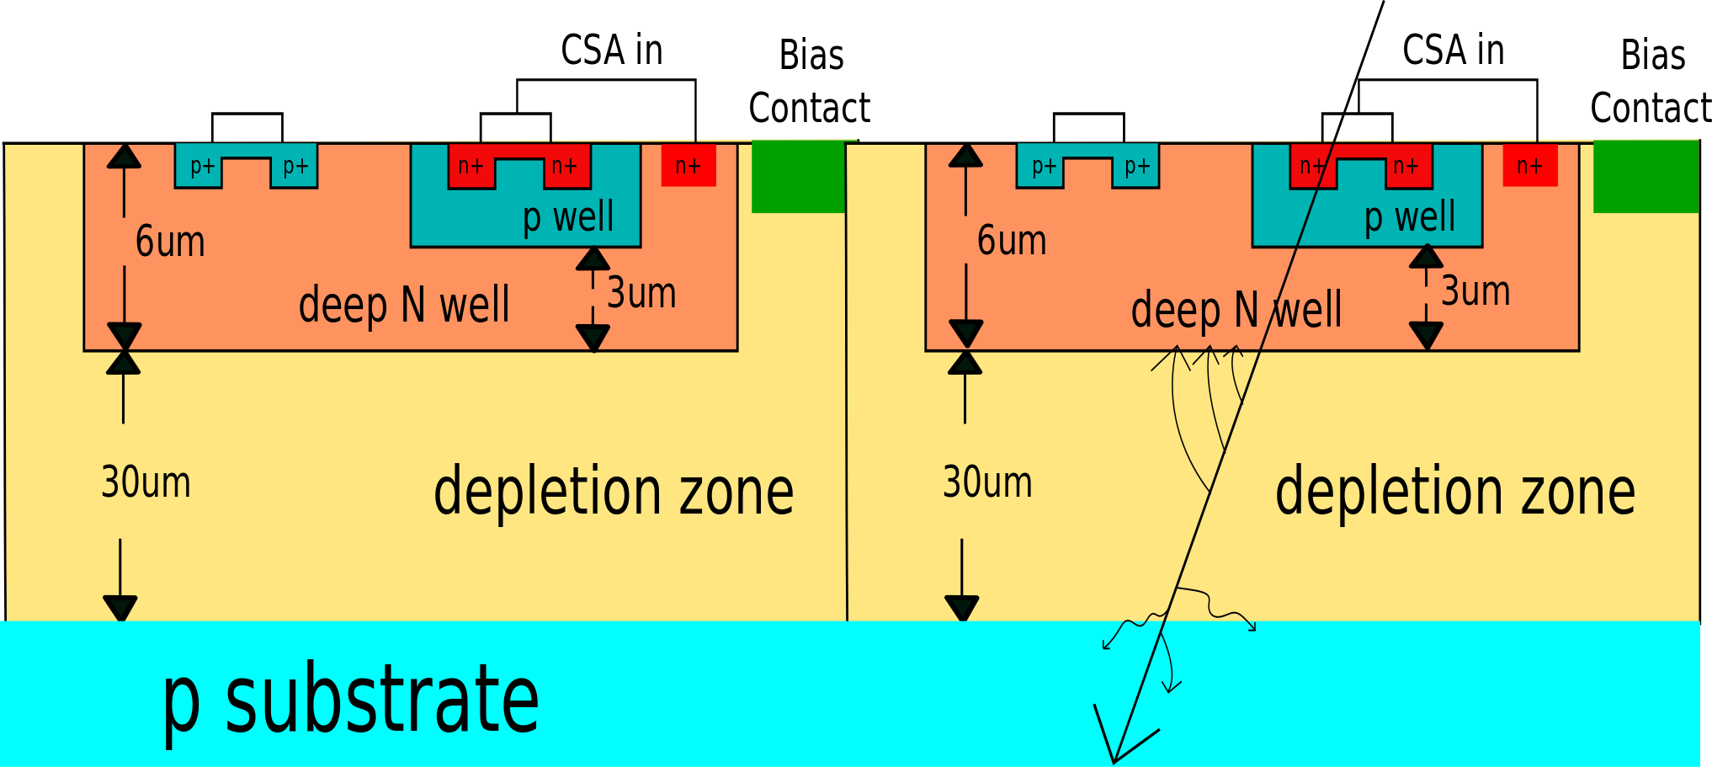
HVCMOS for High Energy Physics Experiments
Fast and efficient charge collection by drift
Charge Collection between p-substrate and deep n-well
Electronics isolated against HV
Implemented in commercial processes
Radiation tolerant technology, further increased by special design
  Radiation tolerant PMOS transistors
  Deep submicron
  Guard Ring
  Shielding
Notes:
通过漂移快速高效地收集电荷
p 衬底和深 n 阱之间的电荷收集
与 HV 隔离的电子设备
在商业流程中实施，可提供大型工厂输出
耐辐射技术，通过特殊设计进一步提高

Slide 15
The Interaction of Charged Particle/Photon on Detector
High energy charged particle (> 1 GeV) goes through senor and ionizes sensor material (silicon) along its track. The number of generated e-h pairs is a random value, with Landau distribution.
Photon of moderate energy (< 70 keV) usually gives all its energy to sensor material (CdTe) in one point (Photo-effect). The number of generated e-h pairs has no fluctuations.
Charged Particle (> 1 GeV)
Photon (< 70 keV)
-
+
-
+
-
+
-
+
-
+
Notes:
这些检测器和光像素检测器（如相机或智能手机）之间的区别在于我们检测的是单个粒子。粒子可以是：高能带电粒子或高能光子（70keV）。带电粒子在传感器上的相互作用和光子在传感器上的相互作用有点不同。
高能带电粒子（~1GeV，mu3e 25MeV）穿过传感器并沿其轨道电离（形成 e-h 对）传感器材料（硅）。 生成的e-h对的个数是随机值（有波动）
中等能量 (<70keV) 的光子通常在一个点上将其所有能量提供给传感器材料 (CdTe)（光效应）。 e-h 对的数量没有波动。

Slide 16
Particle tracking
Typical application for particle detector is particle tracking
Particle goes through many layers of pixel detectors.
  Each layer gives us 2D information of particle track
  Using information of all layers the 3D track can be calculated.
~100 µm
Pixels
Pixels fires
Charged Particle
Notes:
粒子检测器的典型应用是粒子跟踪——我们要测量粒子的轨迹（轨迹），
它是在粒子物理实验中产生的粒子经过多层像素检测器。 每一层都为我们提供了粒子轨迹的二维信息。 使用所有层的信息，可以计算 3D 轨迹。这些层应该很薄（通常为 100µm），这样粒子就不会偏转。

Slide 17
Passive Pixel Detector
The passive pixel detector in silicon (non CMOS) is based on PN junctions.
The e-h pairs are separated by E-field and the movement of electrons makes current.
Collection time (~1ns)
The charge signal is equal to number of generated e-h pairs.
i
1ns
t
n-region
P-type substrate
Depleted zone
P-type substrate
HV contact
Notes:
硅中的无源像素检测器基于 PN 结，即 p 衬底中的 n 区。 交界处已耗尽。衬底被负电压偏置。
e-h 对被电场分开，电子被最近的 n 阱收集。
电子的运动产生电流。 电流的积分是e-h对（电荷）的数量。 在带电粒子的情况下，e-h 对的数量取决于传感器和耗尽层的厚度。
信号采集速度快，采集时间约为1ns。 以这种方式，粒子撞击的精确时间测量是可能的。
我们得到多少电荷？ 电荷信号等于生成的 e-h 对的数量。 在带电粒子的情况下，e-h 对的数量取决于传感器和耗尽层的厚度。 示例 30µm = 3000e-h 对 = 平均 0.5fC。 实际数字随 Landau 分布而波动。

Slide 18
Active Pixel Detector
HVCMOS detector
Pixel contains amplifier
The sensor is deep n-well in p-substrate and the pixel electronics are placed inside the deep n-well
i
1ns
HV
HV contact
C_{nwell} = 100 fF
t
NMOS
PMOS
HV
NMOS
PMOS
HV
p-well
n-well
p-well
n-well
Deep n-well
Deep n-well
~ 30µm
~ 3000e/h
~ 0.5fC
Depleted zone
Depleted zone
P-type substrate
P-type substrate
Notes:
现在我展示了我组开发的一种有源像素检测器。
它是HVCMOS检测器
传感器位于 p 衬底中的深 n 阱中，像素电子器件放置在深 n 阱中。
像素包含放大器——因此被称为有源传感器。

Slide 19
Variants of HVCMOS
Small fill-factor
Large fill-factor
Monolithic Pixel Detector
Hybrid Pixel Detector
HRCMOS：focus on high resistive substrate
HVCMOS：focus on high depletion voltage

Slide 20
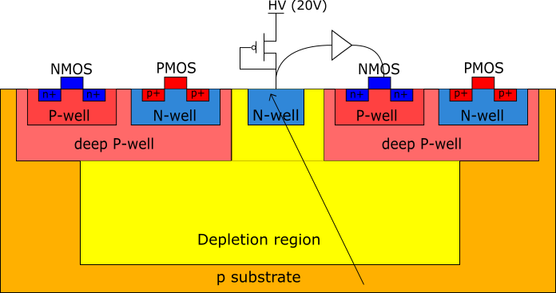
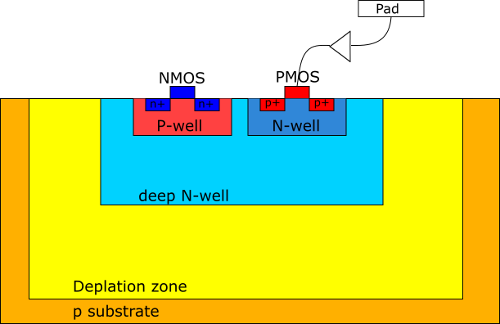
Small fill factor vs. large fill factor
Small fill-factor
  Small collection electrode without electronics
  Smaller input node capacitance and less crosstalk from electronics to detector.
  Not radiation hardness
Large fill-factor
  Larger collection electrode with pixel electronics inside (1*10¹⁶ neq/cm²)

Slide 21
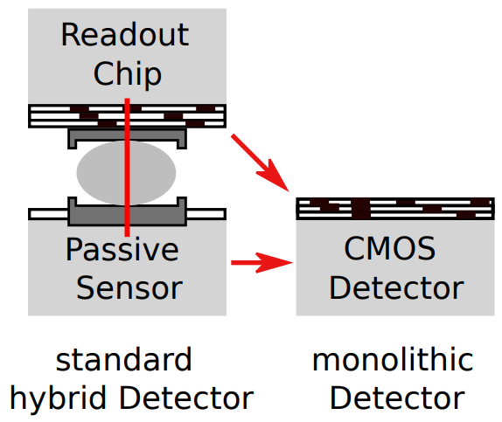
Hybrid vs. Monolithic
Standard Hybrid pixel detector:
  Bump bond for signal transmission
  Passive sensor
  Higher readout speed.
  Materials and technologies can be optimized.
  Higher power consumption.
Monolithic HV-CMOS Detector:
  Sensor and readout electronics are on the same die
  Electronics inside sensing diode
  Lower power consumption because of a small sensor capacitance
  Higher spatial resolution with simplified interconnections.
  Numerous metal lines are needed
Sensor
Sensor
RO
RO

Slide 22

HRCMOS vs. HVCMOS
The depletion depth
  $∅_{0}$ → 120V
  $N_{A}$ → 1kOhmcm
$$x_{n}≈\sqrt{\frac{2ε_{si}}{qN_{A}}(∅_{0}−V_{0})}$$
Notes:
这个公式被用来计算空间电荷区的宽度。通过分析我们可以指导，有两种方法可以扩大耗尽区的宽度
1. 反向偏置电压，这个我们在前面已经提到。但是，更高的外部电压会带来更大的击穿风险。 可施加的最大电压受半导体电阻的限制。目前是120V
2. 需要更高电阻率的材料，也就是说使用更高纯度的半导体或补偿材料来提高掺杂密度。目前是1k，下一步我们想用20k

Slide 23
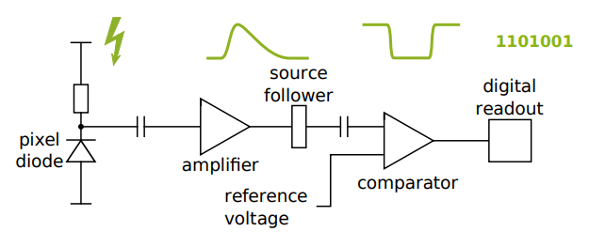
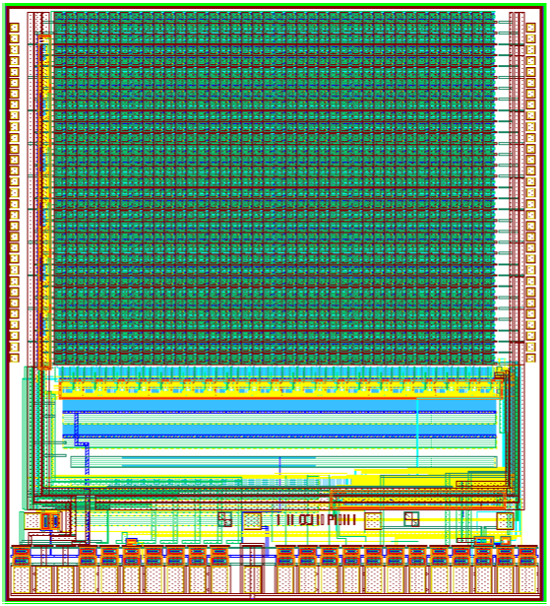
Components of a HVCMOS Detector
Pixel electronics
    Pixel diode
    Amplifier
    Comparator (in pixel or periphery)
Readout (buffer, timestamp generation, encoder, serializer, PLL，State machine)
Configuration
    Shift register (matrix configuration)
    RAM (pixel configuration)
Bias block
Pads
Matrix
Configuration
Bias DAC
Pads

Slide 24
Requirements on electronics
Precise arrival time measurement, Precise ToT measurement (in case of photons energy measurement)
They are difficult to achieve because
  Noise in amplifier
  Noise in current source
Signal fluctuations in the case of charged particles. Because the number of generated e-h pairs is a random value, with Landau distribution.
Threshold dispersion
Notes:
精确的到达时间测量、精确的 ToT 测量（在光子能量测量的情况下）
它们很难实现，因为放大器中的噪声电流源中的噪声
带电粒子情况下的信号波动。 因为生成的e-h对的个数是一个随机值，服从Landau分布。
阈值分散

Slide 25
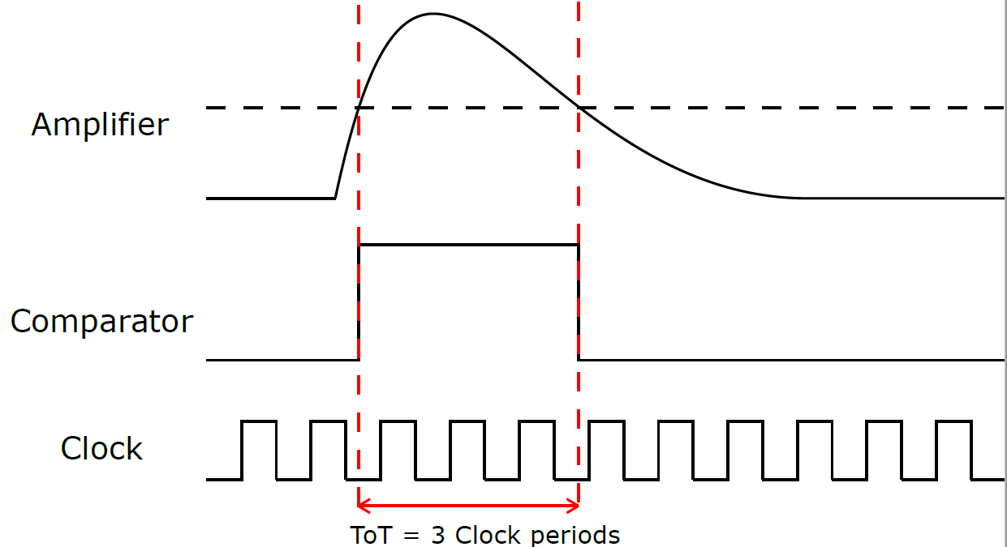
Pixel Electronics
A general front end circuit of a particle detector usually consists of a charge sensitive amplifier (CSA), a shaper, a comparator followed by digital processing cell.
CSA
Shaper
R
f
R
bias
C
f
R
C
-
o
ac
+
C
Digital
c
(Pixel
address
, time, TOT)
C
TH
-
o
BL
Sensor
Cascode
amp
> 100ns
TDAC
Notes:
幻灯片显示了典型的前端电路我们通常将 n 区（此处为 Cc）连接到电荷敏感放大器。 该放大器用作信号电流的积分器。 它产生等于电荷除以反馈电容的输出电压信号。 对于 pf 像素检测器，典型的反馈电容为 2.5fF。示例 0.5fC / 2.5fF = 0.2V = 200mV
然后 Cfb 通过电阻器或电流源放电，因此在粒子撞击后我们会得到一个持续时间 > 100ns 的三角信号。CSA 信号使用比较器进行数字化。
数字电路测量信号的到达时间和与硅中沉积能量成比例的脉冲宽度（超过阈值时间 TOT）。
正如我所说，在带电粒子的情况下，信号电荷取决于结厚度。在光子检测的情况下，信号电荷与光子能量成正比。

Slide 26
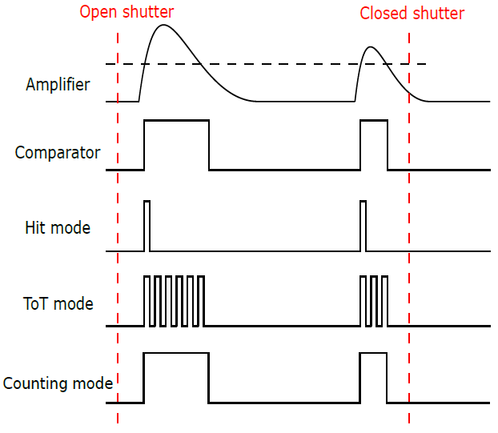
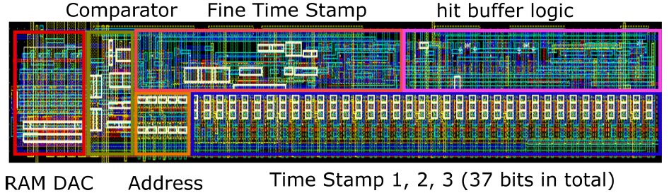
Readout Cells – Three Operation Modes
Hit Mode
ToT (Time to threshold) Mode
Counting Mode
Notes:
命中模式：计数器用于检测粒子到达时的时间。
ToT 模式：计数器用作 ADC，允许在每个像素中直接测量能量。 比较器信号的长度与放大器输出的高度成正比，而放大器输出的高度与沉积在粒子像素中的电荷成正比。
计数模式：ASIC 对进入的粒子进行计数，将多次命中的数据整合到一个像素中。如果模拟信号超过阈值，比较器产生信号。

Slide 27
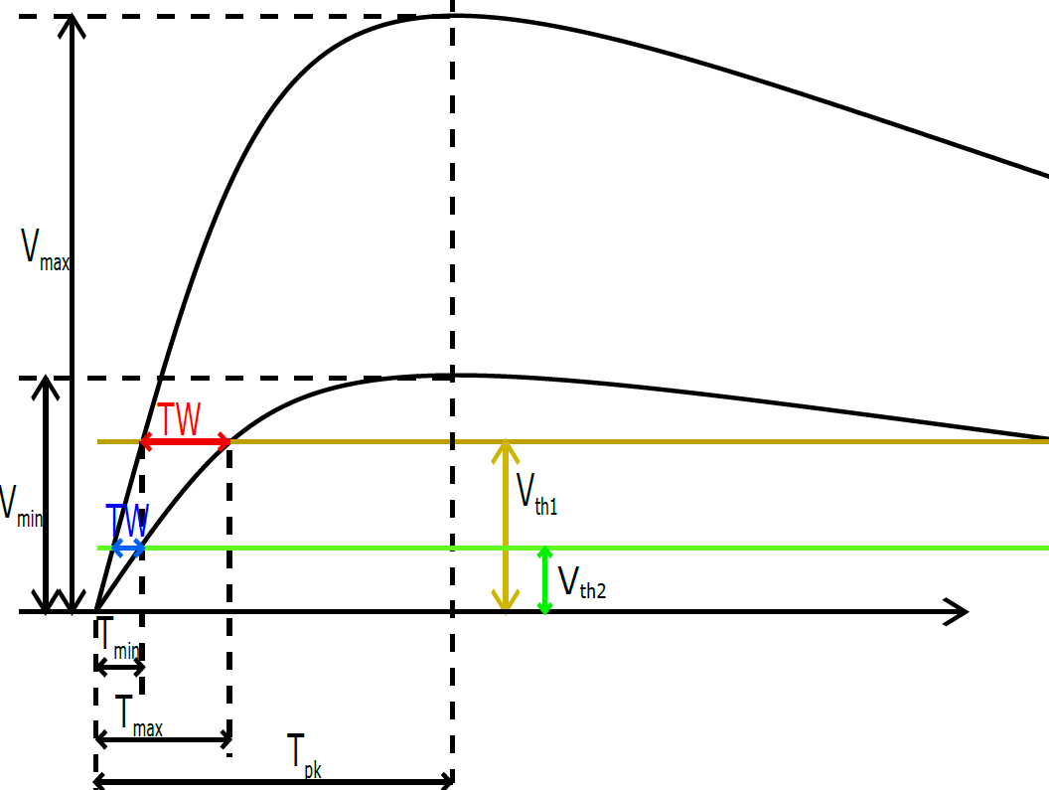
Energy Resolution and Time resolution
Amplitude can be extracted from timing
Timing can be extracted from amplitude
Energy resolution
Sig1
Amp
Shaper
ADC
Readout
TDC
Out
Time resolution
SigN
Amp
Shaper
ADC

Slide 28
Applications
High Voltage CMOS Technology for Particle Physics Experiments
High Voltage CMOS Technology for beam monitor with counting electronics for Heidelberg Ion Beam Therapy Centre
High Voltage CMOS Technology for Scanning Transmission Electron Microscopy

Slide 29
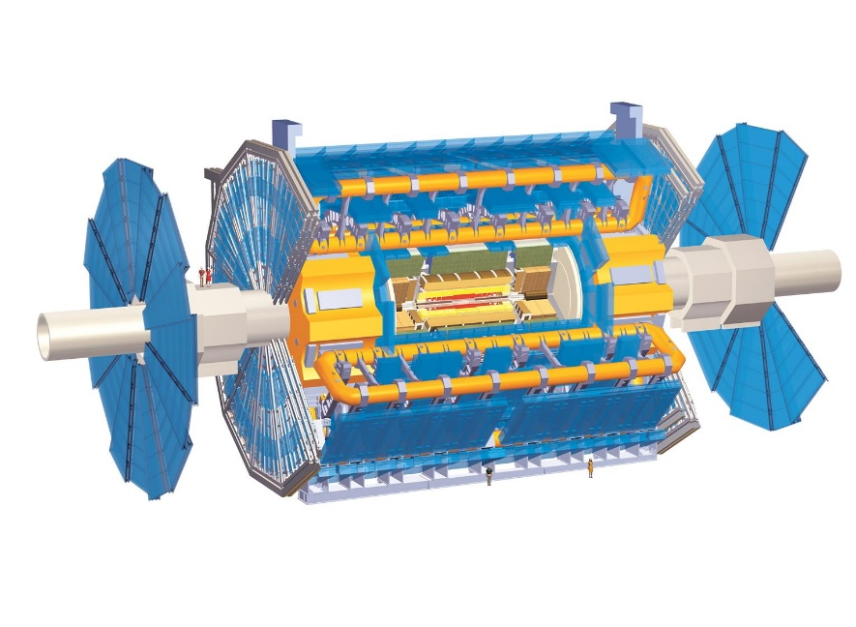
Differences to Pixel Detectors in High Energy Physics
Not an experiment: A failure can not be fixed by repetition
Higher particle rate (> 60 MHz/cm²)
Smaller latency (100 µs)
Homogeneity is important
No tracking of individual particles
Relaxed time resolution (µs, not ns)
Relaxed spatial resolution (200 µm, not <1 µm)
Notes:
医学不是实验，失败的照射不能重复。
我们直接测量光束，而不是从涡流中出现的粒子。 他有更高的通量和粒子率。
延迟对于触发很重要，他限制了传感器的最大读出速率。这里我们需要100μs内的最终结果。
最后我们还需要一个同质检测器。 光束形状不依赖于位置。
同时，一些需求并不再苛刻，如我们不跟踪单个粒子，而是跟踪光束。时间分辨率的数量级是 µs，而不是 ns。空间分辨率约为 100μm，而不是 <1μm

Slide 30
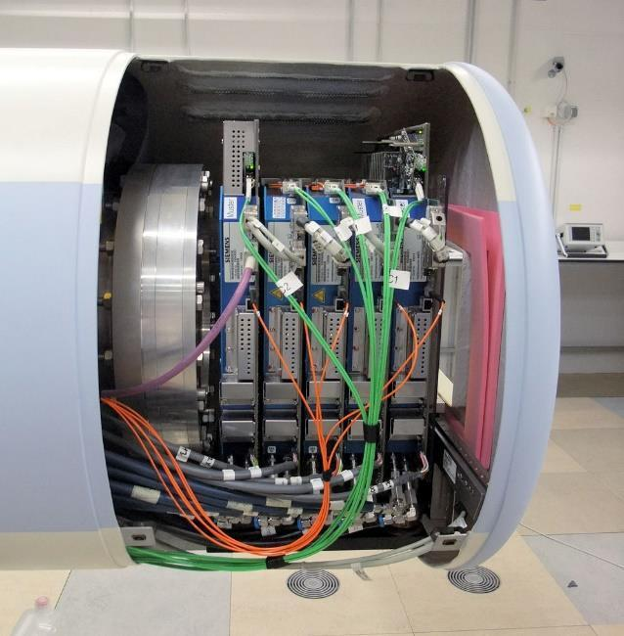
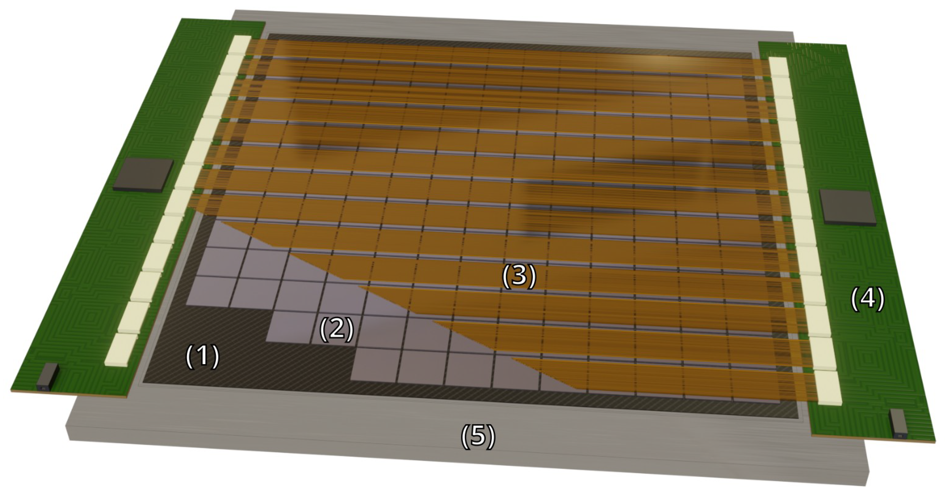
Beam monitoring system requirements
Accuracy of the beam position < 200 µm;
Active area 25 x 25 cm²;
100 µs latency for beam position and shape;
Tolerance to particle fluence up to 10¹⁵ cm⁻² (5 years of operation);
Tolerance to acoustic noise and magnetic fields (at least 100 mT);
Material budget
MWPCs for the beam position measurements
Beam exit window
Existing beam monitoring system at HIT
3D view of the proposed new beam monitor
Notes:
光束位置精度 < 200 µm；有效面积 25 x 25 cm2；光束位置和形状的延迟为 100 µs；对注量粒子的抗辐射要高达 1015 cm-2（运行 5 年）；耐受噪声和磁场（至少 100 mT）

Slide 31
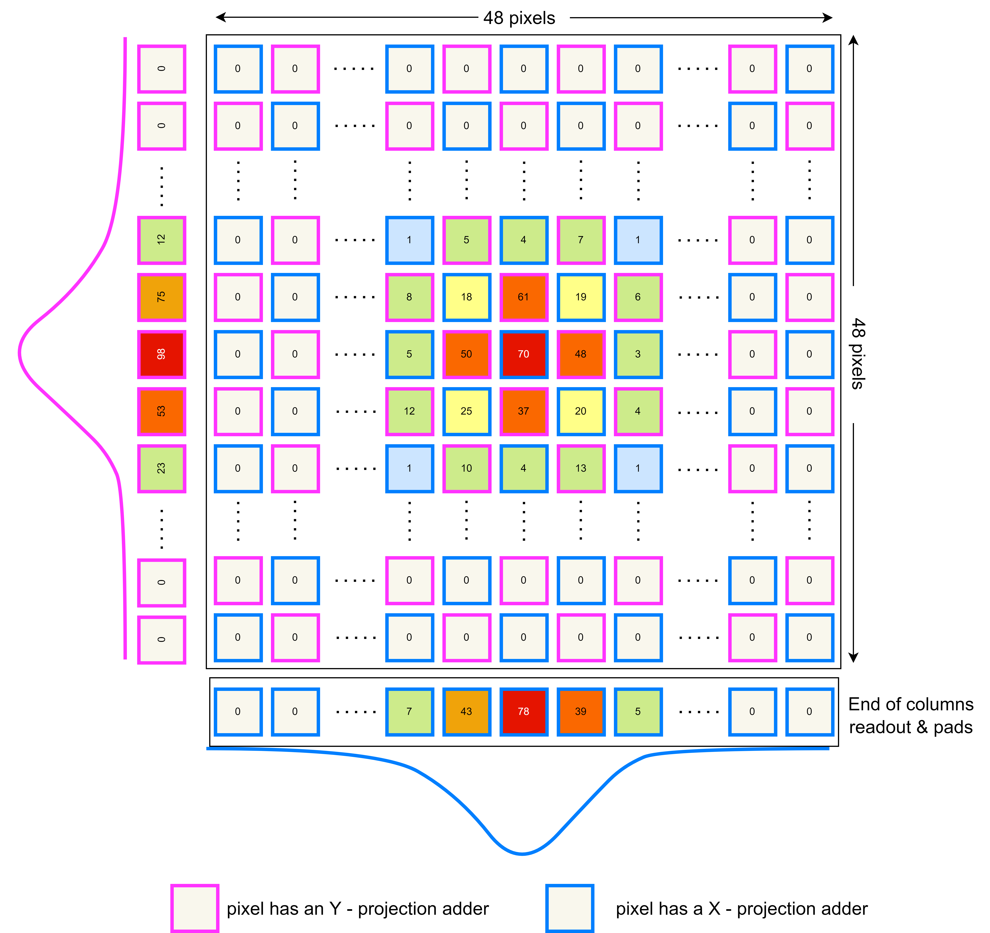
Sensor Design
Beam monitoring specific design features:
High particle rate → frame-based hit counting
Fast data delivery → projection readout mode
Small inactive area → readout and configuration shift registers at the sensor edge
Minimal cooling infrastructure → low power consumption (47 mW/cm⁻²)
2D Projection informations → second adder in row direction

Slide 32
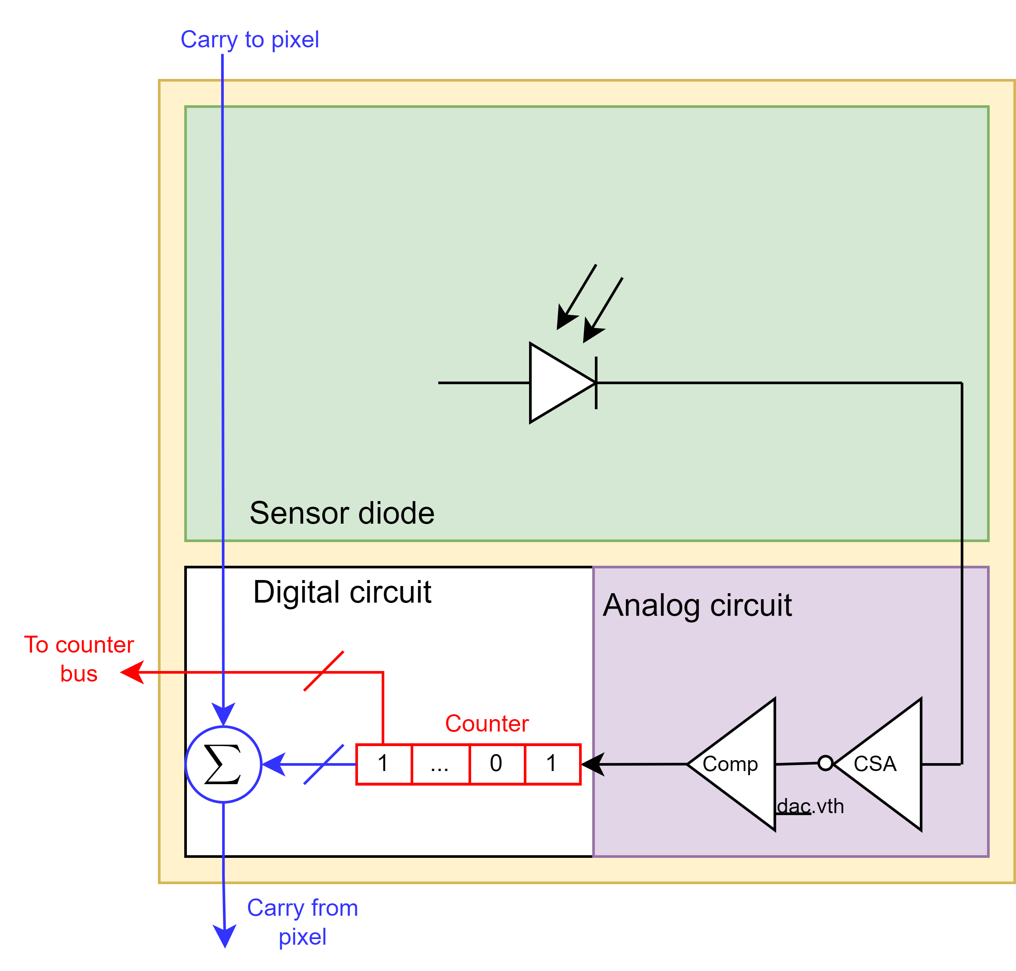
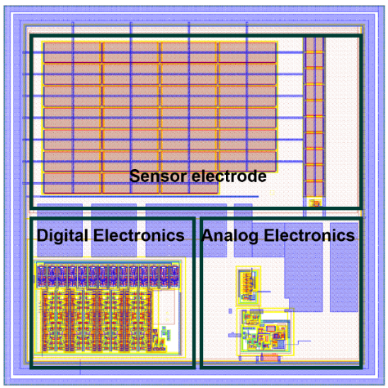
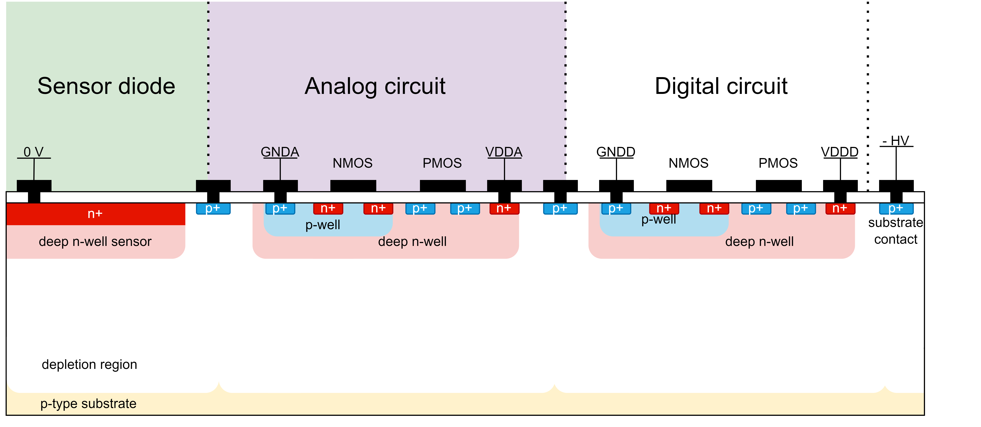
Sensor Design
Sensor properties:
HVCMOS 180 nm
Active area: 1 × 1 cm²
Thickness: 150 µm
Resistivity: 300 Ω × cm
Number of pixels: 48 × 48
Pixel size: 200 × 200 µm²
Frame readout (~10 µs)
Two modes:
  Readout of counter states (beam diagnostic)
  On-chip calculation of projections (quasi live)
Simplified pixel structure
Pixel layout
Simplified cross-section of HitPix v.2 pixel (STD cell)

Slide 33
Applications
High Voltage CMOS Technology for Particle Physics Experiments
High Voltage CMOS Technology for beam monitor with counting electronics for Heidelberg Ion Beam Therapy Centre
High Voltage CMOS Technology for Scanning Transmission Electron Microscopy

Slide 34
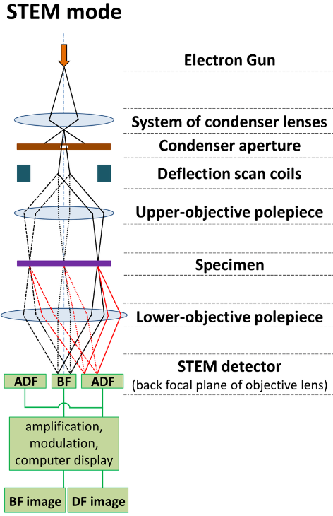
Scanning Transmission Electron Microscopy
Scanning Transmission Electron Microscopy (STEM)
  Applications: Materials Science
  Pixel size: 150µm x 150µm
  Pixel number: 128 x 128
  Frame speed: 40µs
  In pixel counting
Transmission Electron Microscopy (TEM)
  Applications: Biology
  Pixel size: 10µm x 10µm
  Pixel number: 4000 x 4000
  Frame speed: 1500 frames/s
  Post processing counting

Slide 35
Current Challenges in STEM
Connection method: Hybrid technology with bump bonds (→ CCPD)
Compositional analysis and elemental mapping of samples: Use energy-dispersive X-ray spectroscopy indirect method to analysis sample leads to low efficiency (→ dynamic range)
Design option: no user-level flexibility options in ASIC, each pixel cannot individually programmable (→ switch and local threshold design in pixel)
Frame speed: 40µs (→ fast and slow readout logic)
Radiation tolerance: Up to 300 keV (→ use HVCMOS technology)
Notes:
采用凸块键合连接的混合技术成本高昂，并且由于填料塌陷和空隙等因素导致良率问题（→ CCPD）
使用能量色散X射线光谱间接法分析样品导致效率低. 电子显微镜的典型 X 射线探测器仅覆盖很小的立体角，这使得 X 射线检测效率相对较低，因为 X 射线从样品的各个方向发射。（→动态范围）
ASIC 中没有用户级灵活性选项，每个像素不能单独编程（→ 例如，每个像素都有开关和本地阈值）
目前市场上最快的帧速度为 40 µs，但仍有改进的空间（→ 快、慢读出逻辑）迄今为止已证实高达 300 keV。
从ASIC设计的角度来看，耐辐射能力越高，像素和整机的寿命就越长。 (→采用HVCMOS技术)

Slide 36
Measurement Results

Slide 37
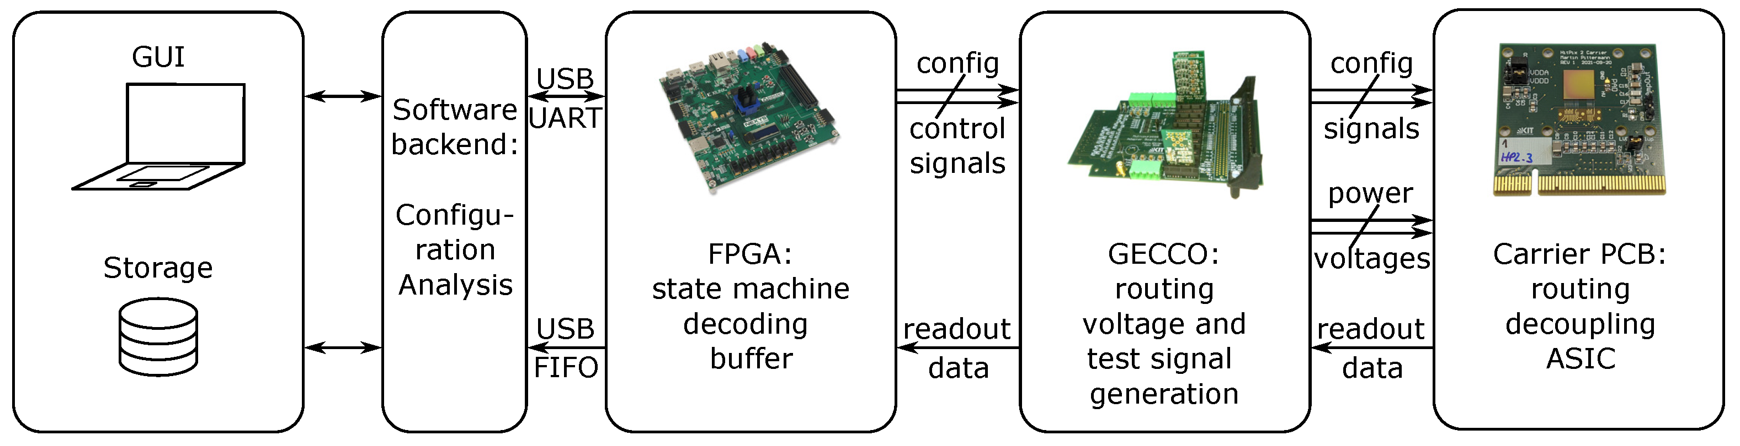
Current data acquisition system
Block diagram of the data acquisition system

Slide 38
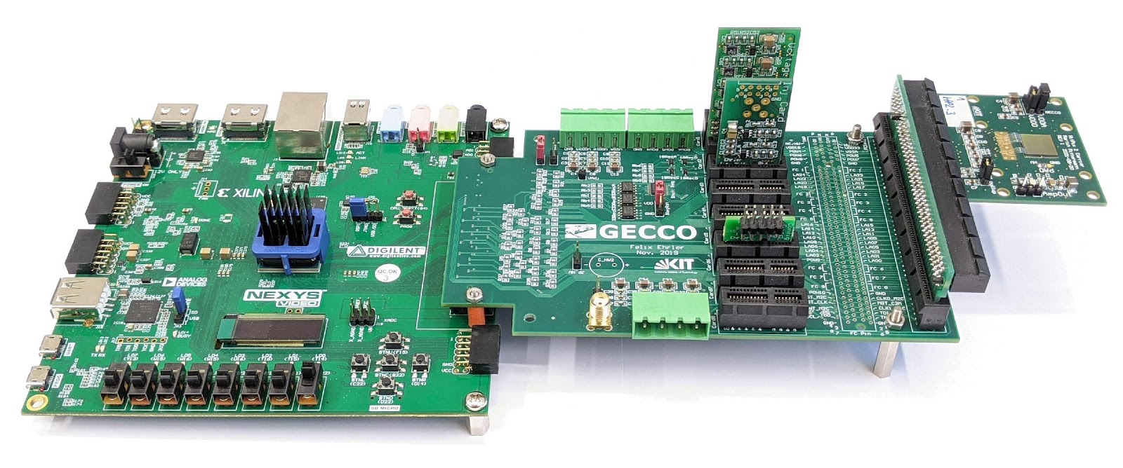
Test system
Artix-7 FPGA
(custom firmware)
GECCO adapter board
(developed at IPE)
HitPix 2
Carrier PCB
Notes:
ASIC 引线接合在载板上。 采用GECCO板作为接口。 GECCO 板提供所有必需的电源电压以及测试信号，并在 FPGA 之间路由数据线。

Slide 39
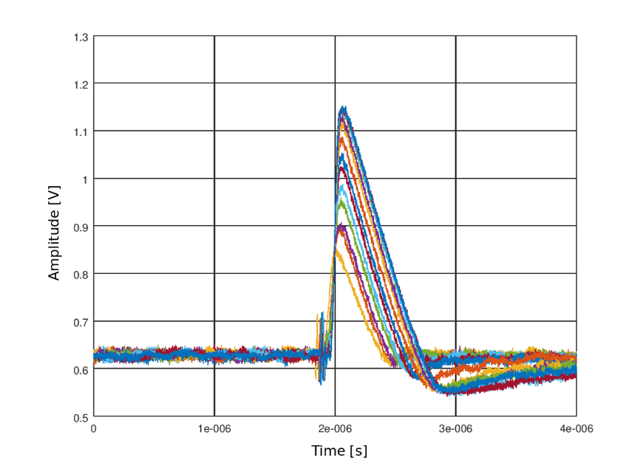
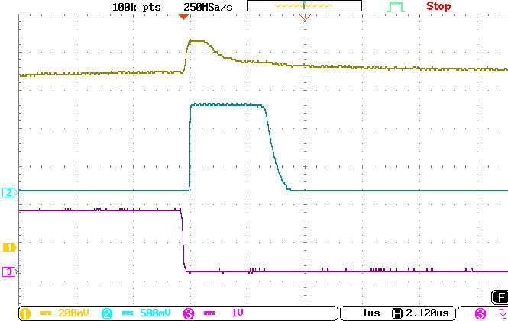
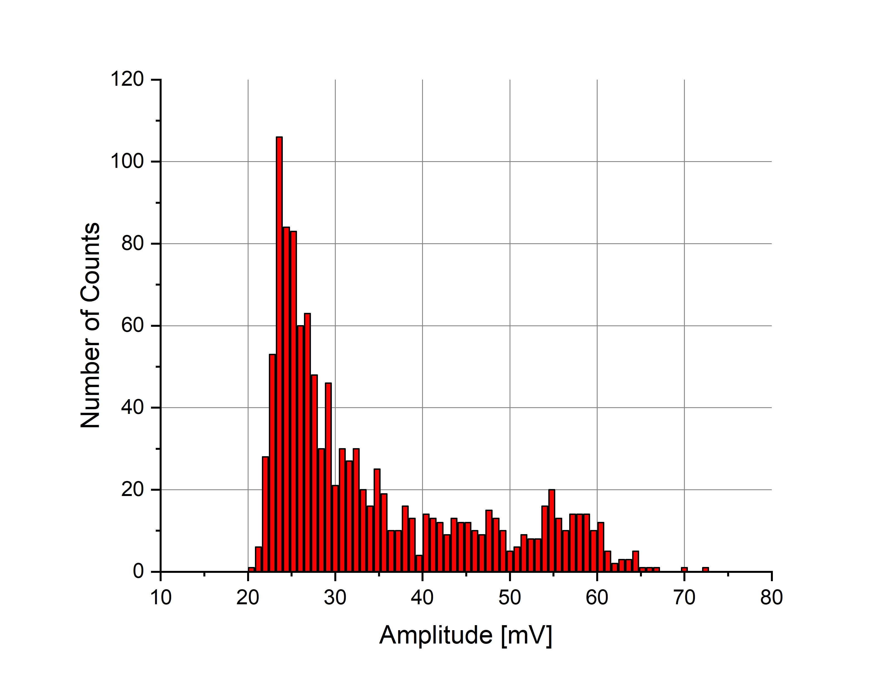
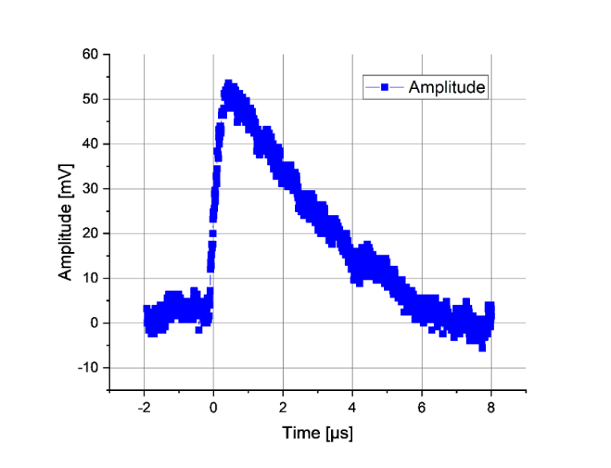
Some Examples of Measurement Results
Functionality measurement

Slide 40
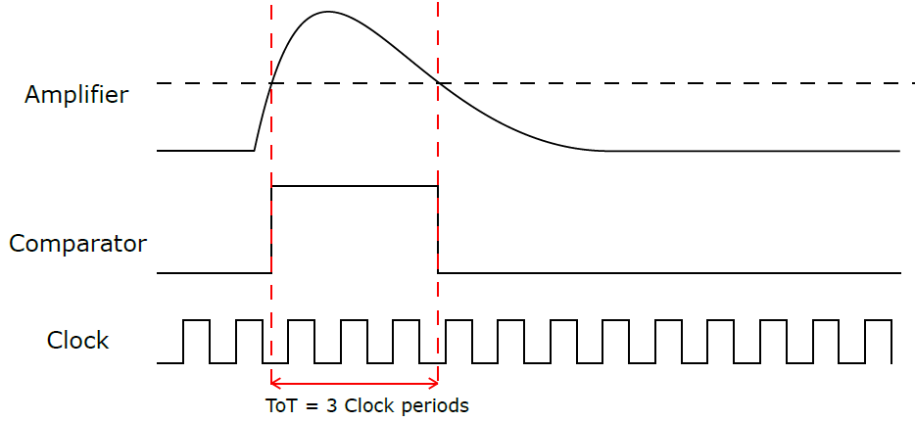
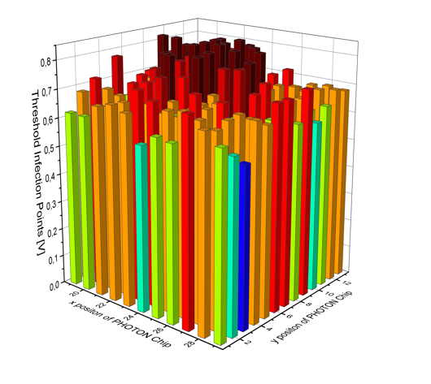
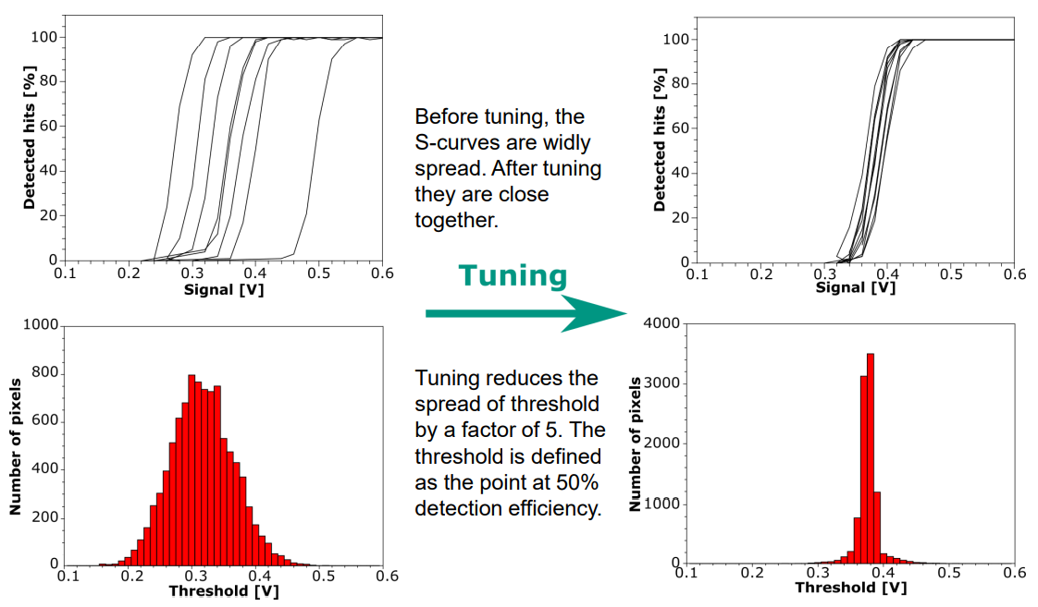
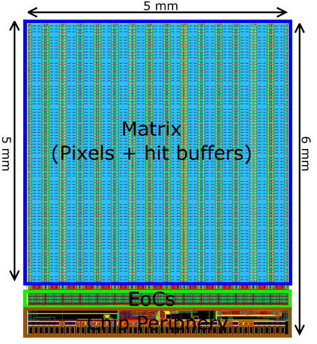
Some Examples of Measurement Results
Threshold tuning

Slide 41
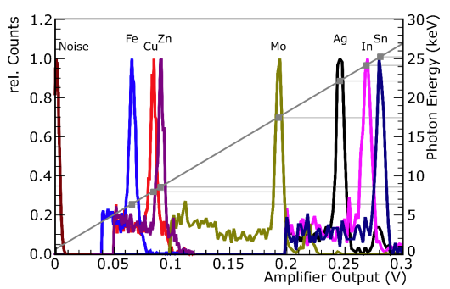
Energy Resolution
Use X-ray Spectrum
Notes:
来自 X 射线管的 X 射线被发送到不同元素的靶上产生单色
X 射线辐射X射线能量对应于硅中产生的一定电荷
用于显示放大器的线性度

Slide 42
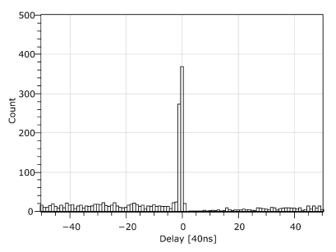
Time Resolution
Strontium-90 Source
Notes:
放置锶 90 源传感器和闪烁体上方
它放射出的信号产生的时间戳（Timestamp）差值，就是时间分辨率

Slide 43
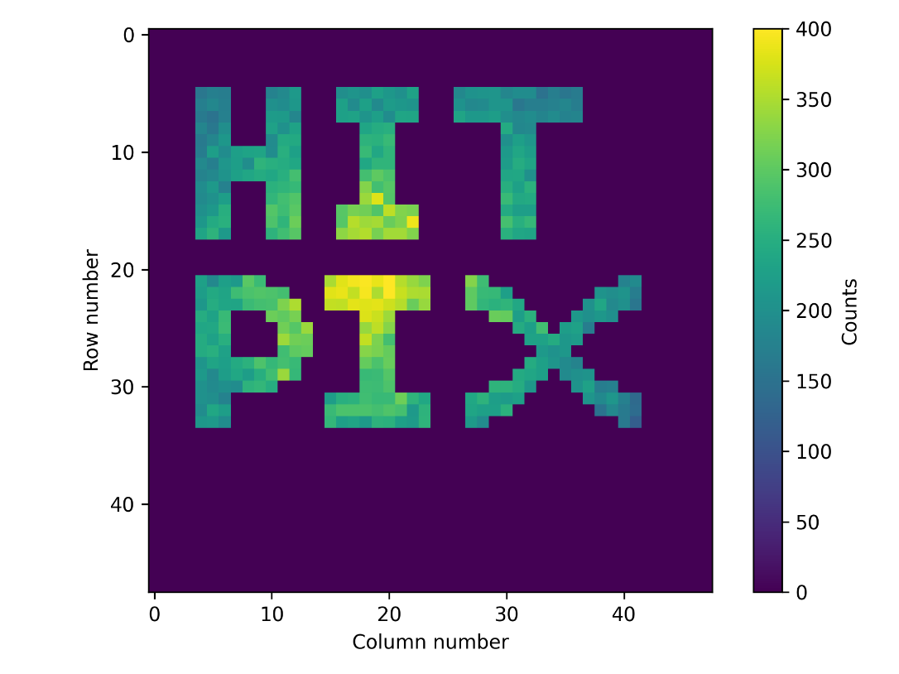
Pixel Masking
Check pixel masking functionality: several mask patterns generated and uploaded to the sensor
The cumulative Sr90 profile measured in the counter mode with masked pixels
Mask the high noise pixel of the sensor.
This function especially useful after radiation damage of the sensor.
Notes:
为了检查该位的功能，生成了多个掩模图案并将其上传到传感器。在计数器模式下使用掩模像素测量的累积 Sr90 轮廓测量证实了掩蔽函数的功能。
它将用于掩盖传感器的高噪声像素。
该功能在传感器受到辐射损坏后变得特别有用。

Slide 44
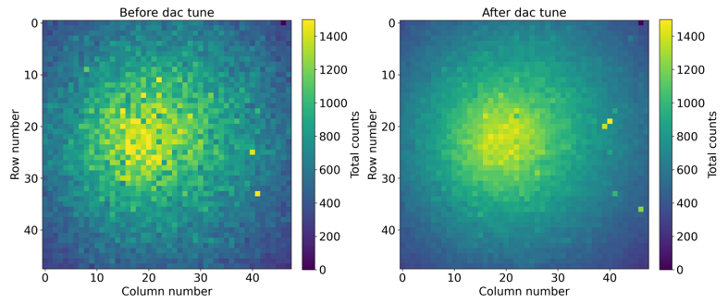
Counter mode
Bias Voltage: –90 V
Frame Size: 5 ms
Readout speed to 180 Mbit/s
Number of Frames: 3000
Dac.vth = 164

Slide 45
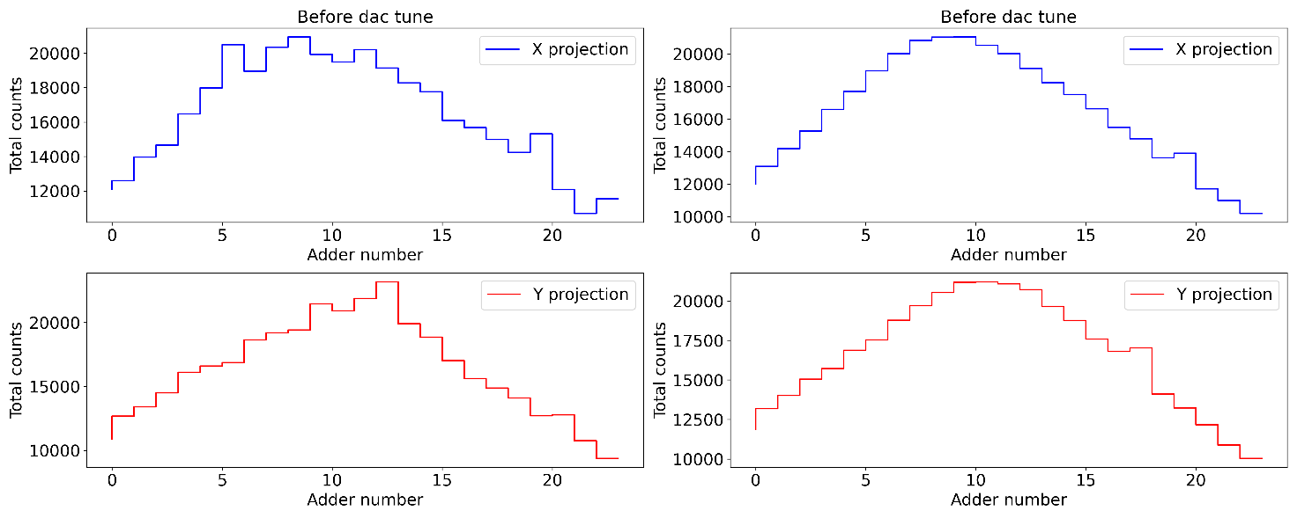
Adder mode
Bias Voltage: –90 V
Frame Size: 5 ms
Readout speed to 180 Mbit/s
Number of Frames: 3000
Dac.vth = 164
Notes:
像素阈值调整后，测量的轮廓变得更加平滑，因为像素阈值的偏差减少了 4 倍以上，因此大多数像素以相同的方式对传入粒子做出反应。 在加法器模式下测量的 Sr90 轮廓的累积 X 和 Y 投影中可以看到相同的效果
Much smoother after the threshold tuning
because the deviation of the pixel threshold reduced more than 4 times, therefore most of pixels reacts on the incoming particles in the same way.

Slide 46
Conclusion
HVCMOS is based on standard CMOS technology
A lot of research is going on in the HVCMOS collaborations
In recent years, most trackers and medical applications might be based on HVCMOS sensors
Notes:
HVCMOS 是一种多功能技术
HVCMOS 合作中正在进行大量研究
在某些年份，大多数跟踪器可能基于 HVCMOS 传感器
一些影响尚未完全了解
需要完成大量的表征

Slide 47








Successfully taped out chip（part）
These chips what I designed (part)
MPROC
CCPD53
ATLASPix1
MuPix8
HVMAPS25
PANDA
ATLASPix3
HIT

Slide 48


