Slide 1
Electromagnetic fields and EM anomaly in small collision system (p-Au & d-Au)
Name: Irfan Siddique
Date: 2024-January-05
E-mail: irfansiddique@ucas.ac.cn

Slide 2
Strong EM fields are produced in Au+Au collision at top RHIC energy, even more stronger at LHC energies in Pb+Pb collisions.
Can induce fields related chiral anomalous effect such as CME. The charge azimuthal correlation or three-particle correlator was proposed to experimentally measure the CME.
The first measurements are consistent with the CME expectations both in Au+Au collisions at RHIC energy and Pb+Pb collisions at the LHC energy, though many background effects can also contribute to the field related observable.
This is valid for large collision system but what about small system?
However I want to look for spatial structure of EM anomaly and it’s capability to give rise to the difference in elliptic flows between positive charged particles and the negatively charged particles in small system.
It is believed that there are three main sources to generate local axial charges, and the axial anomaly equation with the inclusion of mass term reads
where the first term on the right hand side is a source coming from non-zero quark mass due to chiral symmetry breaking, the second and third terms corresponds to the QED and QCD anomalies, respectively. In this work, we focus on the QED anomaly, which is usually represented by the second Lorentz invariant I2 = E · B, in relativistic heavy-ion collisions.
ArXiv: 1901.04156 Novel mechanism for electric quadrupole moment generation in relativistic heavy-ion collisions

Slide 3
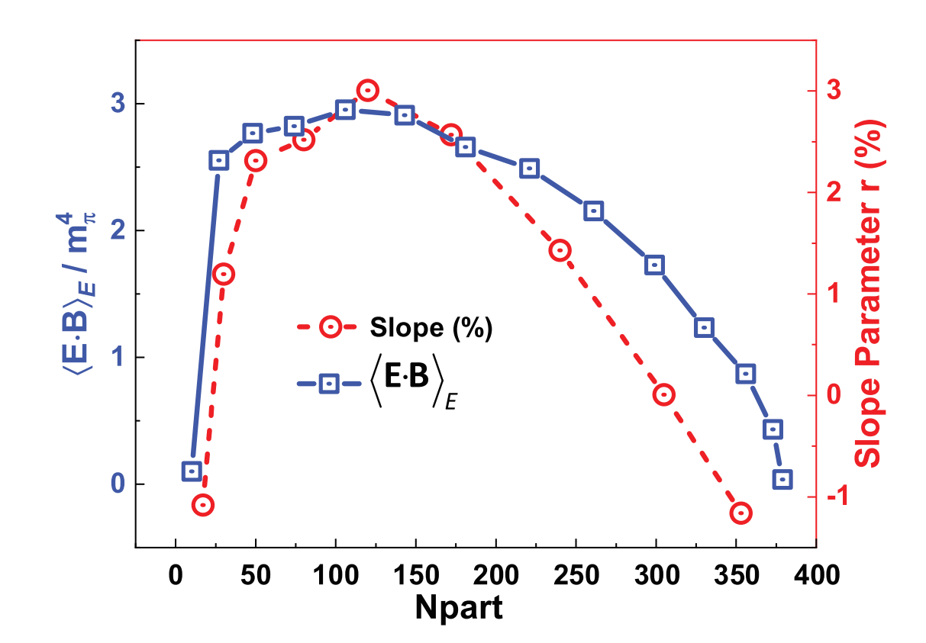
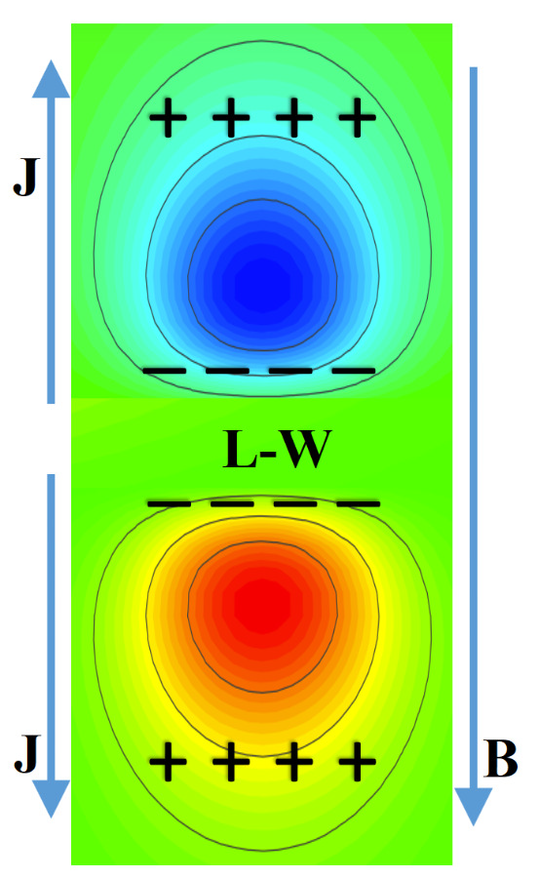
E.B = ExBx + EyBy + EzBz
EM anomaly
E.B
Au+Au
Quadropole structure similar to that of CMW which can also give difference in v2 of positive and negative charge particles.

Slide 4
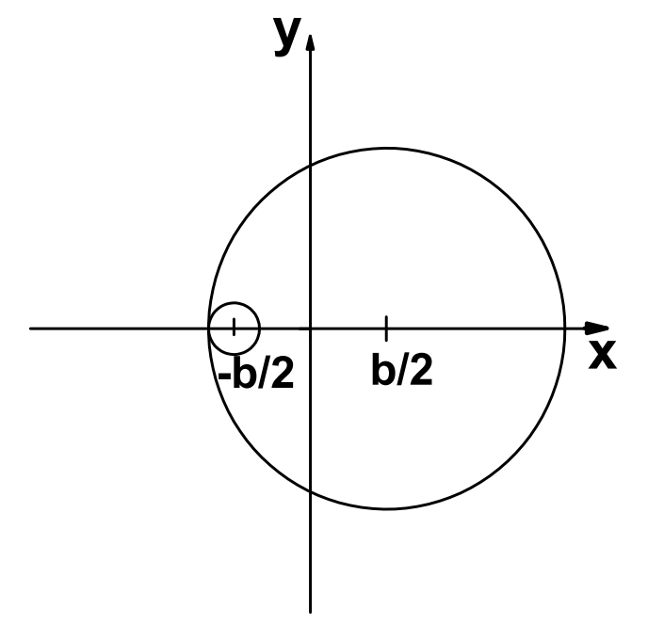
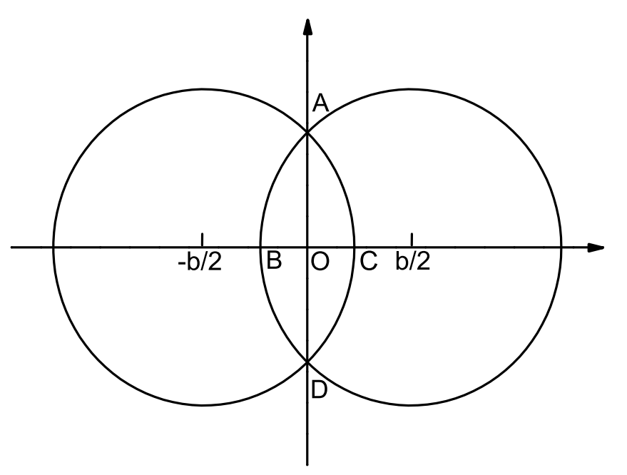
Numerical setup
x-axis – impact parameter b
y-axis – perpendicular to
reaction plane
z-axis – trajectories
MC Glauber model
L-W
A-A collisions
p(d)-A collisions
small system is unsymmetrical
A + A collisions, eccentricity ,aligned ,the magnetic field. (relevant in observable quantities)
p + A collisions, the major axis of the eccentricity is random with respect to the magnetic field.
arXiv:1709.05962
Electromagnetic fields in small systems from a multiphase transport model
ArXiv: 2210.14027
Search for the chiral magnetic wave using anisotropic flow of identified particles at RHIC

Slide 5
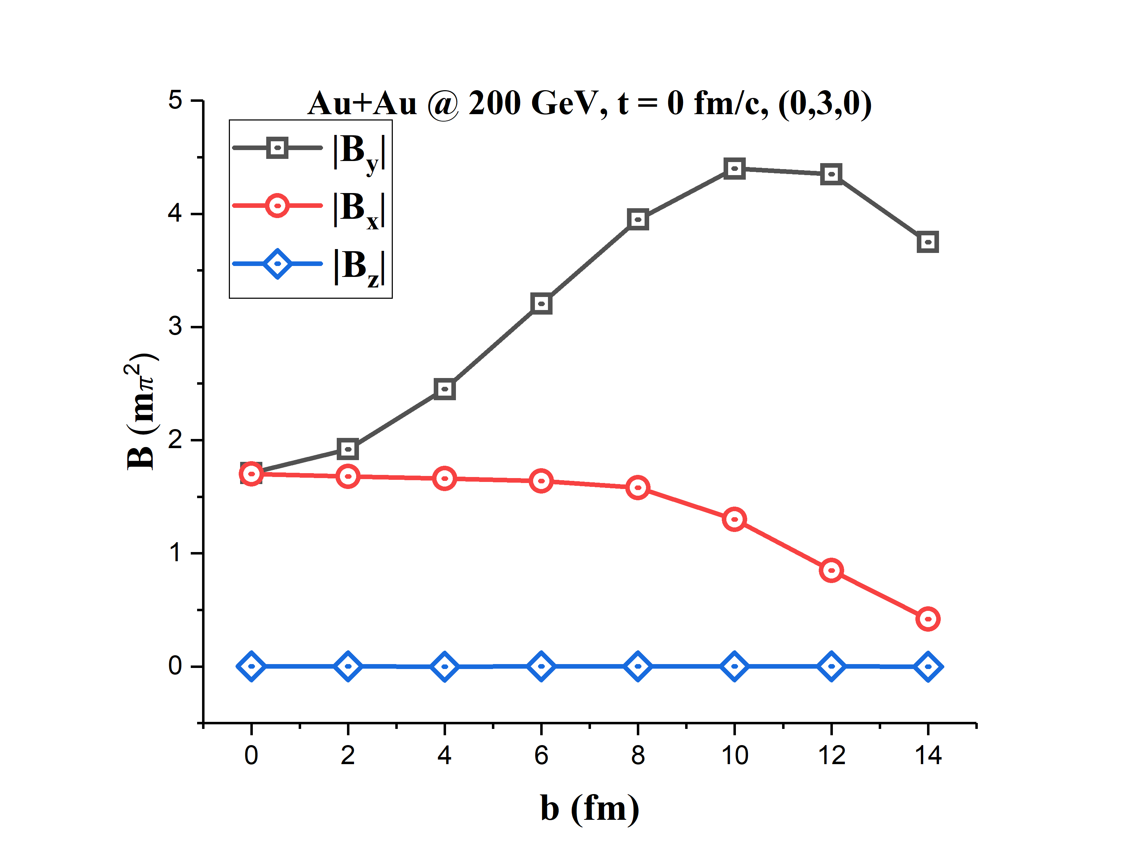
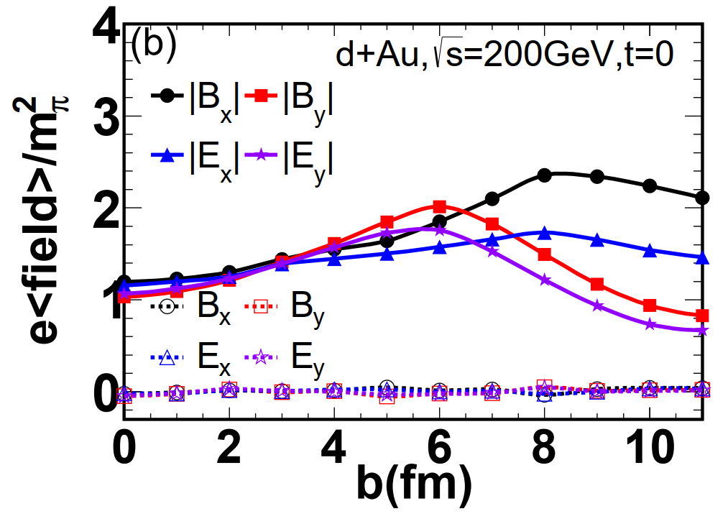
Impact parameter dependence
averaging over many events the electromagnetic fields are almost zero, however the absolute values of the magnetic fields are nonzero on an event-by-event basis and they can still reach the order of several m2 π.

Slide 6
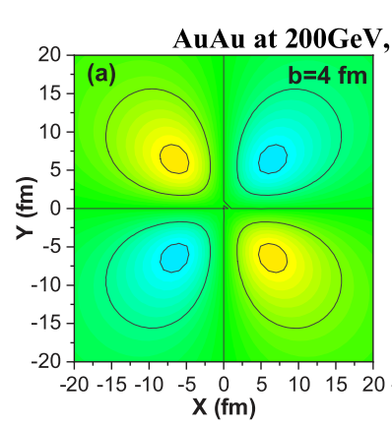
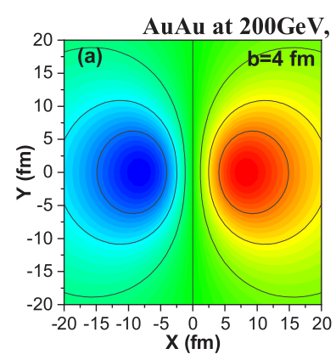
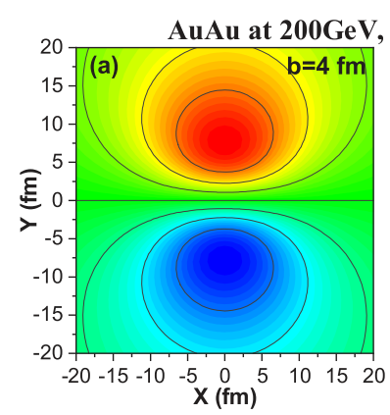
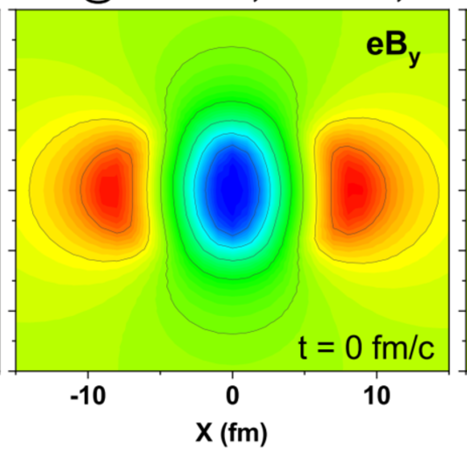
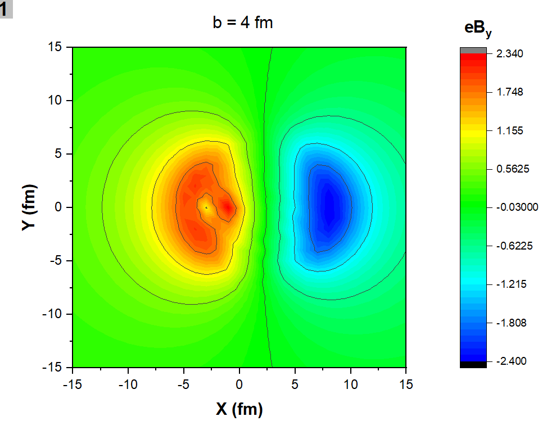
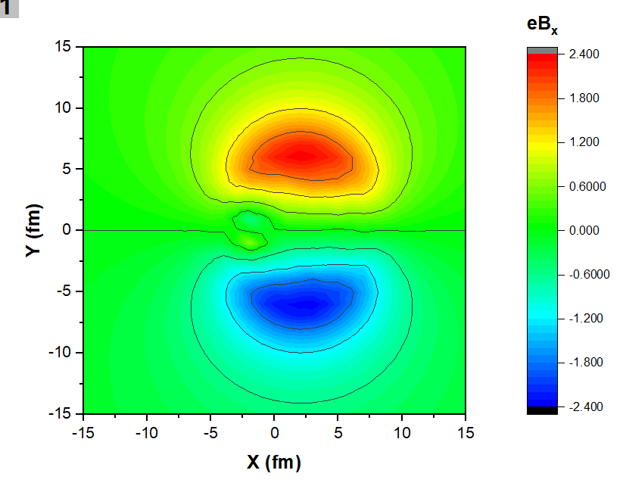
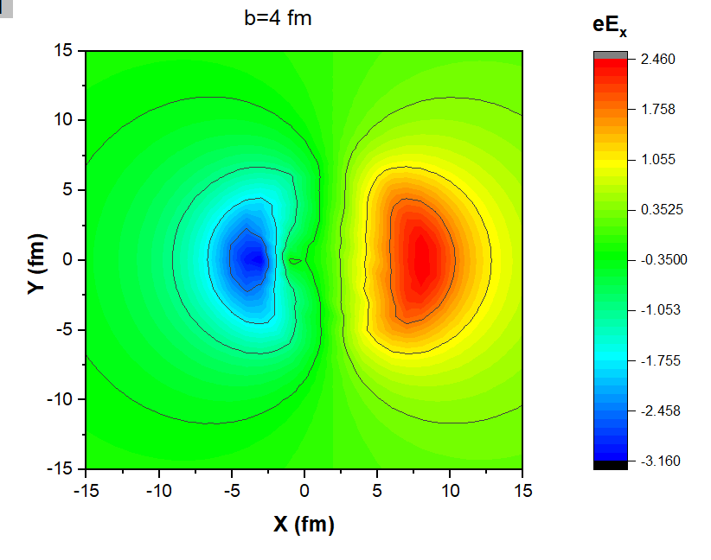
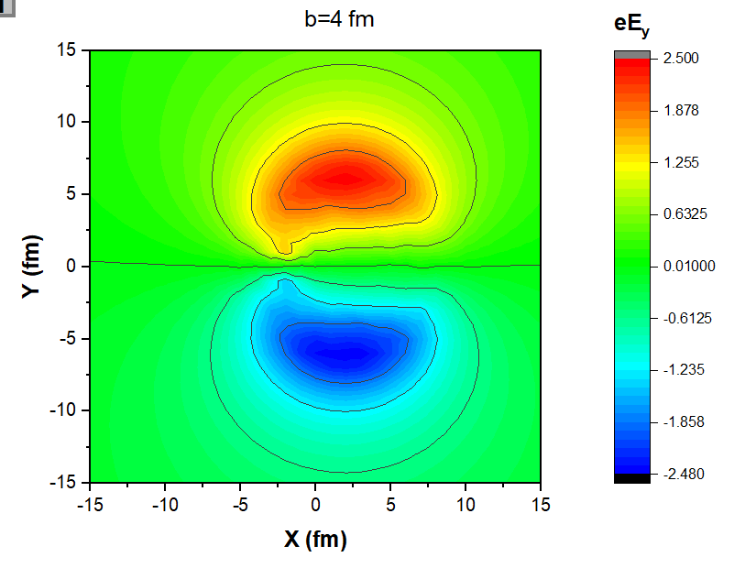
Spatial Distribution
Au+Au
d+Au

Slide 7
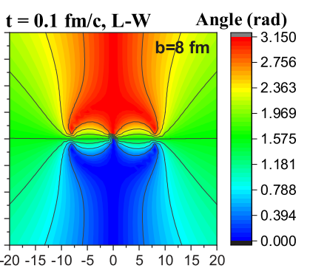
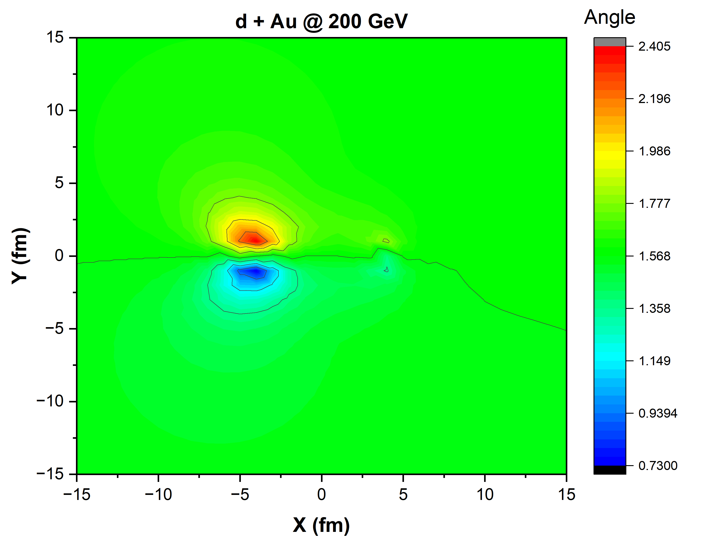
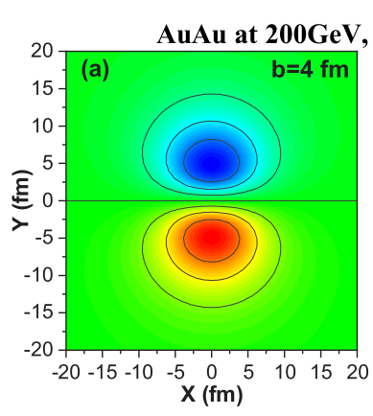
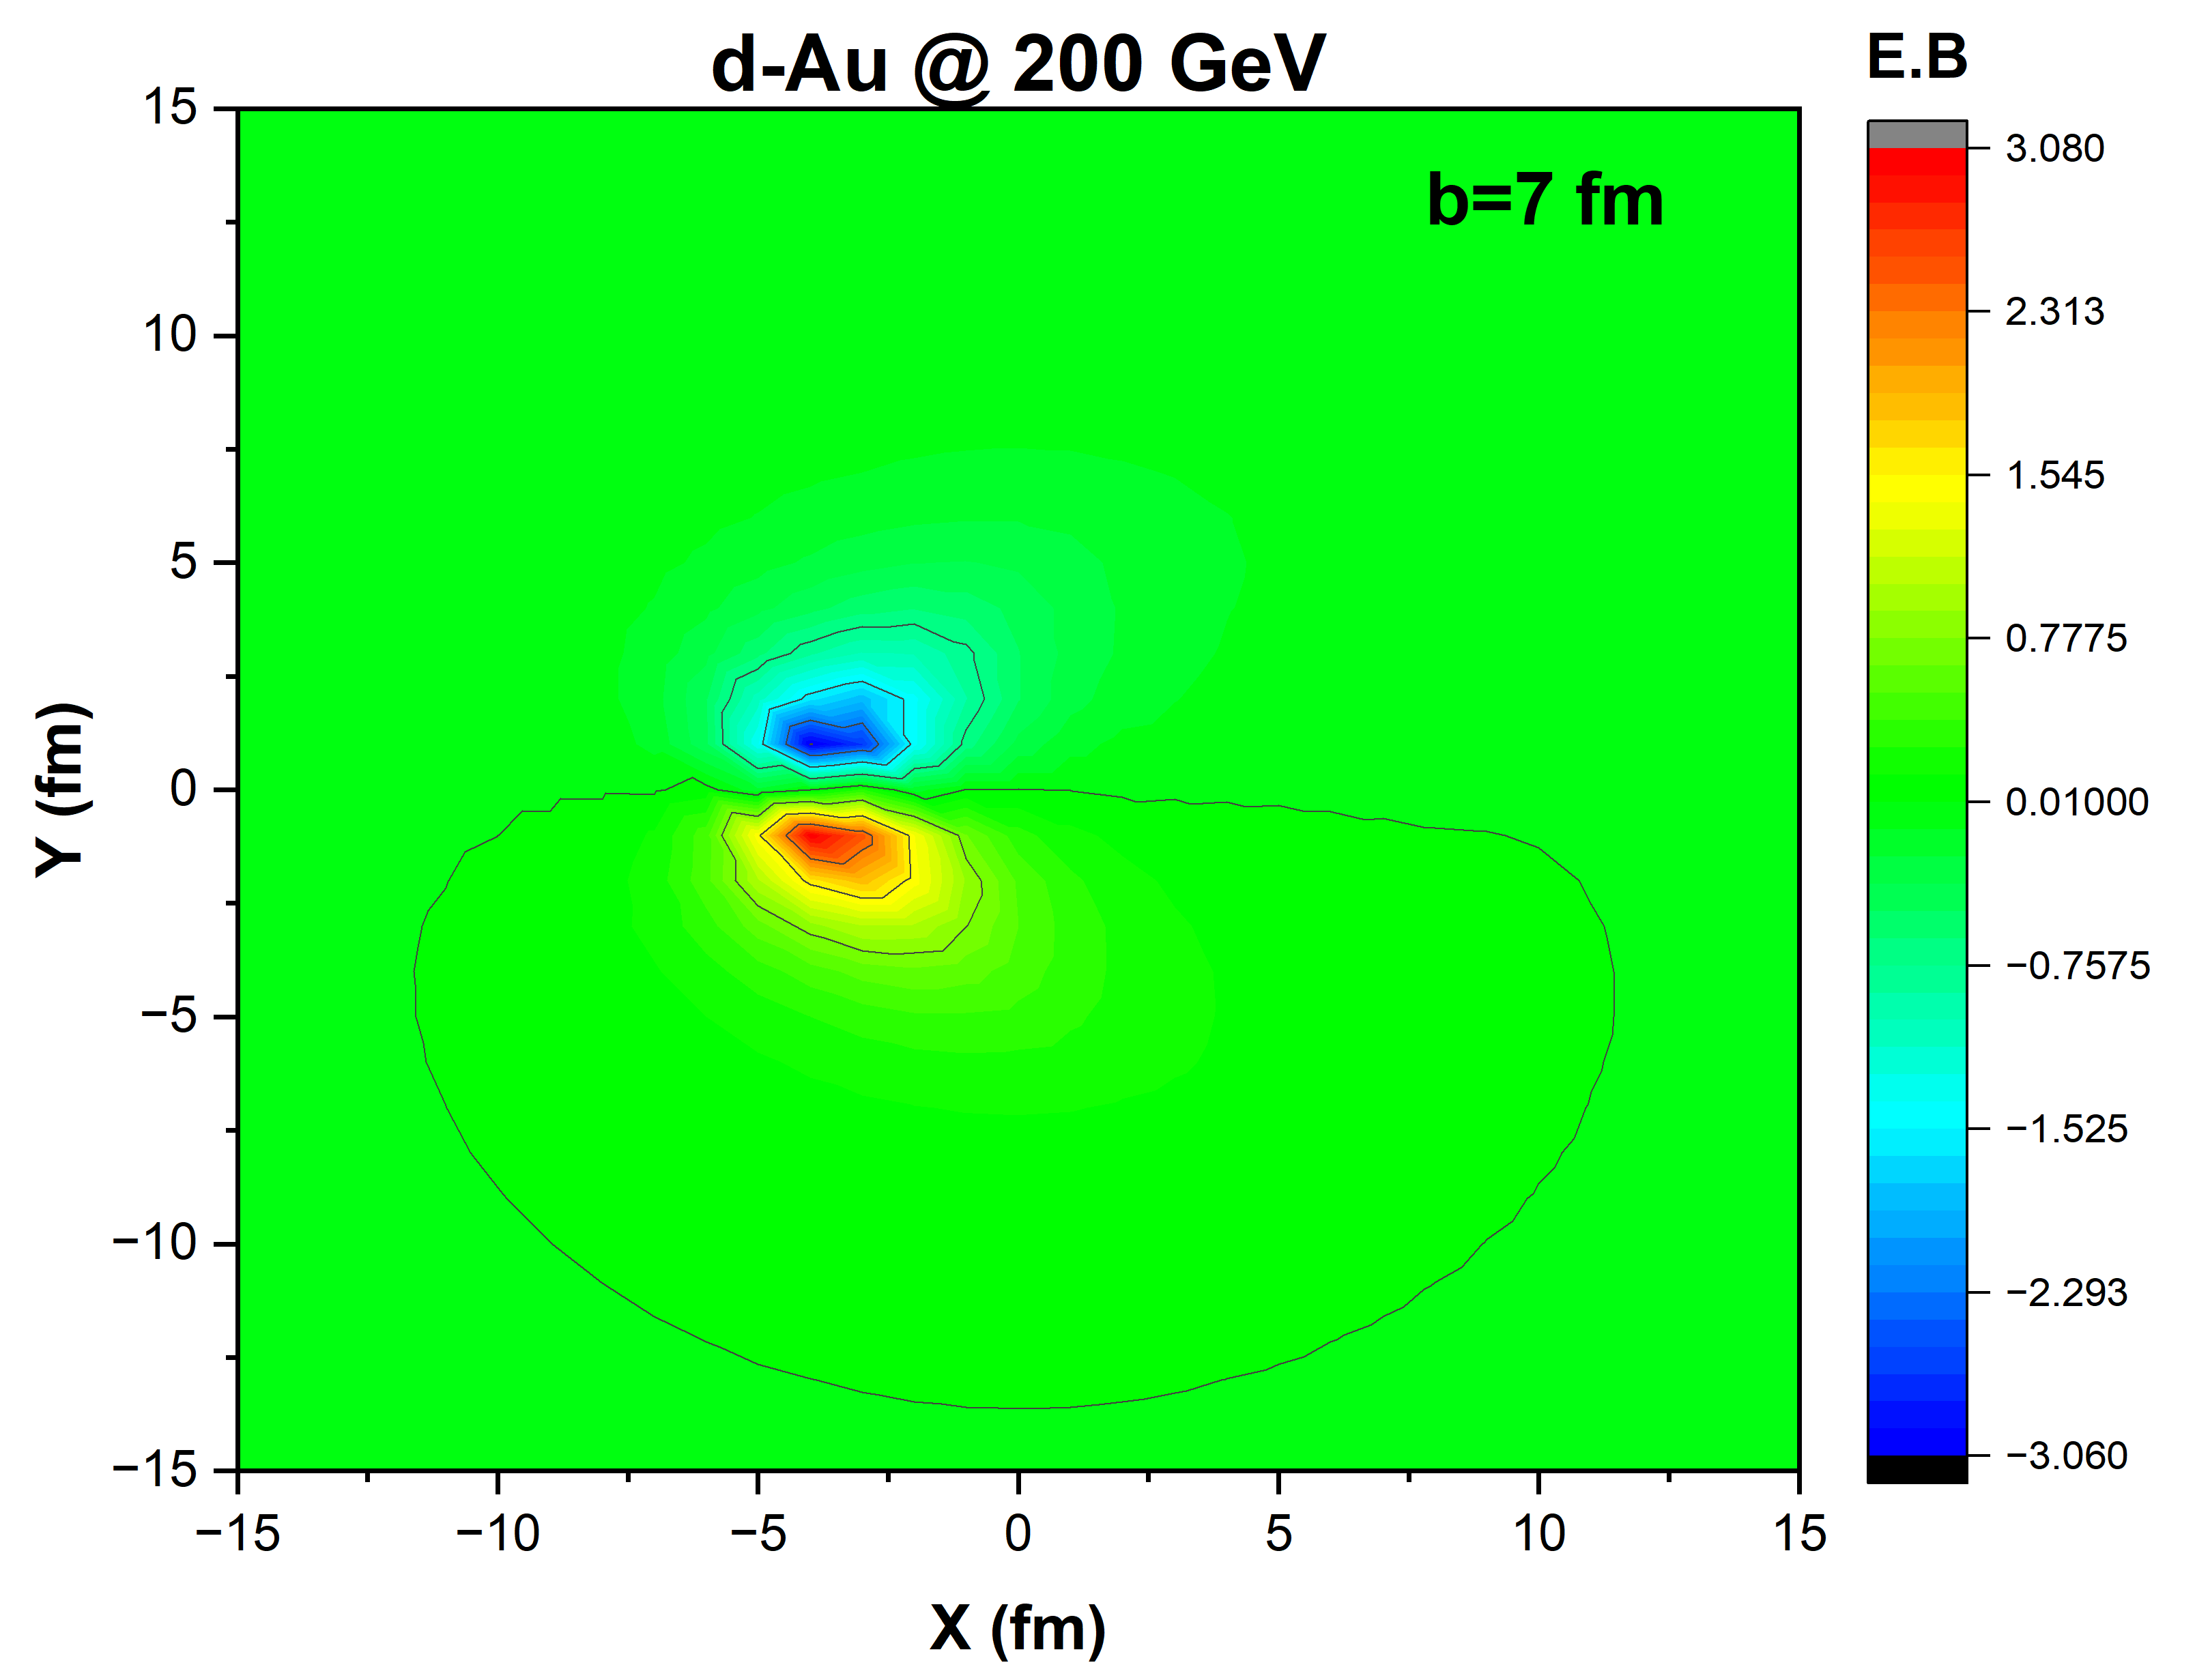
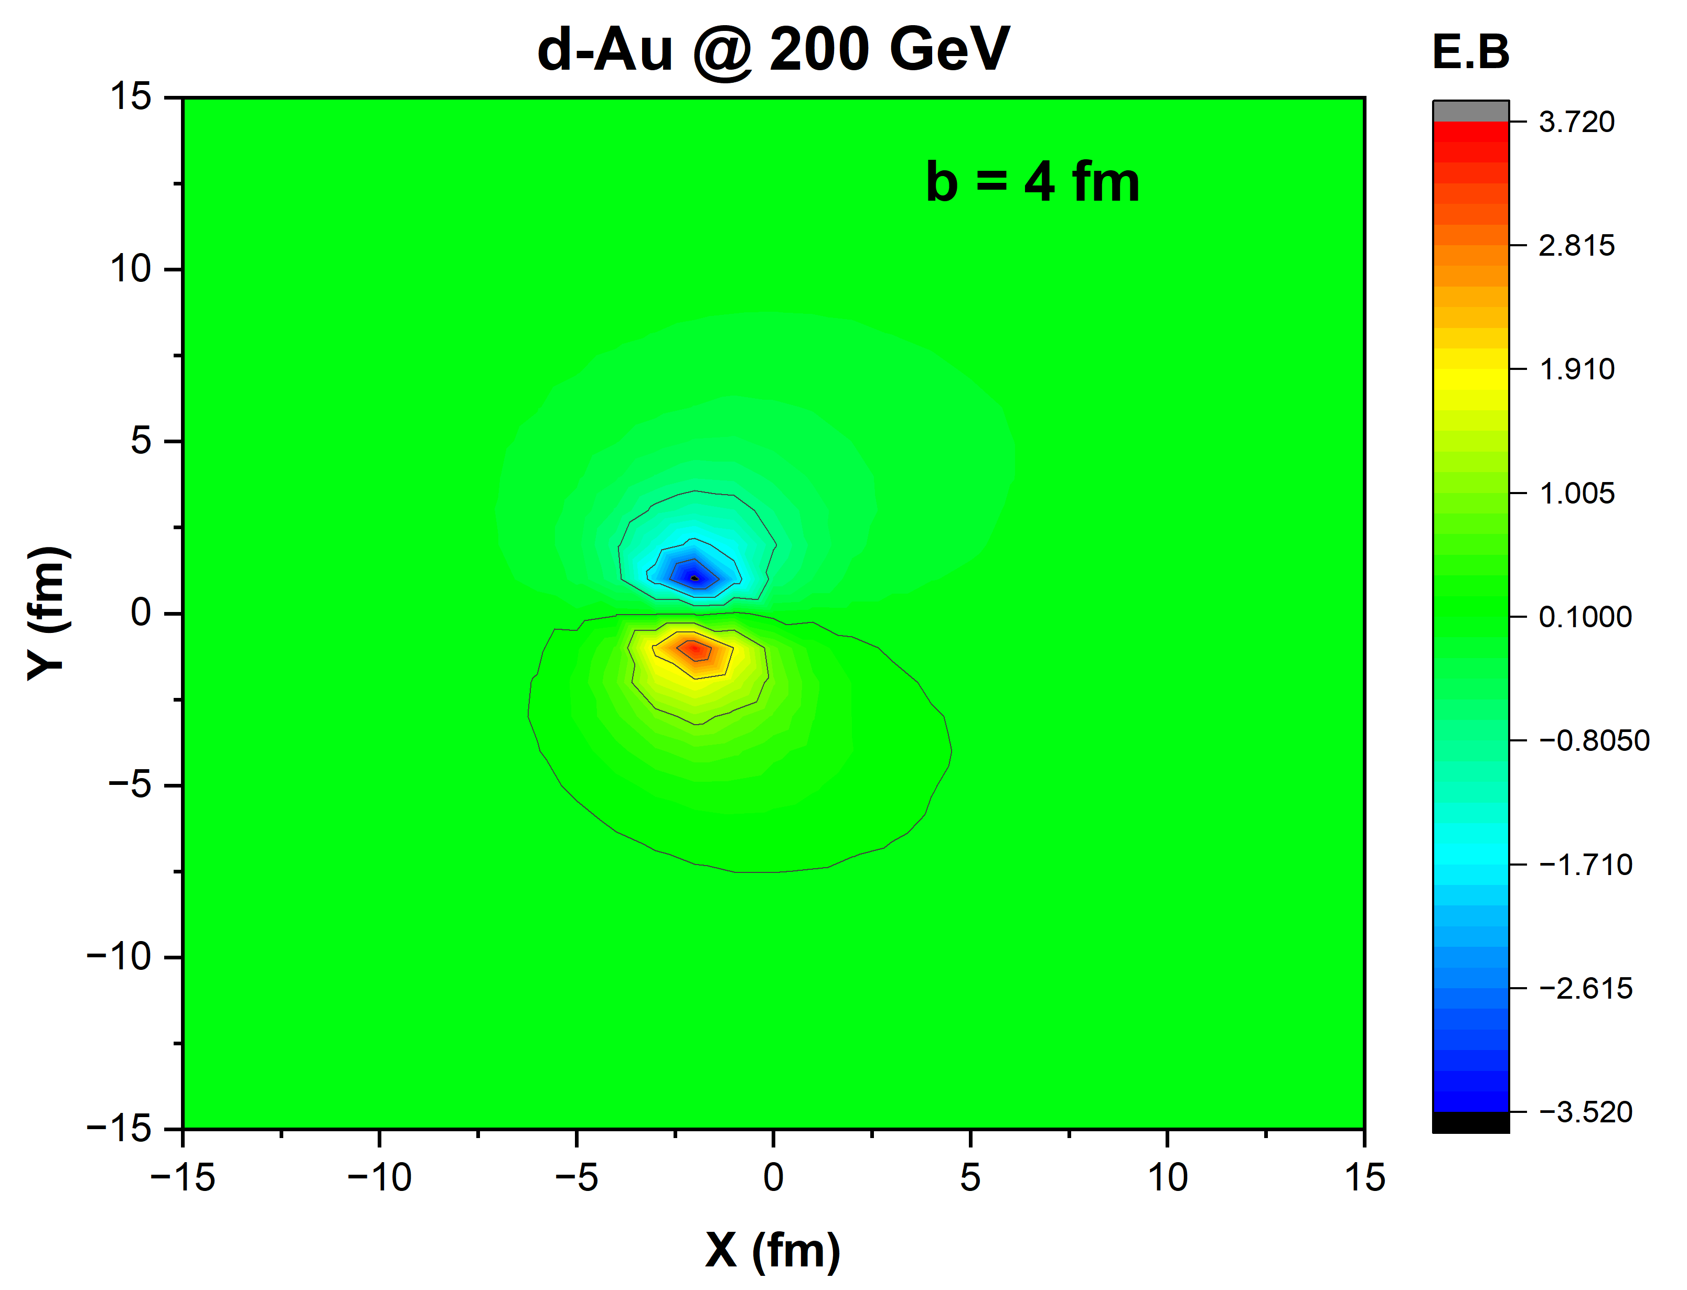
Electromagnetic Anomaly
Can EM anomaly in small system also give difference between v_2 of charged particles?
However, for non-central collisions, the direction of the magnetic field is parallel or antiparallel to that of the electric field somewhere (where the angles can be 0 or π), which means 〈E · B〉 ∕= 0 corresponding to µA ∕= 0 and chiral anomaly happens .

Slide 8
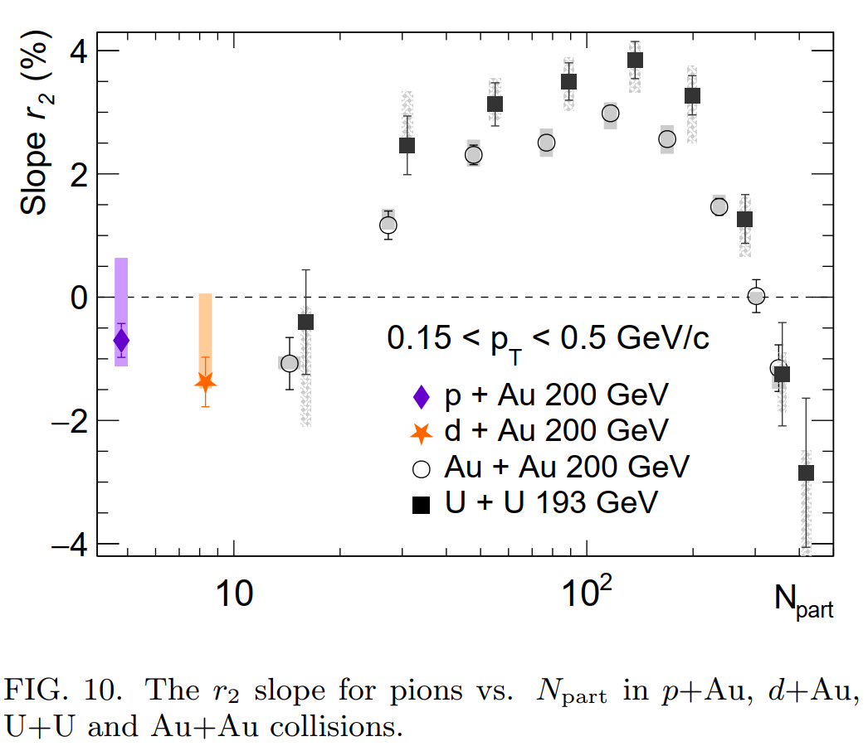
CMW
CMW manifests itself in a finite electric quadrupole moment of the collision system, where the \poles" and the \equator" of the produced fireball acquire additional positive and negative charges, respectively. This effect, if present, will be reflected in the measurements of a charge-dependent elliptic flow.
Experimental measurements of such a linear dependence between v± 2 and Ach is quantified by the slope parameter
To compare with slope parameter we need to calculate the density of the dipolar structure in y>0 or y < 0 and put it together with Npart studies to find out behavior,
Does it will have similar trend or not. It will also define fate of EM anomaly to drive difference of elliptic flow in small system.
arXiv:2210.14027v1

