Slide 1


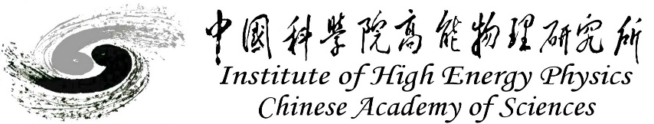
CEPC mockup tunnel and outlook
Haijing Wang, Xiaolong Wang, Yongsheng Ma, Minxian Li, Lei Wu
2024/1/29, CEPC DAY

Slide 2
Content
Mockup tunnel
  Motivation
  Mockup structure
  Things to verify
Plans and cost
Summary

Slide 3
Mockup tunnel
Motivation
  Huge number of supports for the 100 km facility.
Elements in Collider | Unit | Number
Dipole support | set | 13314
Quadrupole support | set | 4128
Sextupole support | set | 1128
Corrector support | set | 3544
Vacuum device support | set | 98979
Beam Instrument Support | set | 4254
RF Support | set | 100
Elements in Linac | Unit | Number
Bunching system support | set | 1
Magnet support | set | 144
EBTL support | set | 6
Accelerating structure support | set | 604
Vacuum device support | set | 5589
Beam Instrument support | set | 213
Elements in Damping Ring | Unit | Number
Magnet support | set | 184
Vacuum device support | set | 335
Beam Instrument support | set | 41
Elements in Booster | Unit | Number
Dipole support | set | 14866
Quadrupole support | set | 3458
Sextupole support | set | 100
Corrector support | set | 1200
Vacuum device support | set | 69164
Beam Instrument support | set | 2412
RF support | set | 12
Elements in Transport lines | Unit | Number
Magnet support | set | 450
Vacuum device support | set | 3732
Beam Instrument support | set | 82

Slide 4
Mockup tunnel
It is necessary to verify the key techniques and construction method before the construction.
  The support stability and flexibility.
  The alignment method and alignment efficiency improvement.
  The installation method and operation space verification like HEPS before tunnel installation.
The tunnel mockup is a good way for CEPC exhibition, with some typical devices like magnet and support, vacuum devices and cryomodules.

Slide 5
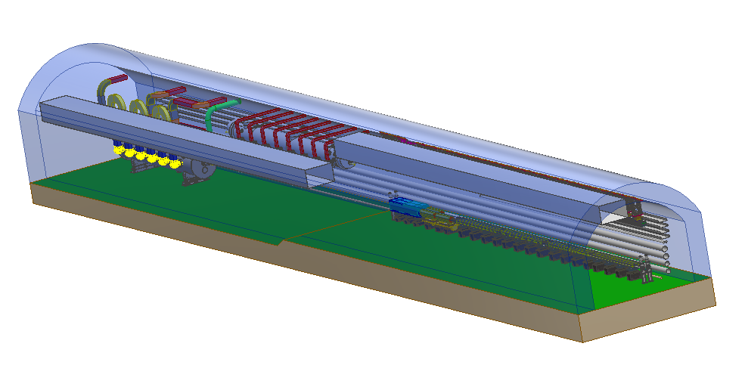
Mockup tunnel
A 60 m long tunnel mockup, including parts of arc section and part of RF section.

Slide 6
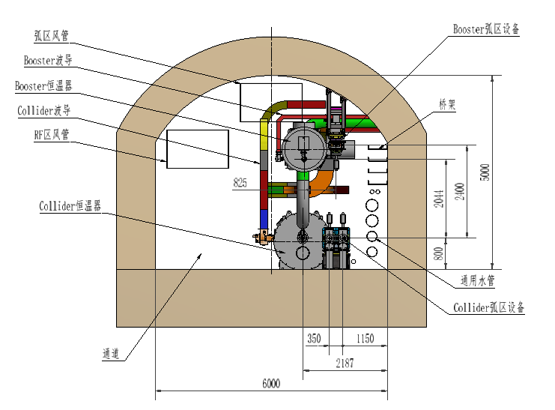
Mockup tunnel
Mockup structure

Slide 7
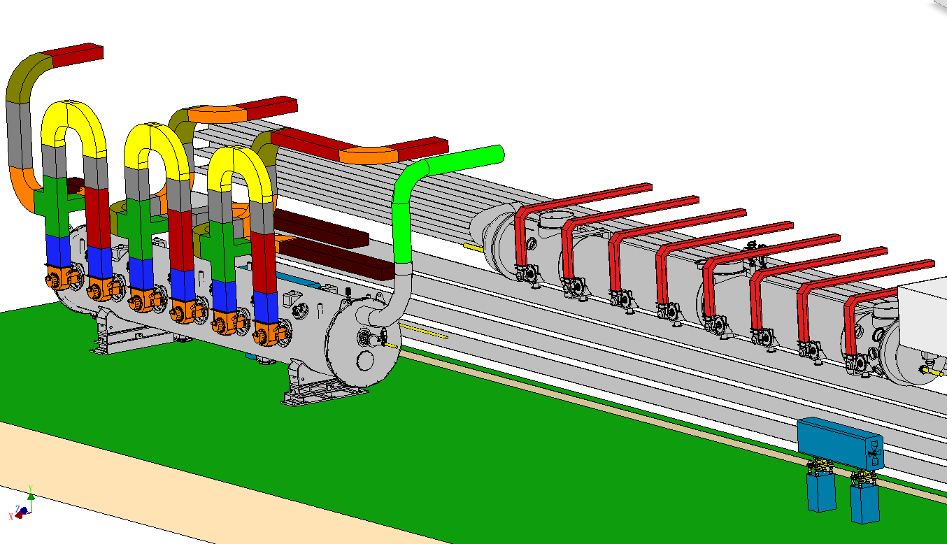
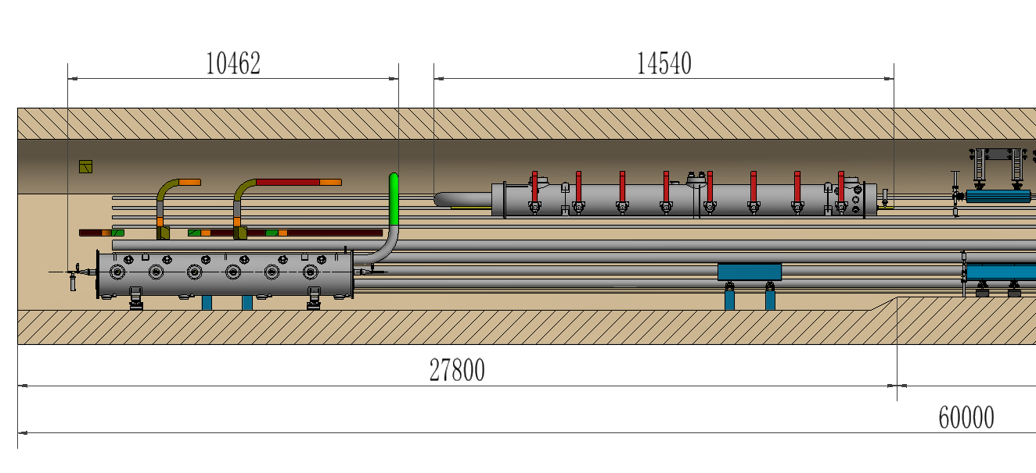
Mockup tunnel
Mockup structure
  RF section: 28 m.
  1 Collider cryomodule, 1 Booster cryomodule, wave guides, 2 single-aperture quadrupoles and supports.
  1:1 fake models made of plastic or steel sheets.

Slide 8
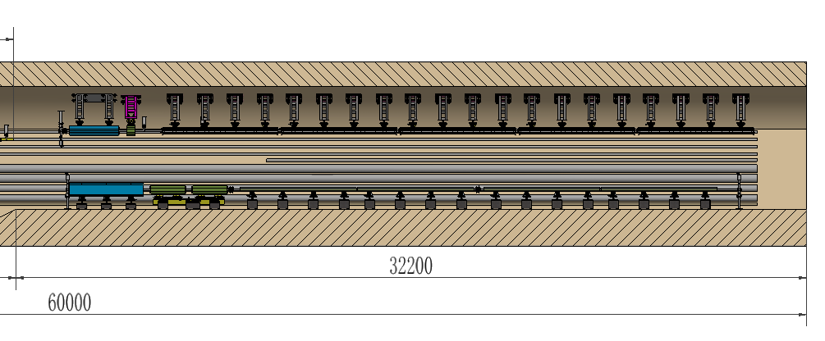
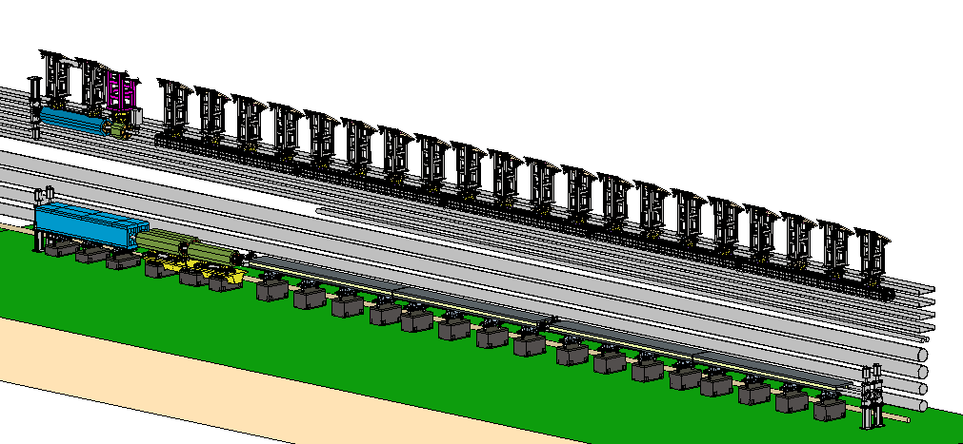
Mockup tunnel
Mockup structure
  Arc section: 32 m.
  Collider: 1 quadrupole, 3 sextupole, 1 dipole (4 cores), 2 correctors and 2 BPMs, supports, vacuum devices.
  Booster: 1 quadrupole, 1 sextupole, 5 dipoles, supports, vacuum devices.

Slide 9

Mockup tunnel
Mockup structure
  Arc section: 32 m.
  Collider: 1 quadrupole, 3 sextupole, 1 dipole (4 cores), 2 correctors and 2 BPMs, supports, vacuum devices.
  Booster: 1 quadrupole, 1 sextupole, 5 dipoles, supports, vacuum devices.
Collider arc section devices
Booster arc section devices

Slide 10
Mockup tunnel
Mockup structure
  Arc section 32 m.
    All the magnets are fake steel model with real weight, can be replaced by magnet prototype.
    All the supports are prototypes, and installed as real project (eg. grouting).
    The vacuum tubes and bellows are prototypes.
    Valves, pumps and BPMs are fake ones.

Slide 11
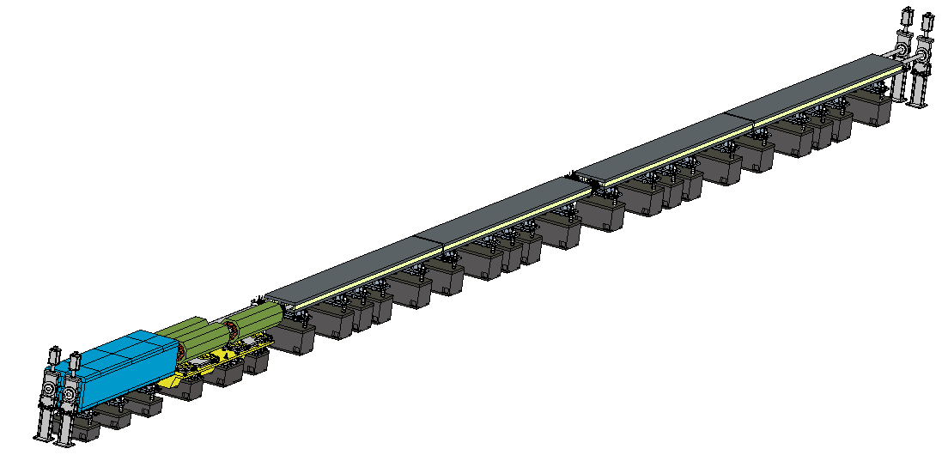
Mockup tunnel
Things to verify
  Collider: Installation experiment of all devices, operating space
  Coil installation and connection on site
  Magnet & support stability
Valve
Vacuum tubes
Bellows
Dipole & support
Sextupole & support
Quadrupole & support
  Stability for dipole will be compared with 3 or 4 supports

Slide 12
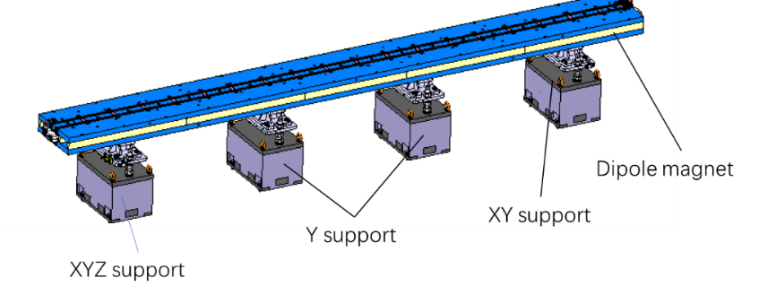
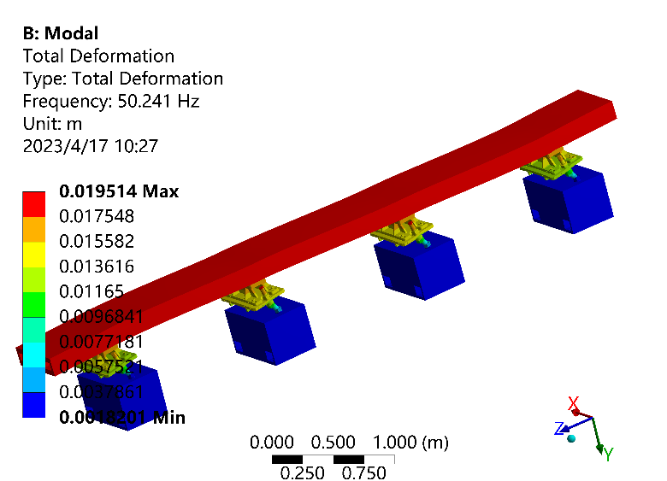

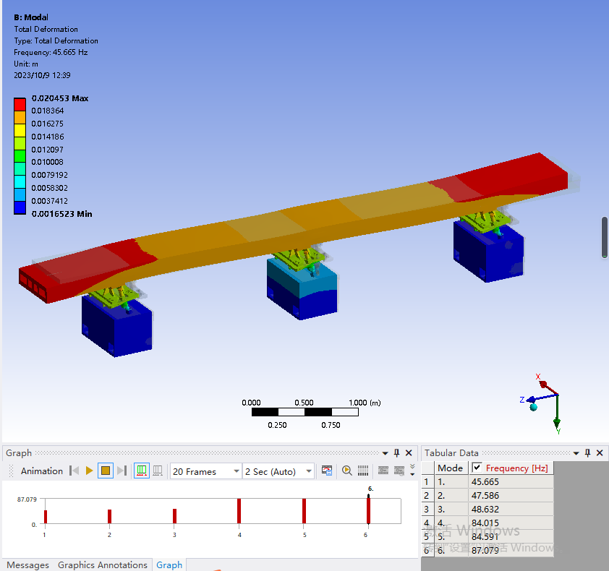

CEPC mechanics system plan in EDR
Magnet supports and mockup tunnel
  For the TDR design, the natural frequency between different magnets differs much → optimize them to avoid over-design or weak stability.
Dipole support in TDR
Order of modes | Dipole & support | Quadrupole & support
1 | 50.2 | 27.3
2 | 51.3 | 31.5
3 | 59.7 | 33.2
No. of dipole supports | Maximum deformation (um) | 1st natural frequency (Hz)
2 | 50.5 | 33.2
3 | 13.0 | 45.7
4 | 6.5 | 50.2
No. of support points should be discussed with magnet and accelerator physics colleagues.

Slide 13
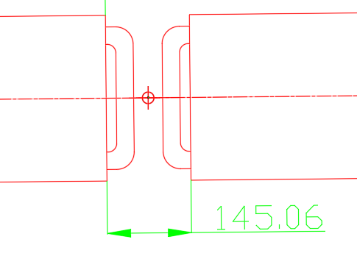
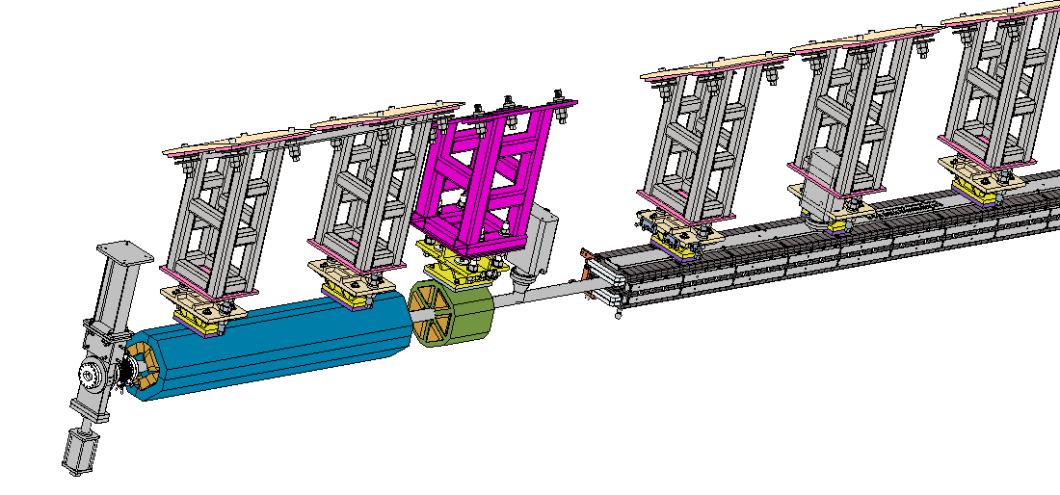
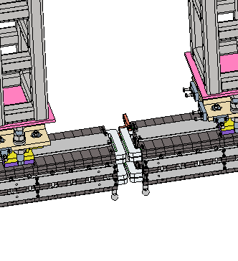
Tunnel mockup
Things to verify
  Booster: Installation experiment of all devices, operating space
  Difficulties: installation to the ceiling, tight space between dipoles
  Magnet & support stability
Dipole & support
Sextupole & support
Vacuum devices
Quadrupole & support

Slide 14
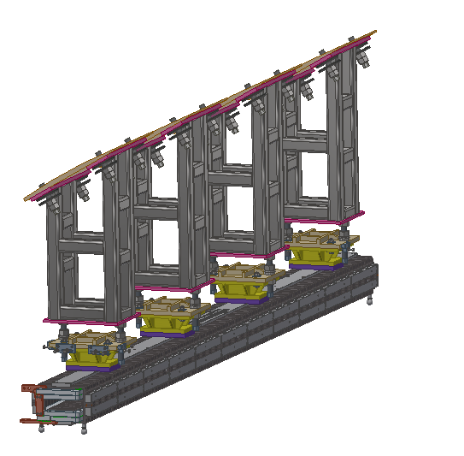
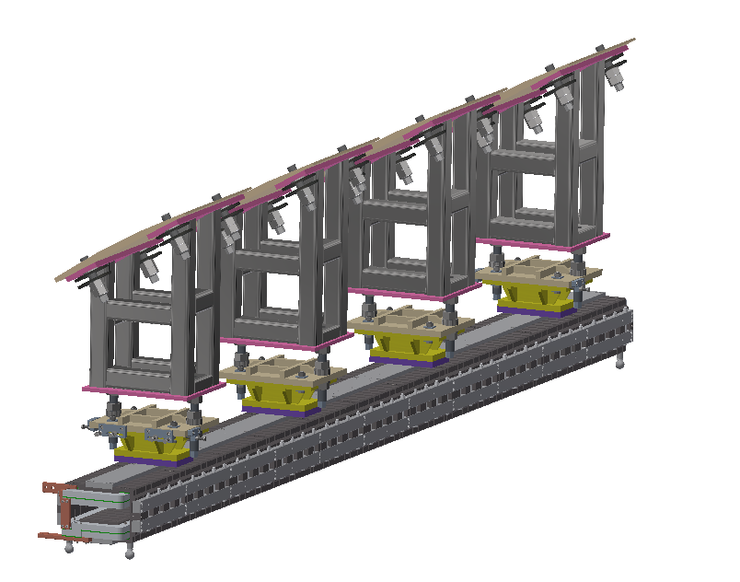
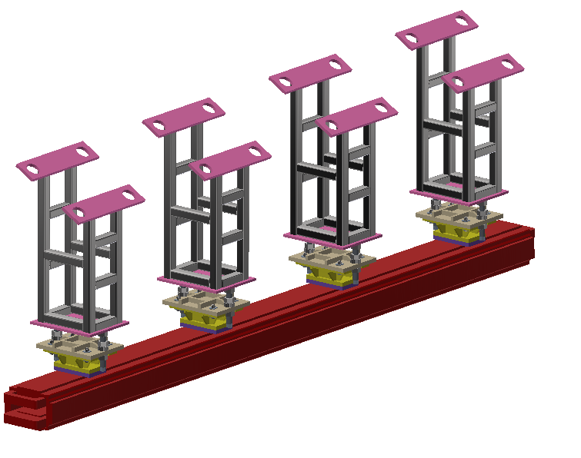
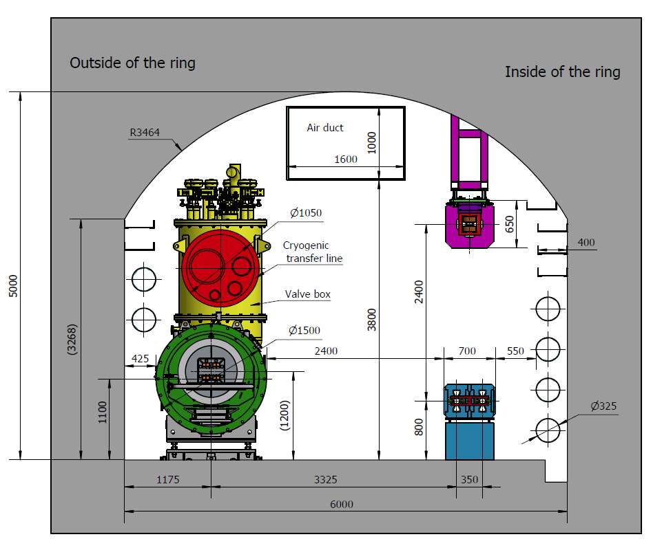
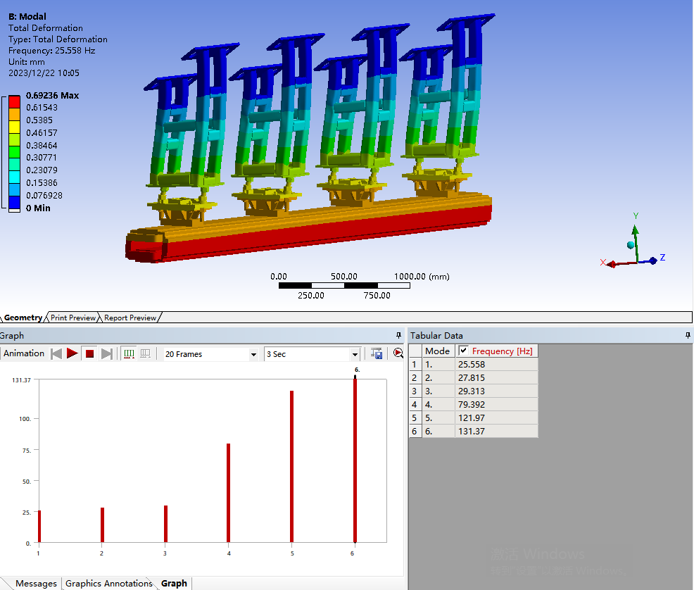
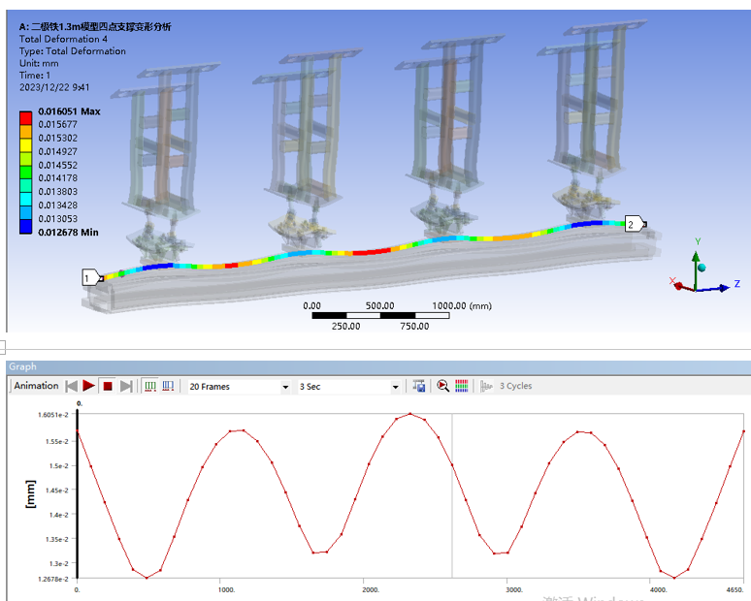
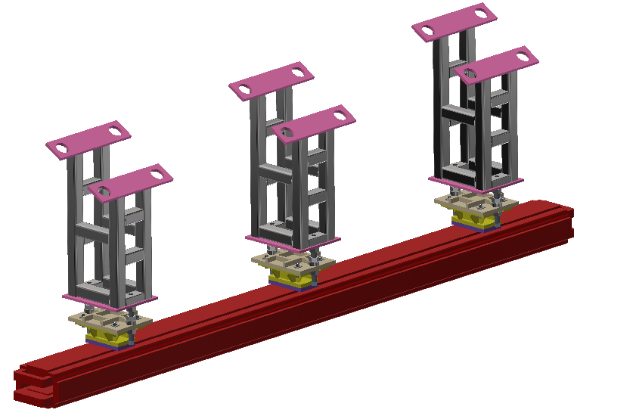
CEPC mechanics system plan in EDR
Magnet supports and mockup tunnel
  For the TDR design, the Booster ring is 2.4 meters higher above Collider. → stability can be improved by shorter support.
Change support height
Change steel sections
Change support number

Slide 15
CEPC mechanics system plan in EDR
Magnet supports and mockup tunnel
  For the TDR design, the Booster ring is 2.4 meters higher above Collider. → stability can be improved by shorter support.
Support height (m) | 1.3 | 1 | 0.7 | 1.3 | 1.3 | 1.3 | 1.3
Support No. | 4 |  |  | 3 | 2 | 4 | 4
Steel section (mm) | 80*80*5 |  |  |  |  | 60*60*3 | 80*80*3
Max. deformation on dipole (um) | 4 | 1 | 1 | 7.4 | 22 | 5.4 | 5.2
1st order of mode /Hz | 25.5 X | 35.9 X | 48.9 X | 22.5 X | 18.7 X | 17.7 X | 21.5 X
2nd order of mode /Hz | 27.8 yaw | 39.0 X+yaw | 56.3 yaw | 24.5 yaw | 19.5 yaw | 19.0 yaw | 23.5 yaw

Slide 16
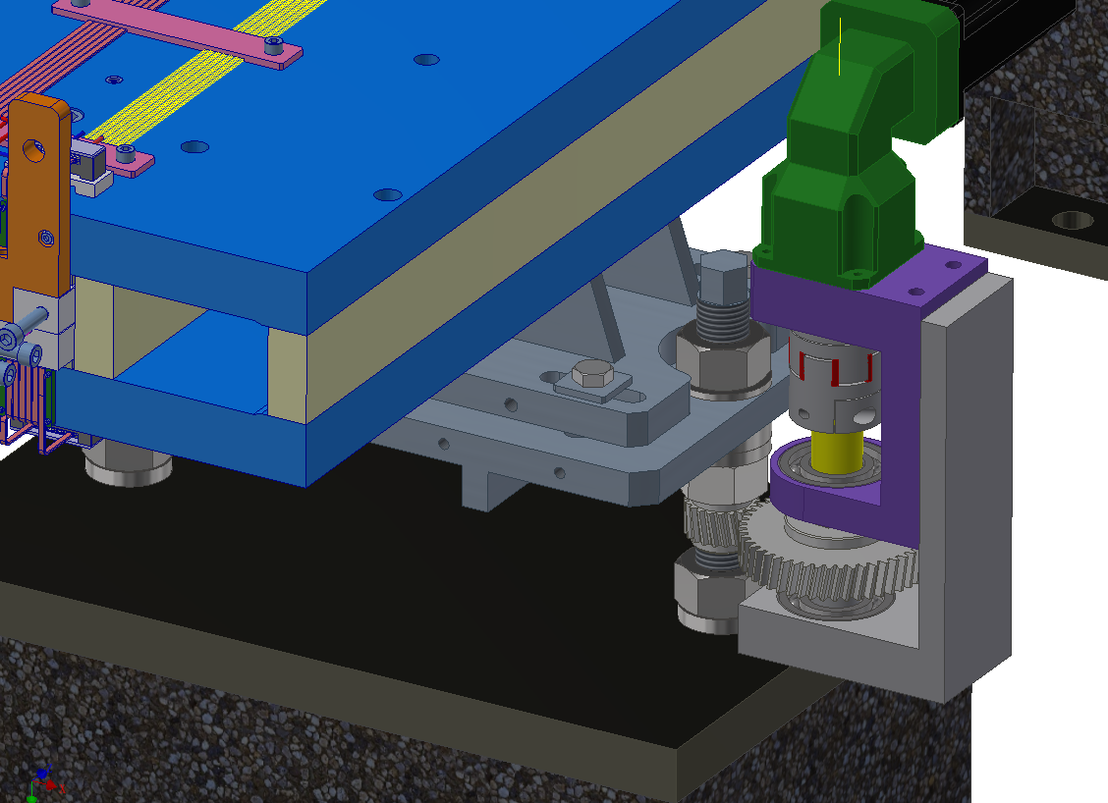
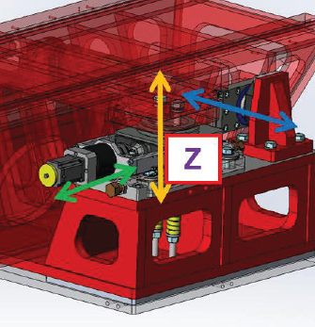
Tunnel mockup
Things to verify
  Semi-automatic adjustment and high-precision alignment field
  Aim: save alignment manpower and cost.
  Add some movable drivers and interface on the adjusting mechanism.
  Validating the technical solution in PAPS, and conducting tunnel alignment simulations in mockup.
Movable drivers V1
For dipole supports
For sextupole girders, similar to girder of EBS

Slide 17
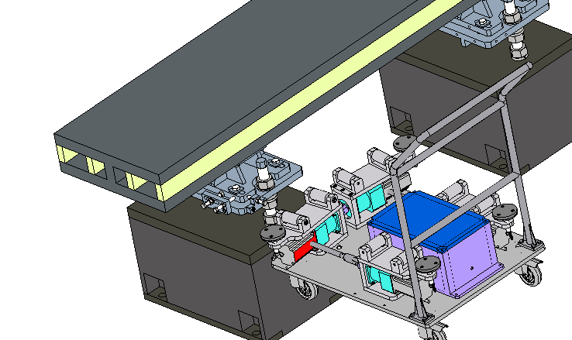
Tunnel mockup
Things to verify
  Semi-automatic adjustment and high-precision alignment field
  Aim: save alignment manpower and cost.
  Add some movable drivers and interface on the adjusting mechanism.
  Validating the technical solution in PAPS, and conducting tunnel alignment simulations in mockup.
Each site has two vertical adjusting joints and two horizontal adjusting joints, standard interface at the sidewalk side.
Movable drivers V2

Slide 18
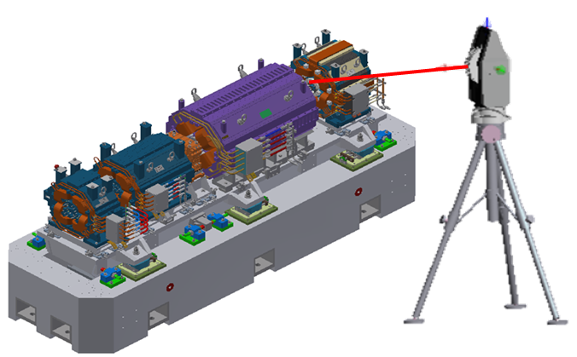
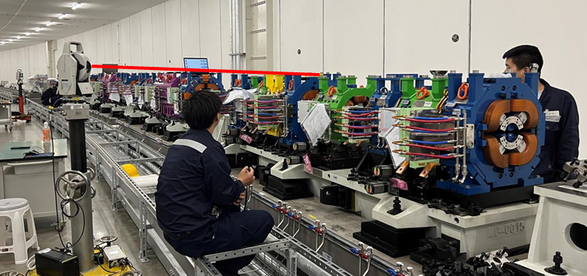
Tunnel mockup
Things to verify
  Pre-alignment and tunnel alignment are the most time-consuming and labor-intensive task in the alignment process.
  The alignment method right now:
    Laser tracker
    Single-point monitoring, single-point adjustment, manual operation, repeated iterations, inefficiency.
  High-precision alignment field
    Multi-camera photogrammetry system
    Multi-point synchronous monitoring
    50% lower cost, significantly larger number of synchronous monitoring points.

Slide 19
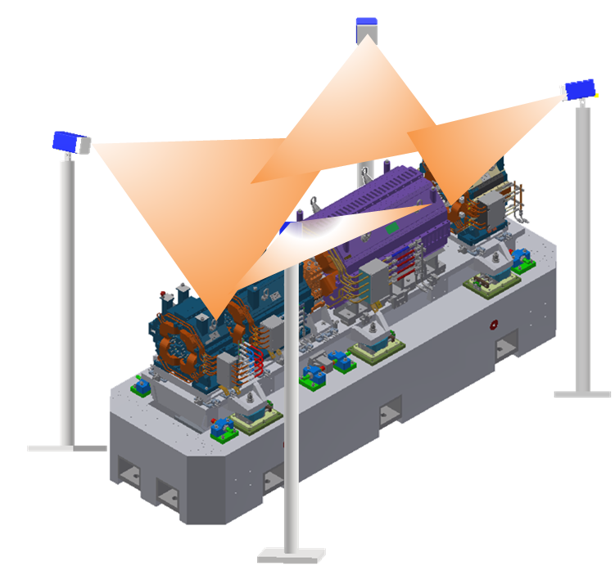
Tunnel mockup
Things to verify
  功能
    根据被测对象类型，自动调整测量视野；
    自动标定相机内外参数和畸变系数。
    通过空间坐标提取，采集标定工装图像，自动建立多目相机空间位姿数学模型；
    高带宽图像传输，实时获取测量场内监测点实测坐标，显示\输出实测坐标与理论坐标的差值。
  系统预期指标
    标定场范围0.5m~20m
    采集频率：≥15 Hz
    空间单点测量误差：≤ 8μm+8μm/m

Slide 20
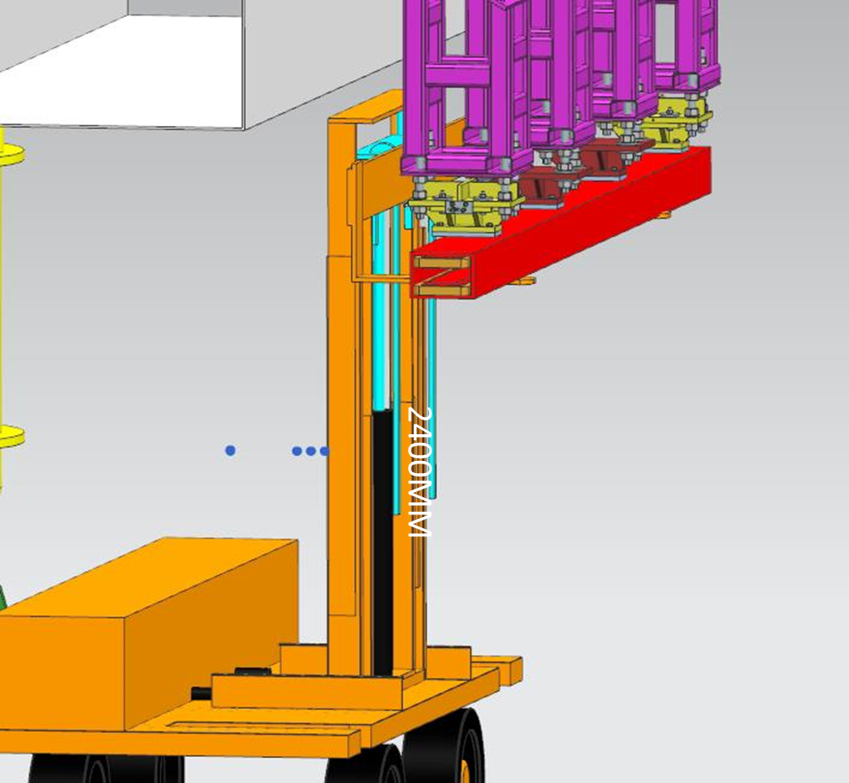
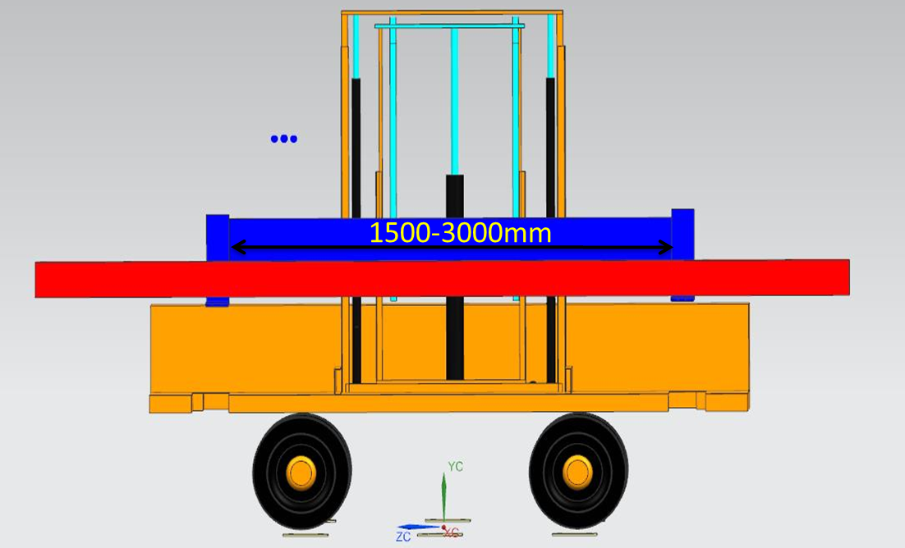
Tunnel mockup
Things to verify
  Magnet transport vehicles
  Aim: efficiency of the transportation and coarse positioning during installation.

Slide 21
Plans
 | 研究内容 | 分项经费 （万元） | 备注
2024年 | 模拟隧道建设 | 332 | 100%
 | 隧道内实验设备设计及研制 | 85 | 60%
 | 隧道内展示设备设计及制作 | 27 | 100%
 | 粗定位运输车设计及研制 | 20 | 60%
 | 准直高精度测量场设计及研制 | 170 | 60%
 | 半自动调节设备设计及研制 | 8 | 60%
2025年 | 隧道内实验设备设计及研制 | 59 | 40%
 | 粗定位运输车设计及研制 | 15 | 40%
 | 准直高精度测量场设计及研制 | 110 | 40%
 | 半自动调节设备设计及研制 | 6 | 40%
 | 隧道内设备工艺安装及实验测试 | 4 | 100%

Slide 22
Plans
参与人员 | 分工
王海静 | 整体设计及进度协调，有限元分析等
李敏贤 | 对撞环实验设备及半自动调节设备设计及研制
吴蕾 | 增强器实验设备设计及研制
王建力 | 机械设计校核、指导
王小龙 | 高精度测量场设计及研制
马永胜 | 真空设备设计及研制，真空相关安装工艺试验
杨梅 | 对撞环相关磁铁安装工艺实验
康文 | 增强器相关磁铁安装工艺试验

Slide 23
Cost
总经费初步估计 836万
  隧道内设备，210万元
设备名称 |  | 子设备名称 | 单位 | 数量 | 价格 | 备注
展示设备 | 27 | Collider 高频腔及支撑 | 套 | 1 | 8
 |  | Booster高频腔及支撑 | 套 | 1 | 9
 |  | 通用管线模拟件 | 套 | 1 | 5
 |  | 真空束测模拟件 | 套 | 1 | 3
 |  | 校正铁、RF区两台四极铁及支撑 | 套 | 1 | 2
实验设备 | 148 | Collider二极铁配重及支撑 | 套 | 1 | 33
 |  | Collider四极铁配重及支撑 | 套 | 1 | 14.5
 |  | Collider六极铁配重及支撑 | 套 | 1 | 18
 |  | Booster二极铁配重及支撑 | 套 | 5 | 29
 |  | Booster四极铁配重及支撑 | 套 | 1 | 5.5
 |  | Booster六极铁配重支撑 | 套 | 1 | 2.2
 |  | 真空设备 | 套 | 1 | 41.4 | 真空盒+波纹管
 |  | 真空设备支架 | 套 | 1 | 4
运输车 | 35 | 三自由度安装运输车及Booster安装架 | 辆 | 1 | 35

Slide 24
Cost
总经费初步估计 836万
  高精度测量场及半自动调节设备，294万元
设备名称 |  | 子设备名称 | 单位 | 数量 | 价格
高精度测量场 | 280 | 测量相机 | 套 | 4 | 168
 |  | 同步控制器 | 套 | 1 | 12
 |  | 测量软件 | 套 | 1 | 4
 |  | 控制系统 | 套 | 1 | 14
 |  | 基准尺 | 套 | 4 | 12
 |  | 相机姿态调整机构 | 套 | 4 | 16
 |  | 相机标定工装 | 套 | 1 | 4
 |  | 基准测量工装 | 组 | 1 | 10
 |  | 基准靶球 | 个 | 20 | 16
 |  | 支撑机构 | 套 | 4 | 12
 |  | 检测费 | 套 | 1 | 2
 |  | 试制费 | 套 | 1 | 10
半自动调节机构 | 14 | 半自动螺杆调节机构 | 套 | 4 | 8
 |  | 半自动楔块调节机构 | 套 | 4 | 6

Slide 25
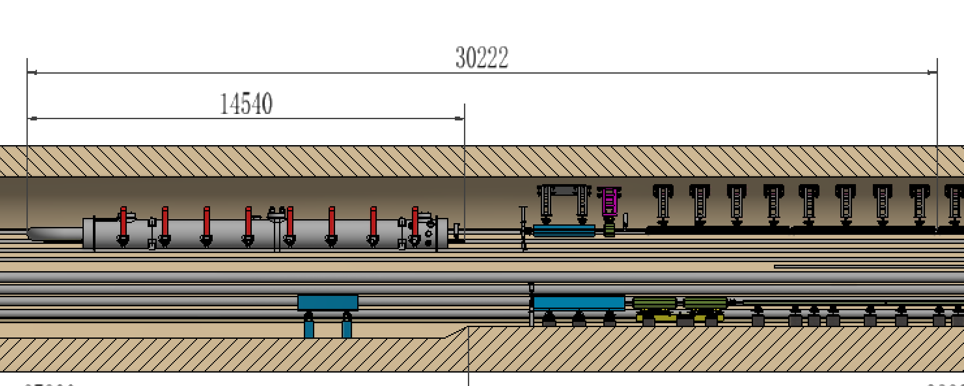
Cost
总经费初步估计 836万
  模拟隧道，332万元
  墙及顶1米，~1000 m³。最短可30米，只含Booster RF模组及Booster 四极铁、六极铁及2块二极铁。
固有频率与墙体厚度关系

Slide 26
Summary
A tunnel mockup has been preliminary designed according to TDR design. Based on which the stability of magnet & support assembly, the high-precision alignment field, and the installation experiment can be verified.

