Slide 1


LHCb实验最新进展
谢跃红, 华中师范大学
第六届重味物理与量子力学研讨会
青岛， 2024年4月19-23日

Slide 2
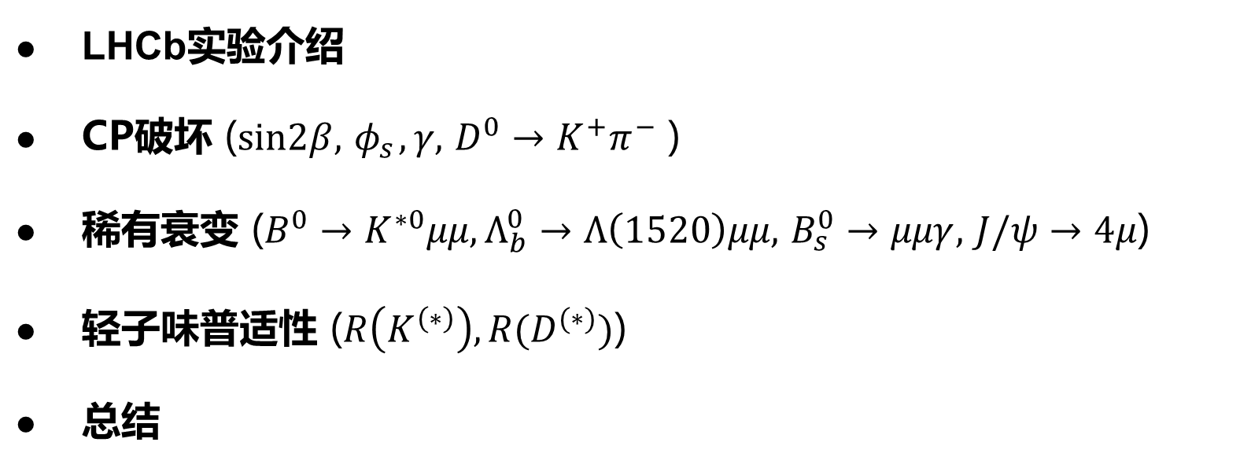
提纲
LHCb实验介绍
CP破坏 ($sin2β, { φ}_{s},γ,$ $D^{0}→K^{+}π^{−}$ )
稀有衰变 ($B^{0}→K^{∗0}μμ, Λ_{b}^{0}→Λ\left(1520\right)μμ,$ $B_{s}^{0}→μμγ,$ $J/ψ→4μ$)
轻子味普适性 ($R\left(K^{\left(∗\right)}\right), R(D^{(∗)})$)
总结
2

Slide 3
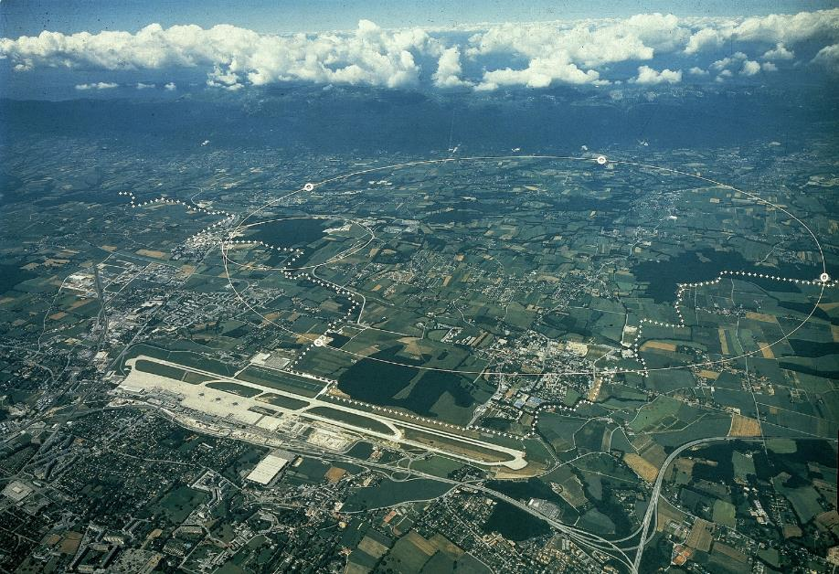
大型强子对撞机
ALICE
ATLAS
27公里环形质子-质子加速器，
每秒4千万次对撞, 设计能量14 TeV
CMS
LHCb
3

Slide 4
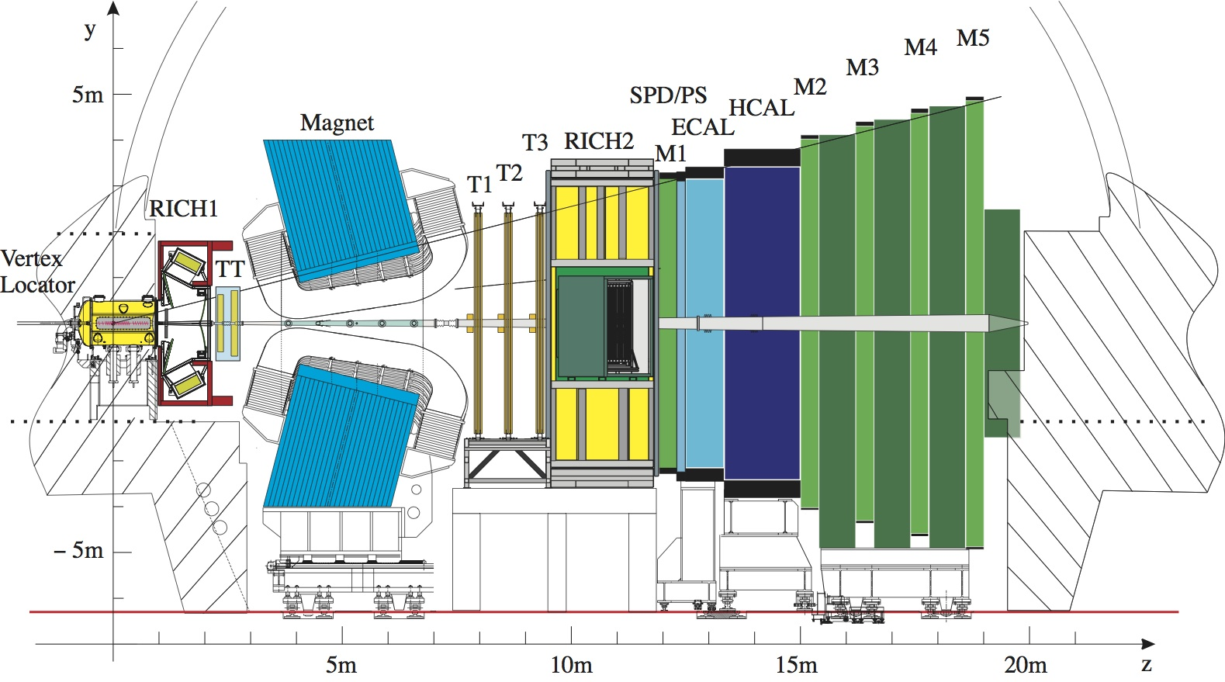
LHCb实验
LHCb合作组
22个国家，99家单位，1698名成员
中国单位：
清华大学，华中师范大学，中国科学院大学，武汉大学，高能所, 华南师范大学，湖南大学，北京大学，兰州大学
理解正反物质不对称 （重味强子衰变中的CP破坏）
间接寻找新物理效应 （稀有衰变、轻子普适性检验）
理解强相互作用机制 （强子性质、新强子态）
前向区域的物理研究 （电弱物理、重离子物理、QCD)
4

Slide 5
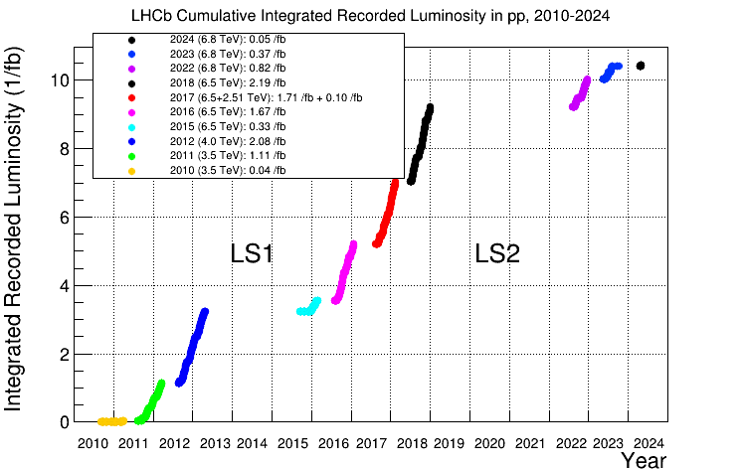
LHCb数据获取（pp 对撞）
第一运行期：Run 1（2011-2012），3 fb⁻¹
第二运行期：Run 2（2015-2018），6 fb⁻¹
第三运行期：Run 3（2022- ），Ongoing
5

Slide 6
CP violation
6

Slide 7
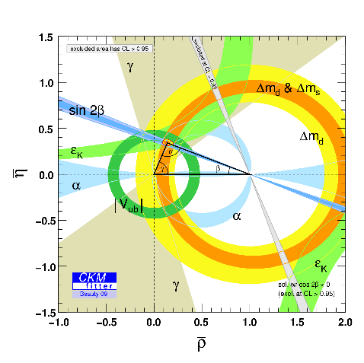
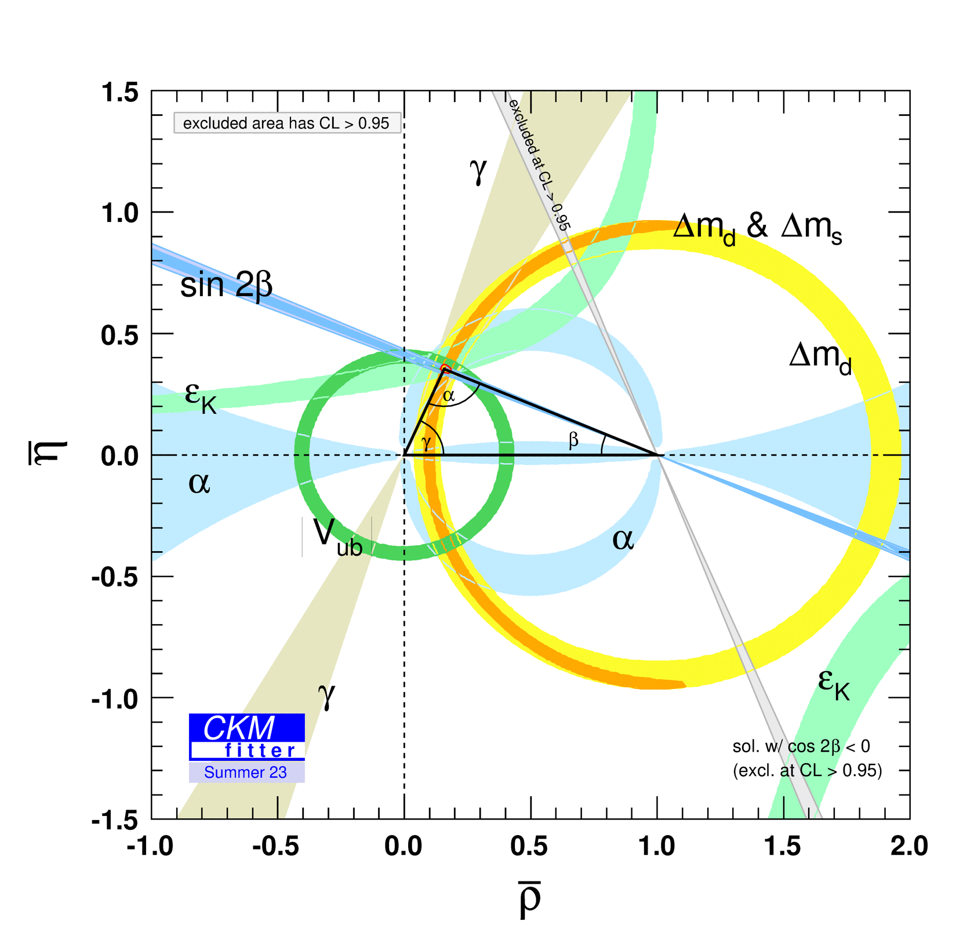
CP violation and CKM matrix
When LHC started
Current picture
7

Slide 8
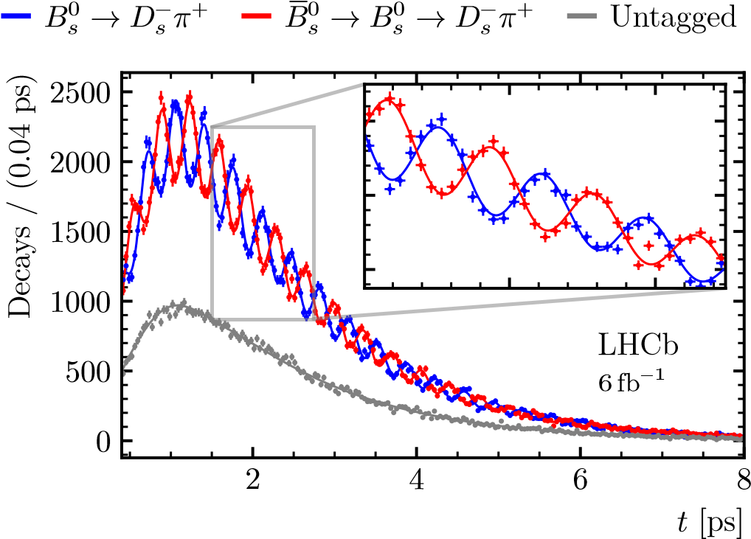
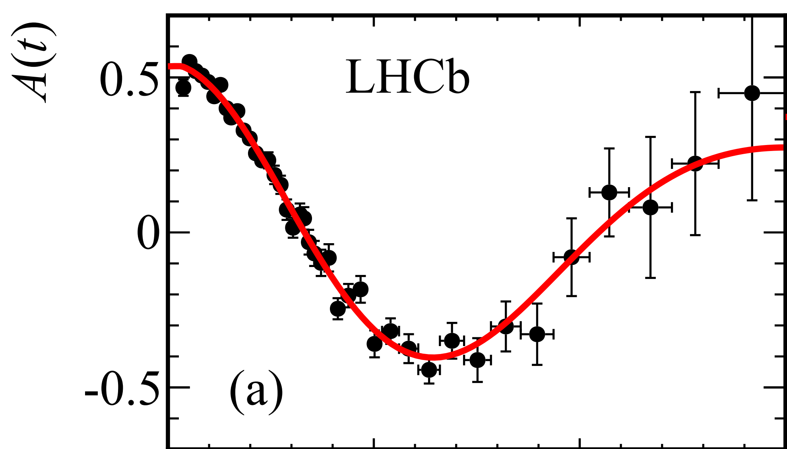
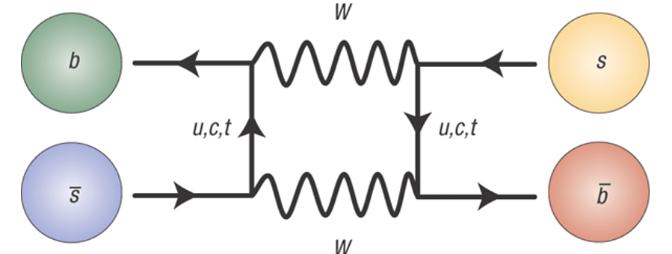
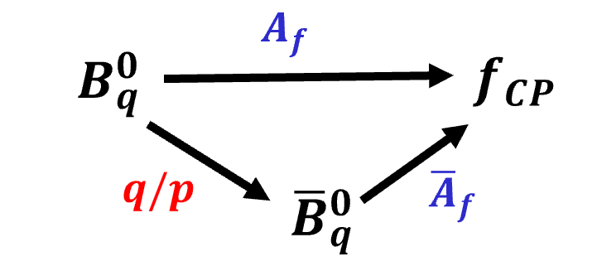
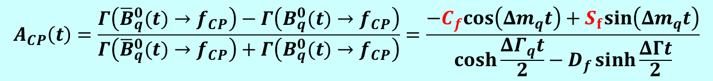

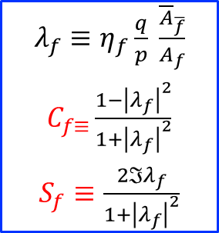



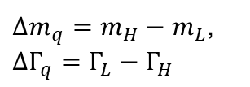


Neutral $B$ mixing and CPV
$B_{q}^{0}−{\overline{B}}_{q}^{0}$oscillation
$$B_{s}^{0}→D_{s}^{−}π^{+}$$
$$B_{d}^{0}→D^{(∗)−}μ^{+}ν$$
$$B_{L,H}={p|B}_{q}⟩±q\left|{\overline{B}}_{q}\right\rangle$$
NP?
$Δm_{q}=m_{H}−m_{L}$,
$ΔΓ_{q}=Γ_{L}−Γ_{H}$
Time-dependent CP violation
Interference of $B_{q}^{0}→f_{CP}$ and $B_{q}^{0}→{\overline{B}}_{q}^{0}→f_{CP}$
$λ_{f}≡η_{f}\frac{q}{p} \frac{{\overline{A}}_{\overline{f}}}{A_{f}}$
$C_{f≡}\frac{1−{\left|λ_{f}\right|}^{2}}{1+{\left|λ_{f}\right|}^{2}}$
$S_{f}≡\frac{2ℑλ_{f}}{1+{\left|λ_{f}\right|}^{2}}$
$$A_{CP}\left(t\right)=\frac{Γ\left({\overline{B}}_{q}^{0}(t)→f_{CP}\right)−Γ\left(B_{q}^{0}(t)→f_{CP}\right)}{Γ\left({\overline{B}}_{q}^{0}(t)→f_{CP}\right)+Γ\left(B_{q}^{0}(t)→f_{CP}\right)}=\frac{−C_{f}cos\left(Δm_{q}t\right)+S_{f}sin\left(Δm_{q}t\right)}{\cosh{\frac{ΔΓ_{q}t}{2}}−D_{f}\sinh{\frac{ΔΓt}{2}}}$$
$C_{f}≠0:$ direct CPV
$S_{f}≠0$：$\text{mixing} \text{induced} \text{CPV}$
8

Slide 9
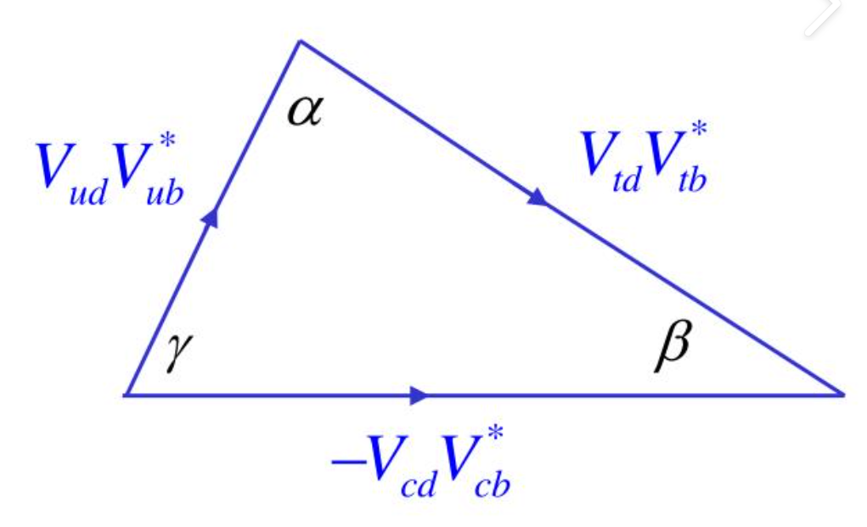
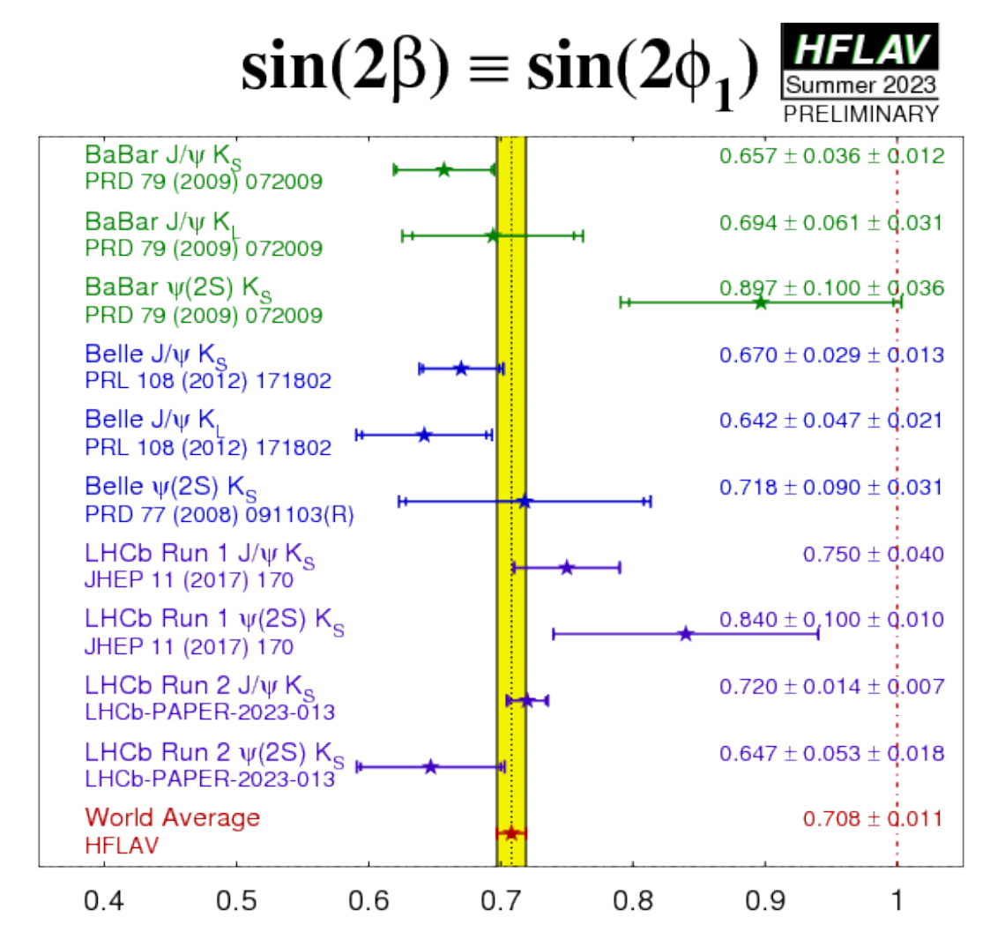
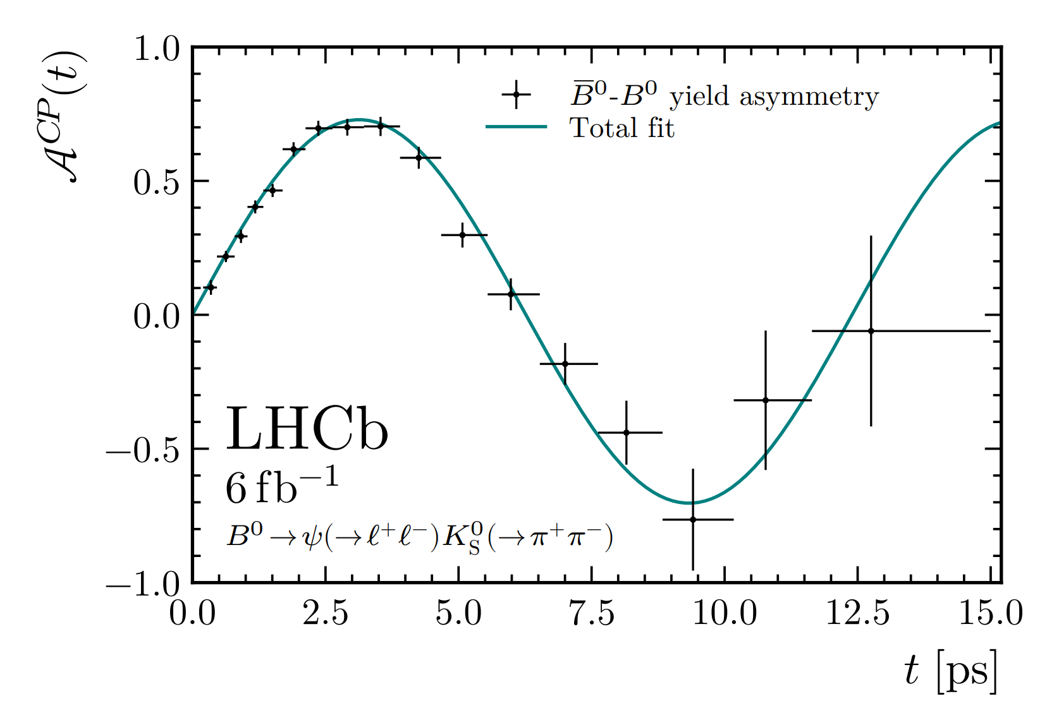

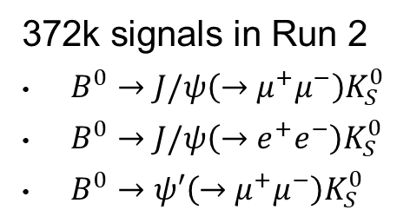
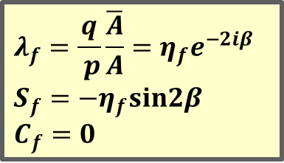
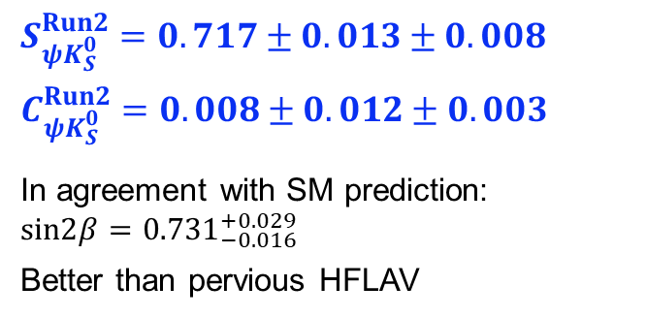
LHCb Run-2 measurement of $sin2β$
PRL 132 （2024）021801
TD-CPV in $B^{0}→ψK_{S}^{0}$decays characterized by mixing phase $φ_{d}=2β$
$$A_{CP}\left(t\right)=−η_{f}sin2β\sin\left(Δm_{d}t\right)=+sin2β\sin\left(Δm_{d}t\right)$$
$$λ_{f}=\frac{q}{ p}\frac{\overline{A}}{A}=η_{f}e^{−2iβ}$$
$$S_{f}=−η_{f}sin2β$$
$C_{f}=0$
372k signals in Run 2
$B^{0}→J/ψ\left(→μ^{+}μ^{−}\right)K_{S}^{0}$
$B^{0}→J/ψ\left(→e^{+}e^{−}\right)K_{S}^{0}$
$B^{0}→ψ′\left(→μ^{+}μ^{−}\right)K_{S}^{0}$
$$S_{ψK_{S}^{0}}^{Run2}=0.717±0.013±0.008$$
$$C_{ψK_{S}^{0}}^{Run2}=0.008±0.012±0.003$$
In agreement with SM prediction: $sin2β={0.731}_{−0.016}^{+0.029}$
Better than pervious HFLAV
9

Slide 10
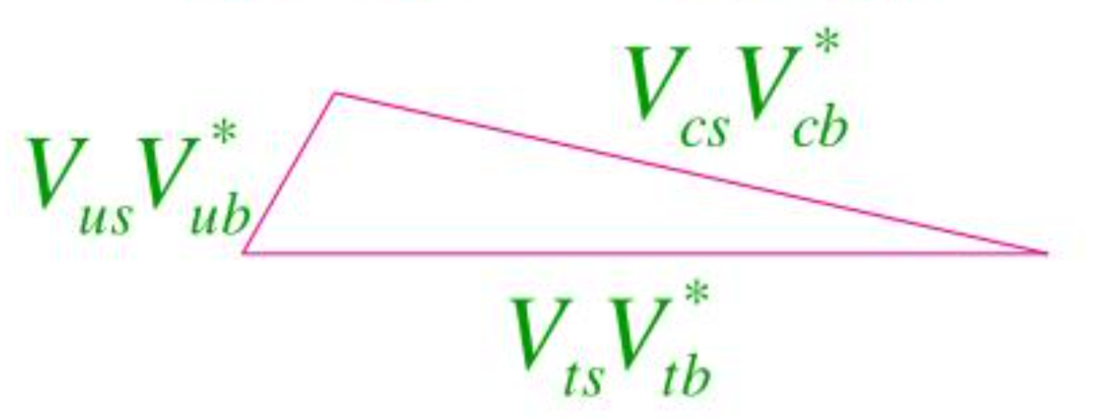
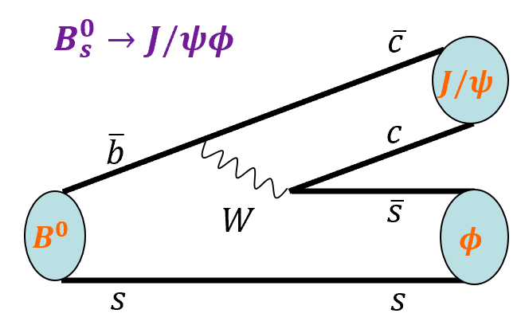
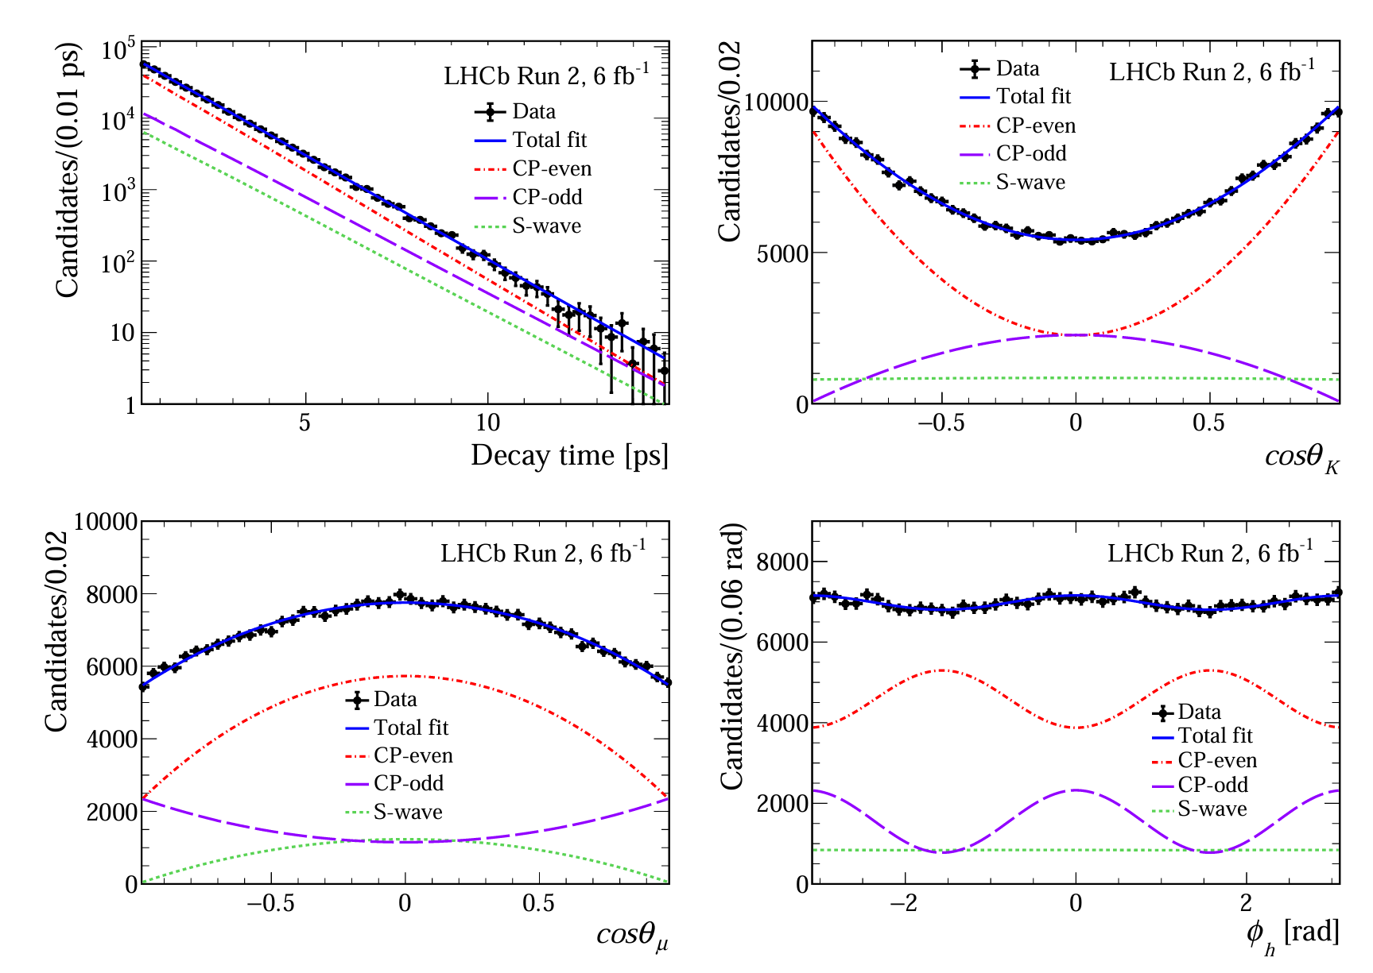
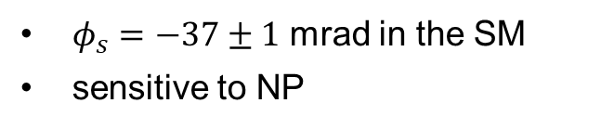



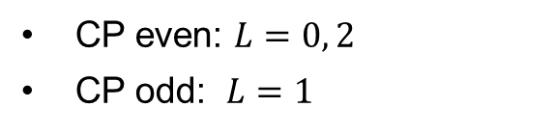
$B_{s}^{0}$ mixing phase $φ_{s}=−2β_{s}$
PRL 132 92024）051802
$$β_{s}$$
For each CP eigenstate of $B_{s}^{0}→J/ψφ$
$$A_{CP}\left(t\right)≈{−η}_{f}sinφ_{s}\sin\left(Δm_{s}t\right)$$
$φ_{s}=−37±1$ mrad in the SM
sensitive to NP
Angular analysis to separate CP even and odd states
CP even: $L=0, 2$
CP odd: $L=1$
10

Slide 11
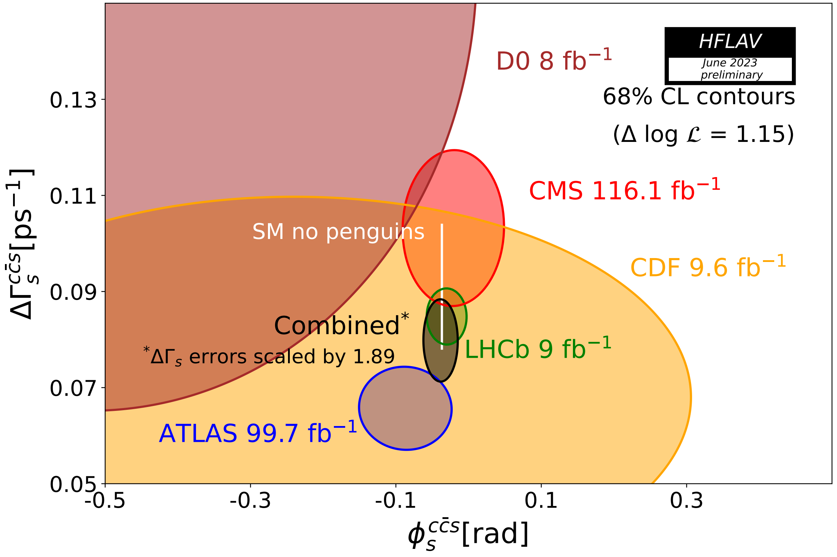
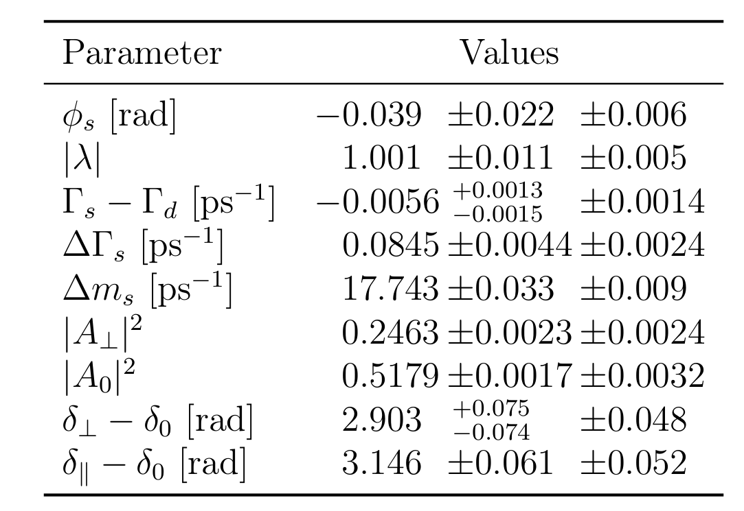
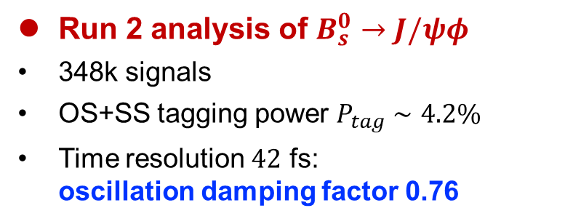
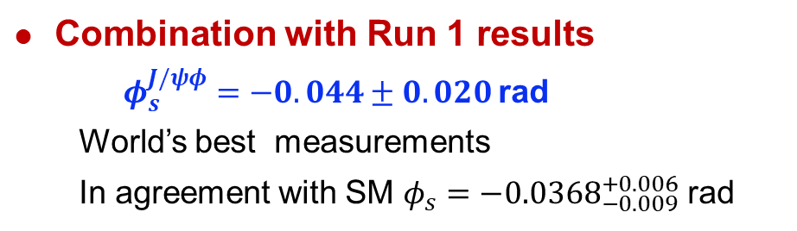
LHCb Run-2 measurement of $φ_{s}$
PRL 132 92024）051802
Run 2 analysis of $B_{s}^{0}→J/ψφ$
348k signals
OS+SS tagging power $P_{tag}∼4.2\%$
Time resolution $42$ fs: oscillation damping factor 0.76
Combination with Run 1 results
$φ_{s}^{J/ψφ}=−0.044±0.020$ rad
  World’s best measurements
  In agreement with SM $φ_{s}=−{0.0368}_{−0.009}^{+0.006}$ rad
11

Slide 12
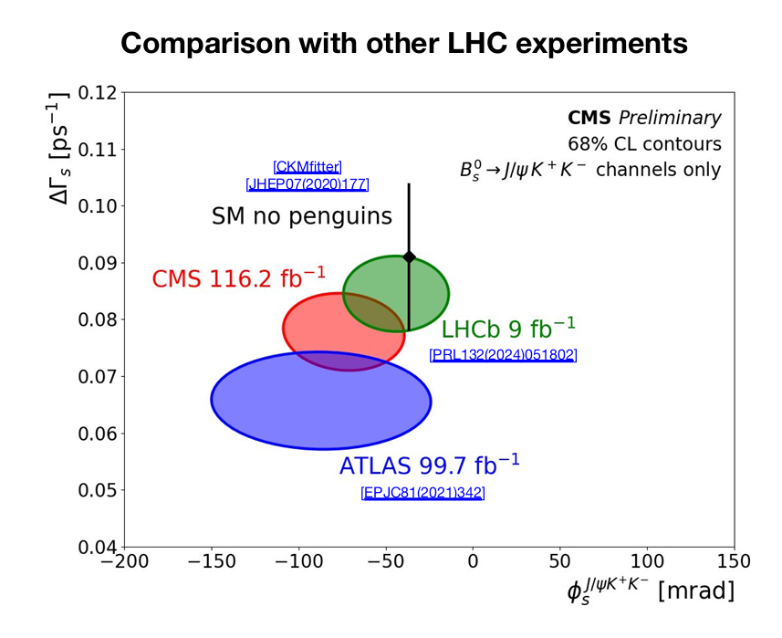
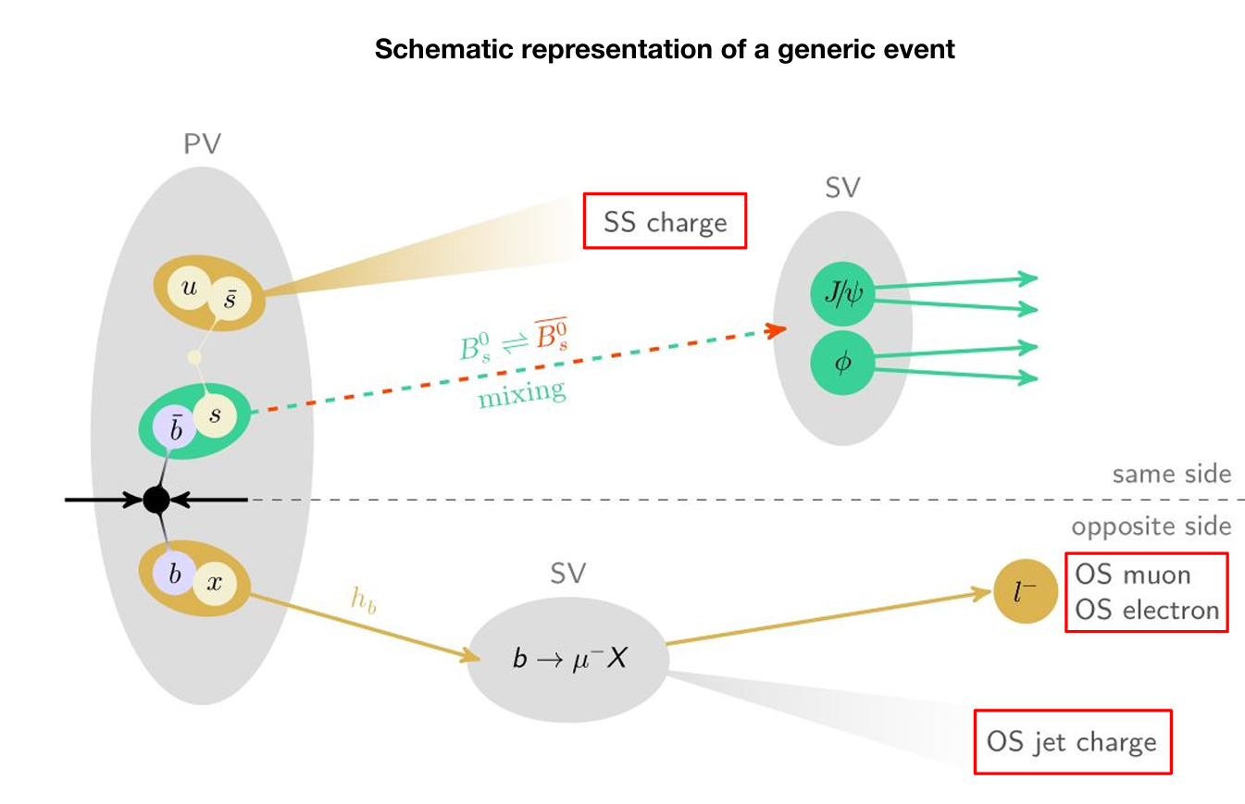

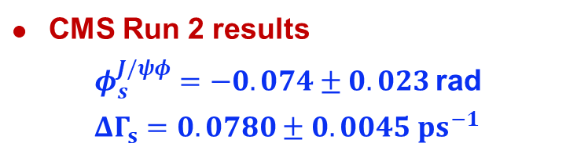
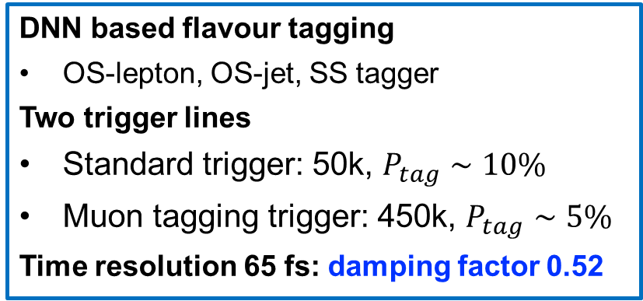
New CMS measurement of $φ_{s}$in $B_{s}^{0}→J/ψφ$
CERN Seminar, 16/4/2024
DNN based flavour tagging
OS-lepton, OS-jet, SS tagger
Two trigger lines
Standard trigger: 50k, $P_{tag}∼10\%$
Muon tagging trigger: 450k, $P_{tag}∼5\%$
Time resolution 65 fs: damping factor 0.52
CMS Run 2 results
$φ_{s}^{J/ψφ}=−0.074±0.023$ rad
$ΔΓ_{s}=0.0780±0.0045 ps^{−1}$
Claimed first evidence of nonzero $φ_{s}$
LHCb marginally wins due to better time resolution!
12

Slide 13
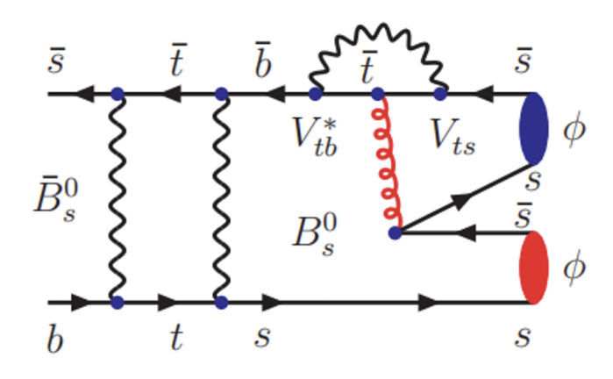
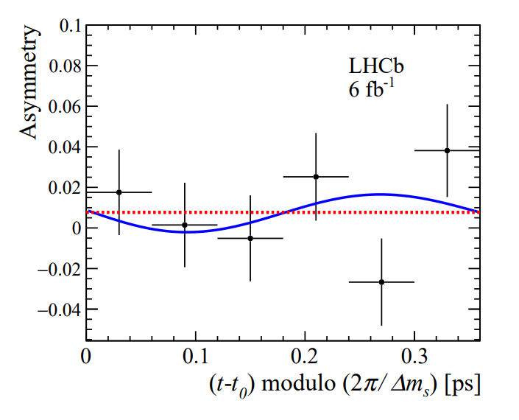
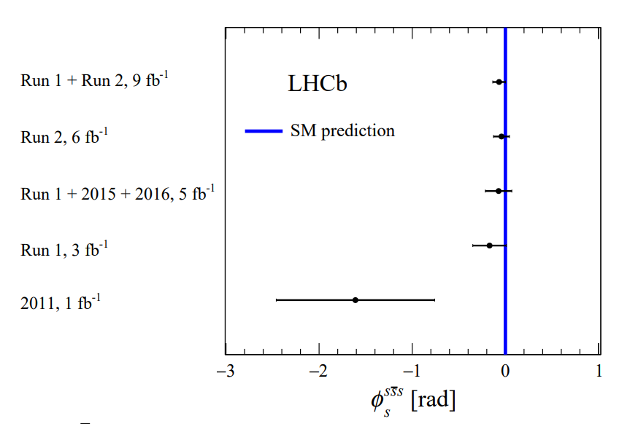
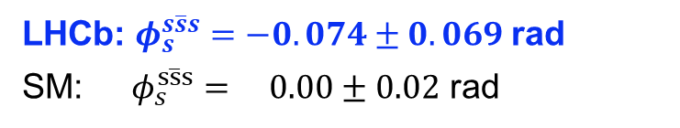

CPV in penguin decay $B_{s}^{0}→φφ$
PRL 131 (2023) 171802
TD-CPV in $b→s\overline{s}s$ characterized by weak phase $φ_{s}^{s\overline{s}s}$
$$A_{CP}\left(t\right)=−η_{f}sinφ_{s}^{s\overline{s}s}\sin\left(Δm_{s}t\right)$$
Run 1+2 time-dependent angular analysis
LHCb: $φ_{s}^{s\overline{s}s}=−0.074±0.069$ rad
SM: $φ_{s}^{s\overline{s}s}= 0.00±0.02$ rad
13

Slide 14
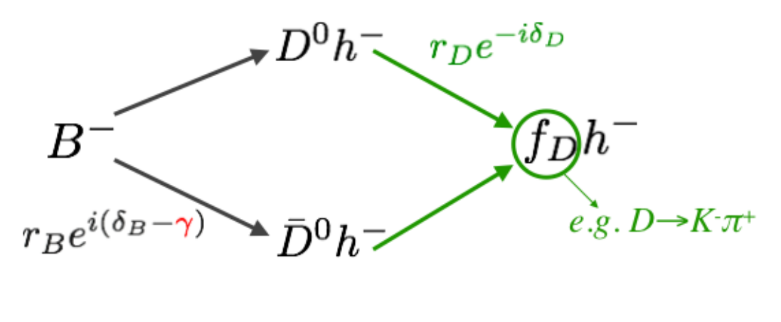
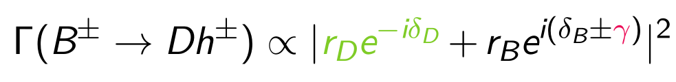
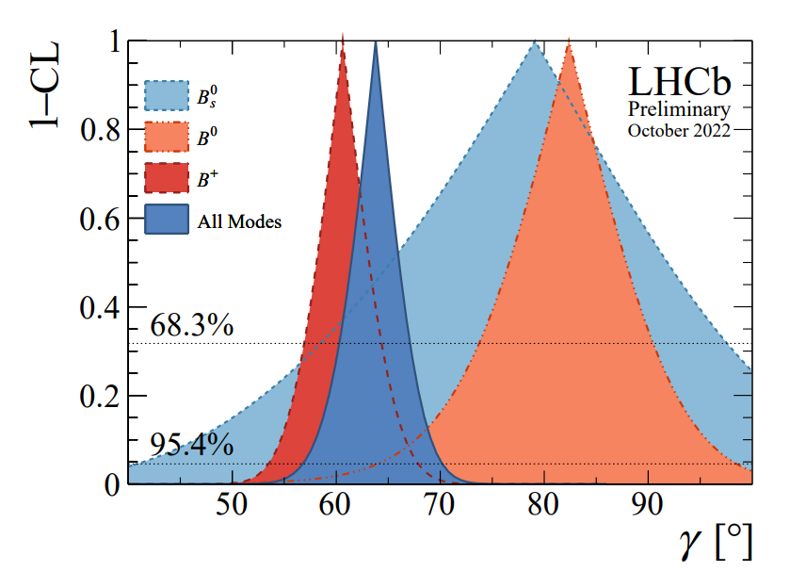
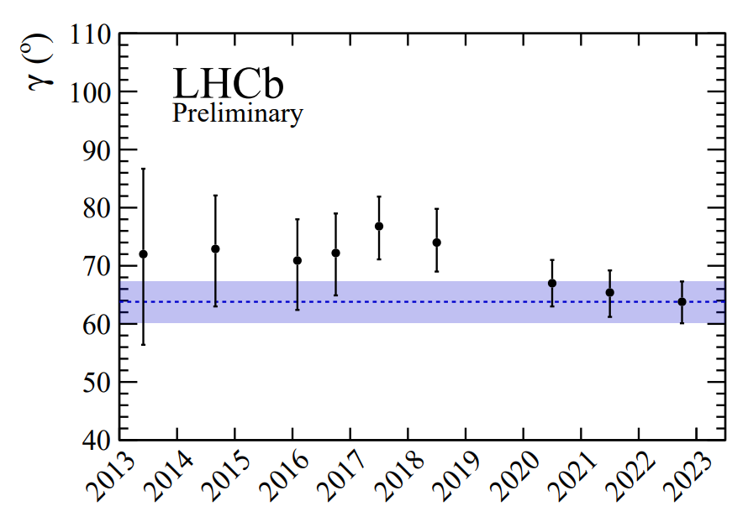
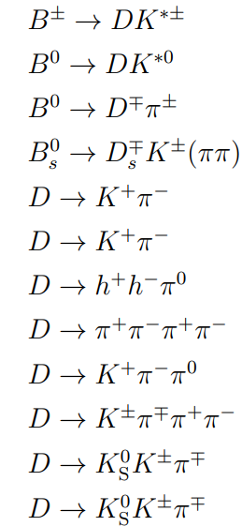



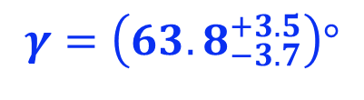
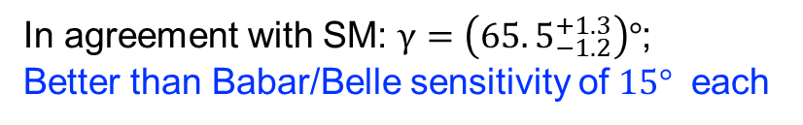
$γ$ from $B→Dh$ decays
LHCb-CONF-2022-002
Access $γ$ from interference of $b→u$ & $b→c$
$b→c$
LHCb combination dominated by $B^{+}→DK^{+}$
$b→u$
$$γ=\left(63.8_{−3.7}^{+3.5}\right)°$$
In agreement with SM: $γ=\left(65.5_{−1.2}^{+1.3}\right)°$;
Better than Babar/Belle sensitivity of $15°$ each
Some tension between $B^{+}, B^{0}, B_{s}^{0}$
14

Slide 15
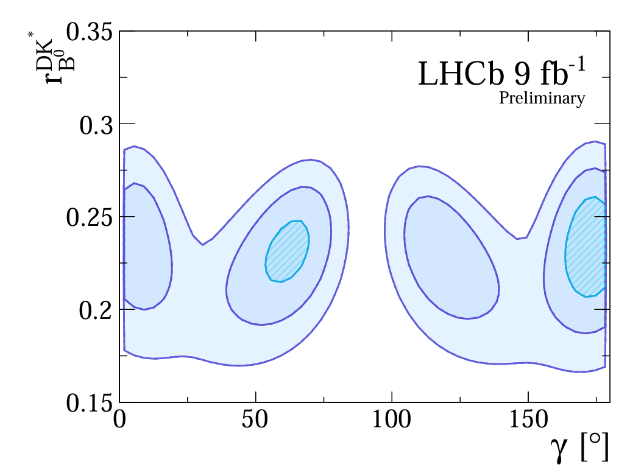
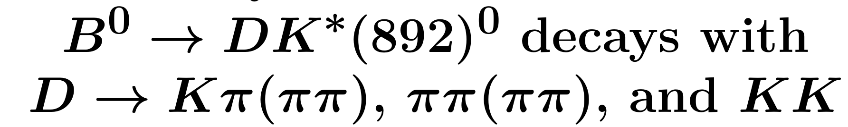
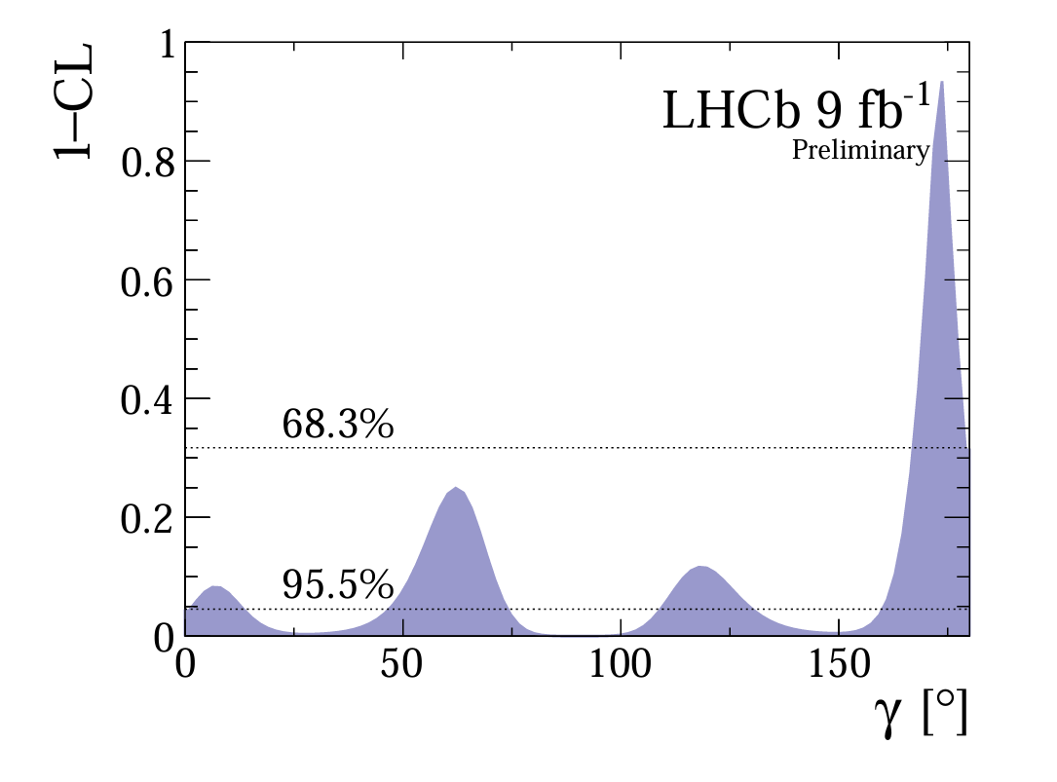
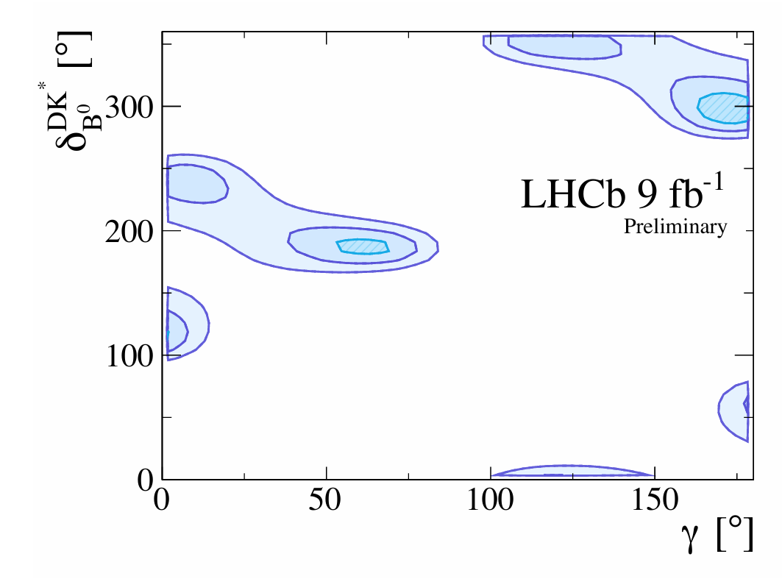



$γ$ measurement in $B^{0}→DK^{∗0}$with $D→hh′(ππ)$
LHCb-conf-2023-004
Four solutions of $γ$ from decay rates and CP asymmetries in
SM-like solution: $γ=\left(62±8\right)°$
Tension between $B^{0}$ and $B^{+}$ eased
15

Slide 16
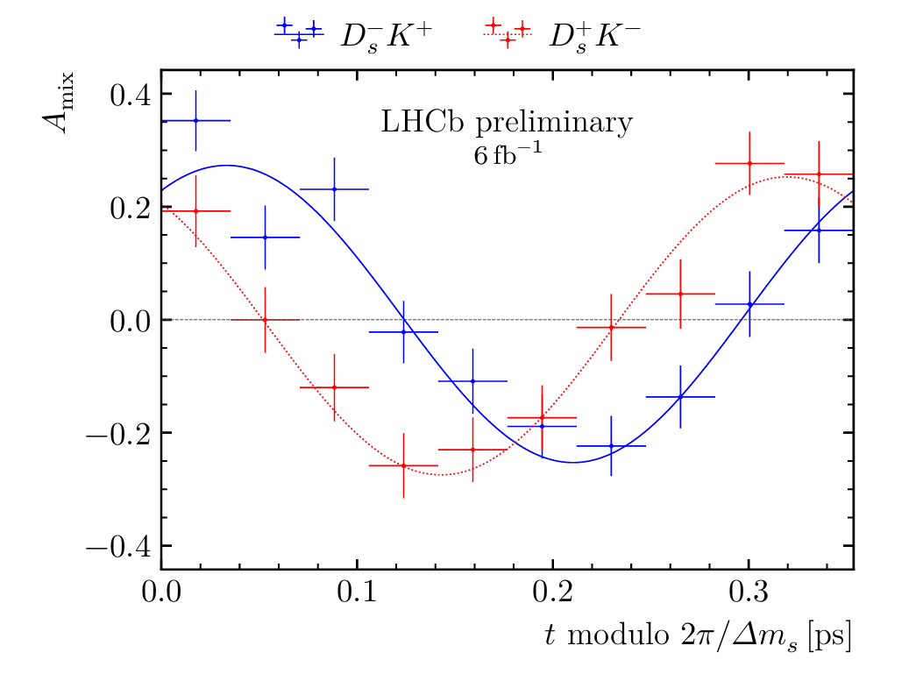
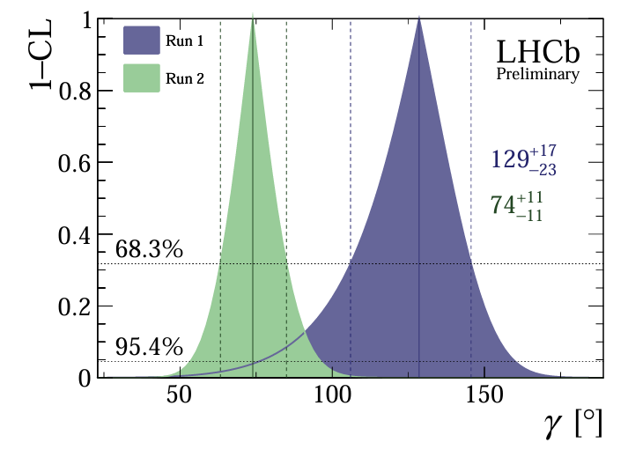




$γ$ from $B_{s}^{0}→D_{s}^{−}K^{+}$
LHCb-conf-2023-004
两条曲线关于$A_{mix}=0$上下不对称，表明存在CP破坏.
Access $γ$ via TD analysis
Tension between $B_{s}^{0}$ and $B^{+}$ eased
$$γ=\left(74±11 \right)°$$
16

Slide 17
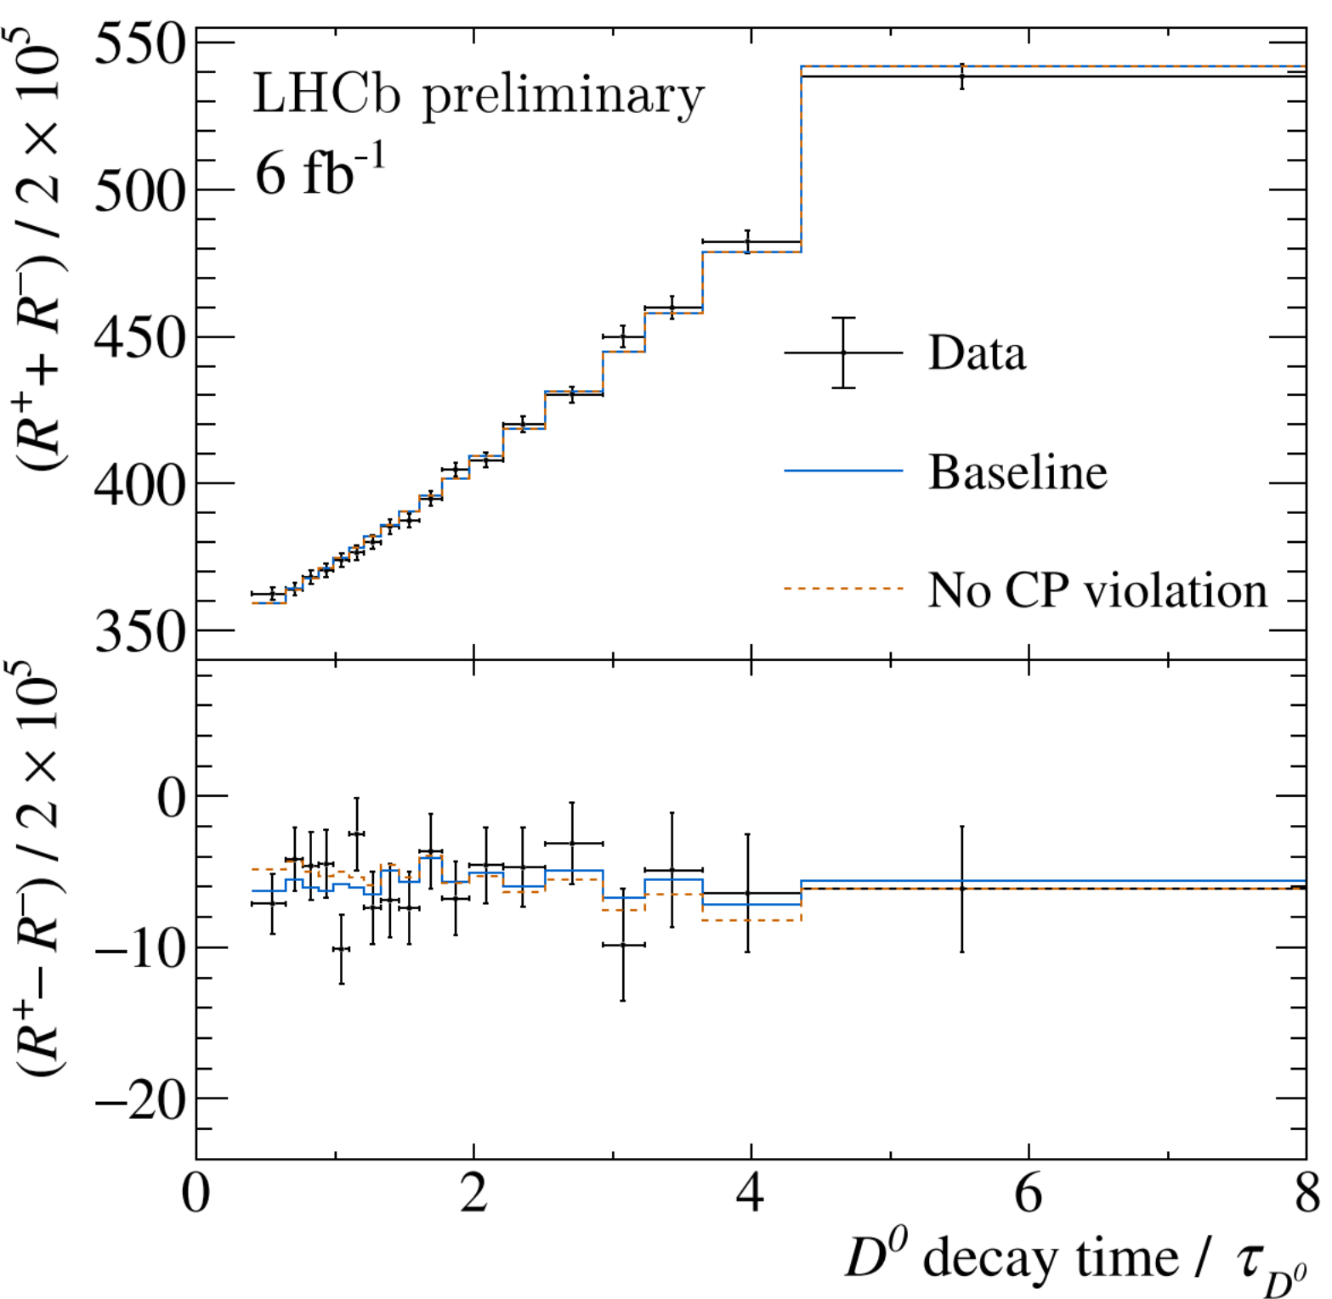



Mixing and CP violation in $D^{0}→K^{+}π^{−}$
CERN Seminar, 2024/3/26
$x_{12}=2\left|M_{12}/Γ\right|$, $y_{12}=2\left|Γ_{12}/Γ\right|,$ $φ_{2}^{M}=arg\left(M_{12}\right),$ $φ_{2}^{Γ}=\arg\left(Γ_{12}\right)$
20% improvement in $φ_{2}^{M}$ related to indirect CPV by adding 2017-2018 data
$R^{±}:$ ratio of WS and RS decay rates for $D^{0}$ and ${\overline{D}}^{0}$
$$Δc_{Kπ}≈x_{12}\sin\left(φ_{2}^{M}\right)$$
17

Slide 18
Rare decays
18

Slide 19



$$b→sl^{+}l^{−}$$
19

Slide 20







Tension in $B^{0}→K^{∗0}μμ$ decays
$$B^{0}→K^{∗0}μ^{+}μ^{−}$$
PRL 126 (2021) 161802
$$B^{0}→K^{∗0}μ^{+}μ^{−}$$
Shift of $C_{9}$ preferred
JHEP 04 (2017) 142
Possible interpretations
New physics contributions?
Under-estimated FF uncertainties?
Effect of SM charm loops? Get it from Run 1+ 2016 data
20

Slide 21



New unbinned analysis of $B^{0}→K^{∗0}μμ$
PRL 132 (2023) 131801
Fit to ${(q}^{2}, cosθ_{l}, cosθ_{K}, φ)$ excluding charmonium regions
  Local FFs constrained to theoretical calculations
  Non-local charm-loop contributions constrained using
    BF & polarization measurements in $J/ψ$, $ψ(2S)$ regions
    Theoretical calculations at $q^{2}<0$ (optional)
Tension between data and SM reduced to below $2σ$
Comprehensive analysis that includes charmonium regions ongoing!
21

Slide 22




$Λ_{b}→Λ(1520)μ^{+}μ^{−}$ differential BF
PRL 131 (2023) 151801
High $q^{2}$: consistent with SM predictions
Low $q^{2}$: tension with theoretical predictions
22

Slide 23




Search for $B_{s}^{0}→μ^{+}μ^{−}γ$
arXiv:2404.03375
$$B\left(B_{s}^{0}→μ^{+}μ^{−}γ\right)<2.8×10^{−8}$$
c.f. $B\left(B_{s}^{0}→μ^{+}μ^{−}\right)<\left({3.09}_{−0.43−0.11}^{+0.46+0.15}\right)×10^{−9}$
23

Slide 24




Measurement of $J/ψ→μ^{+}μ^{−}μ^{+}μ^{−}$
LHCb, Moriond QCD 2024
$$B\left(J/ψ→μ^{+}μ^{−}μ^{+}μ^{−}\right)=$$
$$（1.13±0.10±0.05±0.01）×10^{−8}$$
24

Slide 25
Lepton flavour universality
25

Slide 26



Lepton flavour universality tests in $b→sl^{+}l^{−}$
PRL 131 (2023) 051803
Previous tension with SM
Updated results consistent with SM
26

Slide 27





Hint of LFU violation in $b→clν$
Long standing $3.3σ$ hint of deviation from LFU
27

Slide 28








New LHCb measurements of $R(D^{\left(∗\right)})$
PRL 131 (2023) 111802
Measurements of $R(D)$ and $R(D^{∗})$ with $τ→μ{\overline{ν}}_{μ}ν_{τ}$ decays using Run 1 data
${\overline{B}}^{0}→D^{∗+}μ^{−}π^{+}$ for normalization
$R(D^{∗})$= $0.282±0.018±0.024$
$$R\left(D\right)=0.441±0.060±0.066$$
PRD 108 (2023) 012018
Measurement of $R(D^{∗})$ with $τ→π^{+}π^{−}π^{−}ν_{τ}$ decays using data 2011-2016 data
${\overline{B}}^{0}→D^{∗+}3π^{±}$ for normalization
$R(D^{∗})$= $0.257±0.012±0.014±0.012$
One of the most precise $R(D^{∗})$ measurements!
28

Slide 29


World average of $R(D^{(∗)})$
Discrepancy with SM remains at $3.2σ$, p-value = $1.52×{10}^{−3}$
29

Slide 30







$D^{∗}$ longitudinal polarization in $B^{0}→D^{∗−}τ^{+}ν_{τ}$
arXiv:2311.05224
LHCb result of $F_{L}^{D^{∗}}$
Belle result: $F_{L}^{D^{∗}}=0.60±0.08±0.04$
SM predictions: $F_{L}^{D^{∗}}≈$0.44 ~ 0.47
30

Slide 31



Summary
CKM mechanism seems to stand the rigorous tests so far
  High-precision measurements of $β, β_{s}, γ$ at LHCb
Some puzzles in flavour are gone, while some persist
  $R(K^{(∗)})$ anomalies disappeared
  $R(D^{(∗)})$ tension remains
  Charm loops alone unable to explain anomalies in $b→sμ^{+}μ^{−}$
Looking forward to data from LHCb Run 3
31

Slide 32
Backup slides
32

Slide 33

$γ$ measurement methods
33

Slide 34

34

Slide 35


Unbinned amplitude analysis of $B^{0}→K^{∗0}(K^{+}π^{−})μ^{+}μ^{−}$
35

