Slide 1
(Some) Recent theoretical progress on heavy quark weak decays
王伟
上海交通大学
第六届重味物理与量子色动力学研讨会
青岛 2024年4月20日

Slide 2
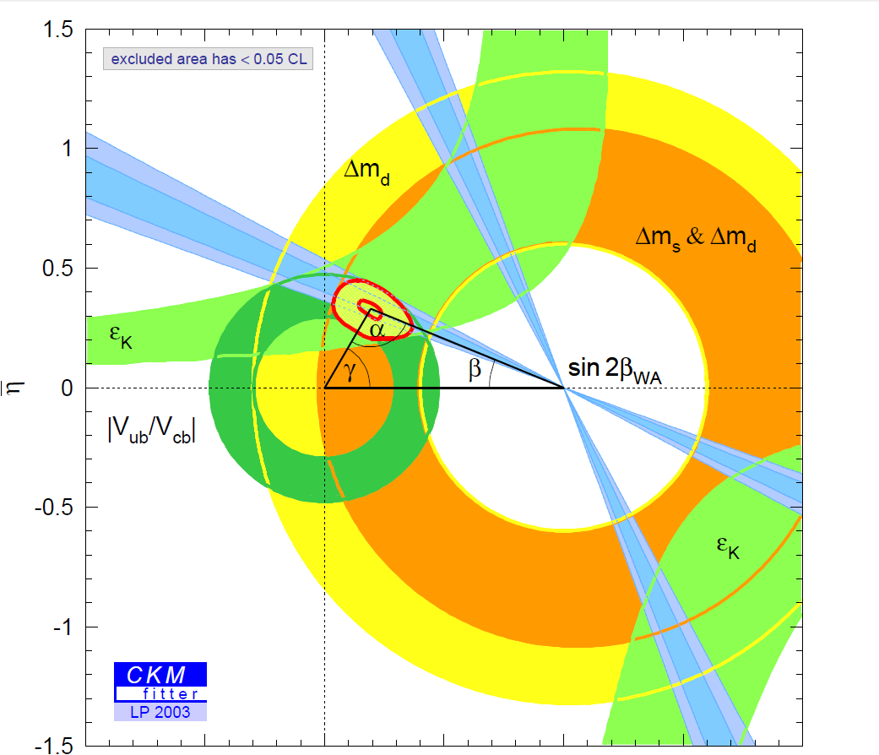
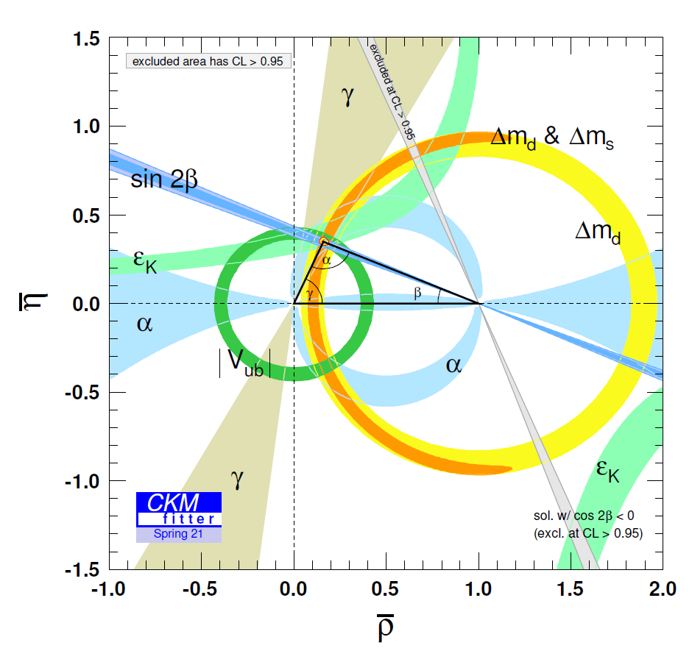
Main tasks of heavy flavor physics
Time-dependent CP violation in B meson decays, [Babar& Belle 2001]
Direct CP violation in B meson decays, [Babar& Belle 2004]
Direct CP violation in D meson decays, [LHCb 2019]
Study on CP violation
Precisely testing the standard model
Indirect search for new physics
Notes:
2

Slide 3








A multi-scale problem
NP scale
EW scale
Bottom mass scale
Charm mass scale
Hadronization scale
TeV or beyond
$$m_{W}$$
$m_{b}(m_{c})$
$\sqrt{m_{b}Λ}$, $m_{c}$
$$Λ$$
$ℋ_{eff}=\frac{G_{F}}{\sqrt{2}}\sum_{i}{C_{i}O_{i}}$+ $\sum_{i}{C_{i}^{′}O_{i}^{′}}$
Low energy QCD
HQET, SCET-II
$$ℒ_{NP}$$
$ℒ_{SM}$+ $ℒ_{D>4}$
SCET-I
$${〈f\left|ℋ_{eff}\right|B〉=𝒜}_{LP}+O\left(\frac{Λ}{m_{b}},\frac{Λ}{E_{f}}\right)$$
Perturbative：matching, resummation, evolution
Nonperturbative：Lattice QCD, sum rules, SU(3) symmetry, Quark model

Slide 4
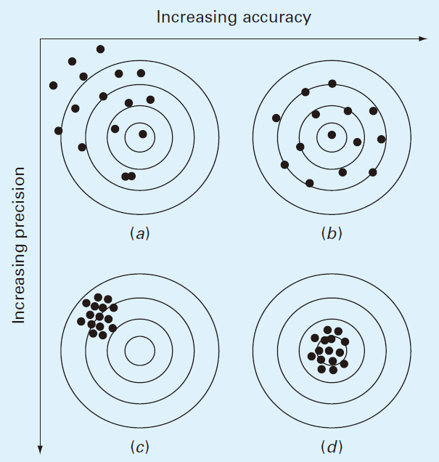
高精度 = High Accuracy + High Precision

Slide 5
Leptonic/Radiative Decays

Slide 6
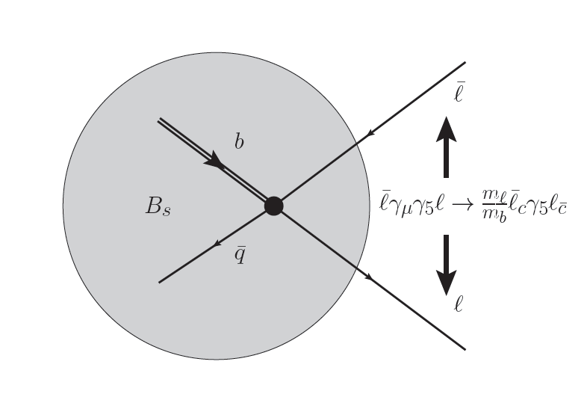



Leptonic B decays
$Γ\sim m_{l}^{2}$ $f_{B}^{2}|V_{ub}|^{2}$
$Γ\sim m_{l}^{2}$ $f_{B}^{2}|V_{tb}{V_{ts}|}^{2}$
Determination of | $V_{ub}$| and |$V_{tb}V_{ts}^{∗}$| largely unaffected by hadronic uncertainties
Helicity suppression: test of new scalar interactions
QCD matrix element is known with <1% accuracy
$f_{B}=\text{(}\text{189.4 ± 1.4}\text{)}$MeV
Structure dependent QED corrections are not negligible

Slide 7
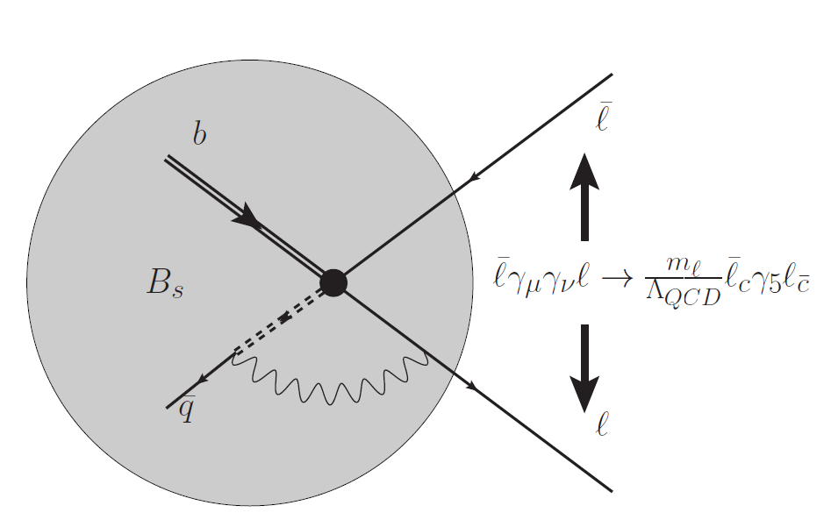
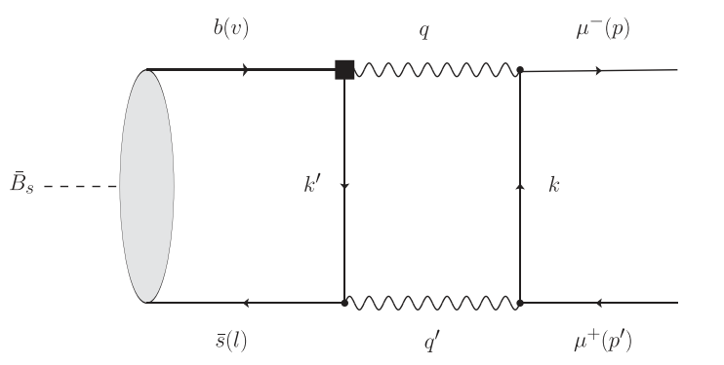

QED corrections in leptonic B decays
$$B_{(s)}→μ^{+} μ^{−}$$
[Beneke et al 2018]
Power enhancement +double Logarithmic enhancement in
Endpoint divergence in the contribution from $O_{7γ}$
[Beneke et al, 2018; Feldmann et al, 2023]
After resummation, the contribution is about 0.3%- 1.1%
[Beneke et al, 2019]
No power enhancement in $B→lν$ due to (V-A) structure of the current

Slide 8



QED corrections in leptonic B decays
$B_{q}→τ^{+}$ $τ^{−}$
[Huang, Shen, Zhao, Zhou, 2023]
Endpoint divergence disappears due to large tauon mass takes place in the jet function: A more rigorous factorization theorem
$$iA_{7}\sim \int{\frac{dω}{ω}φ\left(ω\right)\int{du\left(1−u\right)}\frac{J\left(u,ω\right)}{u}H\left(u\right)}$$
$$J\left(u,ω\right)=N\frac{1−u}{ω}ln \left(1+\frac{ωn_{+}p_{l}}{m_{τ}^{2}}\frac{u}{1−u}\right)$$
No logarithmic enhancement: about 0.04% reduction of LO

Slide 9
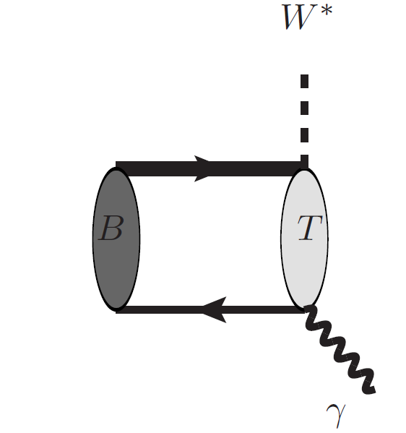



Radiative leptonic/double radiative B decays
$B_{q}→γνℓ, γγ,{γℓ^{+}ℓ^{−},γ}^{∗}γ^{∗}$
$$𝒜_{LP}∼{\frac{G_{F}}{\sqrt{2}}λ_{CKM}f}_{B}m_{B}C(m_{b},μ)\int_{0}^{∞}{\frac{dω}{ω}J\left(\sqrt{Eω},μ\right)}φ^{+}(ω,μ)$$
NNLO hard functions [Bonciani, etc., Asatrain etc., Beneke et al, 2008 ]
NNLO jet function: [Liu, Neubert, 2020].
NNLL resummation for $B_{q}→γνℓ$[ Galda, Nuebert, Wang, 2022].

Slide 10
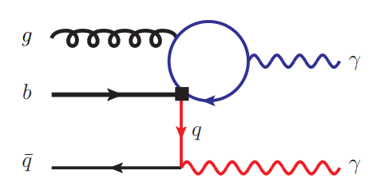


Radiative leptonic/double radiative B decays
Integrate out hard-collinear fields: nonlocal operator
[Qin, YLS, Wang, Wang, 2023]
${m_{c}^{2}≈m}_{b}Λ_{QCD}$:
Hard-collinear
A novel soft function with different light-cone direction
$$〈0|{(\overline{q}}_{s}S_{n})\left(τ_{1}n\right)S_{n}^{†}S_{\overline{n}}\left(0\right)S_{\overline{n}}^{†}{g_{s}G_{μν}S}_{\overline{n}}\left(τ_{2}\overline{n}\right){\overline{n}}^{ν}n⋅γγ_{⊥}^{μ}γ_{5}S_{\overline{n}}^{†}h_{v}(0)|{\overline{B}}_{v}〉$$
$$=2F_{B}\left(μ\right)m_{B}\int_{−∞}^{∞}{dω_{1}dω_{2} }e^{−i{(ω}_{1}τ_{1}+ω_{2}τ_{2})}Φ_{G}(ω_{1},ω_{2},μ)$$

Slide 11
Semi-Leptonic Decays and Form Factors

Slide 12


Heavy-to-light form factors
Semileptonic decays play an essential role in the determination of the CKM matrix elements
QCD/SCET factorization formulae for mesonic form factor[BBNS, BPRS, and many others].
$$F_{i,LP}^{B→M}\left(E\right)=C_{i}^{\left(A0\right)}\left(E\right)ζ_{a}\left(E\right)+\int_{0}^{∞}{\frac{dω}{ω}\int_{0}^{1}{du C_{i}^{\left(B1\right)}\left(E,u\right)J_{i}\left(E,ω\right)φ_{B}^{+}(ω)φ_{M}(u)}}$$
QCD/SCET factorization formulae for baryonic form factor [Wang, 2011].
$$F_{LP}^{Λ_{b}→Λ}\left(E\right)=\int_{0}^{∞}{dω_{1}dω_{2}\int_{0}^{1}{du {dvC}_{i}^{\left(A0\right)}\left(E,u,v\right)J_{i}\left(E,ω_{i}\right)ψ_{Λ_{b}}^{(2)}(ω_{1},ω_{2})ψ_{Λ }^{(3)}(u, v)}}$$
Leading power contribution; but numerically suppressed: dominated by NLP
Lattice simulation: direct calculation of the QCD form factors
Works well at small recoil region, and needs to be extrapolated to the whole physical region

Slide 13
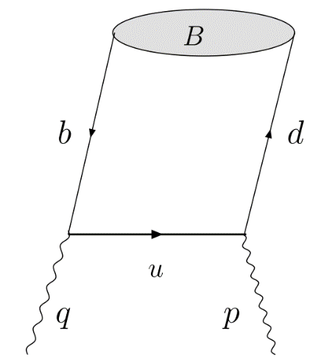


LCSR for the heavy-to-light form factors
LCSR is a QCD inspired method for the large recoil region of the heavy-to-light form factors.
The correlation function
$$〈0\left|T\left\{J_{weak} \left(0\right), J_{B}\left(x\right)\right\}\right|\overline{B}\left(P\right)〉$$
B-meson LCSR(SCET sum rules).
or
$$〈\overline{M}\left(P\right)\left|T\left\{J_{weak} \left(0\right), J_{M}\left(x\right)\right\}\right|0〉$$
Light meson LCSR
Quark level OPE
Quark hadron duality
Hardon level: parameterization
The correlation function can be calculated with standard QCD factorization technique.
$B→π/K$ form factors [Cui, Huang, YLS, Wang, Wang, 2022]
$B→D$ form factors [Gao, Huber, Ji, Wang, Wang, Wei, 2022]
$B→D(D^{∗})$ form factors [Cui, huang, Wang, Zhao, 2023]

Slide 14
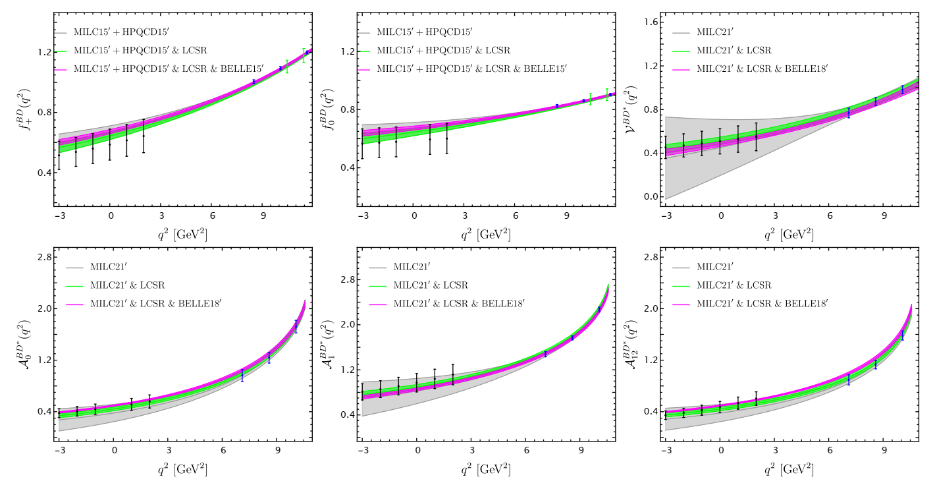
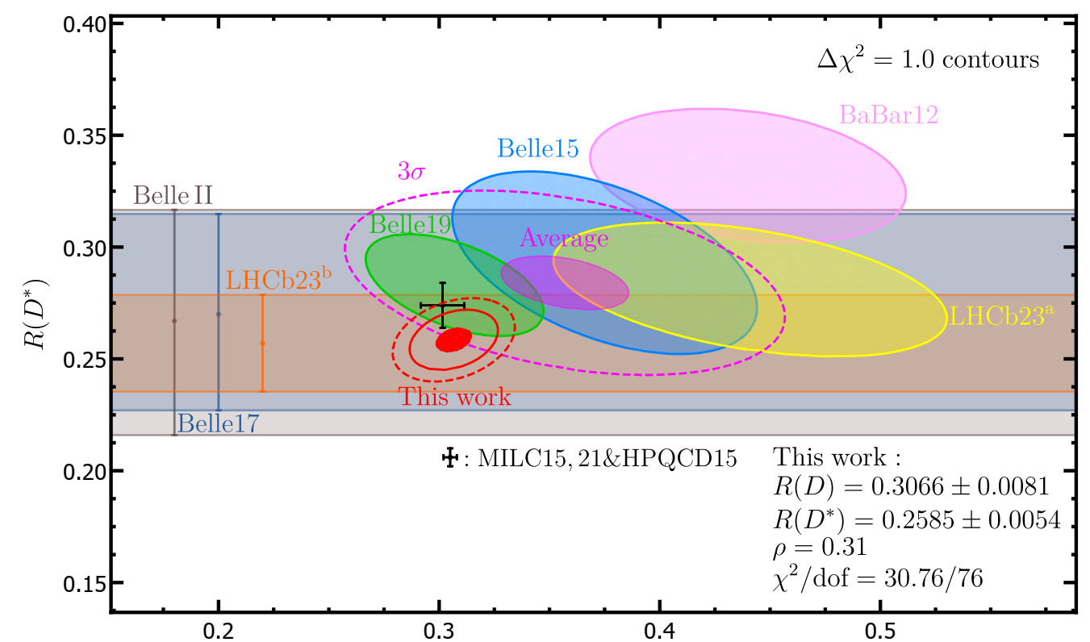





The ${B→D(D}^{∗})$ form factors
$R\left(D\right)/R\left(D^{∗}\right)$ Anormals：about 3.3 $σ$
$$R\left(D\right)=\frac{Br(B→Dτν_{τ})}{Br\left(B→Dℓν_{ℓ}\right)}$$
$$R\left(D^{∗}\right)=\frac{Br(B→D^{∗}τν_{τ})}{Br\left(B→D^{∗}ℓν_{ℓ}\right)}$$
An improved study on the ${B→D(D}^{∗})$ form factors: NLO corrections + power corrections
[Cui, huang, Wang, Zhao, 2023]
Combined analysis of Lattice simulation and LCSR
The updated prediction on $R\left(D\right)/R\left(D^{∗}\right)$

Slide 15
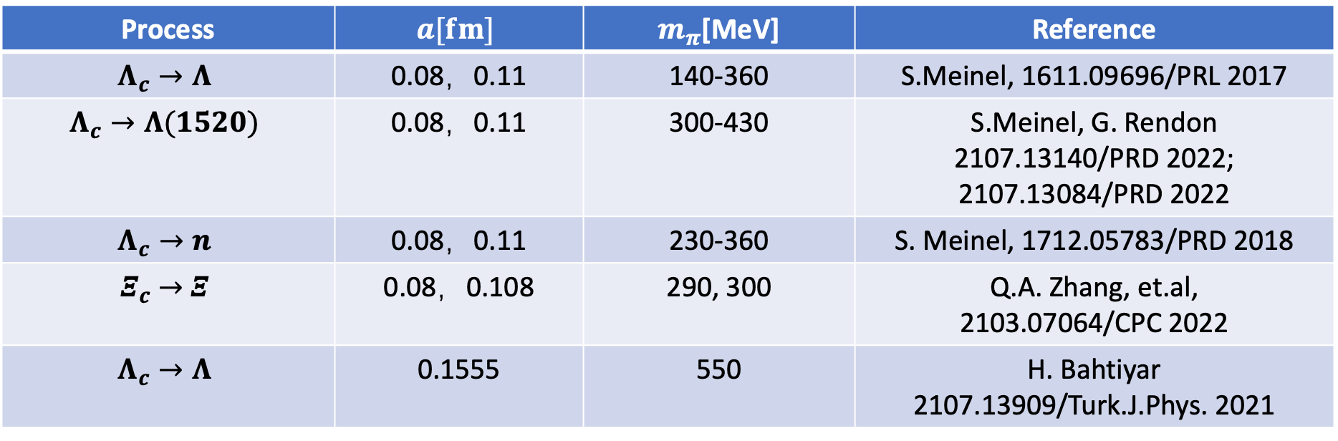
Form factors on Lattice QCD
Process | $$a[fm]$$ | $m_{π}$[MeV] | Reference
$$Λ_{c}→Λ$$ | 0.08，0.11 | 140-360 | S.Meinel, 1611.09696/PRL 2017
$$Λ_{c}→Λ(1520)$$ | 0.08，0.11 | 300-430 | S.Meinel, G. Rendon 2107.13140/PRD 2022; 2107.13084/PRD 2022
$$Λ_{c}→n$$ | 0.08，0.11 | 230-360 | S. Meinel, 1712.05783/PRD 2018
$Ξ_{c}$ $→$ $Ξ$ | 0.08，0.108 | 290, 300 | Q.A. Zhang, et.al, 2103.07064/CPC 2022
$$Λ_{c}→Λ$$ | 0.1555 | 550 | H. Bahtiyar 2107.13909/Turk.J.Phys. 2021
Notes:
15

Slide 16
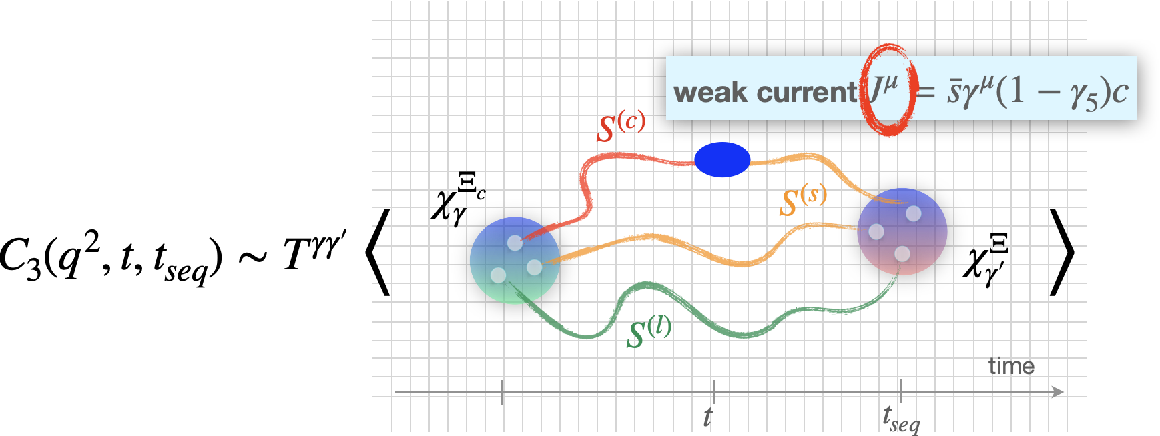
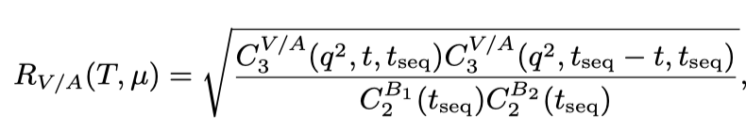
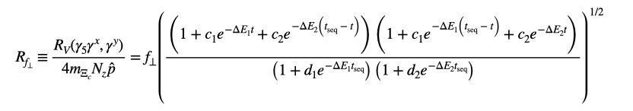

Form factors on Lattice QCD
$Ξ_{c}$ $→$ $Ξ$form factor
Q.A. Zhang, et.al,
2103.07064/CPC 2022
Notes:
16

Slide 17
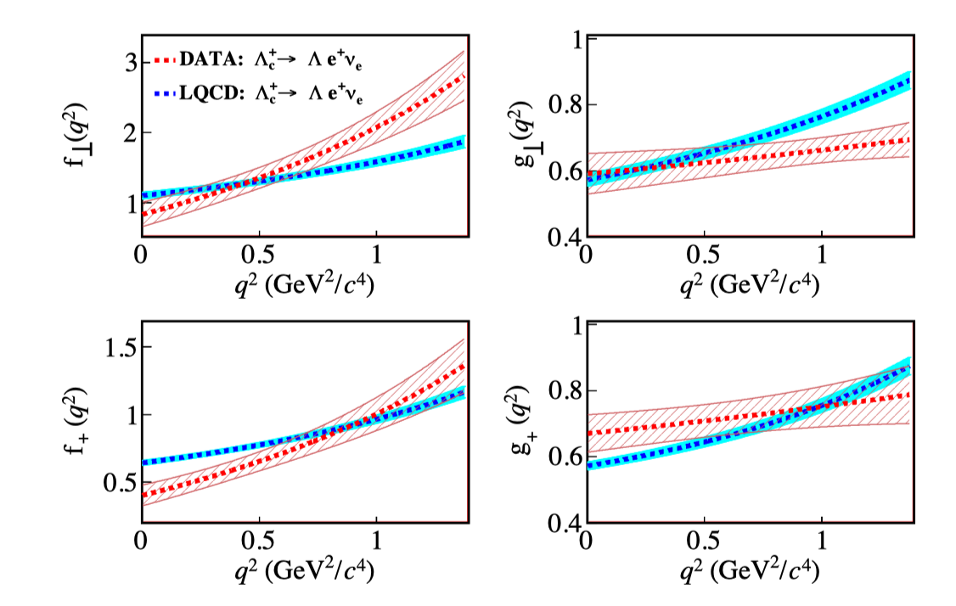
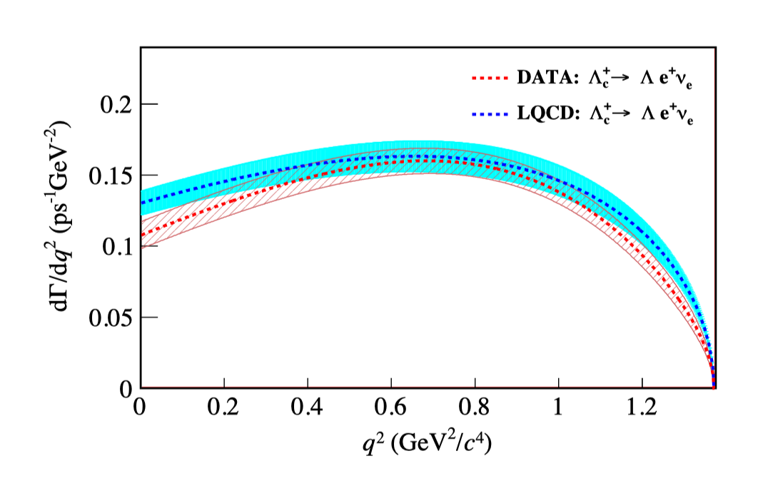

Form factors on Lattice QCD
17
$Λ_{c}→Λ$
no clear difference is observed within uncertainties for the resulting differential decay rate
the dependences of measured FFs show different kinematic behavior compared to those predicted from LQCD calculations.
BESIII: 2207.14149
LQCD: S. Meinel, PRL118, 082001 (2017)

Slide 18
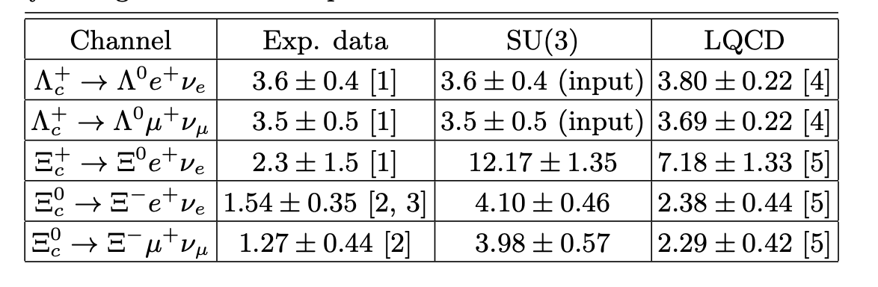

Form factors on Lattice QCD
18
$Λ_{c}→Λ$
$Ξ_{c}$ and large SU(3) breaking
1. PDG/PTEP 083C01 2020
2. Belle, 2103.06496/PRL 2021
3. ALICE, 2105.05187/PRL 2021
4. S. Meinel, 1611.09696/PRL 2017
5. Q.A.Zhang, et.al., 2103.07064/CPC 2022
F. Huang, et.al, 2110.04179/PLB 2021

Slide 19
Nonleptonic Decays

Slide 20
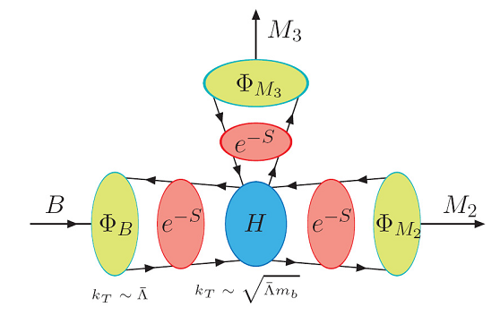
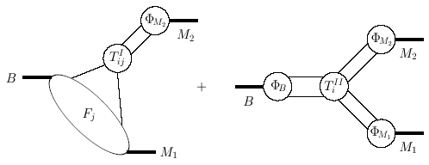
Factorization
20
A ~ ∫d⁴k₁ d⁴k₂ d⁴k₃ Tr [ C(t) Φ_{B}(k₁) Φ₁(k₂) Φ₂(k₃) H(k₁,k₂,k₃,t) ] exp{–S(t)}

Slide 21
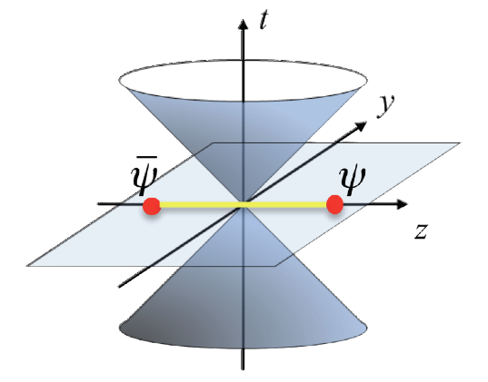
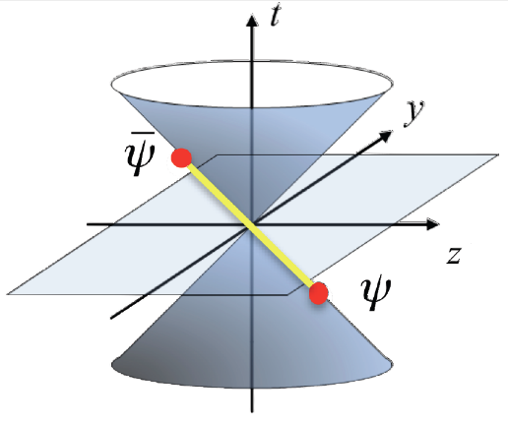
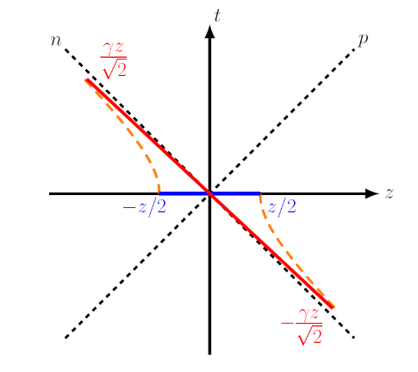
LaMET
21
21
Large momentum effective theory [Ji, 2013]
match
Boost

Slide 22
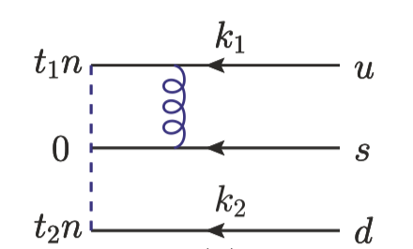
LCDA and TMDWFs
22
精确度待提升
PRL 129, 132001 (2022)
PRL 127, 062002 (2021)
尚未实现格点计算
arXiv: 2302.09961
JHEP 07 (2023) 191; JHEP 12 (2023) 044

Slide 23

B meson LCDA
23
[Grozin, Nuebert, 1997]
Leading twist B meson DA
$$\left\langle 0\left|{\overline{q}}_{β}\left(z\right)\left[z,0\right]h_{vα}\left(0\right)\right|\overline{B}\left(v\right)\right\rangle =−\frac{i}{4}F_{B}m_{B}{\left[\frac{1+v⋅γ}{2}\left\{2{\tilde{φ}}^{+}\left(t,μ\right)+\frac{{\tilde{φ}}^{−}\left(t,μ\right)−{\tilde{φ}}^{+}\left(t,μ\right)}{2}z⋅γ\right\}γ_{5}\right]}_{αβ}$$
[Lange, Nuebert, 2003]
RGE: Lange-Neubert equation
$μ\frac{d}{dμ}φ^{+}(ω,μ)=−\left[Γ_{cusp}\left(α_{s}\right)ln\frac{ω}{μ}+γ_{+}(α_{s})\right]$ $φ^{+}\left(ω,μ\right)−ω\int_{0}^{∞}{dηΓ_{+}(ω, η, α_{s})φ^{+}\left(η,μ\right)}$
The evolution equation at two loops: [Braun, Ji, Manashov, 2019]
Solution to the LN equation: dual space: [Bell, Feldmann, Wang, Yip, 2013]:
Solution to the evolution equation @ two loop level [Galda, Neubert, 2020]

Slide 24
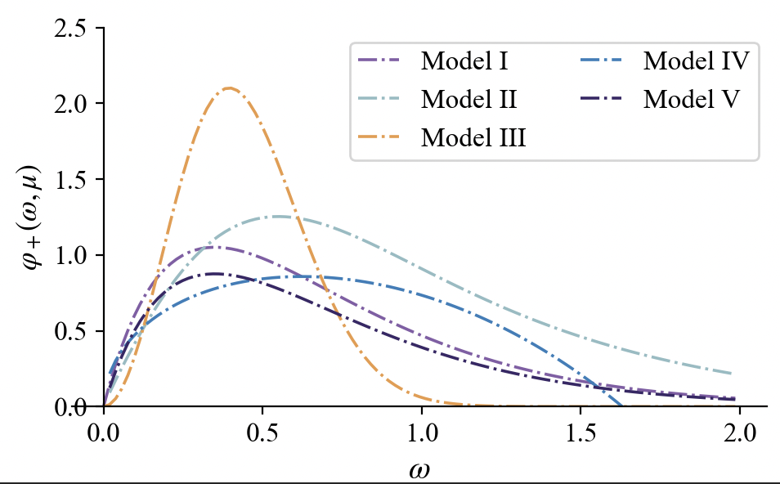
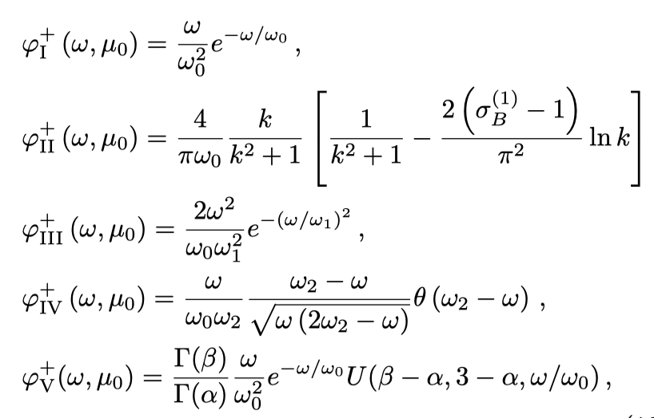
B meson LCDA
24
[Lange, Nuebert, 2003]

Slide 25
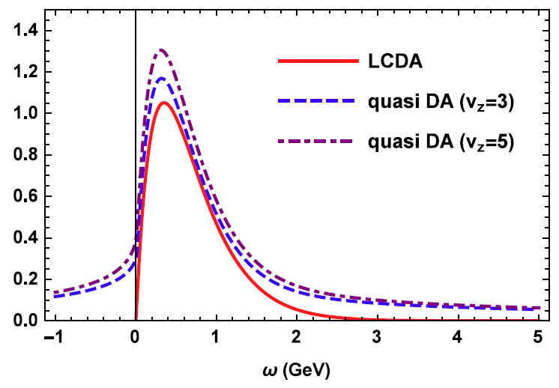

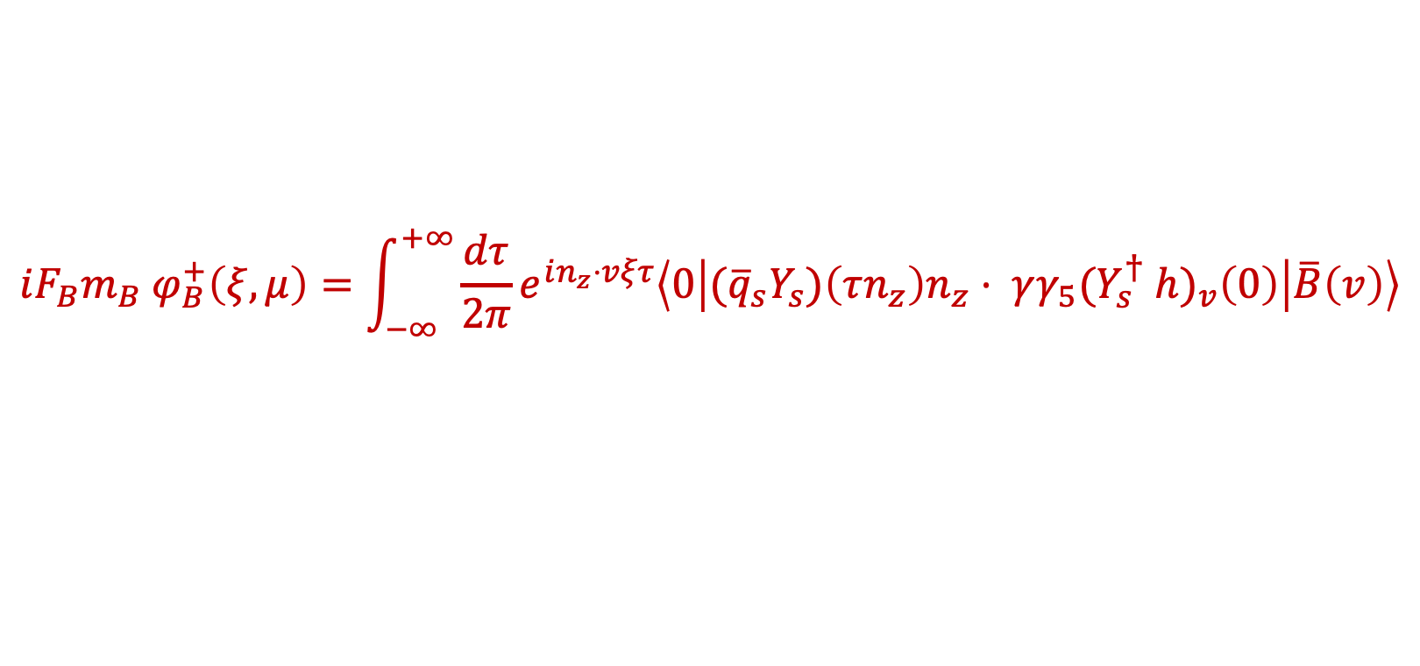
Quasi-DA of B meson
25
Quasi-DA of leading twist B meson
[Wang, Wang, Xu, Zhao 2019]
$$iF_{B}m_{B} φ_{B}^{+}\left(ξ,μ\right)=\int_{−∞}^{+∞}{\frac{dτ}{2π}}e^{in_{z}⋅vξτ}\left\langle 0\left|{(\overline{q}}_{s}Y_{s})\left(τn_{z}\right)n_{z}⋅ γγ_{5}{(Y}_{s}^{†} {h)}_{v}\left(0\right)\right|\overline{B}\left(v\right)\right\rangle$$
The matching
$$φ_{B}^{+}\left(ξ,μ\right)=\int_{0}^{+∞}{dωH(ξ,ω,n_{z}⋅v,μ)}φ_{B}^{+}\left(ω,μ\right)+O\left(\frac{Λ}{n_{z}⋅vξ}\right)$$
The inverse moment of Quasi-DA of leading twist B meson
The Quasi-DA of subleading twist B meson
Problem: simulation of HQET heavy quark field on Lattice

Slide 26
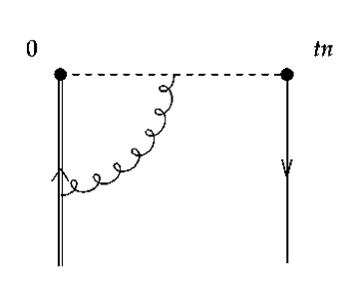
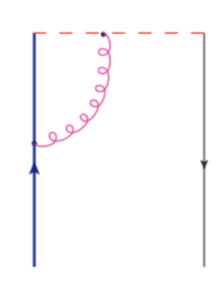
Quasi DA with LaMET Spirit
26
LaMET: lightcone can be accessed by simulating correlation functions with a large but finite P^{z}
HQET fields can be accessed by simulating correlation functions with a large but finite mQ

Slide 27






A Two-step matching method
27
Quasi DA
LCDA in QCD
LCDA in HQET
LaMET
bHQET
[2305.06401]
A multi-scale ($Λ_{QCD}, m_{H}, P^{z}$) processes:
LaMET requires $Λ_{QCD}, m_{H}≪P^{z}$ and finally integrate out $P^{z}$;
bHQET requires $Λ_{QCD}≪m_{H}$ and integrate out $m_{H}$;
$⇒$ Hierarchy $Λ_{QCD}≪m_{H}≪P^{z}$.
A big challenge for lattice simulation:
$Λ_{QCD}$~ hundreds MeV <<
$$m_{H}$$
<< $P^{z}$ can achieve 4~5GeV currently
1 GeV
$m_{D}$ $⋯⋯$ ${1.6m}_{D}$
5 GeV
$$m_{B}$$
The heavy meson could be chosen as $D$
Notes:
27

Slide 28
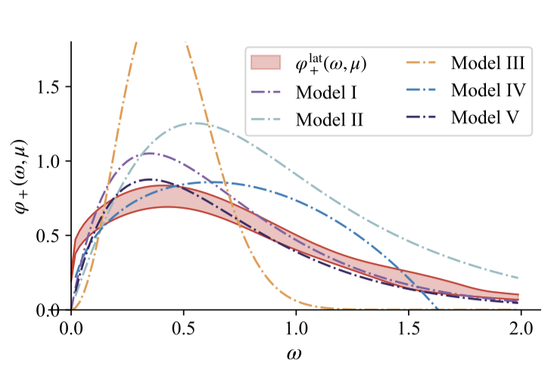
A Two-step matching method
28
[2305.06401]

Slide 29

A Two-step matching method: Future plan
29
Mid - term
More $m_{H}$ and Mass evolution
Power corrections: structure, renormalon?
Operator mixing
Possible systematic uncertainties; ……
Long-term goals (for the future):
Smaller lattice spacing (0.01fm), larger momentum;
More ensembles, continuum and physical mass extrapolation;
More quantities in lattice calculation; ……
Notes:
29

Slide 30
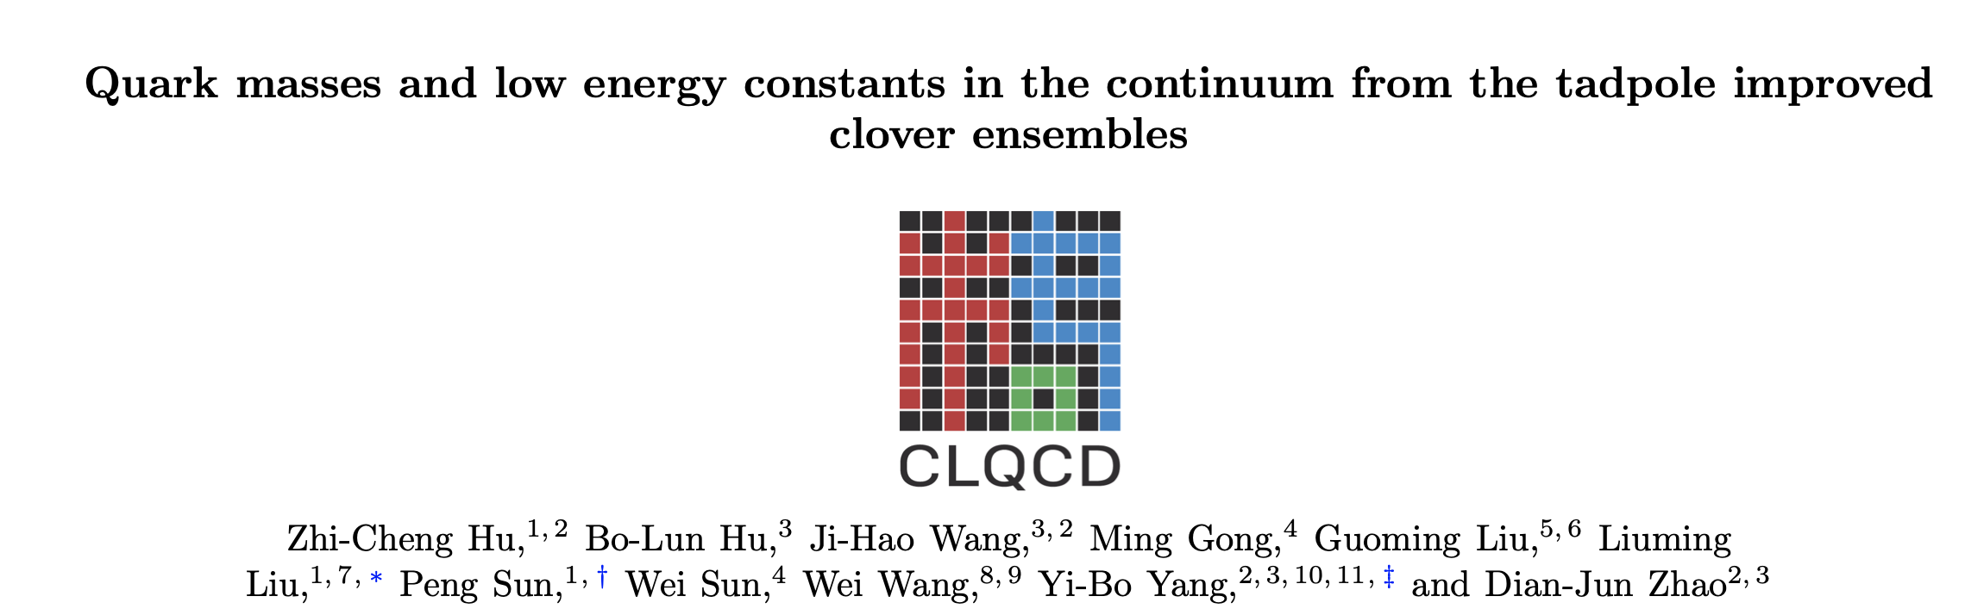
New Lattice QCD configurations
30

Slide 31
Summary
More precise theoretical predictions on the observables in heavy hadron decays are required to accurately test of the SM and search for new physics signals
QCD/QED corrections have been and are now being performed to high order, and higher powers
The determination of the nonperturbative input is essential to improve the theoretical accuracy.

