Slide 1
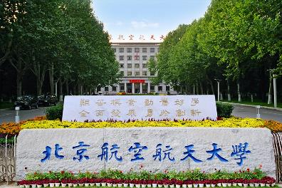
第六届重味物理与量子色动力学研讨会，青岛，2024.04.19-04.22
Introduction to the new probe into the nature of hadronic molecules – Femtoscopy
Li-Sheng Geng（耿立升）@ Beihang U.
PRD 107(2023)074019, Zhi-Wei Liu, Jun-Xu Lu, LSG*
PRD 108(2023)L031503, Zhi-Wei Liu, Jun-Xu Lu, Ming-Zhu Liu, LSG*
To appear online, Zhi-Wei Liu, Jun-Xu Lu, Ming-Zhu Liu, LSG*
arXiv 2404.06399, Ming-Zhu Liu, Ya-Wen Pan, Zhi-Wei Liu, Tian-Wei Wu, Jun-Xu Lu, LSG*

Slide 2
Contents
Brief introduction
Femtoscopic correlation functions (CFs)—general features
Recent applications
$DK$ CFs for $D_{s0}^{∗}(2317)$
$Σ_{c}{\overline{D}}^{∗}$ CFs for $P_{c}(4440)$ and $P_{c}(4457)$
$D{\overline{D}}^{∗}$ and $D{\overline{D}}_{s}^{∗}$ CFs for $Z_{c}(3900)$ and $Z_{cs}(3985)$
Summary and outlook

Slide 3
2003—the beginning of a new era
$$Θ^{+} (1540)$$
𝜣^+ (𝟏𝟓𝟒𝟎)
$$D_{s0}^{∗}(2317)$$
𝑫_𝒔𝟎^∗ (𝟐𝟑𝟏𝟕)
$$X(3872)$$
X(𝟑𝟖𝟕𝟐)
Belle, 0309032
> 1800
BaBar, 0304021
> 900
LEPS, 0301020
> 1100

Slide 4
Many more exotic mesons or baryons discovered
$$X_{0}(2866)$$
$$X_{1}(2904)$$
$D_{s1}$(2460)
$$\text{X}\text{(4160)}$$
$$\text{Y}\text{(4220)}$$
$Z_{c}$(4100)
$$\text{Y}\text{(4660)}$$
$Z_{c}$(4020)
$$P_{c}(4380)$$
$Ξ$(1620)
$$X(6900)$$
$D_{s0}$(2317)
$$\text{Y}\text{(4260)}$$
$$\text{X}\text{(3915)}$$
$$\text{X}\text{(4274)}$$
$Z_{c}$(3900)
$$P_{c}(4450)$$
$$\text{Y}\text{(4390)}$$
$$X(7200)$$
$$\text{Y}\text{(4500)}$$
$$\text{Y}\text{(4360)}$$
$Ω$(2012)
$$P_{cs}(4459)$$
$$P_{c}(4337)$$
2003
2005
2006
2007
2009
2011
2013
2014
2015
2016
2018
2019
2020
2021
2022
$$\text{X}\text{(3960)}$$
$$\text{X}\text{(3872)}$$
$Z_{c}$(4430)
$X$(4140)
$Z_{c}$(4200)
$$P_{c}(4457)$$
$Z_{cs}$(3985)
$$P_{cs}(4338)$$
$$\text{X}\text{(5568)}$$
$$P_{c}(4440)$$
$$T_{cs}(2900)$$
$Y$(3940)
$$P_{c}(4312)$$
$T_{cc}$(3875)
$Z_{b}$(10610)
$Z_{b}$(10650)
$Λ_{c}$(2940)

Slide 5
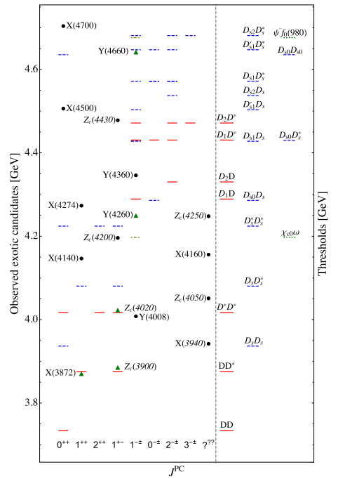
Many (if not all) of them close to thresholds—molecules
Feng-Kun Guo, Christoph Hanhart,
Ulf-G. Meißner, Qian Wang,
Qiang Zhao, Bing-Song Zou. Rev.Mod.Phys. 90 (2018) 015004.
Hua-Xing Chen, Wei Chen, Xiang Liu and Shi-Lin Zhu,The hidden-charm pentaquark and tetraquark states,Phys. Rept.639 (2016) 1
If this is the case, the most important work is to understand the (residual) strong interaction between the constituents (of the molecular states)

Slide 6
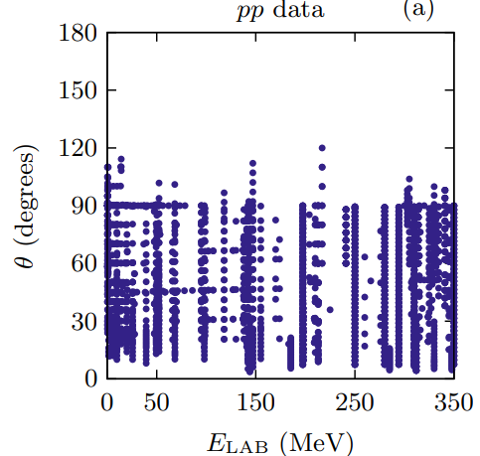
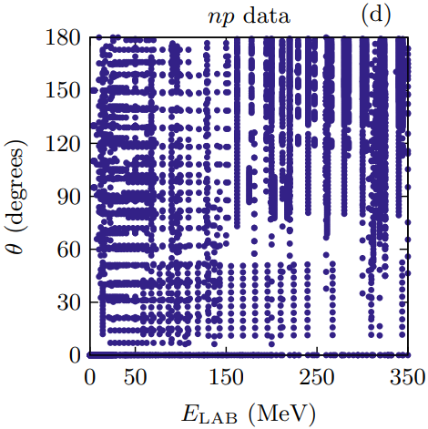
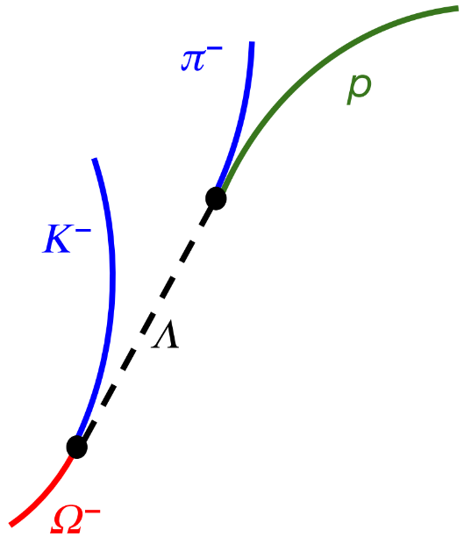
Scattering exp. for stable & unstable particle pairs
For stable hadrons, scattering experiments are extremely valuable in extracting their interactions
There exist
abundant data for
nucleon-nucleon scattering (8125)
Phys.Rev.C 89 (2014) 064006
For unstable particles, scattering experiments are difficult or impossible!

Slide 7
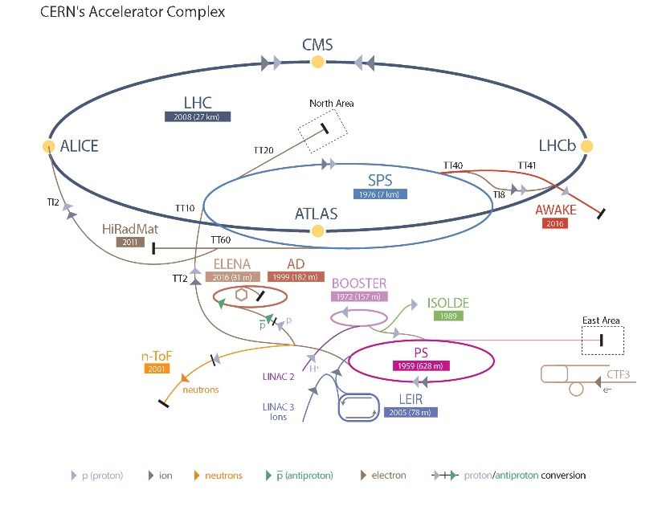
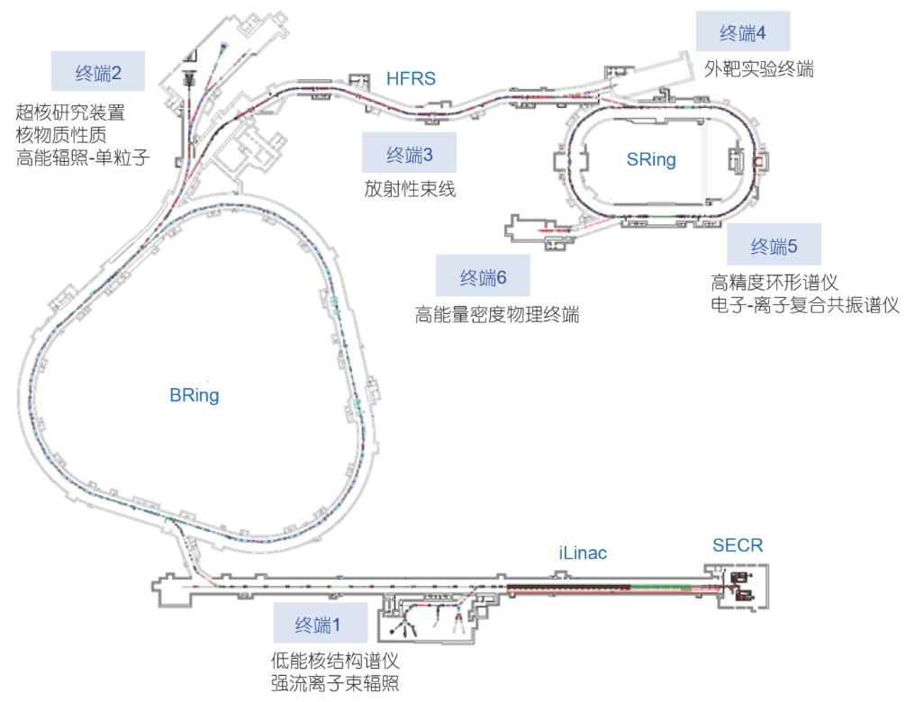
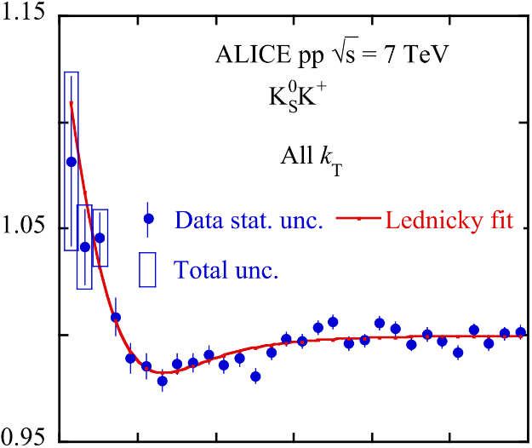
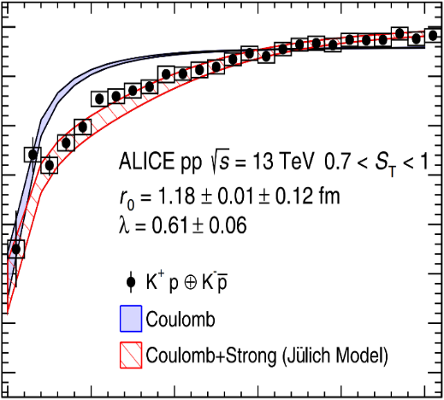
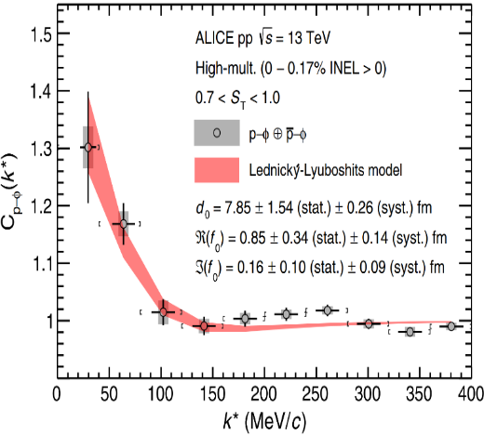
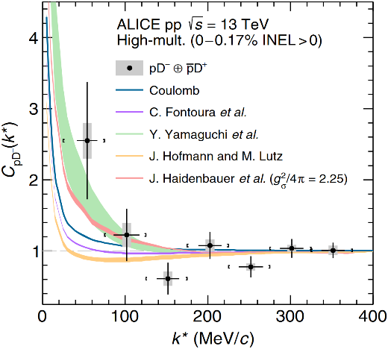
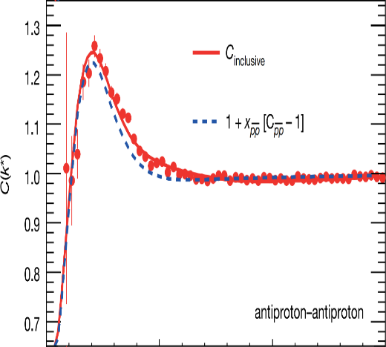
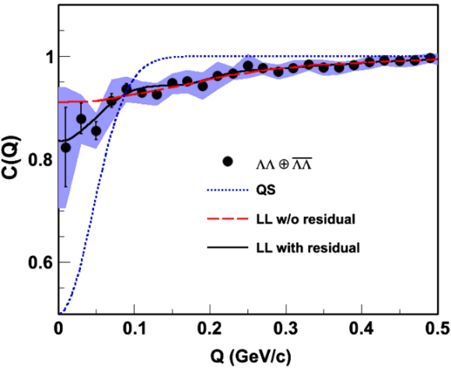
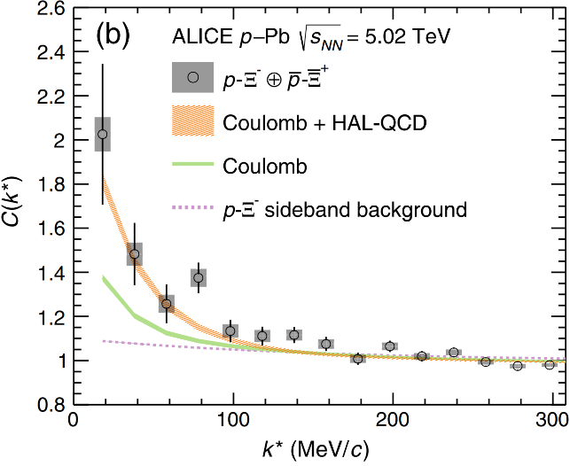
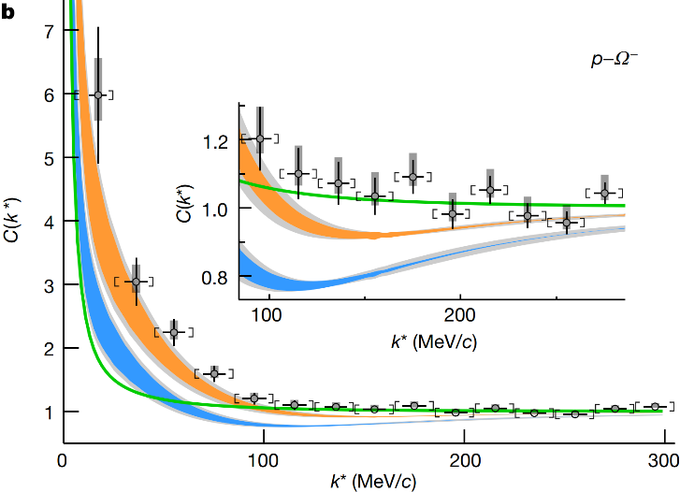
New probe—femtoscopic correlation functions
Large Hadron Collider
$$K_{S}^{0}K^{±}$$
$$p+p, \sqrt{s}=7 TeV$$
$$K^{±}p$$
$$p+p, \sqrt{s}=5,7,13 TeV$$
$$φp$$
$$p+p, \sqrt{s}=13 TeV$$
$$D^{−}p$$
$$p+p, \sqrt{s}=13 TeV$$
$$\overline{p }\overline{p }$$
$$Au+Au, \sqrt{s}=200 MeV$$
$$\text{ΛΛ}$$
$$Au+Au, \sqrt{s}=200 MeV$$
$${\text{X}}^{−}p$$
$$p+Pb, \sqrt{s}=5.02 TeV$$
$$^{−}p$$
$$p+p, \sqrt{s}=13 TeV$$
ALICE Collaboration, Phys. Lett. B 790 (2019) 22
STAR Collaboration, Nature 527 (2015) 345
ALICE Collaboration, Phys. Rev. Lett. 124 (2020) 092301
STAR Collaboration, Phys. Rev. Lett. 114 (2015) 022301
ALICE Collaboration, Phys. Rev. Lett. 127 (2021) 172301
ALICE Collaboration, Phys. Rev. Lett. 123 (2019) 112002
ALICE Collaboration, Phys. Rev. D 106 (2022) 052010
ALICE Collaboration, Nature 588 (2020) 232

Slide 8
Contents
Brief introduction
Femtoscopic correlation functions (CFs)—general features
Recent applications
$DK$ CFs for $D_{s0}^{∗}(2317)$
$Σ_{c}{\overline{D}}^{∗}$ CFs for $P_{c}(4440)$ and $P_{c}(4457)$
$D{\overline{D}}^{∗}$ and $D{\overline{D}}_{s}^{∗}$ CFs for $Z_{c}(3900)$ and $Z_{cs}(3985)$
Summary and outlook

Slide 9
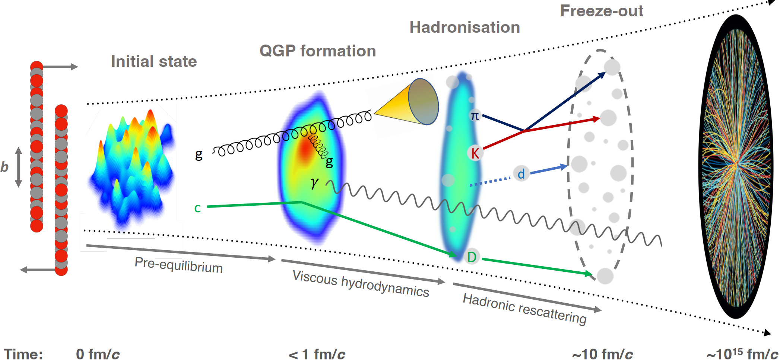
Abundant particles produced in AA, pA, and pp collisions
Final-State Interaction

Slide 10
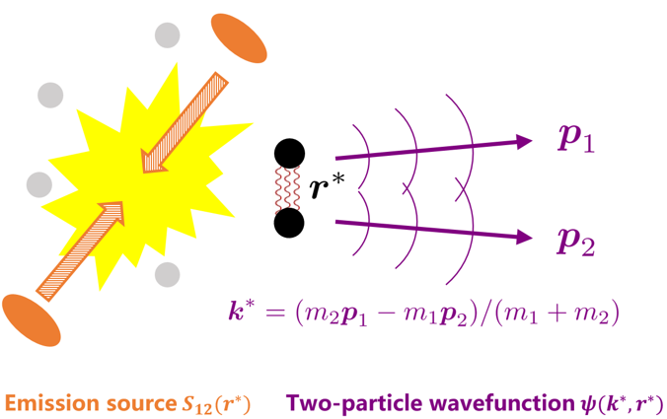
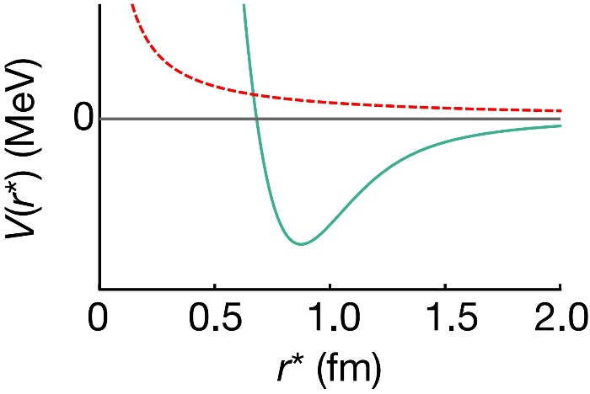
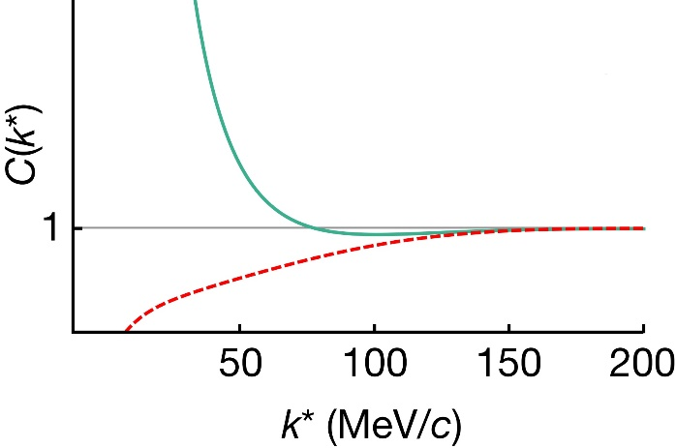
Femtoscopic correlation functions (CFs)
Interacting potential
Correlation function
repulsive
attractive
attractive
repulsive
Schrödinger equation
Two-particle wavefunction$ψ(k^{∗}, r^{∗})$
Theo. description
Koonin–Pratt formula
Exp. measurement
mixed-event technique
>1 if the interaction is attractive
=1 if there is no interaction
<1 if the interaction is repulsive
final-state interactions
quantum statistics effects
coupled-channel effects
the same and mixed event distributions the corrections for experimental effects
spacial structure

Slide 11
Femtoscopic correlation functions (CFs)
S. E. Koonin, Phys. Lett. B 70 (1) (1977) 43
A. Ohnishi, Nucl. Phys. A 954 (2016) 294
Koonin–Pratt (KP) formula
Common static and spherical Gaussian source
Correlation function (consider only correlations in S-waves)
Scattering wave function
Solving the Schrödinger equation in coordinate space
Solving the Lippmann-Schwinger scattering equation in momentum space

Slide 12
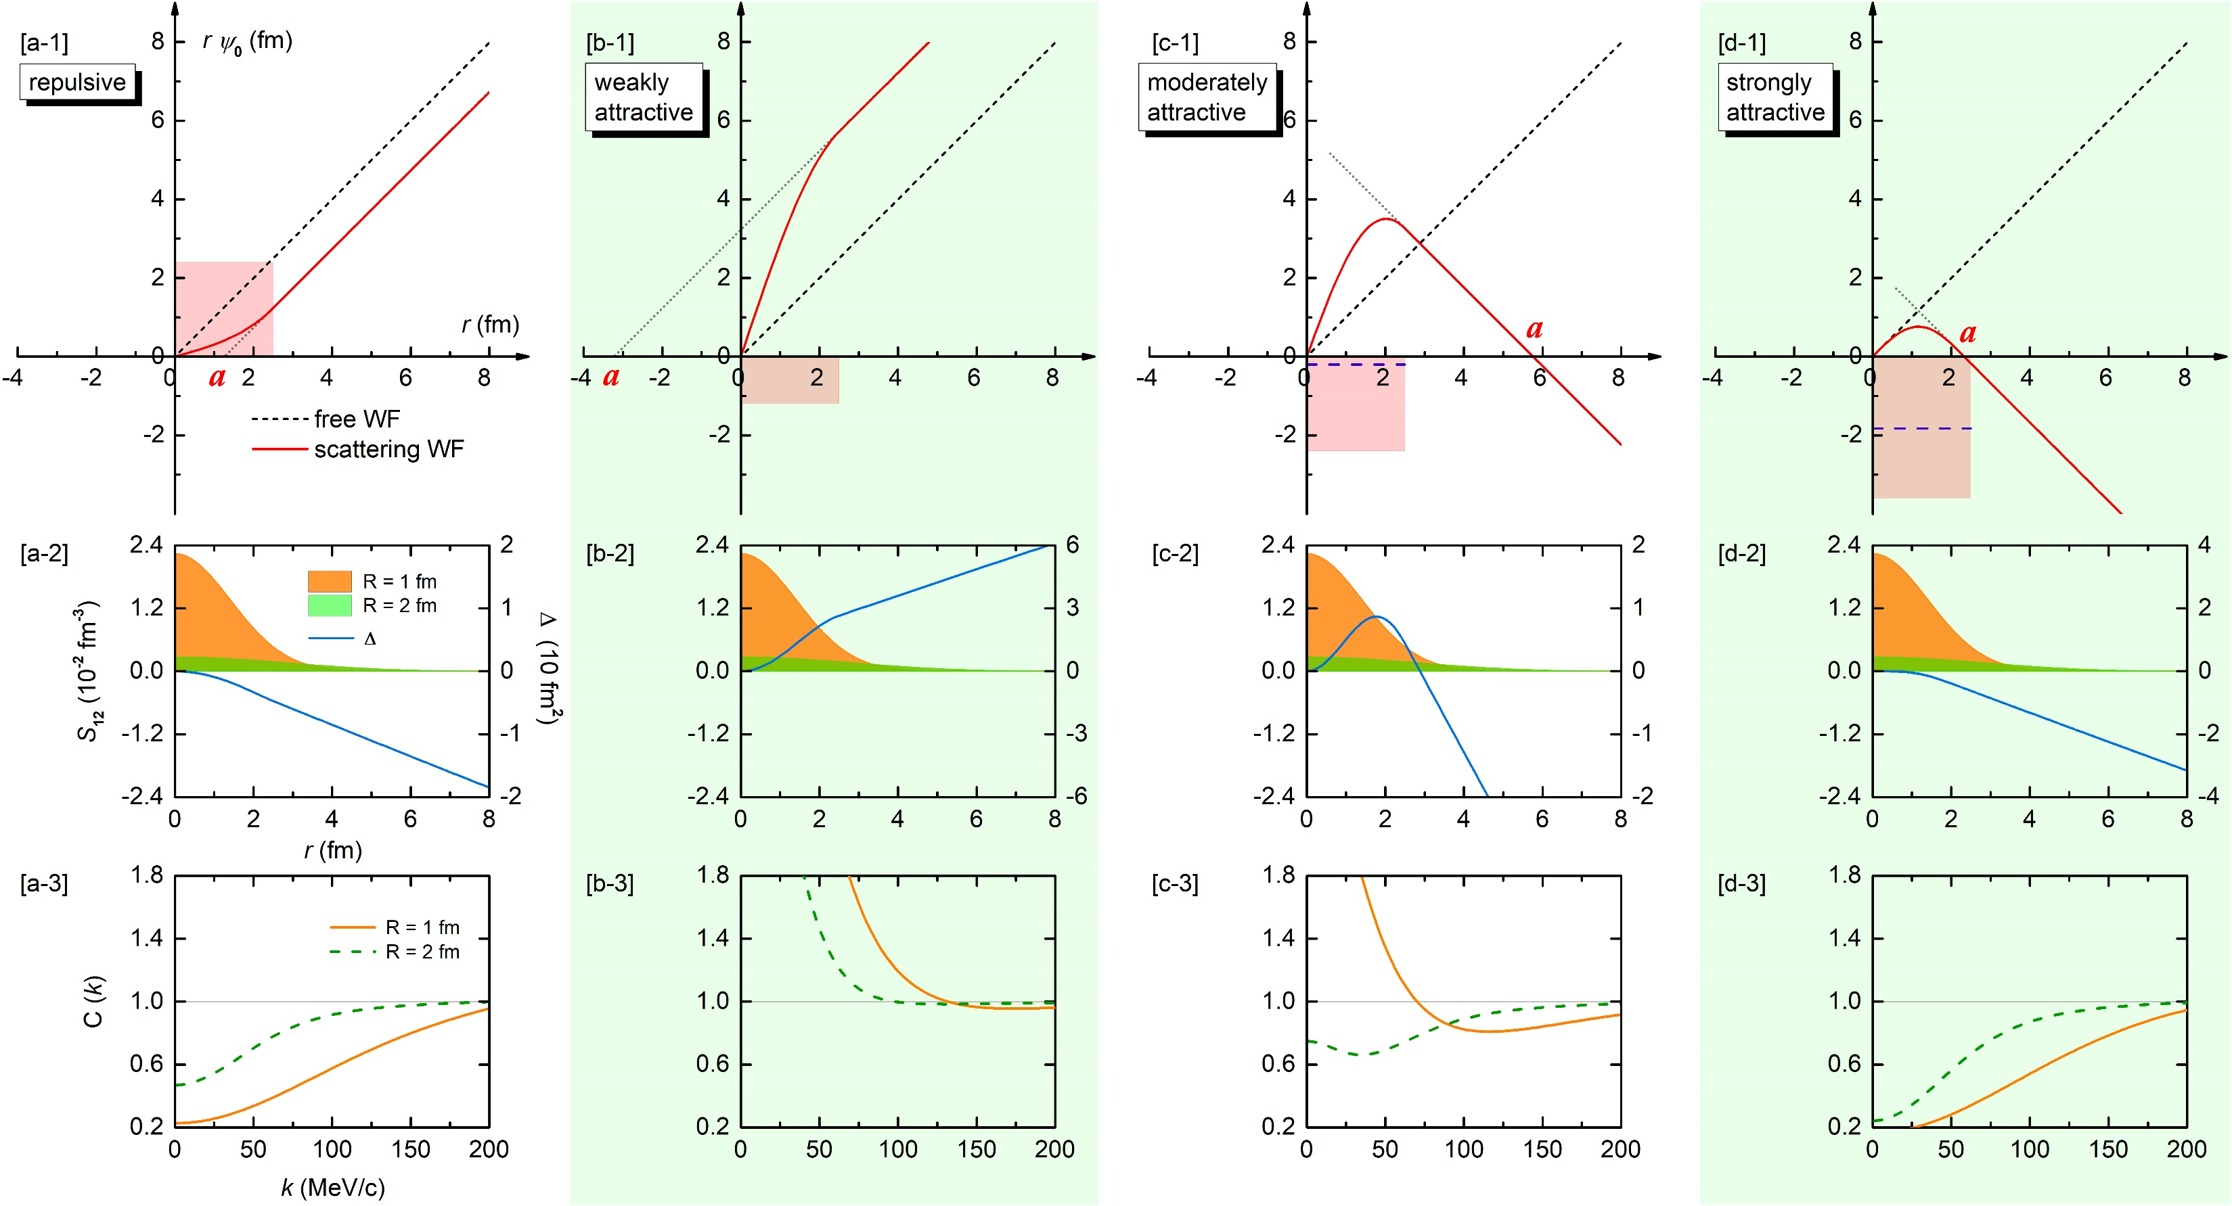
CFs in the presence of bound states
Zhi-Wei Liu, Jun-Xu Lu and LSG*, PRD 107, 074019 (2023)
Notes:
color online) Scattering wave functions, source functions, and correlation functions for the four different square-well potentials, namely, (a) a repulsive potential, (b) a weakly attractive potential, (c) a moderately attractive potential, and (d) a strongly attractive potential.Panels (a1–d1): the product of the relative distance r and the S-channel wave function ψ0 as a function of r in the low-momentum region. The black short-dashed line denotes the free-wave result, while the red solid line denotes the scattering-wave result. The light red region depicts the square-well potential. Panels (a2–d2): Gaussian source function S12 as a function of r. The results are calculated with a source size R = 1 fm (dark orange region) and R = 2 fm (light green region). In the same plot, the difference between the free and scattering wave functions squared ∆ ≡ r 2 (|ψl=0| 2 − |jl=0| 2 ) in Eq. (7) is also shown as the blue solid line. Panels (a3–d3): Correlation function as a function of the relative momentum k. The orange solid line and the green dashed line denote the results obtained with R = 1 fm and R = 2 fm, respectively.

Slide 13
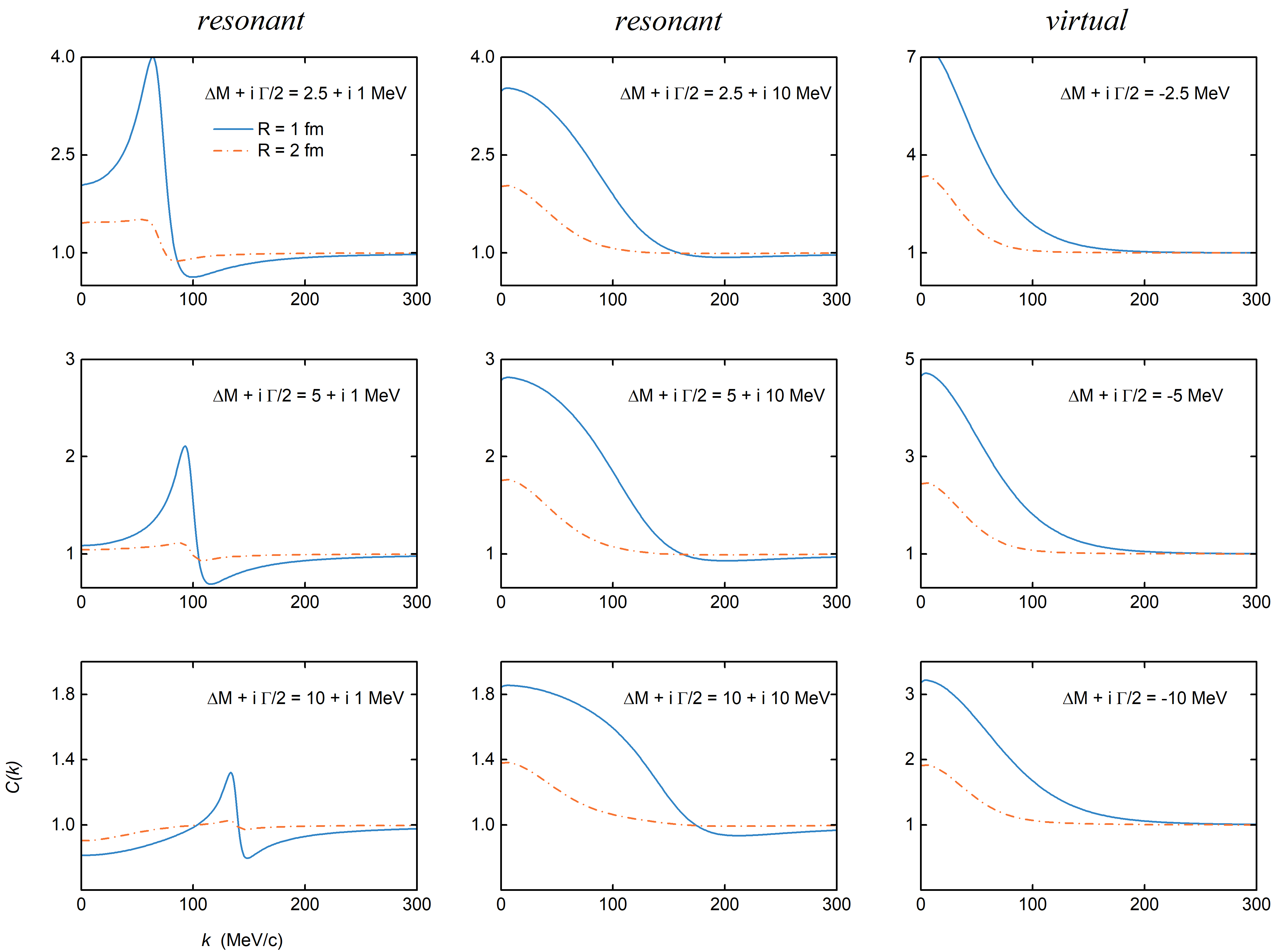
CFs in the presence of resonant and virtual states
In preparation, Zhi-Wei Liu, Ming-Zhu Liu, Jun-Xu Lu and LSG*
narrow
broad

Slide 14
Contents
Brief introduction
Femtoscopic correlation functions (CFs)—general features
Recent applications
$DK$ CFs for $D_{s0}^{∗}(2317)$
$Σ_{c}{\overline{D}}^{∗}$ CFs for $P_{c}(4440)$ and $P_{c}(4457)$
$D{\overline{D}}^{∗}$ and $D{\overline{D}}_{s}^{∗}$ CFs for $Z_{c}(3900)$ and $Z_{cs}(3985)$
Summary and outlook

Slide 15
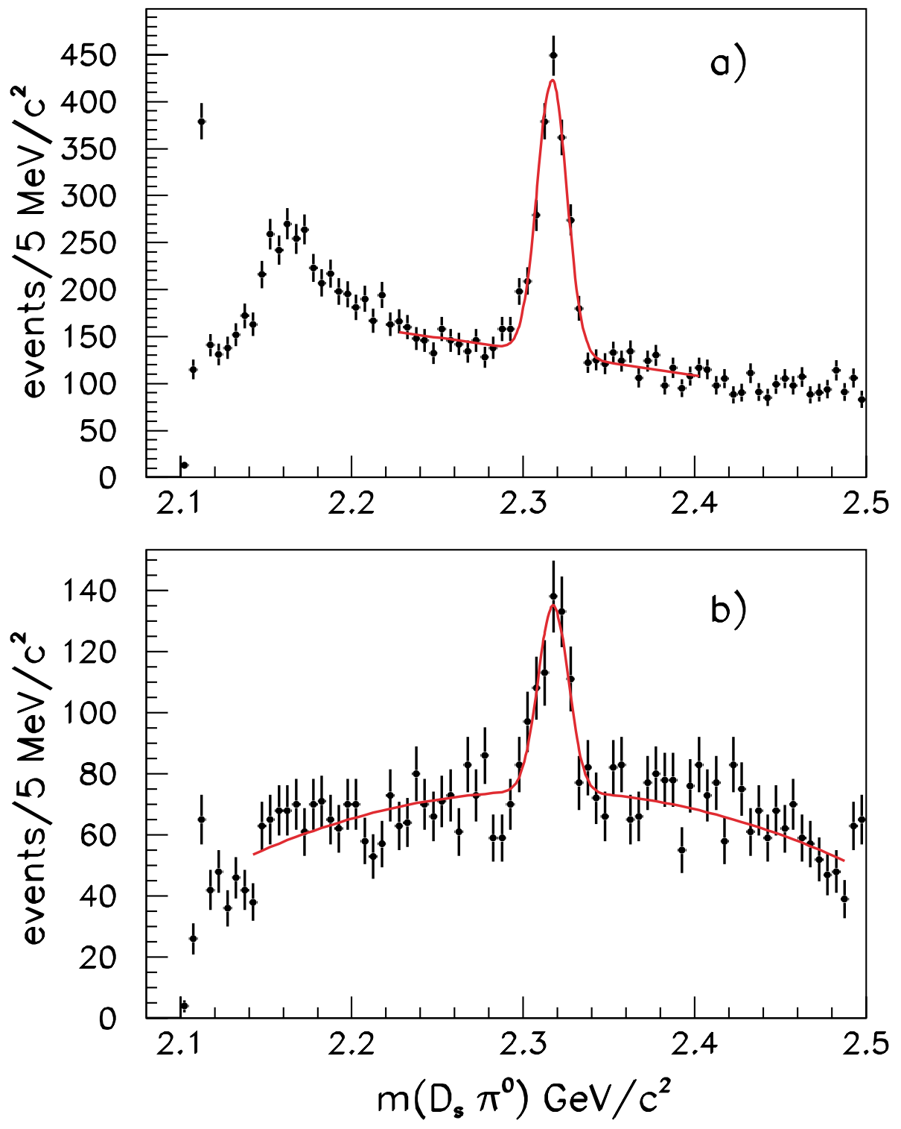
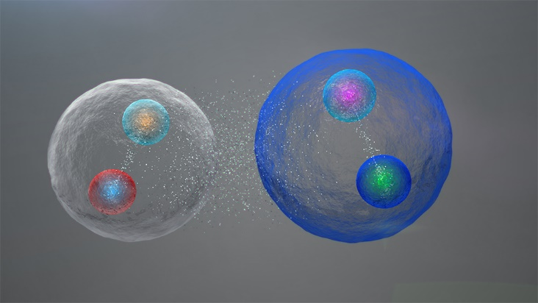
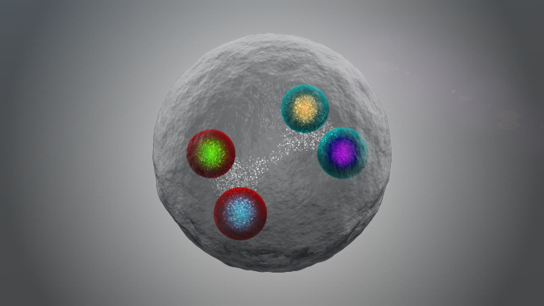
Mysterious exotic hadron $D_{s0}^{∗}(2317)$
160 MeV lower than quark model predictions – difficult to be understood as conventional charm-strange mesons
$m\left(D_{s1}\right)−m\left(D_{s0}^{∗}\right)≈$ $m\left(D^{∗}\right)−m\left(D\right)$
F. K. Guo, C. Hanhart, U.-G. Meißner, Phys. Rev. Lett. 102 (2009) 242004
$DK$ scattering length from LQCD matches molecular scenario
L. Liu, K. Orginos, F. K. Guo, C. Hanhart, U.-G. Meißner, Phys. Rev. D 87 (2013) 014508
……
$$D_{s}^{+}→K^{+}K^{−}π^{+}$$
$$D_{s}^{+}→K^{+}K^{−}π^{+}π^{0}$$
VS
How to verify the $DK$molecular picture ?
From $DK$2-body system to $DDK$ 3-body molecules
T. W. Wu, Y. W. Pan, M. Z. Liu, and LSG*, Sci. Bull. 67 (2022) 1735
Production yields of $D_{s0}^{∗}(2317)$ T. C. Wu and LSG*, Phys. Rev. D 108 (2023) 014015
BABAR, Phys. Rev. Lett. 90 (2003) 242001

Slide 16
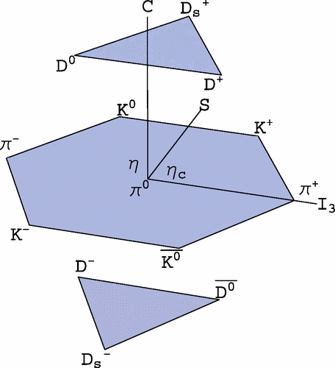
Weinberg-Tomozawa Interaction (leading order)
LO interaction between a NGB and a heavy pseudoscalar boson
Weinberg-Tomozawa (WT) potential – parameter free

Slide 17
Scattering wave function
Coupled-channel scat. eq.
Dynamically generated state — singularities of unitarized amplitude $T$
S-wave scattering wave function (including off-shell effect)

Slide 18
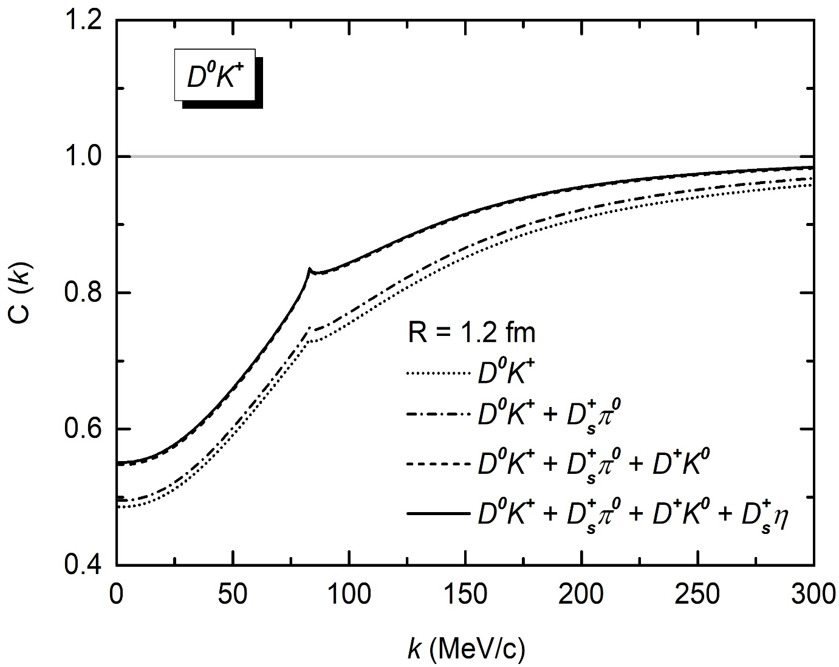
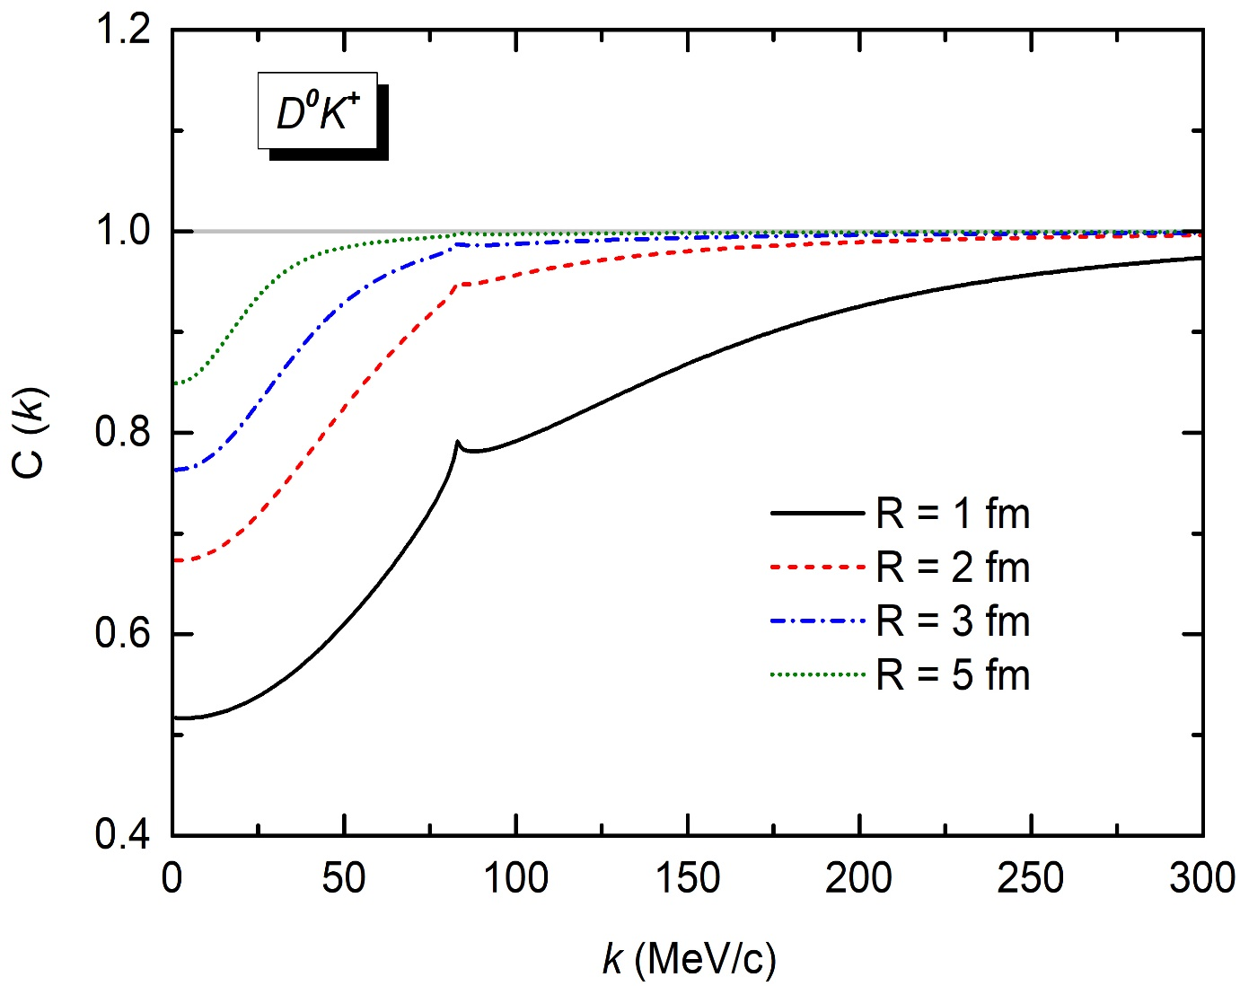
$DK$CFs and its source size dependence
$$D^{+}K^{0} → D^{0}K^{+}$$
Typical feature of deeply bound states
Zhi-Wei Liu, Jun-Xu Lu and LSG*, PRD 107, 074019 (2023)

Slide 19
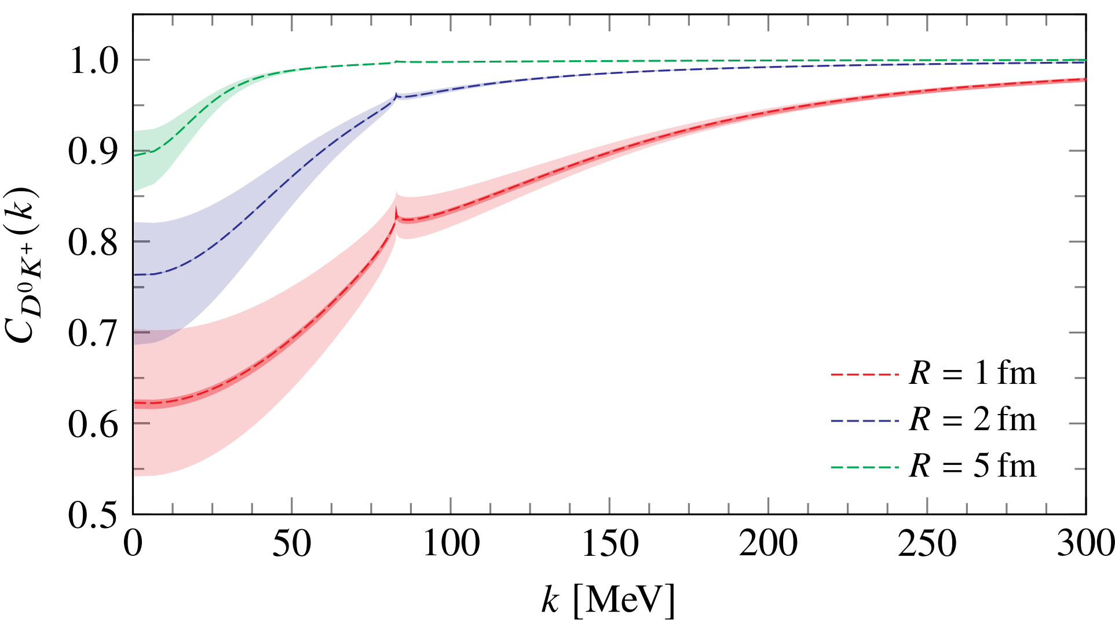
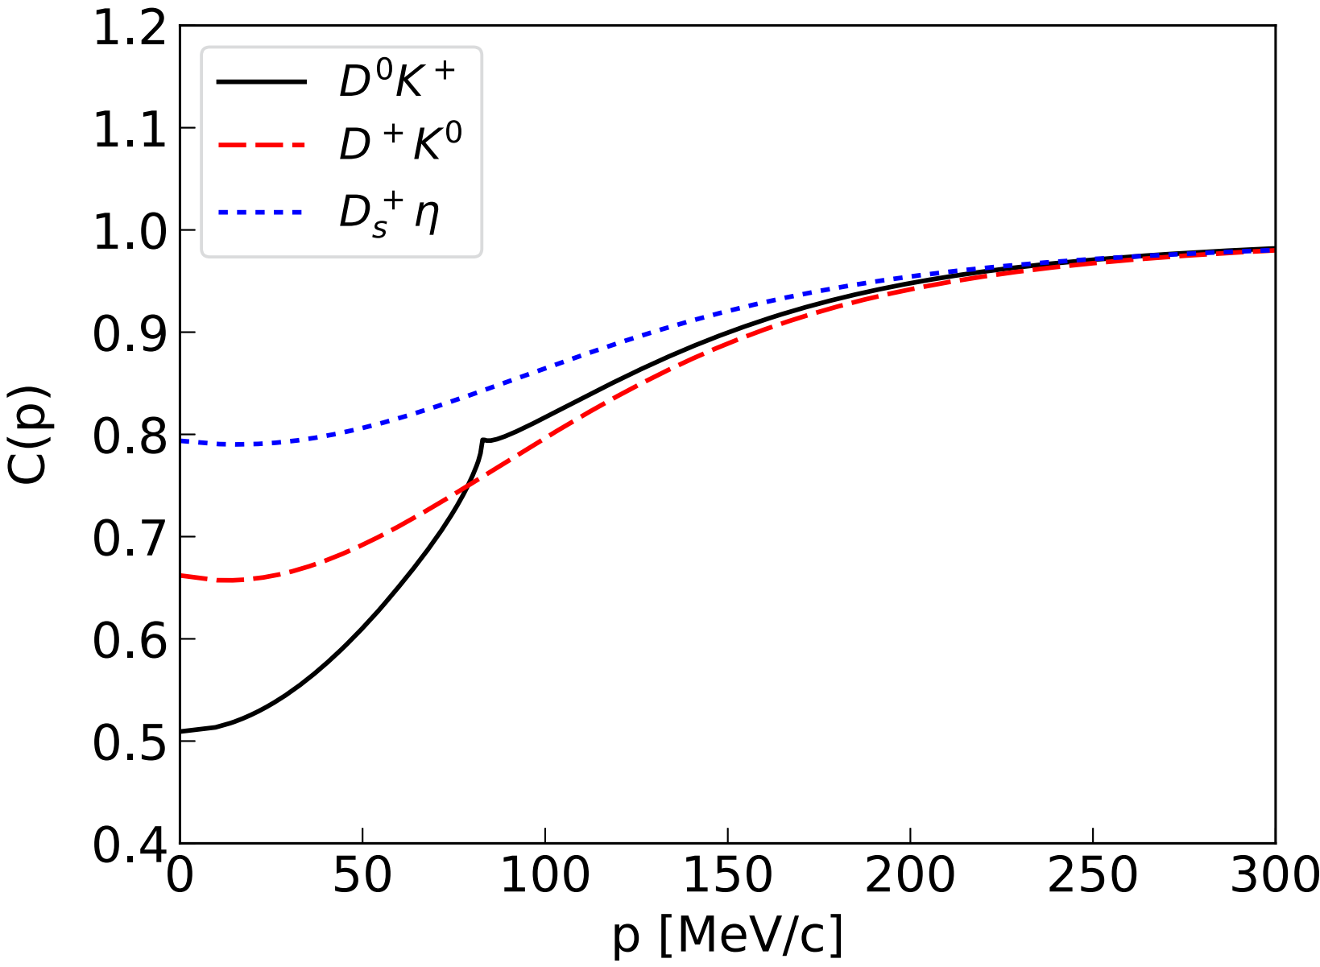
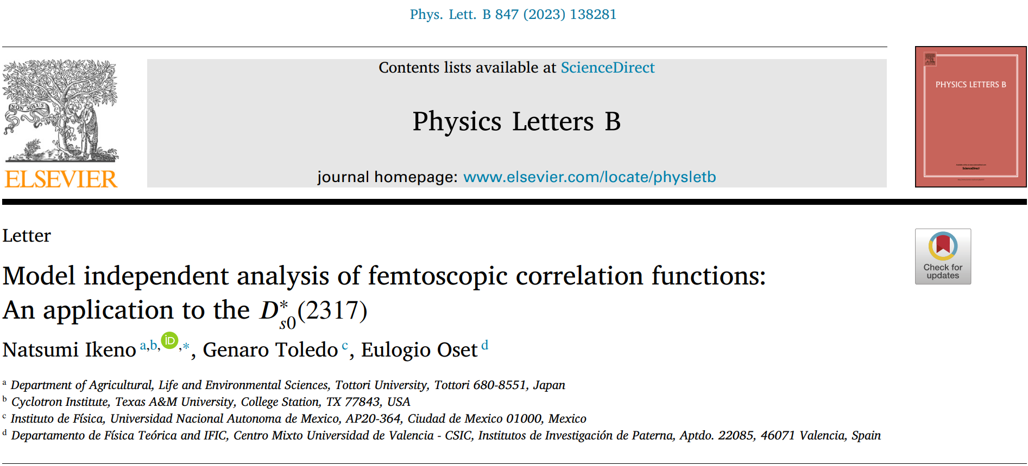
Confirmed by two subsequent studies

Slide 20
Contents
Brief introduction
Femtoscopic correlation functions (CFs)—general features
Recent applications
$DK$ CFs for $D_{s0}^{∗}(2317)$
$Σ_{c}{\overline{D}}^{∗}$ CFs for $P_{c}(4440)$ and $P_{c}(4457)$
$D{\overline{D}}^{∗}$ and $D{\overline{D}}_{s}^{∗}$ CFs for $Z_{c}(3900)$ and $Z_{cs}(3985)$
Summary and outlook

Slide 21
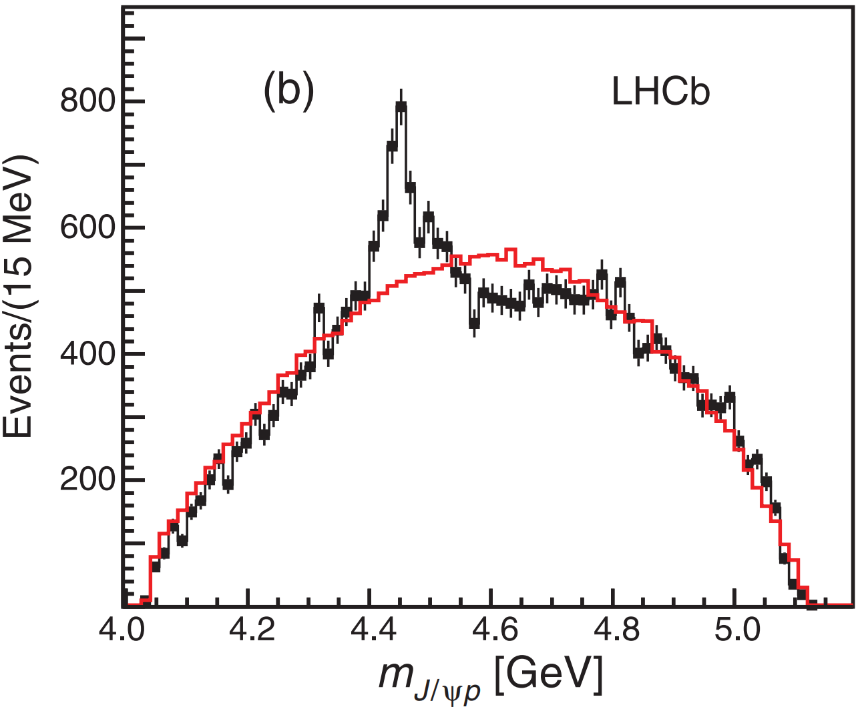
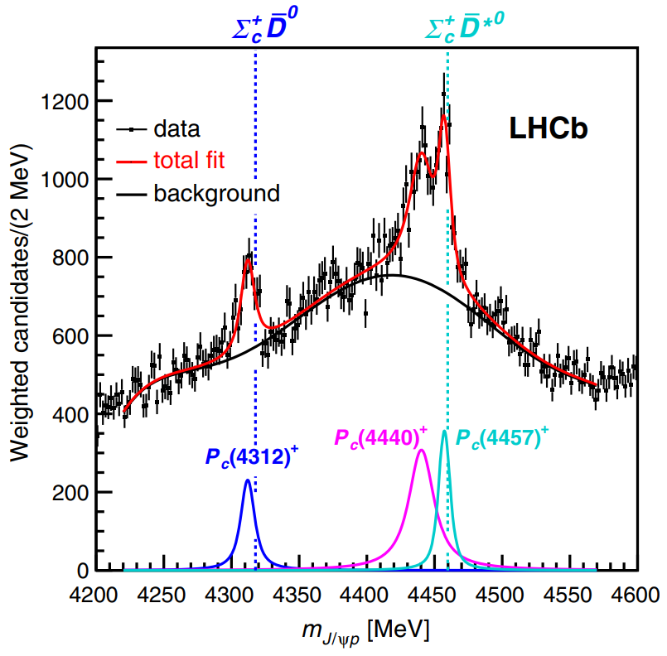
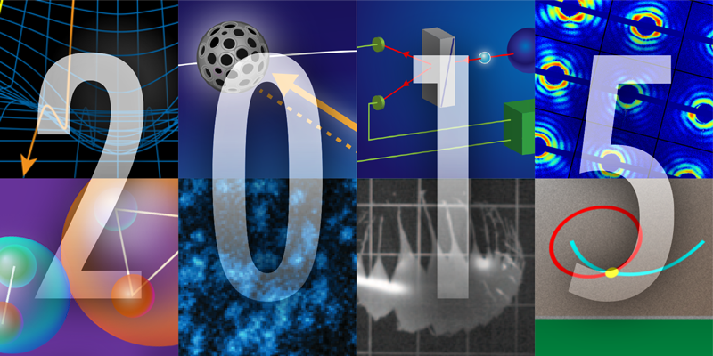
Pentaquark states $P_{c}(4440)$ & $P_{c}(4457)$
LHCb, Phys. Rev. Lett. 115 (2015) 072001
LHCb, Phys. Rev. Lett. 122 (2019) 222001
Pentaquark states · 2015 APS Highlights
How to distinguish the spins of $P_{c}(4440)$ and $P_{c}(4457)$ ?
Masses, invariant mass distributions, decays, magnetic momenta, production rates
M. Z. Liu, Y. W. Pan, F. Z. Peng, M. Sánchez S, LSG*, A. Hosaka, M. P. Valderrama, Phys. Rev. Lett. 122 (2019) 242001
M. L. Du, V. Baru, F. K. Guo, C. Hanhart, U. G. Meißner, J. A. Oller, Q. Wang, Phys. Rev. Lett. 124 (2020) 072001
Y. H. Lin, B. S. Zou, Phys. Rev. D 100 (2019) 056005 M. W. Li, Z. W. Liu, Z. F. Sun and R. Chen, Phys. Rev. D 104 (2021) 054016
Q. Wu, D. Y. Chen, Phys. Rev. D 100 (2019) 114002
Heavy antiquark diquark symmetry Y. W. Pan, M. Z. Liu, F. Z. Peng, M. S. Sánchez, LSG*, M. P. Valderrama, Phys. Rev. D 102 (2020) 011504
Neural network-based approach Z. Zhang, J. Liu, J. Hu, Q. Wang, U.-G. Meißner, Sci. Bull. 68 (2023) 981

Slide 22
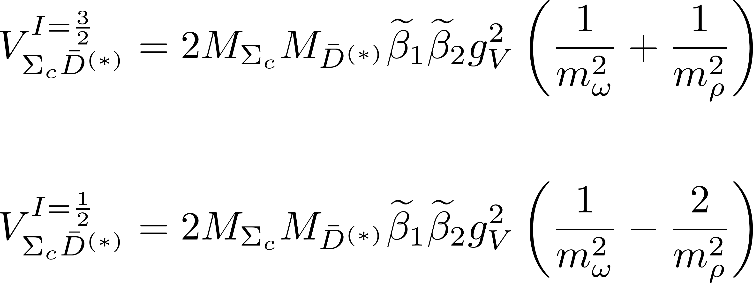
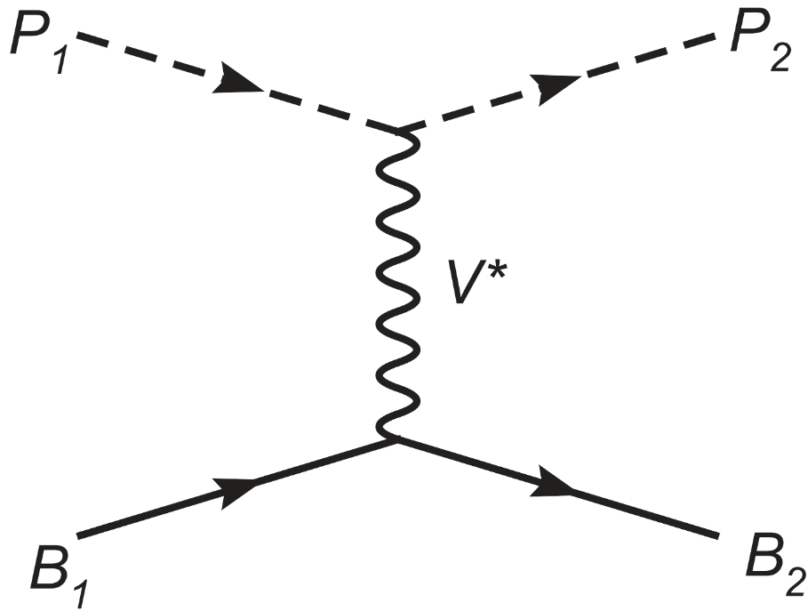
Light vector meson exchange interaction
Interaction in hidden local symmetry approach – parameter free
Isospin basis
Charge basis

Slide 23
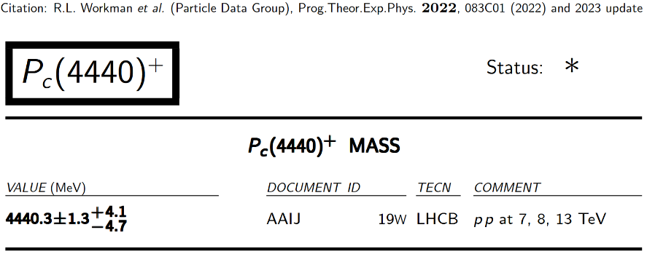
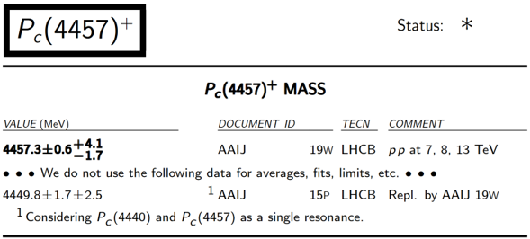
Two different spin assignments
Interaction strengths
deep bound state of $Σ_{c}{\overline{D}}^{∗}$
shallow bound state of $Σ_{c}{\overline{D}}^{∗}$
CF for the shallow bound state is significantly larger than that for the deep bound
Experimental CFs – spin-averaged
Scenarios A
Scenarios B

Slide 24
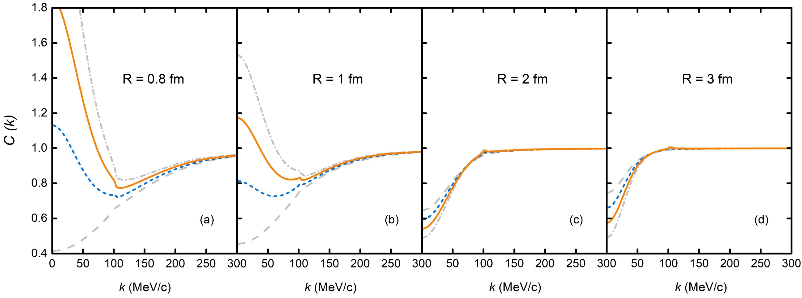
Spin-averaged $Σ_{c}{\overline{D}}^{∗}$CFs
$\text{Scenario} \text{A}$: higher mass, larger spin
model independent
CF for shallow bound state
$$Σ_{c}^{++}D^{∗−}→Σ_{c}^{+}{\overline{D}}^{∗0}$$
CF for deep bound state
Scenario B: higher mass, smaller spin
Zhi-Wei Liu, Ming-Zhu Liu, Jun-Xu Lu and LSG*, PRD 108, L031503 (2023)

Slide 25
Contents
Brief introduction
Femtoscopic correlation functions (CFs)—general features
Recent applications
$DK$ CFs for $D_{s0}^{∗}(2317)$
$Σ_{c}{\overline{D}}^{∗}$ CFs for $P_{c}(4440)$ and $P_{c}(4457)$
$D{\overline{D}}^{∗}$ and $D{\overline{D}}_{s}^{∗}$ CFs for $Z_{c}(3900)$ and $Z_{cs}(3985)$
Summary and outlook

Slide 26
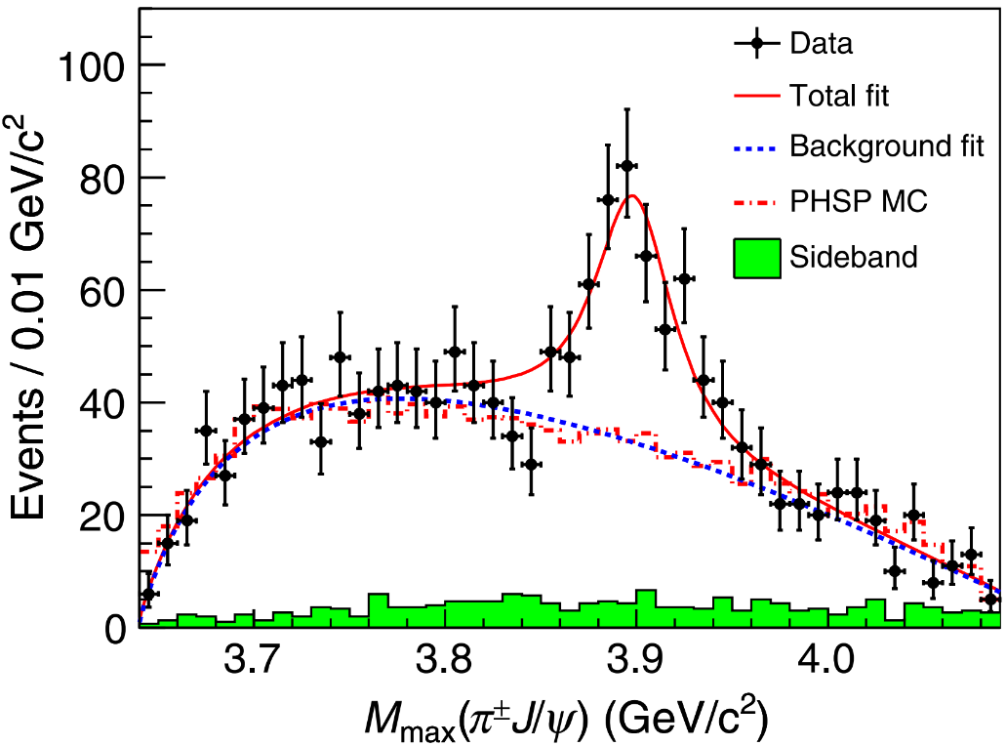
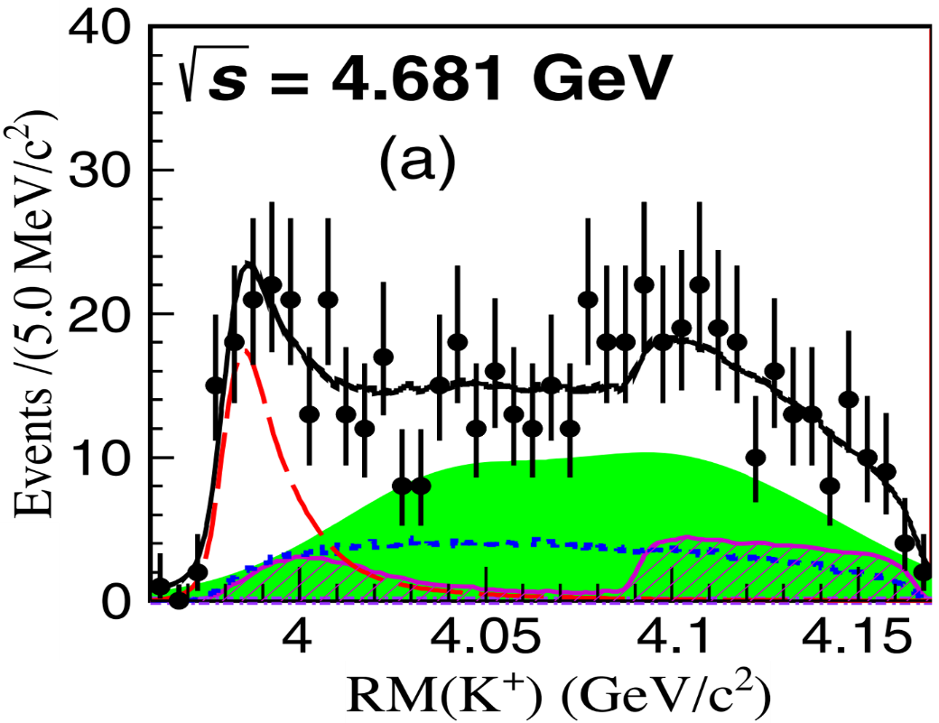
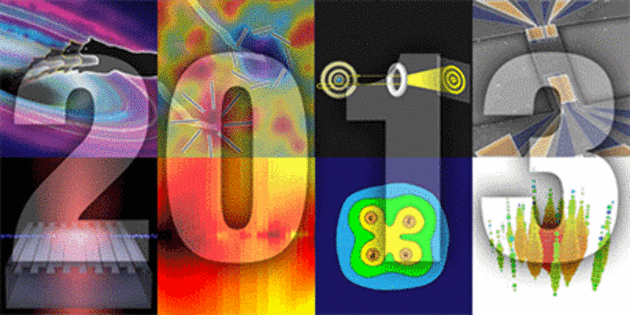
Tetraquark states $Z_{c}(3900)$ & $Z_{cs}(3985)$
$$Z_{c}(3900)$$
$$Z_{cs}(3985)$$
BESIII, Phys. Rev. Lett. 110 (2013) 252001
BESIII, Phys. Rev. Lett. 126 (2021) 102001
Tetraquark states · 2013 APS Highlights
$Z_{c}(3900)$ & $Z_{cs}(3985)$: Resonant state VS Virtual states
Particle Data Group, PTEP 2022 (2022) 083C01
M.-L. Du, M. Albaladejo, F.-K. Guo and J. Nieves, Phys. Rev. D 105 (2022) 074018 T. Ji, X.-K. Dong, M. Albaladejo, M.-L. Du, F.-K. Guo and J. Nieves, Phys. Rev. D 106 (2022) 094002 L.-W. Yan, Z.-H. Guo, F.-K. Guo, D.-L. Yao and Z.-Y. Zhou, Phys. Rev. D 109 (2024) 014026
How to tell whether $Z_{c}(3900)$ and $Z_{cs}(3985)$ are resonant or virtual states ?

Slide 27
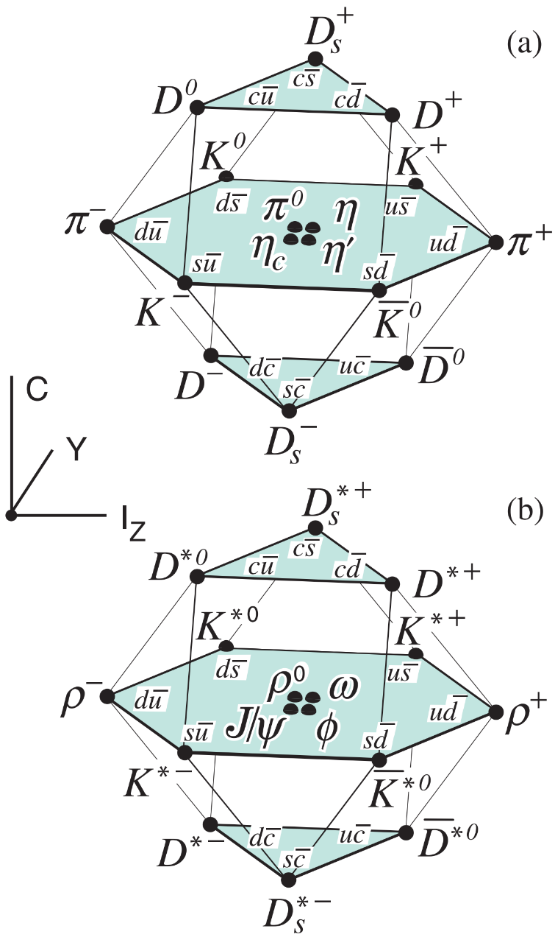
General potential from EFTs
Interaction between heavy pseudoscalar bosons
constant contact-range potential $−→$ bound or virtual state
energy-dependent potential $−→$ virtual state
Scattering equation – unitarity
Loop function G with cutoff regularization

Slide 28
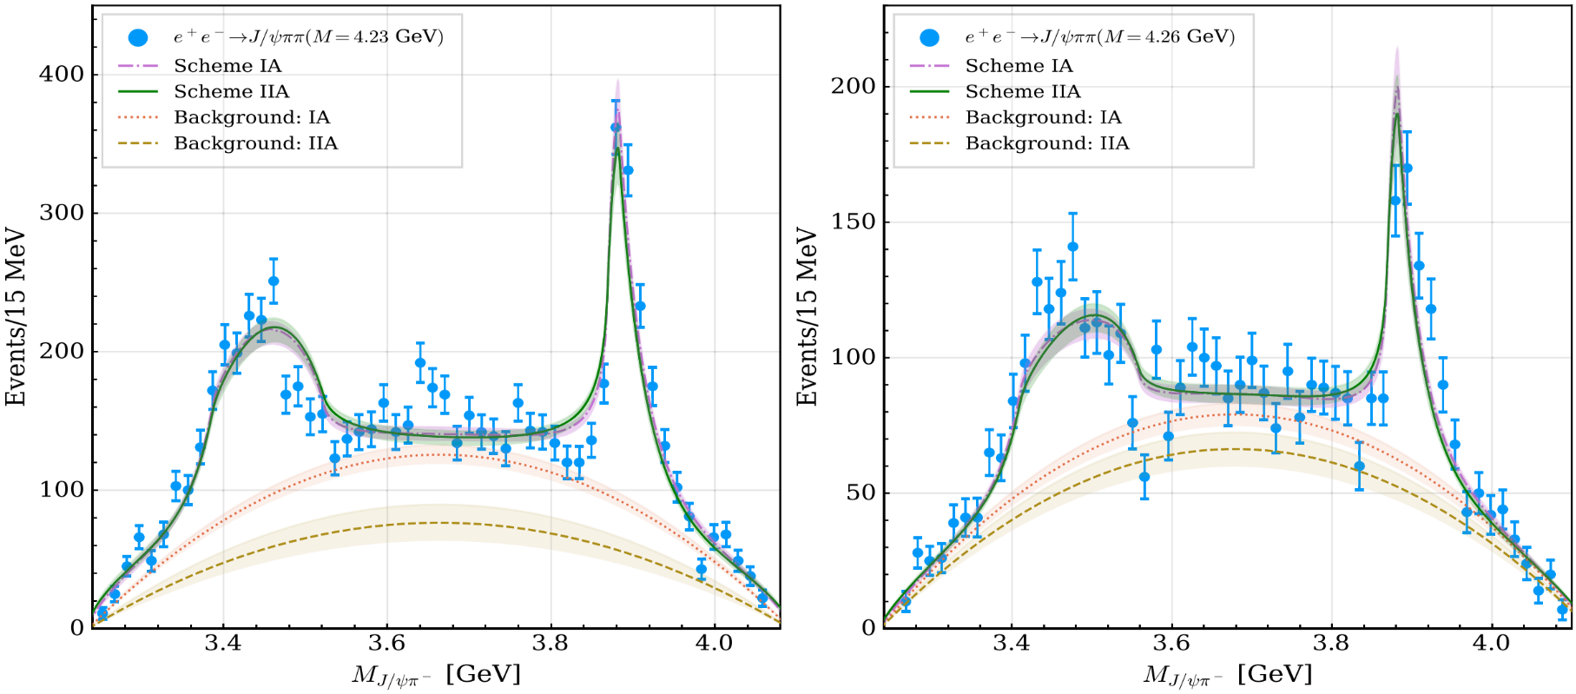
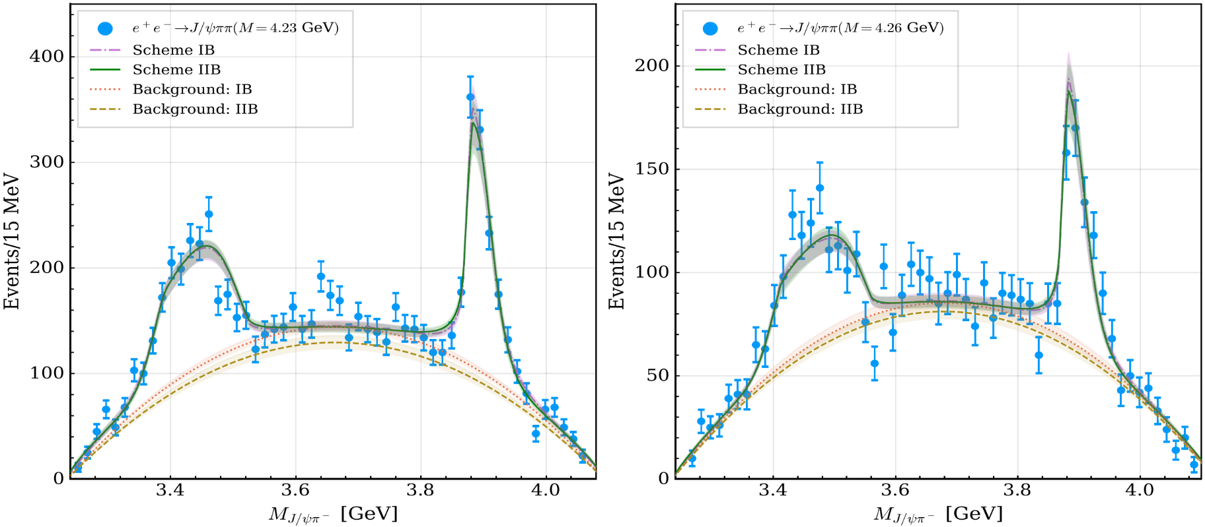
Invariant mass distributions fail to distinguish vir. or res.
Virtual state scenario
Resonant state scenario
M.-L. Du, M. Albaladejo, F.-K. Guo, and J. Nieves, Phys. Rev. D 105, 074018 (2022)
Data are compatible with $Z_{c}(3900)/Z_{cs}(3985)$ as either a resonant or virtual state.

Slide 29
Interaction strengths determined by fitting to data
7777
【95】 Particle Data Group, PTEP 2022, 083C01 (2022) 【27】M.-L. Du, M. Albaladejo, F.-K. Guo, and J. Nieves, Phys. Rev. D 105, 074018 (2022)
Correlation functions with on-shell approximation

Slide 30
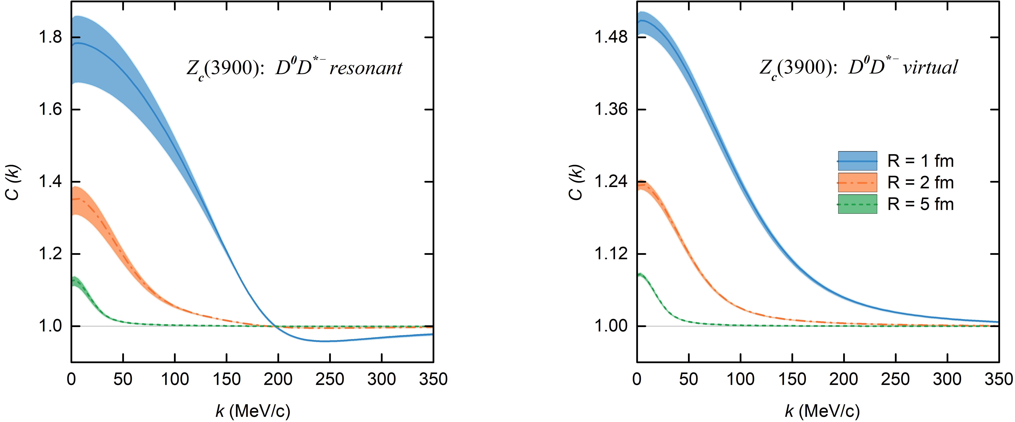
$D^{0}D^{∗−}$CFs for $Z_{c}(3900)$
Resonant state scenario
Virtual state scenario
Typical feature of broad resonant state
In preparation, Zhi-Wei Liu, Ming-Zhu Liu, Jun-Xu Lu and LSG*

Slide 31
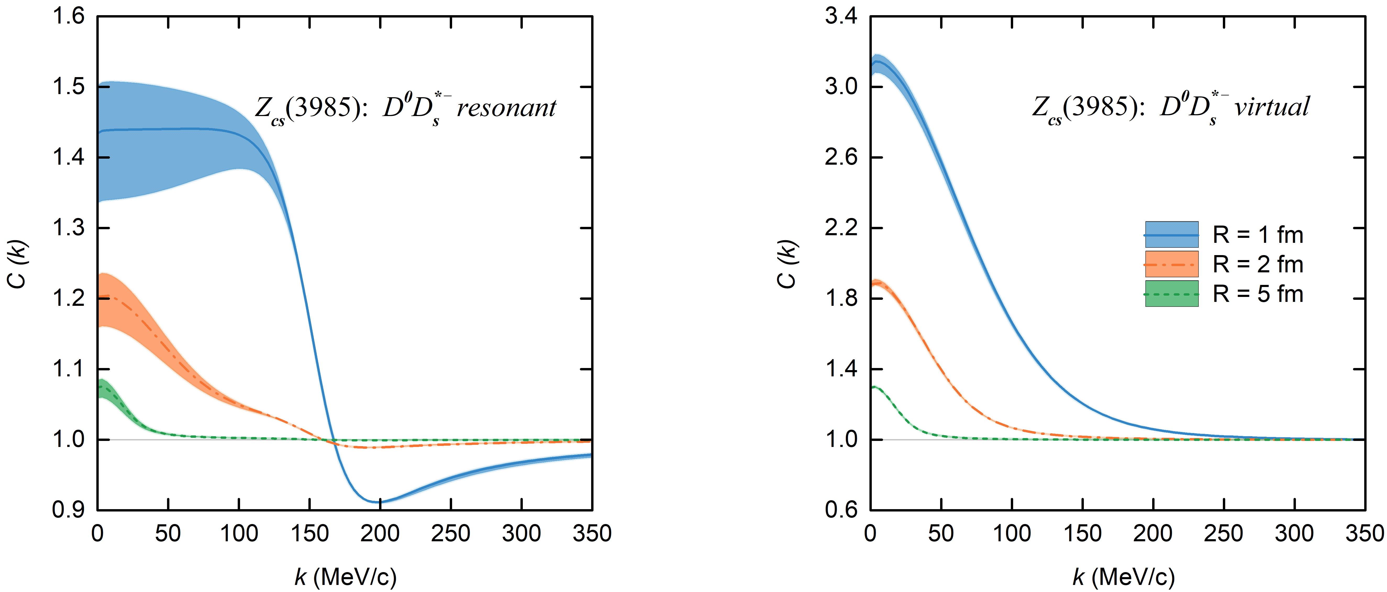
$D^{0}D_{s}^{∗−}$CFs $Z_{cs}(3985)$
Resonant state scenario
Virtual state scenario
Typical feature of narrow resonant state

Slide 32
Contents
Brief introduction
Femtoscopic correlation functions (CFs)—general features
Recent applications
$DK$ CFs for $D_{s0}^{∗}(2317)$
$Σ_{c}{\overline{D}}^{∗}$ CFs for $P_{c}(4440)$ and $P_{c}(4457)$
$D{\overline{D}}^{∗}$ and $D{\overline{D}}_{s}^{∗}$ CFs for $Z_{c}(3900)$ and $Z_{cs}(3985)$
Summary and outlook

Slide 33
Summary and outlook
Femtoscopy offers high-precision tests of the strong interaction between pairs of (un)stable particles.
$DK$ correlation functions can be used to verify or refute the molecular picture of $D_{s0}^{∗}(2317)$
$Σ_{c}{\overline{D}}^{(∗)}$ correlation functions can be used to discriminate the spins of $P_{c}(4440)$ and $P_{c}(4457)$
$D{\overline{D}}^{∗}/D{\overline{D}}_{s}^{∗}$ correlation functions can tell whether $Z_{c}(3900)/Z_{cs}(3985)$ is a resonant or a virtual state

Slide 34
Summary and outlook
$$Σ_{c}{\overline{D}}^{∗}$$
More two-hadron correlations involving s, c, b quarks
$$BD$$
DK, Z.W. Liu, J.X. Lu, LSG*, PRD 107 (2023) 074019
$Σ_{c}{\overline{D}}^{∗}$, Z.W. Liu, J.X. Lu, M.Z. Liu, LSG*, PRD 108 (2023) L031503
$DD^{∗}$, I. Vidana, A. Feijoo, M. Albaladejo, J. Nieves, and E. Oset, PLB 846 (2023) 138201
$DD^{∗}$, Y. Kamiya, T. Hyodo, and A. Ohnishi, EPJA 58 (2022) 131
$D{\overline{D}}^{∗}$, Z.W. Liu, J.X. Lu, M.Z. Liu, LSG*, In preparation ${BB}^{∗}$, A. Feijoo, L. R. Dai, L. M. Abreu, and E. Oset, PRD 109 (2024) 016014
$\text{B}D,$ H.P. Li, J.Y. Yi, C.W. Xiao, D.L. Yao, W.H. Liang, and E. Oset, CPC (2024)
……
$$ΞN$$
$$N\overline{D}$$
$$ΛN$$
$$ΛΛ$$
$$D{\overline{D}}^{∗}$$
$$NN$$
$$DK$$
Three-particle correlations — genuine three-body effects
ppp, pp$Λ$, ALICE Collaboration, Eur. Phys. J. A 59 (2023) 145
pp$K^{±}$, ALICE Collaboration, Eur. Phys. J. A 59 (2023) 298
ppp, A. Kievsky and et al., Phys. Rev. C 109 (2024) 034006

Slide 35
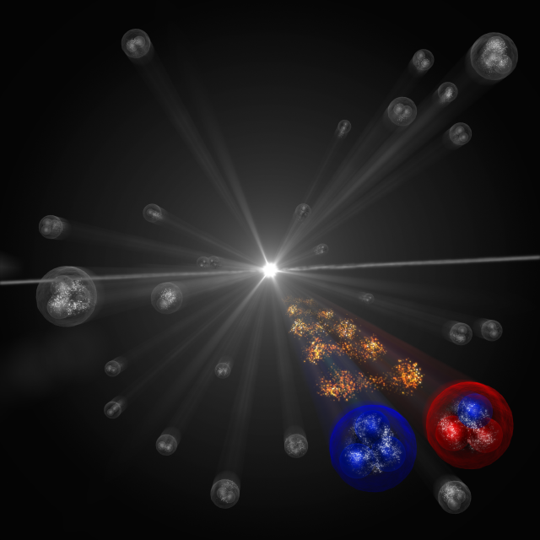
Thanks a lot for your attention!

