Slide 1
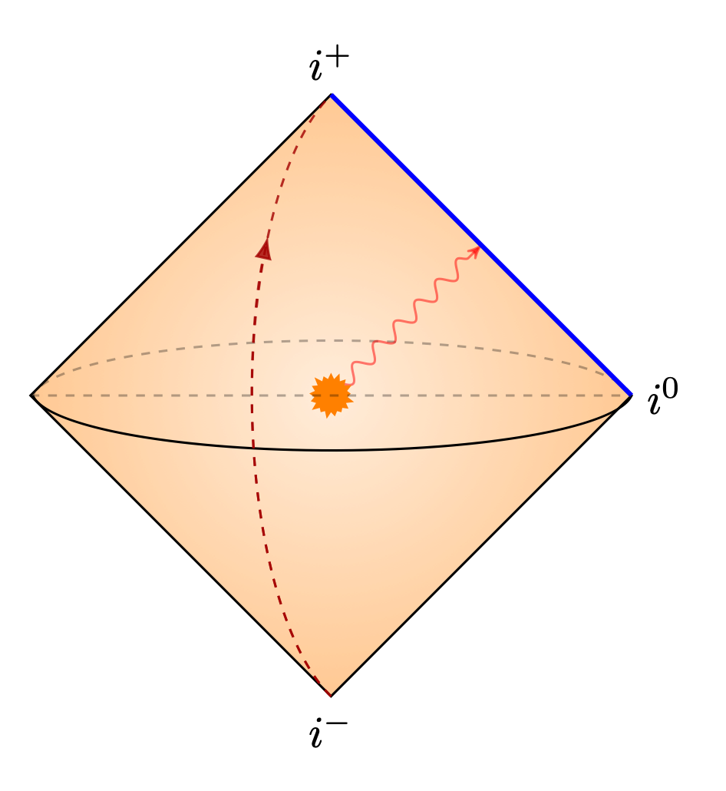
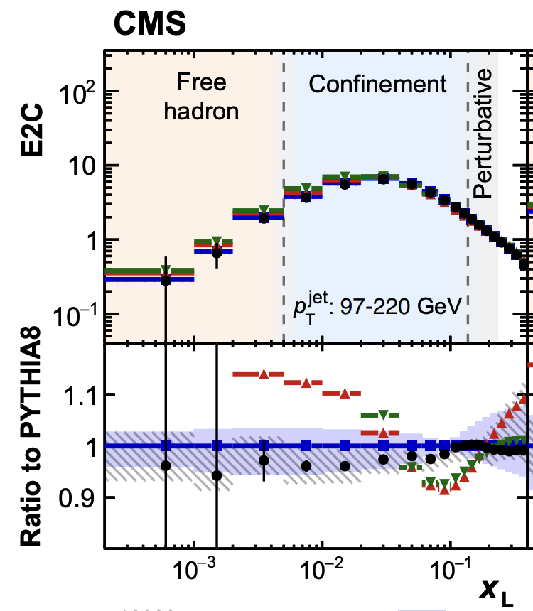
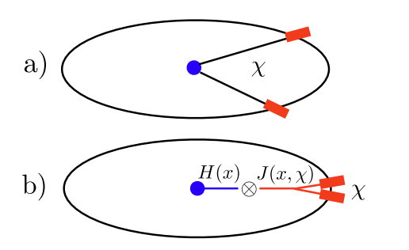
Progress on Energy Correlators:
Theory, Phenomenology, and Experiments
朱华星
北京大学
第六届重味物理与QCD研讨会
2024年4月20日

Slide 2
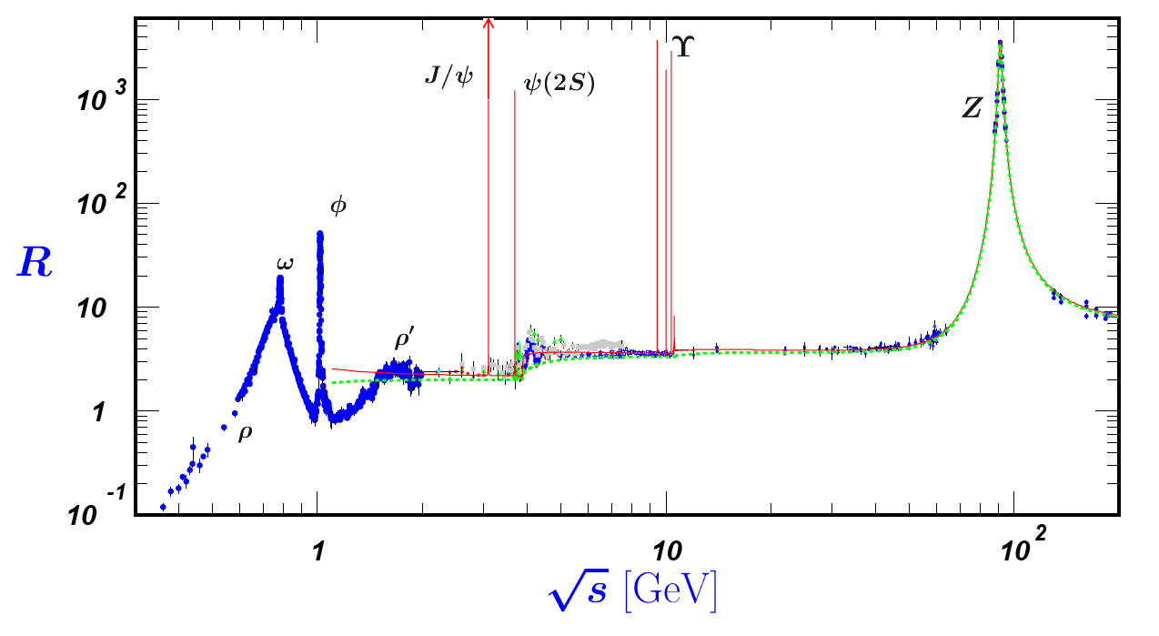
The R-ratio in e+e- annihilation
One of the most important observables in particle physics!
Cleanest definition in terms of operators. Allows first principle calculation in Lattice QCD
Fully inclusive <=> contains less information

Slide 3
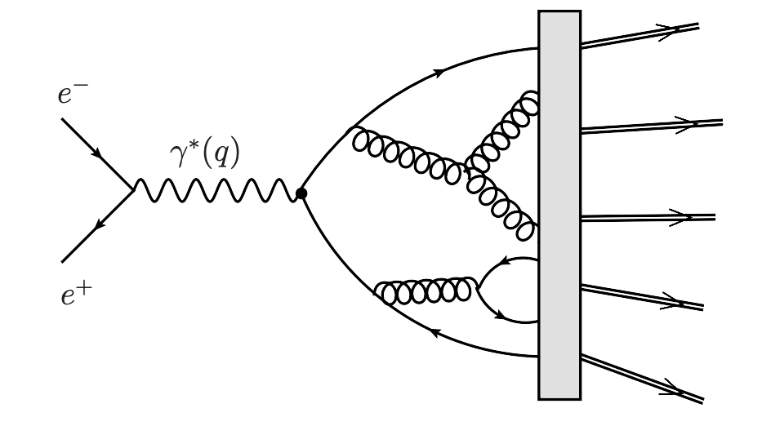
Energy Correlators (EECs)
Basham, Brown, Ellis, Love, 1977-1978
k-point Energy Correlator: Measurement of k-point angular correlation, weighted by product of energy of k particles, inclusive in all-particle combination
Hadron level observable
Sufficiently inclusive to allows perturbation calculations using quarks and gluons
Energy operator
x
x
x
.
.
.
x

Slide 4
What is Energy-Energy Correlator? Basham, Brown, Ellis, Love, 1978

Slide 5
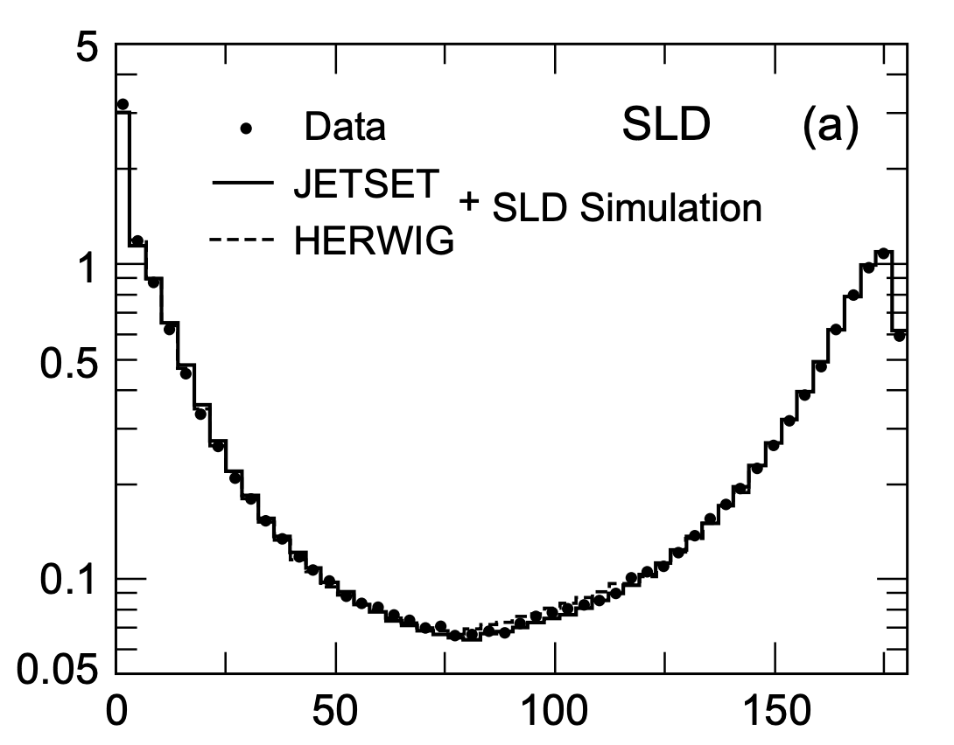
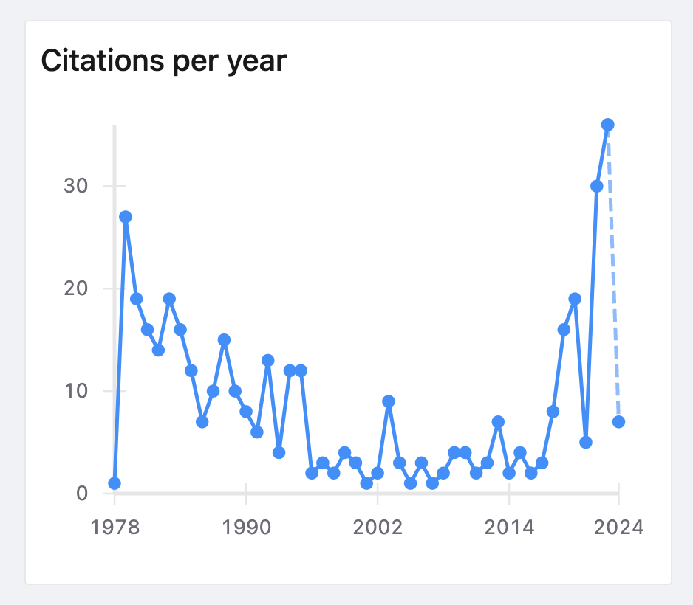
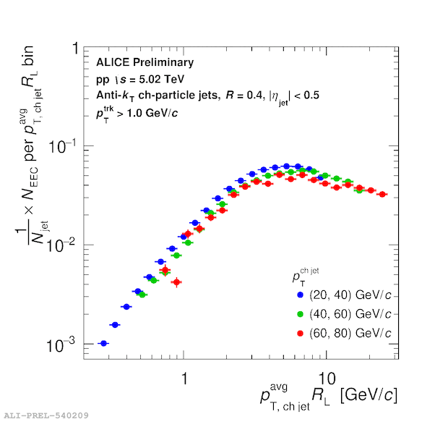
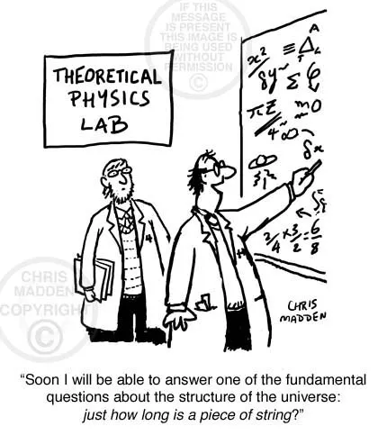
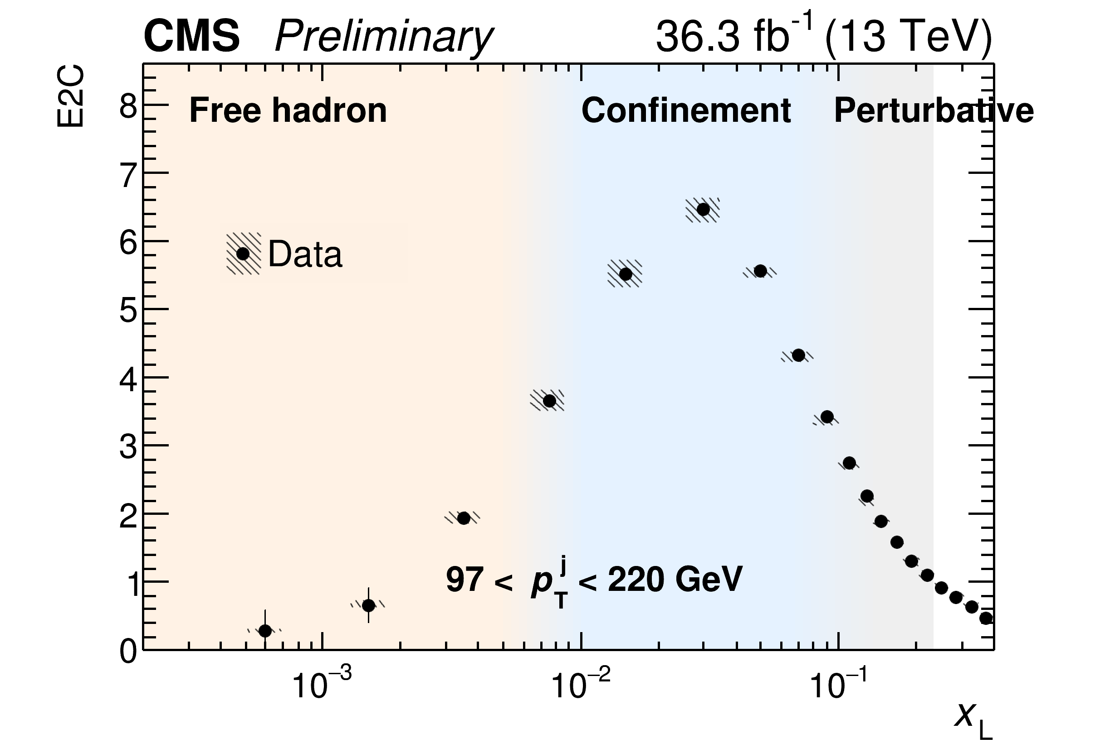
Theory re-inspire experiments
small angle
large angle
2023, …
1994
theorists kick in
Renaissance
of EECs
A re-analysis of LEP data is underway by a MIT group using tracks

Slide 6
Community activities
A burst of dedicated workshops in the past and coming years:
CCNU, Wuhan: One-day workshop on energy-energy correlator in high-energy collisions, 2023
Mainz Institute of Theoretical Physics: Energy Correlators at the Collider Frontier, 2024
Simmons Center for Geometry and Physics: Energy Operators in Particle Physics, Quantum Field Theory and Gravity, 2024
Kavli Institute of Theoretical Physics: Frontiers of Quark-Gluon Matter, 2025
2211.05772

Slide 7
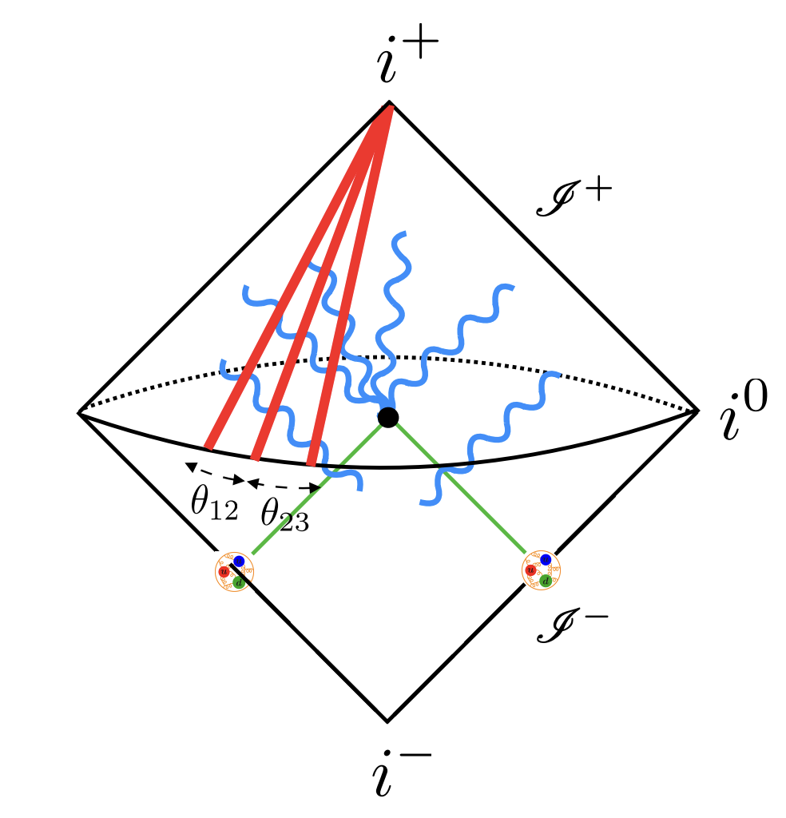
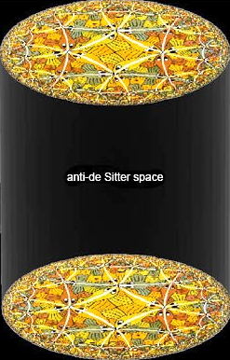
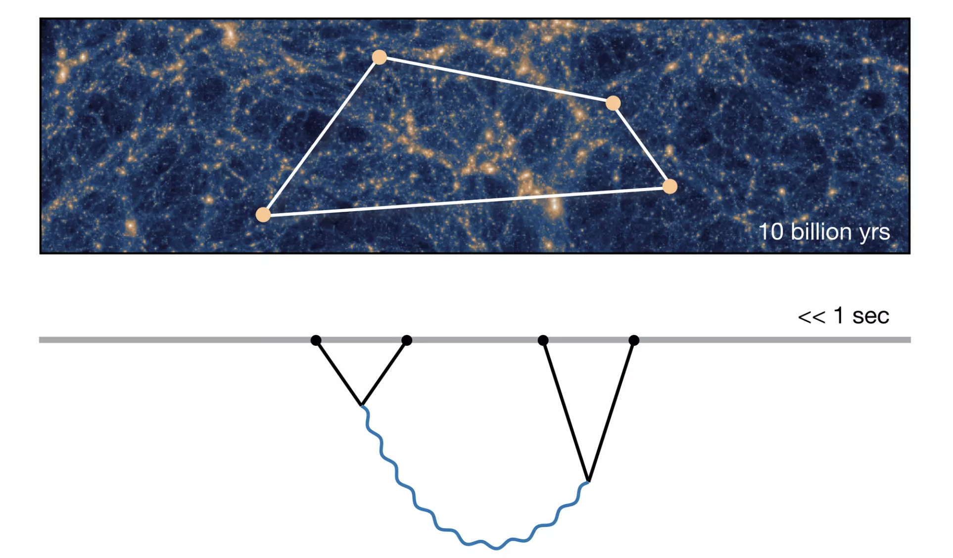
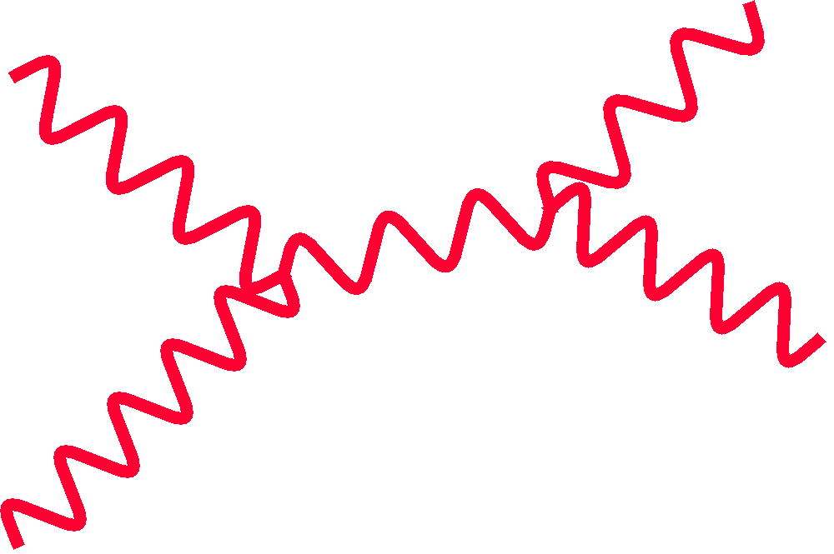
The trilogy
Formal and QCD theory
Particle and nuclear phenomenology
Experiments across colliders
AdS correlator
Collider correlator
Cosmological correlator

Slide 8
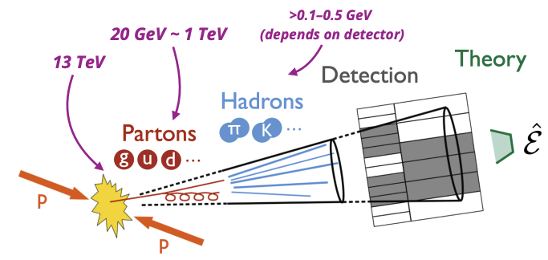
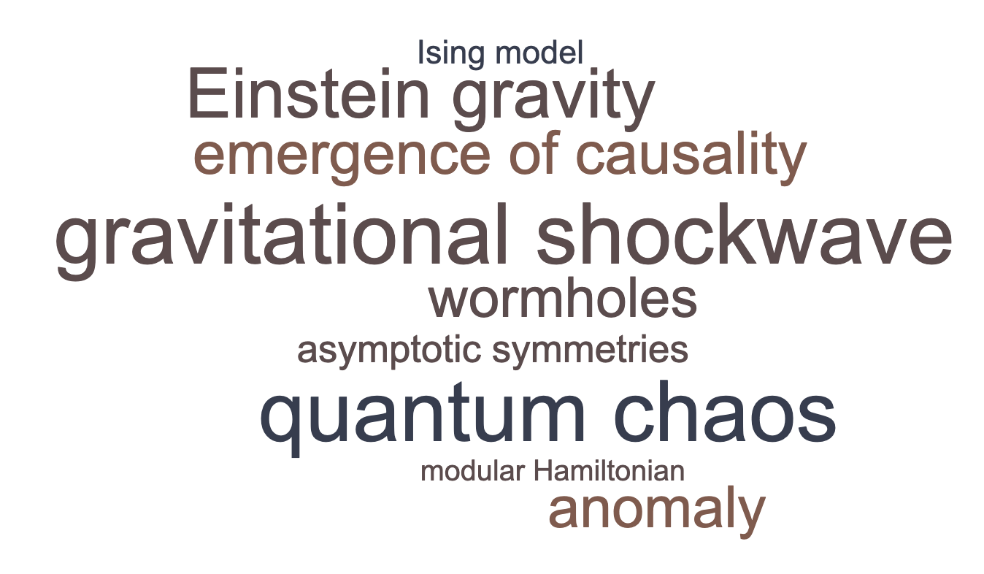
The Energy Operator
A local version appears in the construction of wormhole and time travel (Morris, Thorne, 1988)
In collider context: (Sveshnikov, Tkachov, 1995)
What experimentalist see
What theorist see
Besides central in collider physics, appears in various other context:

Slide 9
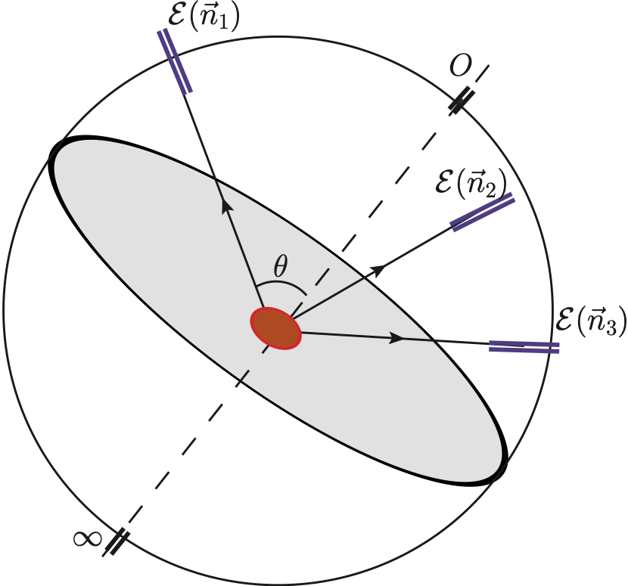
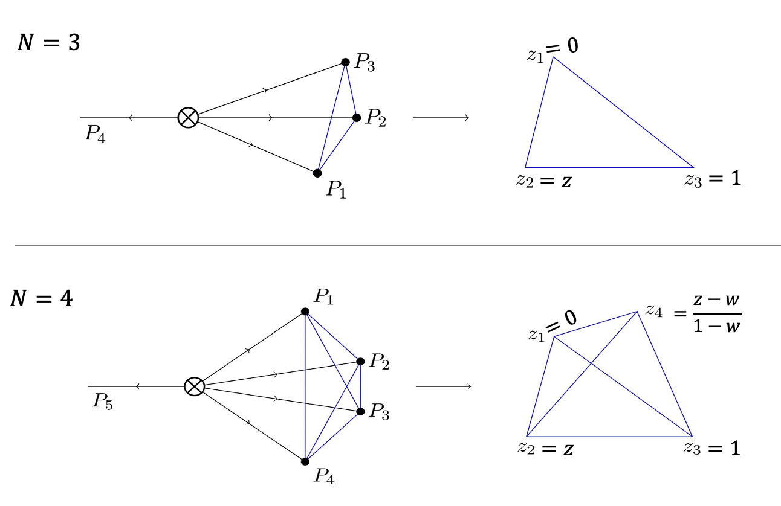
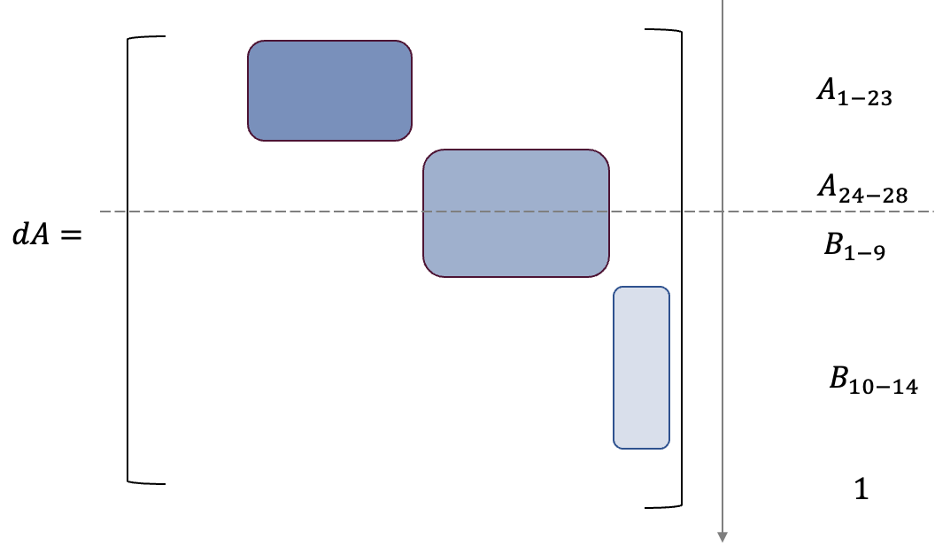
Analytic Simplicity
EEC is the only event shape observable analytically computed beyond leading order!
QCD at NLO (Dixon, M.X. Luo, Shtabovenko, T.Z. Yang, HXZ, 2018)
N=4 SYM at NNLO (Henn, Sokatchev, K. Yan, Zhiboedov, 2019)
Going beyond two point:
Analytic bootstrap?
Chicherin, Moult, Sokatchev, K. Yan, T.Z. Yang,X.Y. Zhang, Y.Y. Zhu, et al.
An iterative structure in N (number of point)?

Slide 10
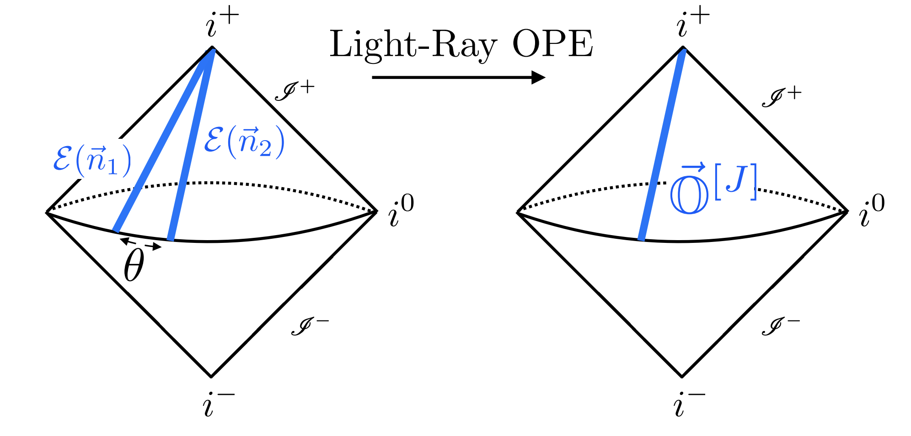
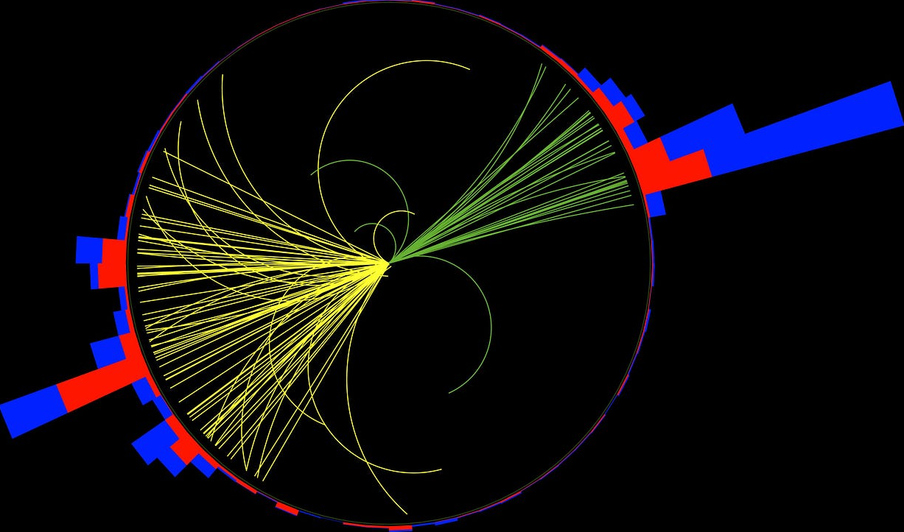
Conformal collider and lightray OPE
Hofman, Maldacena, 2008; Kologlu, Kravchuk, Simmons-Duffin, Zhiboedov, 2019
Enhancement of small-angle energy correlation is evident from experiment
small-angle enhancement
anomalous dimension of twist-2 operator
Scaling law in jet?

Slide 11
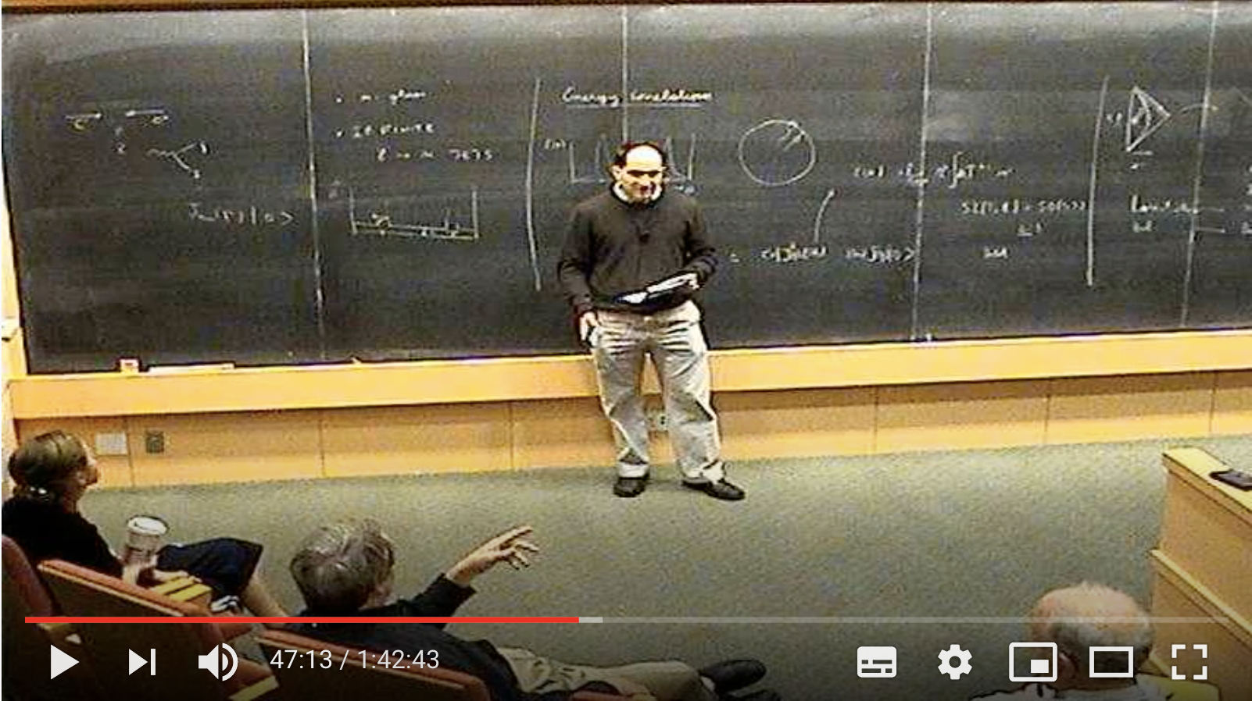
But they didn’t study the small angles. And I asked him whether they had a good reason for not studying the small angles and they said well we didn’t know the resummation formula…
Polchinski: There is a lot of QCD data, can you see this (scaling behavior) there?
https://online.kitp.ucsb.edu/online/strings09/maldacena/rm/qt.html

Slide 12
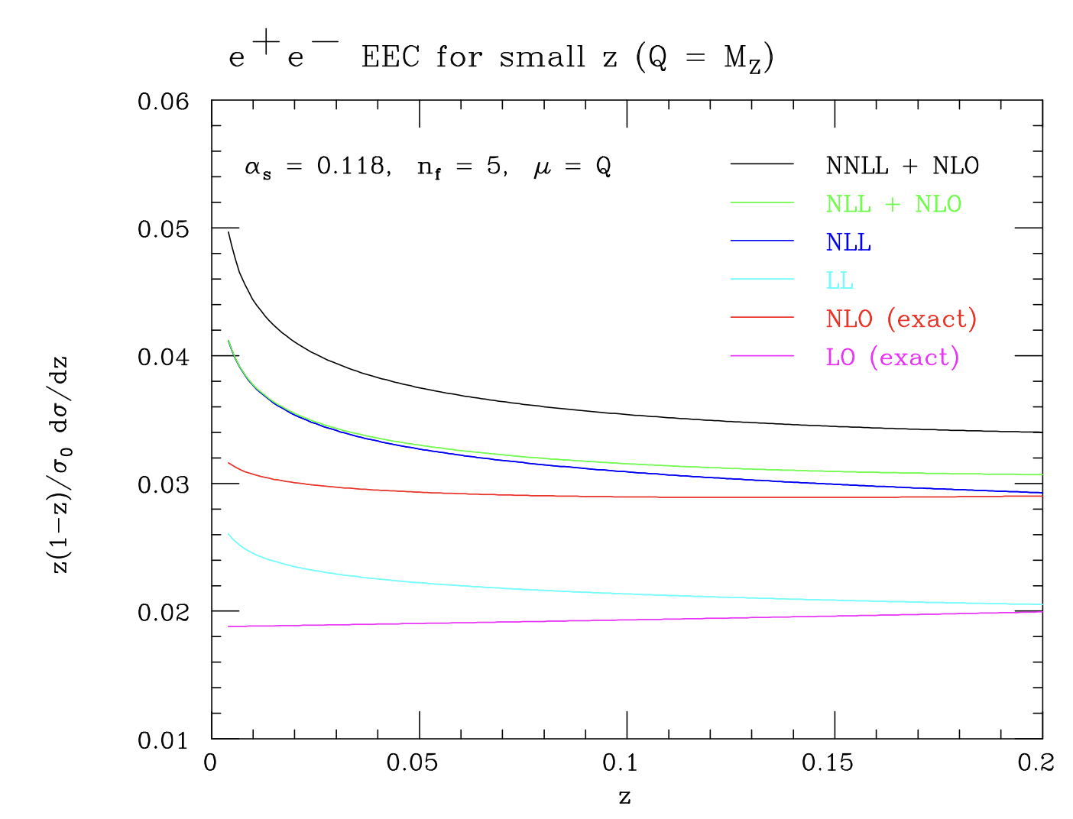
Resummation formula in QCD
Dixon, Moult, HXZ, 2019; H. Chen, Moult, X.Y. Zhang, HXZ, 2020; H. Chen, 2023
Evolution for EEC, valid to all orders
conventional DGLAP evolution for parton fragmentation
correlation of observable and convolution variables obstruct complete factorization
reciprocity relation:
Basso, Korchemsky, 2006
H. Chen, T.Z. Yang, Y.J. Zhu, HXZ, 2021
NNLL
NLL
moment of space-like DGLAP kernel
moment of time-like DGLAP kernel
Numerically significant corrections!

Slide 13
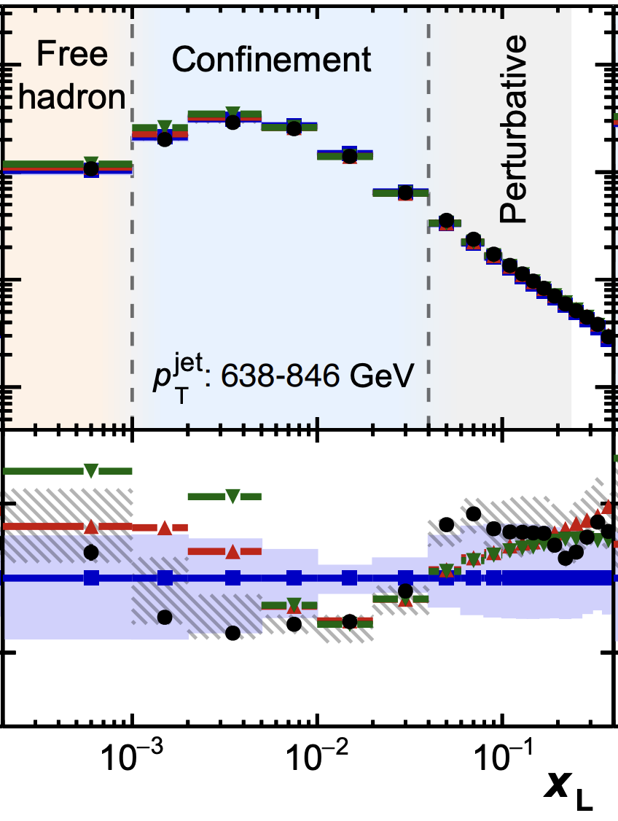
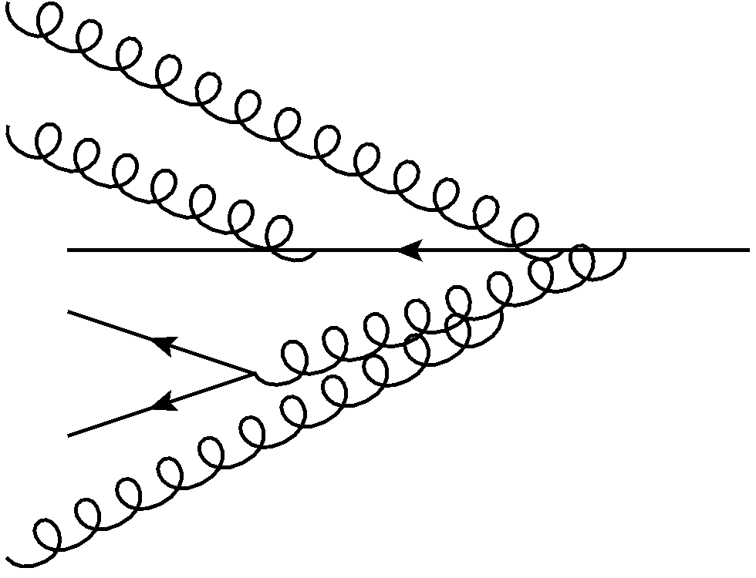
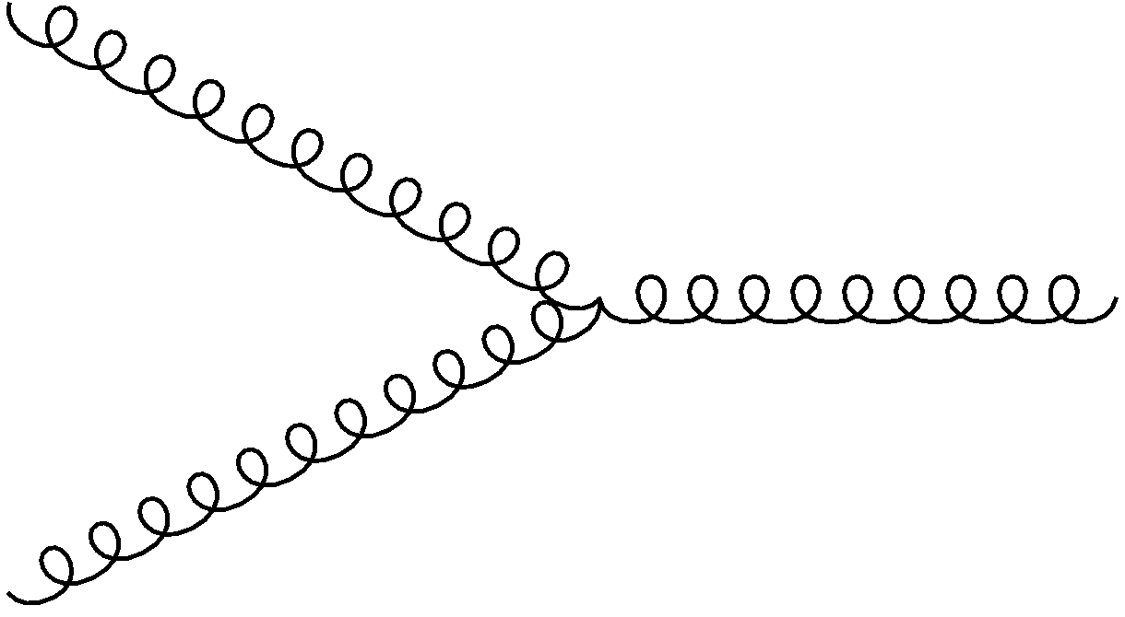
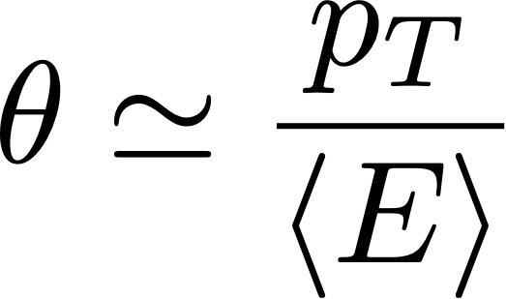
“Jets elucidate how partons evolve into hadrons”
https://cms.cern/news/jets-elucidate-how-partons-evolve-hadrons
2312.07655
see also Komiske, Moult, Thaler, HXZ, 2022
π⁺
.
.
.
Detector
hadronization
K⁺
π⁰
π⁻
free
hadron
perturbative
Observation of two scaling region in jet fragmentation for the first time!
$$E$$
$$p_{T}$$
$$θ$$
low pT
high pT

Slide 14
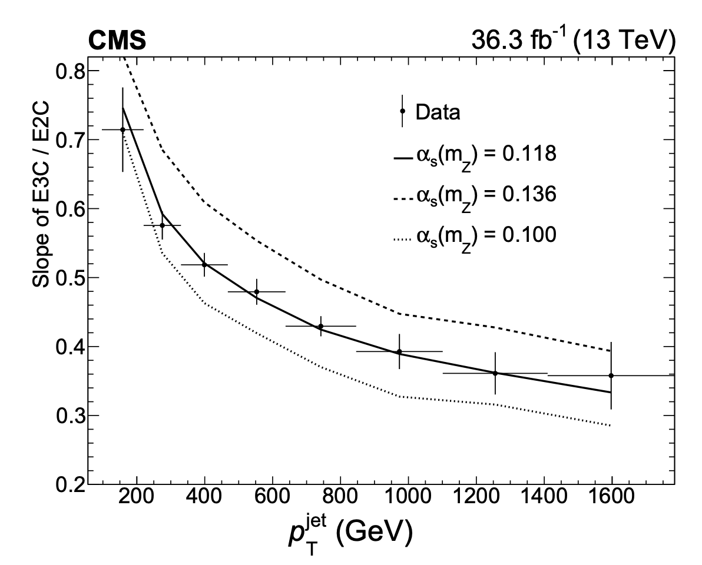
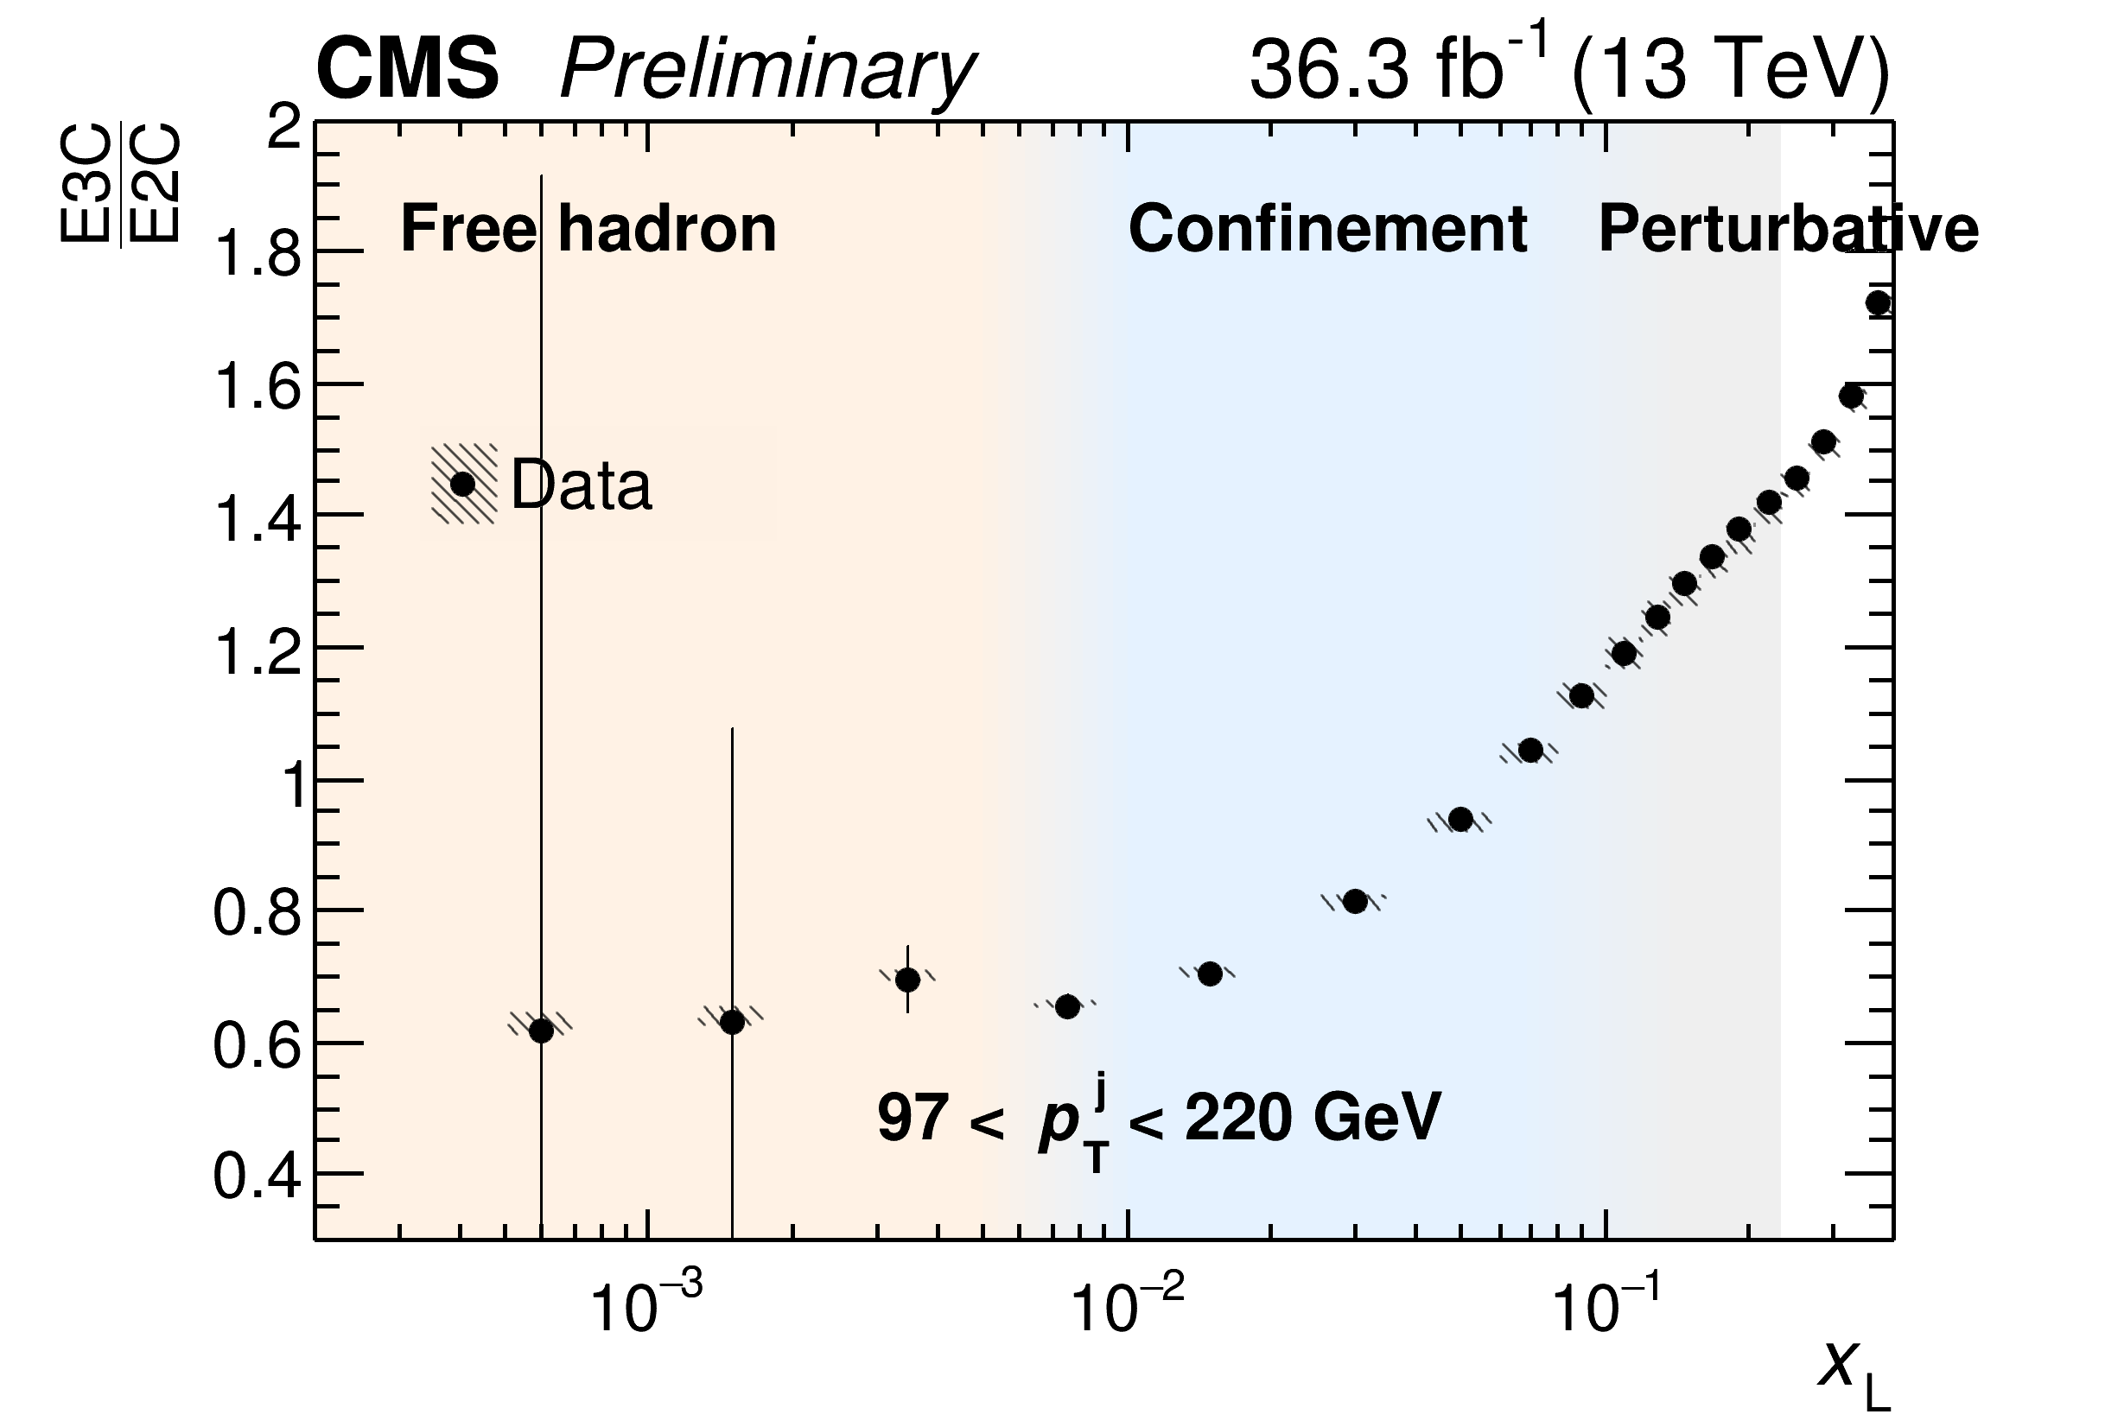
Asymptotic freedom in your face
Ratio between 3 point and 2 point energy correlator
2312.07655
slope as a function of jet pT
$$\text{slope}=α_{s}(p_{T}⟨θ⟩)+O(α_{s}^{2})$$
Reduction of slope at higher energy => asymptotic freedom!

Slide 15
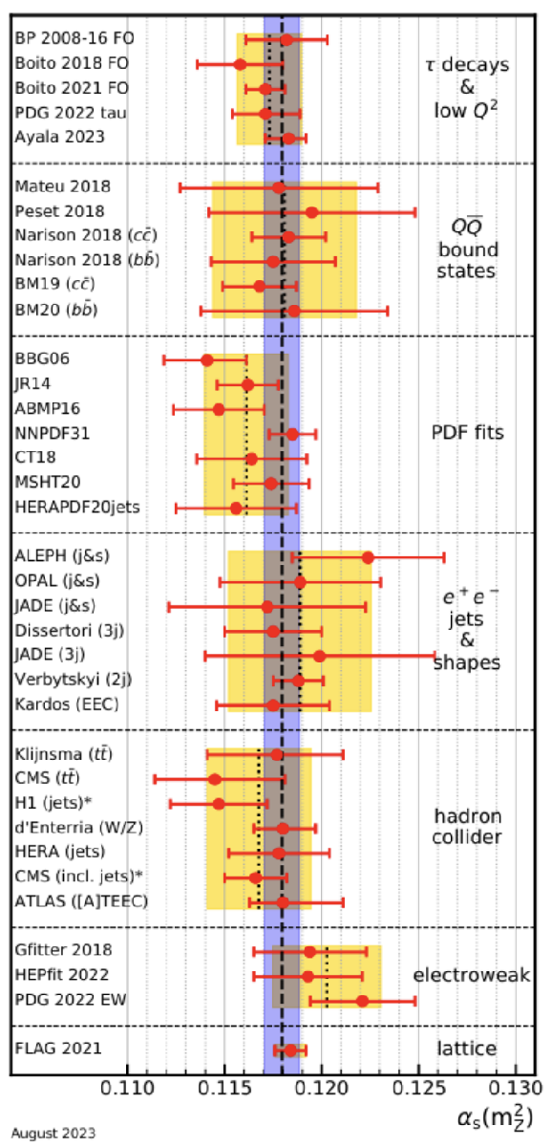
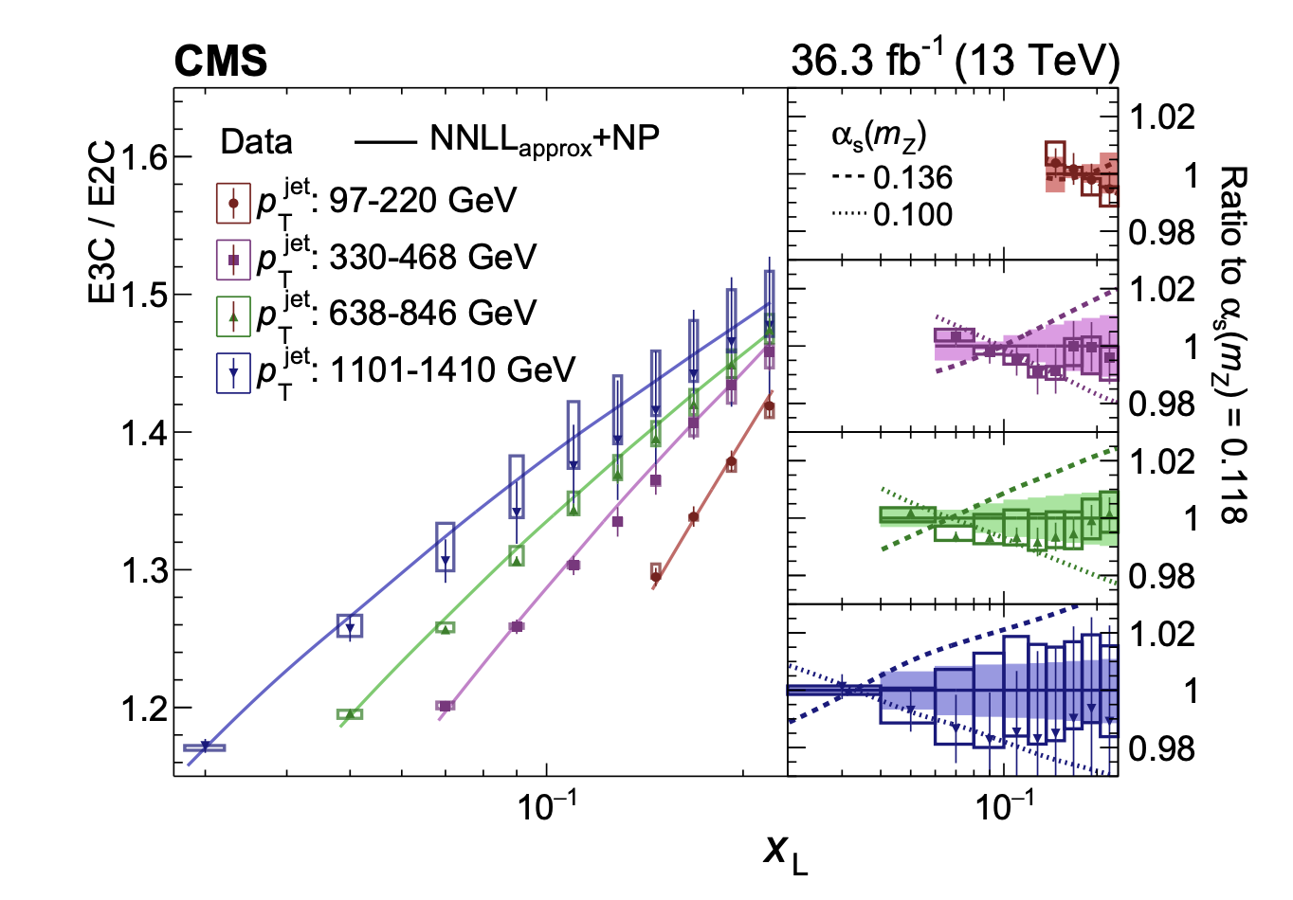
Strong coupling from energy correlators
Hannesdottir, Pathak, Schwartz, Stewart, 2022
2312.07655
NNLL: W. Chen, et al., 2023

Slide 16
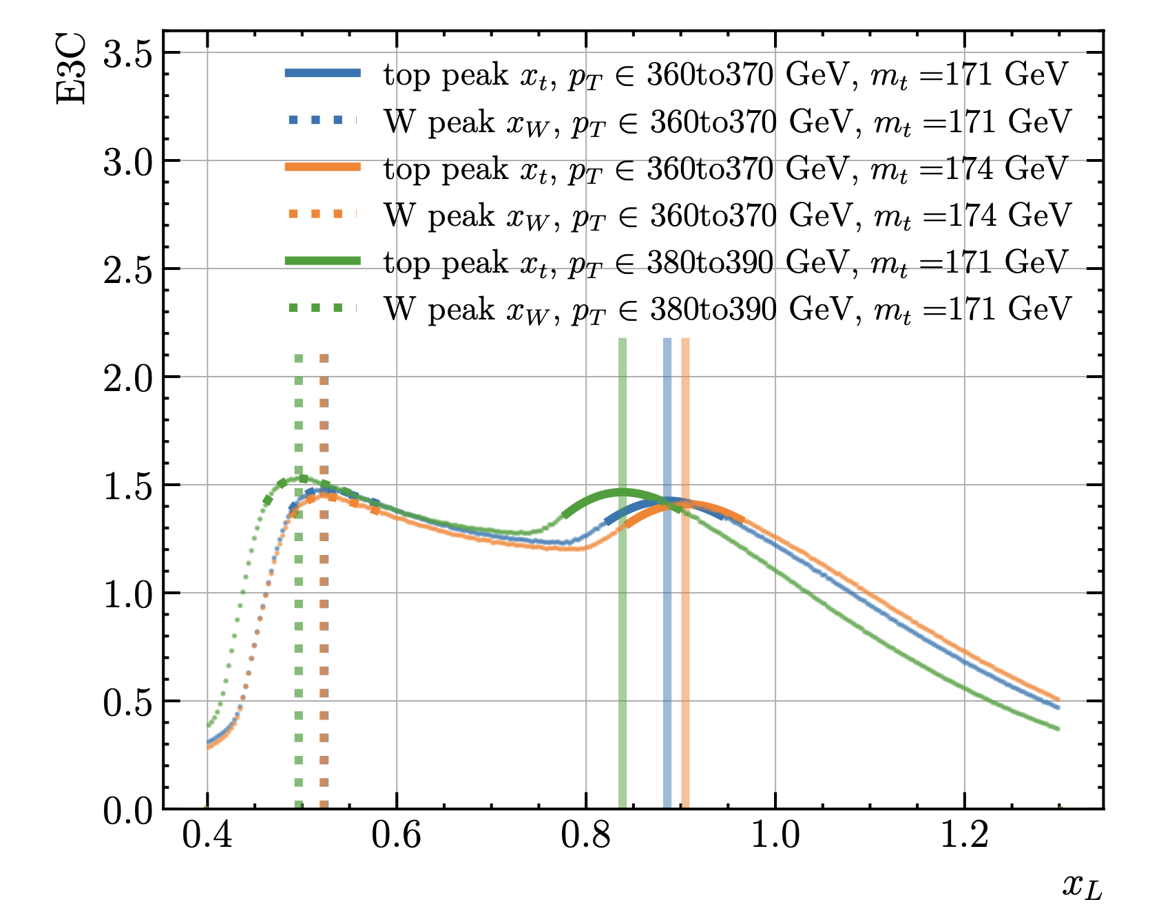
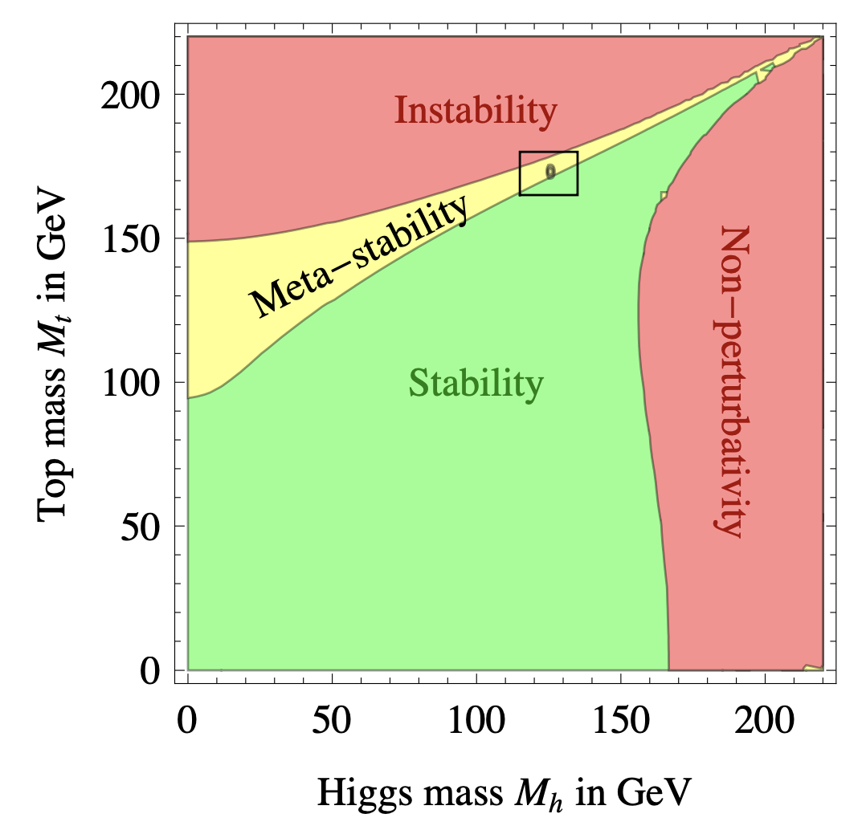
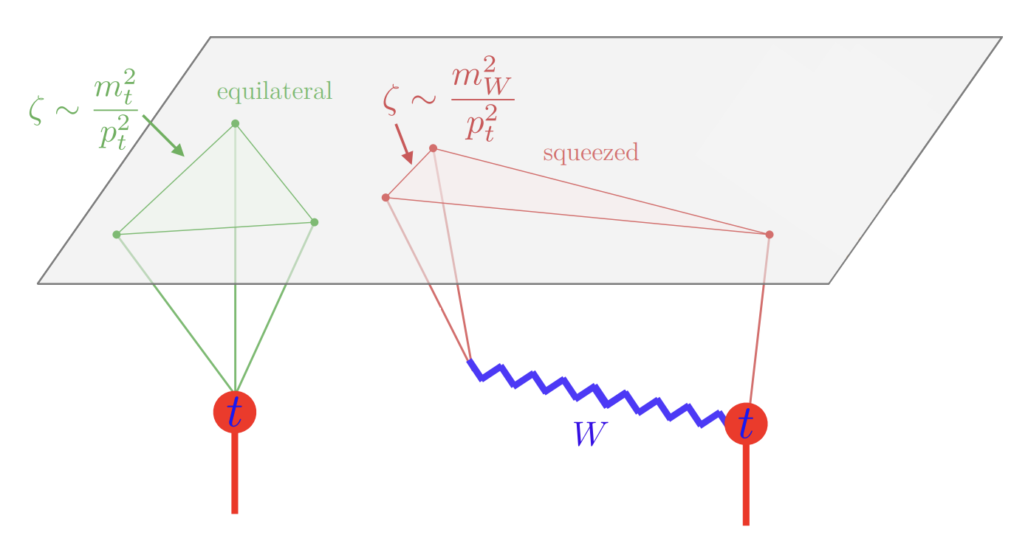
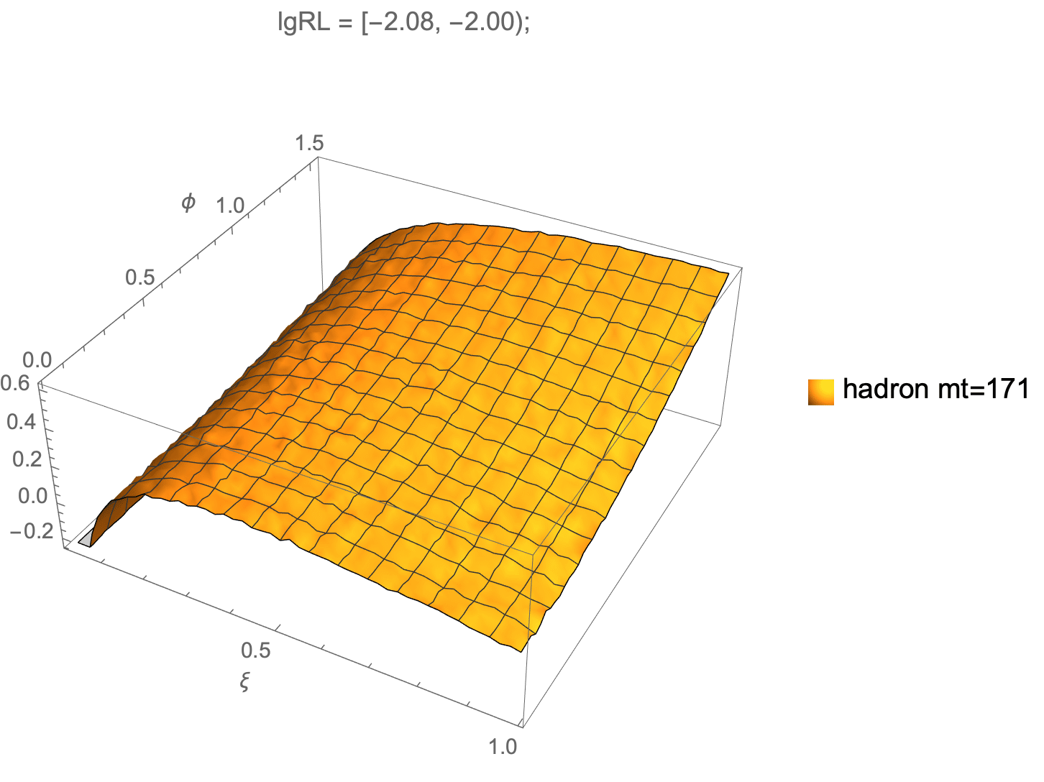
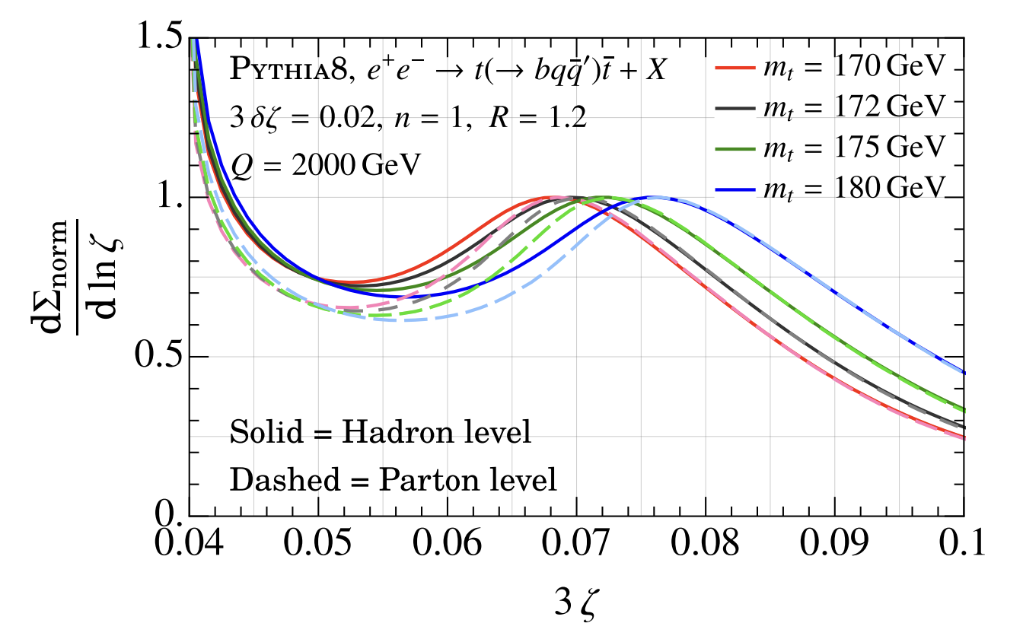
Energy correlators for top physics
top quark mass is closely related to stability of the SM vacuum
low pT region
jet EEEC
Holguin, Moult, Pathak, Procura, 2022
M. Xiao, Y.L. Ye, X.Y. Zhu, in preparation
pythia simulation
from small to large scale

Slide 17
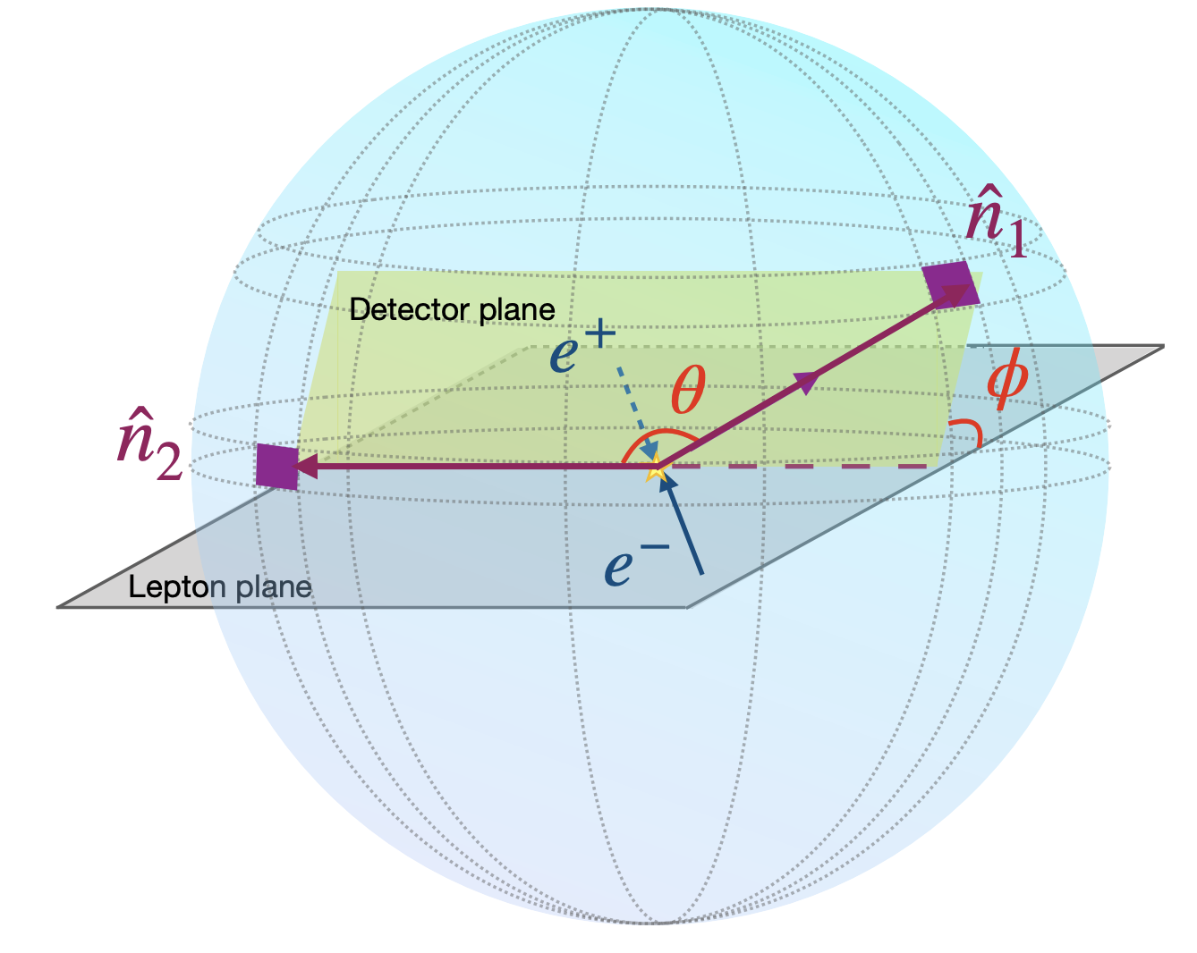
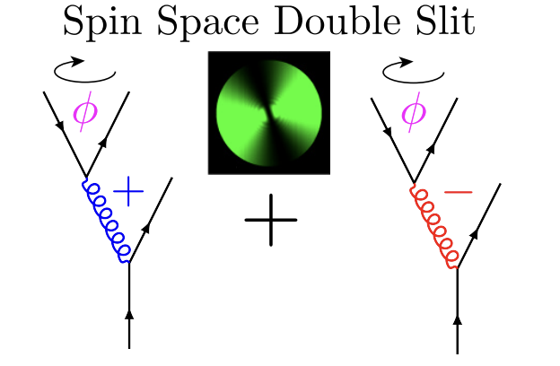
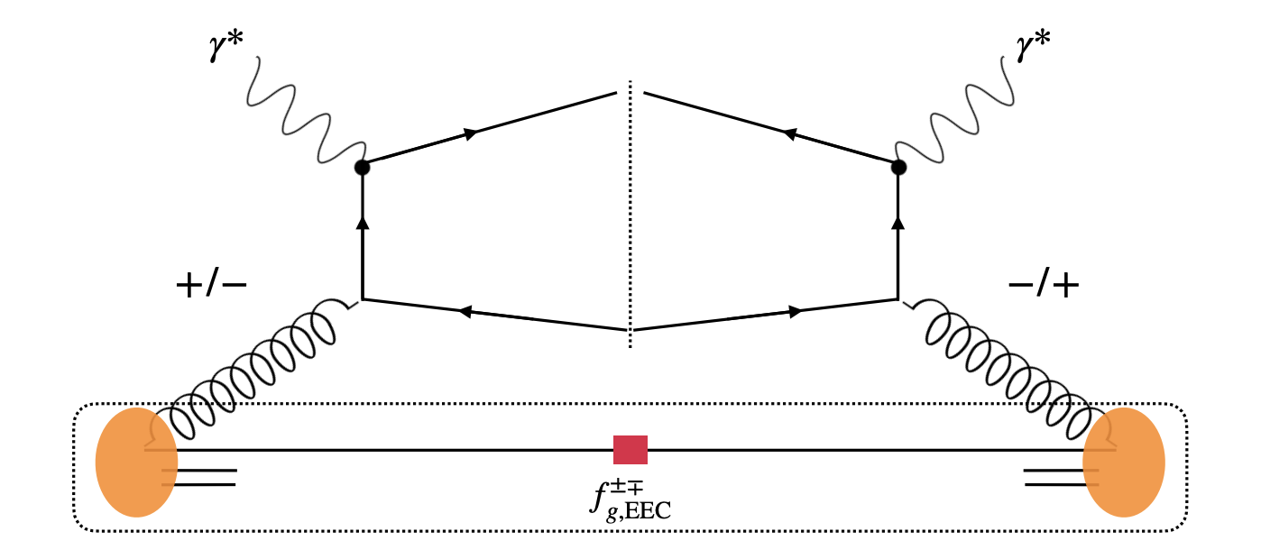
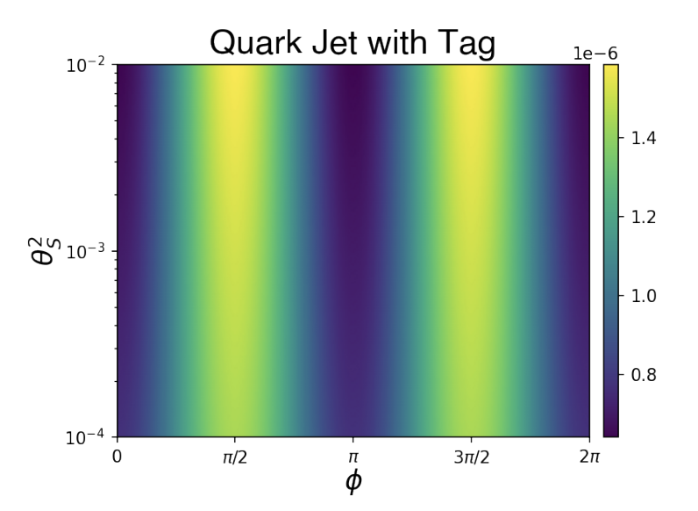
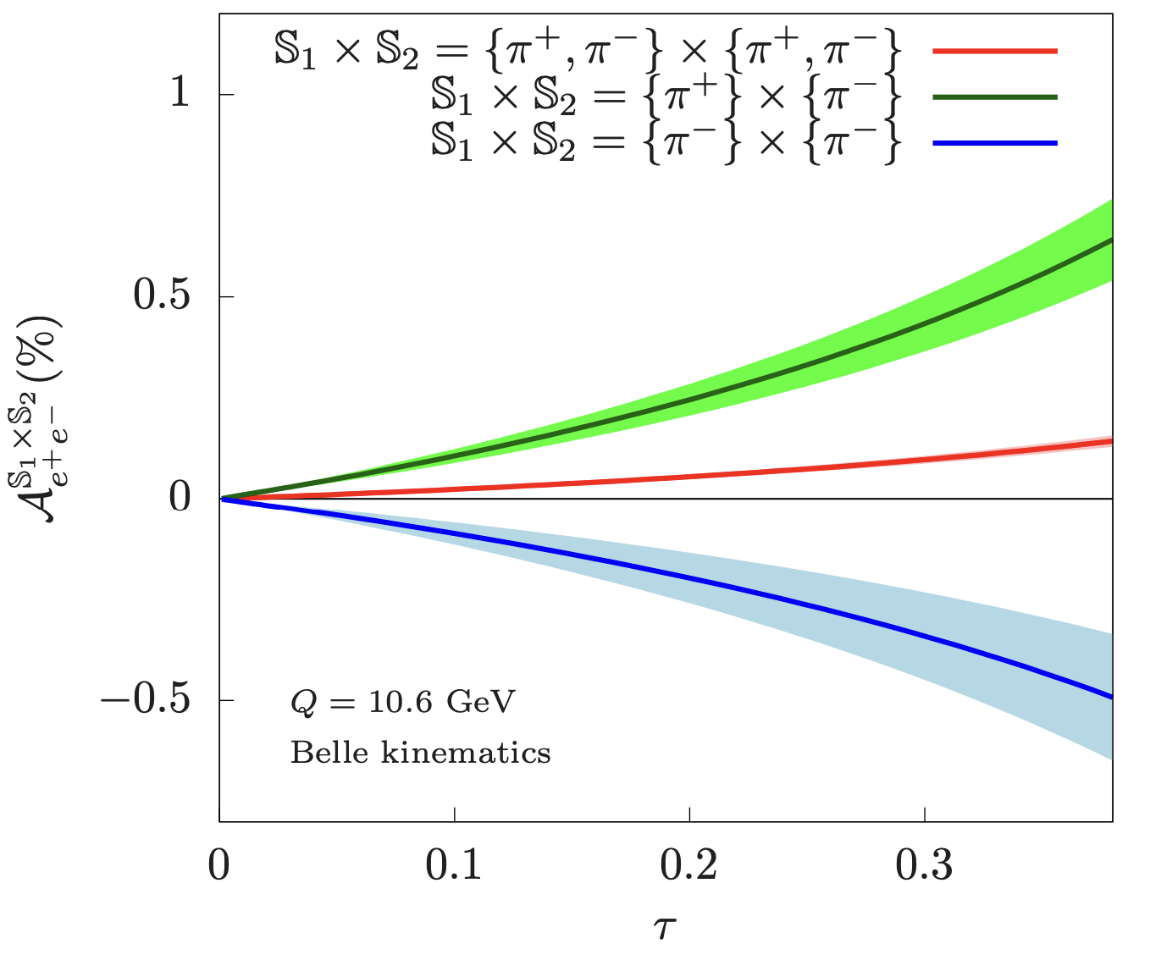
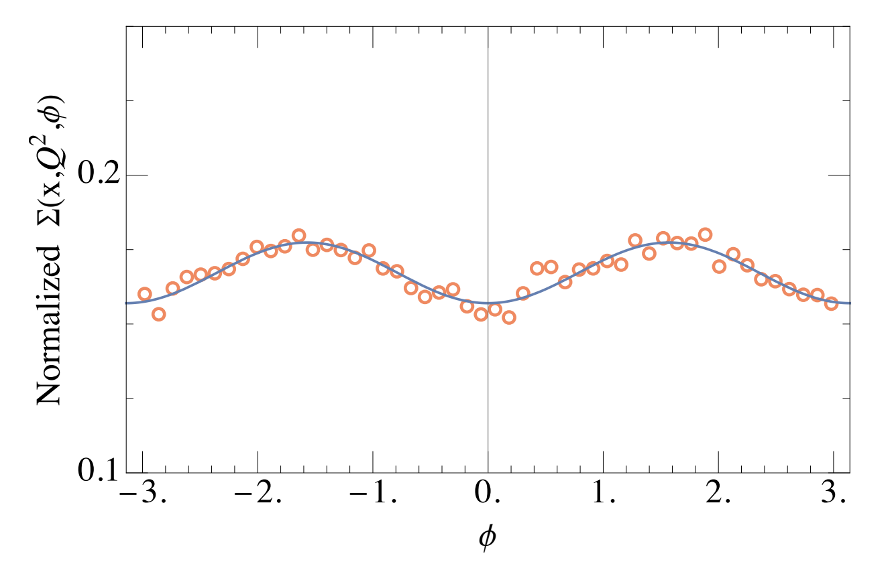
Energy correlators for spin physics
Spin correlation is mostly conveniently measured using Energy Correlators
perturbative calculable + No ambiguity in definition of angle
gluon spin
gluon spin
Collins effect
H. Chen, Moult, HXZ, 2020
X.L. Li, X.H. Liu, F. Yuan, HXZ, 2023
Z.B. Kang, K. Lee, D.Y. Shao, F.Y. Zhao, 2023

Slide 18
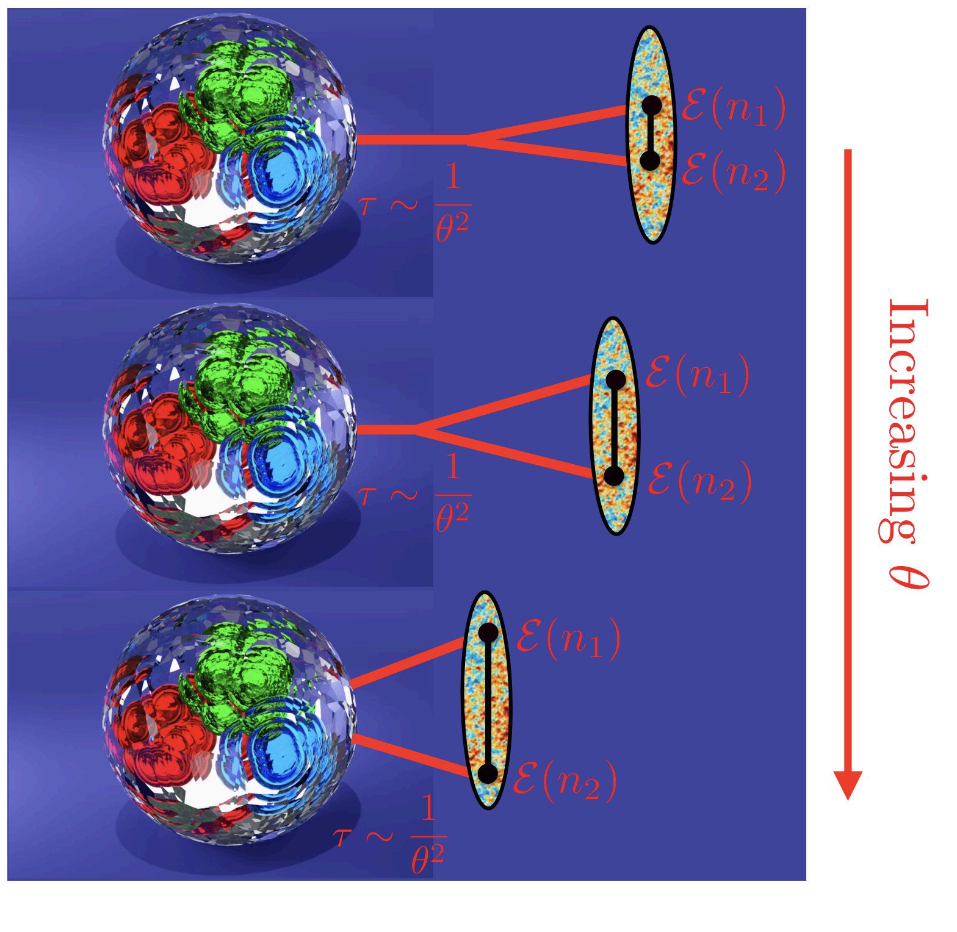
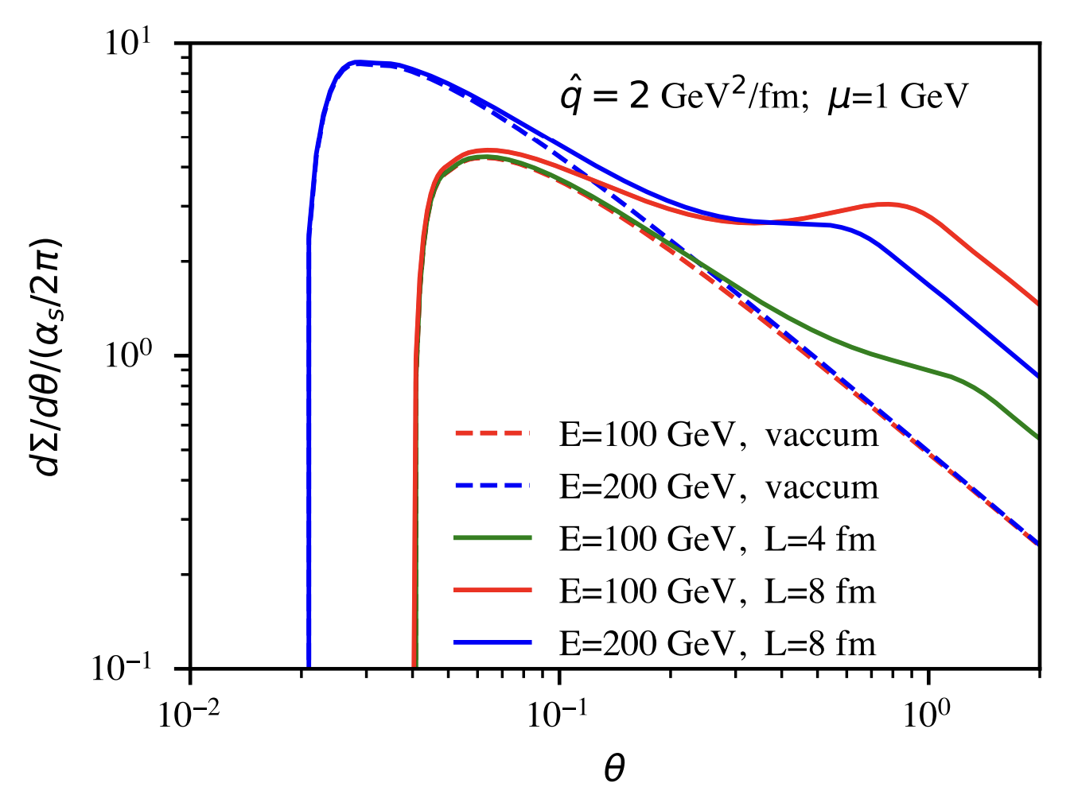
Energy correlators for heavy ion physics

Slide 19
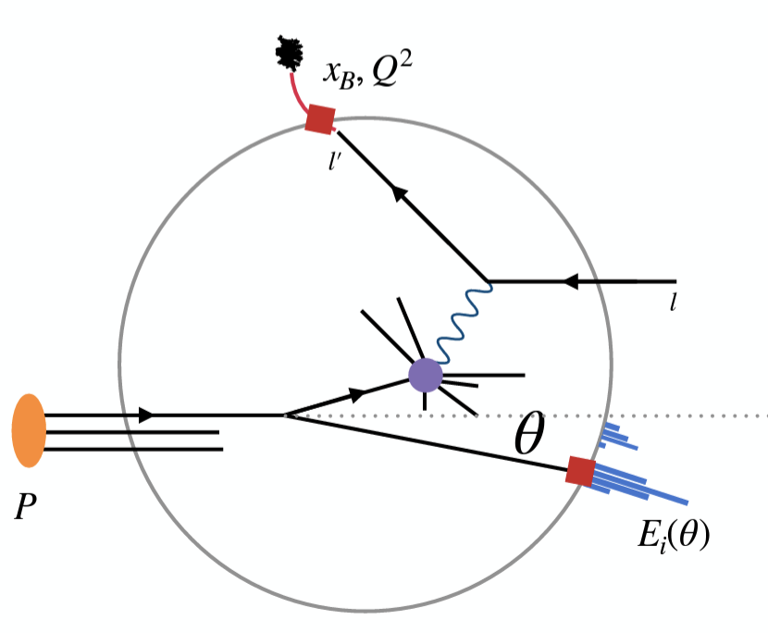
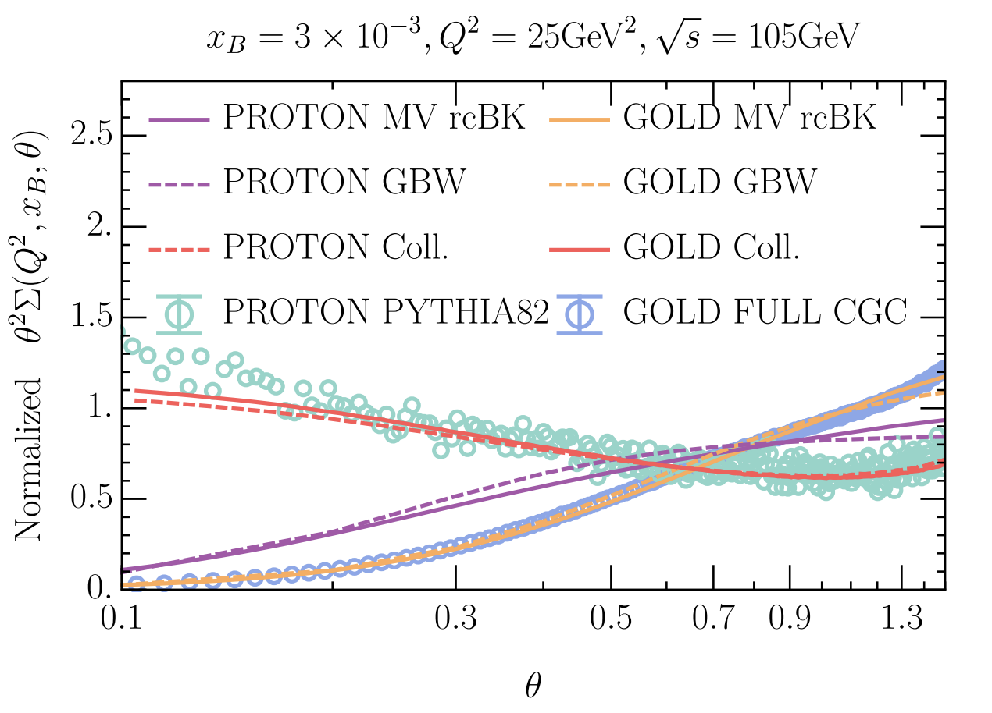
The nucleon EEC: new angle to hadron structure
inclusive DIS
X.H. Liu, HXZ, 2022
H.T. Cao, X.H. Liu, HXZ, 2023
semi-inclusive DIS
current fragmentation
nEEC probing the angular (transverse) structure of nucleon
H.Y. Liu, X.H. Liu, J.C. Pan, F. Yuan, H.X. Zhu, 2023
???
target fragmentation
Trentadue, Veneziano, 1994
APS Synopsis
inclusive -> current frag. -> target frag.
DOE Science Highlight
increasing in detecting techniques
suppression of nEEC due to gluon saturation

Slide 20
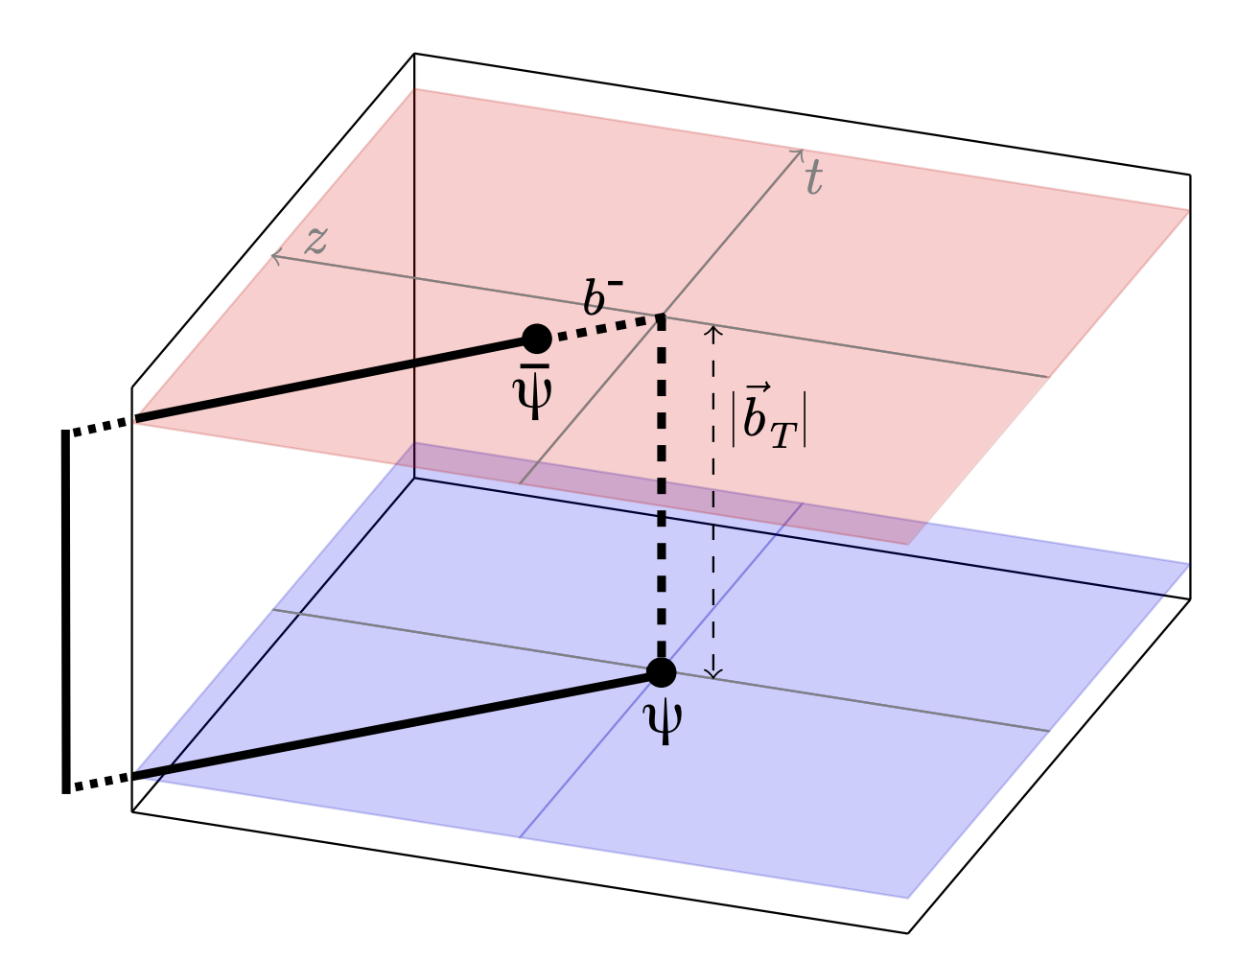
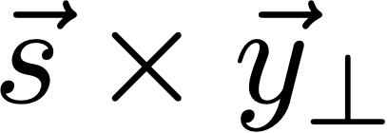
Connecting nEEC to TMD PDFs
Nucleon Energy Correlator
(quark) TMD PDF
The transverse gauge link leads to interesting physics
the Sivers effect

Slide 21
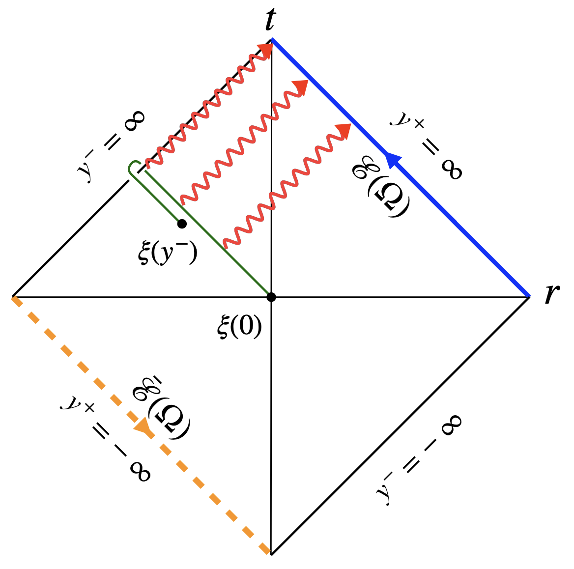
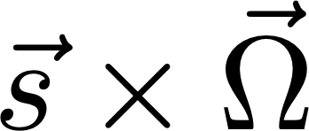
Connecting nEEC to TMD PDFs
Nucleon Energy Correlator
(quark) TMD PDF
X.H. Liu, HXZ, 2024
Glauber gluon
Penrose diagram for nEEC
Allows signal transmitted to $y^{-}=y^{+}=∞$
The transverse gauge link leads to interesting physics
In momentum space => $k=(k^{+},k^{-},k_{⊥})∼Q(λ^{2},λ^{2},λ)$
the Sivers effect
the Sivers effect

Slide 22
A twist-3 collinear factorization
X.H. Liu, D.Y. Shao, HXZ, W.I.P.
glauber
energy operator
energy operator
match onto the Qiu-Sterman function

Slide 23
Sign change of Sivers and factorization breaking
J. Collins, 2002; S. Brodsky, D.S. Hwang, I. Schmidt, 2002; D. Boer, P. Mulders, F. Pijman, 2003; ……
Catani and collaborator’s
factorization breaking
1
S. Catani, D. de Florian, G. Rodrigo, 2011
j
j
DIS
Drell-Yan
DIS: sj1>0
DY: sj1<0
All outgoing convention
can be understood from SCET-Glauber, M. Schwartz, K. Yan, HXZ, 2017

Slide 24
Covering the full 4$π$ angle at EIC
H.T. Cao, H.T. Li, Z.H. Mi, 2023
Full phase space coverage in e+e- exhibit rich dynamics.
Now the same can be done for DIS!
TMD
jet
$$θ$$

Slide 25
Theorizing the track measurement
track function: probability for finding charged hadrons with total momentum fraction x
solution:
Chang, Procura, Thaler, Waalewijn, 2013
Nightmare for precision measurement with neutral hadrons
Using tracks!
Asymmetric EEC on tracks
Y.B. Li et al., 2021
Full NLO evolution for track function
H. Chen et al., 2022
By-product: first NLO evolution kernel for dihadron fragmentation!
First NLO calculation with tracks!

Slide 26
Energy correlators for future colliders
e+e- above 200 GeV: open up the perturbative window for numerous precision measurements
small
angle
(low energy)
large
angle
（high energy）
e+e- below 10 GeV: explore the transition from quarks to hadrons in unprecedented details

Slide 27
Towards understanding QCD hadronization: renormalon
Schindler, Stewart, Z.Q. Sun, 2023; K. Lee, Pathak, Stewart, Z.Q. Sun, w.i.p.
Borel plane
u=1/2

Slide 28
Towards understanding QCD hadronization: evolution
H. Chen, P. Monni, Z. Xu, HXZ, W.I.P.
universal low energy matrix element
Wilson coefficient
perturbative
leading hadronization:
Pythia
91.2
prediction
250
preliminary
500

Slide 29
Conclusion
Energy correlators bridge the gap between quark/gluon and hadron dynamics.
Significant progress in the past few years. It has been transformed from a theoretical concept to actual measurements in experiment.
Many exciting opportunities to be explored. Stay tuned!
Pythia
91.2
prediction
250
preliminary
500

Slide 30
R-ratio
Energy Correlator
Formal/QCD theory-Particle/Nuclear phenomenology/Collider experiments;
Recent workshops dedicated to EECs; Summary report of Snowmass; Craig’s talk 3 correlator
Energy Operators; Formal theory/Black hole/Lightray OPE/Demonstrate of ANEC condition
Analytic calculation, Kai Yan
Scaling law in CFT
Madalcena’s comment
(approximate) Scaling law in QCD
Experiments: from SLAC to CMS/ALICE
Interpretation of the scaling/Collider Energy
Asymptotic Freedom in your face
Extraction of strong coupling constant
Extraction of top quark mass
Spin effects/gluon double slit; Collins effects;
Heavy quark medium effects
EIC TMD; cold nuclear matter
Nucleon EEC/Semi-inclusive EEC
TMD from EEC; Quark gluon plasma; highlight in APS; DOE
tracks and dihadron fragmentation at NLO
Conclusion

