Slide 1
Two-loop QCD Corrections to Pion EM form factors
第六届重味物理与量子色动力学研讨会
arXiv:2312.17228 (Accepted by PRL)
陈龙斌
合作者：陈文、冯锋、贾宇
2024/4/21（青岛）

Slide 2
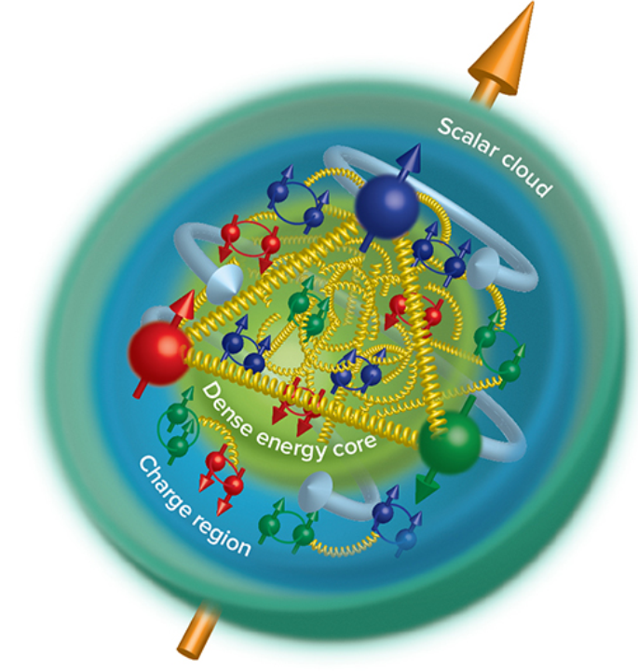
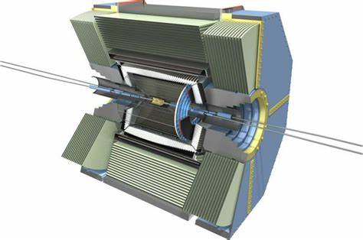
Unveiling the inner structure of hadron
Motivation
Hadron Structure
QCD

Slide 3
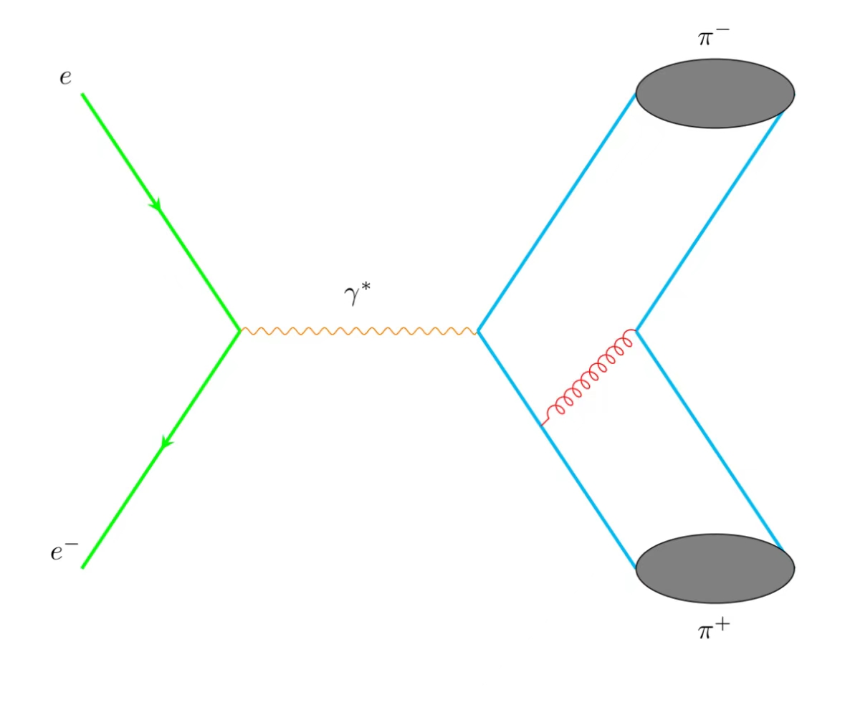
Space Like
Sullivan Process
At small t is sensitive to pion form factor
Lattice : See Heng-Tong Ding’s talk
Time Like
PQCD
Probing pion Form Factors

Slide 4
Probing the internal structure of hadrons
Charge Pion Form Factors:

Slide 5
In framework of Collinear Factorization
(Lepage, Brodsky, Efremov, Radyushkin, Duncan, Mueller)
Leading-Twist Pion LCDA:
ERBL evolution equations

Slide 6
Hard Kernel
Pertubative Expansion
LO: 1977-1980 Lepage, Brodsky, Efremov, Radyushkin, Duncun, Muller…
NLO: Field, Gupta, Otta, Chang(1981), Dittes, Radyushkin(1981), Sarmadi (1984),
Braaten,Tse(1987), Melic, Nizic and Passek (1998).
Our goal on this work is to achieve NNLO calculations.(2023)

Slide 7
Feynman Diagrams(about 1600)
Partonic process

Slide 8
Calculation Methods
Diagrams and amplitudes : HepLib, FeynArts
Partial Fraction: Apart
Integrals Reduction: FIRE
Master Integrals Calculation: Differential Equations
(AmpRed) See Wen Chen’s talk
Validations of analytic results for MIs: AMFLOW, AmpRed

Slide 9
Integral Reduction and calculation

Slide 10
Integrals Reduction: IBP (integration-by-parts)

Slide 11
Differential Equations (DE)

Slide 12
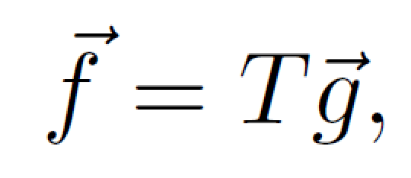
Choosing canonical basis (Basis with uniform transcendentality)
For random integral basis g, we have:
We can choose new basis f:

Slide 14
LO kernel

Slide 15
Perturbative expansion
Renormalized “pion” LCDA can be expressed as :

Slide 16
Renormalized LCDA
Related with EBRL kernel
arXiv:hep-ph/0512208

Slide 17
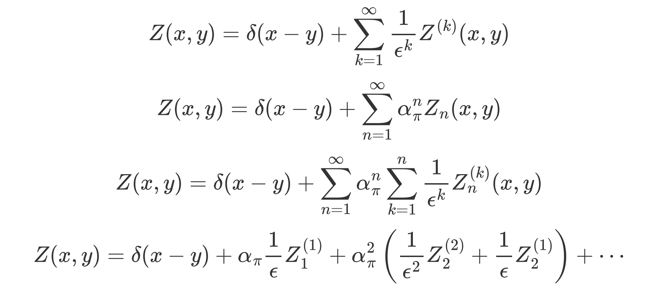
Bare LCDA

Slide 18
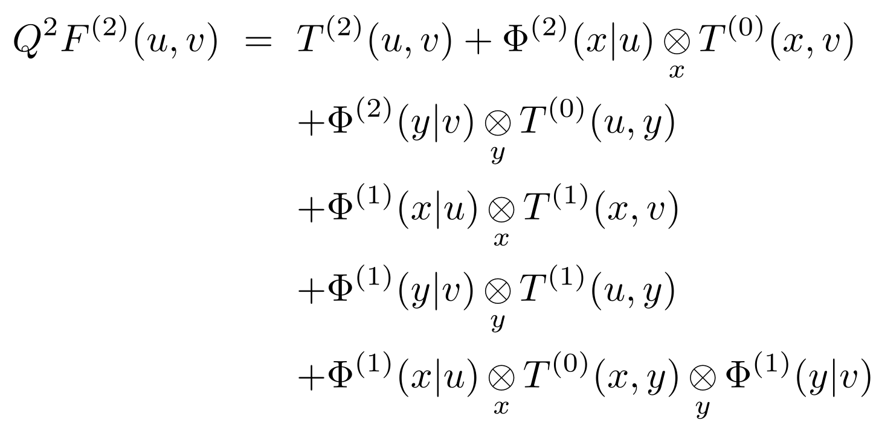
Matching
NLO
NNLO

Slide 19
LO and NLO Matching

Slide 20
NNLO Matching
The convolutions above are calculated analytically.

Slide 21
Asympotic Expression of Kernel $$T^{(1)}$$
NLO results agree with previous calculations

Slide 22
$$T^{(2)}$$

Slide 23
$$T^{(2)}$$
Can the endpoint logarithms be resummation?

Slide 24
Phenomenological Exploration

Slide 25
Leading-twist pion LCDA
$a_{n}$ can be calculated by Lattice QCD
See Jun Hua’s talk

Slide 26
The pion EM form factor
Two-fold Convolution

Slide 27
The convolutions can be evaluated analytically
About ${10}^{5}$ terms appear in the calculation of convolutions

Slide 28
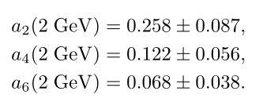
Phenomenological exploration
Inputs: Gegenbauer Moments
LPC
Based on LaMET 1305.1539
RQCD
1909.08038
2201.09173

Slide 29
Phenomenological exploration Results with LPC inputs
Space Like FF
Time Like FF

Slide 30
Results with RQCD inputs
Space Like FF
Time Like FF

Slide 31
Conclusion
The EM form factors for pion have been calculated up to NNLO QCD corrections.
We verify the validity of the collinear factorization for this observable.
The matching kernel have been obtained analytically.
The NNLO corrections turn out to be positive and significant.
The NNLO results can provides strong constraint on the Gegenbauer moments.
Extend this calculation to Kaon or proton FF.

Slide 32
谢谢！

