Slide 1
Study of X(3872)’s structure
康现伟
北京师范大学
第六届重味物理与QCD研讨会
2024年4月19日-23日
PRD2016, EPJC2017, PRD2022, EPJC2022, PLB2024

Slide 2
Outline
Line shape of X(3872)
Radiative decay of X(3872)

Slide 3
Two concepts: compositeness and CDD pole

Slide 4
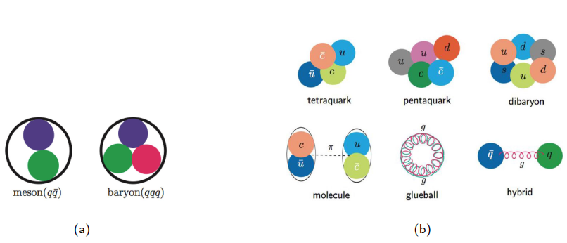
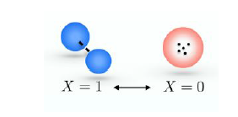
Compositeness $X$: weight of two-meson components in the configuration of configuration

Slide 6
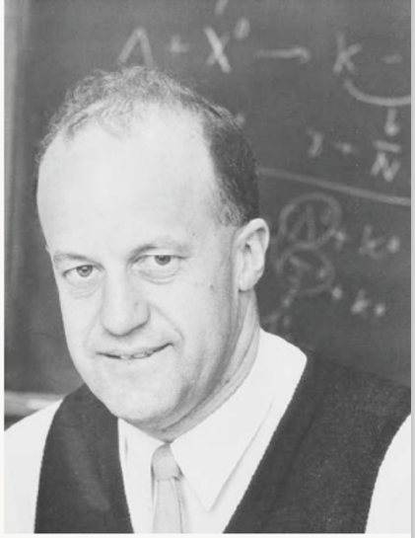
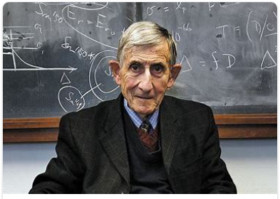
CDD poles
F. J. Dyson
R. Dalitz

Slide 7
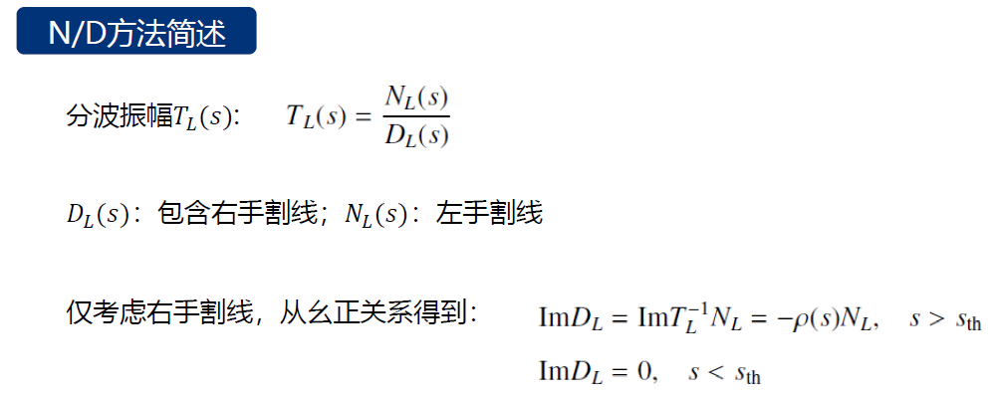

Slide 8
添加这些CDD极点不违背任何解析性、幺正性的要求
CDD极点是T振幅的零点
(3）CDD极点的出现：与分波振幅有相同量子数的基本粒子相关联

Slide 11
Quantum number of X(3872) state

Slide 21
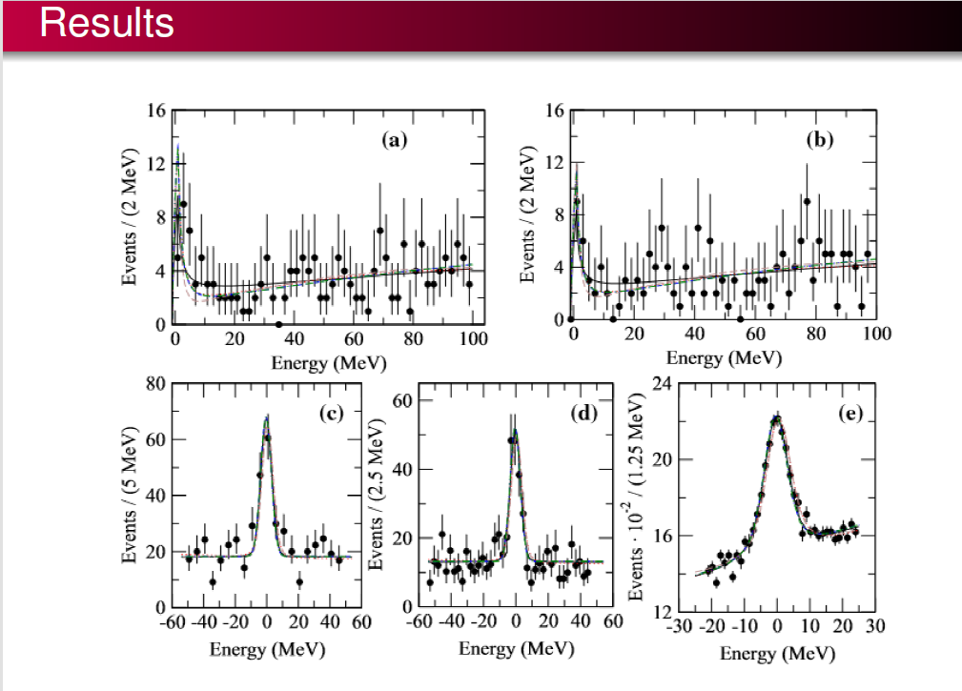

Slide 22
Higher-order poles of S-matrix
出现在相邻黎曼面，Morgan判据

Slide 23
Zb 数值结果
C. Y. Cui, Y. L. Liu and M. Q. Huang, PRD 85, 074014 (2012):
both a $B^{∗}\overline{B}$ molecular state and a$\left[bd\right]\left[\overline{b}\overline{u}\right]$ tetraquark state coincide with $Z_{b}$(10610).

Slide 24
Radiative decay of X(3872) in the covariant light-front quark model (CLFQM)

Slide 25
Overall blueprint:
Assuming X(3872) as a pure $c\overline{c}$ resonance, considering the decay $X\left(3872\right)→γJ/ψ$ and $γψ′$ at the same footing
Conclusion: their partial width can not reconcile with each other.

Slide 26
Feynman rule for light-front quark model
1. Momentum variables expressed in the light front
coordinates
2. Wave function of the (axial-vector, vector, scalar, pseudo-
scalar) meson encodes the bound state nature of $\overline{q}q$
3. Vertex comes from the SM, Melosh transformation:
The connection between spin states in the rest frame and infinite momentum frame Or between spin states in the conventional equal time dynamics and the light-front dynamics
4. Fermion internal line denotes a spin-1/2 propagator as
usual
5. quark masses as parameters, but fixed for all calculations

Slide 27
Parameter $β$characterizing the size of hadron,
will be fixed by decay constant
However, the wave function can be solved by e.g., relativistic quark model in the quasi-potential approach.

Slide 28
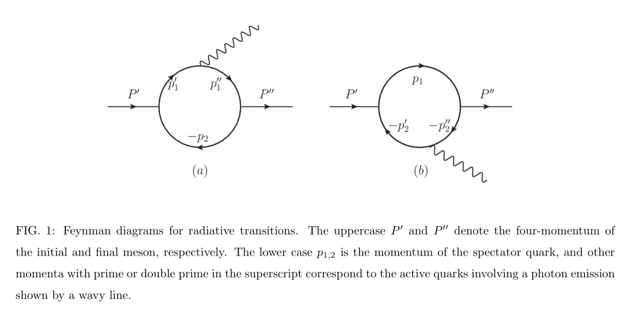

Slide 29
The polarization vectors in order are the ones for photon, X(3872), and $J/ψ$.
Independent from factors $f_{m}\left(q^{2}\right),f_{p}\left(q^{2}\right)$, $f_{6}\left(q^{2}\right)$

Slide 30
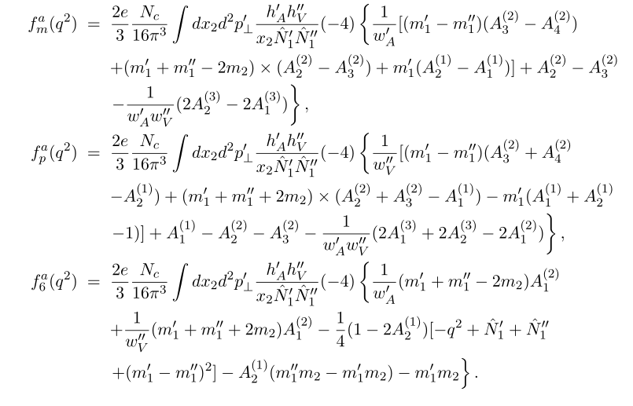
Expressions of form factors. In fact, we only concern the values at q²=0

Slide 31
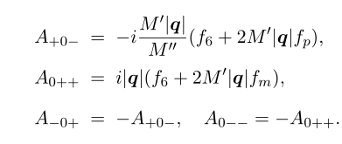
In the helicity basis:
M’ is the mass of X(3872), M’’ is the mass of $J/ψ$

Slide 32
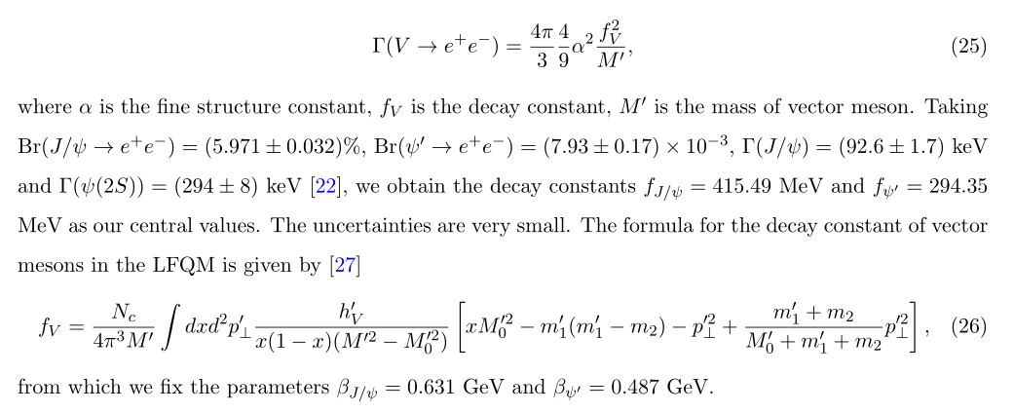
Wave function of $J/ψ$ and $ψ′$

Slide 33
Experimental width $Γ\left(X\left(3872\right)→J/ψγ\right)=\left(3.2±1.6\right)×{10}^{−3}$ MeV
X(3872) as 2P state:
Exp width of $Γ\left(X\left(3872\right)→ψ′γ\right)⟹β_{X\left(3872\right)}={0.56}_{−0.03}^{+0.04}$GeV
$⟹$ $Γ\left(X\left(3872\right)→J/ψγ\right)={0.91}_{−0.15}^{+0.17}$ MeV
X(3872) as 1P state: excluded by its mass value
Consequently, the scenario of a pure charmonium assignment for X(3872) will encounter difficulty to reconcile the widths to J/ψ γ and ψ’ γ.
Or stated differently, the probability that X(3872) is a pure $c\overline{c}$ resonance is rather tiny

Slide 34
Main points
The current line shape data is not enough to pin down the structure of X(3872). Both the virtual state and bound state are possible scenarios.
The radiative decay analysis basically excludes the pure$c\overline{c}$ scenarios.

