Slide 1
Unified Study of the Charmed-Meson Pair System Using the Complex Scaling Method
汇报人：程剑波
汇报时间：2024.4.22
山东青岛

Slide 2
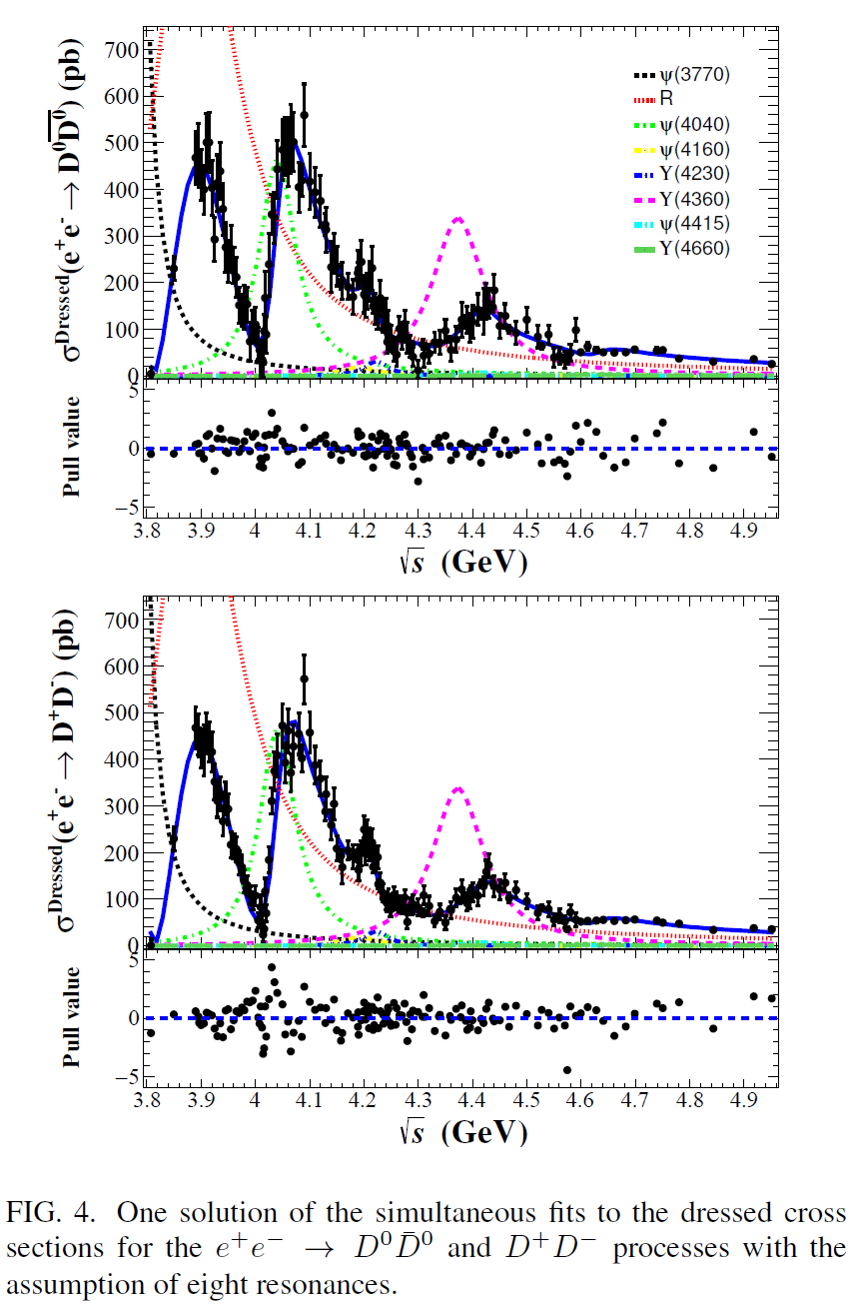
Motivation
Method
Results
Summary
In Feb 2024, BESIII collaboration observed a new particle R
in $e^{+}e^{−}→D\overline{D}$.
arXiv: 2402.03829
Mass: $3872.5±14.2±3.0$ MeV
Width:$179.7±14.1±7.0$ MeV
$$S\left(σ\right)>20$$
In 2008, BABAR and Belle collaborations observed
G(3900) with
BABAR, Phys. Rev. D 76, 111105 (2007);
Belle, Phys. Rev. D 77, 011103 (2008);
2/15

Slide 3
Motivation
Method
Results
Summary
Analysis
P-wave dimeson?
Number: $I^{G}\left(J^{PC}\right)=0^{−}(1^{−−})$
Channel: $D\overline{D}(^{1}P_{1})$, $\frac{1}{\sqrt{2}}(D{\overline{D}}^{∗}−D^{∗}\overline{D})(^{3}P_{1})$, $D^{∗}{\overline{D}}^{∗}(^{1}P_{1},^{5}P_{1})$
Denote as$Y\left(3872\right)$
Single channel investigation: $\frac{1}{\sqrt{2}}(D{\overline{D}}^{∗}−D^{∗}\overline{D})(^{3}P_{1})$,
Input: X(3872) as S-wave $\frac{1}{\sqrt{2}}(D{\overline{D}}^{∗}−D^{∗}\overline{D})(^{3}S_{1})$ with
$I^{G}\left(J^{PC}\right)=0^{+}(1^{++})$.
Decoupled in one-boson-exchange (OBE)
Decay channel: $D{\overline{D}}^{∗}$ and $D\overline{D}(D^{∗}{\overline{D}}^{∗}→D\overline{D})$
Main Channel: $D{\overline{D}}^{∗}$
3/15

Slide 4
Motivation
Method
Results
Summary
Explain the $Y\left(3872\right)$, $X\left(3872\right)\text{,}T_{cc}$ and $Z_{c}\left(3900\right)$ in unified framework?
4/15

Slide 5
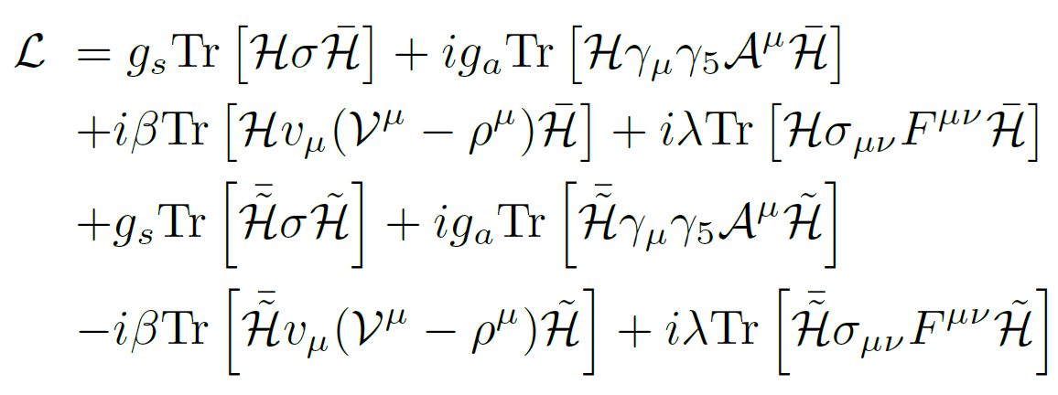
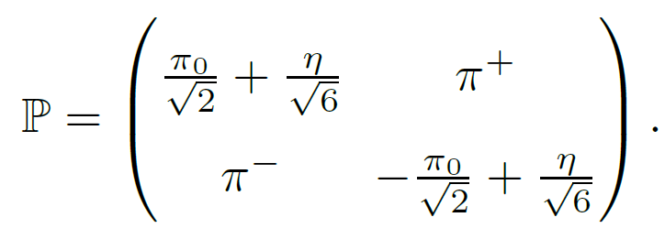
Motivation
Method
Results
Summary
Superfield
Lagrangian
OBE model
($π,η,σ,ρ,ω$)
$\tilde{P}=({\overline{D}}^{0},D^{−})$,
$${\tilde{P}}_{μ}^{∗}=({\overline{D}}^{∗0},D^{∗−})$$
,
5/15

Slide 6
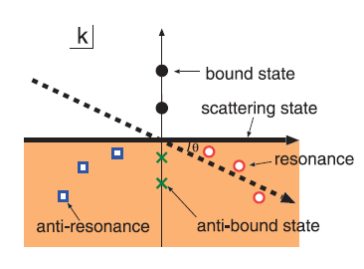
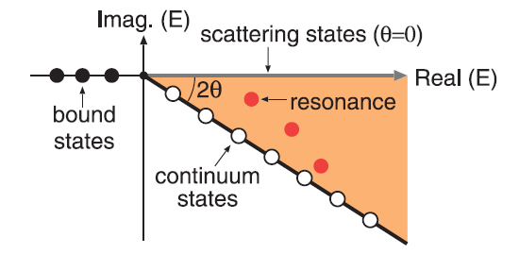
Motivation
Method
Results
Summary
Complex scaling method (CSM)
Operation: $U\left(θ\right)r=re^{iθ},U\left(θ\right)k=ke^{−iθ}$
Character:
(1) CSM LPS
(2) faster
(3) more intuitive
Aguilar, Balslev and Combes (ABC theorem)
Commun. Math. Phys. 22, 269 (1971); Commun. Math. Phys. 22, 280 (1971);
6/15

Slide 7
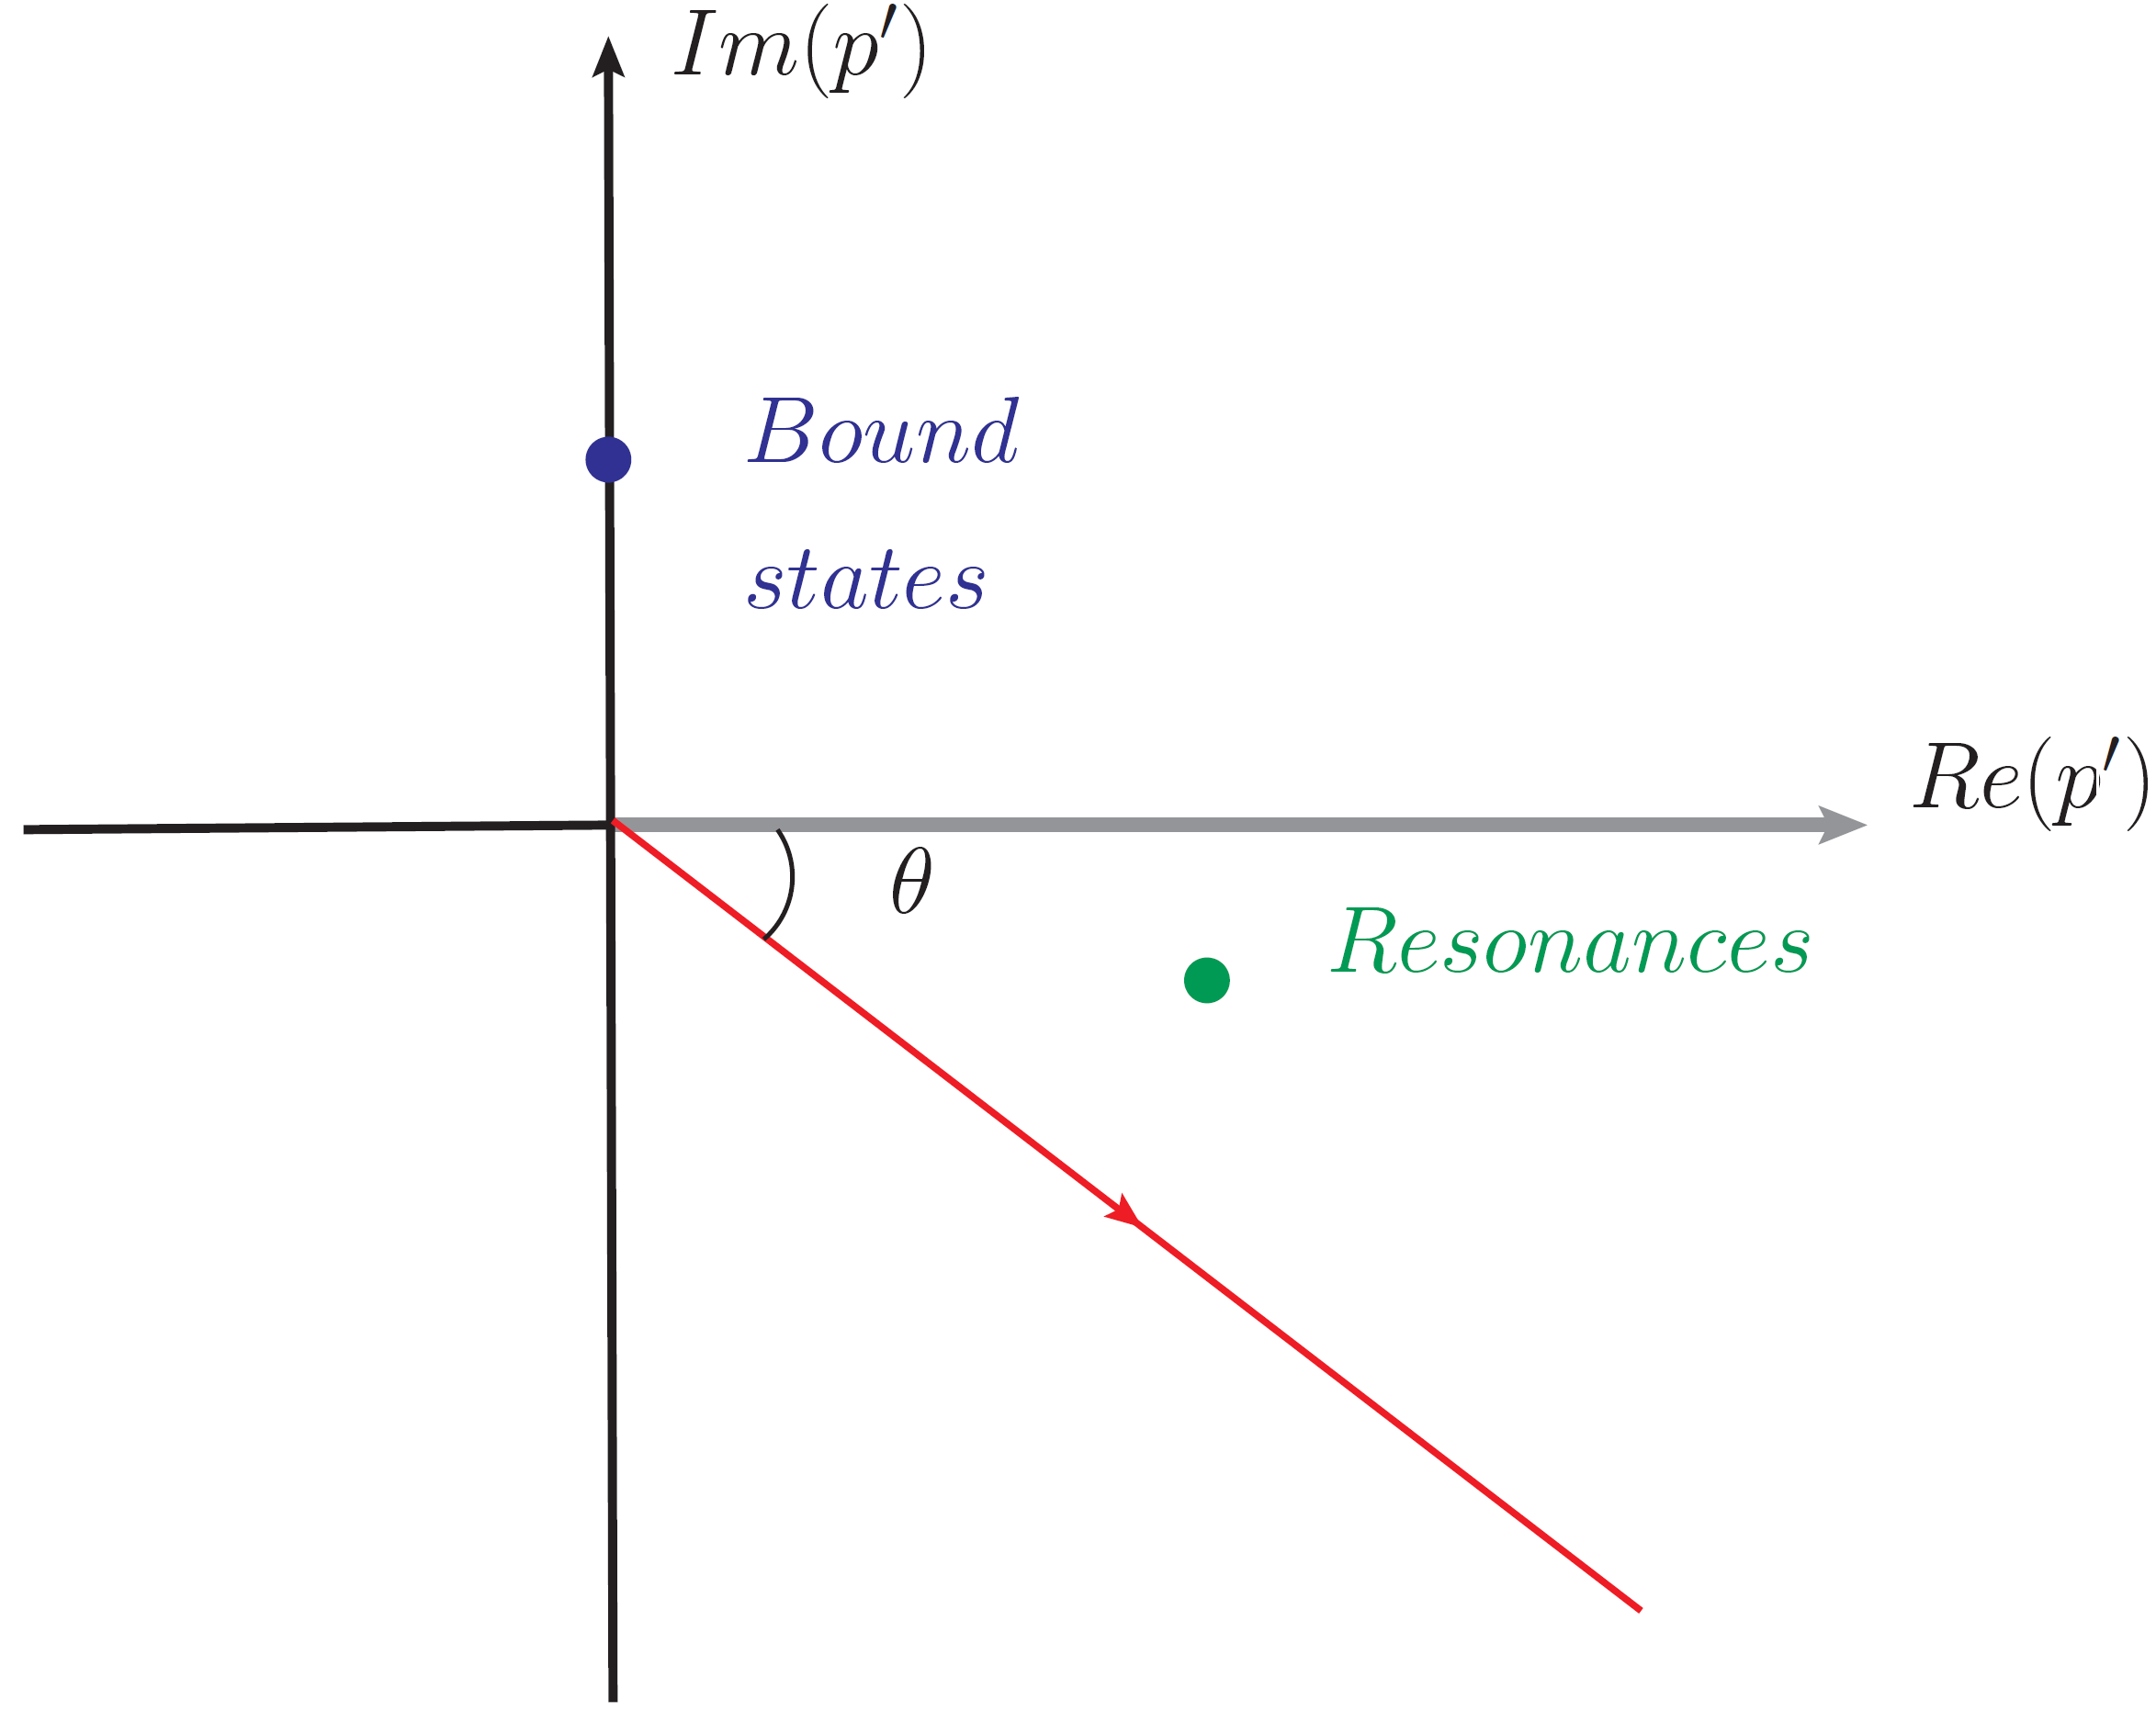
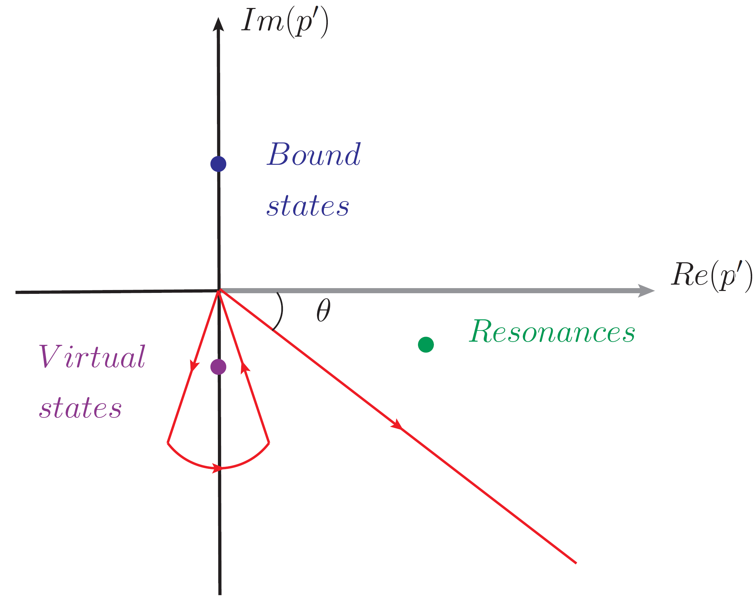
Motivation
Method
Results
Summary
Improved CSM (ICSM)
CSM contour
ICSM contour
Deal with virtual states
Chen et.al., Phys. Rev. D 109, 034006 (2024);
7/15

Slide 8
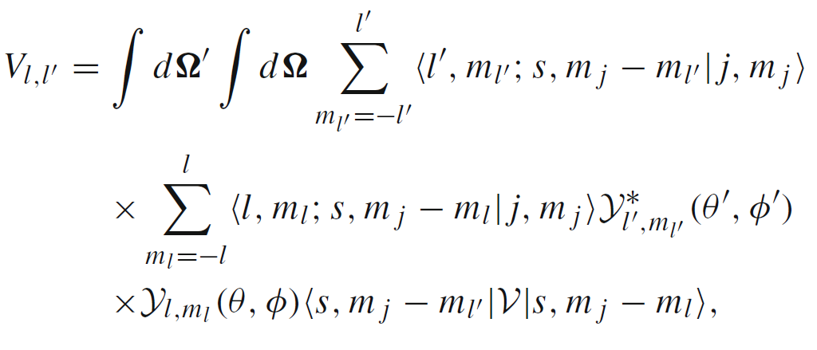
Motivation
Method
Results
Summary
Schr$\ddot{o}$dinger Equation
Schr$\ddot{o}$dinger Equation:
$$p→pe^{−iθ},p′→p′e^{−iθ}$$
Partial wave decomposition:
Nonlocal Regulator:
$$V\left(q\right)→V\left(q\right){\left(\frac{Λ^{2}−m^{2}}{Λ^{2}+q^{2}}\right)}^{2}$$
Local Regulator:
$Λ$ is the only parameter to be determined.
8/15

Slide 9
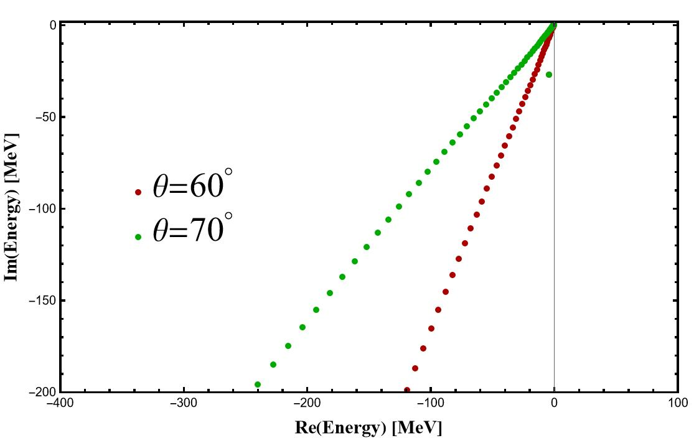
Motivation
Method
Results
Summary
Y(3872)
Y(3872): $\frac{1}{\sqrt{2}}(D{\overline{D}}^{∗}−D^{∗}\overline{D})(^{3}P_{1})$ with $I^{G}\left(J^{PC}\right)=0^{−}(1^{−−})$
Y(3872)
X(3872): $\frac{1}{\sqrt{2}}(D{\overline{D}}^{∗}−D^{∗}\overline{D})(^{3}S_{1})$ with $I^{G}\left(J^{PC}\right)=0^{+}(1^{++})$
Input
$Λ$=0.5 GeV
$δ$m[X(3872)]=-3.1 MeV
$δ$m[Y(3872)]=-4.0 MeV
$Γ$[Y(3872)]=54.6 MeV
coincide with experiment!
9/15

Slide 10
Motivation
Method
Results
Summary
$T_{cc}$ and $Z_{c}(3900)$
$T_{cc}$: ${DD}^{∗}(^{3}S_{1})$ with $I\left(J^{P}\right)=0(1^{+})$
Bound state $δ$m=-0.41 MeV
$Z_{c}\left(3900\right): \frac{1}{\sqrt{2}}(D{\overline{D}}^{∗}+D^{∗}\overline{D})(^{3}S_{1})$ with $I^{G}\left(J^{PC}\right)=1^{+}(1^{+−})$
$δ$m =-34.6 MeV
Virtual state
Instantaneous approximation: $q_{0}=0;$
Avoided the left-hand cut in $Z_{c}$ case.
10/15

Slide 11
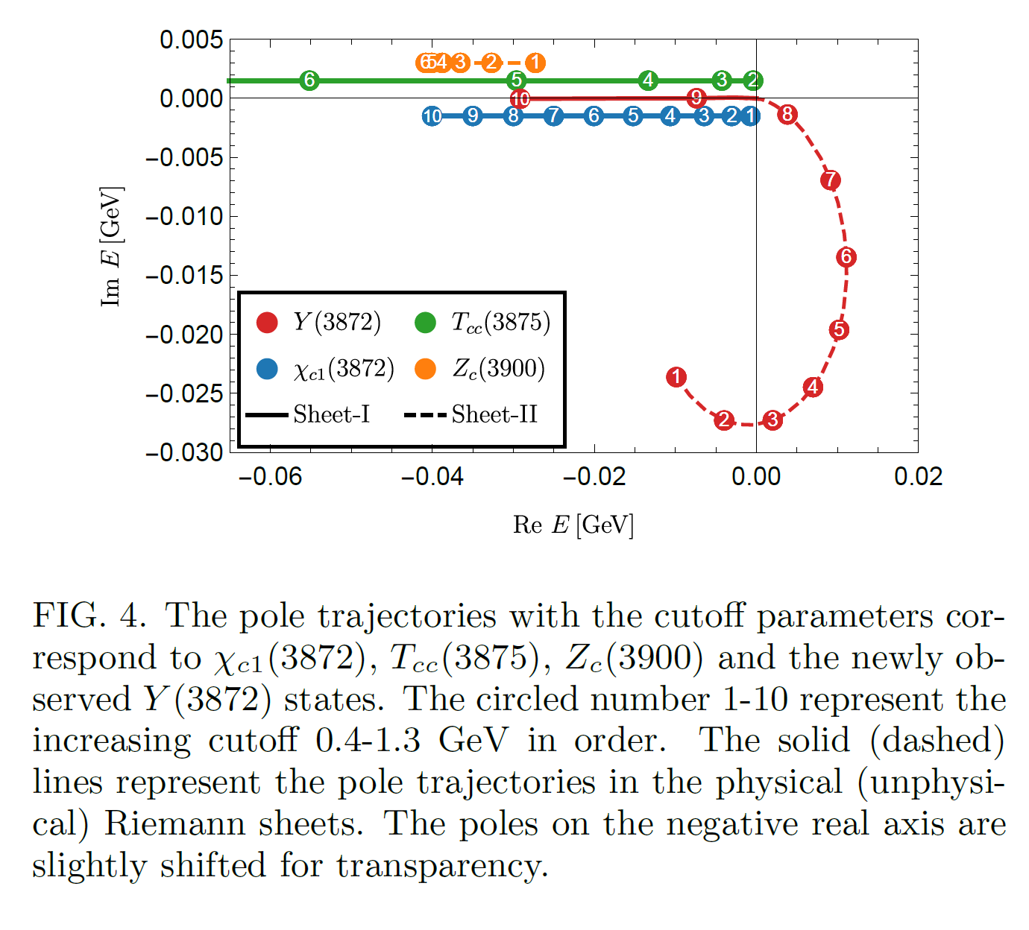
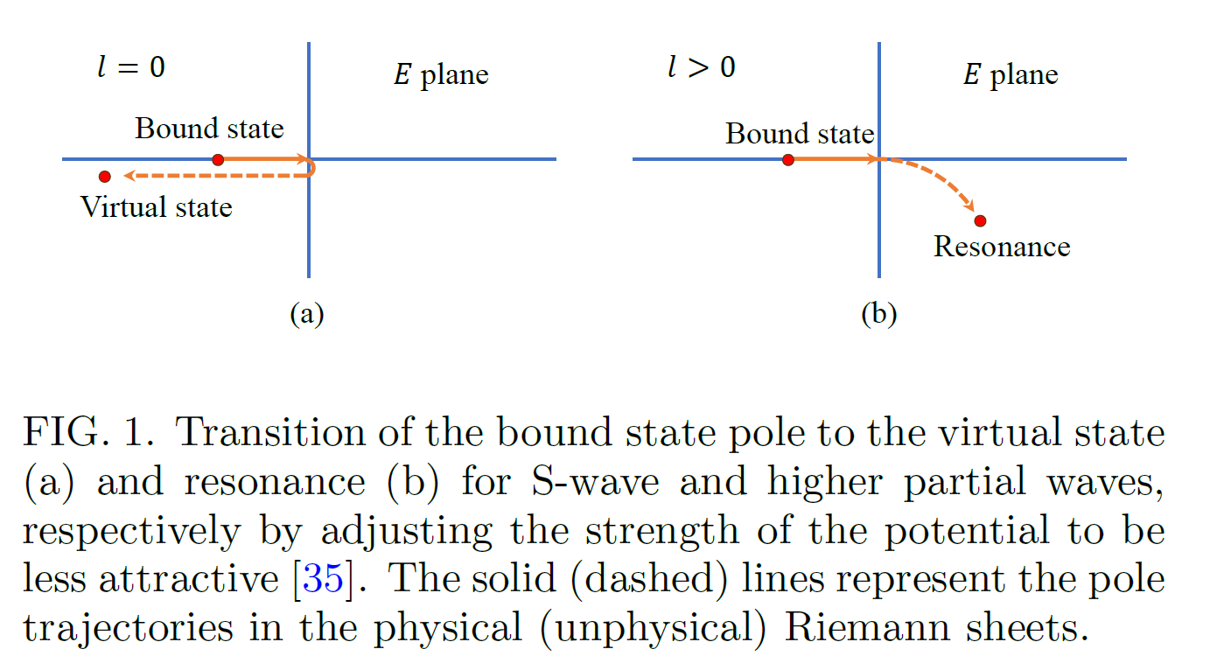
Motivation
Method
Results
Summary
The pole trajectories
11/15

Slide 12
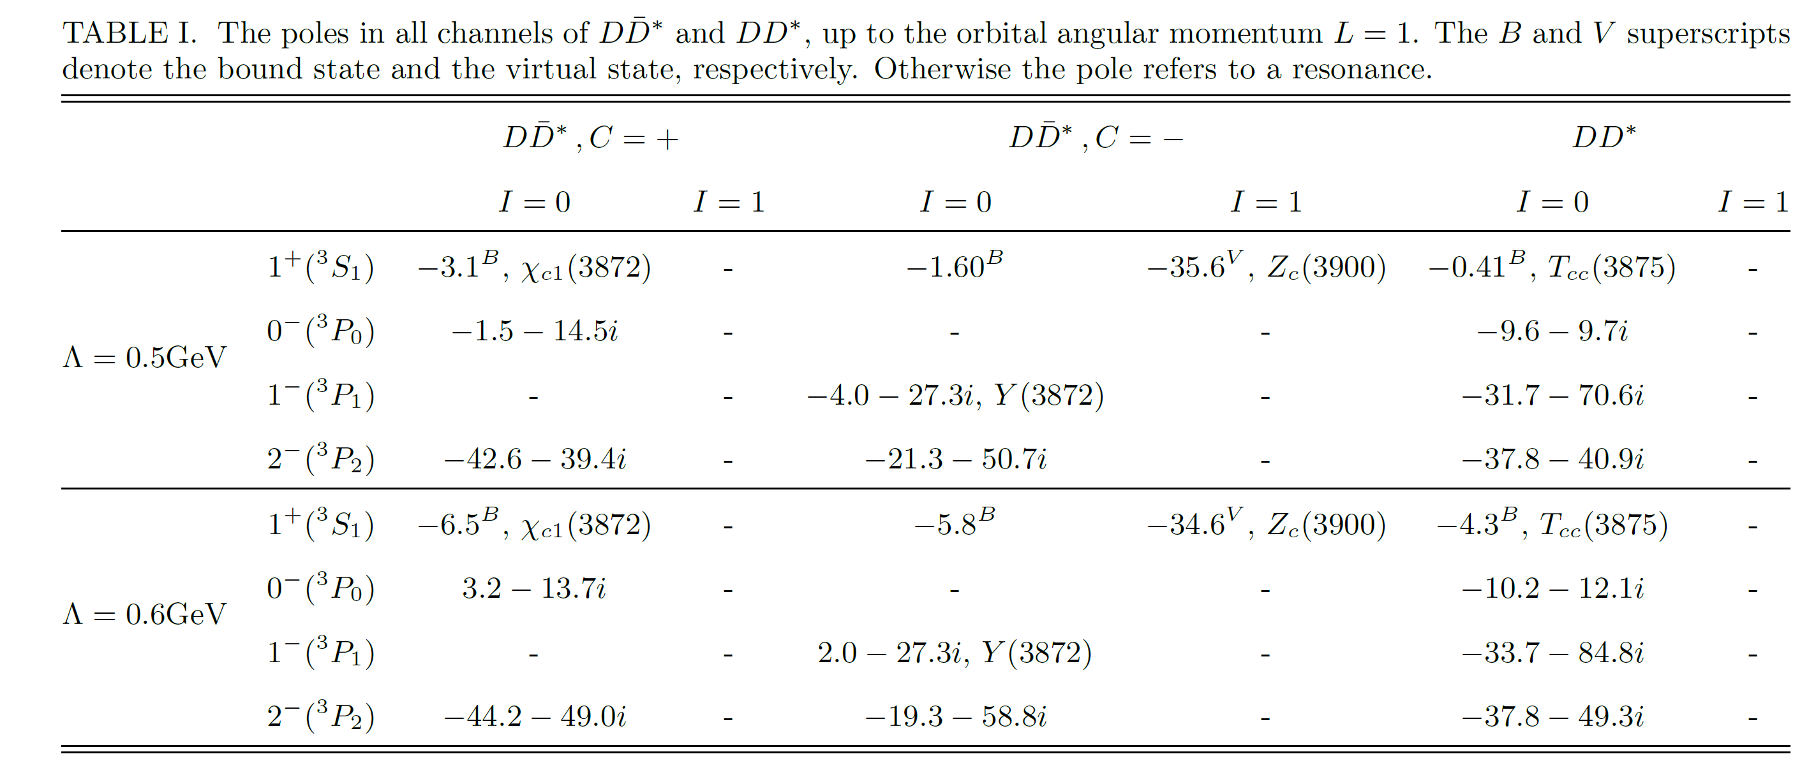
Motivation
Method
Results
Summary
Table with nonlocal regulator
12/15

Slide 13
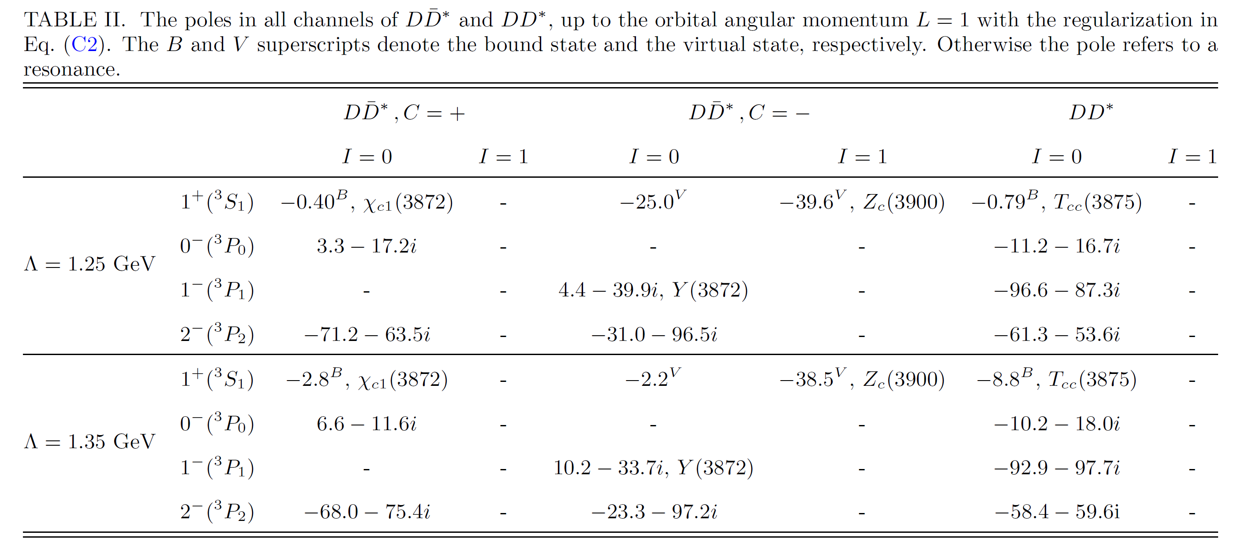
Motivation
Method
Results
Summary
Table with local regulator
Regulator independence!
13/15

Slide 14
Motivation
Method
Results
Summary
Summary
arXiv:2403.01727
Zi-Yang Lin, Jun-Zhang Wang, Jian-Bo Cheng, Lu-Meng, and Shi-Lin Zhu
We employ a unified framework to address both double-charm and hidden-charm tetraquark states.
We achieve reasonable results among Y(3872), X(3872), $T_{cc}$, and $Z_{c}$ using only parameter Λ.
The results are independent of the choice of regulator.
We predict several resonances such as P-wave $DD^{∗}$ with $I\left(J^{P}\right)=0(0^{−})$ and $D{\overline{D}}^{∗}$ with $I^{G}\left(J^{PC}\right)=0^{+}(0^{−+})$.
14/15

Slide 15
Motivation
Method
Results
Summary
Outlook
There is promise in identifying P-wave resonances in other systems, such as $X_{0,1}(2900)$, $ψ\left(4220\right),$ $D_{s}^{∗}{\overline{D}}_{s},$ and S- and P-wave two bottom meson system.
Consider the left-hand cut when dealing with the virtual states.
15/15

Slide 16
Thanks!

