Slide 1
Selected Topics in Nonleptonic B decays
Hai-Yang Cheng
Academia Sinica, Taipei
(鄭海揚)
The Sixth Workshop on Heavy Flavor Physics and QCD
Qingdao, China
April 22, 2024

Slide 2
Outline
Finite width effects
Direct CPV in 2-body B decays
Puzzles with CPV in 3-body B decays

Slide 3
Finite-width effects in 3-body B decays
BF of quasi-two-body decays are usually extracted by assuming the factorization relation
This relation is valid only in narrow width approximation (NWA)
assuming $Γ(B→RP_{3})$ & $B\left(R→P_{1}P_{2}\right)$ are not affected by NWA
How to extract BF($B→RP_{3})$ from measured $Γ\left(B→RP_{3}→P_{1}P_{2}P_{3}\right)$when width is finite$?$
HYC, Chiang, Chua (’21)
Let $η_{R}=1+δ,$ it is expected $δ∼O\left(\frac{Γ_{R}}{m_{R}}\right).$ It is calculable theoretically. Its deviation from unity measures the degree of departure from NWA when width is finite.

Slide 4
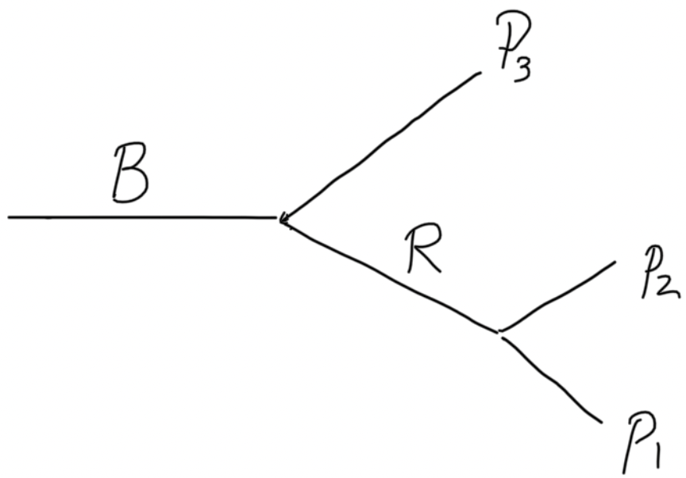
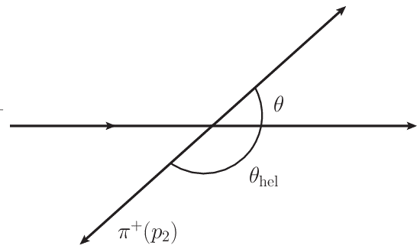
Consider resonant 3-body B decay $B→RP_{3}→P_{1}P_{2}P_{3}$ in isobar model
weak & strong decays
line shape
angular dependence
$$s_{12}=m_{12}^{2}$$
Dalitz plot analysis: $M\left(s_{12,}s_{12}\right)$ is assumed to be a constant fit to the data
Angular distribution governed by Legendre polynomial $P_{J}(cosθ)$
$$P_{1}(p_{1})$$
B
$$P_{3}(p_{3})$$
θ: angle measured in resonance rest frame
$$P_{2}(p_{2})$$
Line shape: relativistic Breit-Wigner parameterization
Flatte line shape for $f_{0}\left(980\right), a_{0}\left(980\right)$; Gounaris-Sakurai for $ρ(770)$
Pole line shape for $σ\left(500\right), κ\left(800\right);$ LASS line shape for $K_{0}^{∗}(1430)$

Slide 5
When resonance is off shell, form factor $F(s, m_{R})$ is introduced for the strong coupling of $R\left(m_{12}\right)→P_{1}P_{2}$ when $m_{12}$ is away from $m_{R}$
Take $B^{−}→f_{2}π^{−}→π^{+}π^{−}π^{−}$ as an example
with
HYC, Yang (’11)

Slide 6
$η_{R}$ is calculable theoretically. It depends on resonance line shape & the approach for describing nonleptonic weak decays
We also consider the Dalitz plot parameterization adopted by many experimental groups (EXPP)
$X_{J}$: Blatt-Weisskopf barrier factor

Slide 7
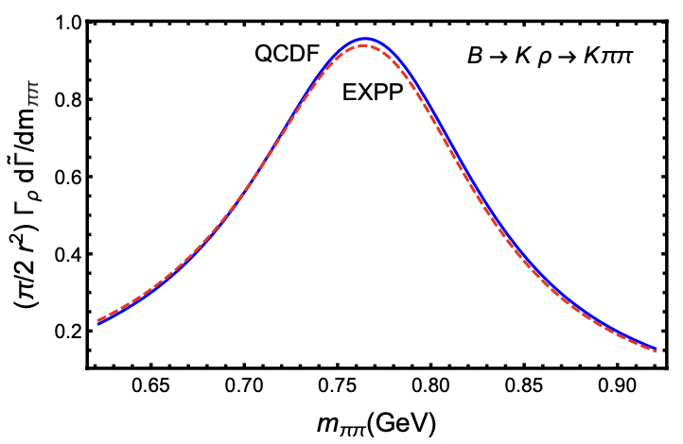
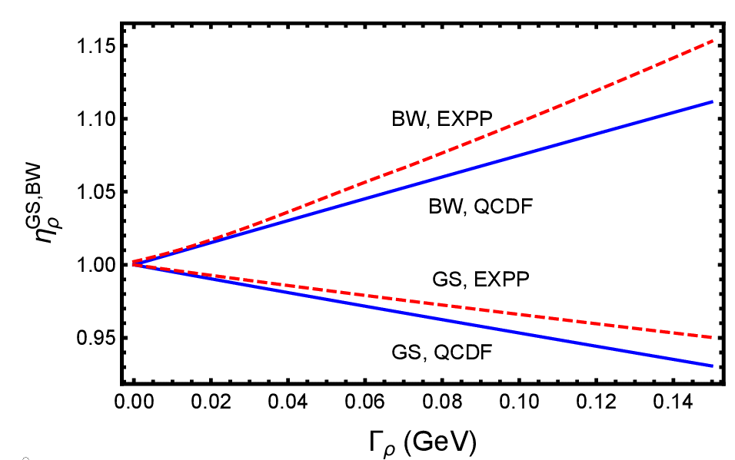
$η_{R}$ can be expressed in terms of normalized differential rate at resonance
⇒
with
$$s_{12}=m_{12}^{2}$$
⇒ $η_{R}→1$ in zero width limit
$$B^{+}→ρπ^{+}→π^{+}π^{−}π^{+}$$
$Γ_{ρ}=149.1±0.8$ MeV
Consider GS & BW line shapes for ρ in QCDF & EXPP schemes
 | $$η_{ρ}^{QCDF}$$ | $$η_{ρ}^{EXPP}$$
GS | 0.93 | 0.95
BW | 1.11 | 1.15

Slide 8
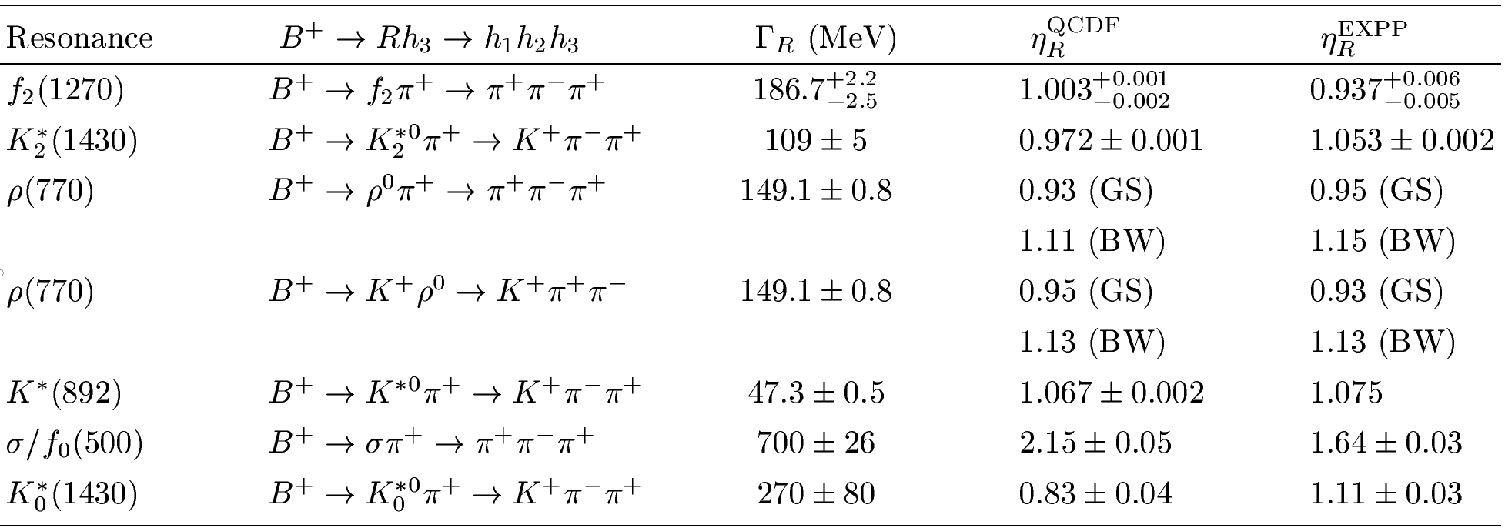
Finite-width effects on BF($B→RP)$ (I)
Finite-width effects are small in general, but they are significant in $B^{+}→ρπ^{+}$ and prominent in $B^{+}→σπ^{+}$ and $B^{+}→K_{0}^{∗0}π^{+}$
$η_{R}^{QCDF}$and $η_{R}^{EXPP}$ are similar for vector mesons but different for tensor and scalar mesons
PQCD calculations of $η_{R}$ are still not available.

Slide 9
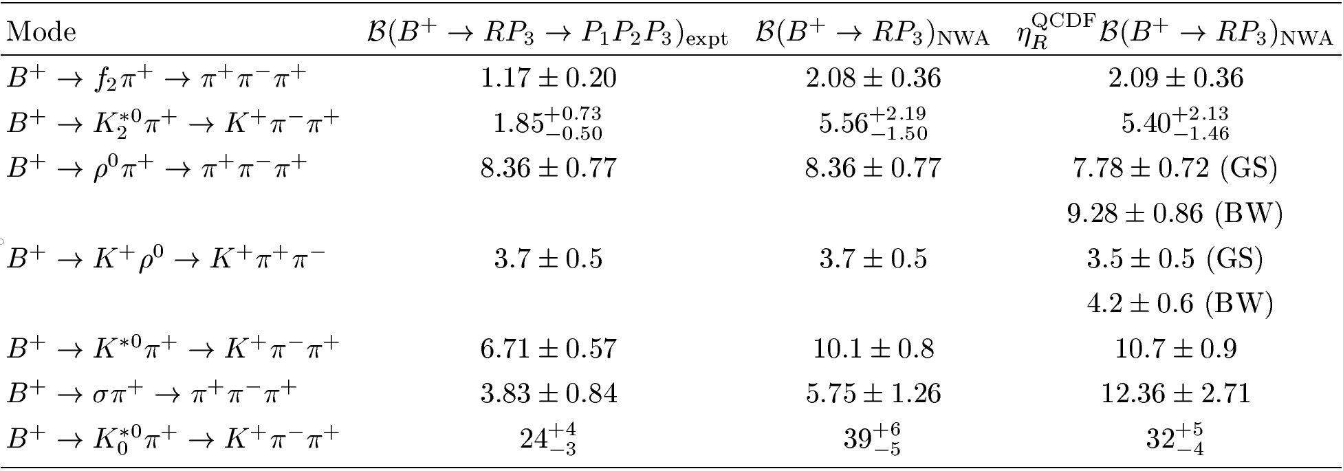
Finite-width effects on BF($B→RP)$ (II)
$BF{\left(B^{+}→ρπ^{+}\right)}_{PDG }=\left(8.3±1.2\right){10}^{−6}$ → $(7.7±1.1){10}^{−6 }$ for $η_{ρ}^{QCDF}=0.93$
$BF{\left(B^{+}→σπ^{+}\right)}_{NWA }=\left(5.8±1.3\right){10}^{−6}$ → $\left(12.4±2.7\right){10}^{−6 }$for $η_{σ}^{QCDF}=2.15$
$BF{\left(B^{+}→K_{0}^{∗0}π^{+}\right)}_{PDG }=\left({39}_{−5}^{+6}\right){10}^{−6}$ → $({32}_{−4}^{+5}){10}^{−6 }$ for ${ η}_{K_{0}^{∗}}^{QCDF}=0.83$

Slide 10
CP violation in 2-body B decays

Slide 11
Two important $subleading 1/m_{b}$ power corrections
Penguin annihilation:
1. to enhance the rates of penguin-dominated modes & account for their CP
asymmetries e.g. $B^{0}→K^{+}π^{−}$
2. to account for CP asymmetries of tree-dominated modes, e.g. $B^{0}→π^{+}π^{−}$
Hard spectator interactions:
1. to enhance the BFs of tree-dominated modes $B^{0}→π^{0}π^{0}, ρ^{0}π^{0}.$
2. to account for CP asymmetries of penguin-dominated modes such as
$B^{+}→K^{+}π^{0} (and hence ΔA_{Kπ}), K^{+}η,$ $B^{0}→K^{∗0}η$

Slide 12
Because of endpoint divergences in QCDF, Λ_{QCD}/m_{b} power corrections due to annihilation and twist-3 spectator interactions can only be modelled
李新强 (4/20)
weak annihilation
$$X_{A}^{i,f}≡\int_{0}^{∞}{\frac{dy}{y}=ln\left(\frac{m_{B}}{Λ}\right)(1+ρ_{A}^{i,f}e^{iφ_{A}^{i,f}})}$$
hard spectator interaction
power corrections due to twist-3 terms
$$X_{H}=ln\left(\frac{m_{B}}{Λ}\right)(1+ρ_{H}e^{iφ_{H}})$$
In QCDF calculations, one should not set default values to be zero
for the parameters $ρ_{A,H}$ and $φ_{A,H},$especially $ρ_{A}$ and $φ_{A}!$

Slide 13
Normally, one chooses $ρ_{A}^{f}=ρ_{A}^{i}∼1$ and $φ_{A}^{f}=φ_{A}^{i}$
$B_{s}^{0}→π^{+}π^{−}$ is a pure annihilation process, proceeding through $A_{1}^{i}$ & $A_{2}^{i}$. Its BF $\left(0.70±0.10\right){×10}^{−6}$ [CDF (’12), LHCb (’12,’17)] is much larger than QCDF’s prediction of $\left({0.26}_{−0.09}^{+0.10}\right)×10^{−6 }$ ⇒ large $ρ_{A}^{i}∼O(3)$
G. Zhu (’11); K.Wang, G. Zhu (’13)
CP & rate deficit issues of $B^{0}→π^{0}π^{0}, ρ^{0}π^{0}$, $ΔA_{Kπ}$ puzzle ⇒ $ρ_{H}≥$ 3 & a large phase $φ_{H}$
HYC, Chua (’09)
Q. Chang, J. Sun et al. (’14, ’15)
To first-order approximation, $ρ_{H}=ρ_{A}^{i}$ and $φ_{H}=φ_{A}^{i}$
To NLO , the real part of $T^{c}$ is enhanced significantly
Lu, Shen, C. Wang, Y.M. Wang (`22)
⇒ ${ ρ}_{A}^{i}∼1$
$BF\left(B^{0}→K^{+}K^{−}\right)=\left(7.8±1.5\right)×{10}^{−8}$ will be too large with a large $ρ_{A}^{i}$

Slide 14
B_{u}/B_{d} | K⁺ π⁻ | π⁺π⁻ | K*⁺ π⁻ | K⁺ρ⁰ | K⁺ η | K^{*0} η
A_{CP}(%) | -8.31±0.32 | 31.4±3.0 | -27.4±4.5 | 15±2 | -37±8 | 19.5±5.0
S | 26σ | 10.5σ | 6.1σ | 6.8σ | 4.6σ | 3.9σ
W/o ρ, φ |  |  | × | ×
penguin annihilation |  |  |  |  | × | ×
hard spectator
$ΔA_{Kπ}≡A_{CP}\left(K^{+}π^{0}\right)−$ $A_{CP}\left(K^{+}π^{−}\right)$
B_{s} | K⁻ π⁺ | Κ⁺Κ⁻
A_{CP}(%) | 22.5±1.2 | -16.2±3.5
S | 18.7σ | 4.6σ
W/o ρ, φ
penguin annihilation
hard spectator
B_{u}/B_{d.} | $$ΔA_{Kπ}$$
A_{CP}(%) | 11.1±1.4
S | 7.9σ
W/o ρ, φ | ≈ 3.3
penguin annihilation | (≈ 1.9)
hard spectator
Penguin annihilation will render ΔΑ_{Κπ} even smaller

Slide 15
CP violation in $B^{+}→ρ^{0}π^{+}$
CP violation in $B^{+}→ρ^{0}π^{+}→π^{+}π^{−}π^{+}$ was measured to be consistent with zero by LHCb using three different models
LHCb (’20): $0.7±1.1±0.6±1.5 \%$ in isobar model
LHCb (’22): $−0.4±1.7±0.9 \%$ Run II
A sizable negative CP asymmetry has been predicted to lie in the range from -7% to -45%
In QCDF, penguin annihilation ⇒ $A_{CP}∼O\left(−0.10\right)$, while hard spectator interactions ⇒ $A_{CP}∼O\left(0.10\right)$. They contribute destructively to $A_{CP}$
A nearly vanishing CP asymmetry results from the large cancellation between penguin annihilation and hard spectator interactions
HYC (’22)

Slide 17
 | LHCb (2023) | Previous measurements
${ B}^{−}→ρ^{0}π^{−}$ | $−0.004±0.017$ | $0.007±0.019$ $\text{(}\text{LHCb}\text{)}$
$B^{−}→ρ^{0}K^{−}$ | $$0.150±0.022$$ | $0.44±0.11\text{ (}\text{BaBar}\text{)}$ $0.30±0.11$ (Belle)
$B^{−}→K^{∗0}π^{−}$ | $−0.015±0.024$ | $$0.032±0.\text{053}\text{ (}\text{BaBar}\text{)}$$ $−0.149±0.\text{067}\text{ (}\text{Belle}\text{)}$
$B^{−}→K^{∗0}K^{−}$ | $0.007±0.063$ | $0.123±0.\text{098}\text{ (}\text{LHCb}\text{)}$
$$B^{−}→{φK}^{0}$$ | $$0.004±0.016$$ | $0.128±0.\text{046}\text{ (}\text{BaBar}\text{)}$
张艳席 (4/20)
Significant improvement compared to BaBar and Belle
Direct CP asymmetries vanish in most of charmless $B→VP$modes
$A_{CP}\left(B^{−}→ρ^{0}K^{−}\right)=\left(15±2\right)\%$ LHCb (2023)
$A_{CP}\left(B^{0}→K^{∗+}π^{−}\right)=−\left(27±4\right)\%$ dominated by LHCb (2018)

Slide 18
$$π^{+}(p_{1})$$
B+
$$π^{+}(p_{3})$$
cos$θ<0$
cos$θ>0$
$$π^{−}(p_{2})$$
张振华 (4/21)
Significant CP violation is seen in the data separated by the sign of cosθ.
CP asymmetry near the ρ resonance is proportional to $\left(m_{12}^{2}−m_{ρ}^{2}\right)cosθ.$
⇒ It gives a nearly vanishing $A_{CP}\left(B^{+}→ρπ^{+}\right)$ when integrating over θ
Well described by the interference between ρ & σ & non-resonant bkg
⇒ 1st evidence of CP violation mediated by interference between
resonances with significance exceeding 25σ (LHCb 2019)
$A_{CP}\left(B^{+}→σπ^{+}\right)=\left(16.0±1.7±2.2\right)\%$ LHCb (2020) in isobar model
$A_{CP}∝ (|c_{−}^{ρ}|^{2}−{|c}_{+}^{ρ}|^{2})|F_{ρ}^{BW}(s_{12})|^{2}\cos{θ^{2}+}$ $(|c_{−}^{σ}|^{2}−{|c}_{+}^{σ}|^{2})|F_{σ}^{BW}(s_{12})|^{2}$
$+2|F_{ρ}^{BW}(s_{12})|^{2}|F_{σ}^{BW}(s_{12})|^{2}\cos{θ}[\left(s_{12}−m_{ρ}^{2}\right)\left(s_{12}−m_{σ}^{2}\right)+$($m_{ρ}Γ_{ρ})(m_{σ}Γ_{σ})]+…$

Slide 19
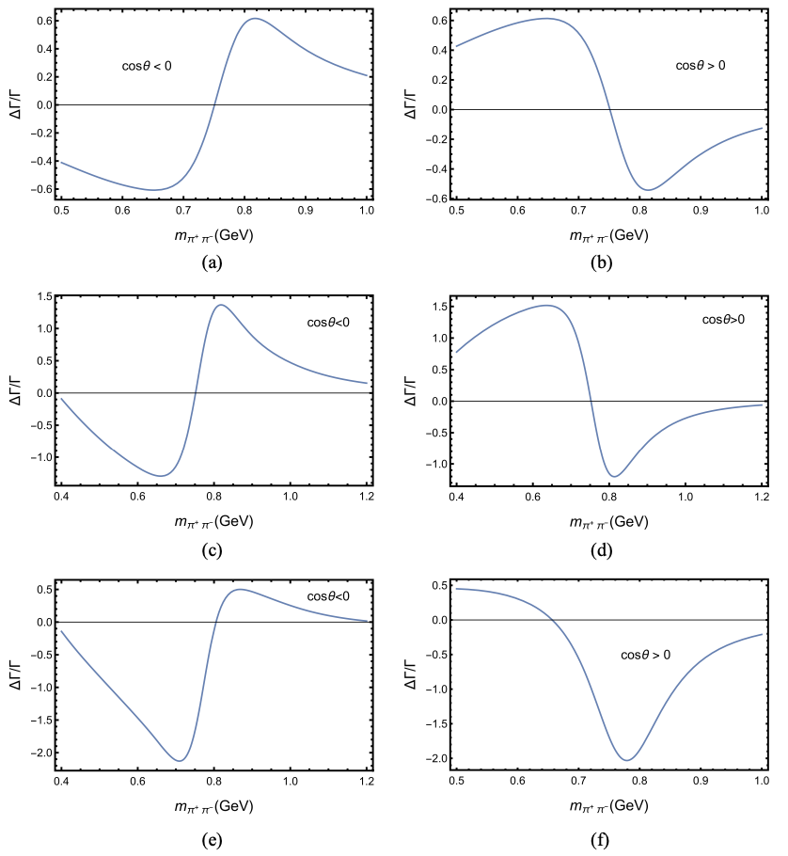
cos$θ<0$
cos$θ>0$
$ρ−σ$ interference
vanishes after integrating over $θ$
add CP violation from $ρ$ & $σ$
add CP violation from $ρ$ & $σ$
$$A_{CP}\left(ρ^{0}π^{+}\right)=−0.005$$
$$A_{CP}\left(ρ^{0}π^{+}\right)=−0.005$$
$$A_{CP}\left(σπ^{+}\right)=0.15$$
add CP violation from $ρ$ & $σ$
$$A_{CP}\left(ρ^{0}π^{+}\right)=−0.12$$
$$A_{CP}\left(σπ^{+}\right)=0.15$$
ruled out by experiment
Interference pattern is well reproduced in the absence of CP violation in $ρ$

Slide 20
Puzzles with CPV in 3-body B decays

Slide 21
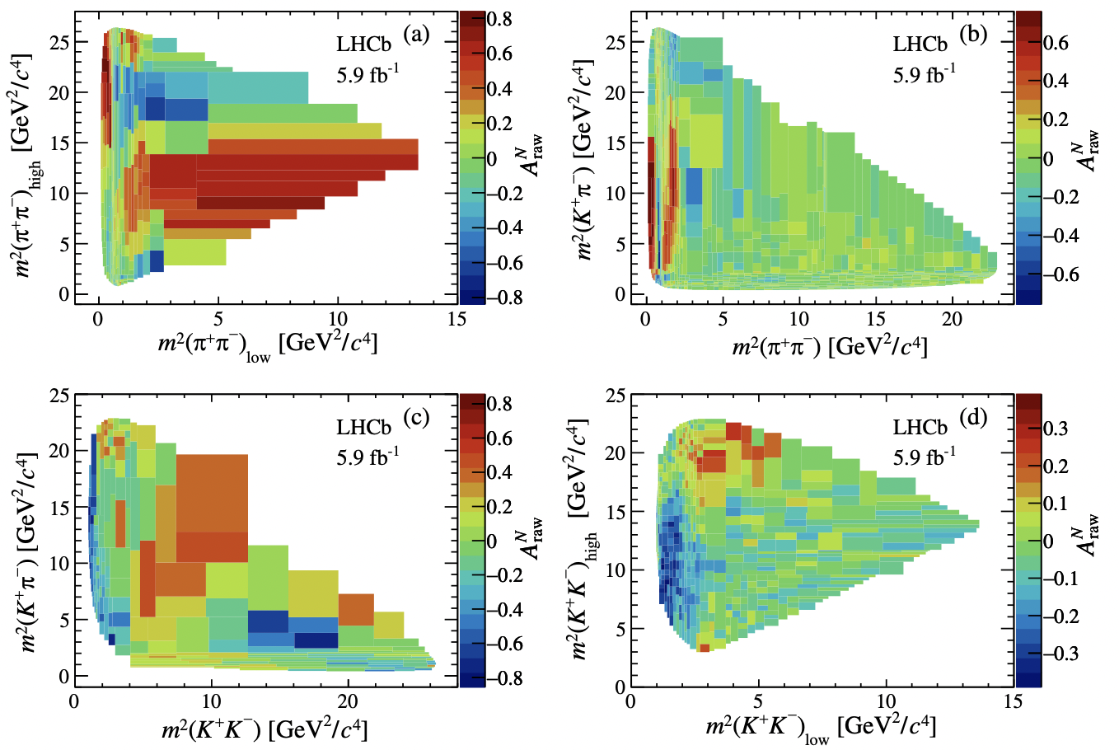
CP violation puzzles in 3-body B decays
LHCb (2022)
张艳席 (4/20)
$$B^{±}→π^{±}π^{+}π^{−}$$
$$B^{±}→K^{±}π^{+}π^{−}$$
$$B^{±}→π^{±}K^{+}K^{−}$$
$$B^{±}→K^{±}K^{+}K^{−}$$
CP asymmetry distributions in Dalitz plots

Slide 22
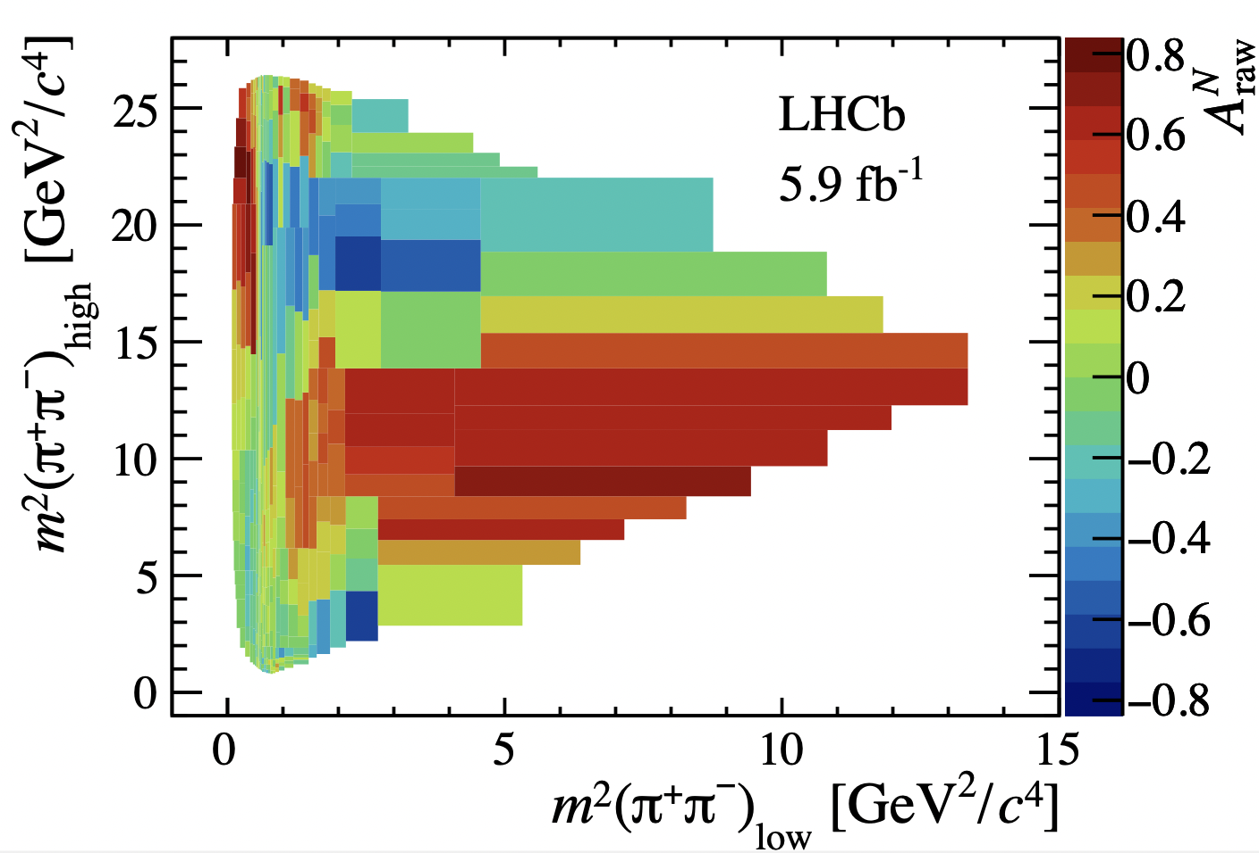
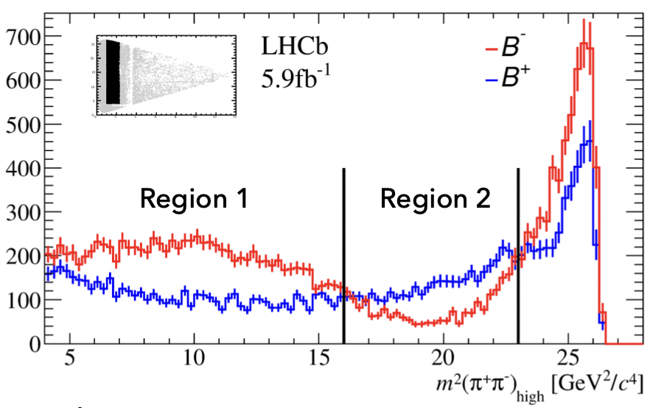
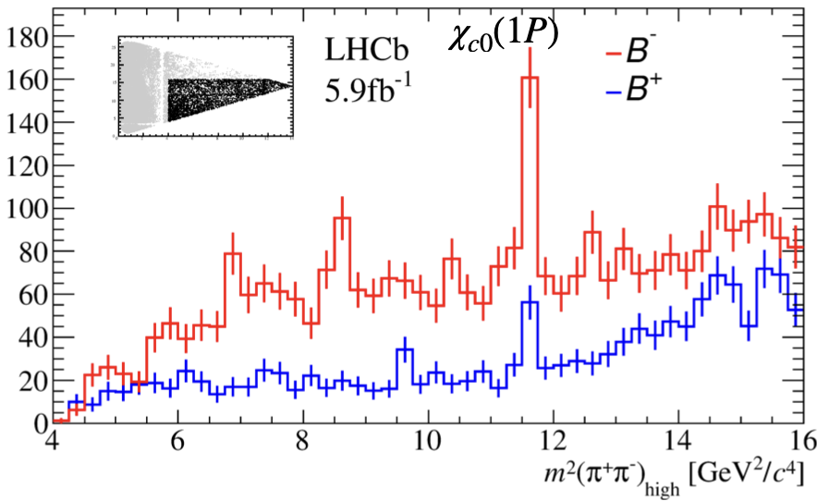
$$B^{±}→π^{±}π^{+}π^{−}$$
2
1
3
Region 1: ${ A}_{CP}=0.303±0.010$
Region 2: ${ A}_{CP}=−0.284±0.019$
Region 3: ${ A}_{CP}=0.745±0.033$
Inclusive: ${ A}_{CP}=0.080±0.006$
Large CPV in $B^{±}→χ_{c0}(1P)π^{±}$
$M\left(χ_{c0}\left(1P\right)\right)=3415$ MeV

Slide 23
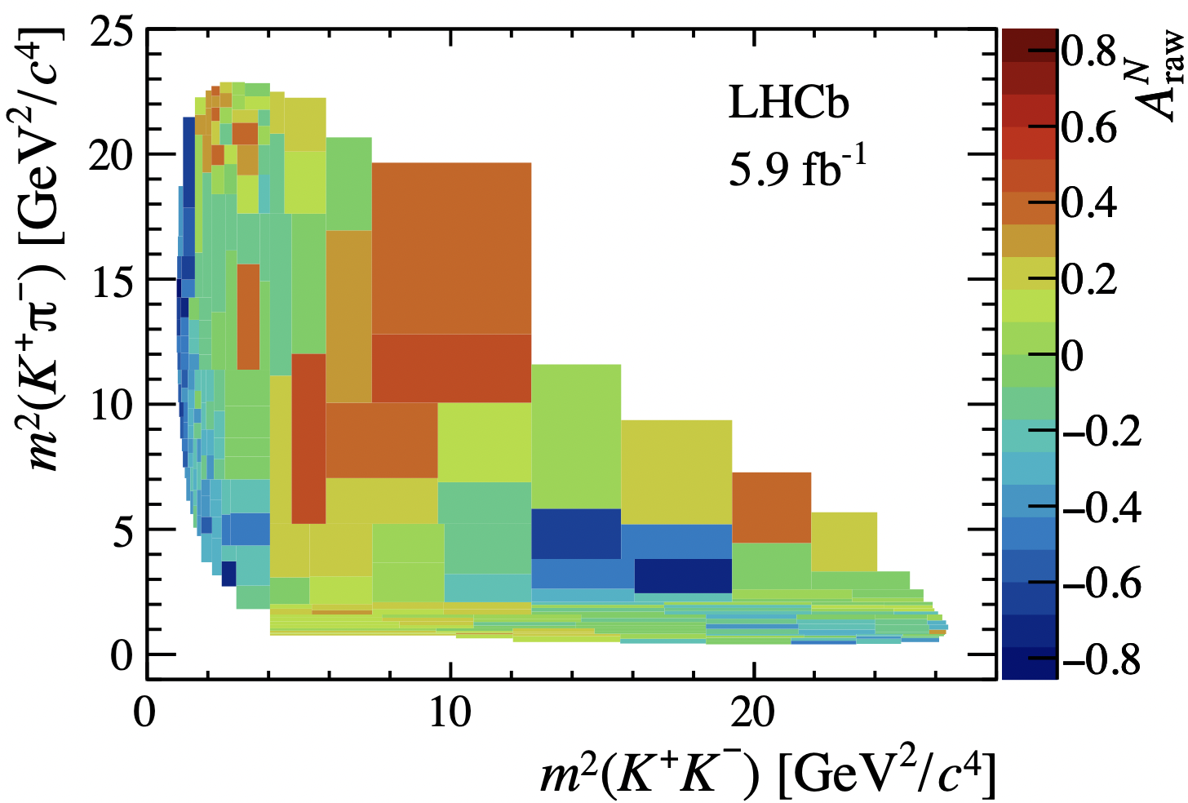
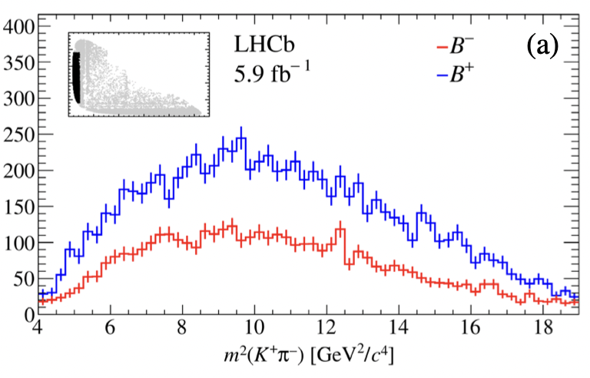
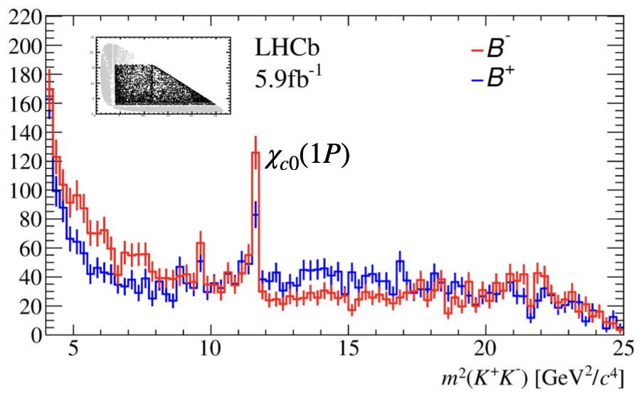
$$B^{±}→π^{±}K^{+}K^{−}$$
2
Region 1: ${ A}_{CP}=−0.358±0.017$
Region 2: ${ A}_{CP}= 0.097±0.032$
Inclusive: ${ A}_{CP}=−0.114±0.008$
Large CPV in $B^{±}→χ_{c0}(1P)π^{±}$

Slide 24
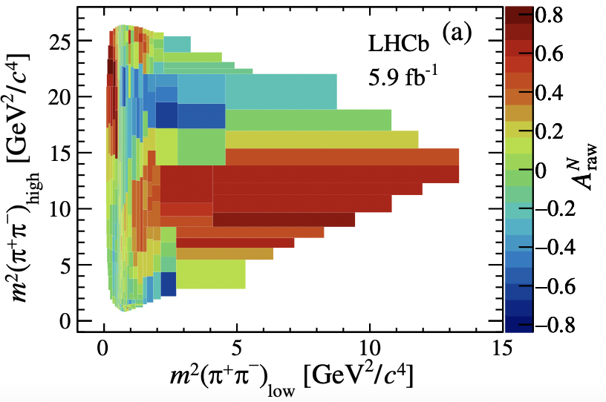
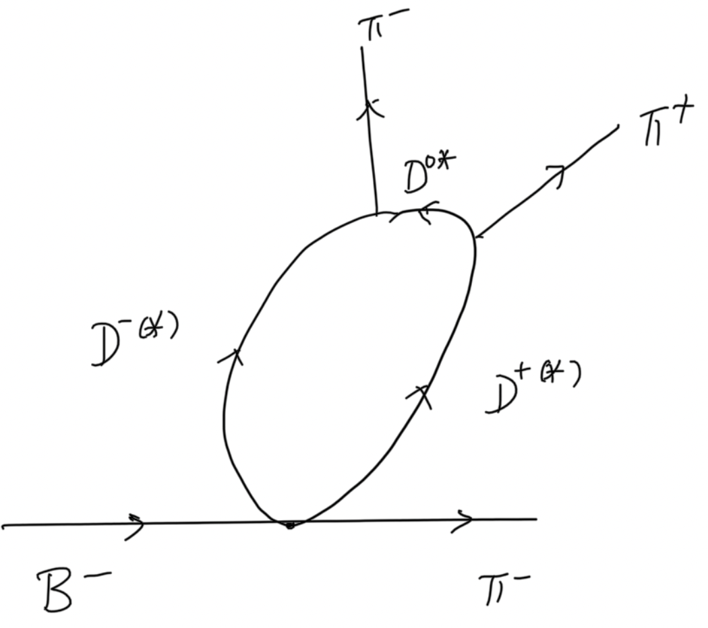
Puzzles:
1. Large CPV in${ B}^{±}→{χ_{c0}^{ }π}^{±}$ while it is expected to be zero in SM
Maybe due to the interference between $χ_{c0}$ and non-resonant background
Eilam, Gronau, Mendel (’95); Deshpande, Eilam, He, Trampetic (’95)
2. Giant CPV in $B^{±}→π^{±}π^{+}π^{−}$in high invariant mass region
Could arise from i) resonant process ${ B}^{±}→{χ_{c0}^{ }π}^{±}→π^{+}π^{−}π^{±}$
non-resonant process through $D\overline{D}→ππ$ rescattering
⇒ threshold effect
3. Sign flips in different invariant mass regions
In this respect, theory is far behind experiment!

Slide 25
Conclusions
Finite-width effects are generally small, but they are significant in $B^{+}→ρπ^{+}$ & prominent in $B^{+}→σπ^{+}$ and $B^{+}→K_{0}^{∗0}π^{+}$. Thus far finite-width effects have been calculated in QCDF only.
The smallness of $A_{CP}\left(B^{+}→ρπ^{+}\right)$ results from the large cancellation between penguin annihilation and hard spectator interactions
CP asymmetry has been seen in $ρ(770)$ region for positive & negative-angle cosines. It is well described by the interference between $ρ$ & $σ$
There exist several puzzles related to CP asymmetries observed in 3-body B decays in high invariant mass regions

Slide 26
Spare Slides

Slide 27
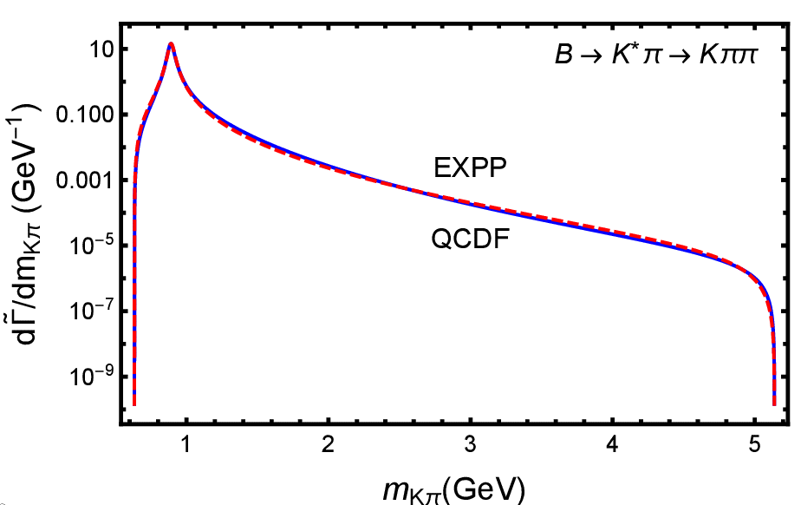
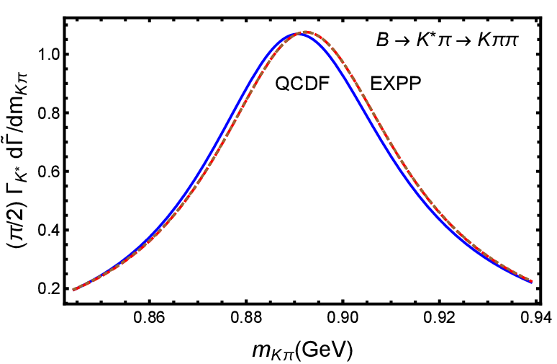
Normalized differential rates (NDRs) in both schemes are alike, so are $η_{R}$’s for both $ρ$ and $K^{∗}$
$$B^{+}→K^{∗0}π^{−}→K^{+}π^{−}π^{+}$$
Large enhancement of QCDF differential rate at large $m_{Kπ}$ distribution
$B^{+}→K_{0}^{∗0}π^{−}$ $→K^{+}π^{−}π^{+}$
$Γ_{K_{0}^{∗}}=270±80$ MeV
$η_{K_{0}^{∗}(1430)}^{QCDF}=0.83±0.04$ $η_{K_{0}^{∗}(1430)}^{EXPP}=1.11±0.03$

Slide 28
Gounaris-Sakurai line shape for $ρ(770)$
f(s): pion-pion scattering amplitude with an intermediate $ρ(770)$ exchange calculated from the dispersion relation to ensure unitarity

Slide 29
