Slide 1
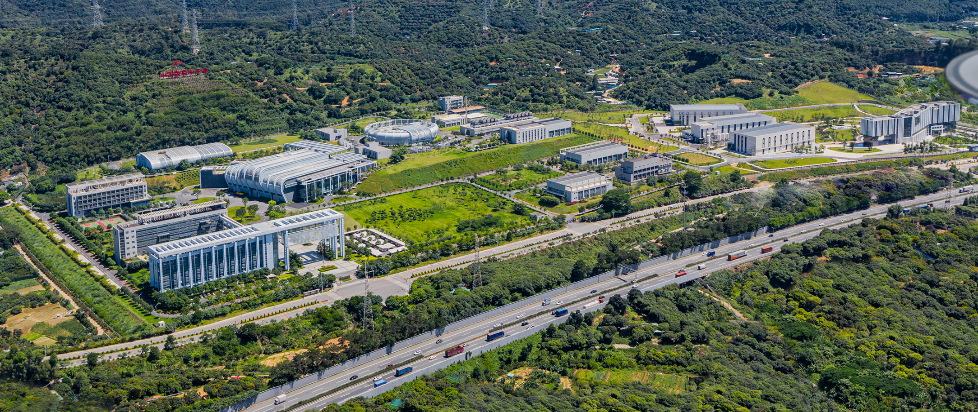
Report of Dongguan Branch
Beam Power Upgrade of CSNS
— challenges and prospectives
Sheng Wang
Institute of High Energy Physics, CAS, Sep. 11, 2024

Slide 2

Outline
The performance of CSNS
The introduction to CSNS-II
Challenges in beam power upgrade
Progress of CSNS-II
Summary

Slide 3
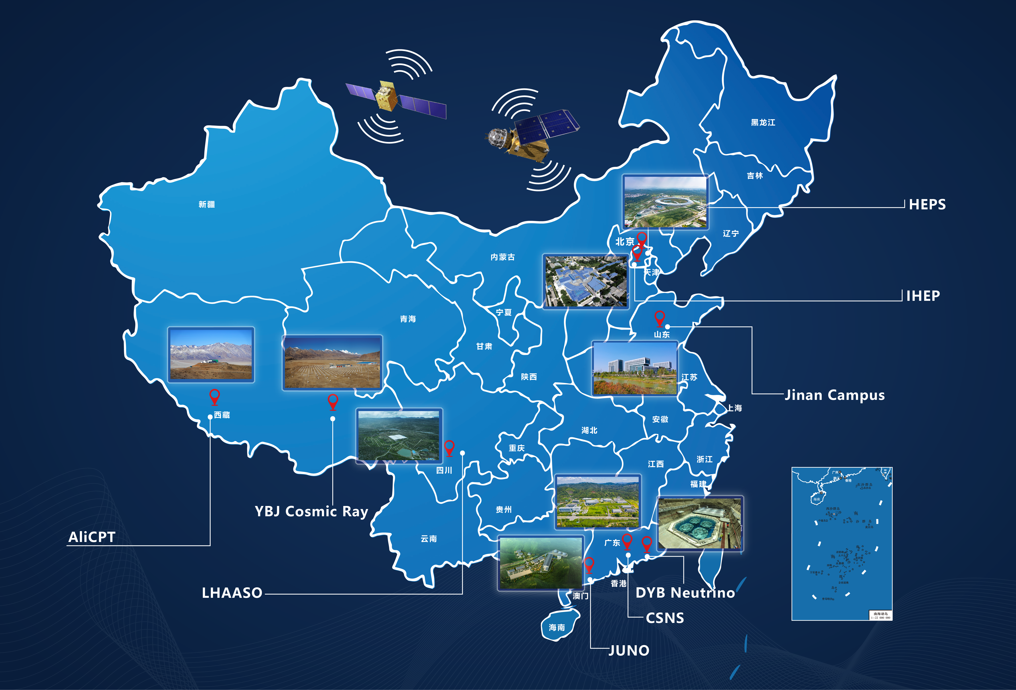
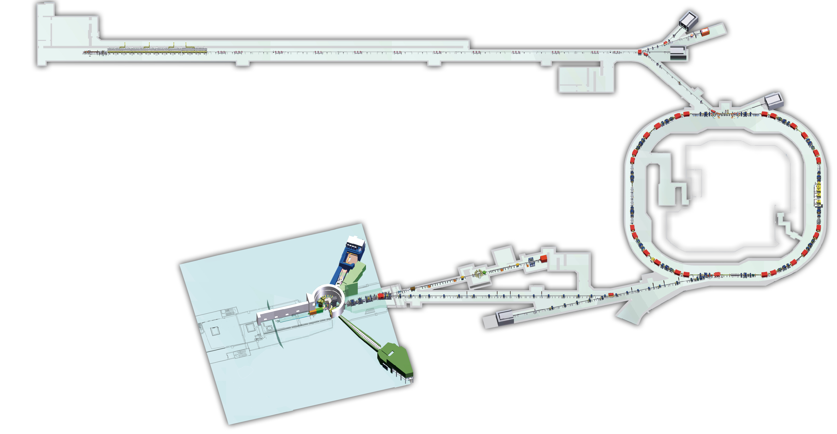
The Performance of CSNS
Construction started at Sep. 2011, and finished at Mar. 2018
User program started in Oct. 2018
Beam power increased from 20kW to 160kW
Operation with long user hours (5000hrs) and high availability (~97%)
3 day-one neutron instruments in full user program
80 MeV H⁻ DTL
1.6 GeV
25 Hz
100 kW

Slide 4
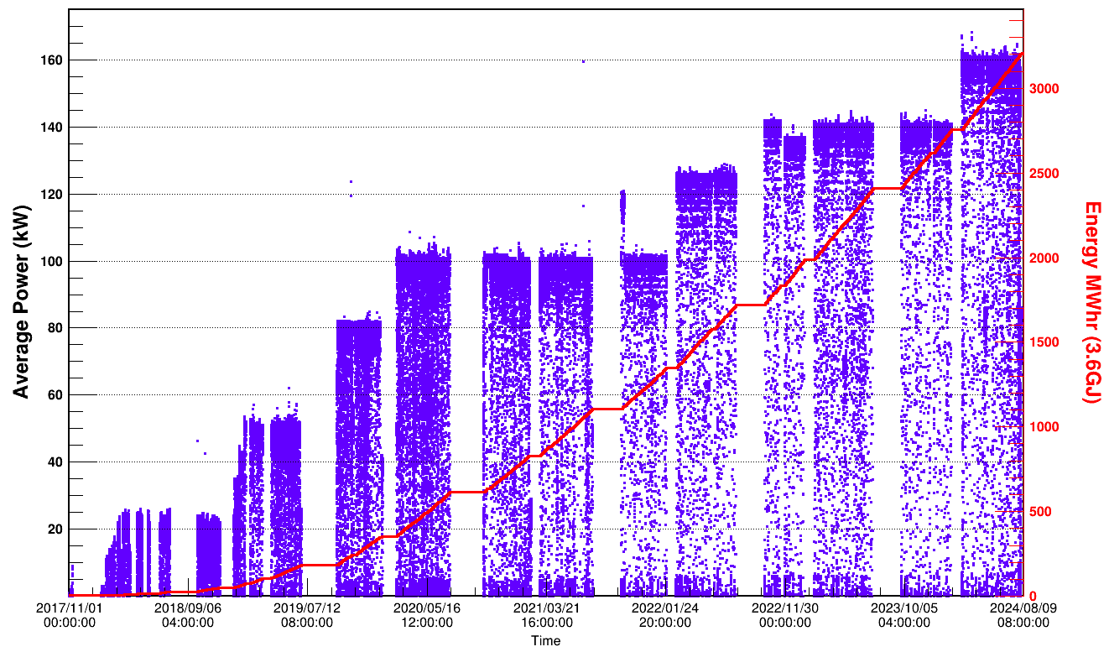
CSNS Beam History
The neutron beamtime 5435 hours and the availability of 97%
160kW
140kW
125kW
100kW
80kW
Two round per year
4054h
4687h
4884h
5262h
5435h
4

Slide 5
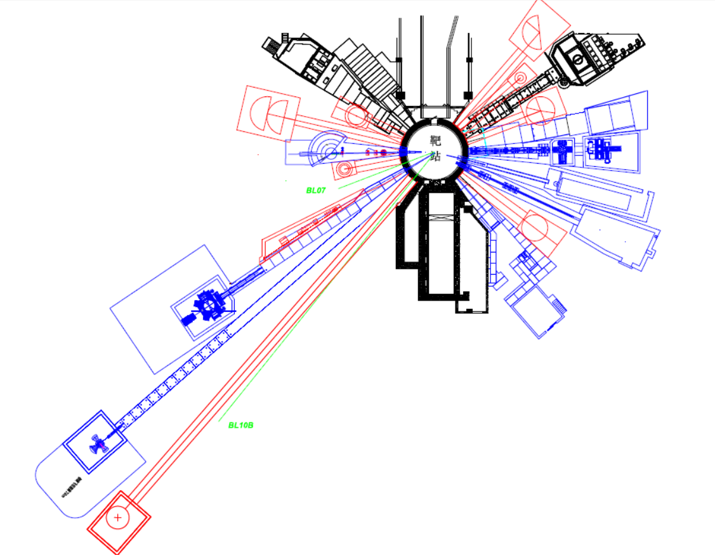
Cooperation Instruments
BL16: Multiple Physics Instrument
BL15: High Pressure Diffractometer
BL14: Very small angle neutron scattering
BL13: Energy resolved neutron imaging
BL11: Atmosphere Neutron Irradiation
BL05: High energy inelastic spectrometer
BL08: Engineering Material Diffractometer
BL09: High resolution Diffractometer

Slide 6
User Operation
The number of registered user is more than 7000, A total of over 1,700 projects from 243 units were completed. Industry users accounted for approximately 10%

Slide 7
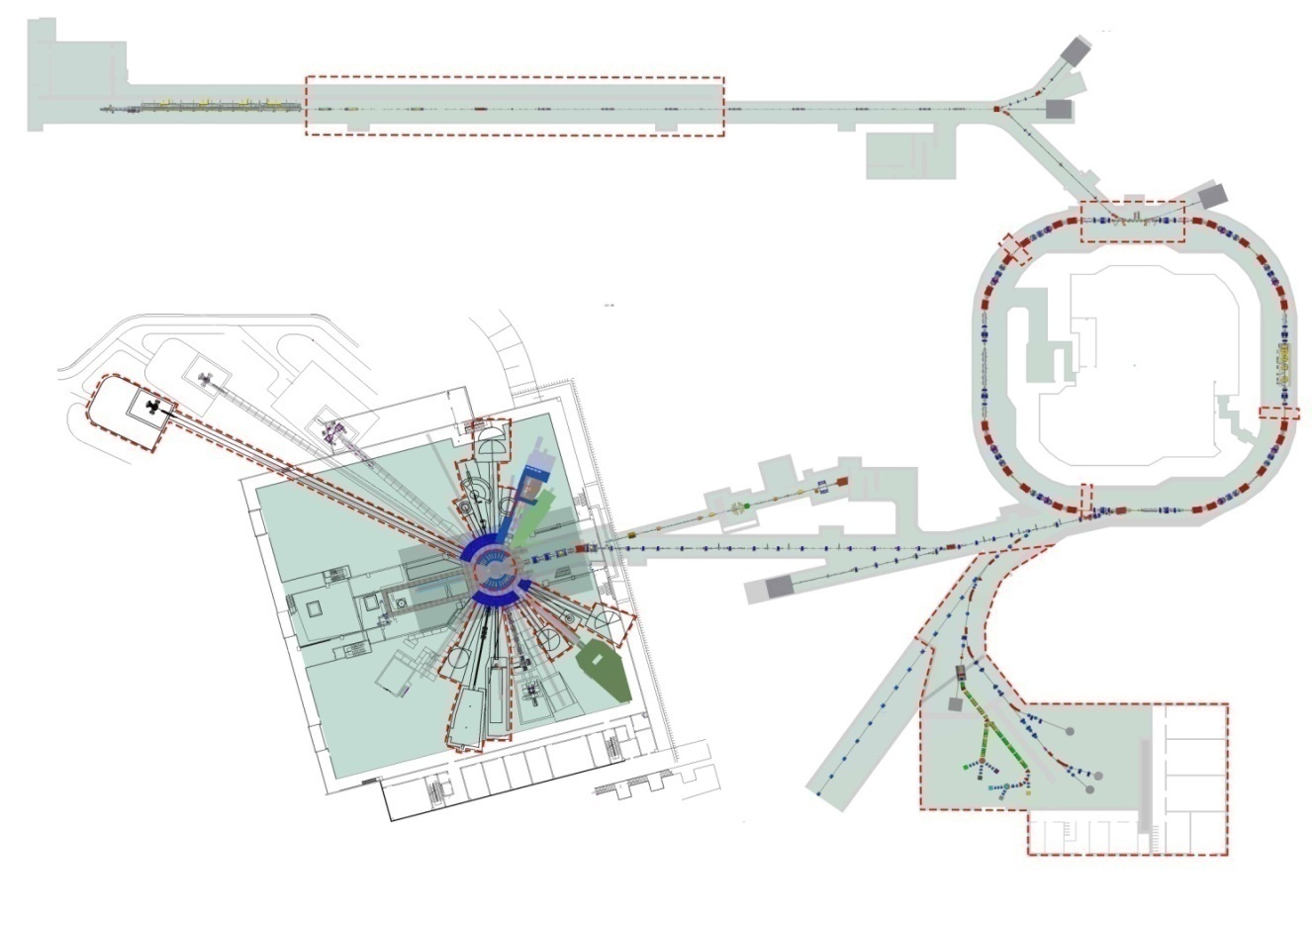
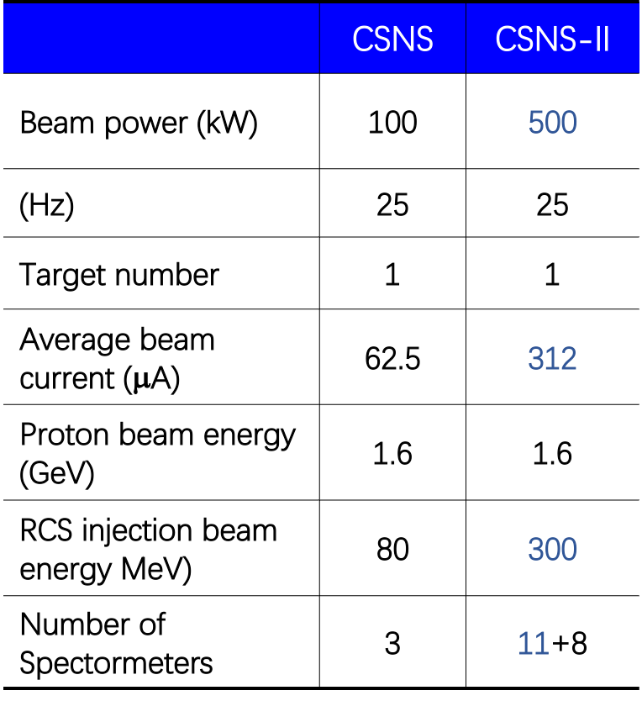
China Spallation Neutron Source-II
Project Budget: 2.9 B CNY
Funded by central and Guangdong local government
Design and R&D completed
Construction: 2024.1~2029.10
（5 years and 9 months）
Linac
Linac upgrade from 80MeV to 300MeV
Rep. rate (Hz)
Beam power upgrade to 500kW
Rapid Cycling
Synchrotron
(25Hz)
靶站
Replacement of Target for 500kW proton
谱仪
9 new neutron instruments
Proton & muon
Experimental station
11+9
Plans to maintain user operation almost unaffected during CSNS II construction

Slide 8
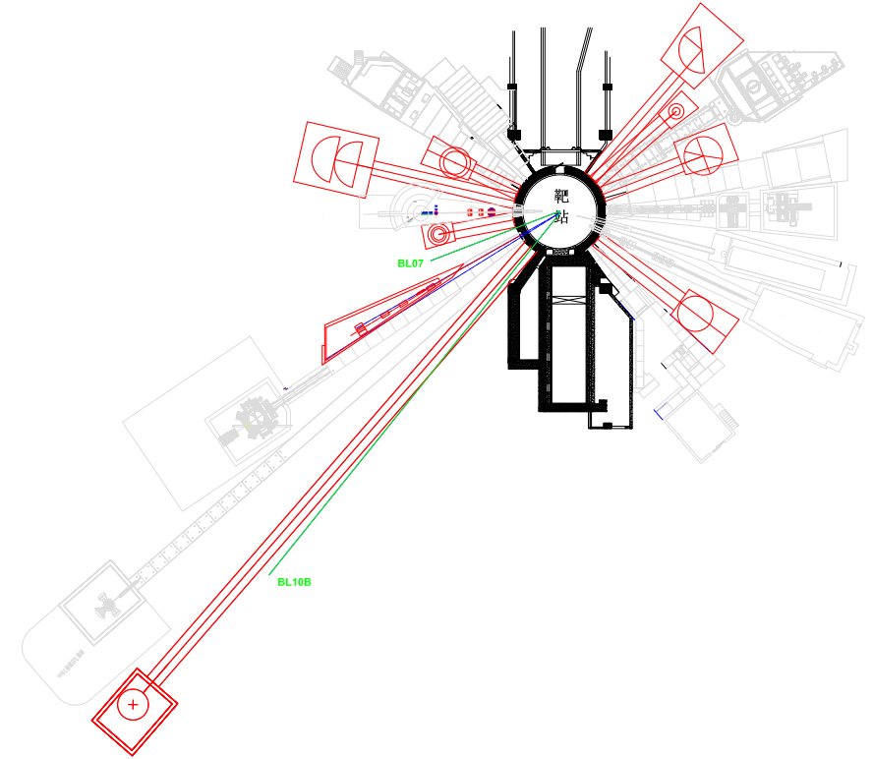
CSNS Phase II Neutron Instruments
BL20: Polarized chopper spectrometer
BL19: Single crystal diffractometer
BL17: Quasi-elastic spectrometer
BL12: Neutron Physics & application
BL07: Reserved
BL10A: Reserved
BL03: Liquid reflectometer
BL04: Cold inelastic Spectrometer
BL06: molecular vibration Spectrometer
BL08A: neutron technology test station
BL10: Backscattering spectrometer
8

Slide 9
Application Area of CSNS-II
The existing instruments cover some structural applications
The Phase II spectrometers will cover the majority of user demands in various fields, enabling characterization of structures and dynamic measurements.
1eV
Molecule
Vibration
Crystal field
100meV
Dynamics
(Inelastic)
10meV
Spin wave
Liquid motion
Lattice
vibration
1meV
Election-phonon coupling
100μeV
Molecule motion
10μeV
Biology Diffusion
Critical phenomena
1μeV
Amorphous
Residual Stress
Structure
(Elastic)
alloy
MOF
polymer
protein
CSNS Inst.
powder
Liquid Film
Magnetic
Film
Cooperation&CSNS-II inst.
Single crystal
10⁻⁴
10⁻³
10⁻²
10⁻¹
1
10¹
10²
(nm⁻¹)

Slide 10
Challenge from Beam Dynamics
Injection energy | Beam power | ΔQ
80MeV (CSNS) | 100kW | 0.28 | 1.6 GeV RCS
300MeV (CSNS-II) | 500kW | 0.19 | 1.6 GeV RCS
400MeV(J-PARC) | 1MW | 0.12 | 3GeV RCS
1GeV(SNS) | 1MW | 0.08 | 1GeV AR
70MeV(ISIS) | 160kW | 0.4 | 800MeV RCS

Slide 11
Beam Power Upgrade （two-step）
1. Linac（80MeV）+ RCS upgrade 150~200kW（the first step）
  New dual harmonic RF system
  Adding AC trim quadrupoles, sextupoles and octupoles
  New injection region
2. Linac （300MeV+）+ upgraded RCS 500kW (the second step)
  SC linac to 300MeV
  Upgrade the power supplies for main magnets
11

Slide 12
Intense beam effects in RCS commissioning
Beam power on target | Challenges | Solutions
50 kW→80 kW | Too large beam size after painting, non-uniform beam distribution, large transverse coupling | By using the correlated painting instead of the anti-correlated painting
80 kW→100 kW | Serious beam instability | Optimization of the tune and chromaticity
100 kW→125 kW | Emittance increase caused by broken four-fold symmetry of the RCS; Stranger beam instability | Slight modification of injection system; installation of AC trim quadrupoles and AC sextupoles
125 kW→140 kW | Strong space charge effects | Installation of a dual harmonic RF cavity
140 kW→160 kW | Space charge effect is very strong which leading to serious beam damage in the early stage. Beam instability leads to occasional beam loss. | Increasing the pulse width of injection beam. Installation of a secondary dual harmonic RF cavity, four new octupole, new momentum collimator and four new correctors.

Slide 13
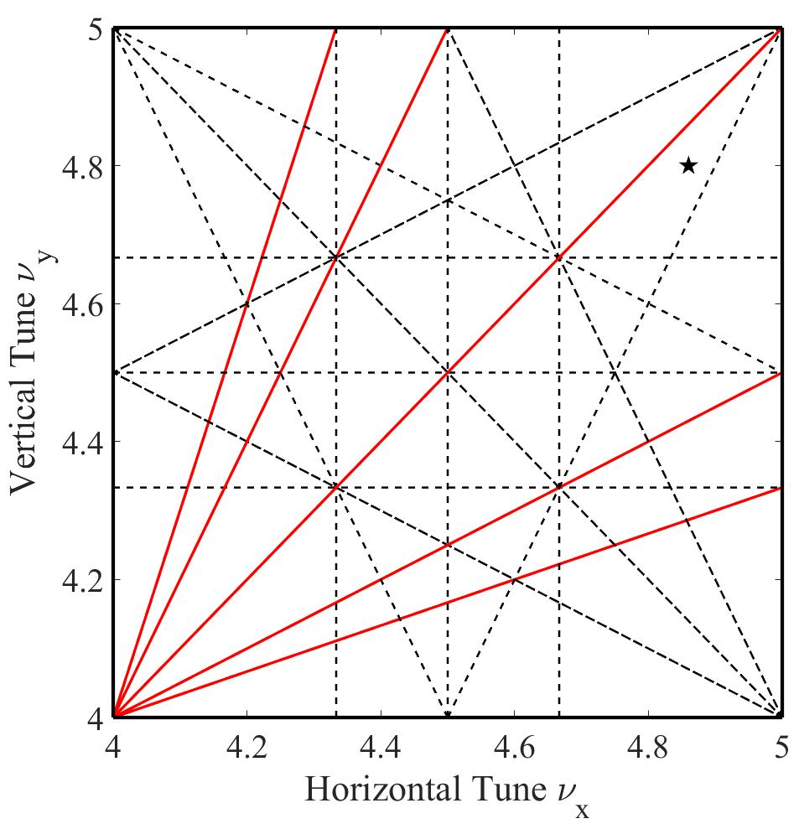
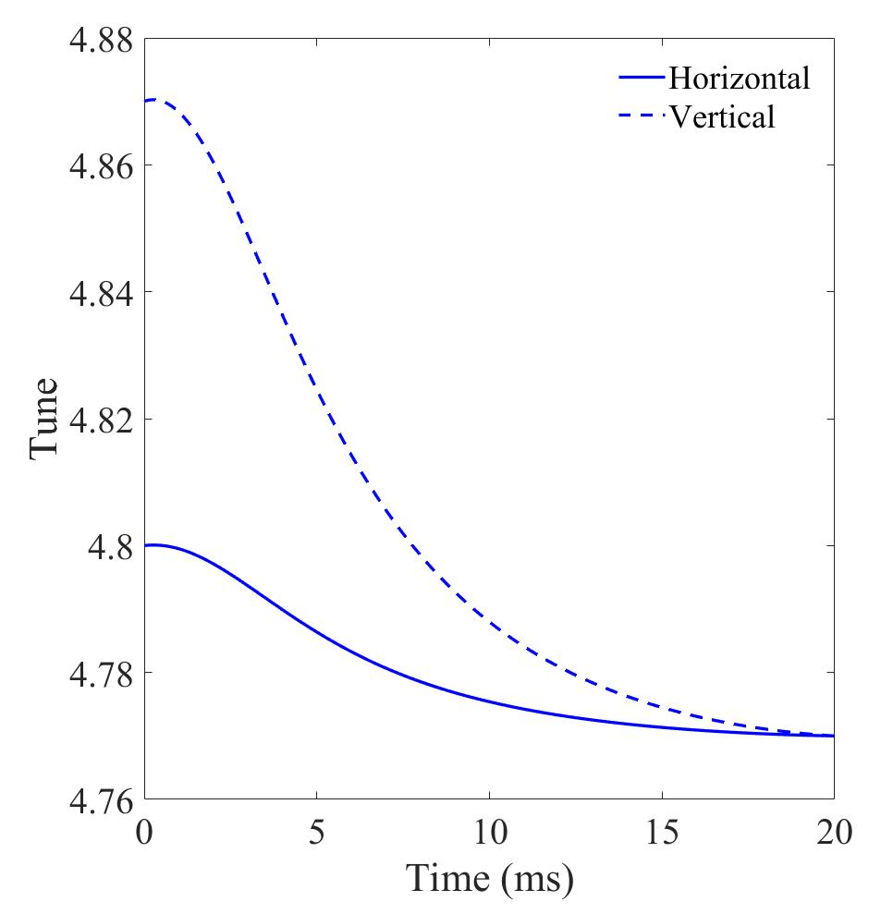
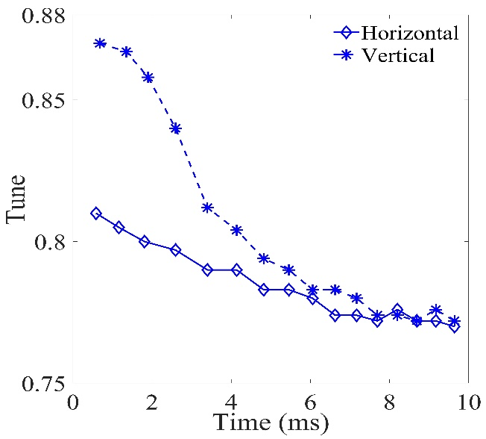
Tune Pattern Optimization
Simulation
Space charge
Instability
Measurement
Tune pattern plays an import role in the control the intense beam effects

Slide 14
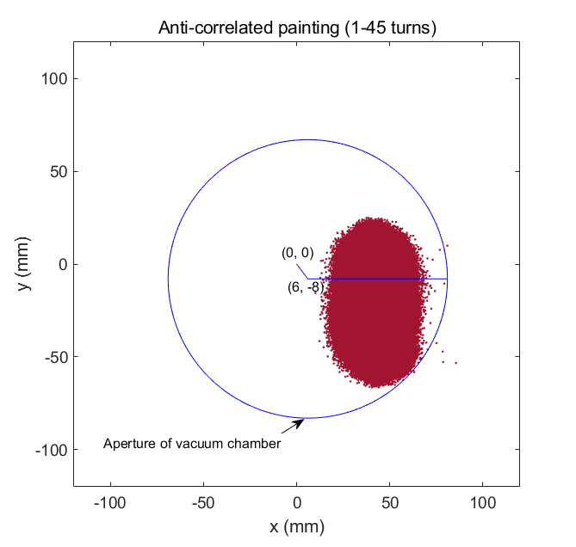
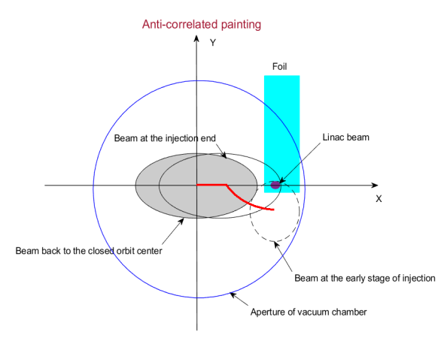
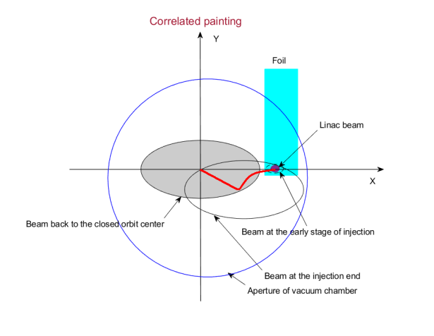
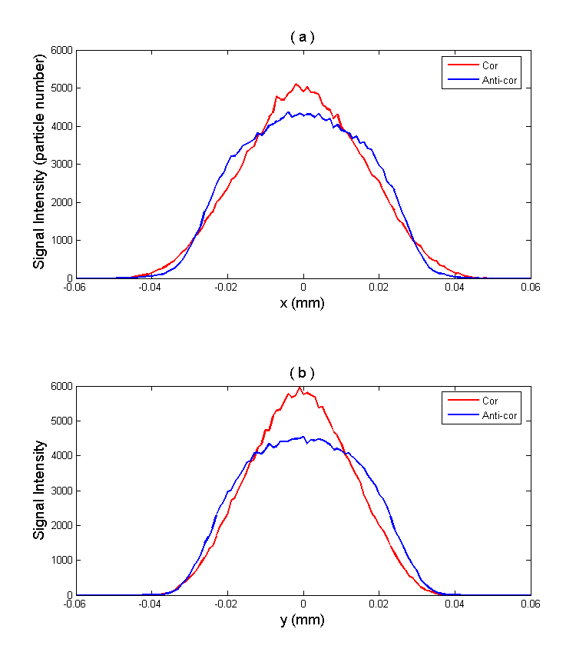
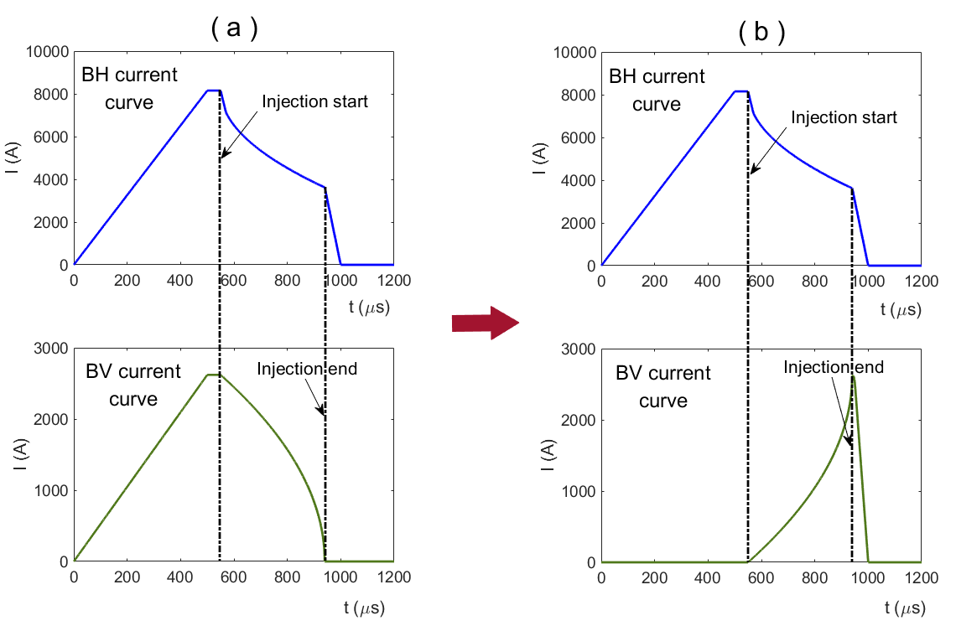
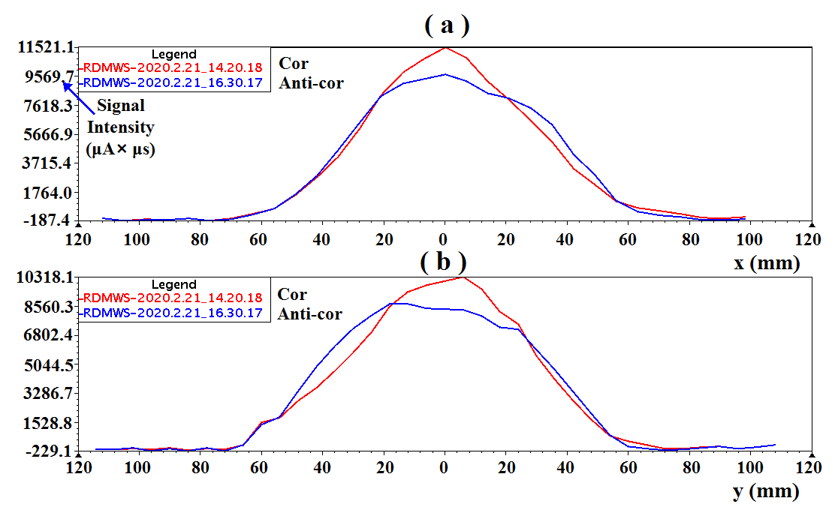
Painting scheme optimization
See Huang’s report
Simulation
Measurement

Slide 15
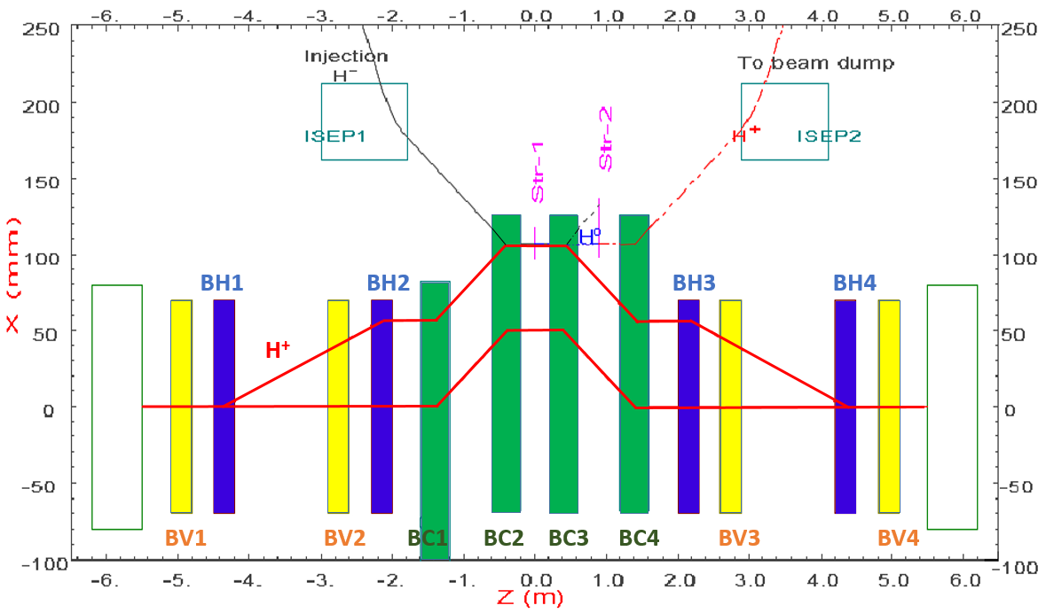
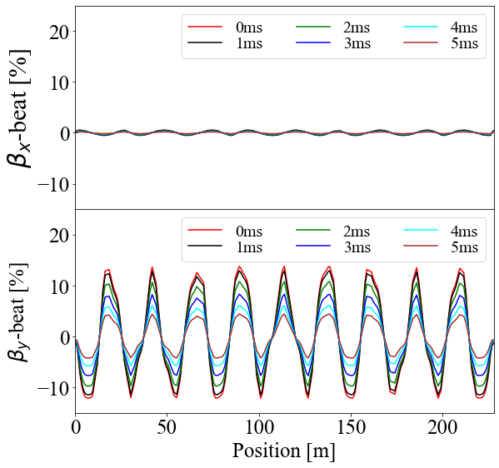
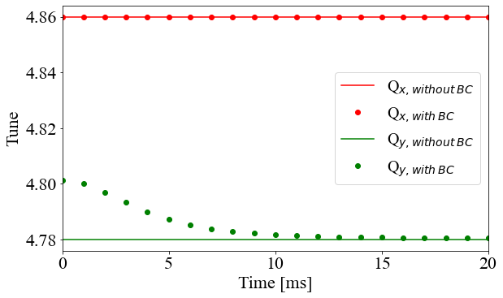
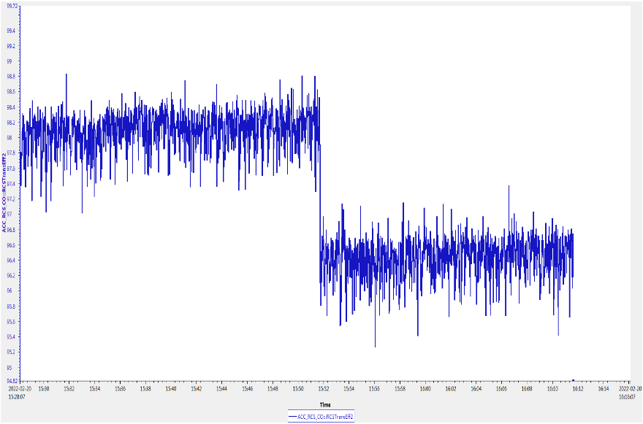
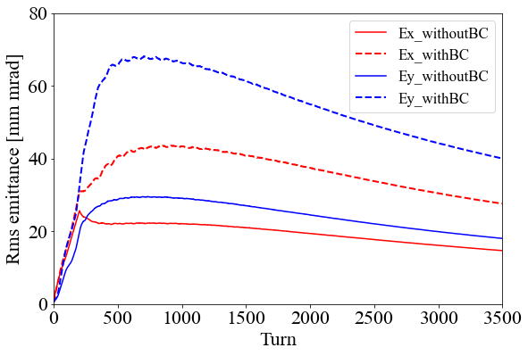
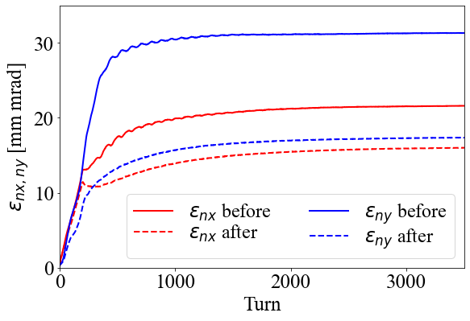
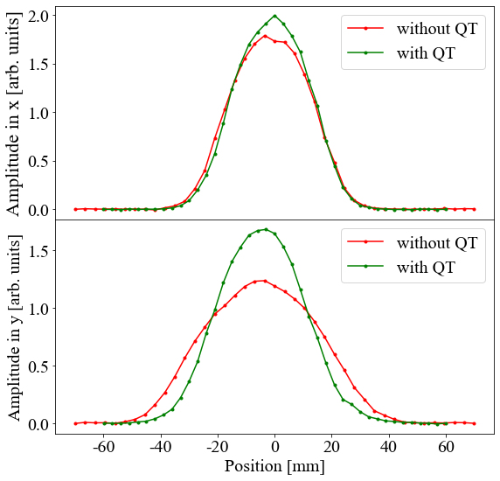
Super-periodicity restoration
Injection system
β-beating@MAD-X
tunes@MAD-X
Design tunes(4.86,4.80)
Emittance@PyORBIT
Emittance_QT@PyORBIT
Measured Beam Profile
Operating mode @125 kW
96.4% @ without QT
98.1% @
with QT
20 min

Slide 16
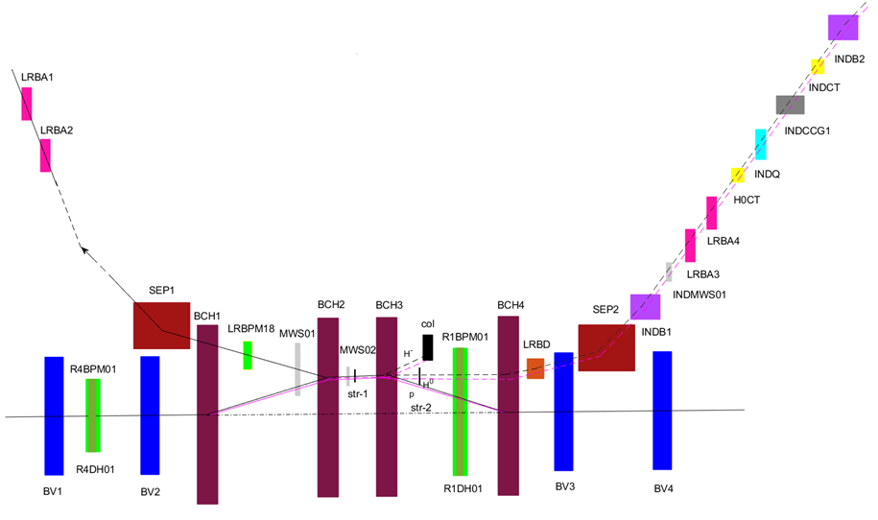
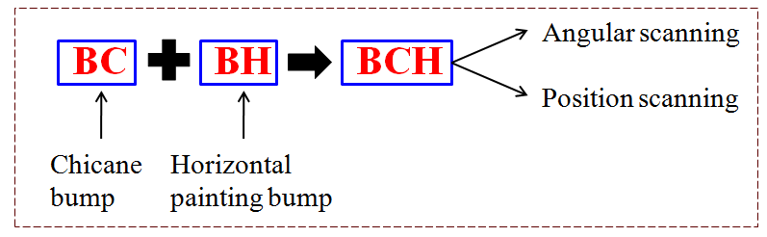
A new injection painting scheme
See Huang’s report
New idea: chicane bump and horizontal painting bump are combined into one bump which make the chicane bump "move“. The horizontal painting is performed by using the position and angle scanning at the same time.
Advantages:
Peak temperature of the stripping foil can be greatly reduced.
Both correlated and anti-correlated painting can be performed.
The edge focusing effect of bump magnets is greatly reduced
The difficulty of large aperture of the injection port and transport line required by angular scanning is solved.
It saves a set of bump magnets and is easier to optimize the layout of the injection system.

Slide 17
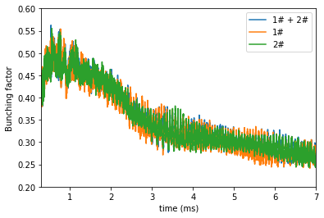
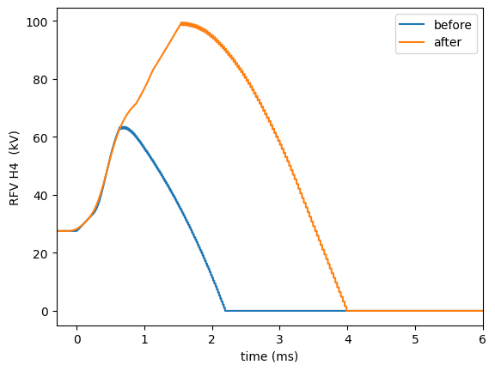
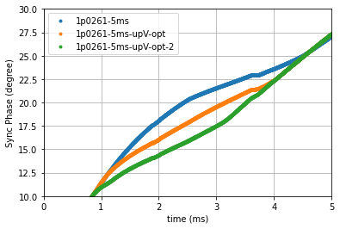
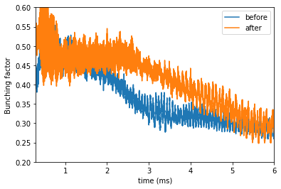
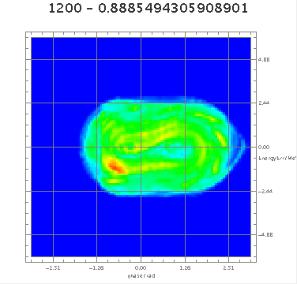
The beam commissioning with MA cavities
Consistent bunching factors with two different MA cavities at 140 kW
Increased H4 cavity voltage extends dual harmonic duration
Fundamental cavity voltage boost lowers sync-phase for larger bucket
Post-optimization, bunching factor at 170kW surpasses 140kW
Phase space reconstructed by tomography from WCM at 2ms

Slide 18
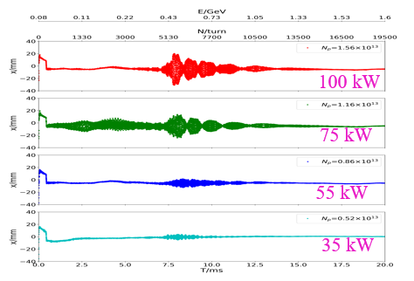
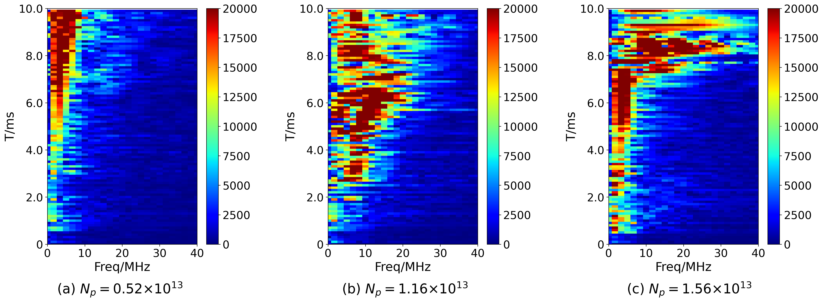
Collective instability in RCS
See Huang’s report
  With nominal tune (4.86/4.78) and nature chromaticity, coherent oscillations were observed when beam power >50 kW, with amplitude increasing as the intensity increases.
  The growth time is less than 1 ms for 100 kW
  The impedance is several handred kΩ/m
  It is a “broadband” impedance

Slide 19
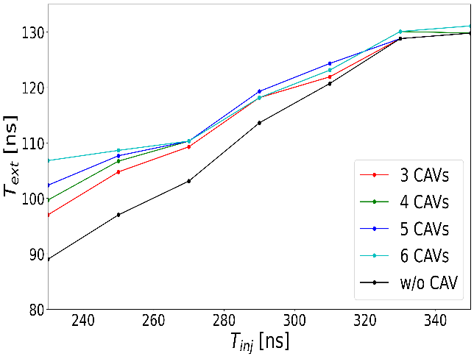
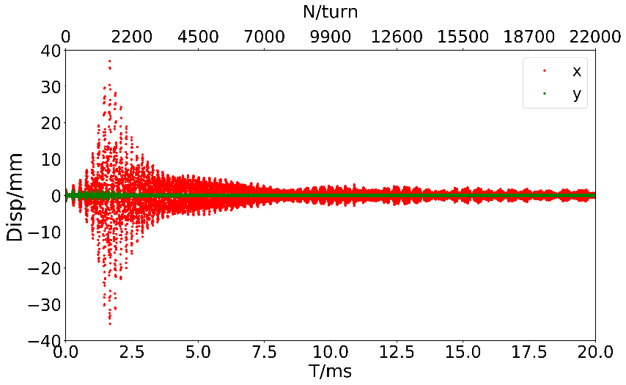
Beam instability in RCS of CSNS-II
The new elements in RCS don’t contribute a lot for impedance
  Bunch lengthening driven by parasitic impedance of MA CAV is very small
  The head-tail coupling bunch instability remains a key issue in CSNS-II
    The threshold of beam power is ~ 300 kW
Prediction of the beam instability with 500 kW beam power in CSNS-II
Bunch length with different number of MA CAV

Slide 20
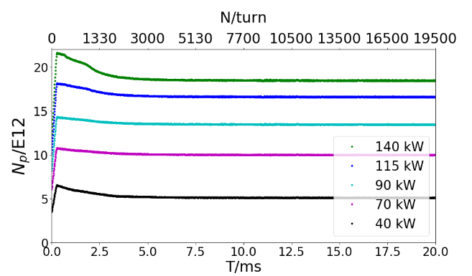
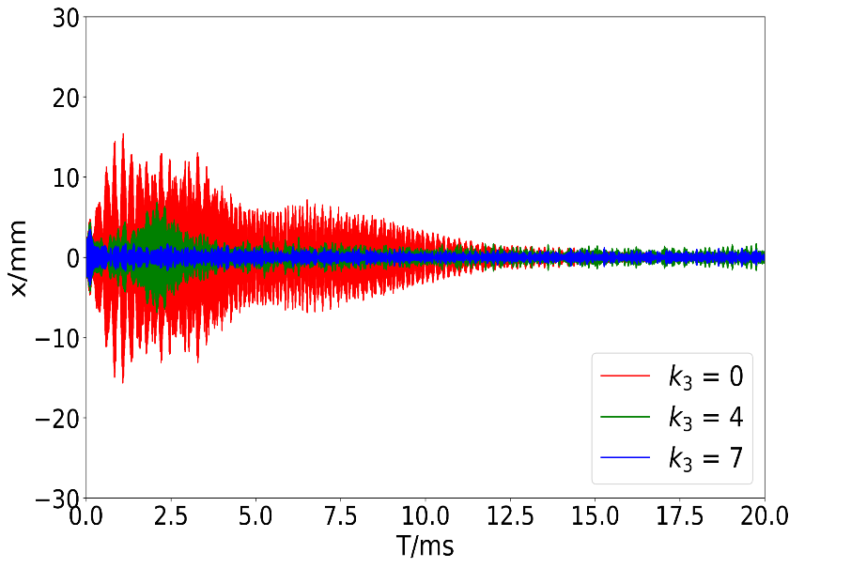
Mitigation strategy for CSNS-II
  Many mitigation methods are being considered
  Tune below 0.5, such as (4.3,5.3), (5.29, 5.32)
    Such as (4.3, 5.3) below, without instability observed until 140 kW
  Octupole magnet were installed to increase Landau damping
  BxB feedback will be adopted
Bandwidth | 2.5 MHz
Shut impedance | 3 kΩ
Voltage | 5 kV
power | 2.5 kW
Damp time | 0.5 ms
(4.3,5.3), w/o instability
Simulation study on using octupole

Slide 21
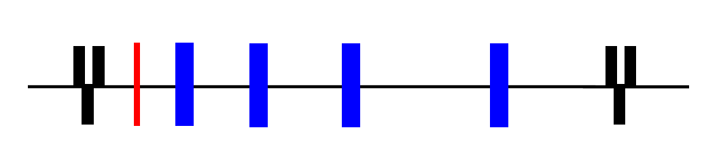
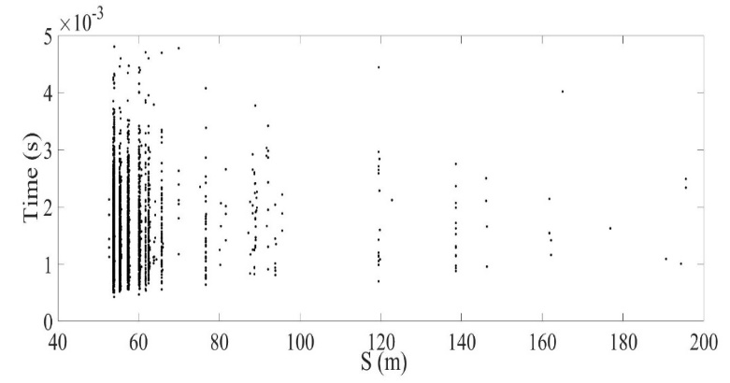
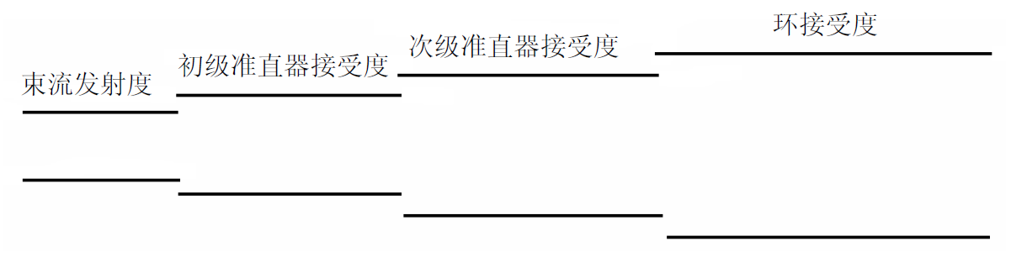
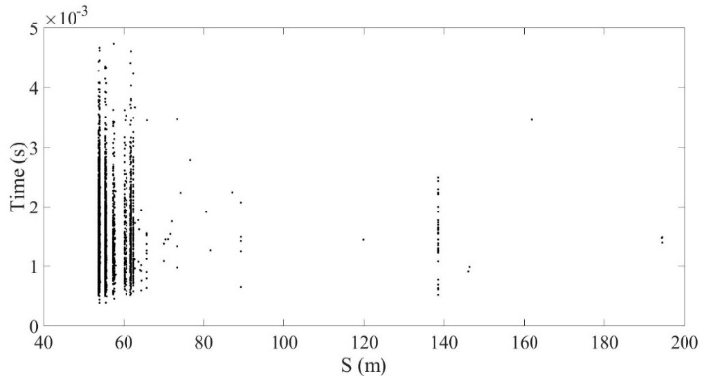
Upgrade of collimation system
二、CSNS设计与调试
Collimation efficiency >95% in simulation
（21°，22°）
（62°，67°）
With primary colli.：89.8%
（9°，9°）
（38°，41°）
Acceptance of Secondary colli.
Acceptance of RCS
Acceptance of primary colli.
Beam Emit.
Without primary colli.：94.6%
~300
~350
420
540
<500
>400

Slide 22
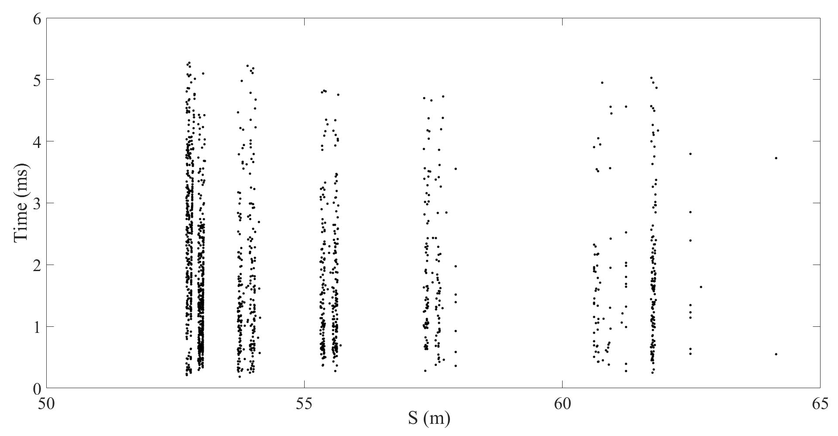
Beam Loss Control
 | (4.80, 4.86) @500kW | (4.80, 4.86) @750kW
C0 | 50.2% (188W) | 53.1% (398W)
C! | 18.1% (68W) | 14.8% (111W)
C2 | 15.0% (156W) | 12.7% (95W)
C3 | 8.4% (32W) | 7.6% (57W)
C4 | 3.2% (12W) | 4.0% (30W)
Shielding | 3.9% (15W) | 4.9% (37W)
Quadrupoles | 0.6% (2.3W) | 1.6% (12W)
Down stream arc (~10m) | 0.6% (2.3W) | 0.8% (6.0W)
Others | ~0 | 0.5% (3.8W)
Colli. efficiency | 98.8% | 97.1%
Total loss | 0.3% (375W) | 0.4% (750W)
C0
C1
C2
C3
C4
Shielding
Down stream quadrupoles

Slide 23
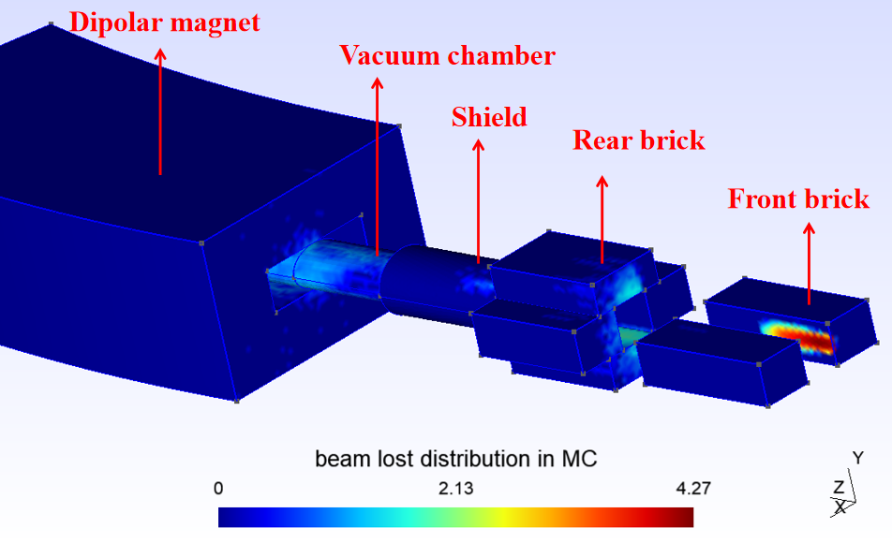
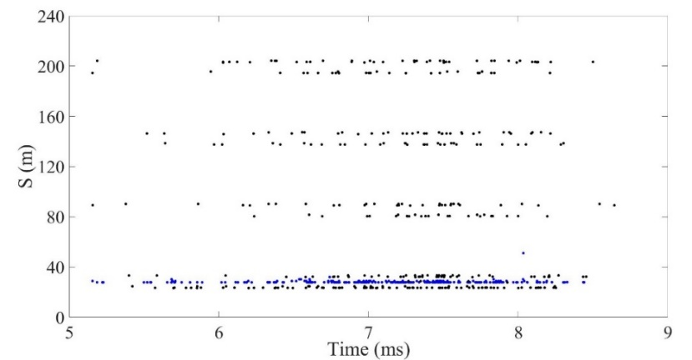
Momentum collimator
四、CSNS RCS动量准直器设计
Beam parameter | Colli. efficiency
130kW (80MeV injection) | 95.8%
200kW(80MeV injection) | 95.6%
500kW(300MeV injection) | 94.4%
Beam loss with/without momentum collimator

Slide 24
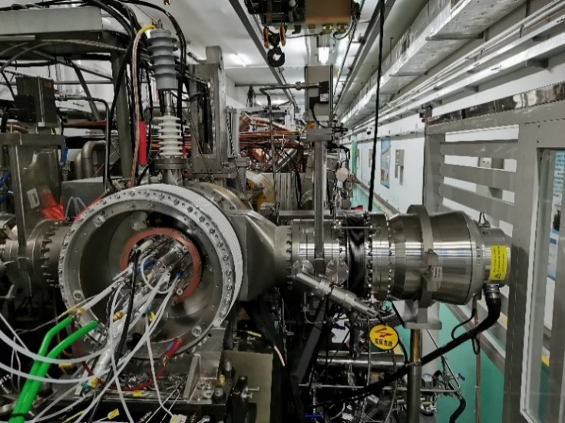
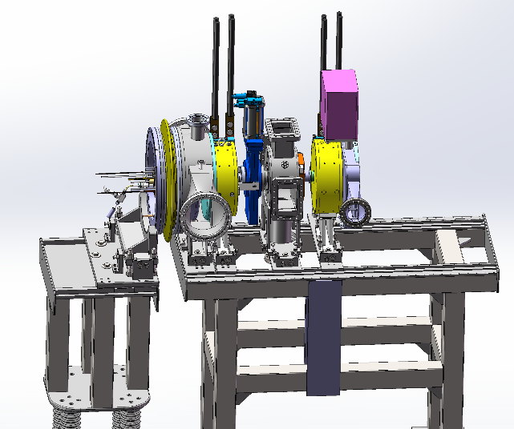
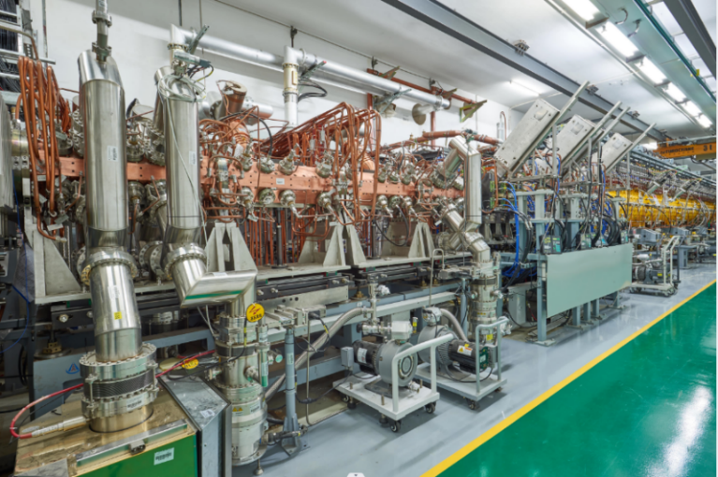
Front-End
The H- ion source was put into commissioning since Sep. 2021 Excellent performance with nearly 100% availability.
The beam intensity and emittance on the test bench have basically met the requirements of CSNS-II
New RFQ (50-60mA)

Slide 25
Upgrade of H⁻ source
Penning H- source
RF-driven H- source
Key Parameters | Penning | RF-driven with ext. antenna
Maximum peak current | 50 mA | 60 mA
Current fluctuation | ~10% in month | <2% in one month
Service life | 30 days | >1 year
Cesium usage | ~2g/month | 0.2g/year
Typical emittance (π∙mm∙mrad) | 0.8@50mA (20mA within 0.2 π∙mm∙mrad) | 0.24@50mA
Hydrogen consumption | 10sccm | 21sccm

Slide 26
Upgrade of LEBT
LEBT for CSNS Phase-I
Parameter | CSNS LEBT | CSNS-II LEBT
Length | 1668mm | 738mm
Inner aperture | 138mm | 64mm
Beam current | ～40mA | 60mA
Trans. Emit. | 0.307@37mA | 0.24@52mA
No. of solenoid | 3 | 2
Length of solenoid | 240mm | 127mm
Proton bending | No | 3.6°
Chopping electrode | 50mm | 27mm
Chopping voltage | 3.8~5kV | 6~8kV
RFQ inlet plane
LEBT for CSNS-II

Slide 27
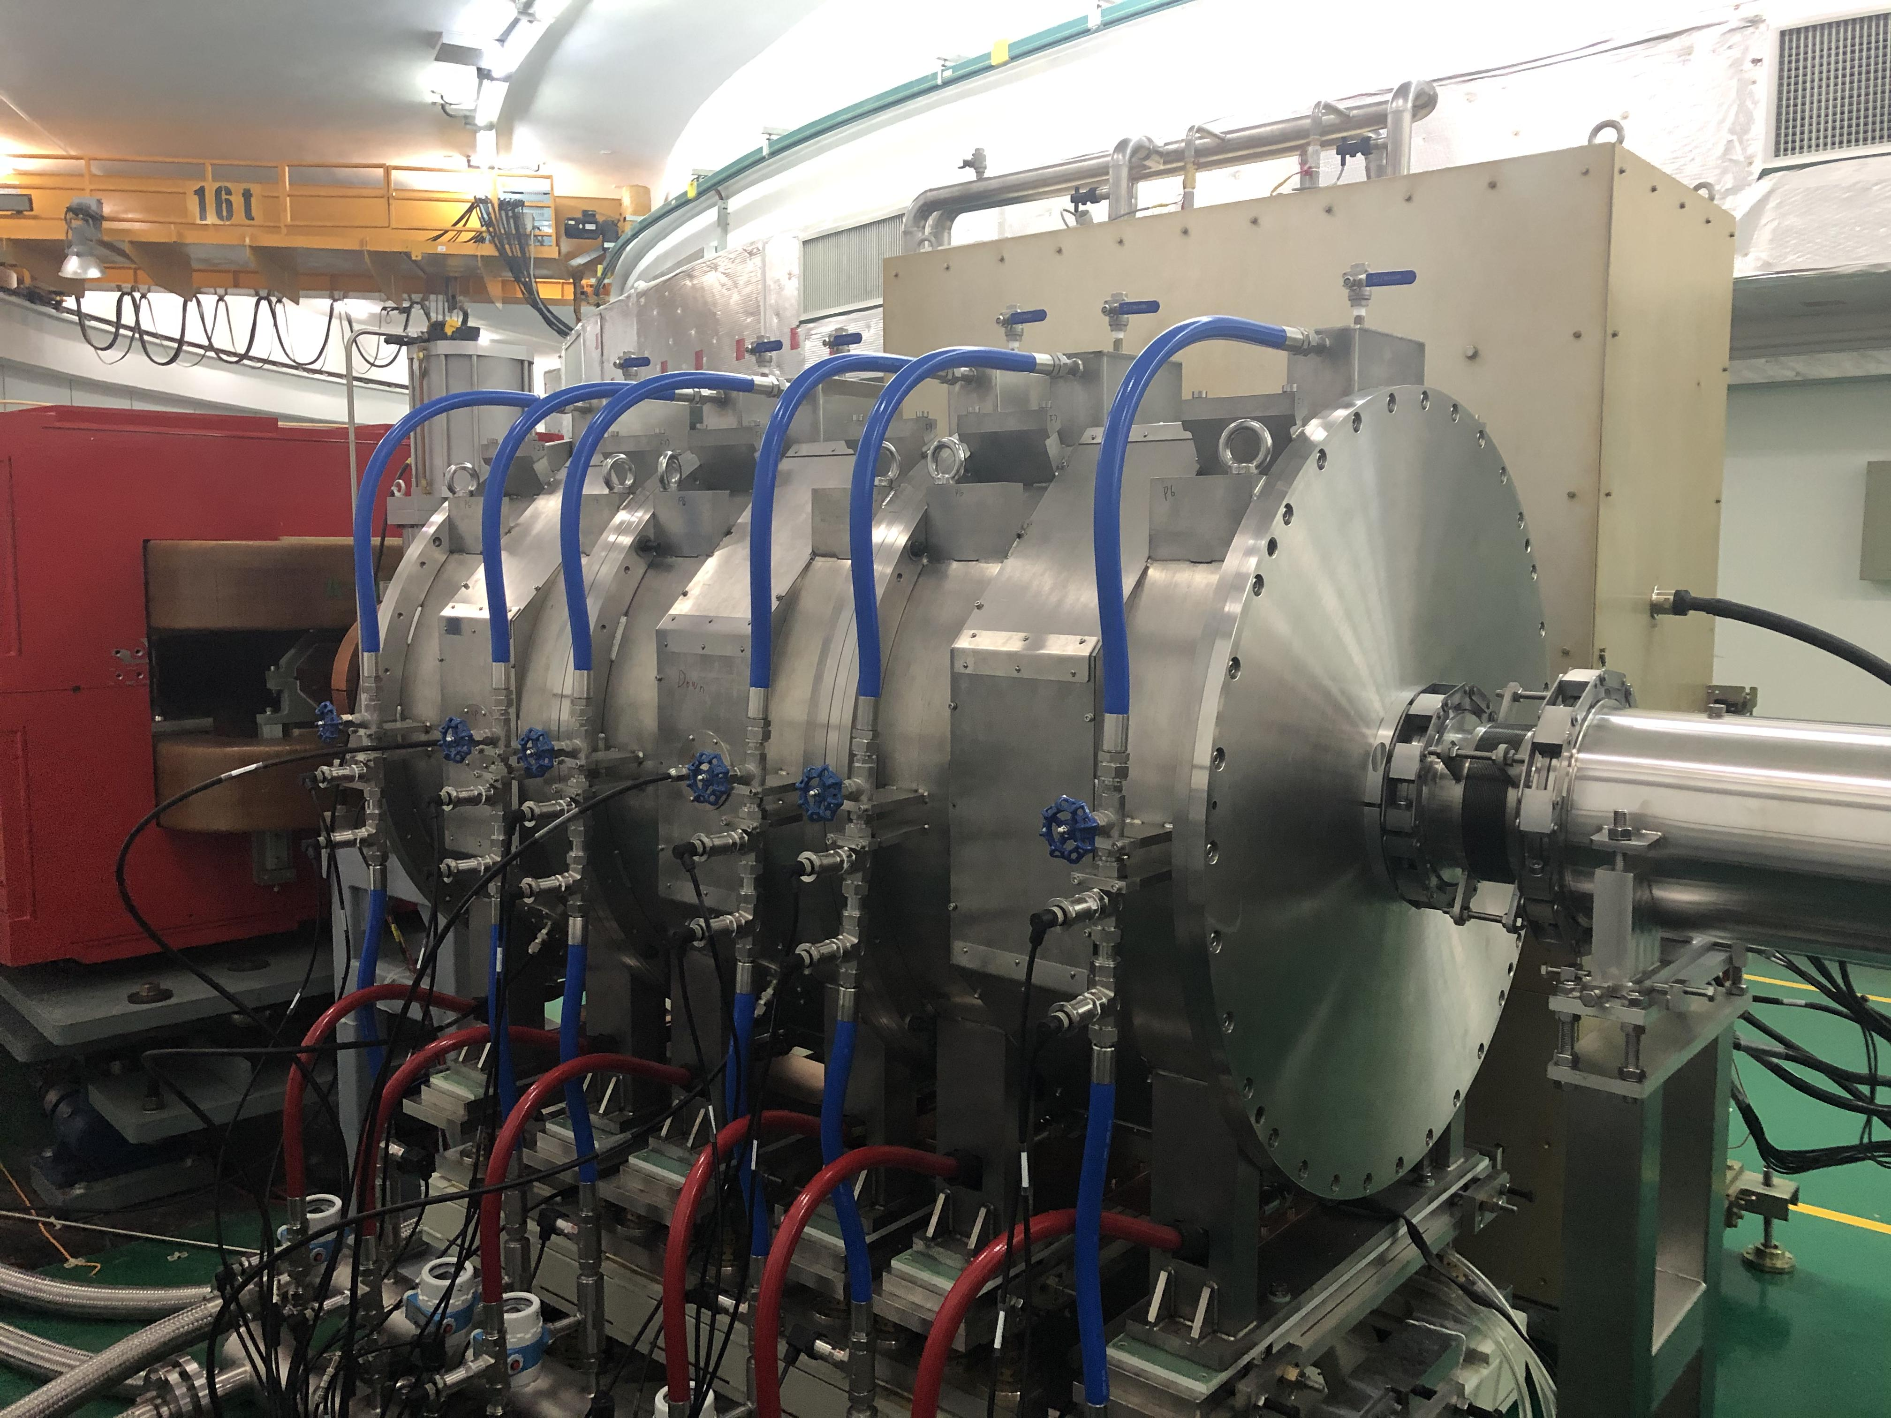
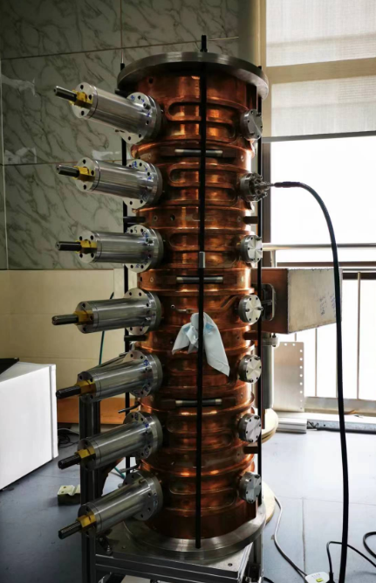
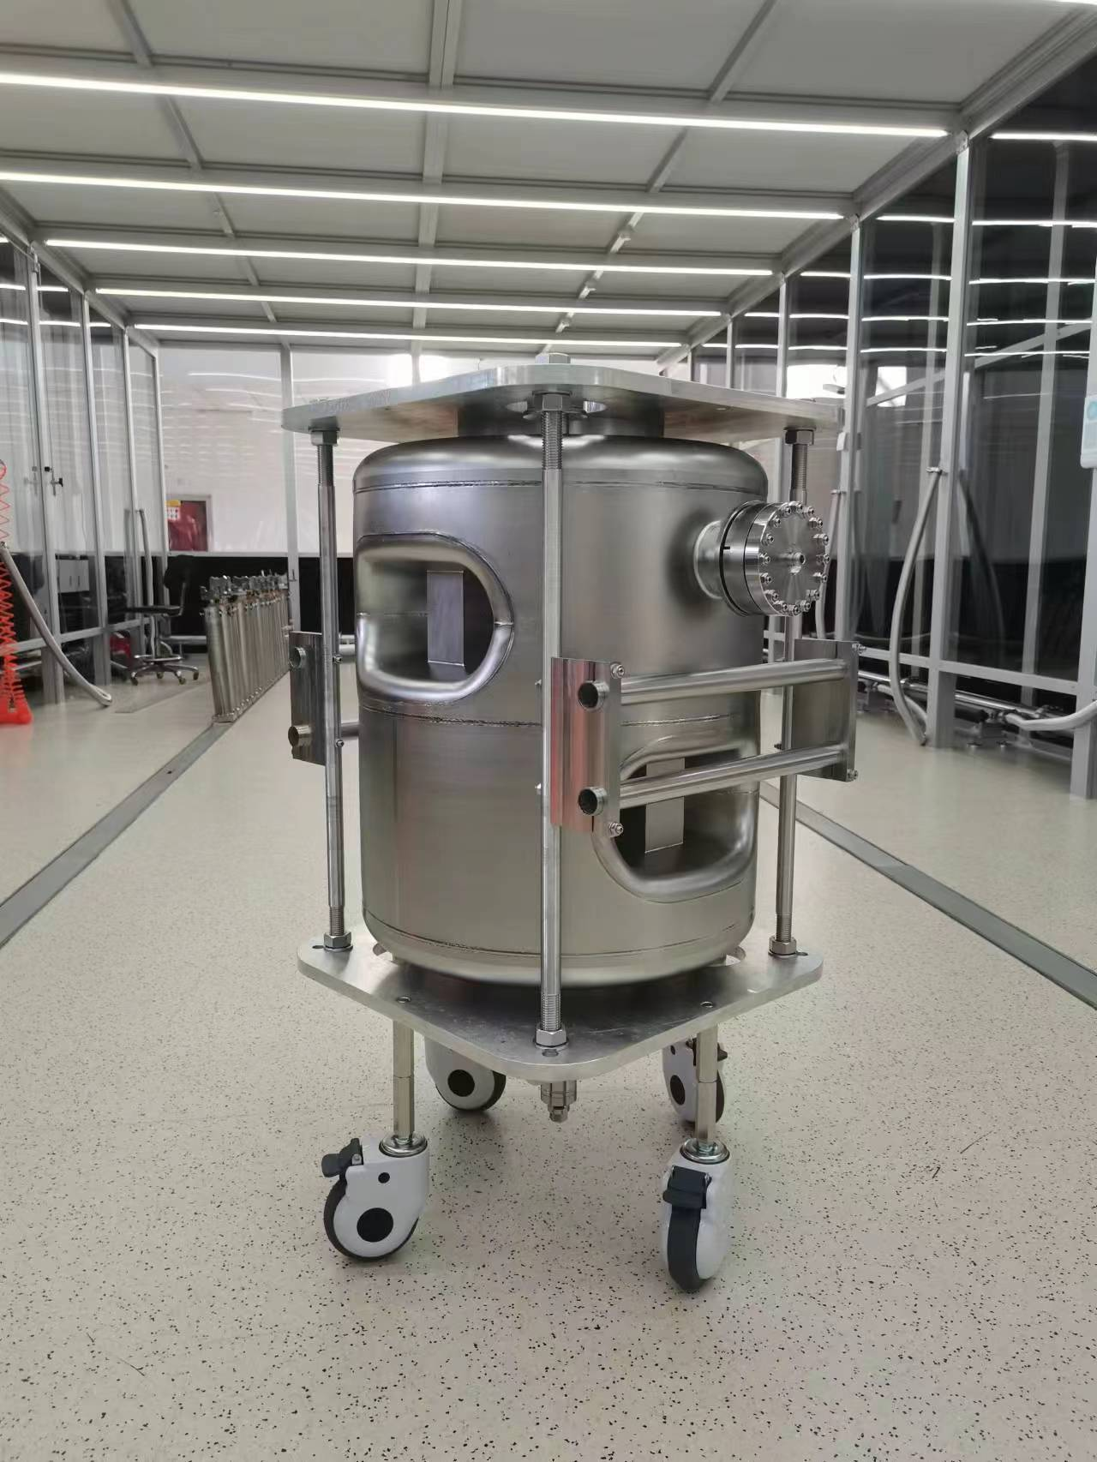



R&D for CSNS-II Accelerator
MA second harmonic cavity
RF H- ion source
7-cell pi-mode debuncher
Prototype SC cavities: Double spoke & Ellipsoidal cavity
Long-pulse solid-state modulator
Low-level RF prototype

Slide 28



Horizontal testing
cryostat
Vaccum
system
Alignment
system
coupler
Eacc:
1# 12.8MV/m
2# 15.2MV/m
Valve box
The successful integration of the cryostat and the completion of the high-power conditioning process for the couplers mark significant milestones.
Horizontal testing yielded promising results with a maximum gradient of 15.2 MV/m and a static heat load of 16.3 W.
Further measurements are required to accurately determine the dynamic heat load.
28

Slide 29





6-cell Elliptical cavity Cryomodule
648 MHz 6-cell Elliptical Cavity
parameter | design
Frequency(MHz) | 648
TTF@β_{g} | 0.7
β_{g} | 0.62
E_{p}/E_{acc} | 2.53
B_{p}/E_{acc}(mT/(MV/m)2 | 5.45
R/Q（Ω） | 309
G（Ω） | 177
Beam tube diameter（mm) | 105/120
Cell-cell coupling（%） | 1.35
E_{acc}(MV/m) | 14
mechanical structure of prototype ellipsoidal cavity
BCP and HPR
The flatness of the electric field is 97.9%.
Bare cavity vertical measurement data
29

Slide 30

Southern Advanced Photon Source（SAPS）
The 4th generation medium-energy (3.5GeV) diffraction-limited storage ring
Attosecond coherent pulses Embedded with SAPS
SAPS will be located next to CSNS（Neutron technique + X-ray technique）
SAPS research and test platform finished
R&D on key techniques
Plans to start construction around 2026
The proposed SAPS
SAPS platform
CSNS
30

Slide 31
Summary
The CSNS beam commissioning has been successful, surpassing the 100 kW (design goal). Currently, CSNS operates steadily at 160 kW with high availability, reliability, and stability.
Many intense beam related issues have been studied in the beam commissioning.
CSNS-II, the upgrade project for CSNS, which will increase beam power to 500kW, started the construction.
The experience and lessons from CSNS have laid an important foundation for the CSNS-II.

Slide 32
Thank you for your attention!

