Slide 1

Space charge effect in the J-PARC RCS
Pranab K. Saha
J-PARC, Japan
6th ICFA mini-workshop on Space charge
Dongguan, China, Sep. 11-13, 2024

Slide 2
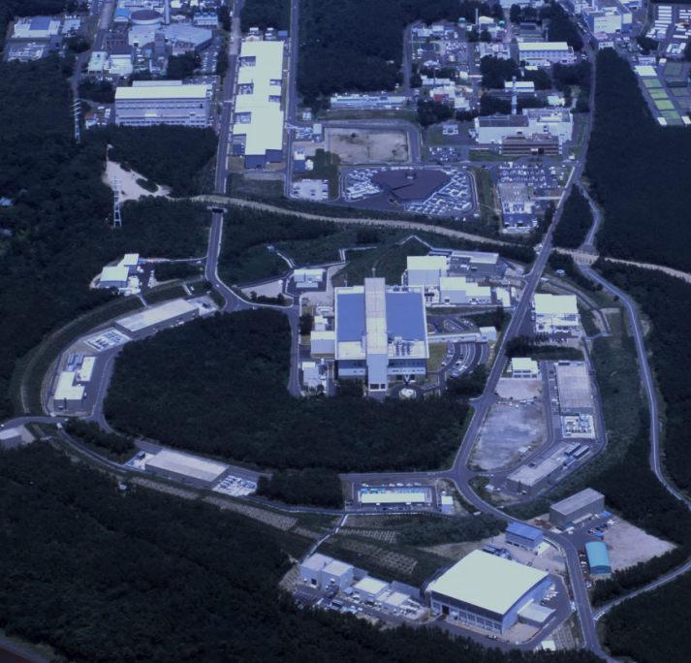
J-PARC facility
J-PARC
(KEK & JAEA)
Overview of J-PARC
400 MeV H⁻ Linac
Accelerators at J-PARC:
■ 400 MeV H⁻ Linear Accelerator (LINAC)
■ 3-GeV Rapid Cycling Synchrotron (RCS)
■ 30 GeV Main Ring (MR)
J-PARC provides high intensity proton beams
for multi-dimensional experimental research,
such as
◆ Material and Life Science
◆ Particle Physis
◆ Nuclear Physics
…….
Foil
3 GeV Rapid Cycling Synchrotron (RCS)
Neutrino Beam Line to Kamiokande (NU)
30 GeV Main Ring Synchrotron (MR)
Material and Life Science Experimental Facility (MLF)
Hadron Expt. Hall (HD)

Slide 3
Outline:
Overview of 3-GeV J-PARC RCS
Scenario of space charge (SC) effect in the RCS
Numerical simulation for identifying the SC effect
Results of beam loss mitigation at 1 MW until 2020
Recent further mitigation of the SC effect for beam loss minimization
Operational performance and suppression of machine activation
Summary and outlook

Slide 4
Overview of the J-PARC RCS
Key parameters:
Circumference : 348.333 m
Superperiodicity : 3
Harmonic number : 2
Number of bunches : 2
Injection : H⁻ multi-turn
charge-exchange injection
Injection energy : 400 MeV
Injection period : 0.5 ms
Injection peak current : 50 mA
Extraction energy : 3 GeV
Repetition rate : 25 Hz
Particles per pulse : 8.33 x 10¹³
Beam power : 1 MW
RCS is a highly space charge (SC) dominated machine at a beam power of 1 MW.
Moreover, RCS is a multi-user machine for
Proton driver for producing pulsed muons
and neutrons at the MLF.
Injector to the MR
Beam sharing ratio between MLF and MR:
88:12 for MR-FX, 96:4 for MR-SX
Operational strategy:
Beam loss mitigation for beam operation to the MLF
Ensure a smaller beam emittance for the MR
The SC effect poses serious challenges to fulfil multiple
demands simultaneously.

Slide 5
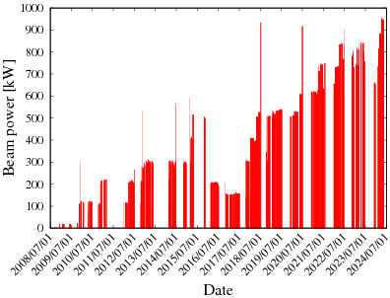
RCS beam power history to the MLF to date
1 MW trial operation
in 2020 (1.5 days)
We have started 1 MW routine operation to the MLF since April 2024.
Net beam power to the MLF: 0.95 MW
(when MR takes 5% of the RCS beam for SX operation)

Slide 6
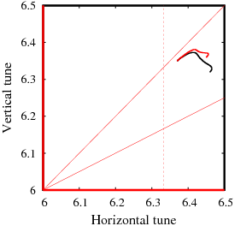
Beam loss and beam emittance minimization strategy
The SC and resonance effects are complicated at high-intensity for simultaneous beam optimizations.
Systematic beam studies and numerical simulations are conducted for optimization of many parameters and their switching pulse-by-pulse for beam loss and beam emittance minimization to the MLF and MR
MR
Parameter | For MLF | For MR
Beam power | ~1 MW | 800 kW-eq. (FX), ~200 kW-eq.(SX)
Tune at inj. & ext. | (6.46, 6.36) & (6.38, 6.35) | (6.417, 6.447) & (6.38, 6.35) by Trim Quads
Trans. painting (TP) & type | 200π mm mrad anti-correlated | 50π mm mrad correlated
Longitudinal Painting (TP) | Inj. Δp/p offset: -0.15% 2nd harmonic duration: 6ms RF freq. offset at inj. | Inj. Δp/p offset: -0.15% 2nd harmonic duration: 7 ms RF freq. offset: None
Sextupoles | ν_{x}-2ν_{y} = -6 Resonance correction | ξ manipulation by bipolar Sextupole Partial ξ cor. at lower energy but extra ξ at higher energy. Reduce SC effect at lower energy and mitigate beam instability at higher energy
ν_{x}+2ν_{y}=19
3ν_{x}=19
MLF
2ν_{x}–2ν_{y}=0
ν_{x}–2ν_{y}=-6
Tune at injection for the MR is changed
by 6 trim quadrupoles (QDT).
Beam loss minimum
Beam emit. minimum

Slide 7
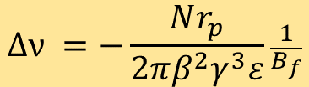
Space charge (SC) effects in the J-PARC RCS
MR
Major resonances driven by the SC effect at injection energy:
① ν_{x} – 2ν_{y} = -6 ; Structure resonance
Excited by sextupole field component intrinsic in the BMs.
K2 = 0.1006 m⁻² (1/4 strength of full ξ correction)
Affects at lower beam energy due to large Δν. Larger emittance growth in the vert. plane.
Corrected for the MLF beam by Sextupoles as ξ correction is not done.
② 3ν_{x} = 19 ; 3rd order random resonance
Excited by not cancelled Sextupole field component (K2 = 0.0012 m⁻²) in the injection
chicane magnets (SB). Hori. emittance growth when SBs are ON during beam injection.
Partially mitigated by reducing magnetic fields of the SB by 20%.
➂ ν_{x} + 2ν_{y} = 19 ; 3rd order random resonance
Arises by sextupole fields in the BMs and ξ correction sextupole magnets.
Additionally, excited due to a distortion of the lattice superperiodicity caused by beta
beating of the SB during injection. Twice larger emittance growth in the vertical plane.
Currently, Δβ/β ~ 10% as ν_{y} is set far from the ν_{y} = 6.5, which is further
reduced by reducing SB fields.
➃ 2ν_{x}-2ν_{y} = 0. ; 4th order systematic resonance (Montague resonance)
Excited by skew-quadrupole errors, 2nd-order effect of Sext. field and also octupole
component in the SC field. Critical when ν_{x} and ν_{y} are closer.
Emittance exchange occurs. Careful choice of injection painting is essential.
Anti-correlated painting is favorable for a larger transverse painting
(H. Hotchi, PRAB23 2020)
ν_{x}+2ν_{y}=19
3ν_{x}=19
MLF
2ν_{x}–2ν_{y}=0
ν_{x}–2ν_{y}=-6
$$∆ν =−\frac{Nr_{p}}{2πβ^{2}γ^{3}ε}\frac{1}{B_{f}}$$
For | Tune at inj. | Painting emittance (π mm mrad) | Δν
MLF | (6.46, 6.36) | ~200 | -0.2
MR | (6.42, 6.45) | ~50 | -0.5

Slide 8
Numerical simulation
The 3-D space charge code simpsons (developed by Shinji Machida) is mainly used since RCS design stage, and continuing the improvement of the calculation model step by step --- Hotchi Hideaki
Since 2012, we also started using ORBIT code (developed at the SNS) for 3-D SC with impedances.
Time independent imperfections
-- Multipole field components for all the main magnets obtained
from field measurements
-- Measured field and alignment errors
Time dependent imperfections
-- Static leakage fields from the extraction beam line:
K0,1 and SK0,1 estimated from measured COD and optical functions
-- Edge focus of the injection chicane magnets (SB):
K1 estimated from measured optical functions
-- Multipole field components of the SB:
K2 . . . estimated from field measurements
-- BM-QM field tracking errors
estimated from measured tune variation over acceleration
-- 1-kHz BM ripple
estimated from measured orbit variation.
Almost corrected by COD correctors.
-- 100-kHz ripple induced by injection bump magnets
estimated from turn-by-turn BPM data . . . etc.
Now PS has almost no such ripples.
Foil scattering
-- Coulomb & nuclear scatterings
Both codes enable us to simulate,
3-D motion of beam particles including the SC modeled
by the PIC algorism.
Applied all beam handlings, such as injection paintings,
dynamic tune manipulations, etc.
To realize realistic and precise numerical simulations, we
have incorporated all lattice imperfections identified so far.
H. Hotchi: Previous SC workshop talks
H. Hotchi et al.: PRAB19, 010401 (2016), PRAB 20, 060402 (2017)
PRAB 23, 050401 (2020)
P.K. Saha et al.: PRAB 21, 024203 (2018), PRAB 16, 120102 (2013)

Slide 9
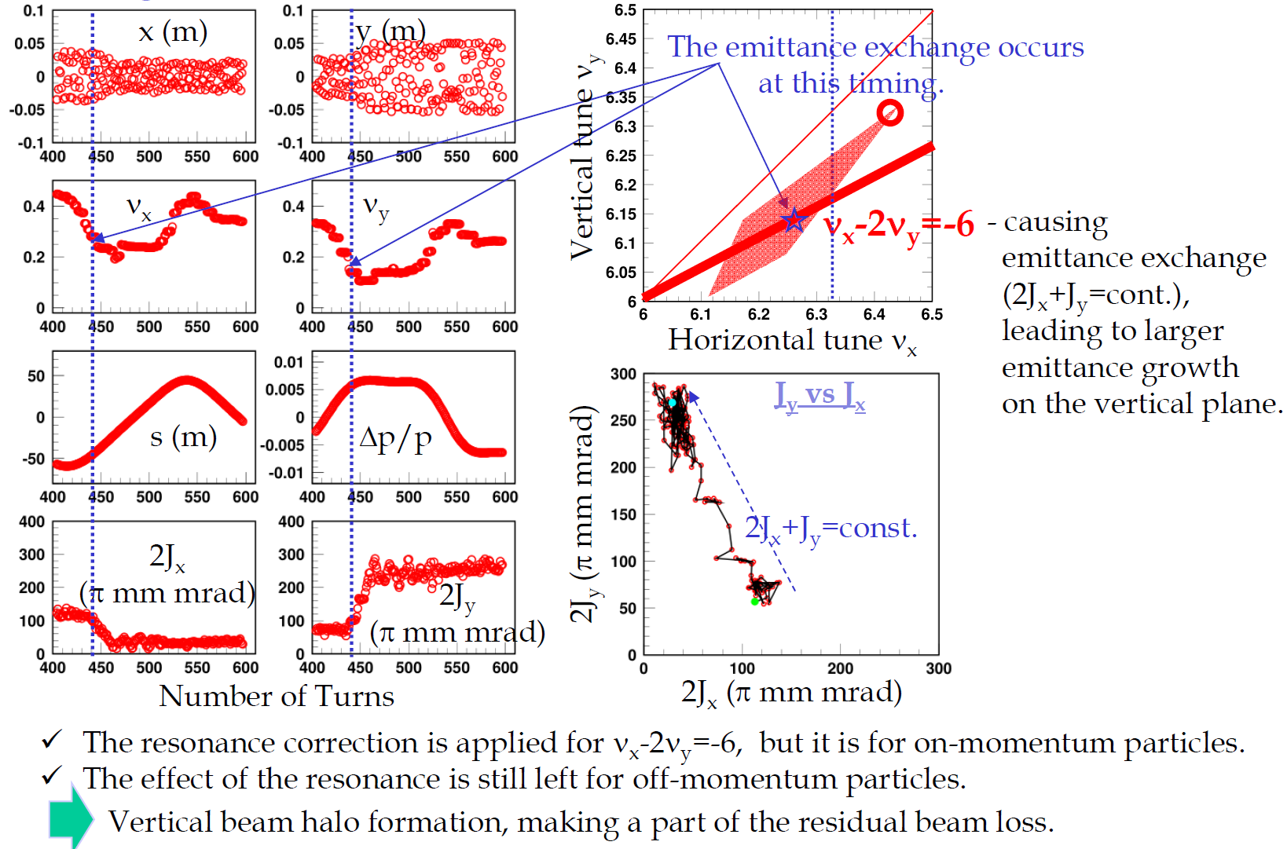
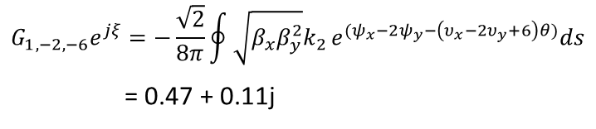

Identification of the effects of resonances
H. Hotchi
① ν_{x} – 2ν_{y} = −6 resonance
Turn by turn single particle motion leading to the vertical beam halo
x
BM
s
y
K0= 2.618E-1
K1=-2.023E-2 (m-1)
K2=-1.006E-1 (m-2)
B_{y}L (Tm)
・・1/4 of the field Strength needed for the
full ξ correction
x (m)
Driving term of ν_{x} $−$2ν_{y} = $−$6 ;
$$G_{1,−2,−6}e^{jξ}=−\frac{\sqrt{2}}{8π}\oint{\sqrt{β_{x}β_{y}^{2}}k_{2}}e^{(ψ_{x}−2ψ_{y}−\left(υ_{x}−2υ_{y}+6\right)θ)}ds$$
= 0.47 + 0.11j
Simulation
Measurement
Compensated by two families of sextupole
magnets with following modest strength;
SDA, SDB K₂ = 0.066 m⁻²
However, residual effect of the
ν_{x} -2ν_{y} = -6 resonance remains for
“OFF-momentum particles”
Beam loss is considerably reduced by
correcting ν_{x} – 2ν_{y} = -6 resonance

Slide 10
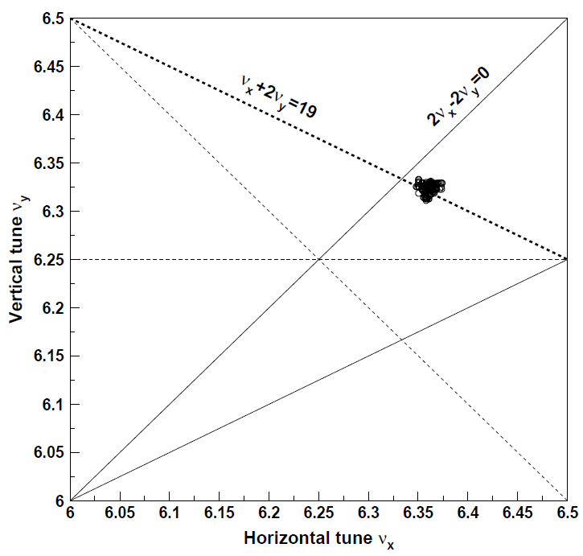
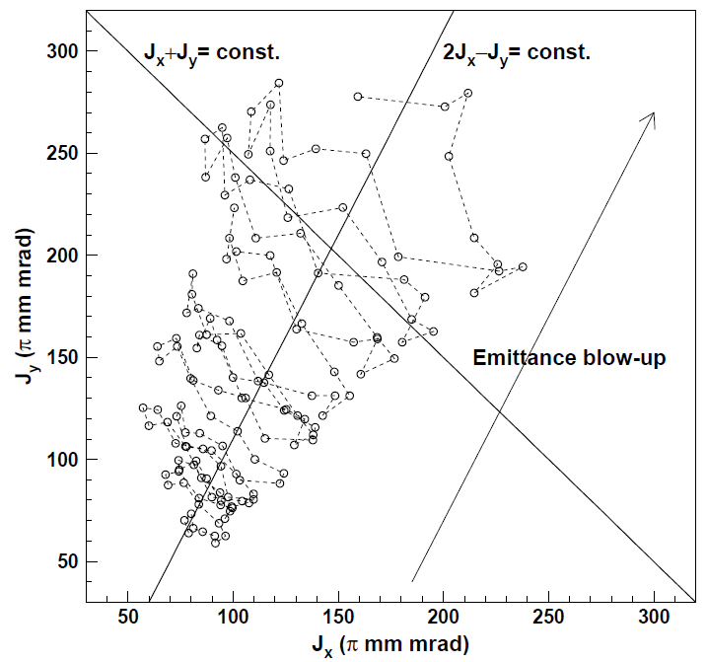
Concerning ν_{x} + 2ν_{y} = 19 and 2ν_{x} – 2ν_{y} = 0 resonances
Operating point (6.45, 6.42)
The incoherent tunes are located
on the ν_{x}+2ν_{y}=19 resonance as well as
near the ν_{x}−ν_{y} / 2ν_{x}−2ν_{y}=0 resonances.
H. Hotchi et al., PRAB 20, 060402 (2017)
Turn by turn incoherent tune
Characteristic emittance blow-up that implies the combined effect of the two resonances,
ν_{x}+2ν_{y}=19 and ν_{x}−ν_{y} /2ν_{x}−2ν_{y}=0;
2D plot of turn-by-turn
betatron actions
The horizontal and vertical actions gradually
grow up along the line of 2J_{x}−J_{y}=const.,
while oscillating in a direction parallel to
the line of J_{x}+J_{y}=const..
ν_{x}+2ν_{y}=19
ν_{x}−ν_{y}/2ν_{x}−2ν_{y}=0
Transverse painting (TP) area limited to
150π mm mrad.
Recover super-periodicity by trim quads (QDT) to
correct the ν_{x} + 2ν_{y} = 19 resonance.
Anti-Correlated painting to mitigate the effect of
ν_{x}−ν_{y} /2ν_{x}−2ν_{y}=0 resonance.
TP area enlarged to 200π mm mrad.
Tune changed (6.45, 6.42) → (6.45, 6.38)
No chromaticity correction (Sextupoles OFF)
Beam loss at 1 MW : 0.2%

Slide 11
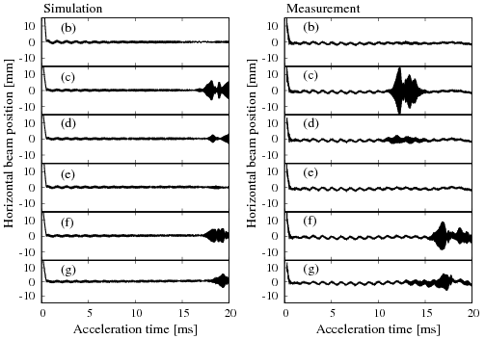
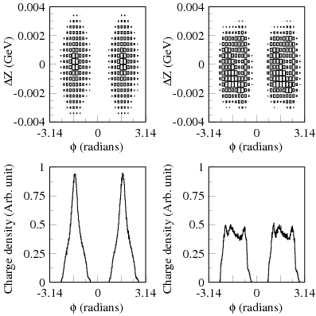
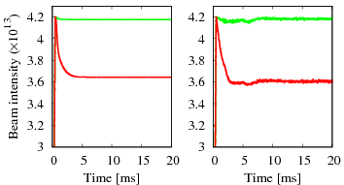
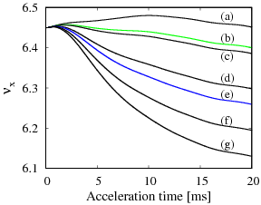
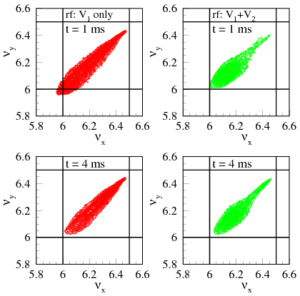
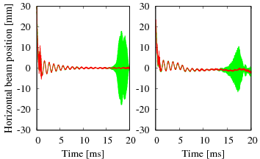
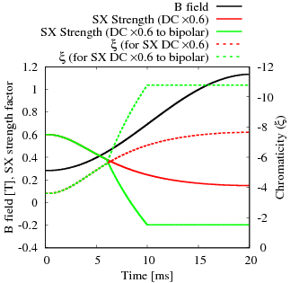
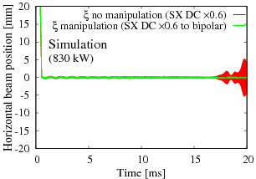
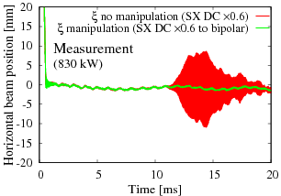
Space charge and impedance: ORBIT simulation for
beam instability and cures
P.K. Saha et al., PRAB21, 024203 (2018)
Transverse impedance of the extraction kickers is extremely serious.
The SC effect should be perfectly taken done for realistic beam instability simulation.
We have implemented time dependent impedances in the ORBIT code.
ORBIT takes indirect SC into account, important to study beam instability with SC.
Tested in the presence of strong SC & ξ corrected
ORBIT guideline to accomplish 1 MW
­­­− Single RF
− Dual RF
Simulation
Meas.
Beam instability occurs when the SC effect is reduced.
Beam is stable in a strong SC condition.
The Landau damping effect of the non-linear SC force
is more effective to stabilize the beam.
For MR: Dynamic variation of ξ. 1/2 correction by DC Sext. up to 6 ms, then
reverse Sext. field for 15% extra ξ than natural one. Beam is stable.

Slide 12
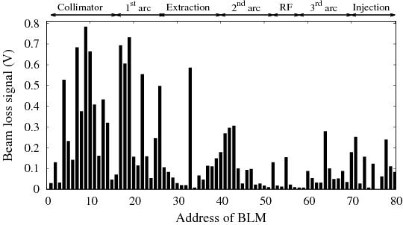
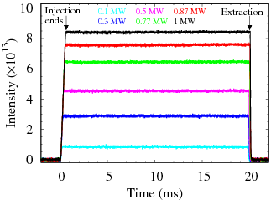
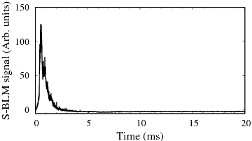
Beam loss scenario in 2020
Temporal structure of the beam loss at the collimator
From the
dump
The beam loss occurs lower energy.
But there exists some additional
beam losses after the injection
No beam intensity loss can be seen.
Measured beam loss throughout the RCS
Estimated beam loss at 1 MW: ~0.2% (Collimator limit: 4%)
However, machine activations measured after 1.5 days operation at 1 MW were not negligible,
especially at the injection, collimator and 1st arc sections.
Further beam loss mitigation is challenging, but interesting for beam dynamics point of view.
We first reduced foil scattering beam loss by reducing sizes of the stripper foil and injection beam.
Next, we studied for further mitigation of the SC and the corresponding resonance effects at 1 MW.

Slide 13
Further beam loss mitigation at 1 MW
The following four measures were taken into account recently for further reducing
the SC effect to minimize the beam loss and beam emittance at 1 MW.
Partial suppression of the 3ν_{x} = 19 resonance
Optimization of the Longitudinal painting (LP)
Modification of the Transverse painting (TP)
Optimization of tune at injection

Slide 14
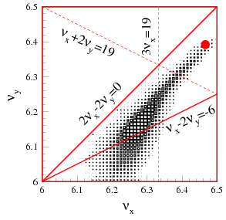
Effect of 3ν_{x} = 19 resonance
The 3ν_{x} = 19 resonance is driven by sextupole fields intrinsic in the
Injection chicane magnets (SB).
ーDipole fields of SBs are compensated through integration over SBs.
ー But for higher order field components, such a compensation is
incomplete due to magnetic interferences in reality.
Remains K₂ = 0.012 m⁻² and excites 3ν_{x}=19
Chicane magnets (SB1~4)
H. Hotchi
Most of the halo particles move around the center of the rf bucket
Tunes of such particles do not widely change turn by turn because
Turn by turn chromatic tune shift is restrictive as Δp/p of such
particles do not widely change.
Turn by turn SC tune shift is also restrictive due to almost constant
effect of the SC because of flat bunch distribution.
A part of such particles stay near the 3ν_{x} = 19 for a relatively
longer time and suffer the resonance effect continously.
Horizontal beam emittance growth, making a part of the
residual beam loss.
Unfortunately, no additional sextupoles exist for correction.
We considered a partial correction by reducing
20% magnetic fields of the SB.

Slide 15
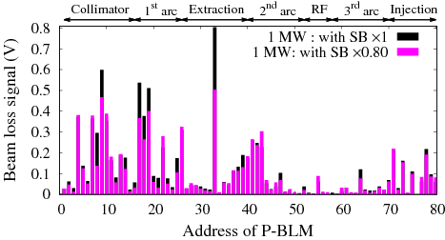
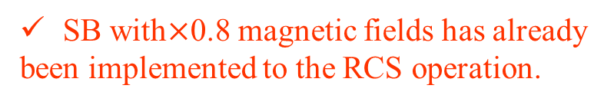
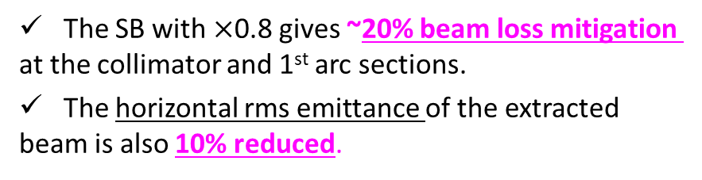
Partial suppression of 3ν_{x} = 19 resonance
For partial suppression of the 3ν_{x} = 19 resonance, we tested reducing
SB magnetic field itself by 20%.
(Further reduction difficult due to injection difficulties)
Reduction of the SB magnetic field has two more advantages:
A less SB magnetic field helps reducing decay rates (~5%)
of the excited H⁰ before arriving to the 2nd foil.
The vertical beta function beating caused by the edge focusing
effect of the SB can also be 40% reduced.
SB with$×$0.8 magnetic fields has already
been implemented to the RCS operation.
The SB with $×$0.8 gives ~20% beam loss mitigation
at the collimator and 1st arc sections.
The horizontal rms emittance of the extracted
beam is also 10% reduced.

Slide 16
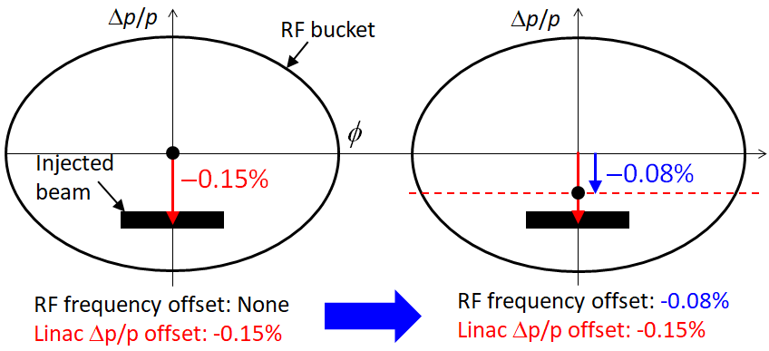
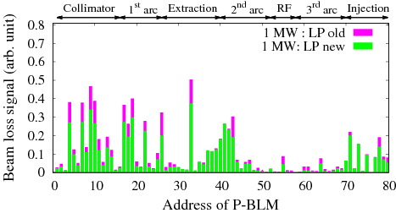
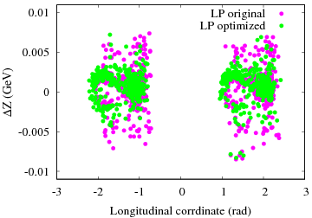
Optimization of the LP
Optimization of the LP gives further 30% beam loss mitigation.
But beam emittances remain unchanged,
Therefore, the longitudinal beam motion is improved reducing
longitudinal beam halos lost by the chromaticity effects.
Simulation results confirm a reduction of the longitudinal beam halos
for an optimized LP.
Simulation results of longitudinal distribution
of the lost particles

Slide 17
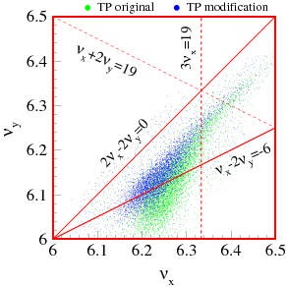
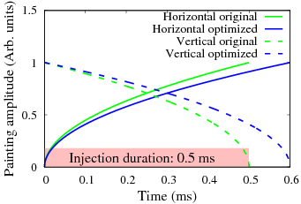
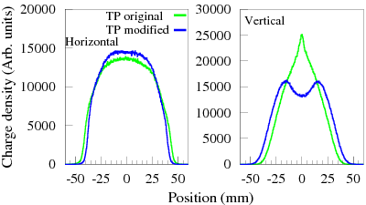
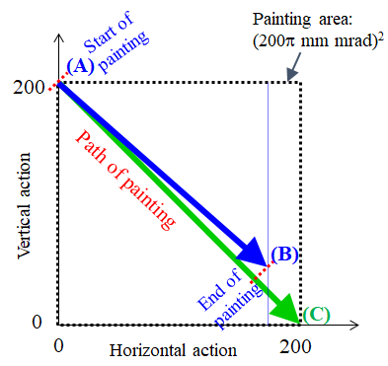
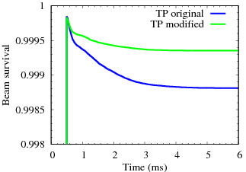
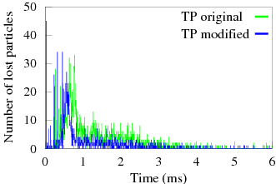




Optimization of the TP
Simulation results:
$$x=x_{max}\sqrt{\frac{t}{T}∗f}$$
$${; x}^{′}={x′}_{max}\sqrt{\frac{t}{T}∗f}$$
$$y^{′}={−y′}_{max}\sqrt{1−\frac{t}{T}∗f}$$
y$=0 ;$
Slow variation of painting
Reduce spatial charge concentration and produce uniform beam distribution.
Maintain a balance distribution of horizontal and vertical painting emittances
crucial for controlling beam emittance growth and emittance exchange.
Obtain a symmetric tune distribution reduceing numerous particles
trapping on the ν_{x}−2ν_{y} = −6 resonance.
Emittance exchange
AC→AB
Temporal structure of
the beam loss
The unpainted area is filled by the SC effect
and emittance exchange.
Reduce number of particles exceeds the
painting emittance.
Additional beam losses continue after the injection are almost mitigated.

Slide 18
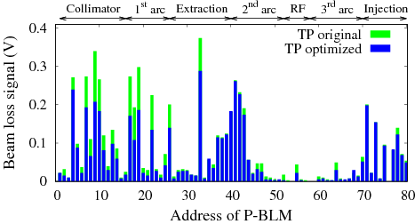
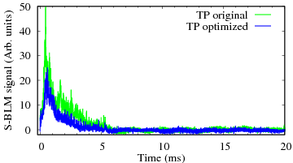
Optimization of the TP
Measurement results:
Temporal structure of
the beam loss at the collimator
The beam loss at 1 MW is another ~35% mitigated by applying a modified TP.
The rms emittance of the extracted beam, especially the horizontal one is ~20% reduced.
The beam loss occurs only around injection energy reducing additional beam losses.

Slide 19
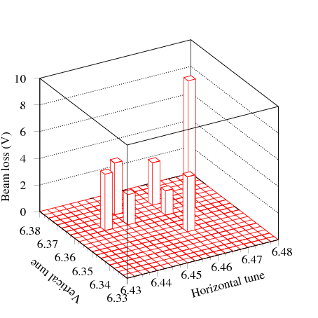
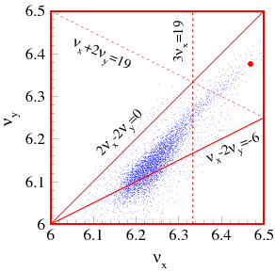
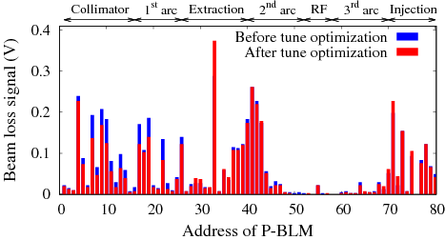
Optimization of the tune at injection
~20% reduced.
Tune scan around (6.45, 6.36)
A little (0.01) increase of the horizontal tune keeping vertical tune
unchanged gives the minimum beam loss .
Gives a better separation from the coupling resonance.
The best tune at injection is set at (6.46, 6.36).
Chromatic
tune shift
Further increase of the horizontal tune to 6.47 results in considerable
beam loss owing the effect of half-integer resonance (2ν_{x} = 13).
Due to chromatic tune shift (~ 0.1) of large emittance beam near the bare tune.
Correction of the half-integer resonance by using trim quadrupoles are under study.

Slide 20
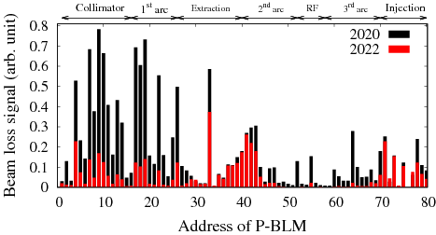
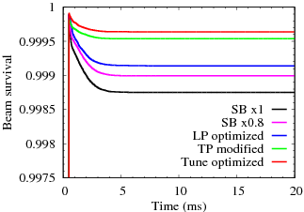
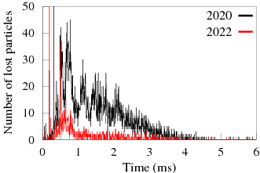
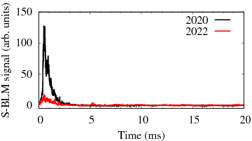
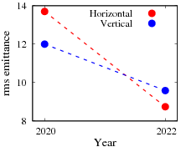
Summary of beam loss mitigation 1 MW beyond 2020
Measurements:
Simulations:
Beam loss:
80% mitigated
The SC effect at 1 MW is well mitigated reducing 80%
beam loss compared to that of a trail operation in 2020.
Beam loss occurs only at the injection energy.
The residual beam loss is << 0.1%, ~1/2 is attributed to
the foil scattering of the circulating beam.
The transverse rms emittance is 40% reduced at maximum.
The simulation results are consistent with measurements.
The beam loss power in the collimator is ~ 0.1 kW,
where collimator capacity is 4 kW.
Time structure of the beam loss
Extracted beam emittance (rms)

Slide 21
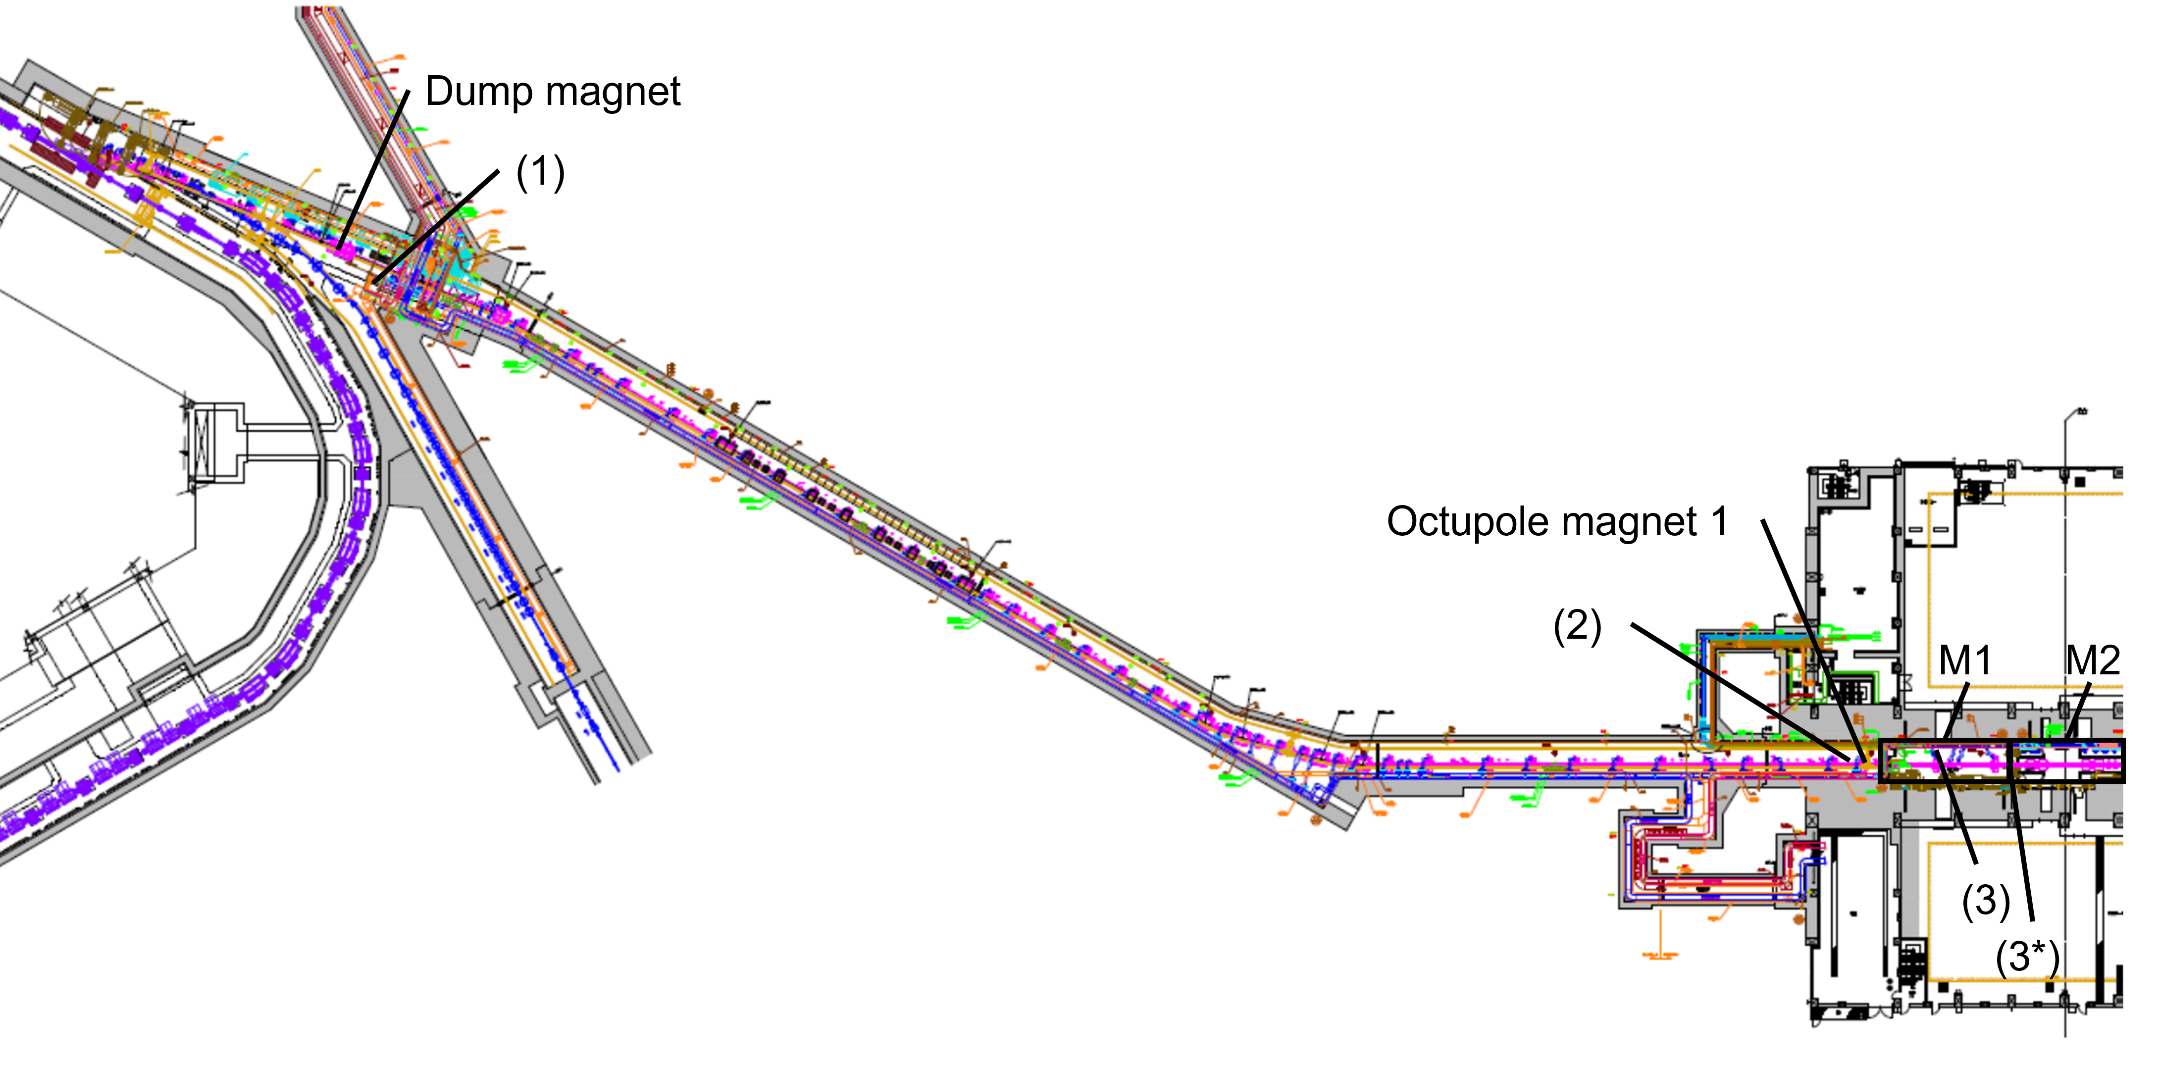
Confirmation of beam emittance and beam halos reduction at the beam transport.
Courtesy: Y. Yamaguchi, S. Meigo
2022 run
Near the neutron target
NanoDot Monitor Unit: mSv | June 16~22 (10²¹ p) | Dec. 1~7 (10²¹ p)
3*H | 9674 | 3479
3*V | 12315 | 4787
BLM integral:
(1) 8.5 → 6.4
RCS
3-GeV to Neutron Beam Transport (3-NBT)
Not only the rms emittance but also the beam quality is significantly improved
reducing the beam halos for the users.
Useful for beam broadening (flat beam) by octupole magnets at the 3-NBT.

Slide 22
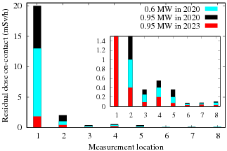
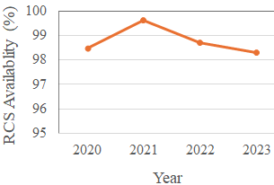
Suppression of machine activation improving operational performance of the RCS
Recent availability chart
Measurement location:
#1 Collimator max
#2 Collimator exit
#3~6 Dispersion peaks
RCS machine activation at present with ~1MW routine operation is significantly
reduced as compared to 1 MW trail operation and even 0.6 MW operation in 2020.
We have achieved sustainable operation with more than 98% availability.
The downtime mainly caused by the Kicker and RF failures and their recovery.

Slide 23
Summary and outlook
The 3-GeV RCS of J-PARC is SC dominated machine at the designed beam power of 1 MW.
The SC effect at injection energy excite many resonances resulting beam emittance and beam losses.
We have incorporated all beam handling, machine properties and errors in the simulation, which gives
precise results to identify each individual resonance effect and the corresponding measures.
Recently, the SC effect at 1 MW is sufficiently mitigated taking into account several appropriate measures.
The beam loss and the beam emittance have been minimized.
The residual beam loss 1 MW is <<0.1% occurs almost during injection period and ~1/2 is attributed
to the foil scattering beam losses.
The beam loss power in the collimator is ~0.1 kW (collimator capacity : 4 kW).
The simulations results are well consistent with measurement ones.
RCS beam quality improvement has also been well recognized at the downstream facilities.
The machine activation is well suppressed achieving sustainable operation with more than 98% availability
We are continuing our efforts for further beam loss mitigation at 1 MW operation as following;
1) Further momentum spread of the injection beam, 2) manipulation of the RF freq. during injection,
3) correcting half-integer resonance, introducing 3rd order RF harmonic and so on.
We would also like to achieve further beyond 1 MW with minimum beam loss.

