Slide 1
Study on the painting injection and transverse coupling under the strong space charge effect in the CSNS
Ming-Yang Huang#
2024-09-11
# huangmy@ihep.ac.cn

Slide 2
Content
Introduction
Painting injection for the CSNS
New injection system for the CSNS-II
Transverse coupling driven by the space charge effects
Summary

Slide 3
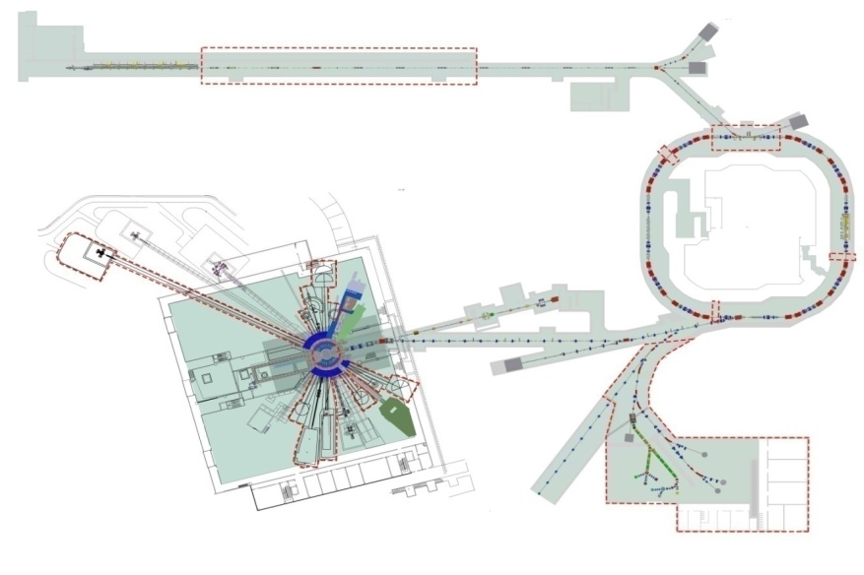
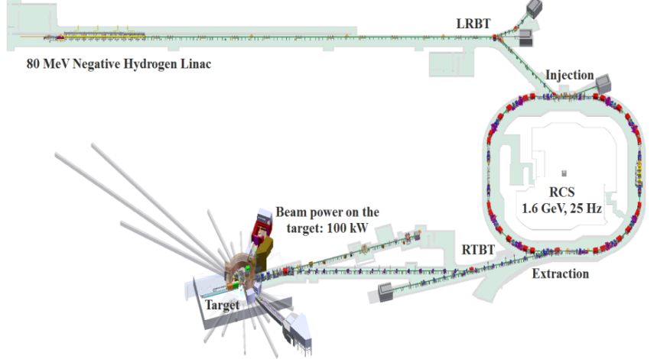
I. Introduction
The CSNS facility consists of an 80 MeV H⁻ Linac, a 1.6 GeV RCS, two beam transport lines, a target station, and several instruments.
Main goal of CSNS-II accelerator: increase the beam power on the target from 100 kW to 500 kW.
Main contents of accelerator upgrade: linac upgrade; injection system upgrade; three dual harmonic cavities would be added to the RCS; beam lines for the proton and muon experimental station.
Linac
New injection system
Linac upgrade from 80 MeV to 300 MeV
Beam power upgrade to 500 kW
RCS
Dual harmonic cavity
CSNS
CSNS-II
Replacement of target
9 new neutron instruments
Proton & muon
Experimental station

Slide 4
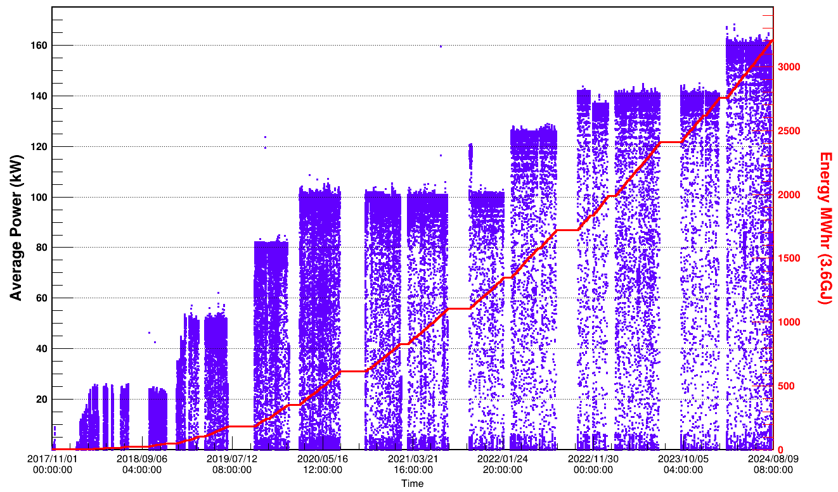
Historical Curve of CSNS Beam Power
Sep. 2019, by using the correlated painting instead of the anti-correlated painting, the beam power was increased to 80 kW;
Feb. 2020, with the optimization of tune and chromaticity, the beam power was increased to 100 kW to achieve the design goal;
Feb. 2022, with the slight modification of injection system and installation of new AC trim quadrupoles and AC sextupoles, the beam power was increased to 125 kW;
Oct. 2022, with the installation of a new dual harmonic RF cavity, the beam power was increased to 140 kW;
Mar. 2024, after detail optimizations in many aspects (injection, new dual harmonic RF cavity, new octupoles, new momentum collimator, new correctors), the beam power was increased to 160 kW.
Nov. 2017, first 10 kW beam power on the target for a short while;
Mar. 2018, beam power over 20 kW in the test operation;
Jan. 2019, beam power was gradually increased to 50kW+ with well controlled beam loss;

Slide 5
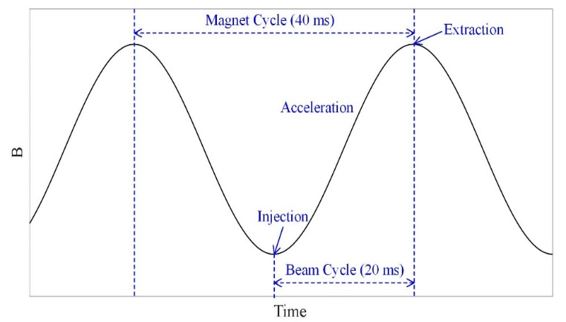
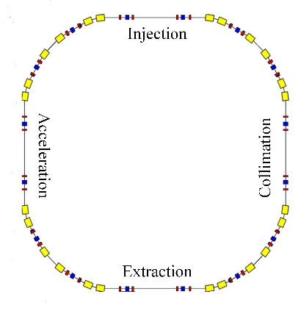
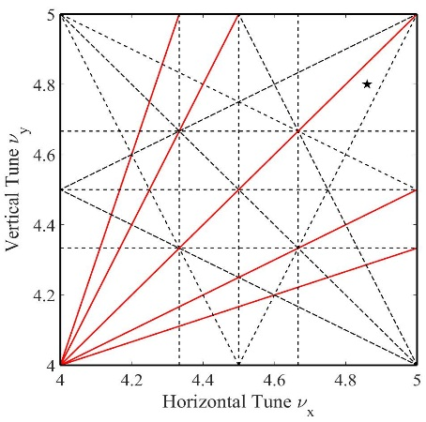
CSNS RCS
Output Beam Power [kW] | 100
Injection Energy [MeV] | 80
Extraction Energy [GeV] | 1.6
Pulse repetition rate [Hz] | 25
Ramping Pattern | Sinusoidal
Acceleration Time [ms] | 20
Circumference [m] | 227.92
Number of dipoles | 24
Number of quadrupoles | 48
Lattice Structure | Triplet
Nominal Betatron Tune (H/V) | (4.86, 4.80)
Natural Chromaticity | -4.0/-8.2
Ring Acceptance [πmm-mrad] | 540
Harmonic Number | 2
Number of Particles per Pulse | 1.56×10¹³
Space-Chare Tune Shift | -0.28
The schematic diagram of the magnetic field waveform
RCS layout
The schematic layout of the RCS
The design tune location in the resonance map

Slide 6
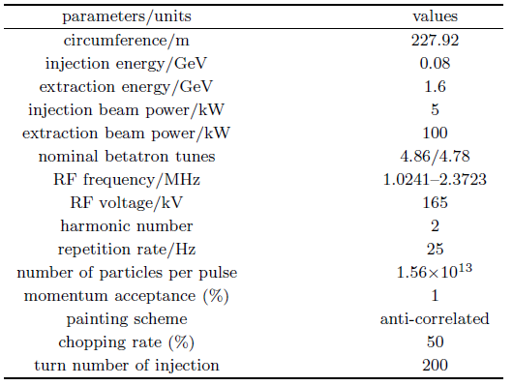
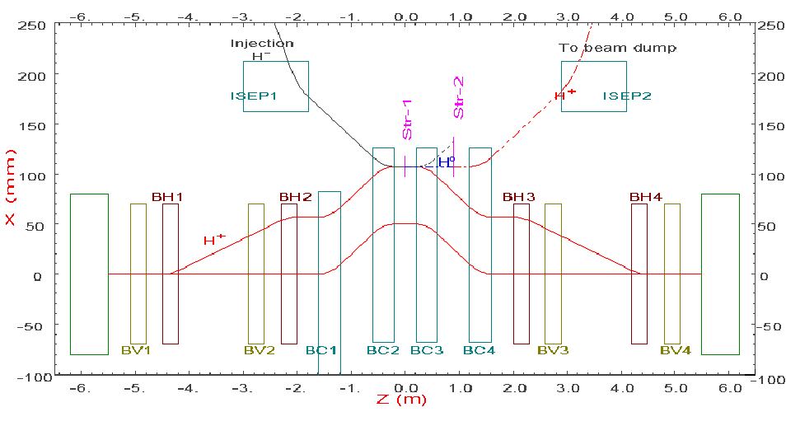
II. Painting injection for the CSNS
For the CSNS, a combination of the H⁻ stripping and phase space painting method is used to accumulate a high intensity beam in the RCS.
There are three kinds of orbit-bumps: a horizontal bump (BH1-BH4) for painting in x-x’ plane; a vertical bump (BV1-BV4) for painting in y-y’ plane; a horizontal chicane bump (BC1-BC4) in the middle for an additional closed-orbit shift.

Slide 7
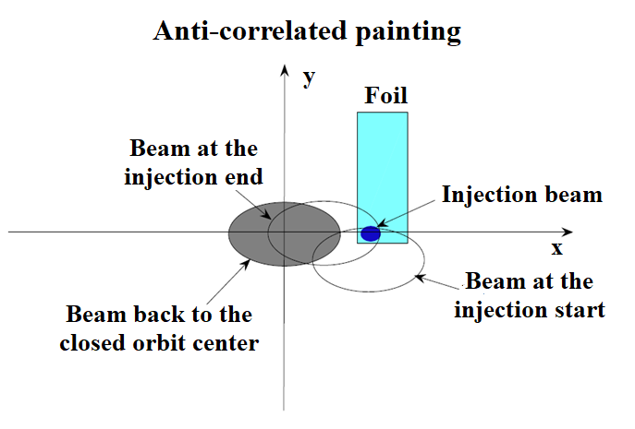
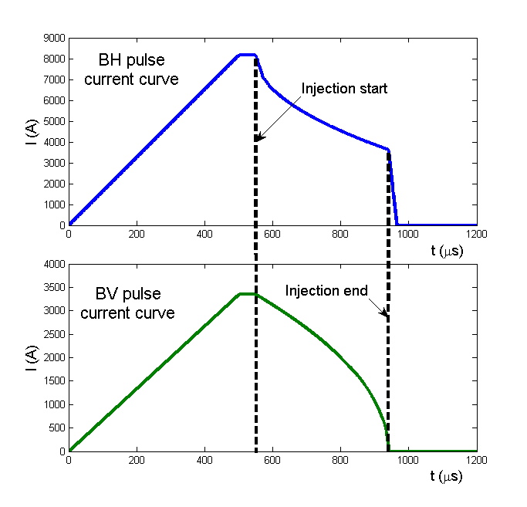
Anti-correlated painting
In order to control the strong space charge effects and reduce the average traversal number of the stripping foil, the phase space painting is used for injecting a small emittance beam from the Linac into the large acceptance of the RCS.
For the CSNS, the anti-correlated painting is adopted as the design scheme for the injection system.

Slide 8
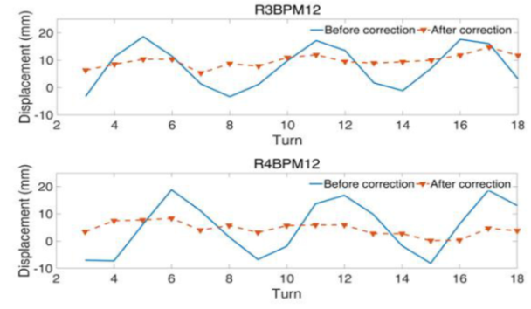
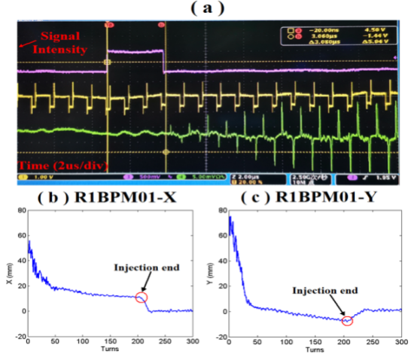
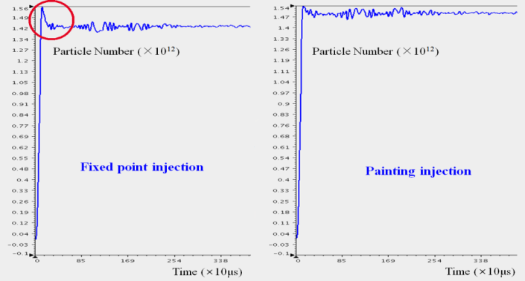
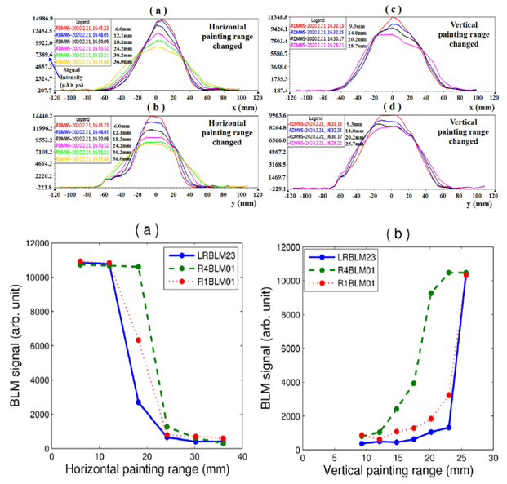
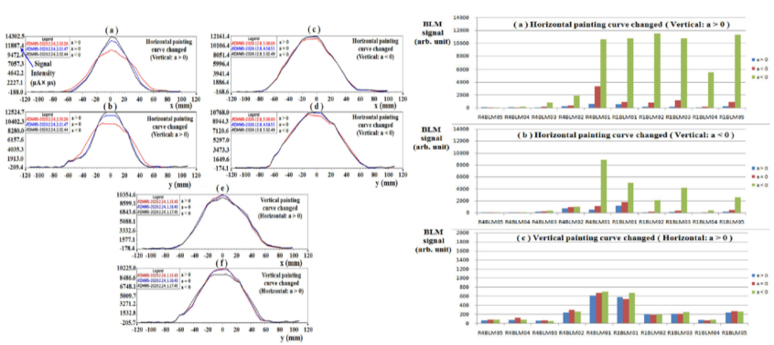
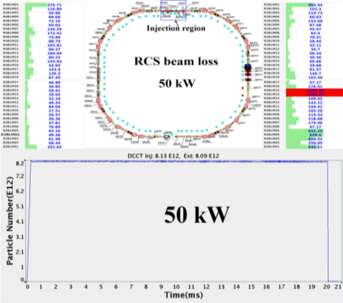
Beam commissioning for the anti-correlated painting (50kW)
Injection beam parameters matching
Injection timing calibration
Painting mode optimization
The beam power has successfully reached 50 kW.
Painting curve optimization
Painting range optimization

Slide 9
Beam commissioning difficulties (>50 kW)
Beam commissioning: By using the design injection scheme of anti-correlated painting, the beam power has successfully reached 50% of the design value. However, after several rounds of long-term beam commissioning, the further improving of the beam power cannot be achieved.
Difficulties: Too large beam size after painting, non-uniform beam distribution, large transverse coupling effect, and so on, resulting in additional beam loss and making it difficult to satisfy the requirements of a stable high-power operation mode.
Reasons: (1) In order to reduce the coherent oscillation effects, new betatron tune (4.81, 4.87) has been used to replace the nominal tune (4.86, 4.78). However, with the new tune (4.81, 4.87), the transverse coupling effect on the beam distribution is very strong. (2) Due to changes in operation mode, the actual vertical painting acceptance of the ceramic vacuum chamber at the painting magnet BH3 is much smaller, which is only about 70% of the design value.

Slide 10
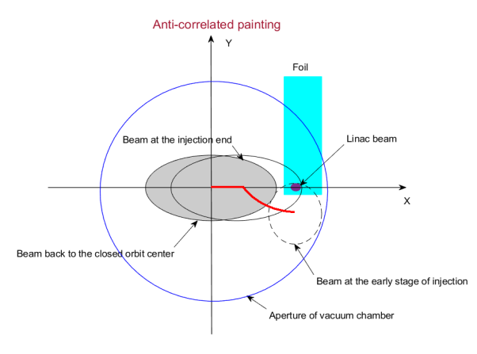
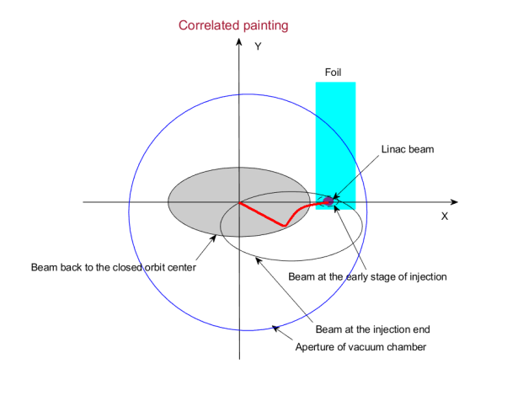
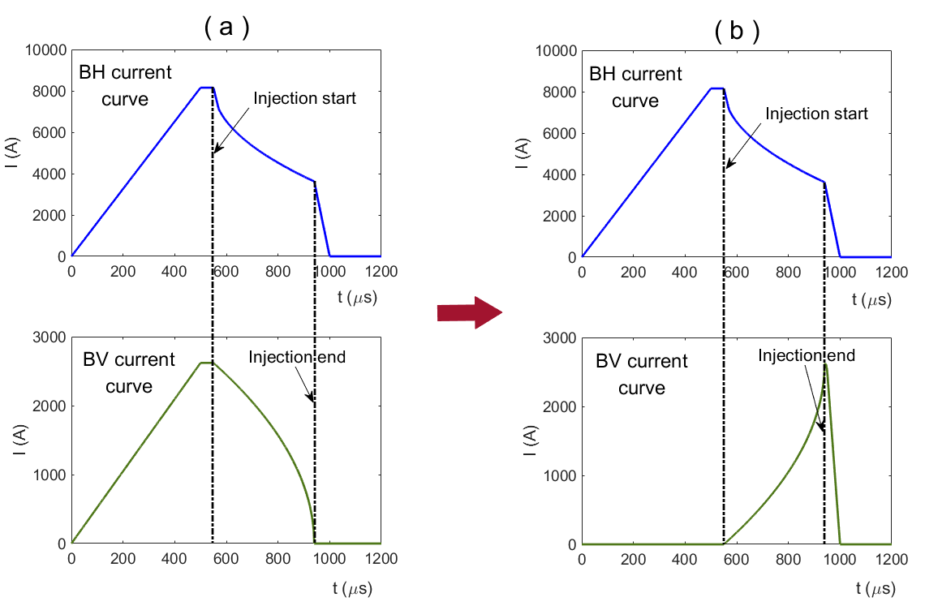
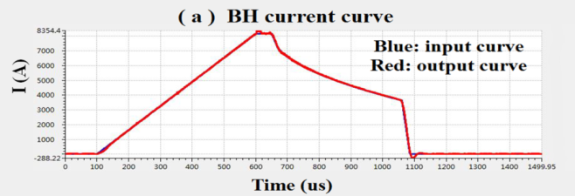
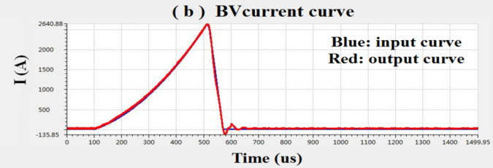
Achieve the correlated painting based on the mechanical structure of the anti-correlated painting scheme
New idea：For the first time in the world, the rising curve of the pulse power supply current has been used for the vertical painting to achieve the correlated painting.

Slide 11
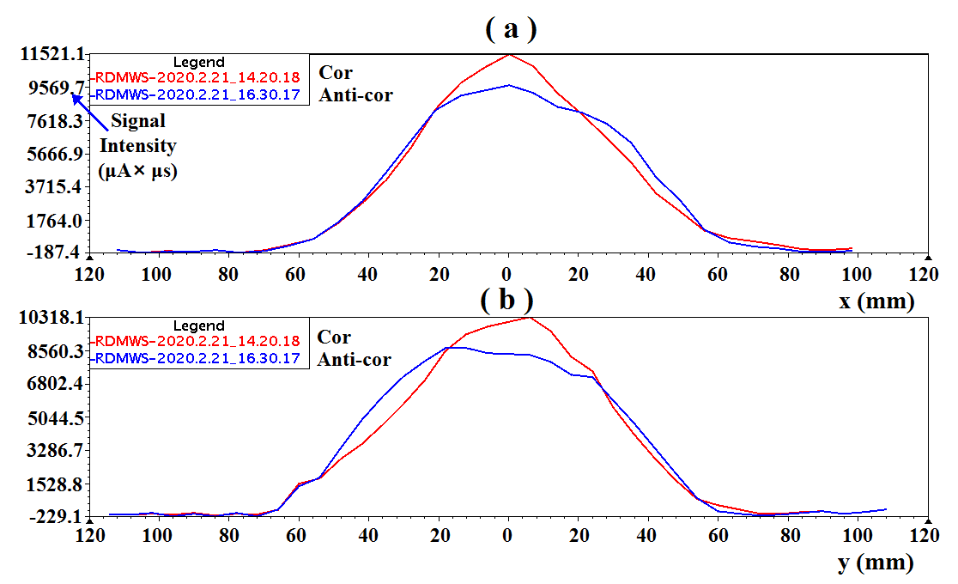
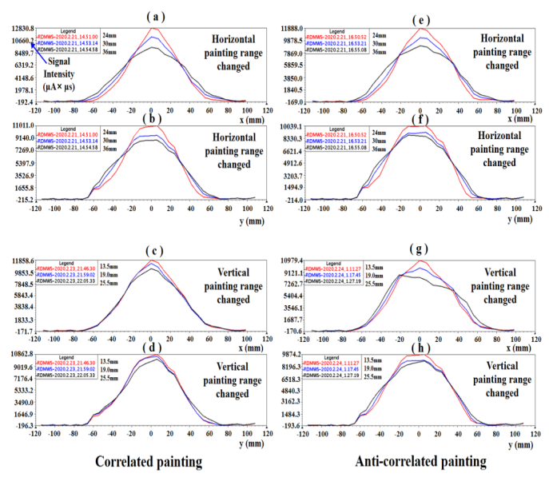
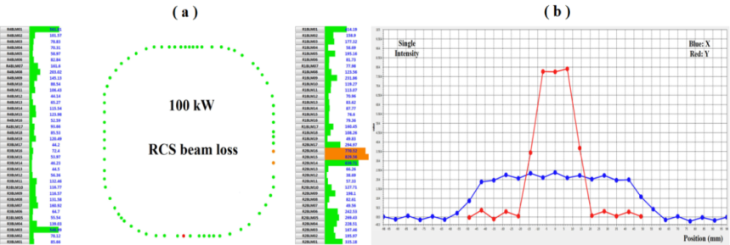
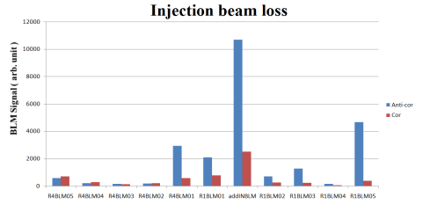
Beam commissioning and design goal
By using the correlated painting:
Beam loss is well controlled.
Transverse beam size is largely reduced.
Beam distribution is much better.
Transverse coupling effect is improved.
Results：The new method unlocks the shackles that restrict the beam power increase of the CSNS accelerator. In the following two rounds of the beam commissioning, the beam power reaches 80 kW and 100 kW (design goal) successively.
Application：The new method can be applied to other similar accelerators (SNS, PIP-II) to realize the switching between correlated and anti-correlated paintings.

Slide 12
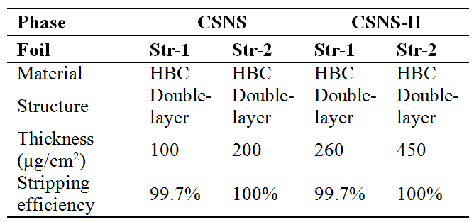
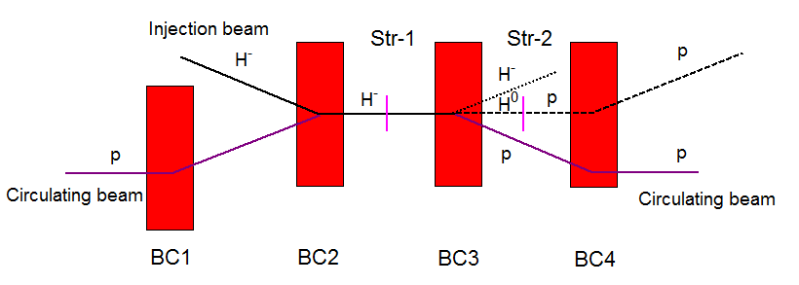
H⁻ stripping scheme
For the CSNS, the foil stripping is adopted to inject the Linac beam to the RCS with high precision and high efficiency. There are two stripping foils: a main stripping foil and a secondary stripping foil.
For the CSNS-II, the foil stripping is also selected as the design scheme. The stripping foil system also consists of two stripping foils.

Slide 13
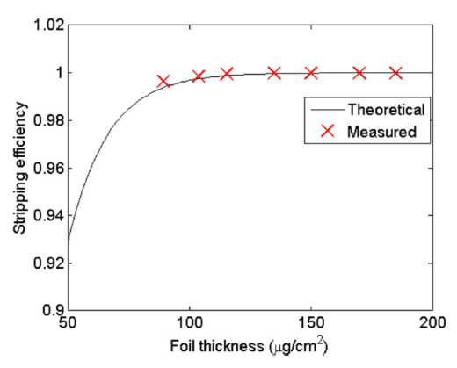
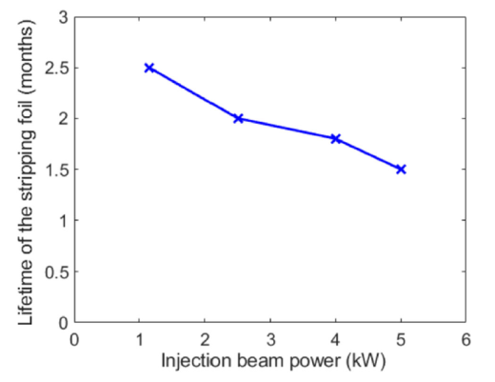
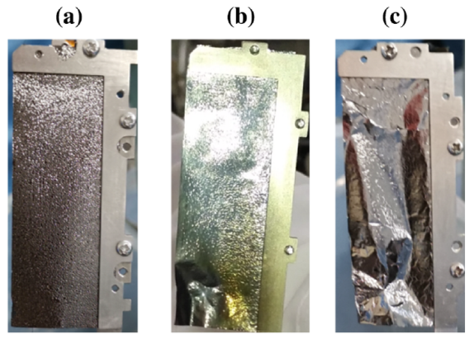
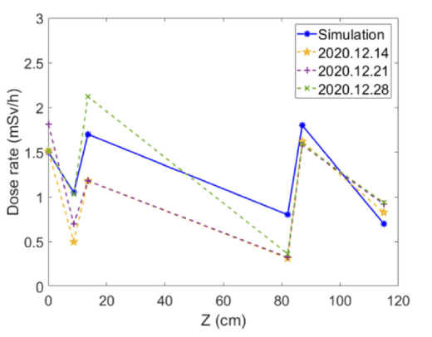
Study on the H⁻ stripping
A method to accurately measure the stripping efficiency has been proposed and the measurement results are consistent with the theoretical results.
The foil lifetime decreases with the increase in the injection beam power and the foil lifetime under the design power is about 1.5 months.
It can be confirmed that the foil scattering is the most important source of the residual doses in the injection region.

Slide 14
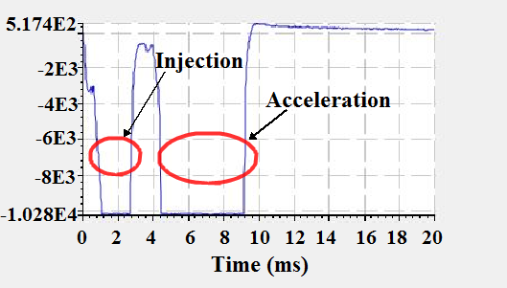
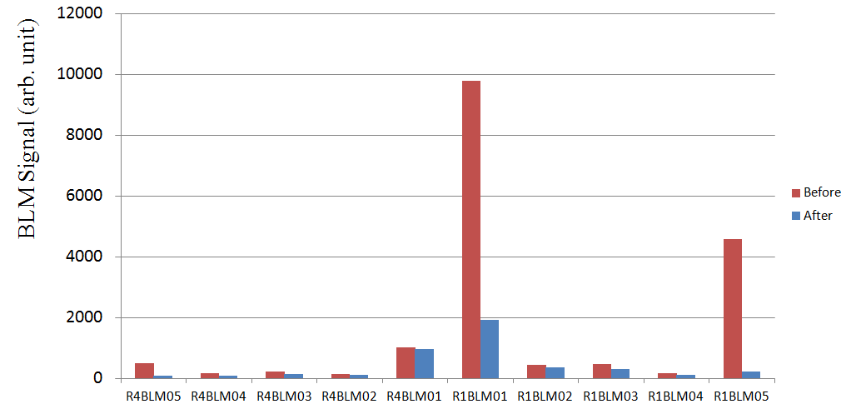
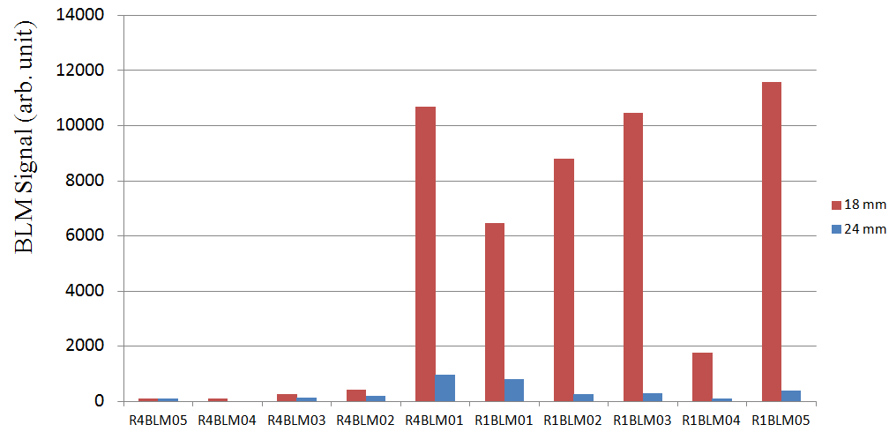
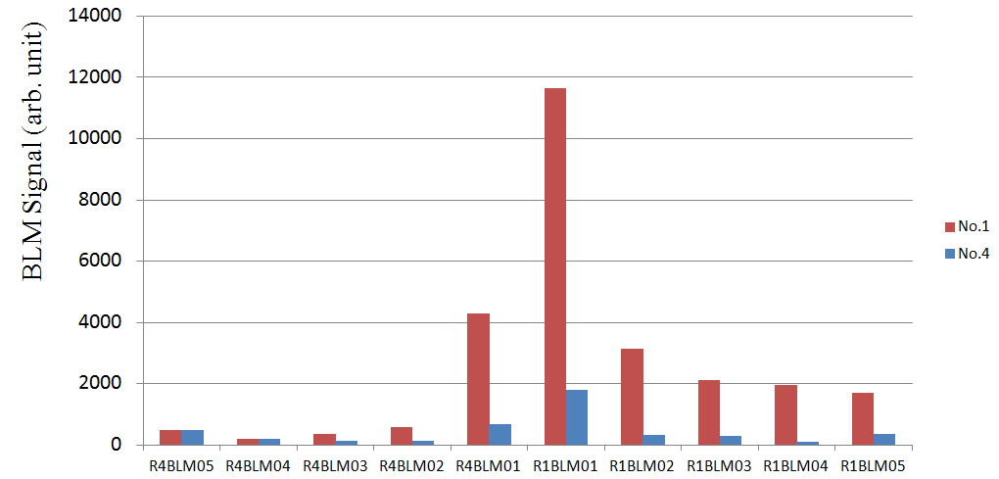
Injection beam loss
Main sources:
(1) Injection parameter mismatch
(2) Unsuitable painting method
(3) Unreasonable injection design scheme
(4) Beam loss associated with foil stripping
Injection parameter matching
Main solutions:
(1) Injection beam parameters matching
(2) Painting optimization
(3) Slight modification of injection system
(4) Optimization of the stripping foil
Painting range optimization
Different stripping foil

Slide 15
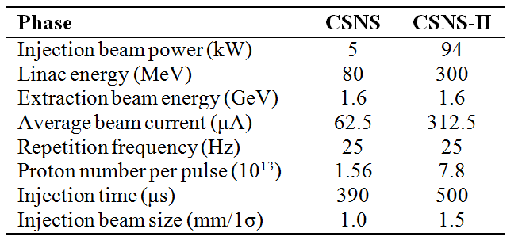
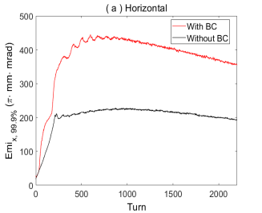
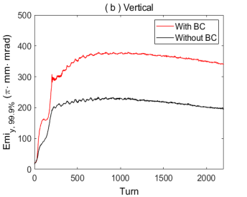
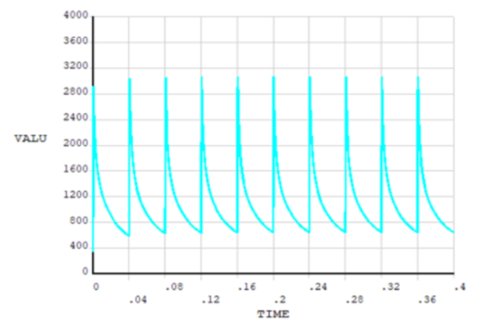
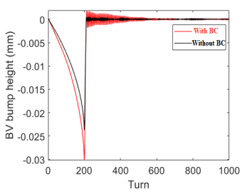
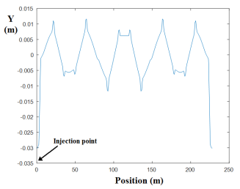
III. New injection system for the CSNS-II
Problems for the CSNS-II beam injection
Key Problems: (1) The peak temperature of the stripping foil is too high (close to or beyond the melting point).
(2) The single fixed painting mode may not be consistent with the future actual beam state.
(3) The beam dynamics is greatly affected by the edge focusing effect of horizontal chicane bump.
Edge focusing effect
T ～ 3000 K
15

Slide 16
New idea for the CSNS-II painting injection
Goals:
(1) The peak temperature of the stripping foil need to be further reduced.
(2) Both correlated and anti-correlated painting can be performed.
(3) The edge focusing effect of the chicane bump should be reduced.
New idea: The chicane bump and horizontal painting bump are combined into one bump which make the chicane bump "move", and the horizontal painting is performed by using the position and angular scanning at the same time.
Angular scanning
SNS: B (1-4) + HK (1-4)
J-PARC: SB (1-4) + PBH (1-4)
CSNS: BC (1-4) + BH (1-4)
BC
BH
BCH
Position scanning
Chicane bump
Horizontal painting bump
16

Slide 17
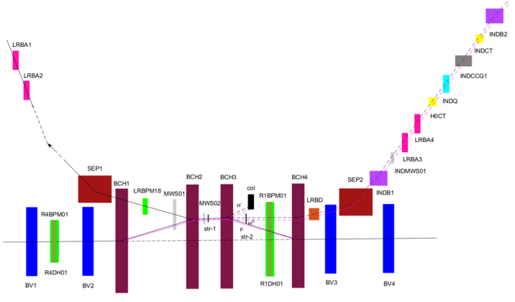
Layout of the new injection system
Key magnets: 4 horizontal painting magnets, 4 vertical painting magnets, 2 septum magnets, 1 pulse septum magnet, 2 DC dipole magnets (compensation), 4 vertical DC bump magnets (one of which with auxiliary winding), 1 DC quadrupole magnet.
17

Slide 18
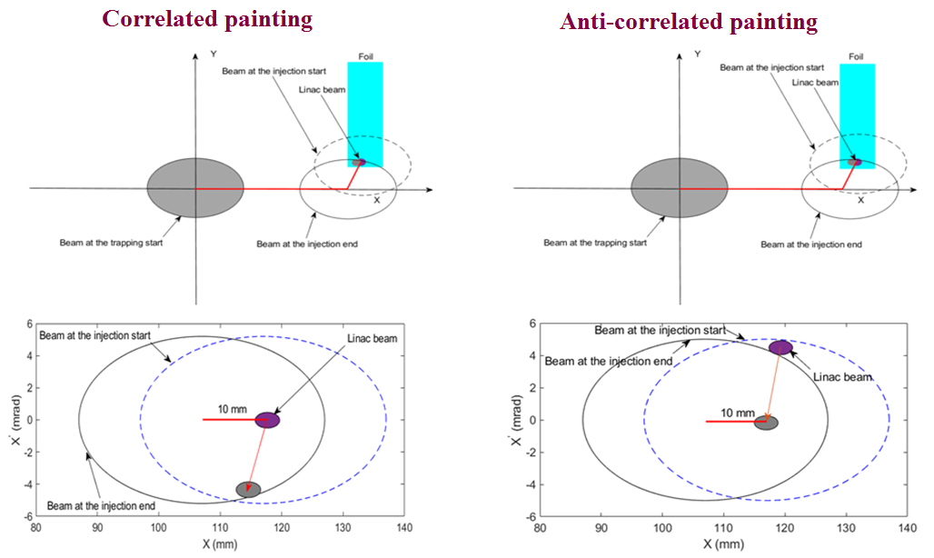
Description for the new painting scheme
Injection beam: BCH is used for horizontal angular scanning, while the horizontal position is also scanned in a small range.
Circulating beam: horizontal and vertical position scanning can be performed with BCH and BV magnets.
Residual H⁰ beam: H⁰ beam at the waste beam outlet has an angular distribution with time. A small pulse magnet is installed for angular scanning compensation.
Compatibility mode for correlated and anti-correlated painting: match the angles of SEP and BCH magnets.
Spatial optimization: BCH bump is irregularly shaped to allow the waste beam line to move a short distance along outside the RCS.
α_{x}~0
α_{y}~0
18

Slide 19
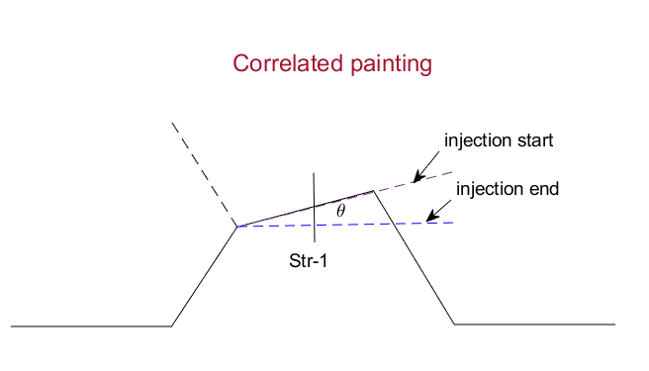
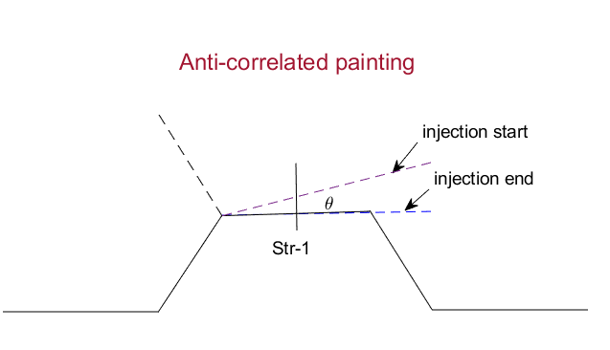
BCH bump and key magnets
Scanning angle : 4.5 mrad
Scanning angle : 5.0 mrad
Painting | Time | SEP1 (mrad) | BCH2 (mrad) | BCH3 (mrad) | BCH4 (mrad) | LRBD (mrad) | SEP2 (mrad) | INDB1 (mrad) | INDB2 (mrad) | BCH1 (mrad)
Correlated | Begin | 226.713 | 53.549 | 64.681 | 60.181 | -4.5 | 349.82 | -13.419 | -34.356 | 58.049
 | End | 226.713 | 49.049 | 60.181 | 55.681 | +4.5 | 349.82 | -13.419 | -34.356 | 53.549
Anti-correlated | Begin | 222.32 | 58. 442 | 58. 442 | 58. 442 | -5 | 351.558 | -13.066 | -34.708 | 58.442
 | End | 222.32 | 53. 442 | 53. 442 | 53. 442 | +5 | 351.558 | -13.066 | -34.708 | 53.442

Slide 20
Advantages for the new painting scheme
The advantages of position scanning and angular scanning have been combined. The peak temperature of the stripping foil has been obviously reduced.
Both correlated and anti-correlated painting can be performed.
Since the BCHs are pulse magnets, their edge focusing effects are obviously reduced.
Since the bump magnet BCH2 which is used for angular scanning is very close to the injection point, the difficulty of large aperture of the injection port and transport line required by angular scanning is solved.
Compared with the traditional painting scheme, it saves a set of bump magnets. The space of the injection area is more loose which is of great significance to the traditional injection area where space is tight.
As a result of the angular scanning, the residual H⁻ beam hits an increased area on the vacuum chamber, and the radiation dose caused by it decreases obviously.
20

Slide 21
Simulations of the new painting scheme
Codes: The new painting scheme has been simulated by using Py-ORBIT and ANSYS.
Typical tunes: (4.86, 4.80) , (4.80, 4.87) , (4.33, 5.30).
After the optimization of the painting curve, the horizontal and vertical painting ranges differ greatly under different tunes.
Painting | Tune | Optimum horizontal sweep angle | Optimum vertical painting range
Correlated | (4.86, 4.80) | θ_{x}=4.5 mrad | y_{max}=25 mm
 | (4.80, 4.87) | θ_{x}=3.0 mrad | y_{max}=30 mm
 | (4.33, 5.30) | θ_{x}=2.5 mrad | y_{max}=30 mm
Anti-correlated | (4.86, 4.80) | θ_{x}=5.0 mrad | y_{max}=30 mm
 | (4.80, 4.87) | θ_{x}=3.75 mrad | y_{max}=30 mm
 | (4.33, 5.30) | θ_{x}=2.5 mrad | y_{max}=30 mm
21

Slide 22
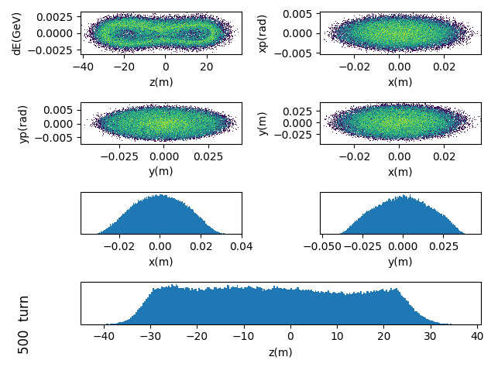
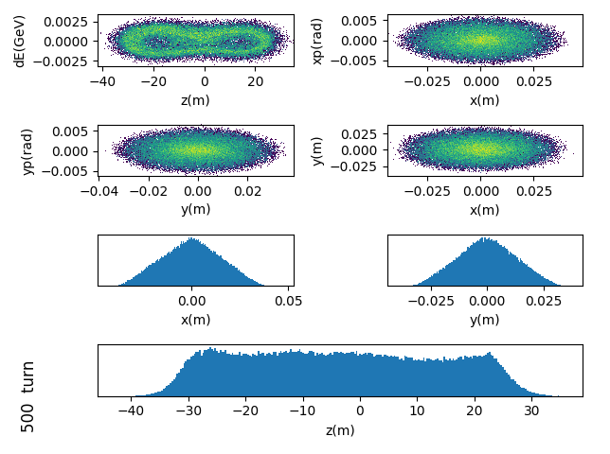
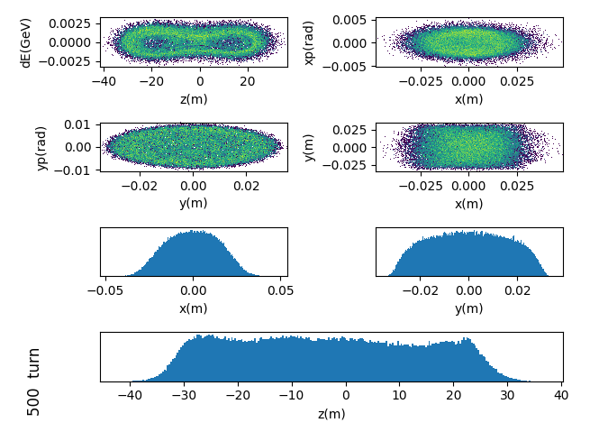
Beam distribution after the correlated painting
（4.86,4.80）
（4.80,4.87）
（4.33,5.30）
θ_{x}=4.5 mrad
y_{max}=25 mm
θ_{x}=3.0 mrad
y_{max}=30 mm
θ_{x}=2.5 mrad
y_{max}=30 mm
22

Slide 23
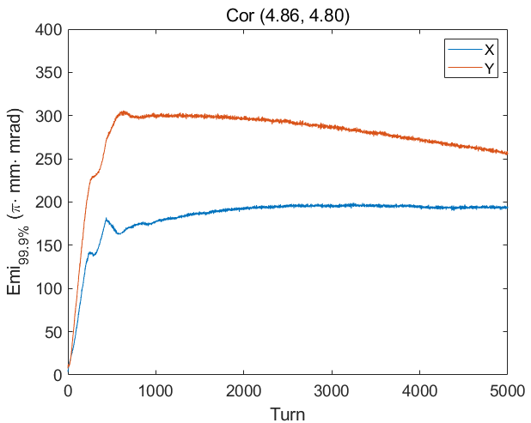
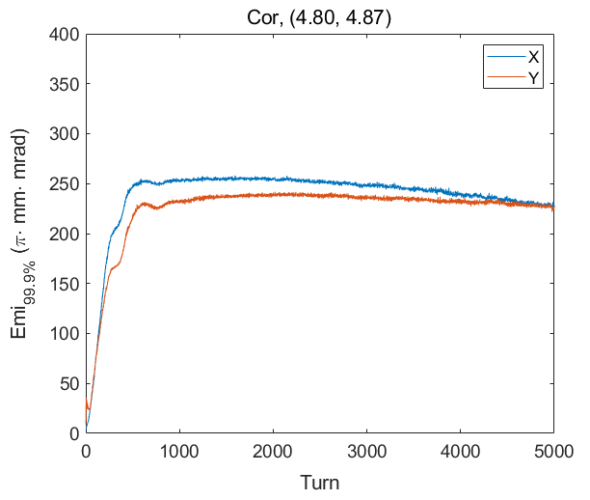
99.9% emittance evolution for the correlated painting
（4.86,4.80）
（4.80,4.87）
（4.33,5.30）
θ_{x}=4.5 mrad
y_{max}=25 mm
θ_{x}=3.0 mrad
y_{max}=30 mm
θ_{x}=2.5 mrad
y_{max}=30 mm
23

Slide 24
Beam distribution after the anti-correlated painting
（4.86,4.80）
（4.80,4.87）
（4.33,5.30）
θ_{x}=5.0 mrad
y_{max}=30 mm
θ_{x}=3.75 mrad
y_{max}=30 mm
θ_{x}=2.5 mrad
y_{max}=30 mm
24

Slide 25
99.9% emittance evolution for the anti-correlated painting
（4.86,4.80）
（4.80,4.87）
（4.33,5.30）
θ_{x}=5.0 mrad
y_{max}=30 mm
θ_{x}=3.75 mrad
y_{max}=30 mm
θ_{x}=2.5 mrad
y_{max}=30 mm
25

Slide 26
Beam loss, average traversal number, peak temperature
After the painting optimization, the beam loss, average number of times that each particle passes through the main stripping foil, peak temperature of the main stripping foil can be given below:
Painting | Tune | Optimum horizontal sweep angle | Optimum vertical painting range | Beam loss | Average traversal number of stripping foil | Peak temperature
Correlated | (4.86, 4.80) | θ_{x}=4.5 mrad | y_{max}=25 mm | 0.0 | 20 | 1727 K
 | (4.80, 4.87) | θ_{x}=3.0 mrad | y_{max}=30 mm | 0.0 | 13 | 1416 K
 | (4.33, 5.30) | θ_{x}=2.5 mrad | y_{max}=30 mm | 0.02% | 11 | 1320 K
Anti-correlated | (4.86, 4.80) | θ_{x}=5.0 mrad | y_{max}=30 mm | 0.0005% | 10 | 1269 K
 | (4.80, 4.87) | θ_{x}=3.75 mrad | y_{max}=30 mm | 0.0 | 13 | 1416 K
 | (4.33, 5.30) | θ_{x}=2.5 mrad | y_{max}=30 mm | 0.002% | 13 | 1416 K
26

Slide 27
Three key problems have been solved
Pre-selected painting scheme
New painting scheme
The difficulty of too high peak temperature for the main stripping foil has been solved.
Both correlated and anti-correlated painting can be performed.
The edge focusing effects of the injection bump magnets have been obviously reduced.
T ～ 1700 K
T ～ 3000 K
27

Slide 28
IV. Transverse coupling driven by the space charge effects
Tune optimization
Harmonic compensation
Harmonic compensation on magnets was used for the tune optimization.
The tune variation during the beam acceleration process was well controlled.
The design tune (4.86, 4.78) was adopted at low-intensity beam commissioning.
Before harmonic compensation
28

Slide 29
Tune pattern optimization
Tune pattern plays an import role in the control of the intense beam effects.
The tune requirements for reducing space charge induced beam loss and suppressing beam instability are different.
A pattern of tune variation is proposed : the tune varies depending on space charge effects and instability.

Slide 30
Tune pattern optimization
Instability growth rates increase rapidly as the tune approaches integer.
In order to suppress the beam instability, the tune (4.86, 4.78) was changed to (4.81, 4.87).
By using the optimized variable tune pattern, the beam transmission rate achieves a remarkable value.

Slide 31
Transverse coupling effects for different tunes
The transverse coupling effect on the beam distribution is small for the nominal tune (4.86, 4.78) while it is serious for the actual tune (4.81, 4.87).
Different tunes can result in different transverse coupling effects.
31

Slide 32
Transverse coupling effects for different painting methods
Simulation: For the anti-correlated painting, the variation of vertical painting range causes obvious changes in the horizontal painting distribution. These changes can be reduced by using the correlated painting.
Beam commissioning: The beam commissioning results of the transverse coupling effect are somewhat different from the simulation results, but the trend is the same.
Simulation
Beam commissioning
32

Slide 33
Transverse coupling effects for different beam modes
Vertical
painting range changed
Vertical
painting range changed
Beam power: 100kW
Tune: (4.81, 4.87)
Vertical painting range: from 13mm to 25mm
Beam power: 130kW
Tune: (4.80, 4.88)
Vertical painting range: from 7mm to 28mm

Slide 34
Discussion
For the beam power more than 130kW, the tune (4.80, 4.88) has very strong transverse coupling effects, and it is difficult to optimize the vertical painting alone to reduce the bunch size.
The tune optimization can improve the transverse coupling effects and thus provide more space for the transverse painting (the beam instability needs to be considered at the same time).

Slide 35
V. Summary
The CSNS accelerator has been introduced and its beam commissioning has been studied.
In order to solve the difficulties when the beam power exceeds 50 kW, a new method has been proposed based on the mechanical structure of the anti-correlated painting scheme. By using the correlated painting, the beam power on the target has successfully risen from 50 kW to the design value of 100 kW.
A new painting scheme for the CSNS-II has been proposed. It not only realizes the compatibility of correlated and anti-correlated painting, but also greatly reduces the peak temperature of the main stripping foil and the edge focusing effect of the chicane bump.
For the beam power more than 130 kW, the tune (4.80, 4.88) has very strong transverse coupling effects. The tune optimization can improve the transverse coupling effects and thus provide more space for the transverse painting.

Slide 36
Thank you for your attention!
(huangmy@ihep.ac.cn )

