Slide 1
Beam quality challenges at the CERN injectors and impact for the LHC
Space Charge Workshop 2024
11-13/09/2024, Dong Guan, China
F. Asvesta
S. Albright, H. Bartosik, C. Bracco, M. Bozatzis, D. Cotte, G.P. Di Giovanni, A. Huschauer, I. Karpov, S. Kostoglou, J.B. Lallement, E. Lamb, A. Lasheen, K. Li, E. Maclean, I. Mases, B. Mikulec, K. Paraschou, G. Papotti, T. Prebibaj, G. Rumolo, M. Schenk, G. Sterbini, P. Skowronski, G. Tangari, W. Van Goethem, C. Zannini, D. Zeitz, P. Zisopoulos
Op Crews & Equipment groups

Slide 2
Overview
Introduction
LIU Project
Motivation
Beam performance
Beam quality characterization
Beam quality impact
Beam quality concerns in the injectors
Linac4
Distribution monitoring
PSB:
Space charge | Resonances | Scraping
PS:
Resonances | Transition crossing
SPS:
Working point along the cycle | Noise concerns
Injector beams in the LHC
Summary & Outlook

Slide 3
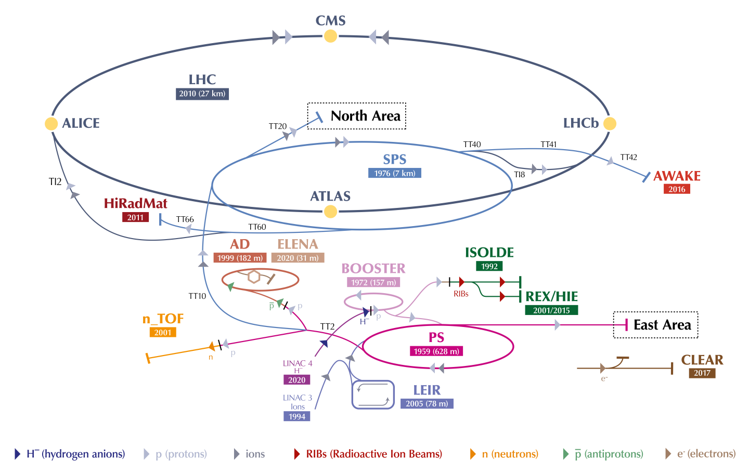
Introduction: The CERN accelerator complex
Chain of linear and circular accelerators to serve:
The four LHC experiments
A variety of Fixed Target experiments/facilities at the different energy stages reached along the chain
Before 2020 LINAC 2 was injecting protons into PSB
Under the LHC injectors Upgrade (LIU) project, a big revamp of the whole injector chain took place!
p⁺@400 GeV/c
Pb⁸²⁺
p⁺ @6.8 TeV Pb⁸²⁺ @6.8 TeV/u
p⁺@440 GeV/c
p⁺@450 GeV/c
p⁺@1.4 GeV
p⁺@24 GeV/c
Pb⁵⁴⁺ ⁽⁸²⁺⁾
p⁺@26 GeV/c
p⁺@20 GeV/c
LINAC 2
p⁺
1978
G. Rumolo, HB2023

Slide 4
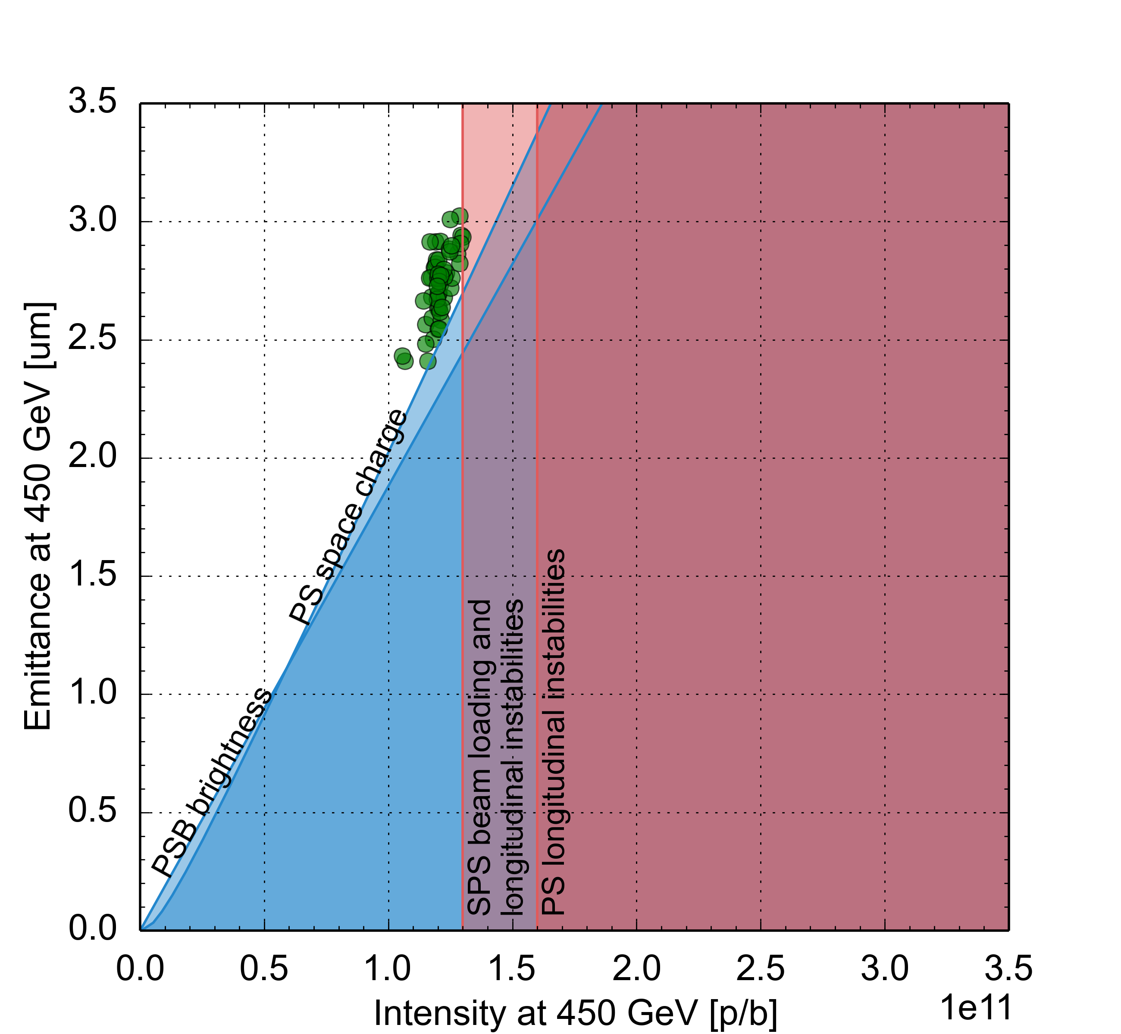
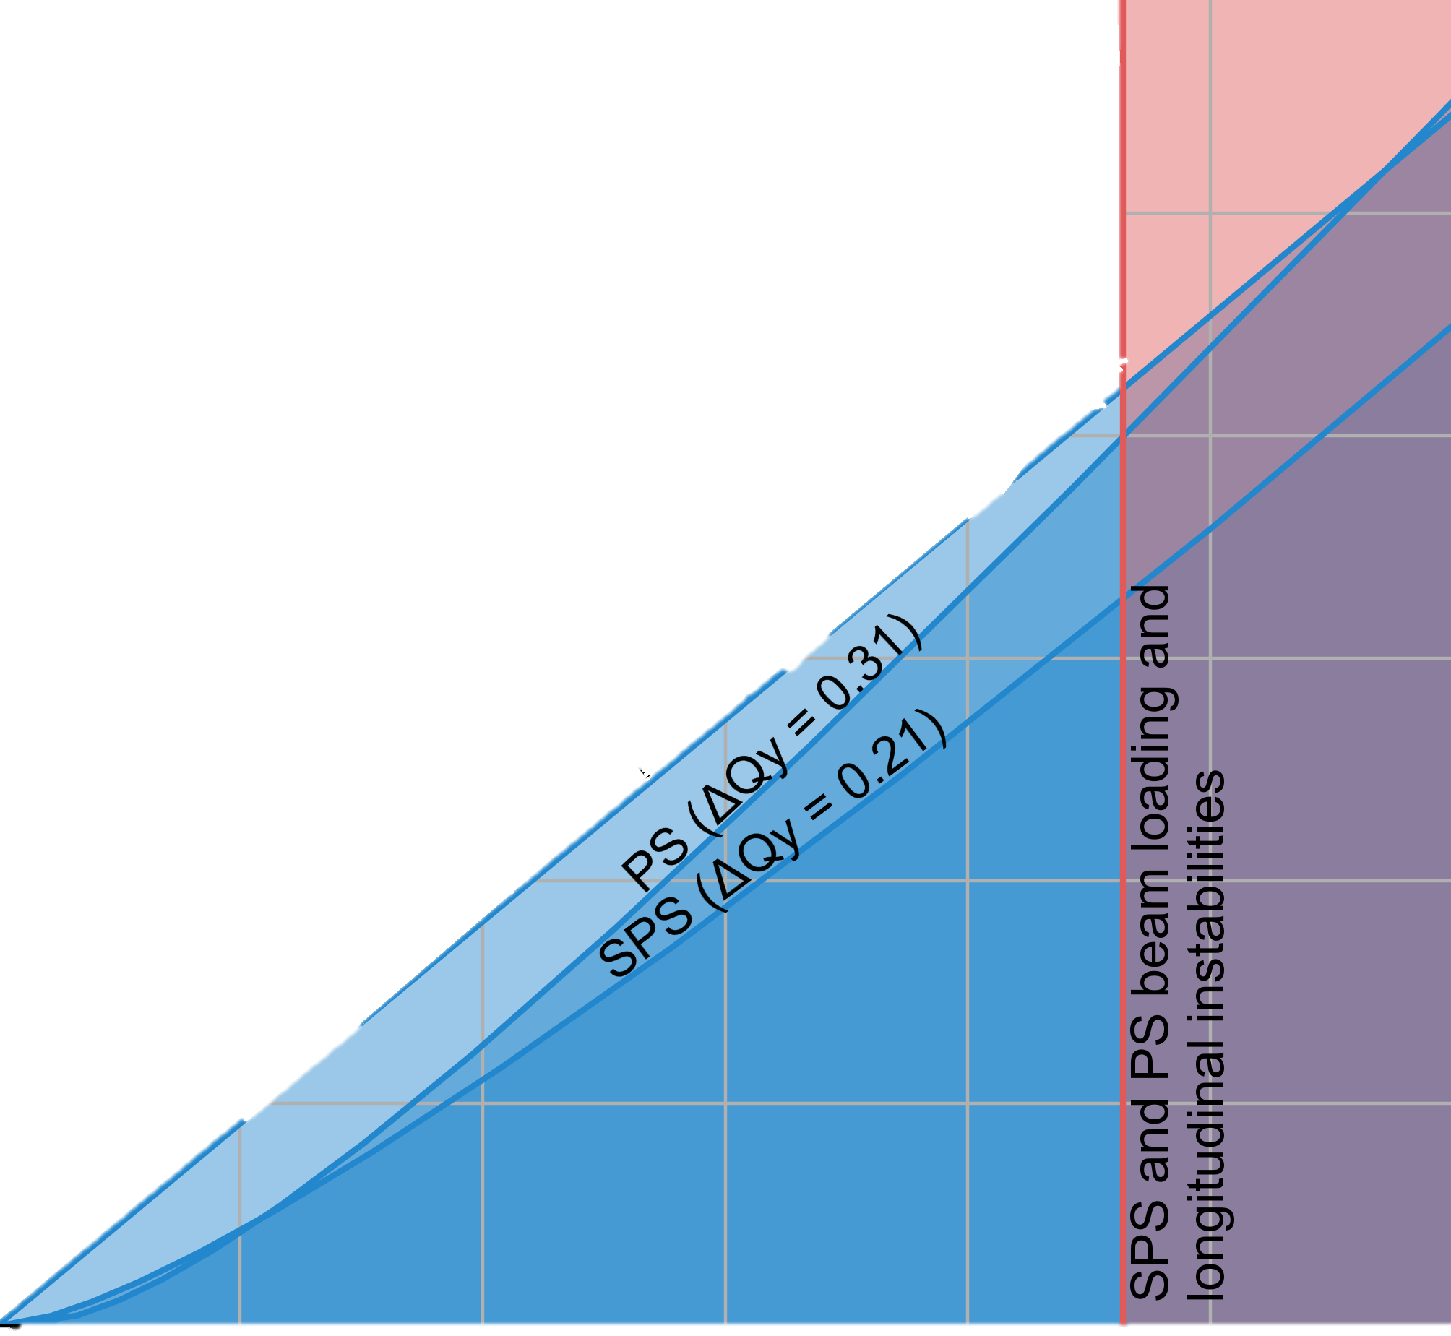
Introduction: The LIU Project
CERN Injectors “Limitation Diagram”
Injectors performance in terms of brightness limited up to 2018
PSB space charge “limit”
PS space charge “limit”
Injectors performance in terms of intensity limited up to 2018
PS longitudinal instabilities
SPS beam loading & longitudinal instabilities
Major Injectors Upgrades:
Connection to Linac4 (PSB Injection: 160 MeV from 50MeV | H⁻ system)
Acceleration to 2 GeV in PSB (PS Injection: 2 GeV from 1.4 GeV)
PS & SPS RF upgrades
e-cloud & impedance reduction
new SPS optics, dumps, stoppers, etc.
Performance
up to 2018
HL-LHC
target
space charge
PSB brightness
LIU

Slide 5
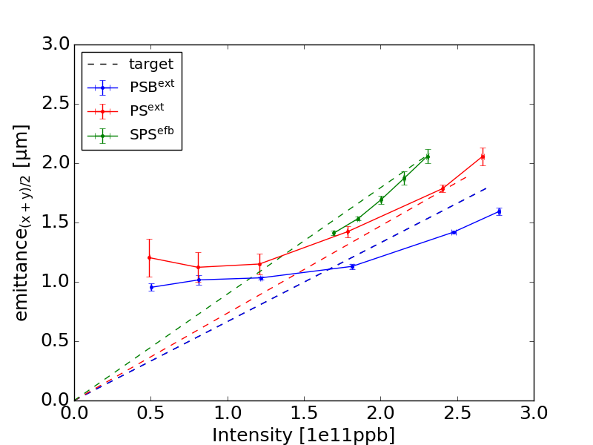
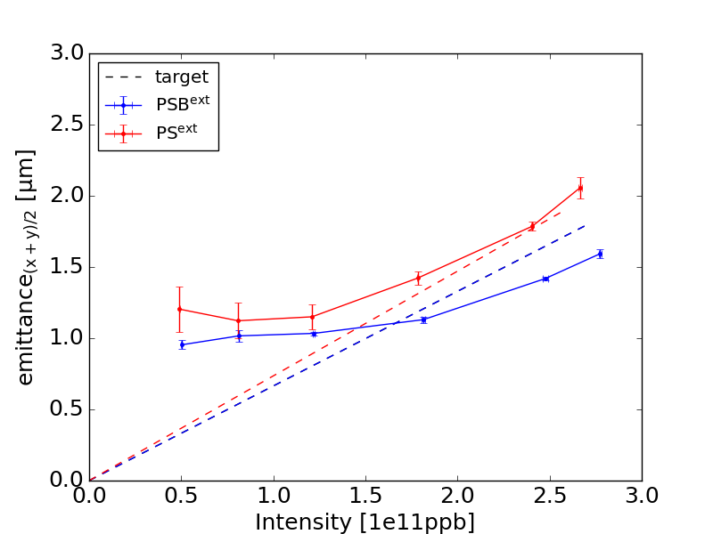
Motivation: LIU Performance
Assessing the performance through the Brightness
PSB
Brightness exceeding LIU target for PSB especially at higher intensity (low intensity is dominated by the H⁻ injection process)
PS
Minor degradation from the PSB especially at higher intensities – consistent with LIU expectations and available margin
Brightness marginally on top of LIU target for PS
SPS
Measurements conducted at the end of flat bottom (with less injections)→ ongoing work for LIU beam at flat top
Brightness on LIU target for these conditions
Is brightness enough to characterize performance & beam quality?

Slide 6
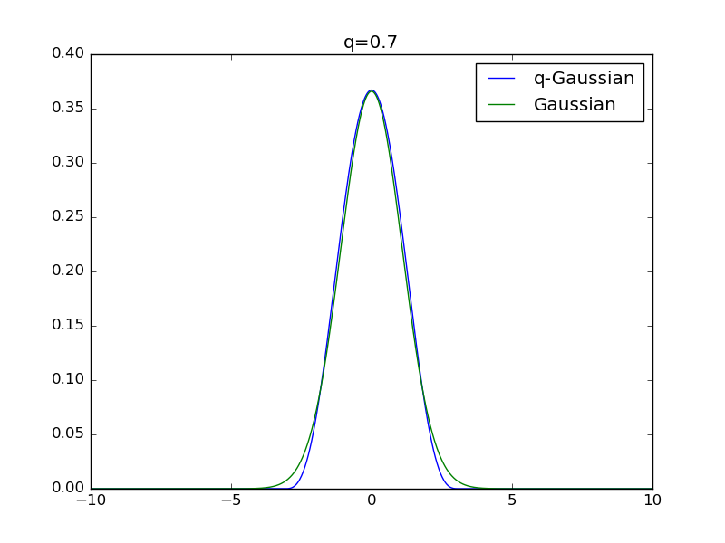
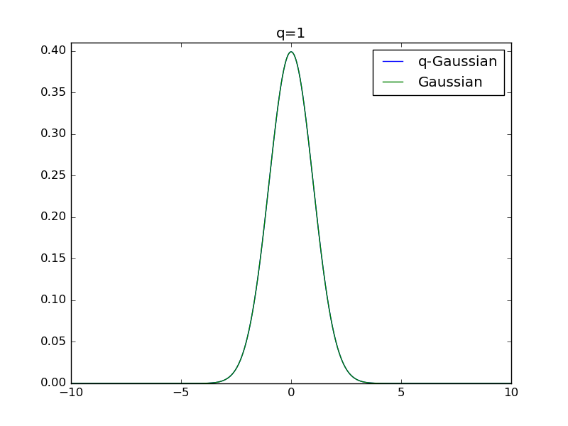
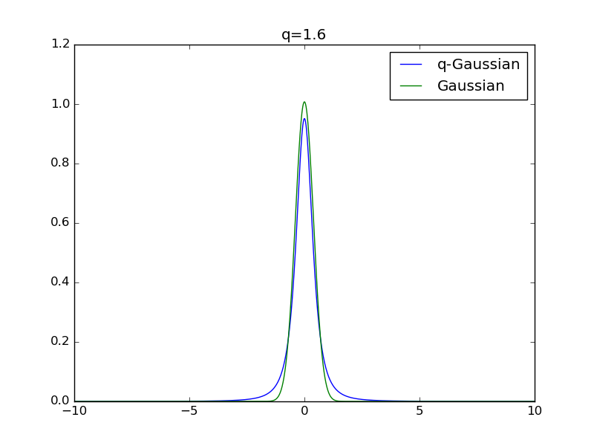
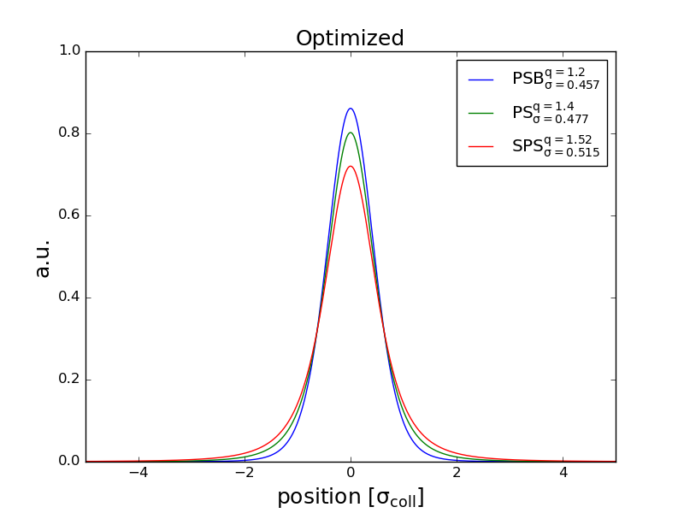
Motivation: Beam quality & characterization
Larger than Gaussian tails are observed all along the Injector chain
q-Gaussian fit is used to characterize the deviation from the Gaussian distribution
underpopulated tails ($q<1$)
Gaussian tails ($q=1$)
overpopulated tails ($q>1$)
Following several optimizations (IPAC23)
PSB
Beam starts off with tails ~1.2
PS
Tails increase to ~1.4
SPS
Tails further increase to ~1.52
Overall increase of q-factor (indicative of tails): 22%
Overall normalized beam size increase: 11%

Slide 7
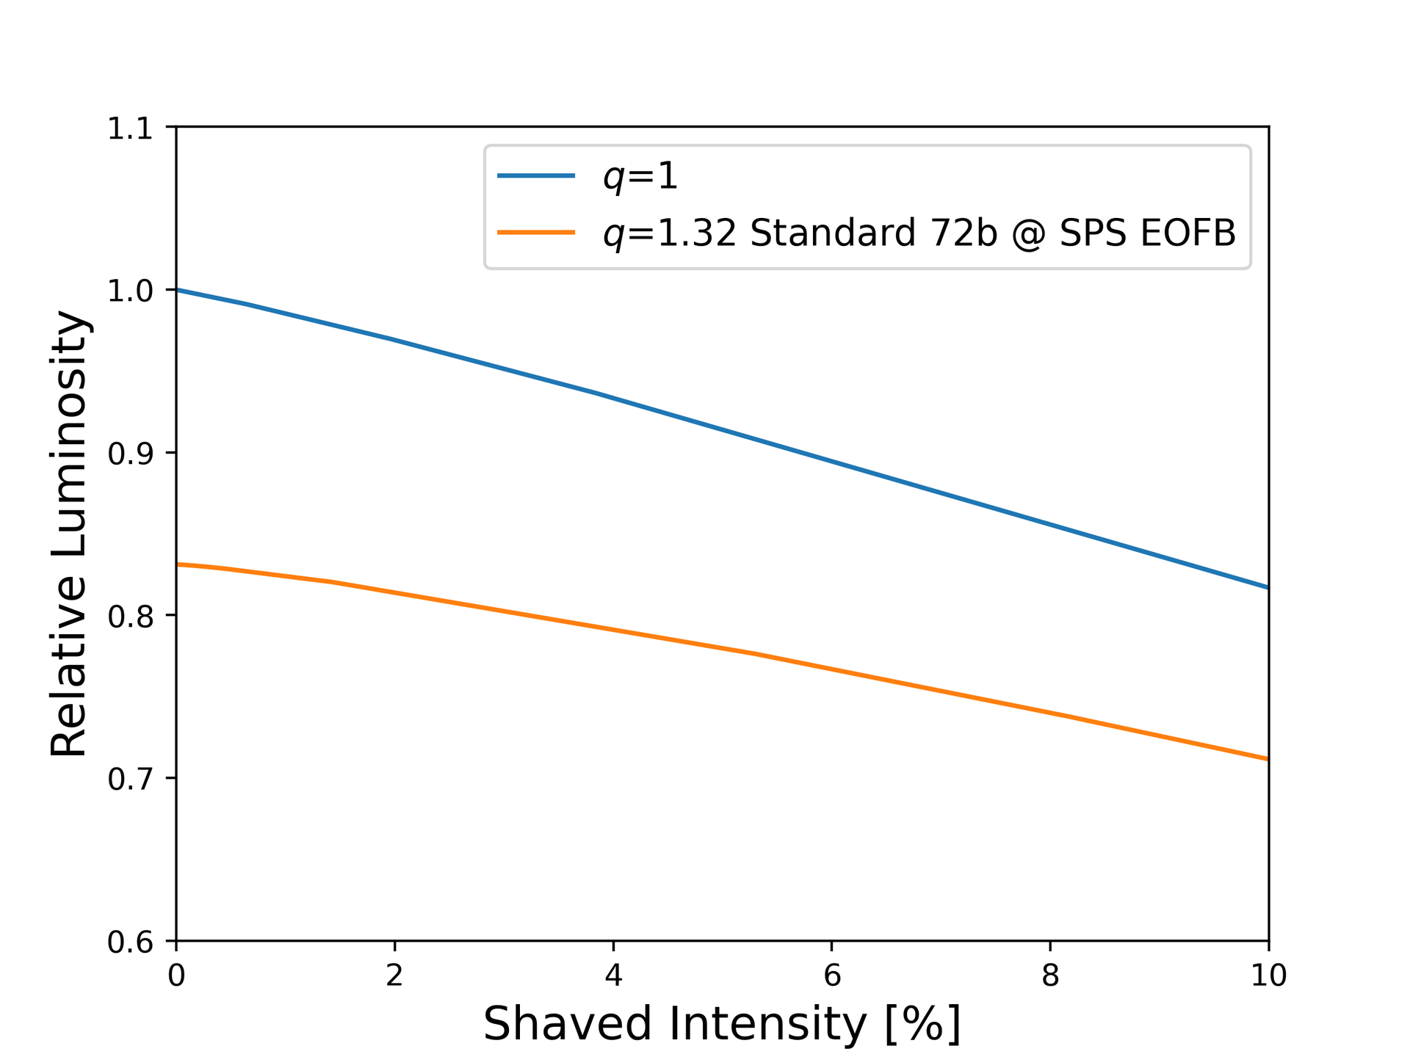
Motivation: Beam quality impact
Non-Gaussian tails contribute to:
Additional losses
at LHC injection
during scraping in the SPS ~2* the LIU budget!
Performance degradation in terms of luminosity
An equivalent luminosity in the injectors can be defined (extrapolating injectors performance to LHC)
Only relative values shown to define the degradation due to tails & scraping
Non-Gaussian tails can reduce performance >15%
Scraping to 2.5 $σ_{coll}$ can further degrade the performance by another ~10%
Injecting higher intensity and applying additional scraping can compensate the loss of luminosity but it is not a sustainable solution
Target tails at the source & minimize them along the complex
E. Lamb, JAP23 workshop

Slide 8
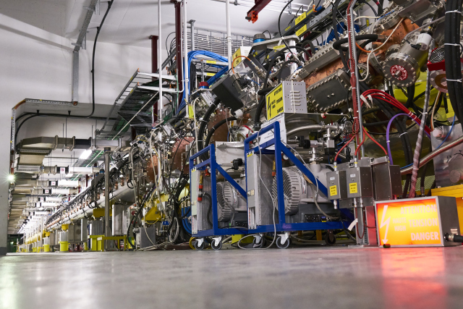
LINAC4
Monitoring the distribution

Slide 9
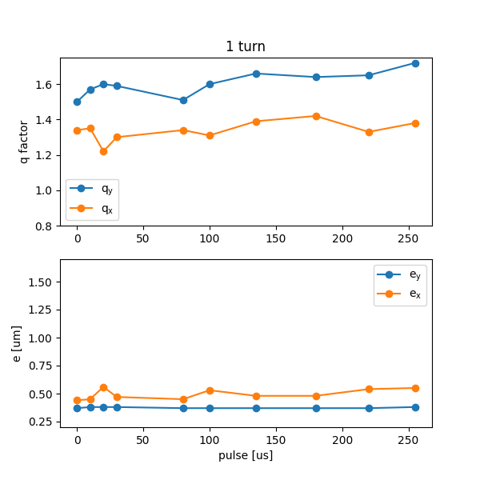
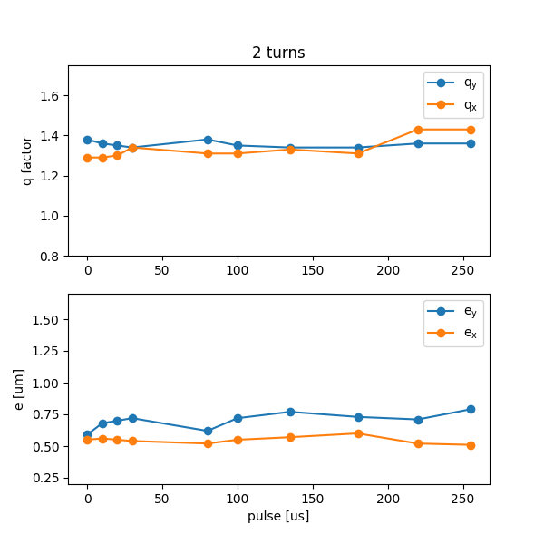
LINAC4: Monitoring the distribution
LINAC4: 600us pulse can provide up to 150 turns (us) / PSB ring
Monitoring the distribution on a single pass machine can be rather challenging
PSB is used as a means of monitoring the distribution after it has been stored in the ring
Tunes on a resonance free regime to limit PSB nonlinearity impact on results
Different parts of the LINAC4 pulse are injected and monitored to identify possible trend along the pulse
Injecting only 1 turn:
Tail content has some evolution along the pulse (~1.5 to >1.7 in V & ~1.2 to >1.4 in H)
For LHC we operate in the <100 turns regime (~1.6 & ~1.3)
Injecting 2 turns:
Tail content remains relatively high (~1.4)
The same trend previously seen is not highlighted in the emittance instead of the tails → RMS of the distribution
Tail extent remains similar

Slide 10
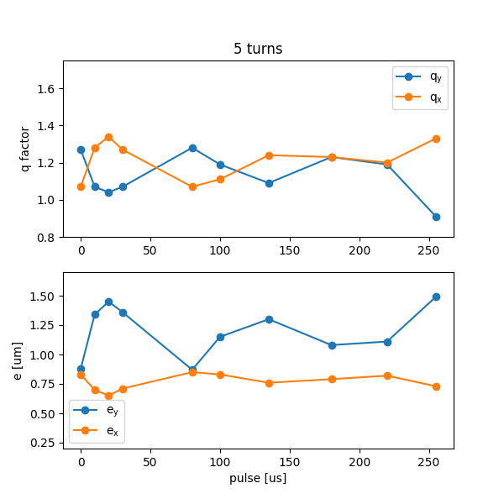
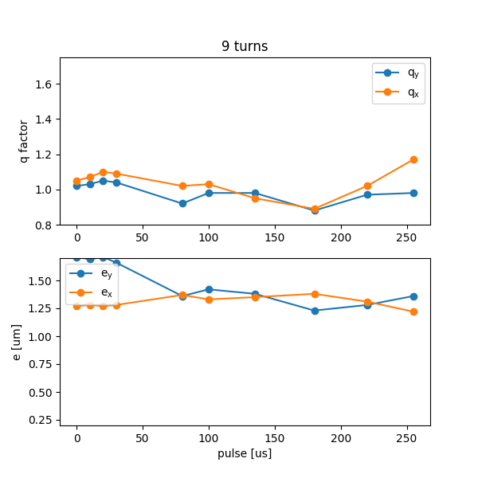
LINAC4: Monitoring the distribution
LINAC4: 600us pulse can provide up to 150 turns (us) / PSB ring
Monitoring the distribution on a single pass machine can be rather challenging
PSB is used as a means of monitoring the distribution after it has been stored in the ring
Tunes on a resonance free regime to limit PSB nonlinearity impact on results
Different parts of the LINAC4 pulse are injected and monitored to identify possible trend along the pulse
Injecting 5 turns:
PSB effects (resonances {integer & coupling}) start appearing
Tail in terms of q appears smaller
Emittances are blowing-up
Injecting 9 turns:
PSB effects (resonances {integer & coupling}) dominate
Tail in terms of q appears smaller
Emittances are blowing-up

Slide 11
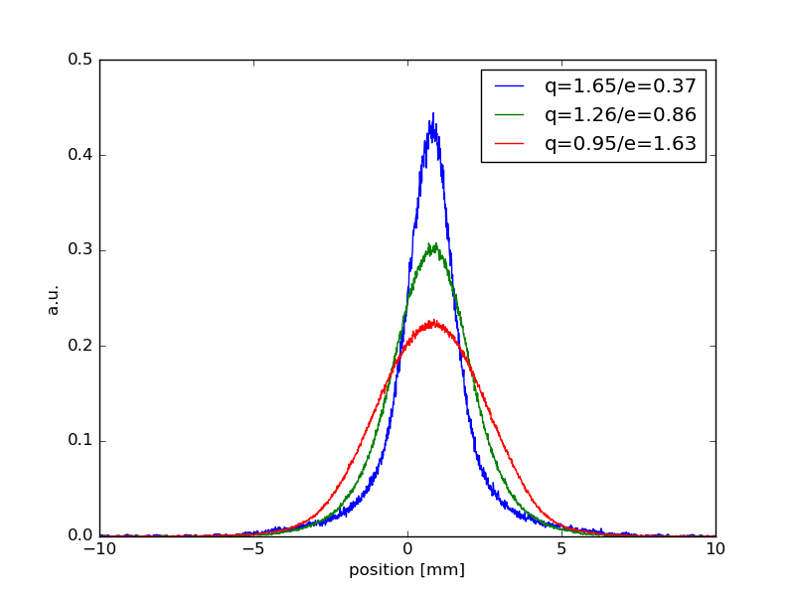
LINAC4: Monitoring the distribution
LINAC4: 600us pulse can provide up to 150 turns (us) / PSB ring
Monitoring the distribution on a single pass machine can be rather challenging
PSB is used as a means of monitoring the distribution after it has been stored in the ring
Tunes on a resonance free regime to limit PSB nonlinearity impact on results
Different parts of the LINAC4 pulse are injected and monitored to identify possible trend along the pulse
A trend along the pulse is visible for different # of turns injected in the PSB
The tail extent always appears similar for the different cases even if the q-factor is modified
Emittances >1.5 are needed to absorb the tails in the core
Tails still relevant for LIU beams
Ongoing work to optimize the distribution manipulating the optics

Slide 12
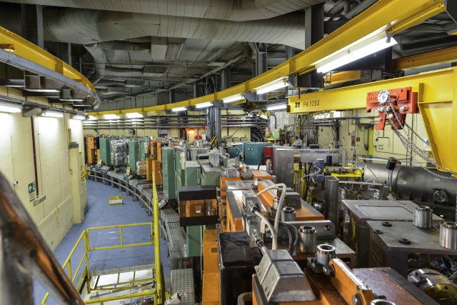
PSB
Space charge
Resonances
Linac4 distribution

Slide 13
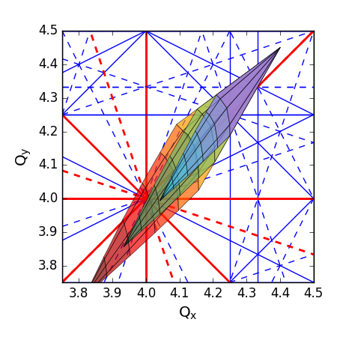
PSB: Space charge “limit”
Space charge remains the main brightness limitation in the PSB – the working point evolution is defined to preserve the brightness (SC2022):
High Injection Tunes (4.4/4.45):
minimizing interaction with integer resonances for low energy that causes: significant emittance blow-up
Ramp to resonance free space (4.17/4.23):
minimizing interaction with higher order resonances that can cause: Losses | Emittance blow-up | Transverse tails
Space charge mitigation (HB2023)
Longitudinal line density reduces with the triple harmonic capture
Space charge tune spread reduces for the lower line density
Reduce blow-up
Improve brightness
Flexibility for tune manipulations
Maintaining the same brightness reduce Injection tunes to avoid several high order resonances

Slide 14
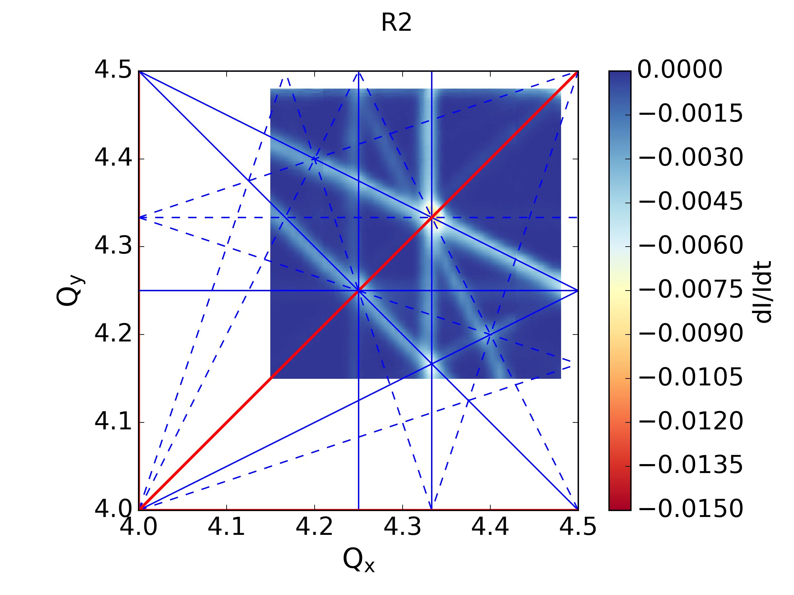
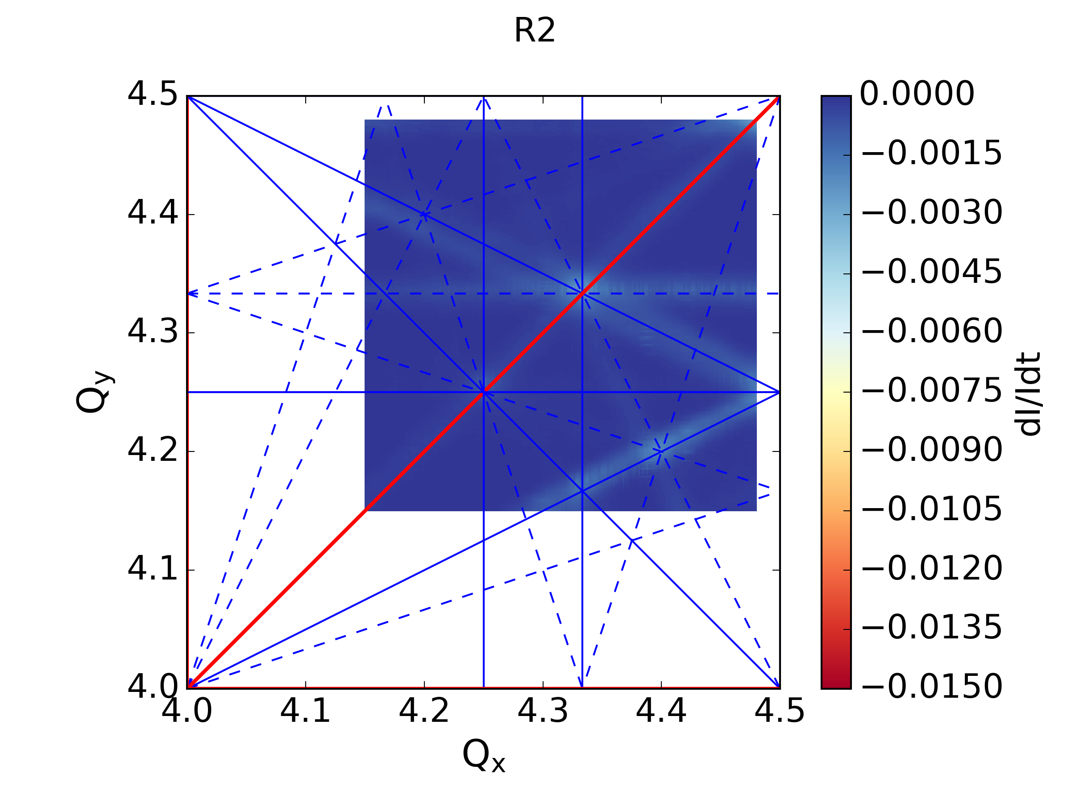
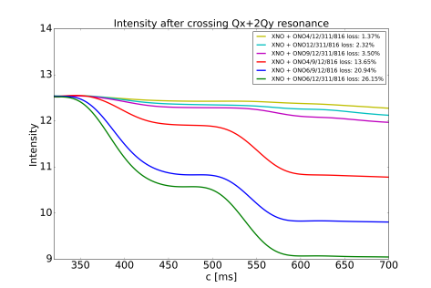
PSB: Resonances
natural
corrected
All resonances up to 4th order visible since 2021
Demonstrated significant suppression @160MeV (HB2021, IPAC22, IPAC24)
Correction for less lines (i.e. lower tunes) is usually cleaner.
Correction along the cycle challenging due to current limitations → earlier tune ramp allows for better correction
Correction of octupole lines has a large impact on sextupole lines → 1 line in the diagram breaking in 2 and not possible to fully correct: “off-momentum resonance”?
Optimal settings change every year…
New application for resonance compensation based on ML (optimizers) (G. Tangari, CERN SC meeting)
D. Zeitz, CERN SCWG
 | 3Qx (2021) | 3Qx (2022) | 3Qx (2023) | 3Qx (2024)
R4 | XNO4L1: 23.7 A XNO9L1: -23.7 A | XNO4L1: 12 A XNO9L1: -21 A | XNO4L1: 15.7 A XNO9L1: -20.1 A | XNO4L1: 21.6 A XNO9L1: -25.3 A

Slide 15
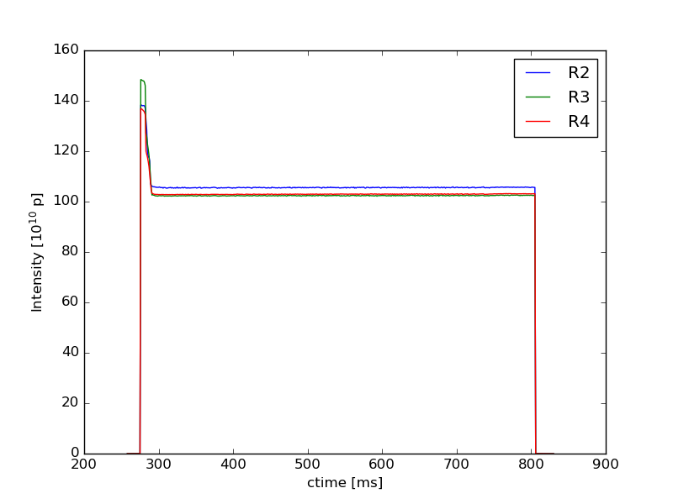
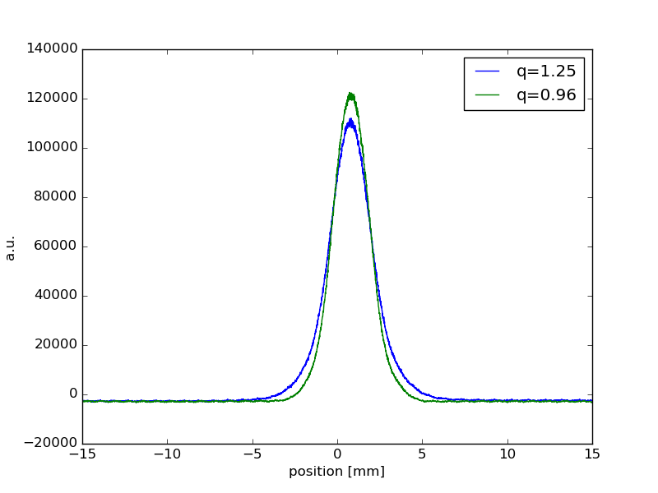
PSB: Linac4 Distribution
Having optimized the PSB, the Linac4 “input” distribution is still having an impact for high brightness beams leading to large tail population at PSB extraction.
Scraping at low energy slightly after the longitudinal shaving: similar losses for both processes
Profiles appear Gaussian at PSB extraction (e~1/q~1)

Slide 16
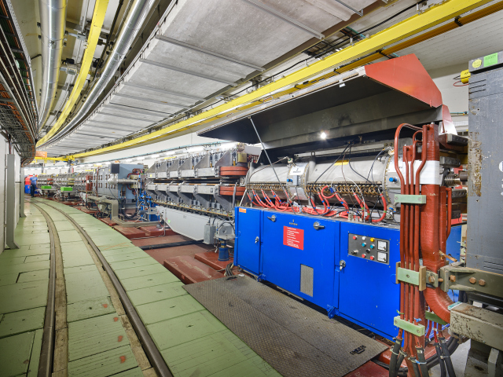
PS
Resonances
Transition crossing

Slide 17
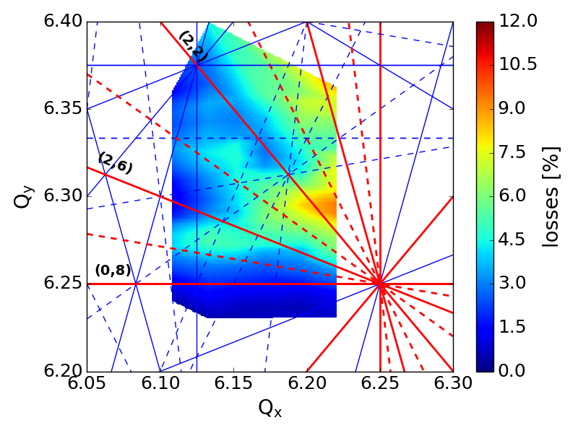
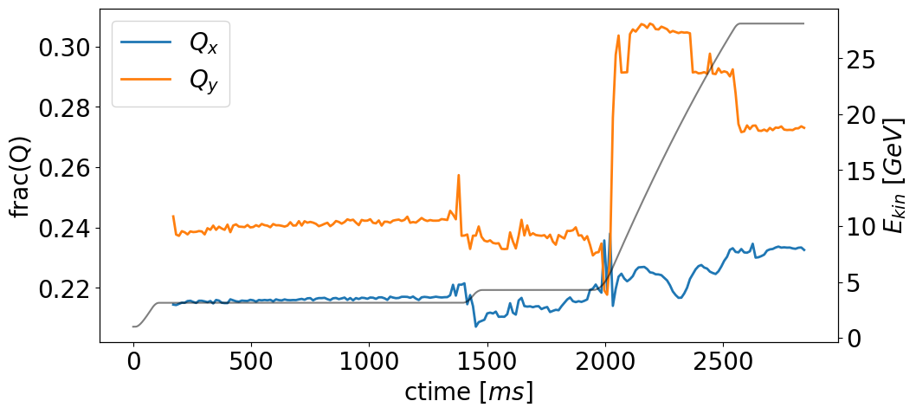
PS: Resonances
Space charge remains the main brightness limitation in the PS
The working point evolution at low energy:
Preserving brightness
Avoiding 8th order space charge driven resonances (PRAB:23.091001)
After the flat bottom part of the PS cycle the tunes are harder to control:
Low Energy Quads out of power
Pole Face Windings used for chroma adjustment at transition crossing
At the intermediate plateau tunes approach each other
At transition crossing the tunes cross & overlap
At acceleration & flat top tunes no longer on a resonance free region

Slide 18
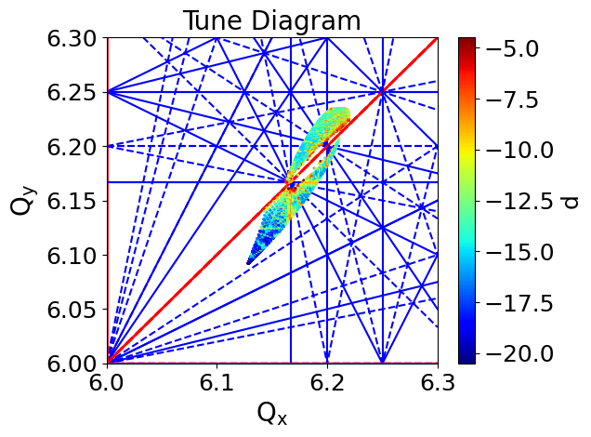
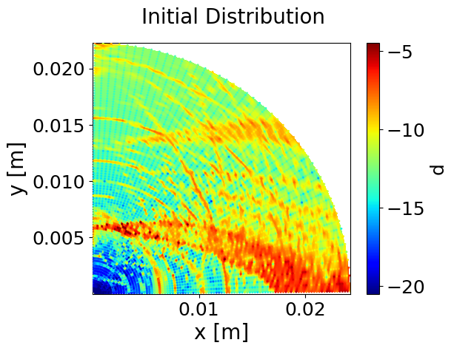
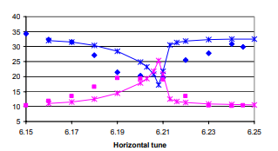
PS: Resonances
At the intermediate plateau tunes approach each other
At transition crossing the tunes cross & overlap
At acceleration & flat top tunes no longer on a resonance free region
Space charge driven coupling excitation in the PS
(i.e. Montague resonance)
Frequency Map Analysis
M. Bozatzis, CERN SCWG
E. Metral et al., HB2004

Slide 19
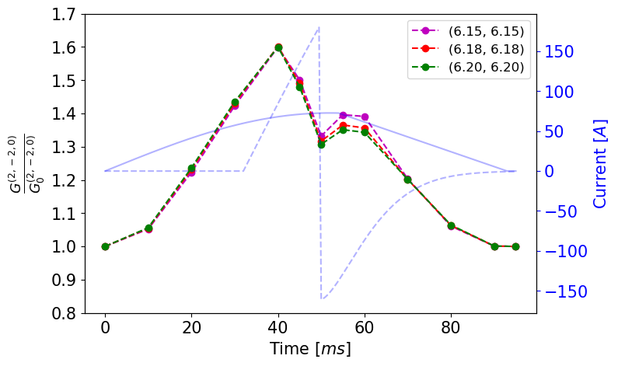
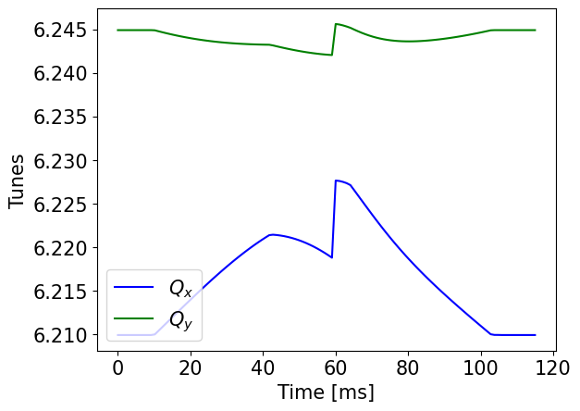
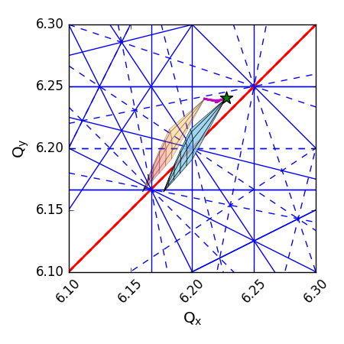
PS: Transition crossing
At the intermediate plateau tunes approach each other
At transition crossing the tunes cross & overlap
At acceleration & flat top tunes no longer on a resonance free region
Optics perturbation due to the γ-jump scheme:
Further enhance the coupling excitation
Push the tunes towards the coupling resonance line
RDT coming from space charge potential (PySCRDT)
Tune modulation induced by the γ-jump
M. Bozatzis, CERN SCWG

Slide 20
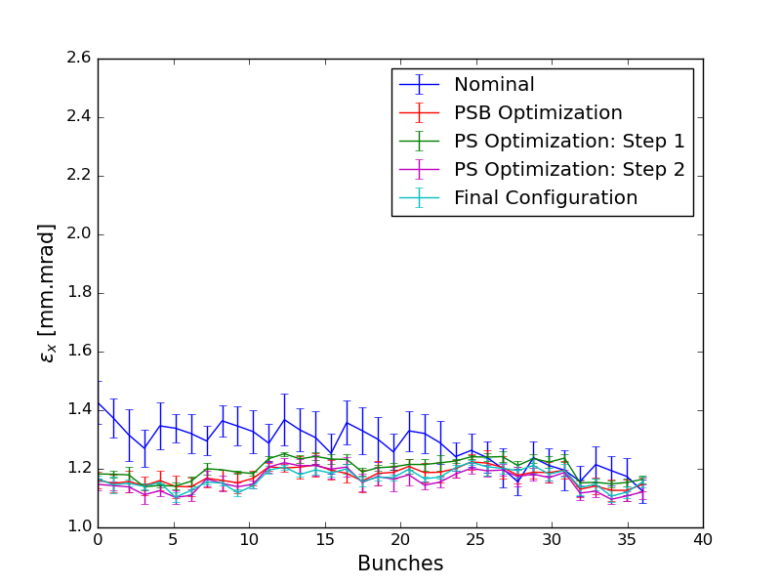
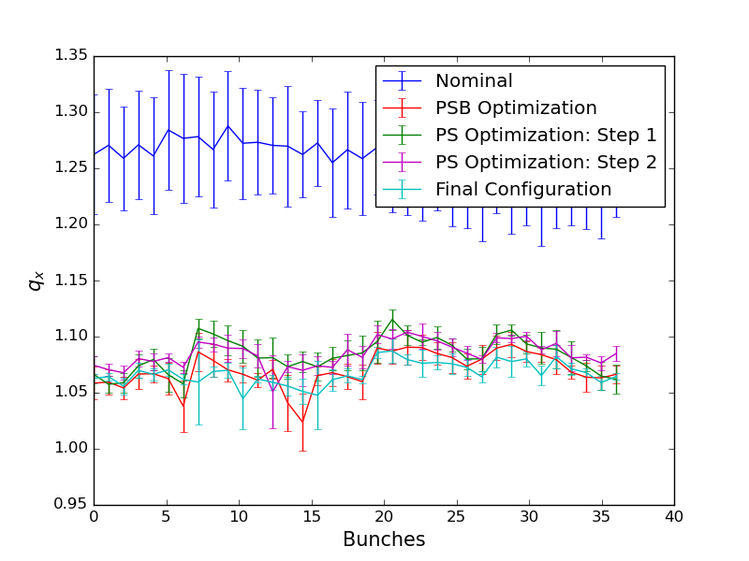
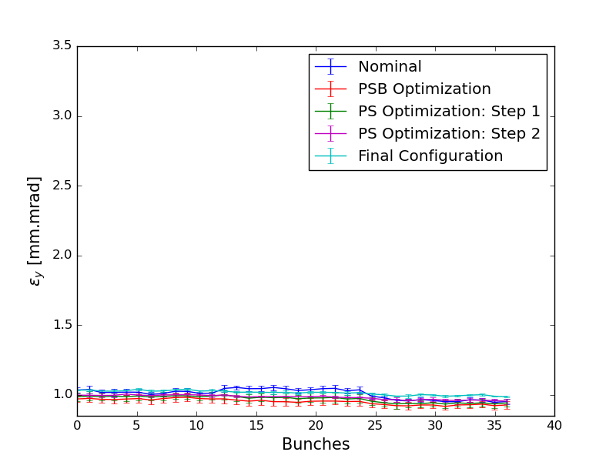
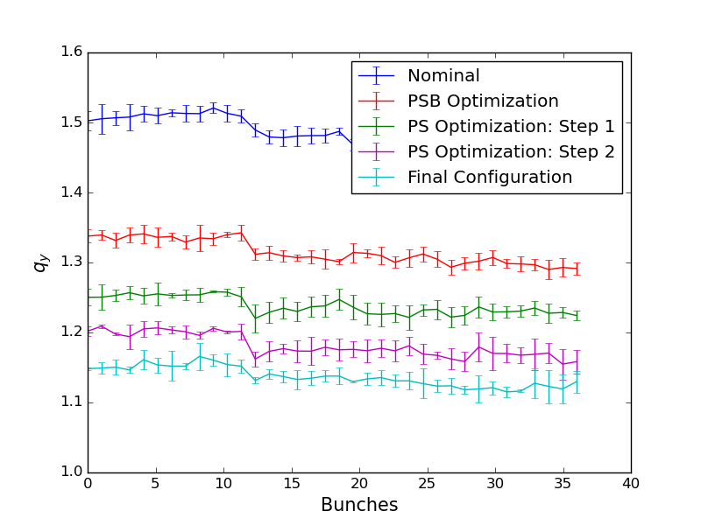
PS: Tune optimization
Optimizing the tune along the cycle in the PS:
Separate tunes at intermediate plateau
Stay on a resonance free region at flat top
Separate tunes at transition crossing
H
Working point adjustments affected only the tail content and not the brightness
Scraping in the PSB greatly reduced tails in the PS
Minor bunch-by-bunch differences
Remnant increase of tails still only around transition crossing
ongoing simulation studies to better characterize the process
V
M. Bozatzis, CERN SCWG

Slide 21
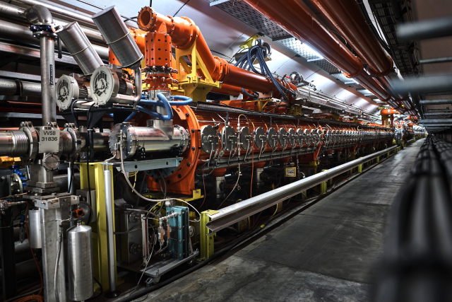
SPS
Tune correction
Noise

Slide 22
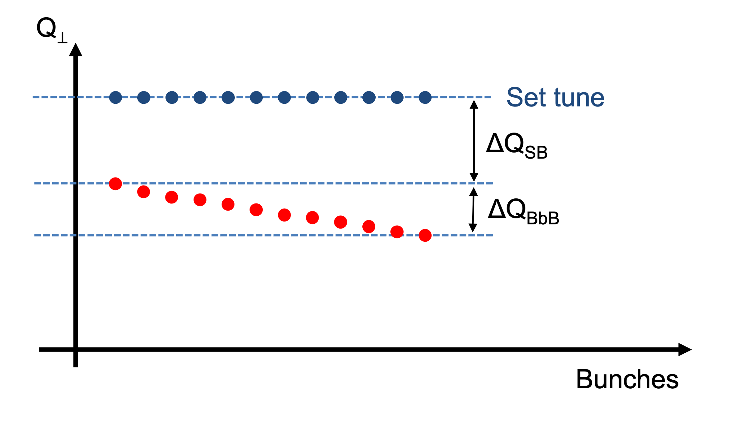
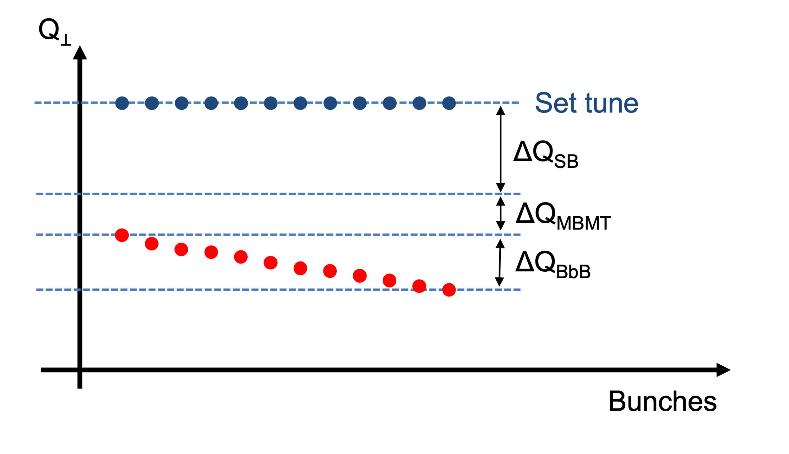
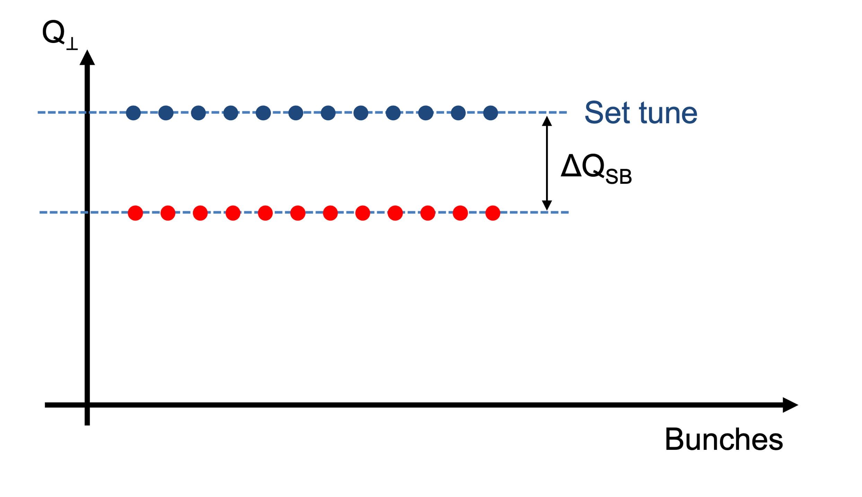
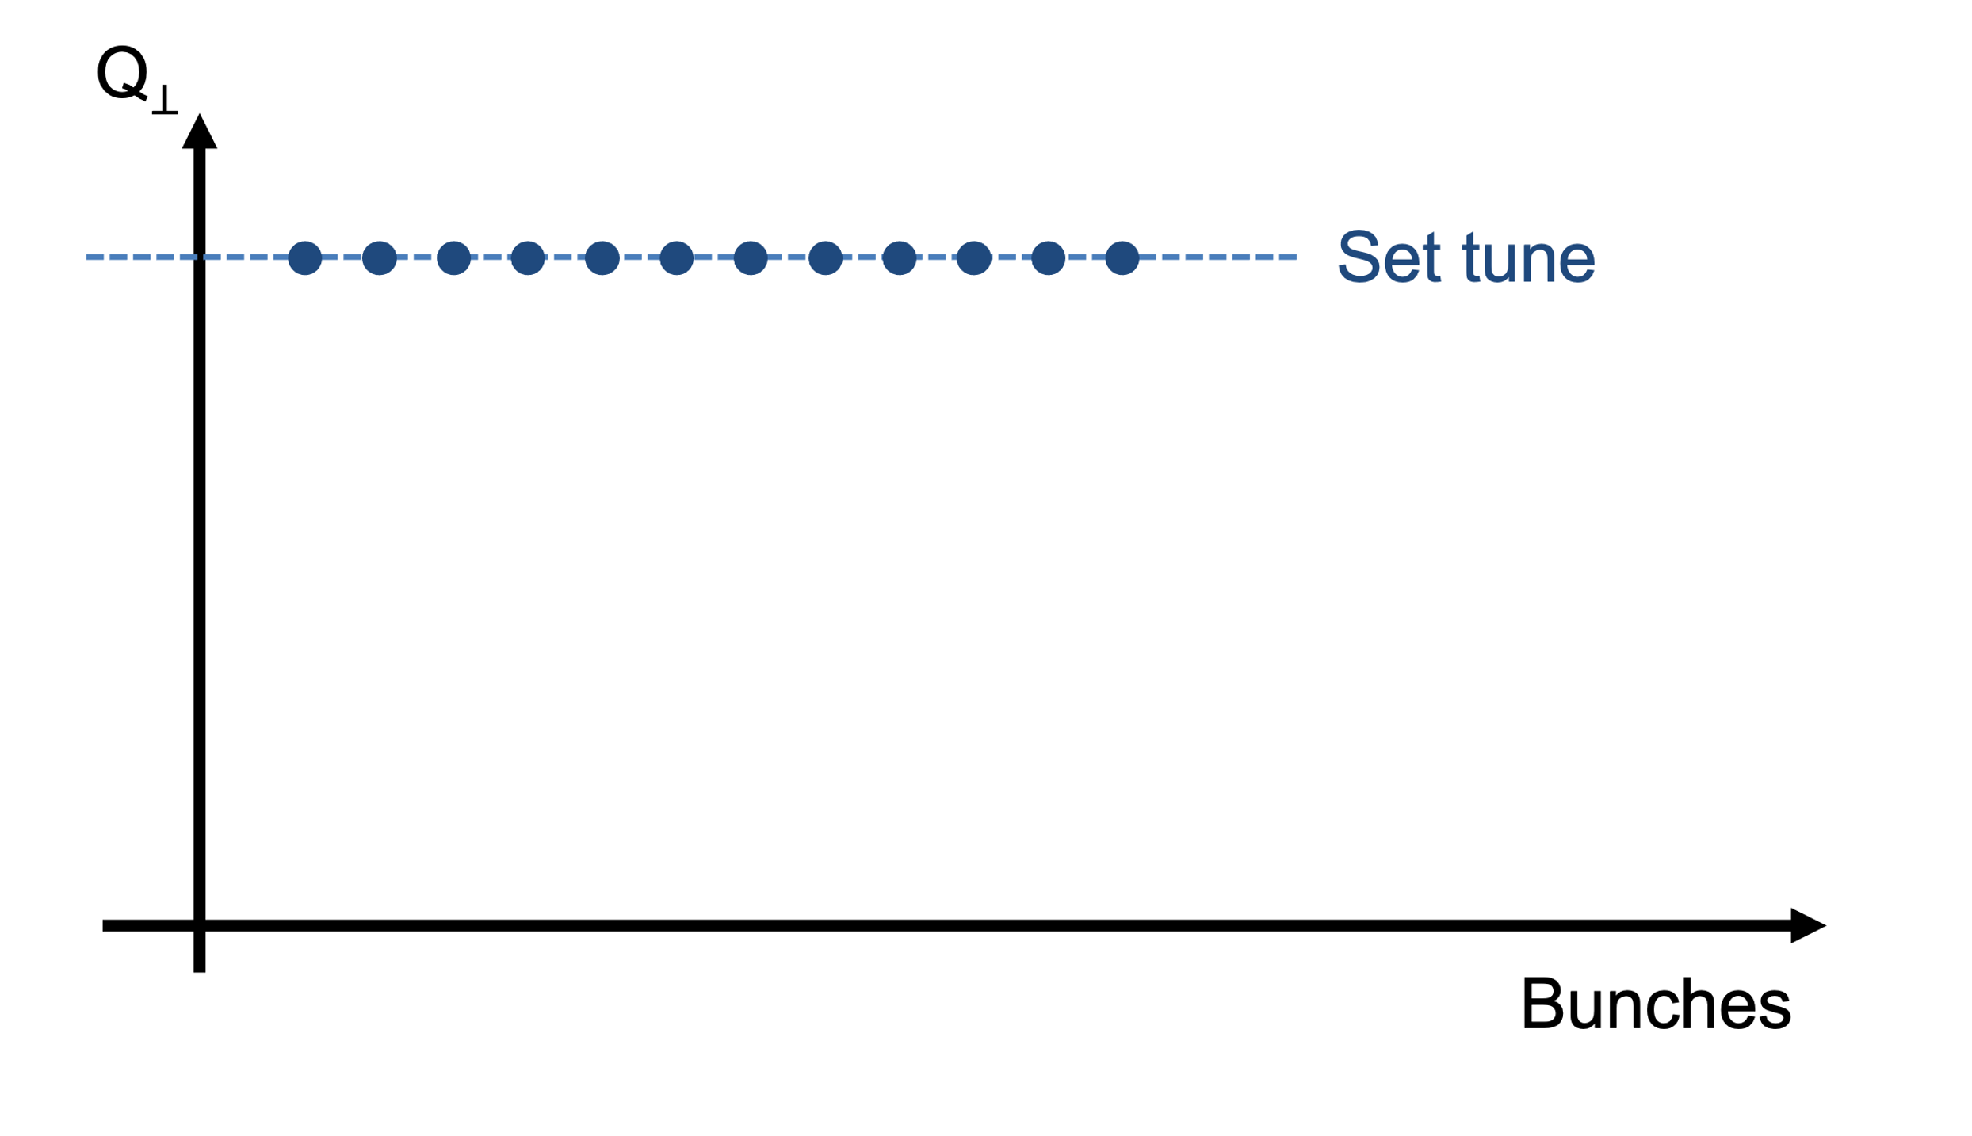
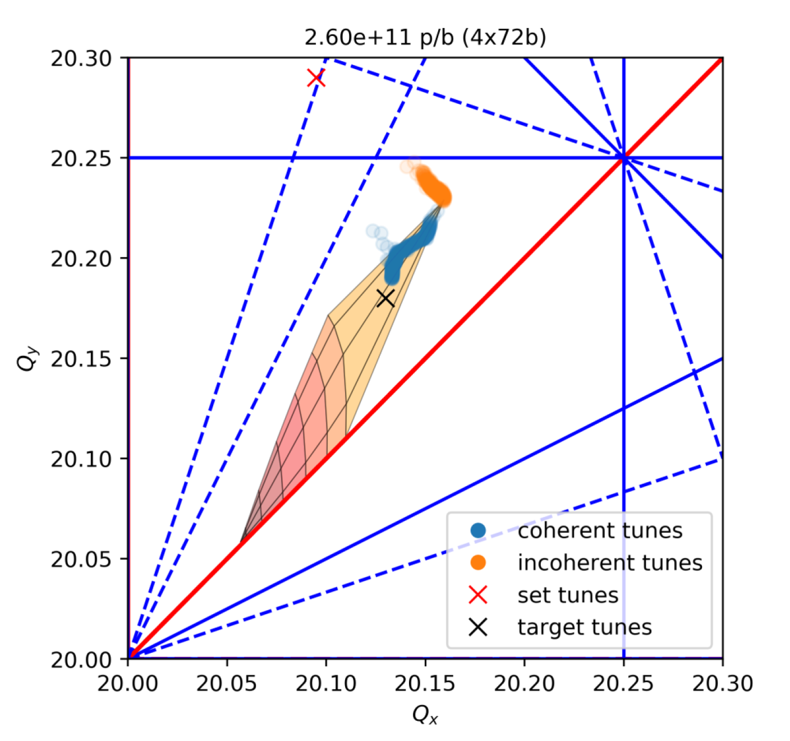
SPS: Tune correction
Having several trains of bunches in the SPS can result to significant tune shifts (from impedance)
Single bunch tune shift ($ΔQ_{SB}$)
Bunch-by-bunch tune shift ($ΔQ_{BbB}$)
Multi-bunch multi-turn tune shift ($ΔQ_{MBMT}$)
Description based on coherent tune shift but tune shifts are observed for the incoherent contribution as well!
This tune behaviour can:
Affect brightness (approaching the integers)
Induce losses (on the 20.25 line)
Introduce coupling (pushing the spread on the coupling line)
Dynamic tunes along the cycle can minimize this effect balancing emittance blow-up and losses
I. Mases, HB2023

Slide 23
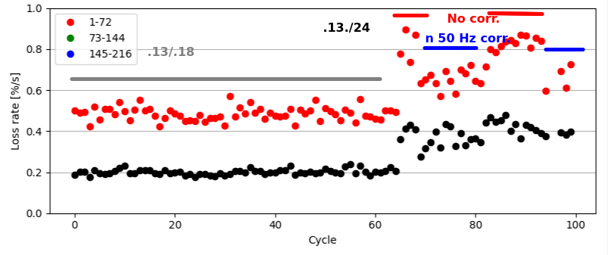
SPS: Noise
In addition to impedance tune shifts the tune in the SPS is modulated through noise (mostly 50Hz) on the power supplies of the Quads
This tune ripple is not harmful for low tunes (no resonances overlapped)
Increasing the tunes to boost brightness:
Significant increase of the loss rate
Inducing noise counteracting the 50Hz the loss rate is reduced
Several studies planned as follow-up aiming to finally be able to online monitor and correct the ripple!
K. Paraschou, CERN IPP

Slide 24
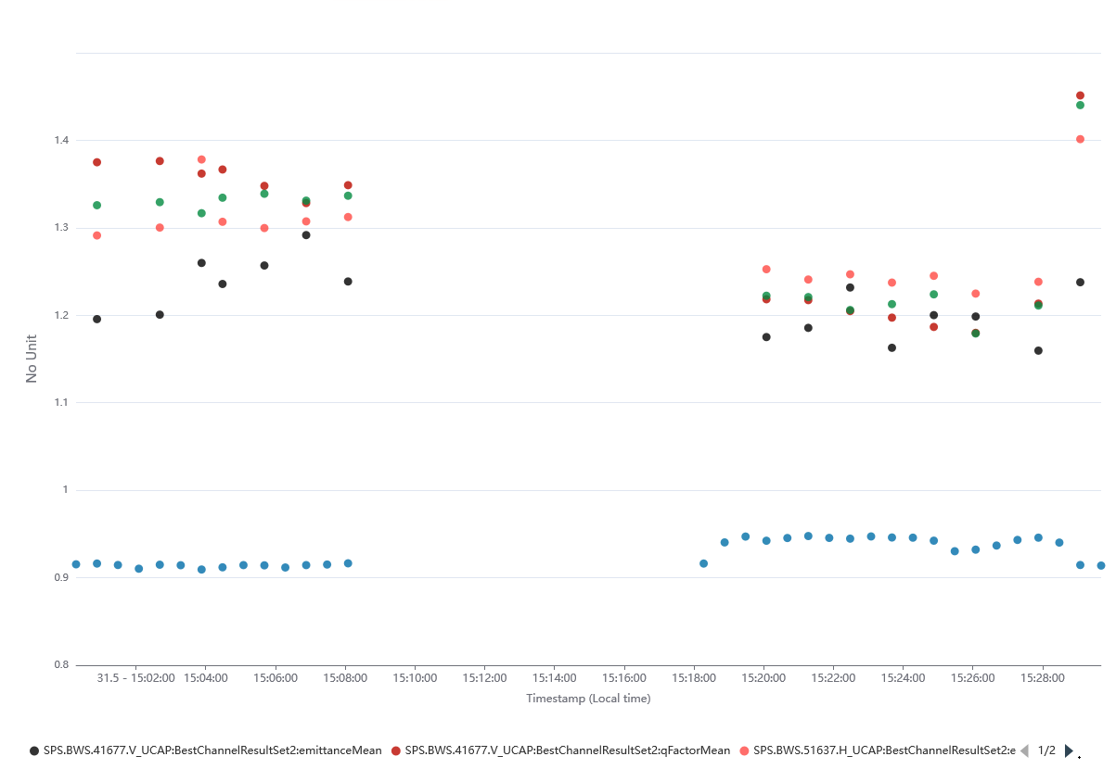
SPS: Operational configuration
Trying to balance the situation in the SPS:
Tune changes “steps” along the flat bottom (storage in-between injections) were introduced
Tune change at the start of ramp to counteract blow-up coming from space charge increase due to bunch shortening
>10 % Emittance gain |e:1.25 (1.45) q: ~1.4
Improving the beam upstream (L4, PSB, PS)
Reduced losses at SPS flat bottom & scraping
~5% emittance gain
~10% less tail
population
Nominal
e & q
Nominal
Improved
Transmission

Slide 25
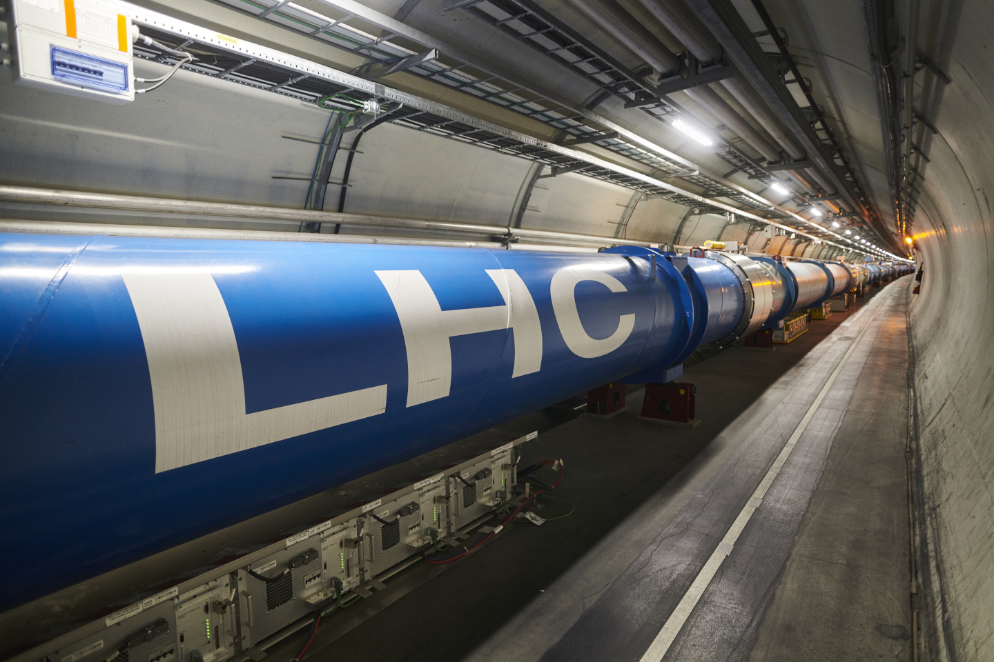
LHC
Injector beams in the LHC

Slide 26
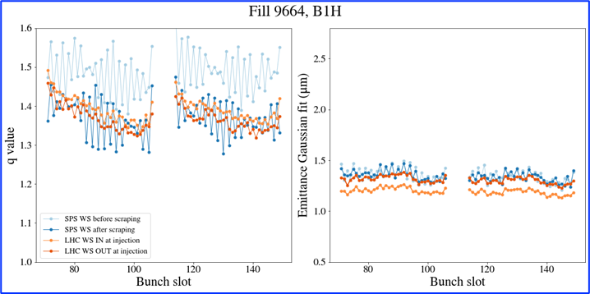
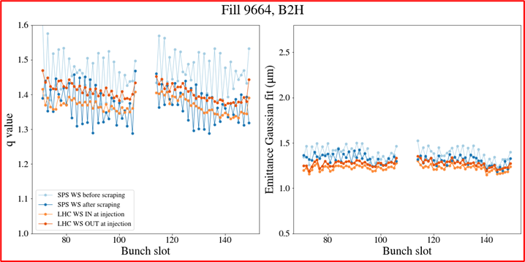
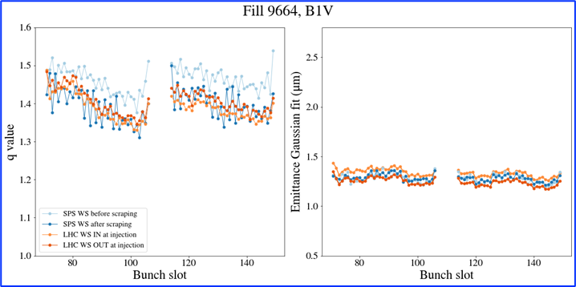
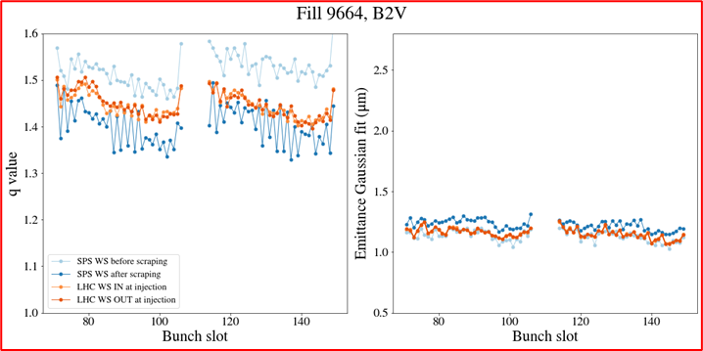
LHC: Comparative measurements with SPS
Measurements taken at SPS before/after scraping & LHC Injection with wirescanners for comparative studies
Emittance measurements consistent between SPS & LHC
Tail content significant at LHC injection similar to SPS (even after scraping)
Overall emittances of ~1.3um measured @LHC injection
S. Kostoglou, CERN IPP

Slide 27
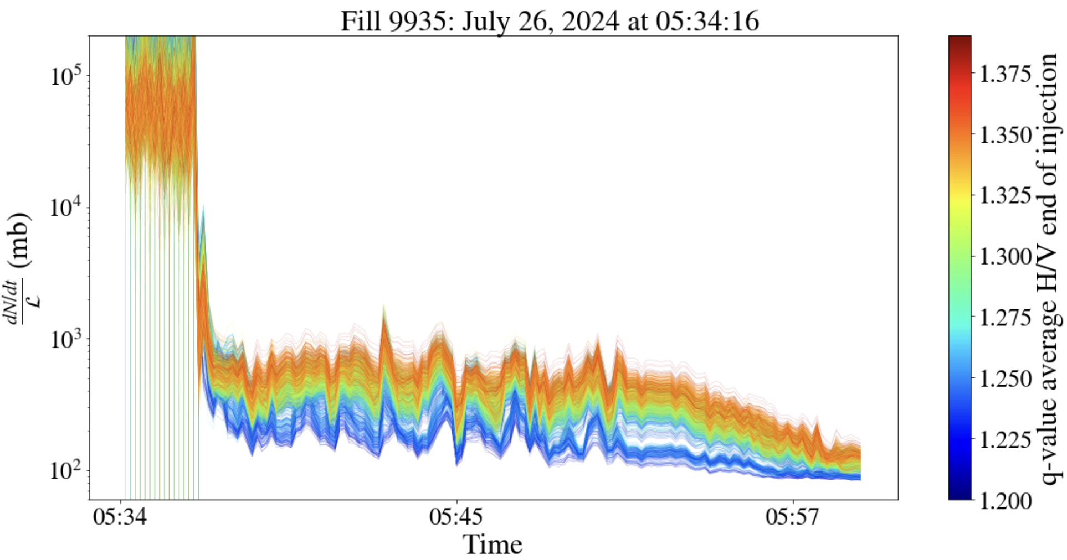
LHC: Impact of tails on losses
Bunch-by-bunch effective cross section from Adjust to 20 minutes into Stable Beams, color-coded with the bunch-by-bunch q-value (average between H/V) measured by the BSRT at the end of injection.
Correlation of losses with bunches with heavier tails.
Particles on the tails of the distribution contribute mostly to losses rather than luminosity
S. Kostoglou, CERN IPP

Slide 28
Summary & Outlook
The CERN Injector complex has managed to achieve the goals of the LIU project in terms of brightness
Beam quality is still a concern due to the strict requirements from the LHC
Heavy tail distributions contribute to losses in the SPS and the LHC, while degrading the performance in terms of luminosity
Detailed studies along the full injector chain to improve brightness & minimize tail population
Linac4: Beyond Gaussian tails have been measured along the pulse and contribute to the operational user
Investigation of possible mitigation at the Linac4 level
PSB: Tails reduced with scraping at low energy
Tails & Brightness improved using margin provided from triple harmonic capture & resonance compensation
PS: Tails & Brightness improved with careful working point adjustments along the cycle avoiding space charge driven resonances (Montague & 8th order).
Ongoing simulation studies to fully characterize the transition crossing process and its impact on the transverse distribution
SPS: Tails & Brightness gain coming from a dynamic working point evolution along the cycle to avoid integer blow- up and higher order resonances (due to tune shifts)
Ongoing work to limit tune modulation coming from power supply ripple to further improve brightness

Slide 29
Thank you!

Slide 30
“brighter low-tail” BCMS & L4
Same procedure for high energy spread, i.e. LHC setting
The trend changes → However, only the regime <100us is relevant for LHC beams!
Tails are worse especially in H
Low energy spread should also be explored → vdM, BSRT etc…
High current configuration?
Natural
Energy spread
Large
Energy spread

