Slide 1
Dominance of particle resonances over parametric instabilities in high-intensity linacs
Dong-O Jeon, Ji-Ho Jang
IRIS
Institute for Basic Science
Space Charge 2024

Slide 2

Drowned in a swamp of terms…?
Resonances
Incoherent
resonances
Parametric resonances
Parametric
instabilities
Structure
resonances
Coherent
resonances
Coherent
instabilities
Instabilities

Slide 3
Space-charge halo mechanisms
As beam current increases, space-charge effects become important.
There are largely two families of space-charge mechanisms and yet they need to be differentiated: particle resonances and parametric instabilities.
Particle resonances: a.k.a. resonances, single particle resonances, incoherent resonances …
Parametric instabilities: a.k.a. parametric resonances, instabilities, structure resonances, coherent resonances, coherent instabilities, mode instabilities …
Jeon et al, NIM A 832, 43 (2016); Jeon, J Korean Phys Soc 72, 1523 (2018)

Slide 4
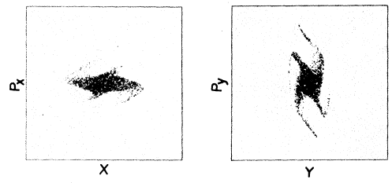
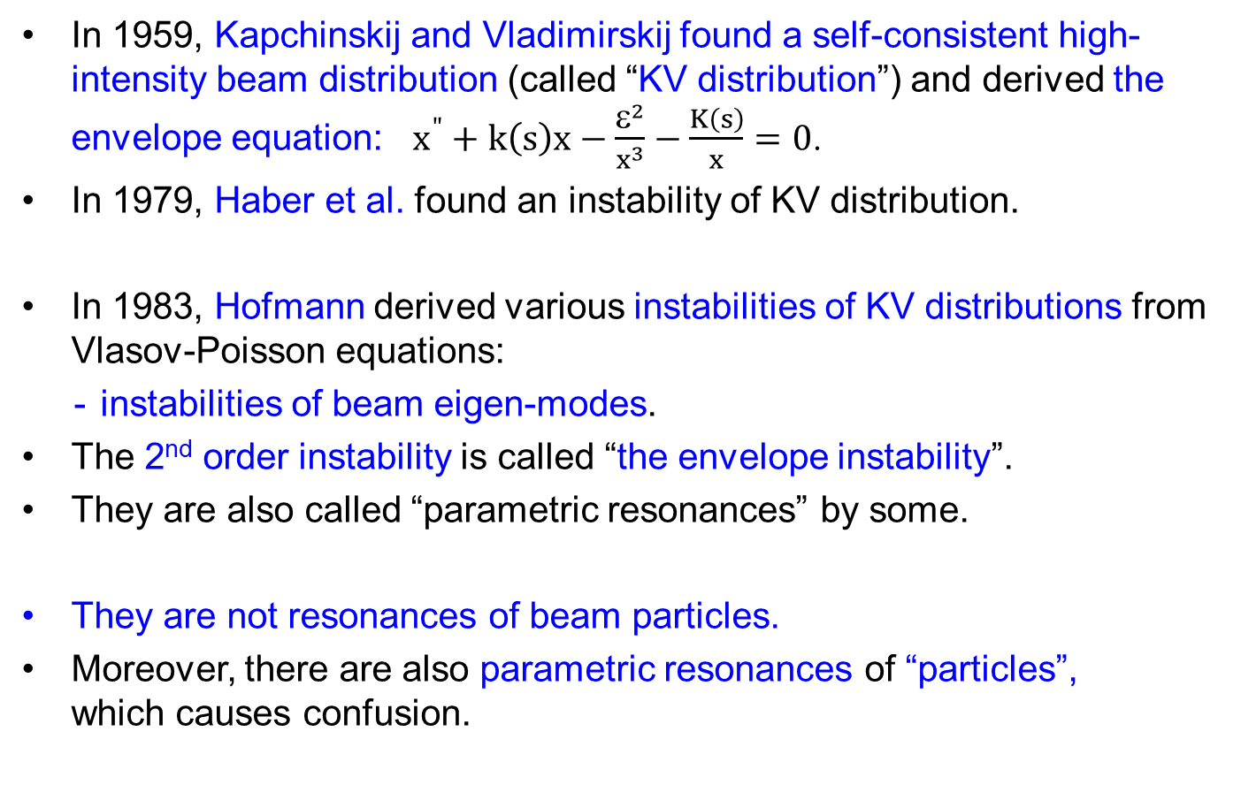
Parametric instabilities
In 1959, Kapchinskij and Vladimirskij found a self-consistent high-intensity beam distribution (called “KV distribution”) and derived the envelope equation: $x^{"}+k\left(s\right)x−\frac{ε^{2}}{x^{3}}−\frac{K\left(s\right)}{x}=0$.
In 1979, Haber et al. found an instability of KV distribution.
In 1983, Hofmann derived various instabilities of KV distributions from Vlasov-Poisson equations:
instabilities of beam eigen-modes.
The 2nd order instability is called “the envelope instability”.
They are also called “parametric resonances” by some.
They are not resonances of beam particles.
Moreover, there are also parametric resonances of “particles”, which causes confusion.
Haber et al, PRL 42, 1479 (1979)

Slide 5
Parametric instabilities in actual linacs?
Few parametric instabilities have been observed in multiparticle PIC simulations for waterbag distribution;
Not observed for Gaussian distribution.
Landau damping suppresses parametric instabilities of higher than second order for Gaussian distribution.
We can ignore the 3rd or 4th order instabilities in actual linacs.
Jeon, J. Korean Phys. Soc. 72, 1523 (2018)
Parametric instability | KV distribution | waterbag distribution | Gaussian distribution
2nd order | Observed | Observed | Observed
3rd order, 4th order | Observed | Observed | Not observed
higher order | Observed | Not observed | Not observed
Hofmann et al, PRAB 24, 024201 (2021)

Slide 6
No sign of parametric instabilities in experiment data
Tiefenback’s thesis (1986) stated: Our work shows no evidence of any unstable behavior for … up to about σ_{o} = 88°.
GSI experiments showed no sign of parametric instability:
Tiefenback’s thesis, LBL Report No LBL-22465 (1986)
2σ_{trans} - 2σ_{long} = 0 particle resonance
4σ = 360° particle resonance
Groening et al, PRST-AB 11, 094201 (2008)
Groening et al, PRL 102, 234801 (2009)

Slide 7
Particle resonances in high-intensity linacs
In 2009, 4σ = 360° particle resonance was discovered in high-intensity linacs. [Jeon et al, PRST-AB 12, 054204 (2009)]
Confirmed by two experiments.
In 2015, 6σ = 720° particle resonance was discovered. [Jeon et al, PRL 114, 184802 (2015)]
6σ = 360° particle resonance is too weak to observe for Gaussian beam; [Jeon et al, PRL 114, 184802 (2015)]
very weak sign for waterbag beam. [Hofmann et al, PRL 115, 204802 (2015)]
Higher order particle resonances were found:
8σ = 1080° resonance, 10σ = 1440° resonance [Hofmann, HB2016]

Slide 8
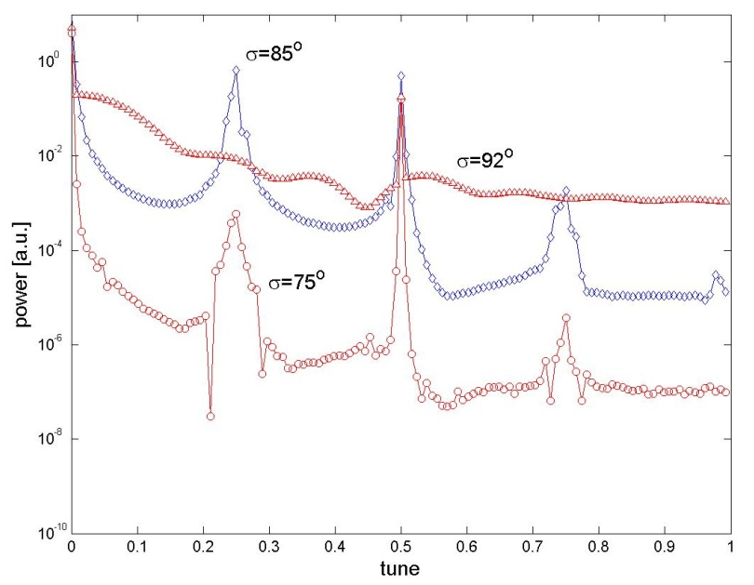
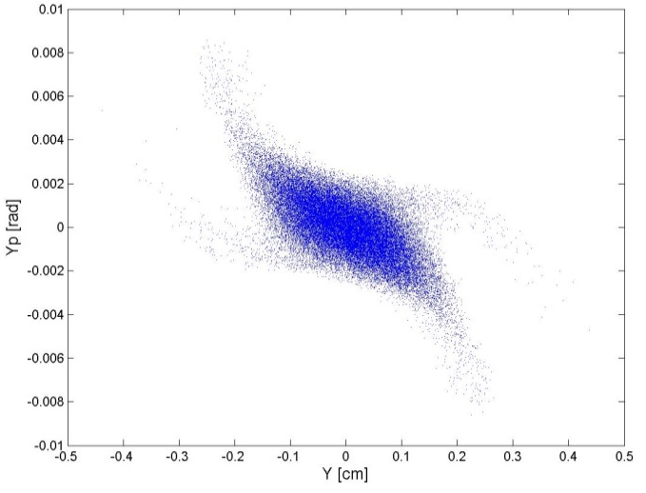
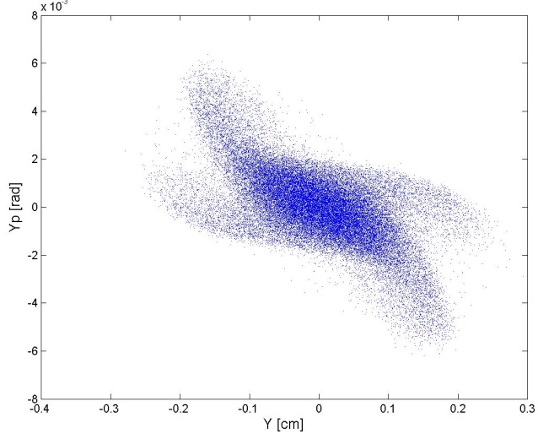
4th order particle resonance in high-intensity linacs
FFT frequency spectrum
Jeon et al, PRST-AB 12, 054204 (2009)
Crossing from below
Crossing from above
1/4
The 4σ = 360° particle resonance was discovered in high-intensity linear accelerators;
Identified as a particle resonance in the linac.
Stable fixed points and their properties were observed:
FFT resonance frequency component,
Behavior difference between crossing the resonance “from above” and “from below”.
Confirmed by two experiments.

Slide 9
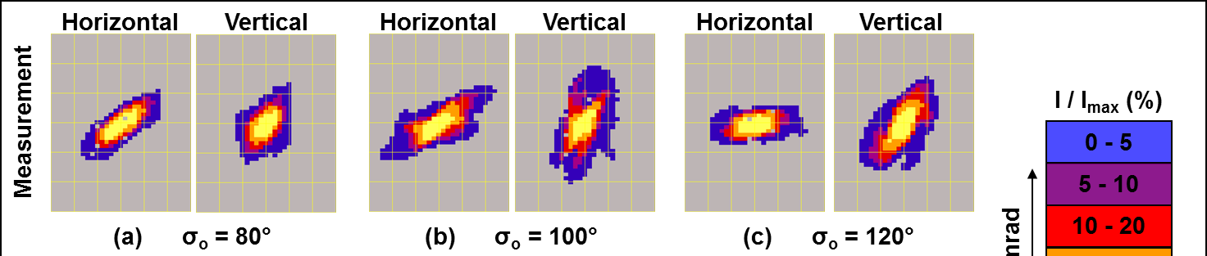
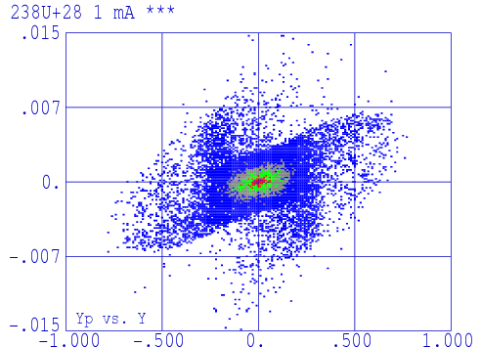
Experiment 1: 4th order particle resonance
GSI UNILAC
Groening et al, PRL 102, 234801 (2009)
experiment
simulation
P_{x}
X

Slide 10
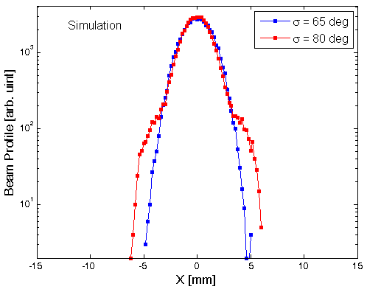
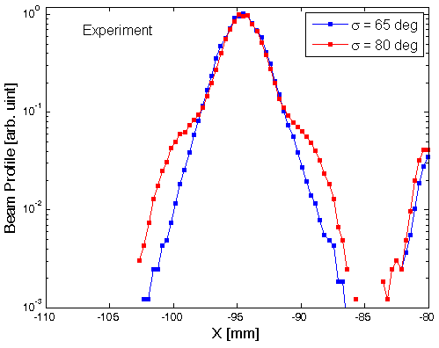
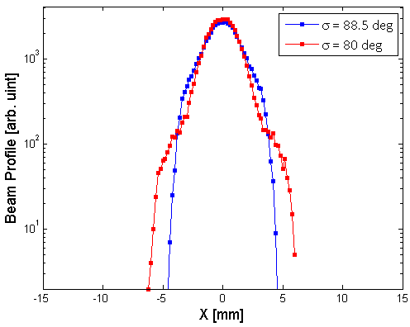
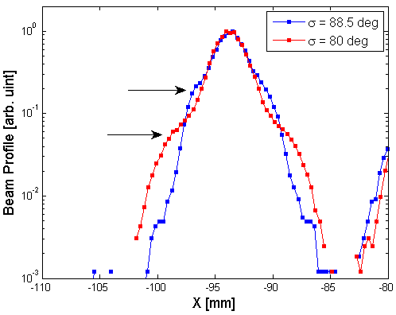
Experiment 2: 4th order particle resonance
ORNL SNS linac
Jeon, PRAB 19, 010101 (2016)
simulation
experiment
σ=80°
σ=80°
σ=65°
σ=65°
simulation
experiment
σ=88°
σ=88°
σ=80°
σ=80°

Slide 11
Tiefenback’s observation
Tiefenback’s PhD thesis (1986) reported an experiment observation of “four-pointed structure”;
But misidentified it as “fourth order structure resonance” (fourth order parametric instability).
Figure 5.15 of Tiefenback’s thesis (σ_{o} = 98° lattice)

Slide 12
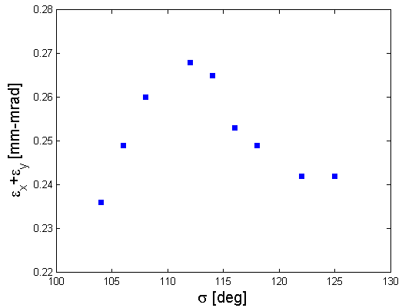
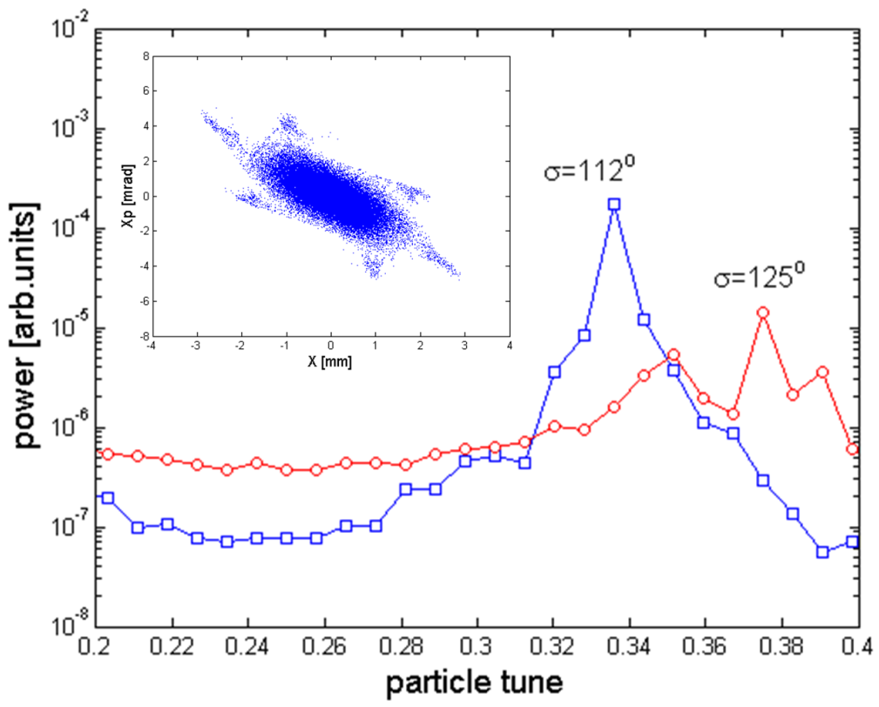
6th order particle resonance in high-intensity linacs
Jeon et al, PRL 114, 184802 (2015)
Gaussian dist.
1/3
6th order resonance
FFT analysis shows a peak at 1/3.
6σ = 720° particle resonance in σ < 120°.
No resonance effects in σ > 120°.

Slide 13
Difference between particle resonances and parametric instabilities

Slide 14
What is the difference? particle resonances and parametric instabilities
Particle Resonances
or incoherent resonances
O resonance frequency component
Particle resonances → resonance islands in phase space
Parametric Instabilities
or parametric resonances
or coherent resonances
X resonance frequency component
Parametric instabilities → no resonance islands in phase space

Slide 15

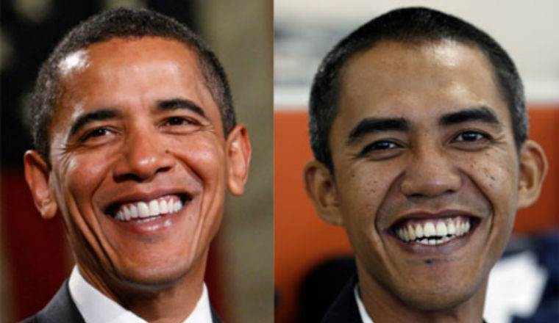

There are look-alike people
There are look-alike people ...
But they have different parents.

Slide 16
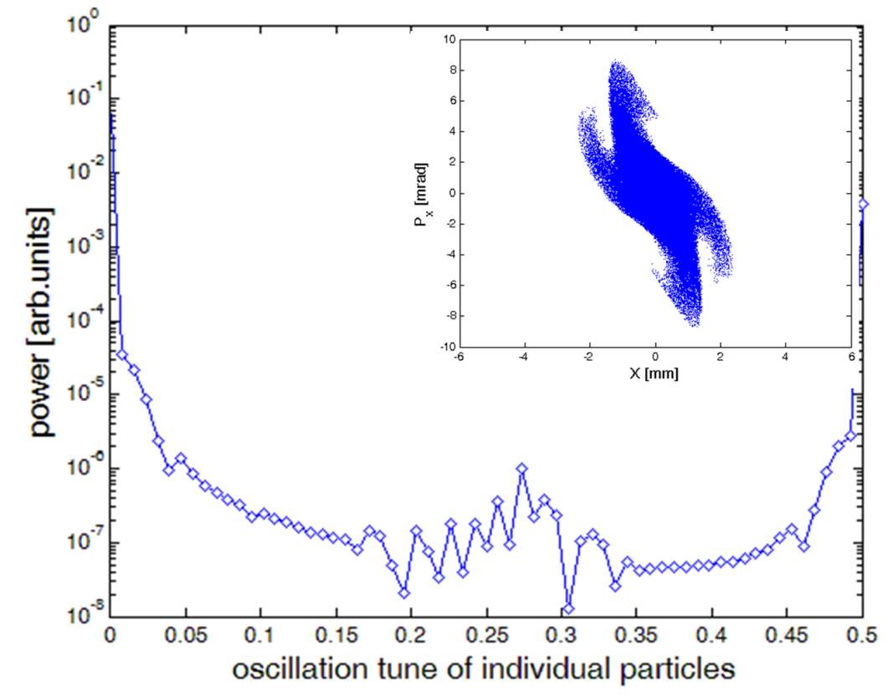
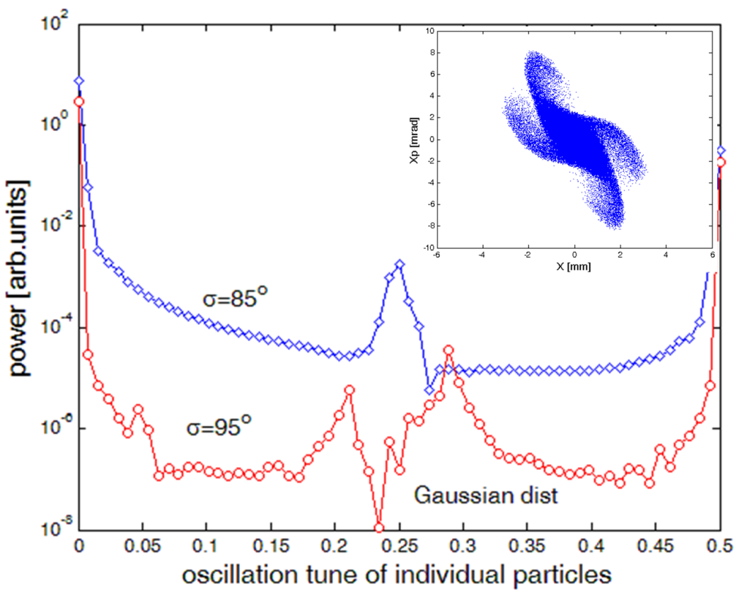
Appearance can be deceiving
Jeon, J Korean Phys Soc 72, 1523 (2018)
KV distribution
Gaussian dist.
σ_{o}=112°
σ=85°~93°
parametric instability
particle resonance
Resonance frequency is observed for the 4th order particle resonance.
Resonance frequency is not observed for the 4th order parametric instability.
For non-KV distributions, the 4th order particle resonance manifests.

Slide 17
Particle resonances dominate
over parametric instabilities

Slide 18
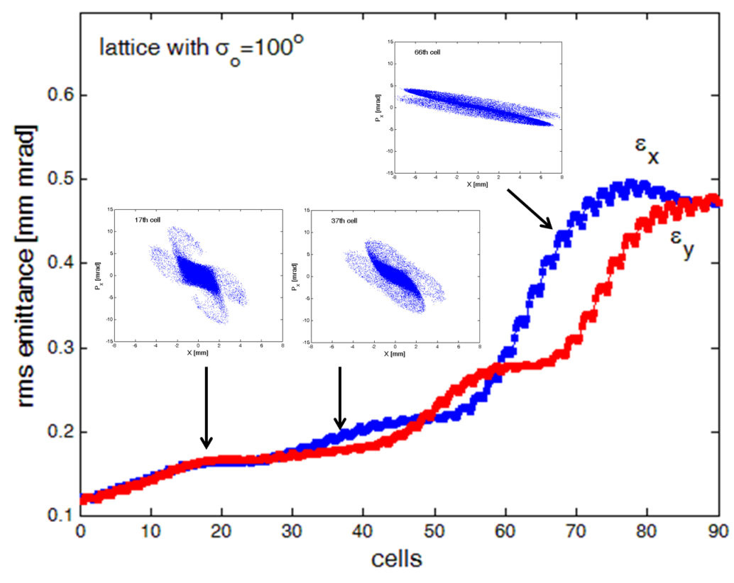
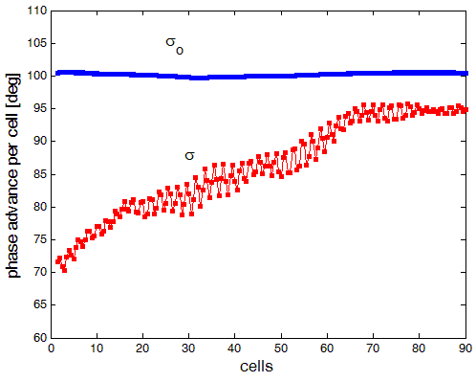
Envelope instability develops when particle resonance fades away
Jeon et al, NIM A 832, 43 (2016)
Gaussian dist.
lattice with σ_{o} = 100°
4th order resonance manifests first for well-matched non-KV distribution.
Envelope instability appears when 4th order resonance fades away (as σ increases and reaches 90°).
For fair comparison, the 4th order resonance should be maintained.

Slide 19
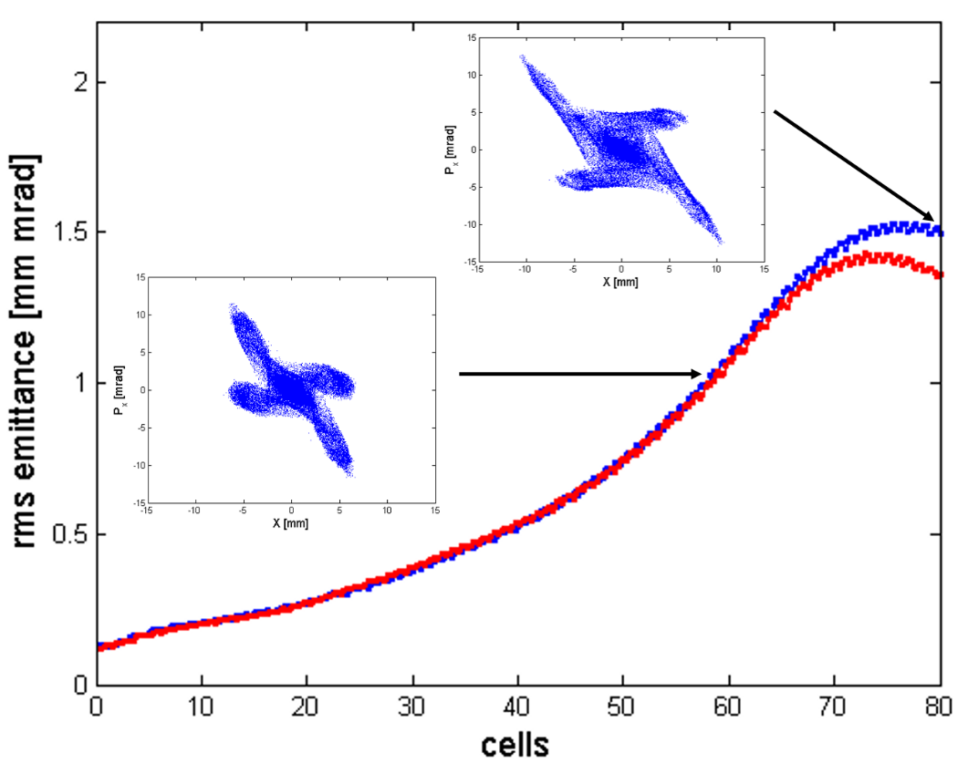
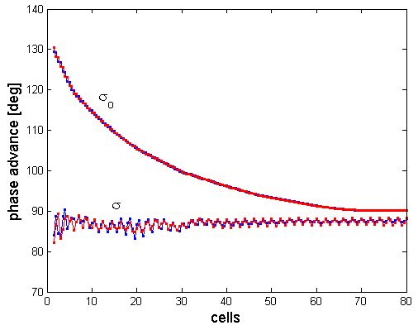
4th order particle resonance dominates over the envelope instability
linac with σ = 87°
Gaussian distribution
In a constant-σ linac, 4th order particle resonance dominates over the envelope instability (particle resonance is maintained).
Envelope instability is suppressed.
4th order particle resonance is the inevitable mechanism in σ_{o} > 90°.

Slide 20
4th order particle resonance dominates over the envelope instability
Gaussian distribution
In constant-σ linacs,
envelope instability is not observed.
well-matched 3D Gaussian input beam
(σ_{o} – σ)_{i}
(5~40 mA)
σ
4th order particle resonance dominates over envelope instability in the domain of particle resonance.

Slide 21
4th order particle resonance dominates over 4(σ_{o} – Δσ_{4,coh}) = 360° parametric instability
4σ = 360° particle resonance:
for non-KV distributions in (σ < 90° & σ_{o} > 90°);
verified by two experiments.
4(σ_{o} – Δσ_{4,coh}) = 360° parametric instability:
for KV distribution in σ < 90°;
does not manifest for non-KV distributions.
For non-KV distributions, 4σ = 360° particle resonance dominates over 4(σ_{o} – Δσ_{4,coh}) = 360° parametric instability.

Slide 22
6th order particle resonance dominates over 3(σ_{o} – Δσ_{3,coh}) = 360° parametric instability
6σ = 720° particle resonance:
for non-KV distributions in σ < 120°.
3(σ_{o} – Δσ_{3,coh}) = 360° parametric instability:
does not manifest for non-KV distributions.
For non-KV distributions, 6σ = 720° particle resonance dominates over 3(σ_{o} – Δσ_{3,coh}) = 360° parametric instability.

Slide 23
Parametric instabilities manifest away from particle resonances
3(σ_{o} – Δσ_{3,coh}) = 180° and 4(σ_{o} – Δσ_{4,coh}) = 180° parametric instabilities:
manifest at σ ~ 40° and at σ ~ 35° respectively;
away from 4σ = 360°, 6σ = 720° particle resonances;
for waterbag distribution, not for Gaussian distribution.
6σ = 360° particle resonance (in σ < 60°) is very weak:
too weak to affect parametric instabilities nearby;
practically non-existent for Gaussian distribution;
very weak for waterbag distribution.
Jeon et al, PRL 114, 184802 (2015)
Hofmann et al, PRAB 20, 014202 (2017)

Slide 24
Dominance of particle resonances for non-KV distribution
4(σ_{o}-Δσcoh)
=180º
instability
waterbag
3(σ_{o}-Δσcoh)
=180º
instability
waterbag
4th order
resonance
non-KV
6th order
resonance
non-KV
8th, 10th order
resonance
non-KV
σ=30°
σ=60°
σ=90°
σ=120°
σ=135°
4(σ_{o}-Δσcoh)
=180º
instability
KV
4(σ_{o}-Δσcoh)
=360º
instability
KV
envelope
instability
KV, non-KV
Particle resonances dominate over parametric instabilities in resonance stopbands for non-KV distributions.
Envelope instability is suppressed in a constant-σ linac.
Envelope instability manifests only when 4th order resonance fades away (as σ increases and reaches 90° in a constant-σ_{o} linac).

Slide 25
Operating the high-intensity linac
in σ_{o} > 90°

Slide 26
Operating in σ > 90° operating the linac in σ_{o} > 90°
4th order
resonance
6th order
resonance
σ_{o}=90°
σ=90°
σ=120°
σ_{o} > 90° region has been avoided due to the envelope instability.
But
No 4th order particle resonance in σ > 90°.
No envelope instability in σ > 90°.
6th order particle resonance is weak.
Operation in σ > 90° seems feasible.
Jeon et al, PRST-AB 12, 054204 (2009)
Li et al, PRST-AB 17, 124202 (2014)

Slide 27
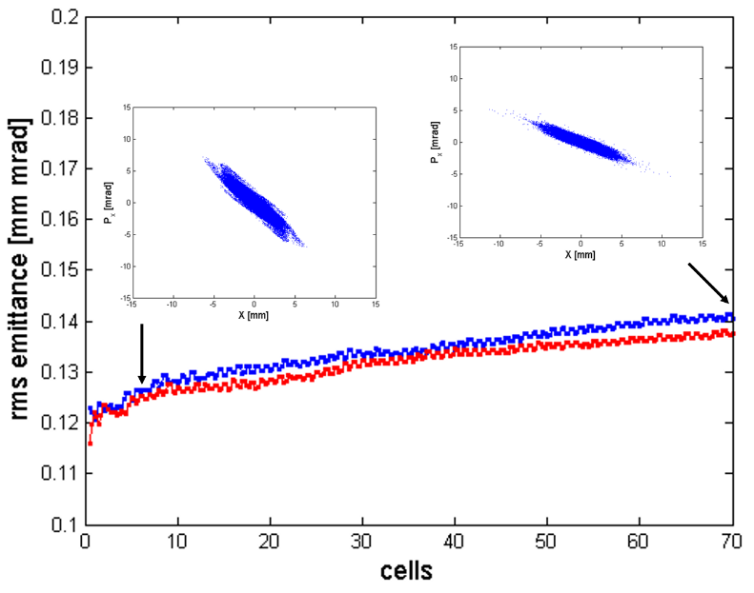
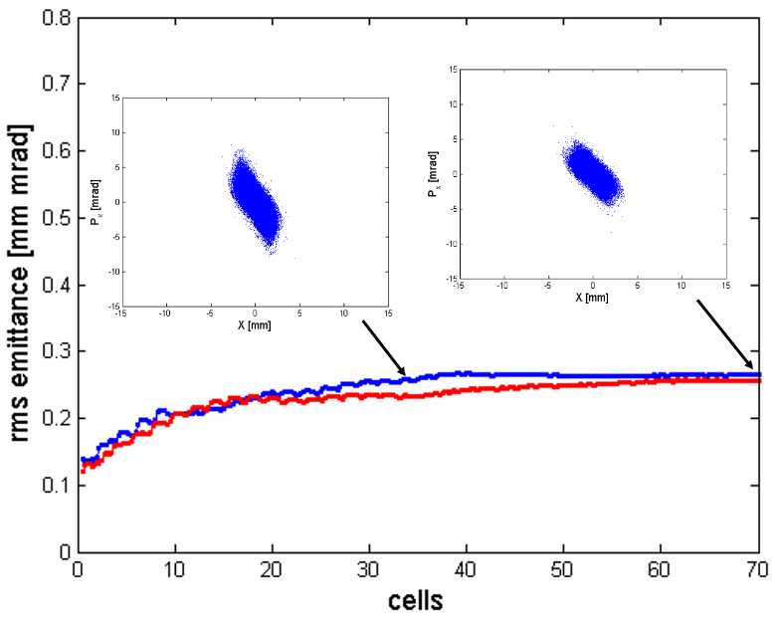
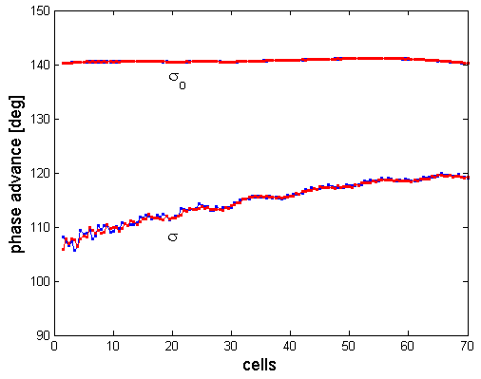
Operating in σ > 90° operating the linac in σ_{o} > 90°
constant-σ lattice (σ = 92°)
50 mA Gaussian distribution
Operation in σ > 90° is feasible:
avoids the 4th order particle resonance and the envelope instability completely,
emittance growth is minimal,
good when small beam size is needed.
constant-σ_{o} lattice (σ_{o} = 140°)
20 mA Gaussian distribution

Slide 28
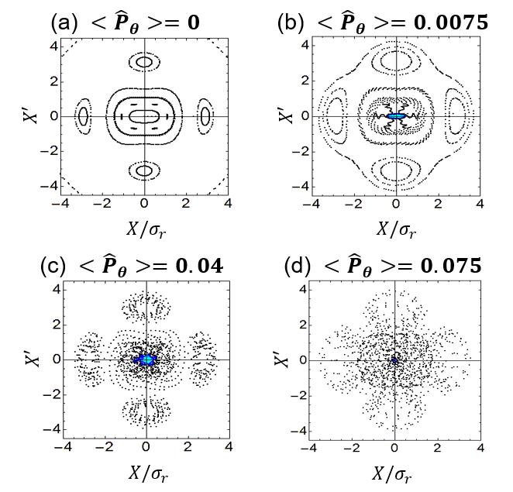
Beam Spinning operating the linac in σ_{o} > 90°
Beam spinning can mitigate the 4th order resonance & envelope instability.
As angular momentum <P_{θ}> increases, resonance island structures get blurred (through coupling).
→
Reduces emittance growth by the 4th order resonance and the envelope instability.
Cheon et al, NIM A 1013, 165647 (2021)
Cheon et al, PRAB 25, 064002 (2022)

Slide 29
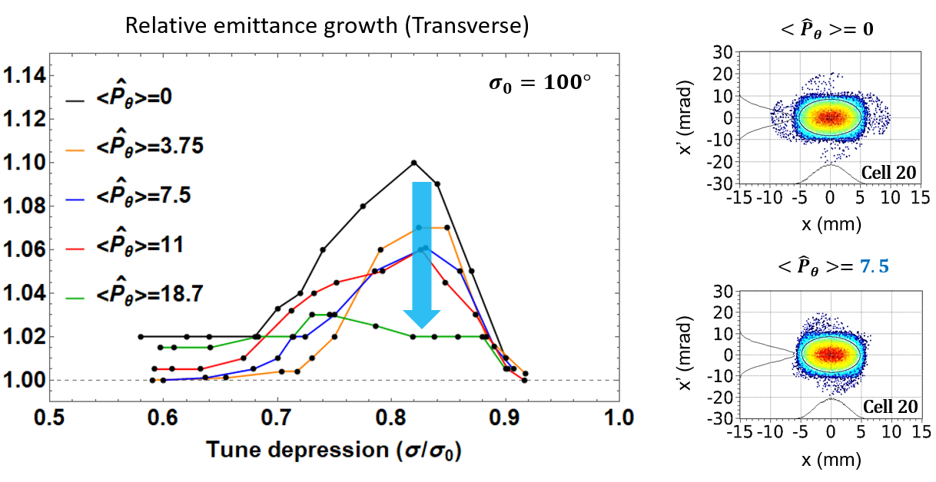
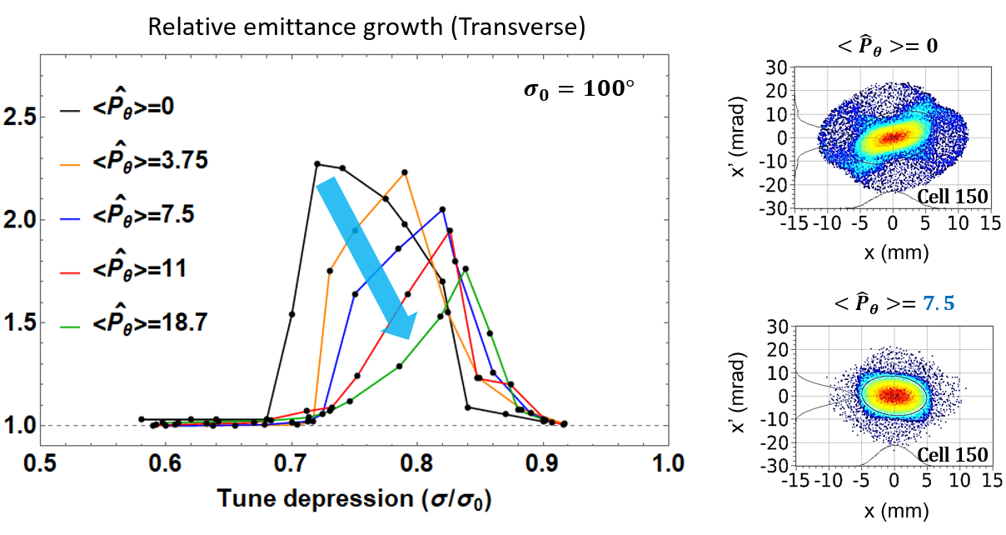
Beam Spinning operating the linac in σ_{o} > 90°
4th order resonance only
Beam spinning mitigates the 4th order resonance and envelope instability.
50 cells
4th order resonance + envelope instability
200 cells

Slide 30
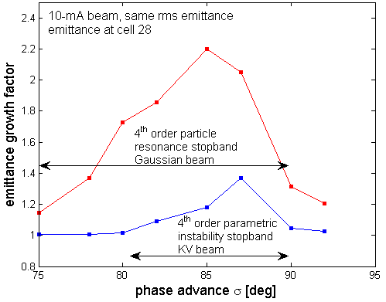
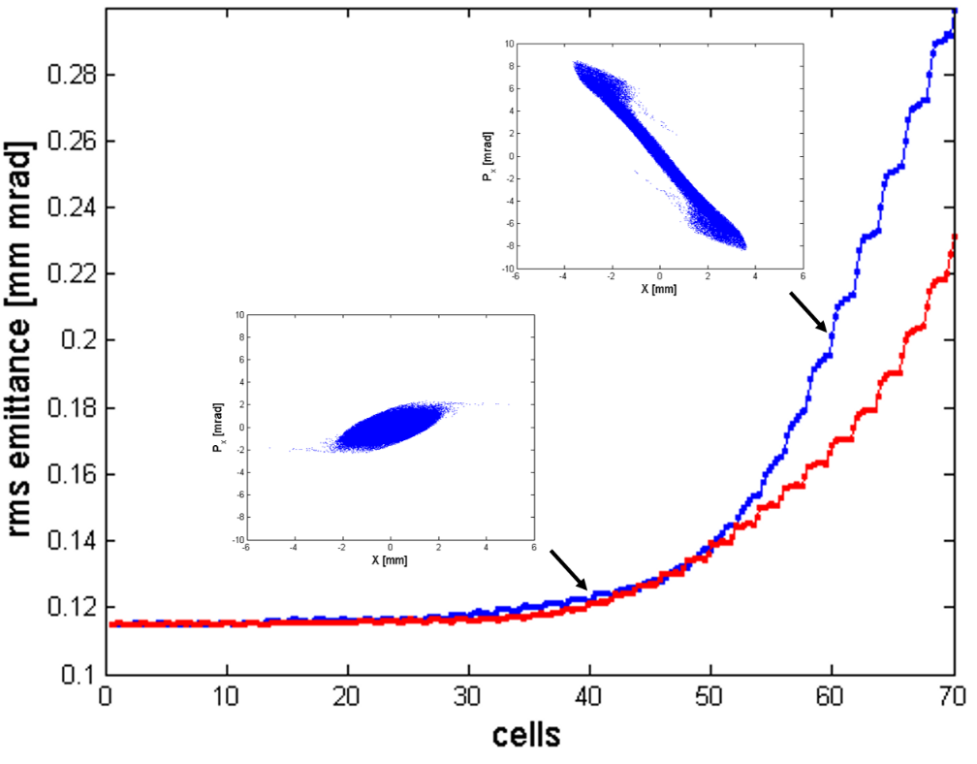
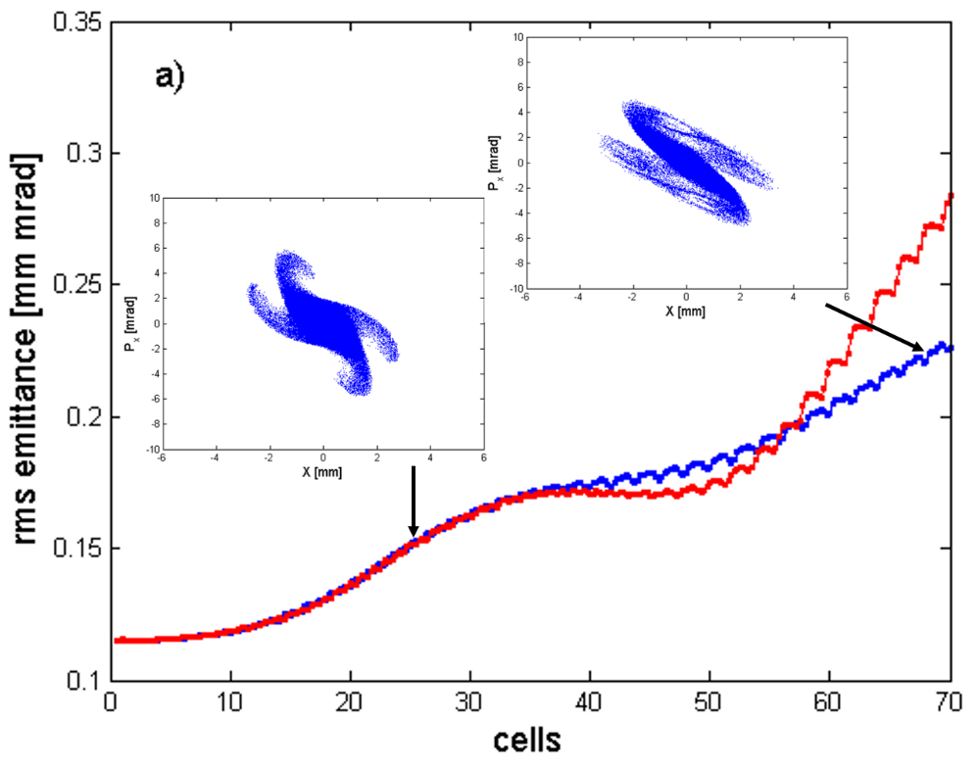
4th order instability and envelope instability
Inside stopband, 4th order instability appears first and envelope instability follows.
Outside stopband, envelope instability appears alone in σ=80° lattice.
Envelope instability is still induced in constant-σ lattices.
σ = 80° lattice
σ = 87° lattice

Slide 31
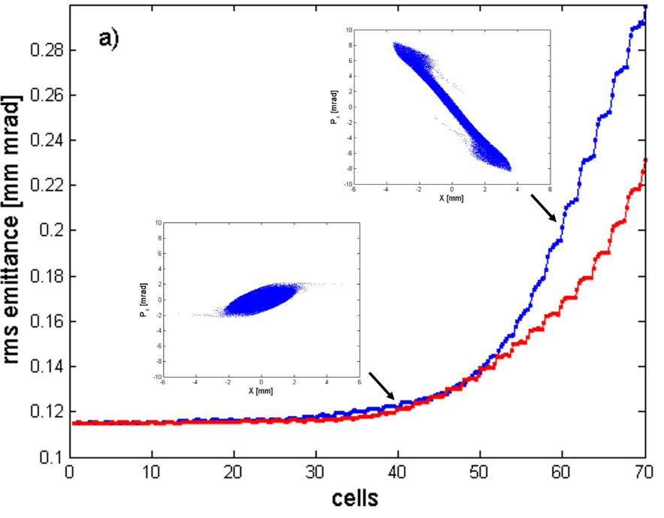

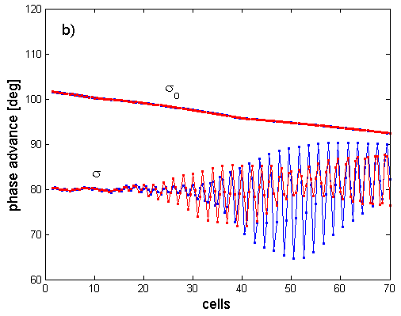
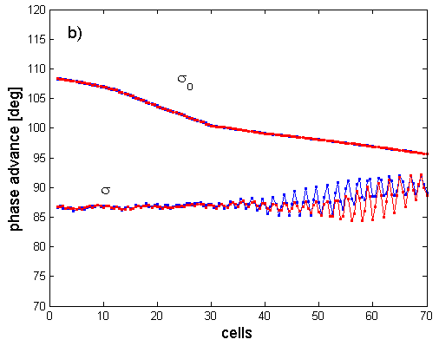
4th order instability and envelope instability
outside
stopband
inside
stopband
σ = 80° lattice
σ = 87° lattice

Slide 32
Mitigation of envelope instability
Operating the linac in σ > 90° avoids the 4th order resonance and the envelope instability.
Adopting constant-σ linac in σ < 90° suppresses the envelope instability (for non-KV distributions).
Beam spinning mitigates the 4th order resonance and the envelope instability in σ < 90°.
Fast acceleration mitigates the envelope instability.
Jeon et al, NIM A 832, 43 (2016)
Cheon et al, PRAB 25, 064002 (2022)
Qiang, PRAB 21, 114201 (2018)

Slide 33
Conclusion
Jeon et al, NIM A 1062, 169230 (2024)
Particle resonances dominate over parametric instabilities in their stopbands.
Parametric instabilities can be disregarded in actual linacs due to Landau damping except for the envelope instability.
Even the envelope instability can be suppressed when constant-σ lattices are used.
Operating linacs in σ > 90° avoids the 4th order particle resonance and the envelope instability.
The envelope instability can be suppressed or mitigated by:
operating the linac in σ > 90°;
operating the constant-σ linac in σ < 90°;
beam spinning;
fast acceleration.

Slide 34
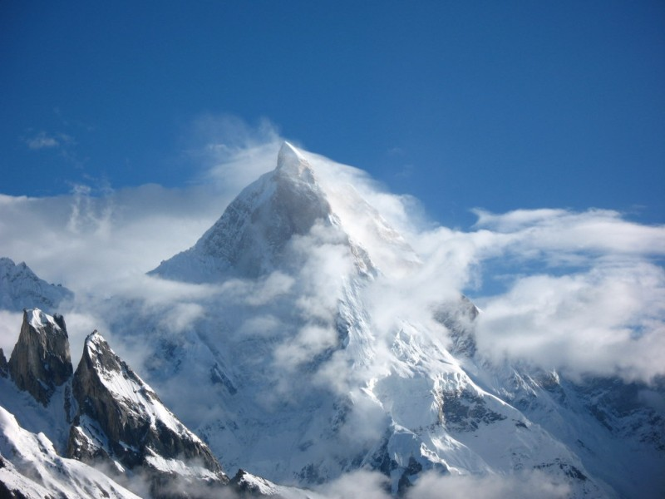
Thank you for your attention!
감사합니다

Slide 35
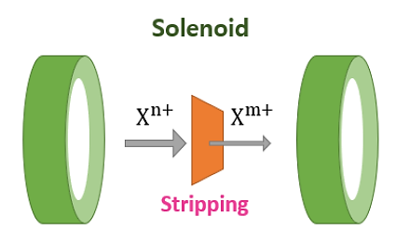
Generating beam spinning
GSI UNILAC : EMTEX -> Flat beam injection to synchrotron
PRAB 14, 064201, L. Groening (2011)
PRAB 16, 044201, C. Xiao, et al. (2013)
PRL 113, 264802, L. Groening, et al. (2014)
PRL 117, 224801, M. Chung, et al. (2016)
Medium energy beam transport (MEBT)
Stripping inside a solenoid
$$H^{−}\left(or D^{−}\right)$$
Non-spinning
$$H^{+}(or D^{+})$$
Spinning
Main linac

Slide 36
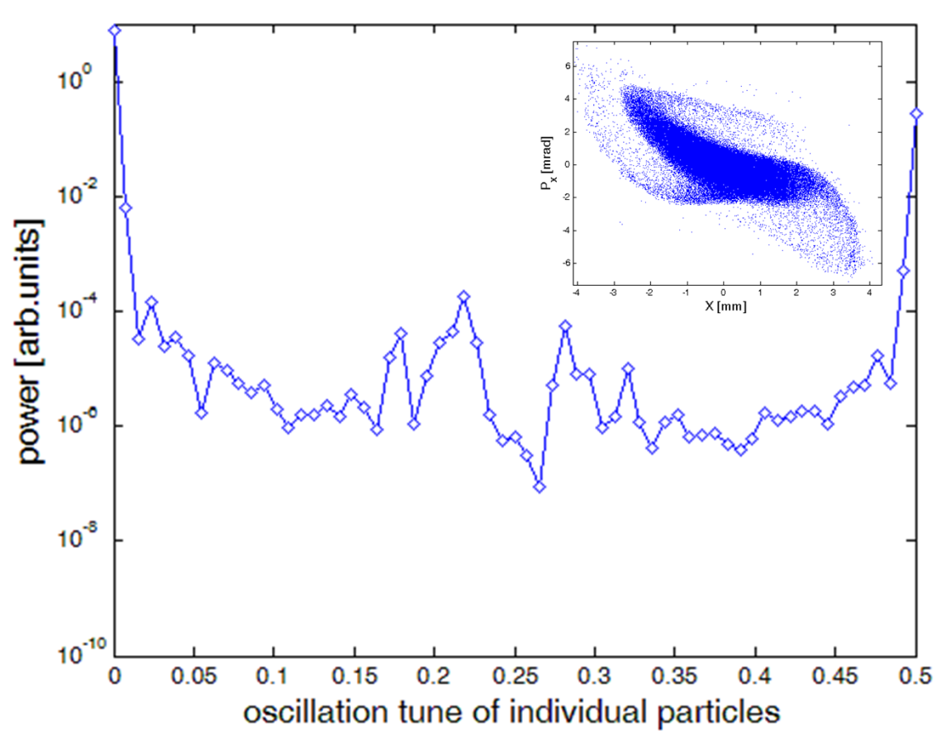
3rd order parametric instability in high intensity linear accelerators
Jeon et al, NIM A 832, 43 (2016)
waterbag distribution
1/6
1/3
σ_{o}=92°, σ=40° (90 mA beam)
3(σ_{o} – Δσ_{3,coh}) = 180° third order instability for a constant-σ_{o} lattice.
Observed for KV and waterbag distributions, but not for Gaussian distribution.
Not a particle resonance: no resonance peaks around 1/3 or 1/6 in the FFT spectrum.
Arises away from the 4th order particle resonance
Not always arises (out of noise).

Slide 37
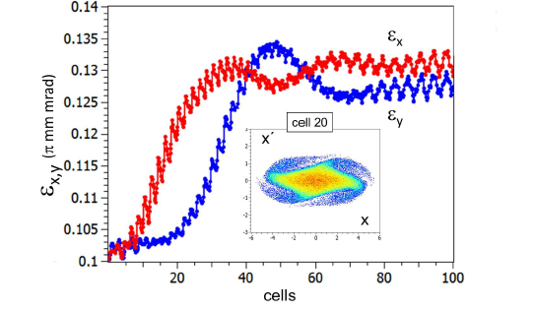
4th order parametric instability in high intensity linear accelerators
Courtesy of Haber and Maschke,
PRL 42, 1479 (1979)
KV dist.
σ_{o} = 90° and σ = 30°
Courtesy of Hofmann
PRAB 20, 014202 (2017)
waterbag dist.
σ_{o} = 70° and σ = 35°
4(σ_{o} – Δσ_{4,coh}) = 180° instability
Observed for KV and waterbag beams, not for Gaussian beams.
Arises away from the 4th order particle resonance.

Slide 38

4th order parametric instability in high intensity linear accelerators
Jeon, J Korean Phys Soc 72, 1523 (2018)
σ_{o}=112°, σ=85°
KV dist.
1/4
4(σ_{o} – Δσ_{4,coh}) = 360° instability.
Observed only for KV distributions when σ is near 90°.
Not a particle resonance: no resonance peak around 1/4 in the FFT spectrum.

Slide 39
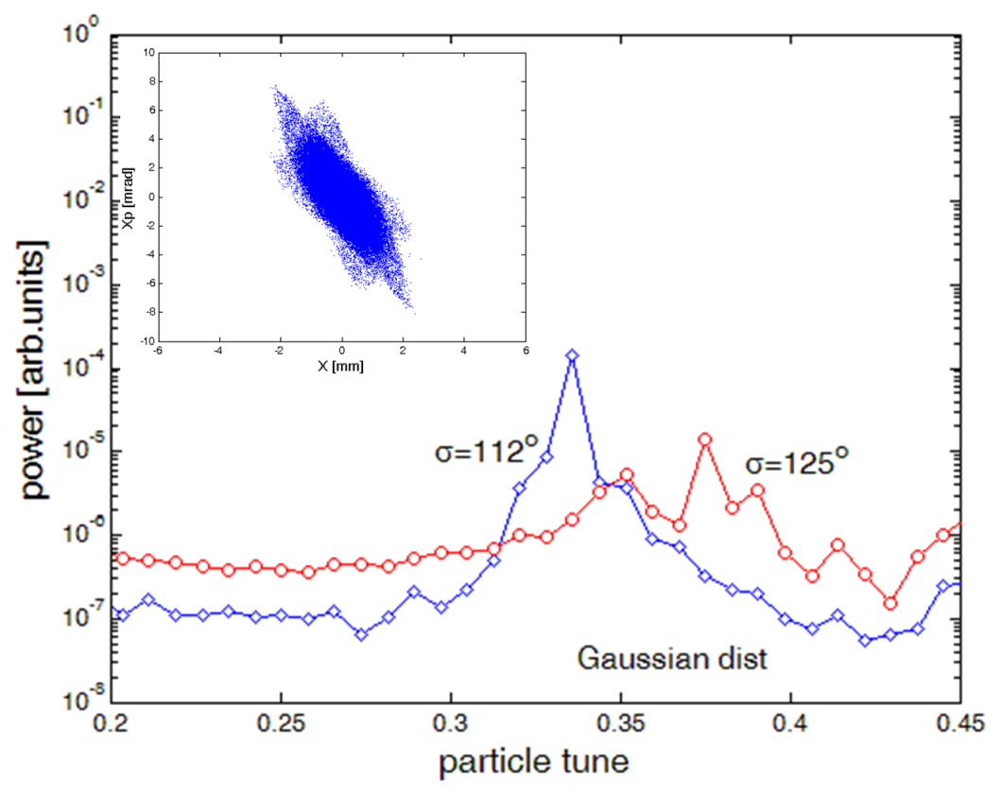
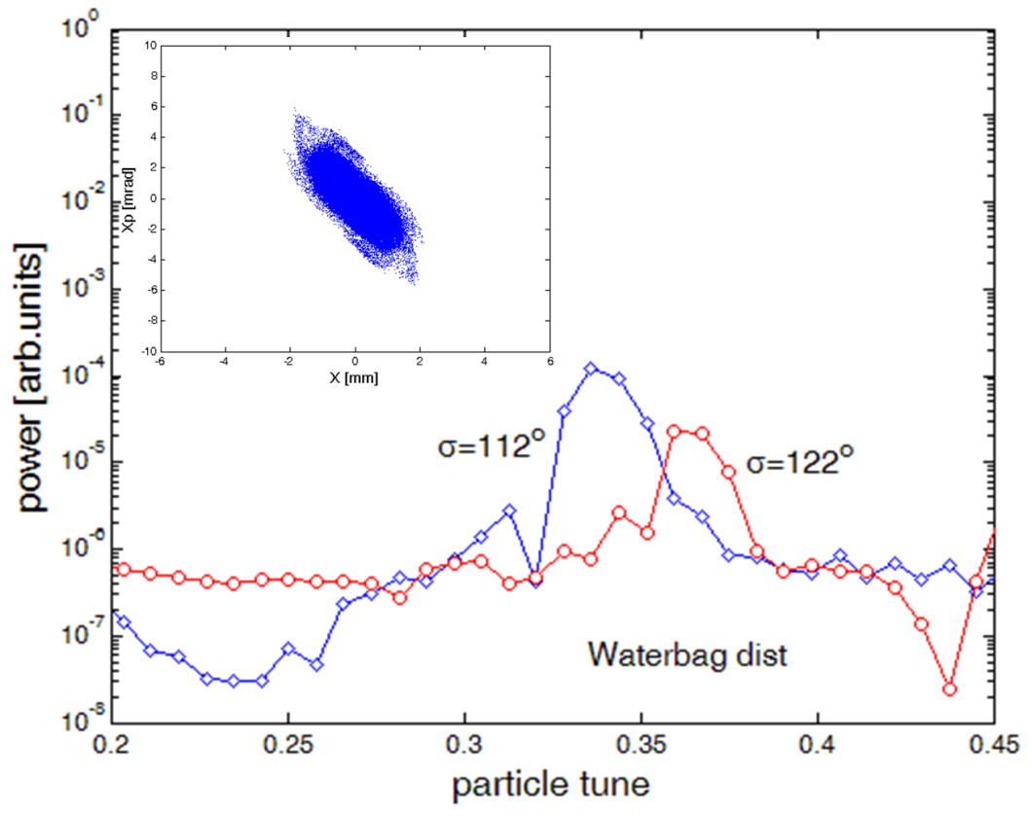
6th order particle resonance in high intensity linear accelerators
Jeon, J Korean Phys Soc 72, 1523 (2018)
Gaussian dist.
waterbag dist.
6th order resonance
10 mA Gaussian beam
6th order resonance
20 mA waterbag beam
Resonance frequency peak at 1/3 for lattice σ < 120° for non-KV beams.
No resonance effect for σ > 120°.

