Slide 1
Interplay of Space Charge, Intrabeam Scattering, and Synchrotron Radiation in the CLIC Damping Rings
M. Zampetakis
F. Antoniou, F. Asvesta, H. Bartosik, Y. Papaphilippou
6th ICFA Mini-Workshop on Space Charge
Dong Guan, China, 11-13 September 2024
michail.zampetakis@cern.ch

Slide 2
Overview
Introduction
The Compact Linear Collider complex
The CLIC damping rings
Incoherent effects
Synchrotron Radiation
Intrabeam Scattering
Space charge
Interplay Studies
Space Charge investigation
Space Charge studies with Intrabeam Scattering
Space Charge studies with Intrabeam Scattering and Synchrotron Radiation
Studies for the CLIC DRs full cycle
Ideal case
Resonance tolerances
Conclusions

Slide 3
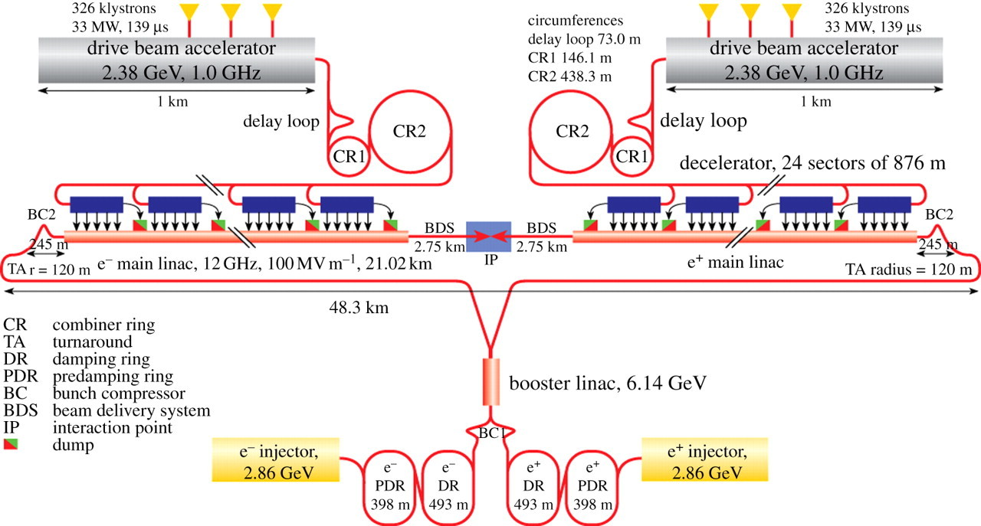
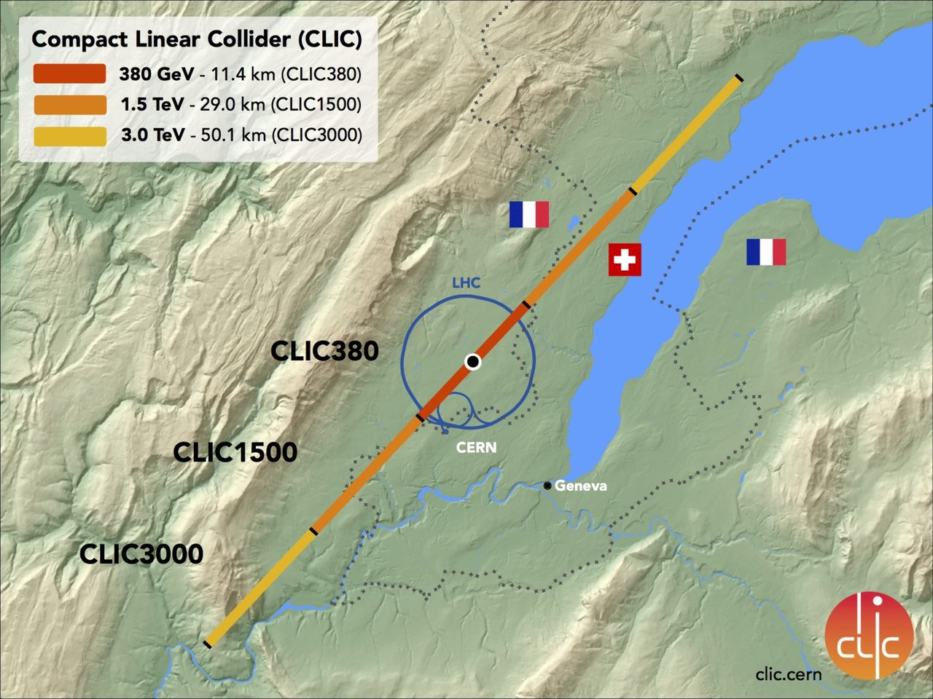
The Compact Linear Collider complex
The Compact LInear Collider (CLIC) [1] is a positron-electron collider, intended to be built and operated in three stages:
Site length of 11 km, 29 km and 50 km
Collision energies of 380 GeV, 1.5 TeV and 3 TeV
Luminosity target of $ℒ≈{10}^{34} {cm}^{−2}s^{−1}$
$$ℒ=ℋ_{D}\frac{N^{2}}{4πσ_{x}σ_{y}}n_{b}f_{r}$$
$ℋ_{D}$: | Correction factor
$N$: | # of particles/bunch
$n_{b}$: | # of bunches/beam pulse
$f_{r}$: | repetition frequency of the beam pulses
$σ_{x,y}$: | RMS beam sizes
Need for ultra-low emittances!!!

Slide 4
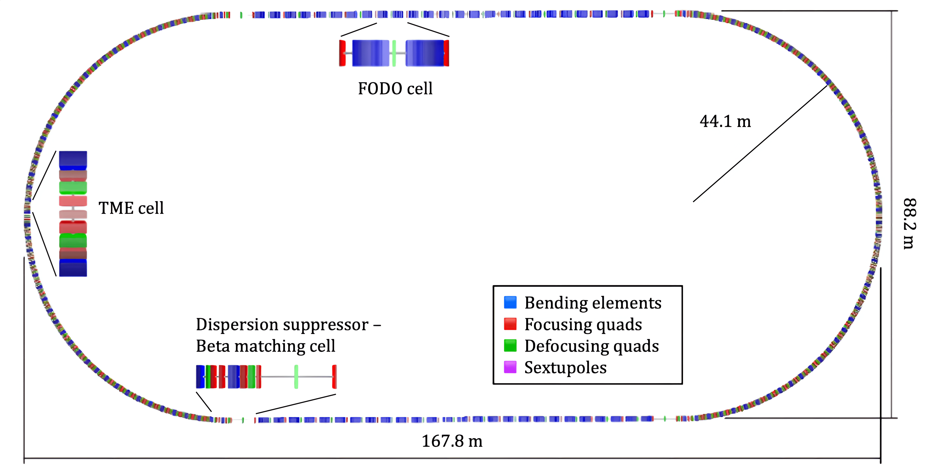
The CLIC Damping Rings
Purpose of the CLIC Damping Rings (DRs)[2]:
Damp the transverse emittances by two orders of magnitude within a repetition rate of 50 Hz
The natural equilibrium emittance is defined by Synchrotron Radiation (SR) and Quantum Excitation (QE)
The steady state emittance is dominated by Intrabeam Scattering (IBS)
In such ultra-low emittance requirements, the performance can be further limited by:
Magnet non-linearities, errors from variable bends and wigglers
Interplay with other incoherent effects such as Space Charge
Goals:
Investigate how SC affects the emittances in the vicinity of an excited, vertical resonance at steady state
Investigate the interplay of SC and IBS
Does SR mitigate the interplay of SC and IBS?
What is the impact of an excited, vertical resonance on the full cycle of the CLIC DRs?
 | Injection | Steady State without/with IBS
$$ε_{x}^{geom} [pm]$$ | $$9.63∙{10}^{3}$$ | $$55.7/103$$
$$ε_{y}^{geom} [pm]$$ | $$268$$ | $$0.59/0.68$$
$$σ_{z} [mm]$$ | $$3.2$$ | $$1.46/1.56$$
$$σ_{δ}$$ | $$1.04$$ | $$1.09/1.16$$

Slide 5
Overview
Introduction
The Compact Linear Collider complex
The CLIC damping rings
Incoherent effects
Synchrotron Radiation
Intrabeam Scattering
Space charge
Interplay Studies
Space Charge investigation
Space Charge studies with Intrabeam Scattering
Space Charge studies with Intrabeam Scattering and Synchrotron Radiation
Studies for the CLIC DRs full cycle
Ideal case
Resonance tolerances
Conclusions

Slide 6
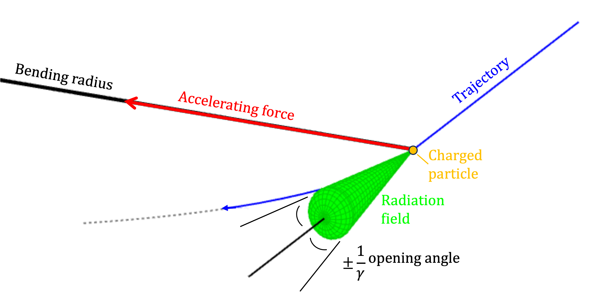
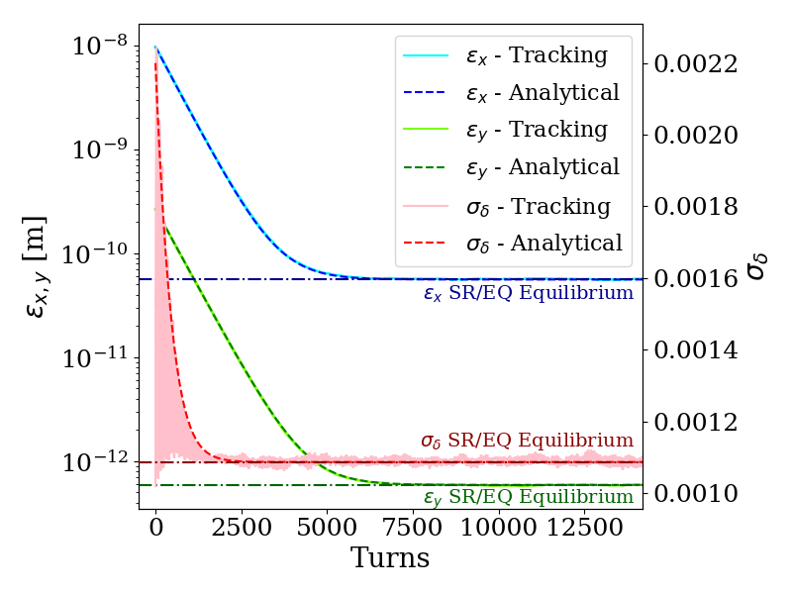
Synchrotron Radiation
Synchrotron Radiation:
Spontaneous photon emission ⇒ Emittances are damped
Non-zero equilibrium due to Quantum Excitation
Implemented in the PyORBIT macroparticle tracking code using a momentum “kick” in each plane [3]:
Transverse planes:
$$p_{u}\left(t+dt\right)=p_{u}\left(t\right)−\frac{2p_{u}\left(t\right)}{τ_{u}}+2σ_{p_{u}}^{EQ}\sqrt{\frac{1}{τ_{u}}}∙R$$
Longitudinal plane:
$$p_{s}\left(t+dt\right)=p_{s}\left(t\right)−\frac{2p_{s}\left(t\right)}{τ_{s}}+2σ_{δ}^{EQ}\sqrt{\frac{1}{τ_{s}}}∙R − \frac{U_{0}}{E_{total}β_{rel}^{2}}$$
Benchmarking
SR
QE
Energy loss
$σ_{p_{u},δ}^{EQ}$: Eq. beam sizes
${ τ}_{i}$: Damping times
${ U}_{0}$: En. Losses/turn
$R$: Random numbers
Perfect agreement against analytical calculations!

Slide 7
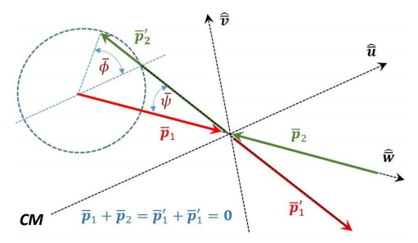
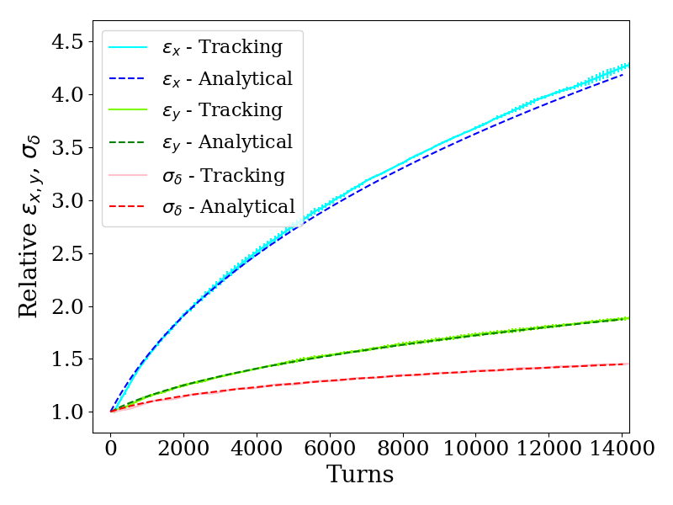
Intrabeam Scattering
Intrabeam Scattering:
Multiple small-angle scattering ⇒ Emittance growth
Limits the performance of damping rings/light sources
Depends on the beam parameters and the optics of the ring
Implemented in the PyORBIT macroparticle tracking code using a momentum “kick” in each plane [3]:
$${Δp}_{u}=R∙σ_{p_{u}}\sqrt{2T_{IBS,u}^{−1}T_{rev}(2σ_{z}\sqrt{π}λ\left(z\right))}$$
The IBS growth rates are calculated every 50 turns, using Nagaitsev’s method [4]
Benchmarking
$R$: Random numbers
${ σ}_{p_{u}}$: RMS momenta
$T_{IBS}^{−1}$: IBS growth rates
$T_{rev}$: Revolution period
${ σ}_{z}$: Bunch length
$λ\left(z\right)$: Norm. long. Line dens.
Perfect agreement against analytical calculations!

Slide 8
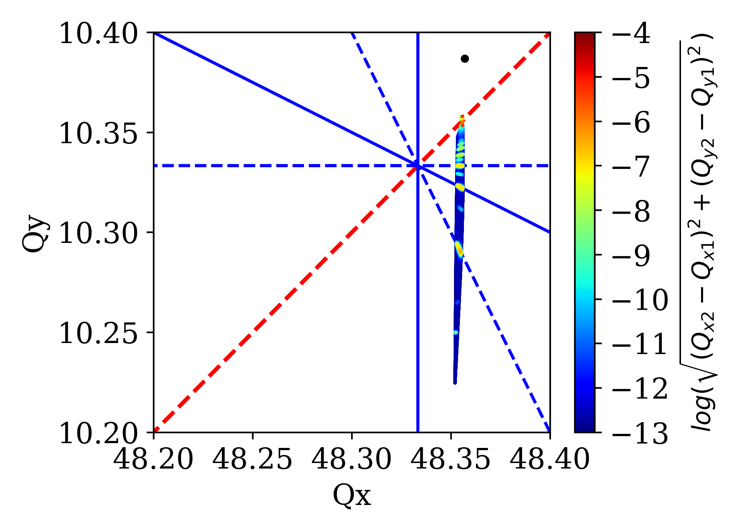
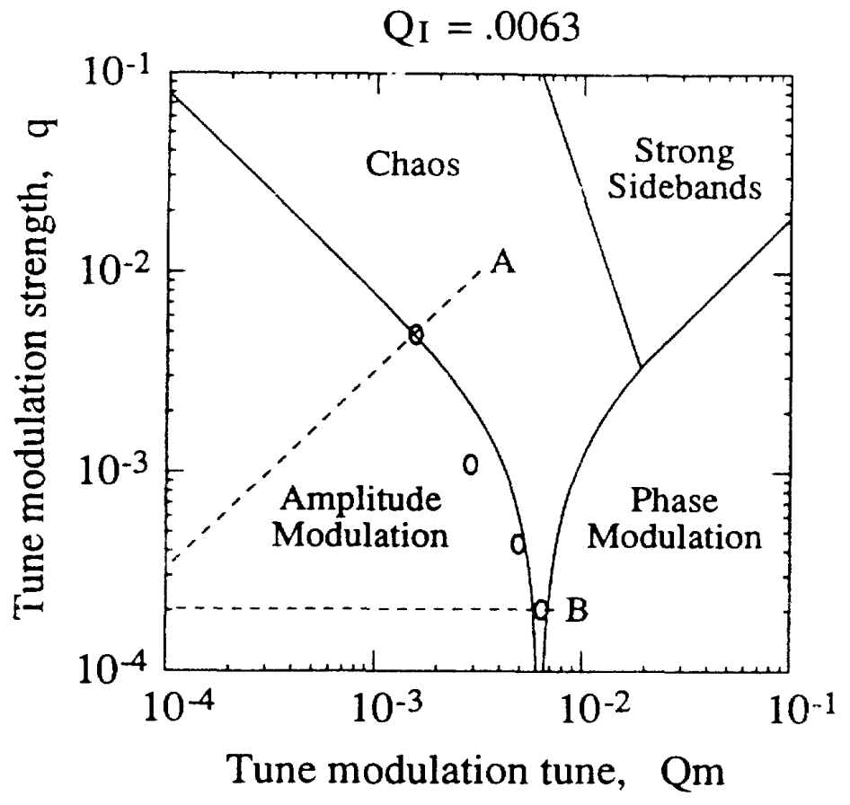
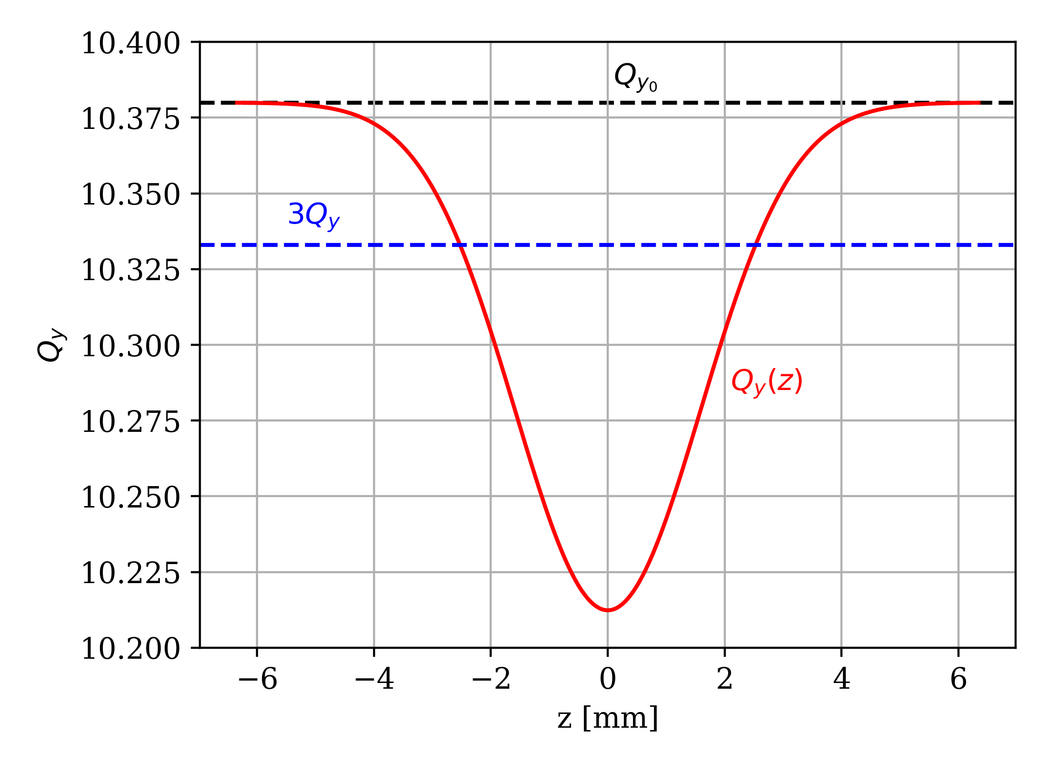
Space Charge
Space Charge:
Induces an incoherent tune spread in the transverse planes
Particles can cross resonances leading to emittance blow-up or particle losses
The tune spread scales with energy $\left(1/{γ^{3}}\right)$ and the beam sizes
*The adaptive “frozen” SC potential module of PyORBIT was used
$$Q_{y}$$
log
The SC-induced tune shift is modulated at even multiples of the synchrotron tune $Q_{s}$ [5]
$$Q_{x}$$
Slow synchrotron motion: Usual particle scattering on the resonance islands
⇒ Strong particle diffusion
Fast synchrotron motion: Resonance sidebands
⇒ Weak particle diffusion

Slide 9
Overview
Introduction
The Compact Linear Collider complex
The CLIC damping rings
Incoherent effects
Synchrotron Radiation
Intrabeam Scattering
Space charge
Interplay Studies
Space Charge investigation
Space Charge studies with Intrabeam Scattering
Space Charge studies with Intrabeam Scattering and Synchrotron Radiation
Studies for the CLIC DRs full cycle
Ideal case
Resonance tolerances
Conclusions

Slide 10
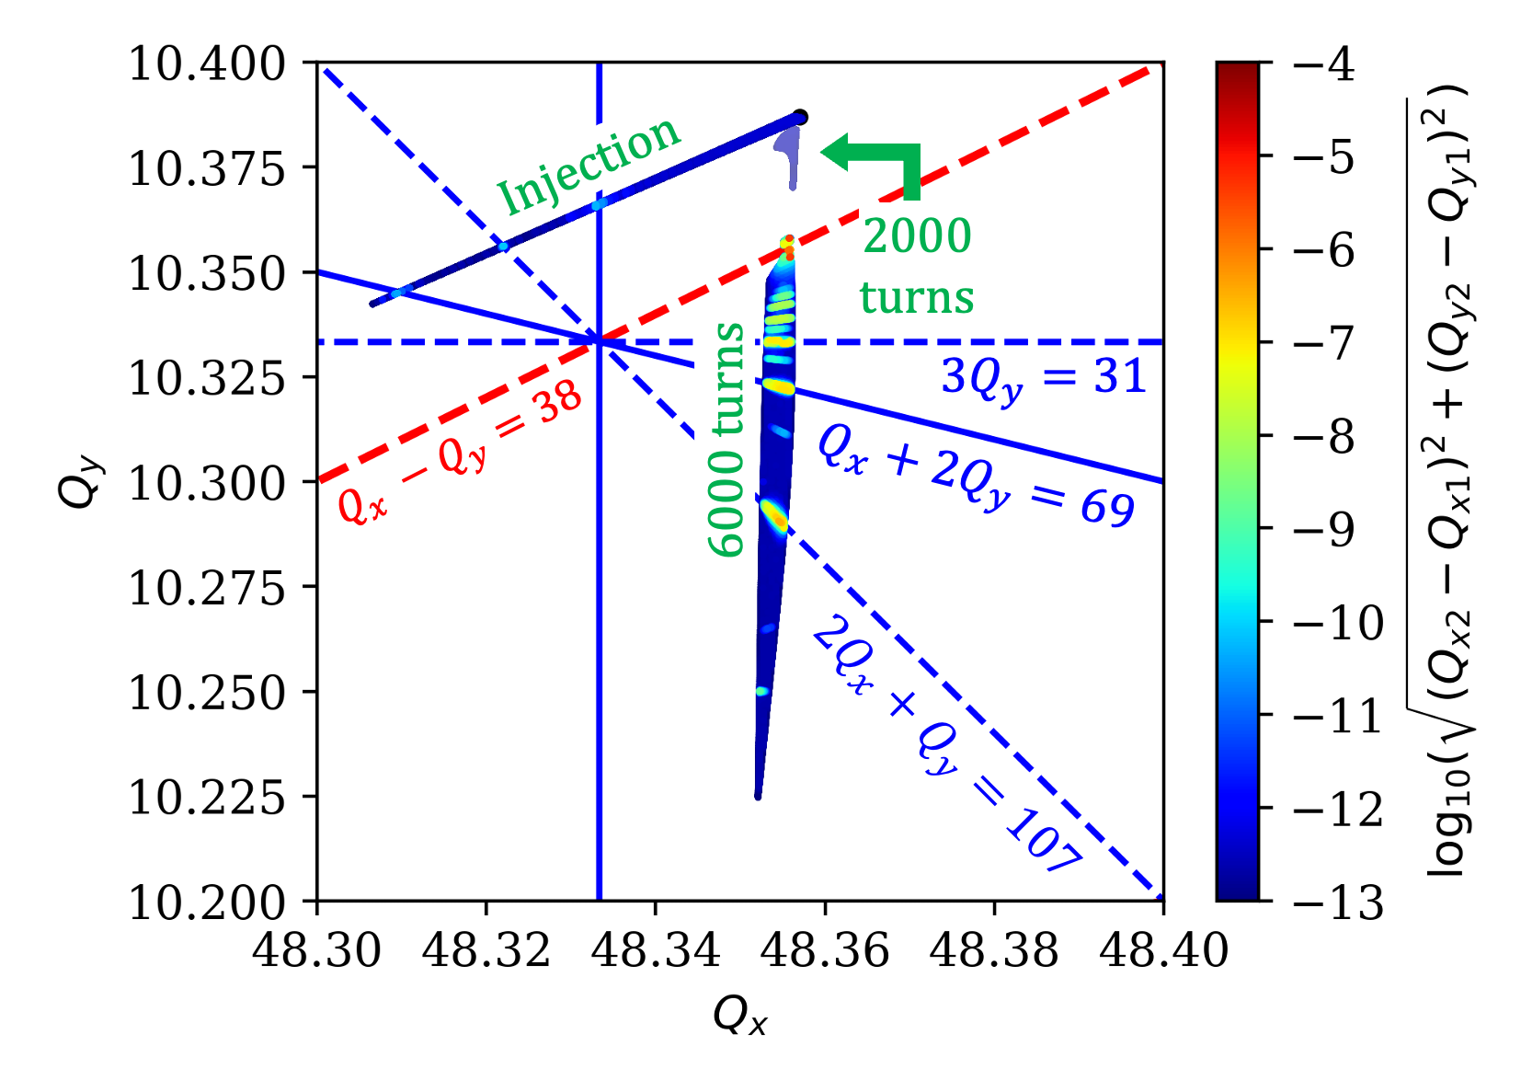
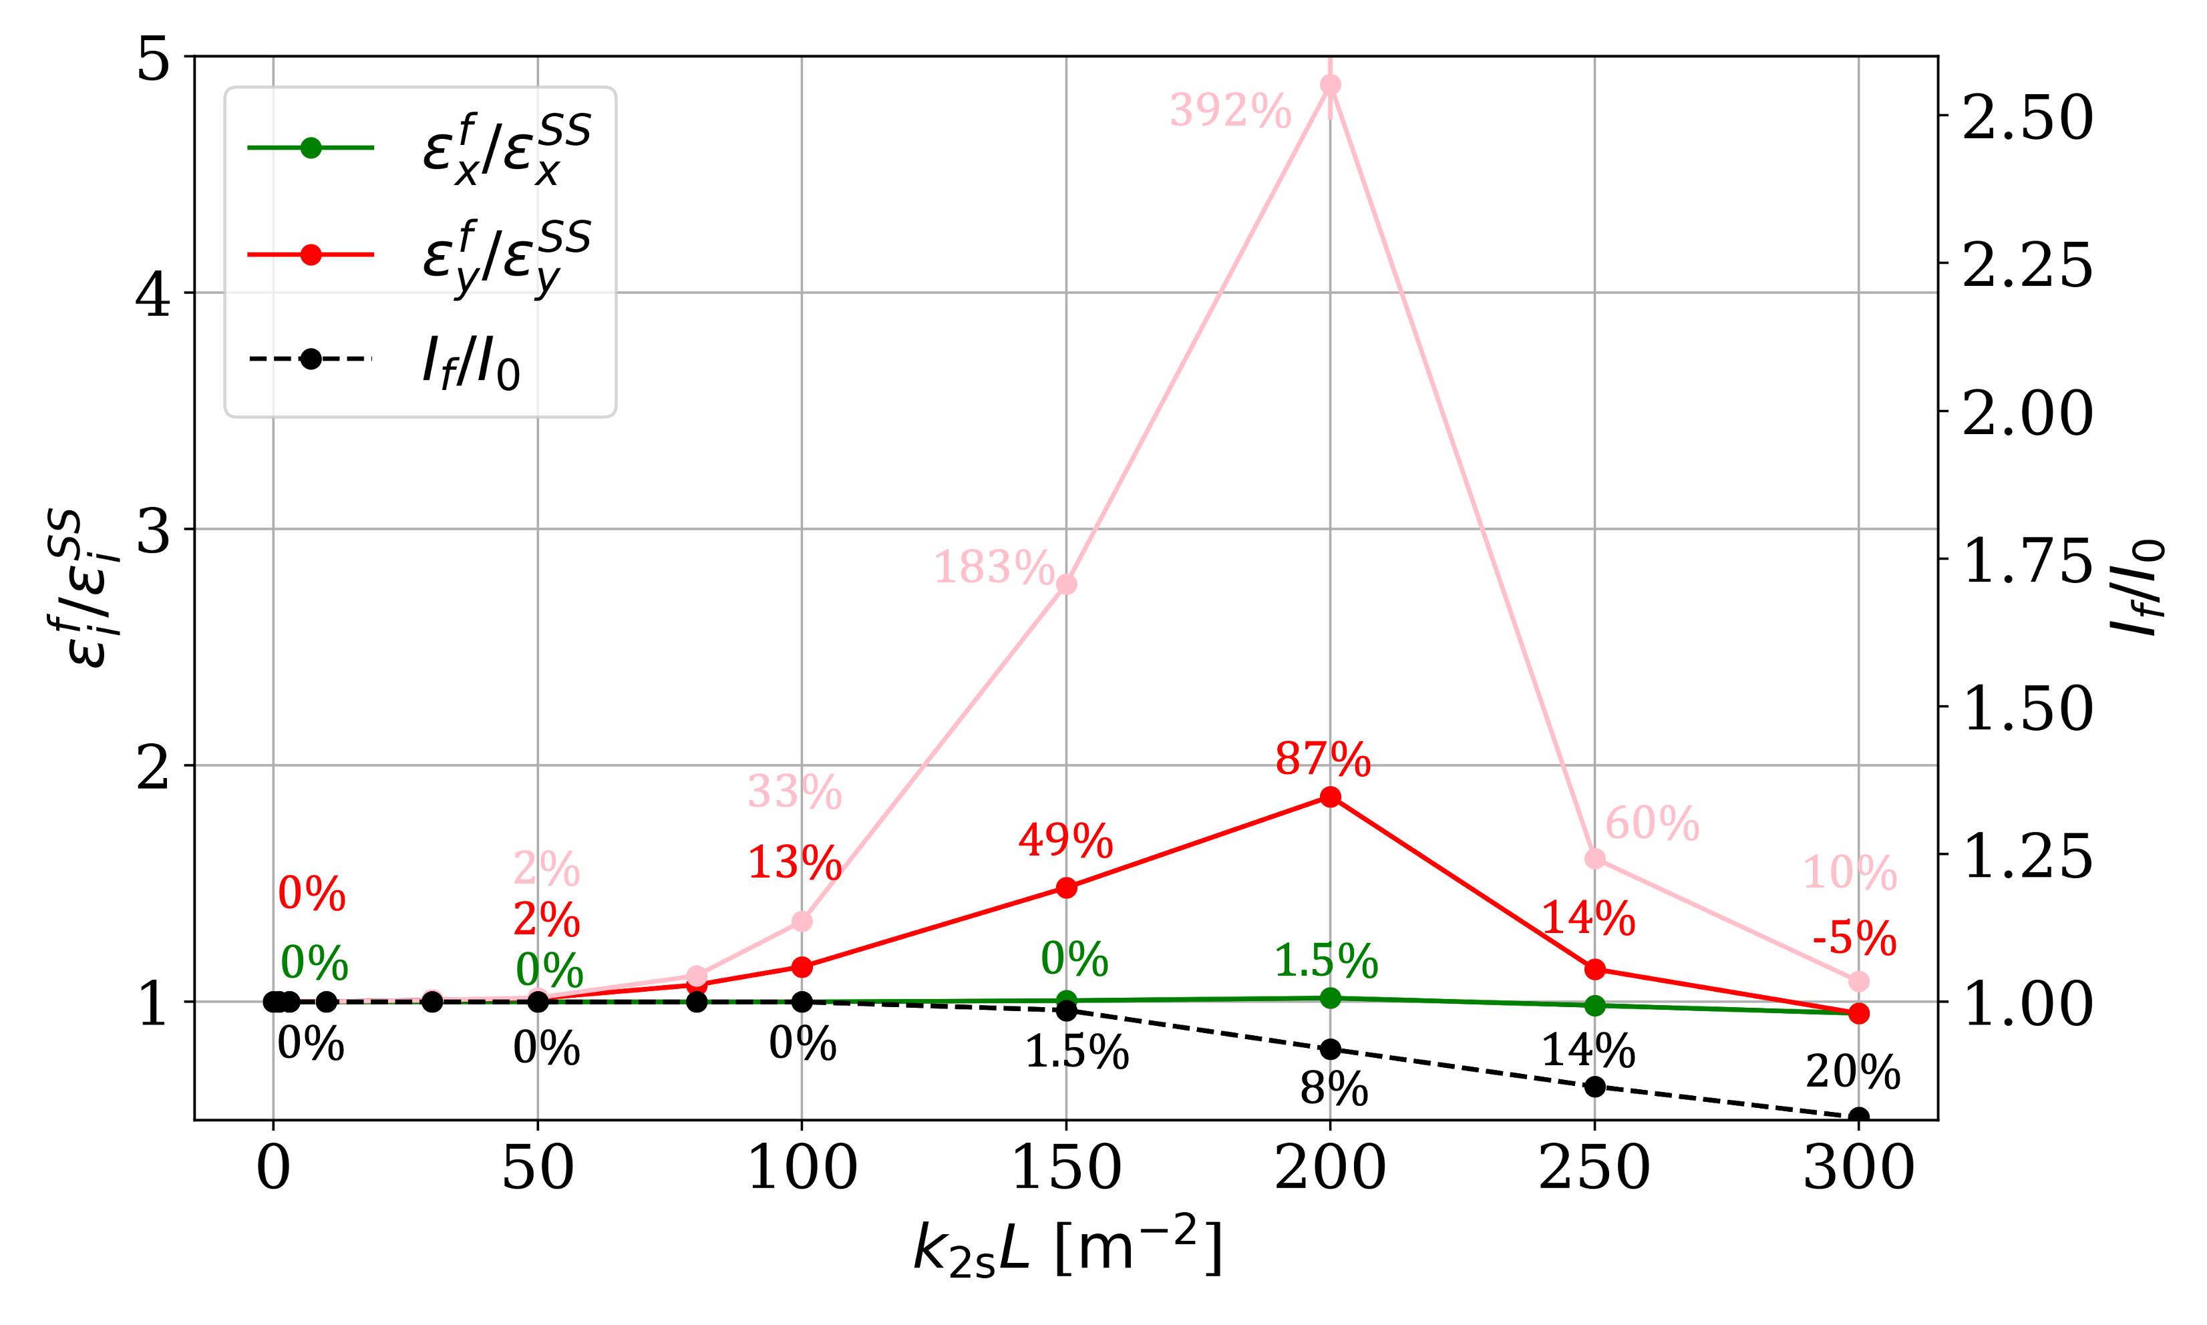
Tune spread evolution in the CLIC DRs
*Bare machine working point $\left(Q_{x},Q_{y}\right)=\left(48.357, 10.387\right)$
Three main regimes are observed:
Injection:
Large emittances + Strong sextupoles ⇒ Detuning by amplitude
After 1 damping time:
Amplitude detuning is decreasing
Extraction/Steady state:
SC is dominant ⇒ A large vertical tune spread is induced
*$k_{2s}L s$can for $\left(Q_{x},Q_{y}\right)=\left(48.39, 10.35\right)$
Many resonances can affect the performance of the CLIC DRs
The ${3Q}_{y}=31$ was chosen
To excite it, two skew sextupolar errors were added
⇒ Integrated normalized strength $k_{2s}L=100 m^{−2}$

Slide 11
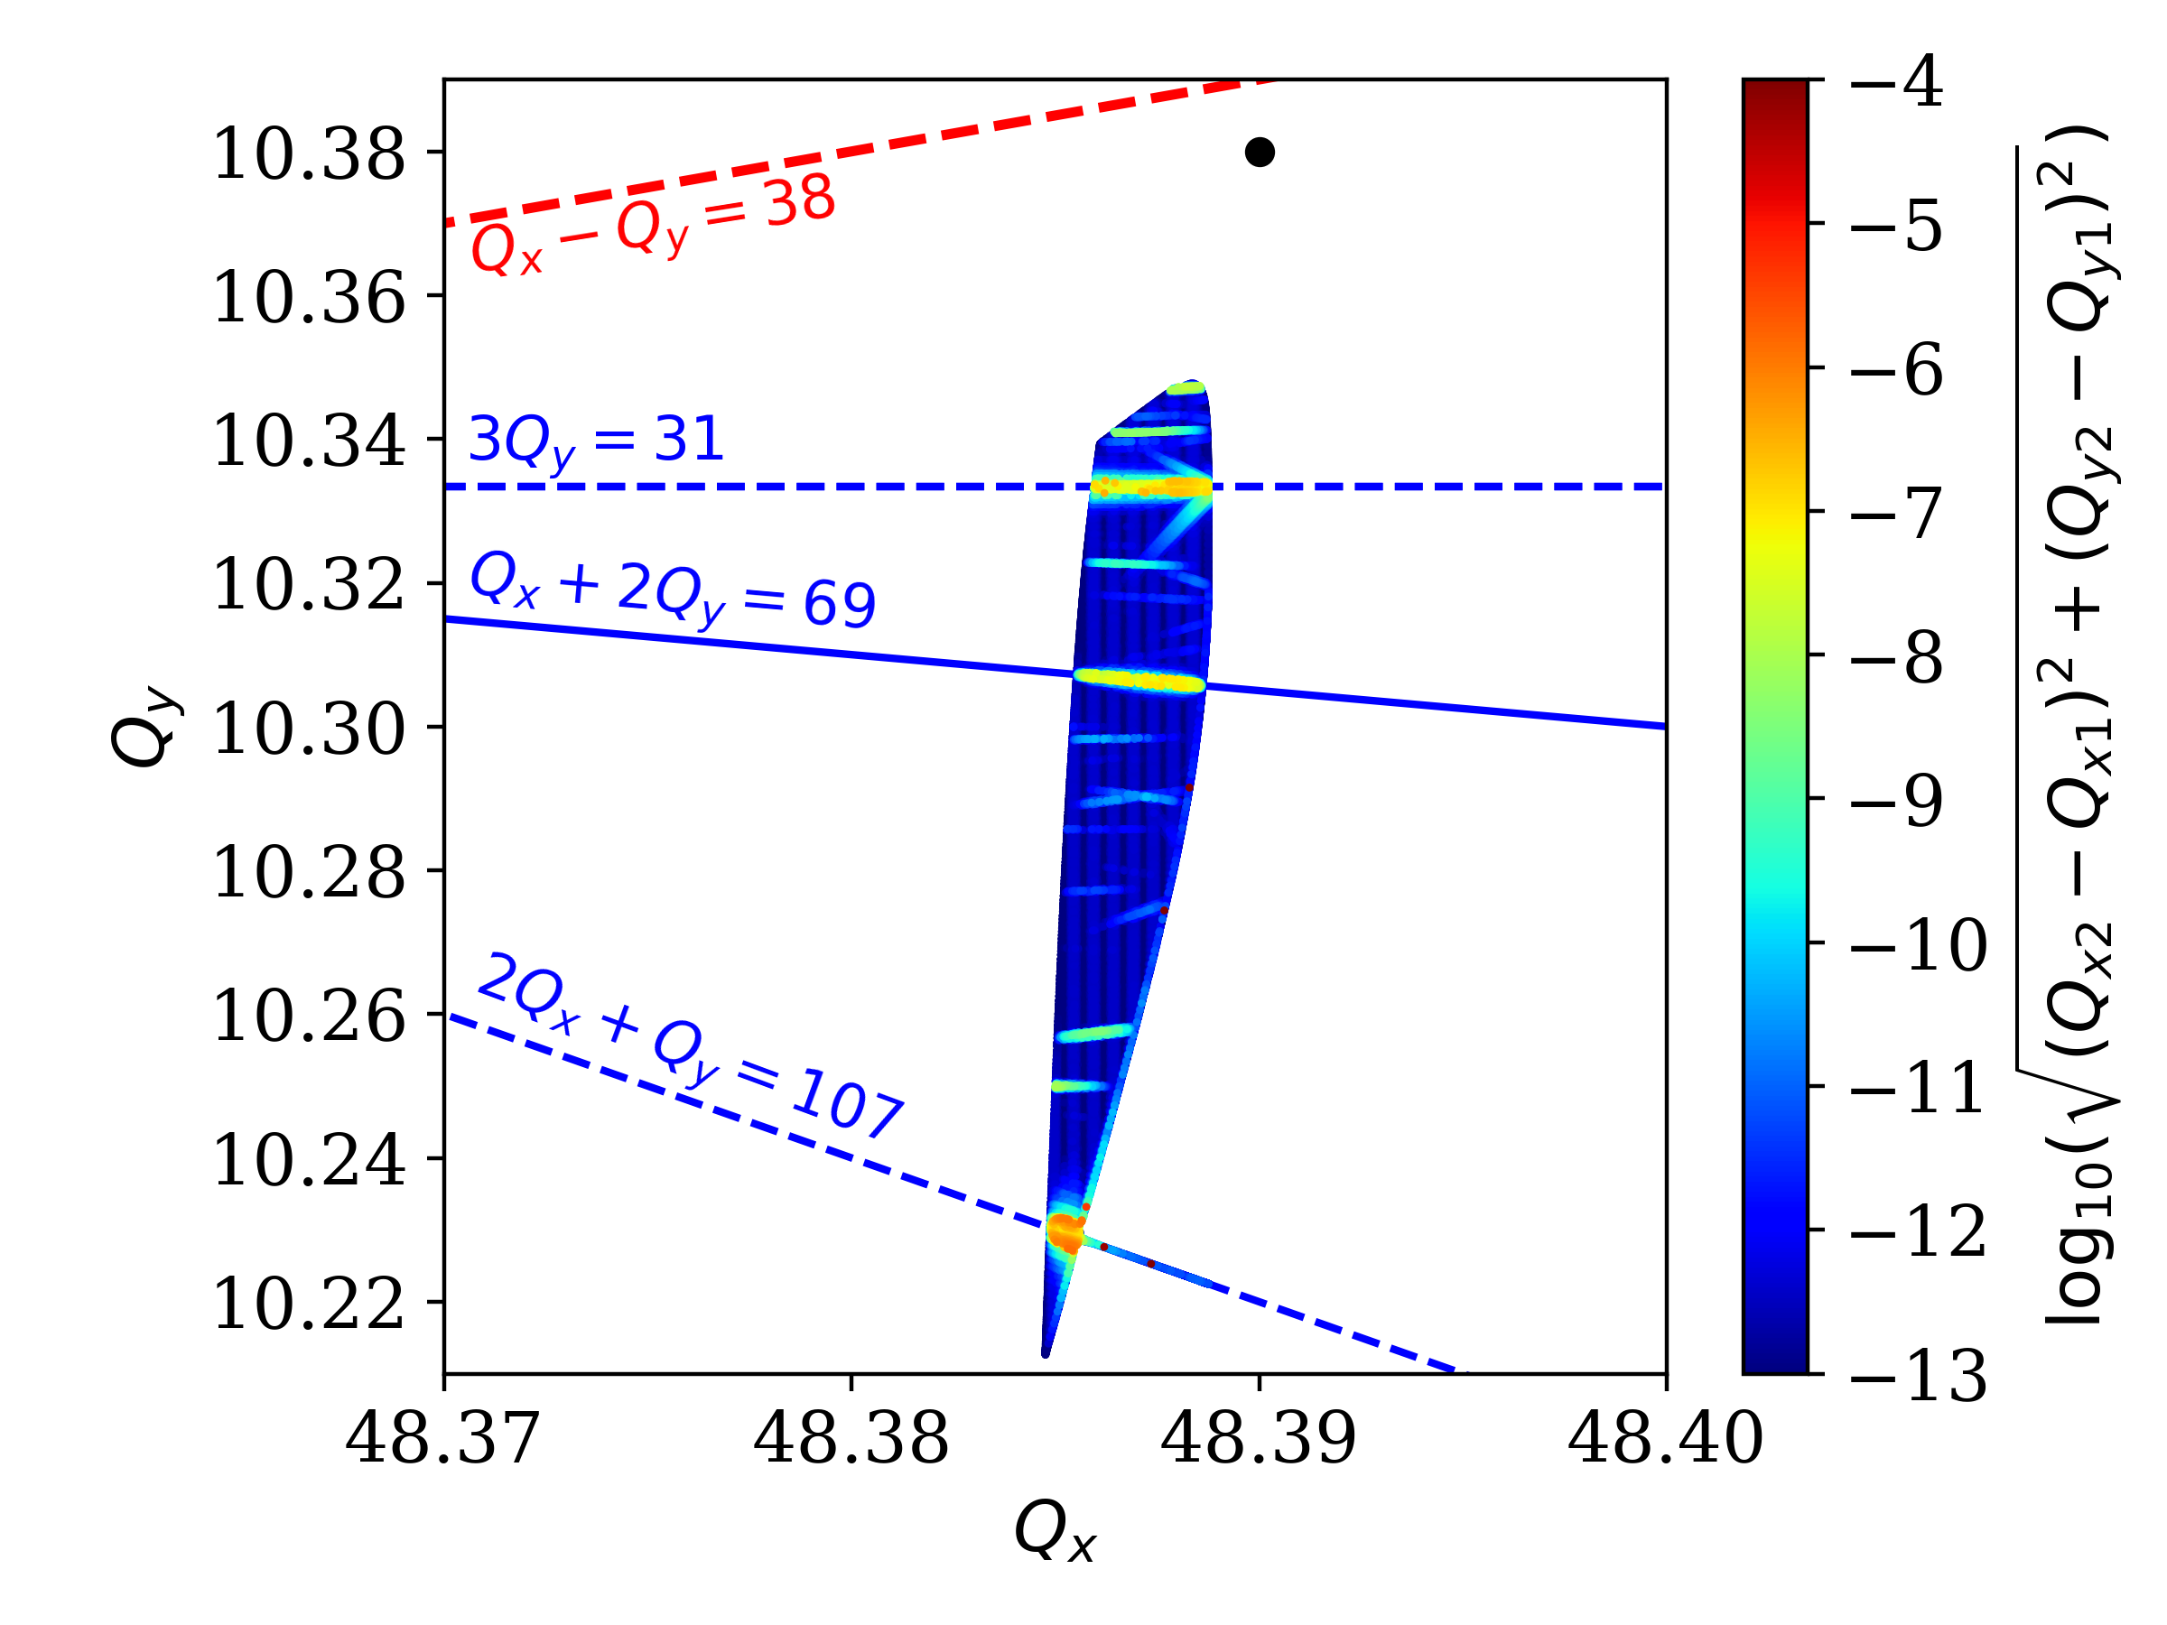
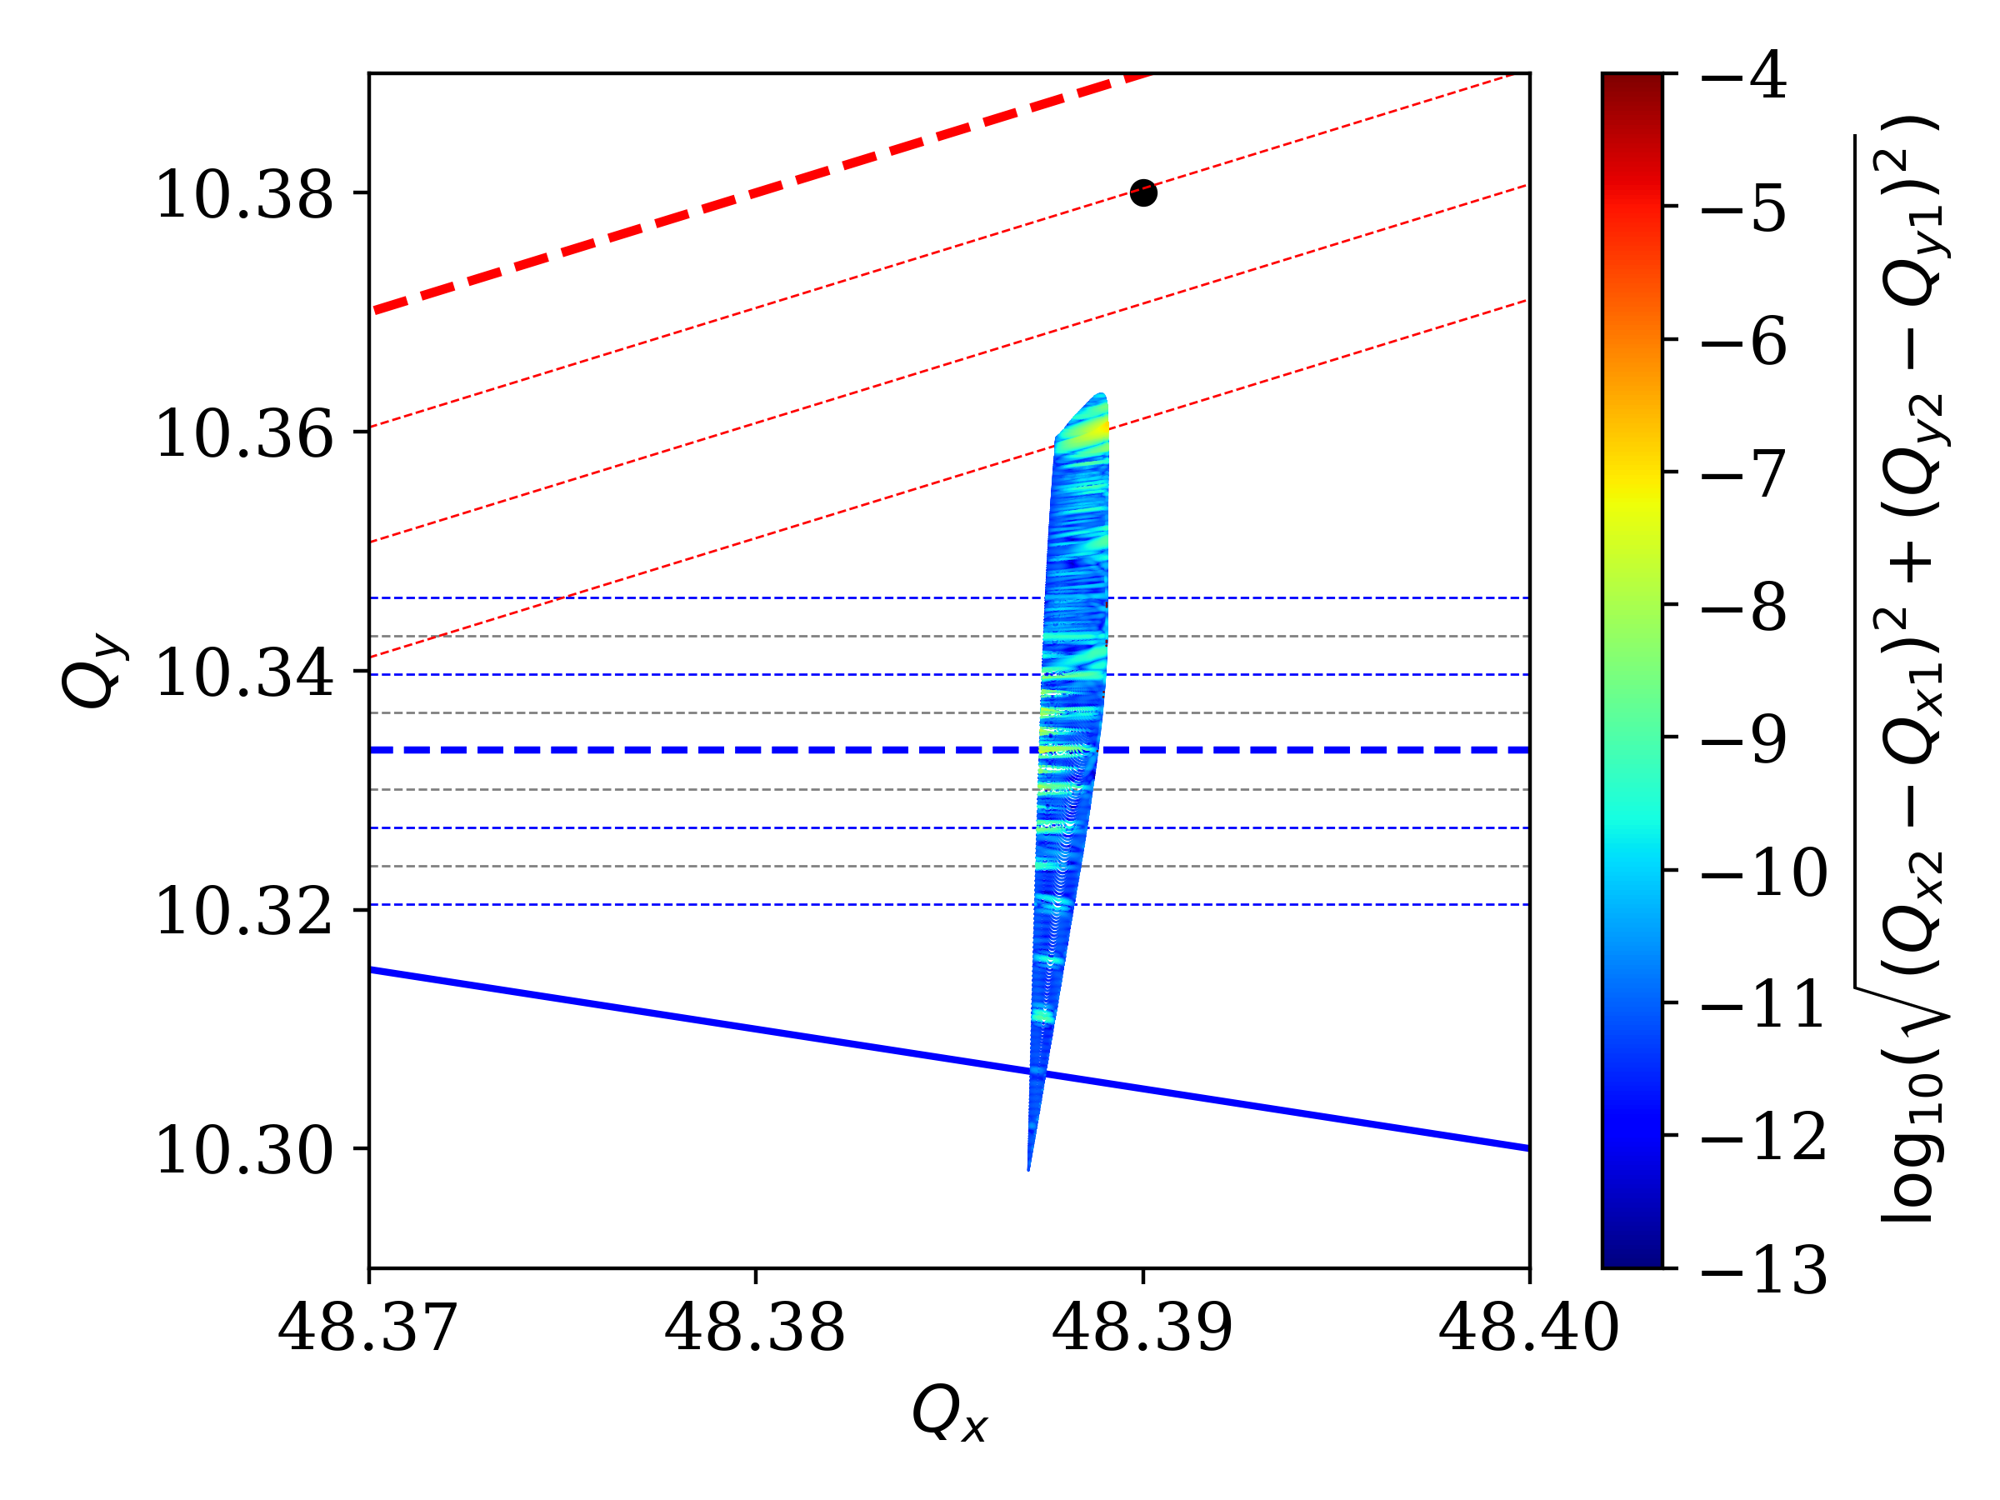
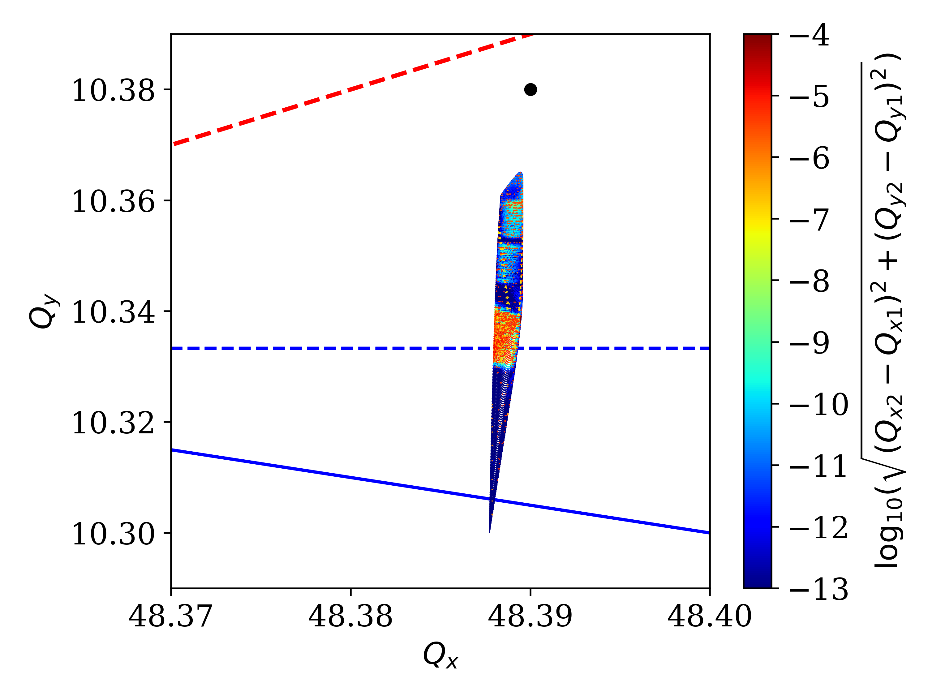
Resonance Sidebands
Why the resonance response is weak?
⇒ Resonance sidebands
Frequency Map Analysis (FMA) for the working point $\left(Q_{x},Q_{y}\right)=\left(48.39, 10.38\right)$
Off –momentum at $1σ_{z}$,
$T_{s}=100 turns$ (nominal)
Off –momentum at $1σ_{z}$,
$$T_{s}=1000 turns$$
On-momentum
$${3Q}_{y}=31±2nQ_{s}$$
$${6Q}_{y}=62±2nQ_{s}$$

Slide 12
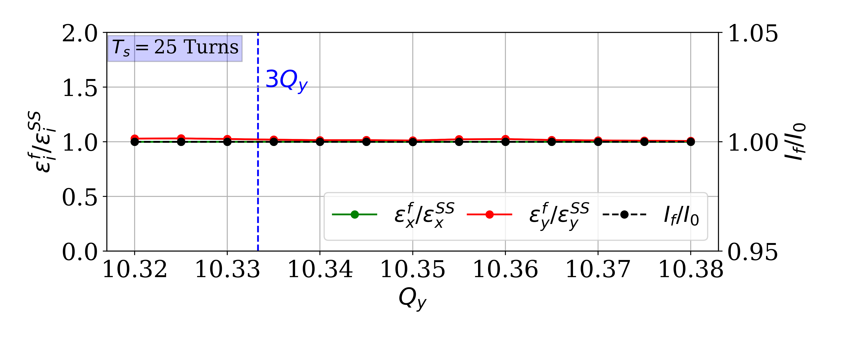
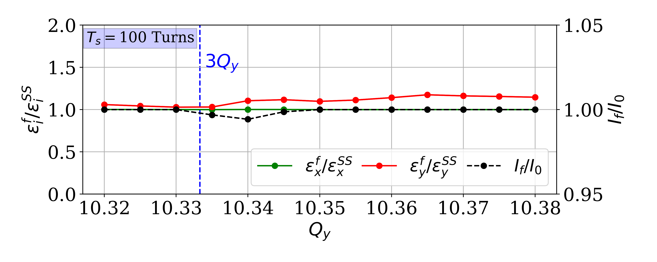
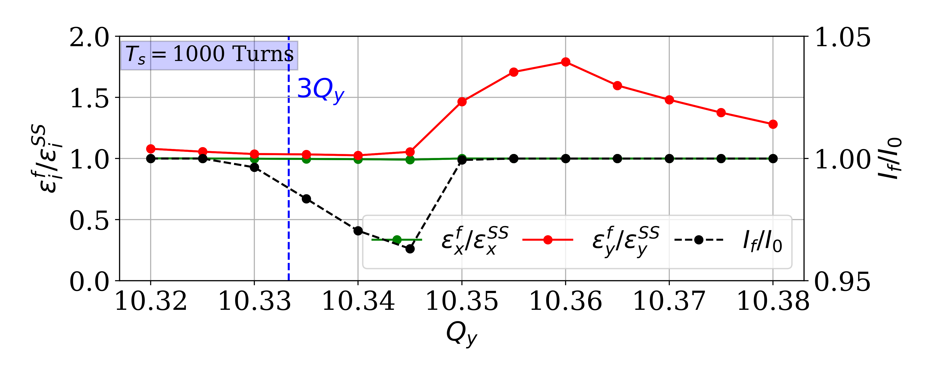
Vertical tune scan – Only SC
A full vertical tune scan around the ${3Q}_{y}$ resonance was performed:
$Q_{x}=48.39$ and $Q_{y}=10.32…10.38$
“Faster”, $T_{s}=25$ turns
“Nominal”, $T_{s}=100$ turns
“Slower”, $T_{s}=1000$ turns
“Nominal” $T_{s}$: vertical emittance blow-up of 15 % and 1 % of particle losses
“Slower” $T_{s}$: vertical emittance blow-up of 80 % and 4 % of particle losses
“Faster” $T_{s}$: negligible impact

Slide 13
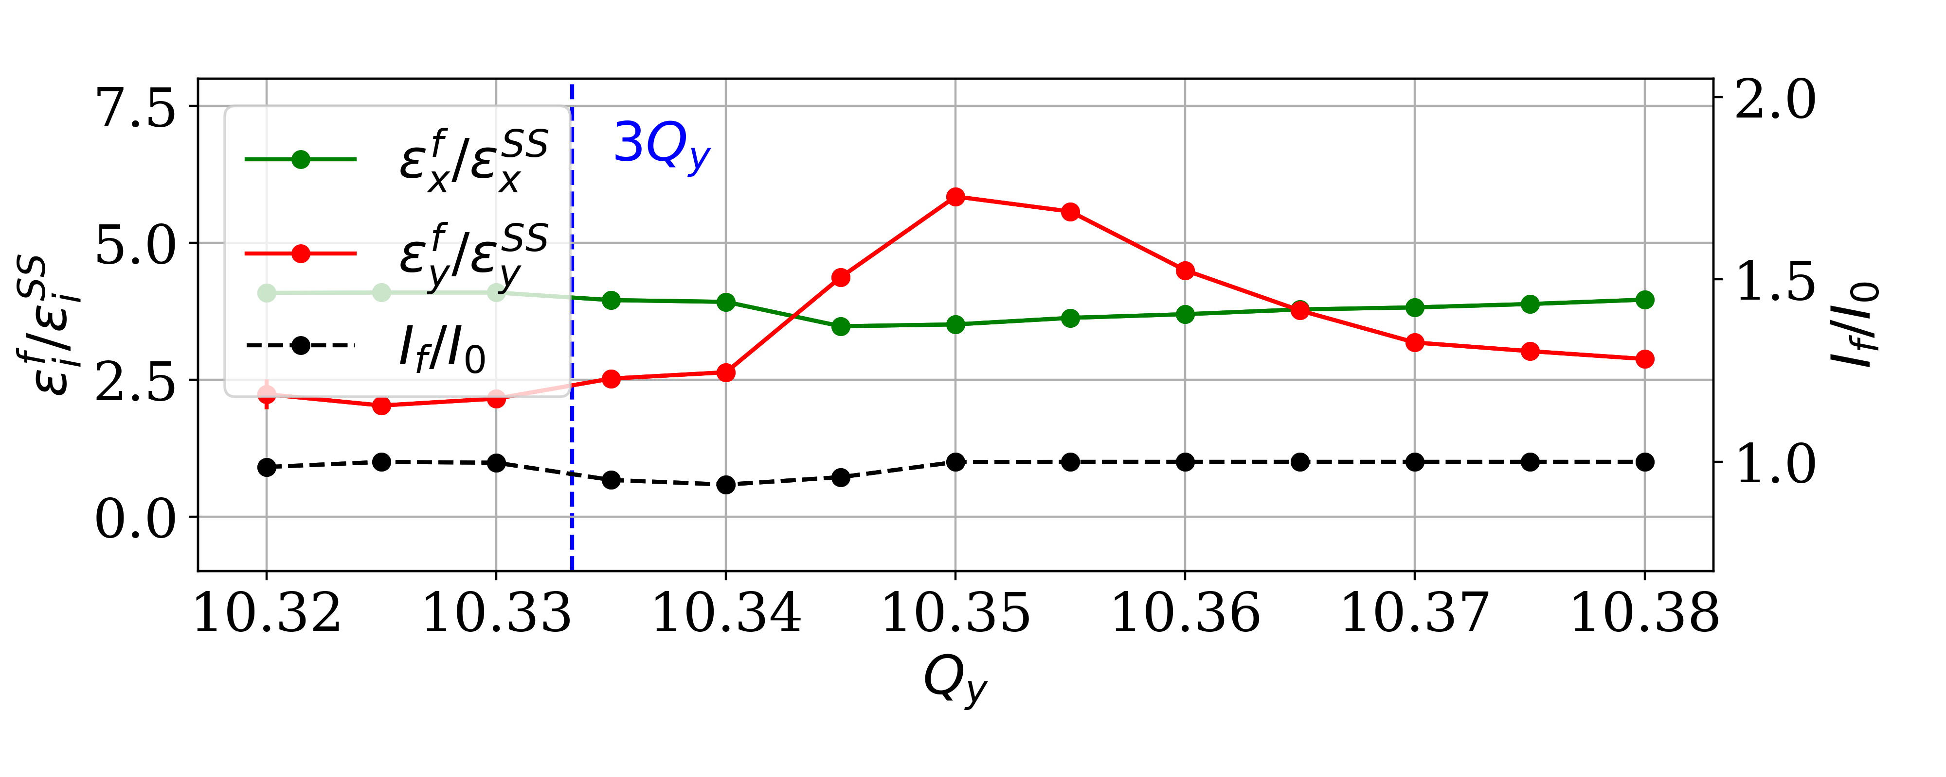
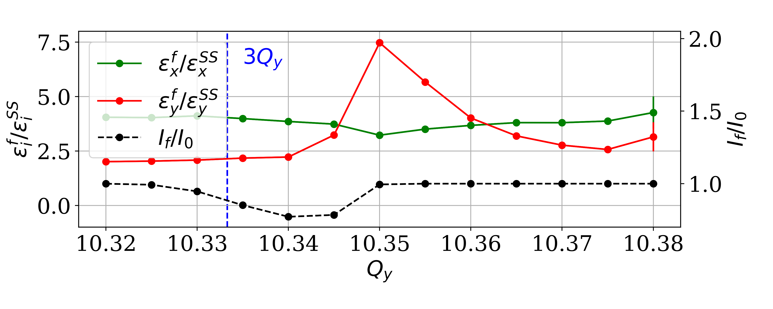
Vertical tune scan – Combining SC and IBS
Identical vertical tune scan around the ${3Q}_{y}$ resonance, with the addition of IBS
Nominal, $T_{s}=100$ turns
$T_{s}=1000$ turns
The sensitivity to the ${3Q}_{y}$ is strongly enhanced when both SC and IBS are present
IBS dominates the emittance growth for the working points sufficiently far away from the resonance

Slide 14
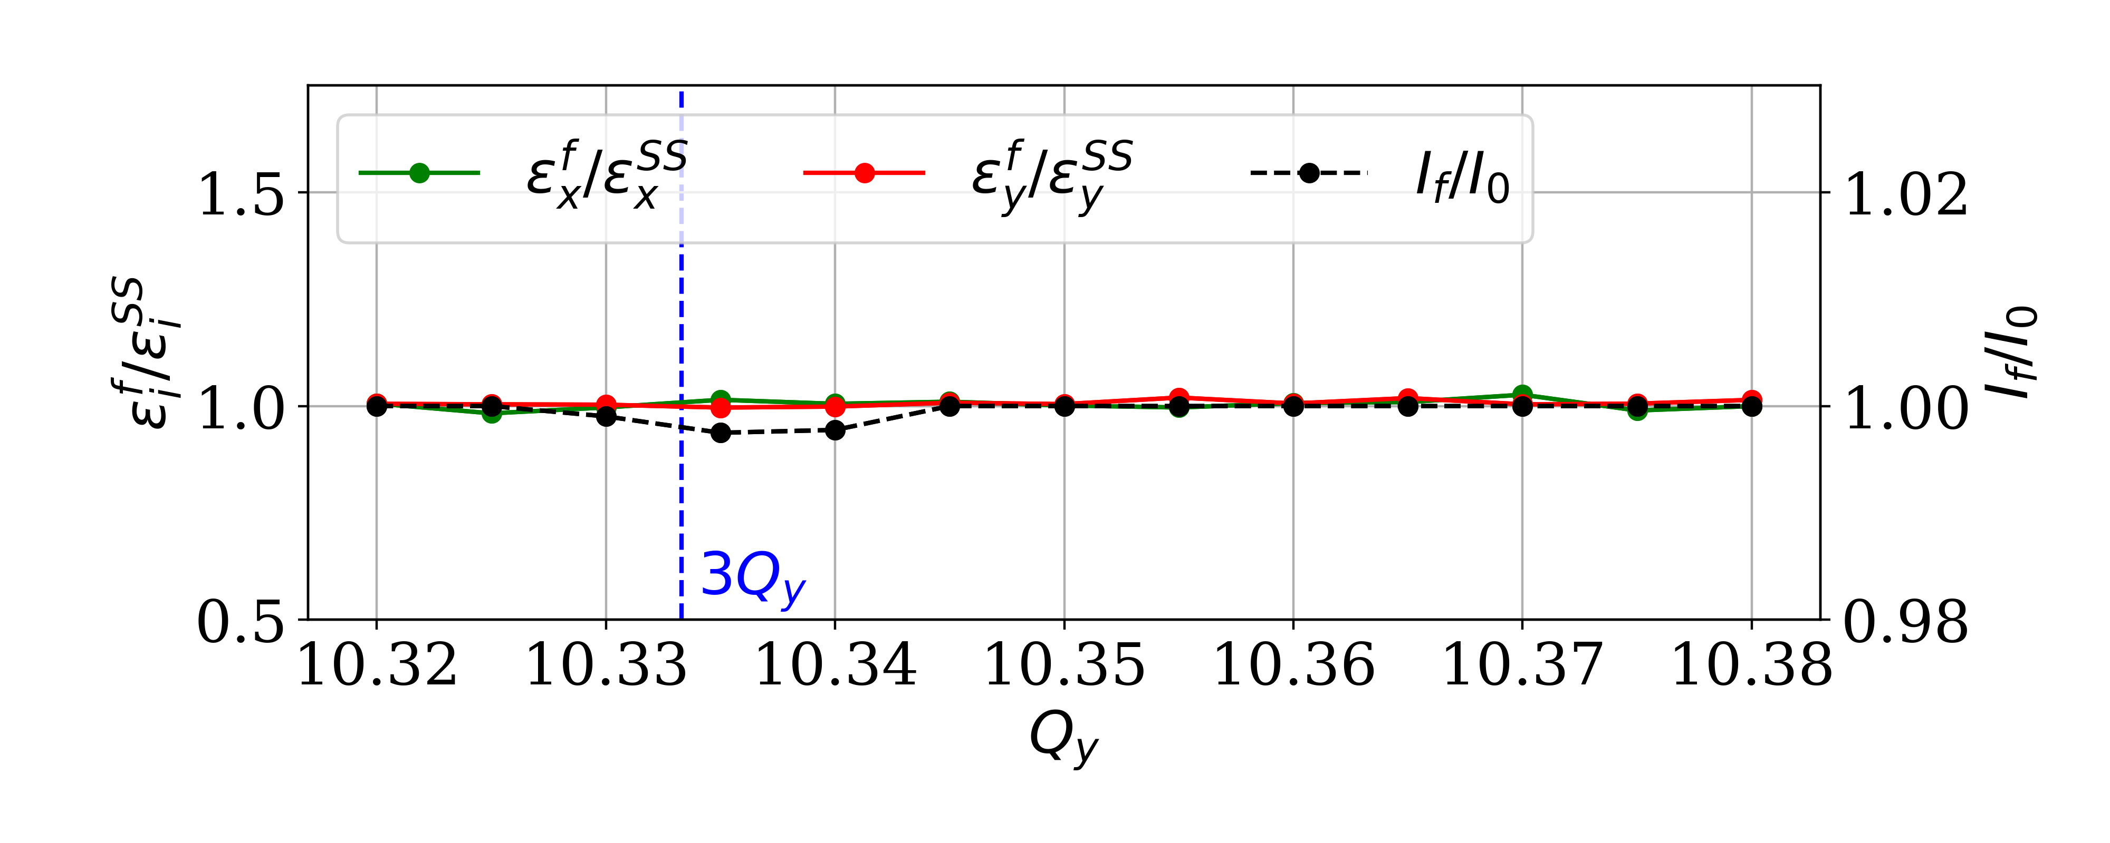
Vertical tune scan – Combining SC, IBS and SR
Does SR mitigate the interplay of SC and IBS?
“Nominal”, $T_{s}=100$ turns
Yes! SR strongly mitigates their effect
⇒ Residual vertical emittance blow-up of the order of 5 % and less than 1 % of particle losses

Slide 15
Overview
Introduction
The Compact Linear Collider complex
The CLIC damping rings
Incoherent effects
Synchrotron Radiation
Intrabeam Scattering
Space charge
Interplay Studies
Space Charge investigation
Space Charge studies with Intrabeam Scattering
Space Charge studies with Intrabeam Scattering and Synchrotron Radiation
Studies for the CLIC DRs full cycle
Ideal case
Resonance tolerances
Conclusions

Slide 16
The CLIC DRs full cycle
Emittance evolution along the full nominal cycle of the CLIC DRs (no errors!)
Perfect agreement between Analytic calculations (IBS, SR) and Tracking simulations (SC, IBS, SR)
⇒ SC plays no role in the final steady state of the beam
Steady state parameters are verified for the first time with macroparticle tracking simulations including SC, IBS and SR!

Slide 17
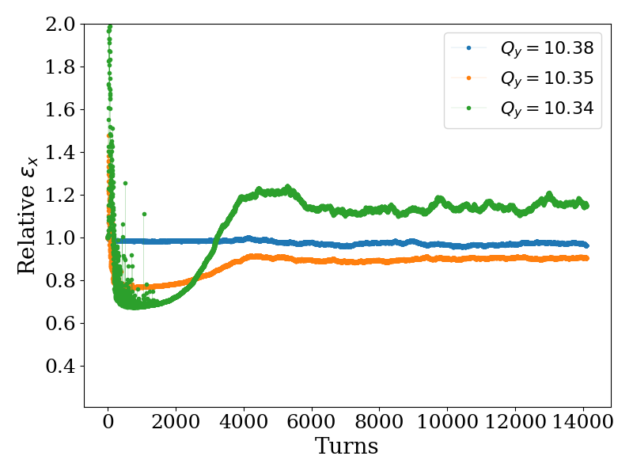
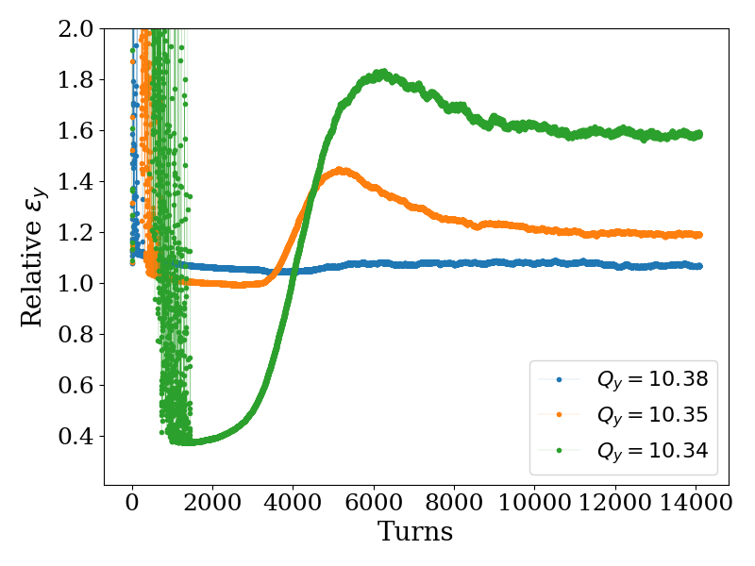
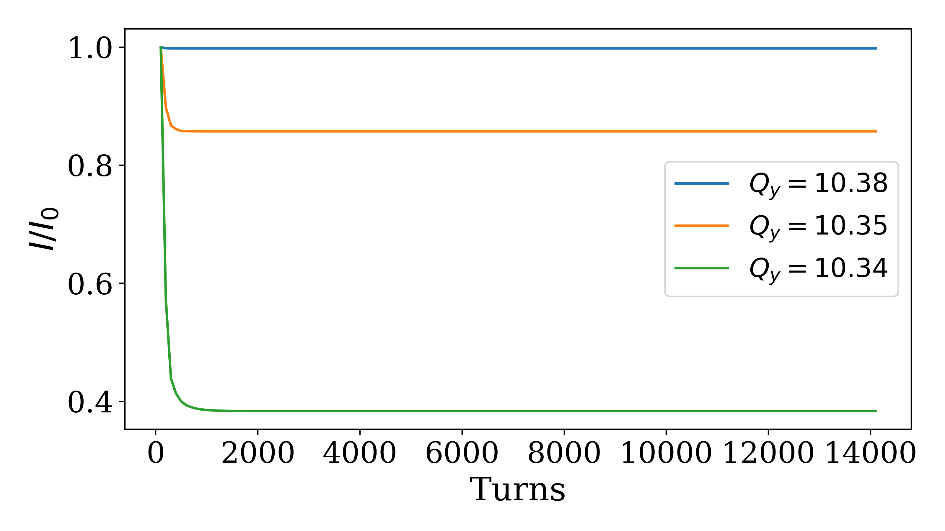
The CLIC DRs full cycle – Resonance tolerances
*$Q_{x}=48.357$
Working point dependence for the full cycle of CLIC DRs (excited ${3Q}_{y}$ resonance):
*Results normalized to the analytical calculations with IBS and SR
$Q_{y}=10.38$: No degradation is observed; Particles are away from the resonance
$Q_{y}=10.34$: Vertical emittance blow-up of 70 % and 60 % of particle losses
Even in the presence of strong SR damping, the working point choice is very important for minimizing the impact of SC and IBS!

Slide 18
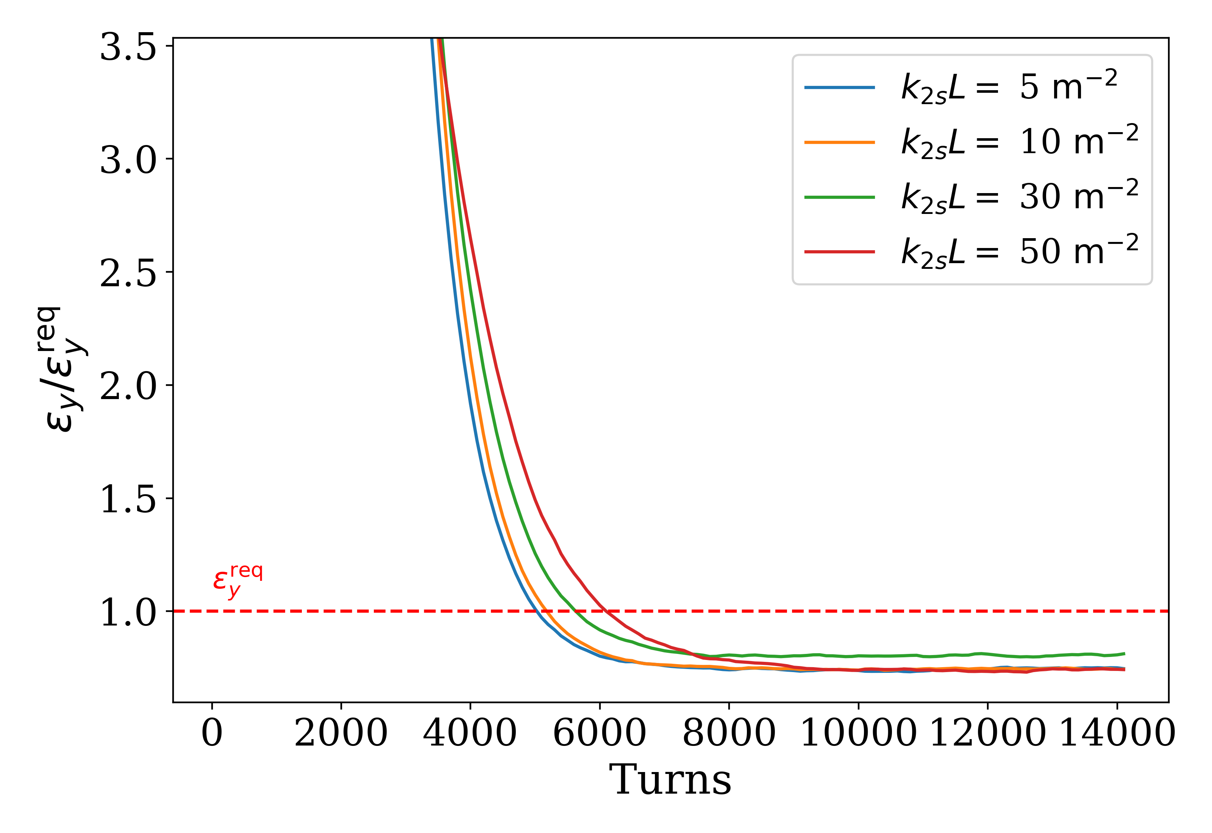
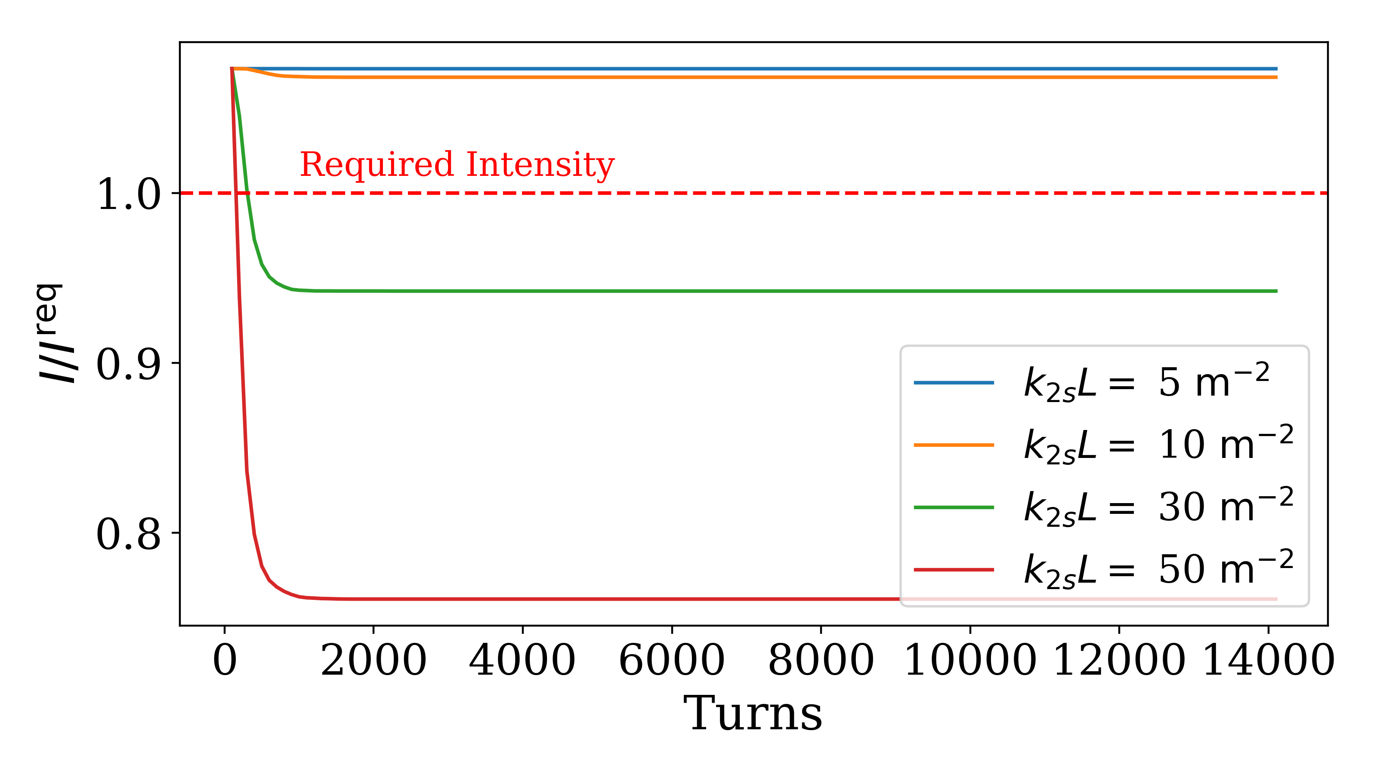
The CLIC DRs full cycle – Resonance tolerances
Sensitivity to the skew sextupolar resonance for the worst case: $Q_{x}=48.357$, $Q_{y}=10.34$
✓
✓
✓
✓
✓
✓
✗
✗
These skew sextupole errors are far from realistically expected field errors
A normal sextupole for chromaticity correction in the CLIC DR lattice has a strength of $k_{2}L=30 m^{−2}$
Could be accumulated through the hundreds of sextupoles in the CLIC DR lattice

Slide 19
Overview
Introduction
The Compact Linear Collider complex
The CLIC damping rings
Incoherent effects
Synchrotron Radiation
Intrabeam Scattering
Space charge
Interplay Studies
Space Charge investigation
Space Charge studies with Intrabeam Scattering
Space Charge studies with Intrabeam Scattering and Synchrotron Radiation
Studies for the CLIC DRs full cycle
Ideal case
Resonance tolerances
Conclusions

Slide 20
Conclusions
Two modules for simulating IBS and SR were implemented in PyORBIT
Simulations at the steady state were performed to investigate the impact of the ${3Q}_{y}$ resonance
The beam degradation due to resonance crossing induced by SC alone is relatively weak
Particle diffusion is strongly enhanced when IBS is also considered
The strong radiation damping mostly mitigates the effect of SC and IBS, even for the case of the strong vertical skew sextupole resonance
The fulfilment of the CLIC target parameters for ultra-high brightness beams is now demonstrated through macroparticle tracking simulations combining SC, IBS and SR
In the absence of errors, SC plays no role in the final steady state of the beam
It was demonstrated that the choice of the working point is critical even in the case of the strong radiation damping
The design study of such machines need to include an assessment of resonance excitation, and the tune spread evolution along the cycle for optimizing the working point
Notes:
Studies of the incoherent effects of SC, IBS and SR and their interplay were performed in the context of the CLIC DRs

Slide 21
Thank you!!!

Slide 22
References
[1] M. Aicheler et al., “A Multi-TeV Linear Collider Based on CLIC Technology: CLIC Conceptual Design Report”, CERN Yellow Reports: Monographs (CERN, Geneva, 2012). Online
[2] Y. Papaphilippou et al., “Conceptual Design of the CLIC damping rings”, Conf. Proc. C 1205201, 1368-1370, TUPPC086 (2012). Online
[3] M. Zampetakis et al., “Interplay of space charge, intrabeam scattering, and synchrotron radiation in the Compact Linear Collider damping rings”, Phys. Rev. Accel. Beams 27, 064403 (2024). Online
[4] S. Nagaitsev, “Intrabeam scattering formulas for fast numerical evaluation”, Phys. Rev. ST Accel. Beams 8, 064403 (2005). Online
[5] T. Satogata et al., “Driven response of a trapped particle beam”, Phys. Rev. Lett. 68, 1838 (1992). Online
More references and details about the presented studies can be found in [3]

