Slide 1
Longitudinal quadrupole frequency shifts in the PSB due to space charge and Finemet cavity impedance
Mariangela Marchi, Simon Albright
Acknowledgements: OP-PSB and all those involved in PSB and Linac4 operation.
12/09/2024
ICFA Mini-Workshop on Space Charge 2024 - M. Marchi

Slide 2
Outline
Introduction
PSB overview
Space charge and Finemet interplay in the PSB
Quadrupole synchrotron frequency shifts
Aim
Measurements setup and analysis
Comparison with simulations
Conclusions and next steps
mariangela.marchi@cern.ch

Slide 3
INTRODUCTION
mariangela.marchi@cern.ch

Slide 4
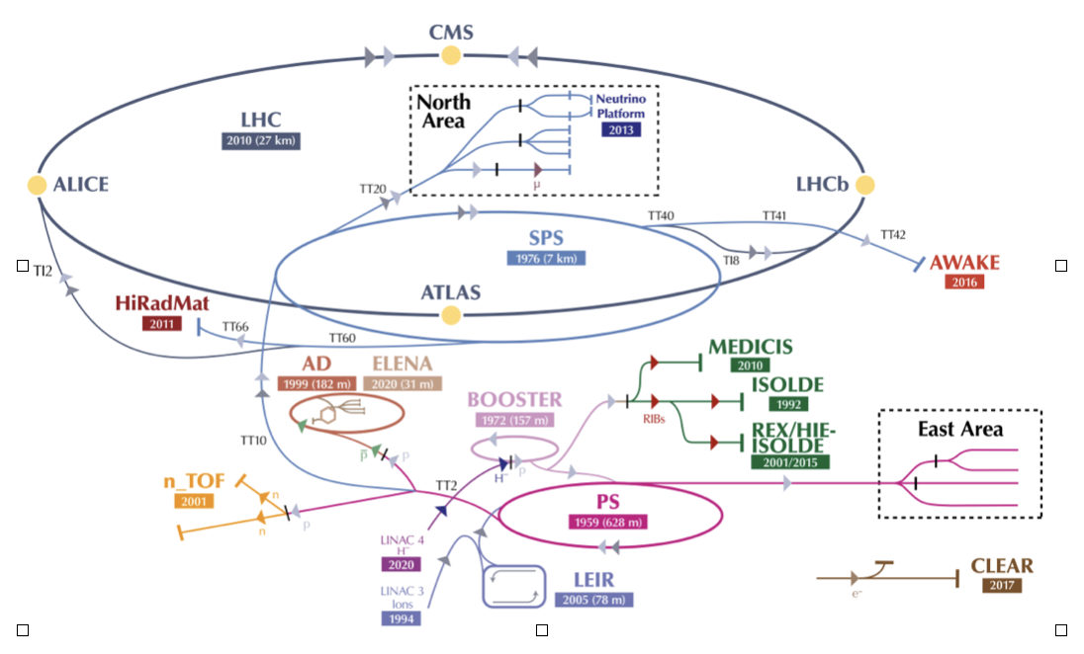
CERN Proton Synchrotron Booster
4 rings
First proton synchrotron in the LHC injectors chain
Composed of four identical super-posed rings
Variety of proton beams production
High-intensity beams for fixed-target experiment facility (e.g. ISOLDE)
Ekin^{inj} = 160 MeV ; Ekin^{extr} = 1.4 , 2 GeV
Large revolution frequency sweep
Below transition energy operation
mariangela.marchi@cern.ch

Slide 5
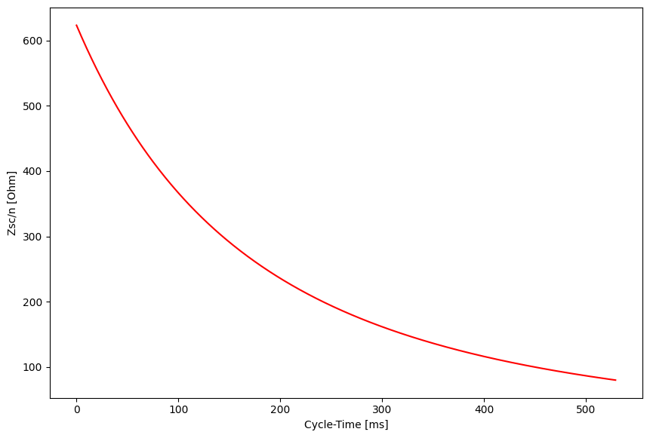
PSB Longitudinal Space Charge
PSB is space charge dominated
Longitudinal space charge modeled through purely imaginary impedance
|ZSC| directly proportional to frequency
Scaling with energy
Reduction of a factor of 8
$$\frac{|Z_{SC}|}{n}(E_{kin})=\frac{β_{0}(E_{ref})γ_{0}^{2}(E_{ref})}{β_{0}(E_{kin})γ_{0}^{2}(E_{kin})}\frac{|Z_{SC}|}{n}(E_{ref})+\frac{Z_{0}}{2β_{0}(E_{kin})γ_{0}^{2}(E_{kin})}log(\frac{β_{0}(E_{kin})γ_{0}(E_{kin})}{Cbu(E_{kin})β_{0}(E_{ref})γ_{0}(E_{ref})})$$
Coupling coefficient
dependent on geometry
623 Ω
Formula takes into account direct and indirect space charge
Self-fields modify RF waveform
Below transition energy: decrease of the effective RF voltage ⇒ defocusing effect
mariangela.marchi@cern.ch

Slide 6
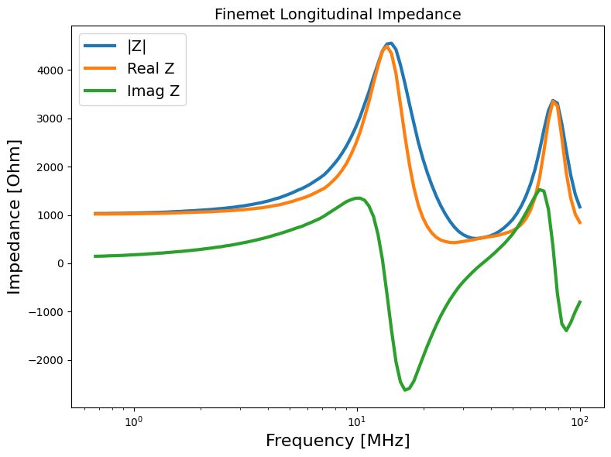
PSB High-Level RF
Finemet-based High-Level RF system
Modular and multi-harmonic operation
1-18 MHz
3 sectors per each ring, 12 cells per each sector
Large broad-band cavity longitudinal impedance
Latest measurements of the model (0 to 100 MHz)
Independent on beam energy
Fast RF feedback compensation (-10 dB)
Mainly resistive in the beam revolution frequency range
mariangela.marchi@cern.ch

Slide 7
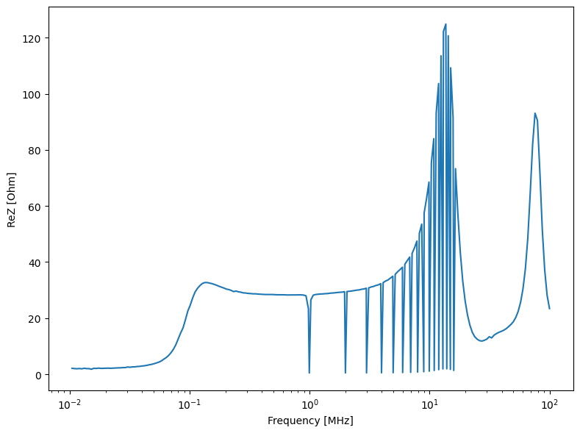
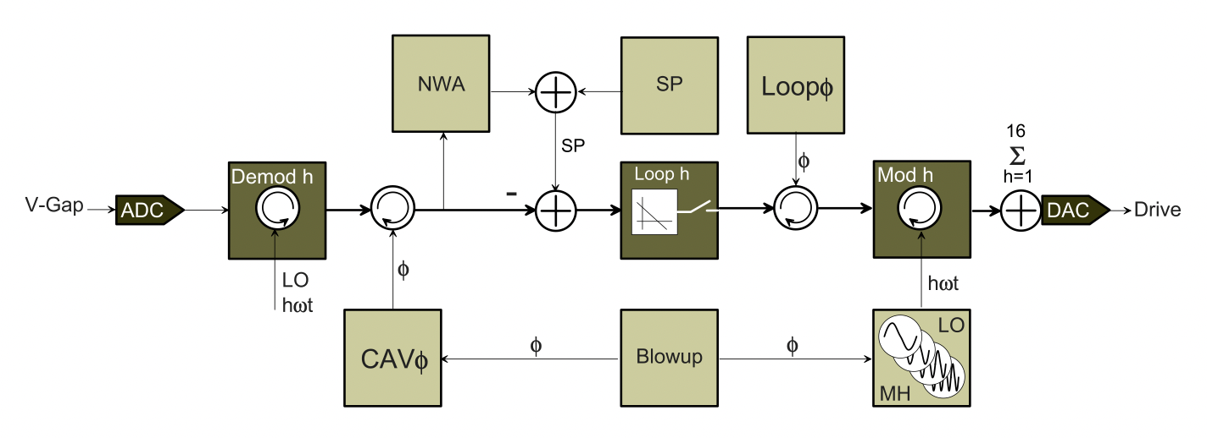
PSB Finemet LLRF
PSB LLRF architecture
D. Barrientos et al., “A New Beam Loading Compensation and Blowup Control System Using Multi-Harmonic Digital Feedback Loops in the CERN PS Booster “ IPAC’22, Bangkok, Thailand, June 2022.
16 harmonic LLRF feedback loops
Notch-filter action on the induced voltage
Current model applied on the coupling impedance
Space charge compensation action reduced
mariangela.marchi@cern.ch

Slide 8
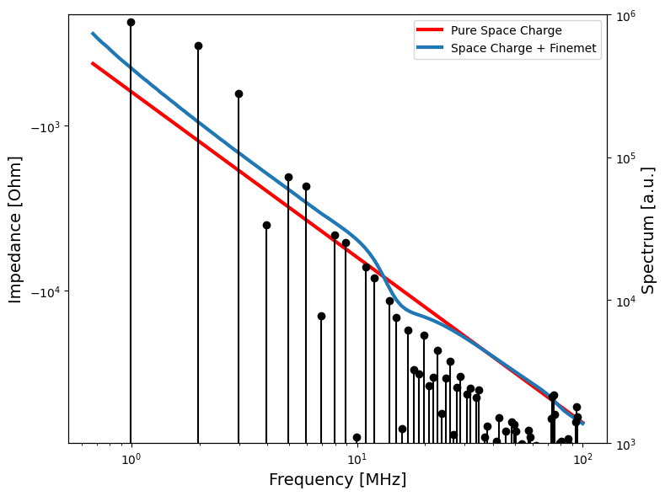
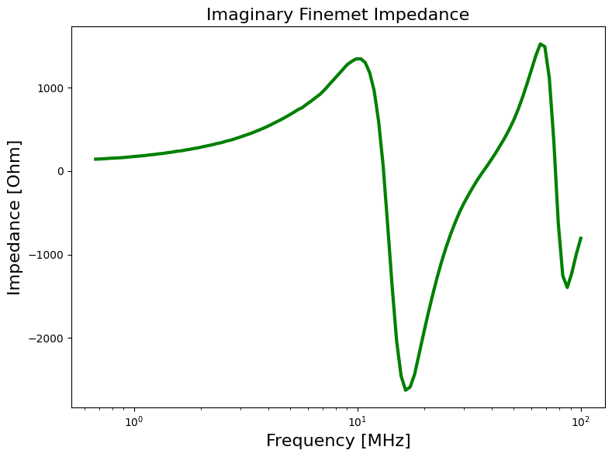
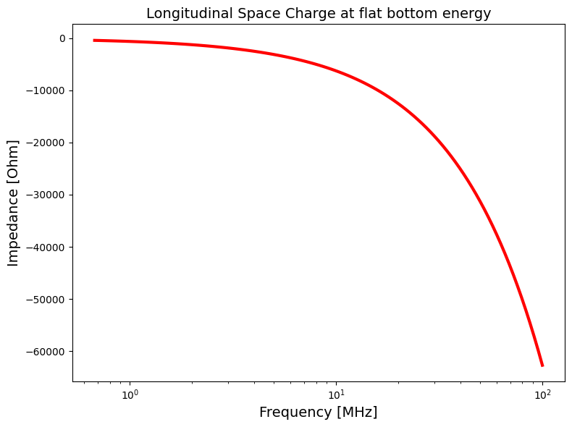
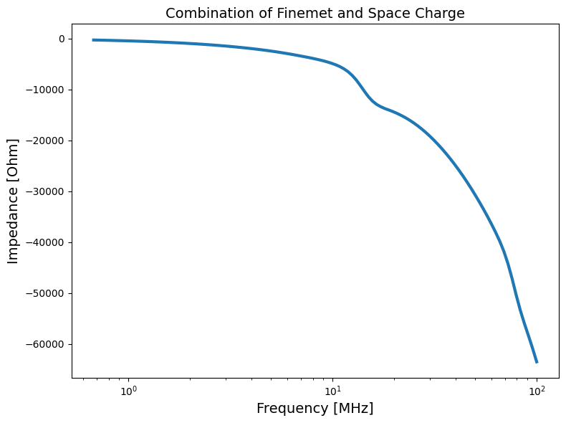
PSB Longitudinal Impedance
Longitudinal Space Charge
Main contributors to the longitudinal impedance in the PSB
+
=
Longitudinal Finemet cavity impedance
Combined coupling impedance of Finemet and space charge and spectrum of a bunch with parabolic distribution.
Vast majority of beam power is at low frequency.
mariangela.marchi@cern.ch

Slide 9
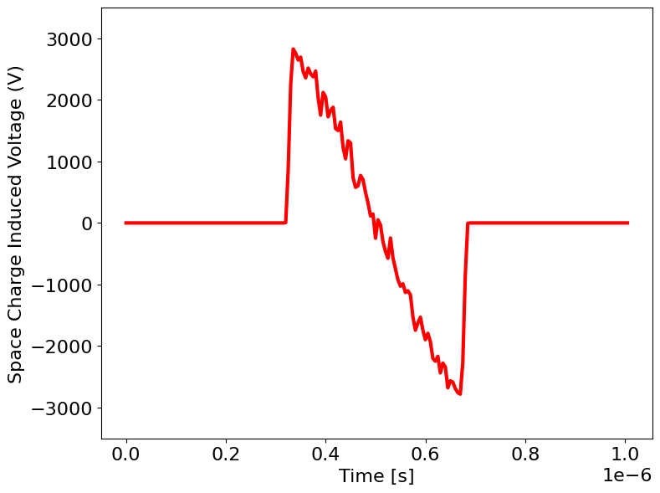
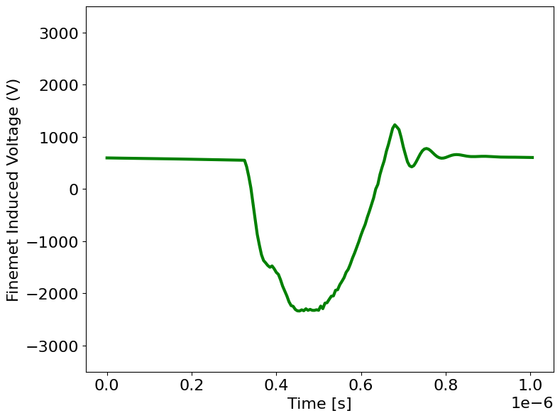
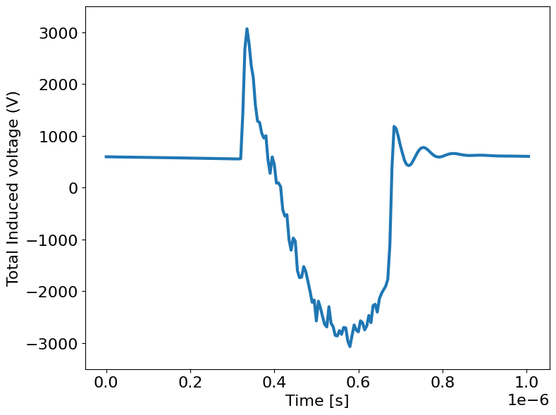
PSB Longitudinal Impedance
CHANGE TO PLOTS WITH SAME LIMITS IN THE AXIS AND LESS NOISE: LARGER INTENSITY OR # MACROP
Longitudinal Space Charge
Main contributors to the longitudinal impedance in the PSB
+
+
=
Longitudinal Finemet cavity impedance
+
=
Focus: Reactive impedance probing through induced quadrupole oscillations
mariangela.marchi@cern.ch

Slide 10
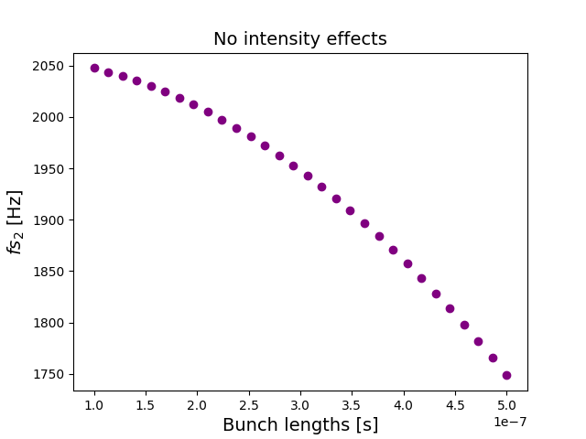
Quadrupole oscillations and synchrotron frequency shifts
ΔE
Matched bunch
Mismatched bunch
×
𝝉
mariangela.marchi@cern.ch

Slide 11
QUADRUPOLE SYNCHROTRON FREQUENCY SHIFTS
mariangela.marchi@cern.ch

Slide 12
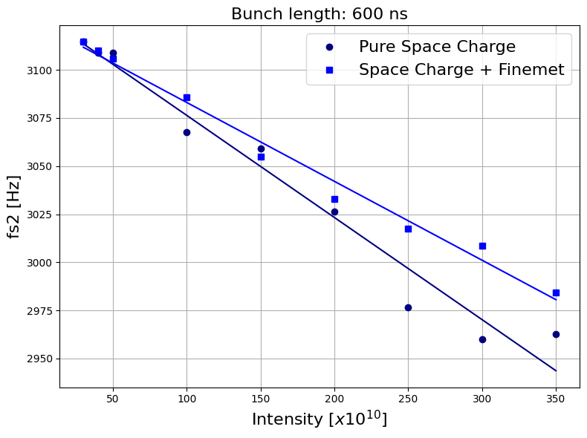
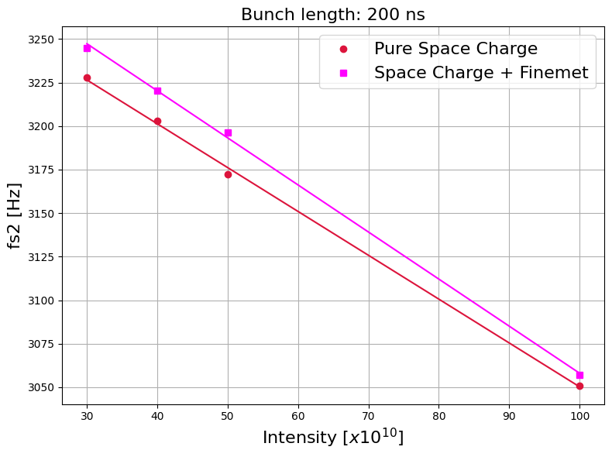
From simulations
Macro-particle simulations with BLonD tracking code help in the study of the quadrupole frequency shift dependence on the PSB impedance.
Incoherent shift decreases when Finemet impedance is included
⇒ Space Charge partially compensated
BLonD GitLab
mariangela.marchi@cern.ch

Slide 13
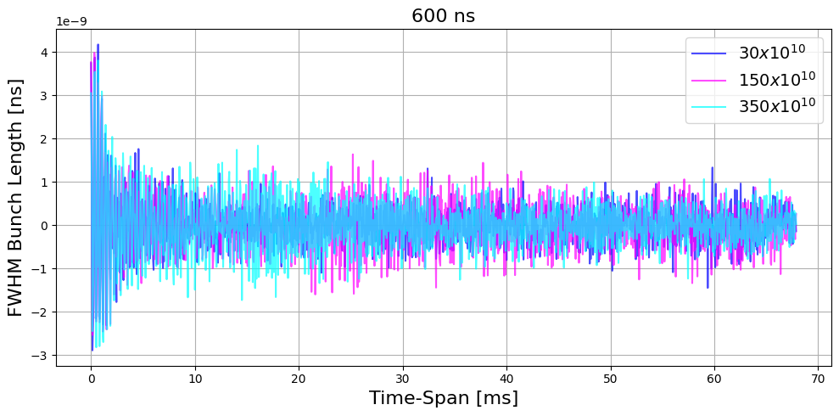
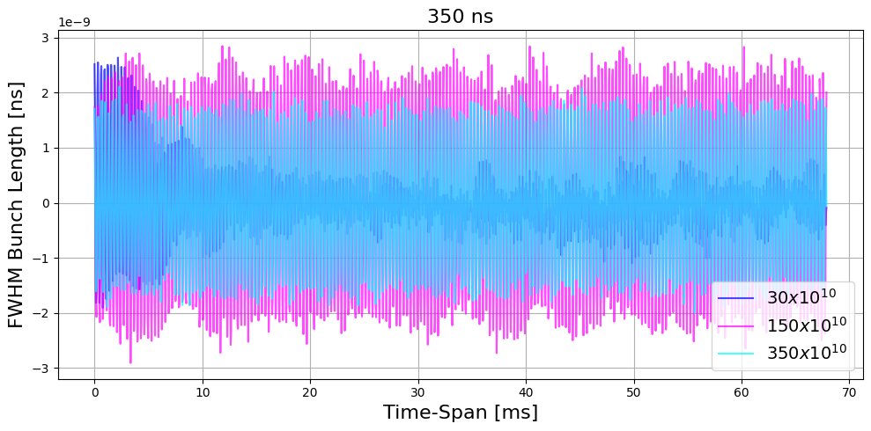
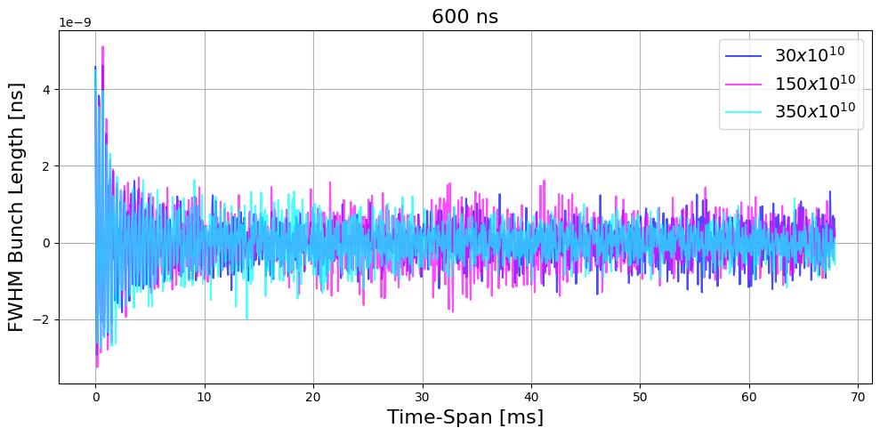
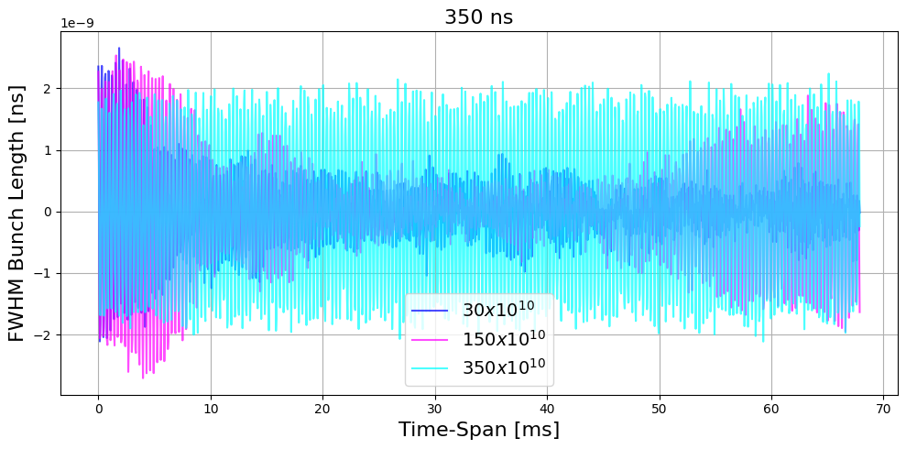
From simulations
Pure Space Charge
Pure Space Charge
Shorter bunch length:
Intermediate intensity with Finemet shows growing oscillations
Longer bunch length:
Expected behaviour
Space Charge and Finemet
Space Charge and Finemet
mariangela.marchi@cern.ch

Slide 14
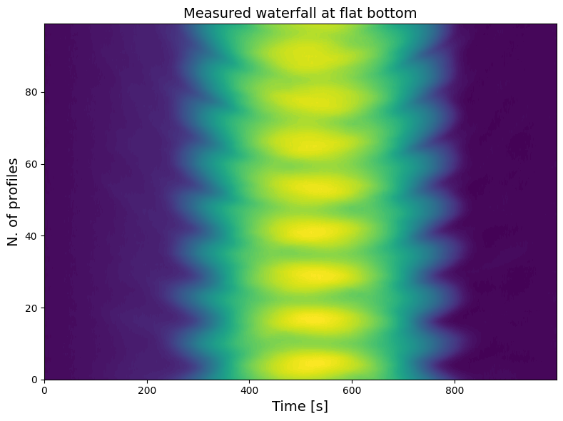
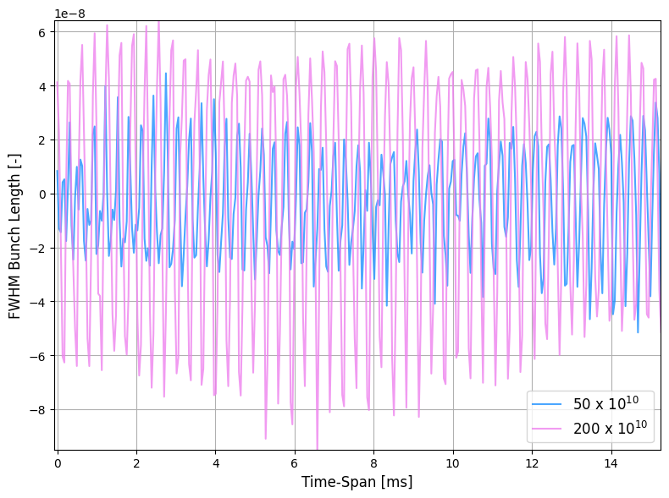
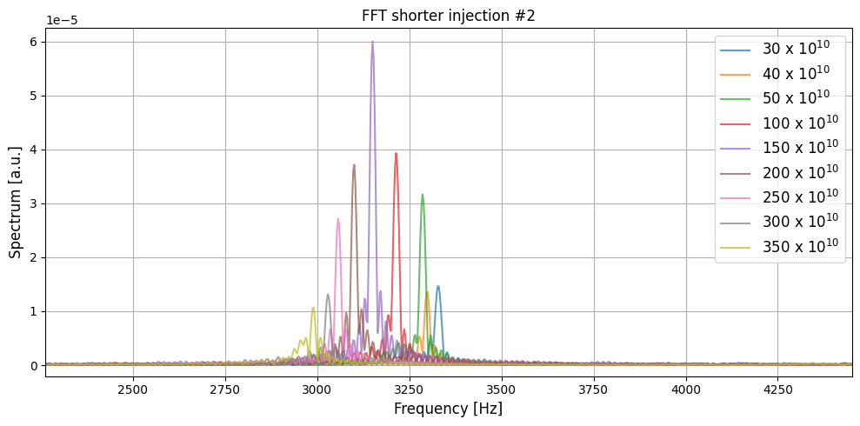
Measurements at flat bottom energy
Setup:
Flat Bottom energy : 160 MeV
Voltage at first harmonic: 3 kV, 8 kV
Small-amplitude synchrotron frequency: 1.030 kHz ,
1.678 kHz
Reference quadrupole synchrotron frequency: 2.060 kHz,
3.357 kHz
Procedure:
Generation of energy plateau of desired time length
Induction of quadrupole oscillations through non- adiabatic kick in the voltage: mismatch
Acquisition of bunch profiles at different intensities and bunch lengths
mariangela.marchi@cern.ch

Slide 15
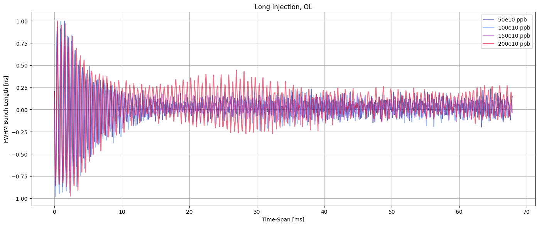
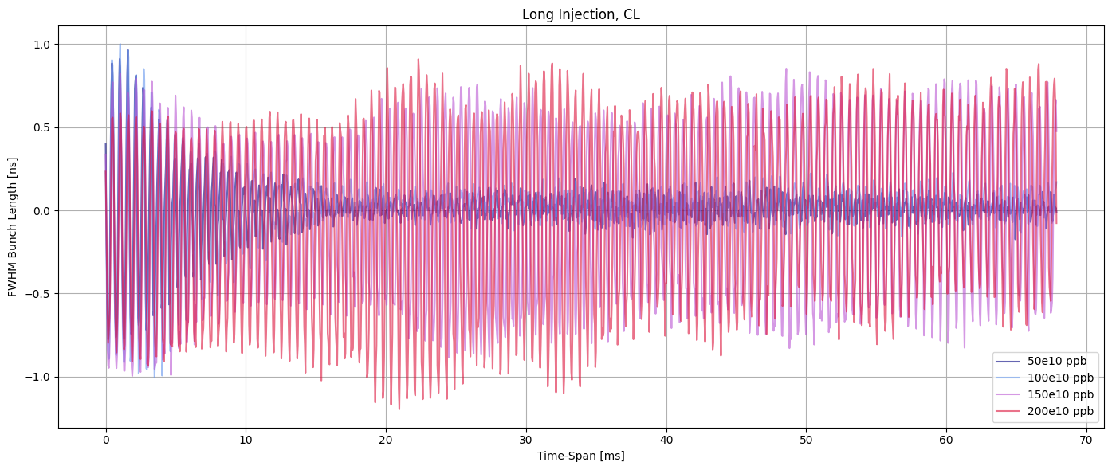
Measurements: two striking examples on cavity loops action
Bunch length evolution during acquisition time (3 kV)
Finemet with LLRF servo-loops inactive : fast damping of the oscillations due to large incoherent effect
Finemet with LLRF servo-loops active: at higher intensity space charge effect visible
mariangela.marchi@cern.ch

Slide 16
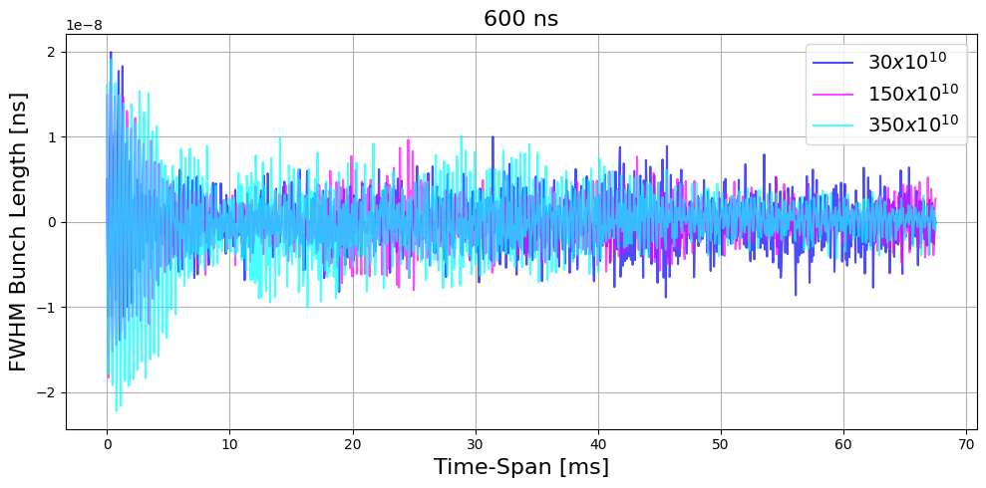
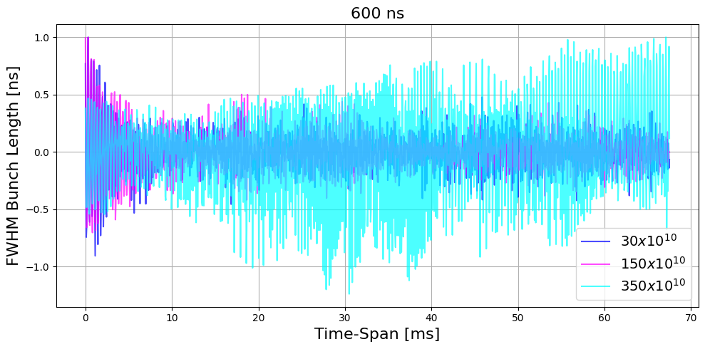
Measurements: two striking examples on cavity loops action
Bunch length evolution during acquisition time (8 kV)
Finemet with LLRF servo-loops inactive : fast damping of the oscillations due to compensation
Finemet with LLRF servo-loops active: different effect due to loops action
mariangela.marchi@cern.ch

Slide 17
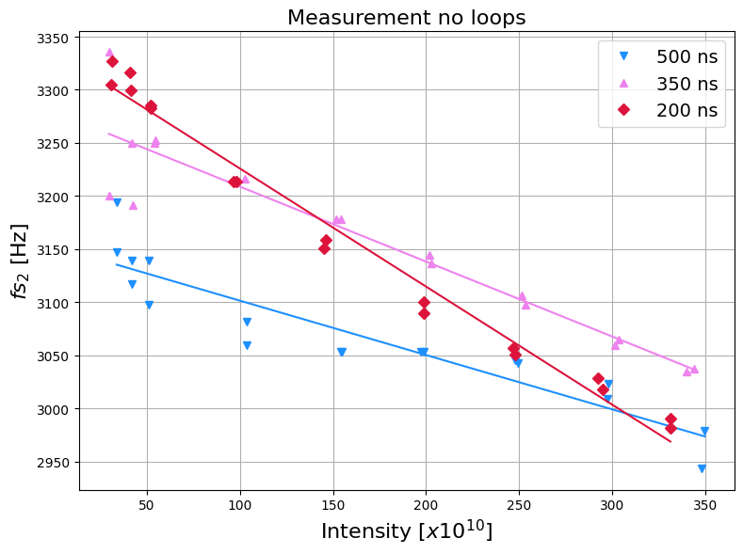
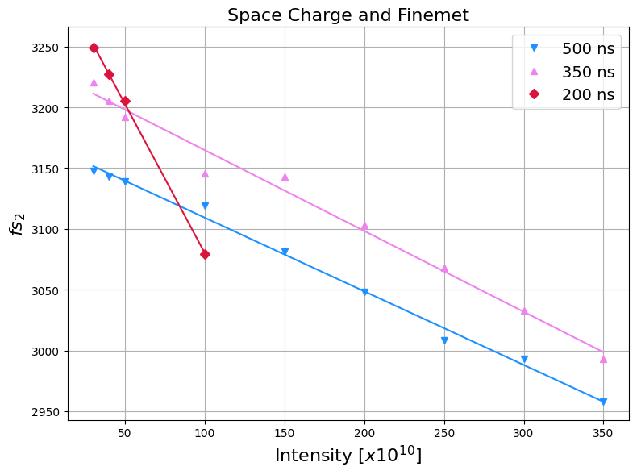
Quadrupole synchrotron frequency shifts
Measurement
Simulation
Linear fit:
$$fs_{2}=a+bN_{b}$$
$$a=2f_{s}^{(0)}$$
no intensity effects
$$b=−\frac{2Δf_{inc}}{N_{b}}$$
intensity effects
500 ns:
a = 3169.73 Hz
b = -0,60 Hz/10¹⁰
350 ns:
a = 3231.16 Hz
b = -0,66 Hz/10¹⁰
200 ns:
a = 3324.87 Hz
b = -2,44 Hz/10¹⁰
500 ns:
a = 3152.82 Hz
b = -0,51 Hz/10¹⁰
350 ns:
a = 3279.56 Hz
b = -0,70 Hz/10¹⁰
200 ns:
a = 3337.23 Hz
b = -1,11 Hz/10¹⁰
comparable
Full comparison not possible for different
implementation of initial conditions !
different
mariangela.marchi@cern.ch

Slide 18
CONCLUSIONS AND NEXT STEPS
Reactive longitudinal impedance can be probed through quadrupole oscillations
Interesting in the PSB to study the expected compensation of space charge with Finemet impedance
Quadrupole synchrotron frequency shifts comparison between measurements and simulations at flat-bottom
Space Charge + Finemet :
Longer bunches behave coherently
Effect at high frequency seen not visible in simulations for short bunch
Pure Space Charge:
Comparable to the closed loops condition in measurements: effect of the loops to be further investigated,
especially with the higher voltage case
Next steps:
Refinement of the initial conditions for comparison between measurements and simulations
Other energies to be included in the study
Cavity loops modeling based on the observations
Thank you!
mariangela.marchi@cern.ch

