Slide 1
Space charge effects on beam-beam mode coupling instability
K. Ohmi (IHEP/KEK)
6-th ICFA Mini workshop on Space Charge, 2024
Dongguan, China
Sep 11-13, 2024
Thanks to Y. Zhang

Slide 2


Space charge tune shift
Tune shift
Beam-beam tune shift

Slide 3

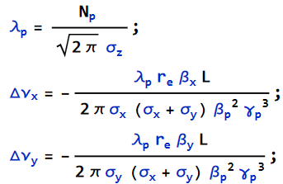


A symmetric collider model
E=4GeVx4GeV, Np=5x10¹⁰, ε_{x}=4nm, ε_{y}=25pm, β_{x}*=8cm, β_{y}*=1mm, σ_{z}=6mm
Arc is tracked by the same way as the mode analysis.
  Divided in to n=8,
(β_{xsc}, β_{ysc})=(5,20) Δν_{y}=0.0512
(5,50) Δν_{ysc} =0.0750
(5,100) Δν_{ysc} =0.0980
(12,12) Δν_{ysc} =0.0275
Δν_{ybb} =0.0726

Slide 4


Space charge force for dipole moment distribution in the longitudinal phase space
Momentum change in the longitudinal phase space
Following the expression using Wake
Effective transverse wake for the space charge force
$$1≤α≤2$$
$$W_{Q/D}\left(z\right)={∓k}_{sc}Lδ\left(z\right) { Z}_{Q/D}\left(ω\right)={∓ik}_{sc}L/c$$

Slide 5


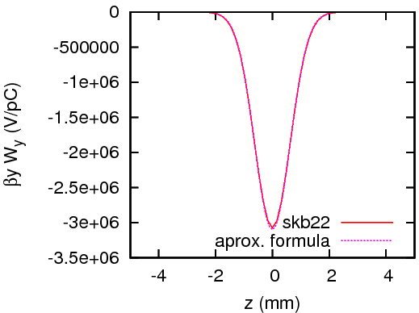

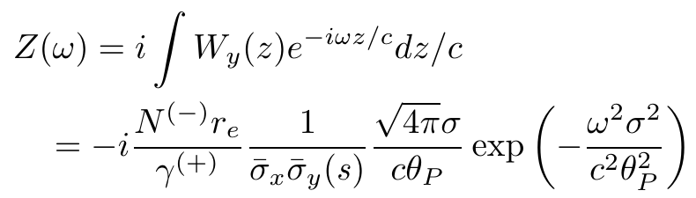

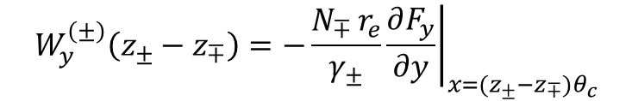

Vertical cross wake in beam-beam interaction
The cross wake exists also in the vertical plain.
$$W_{y}^{\left(±\right)}\left(z_{±}−z_{∓}\right)=−\frac{N_{∓ }r_{e}}{γ_{±}}{\left.\frac{∂F_{y}}{∂y}\right|}_{x=(z_{±}−z_{∓})θ_{c}}$$
For $σ_{x}≫σ_{y}, y=0,$
$$W_{y}^{\left(±\right)}\left(z\right)≈−\frac{N_{∓}r_{e}}{γ_{±}}\frac{1}{σ_{x}σ_{y}}\exp\left(−\frac{z^{2}θ_{c}^{2}}{4σ_{x}^{2}}\right)=−\frac{N_{∓}r_{e}}{γ_{±}}\frac{1}{σ_{x}σ_{y}}\exp\left(−\frac{z^{2}θ_{P}^{2}}{4σ_{z}^{2}}\right)$$
$$∆p_{y}^{\left(±\right)}(z)=\int_{−∞}^{∞}{W^{\left(±\right)}(z−z^{′})ρ^{\left(∓\right)}(z^{′}){(y}^{\left(±\right)}(z)−y^{\left(∓\right)}(z′))dz′}$$

Slide 6
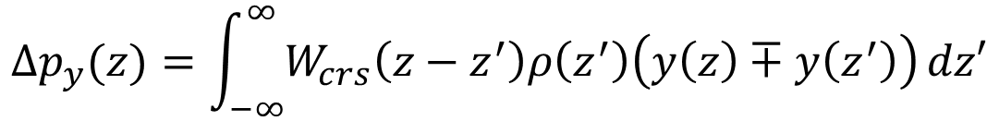




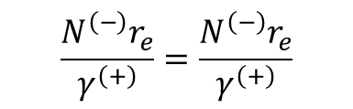
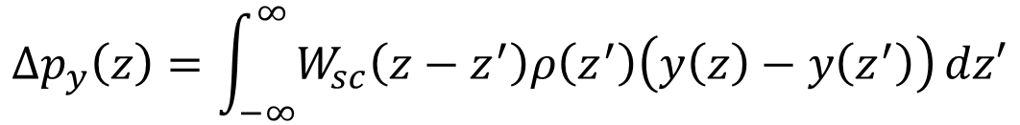
Beam-beam force in the transparency collision
$$\frac{N^{\left(−\right)}r_{e}}{γ^{\left(+\right)}}=\frac{N^{\left(−\right)}r_{e}}{γ^{\left(+\right)}}$$
$$σ_{x,y,z}^{(+)}=σ_{x,y,z}^{(−)}$$
$$β_{x,y}^{∗(+)}=β_{x,y}^{∗(−)}$$
$y^{\left(+\right)}\left(z\right)=y^{\left(−\right)}(z′)$ ${ p}_{y}^{\left(+\right)}(z)=p_{y}^{\left(−\right)}(z)$
  σ mode
  π mode
Space charge force
$y^{\left(+\right)}\left(z\right)={−y}^{\left(−\right)}(z′)$ $p_{y}^{\left(+\right)}(z)={−p}_{y}^{\left(−\right)}(z)$
$$∆p_{y}(z)=\int_{−∞}^{∞}{W_{crs}\left(z−z^{′}\right)ρ\left(z^{′}\right)\left(y\left(z\right)∓y\left(z^{′}\right)\right)}dz′$$
$$δ_{σ}(z)≡\frac{1}{\sqrt{2π}σ}e^{−z^{2}/2σ^{2}}$$
Similar formula and similar wake
$$∆p_{y}\left(z\right)=\int_{−∞}^{∞}{W_{sc}\left(z−z^{′}\right)ρ\left(z^{′}\right)\left(y\left(z\right)−y\left(z^{′}\right)\right)}dz′$$
$${\left\langle β_{y}\right\rangle W}_{sc}\left(z\right)={\left(2π\right)}^{3/2}{αξ}_{sc}σ_{z}δ\left(z\right)$$
$$1≤α≤2$$
TMCI/srcMC α=2

Slide 7



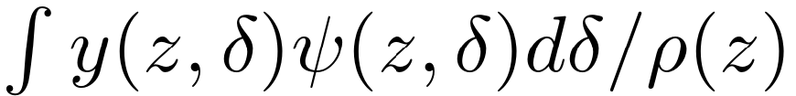
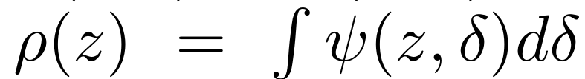
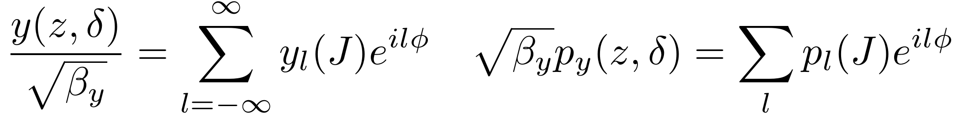
Mode analysis
Dipole and quadrupole wake force
Wake per s length
  Dipolar
  Quadrupolar
Radial-azimuthal mode expansion

Slide 8
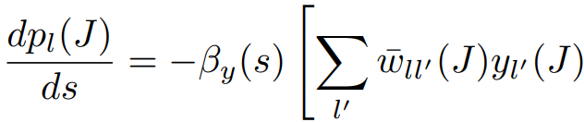
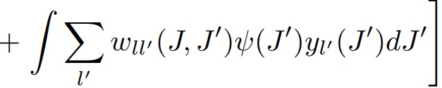

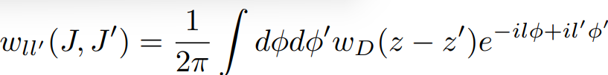
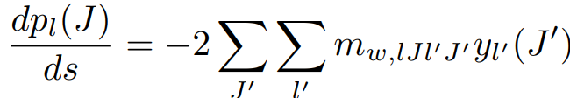

Momentum change of each mode
Dipole and quadrupole wake force
Discretize for J

Slide 9
Two types of TMCI
Instability caused by wakes that are considered uniformly distributed on average.
  Modeled by uniform wake
  The instability is betatron tune independent
  The instability threshold is determined by the frequency difference between synchro-beta sidebands; namely synchrotron tune.
Additional Instability caused by locality of the wake.
  Modeled by wake and transfer model.
  This instability is dependent of the betatron tune.
  Higher order mode for larger separation of the betatron tune from integer/half integer.

Slide 10




Uniformly distributed wake source
Base
Wake
Synchro-betatron motion
One turn matrix e^{-iμ}, square matrix with the order
Matrix to be solved eigenvalue problem
Equipartitioning
$$M_{W}=m_{w}L$$

Slide 11
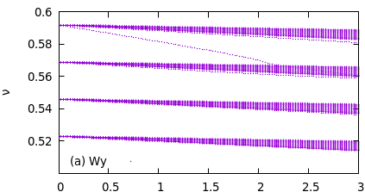
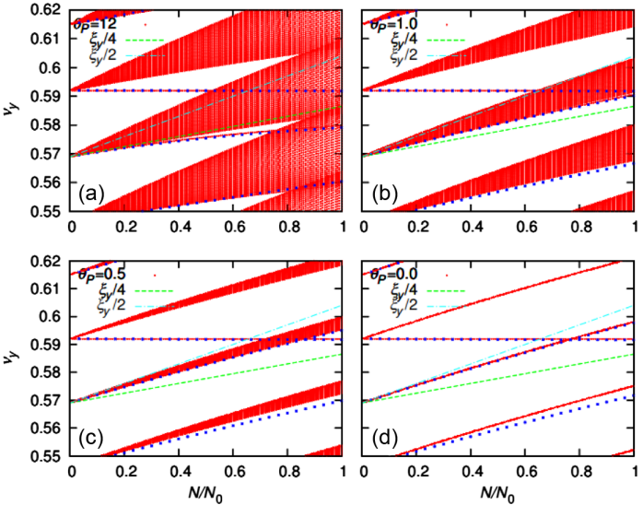
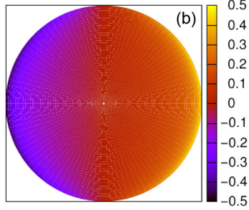
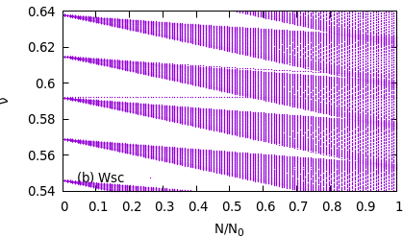
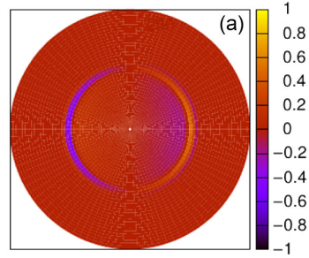
Mode spectrum for cases with one of Wy, SC or BB using uniform wake
Single e+ beam Colliding beam
Wy BB (σ mode)
SC
Isolated mode
Distributed mode

Slide 12

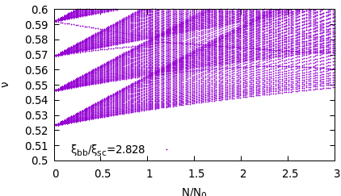
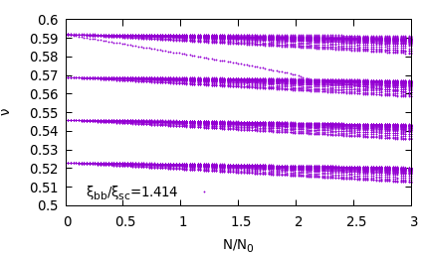
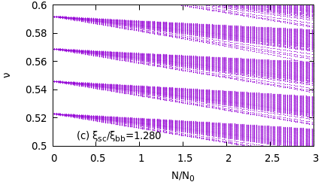
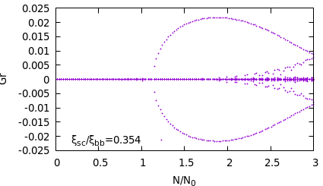
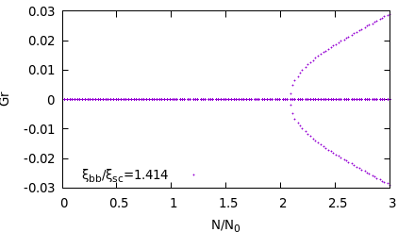
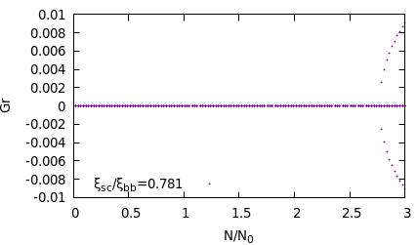
Combined Wake, BB+SC+Wy (approx. uniform)
BB dominant perfect cancel SC dominant
The growth rate and threshold aree seen in the imaginary part of tune.
The threshold of instability increases for higher space charge.
The threshold for is the same as the case only Wy.

Slide 13
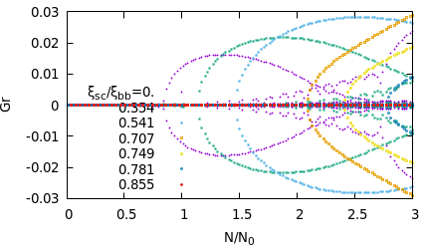
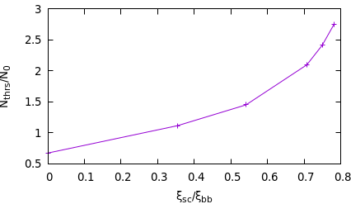
Threshold as a function of ξ_{sc}/ξ_{bb}
Slope of isolated -1 mode decreases for increasing space charge force, while slope of 0 mode is determined by the impedance.
The threshold increases for SC dominant. for SC dominant

Slide 14


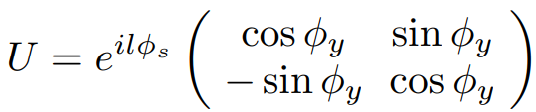



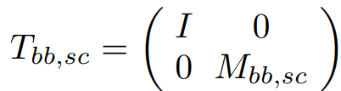


Combined case of localized beam-beam and uniform space charge
Transformation for the vector with the length
Arc is divided by n
Wake
The revolution matrix for which the eigenvalue problem is solved
This formalism is easily extended to realistic space charge considering beta function variation.
$$M_{bb,sc}=m_{bb,sc}δs$$
$$δs=L/n$$

Slide 15
Mixture of localized beam-beam and uniform space charge forces
Characteristic of the localized wake
Mode tune is reflected (wrapped) at (half)-integer.
Instability occurs even pure imaginary impedance coupling with a wrapped mode.
In a large separation for (half)-integer, high order mode instability is concerned.
In a special case satisfying , no tune shift in uniform approx. However a tune shift appears in the presence of a localized wake.

Slide 16
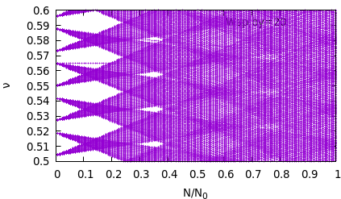
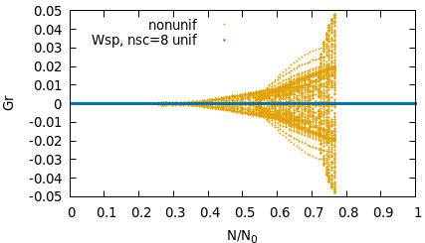
How to realize uniform space charge in the matrix transformation
We study linear instability. Avoid structure resonance of half integer for space charge.
8 points, ν_{y}=43.565
Uniform M_{sc}=M_{ν/16} M_{sc/8} M_{ν/16} , M_{t}= M_{W} (M_{sc})⁸
Break uniformity a bit M_{sc}=M_{sc/8} M_{ν/9}, M_{t}= M_{W}M_{ν/9} (M_{sc})⁸
Artificial growth is avoided by space charge force applying at 8 points uniformly.
Considering beta variation precisely, physical growth is evaluated.

Slide 17
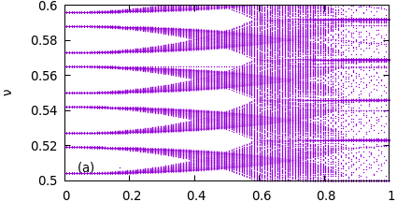
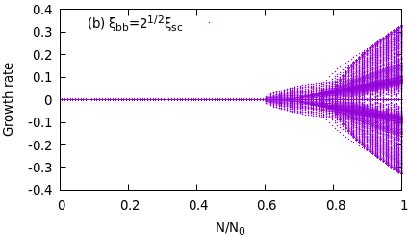
Mode behavior in the case
Unstable for coupling with the same parity mode for pure imaginary impedance like beam-beam and space charge.
  Parity l: even or odd
Instability occurs at coupling with different parity mode, when real part of impedance is finite like ordinary wake.
s
l=0
-5
-1
-4
-2
-3

Slide 18
PIC simulation for beam-beam, space charge and impedance
SCTR-bb (BBSSL), GPU code developed by cuda c++.
https://kds.kek.jp/event/42931/
https://kds.kek.jp/event/43469/
https://kds.kek.jp/event/50714/
Lattice tracking is available using SAD compatible functions (Li Zhiyuan)

Slide 19
Simulation using a symmetric model
E=4GeVx4GeV, Np=5x10¹⁰, ε_{x}=4nm, ε_{y}=25pm, β_{x}*=8cm, β_{y}*=1mm, σ_{z}=6mm
Arc is tracked by the same way as the mode analysis.
  Divided in to n=8,
(β_{xsc}, β_{ysc})=(5,20) Δν_{y}=0.0512
(5,50) Δν_{ysc} =0.0750
(5,100) Δν_{ysc} =0.0980
(12,12) Δν_{ysc} =0.0275
Δν_{ybb} =0.0726

Slide 20
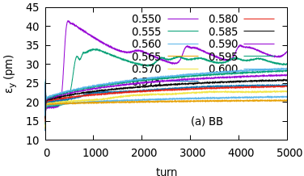
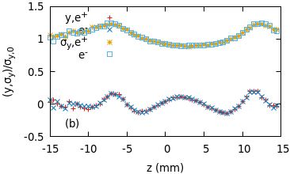
Strong-strong simulation for only beam-beam
Typical result for 2-nd type of TMCI
The emittance growth is saturated at 2xε_{y}, and behaves saw-tooth.
σy growth only at ν_{y} =0.550 and 0.555.
High order (l~3) vertical beam-beam head-tail (Y-Z) instability.

Slide 21
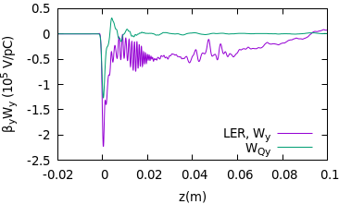
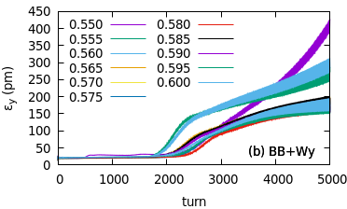
Vacuum environment impedance is added
Impedance data by T. Ishibashi, D. Zhou, https://kds.kek.jp/event/40318/
Instability simulation considering beam-beam and the impedance
Large emittance growth than that for only beam-beam.
Instability occurs independent of ν_{y}.
1st type of TMCI, PRAB 26, 111001

Slide 22
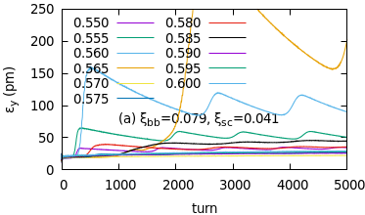
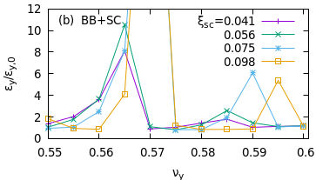
Simulation considering beam-beam and space charge, no impedance
The effective impedance is pure imaginary.
Increasing space charge effect (tune shift), 2nd type of instability is enhanced by lack of Landau damping due to tune shift(spread) cancellation

Slide 23
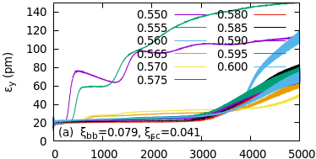
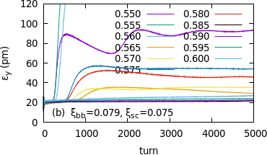
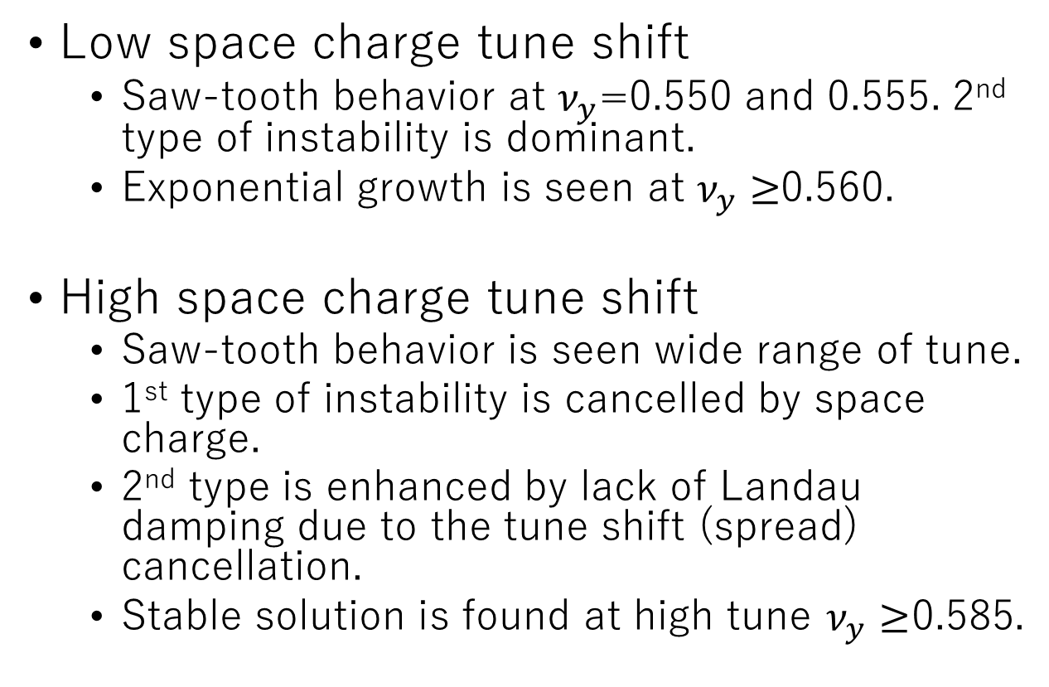
Simulation considering beam-beam, space charge and impedance
Low space charge tune shift
  Saw-tooth behavior at $ν_{y}$=0.550 and 0.555. 2nd type of instability is dominant.
  Exponential growth is seen at $ν_{y}≥$0.560.
High space charge tune shift
  Saw-tooth behavior is seen wide range of tune.
  1st type of instability is cancelled by space charge.
  2nd type is enhanced by lack of Landau damping due to the tune shift (spread) cancellation.
  Stable solution is found at high tune $ν_{y}≥$0.585.

Slide 24
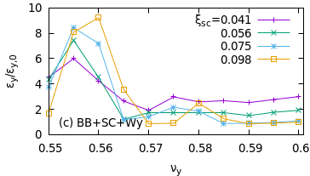

Summary of simulation considering beam-beam, space charge and impedance
Stable solution is found at high tune $ν_{y}≥$0.585 for a high space charge tune shift.
2nd type is strong
1st type is strong (exponential growth).
The emittance should be larger in a long term simulation.
Stable

Slide 25
More Realistic case: asymmetric collision
E(e+)４GeV x E(e-) 7 GeV. N_{p}=7x10¹⁰, N_{e}=4x10¹⁰.
β_{x} =0.08, β_{y} =0.001, ξ_{bb}~0.063 for both beams,
β_{x} =β_{y}=12m, ξ_{sc} =0.0384, β_{x} =8, β_{y}=20m, ξ_{sc} =0.0583,
No space charge for e- beam.
Wake data “Integrated wake potentials in LER/HER“ in https://kds.kek.jp/event/40318/
sed 's/skbts_12/skbts_23/;s/43.555/43.610/' skbts.pl | perl -f

Slide 26
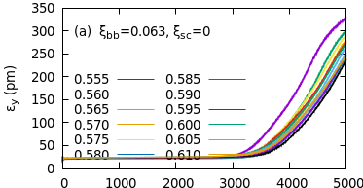
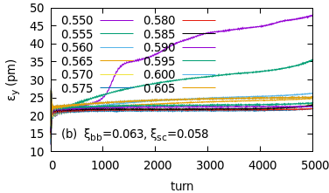
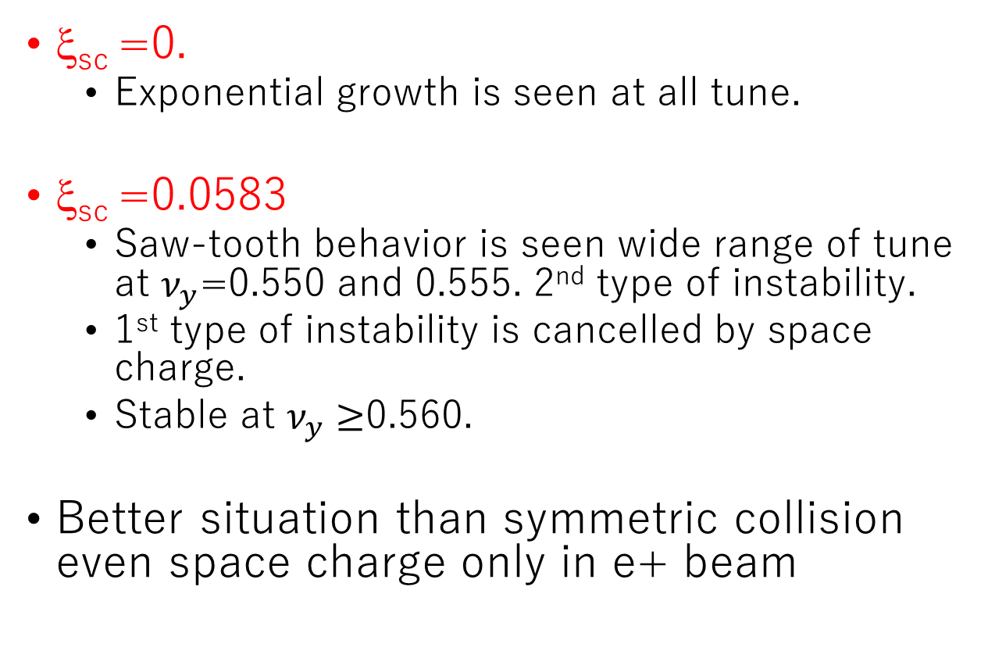
Simulation for an asymmetric collider considering beam-beam, space charge and impedance
ξ_{sc} =0.
  Exponential growth is seen at all tune.
ξ_{sc} =0.0583
  Saw-tooth behavior is seen wide range of tune at $ν_{y}$=0.550 and 0.555. 2nd type of instability.
  1st type of instability is cancelled by space charge.
  Stable at $ν_{y}≥$0.560.
Better situation than symmetric collision even space charge only in e+ beam

Slide 27
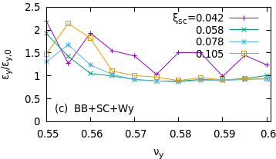
Summary of simulation for an asymmetric collider
Stable area increases compare with the symmetric case.
Coherence of the two beams
2nd type is strong
Stable

Slide 28
Summary
Combined effects of beam-beam, space charge and impedance were studied.
The cross wake for a large Piwinski angle collision is similar to the space charge wake.
Type 1 TMCI: all wakes can be considered uniformly distributed in a ring.
  Typical case: beam-beam modes 0 and -1 are coupled by the impedance. This instability is suppressed by the space charge force.
Type 2 TMCI: localized beam-beam+uniform space charge+ (impedance)
Typical case: mode couples to that wrapped at (half)-integer. High order mode head-tail. The space charge force can not compensate for this instability.
Strong-strong simulation with beam-beam space charge and impedance
  These two types of TMCI are reproduced.
  Space charge compensation worsened the instability due to the decrease of tune spread.
  Asymmetric collision showed better stability than symmetric collision. The coherence of the two beams may be broken

Slide 29
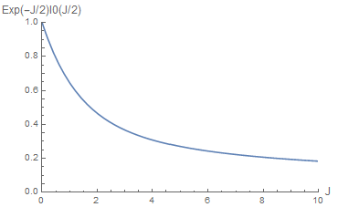
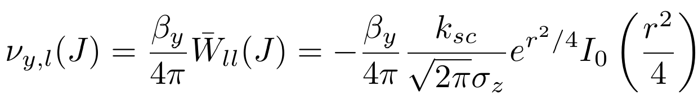




Head-tail oscillation mode in space charge force
Tunes shift for J dependent modes
Tune shift for simple radial mode represented by Laguerre polynomials
L>0 mode can be ν_{L}<ν₀

Slide 30








Space charge mode (J-PARC MR)
E=3.938GeV, σ_{x}=10mm, <β_{x}>=11.8m, σ_{z} =10m, σ_{δ} =0.16%, ν_{s}=0.0024.
Δν_{sc}=0.124 at N_{p}=10¹³.
Isolated modes

Slide 31
Summary for the space charge mode
L>0 modes with ν_{L}>ν₀ exist.
The distribution seems to be flat (smooth) in the longitudinal phase space.
ν_{L}-ν₀<<Lν_{s}
This behavior is known. M. Blaskiewics (PRSTAB 1, 044201) gave using a special longitudinal distribution: an airbag and the longitudinal potential with a square well (ABS).
It is surprising the special mode gives the same solution.
Chromaticity doe not change this behavior, because the space change impedance is not affected by chromatic frequency shift. Beam distribution is modulated by chromaticity.

Slide 32
Thank you for your attention

Slide 34
















Longitudinal distribution
$$σ_{z}≡\sqrt{ε_{z}β}$$
$$ψ\left(J\right)=\frac{1}{2πε_{z}}e^{−J/ε_{z}}$$
$$ρ\left(z\right)=\frac{1}{\sqrt{2π}σ_{z}}e^{−z^{2}/2σ_{z}^{2}}$$
0. Gaussian
Parabolic
2. Parabolic
3. Uniform
Water-bag
4. Uniform
$$\left|z\right|<∞$$
$$ψ\left(J\right)=\frac{1}{πε_{z}^{2}}{(ε}_{z}−J)$$
$$ρ\left(z\right)=\frac{2}{3πσ_{z}^{4}}{\left({2σ}_{z}^{2}−z^{2}\right)}^{3/2}$$
$$\left|z\right|<{\sqrt{2}σ}_{z}$$
$$ψ\left(J\right)=\frac{3}{4πε_{z}^{3/2}}\sqrt{ε_{z}−J}$$
$$ρ\left(z\right)=\frac{3}{8\sqrt{2}σ_{z}^{3}}\left({2σ}_{z}^{2}−z^{2}\right)$$
$$\left|z\right|<{\sqrt{2}σ}_{z}$$
$$ψ\left(J\right)=\frac{1}{2πε_{z}}θ{(ε}_{z}−J)$$
$$ρ\left(z\right)=\frac{1}{πσ_{z}^{2}}\sqrt{2σ_{z}^{2}−z^{2}}$$
$$\left|z\right|<{\sqrt{2}σ}_{z}$$
$$ψ\left(J\right)=\frac{1}{4π\sqrt{ε_{z}}}\frac{1}{\sqrt{ε_{z}−J}}$$
$$ρ\left(z\right)=\frac{1}{2{\sqrt{2}σ}_{z}}$$
$$\left|z\right|<{\sqrt{2}σ}_{z}$$

Slide 35







Mode coupling for various longitudinal distribution
Quadrupole term
Dipole term
Equation of motion
$${i^{n}J}_{n}\left(k_{σ}r\right)={i^{−n}J}_{−n}\left(k_{σ}r\right)$$
$$r=\sqrt{2J/ε_{z}}=\sqrt{2\hat{J}}$$
$$=i^{|l−l^{′}|−1}\int{dωZ_{Q}\left(ω\right)J_{|l−l^{′}|}\left(k_{σ}r\right)D(k_{σ})}$$
$$D\left(k_{σ}\right)=\int_{0}^{∞}{ψ(J^{′})J_{0}\left(k_{σ}r^{′}\right)dJ′}$$
$$\hat{J}=J/ε_{z}$$
$$W_{ll^{′}}(J,J^{′})=i^{l−l^{′}−1}\int{dωZ_{D}\left(ω\right)J_{l}\left(k_{σ}r\right)J_{l^{′}}(k_{σ}r′)}$$
$$k_{σ}=ωσ/c$$

Slide 36












D(k_{σ}) for various Distribution
$$D\left(k_{σ}\right)=\int_{0}^{∞}{ψ({\hat{J}}^{′})J_{0}\left(k_{σ}r^{′}\right)d\hat{J}′}$$
$$\frac{J}{ε_{z}}=\hat{J}=\frac{r^{2}}{2}$$
$$ψ\left(\hat{J}\right)=\frac{1}{2π}e^{−\hat{J}}$$
$$D\left(k_{σ}\right)=\frac{1}{2π}e^{−k_{σ}^{2}/2}$$
0. Gaussian
Parabolic
2. Parabolic
3. Uniform
water-bag
4. Uniform
$$D\left(k_{σ}\right)=\frac{2}{π}\frac{ J_{2}({\sqrt{2}k}_{σ})}{k_{σ}^{2}}$$
$$ψ\left(\hat{J}\right)=\frac{1}{π}(1−\hat{J})$$
$$ψ\left(\hat{J}\right)=\frac{3}{4π}\sqrt{1−\hat{J}}$$
$$D\left(k_{σ}\right)=\frac{3}{2π}\frac{\sin{{\sqrt{2}k}_{σ}}−\sqrt{2}k_{σ}\cos{\sqrt{2}k_{σ}}}{{\left(\sqrt{2}k_{σ}\right)}^{3}}$$
$$ψ\left(\hat{J}\right)=\frac{1}{2π}θ(1−\hat{J})$$
$$D\left(k_{σ}\right)=\frac{1}{π}\frac{ J_{1}({\sqrt{2}k}_{σ})}{\sqrt{2}k_{σ}}$$
$$ψ\left(\hat{J}\right)=\frac{1}{4π}\frac{1}{\sqrt{1−\hat{J}}}$$
$$D\left(k_{σ}\right)=\frac{1}{2π}\frac{\sin{{\sqrt{2}k}_{σ}}}{\sqrt{2}k_{σ}}$$

Slide 37










Normalized by $ρ\left(0\right)$
$$σ_{z}≡\sqrt{ε_{z}β}$$
$$ψ\left(J\right)=\frac{1}{2πε_{z}}e^{−J/ε_{z}}$$
$$ρ\left(0\right)=\frac{1}{\sqrt{2π}σ_{z}}$$
0. Gaussian
Parabolic
2. Parabolic
3. Uniform
Water-bag
4. Uniform
$$ψ\left(J\right)=\frac{1}{πε_{z}^{2}}{(ε}_{z}−J)$$
$$ρ\left(0\right)=\frac{4\sqrt{2}}{3πσ_{z}}$$
$$σ_{z}=\frac{8}{3\sqrt{π}}σ_{z,G}$$
$$ψ\left(J\right)=\frac{3}{4πε_{z}^{3/2}}\sqrt{ε_{z}−J}$$
$$ρ\left(0\right)=\frac{3}{4\sqrt{2}σ_{z}}$$
$$σ_{z}=\frac{3\sqrt{π}}{4}σ_{z,G}$$
$$ψ\left(J\right)=\frac{1}{2πε_{z}}θ{(ε}_{z}−J)$$
$$ρ\left(0\right)=\frac{\sqrt{2}}{πσ_{z}^{2}}$$
$$σ_{z}=\frac{2}{\sqrt{π}}σ_{z,G}$$
$$ψ\left(J\right)=\frac{1}{4π\sqrt{ε_{z}}}\frac{1}{\sqrt{ε_{z}−J}}$$
$$ρ\left(0\right)=\frac{1}{2{\sqrt{2}σ}_{z}}$$
$$σ_{z}=\frac{\sqrt{π}}{2}σ_{z,G}$$

Slide 38










4 Uniform distribution
$$ψ\left(\hat{J}\right)=\frac{1}{4π}\frac{1}{\sqrt{1−\hat{J}}}$$
$$ρ\left(z\right)=\frac{1}{2σ_{z}}$$
$$D\left(k_{σ}\right)=\frac{1}{2π}\frac{\sin{{\sqrt{2}k}_{σ}}}{\sqrt{2}k_{σ}}$$
Space charge impedance
$$W_{Q/D}\left(z\right)={∓k}_{sc}Lδ\left(z\right) { Z}_{Q/D}\left(ω\right)={∓ik}_{sc}L/c$$
$${\overline{W}}_{l−l^{′}}(J)=i^{|l−l^{′}|−1}\int{dωZ_{Q}\left(ω\right)J_{|l−l^{′}|}\left(k_{σ}r\right)D(k_{σ})}$$
$$={−i}^{|l−l^{′}|}\frac{k_{sc}L}{2πc}\int{dωJ_{|l−l^{′}|}\left(k_{σ}r\right)\frac{\sin{{\sqrt{2}k}_{σ}}}{\sqrt{2}k_{σ}}}$$
$$=−δ_{ll^{′}}\frac{k_{sc}L}{2\sqrt{2}σ_{z}}$$
$$δp_{l,Q}(J)=β_{y}\frac{k_{sc}L}{2\sqrt{2}σ_{z}}y_{l}(J)$$
Defocusing
$$δp_{l,D}(J)={−β}_{y}\int_{0}^{∞}{\sum_{l′}{W_{ll^{′}}\left(J,J^{′}\right)ψ\left(J^{′}\right)y_{l^{′}}\left(J^{′}\right)dJ′}}$$
$$W_{ll^{′}}(J,J^{′})=i^{l−l^{′}}\frac{k_{sc}L}{c}\int{dω J_{l}\left(k_{σ}r\right)J_{l^{′}}(k_{σ}r′)}$$
$$={−β}_{y}i^{l−l^{′}}\frac{k_{sc}L}{c}\sum_{l^{′}}{\int{dω J_{l}\left(k_{σ}r\right)\int_{0}^{∞}{ψ\left(J^{′}\right)J_{l^{′}}(k_{σ}r′)y_{l^{′}}\left(J^{′}\right)dJ′}}}$$

Slide 39









Transverse distribution
${2J}_{x}=X^{2}$+ $P^{2}$
$$X=x/\sqrt{β_{x}}$$
$$P=\frac{α_{x}x}{\sqrt{β_{x}}}+\sqrt{β_{x}}p_{x}$$
Parabolic
Uniform (KV)
Gaussian
$$ψ\left(X,P,Y,Q\right)=\frac{2}{π^{2}ε_{x}ε_{y}}θ\left(1−\frac{{2J}_{x}}{ε_{x}}−\frac{{2J}_{y}}{ε_{y}}\right)$$
$$ρ\left(X,Y\right)=\frac{2}{π\sqrt{ε_{x}ε_{y}}}\left(1−\frac{X^{2}}{ε_{x}}−\frac{Y^{2}}{ε_{y}}\right)$$
$$ψ\left(X,P,Y,Q\right)=\frac{1}{π^{2}ε_{x}ε_{y}}δ\left(1−\frac{{2J}_{x}}{ε_{x}}−\frac{{2J}_{y}}{ε_{y}}\right)$$
$$ρ\left(X,Y\right)=\frac{1}{πε_{x}ε_{y}}θ\left(1−\frac{X^{2}}{ε_{x}}−\frac{Y^{2}}{ε_{y}}\right)$$
$$ψ\left(X,P,Y,Q\right)=\frac{1}{{4π}^{2}ε_{x}ε_{y}}\exp\left(−\frac{J_{x}}{ε_{x}}−\frac{J_{y}}{ε_{y}}\right)$$
$$ρ\left(X,Y\right)=\frac{1}{2π\sqrt{ε_{x}ε_{y}}}exp\left(−\frac{X^{2}}{{2ε}_{x}}−\frac{Y^{2}}{{2ε}_{y}}\right)$$

Slide 40
Peak density in real space (transverse)
Transverse
For equal peak density,
Longitudinal

Slide 41




Mathematica
Documents/WorldAccl/CSNS/ModeCouplingFormulae

