Slide 1
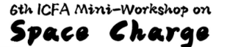

The equilibrium longitudinal emittance of cold ion bunches in storage rings
Lijun MAO
Institute of Modern Physics, CAS
CSNS, 2024.09.13

Slide 2
Contents
Equilibrium between beam cooling and heating
HIRFL and experimental results
Simulation with multi-model particles
Conclusion

Slide 3
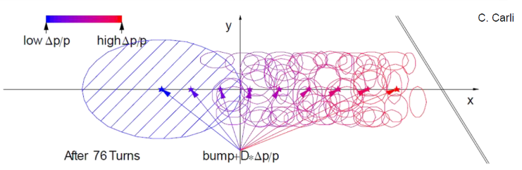
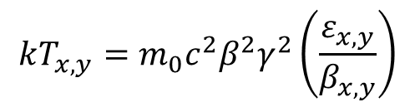
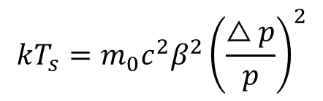
Beam cooling in heavy ion storage ring
Low energy heavy ion storage rings, beam with large emittance is obtained after injection
Combined longitudinal & transverse multi-turn
---Used at CERN LEIR
Horizontal multi-turn
Beam cooling is used for a reduction of beam temperature
Temperature is equivalent to terms as phase space volume, emittance and momentum spread
$$kT_{s}=m_{0}c^{2}β^{2}{\left(\frac{△p}{p}\right)}^{2}$$
$$kT_{x,y}=m_{0}c^{2}β^{2}γ^{2}\left(\frac{ε_{x,y}}{β_{x,y}}\right)$$
Beam cooling techniques are non-Liouvillean processes which violate the assumption of a conservative force, as interaction of the particles with other particles (electrons, photons)
---M.Steck, GSI

Slide 4
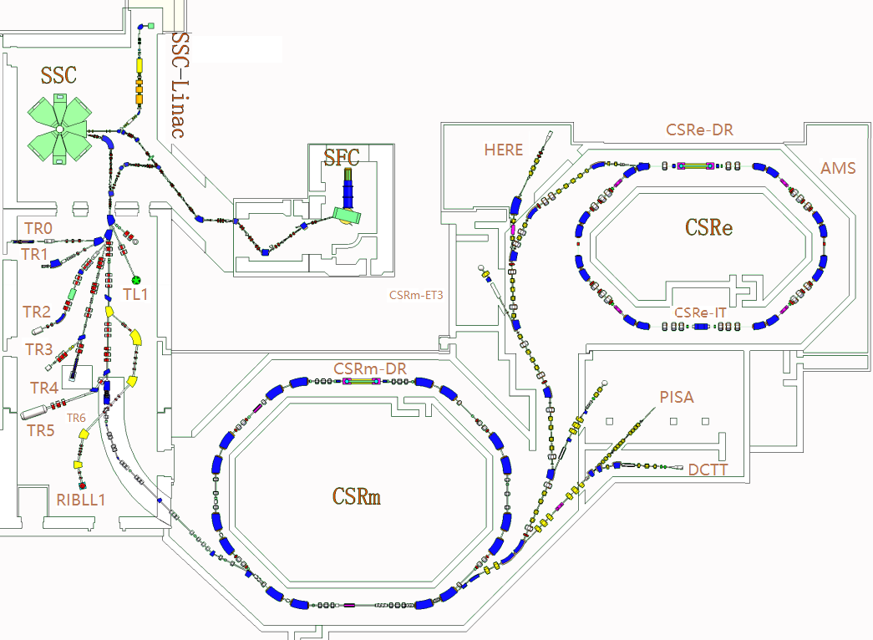
Beam cooling in heavy ion storage ring
Electron cooling, stochastic cooling and laser cooling are used for different purpose in heavy ion storage rings
Main parameters
 | CSRm | CSRe
Ions | H₂⁺~U | C~U
Circumference [m] | 161 | 128
Magnetic rigidity [Tm] | 12 | 9.4
E-cooling [keV] | 35 | 300
Stochastic cooling [GHz] | / | 0.1~1.2
Laser cooling [nm] | / | λ=257
Heavy ion research facility at Lanzhou, HIRFL

Slide 5
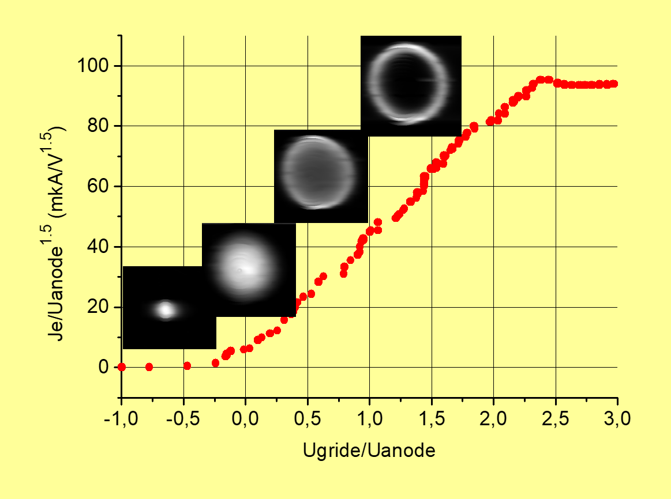
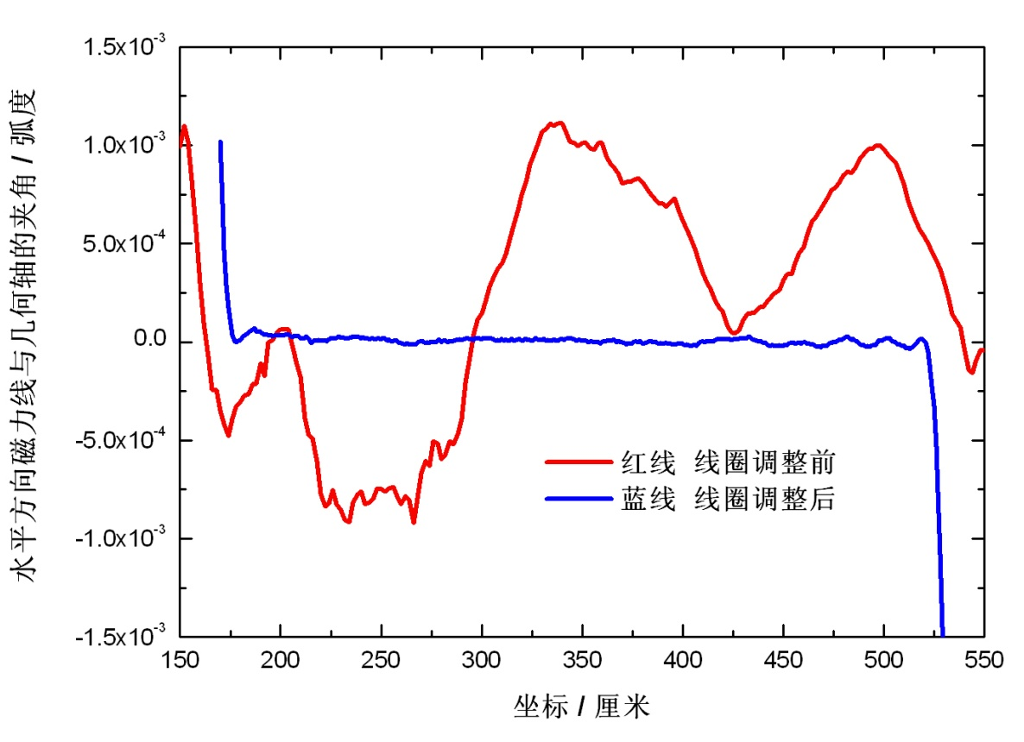
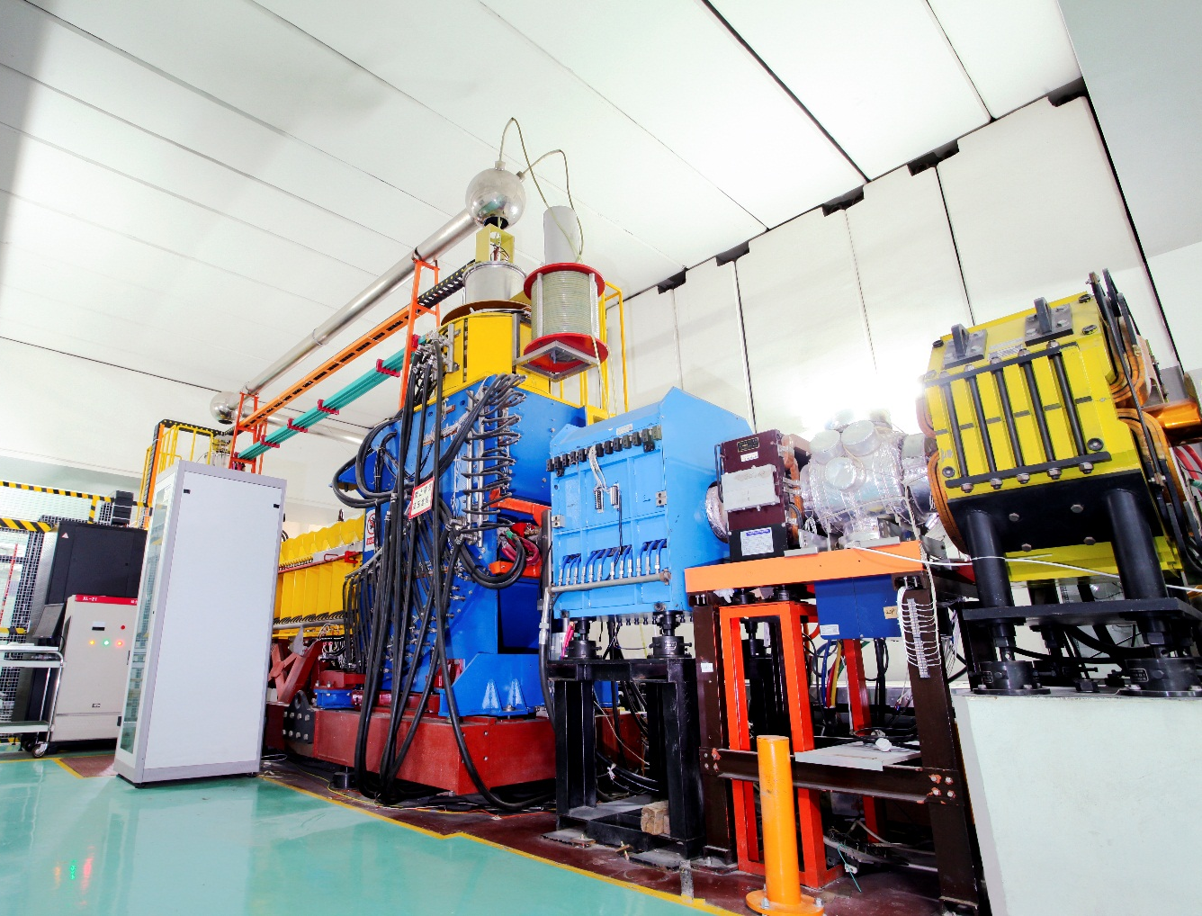
Beam cooling in heavy ion storage ring
Electron coolers developed by BINP
Variable transverse electron beam profile to avoid “heating”
Electrostatic bending to reduce the leakage current
Homogeneity of magnetic field to improve the cooling force
Stochastic cooling and laser cooling system at CSRe
electrodes inside the dipole
stochastic cooling control
laser device

Slide 6
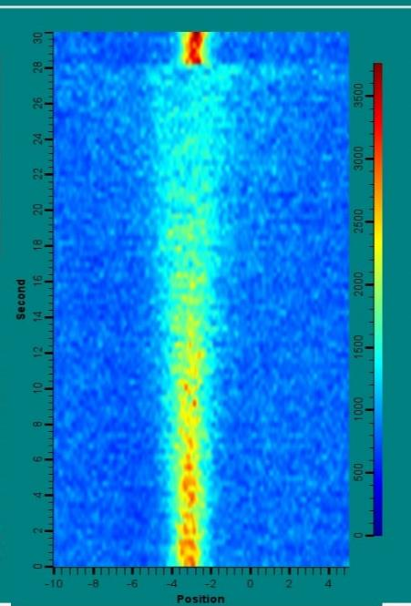
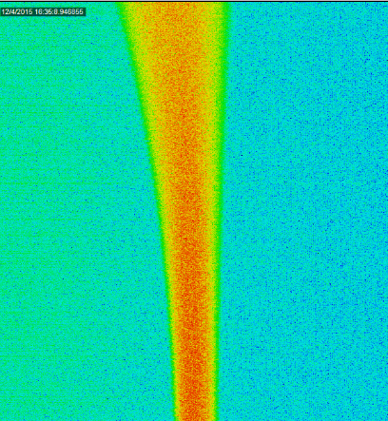
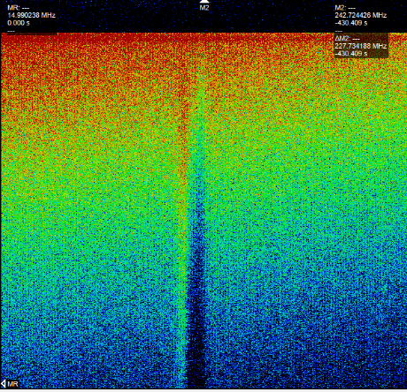
Beam cooling in heavy ion storage ring
Electron cooling, stochastic cooling and laser cooling are used for different purpose in heavy ion storage rings
Fe²⁶⁺ @ 25MeV/u in CSRe
Electron cooling
C⁵⁺ @380 MeV/u in CSRe
Stochastic cooling
O⁵⁺ @275.68 MeV/u in CSRe
Laser cooling

Slide 7
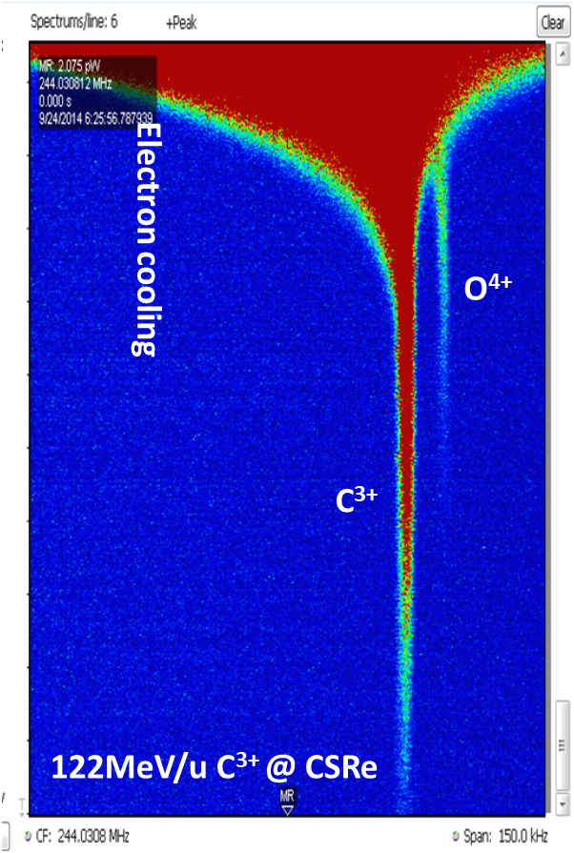
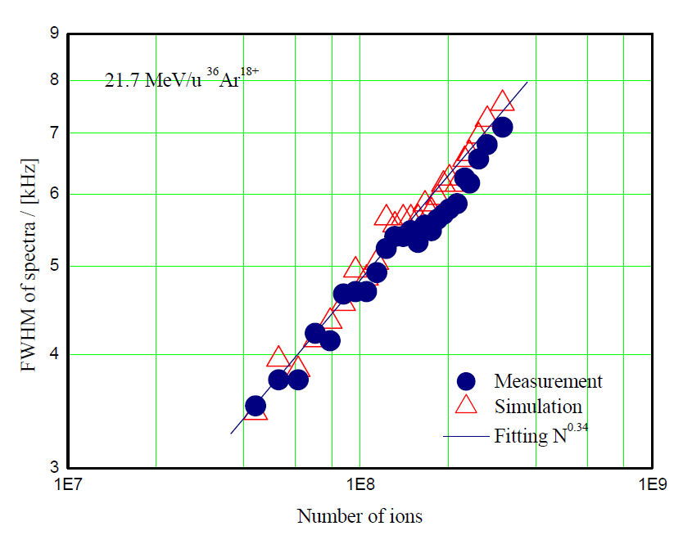

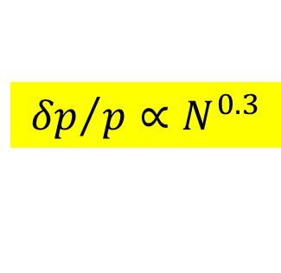
Equilibrium of cooling and heating
Phase space volume increases with coasting ion beam intensity and ion charges
$${δp}/p∝N^{0.3}$$
$$ε_{x,y}∝N^{0.5\sim 0.6}$$
Electron cooled beams equilibrium with Intra-beam Scattering (IBS)
---M.Steck, Seminar at IMP
exp. @ GSI
exp. @ IMP
What about longitudinal emittance (bunch length) in equilibrium?

Slide 8
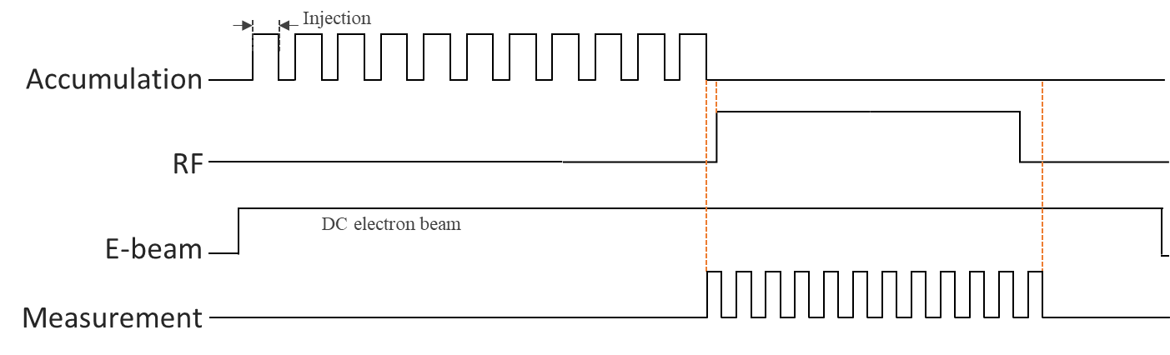
HIRFL and experimental results
First measurement of cold ion beam bunch length at CSRe in 2009
200MeV/u C6+ ions cooled by 0.5A electron beam
U_{RF}≈3kV with a fixed frequency
higher intensity
lower intensity
Bunch length increased faster for higher beam intensity, maybe it’s driven by different beam dynamics
Bunch length measured

Slide 9
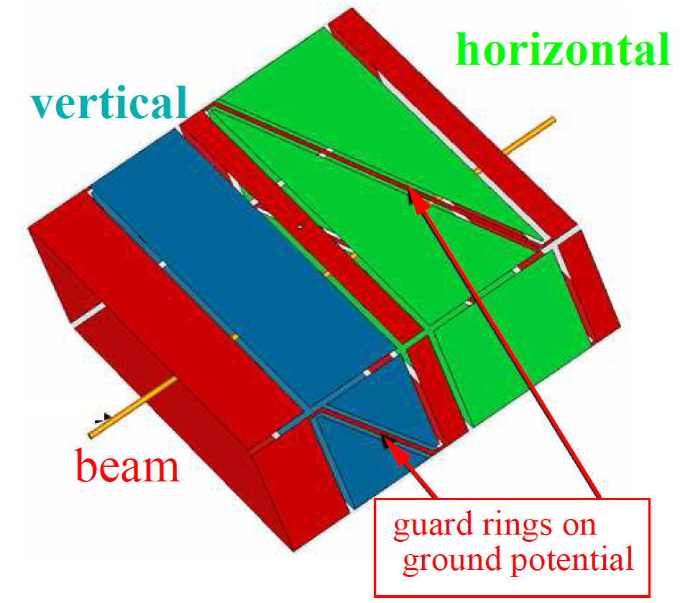
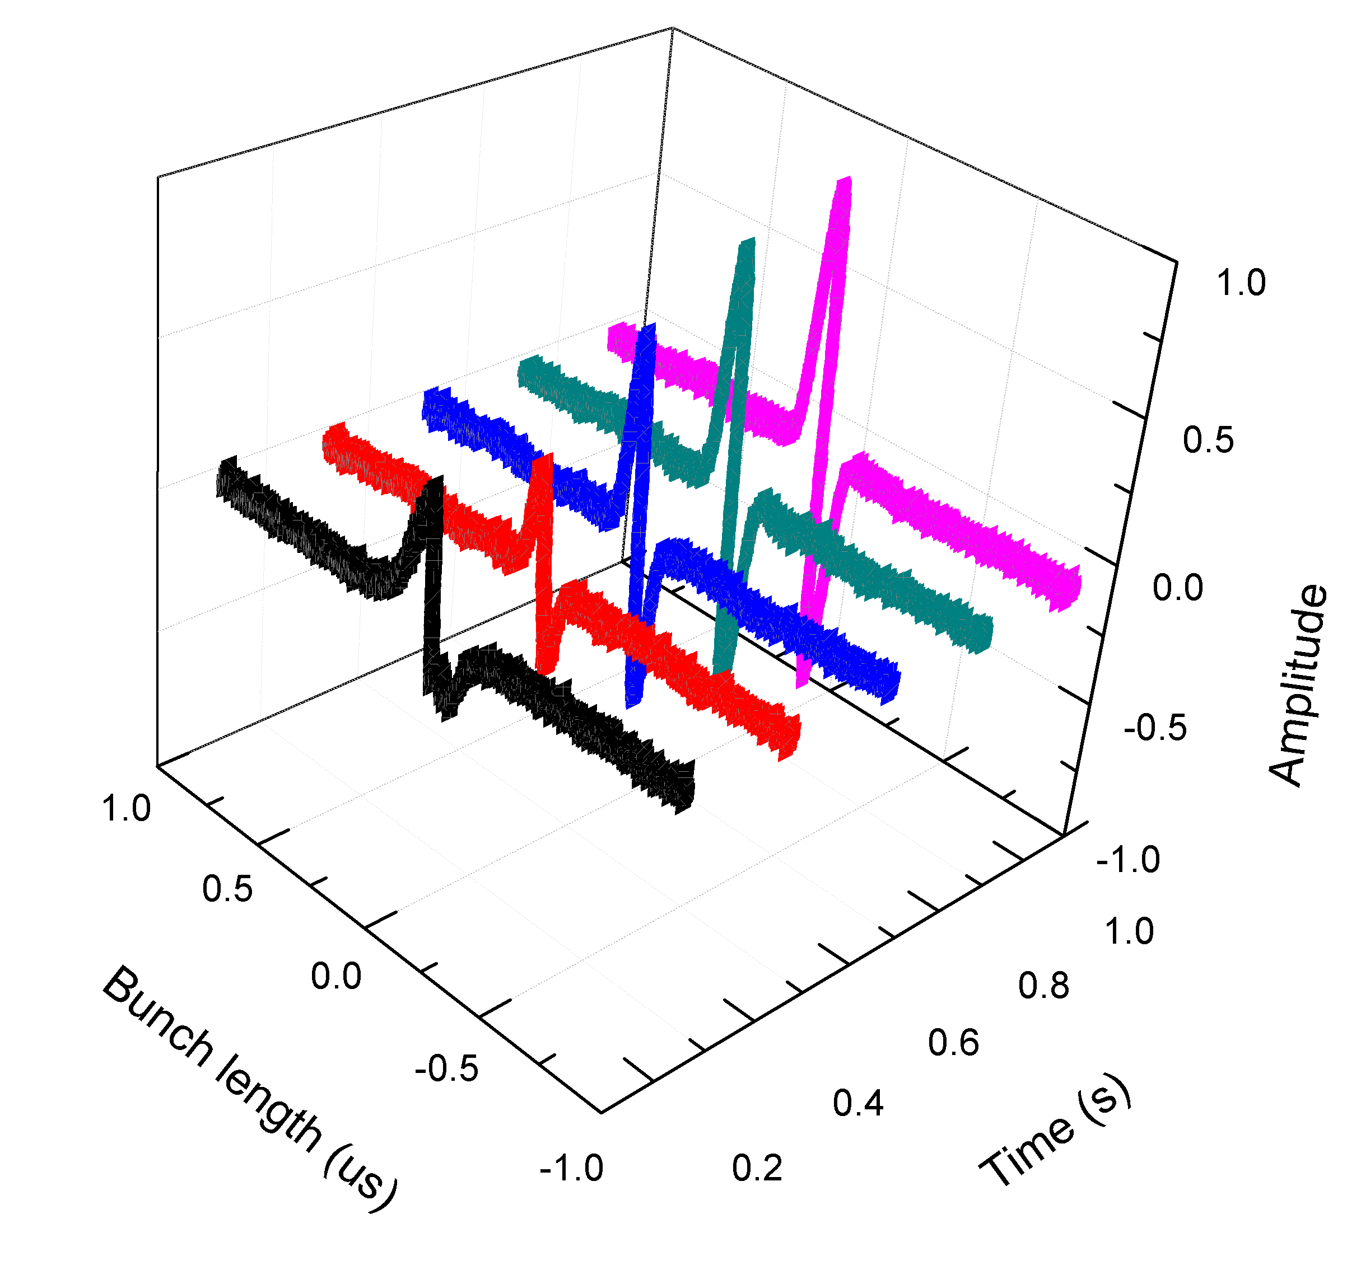
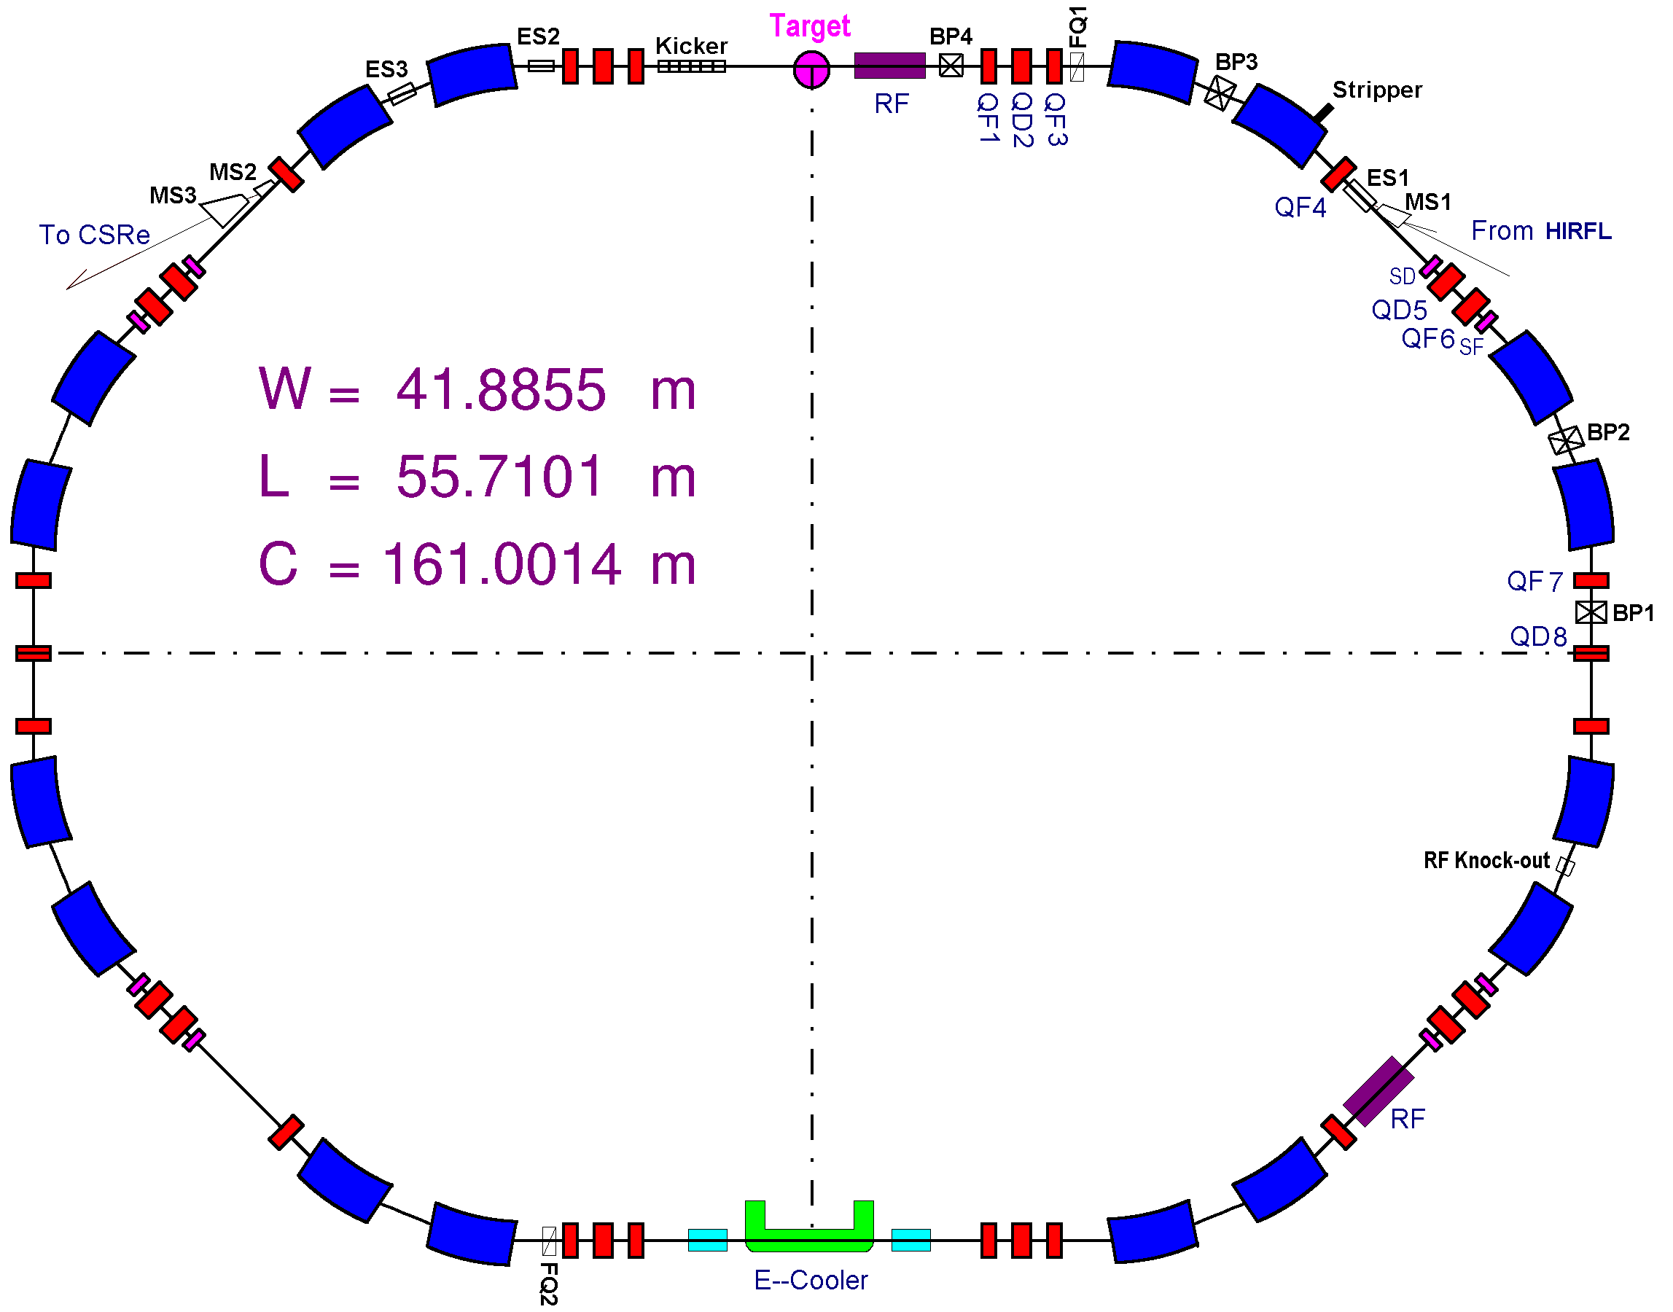
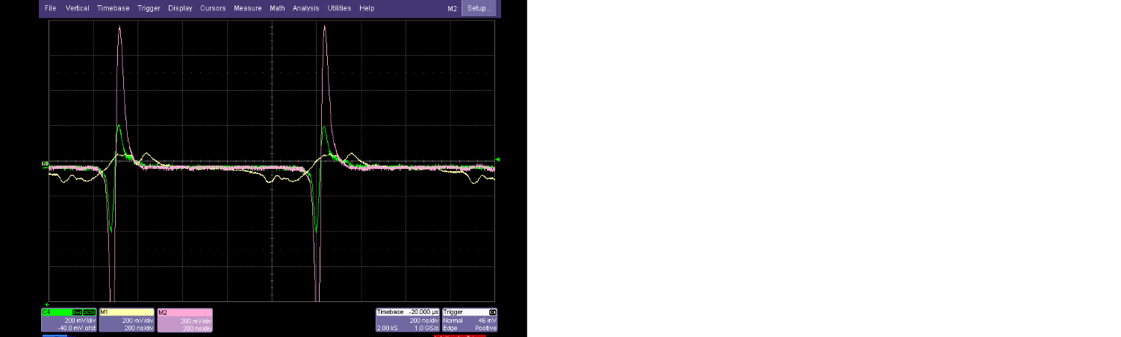
Beam cooling in heavy ion storage ring
Experiment at CSRm
BPM are used for the bunch length measurement
The timing sequence is triggered by events generator
CSRm injection energy
6.9 MeV/u ¹²C⁶⁺ & 3.7 MeV/u ¹¹²Sn³⁶⁺
Bunched ion beam vs. DC e-beam
RF-Cooler-BPM-Schottky
cooled
uncooled

Slide 10
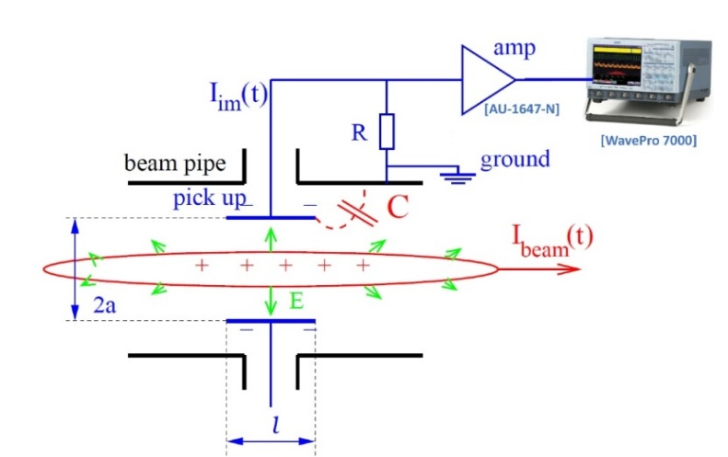
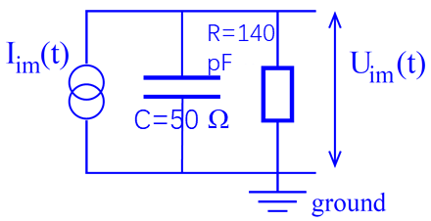
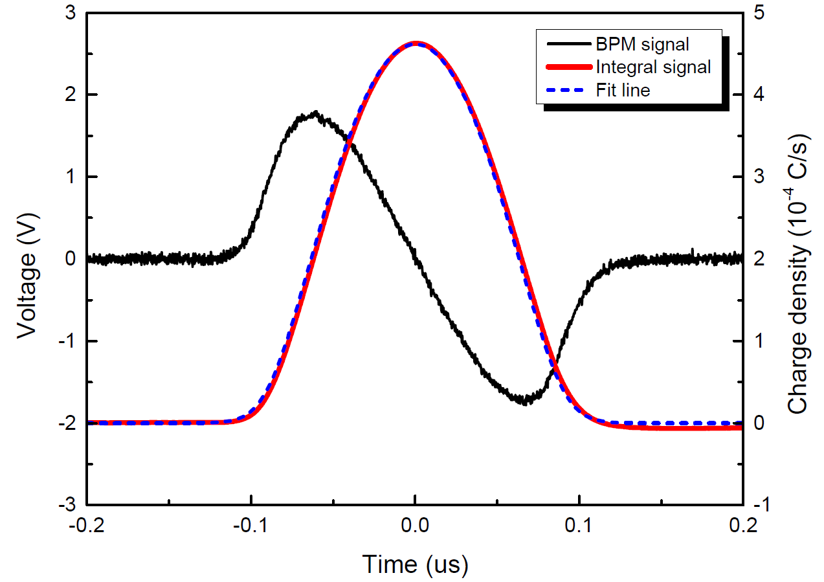
HIRFL and experimental results
How to get the bunch length?
Spectrum transform method: get the ion beam shape
Fokker-Plank equation: the beam distribution in longitudinal

Slide 11
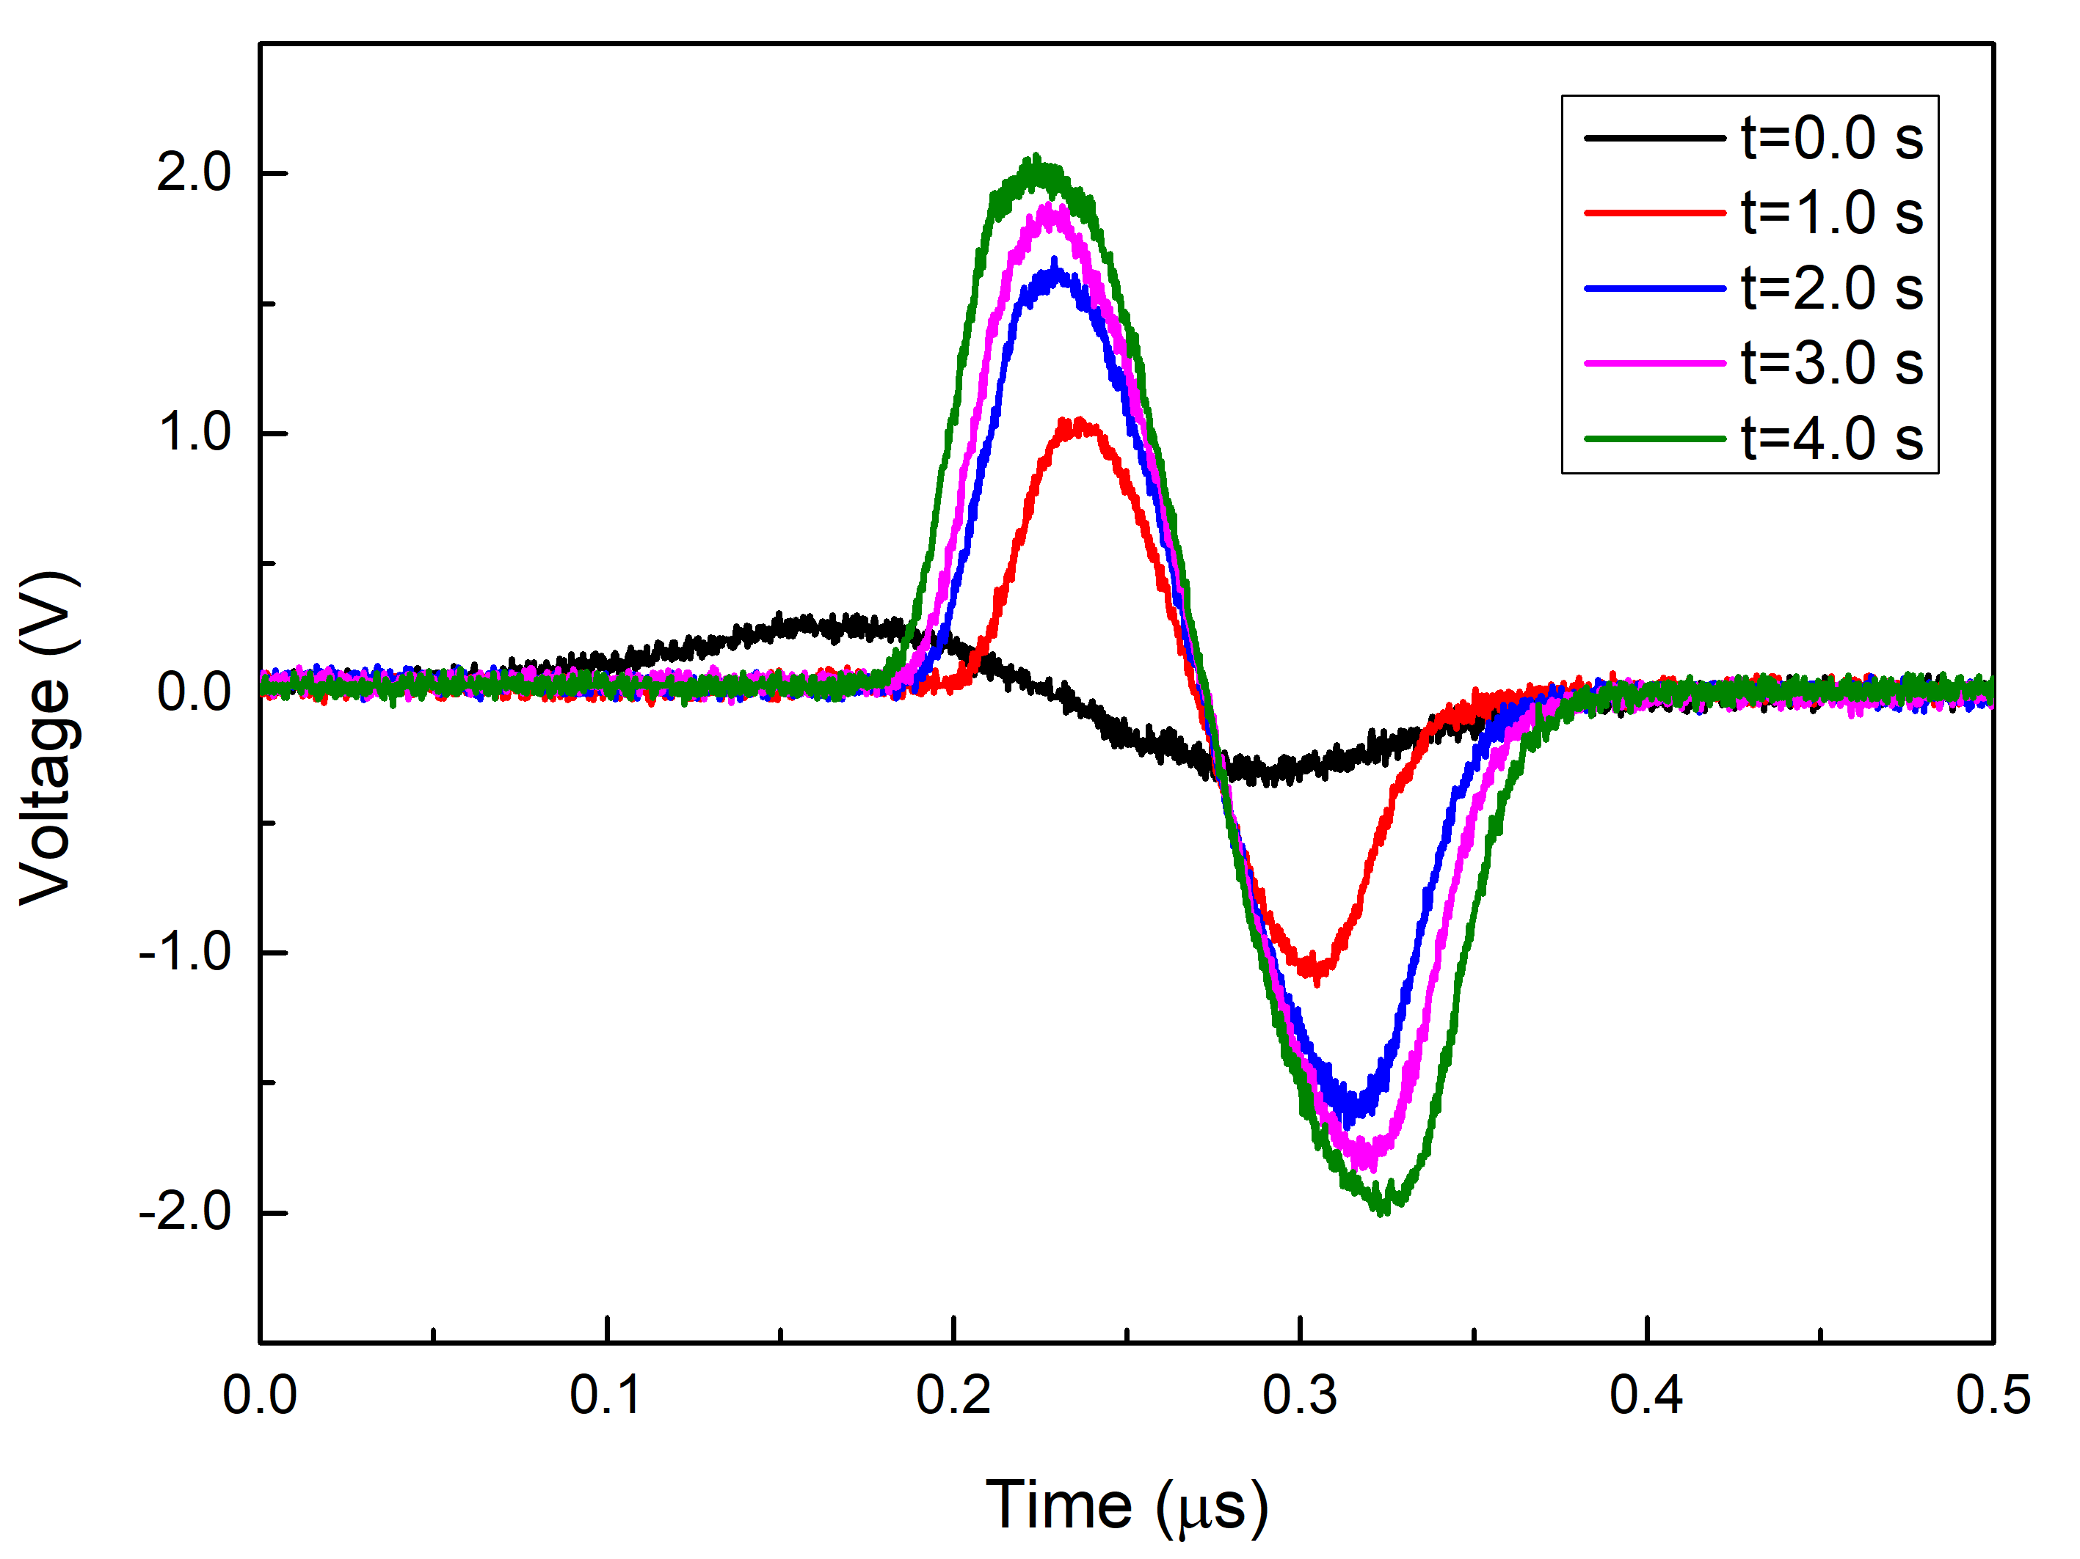
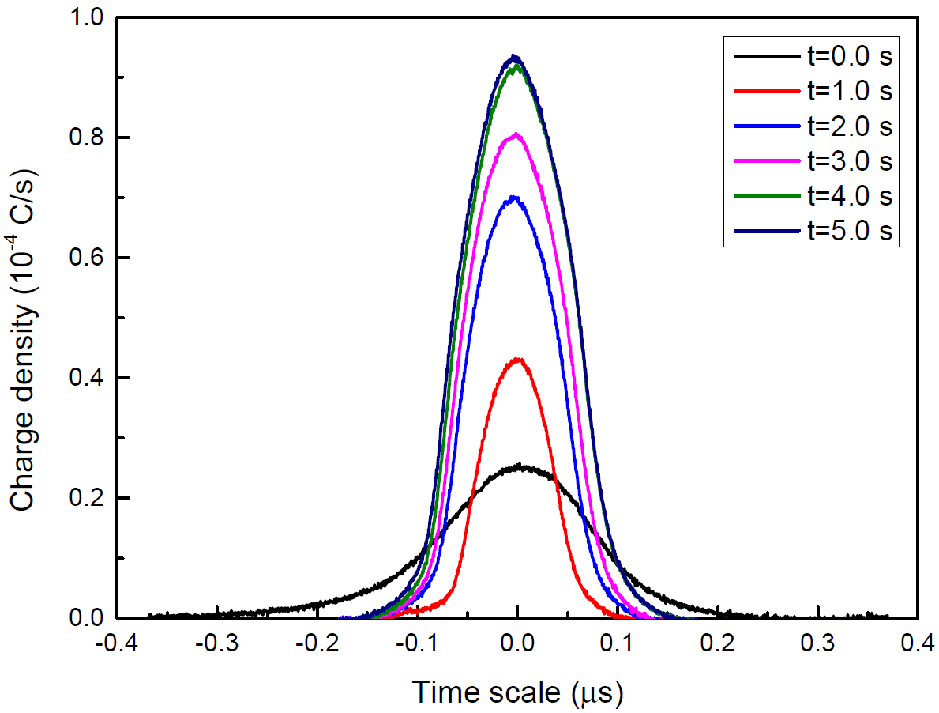
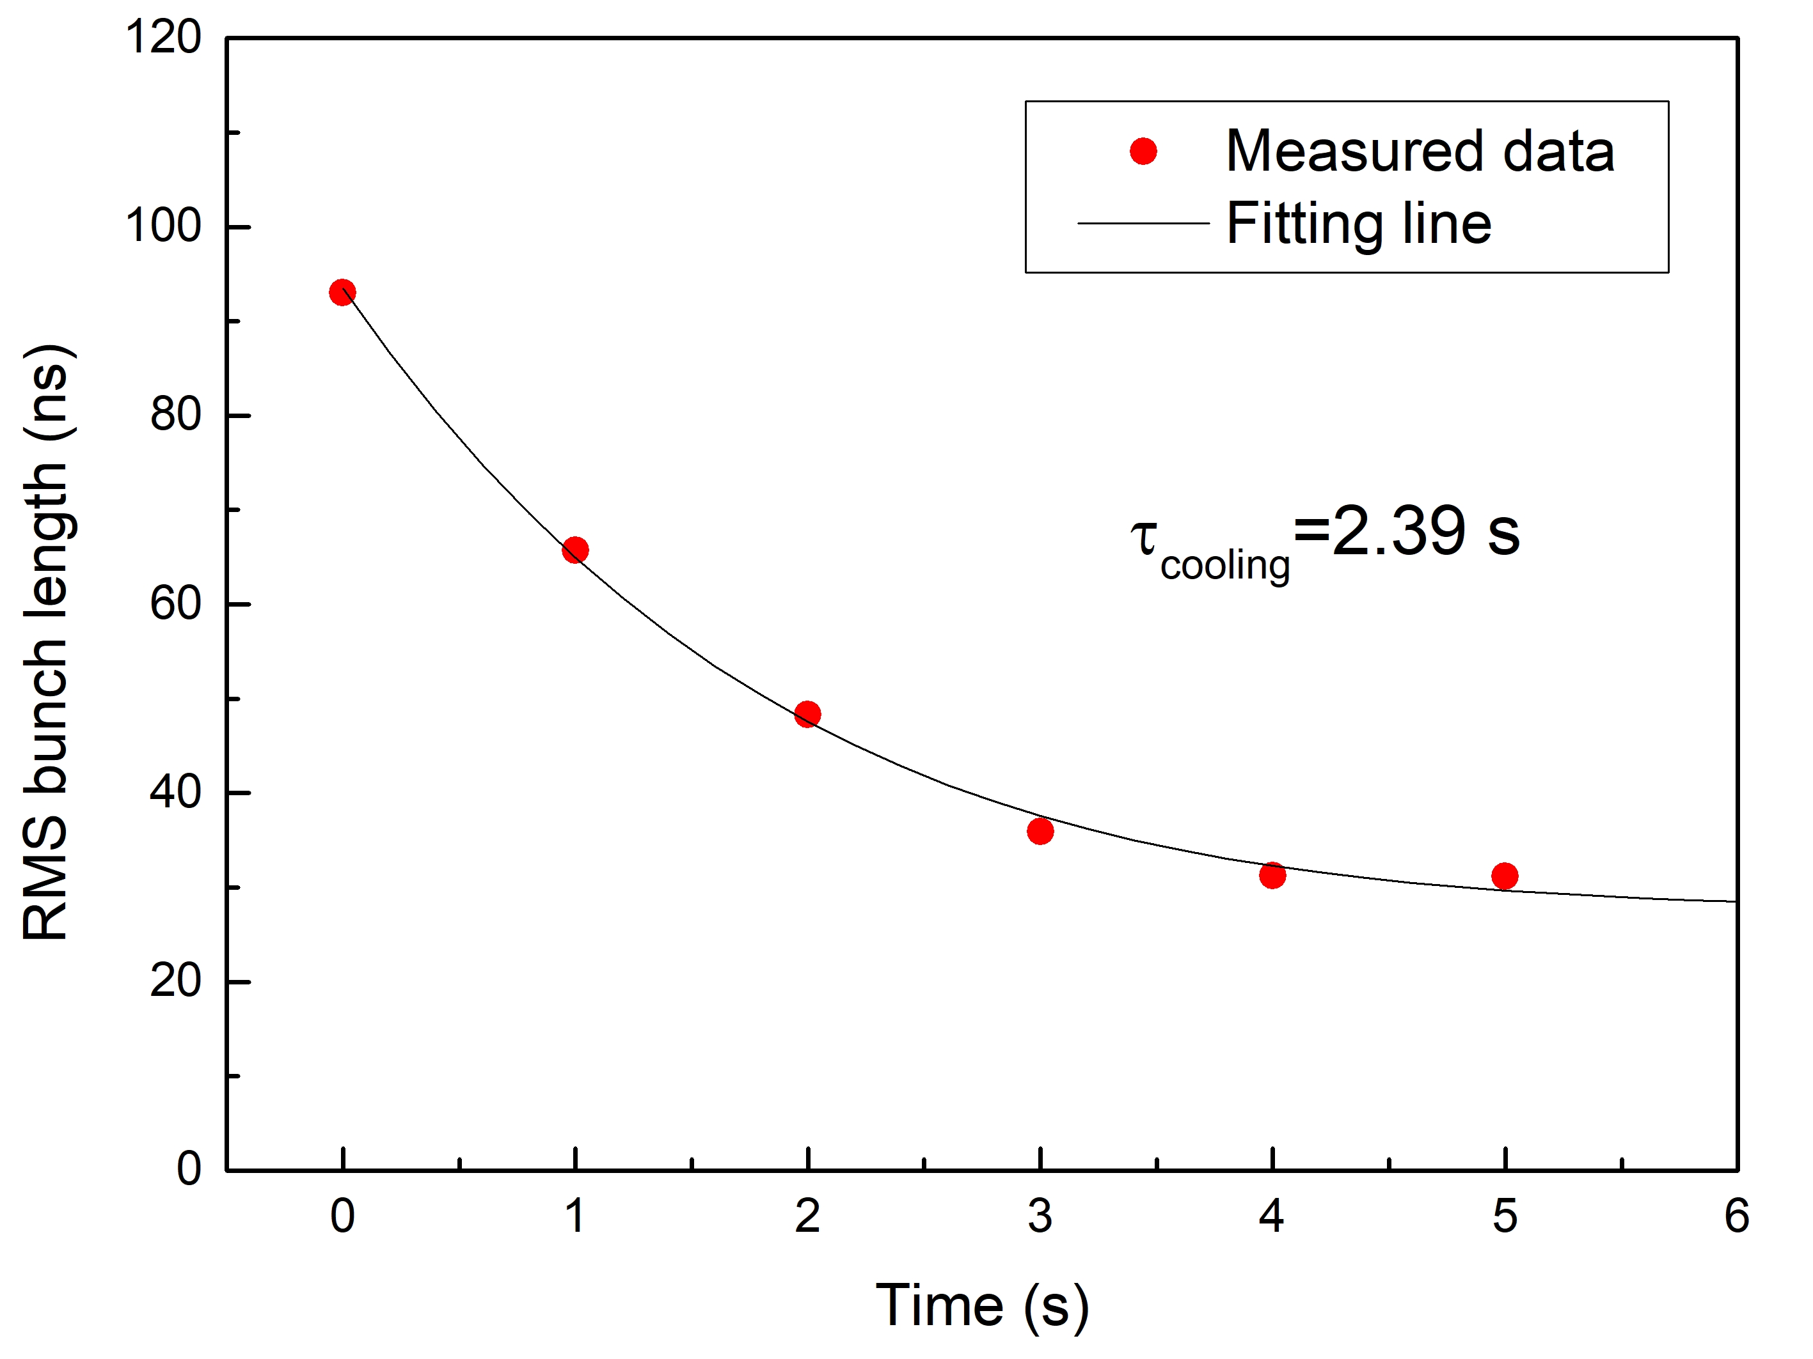
HIRFL and experimental results
Longitudinal cooling time measurement
6.9 MeV/u C⁶⁺ @CSRm, RF=1.5 kV, I_{e}=17 mA, I_{ion}=30 uA
The bunch length is compressed during cooling
What we are interested is the final bunch length at the equilibrium state

Slide 12
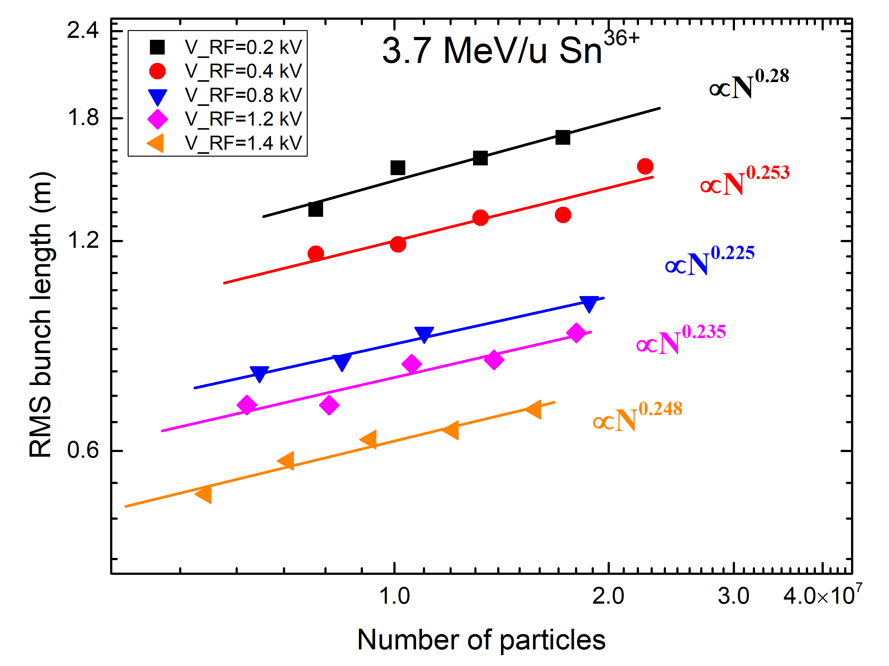
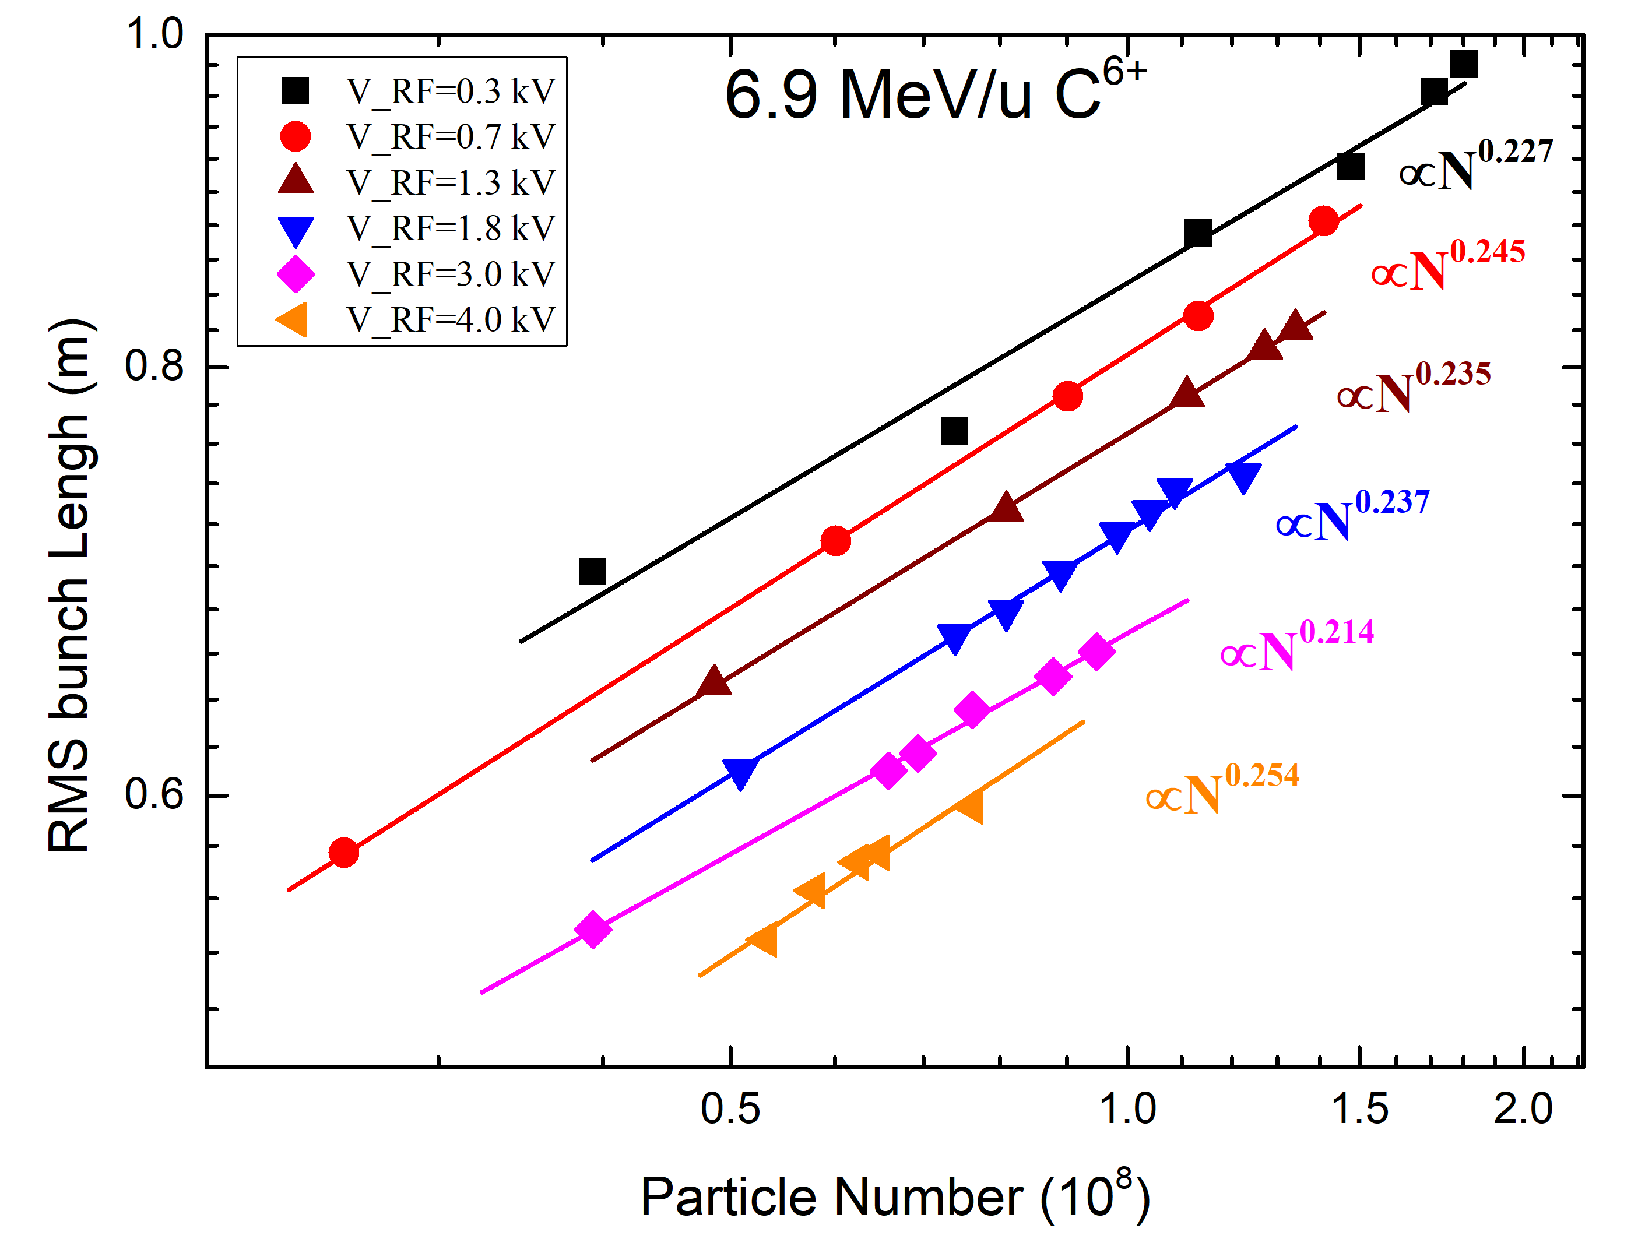

HIRFL and experimental results
Final bunch length vs. particle numbers, also influenced by the RF voltage
The final bunch length increases proportional to stored particle number
The equilibrium state is determined by cooling, IBS and space charge effect
$$σ_{b}∝N^{k} \text{(}\text{k}\text{=0.22−0.28)}$$

Slide 13
HIRFL and experimental results
Estimation with IBS theory and space charge field
Intra-Beam Scattering
Space Charge Effect
Small Amplitude Oscillation:
The space charge potential is:
Equilibrium state between cooling and IBS heating:
The synchrotron tune considered SC is:
Gas relaxation IBS model:
Considering σ_{b}Ω_{s}= σ_{b0}Ω_{s0}, the σ_{b} satisfies:
Finally, the bunch length σ_{b}:
Finally, the bunch length σ_{b}:

Slide 14
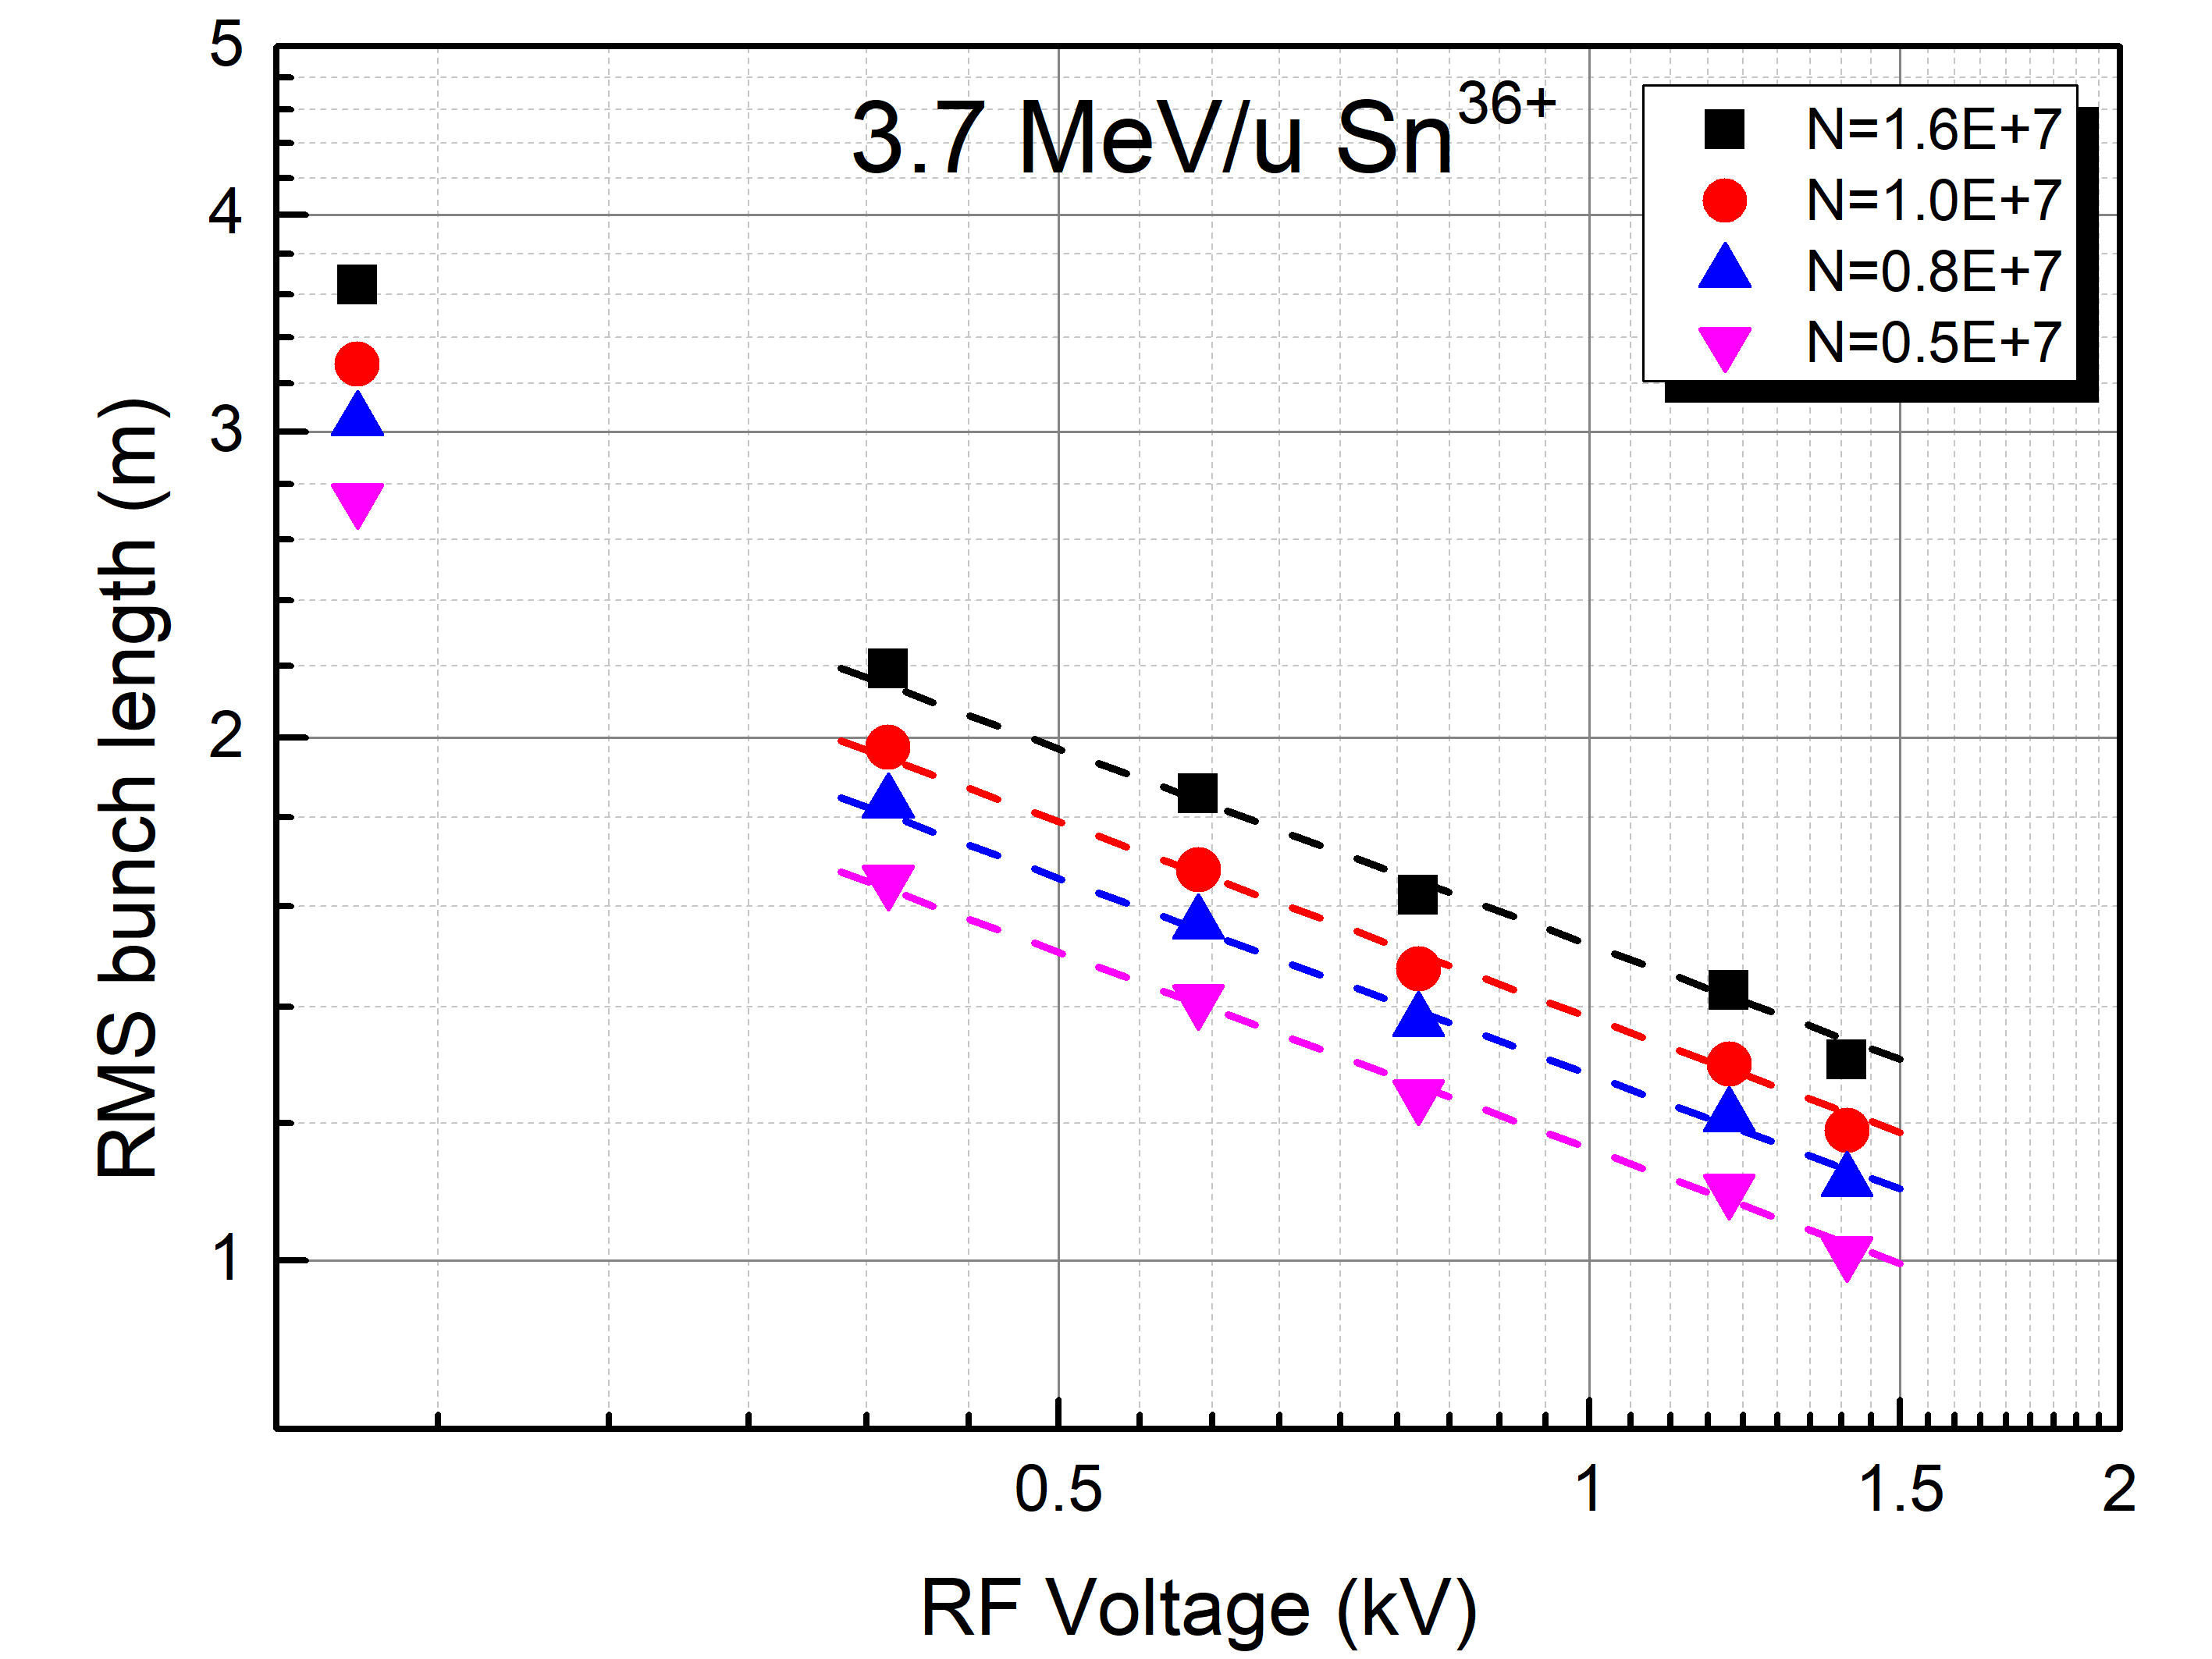
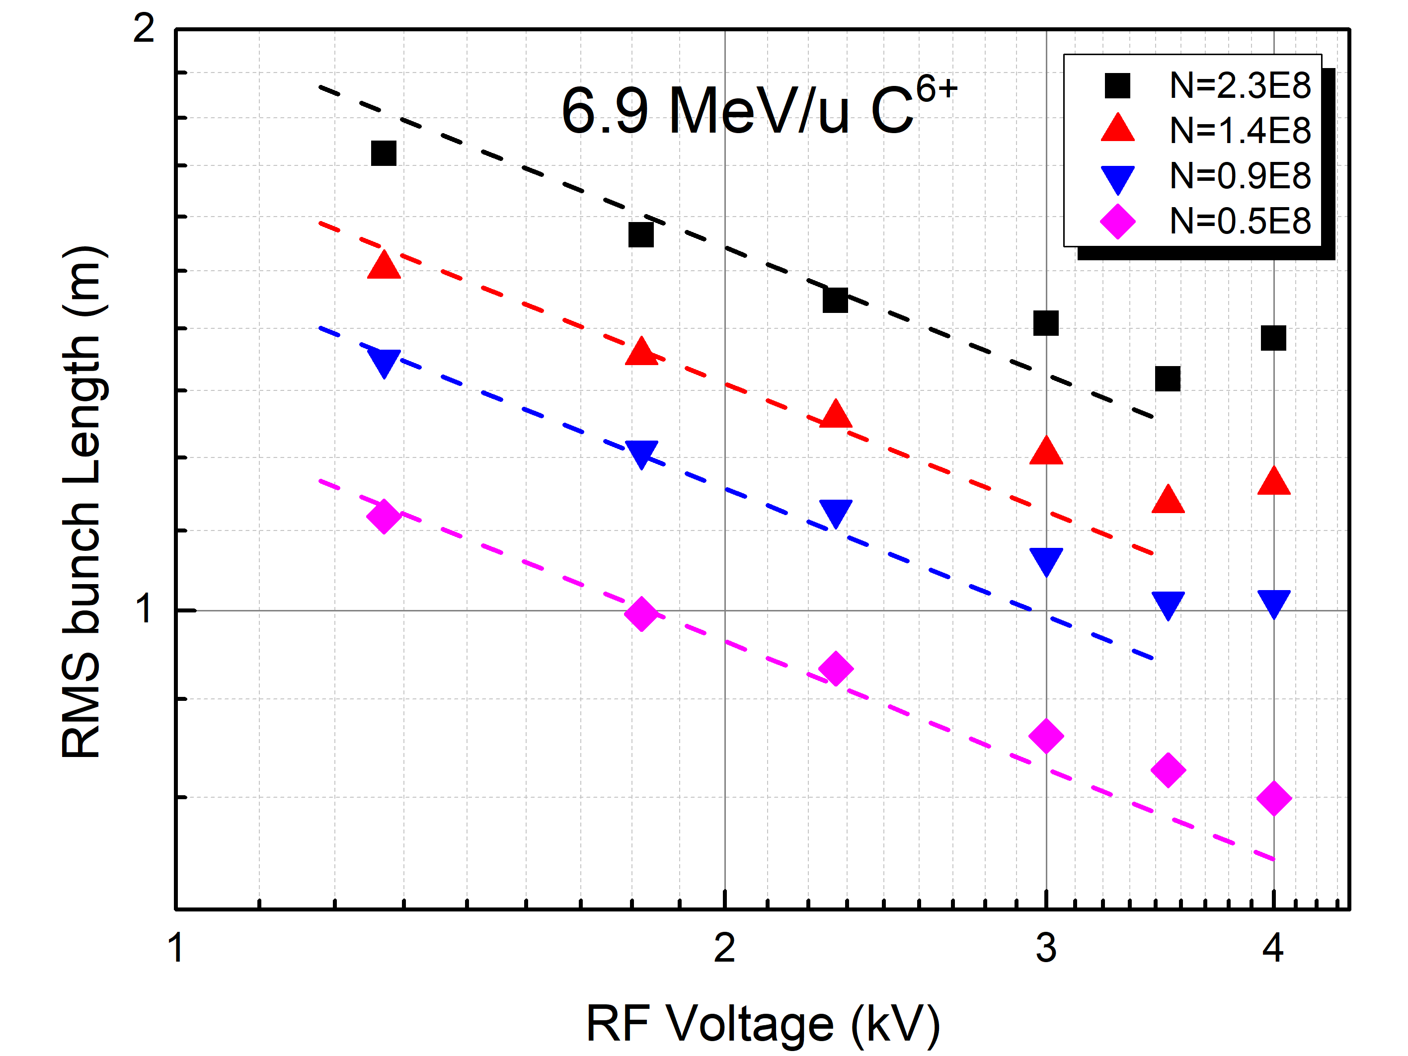
HIRFL and experimental results
First measurement of cold ion beam bunch length at CSRe in 2009
If we believe the bunch length is determined by the IBS effect only:
Space charge effect can not be ignore!
Bucket height is too small
Space charge effect

Slide 15
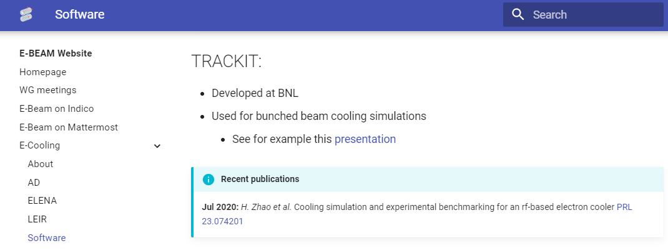
Simulation with multi-model particles
Model particle tracking code
Generation of particles
CERN
https://e-beam.web.cern.ch/
Betatron motion
Synchrotron motion
Parkhomchuk Force Formula
H. Zhao, PRAB, 26, 030101 (2023)
H. Zhao, PRAB 24, 083502 (2021)
H. Zhao, PRAB 24, 043501 (2021)
H. Zhao, PRAB 23, 074201 (2020)
H. Zhao, NIM A 902, 219 (2018)
Ion beam space charge effect used as RF voltage

Slide 16
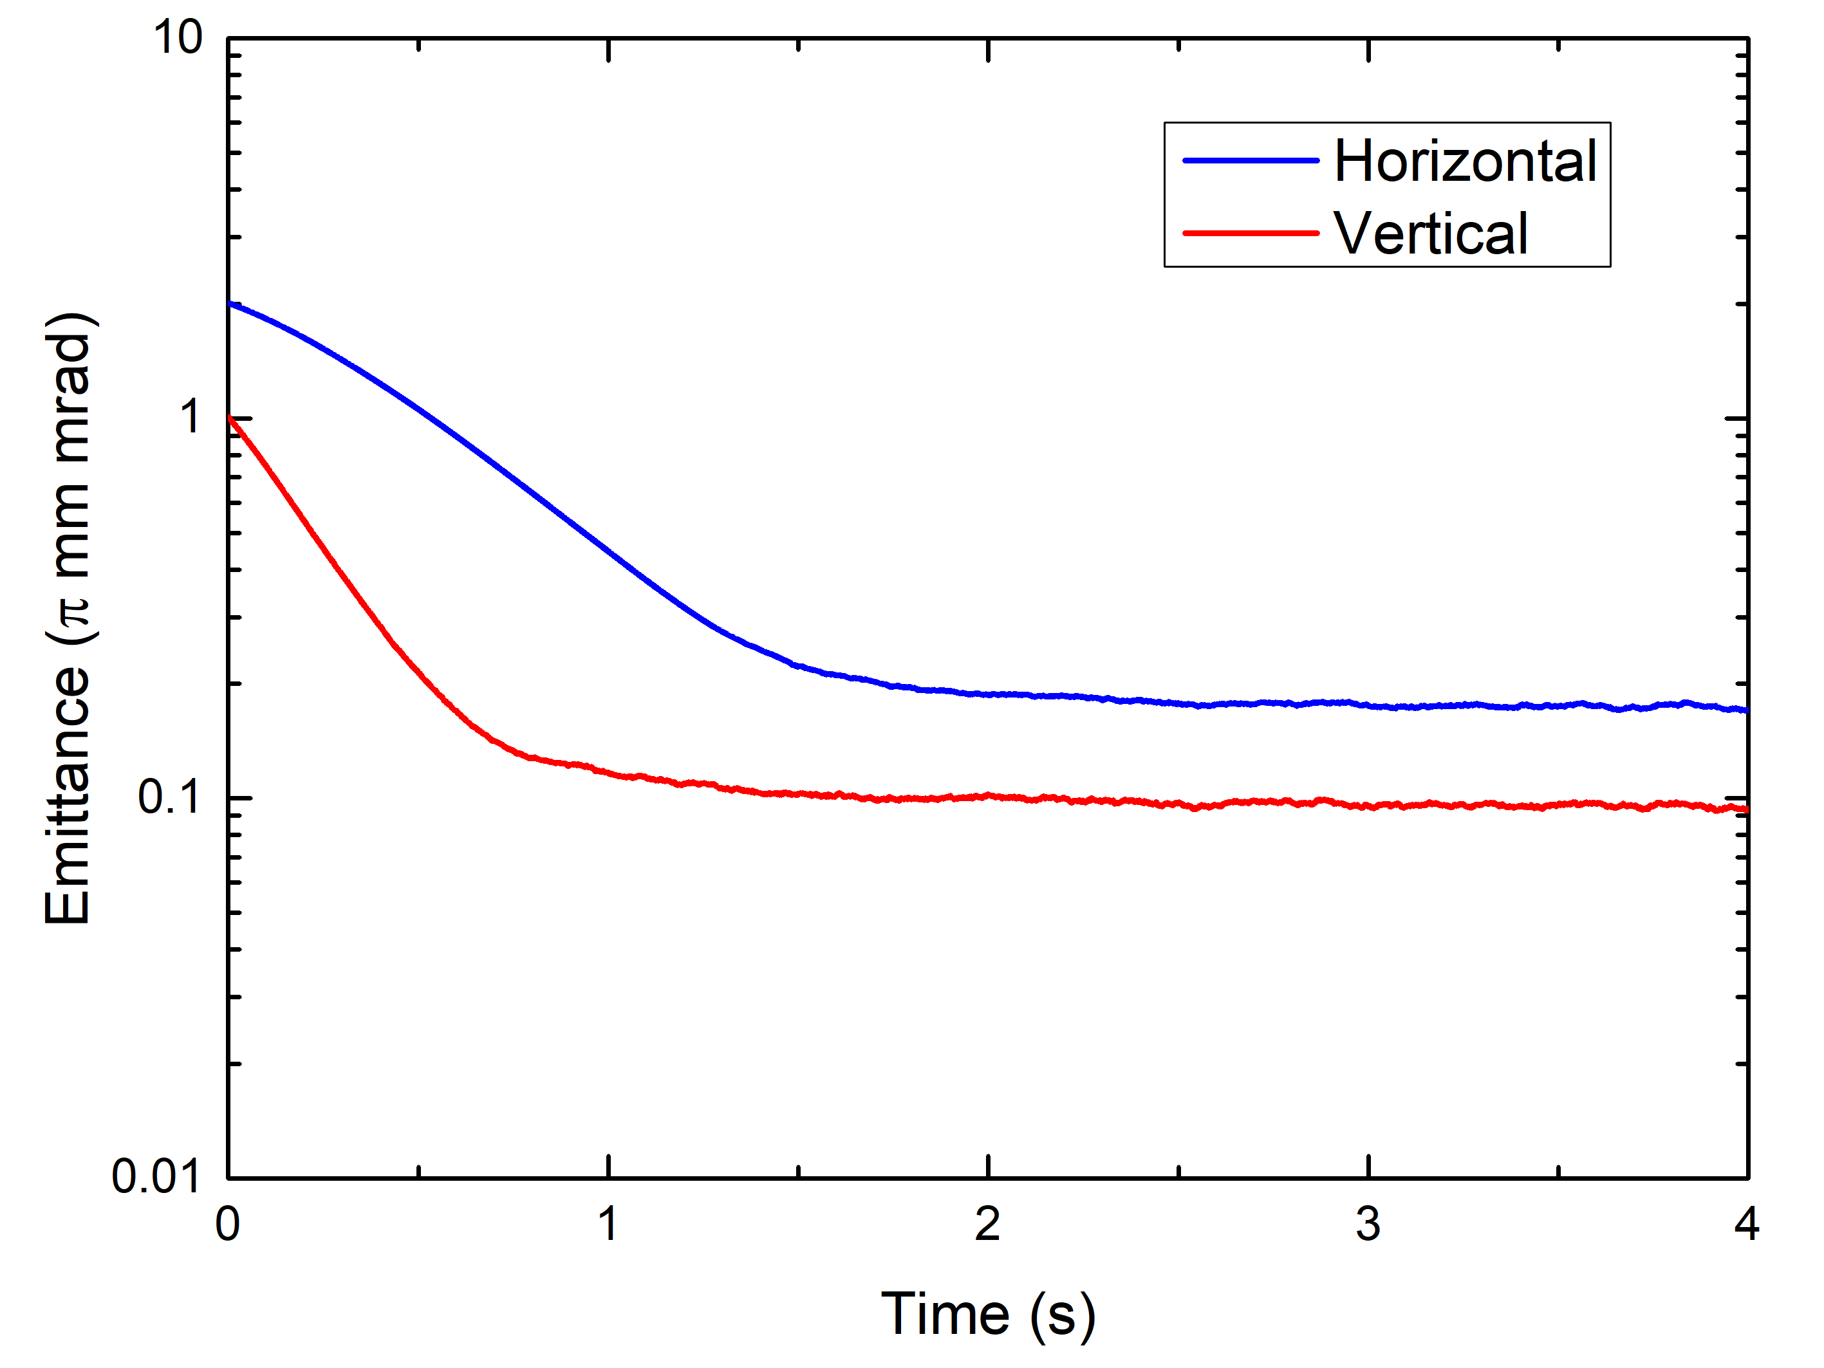
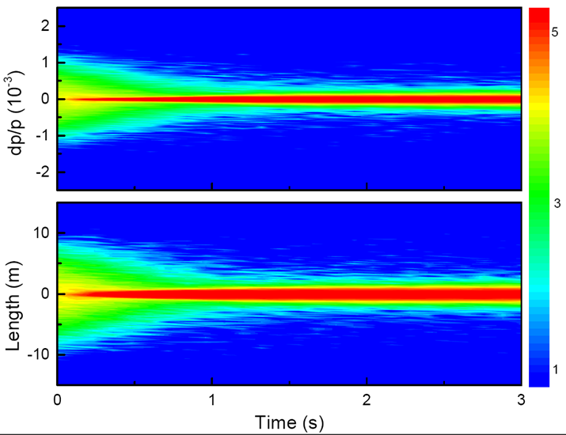
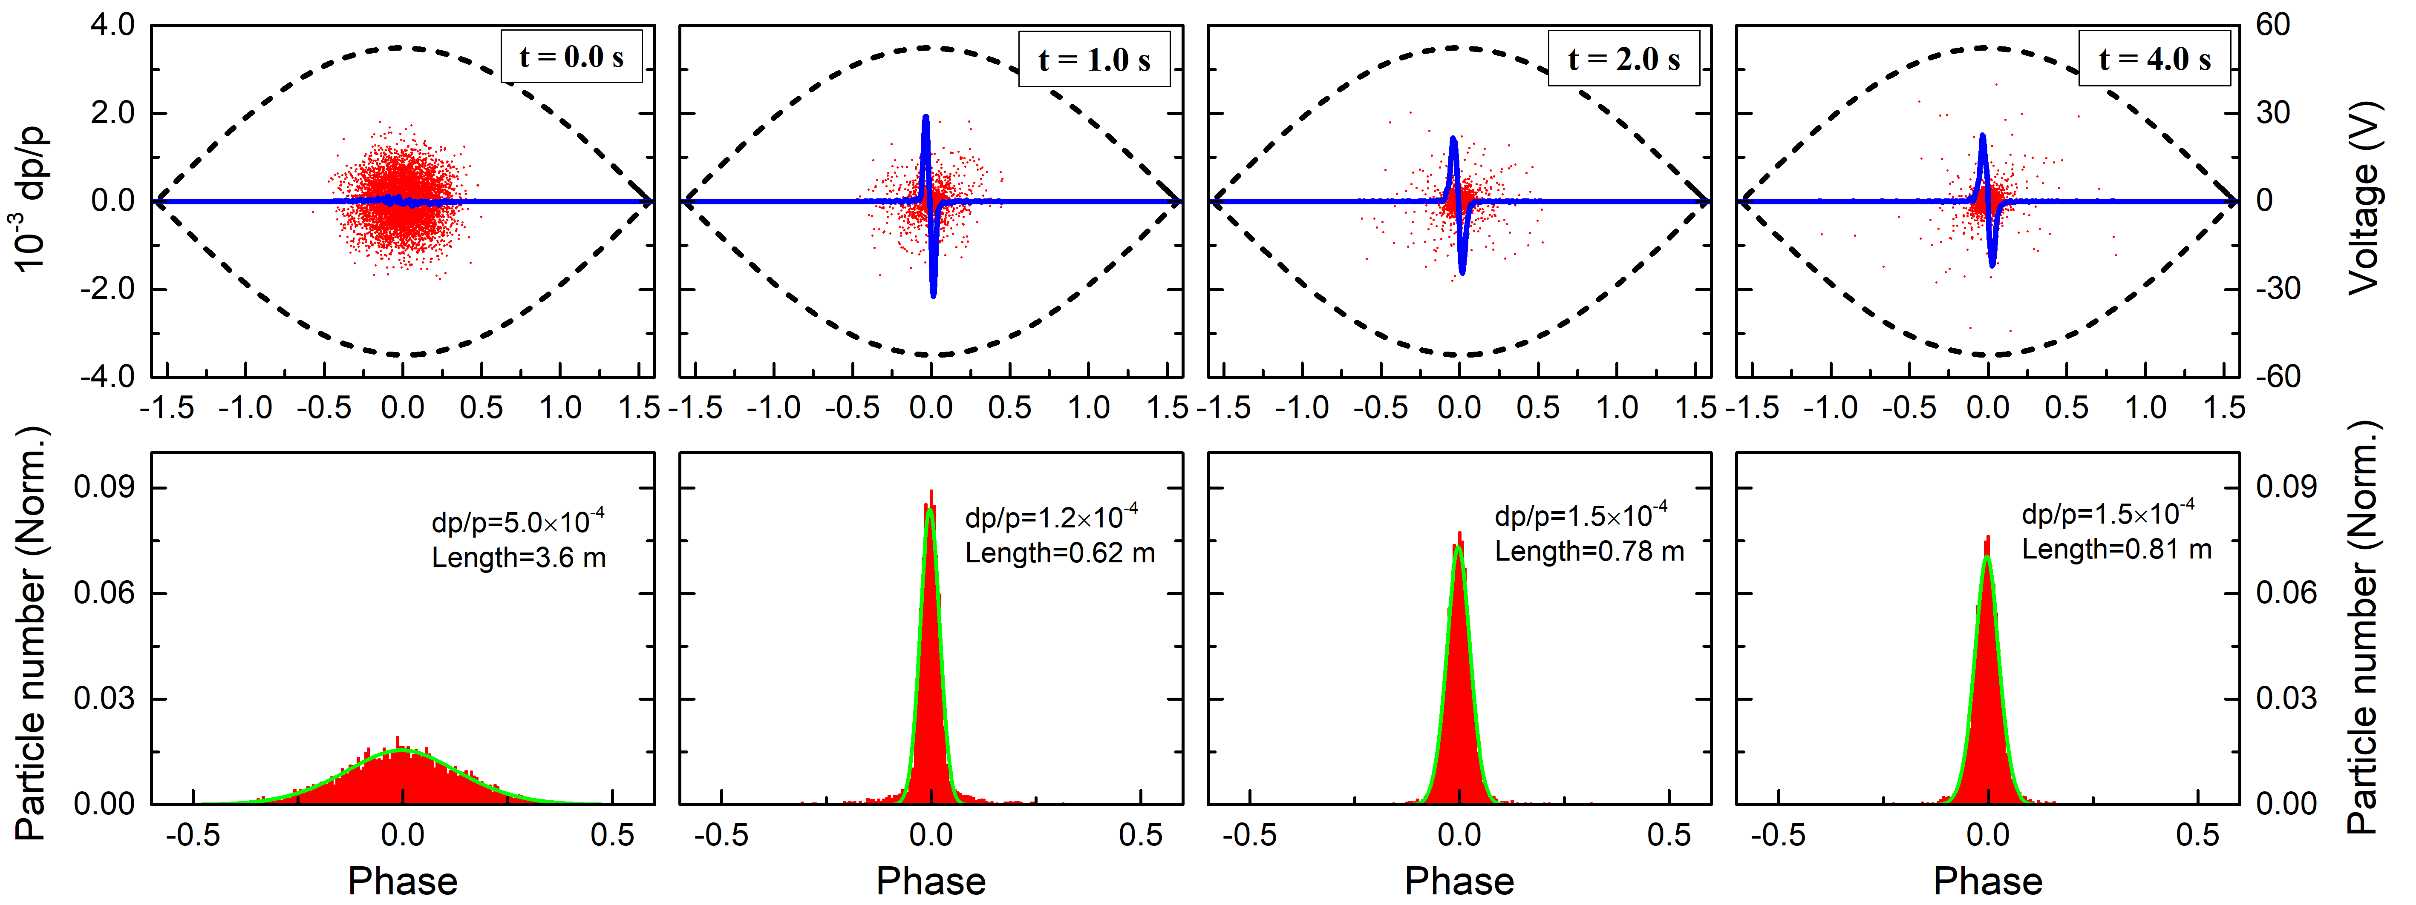
Simulation with multi-model particles
Cooling process similation
Parameters
Ion | C⁶⁺
Energy | 6.9 MeV/u
Particle number | 1.0 x 10⁸
Emittance (RMS) | 2/1 pi mm.mrad
dp/p (RMS) | 5.0 x 10⁻⁴
Tune (h/v) | 3.63/2.61
Beta function | 10/10 m
γ_{tr} | 5.42
RF voltage | 1.0 kV
h | 2
E-bean density | 3.8x10⁶ cm⁻³
E-beam diameter | 50 mm
E-beam temp. | 0.2/10⁻⁴ eV
Magnetic field | 365 Gs
Space charge field
RF bucket

Slide 17
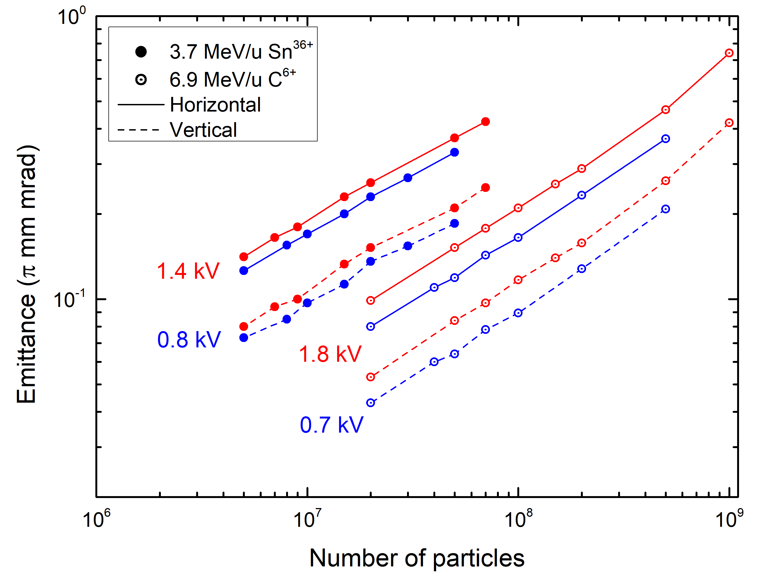
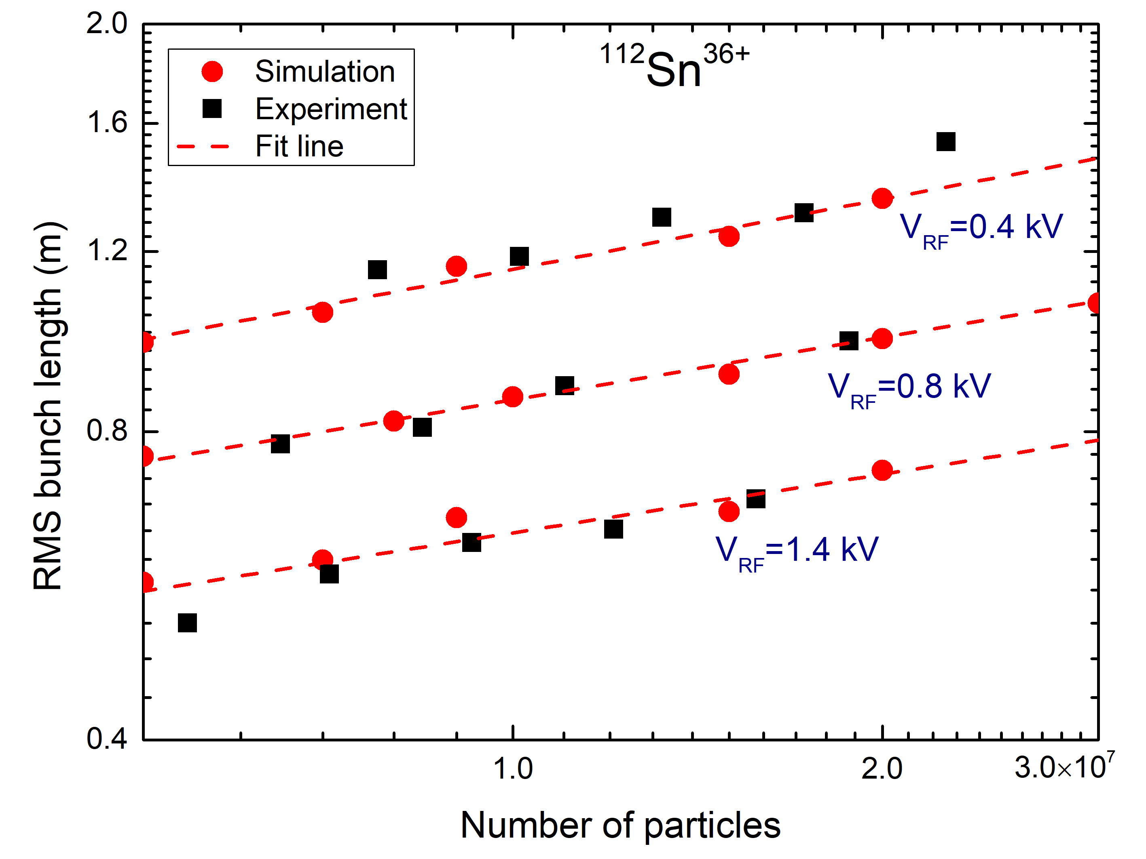
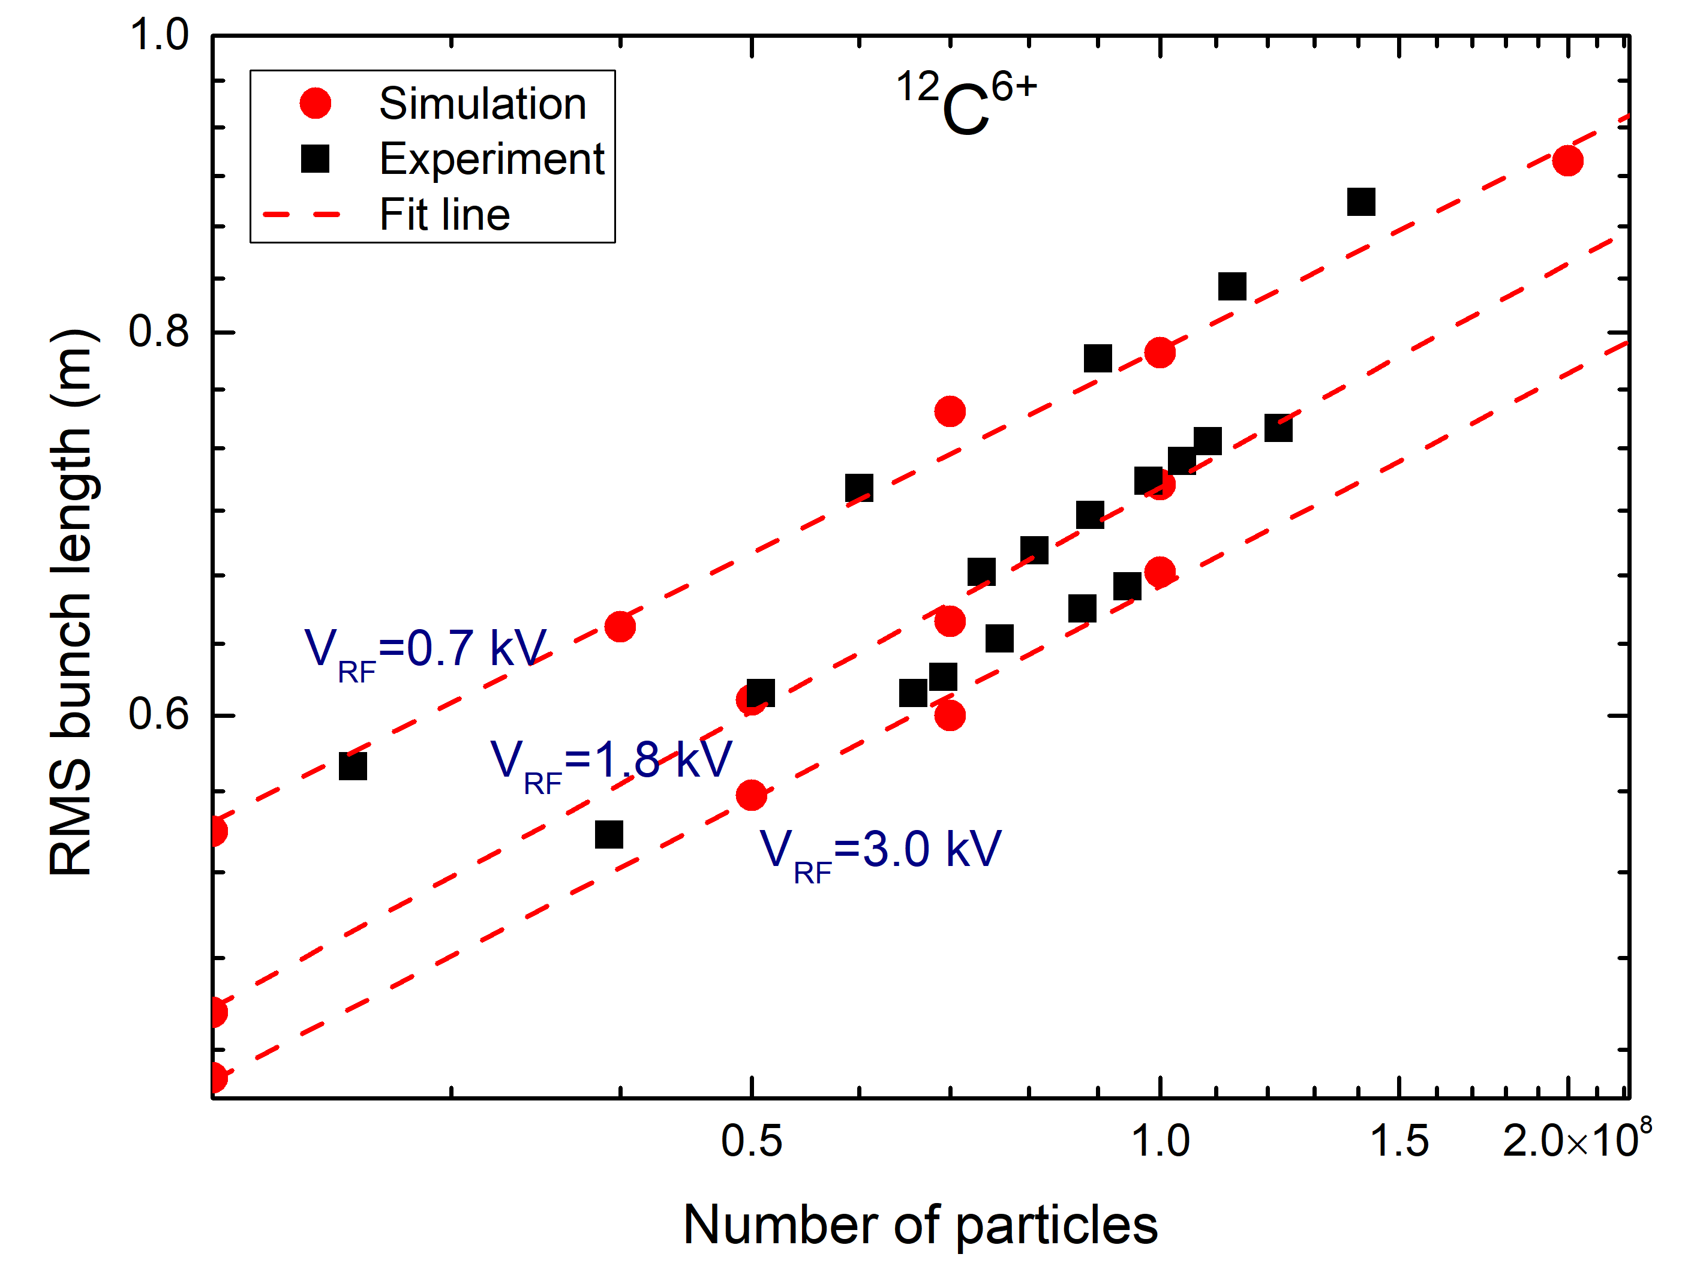
Simulation with multi-model particles
Simulation of cold ion bunch length equilibrium
The simulation results show a good agreement with the measurement
The emittance increases with increasing of RF voltage, which is different to longitudinal phase space
The beam intensity is quite low in the experiment and simulation
emittance
Bunch length

Slide 18
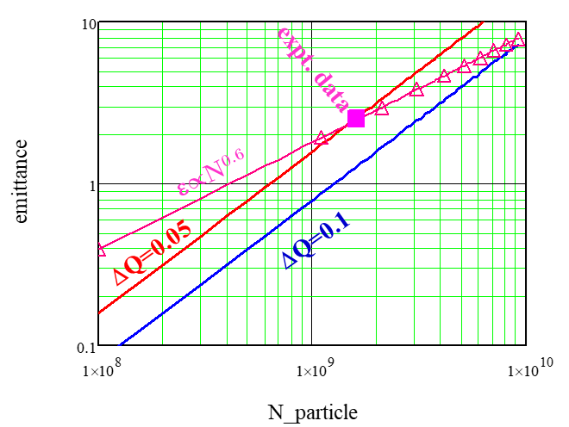
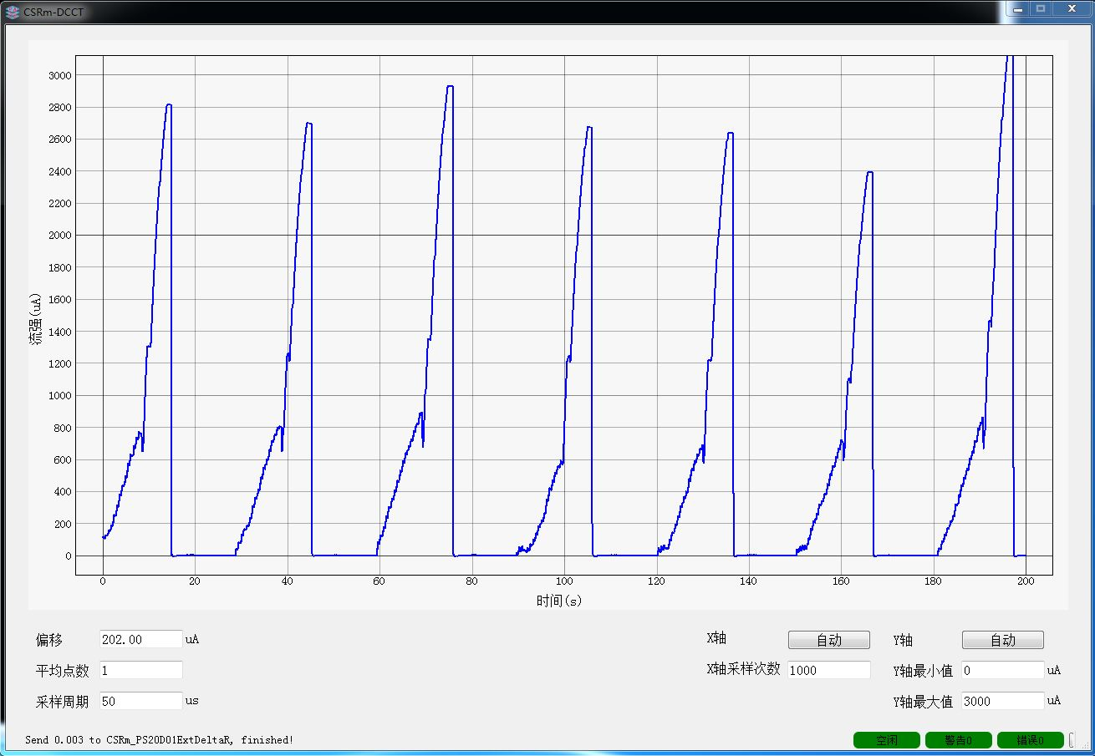
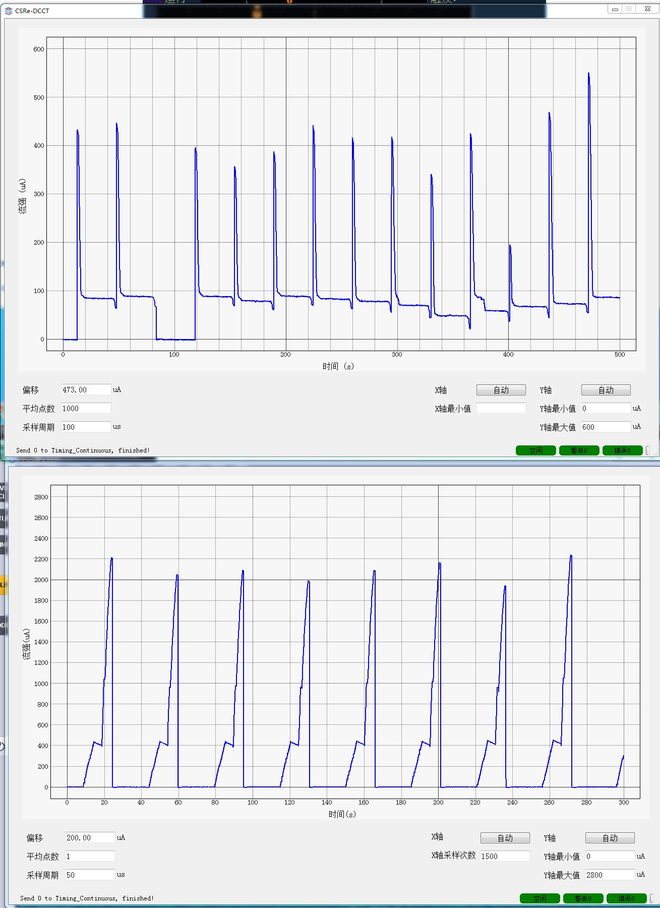
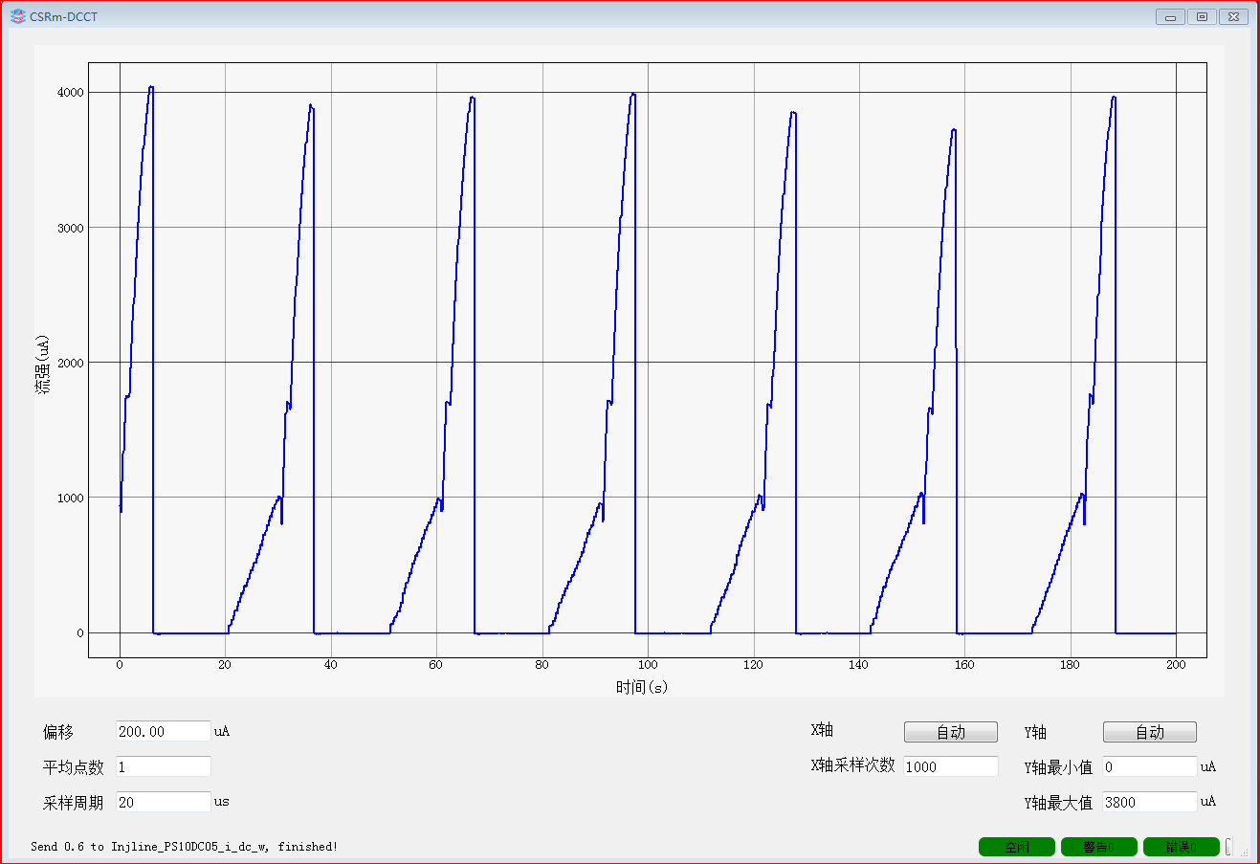
Application on machine operation
RF capture with different harmonic numbers
Kr²⁶⁺@CSRm with 6MeV/u, capture with 2nd harmonic numbers after cooling, beam loss with high intensity,
3rd harmonic numbers
2nd harmonic numbers
A higher RF harmonic number, lower line density, smaller bunch length

Slide 19
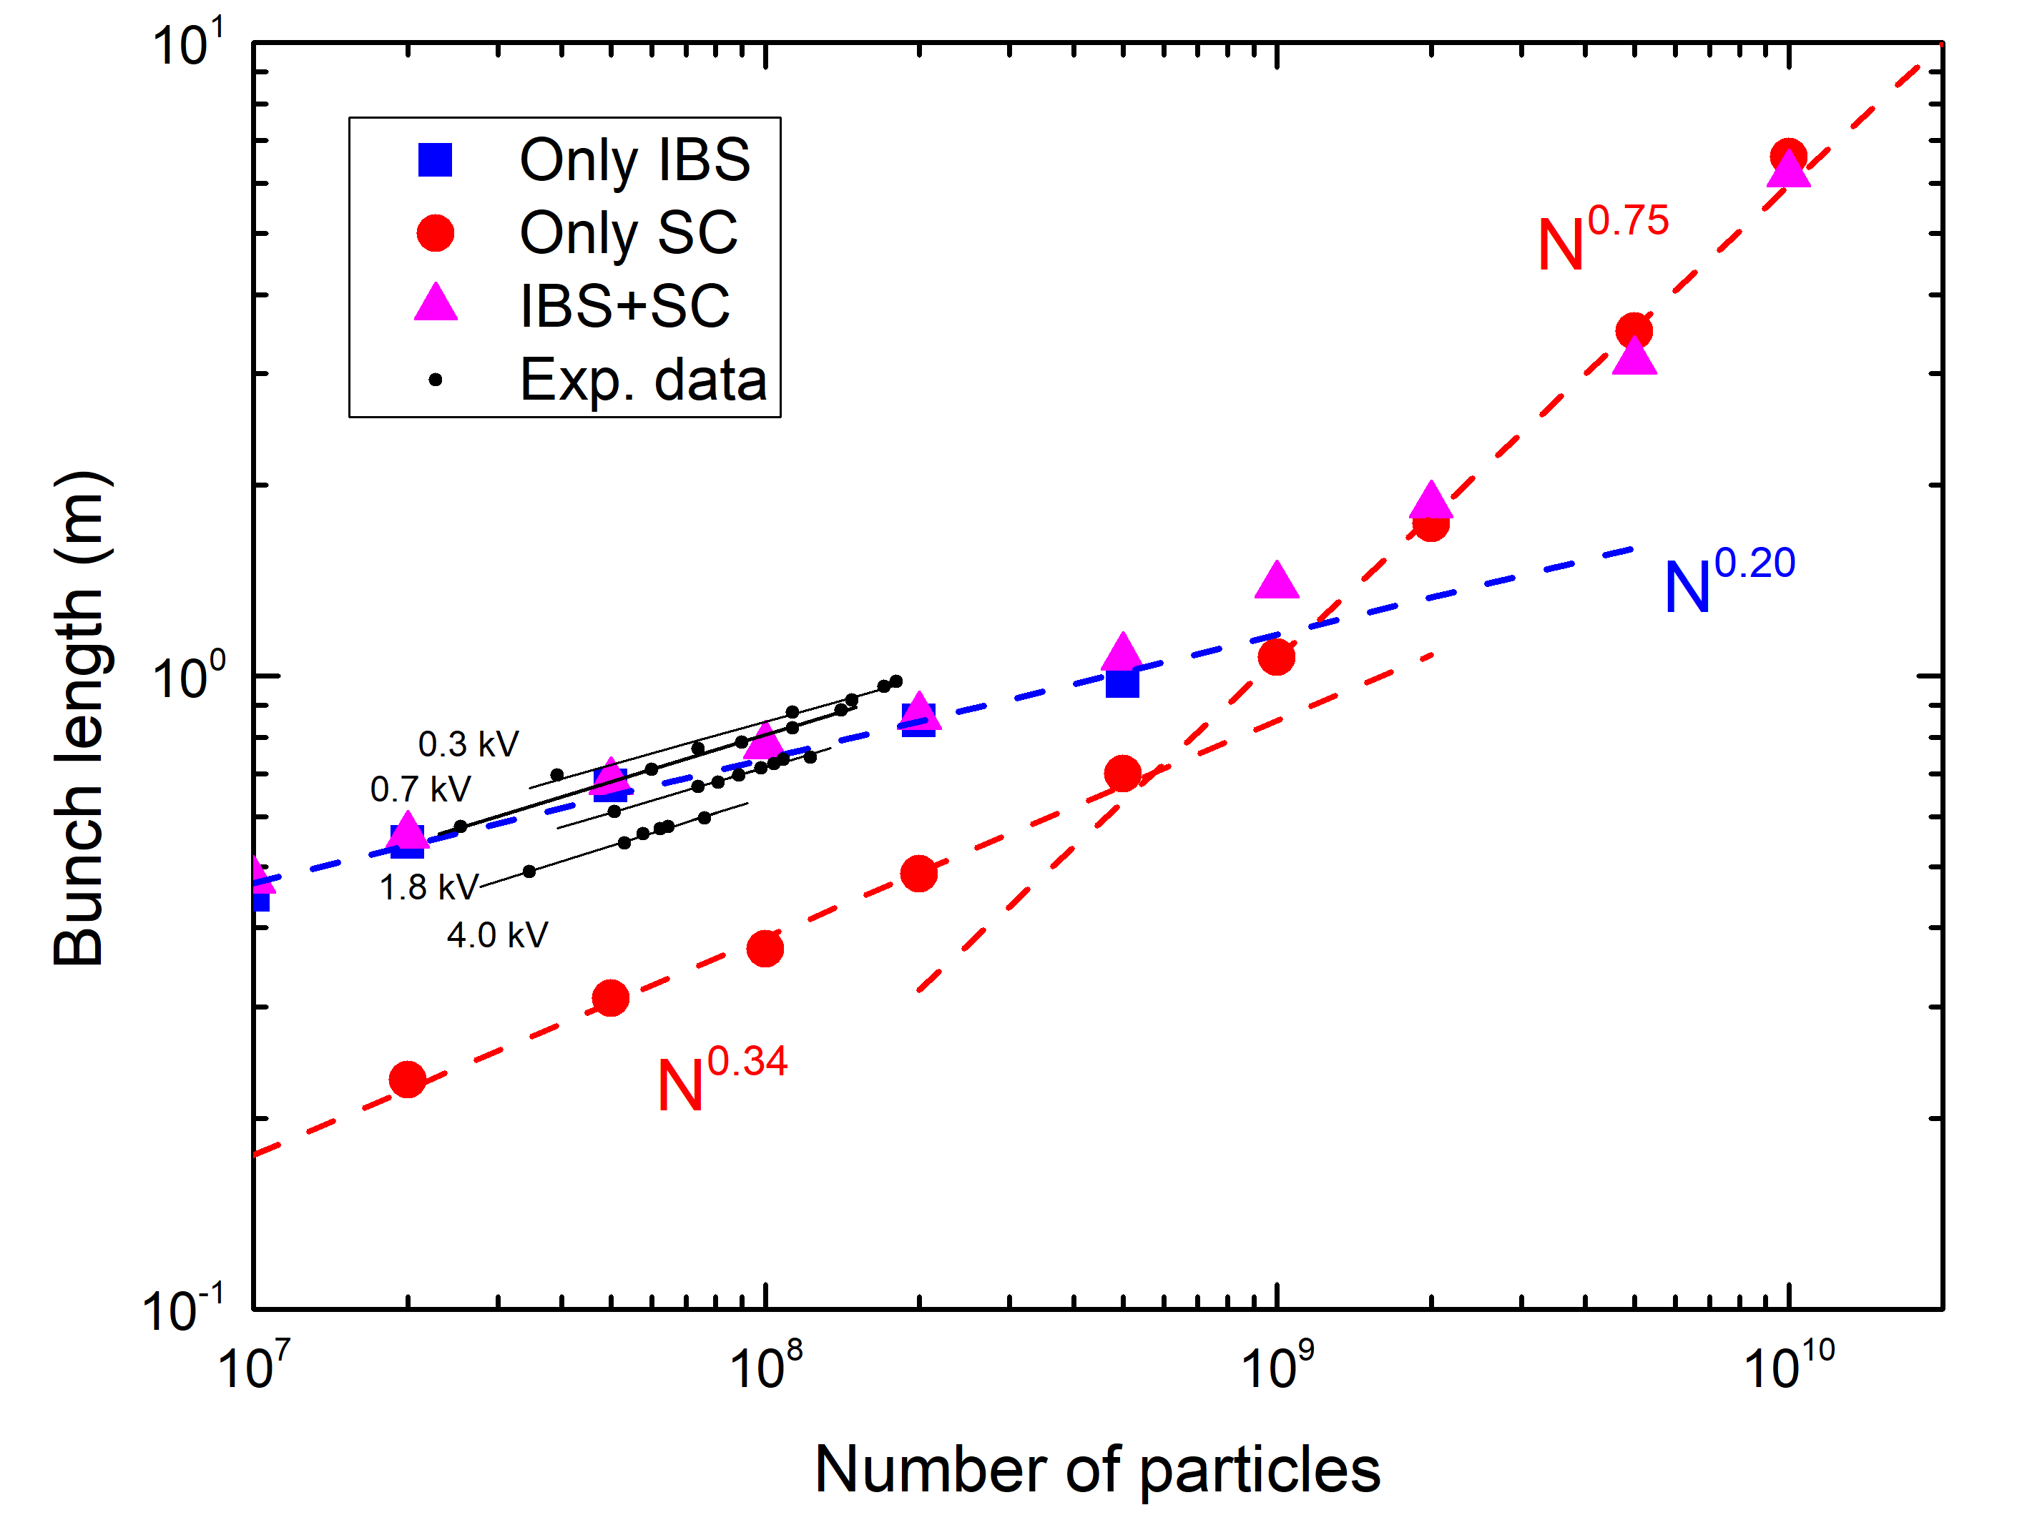
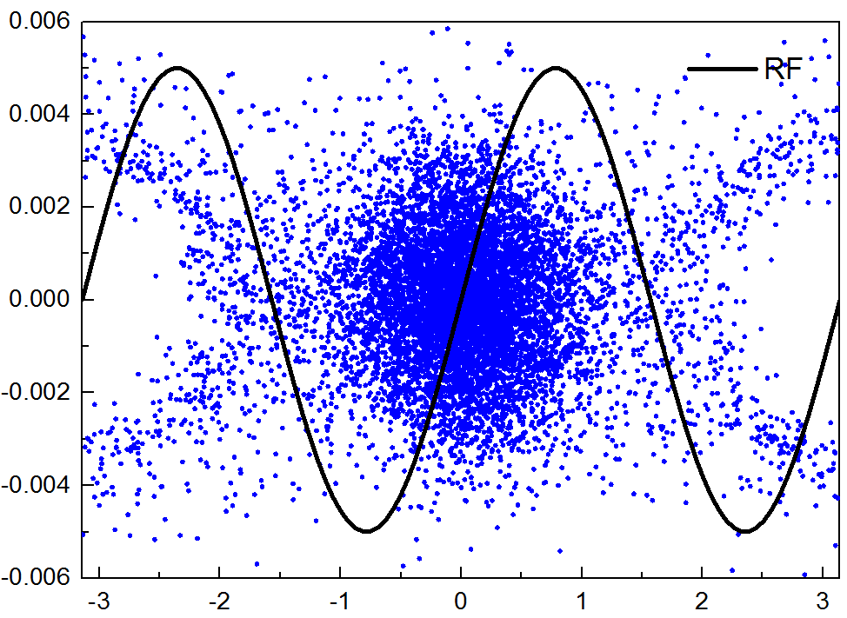
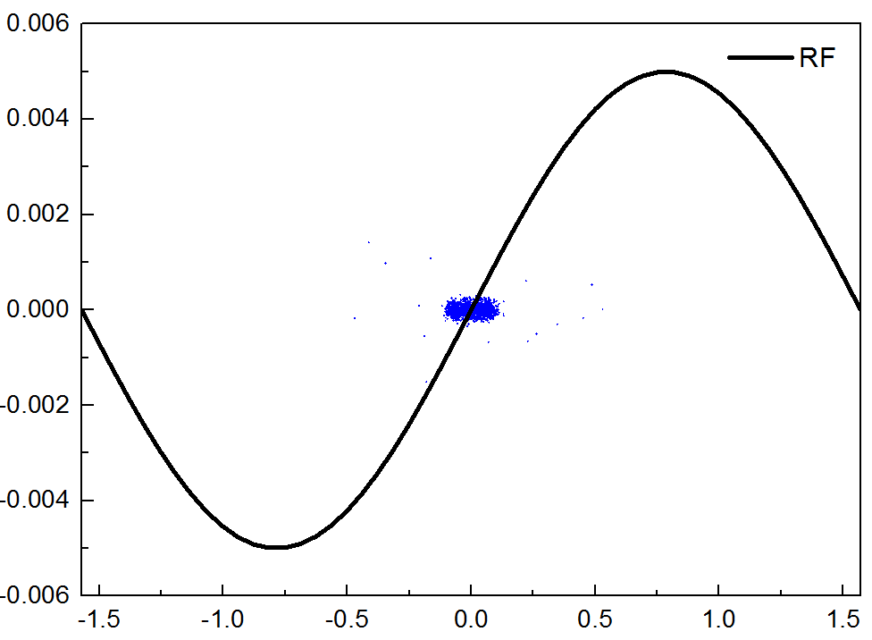
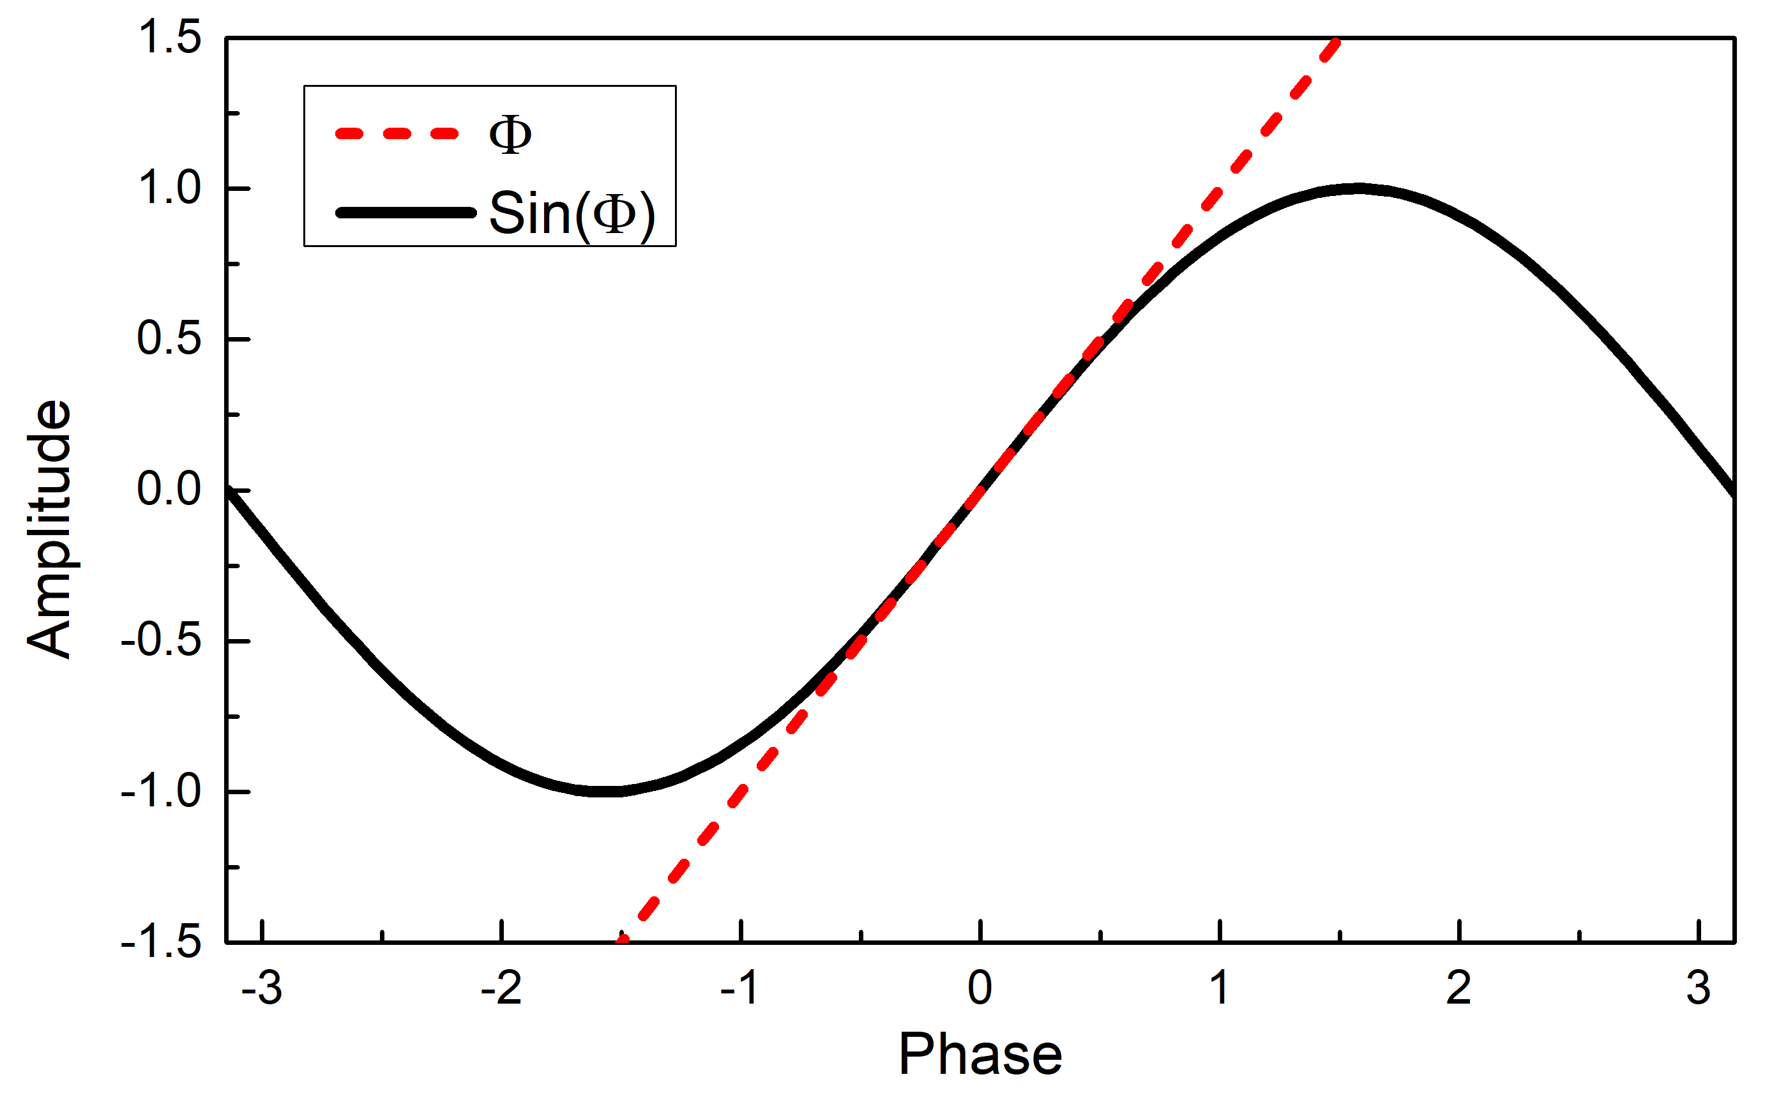
Conclusion
Exp. & Simulation
The experimental results belong to the IBS dominated region, which is coincidence with the theoretical analysis
The bunch length is quite short
The limitation of the bunch length can be estimated
The influence of IBS and space charge effect on the bunch length can be estimated

Slide 20
Thanks for your attention!

