Slide 1
6th ICFA Mini-Workshop on Space Charge 2024
The introduction of the compact laser-driven proton therapy system at Peking University
K.D.Wang
Peking University
Notes:
Mr. chairman, honorable experts, ladies and gentleman, good morning, it is great pleasure indeed for me to attend this mini-workshop. and It’s my honor to introduce our work after professor Yang. He is our doctor superviser.
The topic of my report is the introduction of the compact laser-driven proton therapy system at Peking University

Slide 2
Background information
Background information
Space charge effect in the laser driven accelerator
The compact laser-driven proton therapy system
Summary and prospect
Notes:
My report include 4 parts.
They are Background information
Space charge effect in the laser driven accelerator
The compact laser-driven proton therapy system
Summary and prospect

Slide 3
Background information
Background information
Space charge effect in the laser driven accelerator
The compact laser-driven proton therapy system
Summary and prospect
Notes:
The first part is a brief introduction about the background information of laser acceleration.

Slide 4
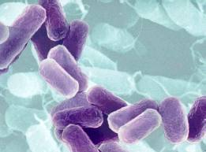
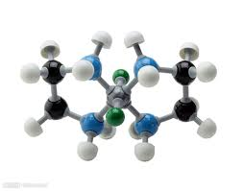
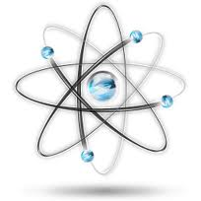
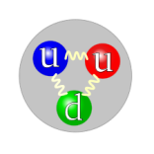
Background information
For understanding of the structure of matter, the role of fundamental forces in nature, and the origin of the universe
object | size（cm） | energy | method
cell | 10⁻⁵~10⁻³ | 0.1~10 eV | optics
molecule | ~10⁻⁷ | ~1 keV | electron
atom | ~10⁻⁸ | ~10 keV | synchrotron
nucleus | ~10⁻¹² | >100 MeV | Low energy electron or proton accelerator
hadron | ~10⁻¹³ | >1 GeV | high energy electron or proton accelerator
Quark Lepton | <10⁻¹⁶ | >1 TeV | High-energy electron or proton collider
…… | …… | ……
High-energy particle accelerators provide the necessary methods to explore the microscopic world.
boundaries of accelerator energy
boundaries of physics
Notes:
As human society's understanding of nature continues to deepen, from observing cells to protons to quarks, we need more and more energy, from microscopy to high-energy particles colliders
High-energy particle accelerators provide the necessary methods to explore the microscopic world.
As we explore the boundaries of physics, we also explore the boundaries of accelerator energy

Slide 5
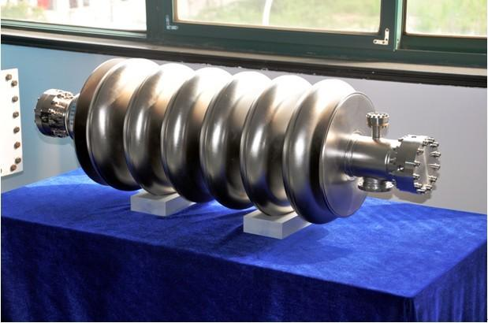
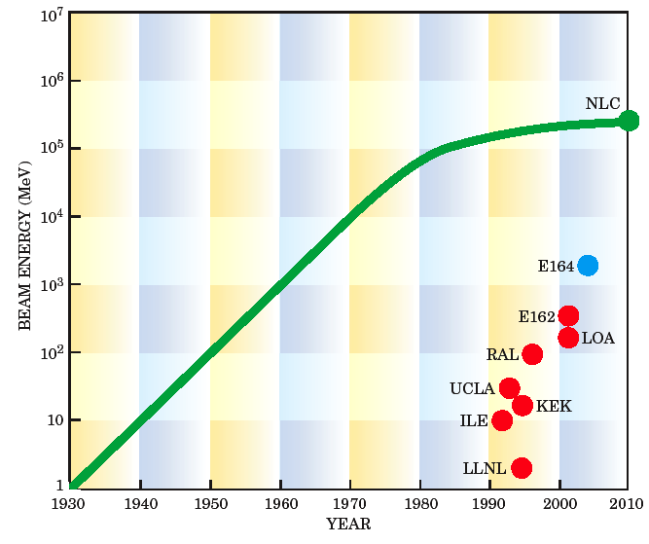
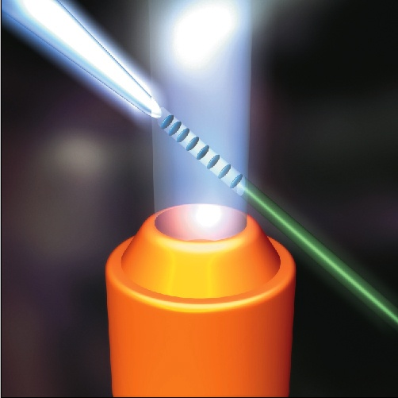
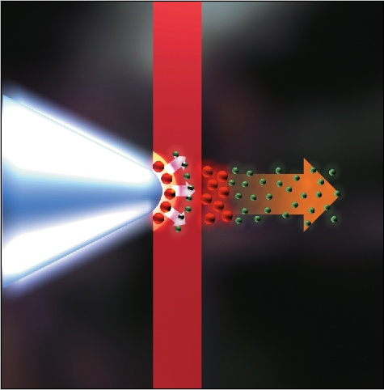
1 m
RF accelerator
E = <100MV/m
laser plasma accelerator
E > 100GV/m
1 mm
1 μm
Laser beam
Laser beam
LBL
RAL
proton beam
Electron beam
Notes:
Traditional RF accelerators, limited by the electric field break down, the acceleration gradient usually less than 100 MV/m.
If we want to obtain higher energy particles, we can only increase the length of the RF cavity or increase accelerator volume..
In laser acceleration, the laser transmits energy to the particles through the plasma. And the plasma don’t have breakdown effect.
So the laser acceleration could get higher acceleration gradient. Its acceleration gradient is usually higher than 100 GV/m.
The two figure on the right shows the laser accelerate electron and proton process. The whole acceleration occur in one millimeter or micro.

Slide 6
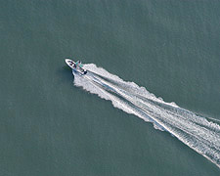
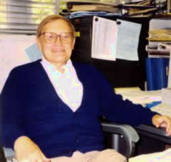

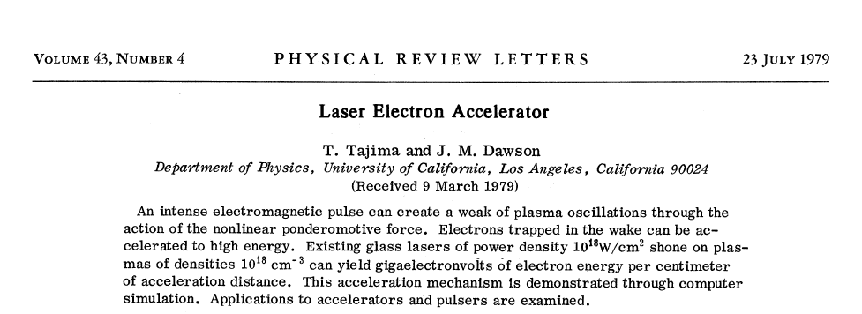
In 1979, Tajima and Dawson first propose LPA.
John M Dawson（1930-2001）
Toshiki Tajima
Laser acceleration process analogy
The only problem:
How to obtain such a high power laser?
Notes:
In 1979, professor Tajima and Dawson proposed a theoretical model.
Through simulation, they proved that a laser with a power density of 10 to the eighteenth per square centimeter is shot on taget for creating high energy electrons is feasible.
A high-powered laser shoots the target into a plasma state and passes through the plasma cloud.
The acceleration process is likened to the picture on the right.
The laser is like a boat on a lake. The tail wave field formed by the laser in the plasma is similar to the wave formed by the boat across the water. When the electron rides on the wave in the right position, it can be accelerated all the time.
At the time, the problem that needed to be solved was how to obtain such a high power laser

Slide 7
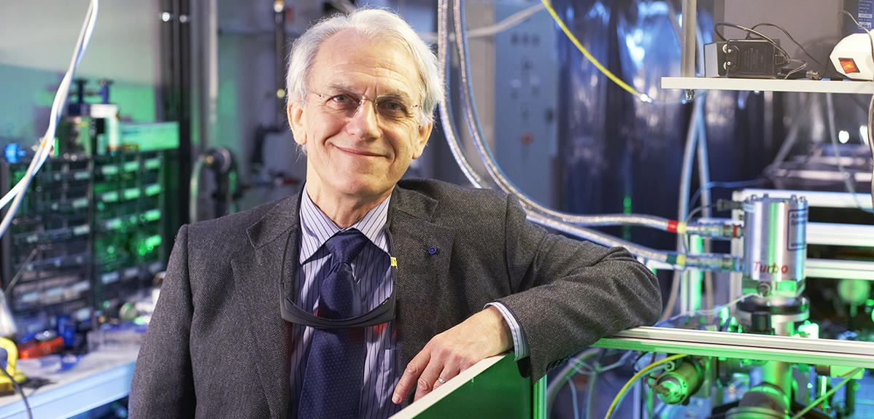
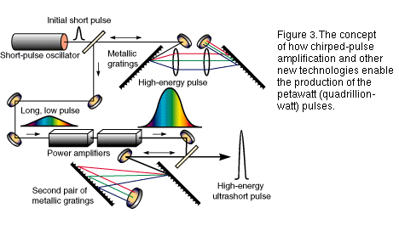
Peak power of ultra high power laser is 100 times of total world power generation
Time domain broadening ns
amplification
~30J
Seed laser
fs（nJ）
compression
(30fs)
‪Gérard Mourou invented CPA(Chirped Pulse Amplification) teachnology
Peek power = laser energy/pulse duration
30J/30fs=10^15 W
Total world power generation 10^13W
Notes:
The laser power required in the laser acceleration simulation is 10 to the 18th per square centimeter.
But the total amount of electricity power produced in the world is 10 to the 12th watt
The laser power problem is solved by professor Gérard Mourou. He invented laser CPA(Chirped Pulse Amplification) teachnology.
The CPA teachnology used seed laser with nJ power to amplify after laser time domain broadening. That teachnology effectivly protect the laser amplification element. Finally the amplified laser is compressed to femtosecond width. The laser peek power could be on the order of 10 to the 15th.

Slide 8
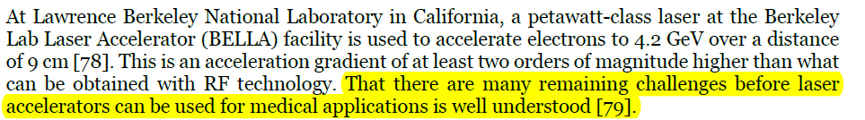
Inventor of Laser Wake Accelerator –Tajima is disappointed !!!
CPA
Energy? Will be Ok
Energy spread? OK
Stability? OK
Nobel prize report:
Notes:
Three scientists including Gerard Mourou shared Nobel prize in 2018, because his prominent contribution in the laser power increasement teachnology.
The experiment of laser acceleration is reported in the Nobel prize report. It said the laser acceleration gradient at least two orders of magnitude higher than what can be obtained with RF technology.
But the report also point out that there are many chanllenges before laser accelerators can be used for application.
All of our researches are centered around solving the pre-application challenges of laser acceleration.

Slide 9
Background information
Background information
Space charge effect in the laser driven accelerator
The compact laser-driven proton therapy system
Summary and prospect
Notes:
The second part is Space charge effect in the laser driven accelerator

Slide 10
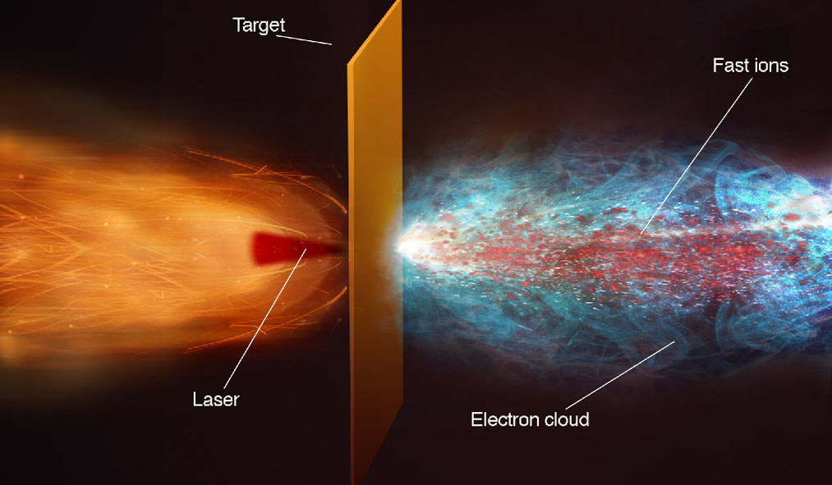
Space charge effect in the laser driven accelerator
Space charge effect in laser acceleration is a valuable research question.
The size of the beam generated by the laser acceleration is directly corelated to the size of the laser.
In the transverse space, beam cross section is as small as few ~um in diameter.
The peak current is very high.
In the longitudinal space, beam is as short as few ~10 ps in pulse length.
Notes:
The short beam generated in laser acceleration usually has ten to the eighth, ten to the tenth ions.
In the transverse space, beam cross section is as small as few microns in diameter.
In the longitudinal space, beam is as short as tens of picoseconds in pulse length, meaning that the peak current is very high. And the particles created in beginning has a complex composition. It is mixed particle bunch. There are electron and proton with different energy in a bunch.
So the particle density is very high at the very beginning of accelerated completion.

Slide 11
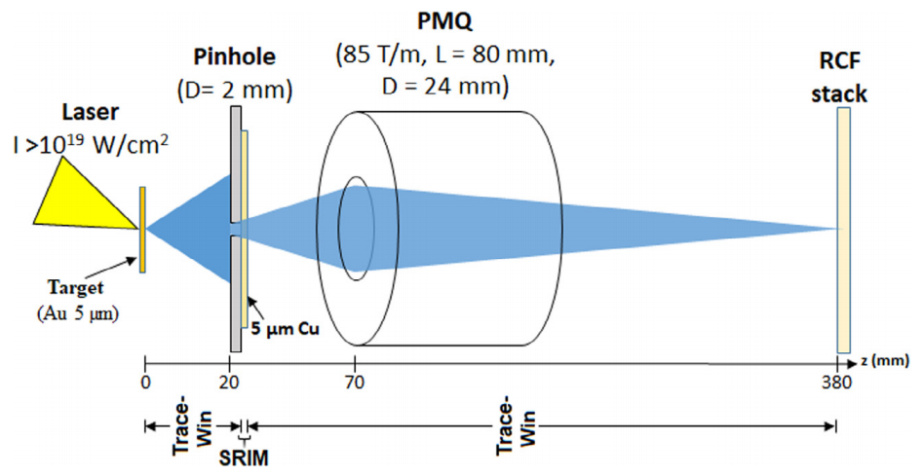
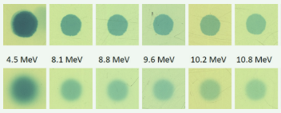
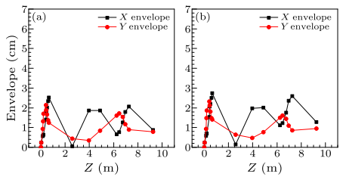
Space charge effect in the laser driven accelerator
GSI
1E8 mixed particles
Initial phase of beam generation
4.5 MeV 1/3 halo growth
8.1-10.8 MeV <20% halo growth
Focused collection phase
The space–charge repulsion is diminishing to neglectable with the temporal expansion of proton beam up to the collection aperture(70 mm).
CLAPA-I
1E7 mixed particles
Proton central energy 15 MeV Fixed 20ps beam length (The space charge effect will decrease )
The effect of the space charge on transverse envelope can be neglectable.
Reference
[1] Space–charge effect of laser accelerated protons on beam profile and permanent magnet quadrupole focal line, Al-Omari H , Hofmann I , Bagnoud V ,et al.
[2] Study of space charge force for a laser-accelerated proton beam,
[3] Beam Line Design of Compact Laser Plasma Accelerator
Notes:
So the space charge effect in laser acceleration is a very valueable reaserch question.
The GSI has do some reaserch about it. In their reaserch, they do a experiment about laser accelerated particles transmition in a quadpole.
In their experiment, the particle indensity is ten to the 8th particles per pulse.
Before the particles go into focusing field, the proton beam is expanded and has some halo growth.
For 4.5 MeV proton, it has one third halo growth. And for 8.1 to 10.8 MeV particle, the halo growth is lass than 20%.
The halo significant growth is only occur in a short range before the beam go into the quadpole. The space–charge repulsion is diminishing to neglectable with the temporal expansion of proton beam up to the collection aperture(70 mm).
We have done some reaserch in our first generation experimental facility CLAPA-I. And we have result similar as GSI.
We use 10 to seventh mixed particles with 15 MeV central energy.
The effect of the space charge on transverse envelope can be neglectable through the whole beam transport system.

Slide 12
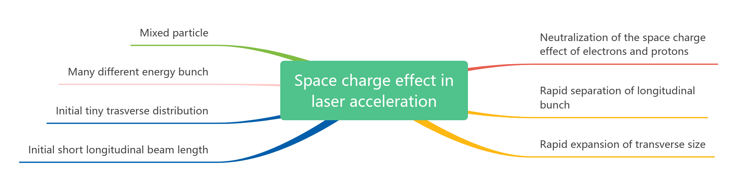
Space charge effect in the laser driven accelerator
Not a big problem
Detailed reaserch is limited by space
Valuable reaserch question
Notes:
So, in brief, the space charge effect in the laser acceleration is a valuable reaserch question.
It is a complex process and it is strong enough to increase the envelope and emiitance in the acceleration beginning.
But it is not a problem in the design laser accelerator. Because the space charge effect will be rapid decrease in short range of beam transport.

Slide 13
Background information
Background information
Space charge effect in the laser driven accelerator
The compact laser-driven proton therapy system
  The compact laser-driven proton accelerator I
  The compact laser-driven proton accelerator II
Summary and prospect
Notes:
In the third part, I will introduce our project about compact laser-driven proton therapy system.
To achieve the goal of laser-driven proton therapy system. We are doing a series reaserch with the support of goverment.

Slide 14
3 challenge of laser-driven proton radiation
Energy
Energy spread
Stability
2 projects of chinese Ministry of Science and Technology
Research project of compact laser accelerator and key technology
PW laser proton therapy device application demonstration
2 facilitis are building to reaserch
CLAPA-I（200 TW-15 MeV）
CLAPA-II （2 PW-200 MeV）
Notes:
To achieve the goal of laser-driven proton therapy system.
We started from the 3 challenge of laser-driven proton radiation
Through 2 projects of chinese Ministry of Science and Technology supported, we built 2 facilitis for reaserch.

Slide 15
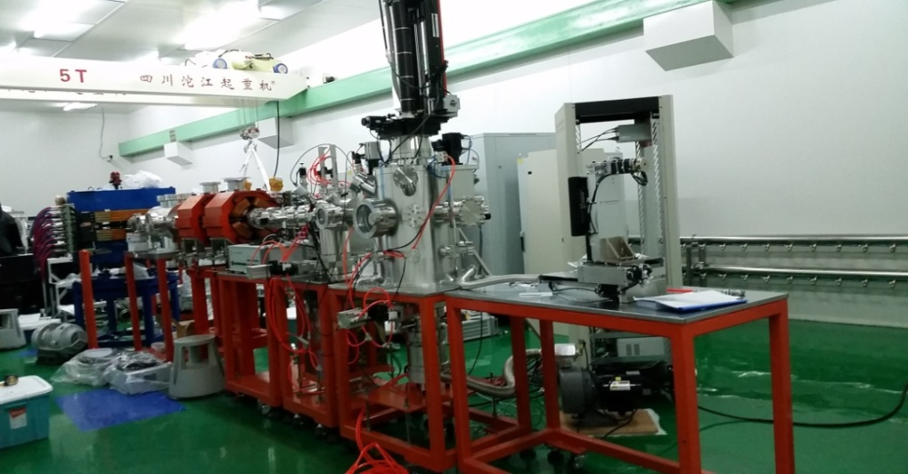
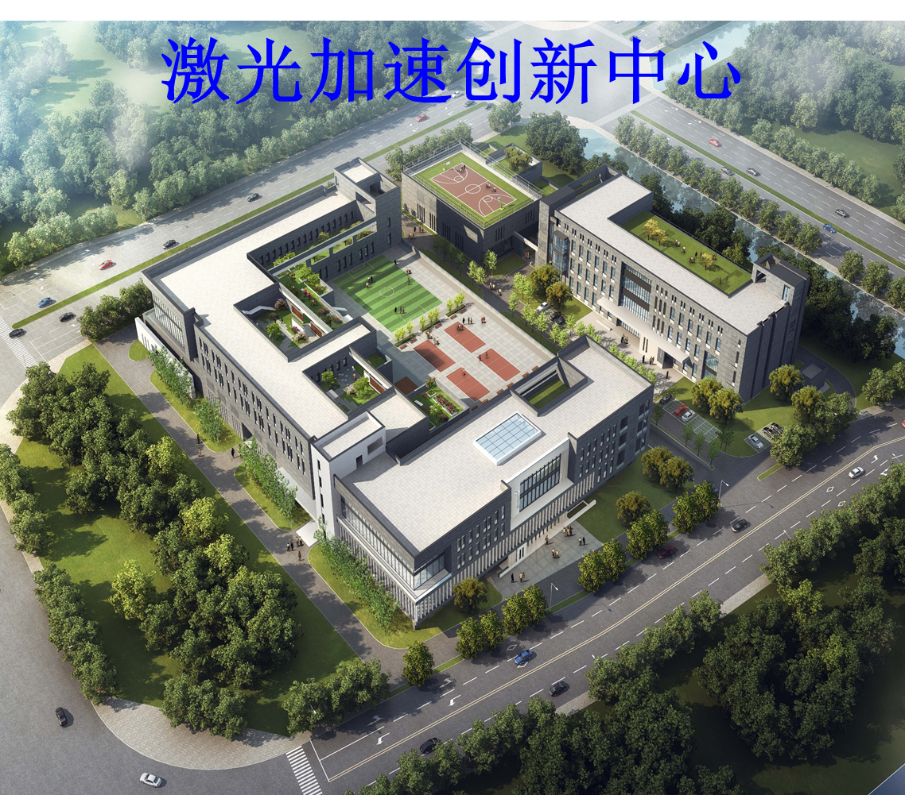
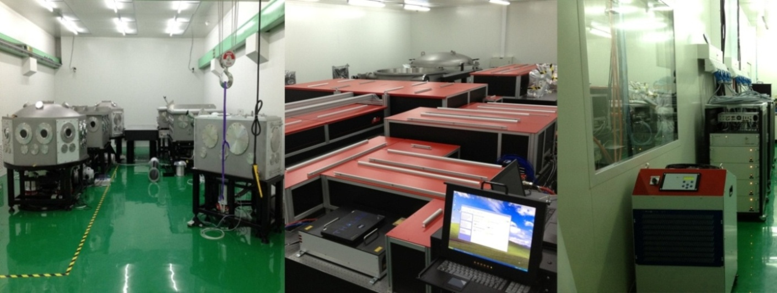

。
CLAPA-I
Laser Accelerated Innovation Center
  CLAPA-II (CLAPA-T)
Total funds allocated by the State：5.19 B
Project Time: 2019-2030
  Location: Huai Rou Science City, Beijing
2012 to 2017
Notes:
During 2012 to 2017, Peking university has built a compact laser plasma accelerator CLAPA-I.
Many researches is carried on CLAPA-I: Such as research on the physical mechanism[ˈmekənɪzəm] of laser-plasma acceleration, transmitting of beams with broad energy spectra and large angular divergence.
Based on the research experience. We built a compact laser plasma accelerator for therapy (CLAPA-II) facility.
This facility is located in the Laser Accelerated Innovation Center in Huai Rou Science City ,Beijing. This image shows the top view of the science city.
Higher power lasers will be used throughout the project, and hundreds MeV proton beam will be produced for cancer treatment.
The Chinese Ministry of Science and Technology support total 5.19 billion for completing this project.
And it will plan be completed during 2019 to 2030

Slide 16
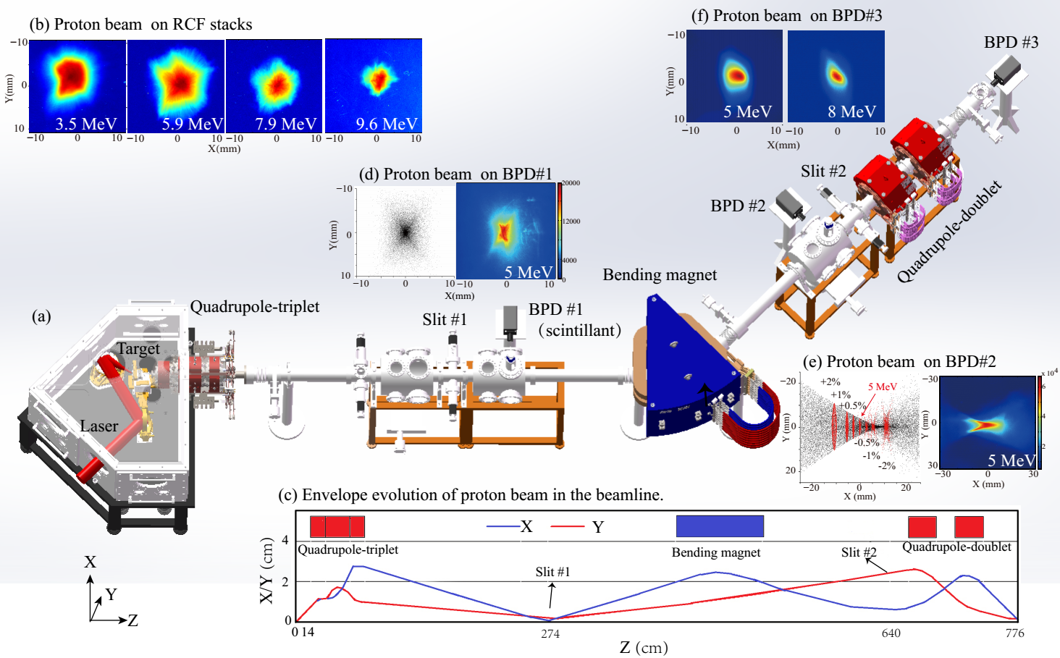
  CLAPA-I: proton beam with 15 MeV, 1% energy dispersion
energy dispersion contral
big divergence angle beam collection
final target beam stability
image3
image1
image2
J.G.Zhu,…, C.Lin*,X.Yan*, PRAB, 2019
Notes:
In the CLAPA-I device, we used 200 TW laser shoot hydrocarbon target to create pronton beam with 15 MeV cental energy.
Except the laser and shooting target acceleration system, we use a beam transport system involved three segments to solve the problem of laser driven beam collection, energy selection and shaping.
We used a triplet close to the target for collecting the beam with big divergence angle.
The different deflection radius from different energy is used to control the energy spread in the end of beamline.
A doublet before the final target is used to shape the beam.
We have vertified the energy dispertion could control in the 1%.
And the beam accelerated by laser with big divergence angle could be collection effective and trasnsport stability

Slide 17
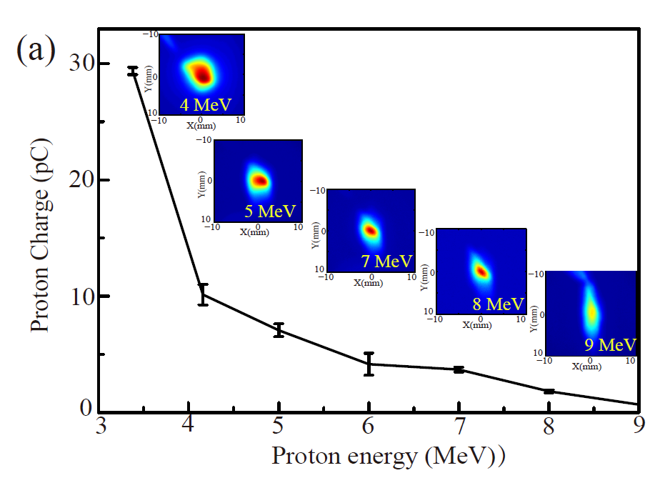
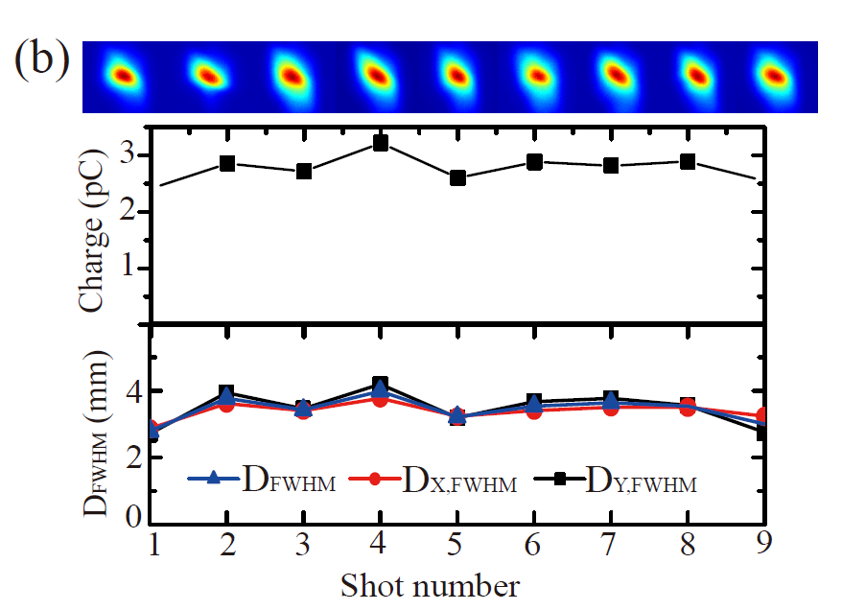
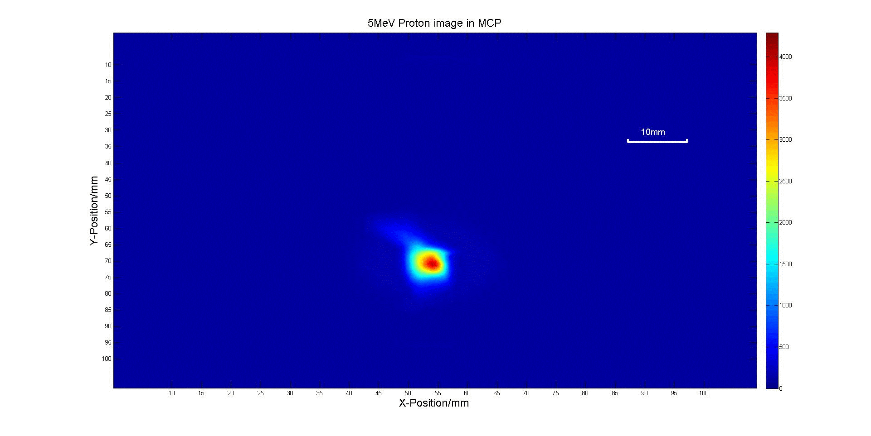
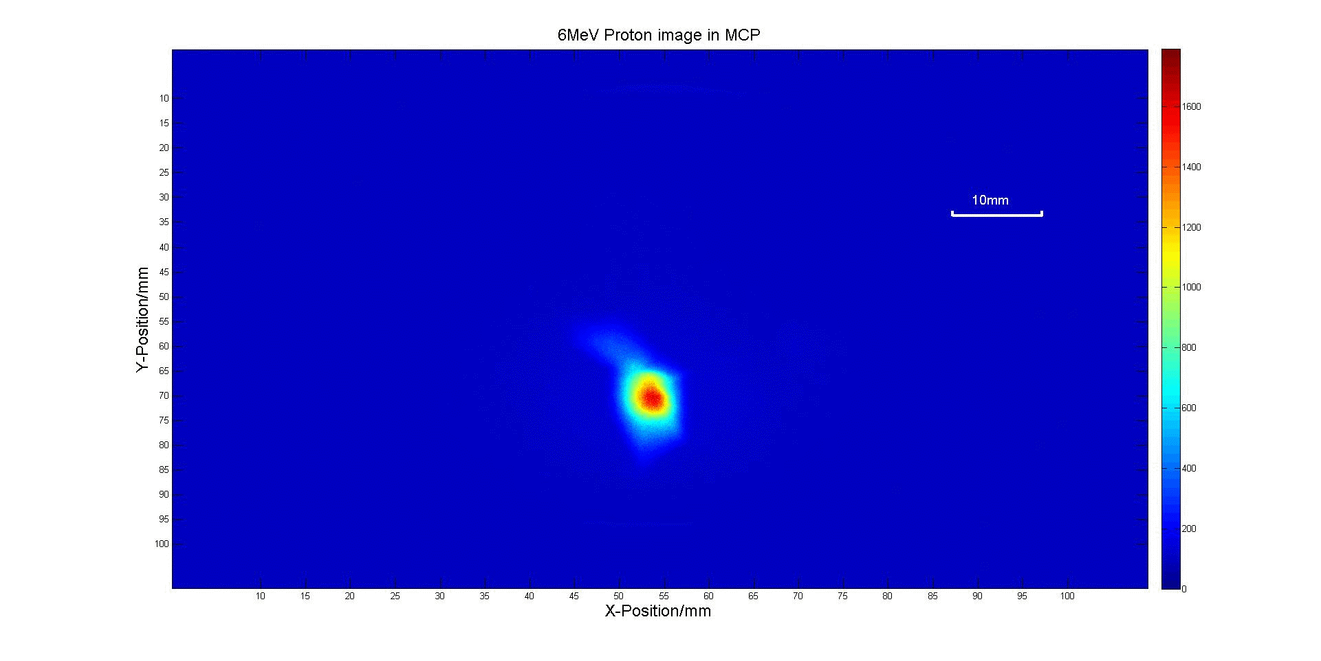
Central Energy 3-9MeV, ΔE=1%
Charge stability 11%，spot stability 8%
5 MeV, 1%
6 MeV, 1%
Notes:
We do the on-line measurement of 1% energy dispersive proton beam.
The experiment result shows that the beam with 3-9MeV central energy is observed. The higher energy beam only can be observed in the entrance of the beam line because the partical indensity is too small.
In our measurement, we have found that the charge stability of the beam can reach 11%, and the position stability can reach 8%.
Such beam stability vertifies the possibility of laser driven proton radio therapy application.

Slide 18
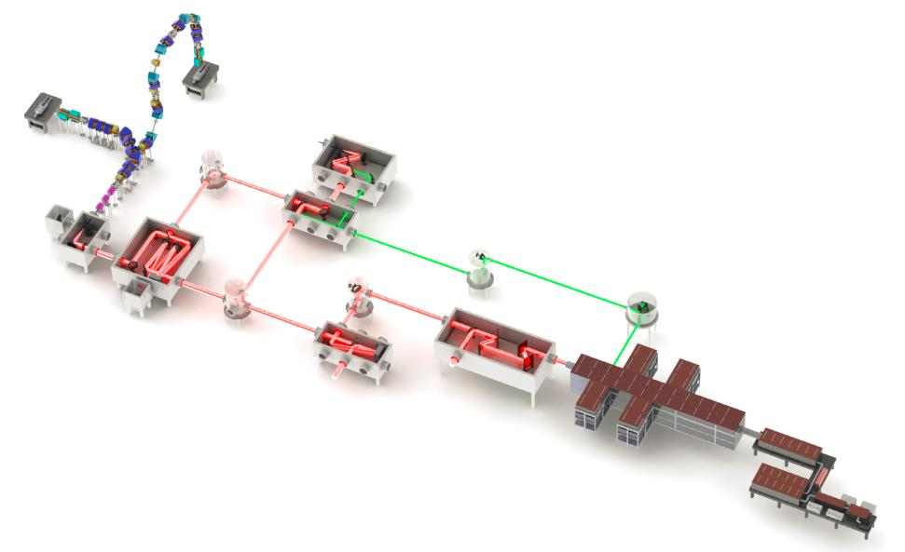
Experimental prototype:
2019-2024
Engineering prototype: 2025-2027
Product prototype:
2028-2030
Proton E_{max} ～100-200MeV
10⁸ ~ 10¹⁰ ppp
repetition rate≥ 1Hz
Notes:
This image shows the overall layout of the whole CLAPA-II. It is built based on the experience of CLAPA-I.
It include a higher power laser. That means it could create higher energy proton.
The CLAPA-II project plan to finish in three phases.
First phase will be construct an experimental prototype before 2024. In the first phase, 100 MeV proton will be created.
Second phase will be transfer experimental prototype to engineering prototype before 2027. 200 MeV proton will be created.
Finally a product prototype will be carry out before 2030.
The proton energy goal is 100-200 MeV. And the repetition rate goal is equal or greater than 1Hz

Slide 19
  CLAPA-II (CLAPA-T)
Laser proton beam acceleration and diagnostic system:
Completed laser shooting target
Produces a beam of high-energy protons
PW Laser system
High contrast frontend,
Amplification system
Compression system
Multi-pass amplification technology
Four granting compressing system
Consisting of XPW and OPCPA in the frontend
Proton Beam Transmission System:
Developed a stable and reliable laser-driven proton therapy system.
Developed the transmission system that can deliver the desired therapeutic beam
The transverse envelope growth of the beam is controlled by achromatic transmission technique.
Notes:
The whole device is mainly divided into four parts containing the control system.
Except the control system，the other three systems, are listed in the figure.

Slide 20
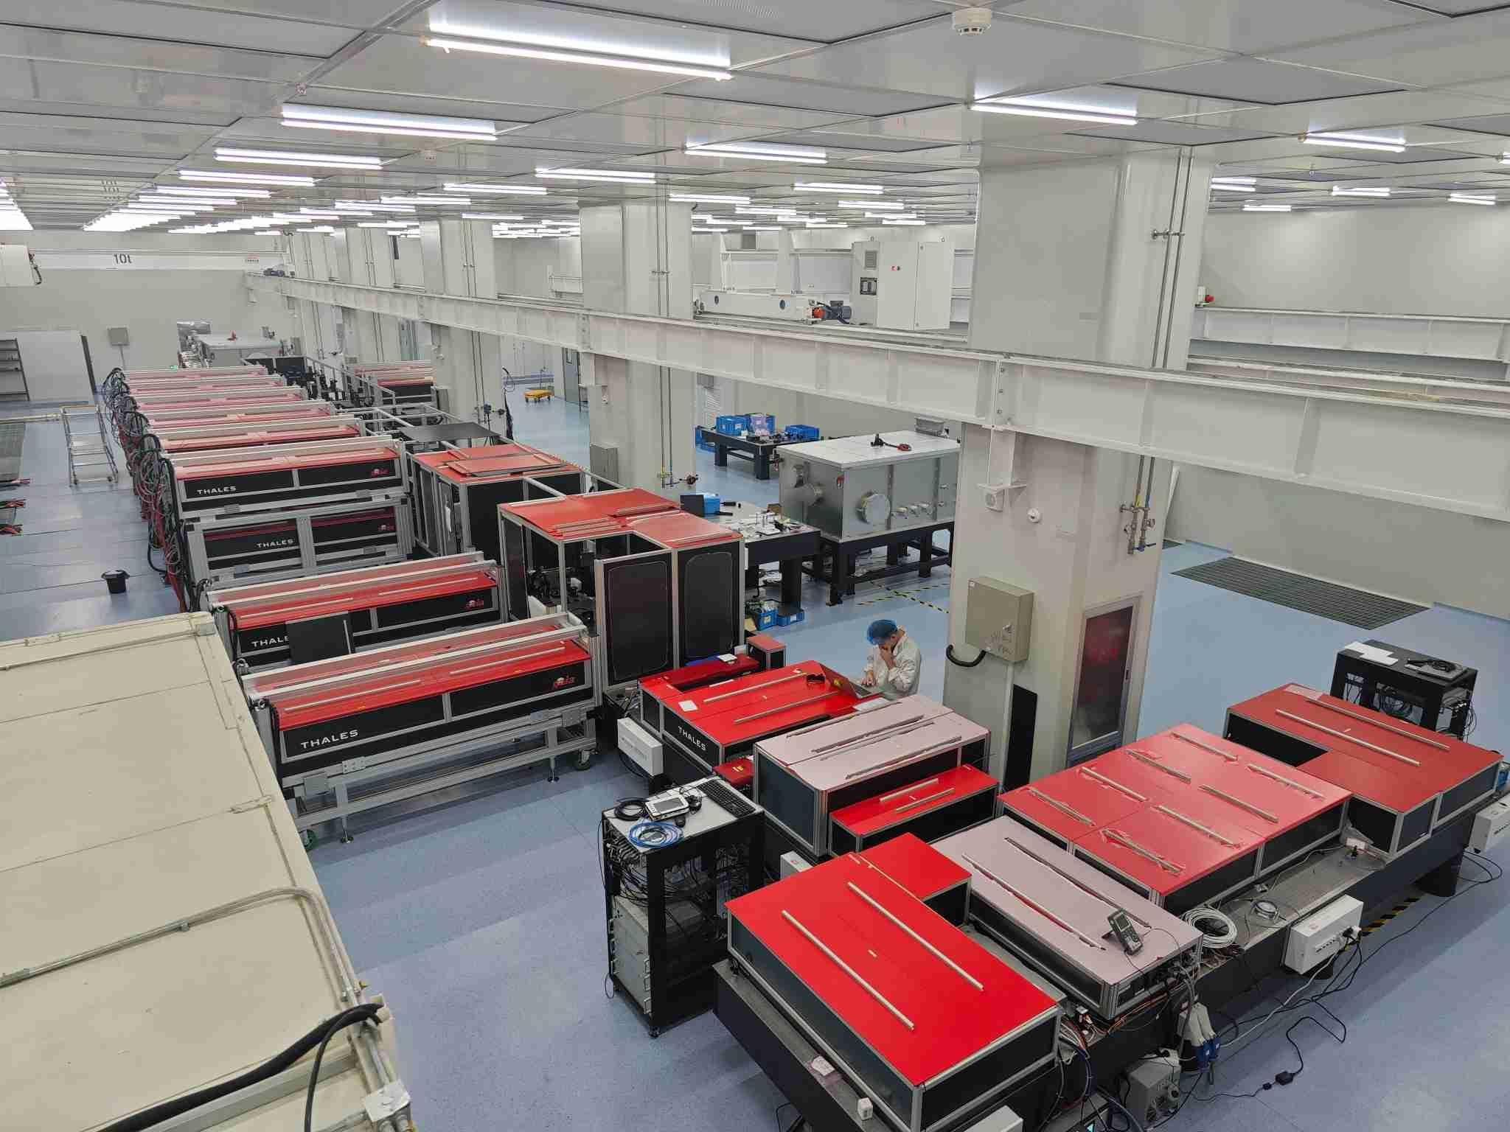
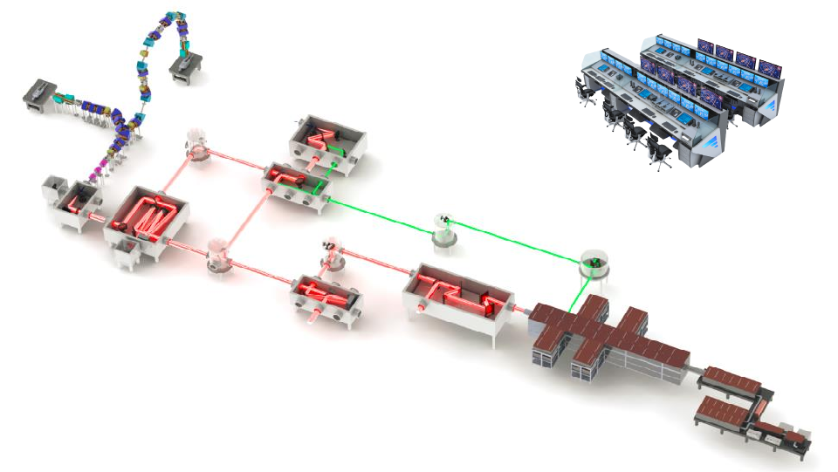
The high power laser system is the driving source of the laser proton accelerator.
Peking University cooperated with THALES Laser Company of France to develop a 2 PW, 1Hz laser system(The highest refrequency at the same power).
The laser has been lit and is being optimized.
Notes:
The first one is Petawatt laser system. The high power laser is created from it.
Now this system is commissioning
The high power laser system is the driving source of the laser proton accelerator.
Peking University cooperated with THALES Laser Company of France to develop a 2 PW, 1Hz laser system
Usually, the peek power and the refrequency contradict each other.
And this system is designed to be the highest refrequency laser at the same power.

Slide 21
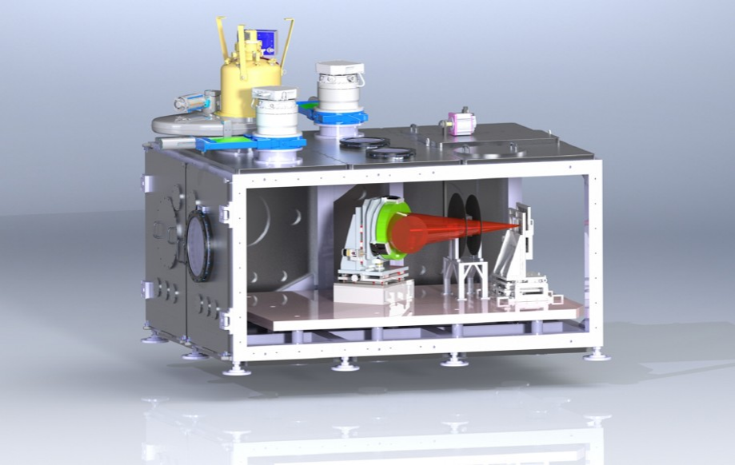
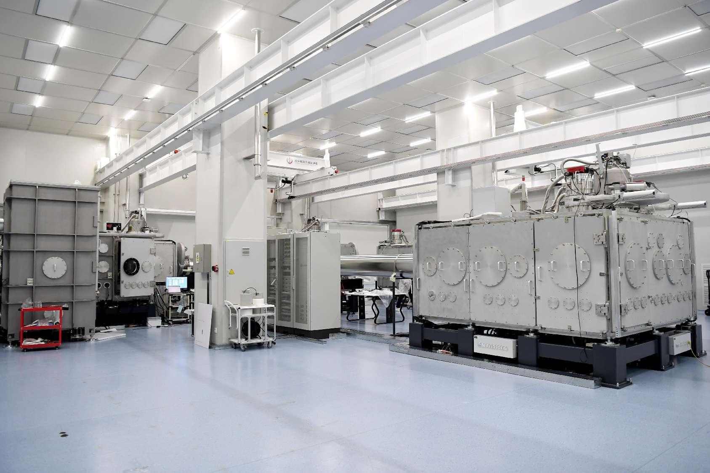
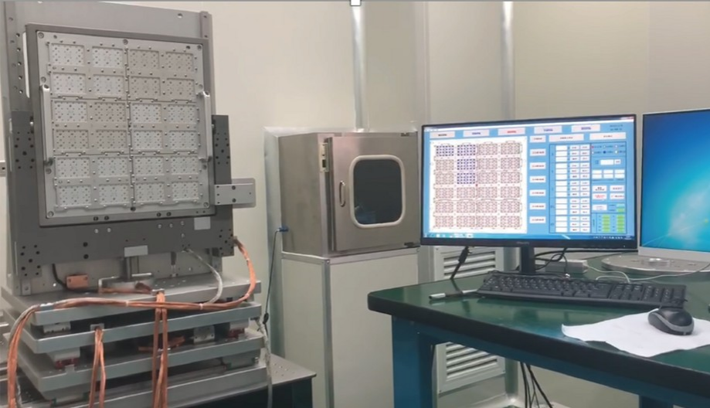
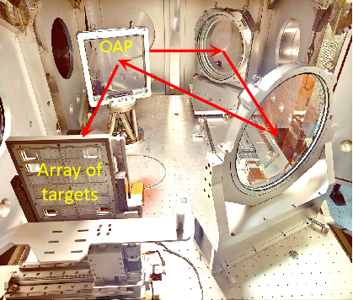
To get high energy laser driven proton beam. The ultra-thin target shooting is needed.
To get 1 Hz laser target shooting, a high-precision array of targets system is designed.
This system has completed the linkage debugging with the whole system.
Notes:
The second system is Laser proton beam acceleration and diagnostic/ˌdaɪəɡˈnɑːstɪk/] system.
It includes a laser target shooting system, and could produce proton beam with high-energy through laser acceleration.
And this system have a complex laser path and laser diagnostic element for adjusting proper laser parameters.
To get high energy laser driven proton beam. The ultra-thin target shooting is needed.
For the proton beam created stably. A high-precision targets array system is designed.
And this system has completed the linkage debugging with the whole system
Last week the low power laser target shooting has been done. And low energy proton beam has been created.

Slide 22
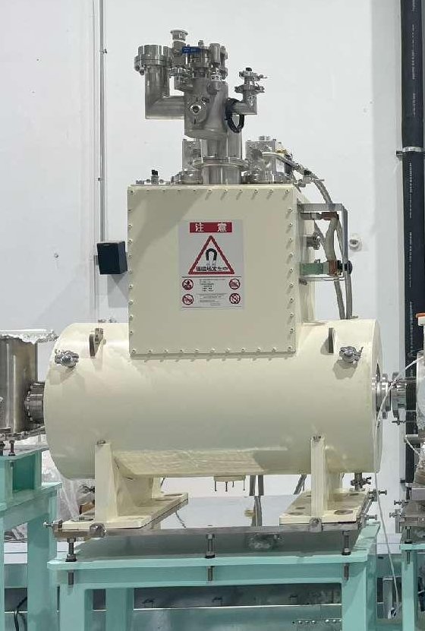
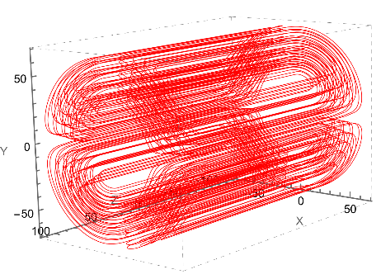
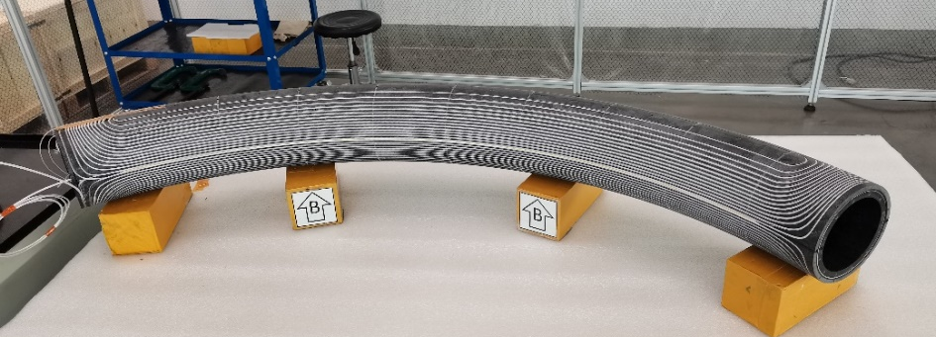
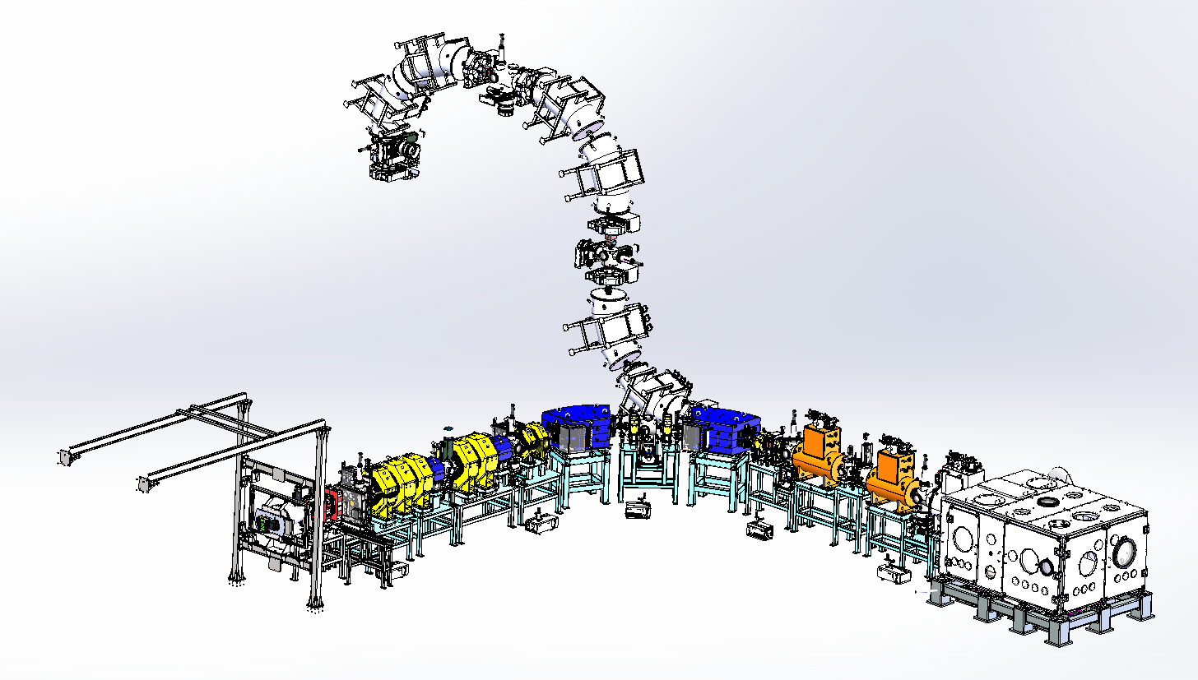
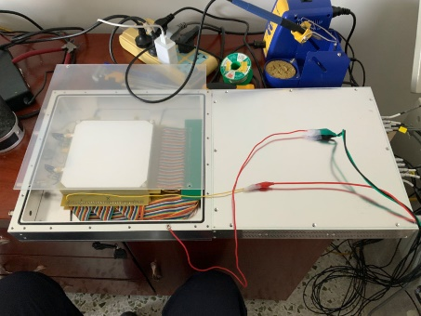
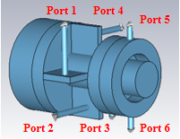
Beam transport system
Function is similar as CLAPA-I beam transport system.
Realize the beam energy selection and stable transport.
Upgrade about transmission efficiency and beam distribution homogenization.
Notes:
The third system is beam transport system. It is After laser shooting target system
Its function is similar as CLAPA-I beam transport system.
It can also realize the beam energy selection and stable transport.
And we do some upgrade about transmission efficiency and beam distribution homogenization.
I will introduce this part of design in more detail, because this part design is more close to a accelerator design.

Slide 23
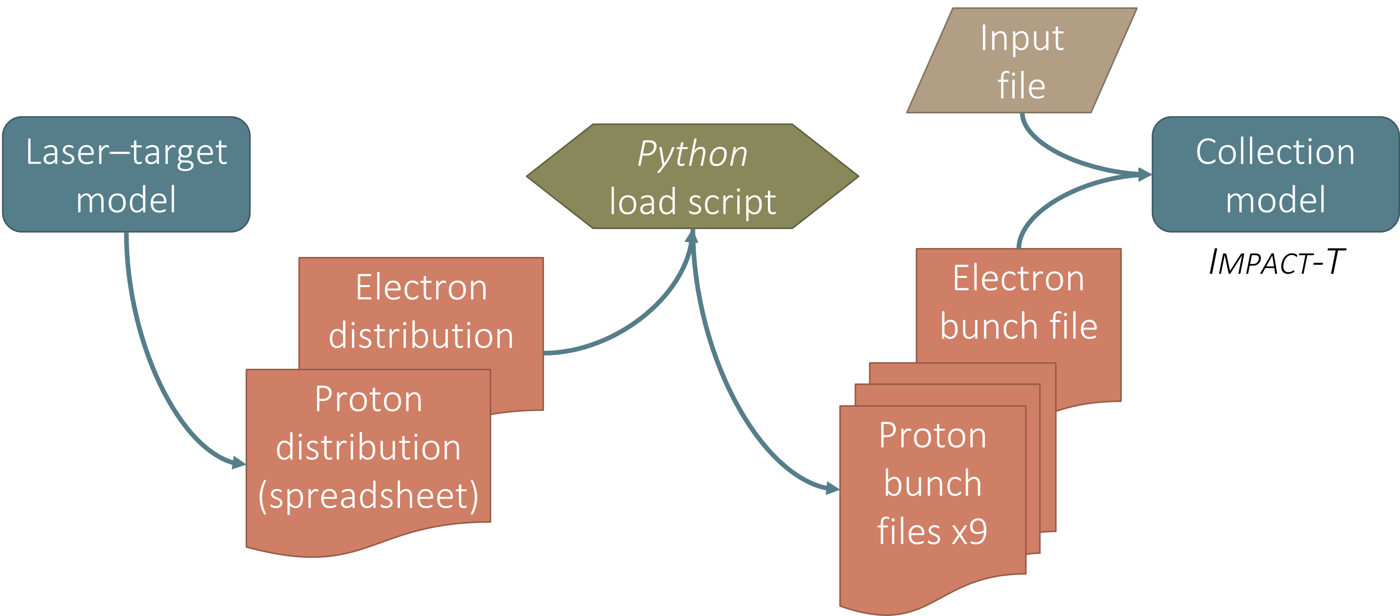
Initial macro library generation program
Laser Plasma Researchers provided
Notes:
First of all, we use a process to carried out the initial particle library for simulation.
The simulation process starts with the proton and electron distributions as produced from the laser–target PIC simulation model.
And we divided the particle bunches from PIC result as 9 proton bunches and 1 electron bunch.
And use IMPACT-T code to simulate the envelope in the acceleration beginning.

Slide 24
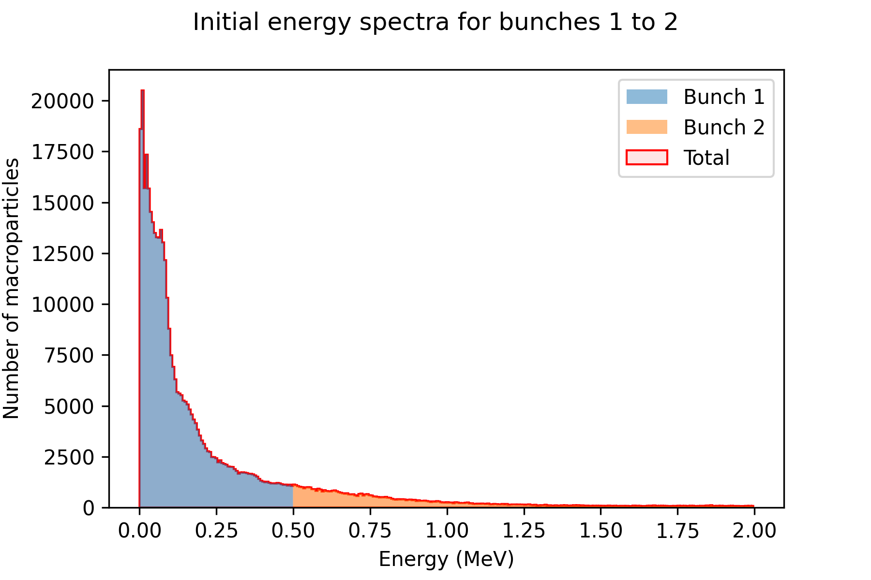
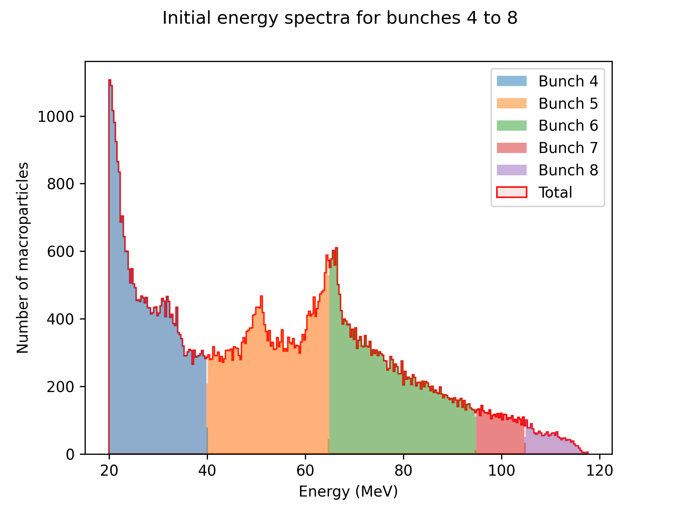
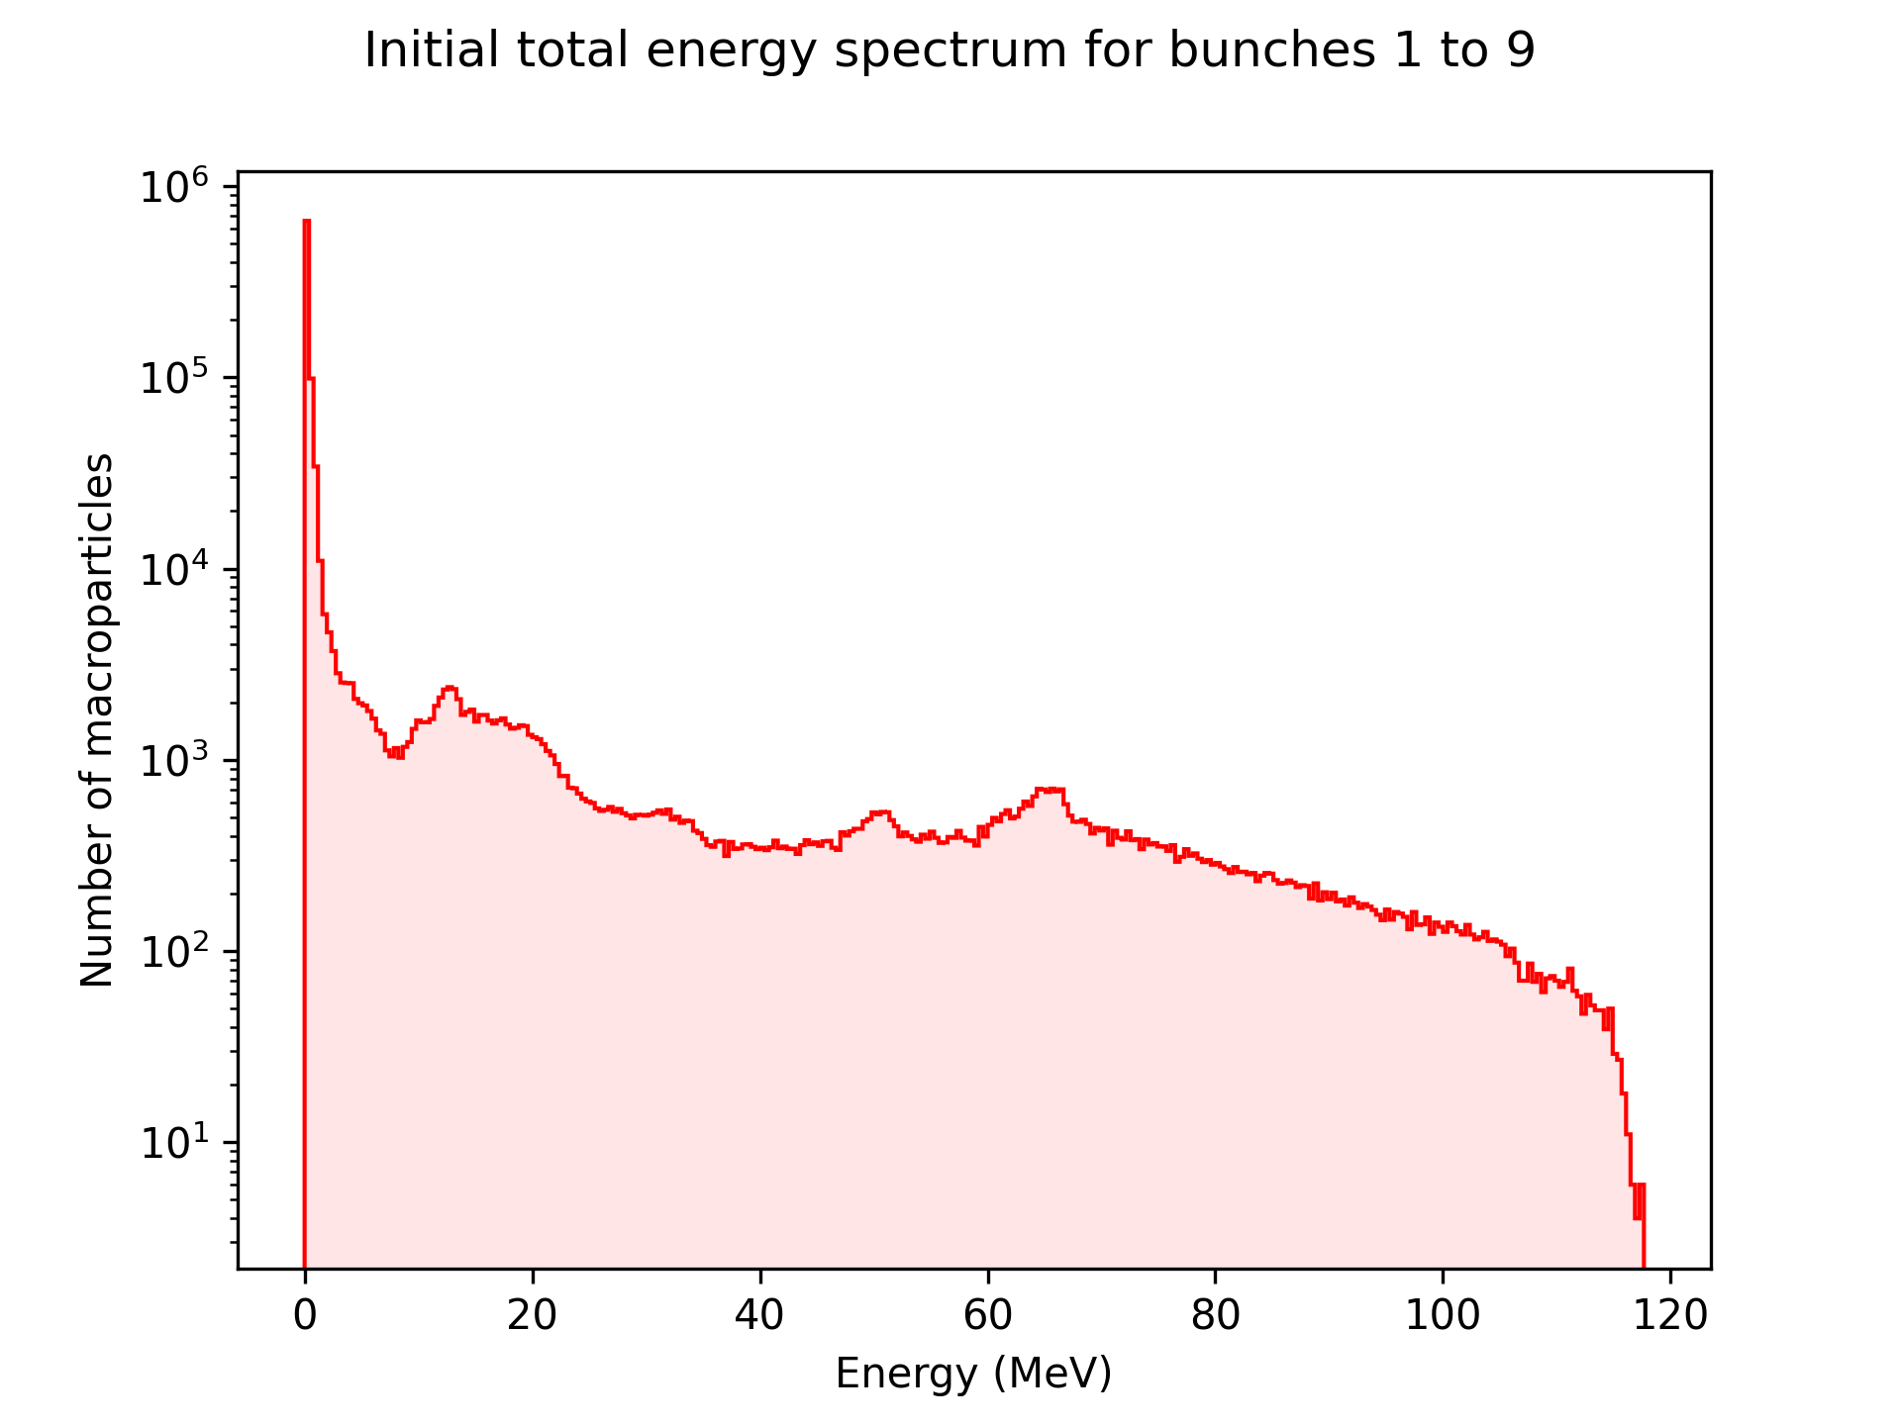
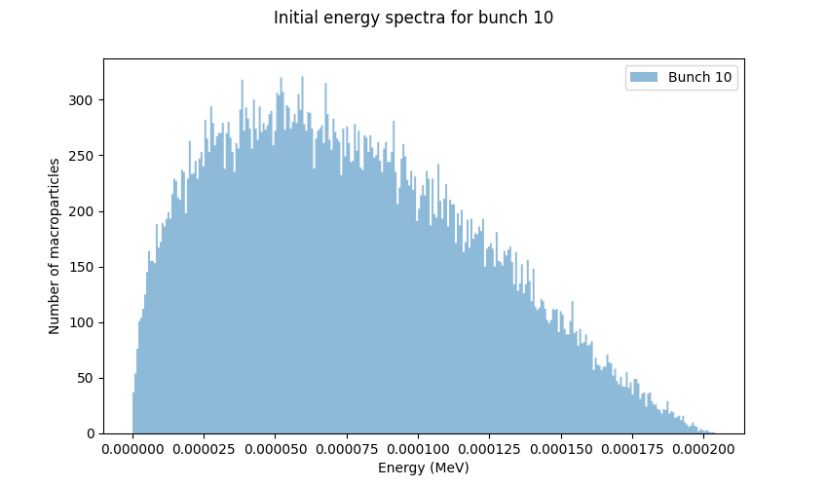
Divided particles into bunches by energy range
Low energy beam bunch
Bunch 7 is the target energy range 100 MeV
Particles with 10% energy dispersion near the center energy can be extracted as data for simulation.
Electron bunch
Notes:
The energy spectrum is very wide, and so for accurate tracking with space-charge calculation, it needs to be split into separate bunches. There are nine proton bunches and one electron bunch.
The key research bunch is bunch 7. It is the target energy of the project phase 1.
Bunches 1–6 are lower energies, bunch 8 is higher energies, bunch 9 is protons moving backwards (in the negative z-direction), and bunch 10 is the electrons.
We use IMPACT simulate these 9 bunches particle transport in the beginning of the beamline
After these simulations are completed, particles with 10% energy dispersion near the center energy can be extracted as data for beamline design.
The beamline is used Tracewin code to designed.

Slide 25
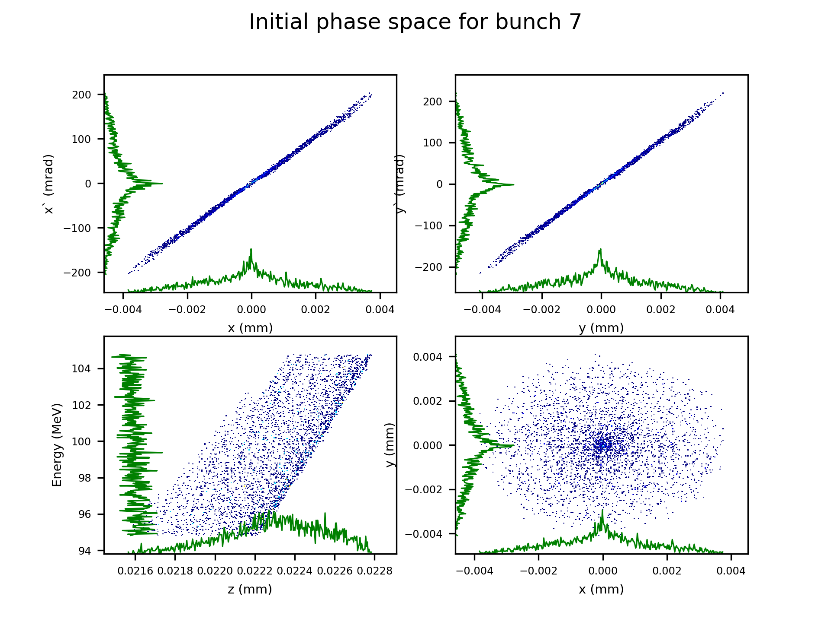
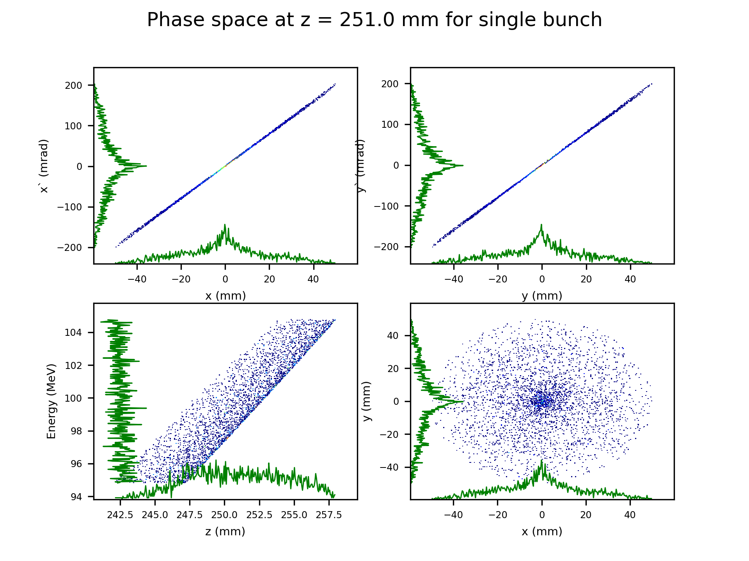
Laser
Solenoid
Target
Multibunches tracking in IMPACT-T
Multi-bunch simulation for wide energy spread with exponential energy spectrum
Full cross-bunch space-charge interactions
Proton beam tracking from target to solenoid entrance
Notes:
The variation of beam parameters from target shooting to the entrance of the solenoid is carried out by IMPACT.
During the simulation, we found that not all particles can enter the collection section of beamline.
But this simulation verified most particles can enter collection section.

Slide 26
Deflection and Energy Selection (DES) section
Provides vertical beam for radiation
Collection section
Beam acceleration cavity
Provides horizontal beam for irradiation
Notes:
In the design process of the beam line, the whole system is divided into three parts according to different functional requirements.
The first section is Collection section which is used to collect the initial large divergence angle beam and make a preliminary energy selection.
In DES section, the beamline is divided into horizontal and vertical parts. The deflection element in the two sub-beamlines transport beam to the desired therapy target direction respectively.
This section is used to accurate energy selection and removed uncharged particles
In the final application section. It completes the final beam shaping before radiation.

Slide 27
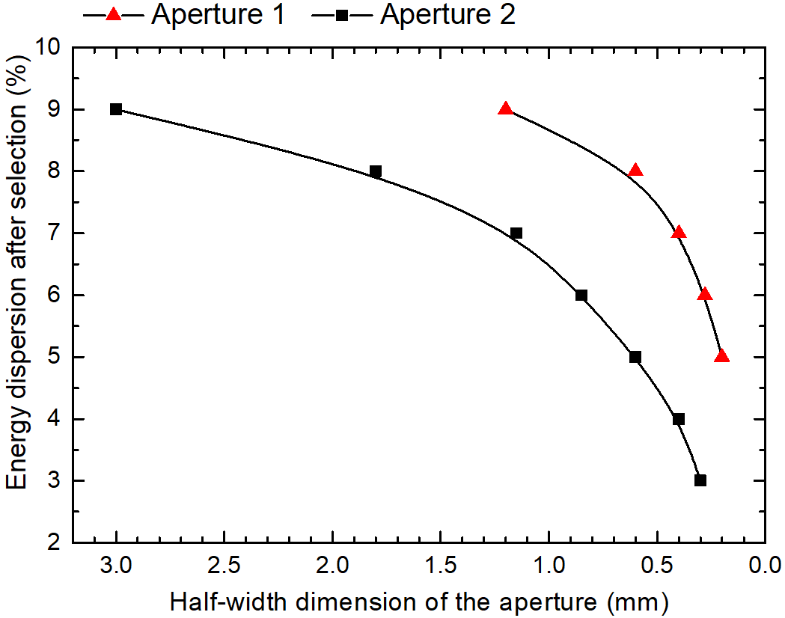
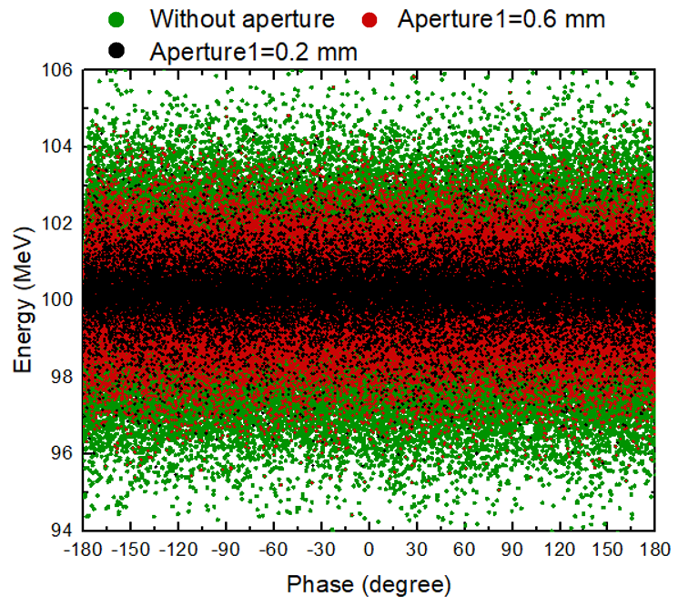
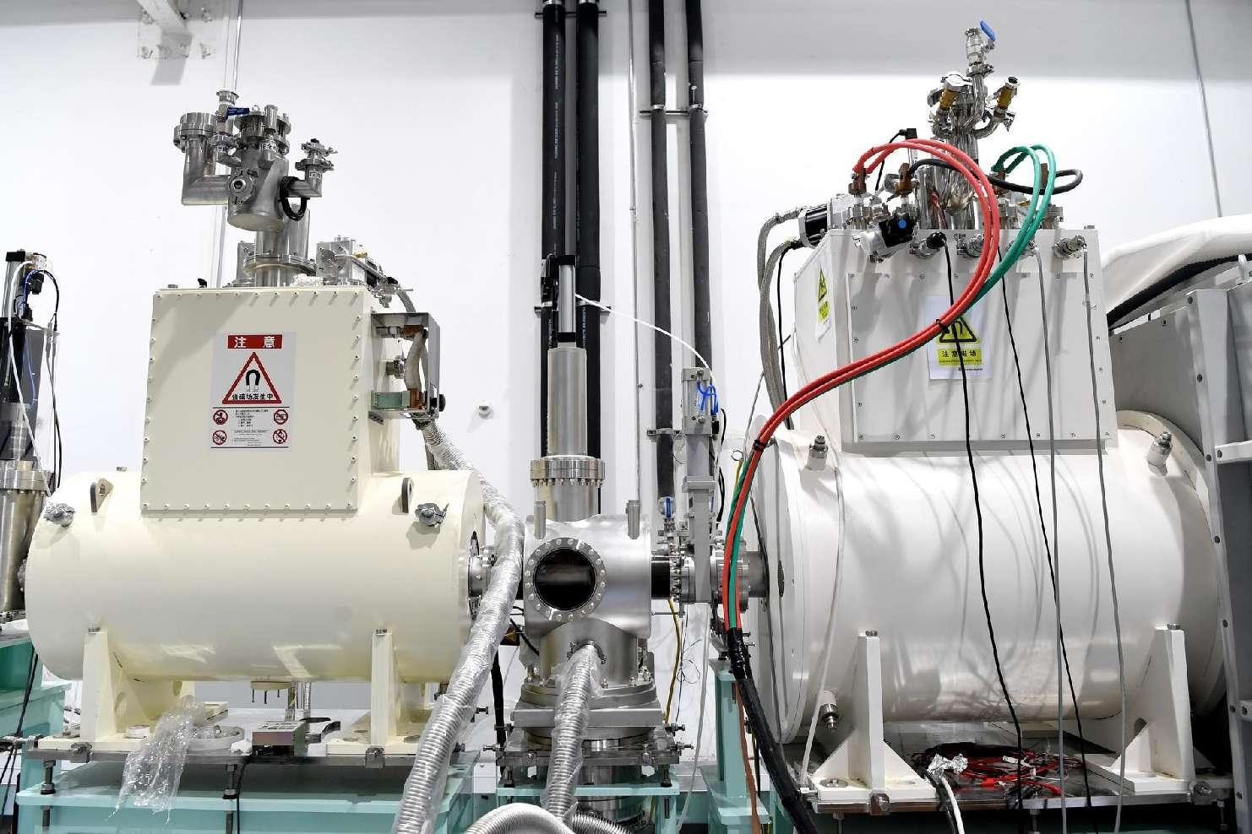

Collection section
Laser shooting cavity
First solenoid
Three superconducting high-field solenoids
Two adjustable apertures between the three solenoids
L=500 mm R=30 mm
B=9.05 T
L=500 mm R=30 mm
B=8.23 T
L=500 mm R=30 mm
B=6.51 T
Notes:
The collection section is consisted by three superconducting high-field solenoids. And the first solenoid has been designed linking with laser shooting cavity as close as possible.
10cm after the particle beam is generated and transmitted, it can enter the focusing field.
It can collect the beam with a wide range of energies and divergence angles.
We use the chromatic effect of solenoid to do a preliminary energy selection.
Two adjustable apertures is set between the three solenoids. Through the different focus point of different energies, the big energy dispertion particles will be preliminary eliminated.
This Figure(right) shows the result of PIC simulations, shows the relationship between aperture size and energy selection, and (右下) shows the final energy distribution when adjusting the first aperture.

Slide 28




Deflection and Energy Selection (DES) section
Accurate energy selection
Removed uncharged particles
The achromatic lattice design is used.
Quadrupole
Dipole
Limit the envelope growth area
Notes:
In the Deflection and Energy Selection section design, when particles with energy deviation pass through the dipole magnet, their trajectories/trəˈdʒektərɪz/ gained angular perturbation/ˌpɜːrtərˈbeɪʃn/.
Under this influence, the transverse and longitudinal motion of the beam will be coupled.
That means the momentum dispersion of the beam will cause the increase of the transverse envelope of the beam.
For increase the beam longitudinal and transverse acceptance, the achromatic lattice design is used.
In the design, the dispersion function appears at the entrance of the first dipole magnet, it reaches its maximum value between two dipole magnets, and drops to 0 at the exit of the second dipole.
After optimization, the twiss-beta parameters decreases with the increase of the dispersion function and reach the minimum value where the dispersion function is maximized.
This method minimizes the effect of dispersion on beam envelope and instability.

Slide 29



Deflection and Energy Selection (DES) section
Canted-cosine-theta (CCT) magnet is used
It use multiple nested coil pairs to produce a hybrid field of dipole and quadrupole components
The achromatic lattice design is used.
Notes:
In the vertical DES section, the novel CCT magnets is applied in addition to the achromatic lattice design.
The vertical DES section lattice is consisted by 3 achromatic cell. Each achromatic cell is consisted by two 45 degree CCT magnets.
The CCT magnet is a light weight superconduct magnet. It need not iron core to construct magnet filed, and its field quality is better than troditional magnet.
This element can reduce the weight of the vertical beamline. In this projects, CCT magnets will use multiple nested coil pairs to produce a hybrid field of dipole and quadrupole.
The curved CCT magnet which is composed of multiple pairs of alternately tilted solenoid windings is used in the design of vertical beam line.

Slide 30


Deflection and Energy Selection (DES) section
The moveable slit set between DES section remove particles with energy deviation and neutral stray particles produced by laser acceleration.
Notes:
The energy selection slit is placed in the middle of DES section. Fine energy selection and removal of uncharged particles can be done here.
Figure shows the simulation results of relationship between final energy spread and the half width of movable slit. The lines with different colors represent simulation with different energy spread pre-selected from collection section.

Slide 31




The horizontal beamline is equipped with a section for beam homogenization.
The octupole magnet modifies the particle distribution by deflecting the transverse beam edges towards the center of the beam.
Notes:
After DES section, both horizontal and vertical beamline set three quadrupoles respectively for beam shaping in the final target.
In the horizontal beamline, there is a special design.
We used 2 octupoles and some quadrupoles design a beam distribution homogenization system.
Octupole magnet middle field is weak, edge field is strong. So Its magnet field mainly acts on the edge region of the beam.
It can change the distribution of particles by folding the transverse edge of the beam toward the beam center.

Slide 32

Homogenization affect of octupole in x and y direction
Octupole y
Octupole x
Notes:
This figure shows the homogenization affect of octupole in x and y directions.
Its can be found that, two directions are uncoupled.
So we can independently adjust beam distribution in a single direction.

Slide 33

CLAPA-II
The 2 PW & 1 Hz laser system has been constructed and is currently commissioning.
The construction of a high-precision target array system has been completed for laser-driven beam radiation.
The design of a beam transport system has been completed. The construction of the horizontal beamline has been accomplished.
40-200MeV proton beam can be transmitted by beam transport system.
The energy dispersion can be controlled to within approximately 1%.
The beam distribution can be adjusted in the horizontal radiation.

Slide 34
Background information
Background information
Space charge effect in the laser driven accelerator
The compact laser-driven proton therapy system
Summary and prospect
Notes:
Final part is summary and prospect.

Slide 35
Summary
Face to the challenges before laser accelerators application, PKU completed the primary exploration of the low energy segment through the device CLAPA-I.
Based on the experience of CLAPA-I, PKU build CLAPA-II. It has higher power laser and more functional beam transport system.
The goal is to have a 100MeV proton beam that can be used for radiotherapy by 2025. The experiment of low power laser shooting is begining.
Welcome all experts to visit our center!
Energy? Will be OK
Energy spread? OK
Stability? OK
Nobel prize report:
Notes:
Back to our report topic. We are talk about the compact laser accelerator.
But the volume of the CLAPA-II is not compact any more,
There are two reasons. First reason is we set many laser diagnose cavity to reaserch the laser acceleration physical mechinism.
Because for high energy proton beam, we need much amplifier to get high power laser.
So the meaning of compact need to be redefined.
First of all, compared the troditional accelerator the radiation protective is compact. Because the beam only need to transport 10 meters.

Slide 36


Prospect
Next generation laser proton therapy accelerator
Challenge:
How to get the energy selection accuracy only using the chromatic effect?
Advantage:
The weight and size of the gantry can be greatly reduced.
Notes:
On the other hand the weight of laser accelerator could be compact.
For the next generation laser proton therapy accelerator, we plan to use the laser light mirrors replace the deflection magnets.
The biggest challenge in this design is to get the energy selection accuracy only using the chormatic effect.
The advantage is that the weight and size of the gantry can be greatly reduced.

Slide 37


Prospect
kA
Beam length only is several nanoseconds
Easily get high dose rate
The beam duration compact
mA
t
Notes:
Finally the most compact is the beam length.
The beam accelerated length is relatively to the laser duration.
So the beam in the entrance of beam line could be picosecond. In the beamline exit the beam length only is several nanoseconds.
So laser accelerator could easily get high dose rate during radiation.
We do some mice radiation experiment. We observed flash radiation effect. The normal cells of mice are better protected.
We are reaserching with IMP to design an laser accelerator injector.
We wish the properties of these short bunches could extend to conventional irradiation as well.

Slide 38
Thank you
Suggestion is welcome
Notes:
Finally, I want to give a big thanks to the experts and scholars from the cooperative units who have been supporting us.

