Slide 1
An Efficient Lorentz Equivariant Graph Neural Network for Jet Tagging
Qi Meng
Microsoft Research, AI4Science
Jan 29, 2024
Notes:
Qi and I will share the progress on the generalization theory of deep learning.

Slide 2
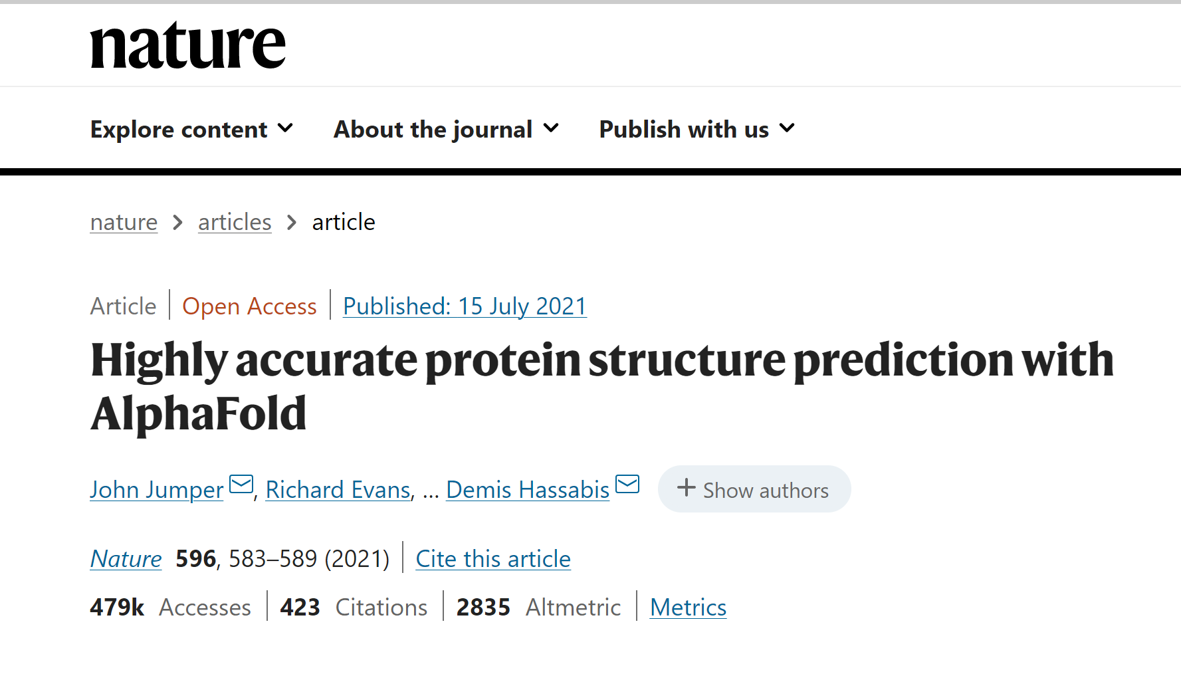
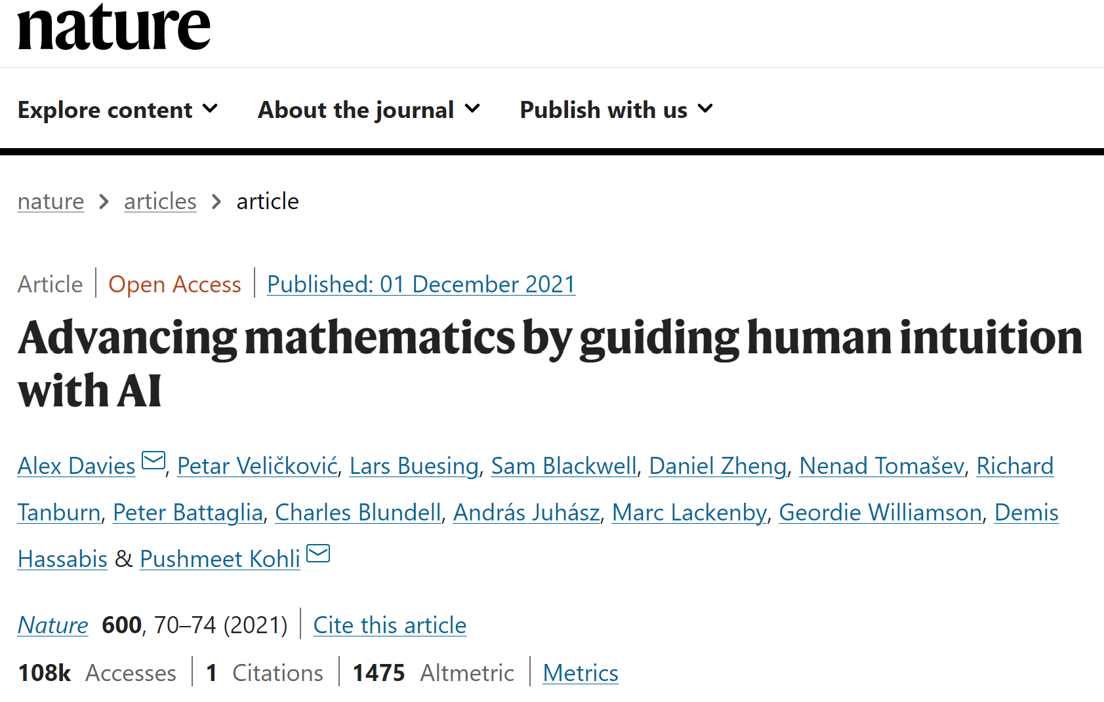
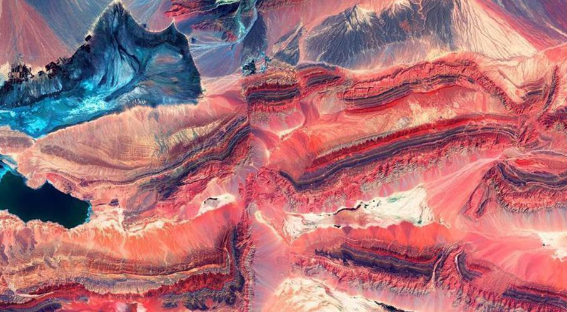
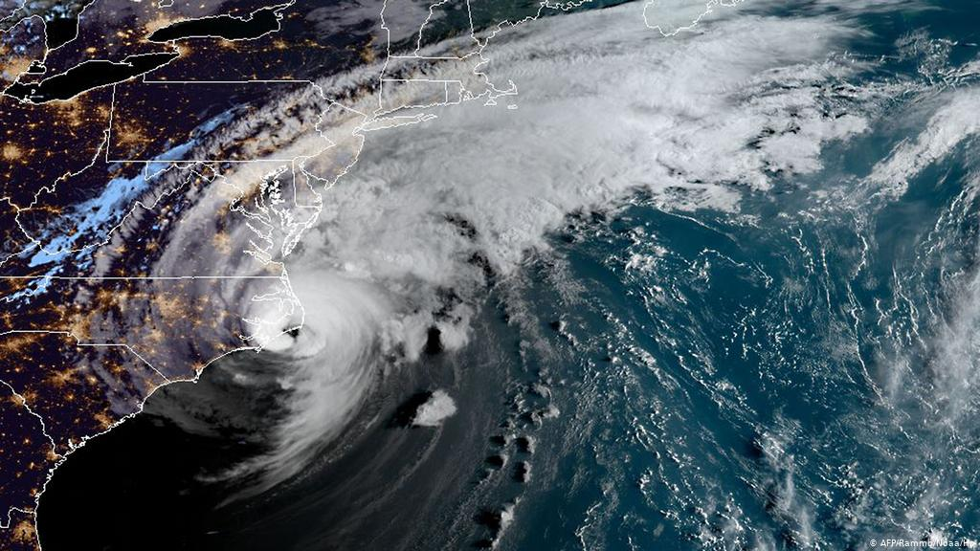
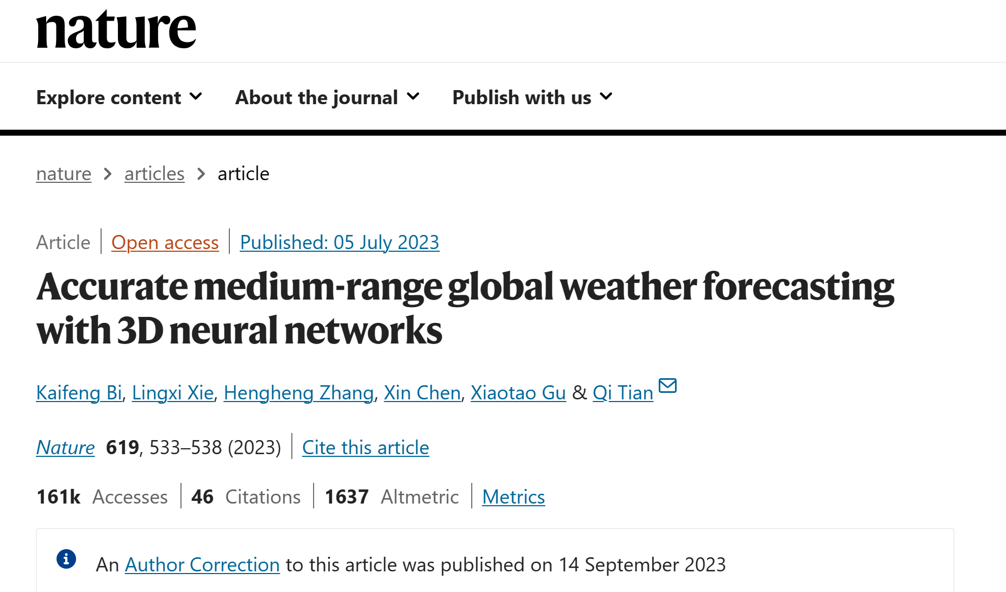
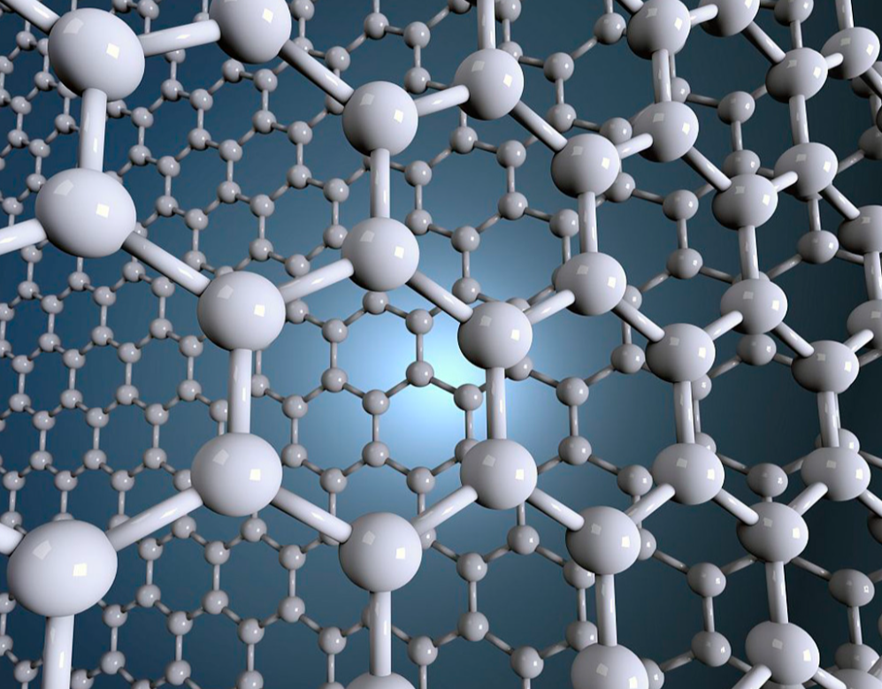
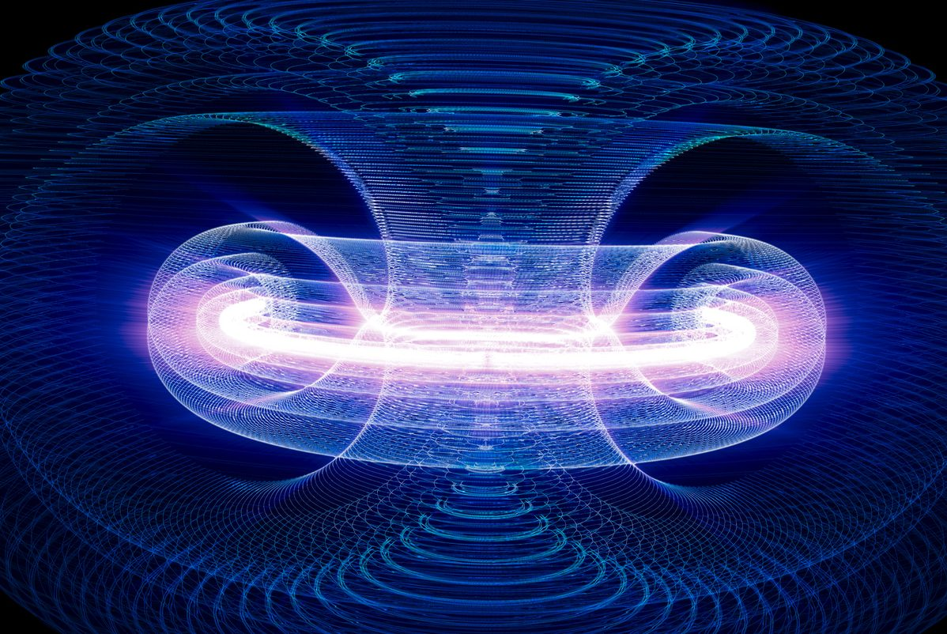
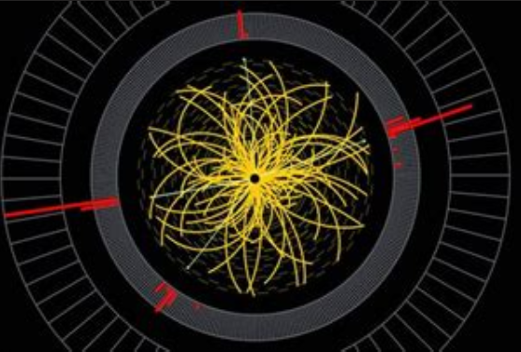
AI for Science
Geological Exploration
Drug Discovery
Weather Forecasting
Particle Detection
Material Design
Clean Energy
Science is the technological foundation to solve many important problems.

Slide 3
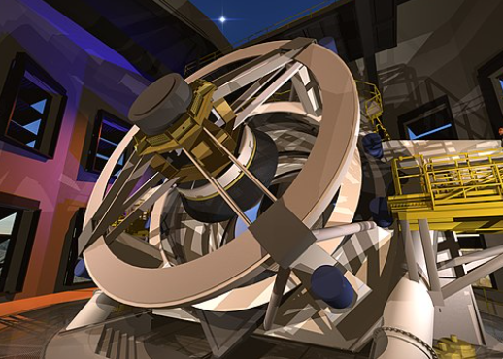
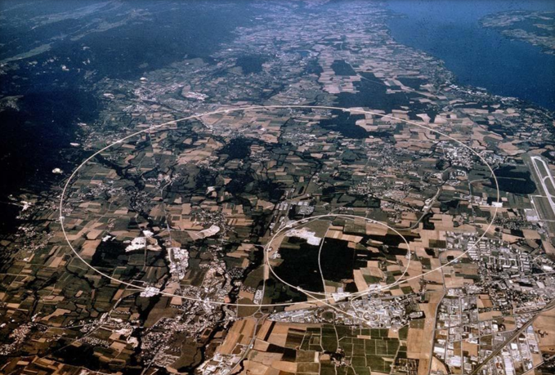
Big Data Era
Large Synoptic Survey Telescope (LSST)
Large Hadron Collider (LHC)
LSST will produce 2 TB data per night and will ultimately produce 100 PB of images!
The rate of experiments at LHC has reached hundreds of millions of collisions per second, which means tens of gigabytes of data will be produced each year.
Notes:
天王星->海王星

Slide 4
Deep Neural Networks
NN structure: $ℱ_{A}^{L}\left(d,m_{1},…m_{L−1},K\right)$
Activation function $σ$:
ReLU, Sigmoid, Tanh, logistic
Training:
Cross-Entropy Loss, for example
$$\min_{w}{L(w;S)≜\left(−\sum_{i=1}^{n}{\sum_{k=1}^{K}{z_{i,k}\ln{f_{w}\left(x_{i},k\right)}}}\right)},$$
$$\text{where} S=\left\{\left(x_{i},y_{i}\right);i=1,…,n\right\}, z_{i,k}=1, \text{if} y_{i}=k\text{, }\text{and} z_{i,k}=0 \text{otherwise}\text{.}$$
Back-propagation (SGD)
Test:
Test accuracy
$$L(w)=E_{\left(x,y\right)∼P}I_{\left[\arg{\max_{k}{f_{w}\left(x,k\right)}=y}\right]}$$
$σ(∑$)
$$\left\{w_{i,j}^{1}\right\}$$
$$\left\{w_{i,j}^{L−1}\right\}$$
Softmax$(∑)$
$$f_{w}(x,1)$$
$x$
…..
…..
…..
$$f_{w}(x,K)$$
Neural networks with $L$ layers:
$L−1$ hidden layers + Output layer
Deep neural networks are efficient universal approximators of high-dimensional continuous function.

Slide 5
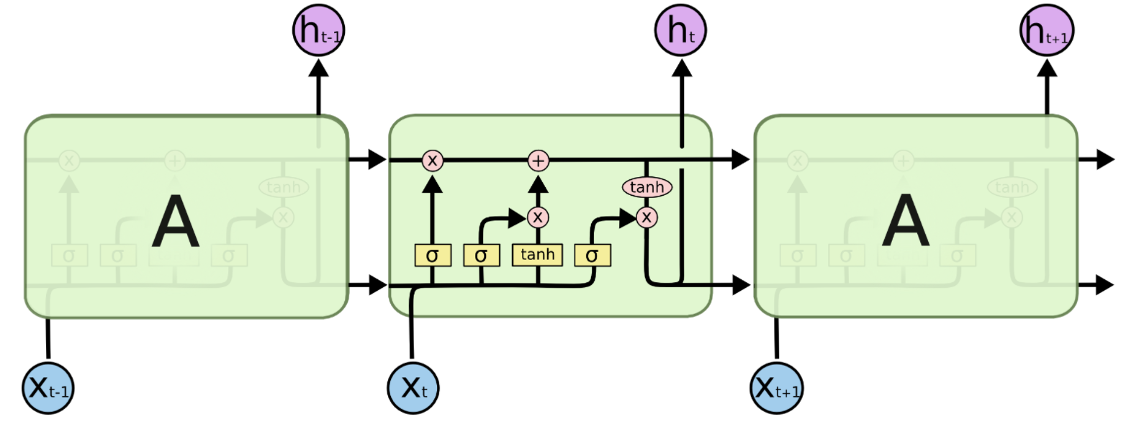
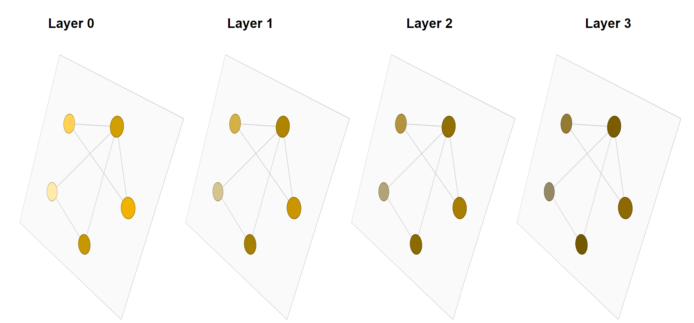
Deep Neural Networks
Convolutional neural network for image
Recurrent neural network for time-series
Neural ODE for irregular time-series [Rubanova, et al, 2020]
Graph neural network for point cloud

Slide 6
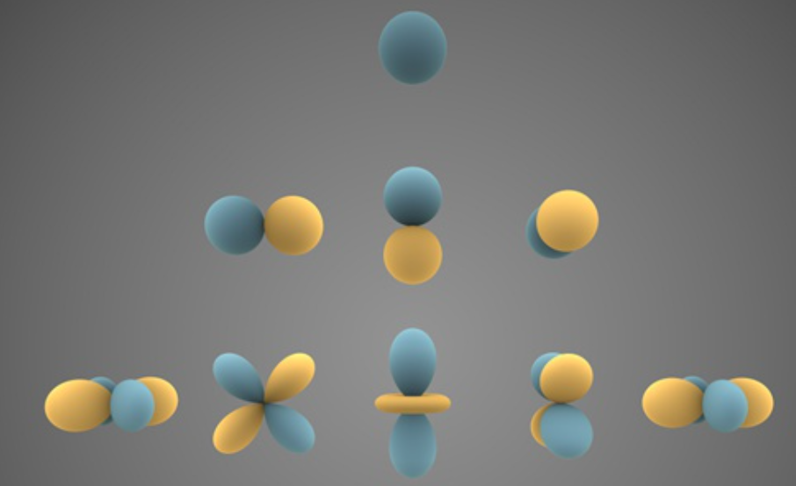
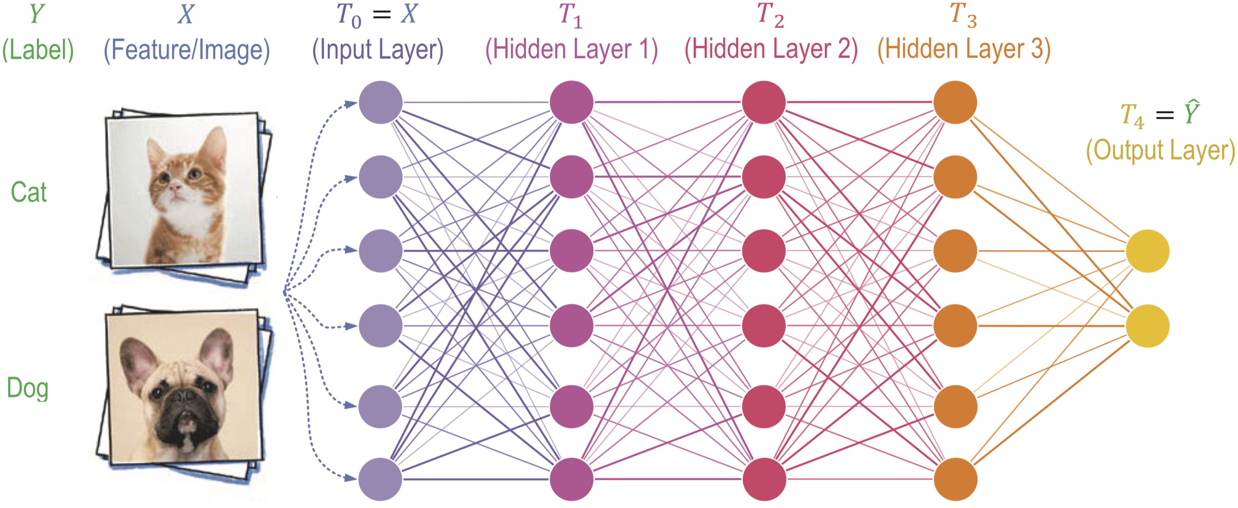
Challenges
Physical systems
Black box model
Accurate models of the world are built upon notions of its underlying symmetries
High expressiveness ☺
Hard to learn the symmetries ☹
Hard to extrapolate to new conditions ☹
Notes:
天王星->海王星

Slide 7
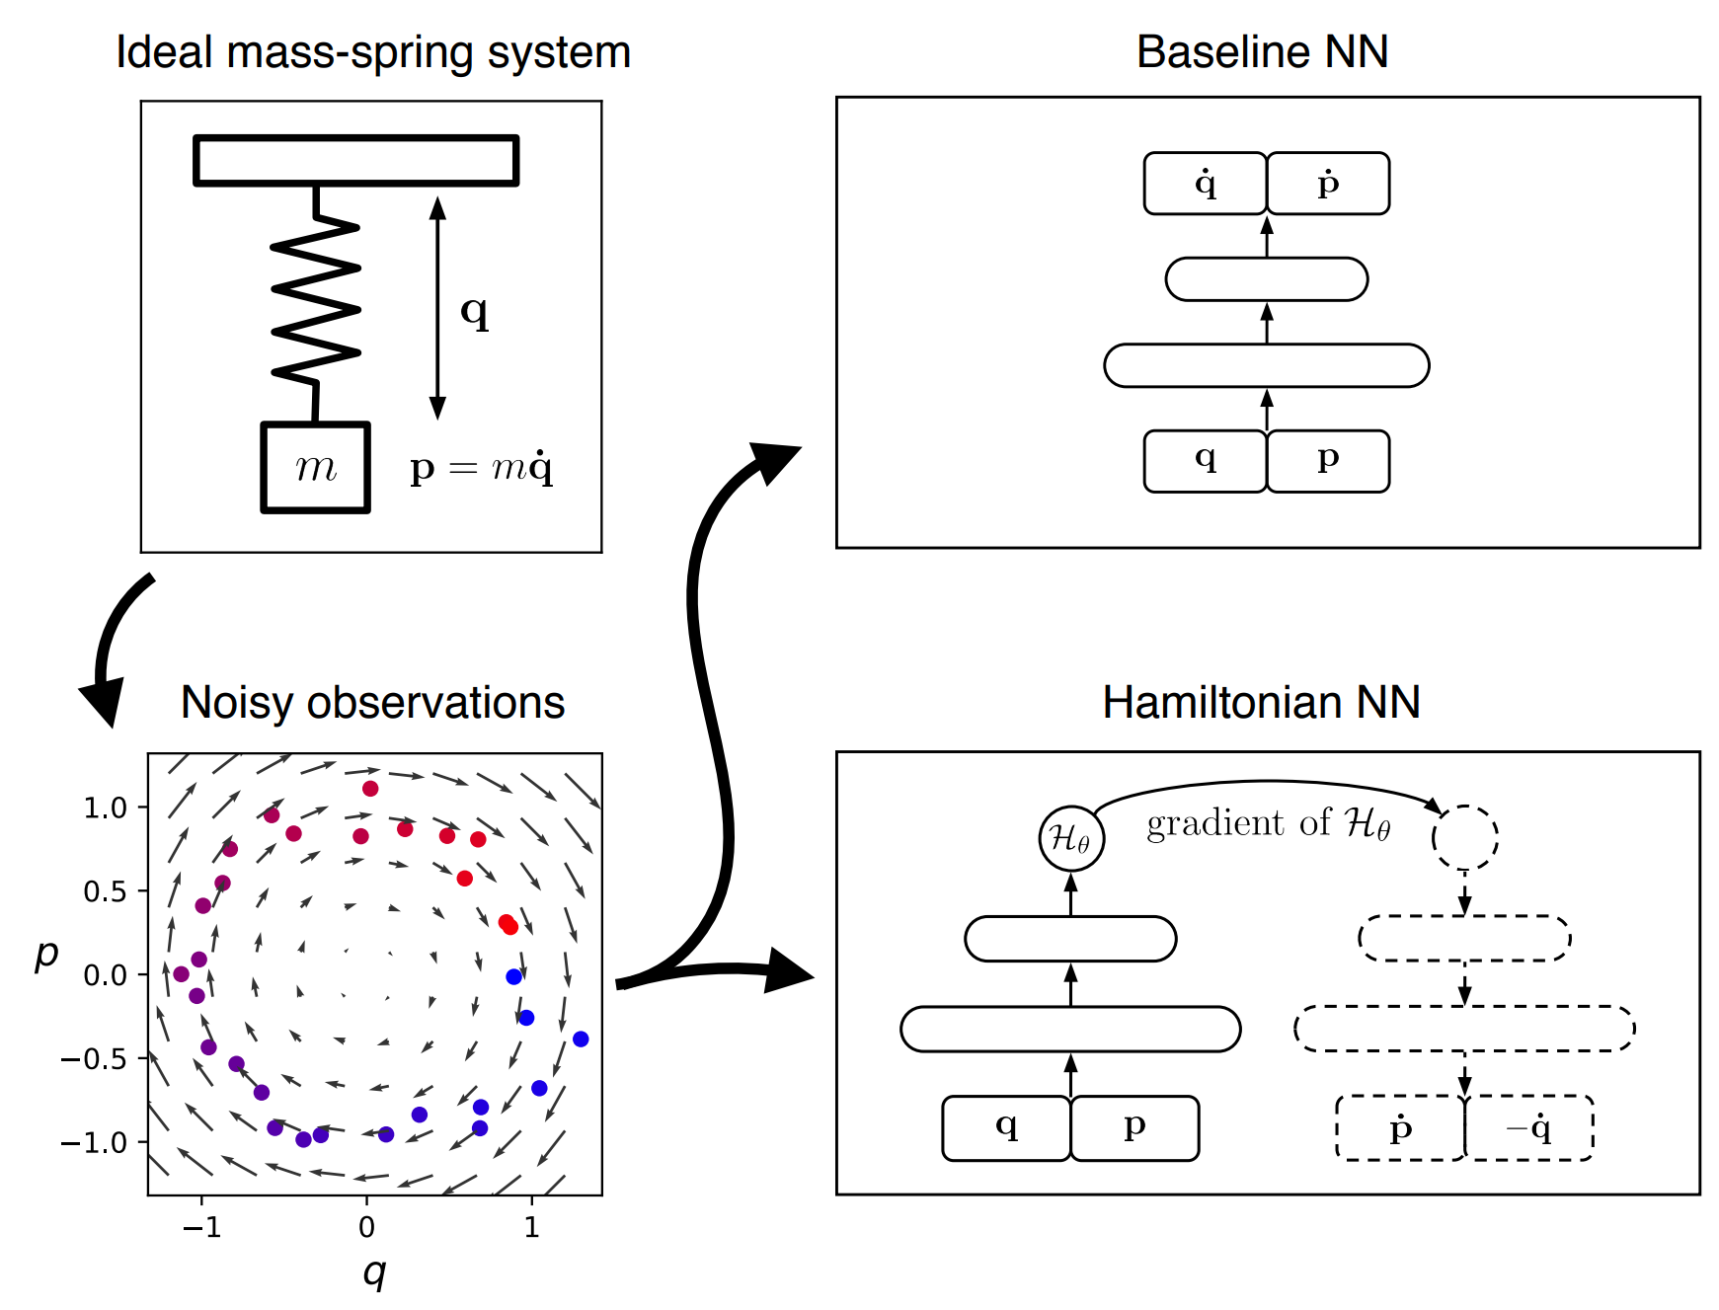
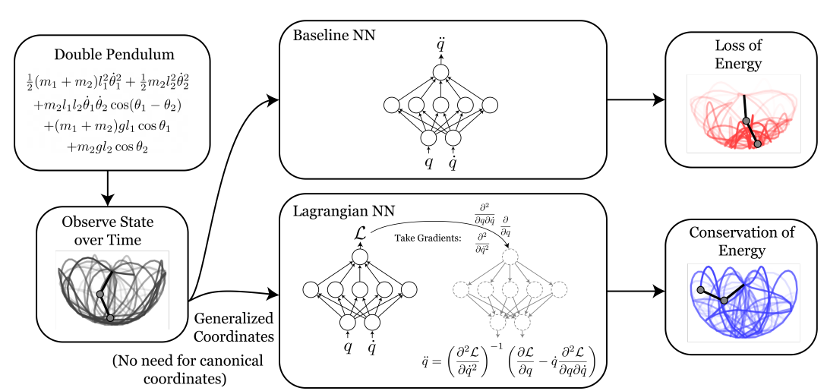
Symmetry Preserving DNN Models
Symmetry: Conservation law -> Hamiltonian neural networks [Greydanus,et al,2019]
Lagrangian neural networks [Cranmer, et al, 2019]
Hamiltonian neural networks
Lagrangian neural networks
Notes:
天王星->海王星

Slide 8
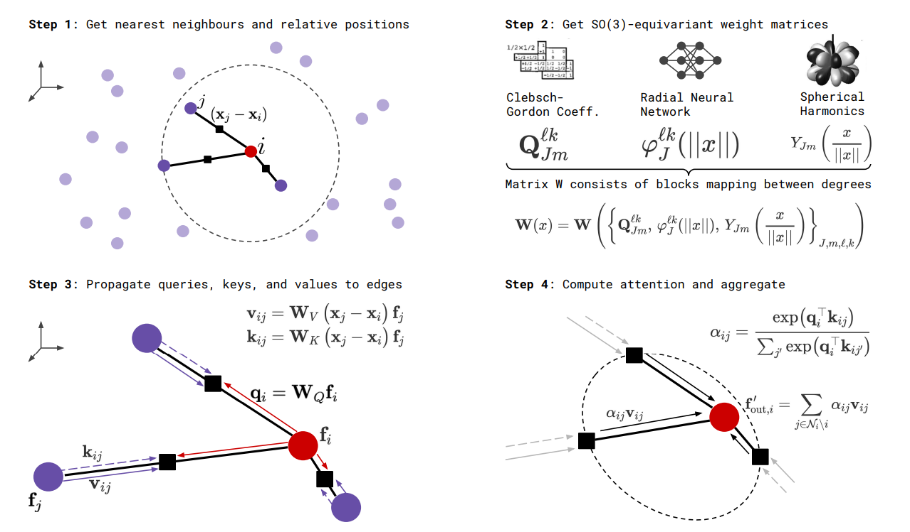
Symmetry Preserving DNN Models
Symmetry: SE(3) equivariance -> SE(3) transformer [Fuchs, et al,2020]
Notes:
天王星->海王星

Slide 9
Our Progress
Embedding Conservation Law
1
Embedding Group Symmetry
2
Notes:
In the first part I will focus on how gradient noise connects with generalization. In the second part, Qi will introduce how the conditioning in adaptive algorithms affects the generalization of deep learning.

Slide 10
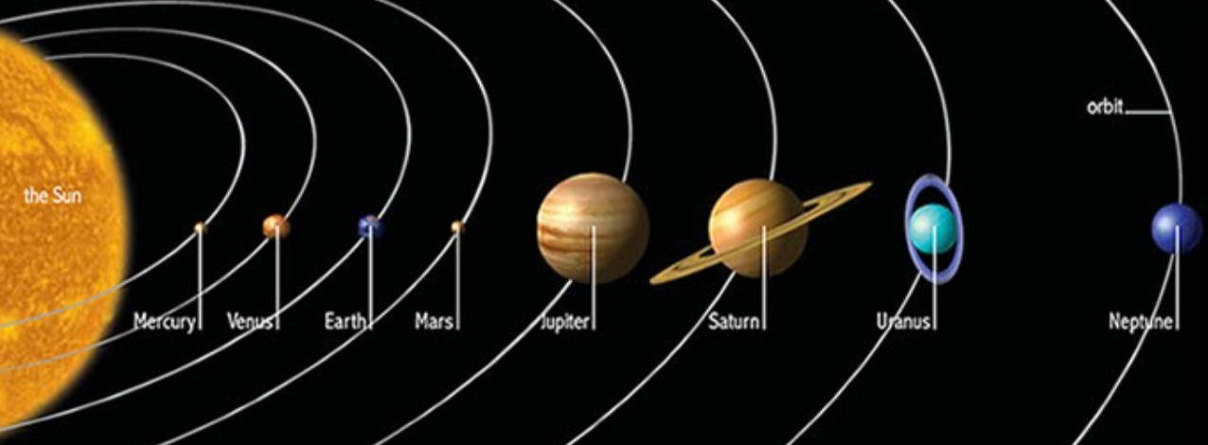
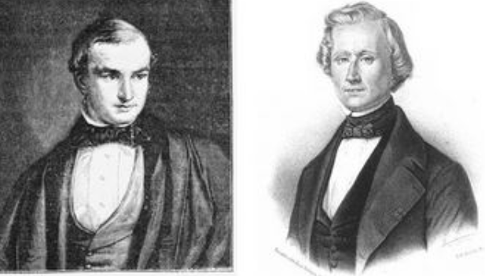
Motivated Example: The Finding of Neptune
LEFT: John Couch Adams (1819-1892),
RIGHT: Urbain Le Verrier (1811-1877)
Observational data -> Hypothesis -> New model for unknown physics
Uranus (1781) -> Neptune (1846) ----- 65 years!
Nowadays, with bigger instruments, we expect a similar and accelerated trend with more observational data in the upcoming decade.
Notes:
天王星->海王星

Slide 11
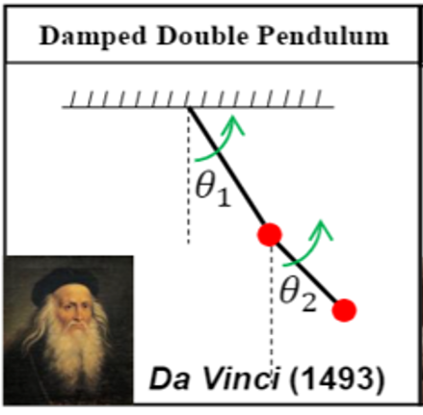
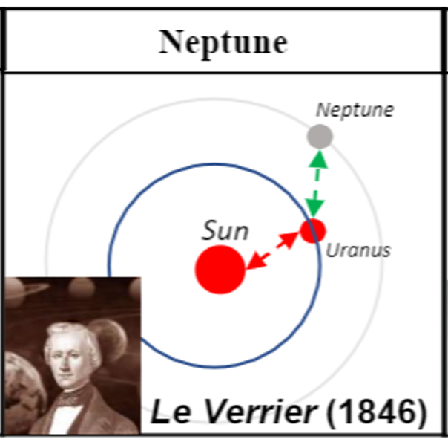
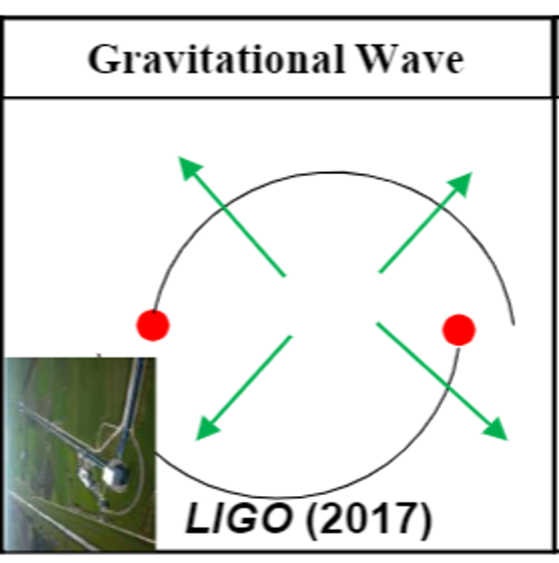
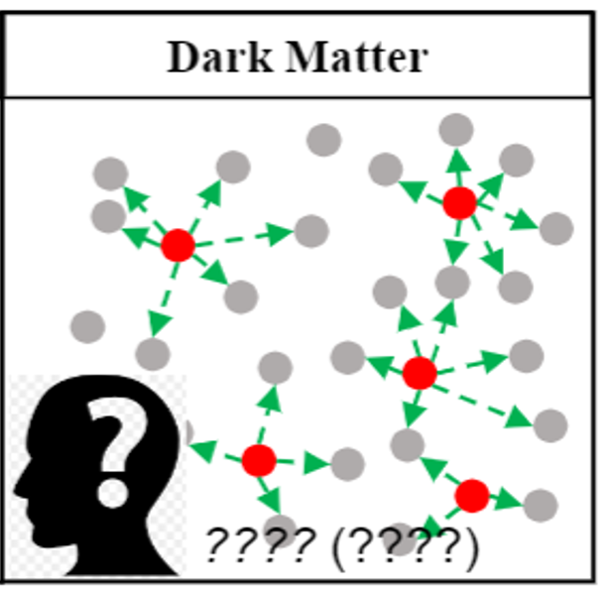
Modeling the Dynamics
physical constrained
models
Augmented by black-box model
The smaller, the better
Notes:
天王星->海王星

Slide 12
Force Decomposition
The time evolution of $q(t)$ is governed by $\ddot{q}=f(q,\dot{q},t)$ according to Newton’s second law.
We decompose the force field as
$$f\left(q,\dot{q},t\right)=f_{c}\left(q,\dot{q}\right)+f_{n}(q,\dot{q},t)$$
Force decomposition with minimal non-conservation
$f_{c}\left(q,\dot{q}\right)≔{argmin}_{g∈ℱ_{c}}\left|\left|f\left(q,\dot{q},t\right)−g\left(q,\dot{q}\right)\right|\right|$ (Conservative component)
$f_{n}\left(q,\dot{q},t\right)≔f\left(q,\dot{q},t\right)−f_{c}\left(q,\dot{q}\right)$ (Non-conservative component)
$f_{c}$ satisfies the Euler-Lagrangian equation: $f_{c}∈ℱ_{c}=\left\{∃ℒ\left(q,\dot{q}\right):R^{2n}→R, s.t. f\left(q,\dot{q}\right)={\left(∇_{\dot{q}}∇_{\dot{q}}^{T}ℒ\right)}^{T}\left(∇_{q}ℒ−\left(∇_{\dot{q}}∇_{\dot{q}}^{T}ℒ\right)\dot{q}\right)\right\}$

Slide 13
Learning Framework of NNPhD
Constrained optimization: $min_{f_{n}^{NN}∈ℱ}\left|\left|f_{n}^{NN}\right|\right| s.t.$ $Loss(q,\hat{q})=0$ with $\hat{q}$ is predicted by $f^{NN}$
$Loss\left(\left(q,\dot{q}\right),\left(\hat{q},\hat{\dot{q}}\right)\right)=\sum_{i=1}^{n}{(||q^{i}−{\hat{q}}^{i}||+|| {\dot{q}}^{i}−{\hat{\dot{q}}}^{i}||)}$ with$\left(\hat{q},\hat{\dot{q}}\right)=ODEsolve\left(f^{NN}\left(q,\dot{q},t\right)\right)$ ------ Unlable case
$Loss\left(\ddot{q},\hat{\ddot{q}}\right)=\sum_{i=1}^{n}{||{\ddot{q}}^{i}−{\hat{\ddot{q}}}^{i}||}$ ------ labeled case
Lagrangian of the constrained optimization: $Loss\left(q,\hat{q}\right)+λ⋅\left|\left|f_{n}^{NN}\right|\right|$
Symbolic regression: library of the symbolic basis -> sparse regression, e.g., Lasso

Slide 14
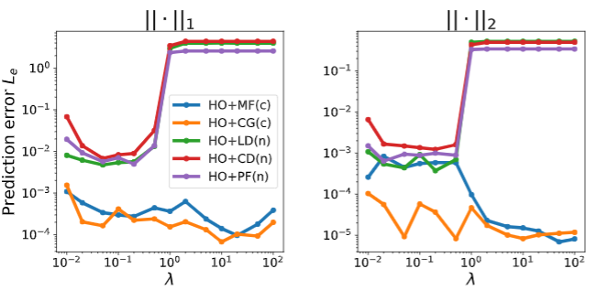
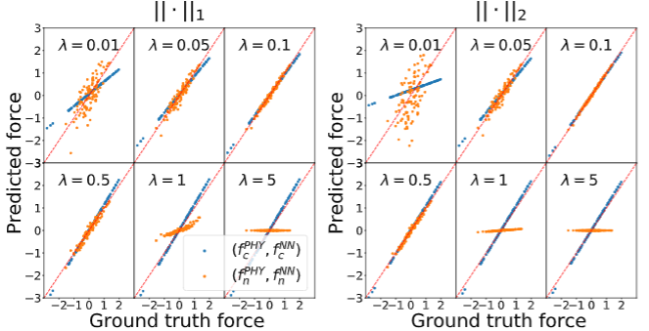
Theoretical Guarantee
Theorem 1 (Informal): Suppose $f_{c}^{NN}$ and $f_{n}^{NN}$ can represent any conservative force field and any continuous force field, and $({f_{c}^{∗},f}_{n}^{∗})$ denotes the pair that minimizes NNPhD loss. Then we have a phase transition at $λ=1$, and $\left(f_{c}^{∗},f_{n}^{∗}\right)=(f_{c},0)$ when $λ>1$.
Sharp phase transition at $λ=1$
Effortless $λ$ tuning: Set $0<λ<1$ to let NNPhD learn the non-conservative component.
Sharp phase transition at $λ=1$
Accurate prediction for $0.05<λ<1$

Slide 15
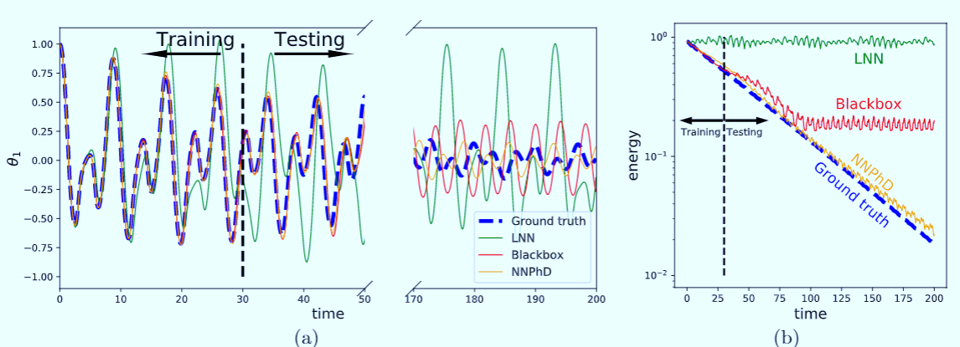
Experiments: Prediction Accuracy
Table 1: Prediction Accuracy on damped double pendulum
NNPhD outperforms LNN and the pure blackbox NN model.

Slide 16
Experiments: Discovered Symbolic Formulas
Table 1: Symbolic Formulas Discovered by NNPhD
Error of the coefficient $≲O({10}^{−3})$
Machine-Learning Non-Conservative Dynamics for New-Physics Detection. Physical Review. E
Ziming Liu, Bohan Wang, Qi Meng, Wei Chen, Max Tegmark, Tie-Yan Liu

Slide 17
Outline
Embedding Conservation Law
1
Embedding Group Symmetry
2
Notes:
In the first part I will focus on how gradient noise connects with generalization. In the second part, Qi will introduce how the conditioning in adaptive algorithms affects the generalization of deep learning.

Slide 18
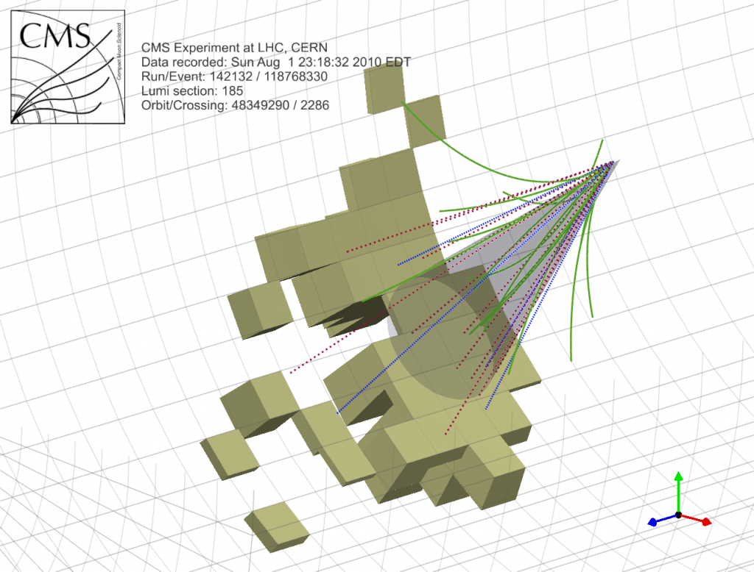
Jet Tagging Dataset
Input: Jet point cloud, each jet contain a group of 4D vectors $\left(E,p_{x},p_{y},p_{z}\right)$ up to 200 constituent particles.
Each jet contains an average of 50 particles, and
events with less than 200 are zero-padded.
Label: is_signal = True or False
Size: 1.2M training entries, 400k validation entries and 400k testing entries.

Slide 19
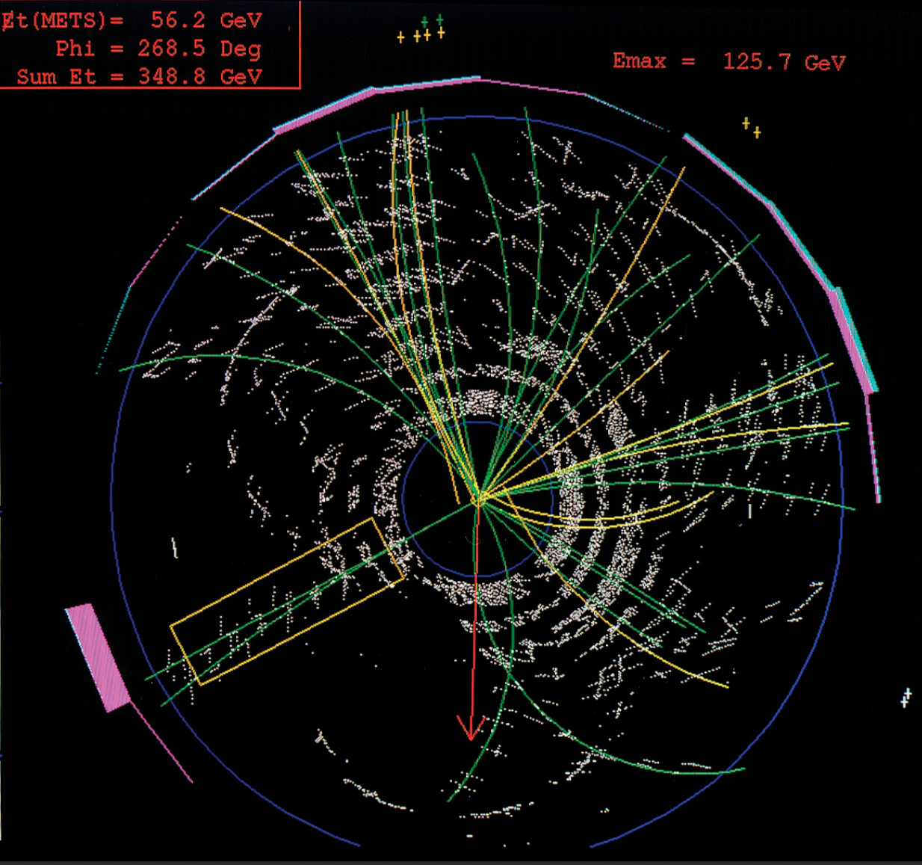
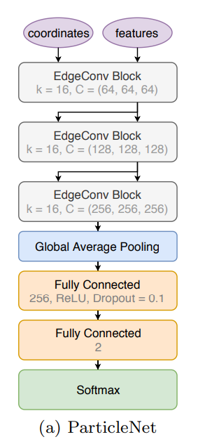
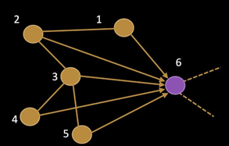
Data Representation
Convolutional neural network
Image
Jet
Graph neural network
Point cloud
Permutation invariance!
[Qu; et al, 2020]

Slide 20
Jet Analysis and Group Equivariance
Particles’ motion follows Quantum Chromo-dynamics (QCD):
$ℒ_{QCD}= {\overline{ψ}}_{i}\left(iγ^{μ}{\left(D_{μ}\right)}_{ij}−mδ_{ij}\right)ψ_{j}−\frac{1}{4}G_{μν}^{a}G_{a}^{μν}$
Lagrange density
Physical quantities are equivariant to Lorentz Group
Lorentz group $G$
Containing all Lorentz transformations $g$ between two inertial frames
Equivariant mapping $F_{G}$ to Lorentz group $G$:
Lorentz transformation on input → output transformed by group action of the same Lorentz transformation
(retaining the linearity to group actions)
$g(t,x,y,z)=\left\{\begin{aligned}t^{′}=γ\left(t−\frac{vx}{c^{2}}\right) \\ x^{′}=γ\left(x−vt\right) \\ y^{′}=y \\ z^{′}=z \end{aligned}\right.$
$c−$ light speed
$v−$ velocity
$γ=$ boost factor
$F_{G}\left(T_{g}∘x\right)=S_{g}∘F_{G}\left(x\right);$
$T_{g}(⋅), S_{g}(⋅)$ are group actions, $g∈G$.

Slide 21
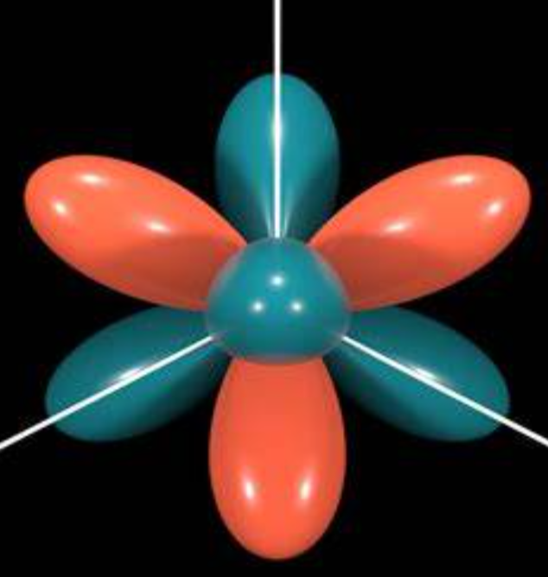
Problems with Existing GNN Models
Graph Neural Networks
Tensor Field Network/ SE(3) Transformer
J M $⋯$
J M $⋯$
$m_{1}$ $m_{2}$
$$⋯$$
coefficients
Spherical harmonics $Y_{JM}\left(\frac{x}{\left|\left|x\right|\right|}\right)$
Clebsch-Gordon Coefficient $Q_{JM}^{m_{1}m_{2}}$
GNN models are NOT equivariant to Lorentz group Traditional message passing process involves activation functions like ReLU, which do not retain the linearity of group actions.
SE(3) operators are NOT equivariant to Lorentz group
Specially designed bases like spherical harmonics work for Euclidean space but not Lorentz group in the 4d spacetime.

Slide 22
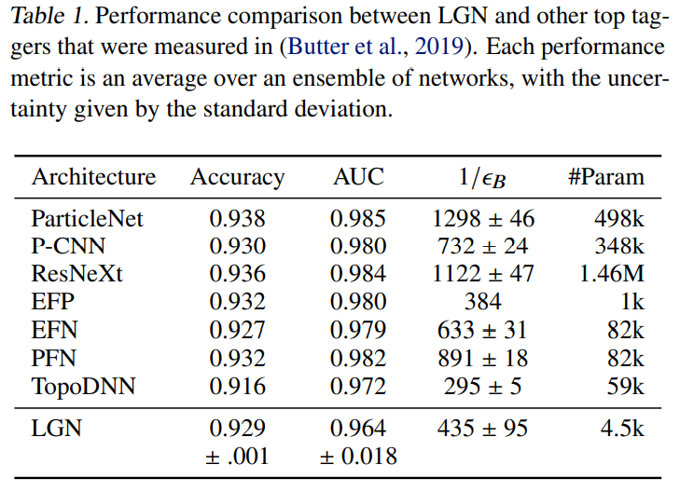
LGN – Lorentz Group Equivariant NN [Bogatskiy, ICML’21]
Input layer:
CG layer: $F_{i}^{(l+1)}=W⋅\left(F_{i}^{\left(l\right)}⊕CG{\left[F_{i}^{\left(l\right)}\right]}^{⊗2}⊕CG\left[\sum_{j}{φ\left(v_{ij}^{2}\right)}v_{ij}⊗F_{i}^{\left(l\right)}\right]\right)$, $v_{ij}=v_{i}−v_{j}$
MLP layer: apply to the scalars
$T^{(0,0) }:$ scalars $T^{(1,1)}$: energy-momentum 4 vector, denoted as $v_{i}$
Can we design general Lorentz group equivariant models that are universal in approximation and efficiency in computation?

Slide 23
LorentzNet: Equivariant Mapping for Lorentz Group
Universal Approximation Theory of Equivariant Mapping
Lorentz Group
Given $f\left(v_{1},⋯,v_{n}\right):{\left(ℝ^{4}\right)}^{n}→ℝ^{4}$, $f\left(v_{1},⋯,v_{n}\right)$ is Lorentz equivariant if and only if
$f\left(v_{1},⋯,v_{n}\right)=\sum_{k=1}^{n}{g_{k}\left({\left\{{\left\langle v_{i},v_{j}\right\rangle }_{M}\right\}}_{i,j=1}^{n}\right)v_{k}}$,
where ${\left\langle ⋅,⋅\right\rangle }_{M}$ is the Minkowski inner product.
Energy-momentum 4d Vector: $v_{i}={(E}^{i},p_{x}^{i},p_{y}^{i},p_{z}^{i})$
Minkowski Inner Product: ${\left\langle v_{i},v_{j}\right\rangle }_{M}=E^{i}E^{j}−p_{x}^{i}p_{x}^{j}−p_{y}^{i}p_{y}^{j}−p_{z}^{i}p_{z}^{j}$

Slide 24
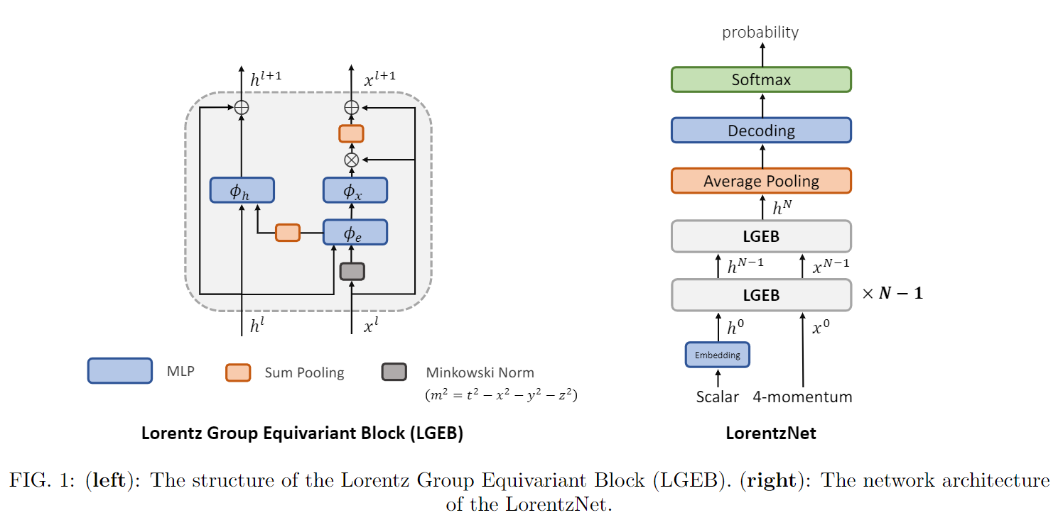
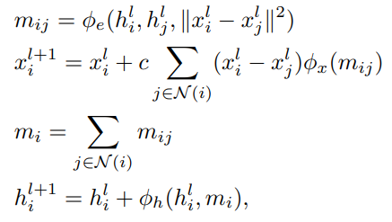
LorentzNet: Message Passing in Minkowski Space
Scalar augmentation
MLP

Slide 25
Experimental Results

Slide 26
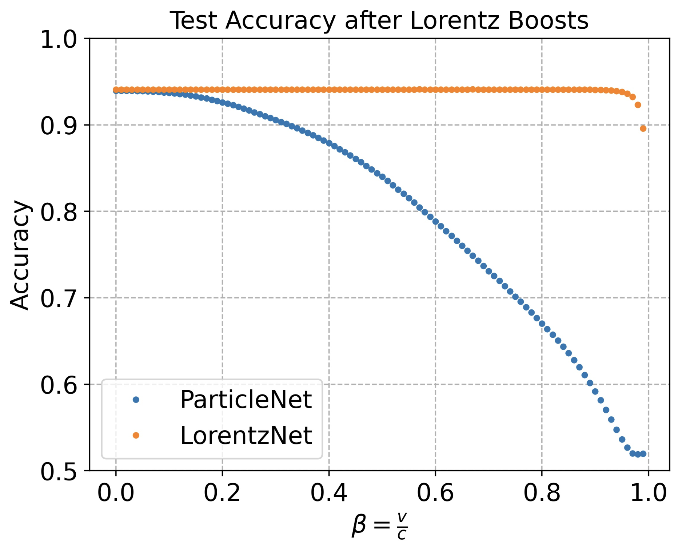
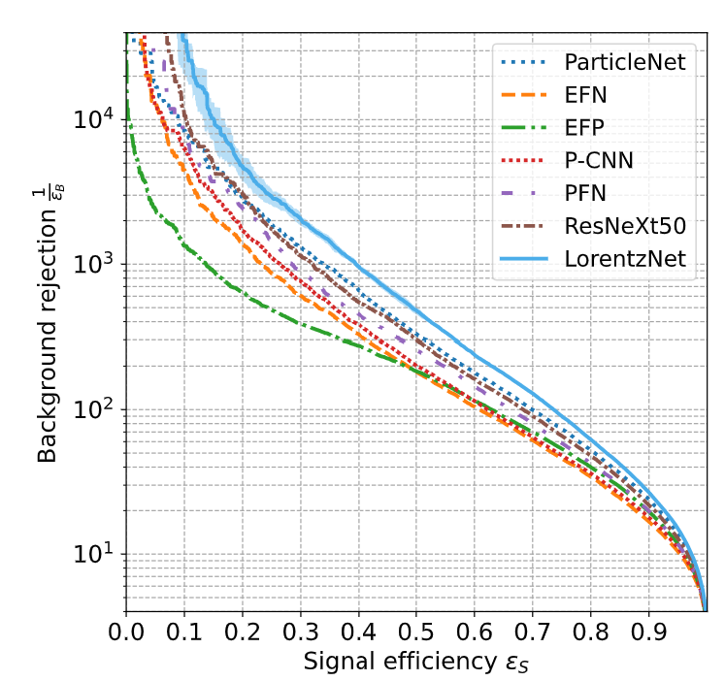
Experimental Results
Robustness test under Lorentz boosts
background rejection $1/ε_{B}$ (higher is better)

Slide 27
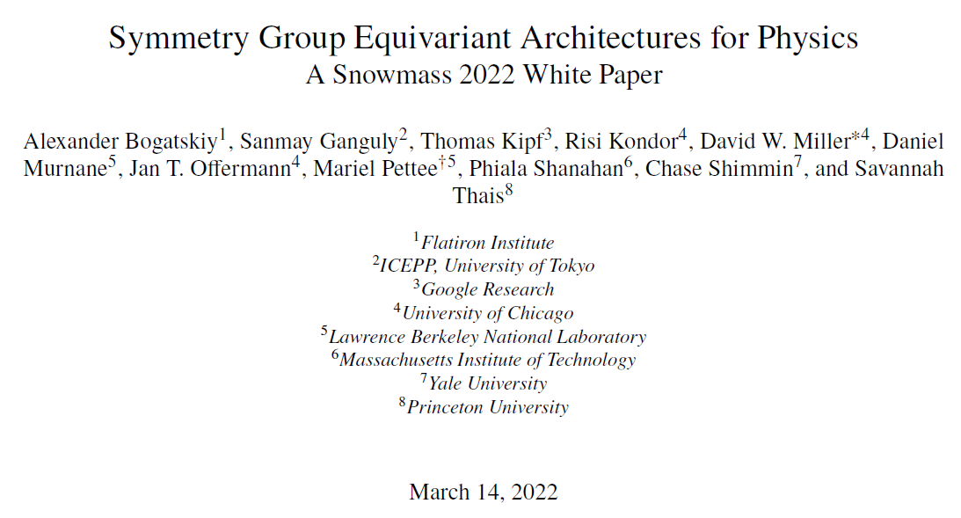
Impact
被高能物理方向2022年度白皮书引用
高能物理Boost 2022会议作学术报告

Slide 28
Open Problems
For AI techniques
Interpretability
Evaluation criterion
Controllability
Transferability
For application in physics
Open problems in physics, with a large amount of data

Slide 29
Thanks!
Contact: meq@microsoft.com
Special thanks to collaborators:
Ziming Liu (MIT), Bohan Wang (USTC), Shiqi Gong (UCAS), Weitao Du (USTC),
Congqiao Li (PKU), Huilin Qu (CERN), Jue Zhang (MSRA), Max Tegmark (MIT), Tie-Yan Liu (MSR)
Notes:
Let me briefly summarize this talk. We study how optimization interplays with generalization in deep learning. For the gradient noise in optimizer, we prove that anisotropic gradient noise helps generalization. For the conditioner, we prove that the conditioner with isotropic limit can guarantee with generalization. Some related works are ongoing, for example, we are studying how normalization tricks and gradient clipping interplay with the generalization.

Slide 30
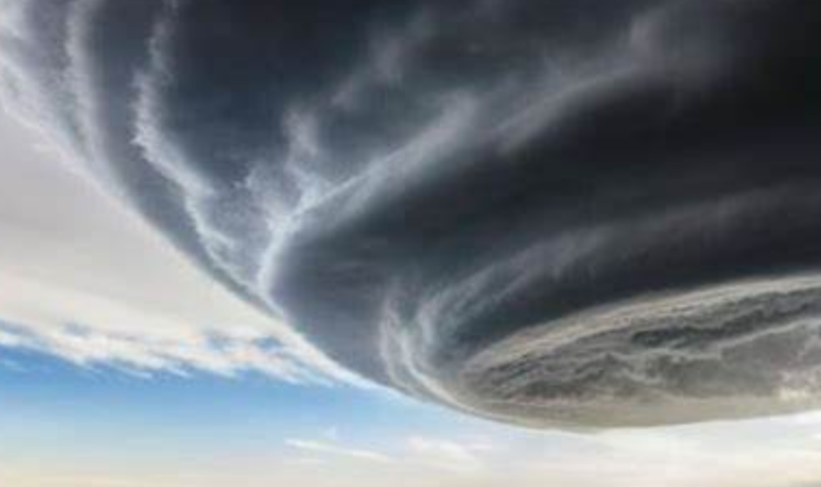
Math Modeling
Differential Equation $ℒ_{θ}\left(u\left(x,t\right)\right)=f(x,t),$ $ℬ\left(𝒯u\left(x,t\right)\right)=f_{b}\left(x,t\right), \left(x,t\right)∈D×[0,T]$
Trajectory Prediction
(Solution of one PDE)
Learn $\left(x,t\right)→u(x,t)$
Operator Learning
(Solution of a family of PDEs)
Learn $θ\left(x\right)→u_{P_{θ}}(x)$
Property Prediction
Given data, Predict $\left(x,t\right)→G(u\left(x,T\right))$
Meteorological simulation
Materials design
Jet tagging

Slide 31
Non-Conservative Dynamics
Non-conservative dynamics break the conservation law.
The breakdown of conservation law implies new-physics!
Energy conservation law (described by Euler-Lagrangian equation):
$$\frac{d}{dt}∇_{\dot{q}}ℒ=∇_{q}ℒ$$
Re-expressed as:
$$\ddot{q}={\left(∇_{\dot{q}}∇_{\dot{q}}^{T}ℒ\right)}^{T}\left(∇_{q}ℒ−\left(∇_{\dot{q}}∇_{\dot{q}}^{T}ℒ\right)\dot{q}\right)$$
$q−$ coordinates
$\dot{q}−$ velocity
$\ddot{q}−$ acceleration
$ℒ−$ Lagrangian

