Slide 1
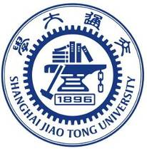
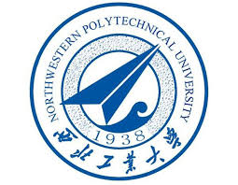
国家重点研发计划
R&D and Verification of Key Technologies for a High Energy Circular Electron-Positron Collider
Zhijun Liang for CEPC MOST2 vertex detector team

Slide 2
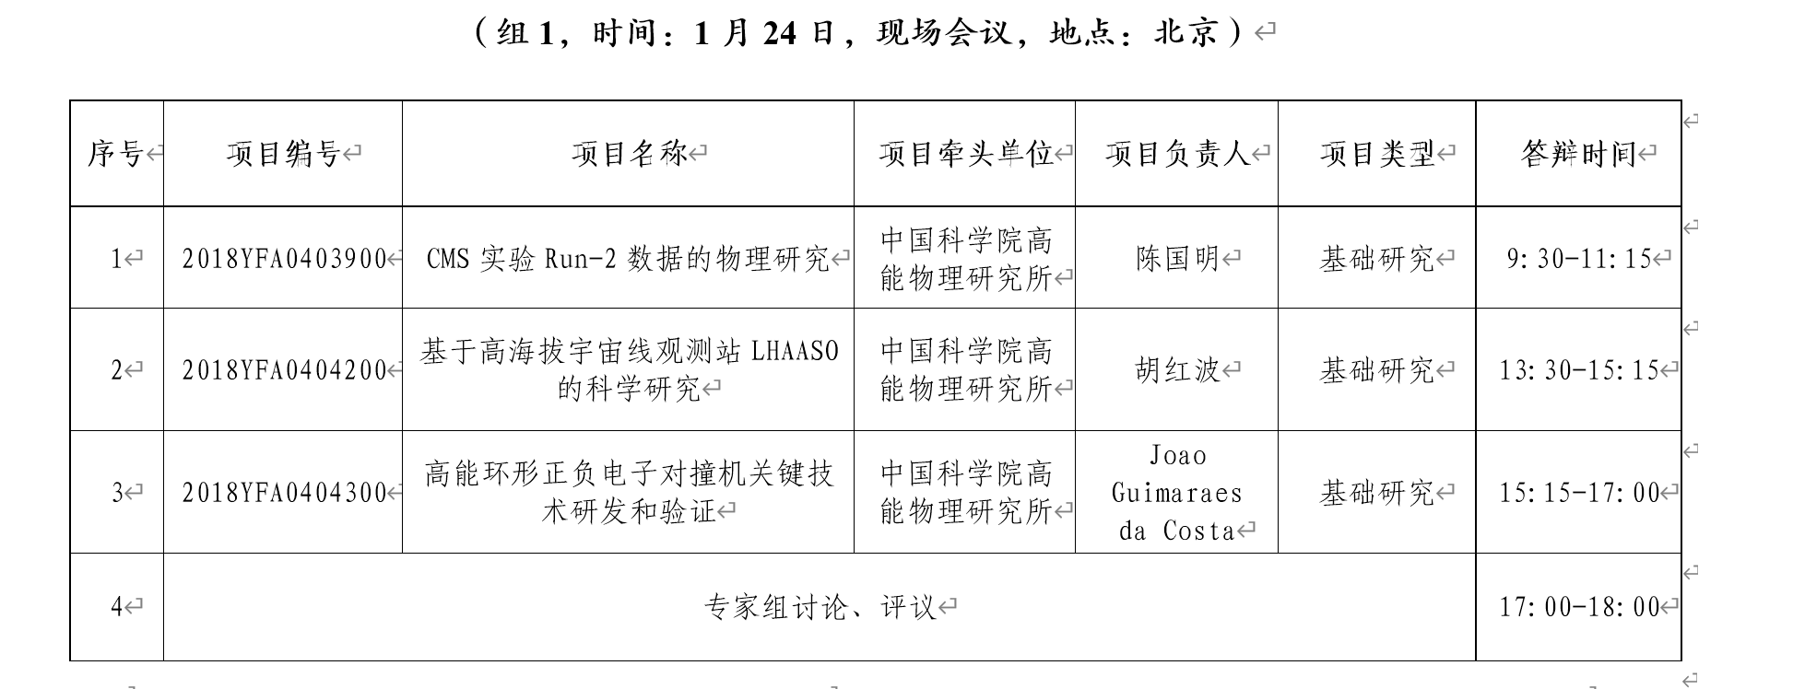
News on MOST2 project
：
MOST project review and final defend
通过1月的评审，结余经费可以继续使用

