Slide 1
A dynamical holographic QCD model for spontaneous chiral symmetry breaking and confinement
Chen Ruixiang

Slide 2
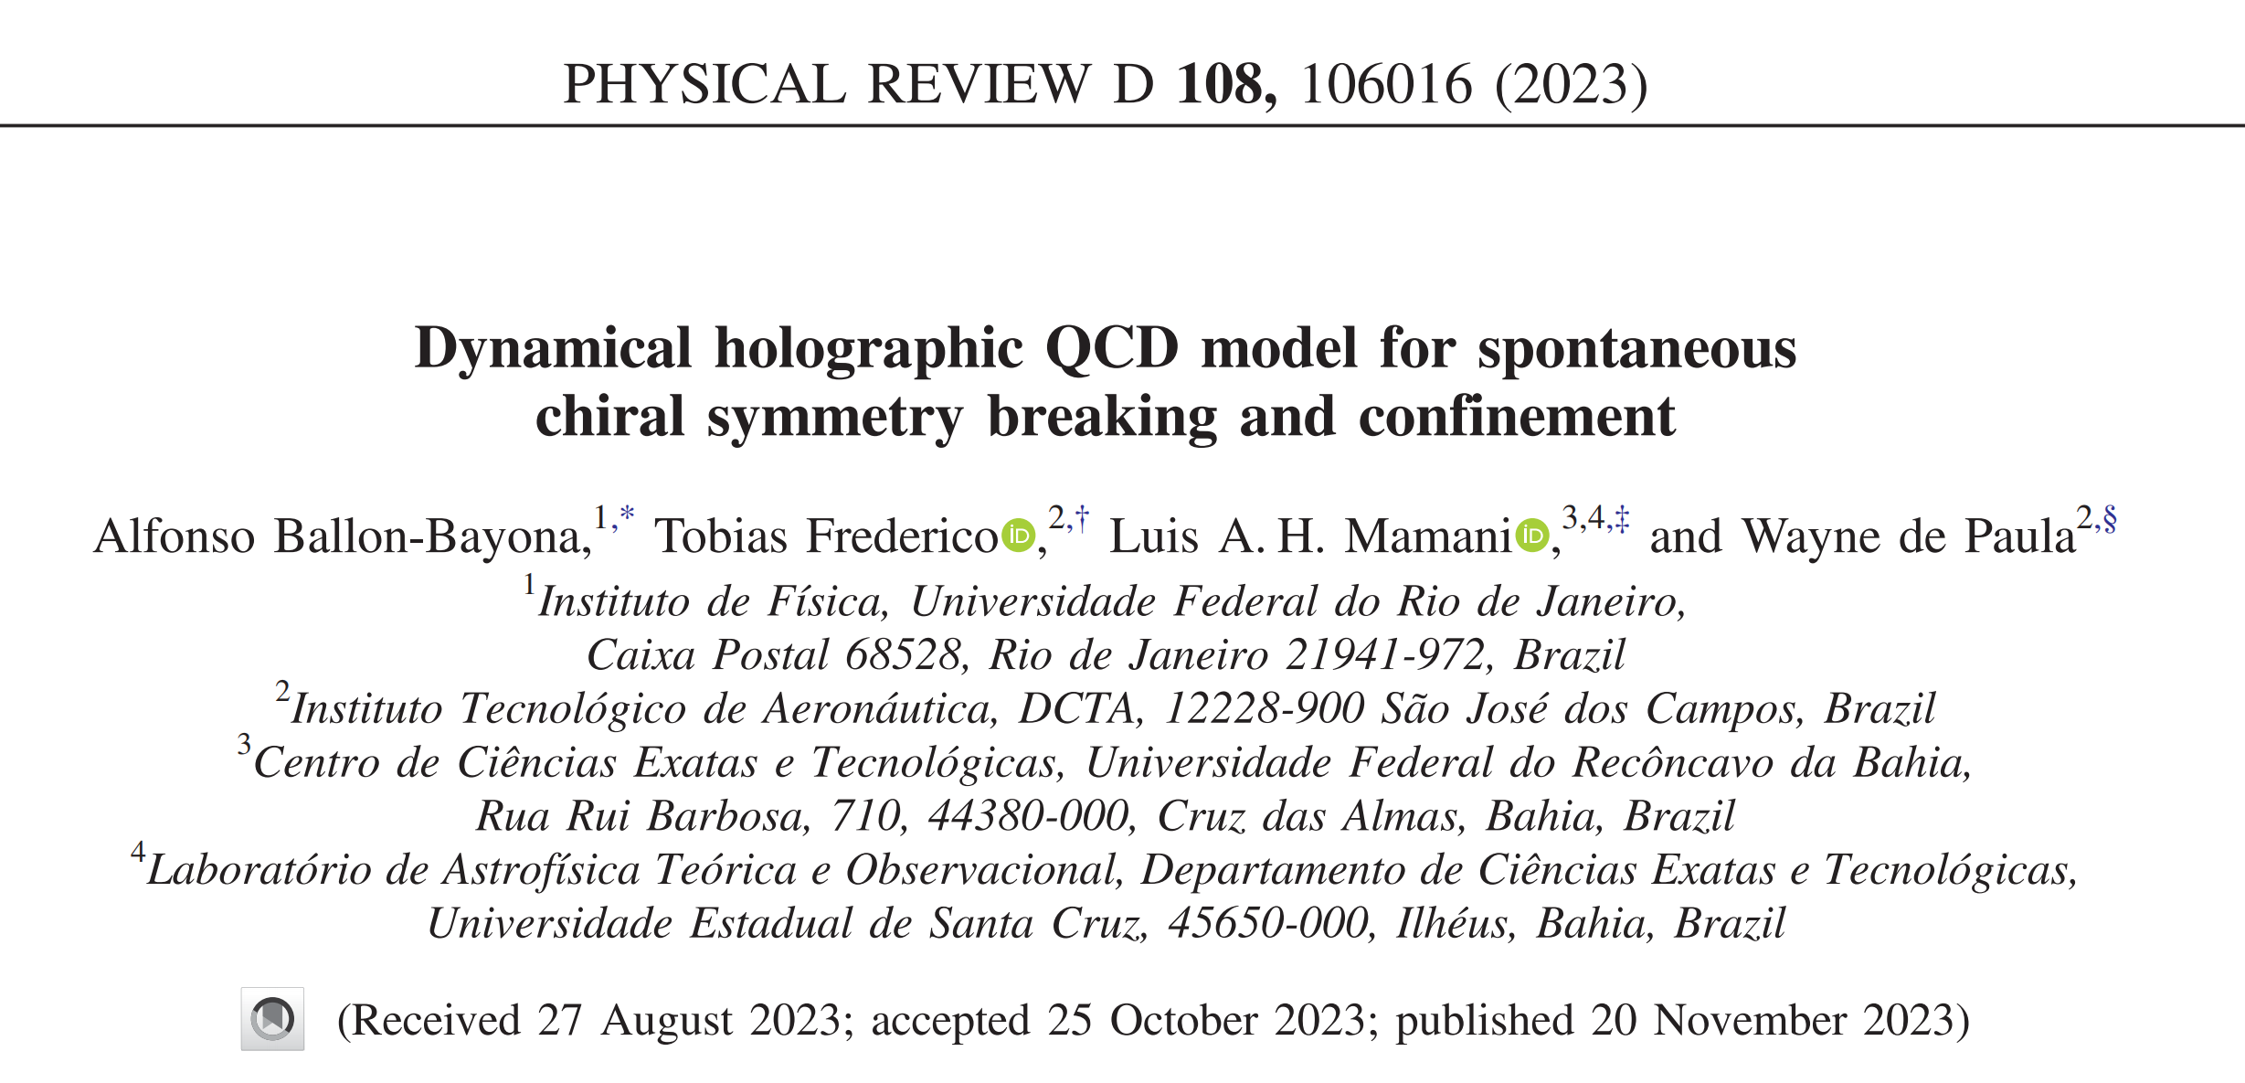
arXiv:2308.07503

Slide 3
Features
Present a novel analytical solution for the warp factor and dilaton field.
Introduce a nonminimal dilaton coupling to the tachyon potential which has two parameters.
Focuse on the effect of chiral symmetry breaking on the spectrum.

Slide 4
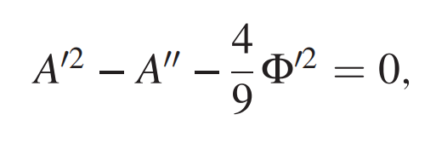
Holographic Model
1. The Einstein-dilaton background
is the effective 5D gravitational coupling， fix the AdS radius as l = 1.
EOM:

Slide 5
Holographic Model
Constraints on warp factor:
i. The 5D metric should become AdS close to the boundary.
ii. To describe confinement properties for the gluon sector of the 4D field theory, it must have a specific asymptotic behavior far from the boundary

Slide 6
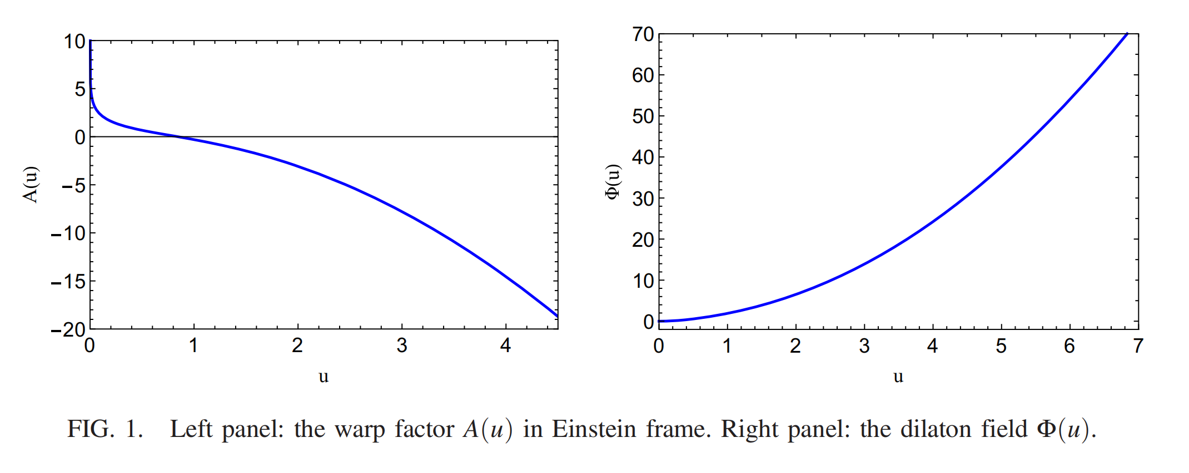
Holographic Model
Introducing the warp factor:

Slide 7
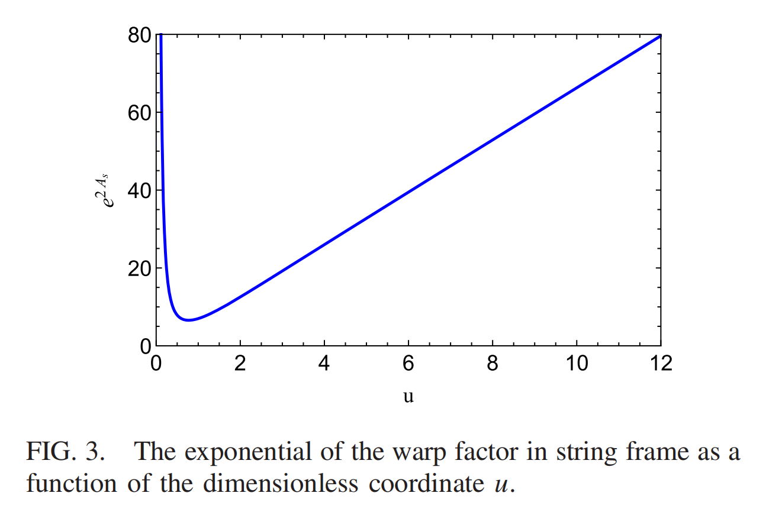
Holographic Model
investigate if our space-time metric presents linear confinement
[1] showed that confinement occurs if f(u)=e^{2A(u)} has a positive global minimum.
1. Y. Kinar, E. Schreiber, and J. Sonnenschein, Nucl. Phys. B566, 103 (2000).

Slide 8
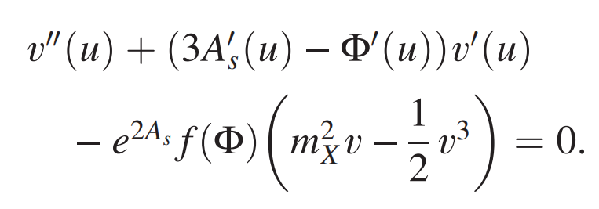
Holographic Model
2. Matter part
Working in the quenched limit of holographic QCD so that the tachyonic and gauge fields do not backreact on the metric and dilaton field.
EOM:

Slide 9
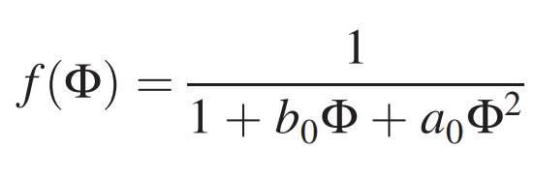
Holographic Model
To get a solution for the tachyon that is regular in the IR and compatible with the AdS/CFT dictionary for the quark mass operator.
.
Later on, we will show that a0 controls the presence of spontaneous chiral symmetry breaking in the model. In turn, b0 will increase the value of the quark condensate in the physical region

Slide 10
Holographic Model
Profile of the tachyon field
UV:
IR:

Slide 11
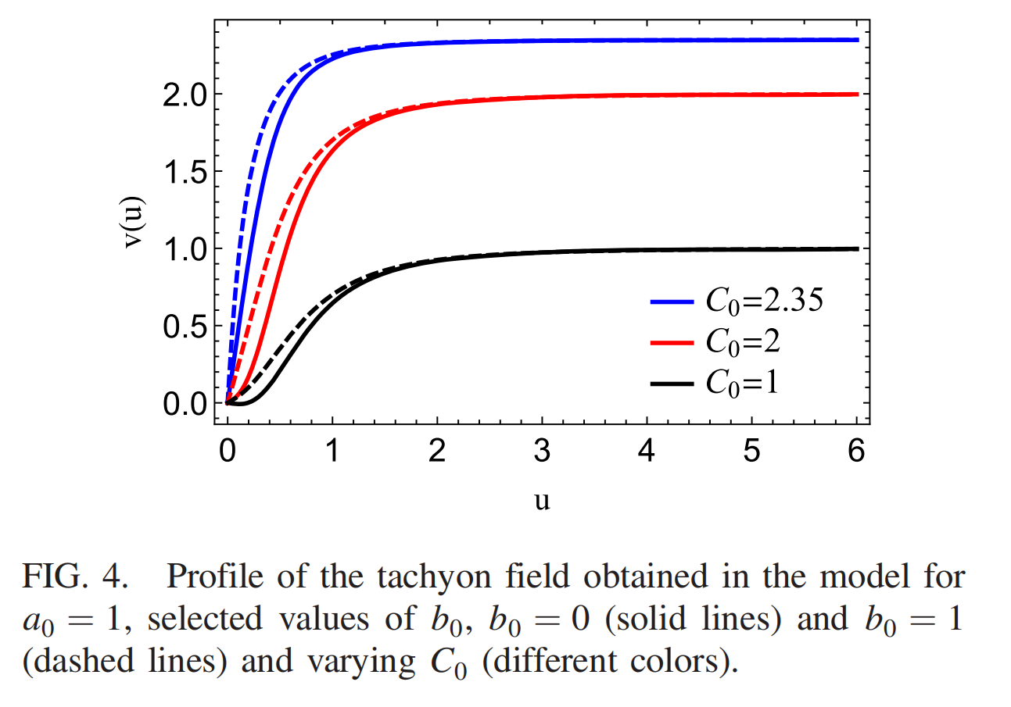
Holographic Model
The effect of the parameter b₀ lies in the region close to the boundary,
where we read off the quark condensate,
We expect that the value of the quark condensate will be sensitive to the value of b₀.

Slide 12
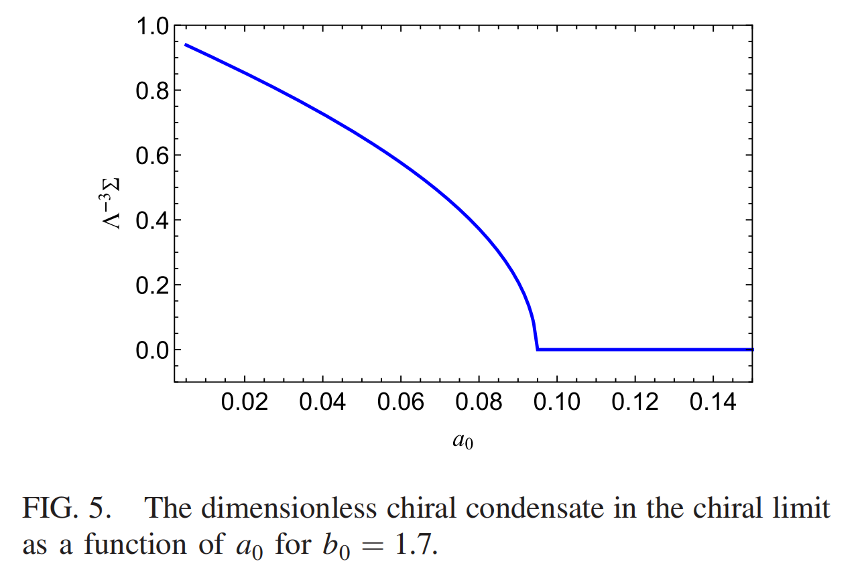
Holographic Model
In the chiral limit,
a₀<a₀^{c}, characterizing the presence of spontaneous symmetry breaking,
a₀>a₀^{c}, the chiral condensate is zero, characterizing the absence of spontaneous chiral symmetry breaking

Slide 13
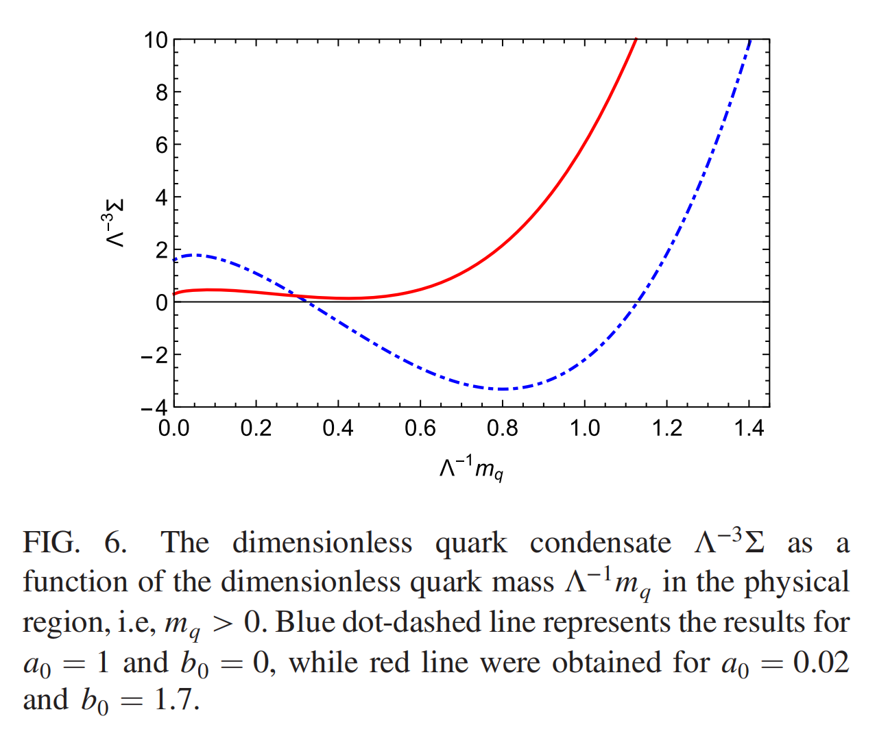
Holographic Model
The dependence of the quark condensate on the quark mass
The value of the quark condensate will be sensitive to the value of b₀
lattice QCD,Schwinger-Dyson solutions:
The value of the condensate increases
with the growth of the quark mass.

Slide 14
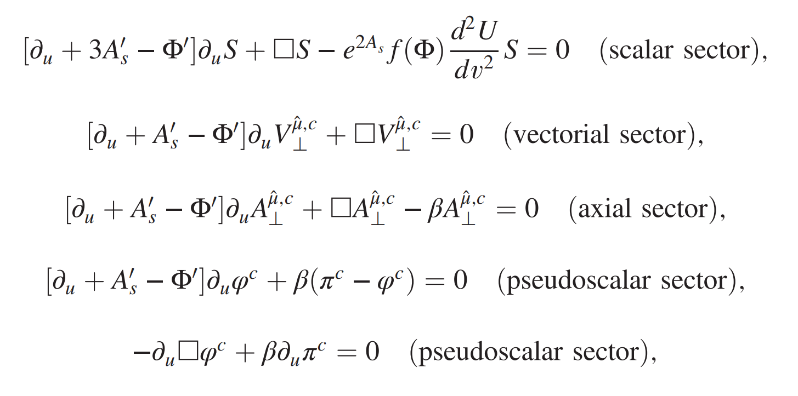
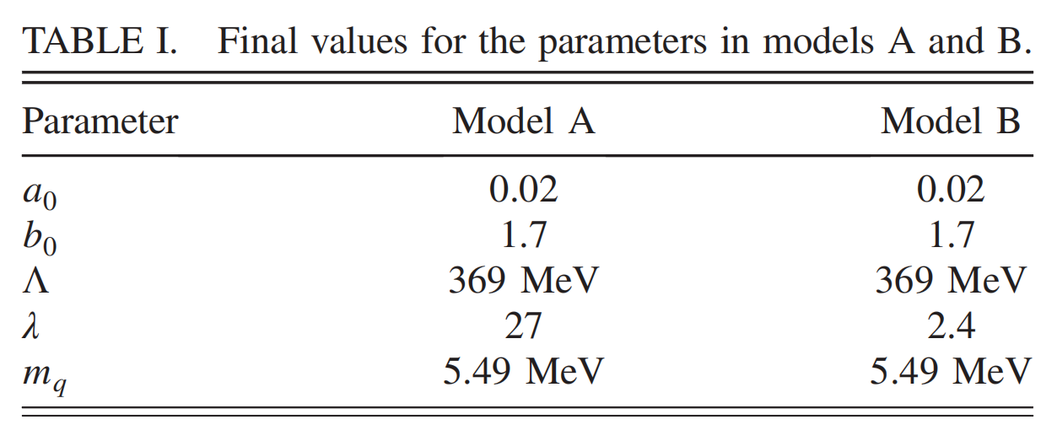
Meson Spectrum
Calculate the spectrum for the vector, scalar, axial-vector, and pseudoscalar mesons using the model.

Slide 15
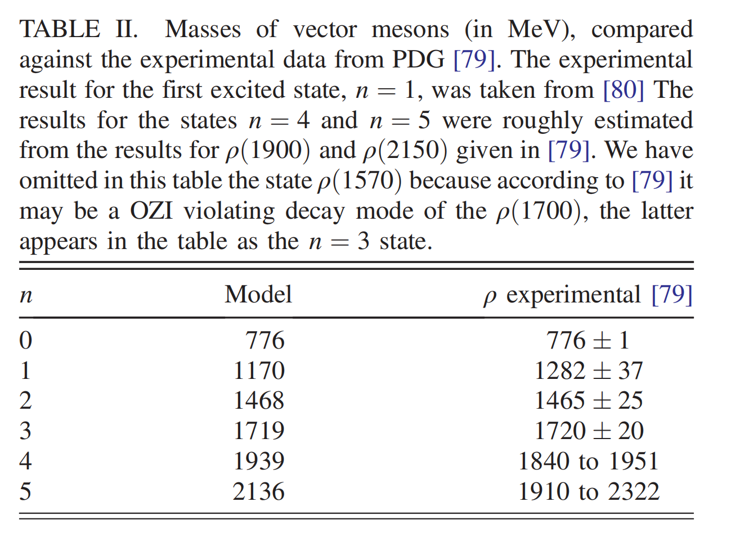
Meson Spectrum
A. Vector mesons
The spectrum of the vector mesons,
which is decoupled from the other sectors.
Results are in quantitative agreement
with the experimental data.

Slide 16
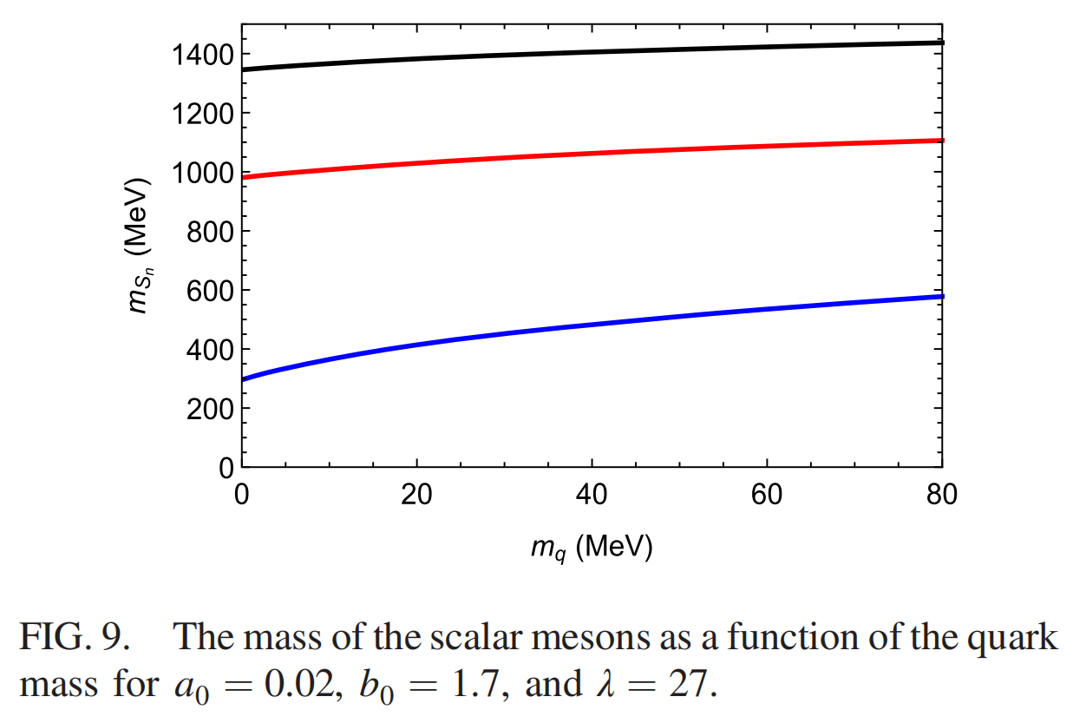
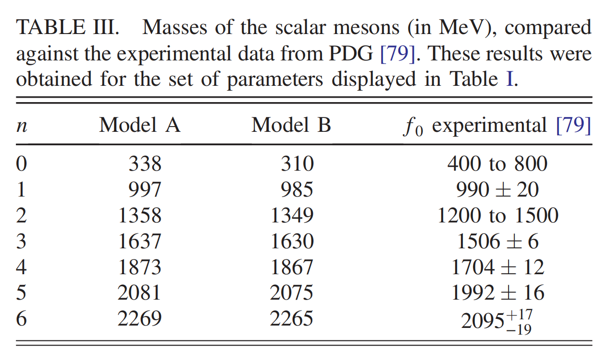
Meson Spectrum
B. Scalar mesons

Slide 17
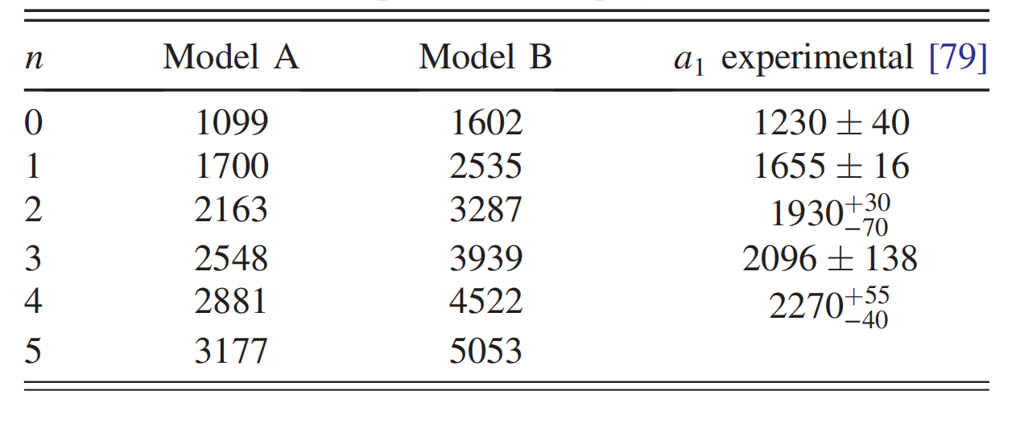
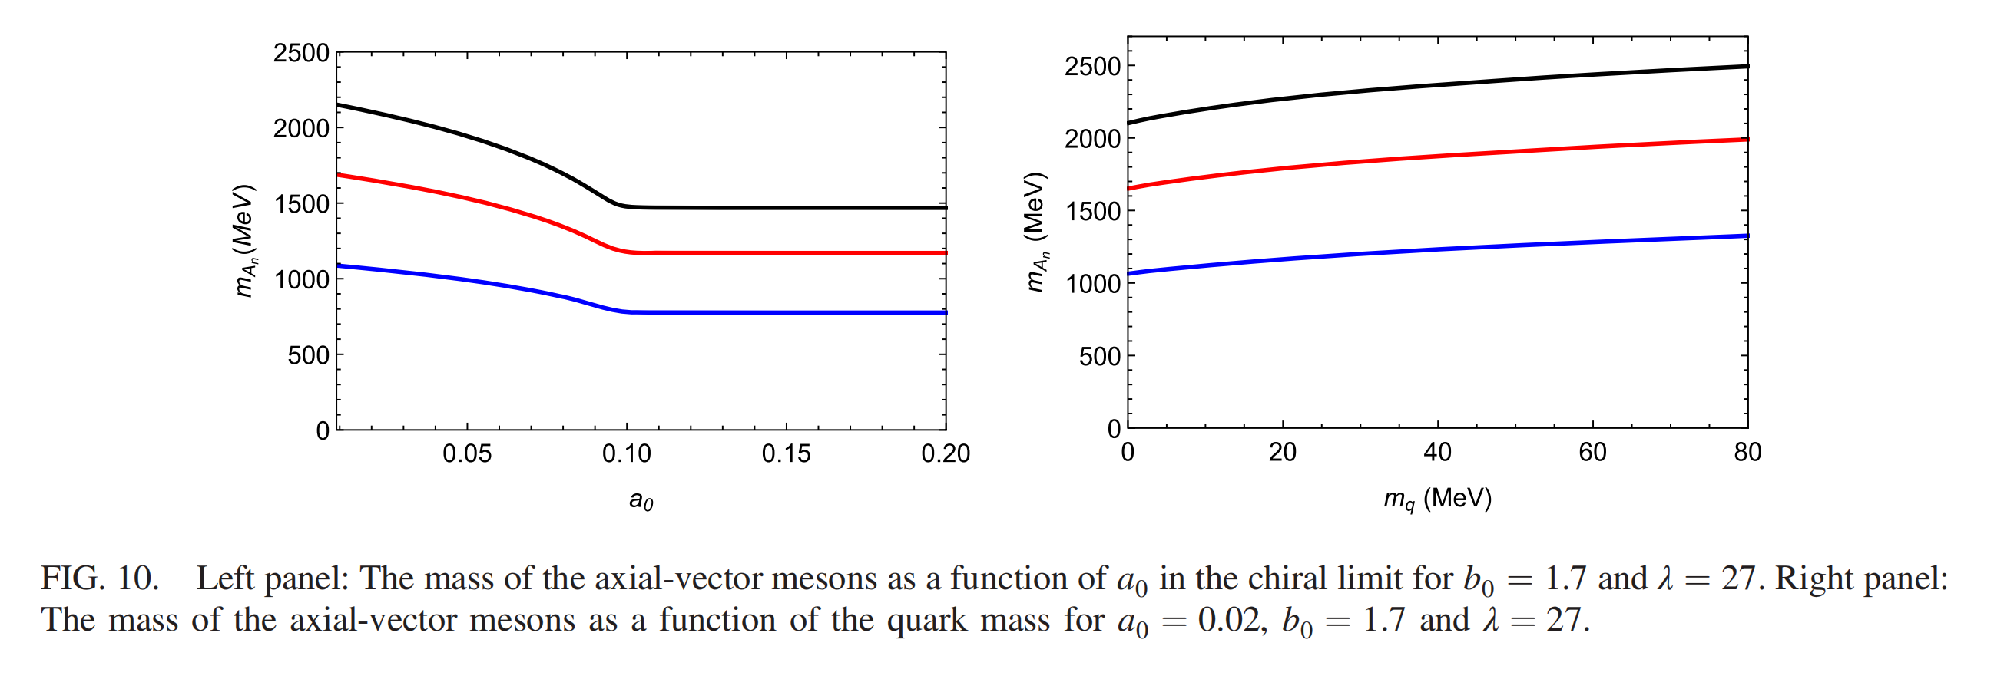
Meson Spectrum
C. Axial-vector mesons

Slide 18
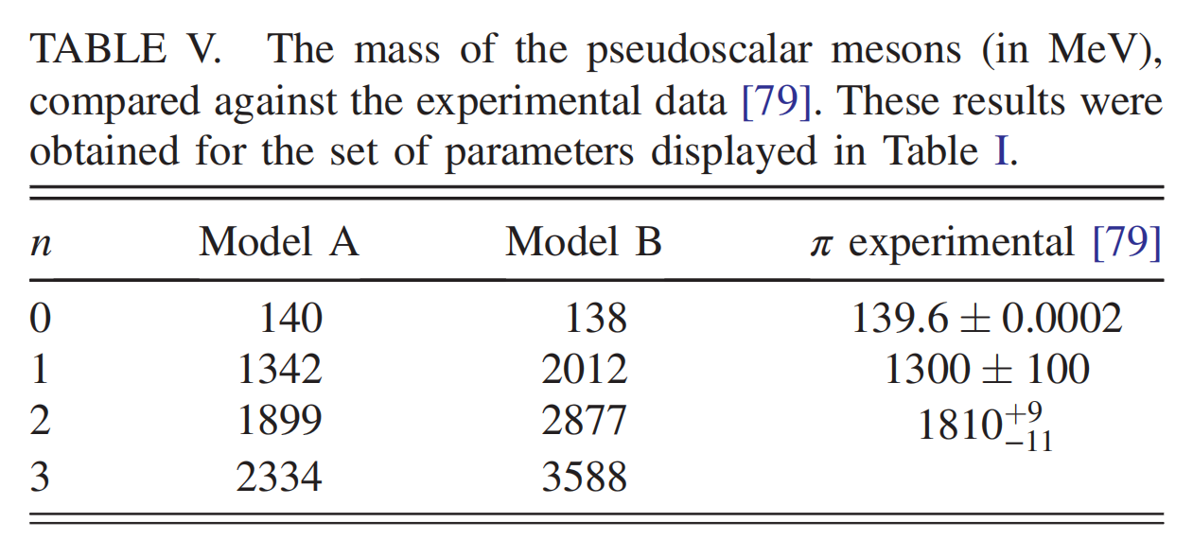
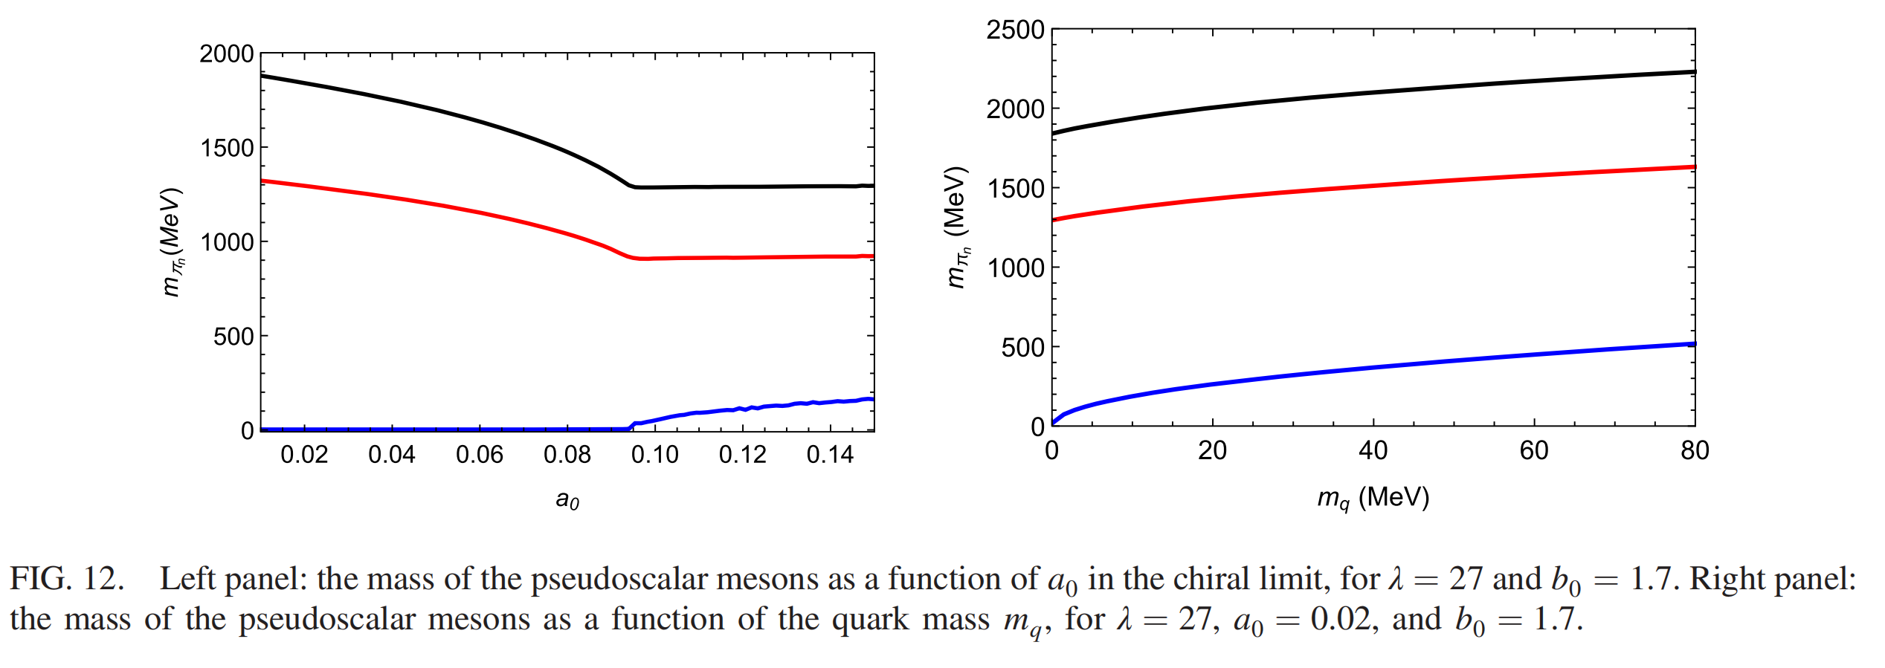
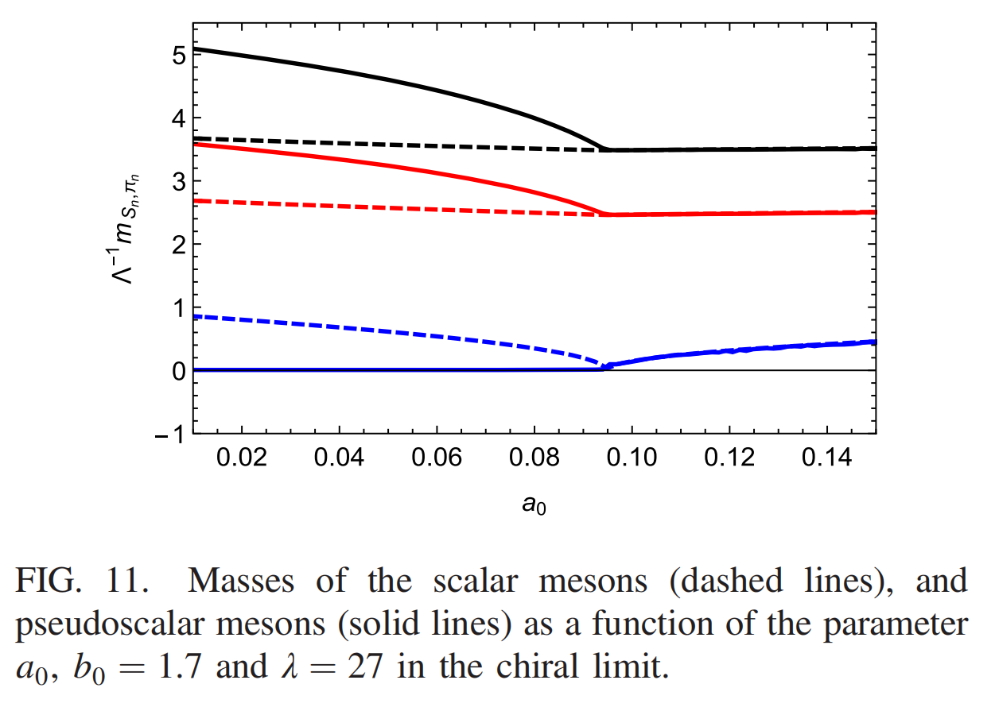
Meson Spectrum
D. Pseudoscalar mesons
a₀<a₀^{c}, the pion becomes a Goldstone boson in the chiral limit.
a₀>a₀^{c} , restoration of chiral symmetry .

Slide 19
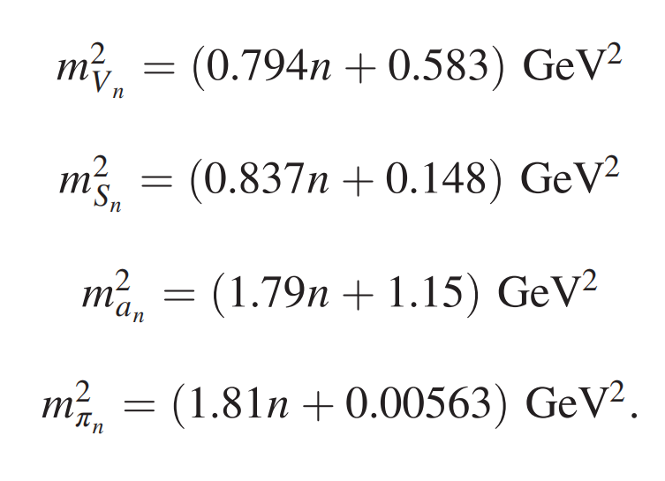
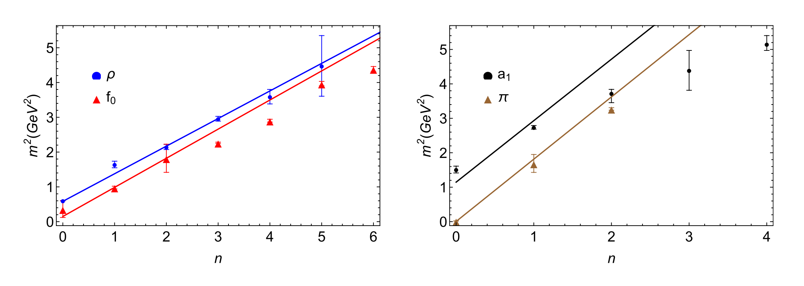
Meson Spectrum
find the following approximately
linear Regge trajectories:

Slide 20
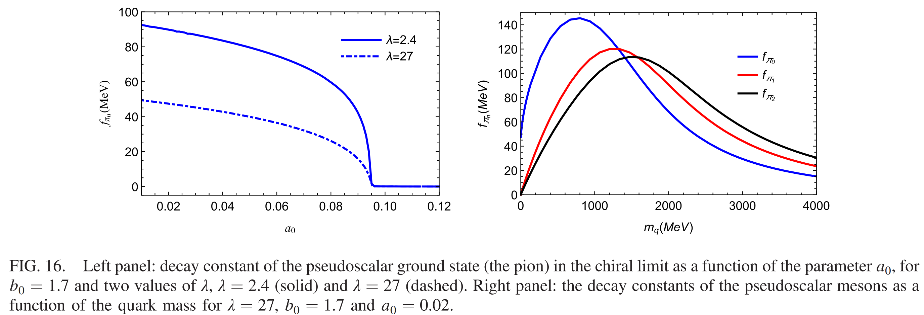
Decay Constants
the pion decay constant becomes zero in the region a₀>a₀^{c}
the decay constant for the ground state (the pion) remains finite in the chiral limit and hierarchy is inverted from light to heavy quarks.

Slide 21
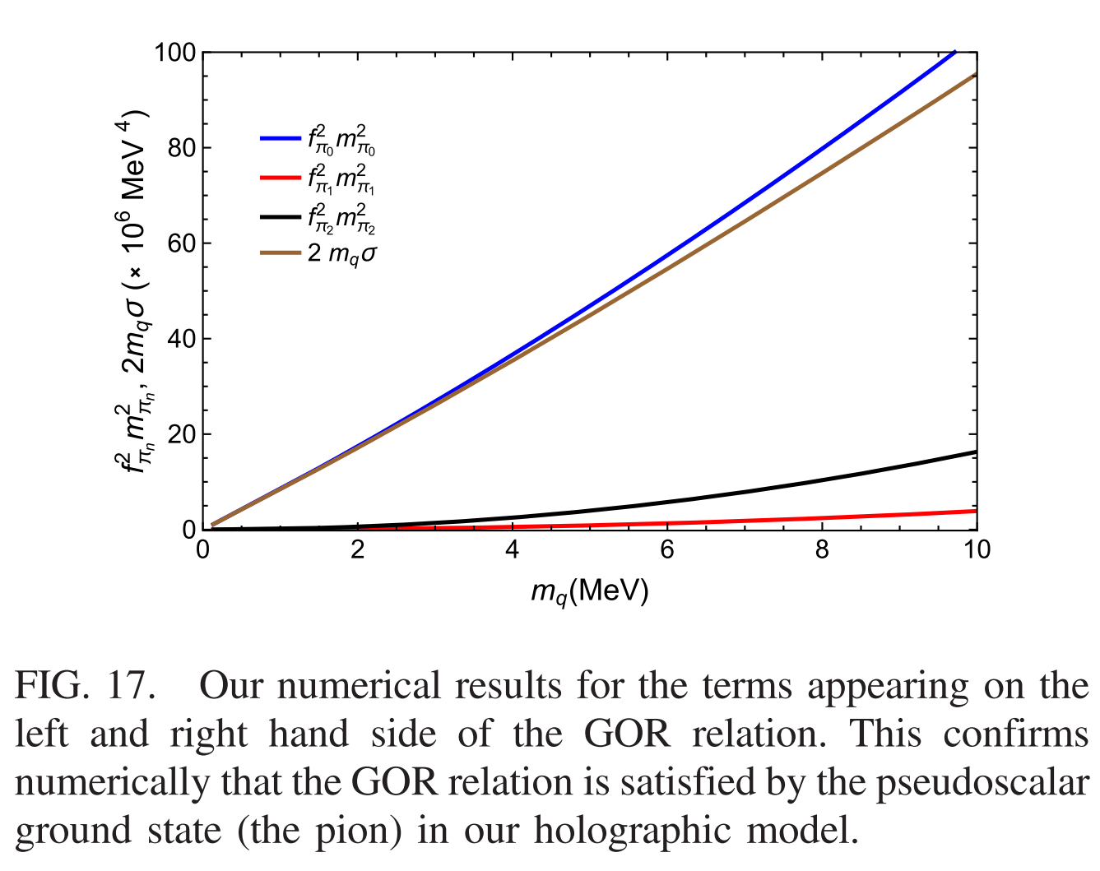
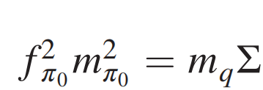
Gell-Mann-Oakes-Renner (GOR) relation.
An important test for a holographic QCD model for spontaneous chiral symmetry breaking.

Slide 22
Conclusion
Built a holographic model that describes confinement and the spontaneous breaking of chiral symmetry.
Provides a description of the meson spectrum and decay constants, consistent with spontaneous breaking of chiral symmetry.

Slide 23
Thanks

