Slide 1
Collision studies with
vortex electrons and ions
Andrey Surzhykov, Anna Maiorova,
Anton Peshkov and Dmitry Karlovets
Technische Universität Braunschweig /
Physikalisch-Technische Bundesanstalt (PTB)/
Helmholtz Institute Jena/ITMO University

Slide 2
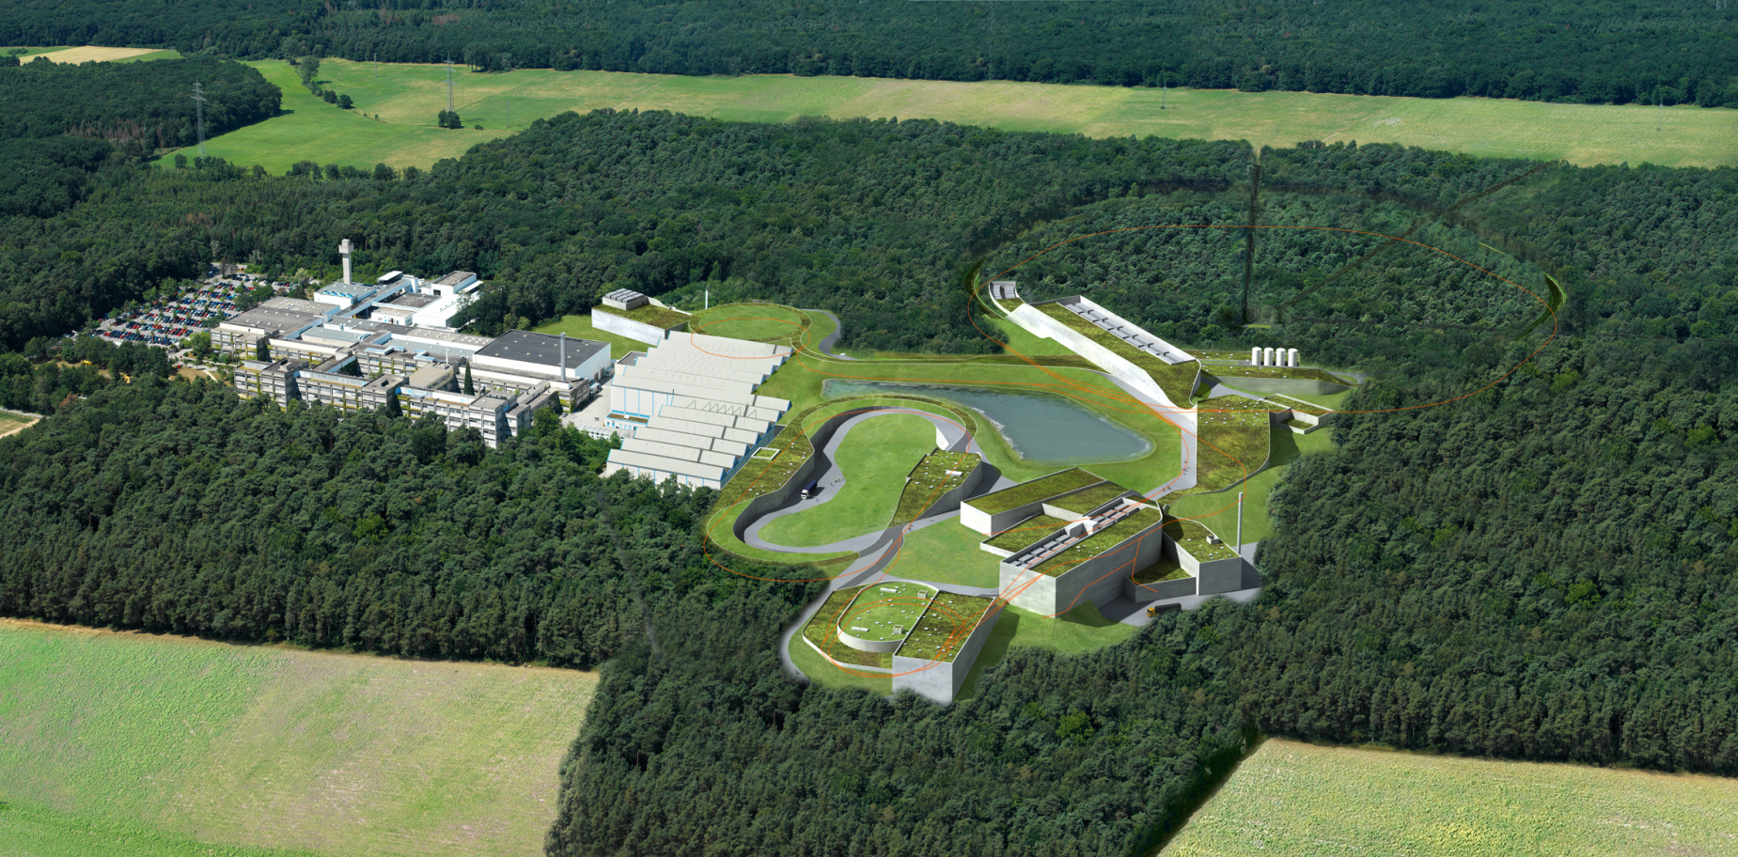


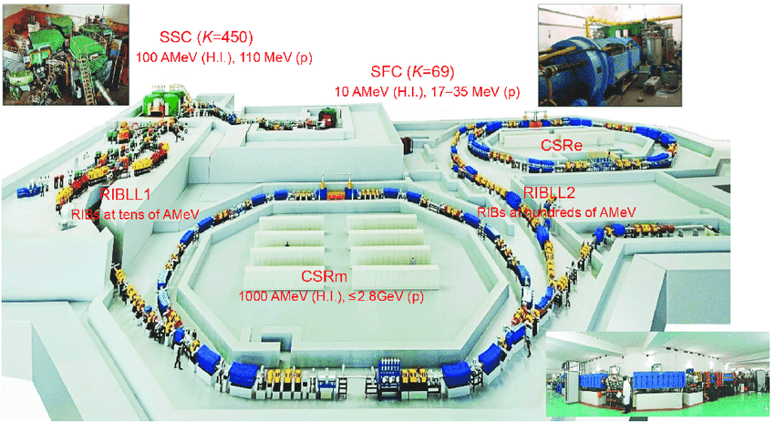
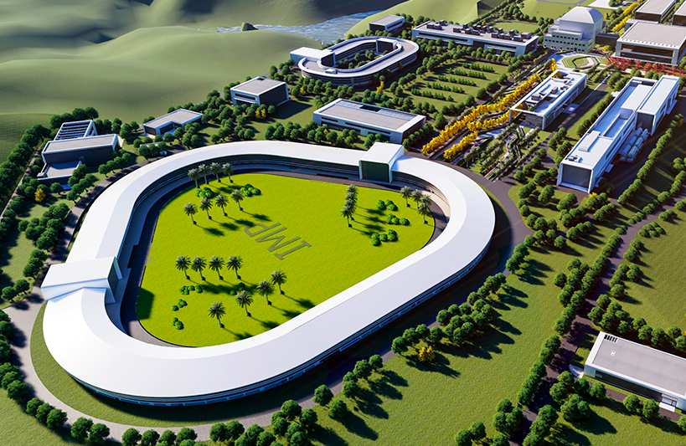
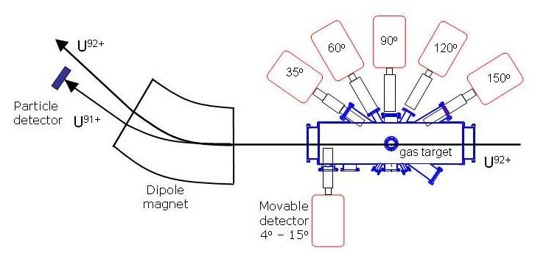
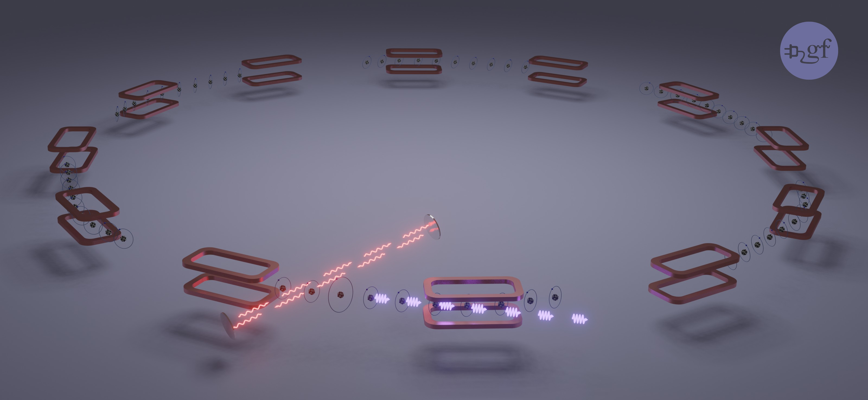

Relativistic atomic collisions: State of the art
Investigations of relativistic collisions of ions with atomic and electronic targets have a rich history at accelerator and storage ring facilities around the world.
Due to advances in (x-ray) detection techniques, collision information is often obtained from photon emission.
Darmstadt
HIRFL
Lanzhou
HIAF
Huizhou
CERN

Slide 3
Ion collisions with electronic (atomic) targets
Radiative recombination
X-ray scattering
Bremsstrahlung
Impact excitation and subsequent decay
… and many other fundamental collision processes, that result in photon emission, have been studied both in experiment and theory in great details. Until now, however, not much attention has been paid to the OAM-related phenomena.
We consider two cases of collisions of vortex particles for storage-ring scenario:
  Coulomb excitation of target atoms by vortex (LG) ion beam
  Radiative recombination of vortex (Bessel) electrons with high-Z ions

Slide 4
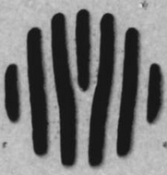
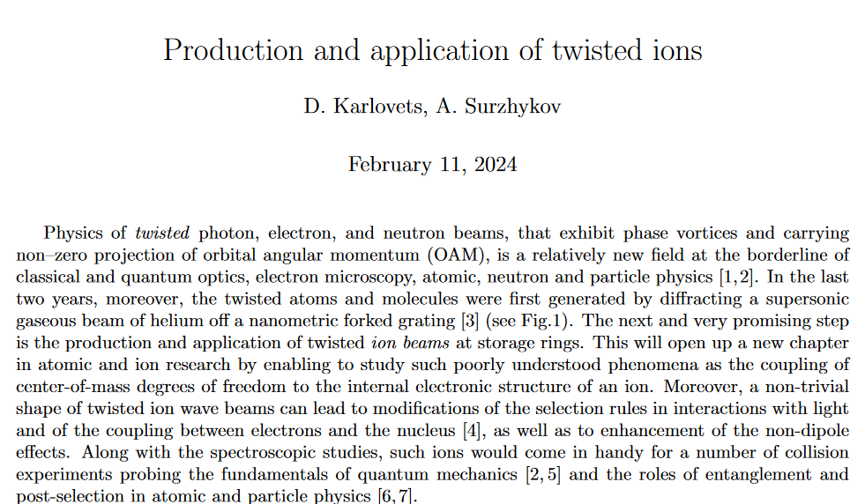




Production of vortex ions beams: Ideas
Forked diffraction grating
$$σ_{0}$$
$$σ\left(z\right)$$
The use of low-intensity beams with negligible space charge is anticipated to achieve $σ\left(z\right)∼1 μm$.
Example:
For N³⁺ with energy T_{p} = 11 MeV/u and $σ_{0}≈1 nm$
GSI G-PAC proposal 2024
$σ\left(z\right)≈1 μm$ at $z≈10 m$

Slide 5
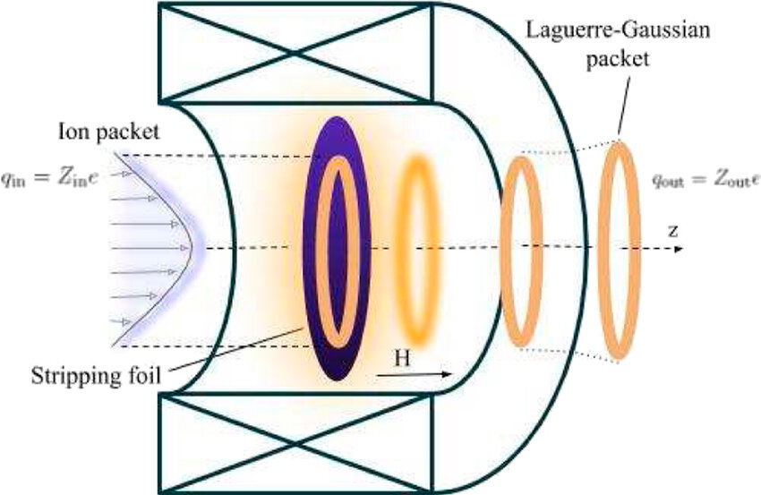
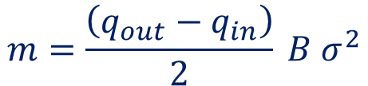
Production of vortex ions beams: Ideas
Forked diffraction grating
Magnetized stripping foil
$$σ_{0}$$
$$σ\left(z\right)$$
The use of low-intensity beams with negligible space charge is anticipated to achieve $σ\left(z\right)∼1 μm$.
Example:
For N³⁺ with energy T_{p} = 11 MeV/u and $σ_{0}≈1 nm$
Sudden change of a charge state of a projectile in homogeneous magnetic field grants it non-zero OAM:
$$m=\frac{\left(q_{out}−q_{in}\right)}{2} B σ^{2}$$
$σ\left(z\right)≈1 μm$ at $z≈10 m$
D. Karlovets, New J. Phys. 23 (2021) 033048

Slide 6
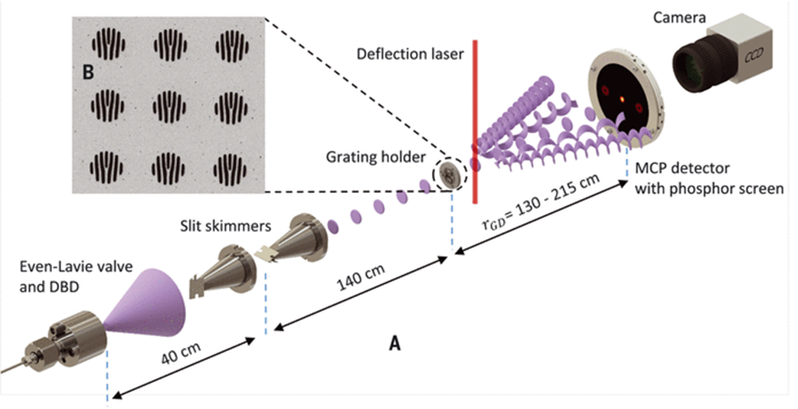
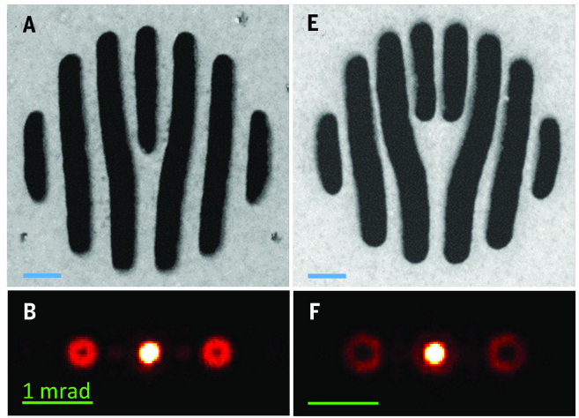
Diagnostics of vortex ion states
A successful experiment with low-intensity vortex ion beams will require not only the production but also the diagnostics of such beams.
A most simple approach to verify vorticity of ions is to measure the intensity profile of a beam in a similar way to neutral atom experiments.
Vortex projectile
Alternatively, one can investigate basic atomic processes, involving vortex ions:
Radiative recombination
Coulomb ionization
Coulomb excitation
A. Luski et al., Science 373 (2021) 1105
Target atoms
(jet target, for example)

Slide 7



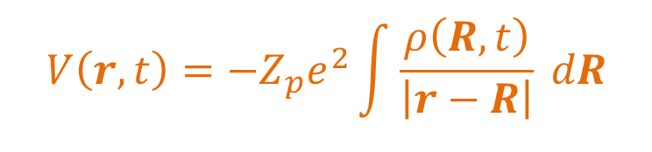
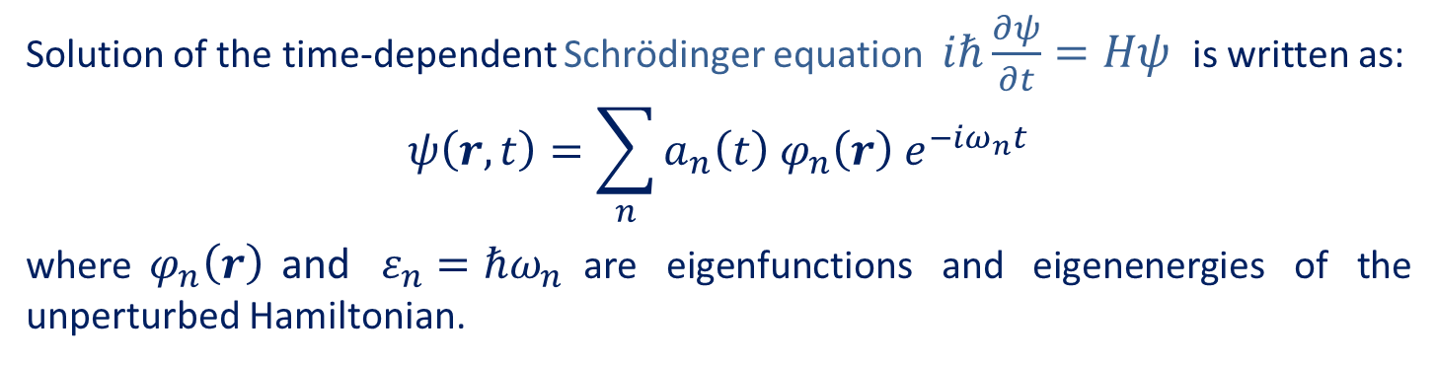
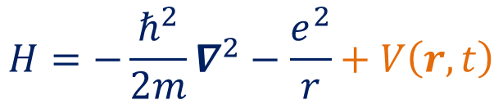

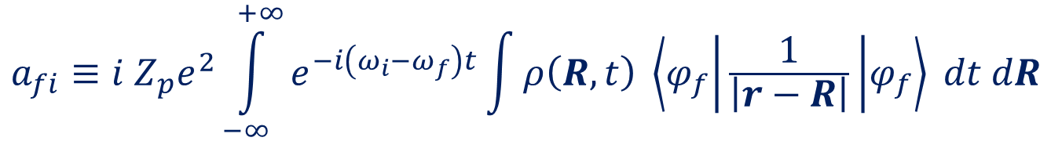


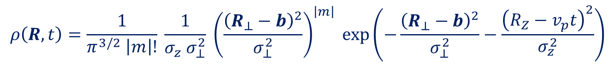
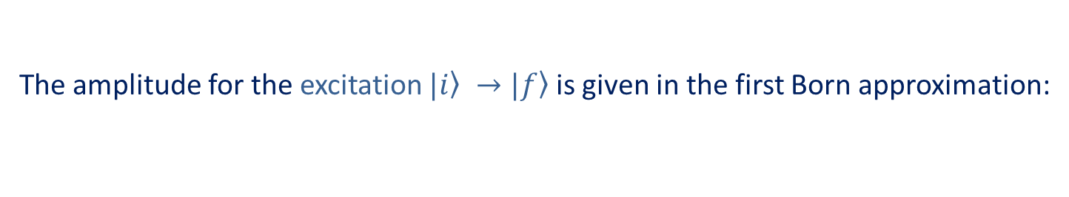
Coulomb excitation by vortex ion
Hamiltonian of a hydrogen like atom, interacting with charged projectile:
with perturbation operator:
x
$$v_{p}$$
$$H=−\frac{ℏ^{2}}{2m}∇^{2}−\frac{e^{2}}{r}+V\left(r, t\right)$$
$$b$$
$$R\left(t\right)$$
$$r$$
z
$$V\left(r, t\right)=−Z_{p}e^{2}\int{\frac{ρ\left(R, t\right)}{\left|r−R\right|} dR}$$
Solution of the time-dependent Schrödinger equation $iℏ\frac{∂ψ}{∂t}=Hψ$ is written as:
$$ψ\left(r,t\right)=\sum_{n}{a_{n}\left(t\right){ φ}_{n}\left(r\right) e^{−iω_{n}t}}$$
where${ φ}_{n}\left(r\right)$and $ε_{n}=ℏω_{n}$are eigenfunctions and eigenenergies of the unperturbed Hamiltonian.
$${}_{}a_{}$$
Assuming no dispersion of a projectile wave-packet during collision ($τ \sim 1 ns$) we derive the probability density of a projectile in LG_{m} state:
The amplitude for the excitation $\left.|i\right\rangle →\left.|f\right\rangle$ is given in the first Born approximation:
$$a_{fi}≡i Z_{p}e^{2}\int_{−∞}^{+∞}{e^{−i\left(ω_{i}−ω_{f}\right)t}\int{ρ\left(R, t\right)} \left\langle φ_{f} | \frac{1}{\left|r−R\right|} | φ_{f}\right\rangle dt dR}$$
$$ρ\left(R, t\right)=\frac{1}{π^{3/2} \left|m\right|!} \frac{1}{σ_{z} σ_{⊥}^{2}} {\left(\frac{{\left(R_{⊥}−b\right)}^{2}}{σ_{⊥}^{2}}\right)}^{\left|m\right|} exp\left(−\frac{{\left(R_{⊥}−b\right)}^{2}}{σ_{⊥}^{2}}−\frac{{\left(R_{Z}−v_{p}t\right)}^{2}}{σ_{z}^{2}}\right)$$

Slide 8
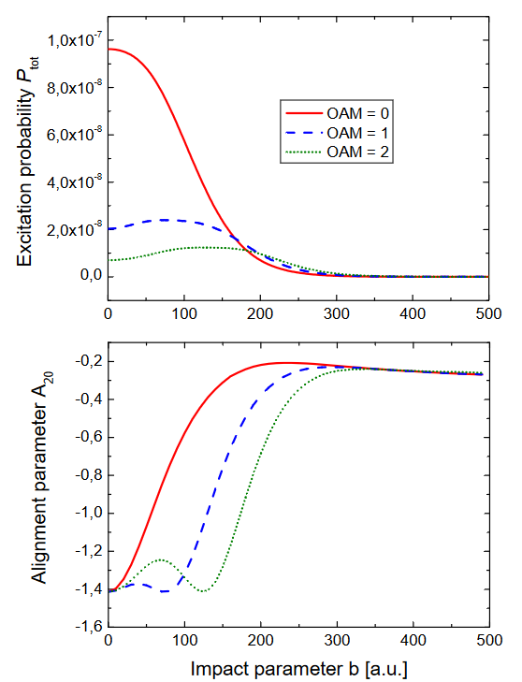
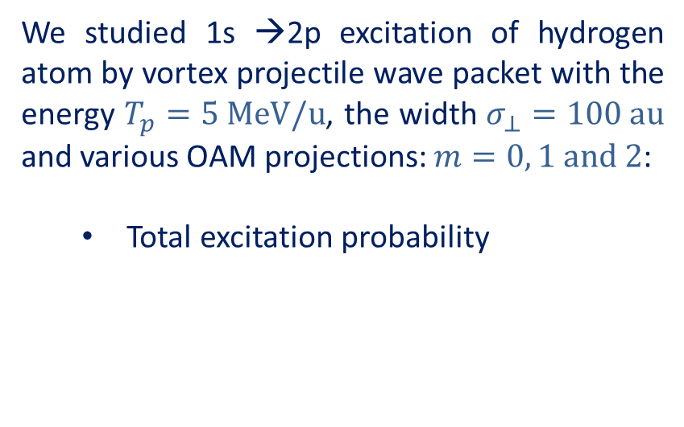
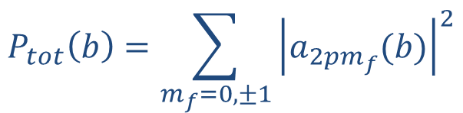
1s → 2p excitation of H: b-dependence
We studied 1s →2p excitation of hydrogen atom by vortex projectile wave packet with the energy $T_{p}=5 MeV/u$, the width $σ_{⊥}=100 au$ and various OAM projections: $m=0, 1 and 2$:
  Total excitation probability
$$P_{tot}\left(b\right)=\sum_{m_{f}=0, ±1}{{\left|a_{2pm_{f}}(b)\right|}^{2}}$$

Slide 9
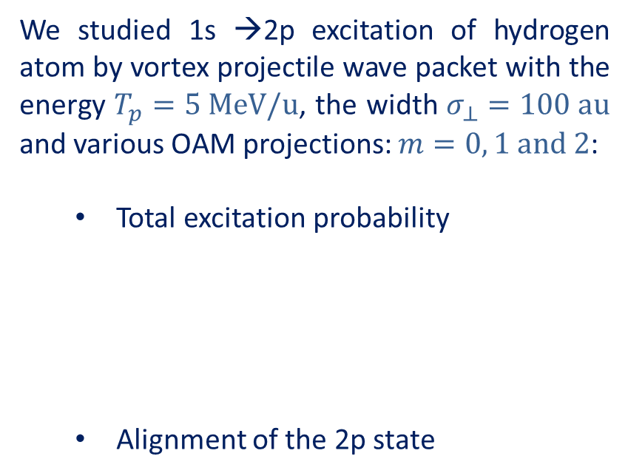
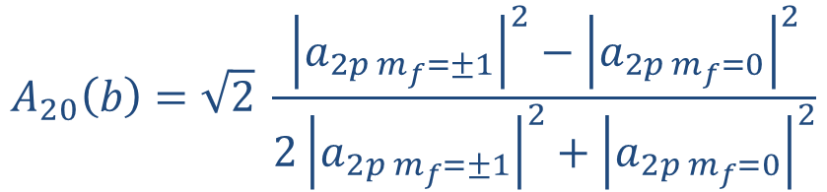


1s → 2p excitation of H: b-dependence
We studied 1s →2p excitation of hydrogen atom by vortex projectile wave packet with the energy $T_{p}=5 MeV/u$, the width $σ_{⊥}=100 au$ and various OAM projections: $m=0, 1 and 2$:
  Total excitation probability
  Alignment of the 2p state
$$P_{tot}\left(b\right)=\sum_{m_{f}=0, ±1}{{\left|a_{2pm_{f}}(b)\right|}^{2}}$$
2$p$
$$m_{f}=−1 m_{f}=0 m_{f}=+1$$
$$A_{20}\left(b\right)=\sqrt{2} \frac{{\left|a_{2p m_{f}=±1}\right|}^{2}−{\left|a_{2p{ m}_{f}=0}\right|}^{2}}{{2\left|a_{2p m_{f}=±1}\right|}^{2}+{\left|a_{2p{ m}_{f}=0}\right|}^{2}}$$
$$1s$$

Slide 10
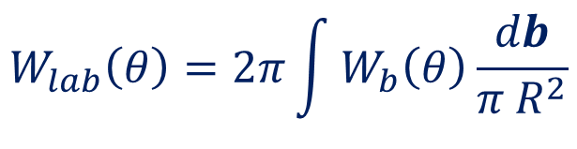
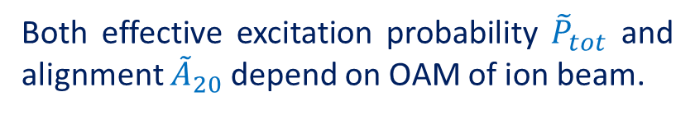
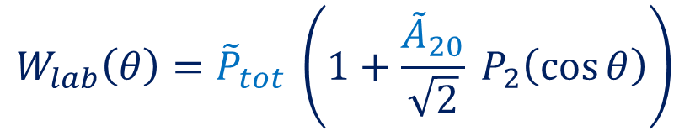
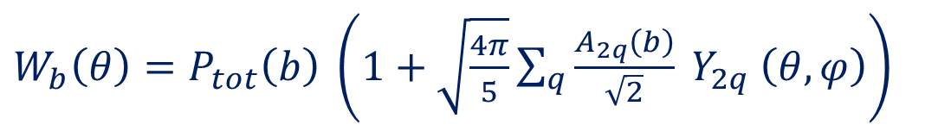

1s → 2p excitation of H: Macroscopic target
Atomic target
Properties of the vortex ion beam are reflected in the angular distribution of the 2p →1s fluorescence emission:
where b-dependent distribution:
Vortex projectile
$$W_{lab}\left(θ\right)=2π\int{W_{b}\left(θ\right)\frac{db}{π R^{2}}}$$
$$θ$$
Detector
$W_{b}\left(θ\right)=P_{tot}\left(b\right) \left(1+\sqrt{\frac{4π}{5}}\sum_{q}{\frac{A_{2q}\left(b\right)}{\sqrt{2}} Y_{2q} \left(θ,φ\right)}\right)$
$$W_{lab}\left(θ\right)={\tilde{P}}_{tot} \left(1+\frac{{\tilde{A}}_{20}}{\sqrt{2}} P_{2}\left(\cos{θ}\right)\right)$$
Both effective excitation probability ${\tilde{P}}_{tot}$ and alignment ${\tilde{A}}_{20}$ depend on OAM of ion beam.

Slide 11
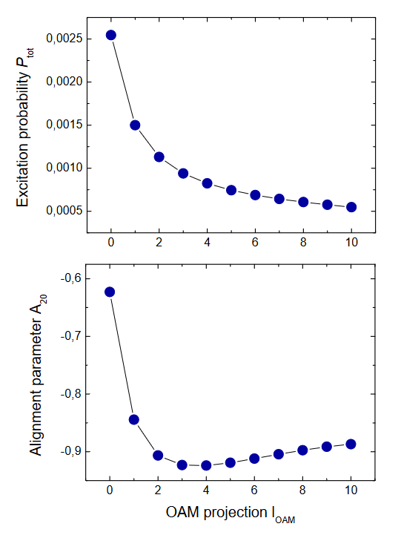
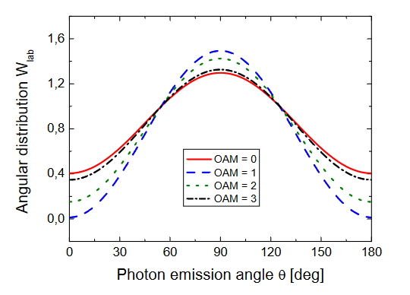
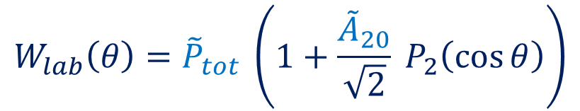
1s → 2p excitation of H: Macroscopic target
Properties of the vortex ion beam are reflected in the angular distribution of the 2p →1s fluorescence emission:
$$W_{lab}\left(θ\right)={\tilde{P}}_{tot} \left(1+\frac{{\tilde{A}}_{20}}{\sqrt{2}} P_{2}\left(\cos{θ}\right)\right)$$
A. V. Maiorova et al., submitted to New J. Phys. (2024)

Slide 12
Ion collisions with electronic (atomic) targets
Radiative recombination
X-ray scattering
Bremsstrahlung
Impact excitation and subsequent decay
… and many other fundamental collision processes, that result in photon emission, have been studied both in experiment and theory in great details. Until now, however, not much attention has been paid to the OAM-related phenomena.
We consider two cases of collisions of vortex particles for storage-ring scenario:
  Coulomb excitation of target atoms by vortex (LG) ion beam
  Radiative recombination of vortex (Bessel) electrons with high-Z ions

Slide 13
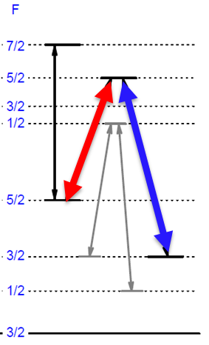
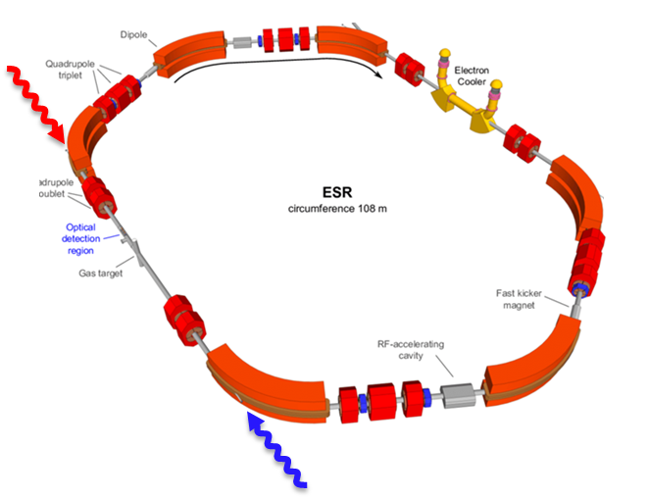
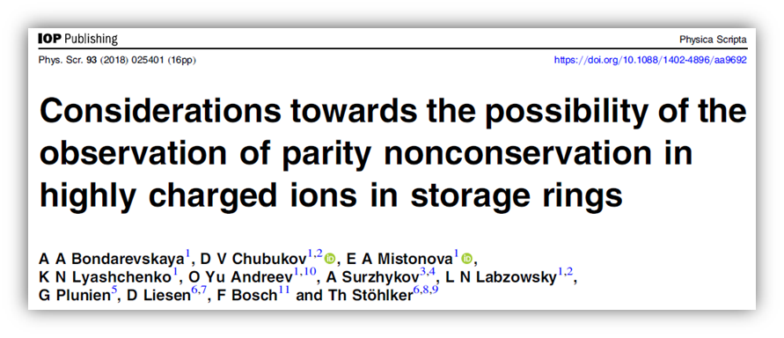
Polarized ions: Production and preservation
Production and preservation of spin-polarized ions in storage rings is under intense discussion:
Parity-violation studies
Search for permanent EDM
Spin-dependent collisions
Optical pumping of
(hyper-) fine structure levels
Radiative recombination of polarized electrons
W. Nörtershäuser et al.,
Phys. Rev. Accel. Beams 24, 024701 (2021)

Slide 14
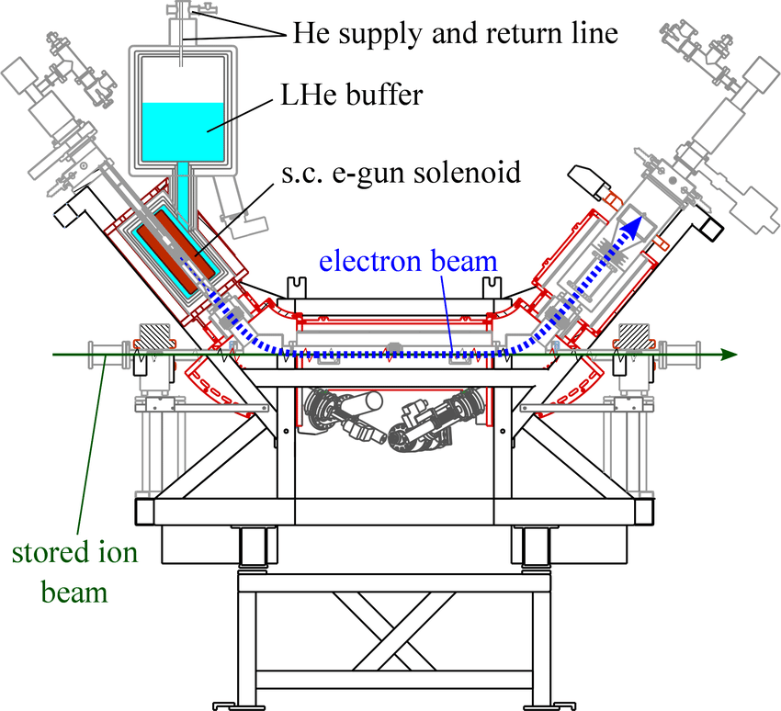
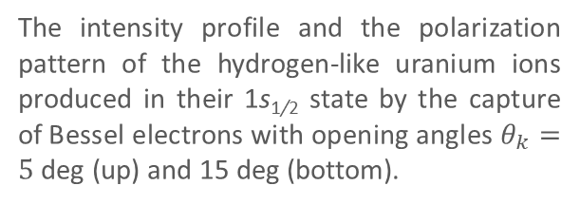
Recombination of vortex electrons
Radiative recombination of vortex electrons results in production of ion beams with inhomogeneous intensity profiles and complex polarization textures.
Are these ion beams also vortex ones?
How these beams evolve during their round trips in a ring?
The intensity profile and the polarization pattern of the hydrogen-like uranium ions produced in their 1s_{1/2} state by the capture of Bessel electrons with opening angles $θ_{k}=5$ deg (up) and 15 deg (bottom).
A. V. Maiorova, A. Peshkov and A.S., Phys. Rev. A 101, 062704 (2020)

Slide 15
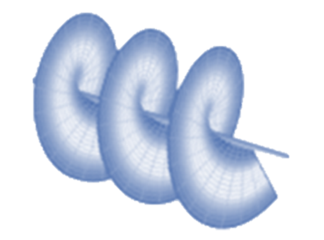
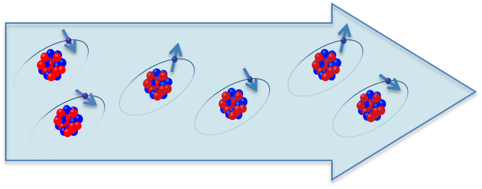
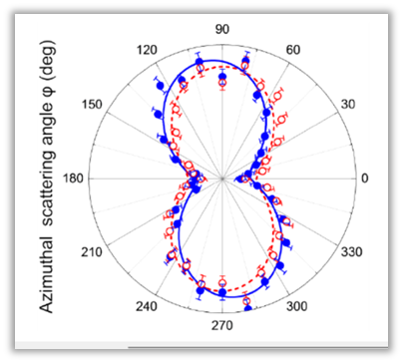
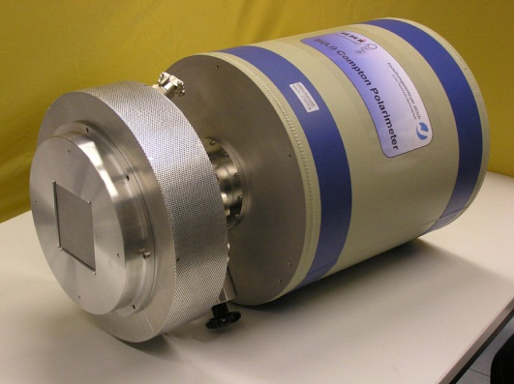
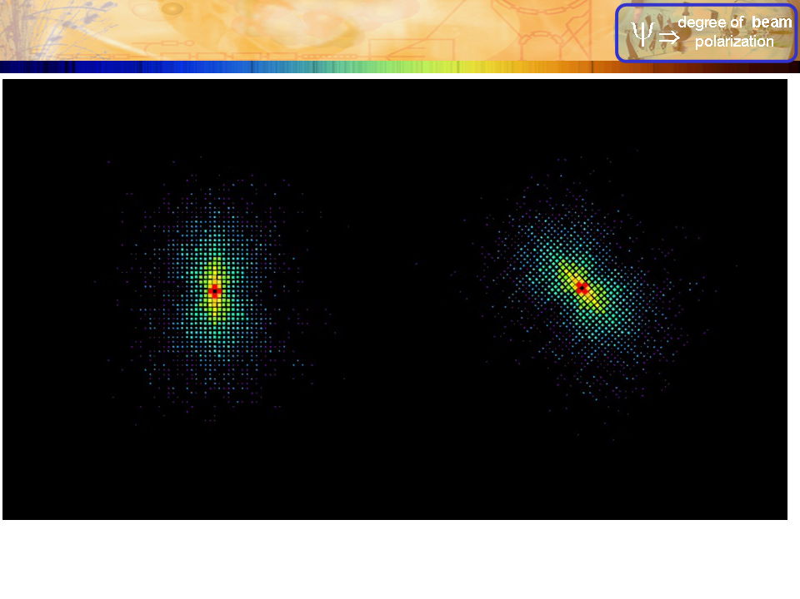


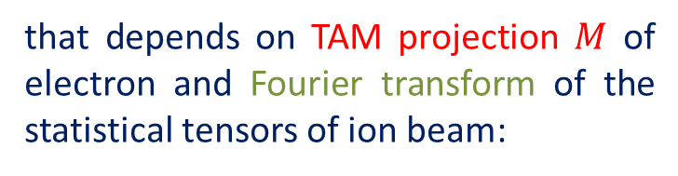

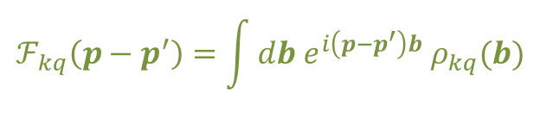

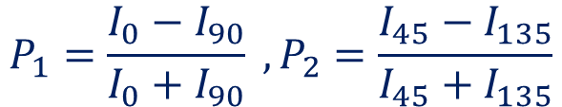
Radiative recombination as a probe process
$$ε$$
$$χ$$
Two Stokes parameter describe linear polarization:
$$k$$
$$P_{1}=\frac{I_{0}−I_{90}}{I_{0}+I_{90}} ,P_{2}=\frac{I_{45}−I_{135}}{I_{45}+I_{135}}$$
beam of hydrogen-like ions
vortex electrons
Parameters of polarization ellipse:
$$P_{L}=\sqrt{P_{1}+P_{2}}, \tan{2χ_{0}=P_{2}/P_{1}}$$
Theoretical analysis, based on the density matrix approach, shows that polarization parameters can be expressed in terms of position-averaged photon density matrix:
$$\int{db}\left\langle kλ | {\hat{ρ}}_{γ} | kλ^{′}\right\rangle =\sum_{μ_{0}μ_{0}^{′}m_{s}}{\sum_{kq}{… \int{dφ_{p} dφ_{p^{′}} e^{i M\left(φ_{p}−φ_{p^{′}}\right)}τ_{m_{s} λ μ_{0}}^{(pl)}τ_{m_{s} λ^{′} μ_{0}^{′}}^{\left(pl\right)∗}}}}ℱ_{kq}\left(p−p^{′}\right)$$
that depends on TAM projection $M$ of electron and Fourier transform of the statistical tensors of ion beam:
$$ℱ_{kq}\left(p−p^{′}\right)=\int{db e^{i\left(p−p^{′}\right)b} ρ_{kq}(b)}$$
The polarization tilt angle can be measured with the help of segmented solid-state Compton detectors.

Slide 16
Production and diagnostics of structured beams
bare ions
“pump” electron beam
H-like ions
“probe” electron beam
Depending on “pump” electrons, one can produce different types of ion beams:
U⁹²⁺ + polarized plane wave electrons → unstructured polarized beam U⁹¹⁺
U⁹²⁺ + polarized Bessel electrons → structured polarized beam U⁹¹⁺
U⁹²⁺ + unpolarized Bessel electrons → structured unpolarized beam U⁹¹⁺
Very rough approximation: polarization texture and intensity profile of ion beams are not varied between two “steps”.

Slide 17
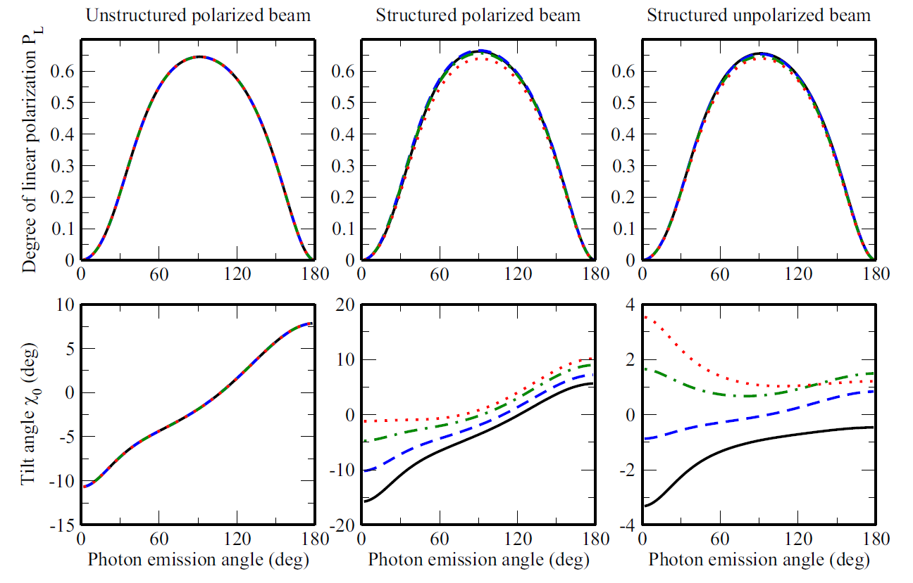
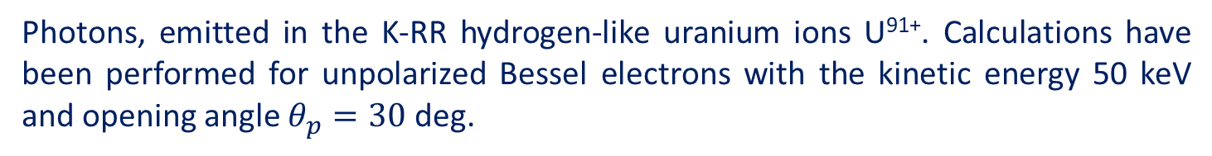
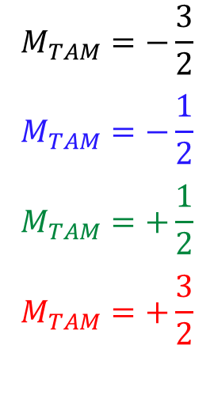
Radiative recombination as a probe process
$$M_{TAM}=−\frac{3}{2}$$
$$M_{TAM}=−\frac{1}{2}$$
$$M_{TAM}=+\frac{1}{2}$$
$$M_{TAM}=+\frac{3}{2}$$
Photons, emitted in the K-RR hydrogen-like uranium ions U⁹¹⁺. Calculations have been performed for unpolarized Bessel electrons with the kinetic energy 50 keV and opening angle $θ_{p}=30$ deg.
A. V. Maiorova, A. Peshkov and A.S., Phys. Rev. A 104, 022821 (2021)

Slide 18
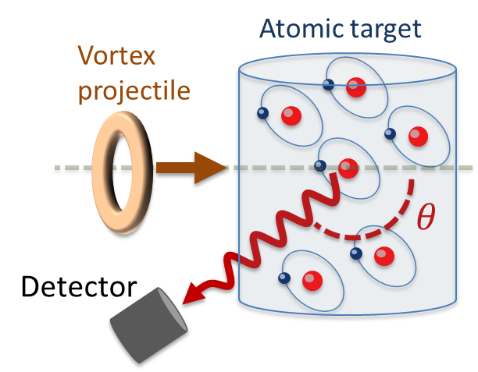
Summary and outlook
Production and operation of vortex electrons and ions open up new avenues in many areas, including atomic, nuclear and particle physics.
We propose to focus on the fundamental atomic processes that occur in (vortex particle) collisions.
Coulomb excitation of target atoms can be used to distinguish OAM states of vortex ions
Radiative recombination of vortex electrons can help to solve a long-standing problem of polarization preservation in storage rings.
Thank you for your attention!

